Slide 1
Lecture 18: Virtualization
CS343 – Operating Systems
Branden Ghena – Fall 2024
Some slides borrowed from: Jaswinder Pal Singh (Princeton), Harsha V. Madhyastha (Michigan), and UC Berkeley CS162

Slide 2
Administrivia
Today is the last lecture!
No class on Thursday
PagingLab due Thursday
Still okay to use slip days or late penalties on it

Slide 3
Administrivia
Midterm exam 2
Wednesday, December 11th from 12:00-1:20 pm in the lecture hall
Normal 80-minute exam
Expect a similar format to the previous exam
Covers Device I/O through Virtualization
Lectures 9 through 18
Does NOT cover scheduling or concurrency
Practice materials on Canvas homepage
May bring: one 8.5x11” sheet with notes on front and back

Slide 4
Today’s Goals
Explore notion of a “virtual machine” and how to virtualize computers.
Understand challenges and tradeoffs for several approaches
Emulation
Hypervisors
Containers

Slide 5
Outline
Virtualization
Approaches
Emulation
Hypervisors
Containers

Slide 6
Virtualization
Virtual (fake) versions of real resources are often provided to users
Memory – virtual memory
CPU – processes and scheduler
Disk – files
OS provides these abstractions to simplify applications
And provide security!

Slide 7
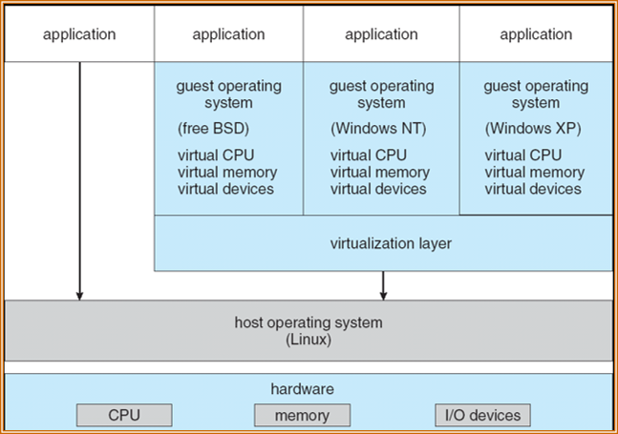
Virtual Machines (VMs)
What about virtualizing the whole computer?
Provide interfaces that look like a normal computer
But actually interact with software that manages and multiplexes access
Run an entire OS within an OS

Slide 8
Original motivation: support more applications
1960s IBM mainframes had many different OSes
Some applications only written for certain OSes though
Virtualization allowed multiple OSes to run on a single mainframe
Which let one powerful computer serve varied needs of many people
Still applies today to some degree
Windows + Ubuntu VM
Want PowerPoint and also terminal environment (vim/make/gcc)
MacOS + Windows VM
Various Windows-only programs
Often dual boot rather than VM if you don’t need to run them simultaneously

Slide 9
Modern motivation: package and isolate applications
High-performance applications aren’t really stand-alone
Assumptions about OS
Assumptions about libraries and services
Multiple processes working together
A virtual machine is a method to encapsulate “entire stack”
Even down to expectations of hardware
Cloud computing platforms run many applications together
Need isolation from each other in a strongly controllable way
Exactly 2 GB of RAM go to this
Exactly two processor cores go to that

Slide 10
Virtualization approaches
Simulate everything in the computer completely
Emulation
Simulate parts of the computer, but not all of it (actually use CPU)
Hypervisor
Simulate the operating system (software environment)
Containers

Slide 11
Outline
Virtualization
Approaches
Emulation
Hypervisors
Containers

Slide 12
Software emulation
User software emulates the behavior of every single instruction
Data structures for Processor, Memory, I/O, etc.
Code for Instruction Cycle:
Fetch next instruction
Decode
Perform operation
Update state
Example: Gameboy emulator
Simulates every behavior as-if it were actually Gameboy hardware

Slide 13
Emulation example: QEMU
We have been using QEMU for lab to simulate an x86-64 computer
2 CPU cores
2 GB of RAM
VirtIO GPU
PS/2 mouse and keyboard
2 PCI IDE interfaces with hard disk and CD-ROM support
nautilus.iso connected to CD-ROM
Serial and parallel ports
stdio connected to serial port
file parport.out connected to parallel port
Other stuff
Floppy disk
PCI and ISA network adapters
Intel HD Audio Controller and HDA codec
PCI UHCI, OHCI, EHCI or XHCI USB controller and a virtual USB-1.1 hub

Slide 14
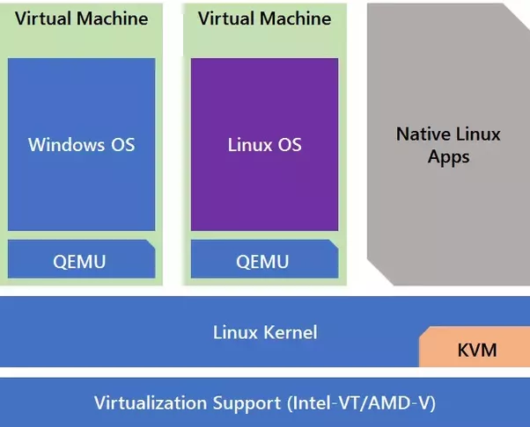
Emulation tradeoffs
Upsides
Any hardware you want
Entirely in userspace
You could even run multiple emulators simultaneously if you wanted to
Downsides
Accurate behavior is difficult to provide
Software runs slower than the hardware would (But modern hardware might run software faster than old hardware)

Slide 15
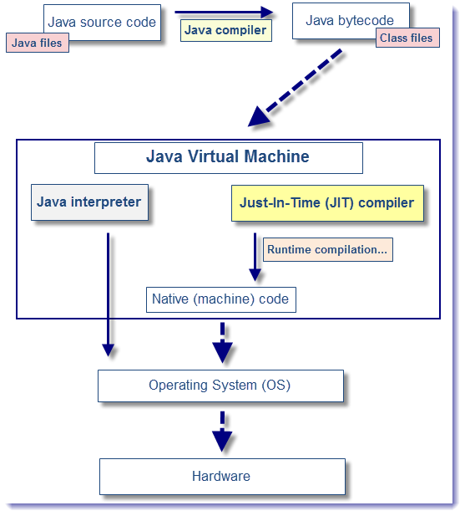
Simple emulators: interpreted languages
Create a simple environment for code to execute within
Interpret code instructions (bytecode or lines of code) and perform actions
Example: fakes a machine that executes Java bytecode
Still ties in to many parts of the real machine
Filesystem
Devices

Slide 16
WebAssembly: modern version of a language emulator
WebAssembly (Wasm) is a compilation target
Like x86-64 or ARM
Compilers generate Wasm from languages like C, C++, or Rust
Web browser runs a virtual machine the understands and executes the Wasm instructions
With an API to make requests to the actual computer OS
End result: C/C++ programs can run in Web browsers
While maintaining decent performance

Slide 17
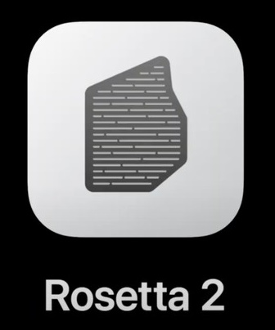
Not-quite-emulation: binary translation
MacOS on ARM (M1)
Uses ARM processor with ARM instruction set
Old programs were compiled for x86-64 instruction set
Solution: translate assembly instructions
Can be translated in advance
Or just-in-time (JIT)
Works fine for applications that are I/O bound
Simulates a different CPU, but leaves the remainder of the computer the same

Slide 18
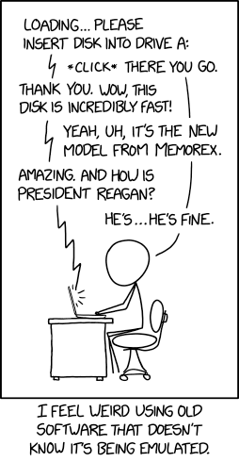
Break + Question + Comic
What are the best use cases for hardware emulation?
https://xkcd.com/2221/

Slide 19
Break + Question + Comic
What are the best use cases for hardware emulation?
Non-standard, slow machines (example: old gaming consoles)
Where people do not have access to the original hardware
The original hardware was slower than modern hardware
And there are existing application binaries that they want to run
Application-level simulation/testing (example: Nautilus!)
Still hopefully for the above (for performance)
Entirely controlled environment: makes debugging easier
Nautilus does run significantly slower in QEMU, but that’s okay for our purposes
https://xkcd.com/2221/

Slide 20
Outline
Virtualization
Approaches
Emulation
Hypervisors
Containers

Slide 21
How do we speed up virtual machines?
“Efficiency … demands that a statistically dominant subset of the virtual processor’s instructions be executed directly by the real processor, with no software intervention…”
—Popek and Goldberg, 1974
Need to use some parts of the computer for real while simulating other parts

Slide 22
Virtual Machine Monitor (VMM)
Also known as hypervisors
OS kernel is the system “supervisor” and manages the computer
Hypervisor manages supervisors
Creates the illusion that the OS has full control over the hardware
And even gives real (limited) access to hardware whenever possible
But may actually be sharing full computer resources among several OSes
Probably what you had in mind as virtual machines
VirtualBox, VMWare, Parallels

Slide 23
Hpyervisors use real hardware for performance
Big idea: Hypervisors run the guest OS on the real hardware for performance
Normal code runs directly on hardware as usual
Assembly instructions, accessing memory, normal application stuff
Significantly faster than emulation
Accesses requiring kernel permissions go through the hypervisor first, then get redirected to the guest OS
Context switching, virtual memory changes, device access, etc.
Hypervisor may intervene on some of these

Slide 24
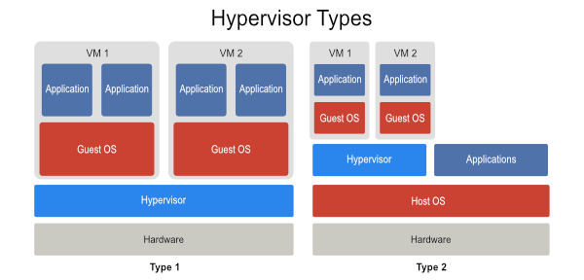
Hypervisor layering option: directly on hardware
Hypervisor manages hardware directly
Guest OSes run on top of it
“Guest OS” as in it isn’t actually in charge of the computer
“Bare Metal” Hypervisor
Hosted Hypervisor

Slide 25
Hypervisor layering option: on top of Host OS
Normal operating system runs on hardware
Known as “Host OS”
Hypervisor runs on top of host and coordinates with it to enable interactions with hardware
Some coordination may be within the host kernel itself
“Bare Metal” Hypervisor
Hosted Hypervisor

Slide 26
Hypervisor layering options: comparison
“Bare Metal” Hypervisor
Hosted Hypervisor

Slide 27
Abstraction choices for hypervisor
Fully virtualizing hypervisor
Virtual machine looks exactly like a physical machine
Though not necessarily the exact same machine it’s actually running on
Guest OS does not need to be modified in any way
Guest may not even be aware it’s running virtually
Para-virtualizing hypervisor
Guest OS has extensions to cooperate with hypervisor
Sacrifice transparency for better performance
Same abstraction-breaking ideal from previous lectures
Might include an API to interact with hypervisor
Guest OS likely can skip some stuff the hypervisor handles instead

Slide 28
Arbitrary combinations of these are possible
Bare Metal Hypervisor
Hosted Hypervisor
 | VMWare ESXi, Microsoft Hyper-V | VMware Workstation, VMware Fusion, Parallels, VirtualBox
 | Xen | User Mode Linux
Fully Virtualized
Para Virtualized

Slide 29
Arbitrary combinations of these are possible
“Normal” VMs
Bare Metal Hypervisor
Hosted Hypervisor
 | VMWare ESXi, Microsoft Hyper-V | VMware Workstation, VMware Fusion, Parallels, VirtualBox
 | Xen | User Mode Linux
Fully Virtualized
Para Virtualized

Slide 30
Arbitrary combinations of these are possible
Cloud/Server stuff
Bare Metal Hypervisor
Hosted Hypervisor
 | VMWare ESXi, Microsoft Hyper-V | VMware Workstation, VMware Fusion, Parallels, VirtualBox
 | Xen | User Mode Linux
Fully Virtualized
Para Virtualized

Slide 31
Arbitrary combinations of these are possible
Bare Metal Hypervisor
Hosted Hypervisor
 | VMWare ESXi, Microsoft Hyper-V | VMware Workstation, VMware Fusion, Parallels, VirtualBox
 | Xen | User Mode Linux
Fully Virtualized
Para Virtualized
Run Linux as an application

Slide 32
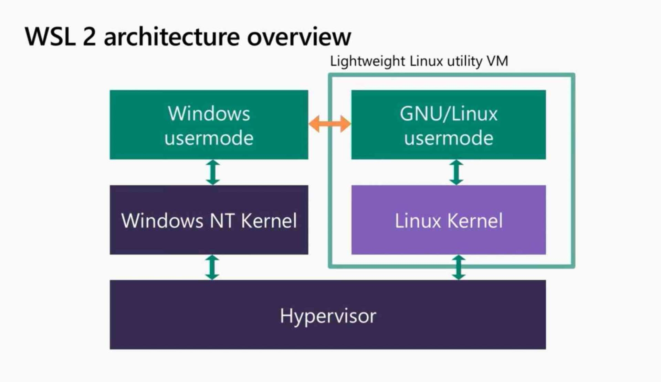
Windows Subsystem for Linux (WSL 2)
Provides Linux environment on a Windows computer
Windows Hyper-V provides a fully-virtualized system
Windows and Linux both run on top of it
Differences:
WSL2 also enables communication between userspaces rather than fully isolating the two
They can both share access to the file system, for example
Windows is a “privileged” guest with full control of the system

Slide 33
Hypervisor challenges: privileged instructions
The guest OS is going to run privileged instructions
Scheduling threads, editing page tables, modifying interrupt state
Cannot let it have full control over the hardware
Otherwise it really isn’t a “guest” and host might never regain control
Solution: trap into hypervisor
Bare metal: Illegal instruction fault goes directly to hypervisor
Hosted: Illegal instruction fault in Host OS passed to hypervisor
Which can actually do something to handle it!!

Slide 34
Hypervisor example: system call
Process
1. System call: trap to OS
5. Resume execution
Guest OS
3. OS trap handler: Decode trap and execute syscall. When done issue return-from-trap
Hypervisor
2. Receive trap. Call guest OS trap handler
4. OS tried to return from trap. Do real return-from-trap

Slide 35
Problem: x86 doesn’t virtualize very well
CPU architecture is virtualizable only if sensitive instructions always trap if run in user mode
Historically, x86 does not guarantee this
Some instructions behave differently in user mode
For example: some instructions have no effect when run in user mode
One solution: binary translation
Find all unacceptable instructions in the OS binary (possibly at runtime)
Replace with different instructions that trap to hypervisor
Which will perform the originally desired operations

Slide 36
Virtualization extensions to x86
Intel VT and AMD-V
Extensions to instruction set architecture to enable virtualization
Fix virtualization problems
Also speed up virtualization performance by requiring less trapping
VM Entry/Exit
Swap out Virtual Machine Control Structure (VMCS) that specifies OS state
Registers, Address Space, Executing Threads
Example optimization: Virtual Processor ID in TLB entries
Allows Guest OS and Host OS to share a TLB

Slide 37
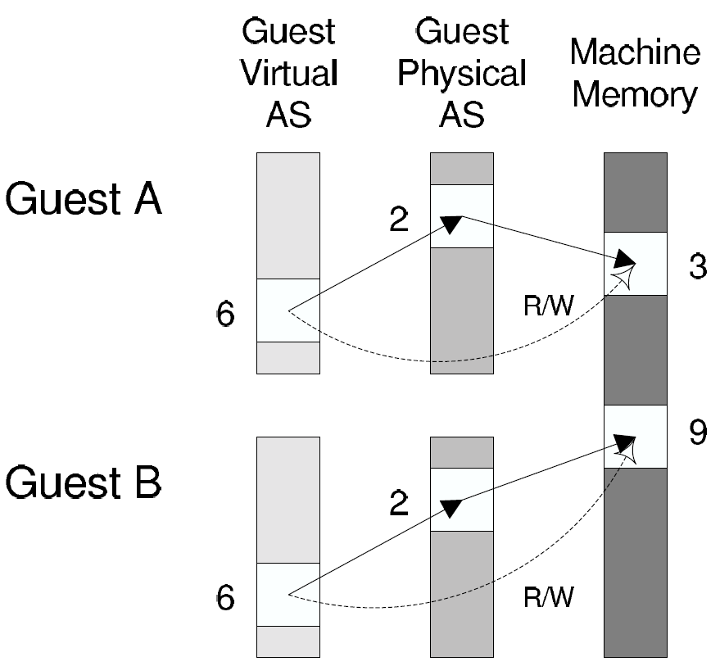
Hypervisor challenges: Memory virtualization
Guest OS maintains its own page tables, mapping virtual to physical memory
But the guest itself is running in virtual memory
Hypervisor maintains “shadow page tables” that map Guest memory pages to actual memory pages
Guest modifications to page tables trap to hypervisor that modifies its own tables accordingly
Virtual extensions can do this double-translation in hardware

Slide 38
Hypervisor challenge: I/O devices
Difficult to replicate all the different drivers that can exist in a kernel in the hypervisor
One solution: leverage host OS drivers
Present virtual I/O devices to guest OS
Guest interacts with virtual I/O through its own device driver
Calls get sent to hypervisor, which makes appropriate calls to host drivers

Slide 39
Break + Questions – VirtualBox on ARM Mac
Will VirtualBox work on the ARM Macs?
Will old versions of VirtualBox work?
What architecture will the guest OS need to be?
Could students run CS213 labs in it?

Slide 40
Break + Questions – VirtualBox on ARM Mac
Will VirtualBox work on the ARM Macs?
Will old versions of VirtualBox work?
No. Originally compiled for x86-64 only. Needs a new version written for ARM. Support exists as of October 2022!
What architecture will the guest OS need to be?
ARM. VirtualBox is a hypervisor that runs code on the actual processor.
Windows and Linux do have some ARM support…
Could students run CS213 labs in it?
Not really… Any x86-64 specific stuff won’t work.
They would need an emulator for x86-64 assembly

Slide 41
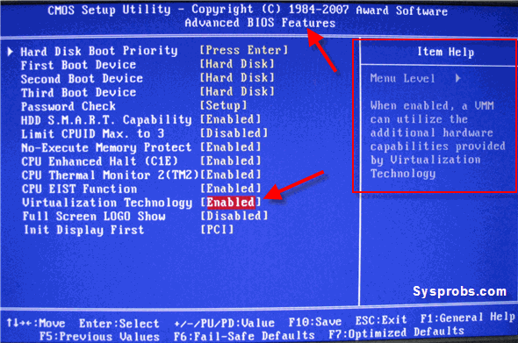
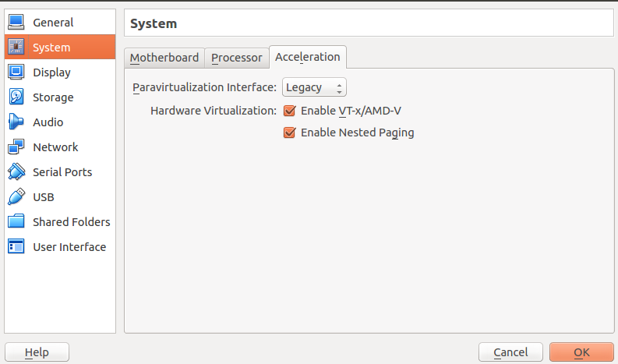
Sidebar: virtualization extensions often disabled by default
Most users will never have a need for them
And developers can probably figure out BIOS settings

Slide 42
Outline
Virtualization
Approaches
Emulation
Hypervisors
Containers

Slide 43
Not-quite-containers: Compatibility layer
To allow software to run on another OS, provide an interface that can translate system calls
Essentially emulating an OS, rather than computer hardware
Wine
Provides dynamic libraries that mirror those that exist in Windows
But new implementations make Linux system calls
WSL (1.0)
Translates Linux system calls into Windows system calls

Slide 44
Cloud platform requirements
May want to provide multiple OSes, but can do so with multiple physical machines
Really want encapsulation and isolation
Encapsulation
Include particular shared libraries that application needs
Without interfering with other applications on system
Isolation
Guarantee certain processing and memory allocations to each application
Limit visibility into the filesystem (without overhead of partition per app)

Slide 45
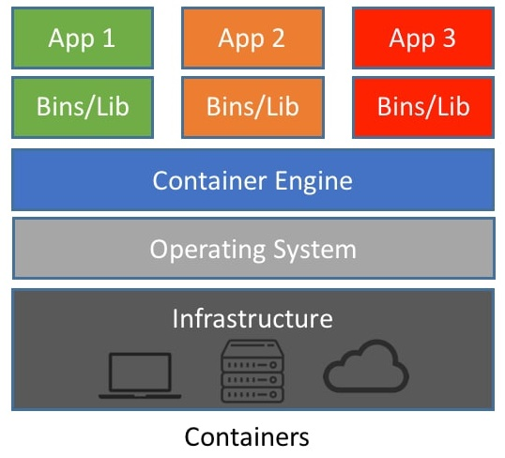
Containers
Provide each application with illusion of its own dedicated OS
Isolated resources: processor and memory
Isolated namespace: PIDs, network, filesystem
Includes only the binaries and libraries it needs

Slide 46
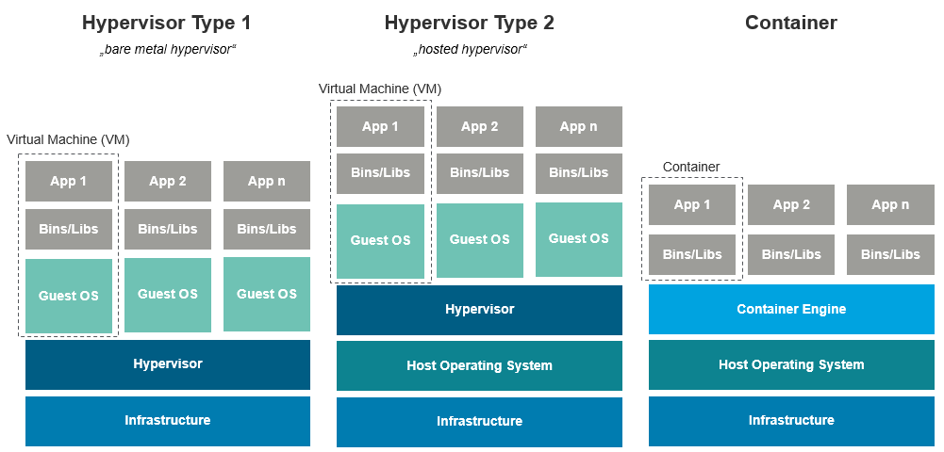
Visual comparison of Hypervisors and Containers

Slide 47
How to implement containers
Needs the ability to isolate one process from the effects of another
More strongly than a normal OS does anyways
On Linux, there is a related idea which is the basis for containers
cgroups

Slide 48
Linux cgroups (control groups)
Collection of processes treated as a group for resource allocation
Provider greater performance isolation between cgroups than between processes
Firm limits per group
Example:
“production”
“testing”
“dev”
User Software
syscall handlers
scheduler
syscall tbl
subsystems
System Software
intr tbl
intrpt handlers
Page Tables
Drivers
Processor
Memory
Net BW
Files
Hardware

Slide 49
Linux cgroups (control groups)
Collection of processes treated as a group for resource allocation
Provider greater performance isolation between cgroups than between processes
Firm limits per group
Example:
“production”
“testing”
“dev”
User Software
syscall handlers
scheduler
syscall tbl
subsystems
System Software
intr tbl
intrpt handlers
Page Tables
Drivers
Processor
Memory
Net BW
Files
Hardware

Slide 50
cgroups can be used to build containers
Devices can be connected or denied to a cgroup
cgroup processes will not be able to detect device at all
Accounting can be done on cgroup usage
Memory, CPU, disk I/O

Slide 51
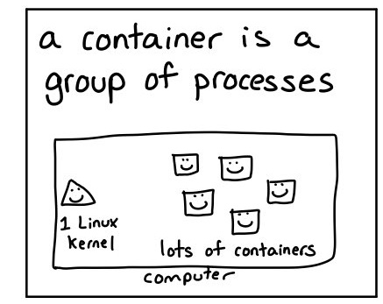
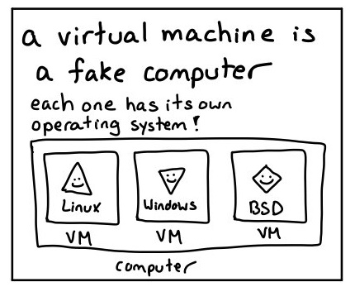
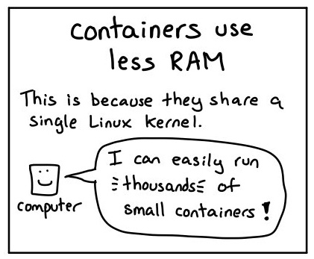
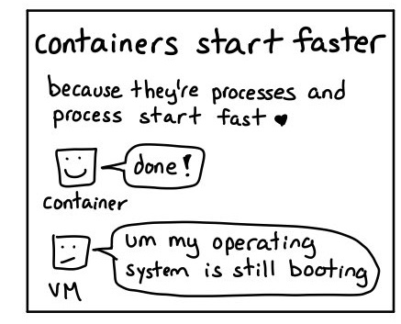
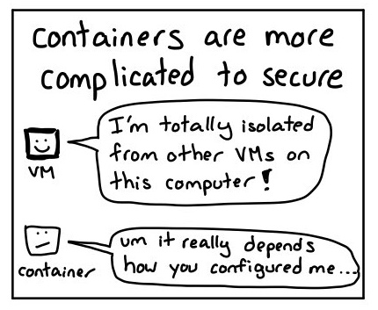
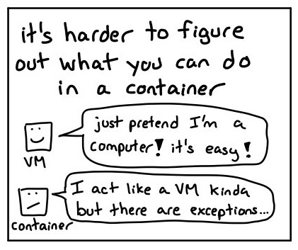
Bonus explanation
https://twitter.com/b0rk/status/1237744128450072578

Slide 52
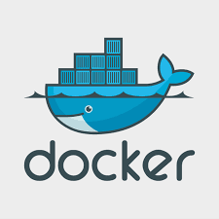
Docker
Container packaging, distribution, and execution
Also created open standard for container runtimes
Images
Describes starting state of a Docker container
Like a snapshot of the system
Union file system
Image describes file system as a sequence of layers
Each layer includes some files
Overall file system is the union of all the layers
Layers can be reused in different images

Slide 53
Docker use cases
Environments are hard to set up
Often the hardest part of starting software development
Containerized applications encapsulate requirements
Can be run on any system that has the same kernel it was built for
Packages an application and its requirements into a container
Can be used by an individual to more easily run an application
Can be deployed to a cloud server to run
Example: could use Docker for QEMU + Nautilus
Need a very specific version of QEMU, with all the proper libraries

Slide 54
Outline
Virtualization
Approaches
Emulation
Hypervisors
Containers

