Slide 1
Lecture 17 Processes
CS213 – Intro to Computer Systems
Mohammad Kavousi – Winter 2023
Slides adapted from: Ghena, St-Amour, Hardavellas, Bustamente (Northwestern), Bryant, O’Hallaron (CMU), Garcia, Weaver (UC Berkeley)

Slide 2
Administrivia
SETI Lab due on Wednesday!
Beware, it’ll take quite a while to get feedback close to the deadline
Run seti-eval as sparingly as possible
It will give you very similar results to seti-perf
Final exam next week Wednesday
3:00-4:20 pm in this classroom (Tech LR2)
Allowed two sheets of standard paper, front and back, for notes
You can reuse your notes from last time as the first sheet
Material from weeks 5 and onwards
x86-64 Assembly Procedures through I/O & Networks (Wednesday)

Slide 3
Common SETI Lab Errors
Straight line performance
Often better than 1.02x right away and graph does not have a curve shape
Doesn’t vary thread count per the program argument
Stuck at 0.3x
Usually didn’t optimize
Or maybe just optimized p_band_scan but not anything it relies on
No Carrier Match
Your code output didn’t match the original band_scan
No Alien Match
You didn’t correctly determine which of your generated signals is alien

Slide 4
Today’s Goals
Explore various mechanisms by which OS and processes interact
System calls and signals
Discuss operations on files from processes

Slide 5
Outline
Process Control Flow
System Calls
File I/O
Standard I/O
Signals

Slide 6
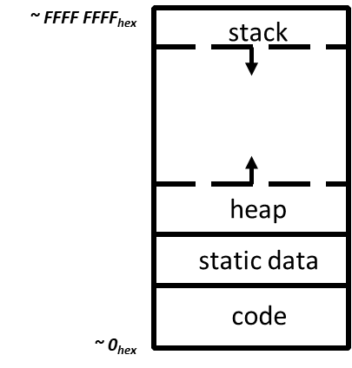
Reminder: view of a process
Process: program that is being executed
Contains code, data, and a thread
Thread contains registers, instruction pointer, and stack
Code and Data
Registers
Instruction Pointer
Condition Codes
Stack
%rax
%r8
%eax
%r8d
%rbx
%r9
%ebx
%r9d
%rcx
%r10
%ecx
%r10d
%rdx
%r11
%edx
%r11d
%rsi
%r12
%esi
%r12d
%rdi
%r13
%edi
%r13d
%rsp
%r14
%esp
%r14d
%rbp
%r15
%ebp
%r15d

Slide 7
Questions remaining about processes
Interaction mechanisms with OS
How do processes make requests of the OS?
How does the OS inform processes of various events?
Both answered by the same basic mechanism: exceptional control flow

Slide 8
Control flow
Processors do only one thing:
From startup to shutdown, a CPU simply reads and executes (interprets) a sequence of instructions, one at a time
This sequence is the CPU’s control flow (or flow of control)
Physical control flow
<startup>
inst₁
inst₂
inst₃
…
inst_{n}
<shutdown>
Time

Slide 9
Altering control flow
Instructions that change control flow allow software to react changes in program state
Jumps/branches
Call/return
Also need to react to changes in system state
Data arrives at network adapter
Instruction divides by zero
User hits Ctrl-C on the keyboard
System timer expires
These mechanisms are known as “exceptional control flow”

Slide 10
Exceptional control flow
Mechanisms
Exceptions: events cause execution to jump to OS handler
Context switch: request or timeout causes execution to jump to OS
Signals: event plus OS causes execution to jump to process handler
Running process
Other code (usually OS)
Event
I_current
Exception
I_next
Exception processing
by exception handler
Return to I_current
Return to I_next
Abort

Slide 11
Exceptions
Hardware detects an event that OS software needs to resolve
Could be an error
Invalid memory access
Invalid instruction
Could just be something the OS should handle
Page fault
USB device detected
OS has a table of “exception handlers”, which are functions that handle each exception class (also known as interrupt handlers)
Hardware jumps execution to the proper handler

Slide 12
Outline
Process Control Flow
System Calls
File I/O
Standard I/O
Signals

Slide 13
Things a program cannot do itself
Print “hello world”
because the display is a shared resource.
Download a web page
because the network card is a shared resource.
Save or read a file
because the filesystem is a shared resource, and the OS wants to check file permissions first.
Launch another program
because processes are managed by the OS
Send data to another program
because each program runs in isolation, one at a time

Slide 14
How does a process ask the OS to do something?
Certain things can only be accessed from kernel mode
All of memory, I/O devices, etc.
Kernel: the portion of the OS that is running and in memory
Bad Idea to allow processes to switch into kernel mode
We do NOT trust processes
Requirements
Switch execution to the OS kernel
Change into kernel mode
Inform the OS kernel what you want it to do

Slide 15
Hardware can save us!
Solution: trigger an exception to run an OS handler
Hardware instruction: trap
When instruction runs:
Instruction Pointer is moved to a known location in the kernel
Mode is changed to kernel mode
Same mechanism is used for other exceptions
Division by zero, invalid memory access
Also very similar to hardware interrupts

Slide 16
System call example
System call: making a request of the OS from a process
Uses exceptional control flow to enter OS kernel
Returns back to process when complete
Instruction after the system call
Kernel code
User code
Exception
syscall
next instruction
Do the thing
Returns

Slide 17
System call steps (simplification)
Process loads parameters into registers (just like a function call)
Process executes trap instruction (int, syscall, svc, etc.)
Hardware moves %rip to “handler” and switches to kernel mode
OS checks what the process wants to do from registers
OS decides whether the process is allowed to do so

Slide 18
Returning from a system call (simplification)
After OS finishes whatever operation it was asked to do
And when the process is scheduled to run again
OS places return result in a register (just like a function call)
OS sets process state to running
OS changes mode to user mode (and sets virtual memory stuff)
OS sets %rip to instruction after the system call
Process continues and can use results of system call

Slide 19
Linux system calls
Example system calls
https://man7.org/linux/man-pages/man2/syscalls.2.html
Number | Name | Description
0 | read | Read file
1 | write | Write file
2 | open | Open file
3 | close | Close file
4 | stat | Get info about file
57 | fork | Create process
59 | execve | Execute a program
60 | _exit | Terminate process
62 | kill | Send signal to process

Slide 20
Example using system calls
Let’s create new processes with system calls
From process view:
Just look like regular C functions
Take arguments, return values
Underneath:
Function uses special assembly instruction to trigger exception

Slide 21
Process management system calls
pid_t fork(void);
Create a new process that is a copy of the current one
Returns either PID of child process (parent) or 0 (child)
void _exit(int status);
Exit the current process (exit(), the library call cleans things up first)
pid_t waitpid(pid_t pid, int *status, int options);
Suspends the current process until a child (pid) terminates
int execve(const char *filename, char *const argv[], char *const envp[]);
Execute a new program, replacing the existing one
Replaces code and data, clears registers, sets %rip to start again

Slide 22
Creating a new process
#include <stdio.h>
#include <unistd.h>
int main(){
if(fork() == 0) {
printf("Child!\n");
} else {
printf("Parent!\n");
}
printf("Both!\n");
return 0;
}

Slide 23
Creating a new process
#include <stdio.h>
#include <unistd.h>
int main(){
if(fork() == 0) {
printf("Child!\n");
} else {
printf("Parent!\n");
}
printf("Both!\n");
return 0;
}
Existential crisis

Slide 24
Executing a new program
#include <stdio.h>
#include <unistd.h>
int main(){
if(fork() == 0) {
execve("/bin/python3", ...);
} else {
printf("Parent!\n");
}
printf("Only parent!\n");
return 0;
}

Slide 25
Creating your own shell
https://danishpraka.sh/2018/01/15/write-a-shell.html
void execute(char** args) {
if (strcmp(args[0], "exit") == 0) {
exit(); // exit the shell when requested
}
pid_t cpid = fork();
if (cpid == 0) {
if (execvp(args[0], args) < 0) { // child, execute new process
printf("command not found: %s\n", args[0]); }
} else {
waitpid(cpid, & status, WUNTRACED); // parent, wait for process to be complete
}}
int main(){
char** args;
while(1){
printf("> ");
args = parse_incoming_text(); // complicated in C unfortunately
execute(args);
}}

Slide 26
Creating your own shell
https://danishpraka.sh/2018/01/15/write-a-shell.html
void execute(char** args) {
if (strcmp(args[0], "exit") == 0) {
exit(); // exit the shell when requested
}
pid_t cpid = fork();
if (cpid == 0) {
if (execvp(args[0], args) < 0) { // child, execute new process
printf("command not found: %s\n", args[0]); }
} else {
waitpid(cpid, & status, WUNTRACED); // parent, wait for process to be complete
}}
int main(){
char** args;
while(1){
printf("> ");
args = parse_incoming_text(); // complicated in C unfortunately
execute(args);
}}

Slide 27
Break + Question
What does the following code do?
#include <stdio.h>
#include <sys/types.h>
int main() {
while(1){
fork();
}
return 0;
}

Slide 28
Break + Question
What does the following code do?
#include <stdio.h>
#include <sys/types.h>
int main() {
while(1){
fork();
}
return 0;
}
Creates a new process
Then each process creates a new process
Then each of those creates a new process…
Known as a Fork bomb!
Machine eventually runs out of memory and processing power and will stop working
Defense: limit number of processes per user

Slide 29
Outline
Process Control Flow
System Calls
File I/O
Standard I/O
Signals

Slide 30
Files
Collections of data
Usually in permanent storage on your computer
Types of files
Regular files
Arbitrary data
Think of as a big array of bytes
Directories
Collections of regular files
Special files
Links, pipes, devices (see CS343)

Slide 31
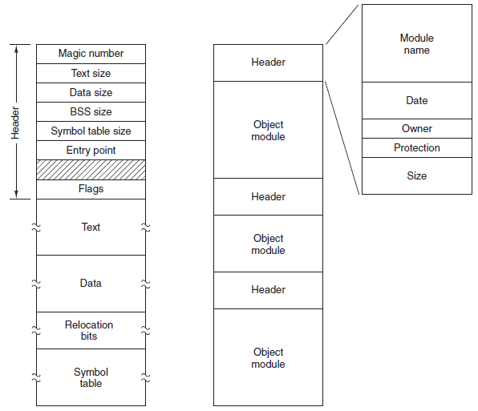
Sidebar: what about types of regular files?
Text files versus Executables versus Tar files
All just differing patterns of bytes!
It really is just all data. The meaning is in how you interpret it.
Executable File
Archive (tar)

Slide 32
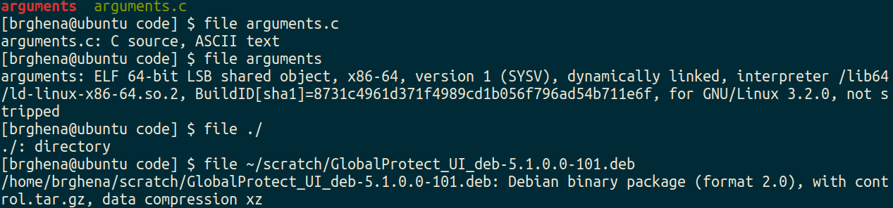
Identifying regular files
file in Linux command line can help determine the type of a file
https://github.com/file/file

Slide 33
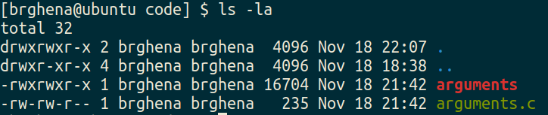
File permissions
Files have owners and permissions associated with them

Slide 34
File permissions
Files have owners and permissions associated with them
Permissions for the owner and name of the owner
Read, Write, eXecute
Cannot execute `arguments.c`
For directories: Read contents, Write new contents, Traverse directory

Slide 35
File permissions
Files have owners and permissions associated with them
Permissions for the group and name of the group
Example: I could make a CS213 group, add you all to it, and only give that group access to some folder or file

Slide 36
File permissions
Files have owners and permissions associated with them
Permissions for everyone else on the computer
Not the owner and not in the group
For my personal machine, not particularly relevant
For Moore, probably don’t want to let others read your files…

Slide 37
How do we interact with files?
Analogy: think of a file as a book
Big array of characters (bytes)
Open the book, starting at the first page
Read from the book
Write to the book
Change pages (without reading everything in between)
Close the book when finished

Slide 38
System calls for interacting with files
Open the book, starting at the first page
open()
Read from the book
read()
Write to the book
write()
Change pages (without reading everything in between)
lseek()
Close the book when finished
close()

Slide 39
Higher-level methods of file interaction
Here, we’re talking about system calls to the OS
C standard library also defines file interactions
fopen, fread, fwrite, fseek, fclose
All are wrappers on top of the actual syscalls
Buffers your interactions to make them more efficient
Reads/Writes large chunks of data at a time
Might collect multiple fwrite’s before doing a single real write
fflush() guarantees that the buffer is written now

Slide 40
Opening files
int open(const char *pathname, int flags);
pathname is the string path for the file
“/home/brghena/class/cs213/s21/code/arguments.c”
“./arguments.c”
“arguments.c”
flags include access permission requests
Read only, Write only, Read and Write (O_RDONLY, O_WRONLY, O_RDWR)
Also can choose to append to a file (O_APPEND)
Or to create the file if it does not exist (O_CREAT)

Slide 41
Open returns a “file descriptor”
int open(const char *pathname, int flags);
OS keeps track of opened files for each process
File descriptor is just a number referring to the opened file
Non-negative number. Always the lowest unused, starting at zero
A “handle” to the file
File descriptor is used in other calls to reference the file
That way the OS doesn’t have to look up pathname every time
Negative number instead specifies an error (for all of these calls)

Slide 42
Reading files
ssize_t read(int fd, void *buf, size_t count);
fd is the file descriptor handle
buf is a pointer to an array of bytes to read into
count is the number of bytes to read
Note: nowhere do we specify where to start reading
OS kernel keeps track of a file offset with the descriptor
Updated on each read
First read of 100 bytes starts at zero, next starts 100 bytes in

Slide 43
How do we know when we finished the file?
ssize_t read(int fd, void *buf, size_t count);
Return from read is a “signed size”, a count of bytes actually read
Negative means an error occurred
Zero means we have reached the end of the file
Positive number is the number of bytes read
Probably how many we asked for, but maybe less

Slide 44
Writing files looks a lot like reading
ssize_t write(int fd, const void *buf, size_t count);
File descriptor, buffer to write from, count of bytes to write
Returns number of bytes actually written
Write occurs at the current file offset

Slide 45
Moving the file offset
off_t lseek(int fd, off_t offset, int whence);
Moves to offset for this file descriptor based on whence:
SEEK_SET – set to offset (essentially start of file plus offset)
SEEK_CUR – current location plus the offset
SEEK_END – end of file plus the offset (which can be negative)
Returns the resulting offset into the file
Units: bytes from the beginning of the file

Slide 46
Closing a file
int close(int fd);
Closes the file descriptor
It is an error to keep using the file descriptor after it is closed
Descriptor might end up getting reused for a different file

Slide 47
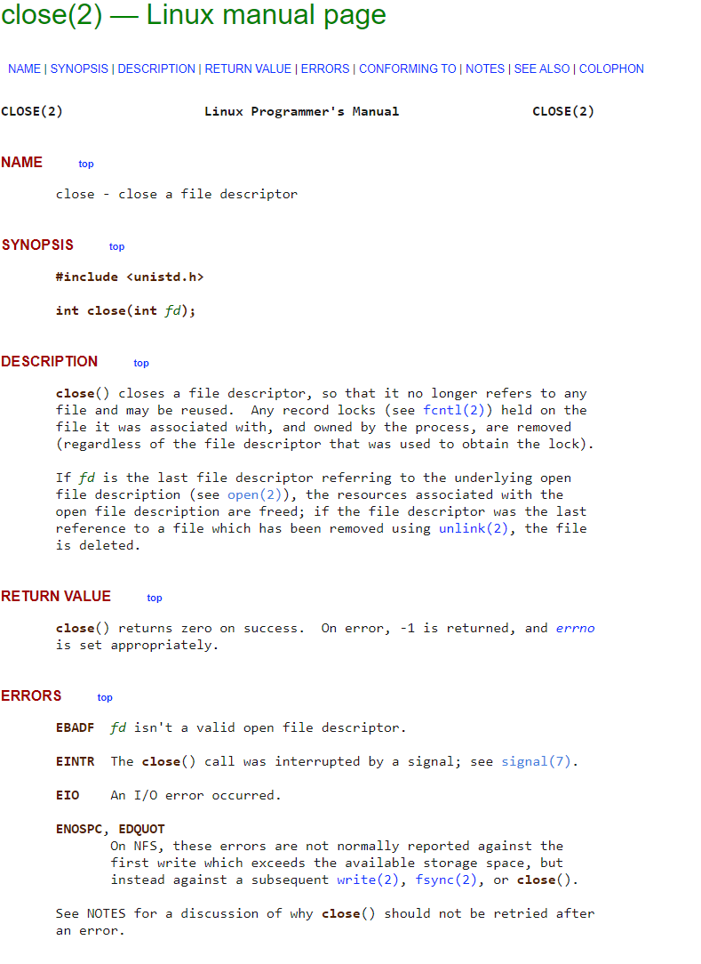
Sidebar: how do you figure out how these calls work?
Manual pages
Online: https://man7.org/linux/man-pages/man2/close.2.html

Slide 48
Example: “kitten” command line tool
int main(int argc, char *argv[]) {
// check argument count
if (argc != 2) {
printf("Usage: ./kitten FILE\n");
return -1;
}
// try opening file
int fd = open(argv[1], O_RDONLY);
if (fd < 0) {
printf("Error opening file!\n");
return -1;
}
// array to hold read data
uint8_t read_size = 10;
uint8_t read_data[read_size];
while(true) {
// read from file
ssize_t read_length = read(fd, read_data, read_size);
if (read_length < 0) {
printf("Error reading file!\n");
return -1;
}
if (read_length == 0) {
break;
}
// print out data
for (int i=0; i<read_length; i++) {
printf("%c", read_data[i]);
}
}
return 0;
}

Slide 49
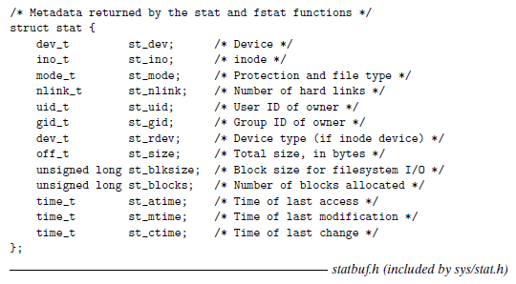
Interacting with file metadata
int stat(const char *pathname, struct stat *statbuf);

Slide 50
Outline
Process Control Flow
System Calls
File I/O
Standard I/O
Signals

Slide 51
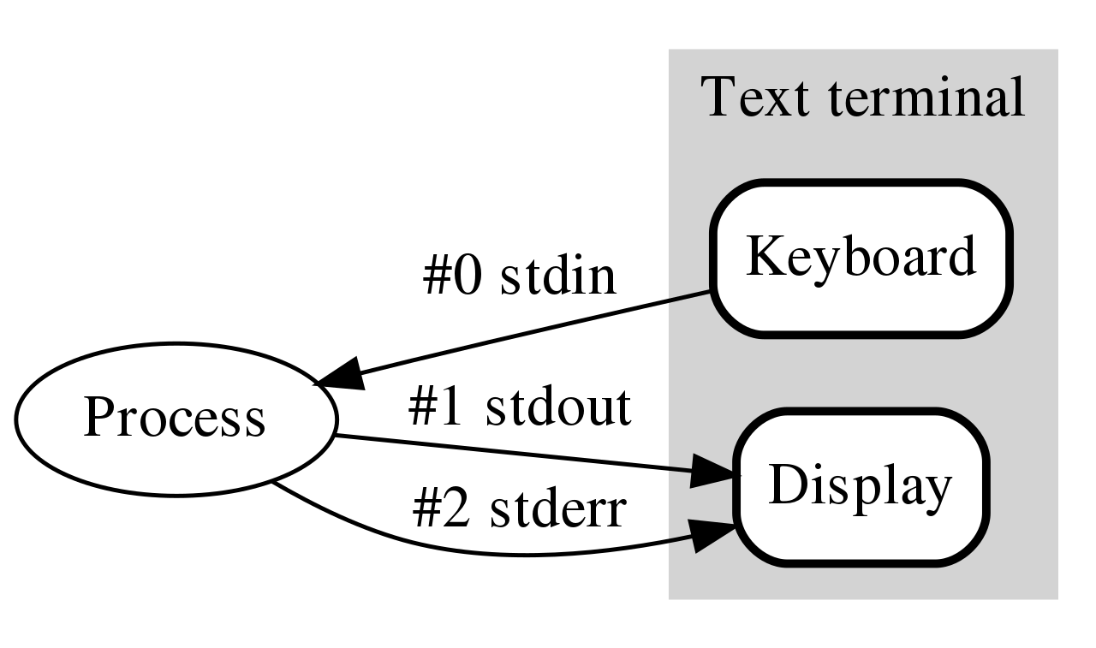
How do programs talk to users?
We glossed over this before in CS211
printf()
gets()
Work through the same file mechanism
Three special files created for each program
stdin – standard input (file descriptor 0)
stdout – standard output (file descriptor 1)
stderr – standard error (file descriptor 2)
printf(…) -> fprintf(1, …) -> handle arguments & write(1, …)

Slide 52
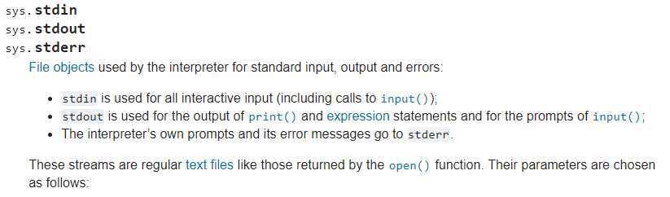
Standard I/O is a process thing, not a C thing
You can access them in Python, for instance
https://docs.python.org/3/library/sys.html#sys.stdin

Slide 53
Example: “kitten” write to standard output
int main(int argc, char *argv[]) {
// check argument count
if (argc != 2) {
printf("Usage: ./kitten FILE\n");
return -1;
}
// try opening file
int fd = open(argv[1], O_RDONLY);
if (fd < 0) {
printf("Error opening file!\n");
return -1;
}
// array to hold read data
uint8_t read_size = 10;
uint8_t read_data[read_size];
while(true) {
// read from file
ssize_t read_length = read(fd, read_data, read_size);
if (read_length < 0) {
printf("Error reading file!\n");
return -1;
}
if (read_length == 0) {
break;
}
// print out data
ssize_t write_length = write(STDOUT_FILENO, read_data, read_length);
}
return 0;
}

Slide 54
Redirecting standard I/O
Shells by default setup standard I/O to connect to the keyboard and the screen
But any file will work
Shell I/O redirection commands
COMMAND < filename
Connect standard input to filename
COMMAND > filename
Connect standard output to filename (overwrite)
COMMAND >> filename
Connect standard output to filename (append)

Slide 55
Piping commands
A command shell desire is to run multiple commands where the output of the first feeds into the second
COMMAND1 | COMMAND2
Connects stdout of COMMAND1 to stdin of COMMAND2
Example: print out files and sort by size
ls –lah | sort –h

Slide 56
Sidebar: super useful command for testing
tee [OPTION]... [FILE]...
Reads from stdin and write to both stdout and file
Example: prints out a list of files and saves results
ls –lah | tee results.txt
I run this with various programs I’m testing, so I can record the results, but also seem them in real-time.

Slide 57
Example: redirection with kitten
Standard I/O redirection is handled when the process is created
So it does not need to be aware of it at all
Our kitten tool works with redirection automatically!
./kitten arguments.c > OUTPUT_FILE

Slide 58
Break + Open Question
How does printf() work?

Slide 59
Break + Open Question
How does printf() work?
Read in arguments and determine what it needs to format
Create a new string buffer and write arguments into it
Call write() on STDOUT with the string

Slide 60
Outline
Process Control Flow
System Calls
File I/O
Standard I/O
Signals

Slide 61
Alerting processes of events
How do we let a process know there was an event?
Errors
Termination
User commands (like CTRL-C or CTRL-\)
Events could happen whenever
Need to interrupt process control flow and run an event handler
Linux mechanism to do so is called “signals”

Slide 62
Signals are asynchronous messages to processes
Sometimes the OS wants to send something like an interrupt to a process
Your child process completed
You tried to use an illegal instruction
You accessed invalid memory
You are terminating now
In POSIX systems, this idea is called “Signals”
1) SIGHUP 2) SIGINT 3) SIGQUIT 4) SIGILL 5) SIGTRAP
6) SIGABRT 7) SIGBUS 8) SIGFPE 9) SIGKILL 10) SIGUSR1
11) SIGSEGV 12) SIGUSR2 13) SIGPIPE 14) SIGALRM 15) SIGTERM
16) SIGSTKFLT 17) SIGCHLD 18) SIGCONT 19) SIGSTOP 20) SIGTSTP
21) SIGTTIN 22) SIGTTOU 23) SIGURG 24) SIGXCPU 25) SIGXFSZ
26) SIGVTALRM 27) SIGPROF 28) SIGWINCH 29) SIGIO 30) SIGPWR
31) SIGSYS ...

Slide 63
Signals are asynchronous messages to processes
Sometimes the OS wants to send something like an interrupt to a process
Your child process completed
You tried to use an illegal instruction
You accessed invalid memory
You are terminating now
In POSIX systems, this idea is called “Signals”
1) SIGHUP 2) SIGINT 3) SIGQUIT 4) SIGILL 5) SIGTRAP
6) SIGABRT 7) SIGBUS 8) SIGFPE 9) SIGKILL 10) SIGUSR1
11) SIGSEGV 12) SIGUSR2 13) SIGPIPE 14) SIGALRM 15) SIGTERM
16) SIGSTKFLT 17) SIGCHLD 18) SIGCONT 19) SIGSTOP 20) SIGTSTP
21) SIGTTIN 22) SIGTTOU 23) SIGURG 24) SIGXCPU 25) SIGXFSZ
26) SIGVTALRM 27) SIGPROF 28) SIGWINCH 29) SIGIO 30) SIGPWR
31) SIGSYS ...
Process Errors

Slide 64
Signals are asynchronous messages to processes
Sometimes the OS wants to send something like an interrupt to a process
Your child process completed
You tried to use an illegal instruction
You accessed invalid memory
You are terminating now
In POSIX systems, this idea is called “Signals”
1) SIGHUP 2) SIGINT 3) SIGQUIT 4) SIGILL 5) SIGTRAP
6) SIGABRT 7) SIGBUS 8) SIGFPE 9) SIGKILL 10) SIGUSR1
11) SIGSEGV 12) SIGUSR2 13) SIGPIPE 14) SIGALRM 15) SIGTERM
16) SIGSTKFLT 17) SIGCHLD 18) SIGCONT 19) SIGSTOP 20) SIGTSTP
21) SIGTTIN 22) SIGTTOU 23) SIGURG 24) SIGXCPU 25) SIGXFSZ
26) SIGVTALRM 27) SIGPROF 28) SIGWINCH 29) SIGIO 30) SIGPWR
31) SIGSYS ...
Process Termination

Slide 65
Sending signals
OS sends signals when it needs to
Processes can ask the OS send signals with a system call
int kill(pid_t pid, int sig);
Users send signals through OS from command line or keyboard
Shell command: kill -9 pid (SIGKILL)
CTRL-C (SIGINT)

Slide 66
Handling signals
Programs can register a function to handle individual signals
signal(int sig, sighandler_t handler);
What are you supposed to do about it?
Do some quick processing to handle it
Reset the process and try again
Quit the process (default handler)

Slide 67
Signals Examples

Slide 68
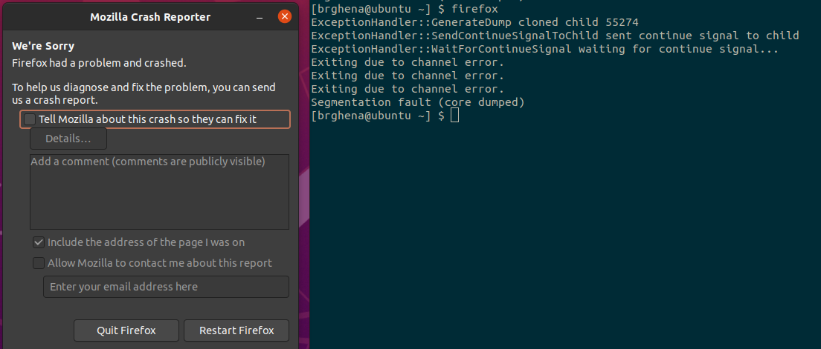
Examples: sending a signal
> kill -11 pid (11 is SIGSEGV – a.k.a segfault)

Slide 69
Example: catching a signal
#include <stdbool.h>
#include <stdlib.h>
#include <stdio.h>
#include <unistd.h>
#include <signal.h>
void sighandler (int signum) {
printf("HA HA You can't kill me!\n");
}
int main (void) {
signal(SIGINT, sighandler);
printf("Starting\n");
while(true) {
printf("Going to sleep for a second...\n");
sleep(1);
}
return 0;
}

Slide 70
Example: catching a segfault
#include <stdbool.h>
#include <stdlib.h>
#include <stdio.h>
#include <unistd.h>
#include <signal.h>
int* pointer = 0x00000000;
void sighandler (int signum) {
printf("Oops, that pointer wasn't valid. Let's try a different one\n");
pointer++;
printf("About to read from pointer 0x%08lX\n", (long)pointer);
}
int main (void) {
signal(SIGSEGV, sighandler);
printf("About to read from pointer 0x%08lX\n", (long)pointer);
int test = *pointer;
return(0);
}

Slide 71
Outline
Process Control Flow
System Calls
File I/O
Standard I/O
Signals

Slide 72
Extra Slides
Calling a syscall without C libraries
Container Systems Overview

Slide 73
Extra: How to call a syscall directly?
In reality, main is simply a convention of the standard library.
The first function, in reality is _start
Compile without the standard library
gcc -s -O2 -nostdlib main.c
How to write a syscall without C standard libraries?
Lots of headache
You can read about it: https://blog.packagecloud.io/the-definitive-guide-to-linux-system-calls/

Slide 74
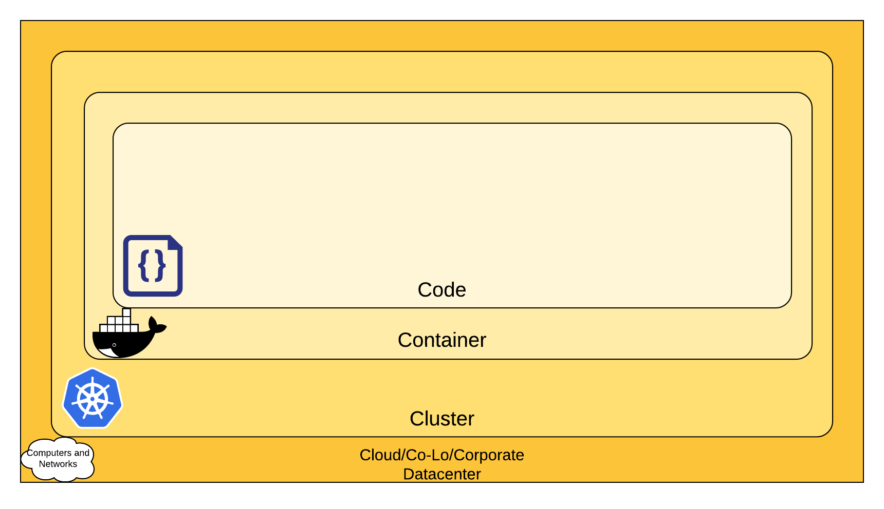
Little intro: Cloud Systems

Slide 75
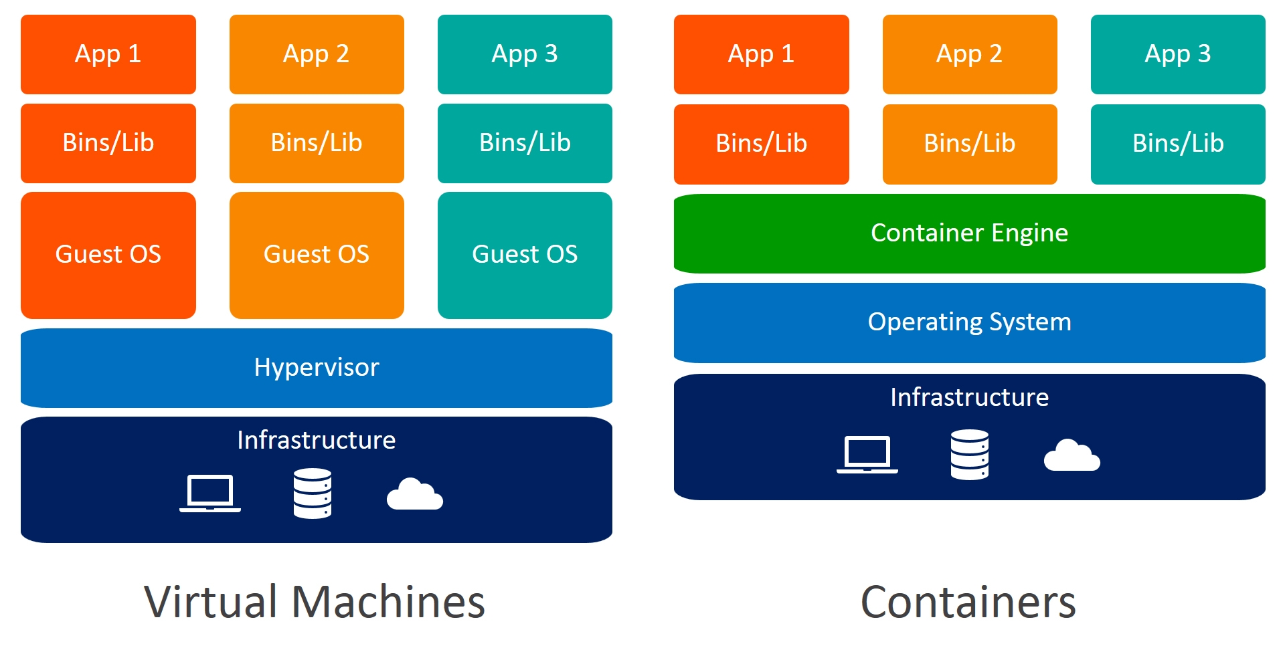
Containers vs. Virtual Machines

Slide 76
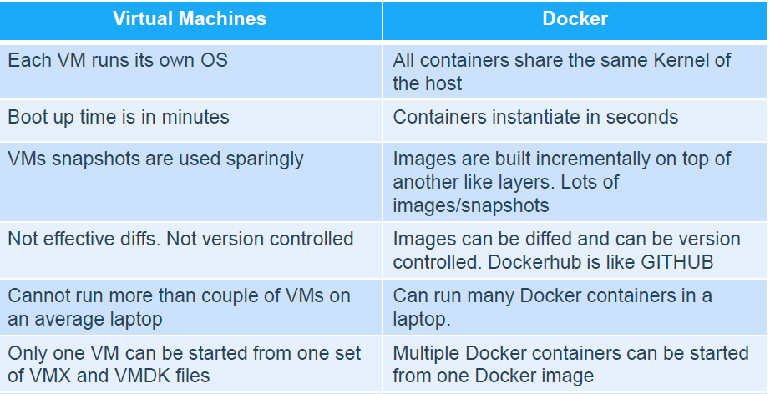
Containers vs. VMs

Slide 77
Extra: Securing Systems by Limiting syscalls
Limit the syscalls a process can call
Uses “seccomp” (secure computing mode). Widely used in containers.
A filter to decide whether to allow certain syscalls
The user needs to think about which syscalls to enable for an untrusted process/container

Slide 78
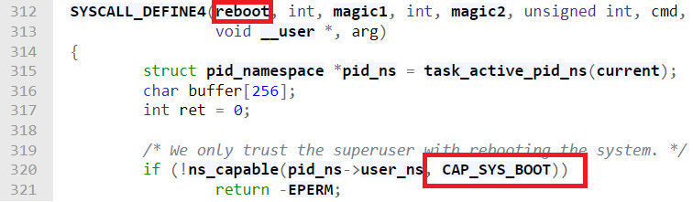
Capabilities and System Calls
41 Capabilities, ~400 syscalls
Users prefer to use capabilities to configure
They provide a higher-level functionality management technique
Less number of descriptions they have to go through
Two examples:
CAP_NET_ADMIN: Modify iptables, add network interfaces
CAP_SYS_BOOT: Reboot the system
Sometimes, the mapping is one-to-one, sometimes not:

Slide 79
Why is this important?
Benefits at some cost
Good: Deployment, Management, Scaling, Memory, Startup,... → Efficiency
Bad: Run on the same kernel, Share resources,... → Vulnerability Exposure
Attacks
In 2022: 215 kernel exploits → Might affect containers too
First half of 2020: 160 attacks on cloud environments
We have to take advantage of isolation mechanisms currently provided by the kernel!

Slide 80
What are the Isolation Mechanisms?
Mandatory Access Control (AppArmor, SELinux) — Deny access to dangerous paths etc.
Cgroups (Resource Control)
Namespaces – View of container resources (containers have a different view of running processes, files, etc.)
Seccomp (syscalls) – Enables functionalities
Capabilities – Enables functionalities
Container Linking – Allow containers to see each other (‘s resources)
CPU protection mechanisms (KASLR, SMEP)

Slide 81

About me
Your TA this quarter!
PhD student in CS, working on system security
All the way from configuration, data collection, detection, forensics, mitigation to finally secure systems
Now working on cloud security

