Slide 1
Lecture 12 Memory Hierarchy
CS213 – Intro to Computer Systems
Branden Ghena – Spring 2021
Slides adapted from: St-Amour, Hardavellas, Bustamente (Northwestern), Bryant, O’Hallaron (CMU), Garcia, Weaver (UC Berkeley)

Slide 2
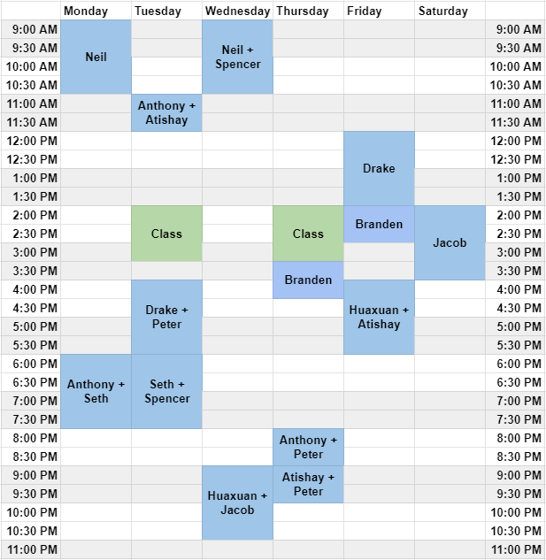
Administrivia
Reminder: office hours
Course staff is amazing!!
Can help with topics as well as assignments
Get started on Homework 3
And on Attack Lab

Slide 3
Changing the focus of CS213
So far in class we’ve focused on how computers do things
Represent data
Run instructions
Now we’re focusing on how to improve those things
Secure (last lecture plus some stuff in two weeks)
Efficient (today and next week
As we’ll show today, the most important thing to speed up is memory
It is possible and hardware does so already
Software can be designed to take advantage of this

Slide 4
Today’s Goals
Explore the memory systems available in modern computers
Understand capabilities and limitations of each
Discuss the memory hierarchy
How it improves performance through caching
Describe software patterns that caching is designed to support

Slide 5
Outline
Technologies and Trends
Memory Hierarchy
Locality of Reference

Slide 6
Storage in a Computer System
Data can be stored in different places
Registers, caches, memory, disk, etc.
Caches are temporary storage in processor used to speed up memory access
Hugely different characteristics
Storage size
x86-64: 16 registers. 128 B total (not including FP registers, etc.)
Memory is measured in GB, disks in TB
Latency (i.e., time to access data)
Registers are really fast, memory less so, disk is incredibly slow
Cost per byte
Registers are really expensive, disks are really cheap, memory somewhere in the middle
Each serves a different purpose in a system
Can design systems to get the best of all worlds (in most cases)

Slide 7
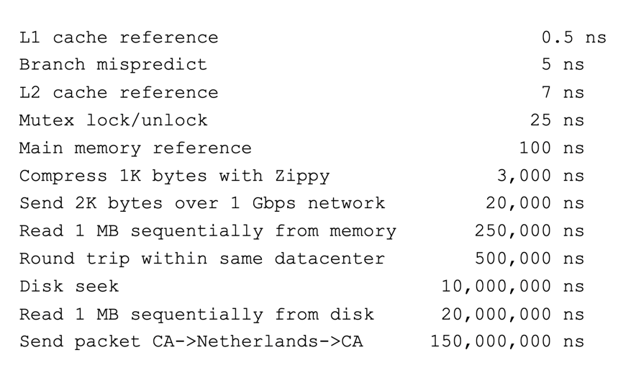
Computing timescales
Assuming 4 GHz processor, Instruction (with registers): 0.25 ns
Jeff Dean (Google AI): “Numbers Everyone Should Know”

Slide 8

Jim Gray’s storage latency analogy
How “far” is data for the CPU, converted to human scale
Storage
Distance
Time
Jim Gray
Turing Award 1998
Registers
In my apartment
1 minute
On-chip cache
Across the street
2-4 minutes
On-board cache
A few blocks away
10 minutes
Main memory
In Milwaukee
1.5 hours
Disk
On Mars
2 years
Tape
On Kepler-76b
2000 years (at speed of light)

Slide 9
Tour of computer memory
System bus
Memory bus
Processor
Main
memory
I/O
bridge
I/O bus
USB
controller
Graphics
adapter
Disk
controller
Mouse
Keyboard
Display
Disk

Slide 10
Tour of computer memory
Registers and Caches
System bus
Memory bus
Processor
Main
memory
I/O
bridge
I/O bus
USB
controller
Graphics
adapter
Disk
controller
Mouse
Keyboard
Display
Disk

Slide 11
Register storage
x86-64
16 registers (general-purpose) with 8 bytes each
32 registers (special-purpose) with up to 64 bytes each
Plus some other odds and ends (%rip, flags, segments, etc.)
128 bytes for general purpose registers
Order 1-2 kB for everything
Accesses are very fast. Within a single cycle

Slide 12
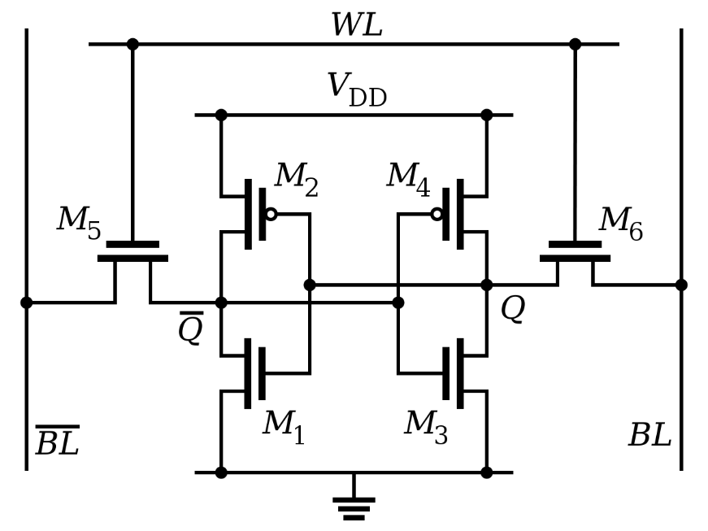
Register technology: SRAM
Static RAM (SRAM)
Each cell stores a bit in a bi-stable circuit, typically a six-transistor circuit
Static – no need for periodic refreshing; keeps data while powered
Relatively insensitive to disturbances such as electrical noise
Energetic particles (alpha particles, cosmic rays) can flip stored bits
Fastest memory on computer
Also most expensive and takes up most space per bit
Typically used for registers and cache memories

Slide 13
Tour of computer memory
RAM
System bus
Memory bus
Processor
Main
memory
I/O
bridge
I/O bus
USB
controller
Graphics
adapter
Disk
controller
Mouse
Keyboard
Display
Disk

Slide 14
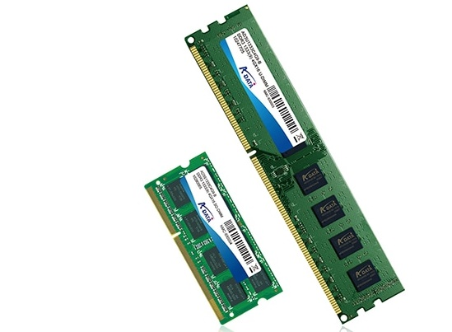
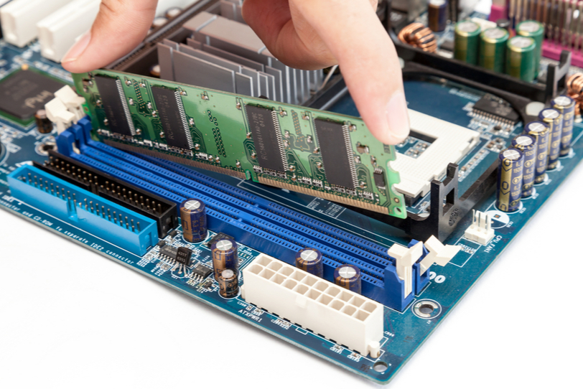
Main memory
The “RAM” in your computer
Random Access Memory
Can access any byte you want in “random” order
Typically measured in GB
1-128 GB
Some special purpose systems may have MUCH less
This is the “array of bytes” we’ve been using in assembly

Slide 15
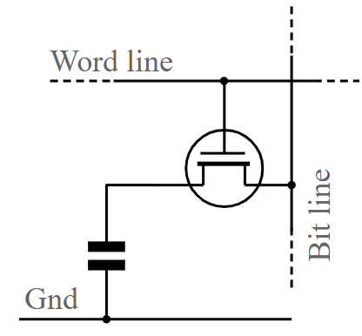
Main memory technology: DRAM
Dynamic RAM (DRAM)
Each cell stores a bit as a charge in a capacitor
Capacitors lose charge; each cell must be refreshed every 10-100 ms
More sensitive to disturbances (EMI, radiation, …) than SRAM
Slower than SRAM, but cheaper and denser
~100x slower than registers
Typically used for main memory

Slide 16
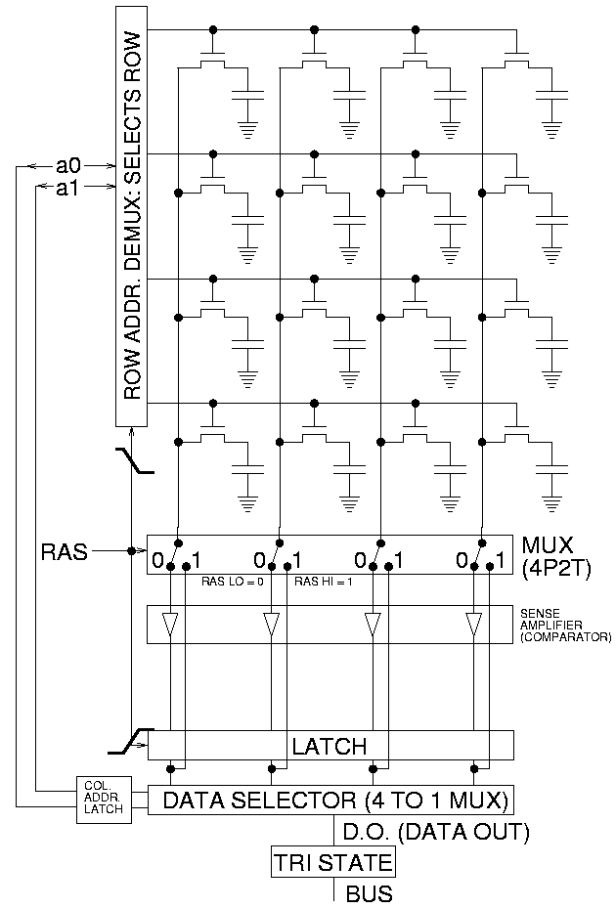
Accessing DRAM
Read entire row of data at a time
Large in practice, kilobytes
Select actual bytes that are wanted
Possibly modifying those bits
Write row back to memory
Must always happen!
Reading is destructive

Slide 17
Connecting main memory and the processor
Data flows between main memory and processor over buses
A collection of parallel wires that carry address, data, and control signals
Typically shared by multiple devices
movl A, %eax (load)
Processor writes address A to the bus
Memory writes data to the bus
Processor reads data from the bus
CPU chip
register file
movl %eax, A (store)
Processor writes address A to the bus
Processor writes data to the bus
Memory reads data from the bus
ALU
Includes memory controller
main
memory
bus interface
system bus
I/O
bridge
memory bus

Slide 18
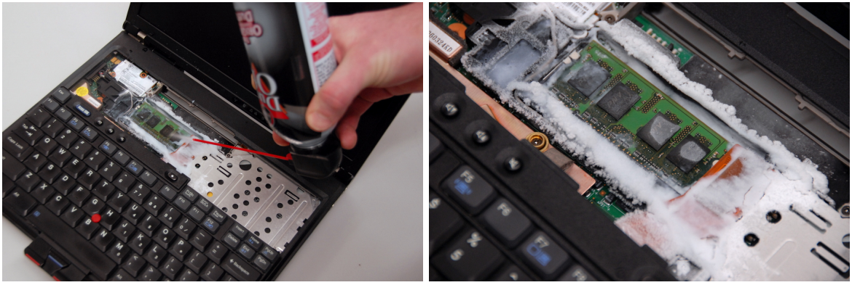
Sidebar: memory security is important
Data in RAM disappears without power
But the rate depends on temperature, minutes to decay if frozen
Cold Boot Attack: freeze RAM to remove from computer and steal contents

Slide 19
Tour of computer memory
System bus
Memory bus
Processor
Main
memory
I/O
bridge
I/O bus
USB
controller
Graphics
adapter
Disk
controller
Mouse
Keyboard
Display
Disk
Disk: Hard drive or SSD

Slide 20
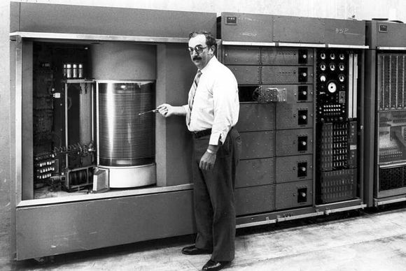
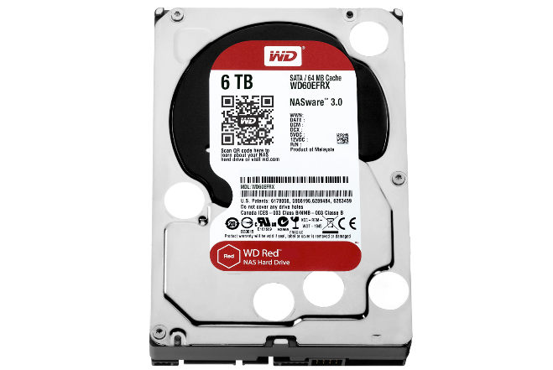
Disk storage
IBM 350 Disk Storage Unit
First disk drive, 1956
Storage?
5MB!
Workhorse storage devices
Terabytes in size in modern computers
Milliseconds to read
100,000x longer than reading from DRAM
10,000,000x longer than reading from SRAM
WD Red 6TB NAS, 2015
146.99mm
Basic mechanisms the same!
101.6mm

Slide 21
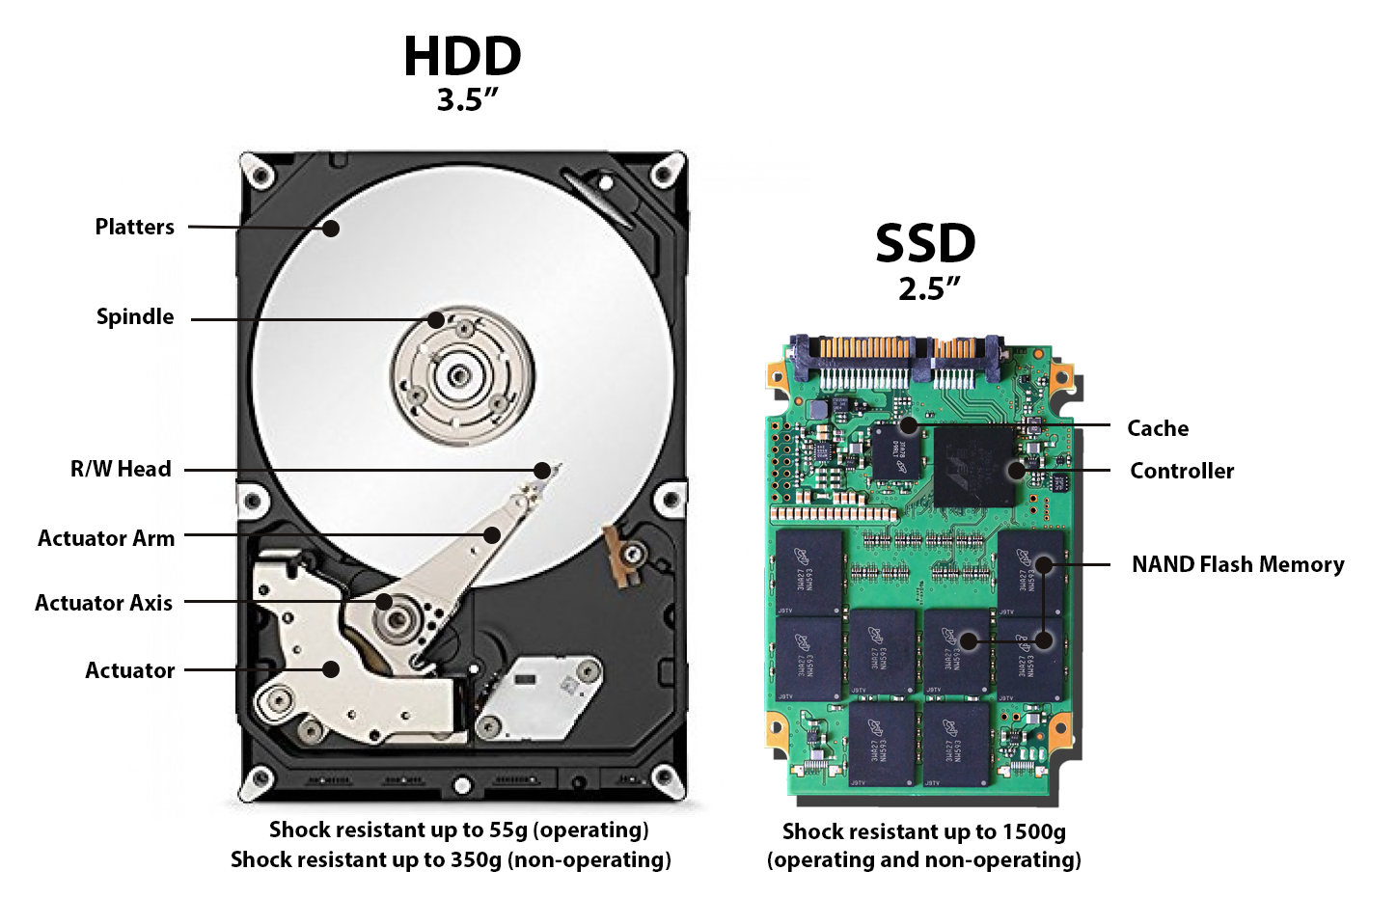
Disk types

Slide 22
Hard disk drive operation
The disk surface
spins at a fixed
rotational rate
(5400-15000 RPM)
The read/write head
is attached to the end
of the arm and flies over
the disk surface on
a thin cushion of air.
spindle
spindle
spindle
spindle
spindle
By moving radially, the arm can position the read/write head over any track.
arm
read/write heads
move in unison
from cylinder to cylinder
spindle

Slide 23
Accessing data on disk
Three-step process
Read head needs to move to the right cylinder: seek time
Platter turns until start of sector under the read head: rotational latency
Sector passes under read head and data is read: transfer time
Time cost dominated by seek time and rotational latency
Consequence: reading first bit of a sector is expensive
But reading the rest of the sector is basically free!
When using disks, best to favor large sequential reads/writes
Terrible for random access! (reading a little bit here, a little bit there)
But overall still really slow compared to main memory or registers

Slide 24
Solid State Drives (SSDs)
I/O bus
Flash memory
Just like Flash Drives
Pages: 2KB to 512KB, Blocks: 32 to 128 pages
Data read/written in units of pages
Page can be written only after its block has been erased
Need to copy rest of the data to not lose it. Expensive!
A block wears out after repeated writes (10k – 100k writes) and can no longer be used
Requests to read and
write logical disk blocks
Solid State Disk (SSD)
Flash
translation layer
Flash memory
Block 0
Block B-1
…
…
…
Page 0
Page 1
Page P-1
Page 0
Page 1
Page P-1
Notes:
SSD based on flash memory (non-volatile memory based on EEPROM – electrically erasable programmable ROM)
Plugs into a standard disk slot – typically USB or SATA
Made of a few chips and a flash translation layer, a hw/firmware piece similar to a disk controller

Slide 25
SSDs vs Rotating Disks
Advantages
No moving parts → faster, less power, more rugged
Disadvantages
Have the potential to wear out
Mitigated by “wear leveling logic” in flash translation layer
Order petabyte (10¹⁵ bytes) of random writes before they wear out
More expensive per byte (but getting cheaper)
2021: HDD $0.02 per GB, SSD $0.09 per GB
Applications
Portable electronics (phones, tablets, etc.)
Began to appear in desktops and servers circa 2007
Now common on laptops as well
Biggest speed improvement to your computer:
Get an SSD

Slide 26
Reading memory from disk
CPU chip
register file
Data from disk is always read into Main Memory
Direct Memory Access (DMA)
Processor starts a read and then returns to programs
Disk performs the read, transfers data, then notifies processor when done
ALU
main
memory
bus interface
I/O bus
USB
controller
graphics
adapter
disk
controller
mouse
keyboard
monitor
disk

Slide 27
Tour of computer memory
System bus
Memory bus
Processor
Main
memory
I/O
bridge
I/O bus
USB
controller
Graphics
adapter
Disk
controller
Mouse
Keyboard
Display
Disk

Slide 28
Break + Question
How do you make an SSD with a longer lifetime (more writes)?
Without changing any of the physics of how it works

Slide 29
Break + Question
How do you make an SSD with a longer lifetime (more writes)?
Without changing any of the physics of how it works
Secretly make it larger than it claims to be
e.g. 200 GB when it claims to be 100 GB
Behind the scenes move around memory as necessary so the device can still hold 100 GB even if half of the flash is
Maintain a mapping of which data is located where

Slide 30
Outline
Technologies and Trends
Memory Hierarchy
Locality of Reference

Slide 31
The CPU-Memory gap
Disk
Increasing gap between DRAM, disk, and CPU speeds.
SSD
DRAM, disk and CPU
performance gap widening
DRAM
SRAM roughly keeping up
SRAM
CPU
Split reflects the introduction of multicores
Notes:
In early 21st century computer manufacturers discover they couldn’t keep increasing CPU clock freq. because chips would consume too much power; answer was multicore – there you see the cycle times getting slower but effective cycle times keeping about the same improvement rate

Slide 32
The CPU-Memory Gap
CPUs outspeed memory
But they can’t compute on data they don’t have!
If the CPU has to wait for data to reach it, it just sits idle!
All these GHz don’t look so useful anymore, do they?
Challenge: get data to the CPU despite “slow” memory
So the CPU can work at full speed, without waiting for data
Two-pronged strategy
Memory hierarchy: keep data we need closer to the CPU
Locality of reference: predict which data we’re likely to need

Slide 33
Memory hierarchy
Some fundamental and enduring properties of systems
The faster the storage, the more expensive ($) it is
The faster the storage, the smaller (capacity) it is
The gap between processor and main memory speed is widening
Key idea: keep the data you need the most in fast memory!
Data you only need from time to time can be in slow memory, no big deal
Most used data goes in registers
Least used data goes to disk
Analogy: kitchen ingredients I use
Salt, all the time: it sits out on the counter
Oregano, frequently: front of the cabinet
Onion powder, occasionally: back of the cabinet
Brown sugar, sometimes: somewhere in the pantry
Saffron, never: I can go buy some if I do need it

Slide 34
Memory hierarchy
Smaller,
faster,
and
costlier
(per byte)
storage
devices
CPU registers hold words retrieved from L1 cache.
L0:
registers
on-chip L1
cache (SRAM)
L1 cache holds cache lines retrieved from the L2 cache memory.
L1:
L2:
off-chip L2
cache (SRAM)
L2 cache holds cache lines retrieved from main memory.
Main memory holds disk
blocks retrieved from local
disks.
L3:
main memory
(DRAM)
Larger,
slower,
and
cheaper
(per byte)
storage
devices
Local disks hold files retrieved from disks on remote network servers.
L4:
local secondary storage
(local disks)
L5:
remote secondary storage
(distributed file systems, Web servers)

Slide 35
Caching, general principle
Cache: A smaller, faster storage device that acts as a staging area for a subset of the data in a larger, slower device
Data lives in both places (typically)
When the consumer (e.g., CPU) reads the data, it gets it from the smaller, faster storage
If the data we want is not in the cache, we pay the full cost of bringing it over from the larger, slower storage into the smaller, faster storage
The hope: we don’t need to do it too often
Fundamental idea in systems. Shows up all over!
Memory hierarchies
Content delivery networks (CDNs) on the Internet (Akamai, Cloudflare, etc.)

Slide 36
Caching in a memory hierarchy
Fundamental idea of a memory hierarchy
For each k, the faster, smaller device at level k serves as a cache for the larger, slower device at level k+1
L2 cache memory as a cache for main memory
Main memory as a cache for disk, etc.
Each level stores some of the most frequently accessed data
The closer the cache is to the processor, the “hotter” the cached data

Slide 37
Memory hierarchies make memory fast and large
Why do memory hierarchies work?
Programs tend to access the data at level k more often than they access the data at level k+1
Thus, the storage at level k+1 can be slower, and thus larger and cheaper per bit
Net effect:
A large pool of memory that costs as little as the cheap storage near the bottom, but that serves data to programs at the rate of the fast storage near the top
Best of both worlds!

Slide 38
Caching in a memory hierarchy
Smaller, faster, more expensive
device at level k caches a
subset of the blocks from level k+1
Level k:
8
9
14
3
Data is copied between
levels in block-sized transfer units
0
1
2
3
4
5
6
7
Larger, slower, cheaper storage
device at level k+1 is partitioned
into blocks.
Level k+1:
8
9
10
11
12
13
14
15
Blocks cannot be stored in an arbitrary location!
They can only live at one of a fixed set of locations.
In this example: they must be in the same “column” for both levels.

Slide 39
General caching concepts
Program needs object d, which is stored in some block b
Cache hit
Program finds b in the cache at level k e.g., block 14
14
Request
14
Level
k:
9
14
3
4*
14
0
1
2
3
Level
k+1:
4
5
6
7
8
9
10
11
12
13
14
15

Slide 40
General caching concepts
Program needs object d, which is stored in some block b
Cache hit
Program finds b in the cache at level k e.g., block 14
Cache miss
b is not at level k, so the level k cache must fetch it from level k+1, e.g., block 12
If the level-k cache is full, then some current block must be replaced (evicted). Which one is the “victim”?
Here, we pick 4; same column as 12
4 is “dirty”, need to write back to k+1
More on this next lecture
12
Request
12
Level
k:
4*
9
14
3
4*
12
12
Request
12
0
1
2
3
Level
k+1:
4
5
6
7
4*
8
9
10
11
12
13
14
15
12
“ * ” means the block is dirty (i.e., it has been modified)

Slide 41
Cache Misses Taxonomy
Cold (compulsory) miss
Cold misses occur when a block is accessed for the first time
No one ever accessed it, so there wasn’t any reason to bring it into cache
Capacity miss
Occurs when the set of active cache blocks (working set) is larger than the cache
There’s no way the working set can all fit in the cache, so there will be misses
Conflict miss
In most caches, blocks cannot be stored in any available slot
If two blocks need to go in the same slot, need to evict the old one to store the new!
If after that, we need to access the old block, conflict miss!
We had a conflict, evicted a block, and now we miss trying to access that block
Note: can happen even when there is “room” elsewhere in the cache!

Slide 42
Break + Video
How do you remember which cache miss is which?
Mr. Bean can help you tell the difference! (video)

Slide 43
Outline
Technologies and Trends
Memory Hierarchy
Locality of Reference

Slide 44
Locality
Goal: predict which data the CPU will want to access
So we can bring it to (and keep it in!) fast memory
Problem: memory is huge! (billions of bytes) how do you decide which to save?
Principle of Locality
Programs tend to reuse/use data items recently used or nearby those recently used
Temporal locality
Recently referenced items are likely to be referenced in the near future
Spatial locality
Items with nearby addresses tend to be referenced close together in time

Slide 45
Types of locality practice
Temporal locality
Recently referenced items are likely to be referenced in the near future
Spatial locality
Items with nearby addresses tend to be referenced close together in time
Quiz: what kind of locality?
Data
Reference array elements in succession:
Reference sum each iteration:
Instructions
Execute instructions in sequence:
Cycle through loop repeatedly:
sum = 0;
for (i = 0; i < n; i++)
sum += a[i];
return sum;
Spatial locality
Temporal locality
Spatial locality
Temporal locality

Slide 46
Locality example
Can get a sense for whether a function has good locality just by looking at its memory access patterns
Does this function have good locality?
Yes!
Array is accessed in same row-major order in which it is stored in memory
a through a+3 , a+4 through a+7, a+8 through a+11, etc.
int sumarrayrows(int a[M][N]){
int sum = 0;
for (int i = 0; i < M; i++) {
for (int j = 0; j < N; j++) {
sum += a[i][j];
}
}
return sum;
}
Temporal or spatial locality?
Spatial: accesses to array
Temporal: accesses to sum
Notes:
sum: both
a: mostly spatial
loop body instructions: both

Slide 47
Locality example
Does this function have good locality?
No!
Scans array column-wise instead of row-wise
a through a+3, then a+4*N through a+4*N+3, etc.
Holy jumping around memory Batman!
More on that in a couple of lectures
int sumarraycols(int a[M][N]){
int sum = 0;
for (int j = 0; j < N; j++) {
for (int i = 0; i < M; i++) {
sum += a[i][j];
}
}
return sum;
}
Notes:
sum: both
instructions: both
a: nope!

Slide 48
Locality to the Rescue!
How can we exploit locality to bridge the CPU-memory gap?
Use it to determine which data to put in a cache!
Spatial locality
When level k needs a byte from level k+1, don’t just bring one byte
Bring neighboring bytes as well!
Good chances we’ll need them too in the near future
Temporal locality
When you bring something into the cache, try to keep it there
Good chances we’ll need it again in the near future
Result: most accesses should be cache hits!
Memory system: size of largest memory, with speed close to that of fastest memory
We’ll see how that works in detail next time

Slide 49
Outline
Technologies and Trends
Memory Hierarchy
Locality of Reference

