Slide 1
Lecture 10 Structured Data
CS213 – Intro to Computer Systems
Branden Ghena – Winter 2022
Slides adapted from: St-Amour, Hardavellas, Bustamente (Northwestern), Bryant, O’Hallaron (CMU), Garcia, Weaver (UC Berkeley)

Slide 2
Administrivia
Remember: drop deadline is Friday
Please come by office hours if you’re concerned and want to talk
Or email me and I can schedule a meeting whenever
If I’m worried at all, I reached out to you
So if you didn’t get an email, you’re doing fine

Slide 3
Administrivia
Bomb Lab due on Thursday (2/10)
Keep up the hard work on it!
Remember, it’s tricky, but not trying to trick you
You can trust function names to roughly do what they say
New assignments will be released on Thursday/Friday

Slide 4
Today’s Goals
Wrap up x86-64 assembly!
Discuss how structures are accessed
Memory layout details
Explore details about how structure memory is aligned
Introduce unions in C
Bonus: deep-dive into how processors work

Slide 5
Outline
Structure Layout
Struct Padding and Alignment
Unions

Slide 6
Structure representation in C
r
struct rec {
int a[4];
size_t i;
struct rec *next;
};
a
i
next
0
16
24
32
Structure represented as block of memory
Big enough to hold all of the fields
Fields ordered according to declaration order
Even if another ordering could yield a more compact representation
(We’ll see how that could happen in a bit)
Compiler determines overall size + positions of fields
Looking at memory, no way to tell it’s a struct (like arrays); just bytes
It’s all in how the code treats that region of memory!

Slide 7
Structure access
r
r+16
struct rec {
int a[4];
size_t i;
struct rec *next;
};
a
i
next
0
16
24
32
Accessing Structure Member
Pointer r indicates first byte of structure
Access member with offsets
Offset of each structure member determined at compile time
Another use for Displacement in memory addressing!
size_t get_i(struct rec *r)
{
return r->i;
}
# r in %rdi
movq 16(%rdi), %rax
ret
r is a pointer to a struct.
Dereference the ponter, then get the i field of the struct.

Slide 8
Array within a struct
r
r+4*idx
struct rec {
int a[4];
size_t i;
struct rec *next;
};
a
i
next
0
16
24
32
Same as before; just need to also index in the array
Pointer r indicates first byte of structure
Offset of each structure member determined at compile time
Offset into array determined based on index and type
Compute as *(structAddr + offset + K*index);
Uses full addressing mode!
int get_a (struct rec *r,
size_t idx)
{
return r->a[idx];
}
# r in %rdi
# idx in %rsi
movq (%rdi,%rsi,4), %rax
ret

Slide 9
Structure Access Practice 1
Arguments:
%rdi
%rsi
%rdx
%rcx
%r8
%r9
struct rec {
int j;
int i;
int a[2];
struct rec *n;
};
void
set_i(struct rec *r,
int val)
{
r->i = val;
}
movl ______, _______
ret
%esi
4(%rdi)

Slide 10
Structure Access Practice 2
Arguments:
%rdi
%rsi
%rdx
%rcx
%r8
%r9
struct rec {
int j;
int i;
int a[2];
struct rec *n;
};
void
set_i(struct rec *r,
int val)
{
r->a[1] = val;
}
movl ______, _______
ret
%esi
12(%rdi)

Slide 11
Structure Access Practice 3
Arguments:
%rdi
%rsi
%rdx
%rcx
%r8
%r9
struct rec {
int j;
int i;
int a[2];
struct rec *n;
};
void
set_i(struct rec *r,
int val,
int index)
{
r->a[index] = val;
}
movl ______, _________________
ret
%esi
8(%rdi, %rdx, 4)

Slide 12
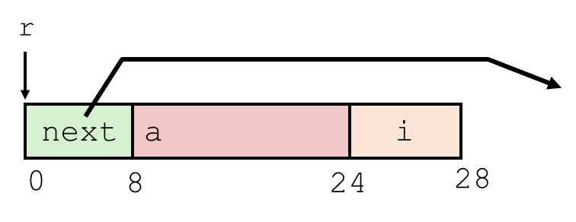
Following Linked List
struct rec {
struct rec *next;
int a[4];
int i;
}; // DIFFERENT ORDER!
By convention, null next
pointer indicates end of list
r
void set_val
(struct rec *r, int val)
{
while (r) {
int i = r->i;
r->a[i] = val;
r = r->next;
}
}
next
a
i
0
8
24
28
Register | Value
%rdi | r
%rsi | val
.L11: # loop:
movslq 24(%rdi), %rax # i = M[r+24]
movl %esi, 8(%rdi,%rax,4) # M[r+8+4*i] = val
movq (%rdi), %rdi # r = M[r]
testq %rdi, %rdi # Test r
jne .L11 # if !=0 goto loop

Slide 13
Following Linked List
struct rec {
struct rec *next;
int a[4];
int i;
}; // DIFFERENT ORDER!
By convention, null next
pointer indicates end of list
r
void set_val
(struct rec *r, int val)
{
while (r) {
int i = r->i;
r->a[i] = val;
r = r->next;
}
}
next
a
i
0
8
24
28
Register | Value
%rdi | r
%rsi | val
.L11: # loop:
movslq 24(%rdi), %rax # i = M[r+24]
movl %esi, 8(%rdi,%rax,4) # M[r+8+4*i] = val
movq (%rdi), %rdi # r = M[r]
testq %rdi, %rdi # Test r
jne .L11 # if !=0 goto loop
Load i

Slide 14
Following Linked List
struct rec {
struct rec *next;
int a[4];
int i;
}; // DIFFERENT ORDER!
By convention, null next
pointer indicates end of list
r
void set_val
(struct rec *r, int val)
{
while (r) {
int i = r->i;
r->a[i] = val;
r = r->next;
}
}
next
a
i
0
8
24
28
Register | Value
%rdi | r
%rsi | val
.L11: # loop:
movslq 24(%rdi), %rax # i = M[r+24]
movl %esi, 8(%rdi,%rax,4) # M[r+8+4*i] = val
movq (%rdi), %rdi # r = M[r]
testq %rdi, %rdi # Test r
jne .L11 # if !=0 goto loop
Write val into r->a[i]

Slide 15
Following Linked List
struct rec {
struct rec *next;
int a[4];
int i;
}; // DIFFERENT ORDER!
By convention, null next
pointer indicates end of list
r
void set_val
(struct rec *r, int val)
{
while (r) {
int i = r->i;
r->a[i] = val;
r = r->next;
}
}
next
a
i
0
8
24
28
Register | Value
%rdi | r
%rsi | val
.L11: # loop:
movslq 24(%rdi), %rax # i = M[r+24]
movl %esi, 8(%rdi,%rax,4) # M[r+8+4*i] = val
movq (%rdi), %rdi # r = M[r]
testq %rdi, %rdi # Test r
jne .L11 # if !=0 goto loop
Move to next node in list

Slide 16
Following Linked List
struct rec {
struct rec *next;
int a[4];
int i;
}; // DIFFERENT ORDER!
By convention, null next
pointer indicates end of list
r
void set_val
(struct rec *r, int val)
{
while (r) {
int i = r->i;
r->a[i] = val;
r = r->next;
}
}
next
a
i
0
8
24
28
Register | Value
%rdi | r
%rsi | val
.L11: # loop:
movslq 24(%rdi), %rax # i = M[r+24]
movl %esi, 8(%rdi,%rax,4) # M[r+8+4*i] = val
movq (%rdi), %rdi # r = M[r]
testq %rdi, %rdi # Test r
jne .L11 # if !=0 goto loop
NULL check

Slide 17
Outline
Structure Layout
Struct Padding and Alignment
Unions

Slide 18
Problem: reordering can lead to different layouts
struct rec {
int a[4];
int i;
struct rec *next;
};
r
void set_val
(struct rec *r, int val)
{
while (r) {
int i = r->i;
r->a[i] = val;
r = r->next;
}
}
a
i
next
0
16
20
28
Register | Value
%rdi | r
%rsi | val
SOMETHING’S WRONG….
.L11: # loop:
movslq 16(%rdi), %rax # i = M[r+16]
movl %esi, (%rdi,%rax,4) # M[r+4*i] = val
movq ??(%rdi), %rdi # r = M[r+??]
testq %rdi, %rdi # Test r
jne .L11 # if !=0 goto loop
Notes:
What’s wrong is that the code generated by the compiler (our ground truth) does not match what we think the data looks like.
Our picture is wrong.

Slide 19
Padding is added to struct to preserve alignment
struct rec {
int a[4];
int i;
struct rec *next;
};
r
void set_val
(struct rec *r, int val)
{
while (r) {
int i = r->i;
r->a[i] = val;
r = r->next;
}
}
a
i
pad
next
0
16
20
24
32
Register | Value
%rdi | r
%rsi | val
.L11: # loop:
movslq 16(%rdi), %rax # i = M[r+16]
movl %esi, (%rdi,%rax,4) # M[r+4*i] = val
movq 24(%rdi), %rdi # r = M[r+24]
testq %rdi, %rdi # Test r
jne .L11 # if !=0 goto loop

Slide 20
Alignment
Aligned data
Primitive data type requires K bytes
Address must typically be a multiple of K (e.g., 1,2,4 or 8)
an address that is a multiple of K is called “K-byte aligned”
Required on some machines; recommended on x86-64
But not doing it will really slow down your program
In our example, pointer needed 8-byte alignment
offset 24 ok, 20 was not

Slide 21
The why and how of alignment
Motivation for aligning data
Inefficient to load or store datum that spans quad word boundaries
Hardware is really good at loading, e.g., 8 bytes at address 16, or 24, or 32
If you want 8 bytes at address 12, may need two memory reads. Oops…
Secondary motivations
Having one datum spanning 2 cache lines = two cache accesses per access
See upcoming lecture on caching
Virtual memory very tricky when a datum spans 2 pages
See upcoming lecture on virtual memory
The compiler manages alignment
Inserts gaps in structure to ensure correct alignment of fields
Also occurs on the stack!

Slide 22
Specific Cases of Alignment (x86-64, Linux)
1 byte: char
1-byte aligned (no restrictions on address)
2 bytes: short
2-byte aligned (lowest 1 bit of address must be 0)
4 bytes: int, float
4-byte aligned (lowest 2 bits of address must be 00)
8 bytes: long, long long, double, char* (any pointer)
8-byte aligned (lowest 3 bits of address must be 000)
16 bytes: long double
16-byte aligned (lowest 3 bits of address must be 0000)
Max possible alignment requirement on x86-64

Slide 23
Satisfying Alignment within Structures
Within structure
Must satisfy each element’s alignment requirement
Overall structure placement
Each structure has alignment requirement K
Where K = Largest alignment of any element
Initial address & structure length must be multiples of K
Example:
K = 8, due to double element
struct S1 {
char c;
int i[2];
double v;
} *p;
c
3 bytes
i[0]
i[1]
4 bytes
v
p+0
p+4
p+8
p+16
p+24
Multiple of 4
Multiple of 8
Multiple of 8
Multiple of 8

Slide 24
Meeting Overall Alignment Requirement
Entire struct must be a multiple of its largest element
For largest alignment requirement K
Overall structure must be multiple of K
Trailing padding
struct S2 {
double v;
int i[2];
char c;
} *p;
 | v |  |  |  |  |  |  | i[0] |  |  |  | i[1] |  |  |  | c | 7 bytes
p+0 |  |  |  |  |  |  | p+8 |  |  |  |  |  |  |  | p+16 |  |  |  |  |  |  |  | p+24
Multiple of K=8

Slide 25
Arrays of Structures
Arrays are the reason for the overall length requirement
Each struct must start at a multiple of its largest member. This means the member is aligned
The compiler adds trailing padding even without array declaration
struct S2 {
double v;
int i[2];
char c;
} a[10];
 | a[0] |  |  |  |  | a[1] |  |  |  |  | a[2] |  |  |  |  | • • •
a+0 |  |  |  |  | a+24 |  |  |  |  | a+48 |  |  |  |  | a+72
 | v |  |  |  |  |  |  | i[0] |  |  |  | i[1] |  |  |  | c | 7 bytes
a+24 |  |  |  |  |  |  | a+32 |  |  |  |  |  |  |  | a+40 |  |  |  |  |  |  |  | a+48

Slide 26
Accessing Array Elements
struct S3 {
short i;
float v;
short j;
} a[10];
 | a[0] |  |  |  |  | • • • |  |  |  | a[idx] |  |  |  | • • |  |  | •
a+0 |  |  |  |  | a+12 |  |  |  | a+12*idx
 |  |  |  |  | i | 2 bytes |  | v |  |  | j | 2 bytes
 |  |  |  | a+12*idx |  |  |  |  |  | a+12*idx+8
sizeof(S3)=12, including padding
Compute array offset 12*idx
Element j is at offset 8 within structure
Assembly contains displacement a+8
Compile-time constant resolved during linking
short get_j(int idx)
{
return a[idx].j;
}
# %rdi = idx
leaq (%rdi,%rdi,2),%rax # 3*idx
movzwl a+8(,%rax,4),%eax

Slide 27
Saving Space
Put large data types first
Effect: saved 4 bytes
C compilers cannot do this automatically!
They have to preserve field ordering
Programmers must do it manually
Other languages aren’t bound to preserve ordering. Rust may reorder for you
struct S4 {
char c;
int i;
char d;
} *p;
struct S5 {
int i;
char c;
char d;
} *p;
c
3 bytes
i
d
3 bytes
i
c
d
2 bytes

Slide 28
Break + Quiz
What is the total size of this struct?
typedef struct { short a; int b; char* c[3]; char d; }

Slide 29
Break + Quiz
What is the total size of this struct?
typedef struct { short a; int b; char* c[3]; char d; }
2 bytes for a
(2 bytes for padding)
4 bytes for b (no padding needed, 8-aligned) 24 bytes for c
(no padding needed, 1-aligned) 1 byte for d (7 bytes padding after struct)
= 40 bytes total
Could have been 32 bytes if reordered

Slide 30
Outline
Structure Layout
Struct Padding and Alignment
Unions

Slide 31
Unions
typedef struct {
char which_kind;
char n_sides;
char cost;
MealKind_t mk;
} Meal_t;
Structs = combine multiple pieces of data into one
Think: “all of the above”
Unions = choose between multiple different kinds of data
Think: “any of the above”
Typically used in conjunction with a struct: variants
That tells us which branch of the union is used
E.g., which_kind of 0 to mean sandwich meal, 1 for pizza, etc.
typedef union {
Sandwich_t s;
Pizza_t p;
Burrito_t b;
} MealKind_t;
typedef struct {
int n_pieces_bread;
char *toppings[2];
float mayo_ounces;
} Sandwich_t;

Slide 32
Union allocation
Principles
Overlay union elements
Allocate according to largest element (strictest)
Can only use one field at a time
Structs: All of the above,
together, one after the other.
Unions: One of the above,
you pick the one you want.
struct S1 {
char c;
int i[2];
double v;
} sp;
 | c | 3 bytes |  |  | i[0] |  |  |  | i[1] |  |  |  | 4 bytes |  |  | v
sp+0 |  |  |  | sp+4 |  |  |  | sp+8 |  |  |  |  |  |  | sp+16 |  |  |  |  |  | sp+24
union U1 {
char c;
int i[2];
double v;
} up;
Union: same bits, different contexts
8 bytes are allocated for the union
Can be interpreted as any member
Changing one member will change some bits of the others
 | c | 7 bytes
 | i[0] |  |  | i[1]
 | v
up+0 |  |  | up+4 |  |  | up+8
Notes:
Struct: all of the above, together
Union: one of the above, pick one

Slide 33
Union allocation
Principles
Overlay union elements
Allocate according to largest element (strictest)
Can only use one field at a time
Structs: All of the above,
together, one after the other.
Unions: One of the above,
you pick the one you want.
struct S1 {
char c;
int i[2];
double v;
} sp;
 | c | 3 bytes |  |  | i[0] |  |  |  | i[1] |  |  |  | 4 bytes |  |  | v
sp+0 |  |  |  | sp+4 |  |  |  | sp+8 |  |  |  |  |  |  | sp+16 |  |  |  |  |  | sp+24
Quiz: If we had 3 ints in that array, how much space would the union take?
union U1 {
char c;
int i[2];
double v;
} up;
 | c | 7 bytes
 | i[0] |  |  | i[1]
 | v
up+0 |  |  | up+4 |  |  | up+8
Answer: 16 bytes (8-byte aligned)
Notes:
Struct: all of the above, together
Union: one of the above, pick one

Slide 34
Using union to access bit patterns
typedef union {
float f;
unsigned u;
} bit_float_t;
 | f
 | u
0 |  |  |  | 4
Store union using one type & access it with another one
Get direct access to bit representation of float
float2bit generates bit pattern from float
NOT the same as (unsigned) f !
Doesn’t convert value to unsigned
Keeps the same bits but interprets them differently
Assembly doesn’t have type info
Just moves the bytes
unsigned float2bit(float f) {
bit_float_t temp;
temp.f = f;
return temp.u;
}
# procedure with float arg
# arg1 passed in %xmm0
# movss = move single-precision
movss %xmm0, -4(%rsp)
movl -4(%rsp), %eax
ret

Slide 35
Access to Bit Pattern Non-Solution
unsigned float2bit(float f) {
unsigned *p;
p = (unsigned *) &f;
return *p;
}
Undefined behavior in C.
Don’t do that.

Slide 36
Byte ordering revisited
Idea
Words/long words/quad words stored in memory as 2/4/8 consecutive bytes
At which byte address in memory is the most (least) significant byte stored?
Can cause problems when exchanging binary data between machines
Little Endian
Least significant byte has lowest address
Intel x86(-64), ARM Android and IOS
Big Endian
Most significant byte has lowest address
Sun/Sparc, Networks
Have to worry about it when working with unions!

Slide 37
Byte Ordering Example
union {
unsigned char c[8];
unsigned short s[4];
unsigned int i[2];
unsigned long l[1];
} dw;
for (int j = 0; j < 8; j++) {
dw.c[j] = 0xf0 + j;
}
printf("Chars 0-7 == [0x%x, 0x%x, 0x%x, 0x%x, 0x%x, 0x%x, 0x%x, 0x%x]\n",
dw.c[0], dw.c[1], dw.c[2], dw.c[3],
dw.c[4], dw.c[5], dw.c[6], dw.c[7]);
printf("Shorts 0-3 == [0x%x, 0x%x, 0x%x, 0x%x]\n",
dw.s[0], dw.s[1], dw.s[2], dw.s[3]);
printf("Ints 0-1 == [0x%x, 0x%x]\n",
dw.i[0], dw.i[1]);
printf("Long 0 == [0x%lx]\n",
dw.l[0]);

Slide 38
Byte ordering on Little Endian
union {
unsigned char c[8];
unsigned short s[4];
unsigned int i[2];
unsigned long l[1];
} dw;
Contents
f0 | f1 | f2 | f3 | f4 | f5 | f6 | f7
c[0] | c[1] | c[2] | c[3] | c[4] | c[5] | c[6] | c[7]
s[0] |  | s[1] |  | s[2] |  | s[3]
i[0] |  |  |  | i[1]
l[0]
Views
LSB
MSB
Print
Output:
Characters 0-7 == [0xf0, 0xf1, 0xf2, 0xf3, 0xf4, 0xf5, 0xf6, 0xf7]
Shorts 0-3 == [0xf1f0, 0xf3f2, 0xf5f4, 0xf7f6]
Ints 0-1 == [0xf3f2f1f0, 0xf7f6f5f4]
Long 0 == [0xf7f6f5f4f3f2f1f0]

Slide 39
Byte ordering on Big Endian
union {
unsigned char c[8];
unsigned short s[4];
unsigned int i[2];
unsigned long l[1];
} dw;
Contents
f0 | f1 | f2 | f3 | f4 | f5 | f6 | f7
c[0] | c[1] | c[2] | c[3] | c[4] | c[5] | c[6] | c[7]
s[0] |  | s[1] |  | s[2] |  | s[3]
i[0] |  |  |  | i[1]
l[0]
Views
MSB
LSB
Print
Output:
Characters 0-7 == [0xf0, 0xf1, 0xf2, 0xf3, 0xf4, 0xf5, 0xf6, 0xf7]
Shorts 0-3 == [0xf0f1, 0xf2f3, 0xf4f5, 0xf6f7]
Ints 0-1 == [0xf0f1f2f3, 0xf4f5f6f7]
Long 0 == [0xf0f1f2f3f4f5f6f7]

Slide 40
Break + Thinking
We’ve covered everything we need to from assembly
Do we know enough to “compile” C++ in x86-64?
Yes!
Classes are structs
Likely with extra members to keep track of things
And function pointers as members
References are just pointers that the compiler handles for you

Slide 41
Lecture BONUS Assembly to Transistors
CS213 – Intro to Computer Systems
Branden Ghena
Slides adapted from: St-Amour, Hardavellas, Bustamente (Northwestern), Bryant, O’Hallaron (CMU), Garcia, Weaver (UC Berkeley)

Slide 42
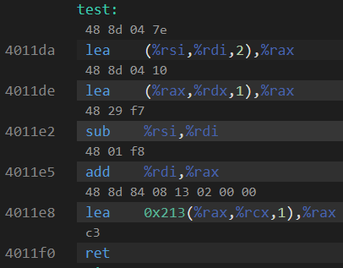
Assembly into machine code
Machine code are the numerical versions of each instruction
Number breaks down into parts
Operation
Source
Destination
Immediates are stored in the instruction encoding

Slide 43
Machine code ideas
Example:
ADD $0x4351FF23, %rax
ADD with destination %rax translates into 0x05
Immediate is appended on to that
Machine code: 0x0523FF5143
Number of bytes for each instruction is variable
1-15 bytes depending on instruction and operands
Translation in complicated
We’re not going to do it by hand, although Attack Lab will touch it a bit

Slide 44
Representing instructions as numbers
Why represent instructions as numbers?
Everything in memory is “just a number”
And instructions go in memory
Hardware can “decode” number to figure out what to do
Break number apart into bits (just like floating point)
Some bits pick operation
Some bits pick register or specify immediate

Slide 45
Computer Processor (in five easy steps)
Reads instruction from memory
Decodes it into an Operation plus Configurations
Immediates, Registers, Memory, etc.
Reads from source (based on configuration)
Executes that operation
Writes to destination (based on configuration)

Slide 46
These steps are relatively easy (we’ll skip them)
Reads instruction from memory
Decodes it into an Operation plus Configurations
Immediates, Registers, Memory, etc.
Reads from source (based on configuration)
Executes that operation
Writes to destination (based on configuration)

Slide 47
This is extremely complicated for x86-64 (skip it too)
Reads instruction from memory
Decodes it into an Operation plus Configurations
Immediates, Registers, Memory, etc.
Reads from source (based on configuration)
Executes that operation
Writes to destination (based on configuration)

Slide 48
We can talk about what execution means though!
Reads instruction from memory
Decodes it into an Operation plus Configurations
Immediates, Registers, Memory, etc.
Reads from source (based on configuration)
Executes that operation
Writes to destination (based on configuration)

Slide 49
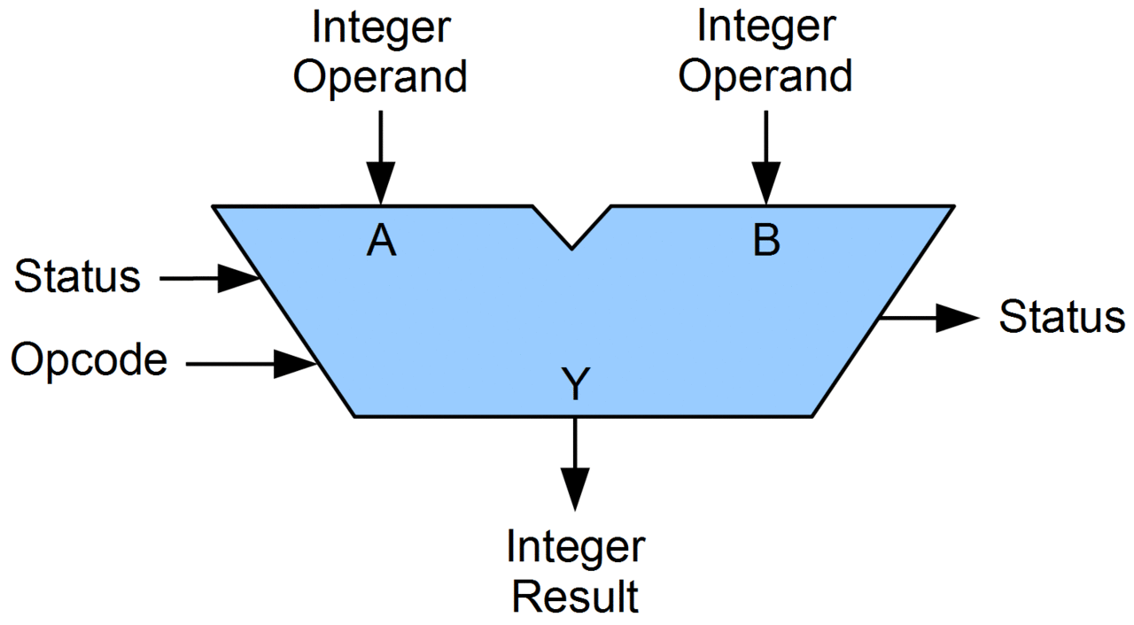
Arithmetic Logic Unit (ALU)
Piece of hardware
Takes in two operands
Source and Destination values
Takes in an Opcode
Which operation to run
Performs operation and outputs result

Slide 50
What can an ALU do?
All the basic arithmetic operations
Add
Subtract
Bitwise And
Bitwise Or
Bitwise Xor
Arithmetic Shift Right
Logical Shift Right
Logical Shift Left
Complex operations are separate hardware
Multiply, Divide, Anything floating point

Slide 51
Let’s zoom in

Slide 52
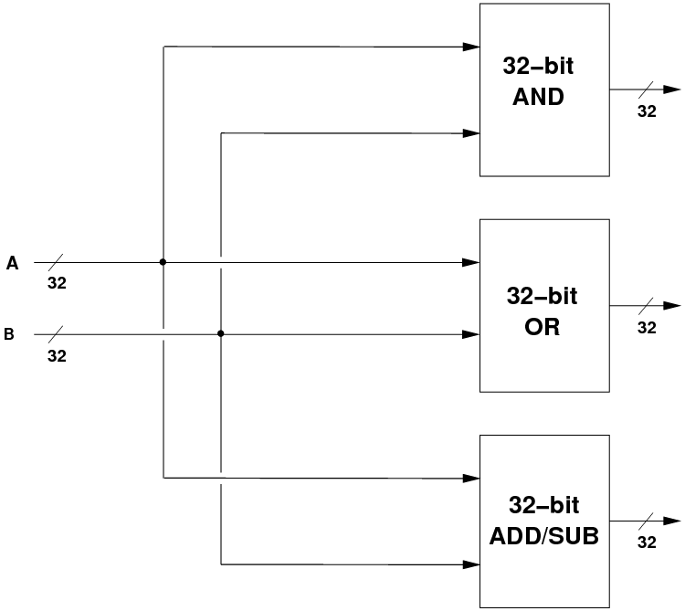
Inside an ALU
Input values go into separate hardware blocks for each operation
Every operation occurs in parallel, simultaneously
We are in hardware so this is essentially free
ALU Inputs

Slide 53
Inside an ALU – selecting the correct output
ALU Inputs
Selector
ALU Output
Selects ALU output based on Opcode
Opcode

Slide 54
Let’s zoom in

Slide 55
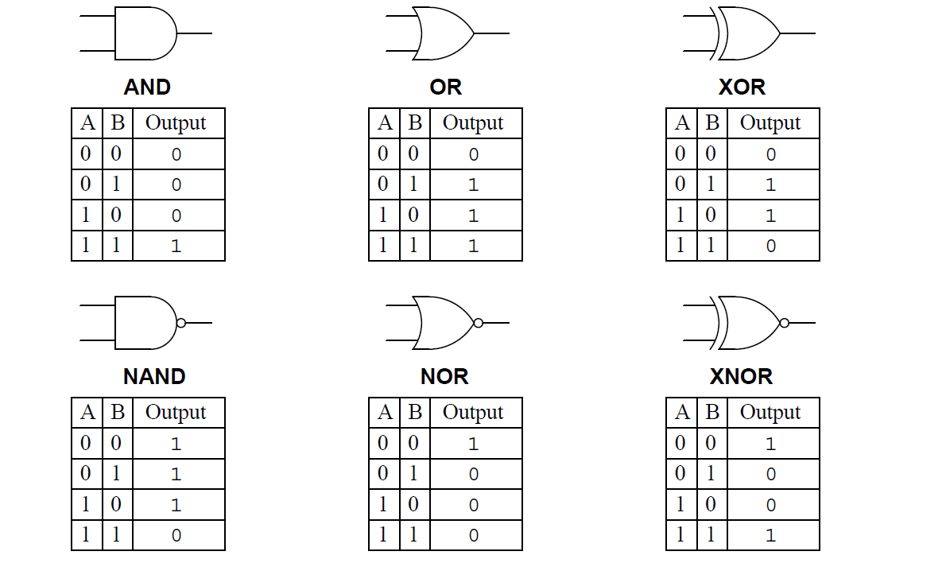
How is an ALU made?
All of those arithmetic operations can be broken down into a series of 1-bit Boolean operations
Add is XOR for result + AND for carry
Subtract is Flip bits (NOT), Add one (XOR + AND), then Add (XOR + AND)
And/Or/Xor are just their respective operations
Shifts are just move the bits around (simple in hardware, just move wires)

Slide 56
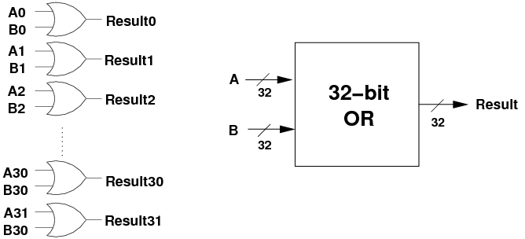
32-bit OR operation
Perform OR operation on each individual bit
Pictured is a series of 1-bit OR gates

Slide 57
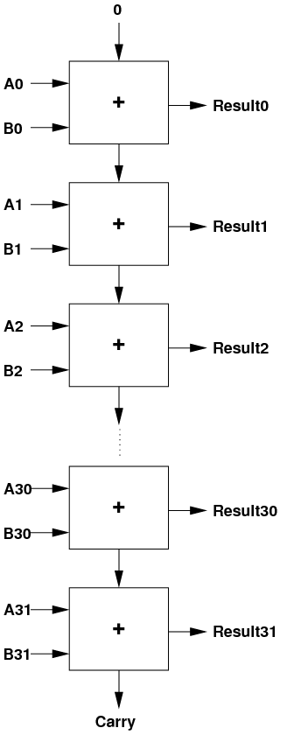
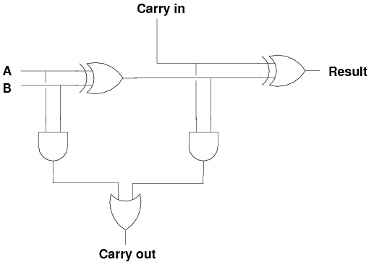
32-bit ADD operation
Below is the 1-bit version with carry-in/out
Two 1-bit AND, two 1-bit XOR, one 1-bit OR
Repeat 32 times, connecting carries together

Slide 58
Let’s zoom in

Slide 59
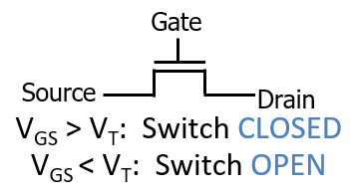
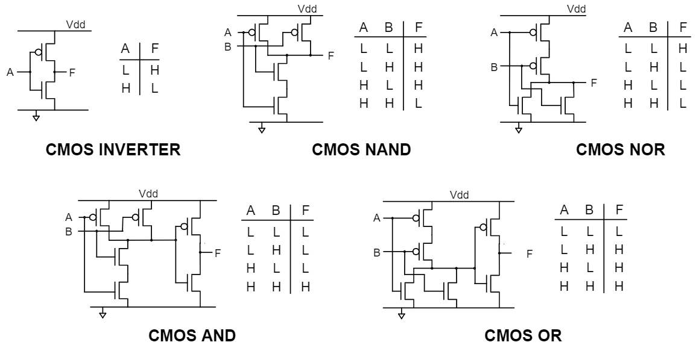
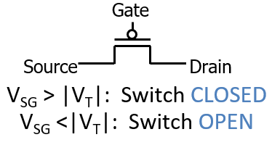
Logic gates can be created with transistors
Transistors are just on/off switches
CMOS implementation of logic gates
Complementary Metal-Oxide Semiconductor

Slide 60
Let’s zoom in

Slide 61
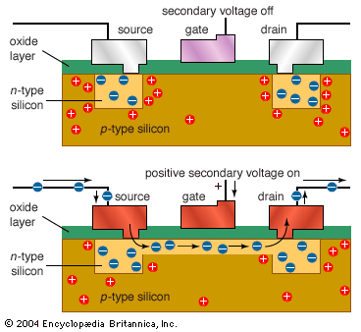
Transistors are made out of silicon and other materials
Turning gate on/off causes source and drain to connect or disconnect
Acts as a switch
We can make very small transistors

Slide 62
That’s the bottom

Slide 63
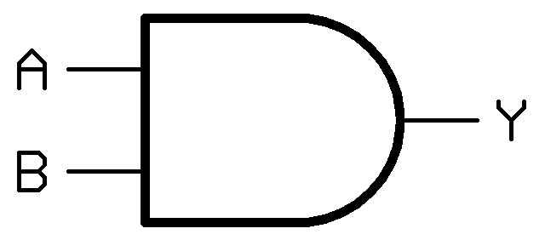
Zooming out again
Transistors make logic gates
F
1-bit AND gate

Slide 64
Zooming out again
Logic gates make operations
1-bit AND gate
1-bit ADD operation

Slide 65

Zooming out again
1-bit operations make 32-bit operations
1-bit ADD operation

Slide 66
Zooming out again
Operations make an ALU
ALU Inputs
Selector
ALU Output
Opcode

Slide 67
ALU allows us to execute operations
Reads instruction from memory
Decodes it into an Operation plus Configurations
Immediates, Registers, Memory, etc.
Reads from source (based on configuration)
Executes that operation
Writes to destination (based on configuration)

Slide 68
All the way back to software
C compiles into assembly
Assembly translates into machine code
Machine code specifies what should be executed

Slide 69
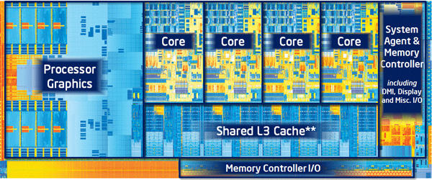
A processor is just a lot of transistors connected very carefully
ALU plus other operations make up a Core
And decode logic
Multiple cores, plus registers, plus caches make up a Processor
And other stuff these days like graphics

Slide 70
Outline
Structure Layout
Struct Padding and Alignment
Unions
Assembly to Transistors (and back)

