Slide 1
Lecture 11 Memory Hierarchy
CS213 – Intro to Computer Systems
Branden Ghena – Winter 2026
Slides adapted from: St-Amour, Hardavellas, Bustamente (Northwestern), Bryant, O’Hallaron (CMU), Garcia, Weaver (UC Berkeley)

Slide 2
Administrivia
Labs are still ongoing
Bomb Lab due today
Attack Lab is out now
Reminder on Attack Lab partnership survey if you want a partner!
Midterm exam grading should be done this afternoon/evening

Slide 3
Changing the focus of CS213
So far in class we’ve focused on how computers do things
Represent data
Run instructions
Now we’re focusing on how to improve those things
Secure (last lecture plus some stuff in two weeks)
Efficient (today and next week)
As we’ll show today, the most important thing to speed up is memory
It is possible and hardware does so already
Software can be designed to take advantage of this

Slide 4
Topics remaining in CS213
Memory System
Memory Hierarchy
Caches
Virtual Memory
Applications
Concurrency
Processes
Other Systems Introductions
Compilers
Networks

Slide 5
Today’s Goals
Hardware day!!
Describe what’s going on inside a processor
Assembly-to-transistors deep-dive
Explore the memory systems available in modern computers
Understand capabilities and limitations of each
Discuss the memory hierarchy
How it improves performance through caching

Slide 6
Outline
What’s in a processor? Assembly-to-Transistors
Memory Technologies
Memory Hierarchy
Caching Concept

Slide 7
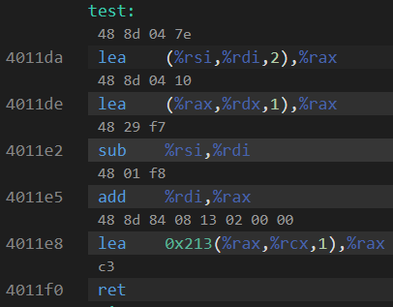
Assembly into machine code
Machine code are the numerical versions of each instruction
Number breaks down into parts
Operation
Source
Destination
Immediates are stored in the instruction encoding

Slide 8
Representing instructions as numbers
Why represent instructions as numbers?
Everything in memory is “just a number”
And instructions go in memory
Hardware can “decode” number to figure out what to do
Break number apart into bits (just like floating point)
Some bits pick operation
Some bits pick register or specify immediate

Slide 9
Machine code ideas
Example:
ADD $0x4351FF23, %rax
ADD with destination %rax translates into 0x05
Immediate is appended on to that
Machine code: 0x0523FF5143
Number of bytes for each instruction is variable
1-15 bytes depending on instruction and operands
So the processor reads it byte-by-byte to figure out the meaning
Translation is tedious
We’re not going to do it by hand, although Attack Lab touches it a bit

Slide 10
Computer Processor (in five easy steps)
Reads instruction from memory
Decodes it into an Operation plus Configurations
Immediates, Registers, Memory, etc.
Reads from source (based on configuration)
Executes that operation
Writes to destination (based on configuration)

Slide 11
These steps are relatively easy (we’ll skip them)
Reads instruction from memory
Decodes it into an Operation plus Configurations
Immediates, Registers, Memory, etc.
Reads from source (based on configuration)
Executes that operation
Writes to destination (based on configuration)

Slide 12
This is extremely complicated for x86-64 (skip it too)
Reads instruction from memory
Decodes it into an Operation plus Configurations
Immediates, Registers, Memory, etc.
Reads from source (based on configuration)
Executes that operation
Writes to destination (based on configuration)

Slide 13
We can talk about what execution means though!
Reads instruction from memory
Decodes it into an Operation plus Configurations
Immediates, Registers, Memory, etc.
Reads from source (based on configuration)
Executes that operation
Writes to destination (based on configuration)

Slide 14
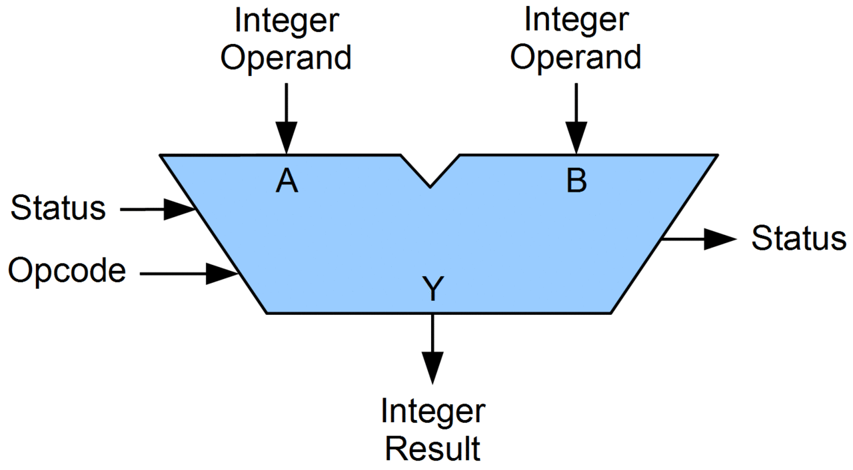
Arithmetic Logic Unit (ALU)
Piece of hardware
Takes in two operands
Source and Destination values
Takes in an Opcode
Which operation to run
Performs operation and outputs result

Slide 15
What can an ALU do?
All the basic arithmetic operations
Add
Subtract
Bitwise And
Bitwise Or
Bitwise Xor
Arithmetic Shift Right
Logical Shift Right
Logical Shift Left
Complex operations are separate hardware
Multiply, Divide, Anything floating point

Slide 16
Let’s zoom in

Slide 17
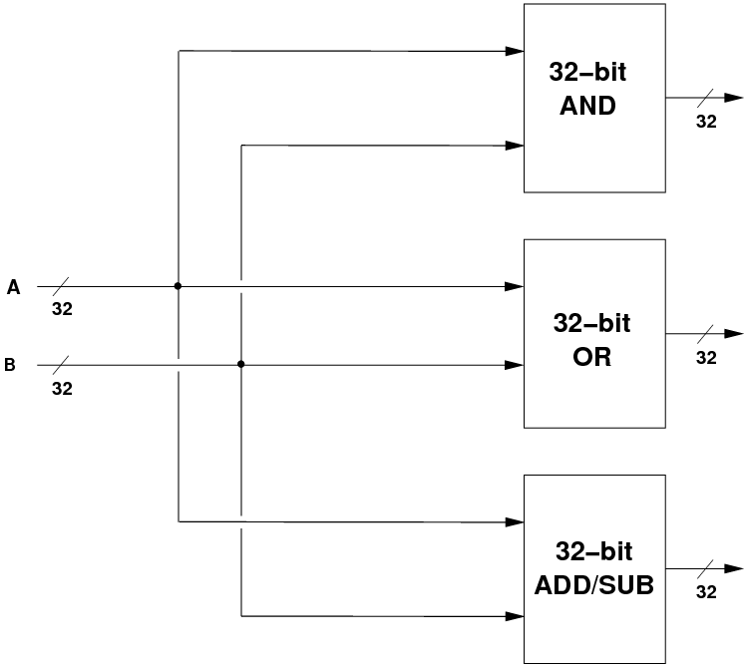
Inside an ALU
Input values go into separate hardware blocks for each operation
Every operation occurs in parallel, simultaneously
We are in hardware so this doesn’t take any additional time
64-bit
AND
64
ALU Inputs
64
64-bit
OR
64
64
64-bit
ADD/SUB
64

Slide 18
Inside an ALU – selecting the correct output
64-bit
AND
64
ALU Inputs
Selector
ALU Output
64
64-bit
OR
64
64
Selects ALU output based on Opcode
64-bit
ADD/SUB
Opcode
64

Slide 19
Let’s zoom in

Slide 20
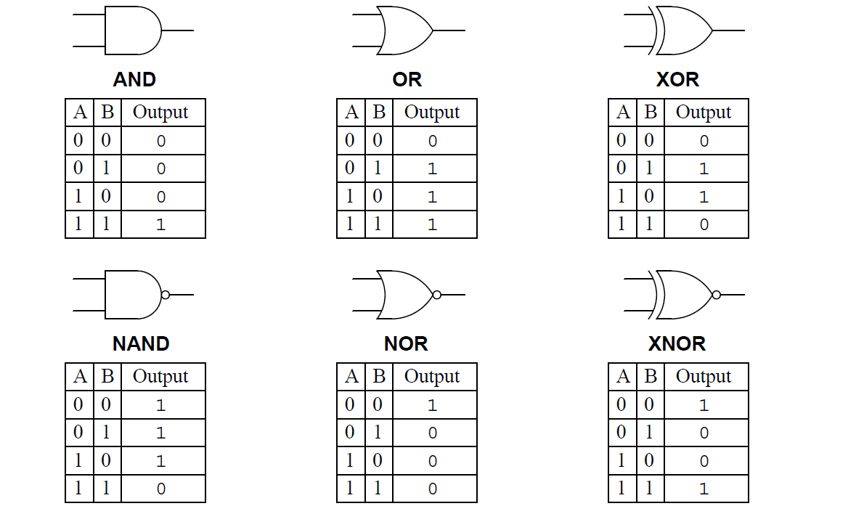
How is an ALU made?
All of those arithmetic operations can be broken down into a series of 1-bit Boolean operations
Add is XOR for result + AND for carry
Subtract is Flip bits (NOT), Add one (XOR + AND), then Add (XOR + AND)
And/Or/Xor are just their respective operations
Shifts are just move the bits around (simple in hardware, just move wires)

Slide 21
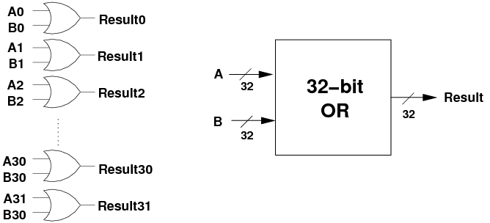
64-bit OR operation
Perform OR operation on each individual bit
Pictured is a series of 1-bit OR gates
64
64-bit
OR
64
64
A62 B62 A63 B63
Result62
Result63

Slide 22
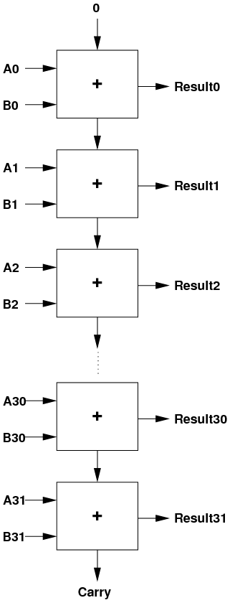
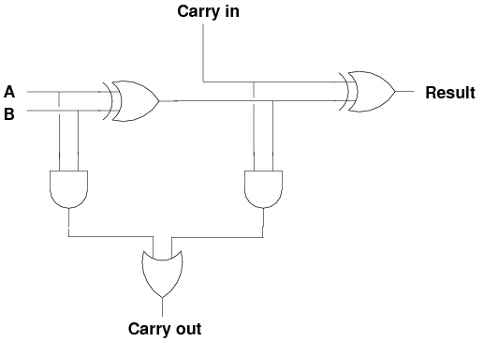
64-bit ADD operation
Below is the 1-bit version with carry-in/out
Two 1-bit AND, two 1-bit XOR, one 1-bit OR
Repeat 64 times, connecting carries together
A62 B62
Result62
A63 B63
Result63

Slide 23
Let’s zoom in

Slide 24
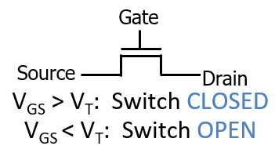
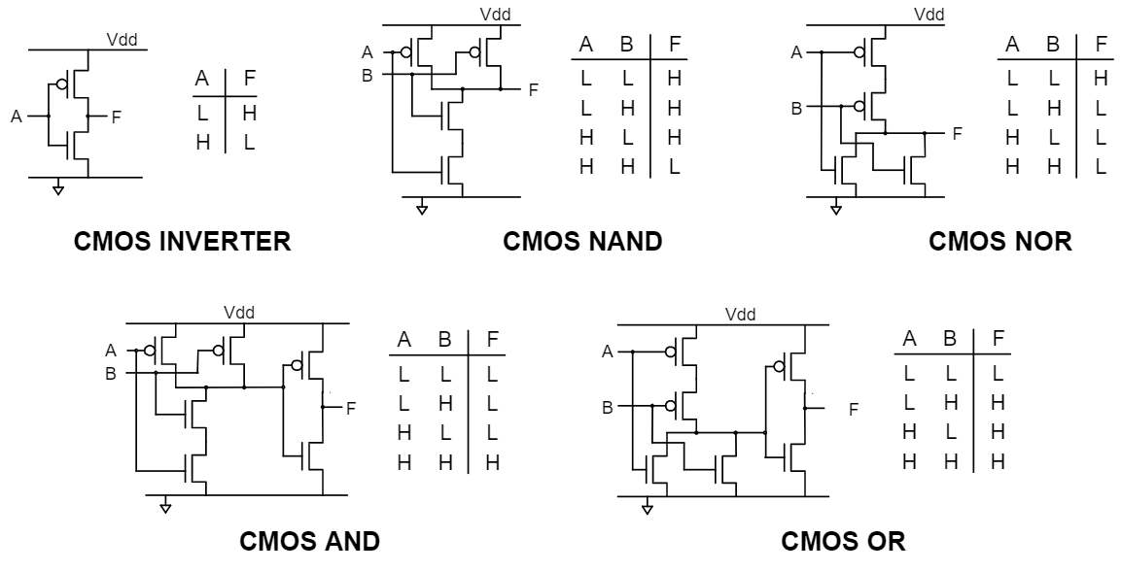
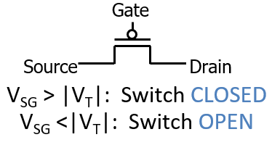
Logic gates can be created with transistors
Transistors are just on/off switches
CMOS implementation of logic gates
Complementary Metal-Oxide Semiconductor

Slide 25
Let’s zoom in

Slide 26
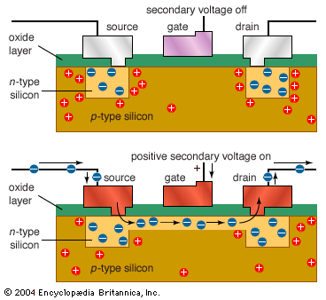
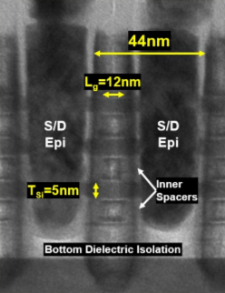
Transistors are made out of silicon and other materials
Turning gate on/off causes source and drain to connect or disconnect
Acts as a switch
We can make very small transistors
Handfuls of nanometers in size

Slide 27
That’s the bottom

Slide 28
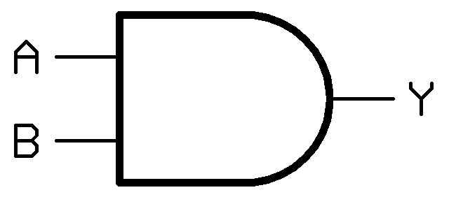
Zooming out again
~6 transistors
Transistors make logic gates
F
1-bit AND gate

Slide 29
Zooming out again
~30 transistors
Logic gates make operations
1-bit AND gate
1-bit ADD operation

Slide 30

Zooming out again
~1000 transistors
1-bit operations make 64-bit operations
A62 B62
Result62
A63 B63
Result63
1-bit ADD operation

Slide 31
Zooming out again
~20K transistors
Operations make an ALU
64-bit
AND
64
ALU Inputs
Selector
64-bit
OR
ALU Output
64
64
64
A62 B62
Result62
A63 B63
Opcode
Result63
64

Slide 32
ALU allows us to execute operations
Reads instruction from memory
Decodes it into an Operation plus Configurations
Immediates, Registers, Memory, etc.
Reads from source (based on configuration)
Executes that operation
Writes to destination (based on configuration)

Slide 33
All the way back to software
Machine code specifies what should be executed
Assembly translates into machine code
C compiles into assembly

Slide 34
Break + Open Question
We hit roughly 20 thousand transistors for an ALU, but a modern processor has more than 1 billion transistors. Where are all the rest going?

Slide 35
Break + Open Question
We hit roughly 20 thousand transistors for an ALU, but a modern processor has more than 1 billion transistors. Where are all the rest going?
Decoding instructions
Multiple processor cores (each with multiple ALUs and decoders)
Graphics
Other peripheral devices
USB, HDMI, Ethernet, etc.
Memory!
Registers and Caches (especially caches)

Slide 36
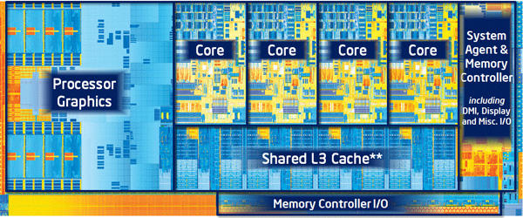
A processor is just a lot of transistors connected very carefully
ALU plus other operations make up a Core
Decode logic, floating point, registers, etc.
Multiple cores plus caches make up a Processor
And other stuff these days like graphics

Slide 37
Outline
What’s in a processor? Assembly-to-Transistors
Memory Technologies
Memory Hierarchy
Caching Concept

Slide 38
Reminder: metric unit prefixes
Going to talk about nanometers and nano/micro/milliseconds today
Also we do frequently mention bytes, kilobytes, megabytes, gigabytes, etc.
For perspective
1 Megasecond ≈ 11 days
1 Gigasecond ≈ 31 years
Prefix | Symbol | Power | Decimal Value
Peta | P | 10¹⁵ | 1 000 000 000 000 000
Tera | T | 10¹² | 1 000 000 000 000
Giga | G | 10⁹ | 1 000 000 000
Mega | M | 10⁶ | 1 000 000
Kilo | k | 10³ | 1 000
- |  | 10⁰ | 1
milli | m | 10⁻³ | 0.001
micro | μ | 10⁻⁶ | 0.000 001
nano | n | 10⁻⁹ | 0.000 000 001
pico | p | 10⁻¹² | 0.000 000 000 001
This table is something you should memorize (at least to 10^{±9})

Slide 39
Storage in a Computer System
Data can be stored in different places
Registers, caches, memory, disk, etc.
Hugely different characteristics
Storage size
x86-64: 16 registers. 128 B total (not including FP registers, etc.)
Memory is measured in GB, disks in TB
Latency (i.e., time to access data)
Registers are really fast, memory less so, disk is incredibly slow
Cost per byte
Registers are really expensive, disks are really cheap, memory somewhere in the middle
Each serves a different purpose in a system
We design systems to get the best of all worlds (in most cases)

Slide 40
Tour of computer memory
System bus
Memory bus
Processor
Main
memory
I/O
bridge
I/O bus
USB
controller
Graphics
adapter
Disk
controller
Mouse
Keyboard
Display
Disk

Slide 41
Tour of computer memory
Registers and Caches
System bus
Memory bus
Processor
Main
memory
I/O
bridge
I/O bus
USB
controller
Graphics
adapter
Disk
controller
Mouse
Keyboard
Display
Disk

Slide 42
Register storage
x86-64
16 registers (general-purpose) with 8 bytes each
32 registers (special-purpose) with up to 64 bytes each
Plus some other odds and ends (%rip, flags, segments, etc.)
128 bytes for general purpose registers
Order 2-3 kB for everything (including floating point stuff)
Accesses are very fast. Within a single processor cycle
Usually, 0.25-4 cycles per instruction

Slide 43
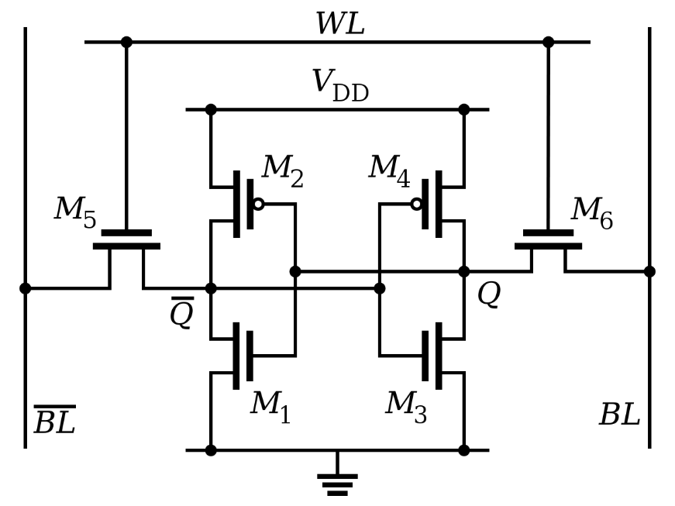
Register technology: SRAM
Static RAM (SRAM)
Each cell stores a bit in a bi-stable circuit, typically a six-transistor circuit
Static – no need for periodic refreshing; keeps data while powered
Relatively insensitive to disturbances such as electrical noise
Energetic particles (alpha particles, cosmic rays) can flip stored bits
Fastest memory on computer
Also most expensive and takes up most space per bit
Typically used for registers and cache memories

Slide 44
Cache memories (a.k.a. caches)
Memory in the processor that duplicates portions of main memory
Goal: speed up accesses to frequently used data
Complicated decision: what should be in the cache at any given moment
Many configurations to try to improve the “hit rate” on data
Not general-purpose memory
Can’t be directly accessed and doesn’t have memory addresses
Hardware automatically chooses what’s in the cache
Cache sizes
Kilobytes to Megabytes of storage: ~1-100 MB total in modern processors

Slide 45
Tour of computer memory
RAM
System bus
Memory bus
Processor
Main
memory
I/O
bridge
I/O bus
USB
controller
Graphics
adapter
Disk
controller
Mouse
Keyboard
Display
Disk

Slide 46
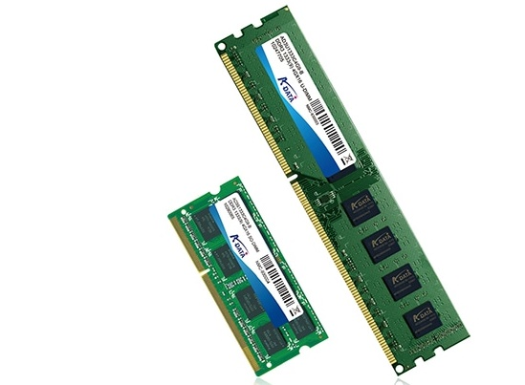
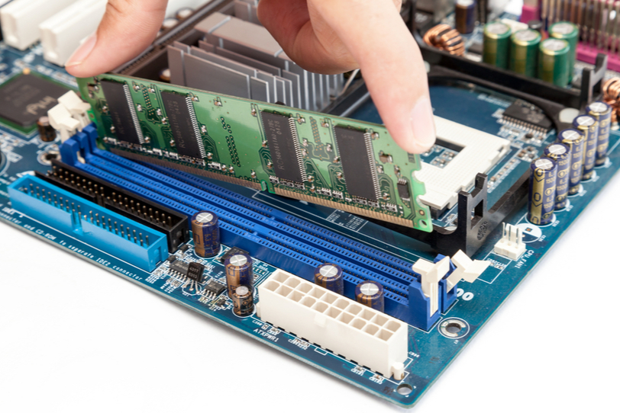
Main memory
The “RAM” in your computer
Random Access Memory
Can access any byte you want in “random” order
Typically measured in GB
1-128 GB
Some special purpose systems may have MUCH less or more
This is the “array of bytes” we’ve been using in assembly
Program memory lives in RAM

Slide 47
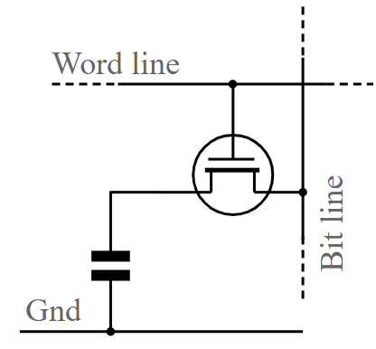
Main memory technology: DRAM
Dynamic RAM (DRAM)
Each cell stores a bit as a charge in a capacitor
Capacitors lose charge; each cell must be refreshed every 10-100 ms
More sensitive to disturbances (EMI, radiation, …) than SRAM
Slower than SRAM, but cheaper and denser
~100x slower than registers
Typically used for main memory

Slide 48
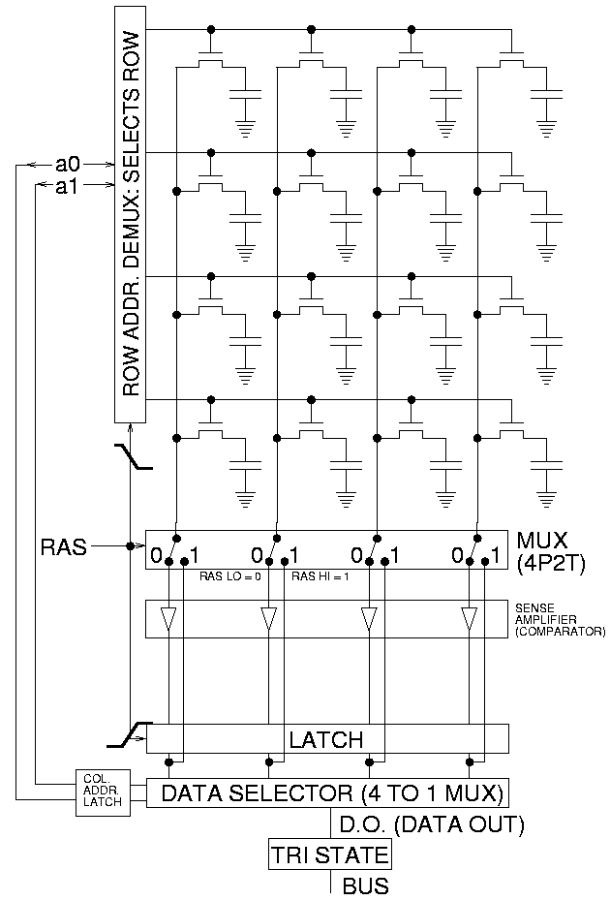
Accessing DRAM
Read entire row of data at a time
Large in practice, kilobytes
Select actual bytes that are wanted
Possibly modifying those bits
Write row back to memory
Must always happen!
Reading is destructive

Slide 49
Connecting main memory and the processor
Data flows between main memory and processor over “buses”
A collection of parallel wires that carry address, data, and control signals
Typically shared by multiple devices
mov (%rdi), %rax {load}
Processor writes address A to the bus
Memory writes data to the bus
Processor reads data from the bus
CPU chip
register file
mov %rax, (%rdi) {store}
Processor writes address A to the bus
Processor writes data to the bus
Memory reads data from the bus
ALU
Includes memory controller
main
memory
bus interface
system bus
I/O
bridge
memory bus

Slide 50
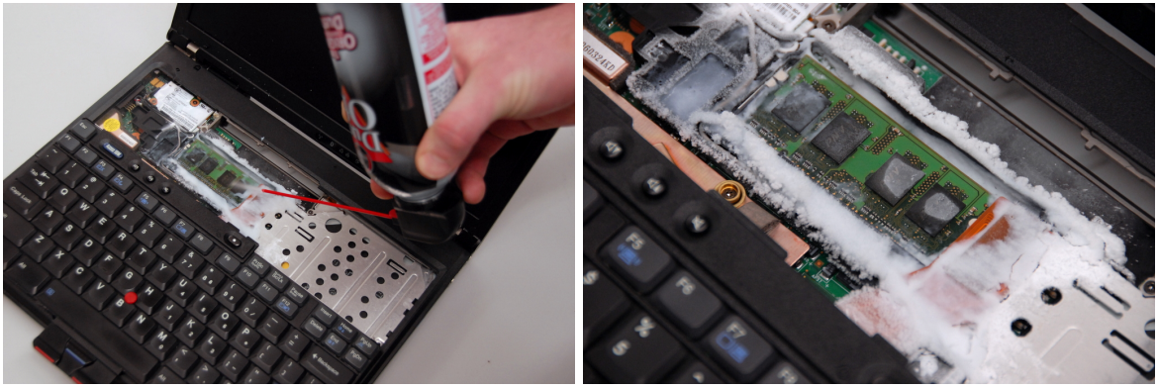
Sidebar: memory security is important
Data in RAM disappears without power
But the rate depends on temperature, minutes to decay if frozen
Cold Boot Attack: freeze RAM to remove from computer and steal contents

Slide 51
Sidebar: what’s going on with RAM prices?
Limited supply
Fabs make computer chips
There really aren’t that many of them, and only some of those make RAM
~3 big RAM manufacturers
Increasing demand
Machine Learning needs lots of memory
Particularly it needs faster, more expensive memory
Result: greatly increased costs
32 GB of RAM: 2024 - $80, 2026 - $360 😱

Slide 52
Tour of computer memory
System bus
Memory bus
Processor
Main
memory
I/O
bridge
I/O bus
USB
controller
Graphics
adapter
Disk
controller
Mouse
Keyboard
Display
Disk
Disk: Hard drive or SSD

Slide 53
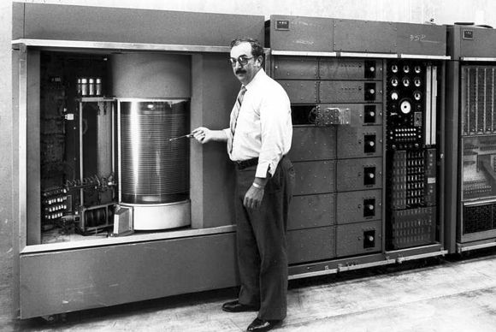
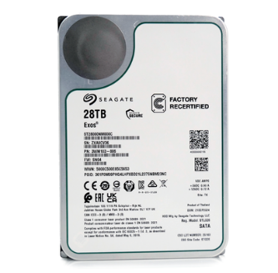
Disk storage
IBM 350 Disk Storage Unit
First disk drive, 1956
Storage?
5MB! (these slides are 8 MB)
Workhorse storage devices
Terabytes in size in modern computers
Milliseconds to read
100,000x longer than reading from RAM
10,000,000x longer than reading from registers
Used for filesystem storage
Running programs do not directly use disk except when interacting with files
Seagate 24TB HDD, 2025
5.75 inches (146 mm)
Basic mechanisms the same!
4 inches (102 mm)

Slide 54
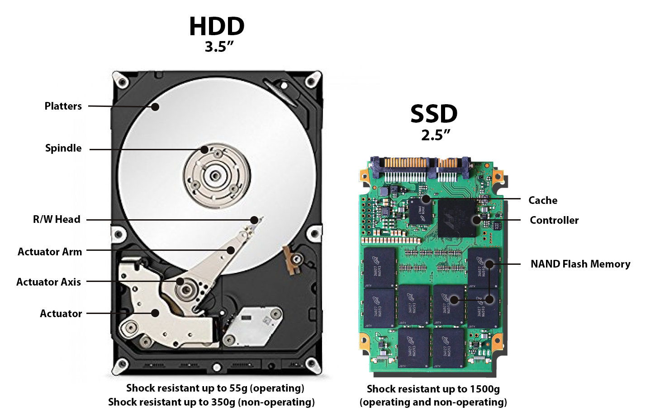
Disk types

Slide 55
Hard disk drive operation
The disk surface
spins at a fixed
rotational rate
(5400-15000 RPM)
The read/write head
is attached to the end
of the arm and flies over
the disk surface on
a thin cushion of air.
spindle
spindle
spindle
spindle
spindle
By moving radially, the arm can position the read/write head over any track.
arm
read/write heads
move in unison
from cylinder to cylinder
spindle

Slide 56
Animation of Disk Access

Slide 57
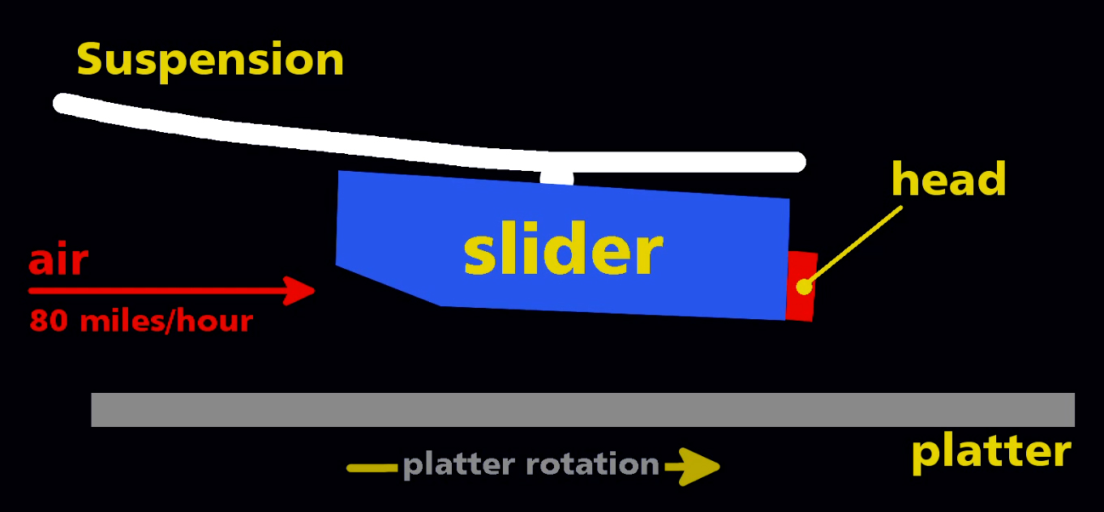
Disk heads read/write data to the platters

Slide 58
Writing bits to the platters
Note: most disks can only move the entire set of arms, not two sets of them

Slide 59
Accessing data on disk
Three-step process
Read head needs to move to the right cylinder: seek time
Platter turns until start of sector under the read head: rotational latency
Sector passes under read head and data is read: transfer time
Time cost dominated by seek time and rotational latency
Consequence: reading first bit of a sector is expensive
But reading the rest of the sector is basically free!
When using disks, best to favor large sequential reads/writes
Terrible for random access! (reading a little bit here, a little bit there)
Fits file access well (read/write in order)
But overall still really slow compared to main memory or registers

Slide 60
Disk types

Slide 61
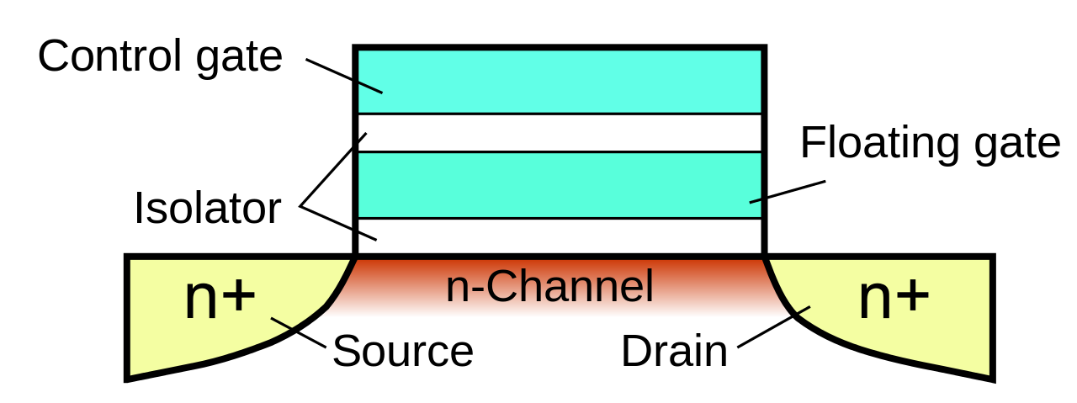
Floating-gate transistors
Concept behind transistor-based non-volatile memory
EPROM, EEPROM, and Flash
High voltage on control gate creates charge on floating gate
Charge on floating gate activates/deactivates transistor
High voltage degrades structure, leading it to eventually fail after enough writes

Slide 62
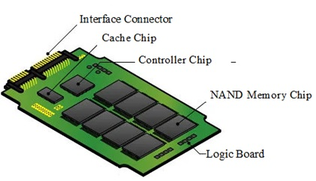
Solid State Drives (SSDs)
Flash memory
Just like Flash Drives
Stores data in chips, so it’s much faster to access
Organize data into chunks, called pages
Each page is 4-16 KB in size
Entire page must be rewritten at once (not individual bytes)
Pages wear out after repeated writes (~100K writes total) and can no longer be used
Notes:
SSD based on flash memory (non-volatile memory based on EEPROM – electrically erasable programmable ROM)
Plugs into a standard disk slot – typically USB or SATA
Made of a few chips and a flash translation layer, a hw/firmware piece similar to a disk controller

Slide 63
Solid State Drives (SSDs)
I/O bus
Flash memory
Just like Flash Drives
Pages: 2KB to 512KB, Blocks: 32 to 128 pages
Data read/written in units of pages
Page can be written only after its block has been erased
Need to copy rest of the data to not lose it. Expensive!
A block wears out after repeated writes (10k – 100k writes) and can no longer be used
Requests to read and
write logical disk blocks
Solid State Disk (SSD)
Flash
translation layer
Flash memory
Block 0
Block B-1
…
…
…
Page 0
Page 1
Page P-1
Page 0
Page 1
Page P-1
Notes:
SSD based on flash memory (non-volatile memory based on EEPROM – electrically erasable programmable ROM)
Plugs into a standard disk slot – typically USB or SATA
Made of a few chips and a flash translation layer, a hw/firmware piece similar to a disk controller

Slide 64
SSDs vs Rotating Disks
Advantages
No moving parts → faster, less power, more rugged
Disadvantages
Have the potential to wear out
Mitigated by “wear leveling logic” in flash translation layer
More expensive per byte (but getting cheaper)
2026: HDD $0.016 per GB, SSD $0.070 per GB (about 4x the cost)
(also roughly 1.5x the cost from last year when I made this slide)
Applications
Portable electronics (phones, tablets, etc.)
Began to appear in desktops and servers circa 2007
Now common on laptops as well
Biggest speed improvement to your computer:
Get an SSD
https://diskprices.com/

Slide 65
Reading memory from disk
CPU chip
register file
Data from disk is always read into Main Memory
Direct Memory Access (DMA)
Processor starts a read and then returns to programs
Disk performs the read, transfers data, then notifies processor when done
ALU
main
memory
bus interface
I/O bus
USB
controller
graphics
adapter
disk
controller
mouse
keyboard
monitor
disk

Slide 66
Tour of computer memory
Registers and Caches
RAM
System bus
Memory bus
Processor
Main
memory
I/O
bridge
I/O bus
USB
controller
Graphics
adapter
Disk
controller
Mouse
Keyboard
Display
Disk
Disk: Hard drive or SSD

Slide 67
Break + Question
How do you make an SSD with a longer lifetime (more writes)?
Without changing any of the physics of how it works

Slide 68
Break + Question
How do you make an SSD with a longer lifetime (more writes)?
Without changing any of the physics of how it works
Secretly make it larger than it claims to be
e.g. 200 GB when it claims to be 100 GB
Behind the scenes move around memory as necessary so the device can still hold 100 GB even if half of the flash is
Maintain a mapping of which data is located where

Slide 69
Outline
What’s in a processor? Assembly-to-Transistors
Memory Technologies
Memory Hierarchy
Caching Concept

Slide 70
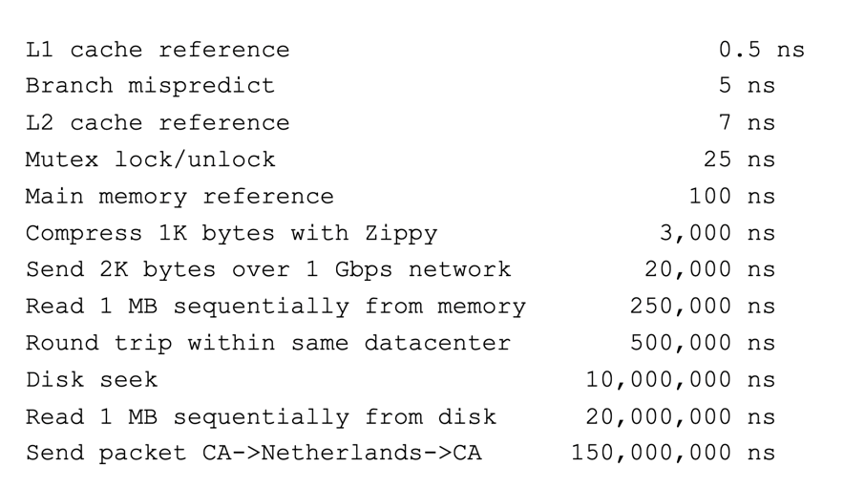
Computing timescales
Assuming 4 GHz processor, Instruction (with registers): 0.25 ns
Jeff Dean (Google AI): “Numbers Everyone Should Know”
Reminder:
1,000,000,000 ns per second

Slide 71

Jim Gray’s storage latency analogy
How “far” is data for the CPU, converted to human scale
Storage
Distance
Time
Jim Gray
Turing Award 1998
Registers
In my apartment
~1 minute
On-chip cache
Across the street
2-4 minutes
On-board cache
A few blocks away
10 minutes
Main memory
In Milwaukee
1.5 hours
Disk
On Mars
2 years
Tape
On Kepler-76b
2000 years (at speed of light)

Slide 72
The CPU-Memory gap
Disk
Increasing gap between DRAM, disk, and CPU speeds.
SSD
DRAM, disk and CPU
performance gap widening
DRAM
SRAM roughly keeping up
SRAM
CPU
Split reflects the introduction of multicores
Notes:
In early 21st century computer manufacturers discover they couldn’t keep increasing CPU clock freq. because chips would consume too much power; answer was multicore – there you see the cycle times getting slower but effective cycle times keeping about the same improvement rate

Slide 73
The CPU-Memory Gap
CPUs outspeed memory
But they can’t compute on data they don’t have!
If the CPU has to wait for data to reach it, it just sits idle!
All that engineering effort, just sitting around waiting…
Challenge: get data to the CPU despite “slow” memory
So the CPU can work at full speed, without waiting for data
Two-pronged strategy
Memory hierarchy: keep data we need closer to the CPU
Locality of reference: predict which data we’re likely to need

Slide 74
Memory hierarchy
Some fundamental and enduring properties of systems
The faster the storage, the more expensive ($) it is
The faster the storage, the smaller (capacity) it is
The gap between processor and main memory speed is widening
Key idea: keep the data you need the most in fast memory!
Data you only need from time to time can be in slow memory, no big deal
Most used data goes in registers
Least used data goes to disk
Analogy: kitchen ingredients I use
Salt, all the time: it sits out on the counter
Oregano, frequently: front of the cabinet
Turmeric, occasionally: back of the cabinet
Brown sugar, sometimes: somewhere in the pantry
Saffron, never: I can go buy some if I do need it

Slide 75
Memory hierarchy
Smaller,
faster,
and
costlier
(per byte)
storage
devices
CPU registers hold words retrieved from L1 cache.
L0:
registers
on-chip L1
cache (SRAM)
L1 cache holds cache lines retrieved from the L2 cache memory.
L1:
L2:
off-chip L2
cache (SRAM)
L2 cache holds cache lines retrieved from main memory.
Main memory holds disk
blocks retrieved from local
disks.
L3:
main memory
(DRAM)
Larger,
slower,
and
cheaper
(per byte)
storage
devices
Local disks hold files retrieved from disks on remote network servers.
L4:
local secondary storage
(local disks)
L5:
remote secondary storage
(distributed file systems, Web servers)

Slide 76
Outline
What’s in a processor? Assembly-to-Transistors
Memory Technologies
Memory Hierarchy
Caching Concept

Slide 77
Caching, general principle
Cache: A smaller, faster storage device that acts as a staging area for a subset of the data in a larger, slower device
Data lives in both places (typically)
When the consumer (e.g., CPU) reads the data, it gets it from the smaller, faster storage
If the data we want is not in the cache, we pay the full cost of bringing it over from the larger, slower storage into the smaller, faster storage
The hope: we don’t need to do it too often
Fundamental idea in systems. Shows up all over!
Memory hierarchies
Content delivery networks (CDNs) on the Internet (Akamai, Cloudflare, etc.)

Slide 78
Caching in a memory hierarchy
Fundamental idea of a memory hierarchy
For each k, the faster, smaller device at level k serves as a cache for the larger, slower device at level k+1
L2 cache memory as a cache for main memory
Main memory as a cache for disk, etc.
Each level stores some of the most frequently accessed data
The closer the cache is to the processor, the “hotter” the cached data

Slide 79
Caching in a memory hierarchy
Smaller, faster, more expensive
device at level k caches a
subset of the blocks from level k+1
Level k:
8
9
14
3
Data is copied between
levels in block-sized transfer units
0
1
2
3
4
5
6
7
Larger, slower, cheaper storage
device at level k+1 is partitioned
into blocks.
Level k+1:
8
9
10
11
12
13
14
15
Blocks cannot be stored in an arbitrary location!
They can only live at one of a fixed set of locations.
In this example: they must be in the same “column” for both levels.

Slide 80
General caching concepts
Program needs object d, which is stored in some block b
Cache hit
Program finds b in the cache at level k e.g., block 14
14
Request
14
Level
k:
9
14
3
4*
14
0
1
2
3
Level
k+1:
4
5
6
7
8
9
10
11
12
13
14
15

Slide 81
General caching concepts
Program needs object d, which is stored in some block b
Cache hit
Program finds b in the cache at level k e.g., block 14
Cache miss
b is not at level k, so the level k cache must fetch it from level k+1, e.g., block 12
If the level-k cache is full, then some current block must be replaced (evicted). Which one is the “victim”?
Here, we pick 4; same column as 12
4 is “dirty”, need to write back to k+1
More on this next lecture
12
Request
12
Level
k:
4*
9
14
3
4*
12
12
Request
12
0
1
2
3
Level
k+1:
4
5
6
7
4*
8
9
10
11
12
13
14
15
12
“ * ” means the block is dirty (i.e., it has been modified)

Slide 82
Memory hierarchies make memory fast and large
Why do memory hierarchies work?
Programs tend to access the data at level k more often than they access the data at level k+1
Thus, the storage at level k+1 can be slower, and thus larger and cheaper per bit
Net effect:
A large pool of memory that costs as little as the cheap storage near the bottom, but that serves data to programs at the rate of the fast storage near the top
Best of both worlds!

Slide 83
What causes a cache miss?
Cold (compulsory) miss
Cold misses occur when a block is accessed for the first time
No one ever accessed it, so there wasn’t any reason to bring it into cache
Capacity miss
Occurs when the set of active cache blocks (working set) is larger than the cache
There’s no way the working set can all fit in the cache, so there will be misses
Conflict miss
In most caches, blocks cannot be stored in any available slot
If two blocks need to go in the same slot, need to evict the old one to store the new!
If after that, we need to access the old block, conflict miss!
We had a conflict, evicted a block, and now we miss trying to access that block
Note: can happen even when there is “room” elsewhere in the cache!
We’ll show examples of this next lecture

Slide 84
Break + Question
Miss types: Cold, Capacity, Conflict
When you first start up a program, it runs really slowly for a few seconds. What kind of cache misses are occurring?
When you have too many browser tabs open and active, all of the tabs run more slowly. What kind of cache misses are occurring?

Slide 85
Break + Question
Miss types: Cold, Capacity, Conflict
When you first start up a program, it runs really slowly for a few seconds. What kind of cache misses are occurring?
Cold (aka Compulsory) misses. The data has never been loaded before!
When you have too many browser tabs open and active, all of the tabs run more slowly. What kind of cache misses are occurring?
Capacity misses. You have too much data to fit it all in the cache
Could be Conflict misses as well, but probably not

Slide 86
Outline
What’s in a processor? Assembly-to-Transistors
Memory Technologies
Memory Hierarchy
Caching Concept

