Slide 1
Lecture 17 Processes
CS213 – Intro to Computer Systems
Branden Ghena – Winter 2026
Slides adapted from: St-Amour, Hardavellas, Bustamente (Northwestern), Bryant, O’Hallaron (CMU), Garcia, Weaver (UC Berkeley)

Slide 2
Administrivia
Homework 3 due tonight
No late submissions
SETI Lab due Thursday
You can still apply slip days / late penalties to it if you need to
Be aware: testing takes 5-20 minutes. Come Thursday evening there may be a queue for testing
Midterm Exam 3 details posted
Covers Memory Security through Networks

Slide 3
Today’s Goals
Introduce the role of an operating system
Explore how processes work, particularly how they interact with the OS.
Describe mechanisms: Exceptions, System Calls, and Signals
Introduce control rules: scheduling policies

Slide 4
Outline
Intro to Operating Systems
Processes
Process Contents
Control Flow
Scheduling
System Calls
Signals

Slide 5
What is an operating system?
User processes
Spotify
Powerpoint
Steam
Chrome
QEMU
Physical computer
Hardware

Slide 6
What is an operating system?
User processes
Spotify
Powerpoint
Steam
Chrome
QEMU
Operating System
Physical computer
Hardware

Slide 7
What is an operating system?
User processes
Spotify
Powerpoint
Steam
Chrome
QEMU
File System
Virtual Memory
Process Manager
Network
Operating System
Device Drivers
Interrupt Handlers
Boot and Init
Physical computer
Hardware

Slide 8
What is an operating system?
User processes
Spotify
Powerpoint
Steam
Chrome
QEMU
Application Interface
File System
Virtual Memory
Process Manager
Network
Operating System
Device Drivers
Interrupt Handlers
Boot and Init
Hardware Abstraction Layer
Physical computer
Hardware

Slide 9
What’s part of the OS?
OS kernel – the part of the OS code that has full control of the system
Process scheduling (who uses CPU)
Memory allocation (who uses RAM)
Accesses hardware devices
Outputs graphics
Reads/writes to network
Read/write to disks
Handles boot-up and power-down
OS distribution – the kernel + lots of other useful stuff
GUI / Window manager
Command shell
Software package manager
“app store”, yum, apt, brew
Common software libraries
Useful apps:
Text editor, compilers, web browser, web server, SSH, anti-virus, file-sharing, media libraries,

Slide 10
Major goals of an Operating System
OSes make advancing technology available to rapidly evolving applications. They do so with two major goals:
Provide abstractions to applications to enable hardware compatibility
Why: allow reuse of common features, avoid low-level details
Challenges: What are the correct abstractions?
Manage sharing of resources across many applications
Why: protect applications, enforce fair access
Challenges: What are the mechanisms and what are the policies?
Good operating systems do these quickly, efficiently, and securely

Slide 11
Three features we’ll consider today
Memory
Files
Processes

Slide 12
OS Abstraction: Memory Management
Memory management
OS is in charge of allocating memory
Abstraction: Address Space via Virtual Memory
OS allows user processes to ignore real messiness of memory

Slide 13
Another example OS abstraction: File Systems
OS manages file systems to restrict and abstract them
Restrictions
Prevent users from accessing other’s files without permission
Abstractions
Files can grow infinitely large
Where a file exists in memory or disk isn’t important!
Default file system types, named directories, file explorer

Slide 14
Files
Collections of data
Usually in permanent storage on your computer (on disk)
Interactions managed by the OS
Types of files
Regular files
Arbitrary data
Think of as a big array of bytes
Directories
Collections of regular files
Special files
Links, pipes, devices

Slide 15
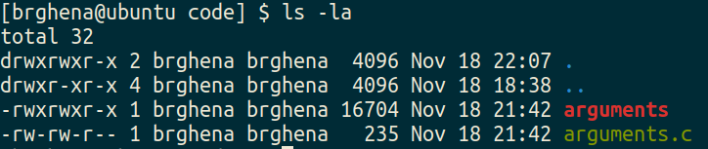
File permissions
Files have owners and permissions associated with them

Slide 16
File permissions
Files have owners and permissions associated with them
Permissions for the owner and name of the owner
Read, Write, eXecute
Cannot execute `arguments.c`
For directories: Read contents, Write new contents, Traverse directory

Slide 17
File permissions
Files have owners and permissions associated with them
Permissions for the group and name of the group
Example: I could make a CS213 group, add you all to it, and only give that group access to some folder or file

Slide 18
File permissions
Files have owners and permissions associated with them
Permissions for everyone else on the computer
Not the owner and not in the group
For my personal machine, not particularly relevant
For Moore, probably don’t want to let others read your files…

Slide 19
Three features we’ll consider today
Memory
Files
Processes

Slide 20
Processes are an abstraction provided by the OS
The machine itself usually doesn’t support processes
Just has a processor and a set of registers
Memory is just arbitrary memory
OS provides the abstraction
Multiple processes can run at the “same time”
Each has its own registers
Each has its own isolated memory
Processes enable
Multiple functionalities on a computer
Multiprogramming of a system

Slide 21
Deep-dive into Processes
Three major questions to consider:
What makes up a process?
How are processes controlled?
How do processes and the OS interact?

Slide 22
Break + Open Question
What makes Windows and MacOS different?

Slide 23
Break + Open Question
What makes Windows and MacOS different?
Distribution: look and feel of desktop, programs they come packaged with
Kernel internals
Specific implementations of managing processor and memory
Security and permissions rules
Interfaces for interacting with them
A particular difference: hardware device support
Windows: supports lots of hardware, with drivers from companies
MacOS: supports minimal hardware, with their own driver software

Slide 24
Outline
Intro to Operating Systems
Processes
Process Contents
Control Flow
Scheduling
System Calls
Signals

Slide 25
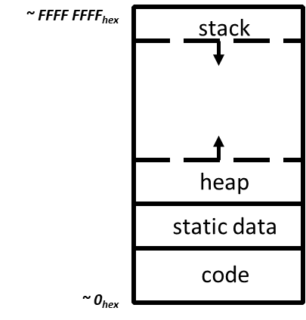
Reminder: view of a process
Process: program that is being executed
Contains code, data, and a thread
Thread contains registers, instruction pointer, and stack
Code and Data
Registers
Instruction Pointer
Condition Codes
Stack
%rax
%r8
%eax
%r8d
%rbx
%r9
%ebx
%r9d
%rcx
%r10
%ecx
%r10d
%rdx
%r11
%edx
%r11d
%rsi
%r12
%esi
%r12d
%rdi
%r13
%edi
%r13d
%rsp
%r14
%esp
%r14d
%rbp
%r15
%ebp
%r15d

Slide 26
Process memory
[branden@moore ~]$ pmap -x 3379171
3379171: ./ctarget -q
Address Kbytes RSS Dirty Mode Mapping
0000000000400000 16 16 0 r-x-- ctarget
0000000000603000 4 4 4 r---- ctarget
0000000000604000 4 4 4 rw--- ctarget
0000000000605000 4 4 4 rw--- [ anon ]
00000000022ab000 132 4 4 rw--- [ anon ]
0000000055586000 1024 264 264 rwx-- [ anon ]
00007f8724857000 1844 1252 0 r-x-- libc-2.28.so
00007f8724a24000 2044 0 0 ----- libc-2.28.so
00007f8724c23000 16 16 16 r---- libc-2.28.so
00007f8724c27000 8 8 8 rw--- libc-2.28.so
00007f8724c29000 16 12 12 rw--- [ anon ]
00007f8724c2d000 188 188 0 r-x-- ld-2.28.so
00007f8724e40000 8 4 4 rw--- [ anon ]
00007f8724e5a000 8 8 8 rw--- [ anon ]
00007f8724e5c000 4 4 4 r---- ld-2.28.so
00007f8724e5d000 8 8 8 rw--- ld-2.28.so
00007fff58b75000 132 20 20 rw--- [ stack ]
00007fff58bf8000 16 0 0 r---- [ anon ]
00007fff58bfc000 8 4 0 r-x-- [ anon ]
ffffffffff600000 4 0 0 r-x-- [ anon ]
---------------- ------- ------- -------
total kB 5488 1820 360
The OS creates a Page Table for each process
Allocates memory in RAM
Page Table connects chunks of RAM to meaningful process parts
I.e., this part is the stack
Example memory map for ctarget from Attack Lab

Slide 27
POSIX processes also have file descriptors
Integers specifying a file the process is interacting with
Process contains a table linking integers to files (and permissions)
Default file descriptors
0 - Standard input (stdin)
1 - Standard output (stdout)
2 - Standard error (stderr)
Function calls to interact with files
int open (const char *path, int oflag, ... );
ssize_t read (int fildes, void *buf, size_t nbyte);
ssize_t write (int fildes, const void *buf, size_t nbyte);

Slide 28
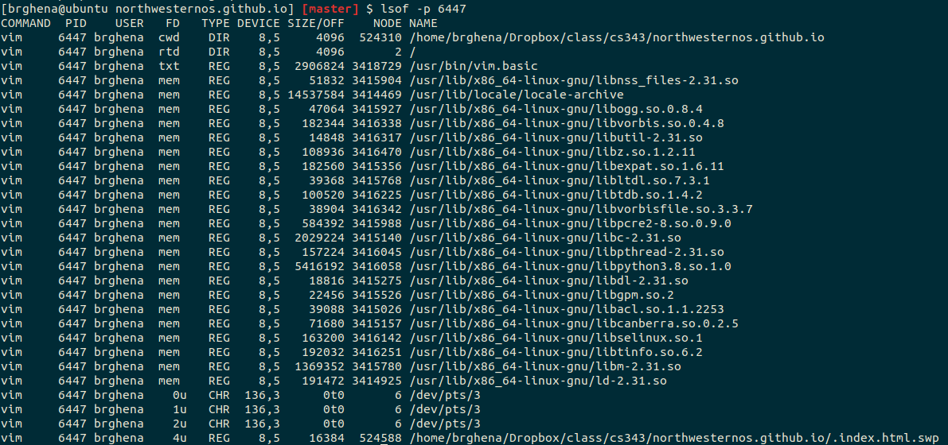
Example file descriptors

Slide 29
Also the code files mapped to the address space

Slide 30
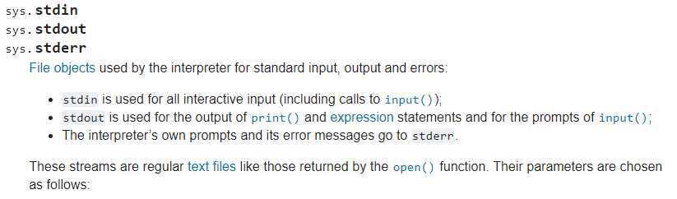
Standard I/O is a process thing, not a C thing
You can access them in Python, for instance
https://docs.python.org/3/library/sys.html#sys.stdin

Slide 31
Additional process contents
Whatever else the OS thinks is useful
Process ID
Priority
Time Used
Process State
Different OSes will attach different things to the “process abstraction”
Literally one or more data structures per process

Slide 32
Outline
Intro to Operating Systems
Processes
Process Contents
Control Flow
Scheduling
System Calls
Signals

Slide 33
Control flow
Processors do only one thing:
From startup to shutdown, a CPU simply reads and executes (interprets) a sequence of instructions, one at a time
This sequence is the CPU’s control flow (or flow of control)
Physical control flow
<startup>
inst₁
inst₂
inst₃
…
inst_{n}
<shutdown>
Time

Slide 34
Altering control flow
Instructions that change control flow allow software to react changes in program state
Jumps/branches
Call/return
But computers also need to react to changes in system state
Data arrives at network adapter
Instruction divides by zero
User hits Ctrl-C on the keyboard
System timer expires
These mechanisms are known as “exceptional control flow”

Slide 35
Exceptional control flow
Context switch: execution changes from process to OS
Typically triggered by a hardware or software event: exceptions
Running process
Other code (usually OS)
Event
I_current
Exception
I_next
Exception processing
by exception handler
Return to I_next

Slide 36
Exceptions
Hardware detects an event that OS software needs to resolve immediately
Could be an error
Invalid memory access
Invalid instruction
Could just be something the OS should handle
Page fault
USB device detected
OS has a table of “exception handlers”, which are functions that handle each exception class (also known as interrupt handlers)
Hardware jumps execution to the proper handler

Slide 37
Perspective of the process on exceptions
The process doesn’t know they happened at all
First it was running an instruction
Them some time passed
Then it was running the next instruction
And there’s no guarantee on how long an instruction takes anyways
Could be a really time-intensive instruction
Could be a cache miss
Could require loading data from disk
So the program runs and works like normal
But the OS briefly takes over to handle something first

Slide 38
Outline
Intro to Operating Systems
Processes
Process Contents
Control Flow
Scheduling
System Calls
Signals

Slide 39
Lies your operating system always told you
“Every process on your computer gets to run at the same time!”
This is an illusion
My desktop at home (running Windows)
Current load: 250 processes with 2987 threads
So how does the magic work?

Slide 40
Exceptional control flow can change the running process
Process A
OS Code
Process B
I_current
Exception
Exception processing
by exception handler
Event
Runing instructions of Process B
Change to Process B
Exception
Event
I_next
Change to Process A
Wow that instruction sure took a long time!

Slide 41
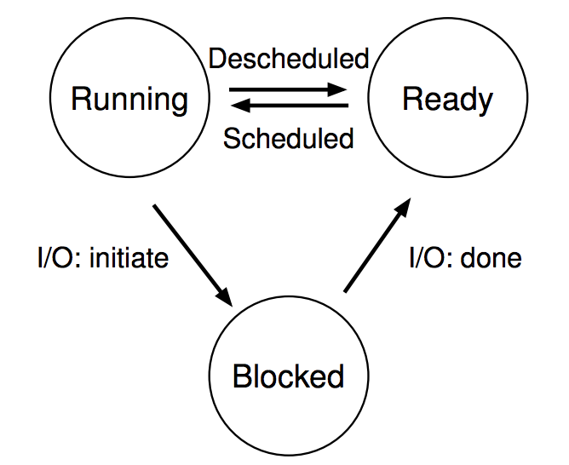
Processes don’t run all the time
The three basic process states:
OS schedules processes
Decides which of many competing processes to run.
A blocked process is not ready to run and is waiting on I/O
I/O means input/output – anything other than computing.
For example, reading/writing disk, sending network packet, waiting for keystroke
While waiting for results, the OS blocks the process, waiting to do more computation until the result is ready

Slide 42
Multiprogramming processes
Even with a single processor, the OS can provide the illusion of many processes running simultaneously
And also use this opportunity to get more useful work done
When one process is Blocked, OS can schedule a different process that is Ready
OS can also swap between various Ready processes so they all make progress
The three basic process states:

Slide 43
Scheduling
We know that multiple processes will be sharing the CPU
Possibly multiple threads in each process
Possibly multiple cores in the CPU
Scheduling is creating a policy for sharing the CPU
Which process/thread is chosen to run, and when?
When (if ever) does the OS change which process is running?

Slide 44
When can the OS make scheduling decisions?
Whenever the OS is actually running
i.e. after a context switch
Possible triggers
Hardware events (interrupts)
I/O complete
Timer triggers – this is the default option
Software events
Faults in processes
System calls (requests from processes)

Slide 45
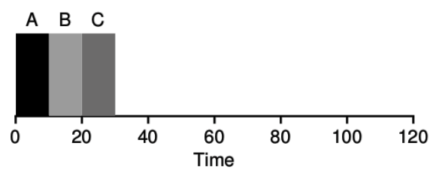
Example scheduler: FIFO Scheduling
First In, First Out (FIFO)
also known as First Come First Served (FCFS)
Policy
First job to arrive gets scheduled first
Let a job continue until it is complete
Then schedule next remaining job with earliest arrival

Slide 46
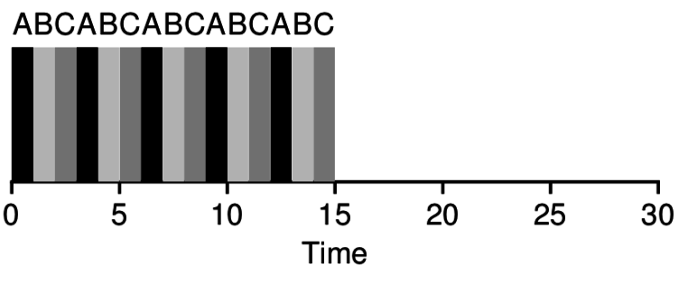
Example scheduler: Round Robin Scheduling
Round Robin scheduling runs a job for a small timeslice (quanta), then schedules the next job
Over time each job makes growing amounts of progress
If we switch fast enough, it seems to the user that all jobs are running in parallel

Slide 47
Break + Open Question
Does it always make sense to use Round Robin scheduling? Can you think of examples where we would want something different?

Slide 48
Break + Open Question
Does it always make sense to use Round Robin scheduling? Can you think of examples where we would want something different?
Server requests
Probably want to prioritize finishing requests rather than getting some work done on many of them
High-reliability computing
Might have a literal priority of some tasks as more important than others

Slide 49
Outline
Intro to Operating Systems
Processes
Process Contents
Control Flow
Scheduling
System Calls
Signals

Slide 50
Things a program cannot do itself
Print “hello world”
because the display is a shared resource.
Download a web page
because the network card is a shared resource.
Save or read a file
because the filesystem is a shared resource, and the OS wants to check file permissions first.
Launch another program
because processes are managed by the OS
Send data to another program
because each program runs in isolation, one at a time

Slide 51
The OS can do things Processes cannot
Bad Idea: let processes manage memory or devices directly
We do NOT trust processes
Instead the OS should play referee and manager here
Hardware supports this limitation with “kernel mode”
Some operations cannot be performed unless in kernel mode
Alternative: processes can request something from the OS
The OS can consider whether it should do that thing
Then the OS has the power to actually do it if necessary
Requirements
Context switch into kernel
Inform the kernel what you want it to do

Slide 52
Trap instructions
On almost all architectures, there is a special instruction that causes an exception to occur
Triggers a context switch into the OS
x86-64: syscall
Other systems
x86 (32-bit and older): int (short for interrupt)
ARM: svc
RISC-V: ecall
Hardware triggers a context switch, running the OS handler

Slide 53
System call example
System call: making a request of the OS from a process
Uses exceptional control flow to enter OS kernel
Returns back to process when complete
Returns to instruction after the system call
Kernel code
User code
Exception
syscall
next instruction
Do the thing
Returns

Slide 54
System call steps (simplification)
Process loads parameters into registers (just like a function call)
Process executes trap instruction (int, syscall, svc, etc.)
Hardware moves %rip to “handler” and switches to kernel mode
OS checks what the process wants to do from registers
OS decides whether the process is allowed to do so

Slide 55
Returning from a system call (simplification)
After OS finishes whatever operation it was asked to do
And when the process is scheduled to run again
OS places return result in a register (just like a function call)
OS changes mode to user mode (and sets virtual memory stuff)
OS sets %rip to instruction after the system call
Process continues and can use results of system call

Slide 56
Linux system calls
Example system calls
https://man7.org/linux/man-pages/man2/syscalls.2.html
Number | Name | Description
0 | read | Read file
1 | write | Write file
2 | open | Open file
3 | close | Close file
4 | stat | Get info about file
57 | fork | Create process
59 | execve | Execute a program
60 | _exit | Terminate process
62 | kill | Send signal to process

Slide 57
Example using system calls
Let’s create new processes with system calls
From process view:
Just look like regular C functions
Take arguments, return values
Underneath:
Function uses special assembly instruction to trigger exception

Slide 58
The C function for syscalls just performs the correct assembly
Example system call: fork
C code:
fork();
x86-64 assembly implementation:
fork:
movq $57, %rdi
syscall
retq
Number | Name | Description
57 | fork | Create process

Slide 59
Process management system calls
pid_t fork(void);
Create a new process that is a copy of the current one
Returns either PID of child process (parent) or 0 (child)
void _exit(int status);
Exit the current process (exit(), the library call cleans things up first)
pid_t waitpid(pid_t pid, int *status, int options);
Suspends the current process until a child (pid) terminates
int execve(const char *filename, char *const argv[], char *const envp[]);
Execute a new program, replacing the existing one
Replaces code and data, clears registers, sets %rip to start again

Slide 60
Creating a new process
#include <stdio.h>
#include <unistd.h>
int main(){
if(fork() == 0) {
printf("Child!\n");
} else {
printf("Parent!\n");
}
printf("Both!\n");
return 0;
}

Slide 61
Creating a new process
#include <stdio.h>
#include <unistd.h>
int main(){
if(fork() == 0) {
printf("Child!\n");
} else {
printf("Parent!\n");
}
printf("Both!\n");
return 0;
}
Existential crisis

Slide 62
Executing a new program
#include <stdio.h>
#include <unistd.h>
int main(){
if(fork() == 0) {
execve("/bin/python3", ...);
} else {
printf("Parent!\n");
}
printf("Only parent!\n");
return 0;
}

Slide 63
Break + Question
What does the following code do?
#include <stdio.h>
#include <sys/types.h>
int main() {
while(1){
fork();
}
return 0;
}

Slide 64
Break + Question
What does the following code do?
#include <stdio.h>
#include <sys/types.h>
int main() {
while(1){
fork();
}
return 0;
}
Creates a new process
Then each process creates a new process
Then each of those creates a new process…
Known as a Fork bomb!
Machine eventually runs out of memory and processing power and will stop working
Defense: limit number of processes per user

Slide 65
Fork bombs in various languages
Python fork bomb
import os
while 1:
os.fork()
Rust fork bomb
#[allow(unconditional_recursion)]
fn main() {
std::thread::spawn(main);
main();
}
Bash fork bomb
:(){ :|:& };:
Bash with spacing and a clearer function name
fork() {
fork | fork &
}
fork

Slide 66
Other Syscalls – File interactions
open() – open file
read() – read contents from current offset
write() – write data to file (usually at the end)
lseek() – modify current offset in the file
close() – close file
These system calls work with process file descriptors

Slide 67
Higher-level methods of file interaction
Here, we’re talking about system calls to the OS
C standard library also defines file interactions
fopen, fread, fwrite, fseek, fclose
All are wrappers on top of the actual syscalls
Buffers your interactions to make them more efficient
Reads/Writes large chunks of data at a time
Might collect multiple fwrite’s before doing a single real write
fflush() guarantees that the buffer is written now

Slide 68
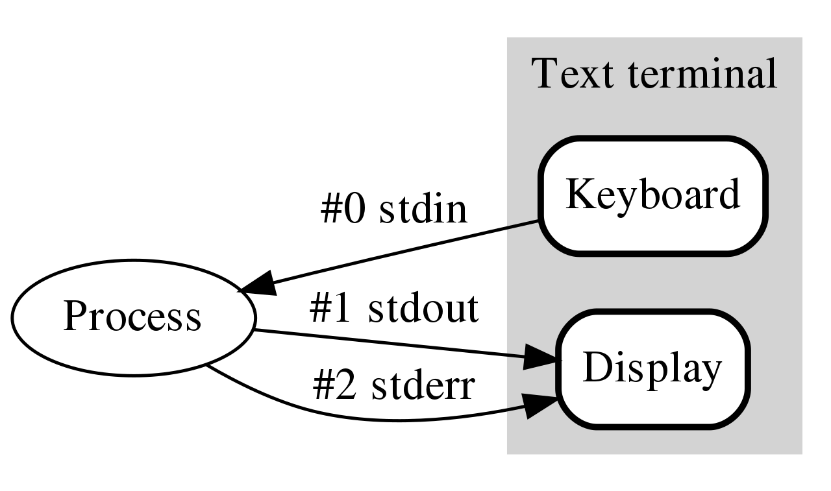
How do programs talk to users?
We often gloss over this in CS211
printf()
gets()
Work through the same file mechanism
Using standard I/O files set up when process starts
stdin – standard input (file descriptor 0)
stdout – standard output (file descriptor 1)
stderr – standard error (file descriptor 2)
printf(…) -> fprintf(1, …) -> handle arguments then write(1, …)

Slide 69
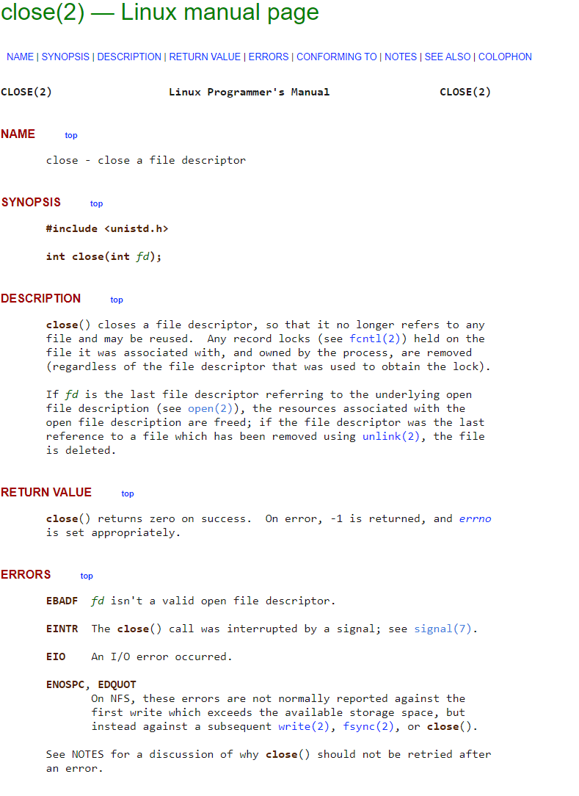
Sidebar: how do you figure out how these calls work?
Manual pages
Online: https://man7.org/linux/man-pages/man2/close.2.html

Slide 70
Outline
Intro to Operating Systems
Processes
Process Contents
Control Flow
Scheduling
System Calls
Signals

Slide 71
Alerting processes of events
How do we let a process know there was an event?
Errors
Termination
User commands (like CTRL-C or CTRL-\)
Events could happen whenever
Need to interrupt process control flow and run an event handler
Linux mechanism to do so is called “signals”

Slide 72
Signals are a different version of exceptional control flow
Signal is generated by the OS
Interrupts user code and jumps to a signal handler
Then returns back to user code afterwards
Unless the signal handler ends the program (this is the default handler)
User code
User code
Signal
some instruction
next instruction
Handle Signal
Returns

Slide 73
Signals are asynchronous messages to processes
Sometimes the OS wants to send something like an interrupt to a process
Your child process completed
You tried to use an illegal instruction
You accessed invalid memory
You are terminating now
In POSIX systems, this idea is called “Signals”
1) SIGHUP 2) SIGINT 3) SIGQUIT 4) SIGILL 5) SIGTRAP
6) SIGABRT 7) SIGBUS 8) SIGFPE 9) SIGKILL 10) SIGUSR1
11) SIGSEGV 12) SIGUSR2 13) SIGPIPE 14) SIGALRM 15) SIGTERM
16) SIGSTKFLT 17) SIGCHLD 18) SIGCONT 19) SIGSTOP 20) SIGTSTP
21) SIGTTIN 22) SIGTTOU 23) SIGURG 24) SIGXCPU 25) SIGXFSZ
26) SIGVTALRM 27) SIGPROF 28) SIGWINCH 29) SIGIO 30) SIGPWR
31) SIGSYS ...

Slide 74
Signals are asynchronous messages to processes
Sometimes the OS wants to send something like an interrupt to a process
Your child process completed
You tried to use an illegal instruction
You accessed invalid memory
You are terminating now
In POSIX systems, this idea is called “Signals”
1) SIGHUP 2) SIGINT 3) SIGQUIT 4) SIGILL 5) SIGTRAP
6) SIGABRT 7) SIGBUS 8) SIGFPE 9) SIGKILL 10) SIGUSR1
11) SIGSEGV 12) SIGUSR2 13) SIGPIPE 14) SIGALRM 15) SIGTERM
16) SIGSTKFLT 17) SIGCHLD 18) SIGCONT 19) SIGSTOP 20) SIGTSTP
21) SIGTTIN 22) SIGTTOU 23) SIGURG 24) SIGXCPU 25) SIGXFSZ
26) SIGVTALRM 27) SIGPROF 28) SIGWINCH 29) SIGIO 30) SIGPWR
31) SIGSYS ...
Process Errors

Slide 75
Signals are asynchronous messages to processes
Sometimes the OS wants to send something like an interrupt to a process
Your child process completed
You tried to use an illegal instruction
You accessed invalid memory
You are terminating now
In POSIX systems, this idea is called “Signals”
1) SIGHUP 2) SIGINT 3) SIGQUIT 4) SIGILL 5) SIGTRAP
6) SIGABRT 7) SIGBUS 8) SIGFPE 9) SIGKILL 10) SIGUSR1
11) SIGSEGV 12) SIGUSR2 13) SIGPIPE 14) SIGALRM 15) SIGTERM
16) SIGSTKFLT 17) SIGCHLD 18) SIGCONT 19) SIGSTOP 20) SIGTSTP
21) SIGTTIN 22) SIGTTOU 23) SIGURG 24) SIGXCPU 25) SIGXFSZ
26) SIGVTALRM 27) SIGPROF 28) SIGWINCH 29) SIGIO 30) SIGPWR
31) SIGSYS ...
Process Termination

Slide 76
Sending signals
OS sends signals when it needs to
Processes can ask the OS send signals with a system call
int kill(pid_t pid, int sig);
Users send signals through OS from command line or keyboard
Shell command: kill -9 pid (SIGKILL)
CTRL-C (SIGINT)

Slide 77
Handling signals
Programs can register a function to handle individual signals
signal(int sig, sighandler_t handler);
What are you supposed to do about it?
Do some quick processing to handle it
That needs to be “reentrant” safe
Reset the process and try again
Quit the process (default handler)
Not much: signals are not supported by all OSes

Slide 78
Examples: sending a signal
> kill -11 pid (11 is SIGSEGV – a.k.a segfault)

Slide 79
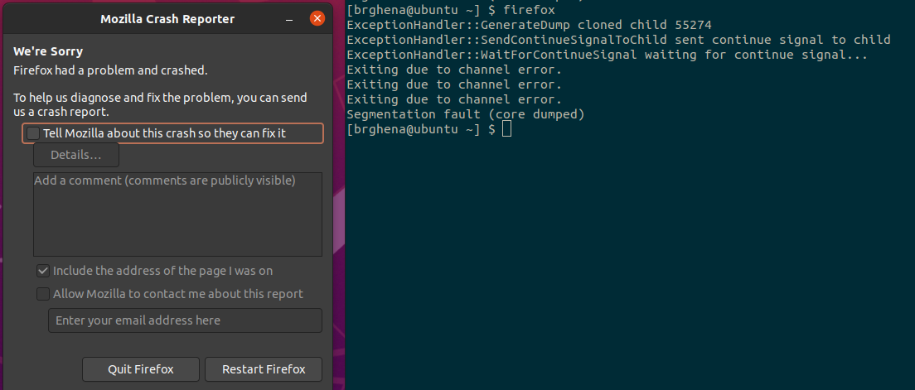
Examples: sending a signal
> kill -11 pid (11 is SIGSEGV – a.k.a segfault)

Slide 80
CS343 – Operating Systems
213 topics in more depth: Concurrency, Processes, Virtual Memory
Deal with data races directly
Implement virtual memory system
Also, totally new topics: File Systems and Devices
Focus: “how does the Operating System make the computer work”?

Slide 81
Outline
Intro to Operating Systems
Processes
Process Contents
Control Flow
Scheduling
System Calls
Signals

