Slide 1
Lecture 18: Networks
CS213 – Intro to Computer Systems
Branden Ghena – Winter 2026
Some slides borrowed from: Bryant and O’Hallaron (CMU) and Eleftherios Kosmas (UCSD)

Slide 2
Administrivia
SETI Lab
Due tonight, but it’s okay to use slip days or late days
Feel free to ask questions on Piazza
Office hours
Normal today and Friday
No normal office hours next week
We’ll try to put something together on Tuesday/Wednesday

Slide 3
Exam reminders
Midterm Exam 3 details
Thursday, March 19 at noon in lecture room (Tech LR3)
75-minute exam, same style as last time
Covers lectures 10-18 (Memory Security to Networks)
Particular emphasis:
Security
Caches and Cache Performance
Virtual Memory
Concurrency
One 8.5” x 11” sheets of paper with notes on front and back
Prior exams posted on Canvas

Slide 4
Today’s Goals
How do computers communicate?
What choices does the Internet make about how to communicate?
Explore Internet communication mechanisms: TCP and HTTP
See CS340 for more details!
This is an 80-minute speedrun of a full quarter-long course

Slide 5
Outline
Computer Networks
Topology
Inter-network communication
The Internet
Protocol choices
Sockets
System calls for communicating with other computers
The Web

Slide 6
Computer networks
A network is a connection of two or more computers
Definition includes hardware and software components
Networks might serve a variety of regions
Local Area Network (LAN)
Connects computers in some small area
Home, building, campus
Wide Area Network (WAN)
Connects computers over distant areas
City, country, world
Could be wired or wireless

Slide 7
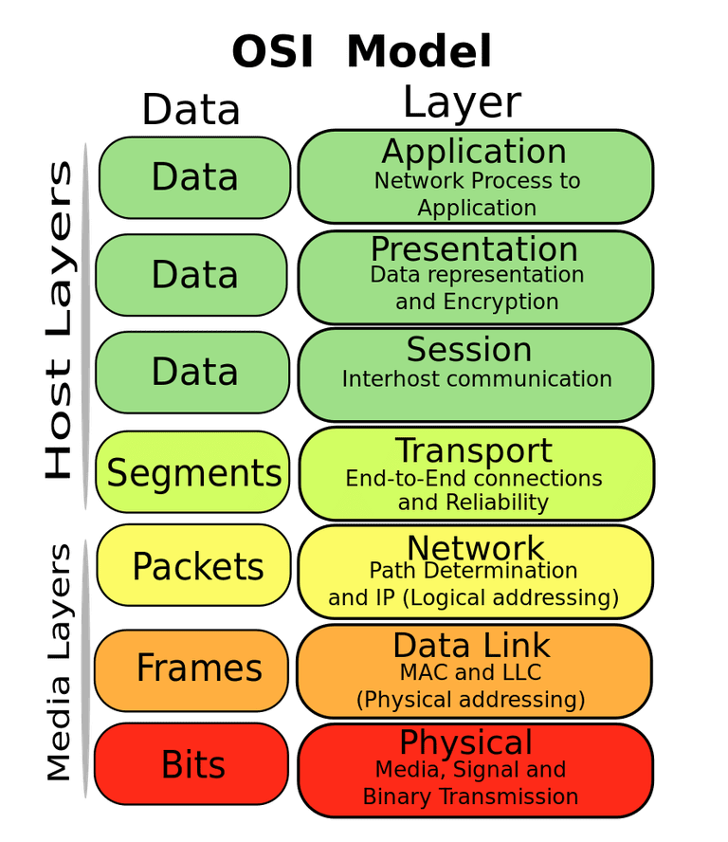
OSI model of communication layers
Transport
How to form connections between computers
Example: TCP and UDP
Network
How to send packets between networks
Example: IP
Data Link
How to send frames of data
Example: Ethernet, WiFi
Physical
How to send individual bits
Example: Ethernet, WiFi

Slide 8
How do we connect computers?
First question of a network: how are the computers actually connected?
There are various choices here with different implications

Slide 9

How to connect: point-to-point networks
How do we connect computers in a network?
This is a question of “network topology”
Simple option: just connect them directly
Problem: what if I find a third computer?

Slide 10
How to connect: bus networks
Connect everything to one wire in parallel
Actually a “multidrop bus”
Scales pretty well to many computers
Problem: which computer gets to transmit when?
Simultaneous transmissions conflict

Slide 11
How to connect: ring networks
Connect everything with point-to-point connections
Connect the last computer back to the first computer
Problem: what if a computer stops sending?

Slide 12
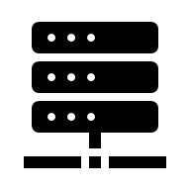
How to connect: star networks
Connect to a hub with point-to-point connections
Hub connects all computers
Hub is a simple computer with one job: transfer communications between computers
Hopefully more reliable than any of the computers

Slide 13


Common home networks
Example of a star topology network
Your home router is the hub connecting multiple computers
Could be wired (Ethernet) or wireless (WiFi)

Slide 14
Building a network: local area network
A
B
C
host
host
host
Smallest division of a network
Hosts are connected to router (wired or wireless)
Operation (same for Ethernet or WiFi)
Each “adapter” has a unique 48-bit address (MAC Address)
e.g. 00:16:ea:e3:54:e6
Hosts send bits to router in chunks called frames
Routers are aware of other connected hosts (by ID) and forward message
Story: how to connect a kindle to airport WiFi
router

Slide 15
Building a network: internets
Multiple local area networks (LANs) can be physically connected
The connected networks are called an internet (short for internetworking)
Networks might be running totally separate protocols: Ethernet, WiFi, …
Modems translate between network types: e.g., Ethernet <-> Cable
LAN Network 1
LAN Network 2
A
B
C
X
Y
Z
host
host
host
host
host
host
WiFi
Ethernet
router
router
modem
modem
Coax Cable (DOCSIS Protocol)

Slide 16
Structure of an internet
host
host
router
router
router
router
router
router
Ad hoc interconnection of networks
No particular topology
Possibly vastly different link capabilities
Send packets from source to destination by hopping through networks

Slide 17
Outline
Computer Networks
Topology
Inter-network communication
The Internet
Protocol choices
Sockets
System calls for communicating with other computers
The Web

Slide 18
Managing inter-network communication with a protocol
Now we have the ability to form and connect networks
But how do we transmit data between them?
Especially given that they differ in capabilities and design
Solution: protocol software running on each host AND router
The protocol is a set of rules that governs how hosts and routers should cooperate when they transfer data from network to network
Smooths out the differences between the different networks

Slide 19
The role of an inter-network protocol
Provides a naming scheme
We cannot rely on any particular lower-layer address
Defines a uniform format for host addresses
Each host (and router) is assigned at least one of these internet addresses that uniquely identifies it
Provides a delivery mechanism
Defines a standard transfer unit: packet
A packet consists of a header and a payload
Header: Metadata such as packet size, source and destination addresses
Payload: data bits sent from the source host

Slide 20
Protocols are “layered”
Headers for each layer of communication wrap data
Data is wrapped with header for the network to make a packet
i.e., bytes are added to the start/end of it
Packet is wrapped with header for the link to make a frame
Internet Packet
Data
Packet Header
Frame Header
Ethernet Frame

Slide 21
Transmitting data between networks
LAN1
Host A
Host B
LAN2
client
server
(1)
data
(8)
data
protocol
software
protocol
software
internet packet
(2)
data
PH
(7)
data
PH
LAN1
adapter
LAN2
adapter
LAN1 frame
Router
(3)
data
PH
FH1
(6)
data
PH
FH2
LAN1
adapter
LAN2
adapter
LAN2 frame
(4)
data
PH
FH1
data
PH
FH2
(5)
PH: Internet packet header
FH: LAN frame header
protocol
software

Slide 22
Other inter-network issues
We are glossing over a number of important questions:
What if different networks have different maximum frame sizes? (segmentation)
How do routers know where to forward frames?
How are routers informed when the network topology changes?
What if packets get lost?
These (and other) questions are addressed by the area of systems known as computer networking
CS340 – Intro to Computer Networks

Slide 23
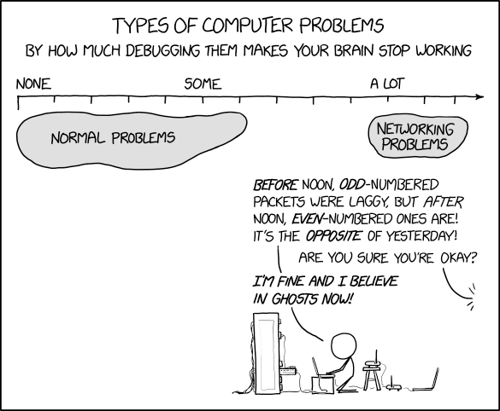
Break + xkcd
https://xkcd.com/2259/

Slide 24
Outline
Computer Networks
Topology
Inter-network communication
The Internet
Protocol choices
Sockets
System calls for communicating with other computers
The Web

Slide 25
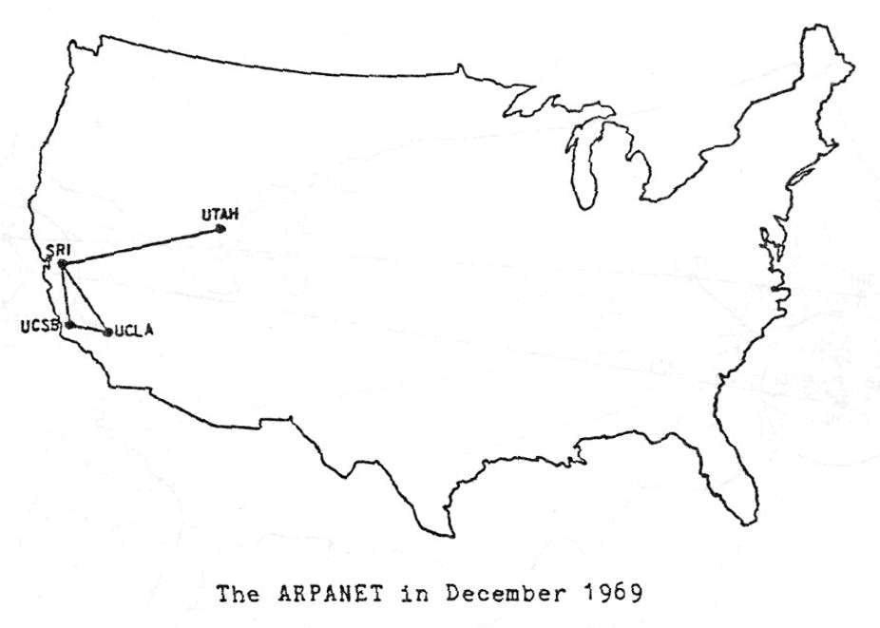

Slide 26
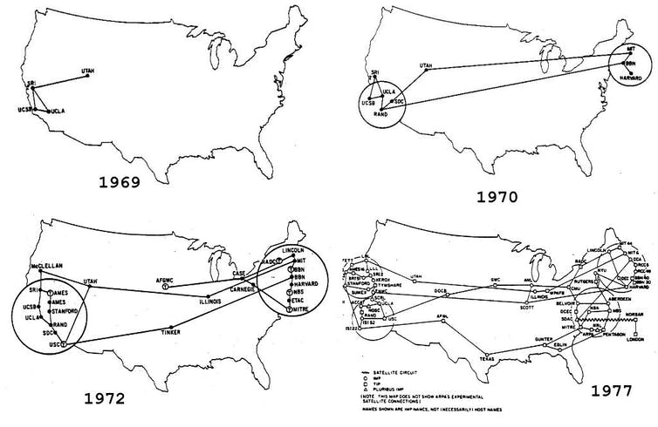

Slide 28
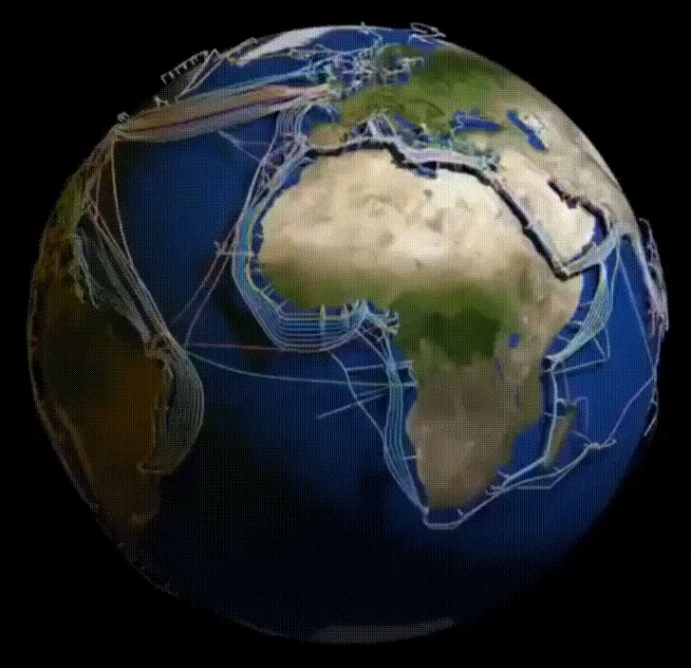

Slide 29
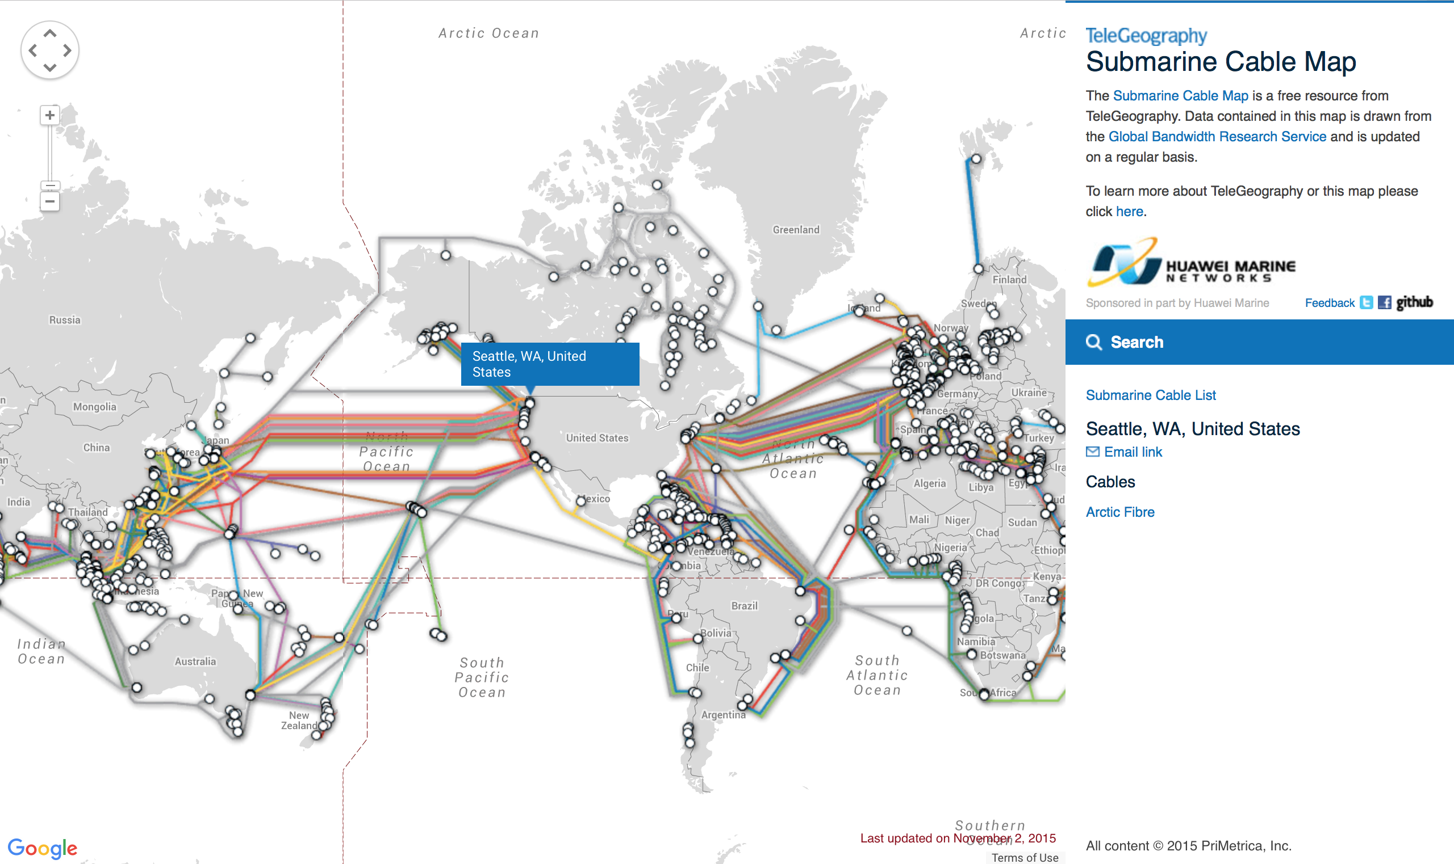
Notes:
Top right: Svalbard

Slide 30
The global Internet
Most famous example of an internet (uppercase to distinguish)
Based on the TCP/IP protocol family
IP (Internet Protocol)
Provides a naming scheme and unreliable delivery of packets from host-to-host
UDP (Unreliable Datagram Protocol)
Uses IP to provide unreliable data delivery from process-to-process
TCP (Transmission Control Protocol)
Uses IP to provide reliable data delivery from process-to-process
Accessed via a mix of Unix file I/O and the sockets interface

Slide 31
Hardware and software organization of an Internet application
Internet client host
Internet server host
Client
User code
Server
Sockets interface
(system calls)
TCP/IP
OS code
TCP/IP
Hardware interface
(interrupts)
Network
adapter
Hardware
and firmware
Network
adapter
Global IP Internet

Slide 32
A programmer’s view of the internet
1. Hosts are mapped to a set of 32-bit IP addresses
129.105.5.212
2. The set of IP addresses is mapped to a set of identifiers called Internet domain names
129.105.5.212 is mapped to moore.wot.eecs.northwestern.edu
3. A process on one Internet host can communicate with a process on another Internet host over a connection

Slide 33
A programmer’s view of the internet
1. Hosts are mapped to a set of 32-bit IP addresses
129.105.5.212
2. The set of IP addresses is mapped to a set of identifiers called Internet domain names
129.105.5.212 is mapped to moore.wot.eecs.northwestern.edu
3. A process on one Internet host can communicate with a process on another Internet host over a connection

Slide 34
1. IP addresses
32-bit IP addresses are stored in an IP address struct
IP addresses are always stored in memory in network byte order (big-endian)
Remember: most computers use little-endian😭
True in general for any integer transferred in a packet header from one machine to another
E.g., the port number used to identify an Internet connection
By convention, each byte in a 32-bit IP address is represented by its decimal value and separated by a period
IP address: 0x816905D4 = 129.105.7.212
/* Internet address structure */
struct in_addr {
uint32_t s_addr; /* network byte order (big-endian) */
};

Slide 35
How many hosts can there be?
IP addresses are 32-bits

Slide 36
How many hosts can there be?
IP addresses are 32-bits
2³² = 4.3 billion hosts
However, some addresses are reserved for special purposes
Private networks (10.x.x.x, 192.168.x.x, …)
Within a computer (127.x.x.x)
Various testing or reserved purposes
588 million are reserved
So 3.7 billion publicly accessible hosts
Typically, a home router has one publicly accessible IP address
All devices within the home are on a private network
Phones on cellular data are also within a private network

Slide 37
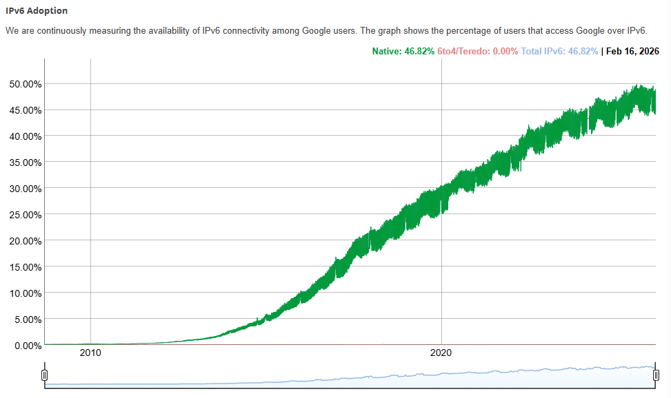
Aside: IPv4 and IPv6
The original Internet Protocol, with its 32-bit addresses, is known as Internet Protocol Version 4 (IPv4)
1996: Internet Engineering Task Force (IETF) introduced Internet Protocol Version 6 (IPv6) with 128-bit addresses
Intended as the successor to IPv4
Majority of Internet traffic still carried by IPv4 (we’ll focus on it today)
IPv6 traffic at Google
2026: 46%
2025: 48%
2024: 44%
2023: 41%

Slide 38
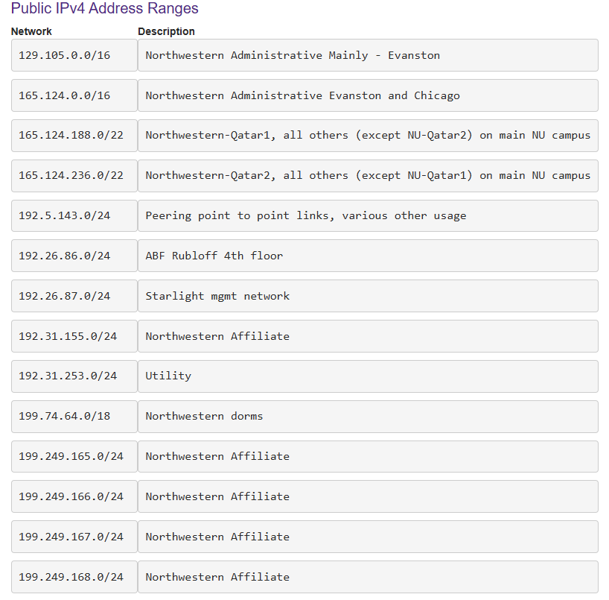
Northwestern IPv4 ranges
Format: ip.addr/NUM
NUM is the number of meaningful bits, from the most-significant bit
129.105.0.0/16 means the most-significant 16 bits are meaningful i.e., 129.105.x.x
Remaining bits can be used for unique addresses
2^{(32-NUM)} machines

Slide 39
A programmer’s view of the internet
1. Hosts are mapped to a set of 32-bit IP addresses
129.105.5.212
2. The set of IP addresses is mapped to a set of identifiers called Internet domain names
129.105.5.212 is mapped to moore.wot.eecs.northwestern.edu
3. A process on one Internet host can communicate with a process on another Internet host over a connection

Slide 40
2. Internet domain names
unnamed root
.net
.edu
.gov
.com
Top-level domain names
mit
northwestern
berkeley
amazon
Second-level domain names
eecs
mccormick
www
54.230.48.28
Third-level domain names
and onwards…
wot
www
165.124.149.20
moore
129.105.5.212
finagle
129.105.5.211
Note: Northwestern owns 129.105.0.0/16 and 165.124.0.0/16

Slide 41
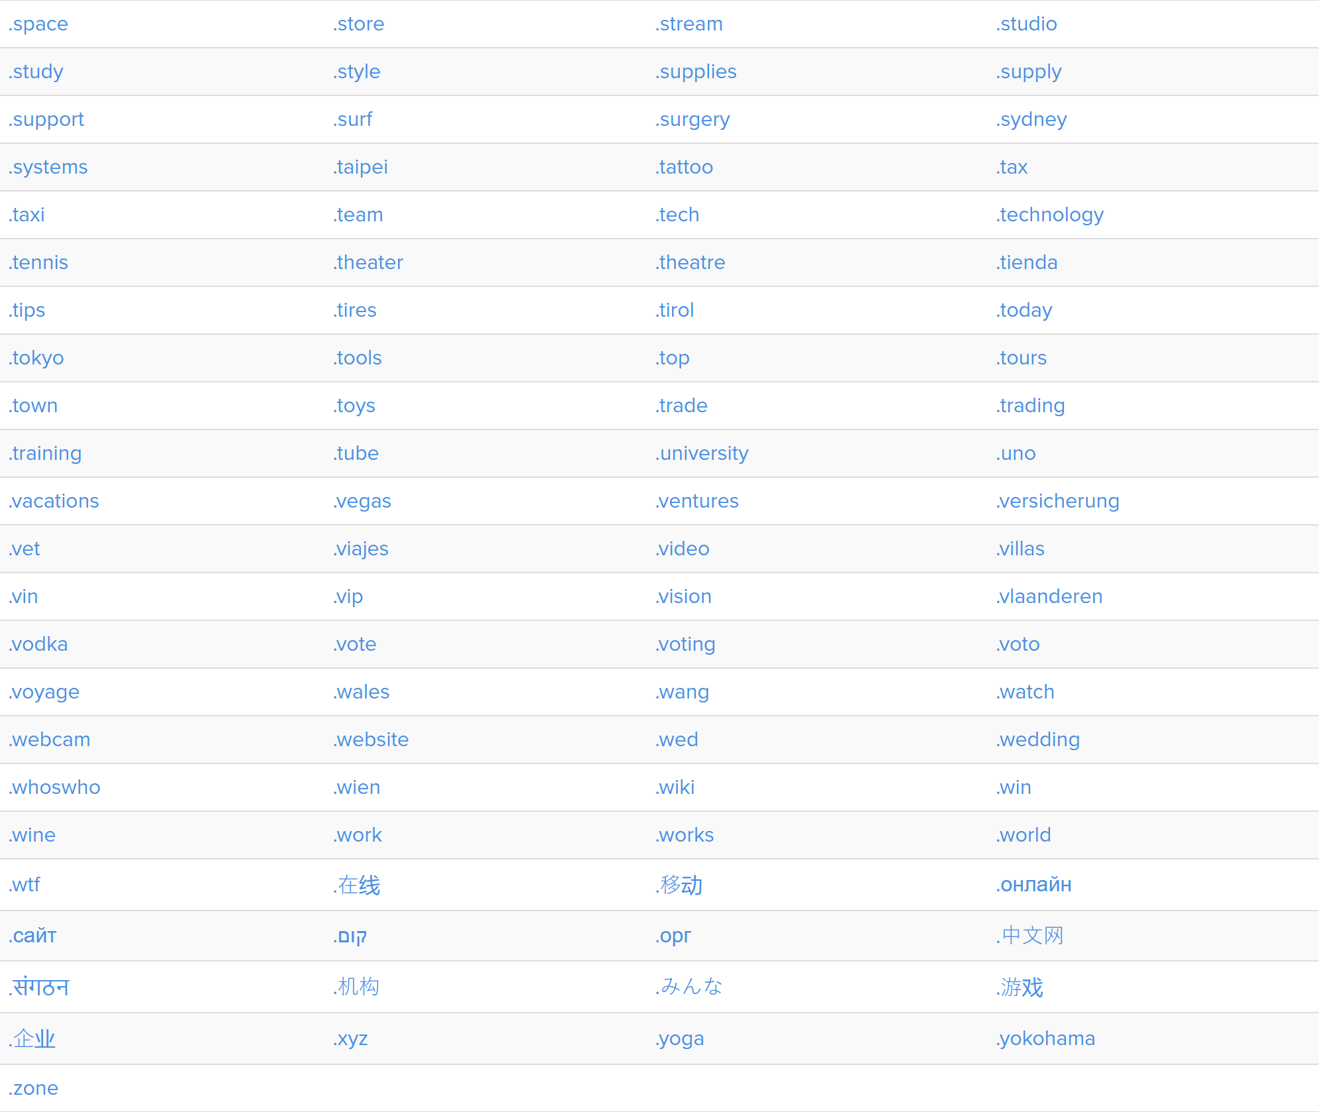
Some top-level domain names (TLDs)

Slide 42
Domain Naming System (DNS)
The Internet maintains a mapping between IP addresses and domain names in a huge worldwide distributed database called DNS
Conceptually, programmers can view the DNS database as a collection of millions of host entries
Each host entry defines the mapping between a set of domain names and IP addresses
A special name: localhost
Refers back to the computer being used (IP address 127.0.0.1)

Slide 43
DNS lookups
The entire DNS mapping is rather large
Billions of entries at 10s of bytes in size = 10s-100s of GB
DNS servers maintain the lists and requests are made to those servers to translate into an IP address
DNS entry can then be cached on the local client!!
DNS servers have well-known IP addresses
Google: 8.8.8.8 and 8.8.4.4
Cloudflare: 1.1.1.1 and 1.0.0.1
Comcast: 75.75.75.75

Slide 44
A programmer’s view of the internet
1. Hosts are mapped to a set of 32-bit IP addresses
129.105.7.30
2. The set of IP addresses is mapped to a set of identifiers called Internet domain names
129.105.7.30 is mapped to moore.wot.eecs.northwestern.edu
3. A process on one Internet host can communicate with a process on another Internet host over a connection

Slide 45
3. Internet connections
Clients and servers communicate by sending streams of bytes over TCP connections. Each connection is:
Point-to-point: connects a pair of processes.
Full-duplex: data can flow in both directions at the same time,
Reliable: stream of bytes sent by the source is eventually received by the destination in the same order it was sent.
There are other communication mechanisms, like UDP
But we’ll focus on TCP today

Slide 46
Connections are identified by IP address and Port
Connection endpoints are called “sockets”
Socket address is an IPaddress:port pair
A port is a 16-bit integer that identifies a process:
Ephemeral port
Assigned automatically by client kernel when client makes a connection request
Usually 1000 and up
Well-known port
Associated with some service provided by a server

Slide 47
Anatomy of a connection
A connection is uniquely identified by socket addresses of endpoints
Socket address is an IP_address:Port pair
Connection: (client_address:client_port, server_address:server_port)
Client socket address
128.2.194.242:51213
Server socket address
208.216.181.15:80
Client
Server
(port 80)
Connection socket pair
(128.2.194.242:51213, 208.216.181.15:80)
Client host address
128.2.194.242
Server host address
208.216.181.15
51213 is an ephemeral port
allocated by the kernel
80 is a well-known port
associated with Web servers

Slide 48
Ports are used to identify services to the kernel
Server host 128.2.194.242
Client host
Service request for
128.2.194.242:80
(i.e., the Web server)
Web server
(port 80)
Client
Kernel
SSH server
(port 22)
Service request for
128.2.194.242:22
(i.e., the SSH server)
Web server
(port 80)
Client
Kernel
SSH server
(port 22)

Slide 49
Well-known service ports and names
Popular services have permanently assigned well-known ports and corresponding well-known service names:
echo servers: echo 7
ftp servers: ftp 21
ssh servers: ssh 22
email servers: smtp 25
Web servers: http 80
Mappings between well-known ports and services are listed in /etc/services on Linux

Slide 50
Break + Thinking
What are the steps for viewing a website?
You enter a domain name for the website
???

Slide 51
Break + Thinking
What are the steps for viewing a website?
You enter a domain name for the website
Computer looks up domain name to get IP Address
Computer sends request to IP_address:80
Computer gets back data, which it renders into a website

Slide 52
ALL the layers
A ‘famous’ interview question
“What happens when you type google.com into your browser’s address bar and press enter?”
https://github.com/alex/what-happens-when (11 pages!)
Keyboard events
Parsing URL
DNS lookup
Opening socket
HTTP protocol
HTML parsing
GPU rendering

Slide 53
Outline
Computer Networks
Topology
Inter-network communication
The Internet
Protocol choices
Sockets
System calls for communicating with other computers
The Web

Slide 54
What is a socket?
To an application, a socket is a file descriptor that lets the application read/write from/to the network
Connects a process on one host to a process on another
Clients and servers communicate with each other by reading from and writing to socket descriptors
The main distinction between regular file I/O and socket I/O is how the application “opens” the socket descriptors
Client
Server
clientfd
serverfd

Slide 55
Client-Server transaction design pattern
Most network applications are based on the client-server model:
A server process and one or more client processes
Server manages some resource
Server provides service by manipulating resource for clients
Server activated by request from client
1. Client sends request
Client
process
Server
process
Resource
4. Client
handles
response
3. Server sends response
2. Server
handles
request
Note: clients and servers are processes running on hosts
(can be the same or different hosts)

Slide 56
Socket communication flow
Server
Client
1. Initialize socket()
socket()
socket()
bind()
listen()
2. Create connection
accept()
connect()
3. Transfer data
read()
write()
write()
read()
4. Close
close()
close()

Slide 57
Socket communication flow
Server
Client
1. Initialize socket()
socket()
socket()
bind()
listen()
2. Create connection
accept()
connect()
3. Transfer data
read()
write()
write()
read()
4. Close
close()
close()

Slide 58
Initializing a socket
Both sides create a socket
Identifies the type of communication: AF_INET for internet communication
Alternatives are AF_INET6, AF_BLUETOOTH, etc.
Server needs to do more work here
Pick an IP address and Port to connect to
Start listening for incoming requests

Slide 59
Creating a socket
int socket(int domain, int type, int protocol);
Domain: broad communication category
AF_INET for internet communication (Also: AF_INET6, AF_BLUETOOTH, etc.)
Type: communication type within that category
SOCK_STREAM for TCP streams
SOCK_DGRAM for UDP datagrams
Protocol: protocol ID within that type
Basically always 0
Returns: a file descriptor for the socket

Slide 60
Is creating a socket enough?
If we are a client
We will be connecting to a server
So no other steps are necessary
OS will just pick some arbitrary port to send on
If we are a server
Some client will be connecting to us
We need to specify the IP_address:Port pair for the server
Pick any available port (or a well-known one)
Pick an IP address, if the computer has multiple
We also need to tell the OS we will be accepting messages

Slide 61
Picking an address and port for the socket
int bind(int sockfd, const struct sockaddr *addr, socklen_t addrlen);
Addr: a struct containing port and IP address
in_addr: just holds a uint32_t
INADDR_ANY selects all IP addresses
Arguments and structs are intentionally generic to handle other protocols
struct sockaddr_in {
uint16_t sin_family; /* Protocol family (always AF_INET) */
uint16_t sin_port; /* Port num in network byte order */
struct in_addr sin_addr; /* IP addr in network byte order */
unsigned char sin_zero[8]; /* Pad to sizeof(struct sockaddr) */
};

Slide 62
Inform the kernel that this process will receive packets
int listen(int sockfd, int backlog);
Backlog: maximum queue length for pending connections before they should be refused
Note: this doesn’t actually accept connections
Tells the OS to start listening for connection requests and returns
A separate function actually accepts connections

Slide 63
Socket communication flow
Server
Client
1. Initialize socket()
socket()
socket()
bind()
listen()
2. Create connection
accept()
connect()
3. Transfer data
read()
write()
write()
read()
4. Close
close()
close()

Slide 64
Creating a connection
Client “connects” to a server somewhere
Provides a server IP address and Port
OS will pick a random outgoing Port on the client
Server waits until a connection arrives
For performance, modern servers often create a worker thread to handle each incoming connection
Both sides get a “file descriptor” for the connection
Looks very similar to file I/O from a system call perspective

Slide 65
Starting a connection as a server
int accept(int sockfd, struct sockaddr *addr, socklen_t *addrlen);
Blocks until a connection occurs
Addr: Pointer to address structure, to be filled with client metadata
Returns: a new file descriptor for this connection
New descriptor is used to perform data transfer
Original socket file descriptor remains functional
Why?

Slide 66
Starting a connection as a server
int accept(int sockfd, struct sockaddr *addr, socklen_t *addrlen);
Blocks until a connection occurs
Addr: Pointer to address structure, to be filled with client metadata
Returns: a new file descriptor for this connection
New descriptor is used to perform data transfer
Original socket file descriptor remains functional
Why? To allow for additional connections to be made
Might accept multiple connections simultaneously
Separate threads might handle the created connections!

Slide 67
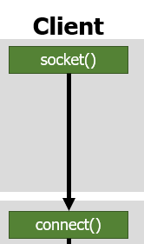
Starting a connection as a client
int connect(int sockfd, const struct sockaddr *addr, socklen_t addrlen);
Blocks until a connection is made
Addr: address of the server to connect to
Includes IP address and Port
Remember: all the client has done is created a socket(). This call specifies the location to connect the socket to.
Only returns an error code. No need to reuse socket for client.

Slide 68
Socket communication flow
Server
Client
1. Initialize socket()
socket()
socket()
bind()
listen()
2. Create connection
accept()
connect()
3. Transfer data
read()
write()
write()
read()
4. Close
close()
close()

Slide 69
Socket-specific send/receive calls
The same as read/write for files except with additional flags
Blocks until data is completed
ssize_t recv(int sockfd, void *buf, size_t len, int flags);
Receive data into an array (equivalent to read)
ssize_t send(int sockfd, const void *buf, size_t len, int flags);
Send data from an array (equivalent to write)
Flags: various networking-specific configurations
Wait for all requested data, or Never wait for data
Request confirmation of send, Hint that there will be more data after this
Etc.

Slide 70
Socket communication flow
Server
Client
1. Initialize socket()
socket()
socket()
bind()
listen()
2. Create connection
accept()
connect()
3. Transfer data
read()
write()
write()
read()
4. Close
close()
close()

Slide 71
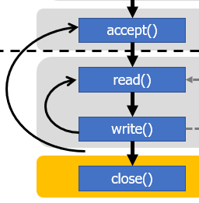
Closing the connection
int close(int fd);
Exactly the same close() system call from file I/O
If other computer is waiting on a read/recv, gets end-of-file
Reads in data with a length of zero
Write/send gets an error
Server might close connection-specific socket
And then call accept() again to handle new clients
Using the original, bind+listen socket
Server

Slide 72
Example client and server code
Adapted from: https://www.geeksforgeeks.org/tcp-server-client-implementation-in-c/
Warning: this code is written with terrible style
But is a good socket example
IPv6 server example: https://www.tack.ch/unix/network/sockets/udpv6.shtml
Sidebar: should you write your own server in C?
That’s just asking for trouble (see buffer overflow attacks)
But if you’re a major web company and then you might need to for performance reasons
Generally: use some existing server library instead

Slide 73
Outline
Computer Networks
Topology
Inter-network communication
The Internet
Protocol choices
Sockets
System calls for communicating with other computers
The Web

Slide 74
Internet versus the World Wide Web (WWW)
Internet allows for communication to occur between computers all over the world
The Web is a system for sharing file content across the Internet
Uses HTTP (HyperText Transfer Protocol) for communication
Identifies the types of files so they can be interpreted
Images
Plaintext
HTML (HyperText Markup Language)
A web browser is an application that can request and interpret web content

Slide 75
Web server basics
Clients and servers communicate using HyperText Transfer Protocol (HTTP)
Client and server establish TCP connection
Client requests content
Server responses with requested content
Client and server close connection (eventually)
Web
client
(browser)
HTTP request
Web
server
HTTP response
(content)
HTTP
Web content
TCP
Streams
IP
Datagrams

Slide 76
URLs and how they are used
Unique name for a file: URL (Universal Resource Locator)
Example URL: http://www.northwestern.edu:80/index.html
Clients use prefix (http://www.northwestern.edu:80) to infer:
What kind (protocol) of server to contact (HTTP)
Where the server is (www.northwestern.edu)
What port it is listening on (80)
Servers use suffix (/index.html) to:
Find file on file system
Initial “/” in suffix denotes home directory for requested content.
Minimal suffix is “/”, which server expands to configured default filename (usually, index.html)
Alternatively determine what dynamic content to serve

Slide 77
HTTP requests
HTTP requests are sent from a client to a server
It’s in plain text, so it’s human readable
Request line: <method> <uri> <version>
<method> is one of GET, POST, PUT, DELETE, etc.
<uri> path to the data you want to get (URI: Uniform Resource Identifier)
<version> is HTTP version of request (HTTP/1.0 or HTTP/1.1)
Request headers: <header name>: <header data>
Provide additional information to the server
Appended after the request line

Slide 78
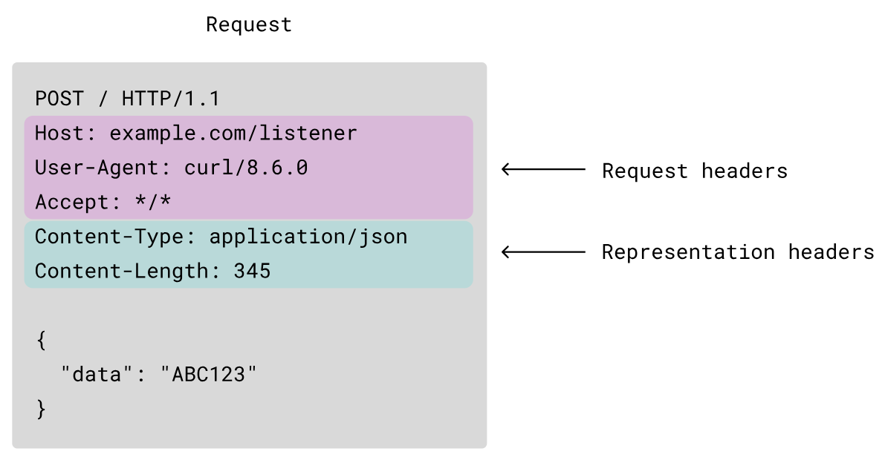
Example HTTP requests
GET /index.html HTTP/1.0\r\n\r\n
Method: GET
URI: /index.html
Version: Http/1.0
More complex example:

Slide 79
HTTP responses
HTTP response is sent back from the server to the client
Response line: <version> <status code> <status msg>
<version> is HTTP version of the response
<status code> is numeric status
<status msg> is corresponding English text
200 OK Request was handled without error
301 Moved Provide alternate URL
404 Not found Server couldn’t find the file
Response headers: <header name>: <header data>
Provide additional information about response
Content-Type: MIME type of content in response body
Content-Length: Length of content in response body

Slide 80
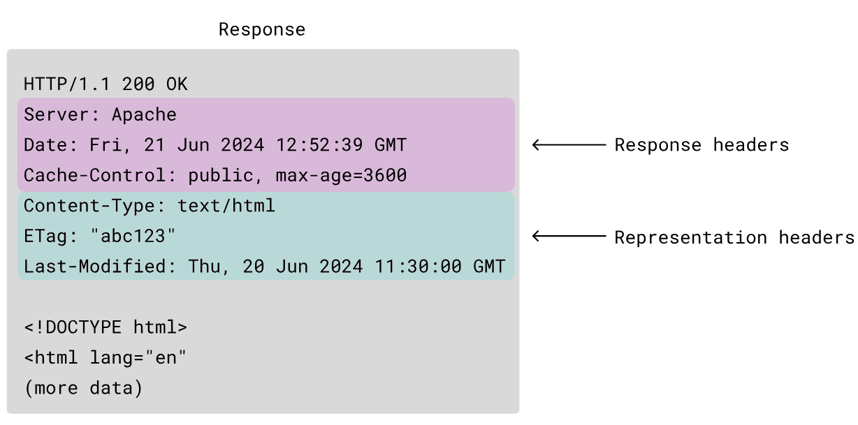
Example HTTP responses
HTTP/1.1 200 OK\r\nContent-Length: 13\r\nContent-Type: text/html\r\n\r\nHello World!
Version: HTTP/1.1
Status code/message: 200 OK
Headers: Content-Length: 12 Content-Type: text/html
Data: “Hello World!”
More complex example

Slide 81
Web content
Web servers return content to clients
content: a sequence of bytes with an associated MIME type (Multipurpose Internet Mail Extensions) which describe how to interpret the data
Example MIME types
text/html HTML document
text/plain Unformatted text
image/gif Binary image encoded in GIF format
image/png Binary image encoded in PNG format
image/jpeg Binary image encoded in JPEG format
List of MIME types: http://www.iana.org/assignments/media-types/media-types.xhtml

Slide 82
Static and dynamic content
Web content is associated with a filename that is managed by the server
The content returned in HTTP responses can be static or dynamic
Static content: content stored in files and retrieved in response to an HTTP request
Examples: HTML files, images, audio clips
Request identifies which content file
Dynamic content: content produced on-the-fly in response to an HTTP request
Example: content produced by a program executed by the server on behalf of the client
Request identifies name of content desired from executable code

Slide 83
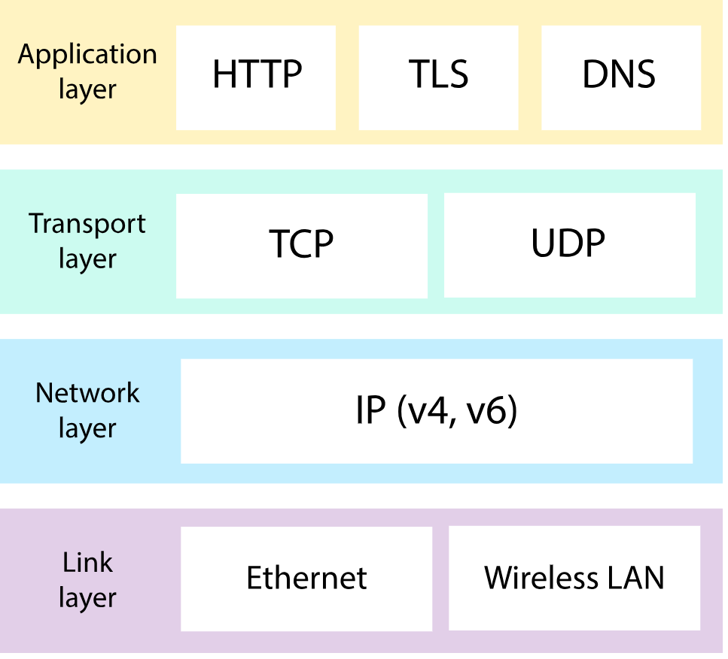
The Internet is made of layers
Each layer handles its own issues and abstracts details away
Ethernet/WiFi sends bits and packets
IP identifies which computer to send packets to
TCP creates a reliable connection to a process on that computer
HTTP allows file data to be requested and interpreted

Slide 84
CS340 – Intro to Computer Networking
Computer-to-Computer Communication
OSI Model
IPv4, IPv6, and Routing
TCP, UDP
Application Protocols: HTTP, FTP
Sockets and Web Servers
A systems class that feels more different from CS213 rather than more similar
Usually taught twice a year

Slide 85
Outline
Computer Networks
Topology
Inter-network communication
The Internet
Protocol choices
Sockets
System calls for communicating with other computers
The Web

