Slide 1
Lecture 04 Input and Output
CE346 – Microprocessor System Design
Branden Ghena – Fall 2023
Some slides borrowed from: Josiah Hester (Northwestern), Prabal Dutta (UC Berkeley)

Slide 2
Administrivia
Lab on Friday!
Frances Searle room 3220
See you all there!!
Show up on-time. We are going to get started right away
None of this 5-10 minutes late nonsense
Bring a USB-C adapter if you need one
Remember that you need to attend the section you registered for in CAESAR
If you need to switch for a day, ask me for permission in advance on Piazza

Slide 3
Quiz coming soon
First quiz is next week Tuesday! (10/08)
15-minute quiz, taken in-class on paper
Last fifteen minutes of class
Bring a pencil
No notes, no calculator
Covers material from the last two weeks, including today
Goals:
The quiz is not meant to be difficult. It’s meant to keep you involved
Do review class material and make sure you actually understand it

Slide 4
Today’s Goals
How does a microcontroller interact with peripherals to perform input and output operations?
Explore reliable use of Memory-Mapped I/O
Learn about our first peripherals: Temperature and GPIO
Explore General Purpose I/O (GPIO) peripheral use
Understand how it works
Understand what kinds of configurations it might have

Slide 5
Outline
I/O Motivation
Memory-Mapped I/O
Controlling digital signals
GPIO
GPIOTE

Slide 6
Devices are the point of computers
Traditional systems need to receive input from users and output responses
Keyboard/mouse
Disk
Network
Graphics
Audio
Various USB devices
Embedded systems have the same requirement, just more types of IO
Computer
Processor
Memory
Devices
Control
Input
Datapath
Output

Slide 7
Devices are core to useful general-purpose computing
Input
Output
Mouse
Monitor
Computer
Keyboard
Headphones
Ethernet
Ethernet
Bluetooth
Bluetooth

Slide 8
Devices are essential to cyber-physical systems too
Input
Output
Lidar
Throttle Control
Computer
Inertial Measurement Unit
Brake Control
Camera
Wheel Rotation
CAN
CAN

Slide 9
Device access rates vary by many orders of magnitude
Rates in bit/sec
System must be able to handle each of these
Sometimes needs low overhead
Sometimes needs to not wait around
Device | Behavior | Partner | Data Rate (Kb/s)
Keyboard | Input | Human | 0.2
Mouse | Input | Human | 0.4
Microphone | Output | Human | 700.0
Bluetooth | Input or Output | Machine | 20,000.0
Hard disk drive | Storage | Machine | 100,000.0
Wireless network | Input or Output | Machine | 300,000.0
Solid state drive | Storage | Machine | 500,000.0
Wired LAN network | Input or Output | Machine | 1,000,000.0
Graphics display | Output | Human | 3,000,000.0

Slide 10
Outline
I/O Motivation
Memory-Mapped I/O
Controlling digital signals
GPIO
GPIOTE

Slide 11
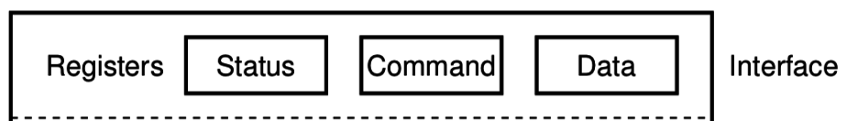
How does a computer talk with peripherals?
A peripheral is a hardware unit within a microcontroller
Sort of a “computer-within-the-computer”
Performs some kind of action given input, generates output
We interact with a peripheral’s interface
Called registers (actually are from EE perspective, but you can’t use them)
Read/Write like they’re data
How do we read/write them?
Options:
Special assembly instructions
Treat like normal memory

Slide 12

Memory-mapped I/O (MMIO): treat devices like normal memory
Certain physical addresses do not actually go to memory
Instead they correspond to peripherals
And any instruction that accesses memory can access them too!
Every microcontroller I’ve ever seen uses MMIO
Address
0xFFFFFFFF
0xFFFF0000
control reg.
data reg.
0x00000000

Slide 13
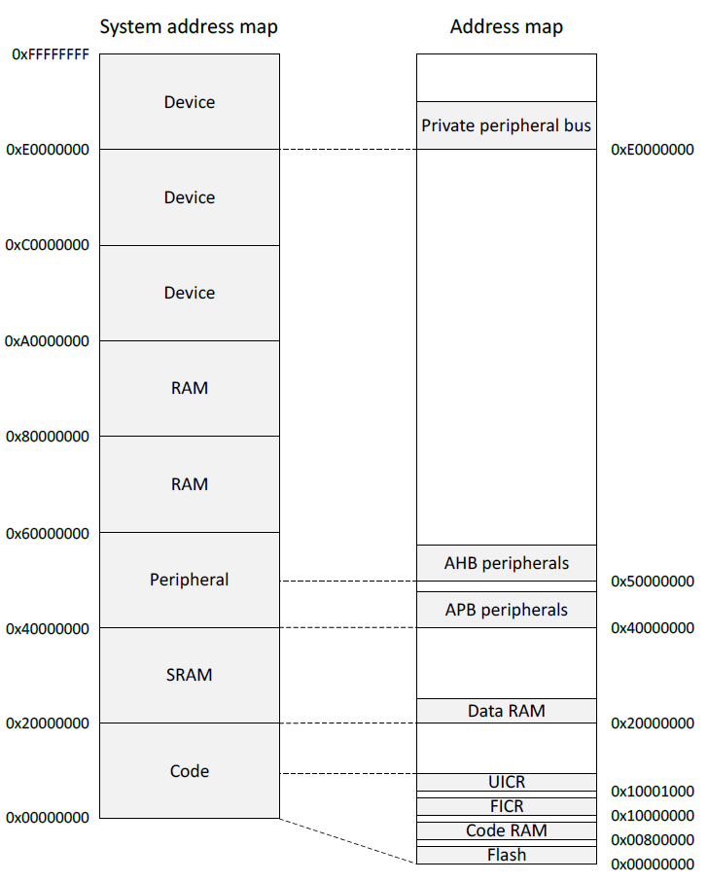
Memory map on nRF52833
Flash 0x00000000
SRAM 0x20000000
APB peripherals 0x40000000
Everything but GPIO
AHB peripherals 0x50000000
Just GPIO
UICR – User Information Config
FICR – Factory Information Config

Slide 14
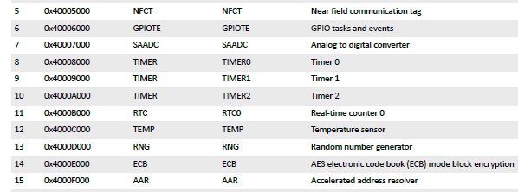
Example nRF52 peripheral placement
0x1000 is plenty of space for each peripheral
1024 registers, each 32 bits
No reason to pack them tighter than that

Slide 15
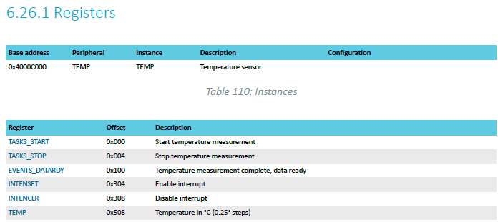
TEMP on nRF52833 example
Internal temperature sensor
0.25° C resolution
Range equivalent to microcontroller IC (-40° to 105° C)
Various configurations for the temperature conversion (ignoring)

Slide 16
MMIO addresses for TEMP
What addresses do we need? (ignore interrupts for now)
0x4000C000 – TASKS_START
0x4000C100 – EVENTS_DATARDY
0x4000C508 - TEMP

Slide 17
Accessing addresses in C
What does this C code do?
*(uint32_t*)(0x4000C000) = 1;

Slide 18
Accessing addresses in C
What does this C code do?
*(uint32_t*)(0x4000C000) = 1;
0x4000C000 is cast to a uint32_t*
Then dereferenced
And we write 1 to it
“There are 32-bits of memory at 0x4000C000. Write a 1 there.”

Slide 19
Example code
To the terminal!
Let’s write it from scratch

Slide 20
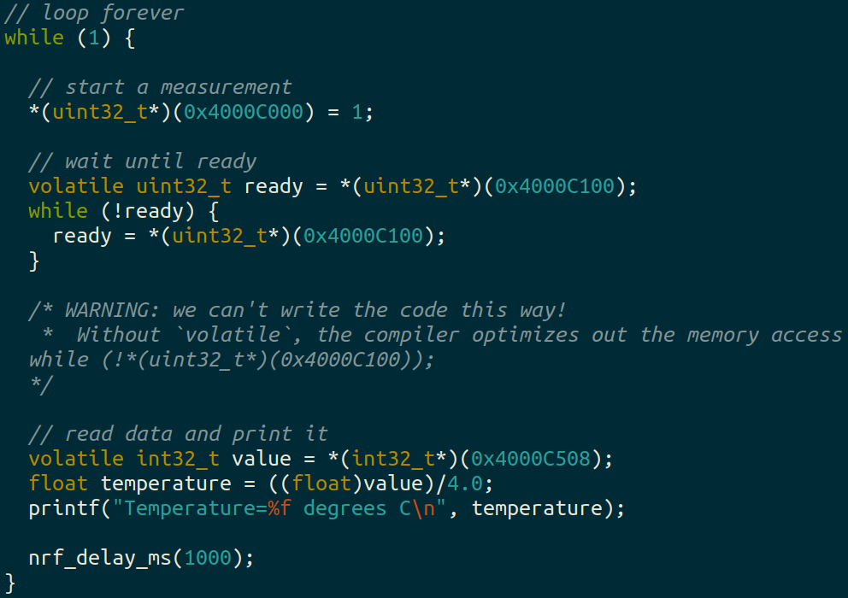
Example code (temp_mmio app)

Slide 21
Using structs to manage MMIO access
Writing simple C code and access peripherals is great!
Problems:
Need to remember all these long addresses
Need to make sure compiler doesn’t stop us!
Solution:
Wrap entire access in a struct!
Compilers turn it into the same thing in the end anyways

Slide 22
C structs
Collection of variables placed together in memory
typedef struct {
uint32_t variable_one;
uint32_t variable_two;
uint32_t array[2];
} example_struct_t;
Placement rules - Variables are placed adjacent to each other in memory except:
Variables are always placed at a multiple of their size
Padding added to the end to make the total size a multiple of the biggest member
Microcontrollers can usually ignore these: all registers are the same size!

Slide 23
Temperature peripheral MMIO struct
typedef struct {
} temp_regs_t;

Slide 24
Temperature peripheral MMIO struct
typedef struct {
uint32_t TASKS_START;
uint32_t TASKS_STOP;
uint32_t _unused_A[62];
uint32_t EVENTS_DATARDY;
uint32_t _unused_B[0x204/4 - 1];
uint32_t INTENSET;
uint32_t INTENCLR;
uint32_t _unused_C[(0x508 – 0x308)/4 – 1];
uint32_t TEMP;
} temp_regs_t;
volatile temp_regs_t* TEMP_REGS = (temp_regs_t*)(0x4000C000);
With increasingly verbose ways to write the size of the “unused” space (any of these will do, but don’t forget the -1)

Slide 25
Temperature peripheral MMIO struct
typedef struct {
uint32_t TASKS_START;
uint32_t TASKS_STOP;
uint32_t _unused_A[62];
uint32_t EVENTS_DATARDY;
uint32_t _unused_B[0x204/4 - 1];
uint32_t INTENSET;
uint32_t INTENCLR;
uint32_t _unused_C[(0x508 – 0x308)/4 – 1];
uint32_t TEMP;
} temp_regs_t;
volatile temp_regs_t* TEMP_REGS = (temp_regs_t*)(0x4000C000);
// code to access
TEMP_REGS->TASKS_START = 1;
while (TEMP_REGS->EVENTS_DATARDY == 0);
float temperature = ((float)TEMP_REGS->TEMP)/4.0;

Slide 26
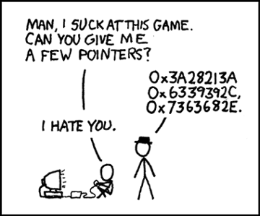
Break + relevant xkcd
https://xkcd.com/138/

Slide 27
Outline
I/O Motivation
Memory-Mapped I/O
Controlling digital signals
GPIO
GPIOTE

Slide 28
Digital signals
Simplest form of I/O
Exist in two states:
High (a.k.a. Set, a.k.a. 1)
Low (a.k.a. Clear, a.k.a. 0)
Simpler to interact with
Constrained to two voltages
With quick transitions between the two
No math for voltage level
Either high or low

Slide 29
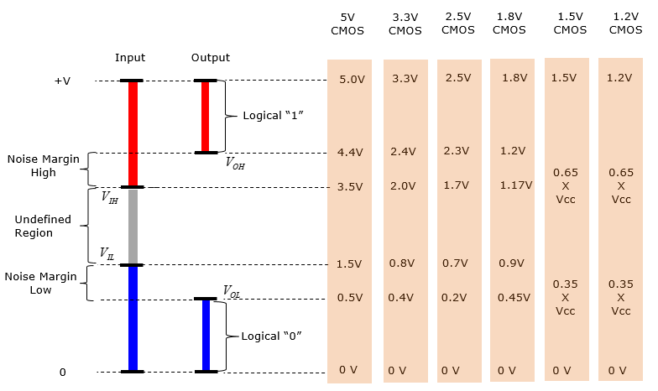
Digital signals map to voltage ranges
Upper range is high signal
~0.7*VDD
Bottom range is low signal
~0.3*VDD
Middle is undefined
Only exists during transitions
http://www.sharetechnote.com/html/Electronics_CMOS.html

Slide 30
General Purpose Input/Output (GPIO)
Read/write from/to external pins on the microcontroller
Two possible values: high (1) or low (0)
Basic unit of operation for microcontrollers
Allows them to interact with buttons and LEDs
Every microcontroller has GPIO

Slide 31
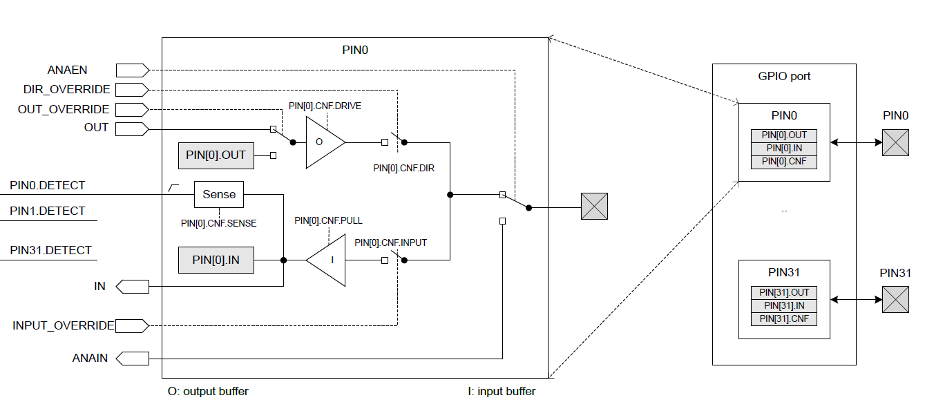
GPIO on nRF52833

Slide 32
GPIO on nRF52833
Abstract model of the pin.
This isn’t really how the hardware is implemented. But it’s a reasonable model for users.

Slide 33
GPIO on nRF52833
Inputs and outputs to/from the peripheral.
GPIO could be controlled by other peripherals. Controlling a pin in use by other peripherals is bad.

Slide 34
GPIO on nRF52833
Registers within the GPIO peripheral. Configure various things about setup.

Slide 35
GPIO on nRF52833
Peripheral contents are duplicated for each output pin.
Each pin has its own registers (or portions thereof).

Slide 36
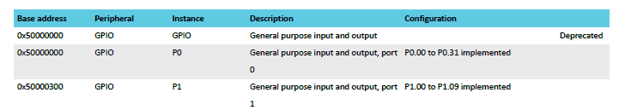
Multiple ports
nRF52833 has up to 42 I/O pins
But only 32 can fit in a single 32-bit word
Splits them into two “ports”
Pins are named based on port
P0.14 – Button A, P0.23 – Button B
P1.04 – LED column 4

Slide 37
GPIO on nRF52833
External pin on the microcontroller

Slide 38
GPIO on nRF52833
Output chain. Signal comes from OUT register, through output buffer, to external pin.

Slide 39
GPIO Output
Outputs a high or low signal
Output configurations
High drive output (either for high, low, or both)
Sources or sinks additional current
For powering external devices
Normal drive: ~2 mA
High drive: ~10 mA
Disconnect (a.k.a. High Impedance or High-Z)
Wired-OR or Wired-AND scenarios (we’ll talk about these later in class)

Slide 40
GPIO on nRF52833
Input chain. Signal goes from pin, through input buffer, to IN register.

Slide 41
GPIO Input
Reads in a signal as either high or low
Input Configurations
Input buffer connect/disconnect
Allows the pin to be disabled if not being read from
Pull
Disabled, Pulldown, Pullup (we’ll discuss in a future lecture)
Connects an internal pull up/down resistor (~13 kΩ)
Sets default value of input

Slide 42
Electrical specifications
High voltage range: 0.7*VDD to VDD (~2.3 volts)
Low voltage range: Ground to 0.3*VDD (~1 volt)
GPIO are extremely fast
Transition time is <25 ns
Connected directly to memory bus for faster interactions
This allows complicated signal patterns to be replicated in software
If they aren’t implemented as a hardware peripheral
Known as “bit-banging”

Slide 43
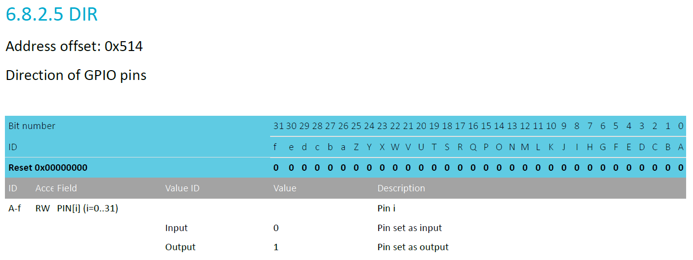
Pin configuration
DIR register controls direction (input or output) for each pin
Each bit 0-31 corresponds to pin 0-31
Reset value: 0x00000000 -> all pins are inputs by default

Slide 44
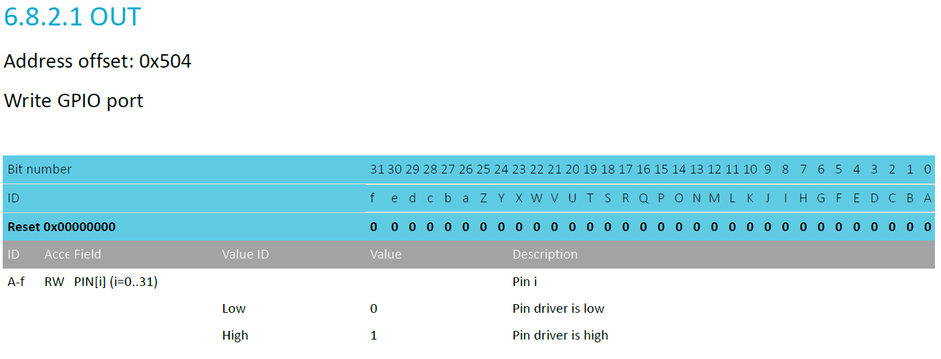
Controlling output level
OUT register controls whether each pin is high or low
Only meaningful if the pin is configured as an Output
Again, each bit is a single pin and reset is 0x00000000 (all pins low)

Slide 45
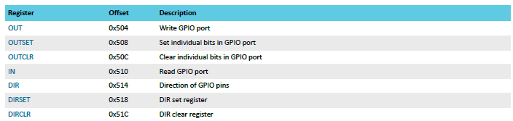
Set/Clear registers
OUT works traditionally: write a 1 for high, 0 for low
OUTSET write a 1 to set that pin (high) zero has no effect
OUTCLR write a 1 to clear that pin (low) zero has no effect
Lets you modify a pin without modifying the others (or reading first)

Slide 46
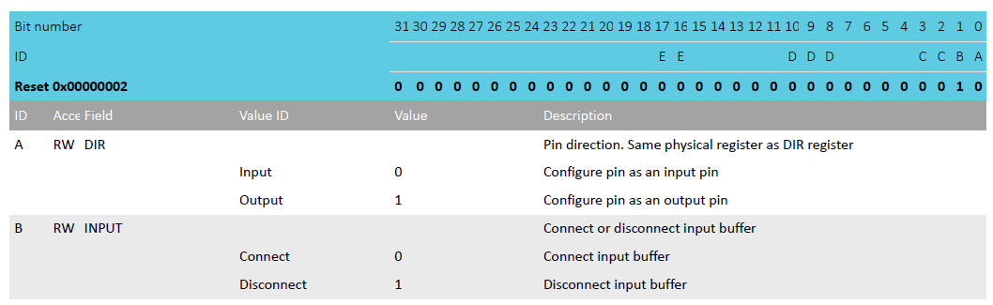
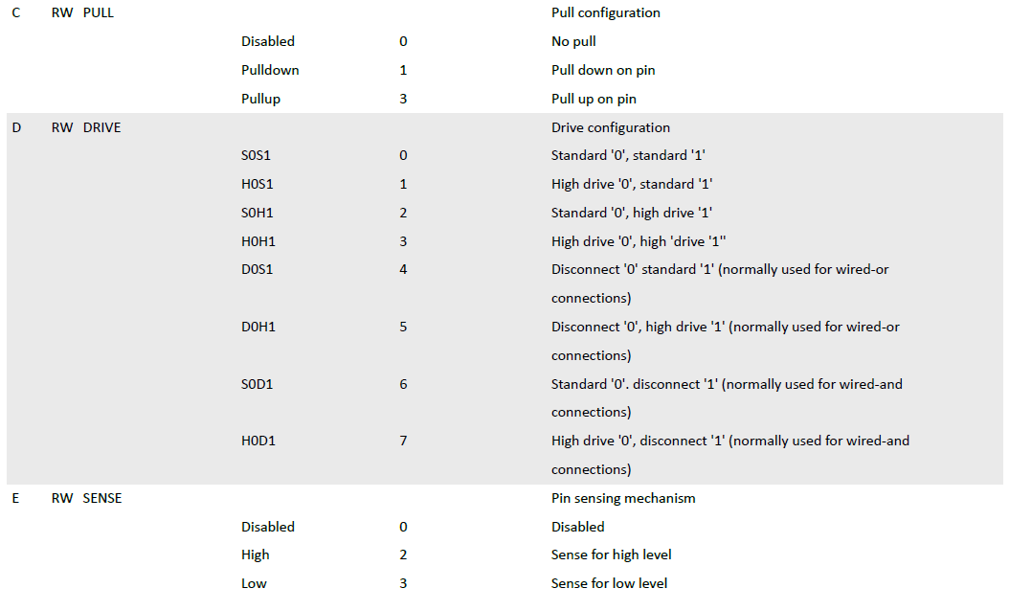
Complex configuration
If you want to change other pin configurations, you do so per pin with the PIN_CNF[n] registers
There are 32 of them, one per pin
Various fields correspond to different groups of bits
Direction, Input buffer, Pullup/down, Drive strength, Sensing mechanism
Bits not part of a field should be ignored
Do not modify them

Slide 47
Writing to arbitrary bits
Remember that you can’t just write to arbitrary bits
You’ll have to use bit-operations to do so
In C: &, |, ~, ^, <<, >>
For a review of “bit masking” operations, see bonus slides

Slide 48
Outline
I/O Motivation
Memory-Mapped I/O
Controlling digital signals
GPIO
GPIOTE

Slide 49
Handling interrupts from GPIO
Separate peripheral, GPIOTE (GPIO Task/Event)
Manages up to 8 individual pins
Can read inputs and trigger interrupts
Can also connect outputs from events on other peripherals (PPI)
Can trigger interrupts for a “Port event” as well
Any pin in the Port can trigger the interrupt
Software checks which pin(s) caused the event to occur
Very low power operation (works with system clocks off)
Unclear to me why this is a separate peripheral
Presumably too complicated/expensive to have 42 of them

Slide 50
Configuring individual input interrupts
Pick an available GPIOTE channel (0-7)
Configure it
Port and Pin number
Task (output), Event (input), or Disabled
Polarity for input events
Low-to-high
High-to-low
Toggle (both directions)
Enable interrupts for channel in GPIOTE (and in NVIC!)
Clear event in interrupt handler
Doesn’t happen automatically

Slide 51
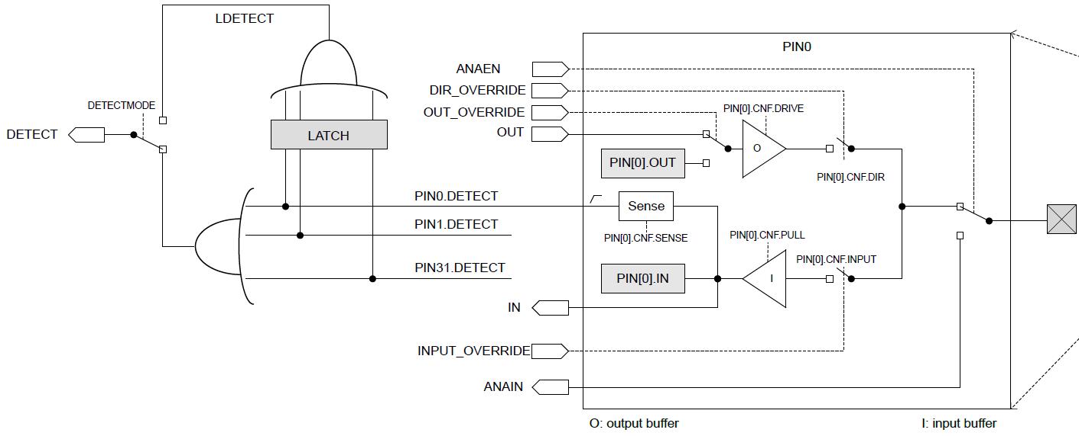
Sensing port events
Uses the “Detect” signal. Generated from pin Sense configuration

Slide 52
Configuring port input interrupts
Configure the Sense for each pin
High or Low
Allows different pins to have different “active” states
Select detect mode
Direct connection to pins
Latched version (saved even if pin later changes back)
Enable interrupts for port in GPIOTE (and in NVIC!)
Clear event in interrupt handler and value in Latch register
Doesn’t happen automatically

Slide 53
Outline
I/O Motivation
Memory-Mapped I/O
Controlling digital signals
GPIO
GPIOTE

Slide 54
Bonus: Bit Masking

Slide 55
Bit Masking
How do you manipulate certain bits within a number?
Combines some of the ideas we’ve already learned
~, &, |, <<, >>
Steps
Create a “bit mask” which is a pattern to choose certain bits
Use & or | to combine it with your number
Optional: Use >> to move the bits to the least significant position

Slide 56
Bit mask values
Selecting bits, use the AND operation
1 means to select that bit
0 means to not select that bit
Writing bits
Writing a one, use the OR operation
1 means to write a one to that position
0 is unchanged
Writing a zero, use the AND operation
0 means to write a zero to that position
1 is unchanged
Select bottom four bits:
num & 0x0F
Set 6th bit to one:
num | (1 << 6)
num | (0b01000000)
Clear 6th bit to zero: num & (~(1 << 6))
num & (~(0b01000000))
num & (0b10111111)

Slide 57
Example: swap nibbles in byte
Nibble - 4 bits (one hexit)
Input: 0x4F -> Output 0xF4
Method:
1. Shift and select upper four bits
2. Shift and select lower four bits
3. Combine the two nibbles
uint8_t lower = input >> 4;
uint8_t upper = input << 4;
uint8_t output = upper | lower; // combines two halves
What are the values of the new upper bits?
Unsigned -> Will be zero
Shifting implicitly zero’d out irrelevant bits. Otherwise we would have needed an & operation too.

Slide 58
Example: selecting bits
0b01100100
Input: 0b01100100
Select bits 2 and 3 from a number
Mask: 0b00001100
0b01100100
& 0b00001100
0b00000100
In C: result = (input & 0x0C) >> 2;
Finally, shift right by two to get the values in the least significant position:
0b00000001

