Slide 1
Lecture 06 Timers
CE346 – Microcontroller System Design
Branden Ghena – Fall 2024
Some slides borrowed from: Josiah Hester (Northwestern), Prabal Dutta (UC Berkeley)

Slide 2
Administrivia
Last chance for Lab1 checkoffs 5:00-6:00 today
Quite a few groups remaining, so it’ll likely focus on checkoffs first
Don’t forget to answer the postlab questions on Gradescope
You and your partner can work on them together, but submit separately
Lab2 tomorrow! Virtual Timer Lab
Project proposals due next week Thursday!
Be sure to find a group. Fill out the survey if you want to find someone!

Slide 3
Next week Tuesday: online recording
Unfortunately, I’ll be out-of-town on Tuesday next week
So, no in-person class on that day
I will record the lecture in advance and put it out on Panopto
Lecture on Sensors
Moved the schedule around a little

Slide 4
Today’s Goals
Understand the role of clocks in a microcontroller
Explore functionality of various timer peripherals on the Microbit

Slide 5
Outline
Clocks
Timers
Virtualizing Resources
Real-Time Counter
Watchdog

Slide 6
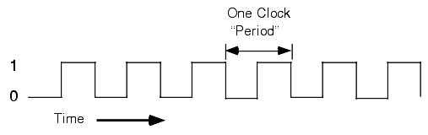
What are clocks?
Clock signals, in the microcontroller context, are oscillating square wave signals used to switch transistors and latch inputs
A clock MUST be running for (almost) anything on a microcontroller to function (processor and peripherals)
Exceptions:
Low-power input interrupts
GPIOTE port interrupt, Analog LPCOMP interrupt, NFC sense interrupt, USB power interrupt
Reset signal

Slide 7
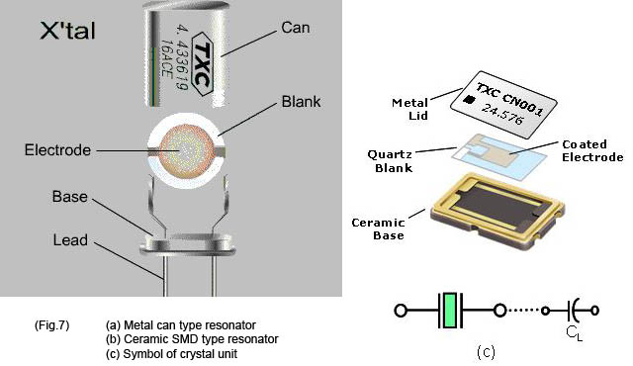
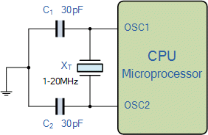
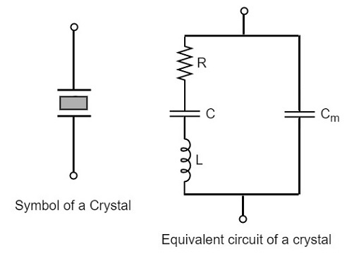
Generating clocks
External crystal oscillator
Creates clock signal
Chunk of quartz
Behaves like RLC circuit but uses less energy
Internal mechanisms
RC oscillator
Creates clock signal
Less accurate and higher energy than crystal
Phase-Locked Loop (PLL)
Multiply input to create new higher frequency clocks

Slide 8
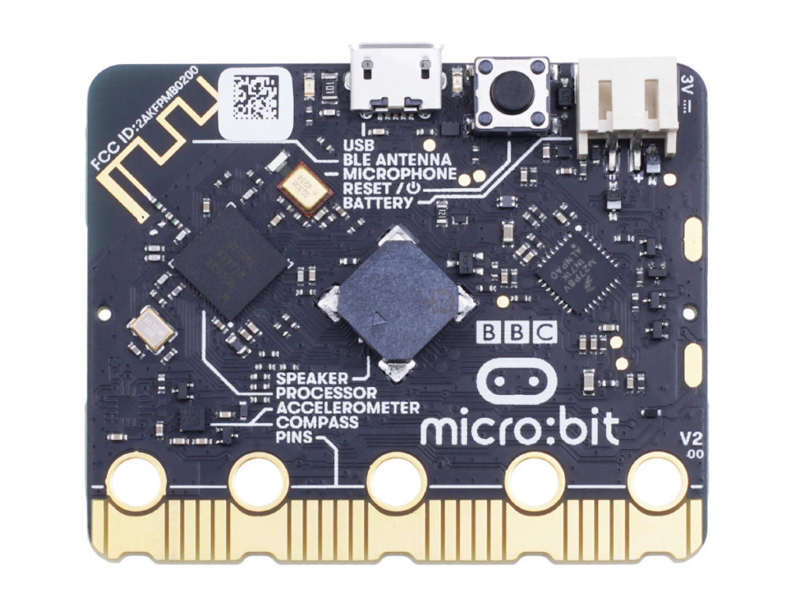
Microbit crystal for nRF52833

Slide 9
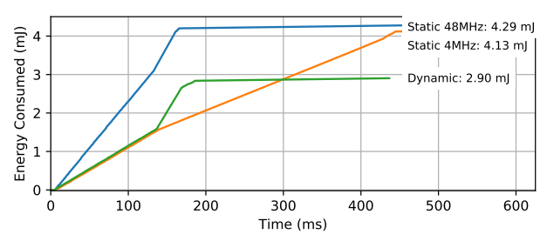
Clocks and energy
Fundamental tradeoff
Faster clock gets things done faster but uses more energy
Slower clock uses less energy but gets things done slower
Which to use depends on the situation
CPU bound: faster clock, IO bound: slower clock
Example of clock selection for a mixed load (part IO, part CPU)
Energy consumed becomes a horizontal line when the task is completed
Chiang et al. “Power Clocks: Dynamic Multi-Clock Management for Embedded Systems” EWSN 2021

Slide 10
Controlling clocks
Some microcontrollers provide extremely fine-grained control over clocks
Really complicated section of code to get working
Many combinations are invalid
Manually enable/disable clocks as needed
nRF52 instead gives almost no control but is easier to use
One 64-MHz clock for processor
Multiple peripheral clocks, but (most) peripherals are hardwired to one
16 MHz for almost all peripherals (PDM and I2S are 32 MHz)
Low-frequency 32 kHz clock for low-power peripherals
Automatically enables/disables clocks

Slide 11
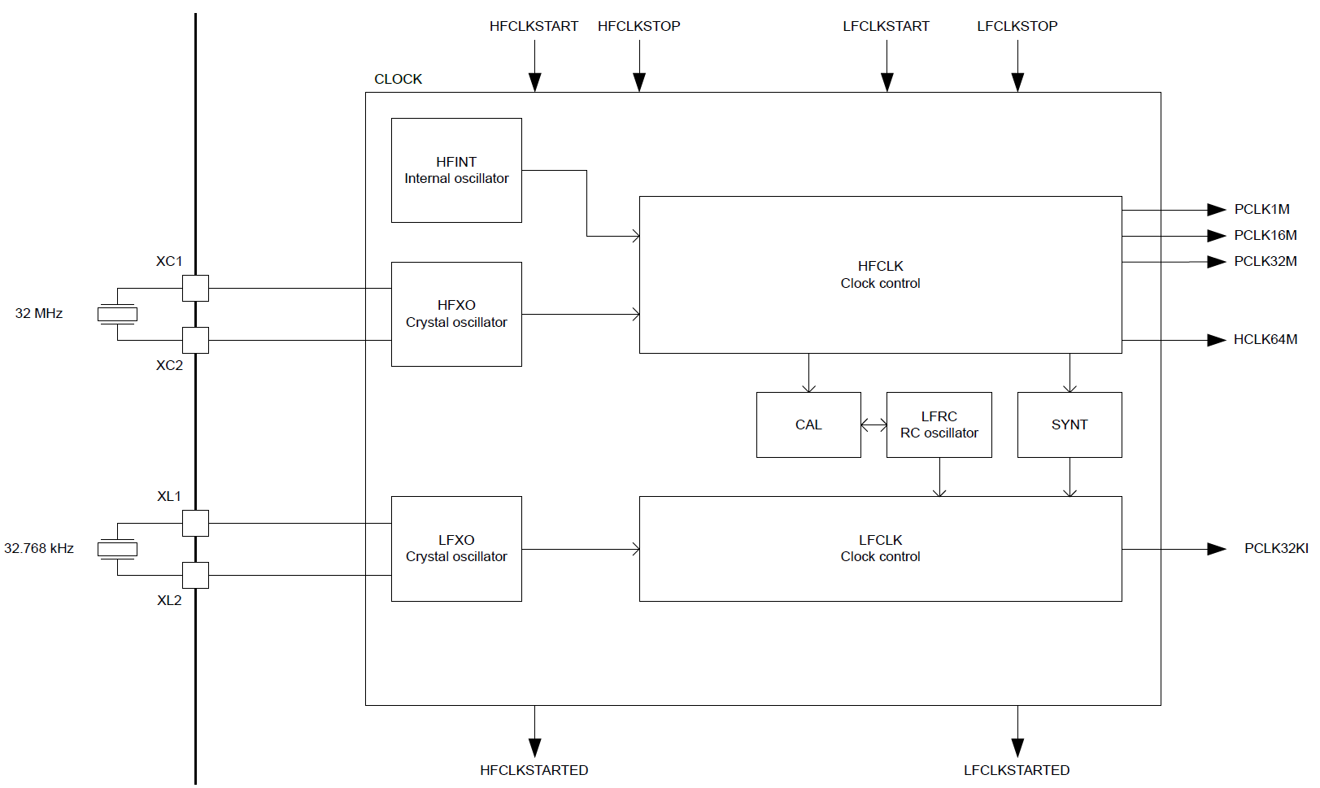
nRF52833 clocks
Optional: for lower energy and higher accuracy

Slide 12
Electrical characteristics
Active power of clocks
32 kHz crystal run current: 0.23 μA
32 kHz RC oscillator run current: 0.70 μA
32 MHz crystal average run current: 300-700.00 μA
32 MHz standby current: 110.00 μA
Startup time for external crystals
32 kHz crystal: 250-500 ms (milliseconds!!!)
32 MHz crystal: 60-200 μs
Beware: switching can lead to delays and instability
nRF52 uses RC oscillator while crystal is not yet ready

Slide 13
Outline
Clocks
Timers
Virtualizing Resources
Real-Time Counter
Watchdog

Slide 14
Timer peripherals
Common need for embedded systems: sense of time
Start this behavior after a certain amount of time
Stop this behavior after a certain amount of time
Measure how much time passed between two events
Timer peripherals
Input is one of the system clocks
Counts up a register at each clock tick
Looking at register at start and end can give real-world duration
Compare to saved value and trigger interrupt on match
Allows interrupts to be scheduled in the future

Slide 15
Break + Discussion
What is the finest granularity you might need from a timer?
Give an example of the use case
What is the longest duration you might need from a timer?
Give an example of the use case

Slide 16
Break + Discussion
What is the finest granularity you might need from a timer?
Give an example of the use case
What is the longest duration you might need from a timer?
Give an example of the use case
Concern: high granularity for long durations require MANY bits
We often optimize for one of the other

Slide 17
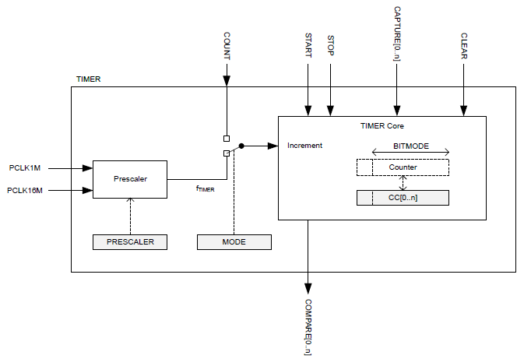
Timer peripheral on nRF52833

Slide 18
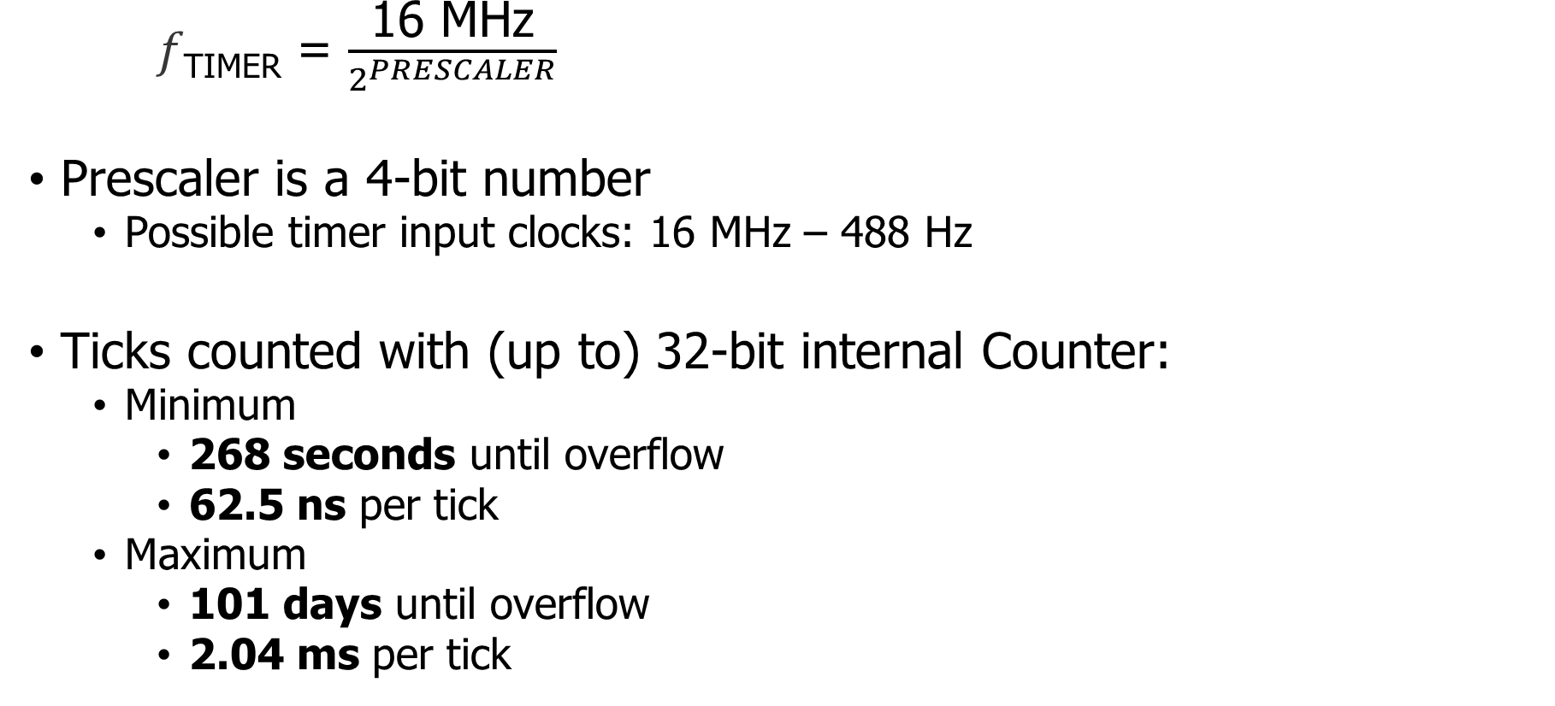
Input and Prescaler
𝑓_{TIMER} = $\frac{\text{16 }\text{MHz}}{2^{PRESCALER}}$
Prescaler is a 4-bit number
Possible timer input clocks: 16 MHz – 488 Hz
Ticks counted with (up to) 32-bit internal Counter:
Minimum
268 seconds until overflow
62.5 ns per tick
Maximum
101 days until overflow
2.04 ms per tick

Slide 19
Alternate input source for counter mode
Counter mode works with non-timer inputs
E.g. GPIO input event
Count anything!

Slide 20
Capture/Compare registers (CC)
32-bit storage registers (each timer has multiple)
Uses: capturing or comparing
On Capture[n] event
Internal Counter value copied to CC[n]
Then you can read the former Counter value from CC[n]
Capture used to measure durations of events
Capture can be triggered by software or by Events from other peripherals
Multiple registers to measure multi-part events

Slide 21
Comparing with CC registers
When internal Counter value equals a CC register
Corresponding Compare[n] event is triggered
Can trigger interrupts
Usually written to in advance to start/stop behavior
Toggle LED every second
Sample sensor every five minutes
Refresh LED matrix every 1/60 seconds

Slide 22
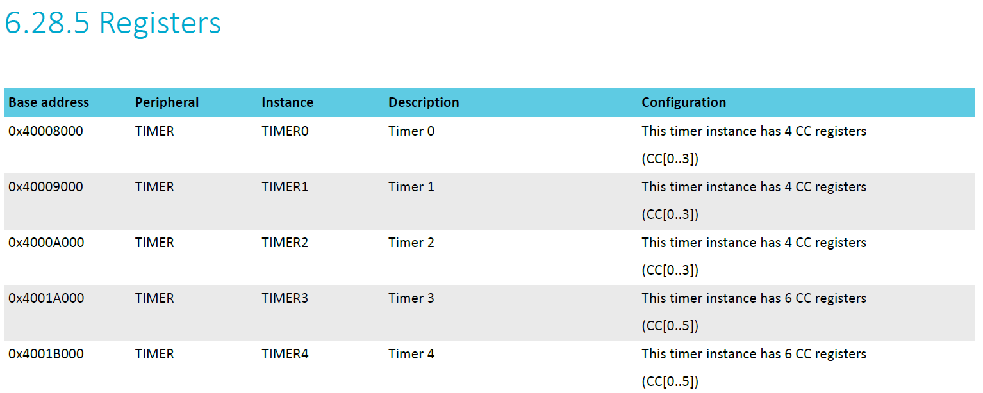
The nRF52833 has multiple Timer instances

Slide 23
Bonus concept: shorts
In a peripheral: Tasks are inputs and Events are outputs
Shorts connect an Event to a Task within a peripheral
Tasks and Events idea is fairly nRF specific
Timer shorts
Connect Compare[n] to Clear
Connect Compare[n] to Stop

Slide 24
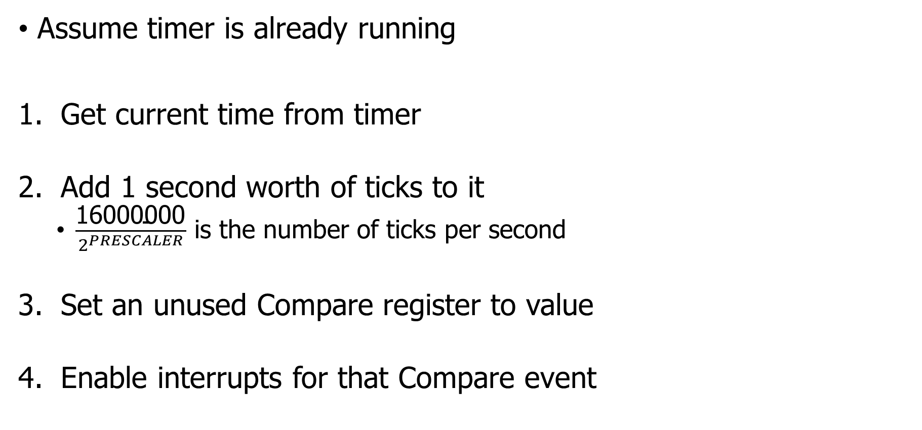
Usage: how do we set a one second timer?
Assume timer is already running
Get current time from timer
Add 1 second worth of ticks to it
$\frac{\text{16}\text{000000}}{2^{PRESCALER}}$ is the number of ticks per second
Set an unused Compare register to value
Enable interrupts for that Compare event
Warning: what if you’re setting a 1 us timer instead? Or a 100 ns timer?
Timer could expire before software writes it to the peripheral.

Slide 25
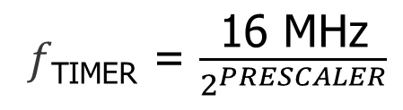
Break + Check your understanding
𝑓_{TIMER} = $\frac{\text{16 }\text{MHz}}{2^{PRESCALER}}$
Prescaler value is 4
Current internal Counter value is 0x1000
Want a 0.5 second timer
What do you set the CC[0] register to? (32-bits)

Slide 26
Break + Check your understanding
𝑓_{TIMER} = $\frac{\text{16 }\text{MHz}}{2^{PRESCALER}}$
Prescaler value is 4
Current internal Counter value is 0x1000
Want a 0.5 second timer
What do you set the CC[0] register to? (32-bits)
1 MHz Timer frequency -> 500,000 ticks in 0.5 seconds
500000 -> 0x7A120
Plus initial value of counter = 0x7B120

Slide 27
Outline
Clocks
Timers
Virtualizing Resources
Real-Time Counter
Watchdog

Slide 28
Choosing resource amounts is a problem
Problem: applications may require any number of resources
Particularly in this case: peripherals
For example, how many timers should there be?
But hardware has to pick some number to provide
More is wasted cost
Too few and applications cannot succeed
Solution: virtualize the resource

Slide 29
Virtualization pattern
Create a queue of requests and a pool of resources
N requests to M resources
Application requests are queued when they come in
Rather than serviced immediately
When a resource is available
Pop request from queue (by some priority)
Service with hardware
Then wait until another resource is available

Slide 30
Example: sending serial messages
Serial messages (such as printf() strings) are sent via UART
UARTE peripheral (we’ll talk about this later)
nRF52 has two UARTE peripherals
Can be attached to any output pins
Changing pins is a quick operation
What if we want to talk to three serial devices?
Console (printf output)
GPS (NMEA)
WiFi radio (AT commands)

Slide 31
Virtualized UART
Microcontroller
Application
Virtual UART
Request Queue
UARTE0
UARTE1
Empty
Serial Console
GPS
WiFi Radio

Slide 32
Virtualized UART: serves request with hardware
Microcontroller
Application
Virtual UART
Request Queue
UARTE0
UARTE1
{Serial Console, TX, 0x20001F00, 20}
Serial Console
GPS
WiFi Radio

Slide 33
Virtualized UART: serves until resources are full
Microcontroller
Application
Virtual UART
Request Queue
UARTE0
UARTE1
{WiFi Radio, TX, 0x20000020, 1500}
{GPS, RX, 0x20001000, 150}
{Serial Console, TX, 0x20001F00, 20}
Serial Console
GPS
WiFi Radio

Slide 34
Virtualized UART: additional requests are queued
Microcontroller
Application
Virtual UART
{Serial Console, TX, 0x20001E00, 10}
Request Queue
{Serial Console, TX, 0x20000500, 20}
UARTE0
UARTE1
{WiFi Radio, TX, 0x20000020, 1500}
{GPS, RX, 0x20001000, 150}
{Serial Console, TX, 0x20001F00, 20}
Serial Console
GPS
WiFi Radio

Slide 35
Virtualized UART: moves to next item when complete
Microcontroller
Application
Virtual UART
{Serial Console, TX, 0x20001E00, 10}
Request Queue
{Serial Console, TX, 0x20000500, 20}
UARTE0
UARTE1
{WiFi Radio, TX, 0x20000020, 1500}
{GPS, RX, 0x20001000, 150}
{Serial Console, TX, 0x20001F00, 20}
Serial Console
GPS
WiFi Radio

Slide 36
Virtualized UART: moves to next item when complete
Microcontroller
Application
Virtual UART
{Serial Console, TX, 0x20001E00, 10}
Request Queue
{Serial Console, TX, 0x20000500, 20}
UARTE0
UARTE1
{WiFi Radio, TX, 0x20000020, 1500}
{GPS, RX, 0x20001000, 150}
{Serial Console, TX, 0x20001F00, 20}
Serial Console
GPS
WiFi Radio

Slide 37
Challenges to making virtualization work
How fast are requests coming in?
Requests more quickly than service are an unsatisfiable system
How long does it take to reconfigure the resource?
Long delays could mean high latency
Might want to optimize for requests with same configuration first
Need to ensure all of the configuration changes
Common bug: forget to modify part of one register and system works most of the time, but not in all cases
Need ability to queue requests
Usually stored in a linked list structure
Dynamically… But we generally want to avoid dynamic memory

Slide 38
Dynamic resource allocation options
Create a queue with a maximum size in Virtual Driver
Some number larger than the hardware picked, based on app knowledge
Still either runs out or wastes memory
Just use malloc()
Is actually possible on the nRF52 with newlib (libc implementation)
Might run out, but then just wait for requests to complete
Create list nodes individually as global variables
Application decides how many it needs at compile time
Passes them into the Virtual Driver at first use
“Here’s my request and a linked list node to store it in”

Slide 39
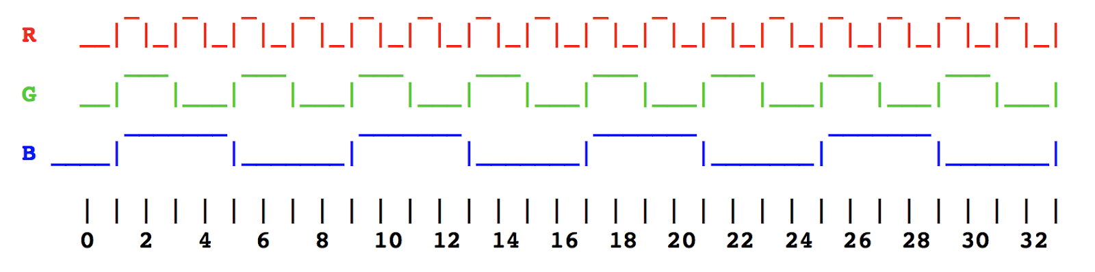
Another example: managing multiple timers
You often have tasks that look like this:
Most easily thought about as three separate timers
But maybe the system doesn’t have that many timers to spare!
Virtualization can help

Slide 40
Virtual timers
Solution: keep a list of timer expiration times
Soonest expiration goes in the Capture/Compare register
Others stay in linked list, sorted by expiration
Timer Requests
10010, A
10050, B
10110, C
20000, D
CC Register: 10010
10010
10050
10110
20000
time

Slide 41
Virtual timers
Solution: keep a list of timer expiration times
Soonest expiration goes in the Capture/Compare register
Others stay in linked list, sorted by expiration
Timer Requests
10010, A
10050, B
10110, C
20000, D
CC Register: 10010
Call timer handler A!
Update CC register and list
10010
10050
10110
20000
time

Slide 42
Virtual timers
Solution: keep a list of timer expiration times
Soonest expiration goes in the Capture/Compare register
Others stay in linked list, sorted by expiration
Timer Requests
10050, B
10110, C
20000, D
CC Register: 10050
10010
10050
10110
20000
time

Slide 43
Virtual timers
Solution: keep a list of timer expiration times
Soonest expiration goes in the Capture/Compare register
Others stay in linked list, sorted by expiration
Timer Requests
10050, B
10110, C
20000, D
CC Register: 10050
Call timer handler B!
Update CC register and list
10010
10050
10110
20000
time

Slide 44
Virtual timers
Solution: keep a list of timer expiration times
Soonest expiration goes in the Capture/Compare register
Others stay in linked list, sorted by expiration
Timer Requests
10110, C
20000, D
CC Register: 10110
10010
10050
10110
20000
time

Slide 45
Virtual timers
Solution: keep a list of timer expiration times
Soonest expiration goes in the Capture/Compare register
Others stay in linked list, sorted by expiration
Timer Requests
10100, E
10110, C
20000, D
CC Register: 10100
New request arrives for 10100
Enqueue and sort queue
Update CC if first request has changed
10010
10050
10110
20000
time

Slide 46
Enqueuing timer requests
Timer requests come in the form: {N seconds from now}
timer_request(duration, handler);
Requests are always relative to the current time
Need to enqueue by expiration time
Duration + Current Time
Allows for a globally sortable list
Need to decide how to handle overflow logic in real world

Slide 47
Make sure not to miss timers
Sorting list and modifying the CC register takes time
Might have skipped right past the soonest event
Check for this, and call handler manually if necessary
Timer Requests
10100, E
10110, C
20000, D
CC Register: 10100
Handle 10100 event, Call E
10010
10050
10110
20000
time

Slide 48
Make sure not to miss timers
Sorting list and modifying the CC register takes time
Might have skipped right past the soonest event
Timer Requests
10110, C
20000, D
CC Register: 10110
Update list
Update CC register
Oh no! That’s in the past!!
10010
10050
10110
20000
time

Slide 49
Break + Question
Sorting list and modifying the CC register takes time
Might have skipped right past the soonest event
What do we do about the missed timer?
There are multiple “correct” answers here

Slide 50
Break + Question
Sorting list and modifying the CC register takes time
Might have skipped right past the soonest event
What do we do about the missed timer?
There are multiple “correct” answers here
Some options:
Just call handle that timer event as soon as possible
Possibly telling it about the delay
Crash the system! (Deadlines cannot be missed in some systems)
Or at least enter some fault recovery handler

Slide 51
Make sure not to miss timers
Sorting list and modifying the CC register takes time
Might have skipped right past the soonest event
Check for this, and call handler manually if necessary
Timer Requests
20000, D
CC Register: 20000
Call C manually
Update list and CC register again
10010
10050
10110
20000
time

Slide 52
Some timers are periodic
Repeating timers are easy to add to this system
Include a Boolean for “repeating” and the duration in the request
When timer expires
If not repeating, just call handler and then drop it
If repeating,
First reinsert based on duration and new current time
Then call the handler
Don’t want the latency of the handler to slow us down

Slide 53
Concurrency safety
Modifying the request structure in an interrupt context is dangerous
New request might be in the middle of getting added
Interrupt would run right in the middle of that
Literally an OS data race example
Solution: disable interrupts during critical section
Whenever editing request structure
Enable interrupts after, which may result in an event
Note: Interrupt handler might now fire but have no work to do. Should always check if something should actually be handled first

Slide 54
Outline
Clocks
Timers
Virtualizing Resources
Real-Time Counter
Watchdog

Slide 55
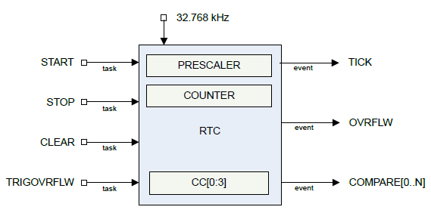
Real-time Counter
Low-power (32 kHz) version of Timer
Only a 24-bit internal Counter
Note: abbreviated RTC, but that already means something else (Real-Time Clock)

Slide 56
Differences between Real-Time Counter and Timer
Runs off of LFCLK instead of HFCLK
With smaller prescaler value (4096 vs 32768)
24-bit counter vs 32-bit counter for Timer
Can read the Counter value directly
No need for Capture task
Otherwise extremely similar. Just a low-power version of Timer

Slide 57
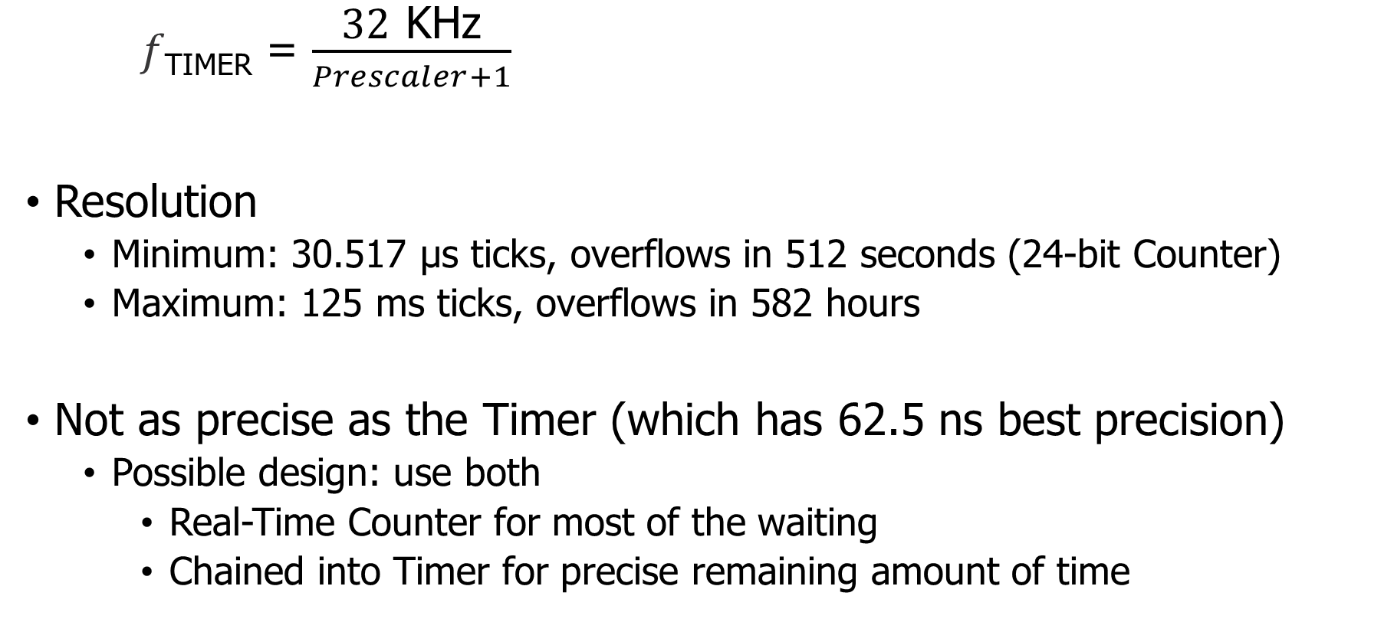
Time resolution for Real-Time Counter
𝑓_{TIMER} = $\frac{\text{32} \text{K}\text{Hz}}{Prescaler+1}$
Resolution
Minimum: 30.517 μs ticks, overflows in 512 seconds (24-bit Counter)
Maximum: 125 ms ticks, overflows in 582 hours
Not as precise as the Timer (which has 62.5 ns best precision)
Possible design: use both
Real-Time Counter for most of the waiting
Chained into Timer for precise remaining amount of time

Slide 58
Comparing timer types
Real-Time Counter
Low precision and duration
Low energy
Timer
High precision or duration
High energy

Slide 59
nRF SDK Virtualized Timers: APP_TIMER
Runs off the RTC
APP_TIMER_DEF creates a node for the timer and initializes it
app_timer_create inserts the node in an internal linked list
app_timer_start actually starts running the timer
SDK documentation
// Create a new timer instance APP_TIMER_DEF(my_timer); int main(void) { // Initialize the timer library app_timer_init(); // Initialize a timer instance // Mode: single or repeated // Callback function: called on expiration app_timer_create(&my_timer, APP_TIMER_MODE_REPEATED, callback_function);
// Start a timer // Duration: 32768 ticks per second // app_timer_start(my_timer, 32768, NULL); }
For example code, in nu-microbit-base see: apps/app_timer_example/main.c

Slide 60
Outline
Clocks
Timers
Virtualizing Resources
Real-Time Counter
Watchdog

Slide 61
Reliable systems
What’s the most common way to solve computer problems?
Turn it off and turn it on again.
Why?

Slide 62
Reliable systems
What’s the most common way to solve computer problems?
Turn it off and turn it on again.
Why?
Resets “state” to original values, which are likely good
Startup is often well-tested
It’s long-running code interacting in unexpected ways that leaves systems in a broken state

Slide 63
Watchdog timer (WDT)
Focused on failures where the system “hangs” forever
Maybe software, maybe hardware!
Can’t know for certain the system is hung, but can know practically
Select a timeout that is the maximum amount of time you expect the system to ever go without looping in main()
Multiply it by 2-10
Set a watchdog timer to that value
If watchdog timer ever expires, it resets the system (in hardware)

Slide 64
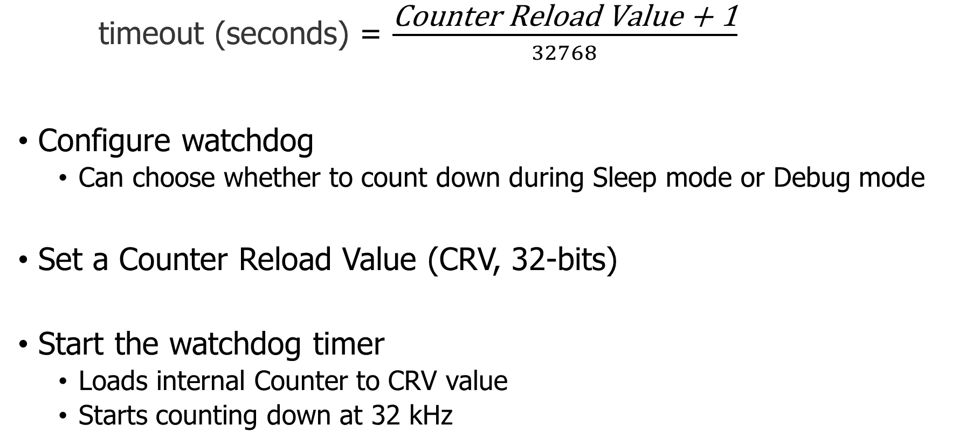
Watchdog configuration
timeout (seconds) = $\frac{\text{Counter} \text{Reload} \text{Value}\text{ + 1}}{32768}$
Configure watchdog
Can choose whether to count down during Sleep mode or Debug mode
Set a Counter Reload Value (CRV, 32-bits)
Start the watchdog timer
Loads internal Counter to CRV value
Starts counting down at 32 kHz

Slide 65
Running applications with a watchdog timer
Need to periodically reset the watchdog to keep it from expiring
Known as “feeding” the watchdog or “kicking” the watchdog
Reload Request register
Must write sequence 0x6E524635 to reload watchdog (“nRF5”)
Incredibly unlikely to happen by accident
While running, watchdog is protected from modification
Configure once, run forever (at least until a reboot)
Only option is to make periodic Reload Requests
Default off on the nRF52833 (default on for the MSP430!)

Slide 66
Outline
Clocks
Timers
Virtualizing Resources
Real-Time Counter
Watchdog

