Slide 1
Lecture 10 Analog Output
CE346 – Microprocessor System Design
Branden Ghena – Fall 2024
Some slides borrowed from: Josiah Hester (Northwestern), Prabal Dutta (UC Berkeley)

Slide 2
Administrivia
Design presentations all next week!
Happy to discuss things before then via Piazza
I will provide individual group feedback as I get time to
Drop deadline is Friday next week
I’m not worried about anyone in CE346
But if you’re worried, I’m happy to talk about it.

Slide 3
Today’s Goals
Explore common methods for generating analog signals
Understand the role of Digital-to-Analog converters
Discuss the concepts of Pulse-Width Modulation
And the nRF52 implementation of it

Slide 4
Outline
Digital-to-Analog Converters
Pulse-Width Modulation
nRF52 PWM

Slide 5
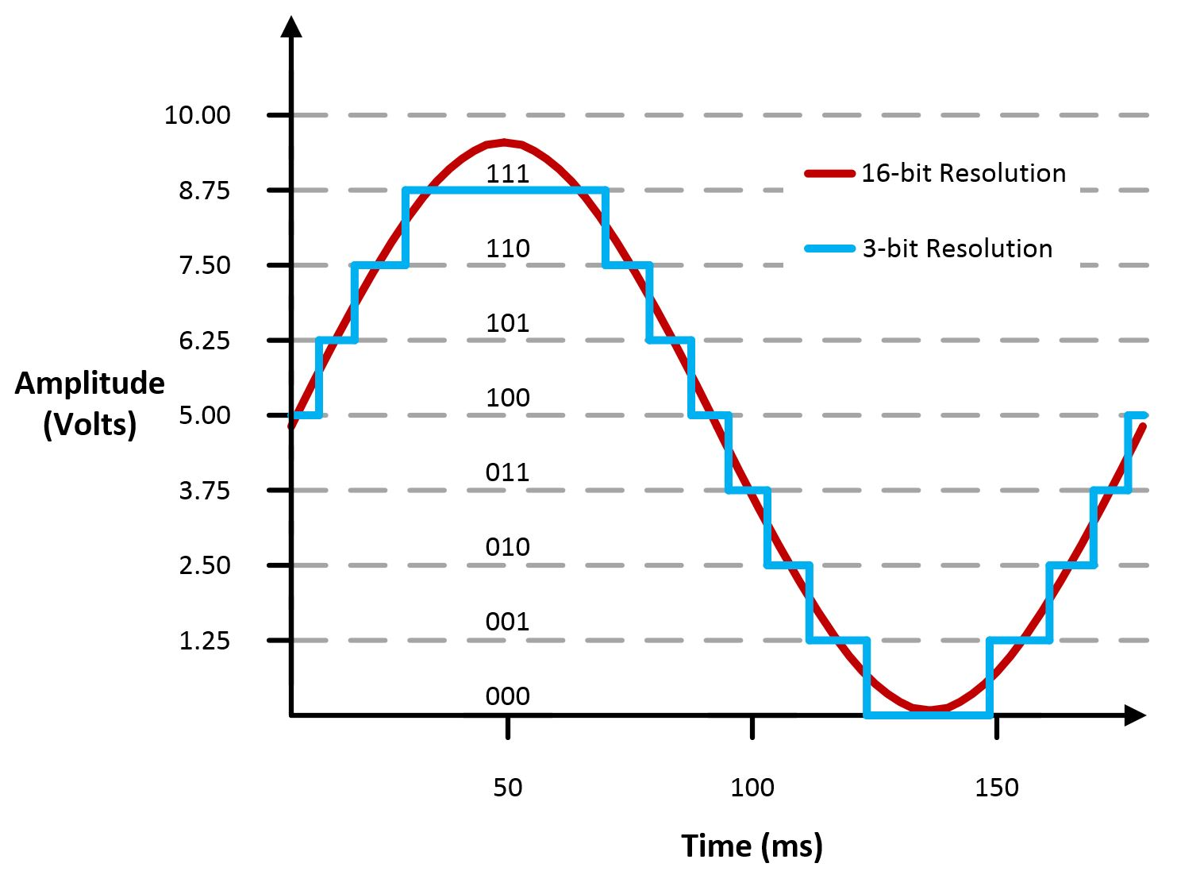
Digital-to-Analog Converters
Generates an analog voltage
DACs are conceptually the inverse of ADCs
Number of bits of resolution choose analog step size
Frequency determines step duration

Slide 6
High resolution versus high frequency
What role does each play in a DAC? Which is more important?
High resolution can accurately represent a voltage
High frequency can accurately represent a changing voltage
In practice:
Need high enough resolution, then as high of frequency as possible

Slide 7
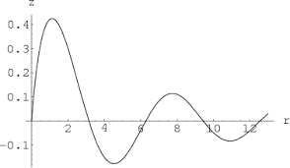
Infinite resolution is not sufficient
DAC frequency corresponds to representable signal changes
Rise and fall times
Even an infinite resolution DAC cannot represent a signal if it is not fast enough

Slide 8
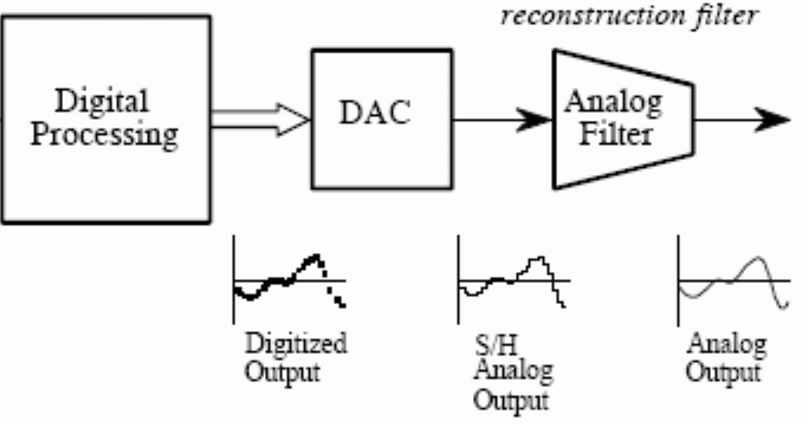
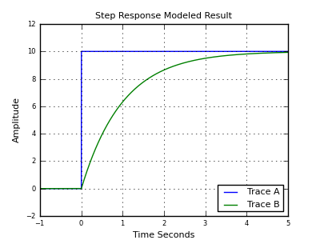
Low-pass filter smooths output
Low-pass filter delays changes in voltage and smoothly transitions between them
Low-frequency signals stay
High-frequency are smoothed
Greatly improves quality of output but must be tuned to the desired signal frequency
Usually not included in microcontroller

Slide 9
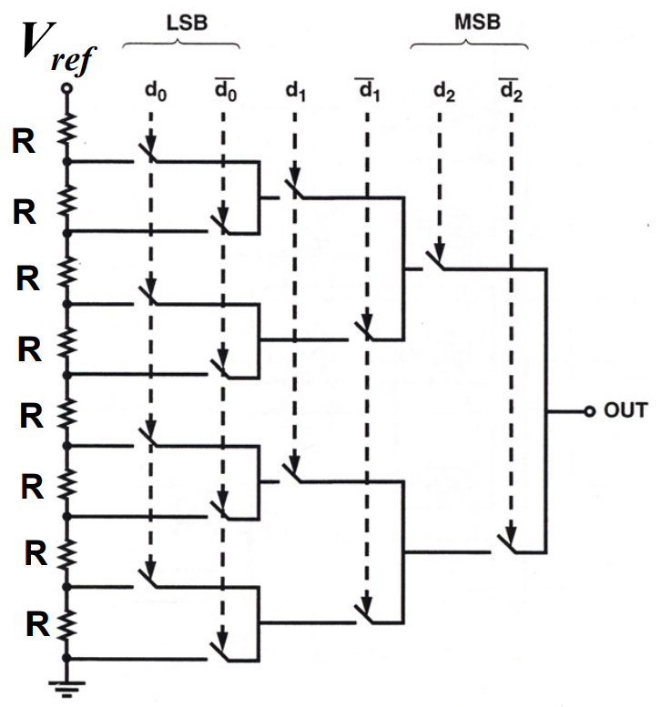
Resistor string DAC
Use series of voltage dividers and switches to set output voltage
Generates equally spaced voltages that can be selected between
Needs output buffer to provide stable current
Takes a lot of resistors
And resistors take a lot of silicon

Slide 10
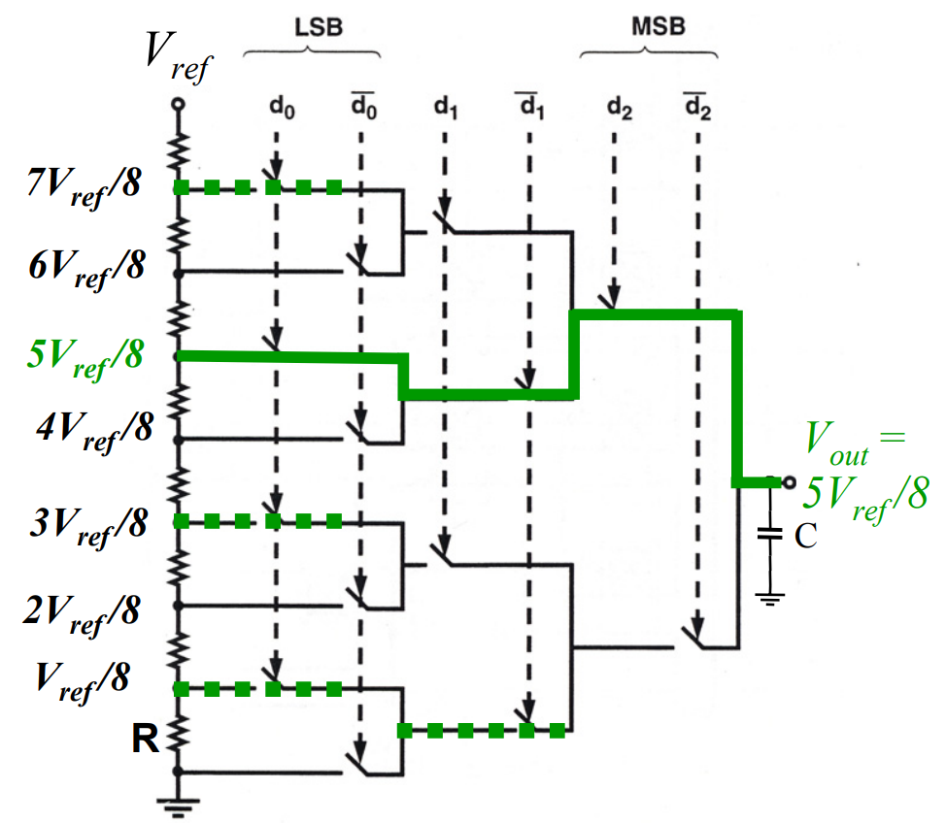
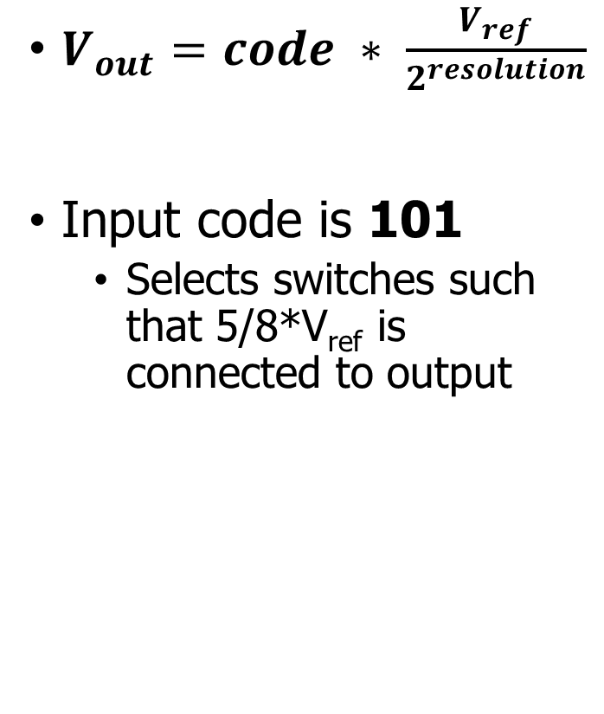
Resistor string example
$V_{out}=code ∗ \frac{V_{ref}}{2^{resolution}}$
Input code is 101
Selects switches such that 5/8*V_{ref} is connected to output

Slide 11
Break + DAC applications
What do you use an analog output for?

Slide 12
Break + DAC applications
What do you use an analog output for?
Audio output
But it needs to be high quality (resolution and speed)
Motors
But only with a controller that actually drives them with enough current
LED brightness
Not Much
And these last two can be done more easily with PWM

Slide 13
DACs are not in all microcontrollers
Not rare, but not ubiquitous either
Every microcontroller has GPIO
Just about every microcontroller has an ADC
Some microcontrollers have DACs (the nRF52833 does not!)
Reasons
Hardware is complicated (but we could fit it if we wanted)
Use cases are uncommon (and might need very high quality)
Many devices can be controller digitally
Pulse-Width Modulation (PWM) can emulate usably analog signals

Slide 14
Outline
Digital-to-Analog Converters
Pulse-Width Modulation
nRF52 PWM

Slide 15
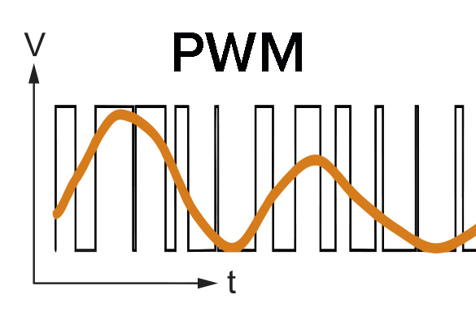
Pulse-Width Modulation
Much easier to control high or low than an analog output
Idea: modify how long a signal is high within some switching frequency, a.k.a duty cycle
On 50% of the time for half voltage
On 10% of the time for tenth voltage
Duty cycle, not frequency!

Slide 16
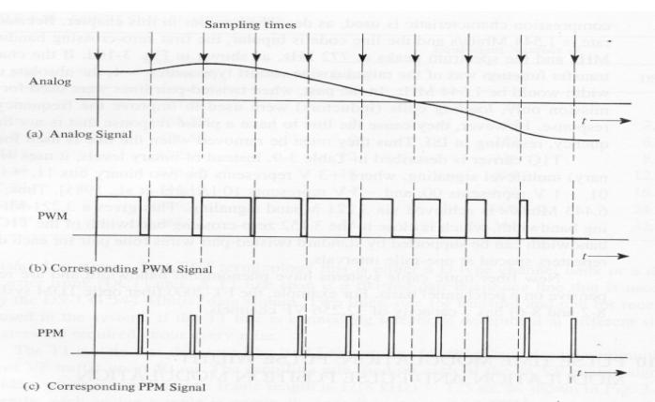
Analog to PWM example

Slide 17
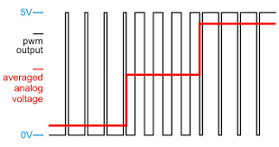
PWM to Analog Signal example
PWM period should be much faster than the desired analog signal
PWM duty cycle represents the voltage along the way
Multiple duty cycles per output point makes it more accurate

Slide 18
Low-pass approach works here too
Importantly, many devices are inherent low-pass filters
Heaters, Motors
Low-pass by physical design
I.e., they can’t start/stop quickly
LEDs are not
But our eyes are!

Slide 19
Controlling PWM
Vary duty cycle by selecting transition points
Time when set
Time when unset
Repeat every cycle
Period much faster than signal if possible
Makes analog approximation more accurate
The faster you run it, the less likely it matters that it is not actually analog
Example: LED switching frequency
Duty cycle could vary cycle-by-cycle if it must

Slide 20
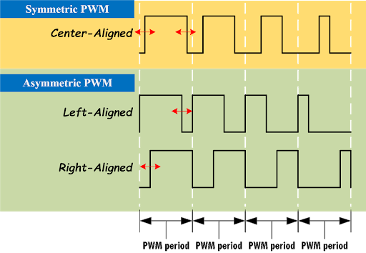
PWM alignment
Can select alignment as well
Equivalent to a phase delay
Centering produces cleaner analog output
Less harmonics
Not relevant for most devices

Slide 21
Every microcontroller can do PWM
Not every microcontroller has a PWM peripheral
But every microcontroller has timers and digital outputs
All that is needed is a GPIO and a Timer (or two)
Timer determines when to turn GPIO on and off
Often can be automated in hardware rather than using an interrupt
Connect timer expiration to GPIO toggling

Slide 22
PWM is an example of encoding data on a signal
PWM is a pulse-width modulated signal
There are many other ways to “modulate” a signal to transmit data
Amplitude, Frequency, and Phase are common
Layers data on top of an existing “carrier signal”
Used especially for high-speed communication
Wired (cable lines) or Wireless (basically everything)

Slide 23
PWM applications
Servos
Duty cycle chooses angle or rotation speed
Motor controllers
Duty cycle chooses current and therefore speed
LED brightness
And “breathing” effect
Audio
Can sound okay if frequency is high enough

Slide 24
Controlling LED Matrix brightness
Option 1: PWM peripheral
Need to use multiple PWM peripherals to get 5 pins to control each LED
Alternatively, could only control brightness for the entire matrix
Then use a single PWM output to control the row
When timer fires, change which row pin is used for PWM
Option 2: do it manually (instead of PWM peripheral)
Need to apply duty cycle on top of the existing stepping through rows
Add 5 new one-shot app timers, one for each column
Fire some percentage into the time the LED is active (within the 2 ms)
Use to toggle individual column LED back to off
Result: the LED is on for some portion of the time it should be active

Slide 25
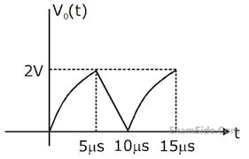
Break + Open Question
Imagine you want to represent the following signal with PWM
What should the PWM period be?
What kinds of duty cycle values would you use? (3.3v is 100%)

Slide 26
Break + Open Question
Imagine you want to represent the following signal with PWM
What should the PWM period be?
Signal period is ~10 μs
PWM period should be at least 2x that
10x faster seems like a good start
Then if we want multiple PWM outputs per sample, that’s ~20-40x faster
What kinds of duty cycle values would you use? (3.3v is 100%)
2/3.3 = 61% duty cycle max
0/3.3 = 0% duty cycle min

Slide 27
Outline
Digital-to-Analog Converters
Pulse-Width Modulation
nRF52 PWM

Slide 28
nRF52 PWM – theory of operation
A clock continuously adds to a counter value
(just like the Timer peripheral does)
When the counter value reaches COMP[n], the GPIO value on channel n changes from high to low (or vice-versa)
When the counter value reaches COUNTERTOP, the GPIO value on channel n changes from low to high (or vice-versa)
AND the counter value resets to zero

Slide 29
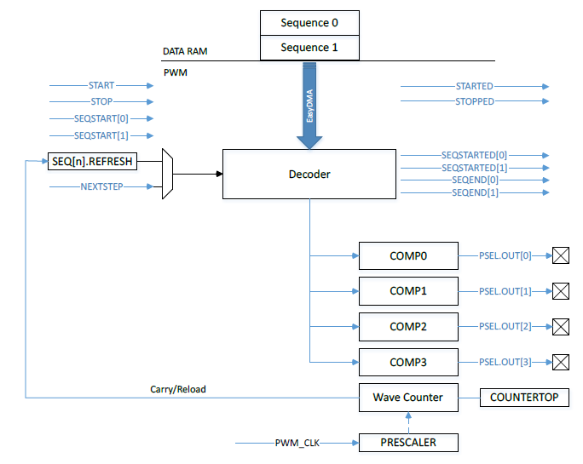
nRF52 PWM peripheral
Uses internal timer to create PWM output on up to 4 pins
4 peripherals, so up to 16 pins total
Loads compare values via DMA to rapidly vary “analog” signal

Slide 30
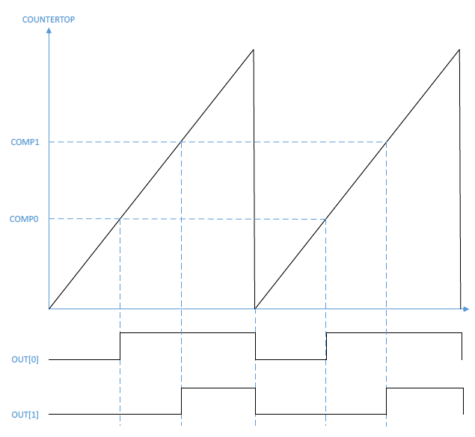
PWM example
One PWM period
Counter increments up to COUNTERTOP, resets and continues
Period/Frequency
Chosen by COUNTEROP and timer PRESCALER
Counter Value
Time

Slide 31

PWM example
One PWM period
Counter increments up to COUNTERTOP, resets and continues
Duty Cycle
COMP0 chooses first toggle point for OUT[0]
Second toggle point is when the timer resets
Counter Value
(right-aligned) $COMP=$
$$COUNTERTOP−(COUNTERTOP∗DutyCycle)$$
(left-aligned) $COMP=$
$$COUNTERTOP∗DutyCycle$$
Time

Slide 32
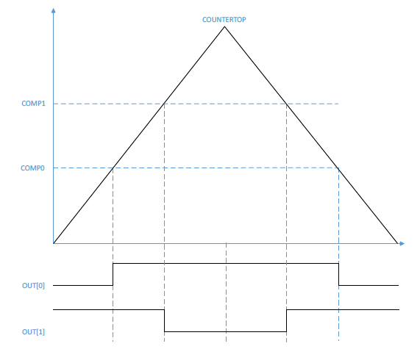
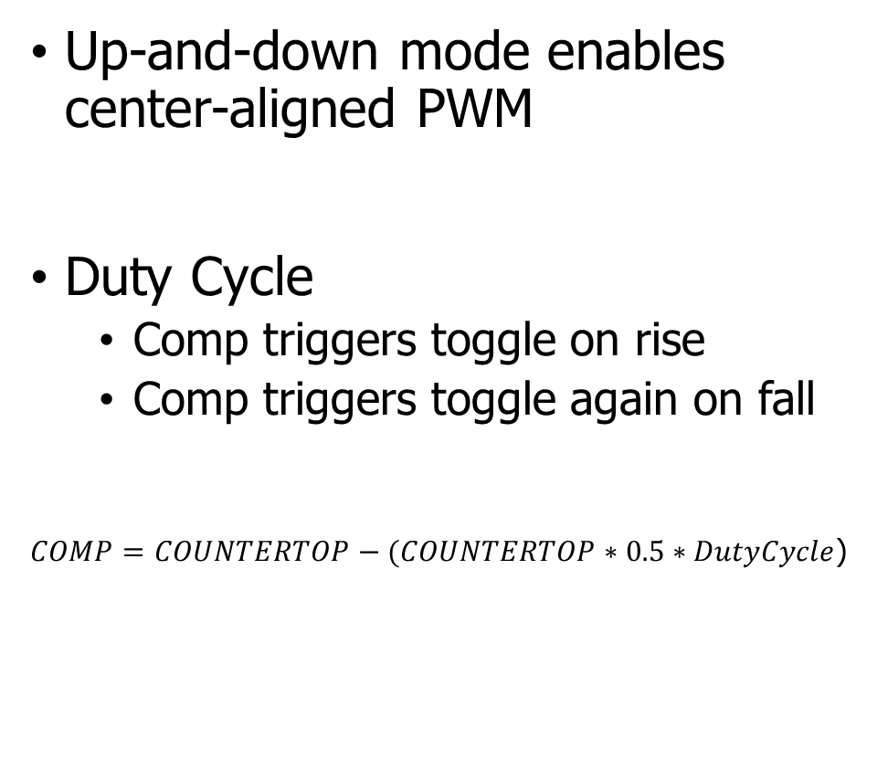
Center-aligned PWM
Up-and-down mode enables center-aligned PWM
Duty Cycle
Comp triggers toggle on rise
Comp triggers toggle again on fall
$COMP=COUNTERTOP−(COUNTERTOP∗0.5∗DutyCycle$)

Slide 33
Trading speed and accuracy
How do you get the most accurate PWM values?
Select the largest COUNTERTOP possible
Most possible COMP values
Up to 15-bit resolution (32767 max)
How do you get the fastest PWM frequency?
Select the smallest COUNTERTOP possible
PRESCALER also affects this
16 MHz – 128 kHz (8 possible values)
Fastest PRESCALER + largest COUNTERTOP equals 488 Hz
Likely need to sacrifice resolution for speed

Slide 34
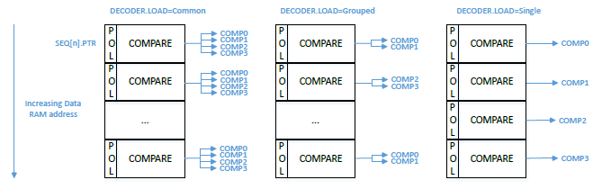
DMA with PWM
Every N periods it loads a new configuration from RAM
N combined with PRESCALER and COUNTERTOP chooses “analog signal” period
Configuration sets COMP values for each output channel
Also sets polarity (starting value: low or high)
Application of memory loads to channels is configurable

Slide 35
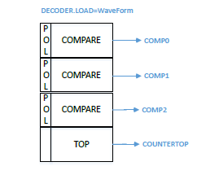
Waveform mode
Also has the option to change COUNTERTOP every N PWM periods
Allows arbitrary waveforms to be created
Frequency changes every period
Duty cycle can also change each period
We don’t normally need this, as a constant frequency with changing duty cycle should be fine

Slide 36
Other configurations
How many times the entire DMA sequence repeats
0 to large number, infinite with a configuration in SHORTS
How long to delay between repeating sequence cycles
Repeats last PWM configuration
Two DMA sequence configurations (0 and 1)
Can modify one while the other is playing - “Double Buffering”
Allows continuous signal (for example, music)

Slide 37
nRF SDK PWM driver
https://infocenter.nordicsemi.com/index.jsp?topic=%2Fsdk_nrf5_v16.0.0%2Fgroup__nrfx__pwm.html
Initialize PWM with base configuration
Output pins, Clock frequency, COUNTERTOP, DMA grouping mode
Handler for events from peripheral
nrfx_pwm_simple_playback(instance, sequence, count, flags)
Instance: pointer to global variable with registers
Sequence: struct containing sequence to be played (see next slide)
Count: number of times (1 or more) to repeat sequence
Flags: stop peripheral when done, loop forever, various events

Slide 38
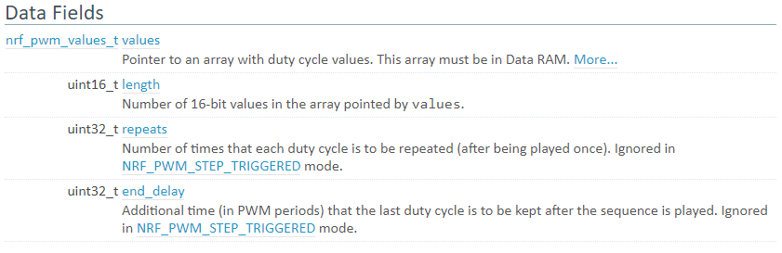
Sequence struct
values: pointer to array of uint16_t values (union of types)
length: length of array
repeats: number of times to repeat each individual value
Sets period for “analog value” changing

Slide 39
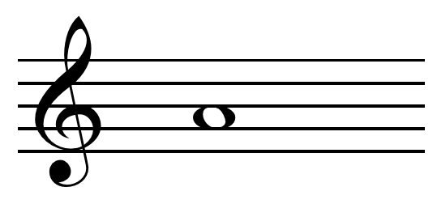
Example, playing a note with a square wave
Pick PWM frequency to match note frequency
Combination of PRESCALER, COUNTERTOP, and repeats
440 Hz for the note A
PRESCALER 1 MHz, COUNTERTOP 2273 -> 440 Hz
Set duty cycle of PWM to control volume
50% duty cycle -> COMP value of 1137
Set sequence with an array of length 1, content is {1137} (polarity 0)
Repeats 0, end_delay 0
Set playback_count to 1 and flags to NRFX_PWM_FLAG_LOOP

Slide 40
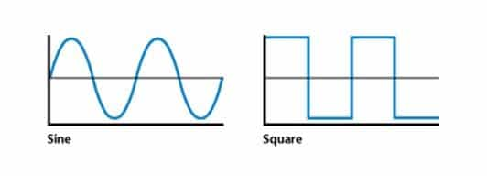
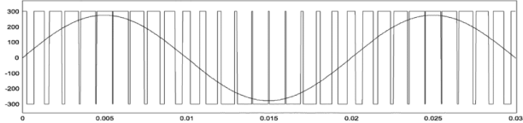
Playing sine waves instead of square waves
Sine waves sound different than square waves
Sine is more smooth
Square is more harsh and buzzy
For better sound quality, we can play sine waves via PWM

Slide 41
Steps to playing a note with a sine wave
Calculate sine wave values for some amount of duration
Reasonable to calculate one second of data at a time
sin() function might be too slow here
Instead calculate sine values in advance and interpolate into an array based on frequency
Translate sine wave values into duty cycle values
Fill an array with these duty cycle values
Play the array of duty cycle values
That gets one second of audio
For music, might change schedule a timer for when to stop current playback and play the next note instead

Slide 42
Outline
Digital-to-Analog Converters
Pulse-Width Modulation
nRF52 PWM

