Slide 1
Lecture 11 Wired Communication: UART
CE346 – Microcontroller System Design
Branden Ghena – Fall 2024
Some slides borrowed from: Josiah Hester (Northwestern), Prabal Dutta (UC Berkeley), Alanson Sample (Michigan)

Slide 2
Administrivia
Project purchasing is ready to go!
Send me requests and I’ll start buying stuff tomorrow
35 days, counting holidays and weekends, until Project Demo Day
Remember that shipping takes a couple days…
Quiz today!

Slide 3
Today’s Goals
Explore tradeoffs in wired communication
Signals, Speed, Timing, Topology
Describe wired serial communication protocol: UART
Discuss nRF52 implementation of UART

Slide 4
Outline
Wired Communication
UART
nRF52 UARTE

Slide 5
Purpose of communication
Goal: convey digital information between two devices
Simple solution
Digital I/O pin – 1-bit of information
Complex solution
Send multiple bits (arbitrarily many)
While also minimizing
Time, Energy, Pins, Errors, etc.

Slide 6
Wired versus wireless communication
Wired
Send digital signals across one or more wires
Advantages: Reliable, Low energy, Often simpler topology
Disadvantages: Physically limiting
Wireless
Send digital signals across another medium (usually RF)
Advantages: Physically flexible,
Disadvantages: Unreliable, High energy, Usually broadcast

Slide 7
Wired versus wireless communication
Wired
Send digital signals across one or more wires
Advantages: Reliable, Low energy, Often simpler topology
Disadvantages: Physically limiting
Today + next two lectures: UART, I2C, SPI, USB
Wireless
Send digital signals across another medium (usually RF)
Advantages: Physically flexible,
Disadvantages: Unreliable, High energy, Usually broadcast
After that: Wireless Communication

Slide 8
Tradeoffs in Wired Communication
Number of signals
Communication speed
Controlling timing
Network topology
Let’s talk about each of these in the coming slides

Slide 9
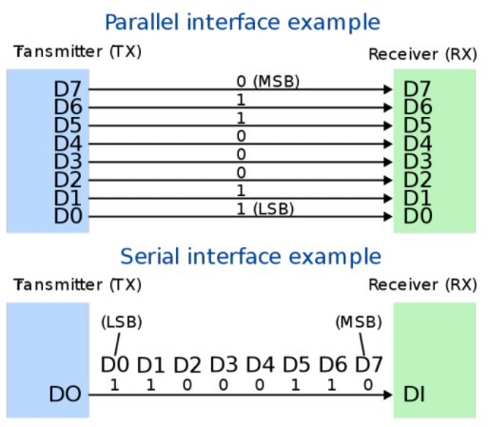
Tradeoff: number of signals
Serial interface
Single wire
Transmit data as a “series” of bits separated by time
Parallel interface
Multiple wires
How many depends on the system
Transmit data across multiple “parallel” wires simultaneously
Still separate by time for more data than wires
Transmitter
Transmitter

Slide 10
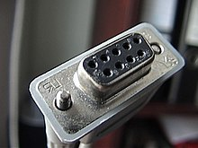
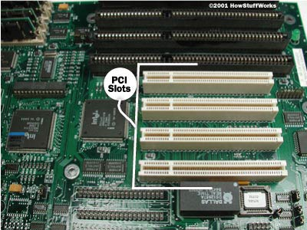
Serial versus parallel
Serial
Cheaper to use less wires
Slower to transmit data
Examples
RS-232, UART, I2C, USB (2.0)
Parallel
More expensive for more pins and wires
Faster to transmit data
Examples
Internal buses, PCI, USB (3.0)

Slide 11
Tradeoffs in Wired Communication
Number of signals
Parallel versus Serial
Communication speed
Controlling timing
Network topology

Slide 12
Tradeoff: communication speed
Round-trip-time inherently limited by the speed of light
Speed of electricity 50-99% of that
29 cm (11.4 in) = 1 nanosecond
Totally relevant for Gbps speeds within computers
Also limited by interference
Faster signals are harder to distinguish
More susceptible to interference (matters less for wired comms)
Limited by whether the other device can keep up
Might need some flow-control signaling to slow down when not ready

Slide 13
Example communication speed
Note: Speeds are always measured in bits per second
Internal, low-energy communication
UART, 1-1000 kbps
I2C, 100-400 kbps
SPI, 1-100 Mbps
External (mostly serial) communication
USB, 1-10000 Mbps
Ethernet, 1-1000 Mbps
HDMI, 4-48 Gbps
Internal parallel communication
PCI, 8-32 Gbps
RAM, 12-25 Gbps

Slide 14
Tradeoffs in Wired Communication
Number of signals
Parallel versus Serial
Communication speed
1000 bps to 10000000000 bps
Controlling timing
Network topology

Slide 15
Tradeoff: controlling timing
Synchronous systems can be Serial (top) or Parallel (bottom)
Synchronous communication
Clock signal sent along with data
Data is captured at edge of clock signal (rising or falling)
Advantage: send signals very fast
Disadvantage: extra pin and wire
Asynchronous communication
Agree upon timing in advance and read data at that rate
Advantage: no need for clock signal
Disadvantage: clock synchronization
Transmitter
Receiver
b0
b1
b2
b3
b4
b5
b6
b7
DATA
CLK
Transmitter
Receiver
b0
b0
b0
b0
b0
b0
D0
b1
D1
b2
D2
b3
D3
b4
D4
b5
D5
b6
D6
b7
D7
CLK

Slide 16
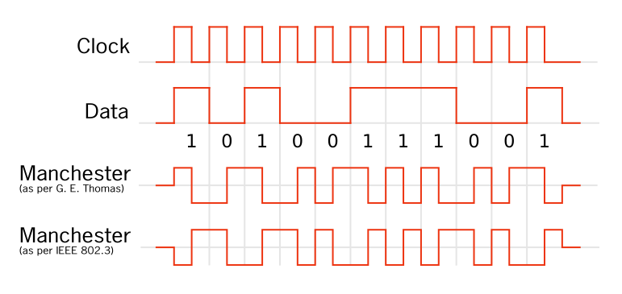
Compromise: combining signals and clocks
There is a method of recovering the clock from the signal
Either the clock is directly encoded in the signal
Or the signal will have mandatory high/low changes to synchronize
https://en.wikipedia.org/wiki/Clock_recovery
https://en.wikipedia.org/wiki/Self-clocking_signal

Slide 17
Tradeoffs in Wired Communication
Number of signals
Parallel versus Serial
Communication speed
1000 bps to 10000000000 bps
Controlling timing
Synchronous versus Asynchronous
Network topology

Slide 18

How to connect: point-to-point networks
How do we connect computers in a network?
This is a question of “network topology”
Simple option: just connect them directly
Problem: what if I find a third computer?

Slide 19
How to connect: bus networks
Connect everything to one wire in parallel
Actually a “multidrop bus”
Scales pretty well to many computers
Problem: which computer gets to transmit when?
Simultaneous transmissions conflict
Need a scheme for “arbitration”, deciding who transmits when

Slide 20
How to connect: ring networks
Connect everything with point-to-point connections
Connect the last computer back to the first computer
Also known as Daisy-Chain (without the last connection back to the start)
Problem: what if a computer stops sending?

Slide 21

How to connect: star networks
Connect to a hub with point-to-point connections
Hub connects all computers
Hub is a simple computer with one job: transfer communications between computers
Hopefully more reliable than any of the computers

Slide 22
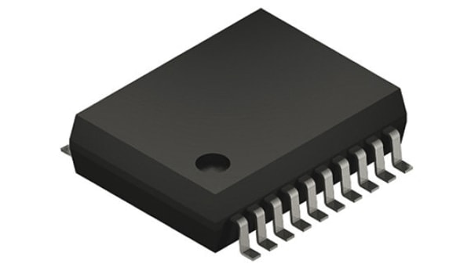
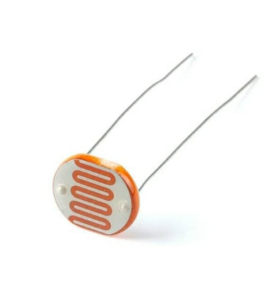
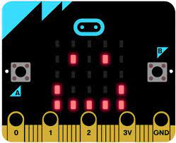
Microcontrollers are often hubs of star networks
Connect to multiple different sensors
Sometimes a few sensors are connected on a bus

Slide 23
Tradeoffs in Wired Communication
Number of signals
Parallel versus Serial
Communication speed
1000 bps to 10000000000 bps
Controlling timing
Synchronous versus Asynchronous
Network topology
Point-to-Point, Bus, Ring, Star

Slide 24
Break + Open Question
What network topology is WiFi?
Point-to-Point
Shared Bus
Ring
Star

Slide 25
Break + Open Question
What network topology is WiFi?
Point-to-Point
Shared Bus
Ring
Star (but close)
Any wireless device can hear any other wireless device (in range)
BUT, it tries to emulate a Star topology, where each device only talks to the router

Slide 26
Outline
Wired Communication
UART
nRF52 UARTE

Slide 27
UART Overview
Universal Asynchronous Receiver Transmitter
Serial communication between two devices
Two wires: transmit and receive
Simple to implement and very common on microcontrollers
Tradeoff choices: Serial, Low speed, Asynchronous, Point-to-Point
Most frequently used to send text data between devices
Microcontroller printf() output
GPS to microcontroller
Radio AT commands to/from microcontroller

Slide 28
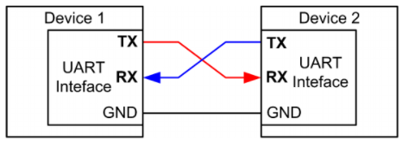
UART: chip-to-chip communication
Usually implemented as a two-wire interface
TXD: Transmits data
RXD: Receives data
Optionally two additional pins for flow control
No clock signal! Asynchronous
Note: TX connects to RX (you’ll always get this wrong on the first try)

Slide 29
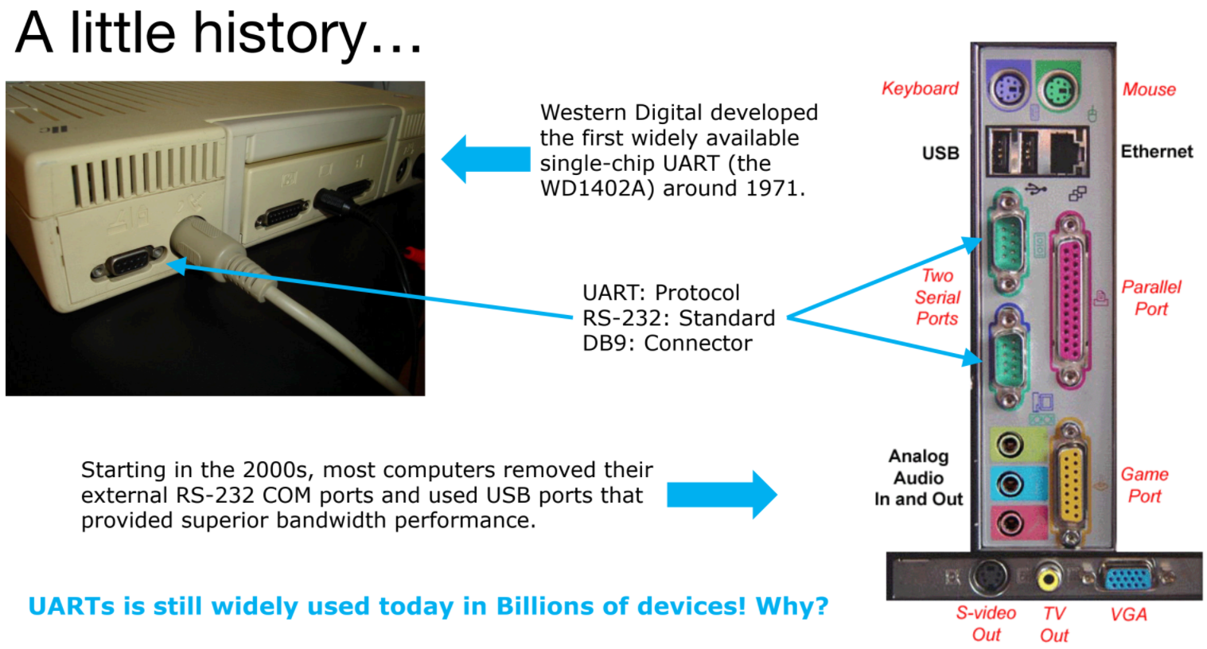

Slide 30
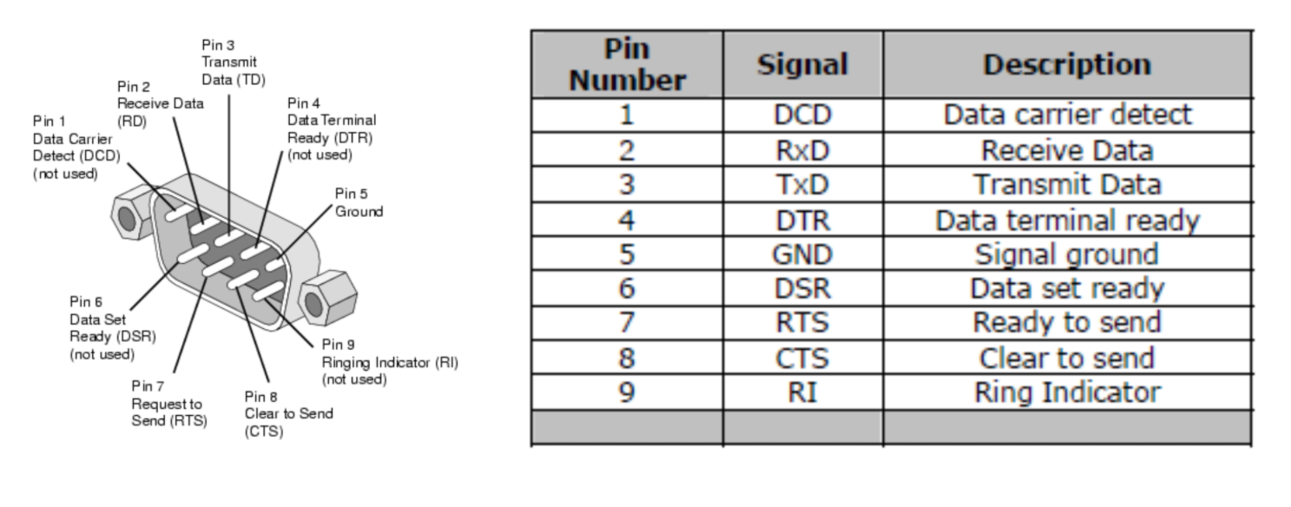
Serial communication - DB9 connector
Common pattern in cables
Ground (must be common), often VCC, Tx, RX
Plus extra wires for signaling metadata
Signal voltage not compatible with modern microcontrollers!
Up to +/- 15 volts

Slide 31
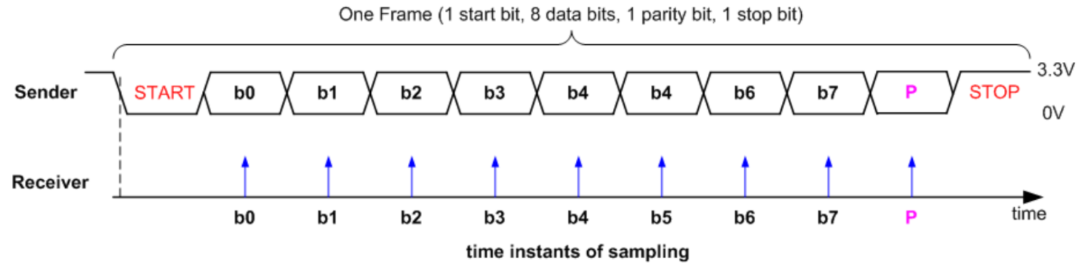
UART data frame
Signal is high by default
Goes low to trigger Start
Send each data bit (high=1, low=0), plus optionally parity bit
Goes high to trigger Stop

Slide 32
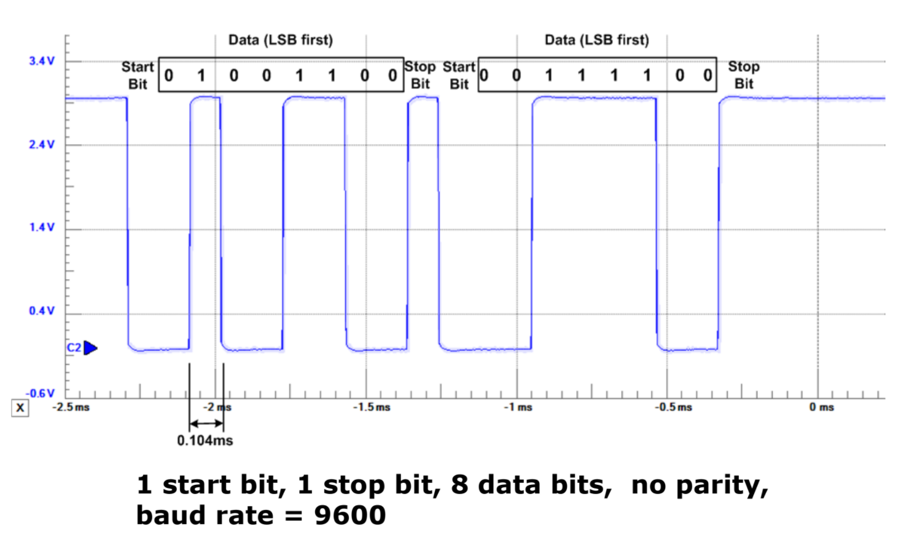
UART example, transmitting 0x32 and 0x3C

Slide 33
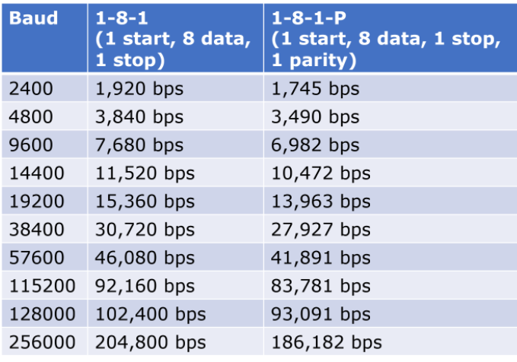
UART baud rates
Baud rate is a measure of “symbols per second”
Typically 1 bit per symbol, but not always
UART is 1 bit per symbol, but 8 data bits per 10/11 symbols
Any baud rate is possible
But there are a handful of normal configurations
115200 and 9600 are most common
We use 38400 for labs!

Slide 34
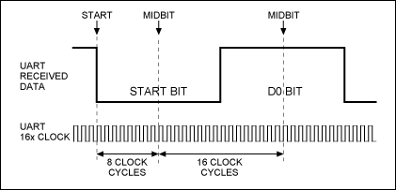
UART sampling rate
How do we make asynchronous communication work?
Both sides must agree on the baud rate
Listen for start bit
Conceptually:
Only need to sample 9-10 more times at baud rate spacing
Short enough that clocks should not diverge too much
Realistically:
Sample 8 or 16 times per bit
Determine boundaries between bits
Select most common value between boundaries

Slide 35
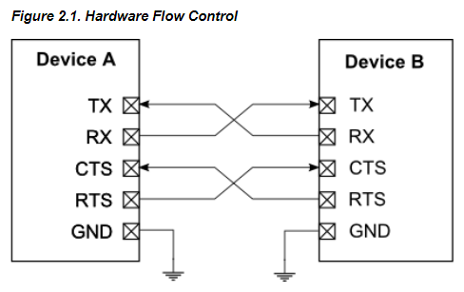
UART flow control
How do we ensure that the other device is ready for the message?
Add two pins for “hardware flow control”
Ready To Send (RTS) output, signals that you want to send data
Clear to Send (CTS) input, signals that other device is ready to receive
Software flow control is possible too
Send special byte that means pause or resume transmissions
Only works with ASCII though (otherwise, byte might be valid data)

Slide 36
UART error conditions
Parity failure
Bit error when receiving data
Overrun
New data arrived and overwrote buffer in peripheral before it was read
Framing
Did not see Stop Bit when expected (should be guaranteed “1”)
Break condition
Signal is low for entire message (Zero data plus Framing Error)
Often used as a signal between devices

Slide 37
Detecting errors with parity
If enabled, choose one configuration for all UART messages
Even parity: total number of “1” bits in data is even
Odd parity: total number of “1” bits in data is odd
Parity bit: set to 1 or 0 based on configuration and message data
If message doesn’t match parity configuration at receiver, there was a bit error (single error detecting)
Example: Data = 10101011 (five “1” bits)
Odd parity: set parity bit to zero
Even parity: set parity bit to one

Slide 38
UART Pros and Cons
Pros
Only uses two wires
No clock signal is necessary
Can do error detection with parity bit
Cons
Data frame is limited to 8 bits out of 10 bits (20% signaling overhead)
Doesn’t support multiple device interactions (point-to-point only)
Relatively slow to ensure proper reception

Slide 39
Longer Decoding Example
How many bytes are transmitted here?
REMINDER: animation messed up here

Slide 40
Longer Decoding Example
START
STOP
START
START
STOP
STOP
How many bytes are transmitted here? 3 bytes

Slide 41
Break + Longer Decoding Example
START
STOP
START
START
STOP
STOP
How many bytes are transmitted here? 3 bytes
What is the data for the first byte?
Remember: least significant bit is first
What message is sent here?

Slide 42
Break + Longer Decoding Example
 |  |  | 0 | 0 | 0 | 1 | 0 | 0 | 1 | 0
START
STOP
START
START
STOP
STOP
How many bytes are transmitted here? 3 bytes
What is the data for the first byte? 0b01001000 -> 0x48
Remember: least significant bit is first
What message is sent here?

Slide 43
Break + Longer Decoding Example
 |  |  | 0 | 0 | 0 | 1 | 0 | 0 | 1 | 0 |  |  | 1 | 0 | 0 | 1 | 0 | 0 | 1 | 0 |  |  | 1 | 0 | 0 | 0 | 0 | 1 | 0 | 0
START
STOP
START
START
STOP
STOP
How many bytes are transmitted here? 3 bytes
What is the data for the first byte? 0b01001000 -> 0x48
Remember: least significant bit is first
What message is sent here? 0x48, 0x49, 0x21
In ASCII: HI!

Slide 44
Real-world signals don’t have the guide
Assume the smallest step you ever see is the bit length
Check that the start/stop bits are where you expect
Calculate the values
Or use a logic analyzer that can decode it for you

Slide 45
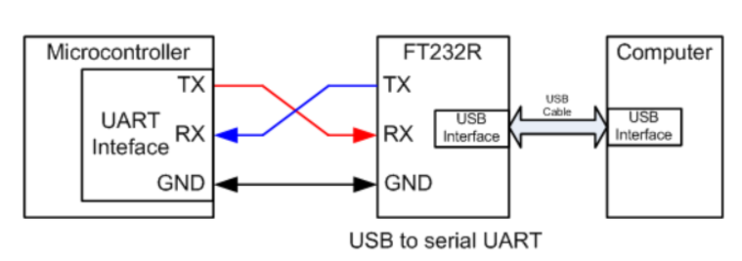
UART to USB bridge
FTDI makes the most common chip to do this (FT232)
Microbit uses a microcontroller to do this!
Secondary microcontroller connects to USB
Also connects to nRF52833 via UART and JTAG
ttyACM0 is a “virtual serial device” on top of USB, miniterm is a serial console

Slide 46
Outline
Wired Communication
UART
nRF52 UARTE

Slide 47
Which UART peripheral?
Two peripherals in the nRF52 documentation
UART peripheral
Standard UART without DMA
Deprecated (as in, they strongly suggest not using it)
UARTE peripheral
Standard UART with DMA
Their registers overlap
They are two different ways of using the same hardware
Only one at a time can be “active”

Slide 48
UARTE Peripheral
Configurations
Pins: TXD, RXD, and optionally RTS, CTS
Baudrate, Parity, Flow control
Actions
Transmit via DMA
Provide a pointer to RAM (not Flash) and a length
Receive via DMA
Provider a pointer to RAM and a length

Slide 49
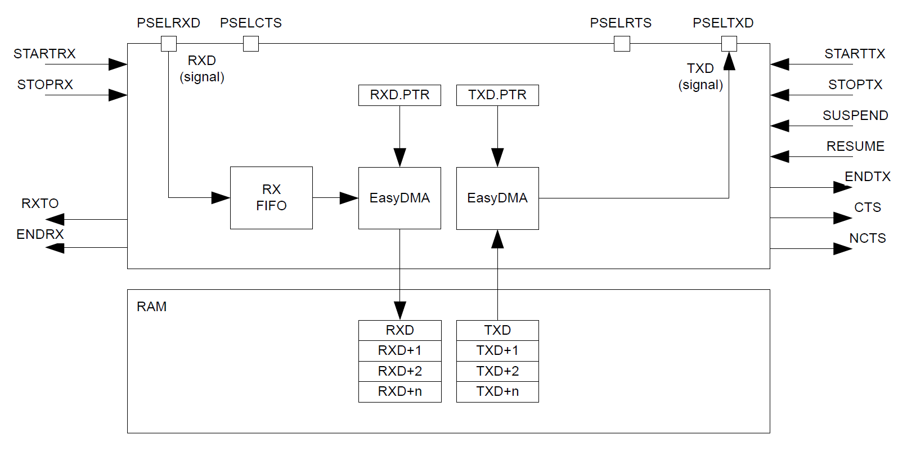
UARTE peripheral

Slide 50
UARTE peripheral
Pins: RX, TX, (optional) CTS and RTS

Slide 51
UARTE peripheral
Receive connects directly to buffer in RAM

Slide 52
UARTE peripheral
Transmit connects directly from buffer in RAM (not flash!)

Slide 53
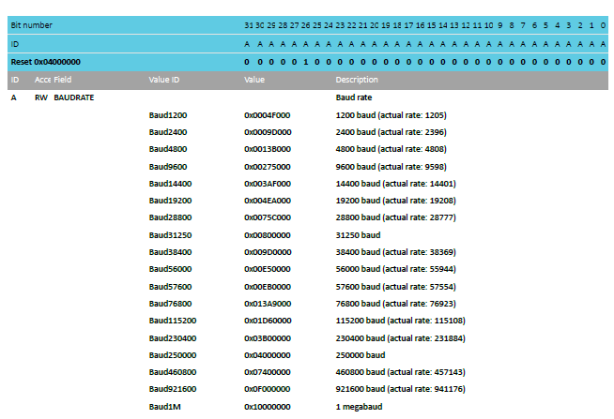
UARTE baudrates
Choose from standard, preconfigured buad rates
That values are 32-bit numbers implies other baudrates are possible…

Slide 54
Typical UART configurations
Baud rate 115200
No parity
No flow control
Probably covers ~70% of UART communication
Baud rate 9600, No parity, No flow control covers another 15%
We are the rare case of an unusual baudrate 38400
It was as fast as the Microbit could keep up with

Slide 55
UARTE driver code
Pretty straightforward to implement driver for this
Definitely could have been a lab
DMA is exactly what you want
Pointer to buffer of data (in RAM)
Length
Go!
More interesting: how does printf() use the UART?

Slide 56
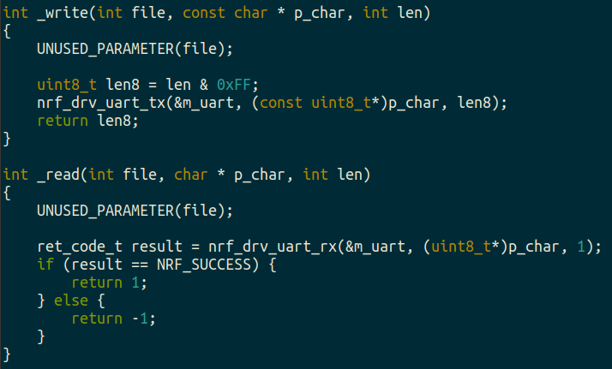
boards/microbit_v2/microbit_retarget.c
printf() eventually calls _write()with formatted data
Converts stdio calls into UART TX and RX
Library just sets DMA and starts Tx

Slide 57
Outline
Wired Communication
UART
nRF52 UARTE

