Slide 1
Lecture 12 Wired Communication: SPI and I2C
CE346 – Microcontroller System Design
Branden Ghena – Fall 2024
Some slides borrowed from: Josiah Hester (Northwestern), Prabal Dutta (UC Berkeley), Sparkfun

Slide 2
Administrivia
I’ve got so much hardware to distribute today
Mostly from stuff I had on-hand already
I’ll bring stuff that I get to lecture and labs
You can also grab from me in my office, if I’m around
What did I give you:
What you ordered
Unless I messed it up
Or I thought something else I had on hand was “better” than what you ordered
Sometimes I add “extra” stuff that seems like it could be useful
So, double-check the stuff I gave you
You might also need batteries, jumper wires, breadboards, etc.
I tried to remember some of this, but didn’t always
I have that stuff on hand, but you’ll have to grab it

Slide 3
Today’s Goals
Discuss additional wired communication protocols: SPI and I2C
Understand tradeoffs in design
UART, SPI, and I2C are each useful for different scenarios
Explore real-world usage of SPI and I2C

Slide 4
Outline
SPI
I2C
Using SPI and I2C

Slide 5
UART Pros and Cons
Pros
Only uses two wires
No clock signal is necessary
Can do error detection with parity bit
Cons
Data frame is limited to 8 bits (20% signaling overhead)
Doesn’t support multiple device interactions (point-to-point only)
Relatively slow to ensure proper reception
Let’s get rid of all the cons (by sacrificing on all the pros)

Slide 6
Synchronous UART
Transmitter
Receiver
DATA
USART
Synchronous/Asynchronous
Just add a clock line
Common peripheral in many microcontrollers to allow adaptable communication
Could build various protocols (like SPI or UART) on top of it
Still point-to-point limited in this form
b0
b1
b2
b3
b4
b5
b6
b7
CLK

Slide 7
Synchronous serial communication with a single device
Device 1
Microcontroller
Device 2
Data Out Clock
Data In Clock
Device 3

Slide 8
Want bi-directional communication, so three wires
Device 1
Microcontroller
Device 2
Data Out Data In Clock
Data In Data Out Clock
Device 3

Slide 9
Wire signals to all devices to form a bus
Device 1
Data In Data Out Clock
Microcontroller
Device 2
Data Out Data In Clock
Data In Data Out Clock
Device 3
Data In Data Out Clock

Slide 10
Communicating on a bus
How do you distinguish which device you are talking to?
GPIO pin for each device
Signal which device is being communicated with
Only activates communication on transition of “select” line
Needs a separate pin for each device
Address for each device
Devices must always listen and then discard messages that aren’t for them
Need to define packet format so it’s clear where the address is
Need a method for addressing devices

Slide 11
Separate chip select line for each device
Device 1
Data In Data Out Clock
Chip Select
Microcontroller
Device 2
Data Out Data In Clock
(2) Chip Select
Chip Select
(3) Chip Select
Data In Data Out Clock
Chip Select
Device 3
Data In Data Out Clock
Chip Select

Slide 12




Serial Peripheral Interface (SPI)
Serial, synchronous, bus communication protocol
Single controller with multiple peripherals
Within a circuit board
High-speed communication
Multiple Mbps
Device 1
Serial Data In Serial Data Out Serial Clock
$$\overline{\text{Chip} \text{Select} }$$
Microcontroller
Device 2
Serial Data Out Serial Data In Serial Clock
$$\overline{\text{Chip} \text{Select} }$$
$$\overline{\text{Chip} \text{Select} }$$
$$\overline{\text{Chip} \text{Select} }$$
Serial Data In Serial Data Out Serial Clock
$$\overline{\text{Chip} \text{Select} }$$
Device 3
Serial Data In Serial Data Out Serial Clock
$$\overline{\text{Chip} \text{Select} }$$

Slide 13
A note on outdated notation
Master/Slave paradigm
Master is the “Computer” and is in charge of interaction
Slave is the “Device” and has little control over interaction parameters
Really common notation in EE side of the world.
Not intended to be harmful, but also literally inconsiderate.
Field is changing for the better. It’s going to take some time.
Controller/Peripheral
Central/Peripheral
Device/Peripheral
Master/Minion
Primary/Secondary

Slide 14
SPI naming schemes
Historical SPI Naming
MISO – Master In Slave Out
MOSI – Master Out Slave In
SS – Slave Select
Revised SPI Naming
SDI – Serial Data In -> also known as CIPO (Controller In, Peripheral Out)
SDO – Serial Data Out -> also known as COPI (Controller Out, Peripheral In)
CS – Chip Select
https://www.oshwa.org/a-resolution-to-redefine-spi-signal-names
https://www.sparkfun.com/spi_signal_names

Slide 15

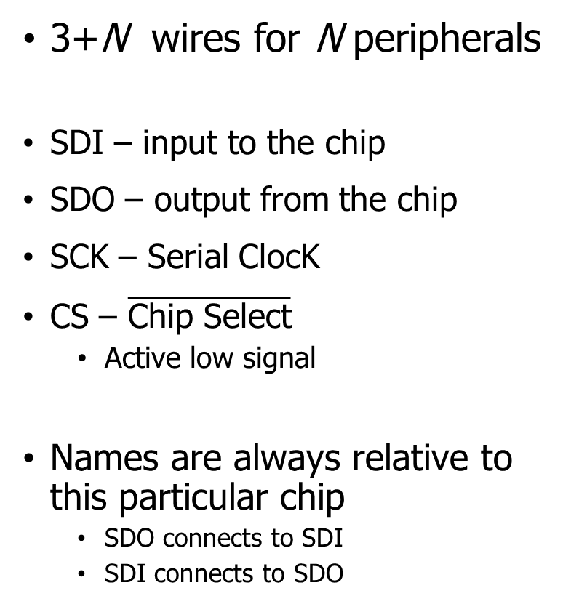



SPI wiring
3+N wires for N peripherals
SDI – input to the chip
SDO – output from the chip
SCK – Serial ClocK
CS – $\overline{\text{Chip} \text{Select}}$
Active low signal
Names are always relative to this particular chip
SDO connects to SDI
SDI connects to SDO
Device 1
SDI SDO SCK
$$\overline{\text{CS}}$$
Microcontroller
Device 2
SDO SDI SCK
$$\overline{\text{CS}}$$
$$\overline{\text{CS}}$$
$$\overline{\text{CS}}$$
SDI SDO SCK
$$\overline{\text{CS}}$$
Device 3
SDI SDO SCK
$$\overline{\text{CS}}$$

Slide 16
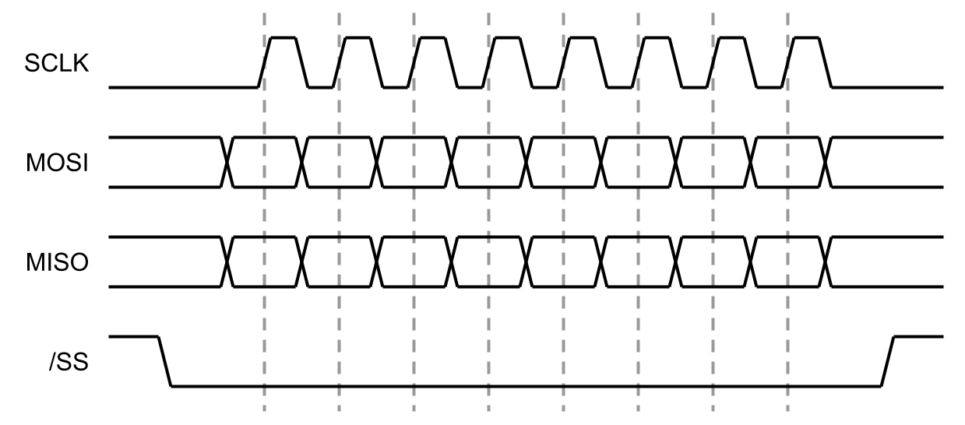
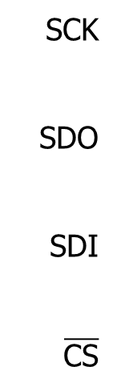
SPI timing diagram
CS goes low to start transaction and high to end
Data is sent synchronously with clock signals
Capable of full-duplex transfers
Both directions at the same time
SCK
SDO
SDI
$$\overline{\text{CS}}$$

Slide 17
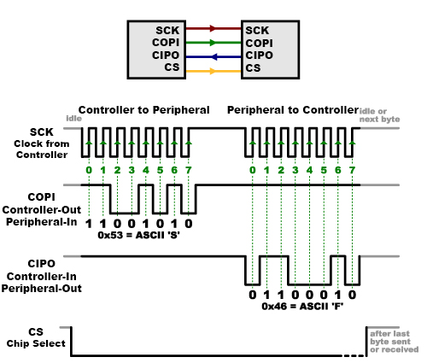
SPI communication
Transactions usually in multiples of bytes (as many as needed)
Either bit endianness is possible
nRF can do LSb first OR MSb first
No need for framing bits (start/stop)
CS handles that

Slide 18
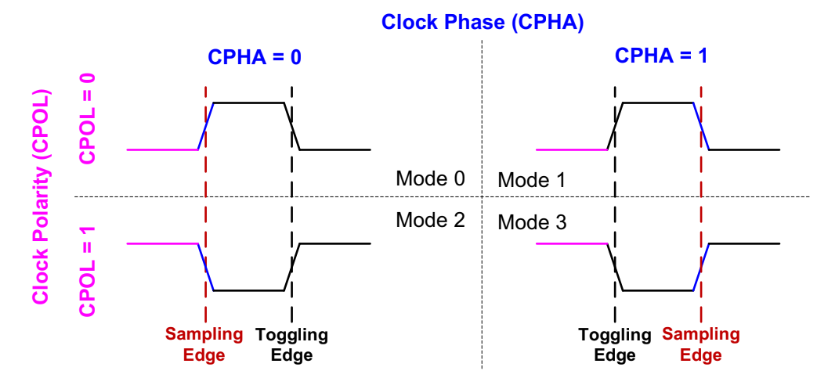
SPI configurations
CPOL – is the clock default low or default high
CPHA – is data read on first edge or second edge
Peripherals tell you what their configuration is

Slide 19
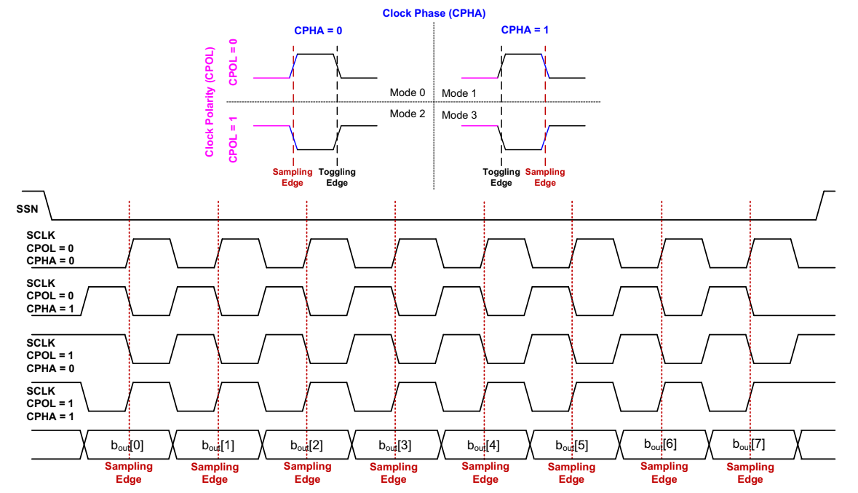

Slide 20
SPI data rate
No particular requirements
Speed can go as fast as your clock and line capacitance can handle
Datasheet for devices will specify their speeds
Sort of standards (less so than UART, for example)
700 kbps
3.4 Mbps
10 Mbps

Slide 21
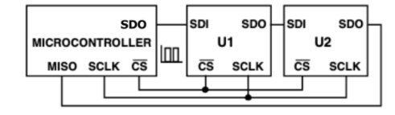
Daisy-chaining SPI
SPI can also be formed into a ring bus
Doesn’t save on pins, but does reduce wires…
At the cost of reliability and speed
Fairly rare in practice

Slide 22
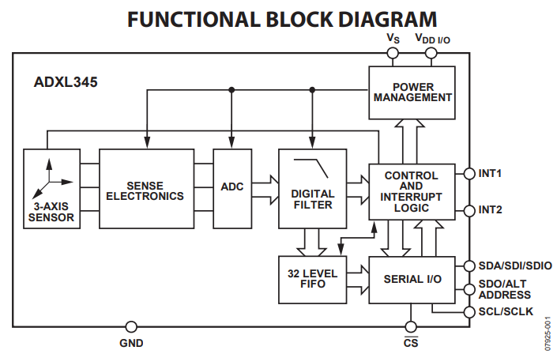
How do we determine when peripheral has information?
Controller starts/stops SPI transfers
Could ask peripheral periodically
Peripherals often add interrupt outputs to signal controller that an event has occurred
More pins, yay!

Slide 23
Use Cases
High-speed peripherals
Microphone, External ADC
Displays!
External memory
Memory chips
SD cards
All SD cards support a SPI communication mode
QSPI – Quad SPI (four SDO lines for more throughput)
Often used for communication with external memory

Slide 24
SPI Pros and Cons
Pros
Faster throughput (and no overhead)
No restrictions on data frame
No addressing requirements or word size assumptions
Full duplex transfers
Cons
Many pins: 3+N (for N peripherals)
CS line scales linearly (other signals are a bus)
Controller must initiate all transfers
Not designed for multi-controller scenarios

Slide 25
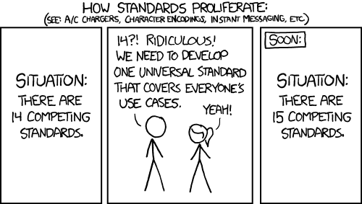
Break + relevant xkcd
https://xkcd.com/927/

Slide 26
Outline
SPI
I2C
Using SPI and I2C

Slide 27
Choosing different tradeoffs from other wired communication
Things we like from SPI
Communication over a bus
Synchronous communication
Things we want from new protocol
Fewer I/O pins
Use a single data line for bi-directional communication
Needs addressing and more specified data frame
Multiple controllers sharing the bus
Needs a bus contention solution

Slide 28
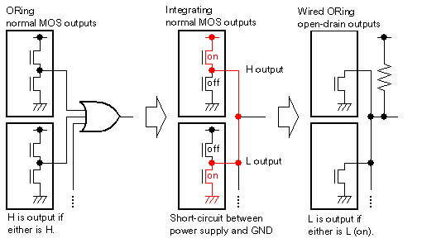
Bus contention could short a shared bus
Want to enable multiple controllers
Problem
What if they each try to transmit different data?
At some point, there will be a short-circuit

Slide 29
Disconnected I/O pins enable shared communication
ANDing
I/O pins often have three states
High
Low
Disconnected (also known as High-Impedance/High-Z)
We can use this third state to enable communication over a shared line
Low or Disconnected
Wired-AND
1 if they are all disconnected
0 if any are low

Slide 30
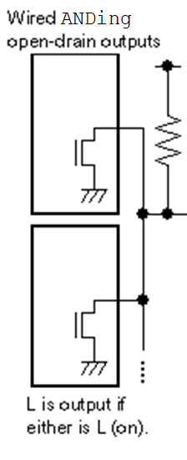
Wired-AND solves the shared-bus short-circuit
Possible states
Both are Low
Signal connected to Ground multiple times
Output value is Low
Both are Disconnected
Signal pulled-up to Vcc once
Output value is High
One Low and one Disconnected
Signal connected to Ground AND pulled-up to Vcc
Output value is Low (pull-up is a weak connection)

Slide 31
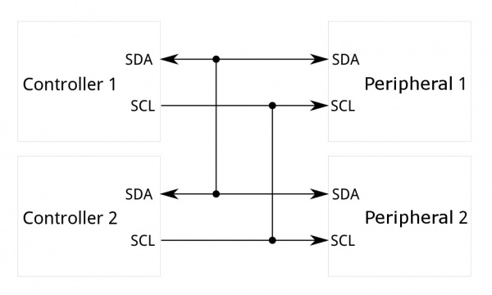
Inter-Integrated Circuit (I²C)
Two-wire, synchronous, bus communication
Ubiquitous in the embedded world
De-facto standard for sensors
Invented and patented by Phillips (now NXP)
Patent expired in 2004
Also known as Two-Wire Interface (TWI)
Occasionally as System Management Bus (SMBus or SMB) but that’s actually a related but separate thing

Slide 32
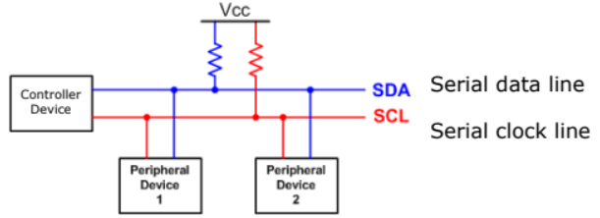
I2C overview
SDA – Serial Data
SCL – Serial Clock
Usually 100 kHz or 400 kHz
Communication is a shared bus between all controller(s) and peripheral(s)
Pull-up resistors for open-drain communication

Slide 33
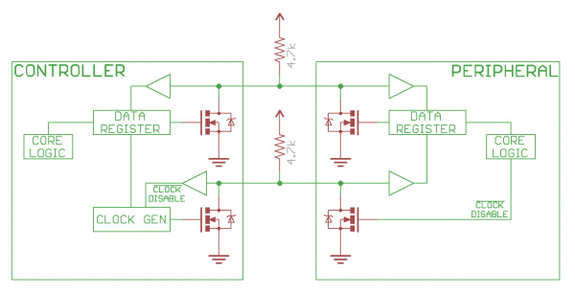
Open drain bus communication
SDA and SCL are open-drain
1 – high-impedance, let line float high
0 – active drive, pull line low
Pull-up resistor to provide high signal
Low enough resistance that current can flow in a reasonable amount of time
Common value: 4.7 kΩ

Slide 34
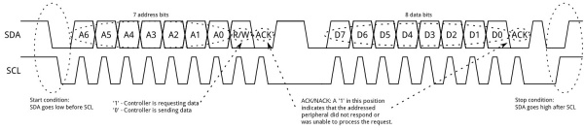
I2C transactions
Default
Both lines float high (pull-up resistor)
Start condition
Drive SDA low while SCL is still high

Slide 35
I2C transactions
First byte is chip address + R/W indication
Address: 7-bit value that needs to be different for each participant
R/W: 1 for read, 0 for write
Values are sent MSb first (reverse of other protocols 😱)

Slide 36
I2C transactions
Acknowledgement from peripheral follows each byte
Controller lets line float high
Peripheral drives line low to signal receipt of message

Slide 37
I2C transactions
Data frame(s) follow
Sent as entire bytes, plus and ACK
As many as needed before Stop condition
Stop condition
SDA goes high while SCL is high (normally data only changes when clock is low)

Slide 38
Bus arbitration
Arbitration decides which controller gets to proceed if multiple try to communicate simultaneously
What happens in I2C if one controller wants a low bit and the other wants a high bit?

Slide 39
Bus arbitration
Arbitration decides which controller gets to proceed if multiple try to communicate simultaneously
What happens in I2C if one controller wants a low bit and the other wants a high bit?
Low bit wins! (so smaller address or data wins)
Each controller constantly checks whether SDA matches the voltage level it expects
Stops attempting to transmit if it ever does not
(Only actually needs to check high signals)

Slide 40
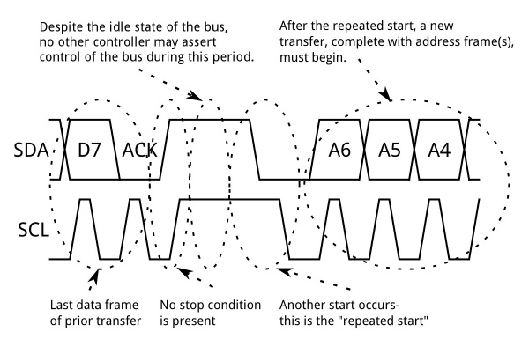
Repeated start conditions
Repeated start conditions allow the bus to be used again while arbitration was won
Trigger another Start condition without triggering Stop condition
Send address again
Frequently used for write then read pattern
Write which value you want
Then repeated start and read

Slide 41
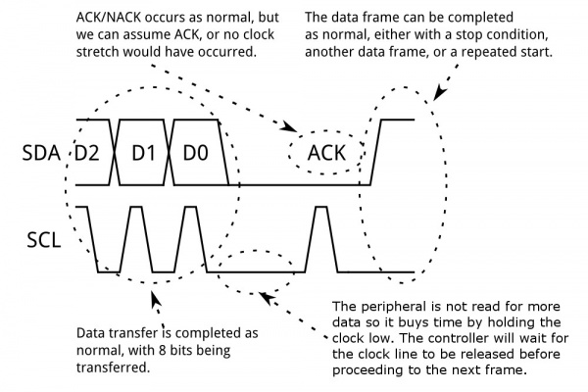
Clock stretching
Clock is an open-drain line too
Either device could keep it low
Transaction can be briefly paused by holding SCL low
ready

Slide 42
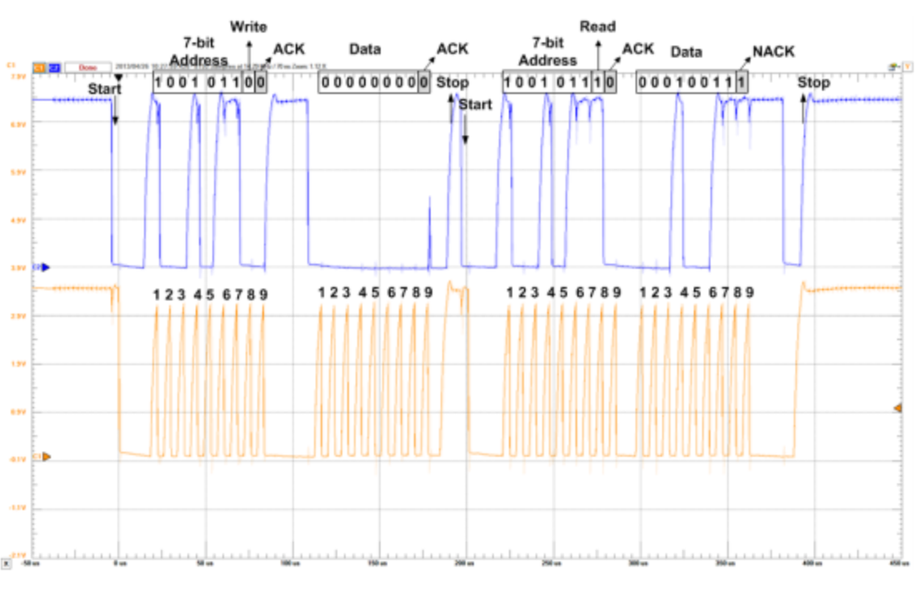
Real-world I2C transactions

Slide 43
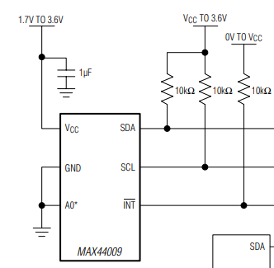
Each I2C device on a bus must have a different address
Shared addresses would cause both to respond
ICs often have one or more address pin(s) used to select bit(s) of address
0 pins: only one may be on bus
1 pin: two may be on bus
2 pins: four may be on bus
If no address pins (or not enough), need an I2C address translator chip
Translates addresses for one or more peripheral chips
I have a bunch of these on hand, just in case
A0 is low: address 1001010x
A0 is high: address 1001011x

Slide 44
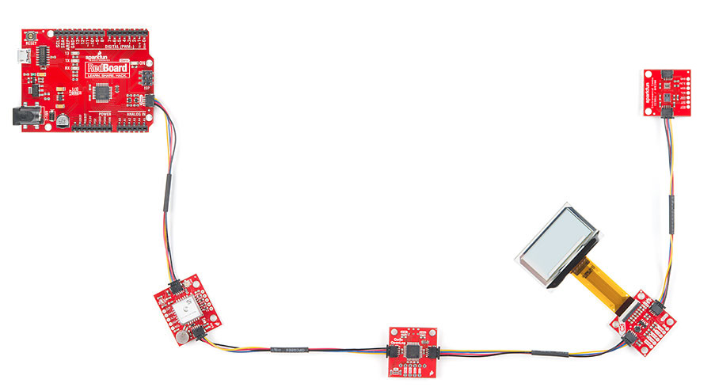
Sparkfun Qwiic connect system
System for wiring multiple prototyping boards together
Four-pin connector
VCC (3.3 volts)
Ground
SDA
SCL
Daisy-chains through boards
Actually connects to chips in parallel as a bus
https://www.sparkfun.com/qwiic

Slide 45
System Management Bus (SMBus)
Related communication specification
A little more strict in places, but generally interoperable
Adds ability to broadcast or unicast messages
Generic addresses for Controller and various peripherals (Battery)
Adds an open-drain shared interrupt signal
High-impedance or pull low, just like SDA and SCL
Allows any device to alert a controller
Controller has to probe bus to determine which device wants attention

Slide 46
I2C use cases
Various sensors
Usually low to medium speed
Even relatively high speed stuff often has I2C for convenience
Accelerometers and microphones
Often with intelligent filtering built in
Communication between microcontrollers
Either can act as the Controller when necessary
Commonly exists internally within smartphones and laptops too
Light sensors, Temperature sensors, etc.

Slide 47
I2C Pros and Cons
Pros
Wiring is simple
Only uses two pins
Very widely supported
Cons
Relatively slow communication rate
Speed versus power use tradeoff (due to pull-down resistor)
Open collector makes debugging difficult

Slide 48
Break + Open Question
Why are SPI and I2C common internally in embedded systems, but not common externally? (like USB, Ethernet, HDMI, etc.)

Slide 49
Break + Open Question
Why are SPI and I2C common internally in embedded systems, but not common externally? (like USB, Ethernet, HDMI, etc.)
Too slow:
Especially I2C (100 Kbps compared to 12 Mbps for slowest USB)
Not robust:
No effort put into the electrical encoding of data or error checking
Long external cables lead to additional errors
Overall: they’re too simple

Slide 50
Outline
SPI
I2C
Using SPI and I2C

Slide 51
Common sensor interaction pattern
First write one byte to the device
This selects what data you want to interact with, called a “register address”
Second read/write one (or more) bytes
This is the actual data
SPI and I2C devices both work this way
Datasheet will have a list of registers you can read/write
Each register will have some address: that’s the first byte you write

Slide 52
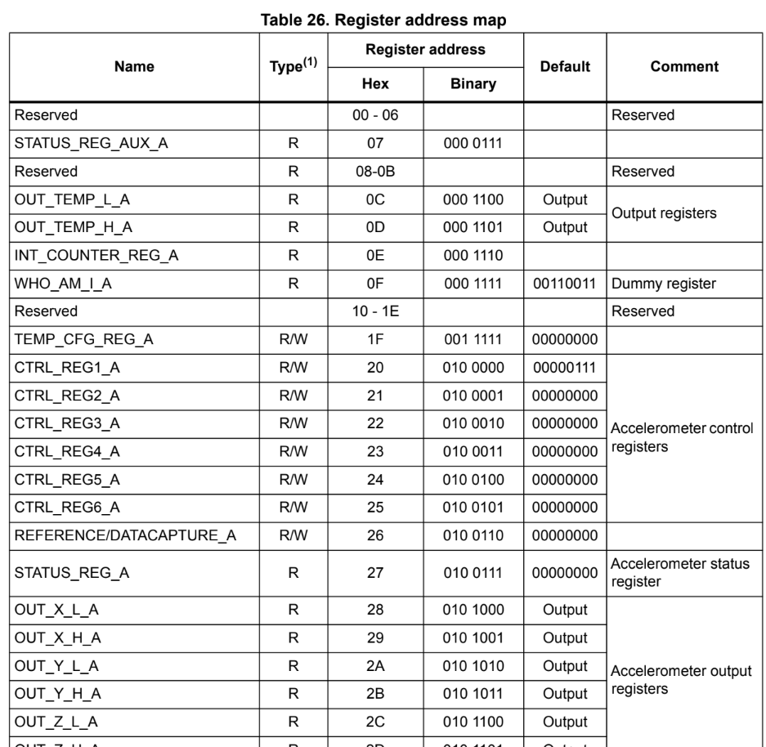
Example: Microbit accelerometer
Details of each register on later pages show you the structure of the data read or written

Slide 53
Register/data pattern in I2C
I2C is the more difficult of these
Need some way to tell the device “this transaction is still going”, but switch from writing to reading
This is the use of the “repeated start” option
Continues the “transaction”

Slide 54
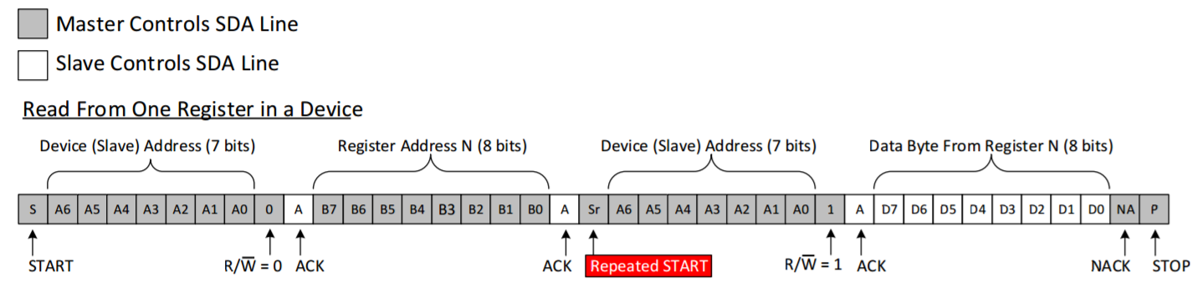
I2C Read Transaction
Controller Controls SDA Line
Peripheral Controls SDA Line
First, write the address of the register you want
Then, repeated start
Finally, read the data from the device

Slide 55
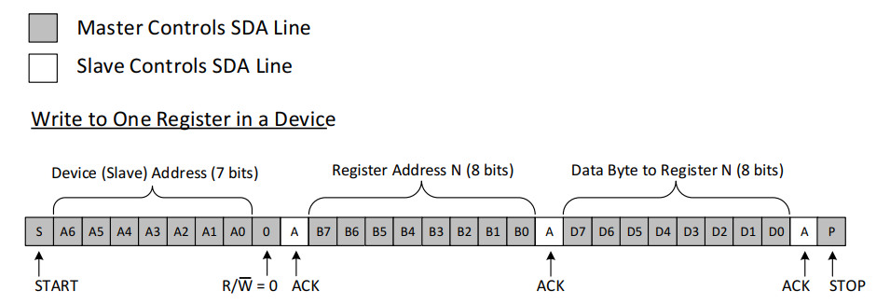
I2C Write Transaction
Controller Controls SDA Line
Peripheral Controls SDA Line
Just write the data. No need to change modes in the middle
Some devices also allow “repeated start” in the middle of write transactions
But it’s not necessary

Slide 56
nRF I2C Implementation
nrf_twi_mngr driver: I2C (Two-Wire Interface) manager
Expects transactions to occur and is set up to run those
Takes in an array of “transfer” operations as an argument
Each operation is either a read or a write
Includes a device address, includes a pointer to data and length
Includes flags like NRF_TWI_MNGR_NO_STOP which does not execute a stop bit (and instead does a repeated start for the next operation)
Your job is to set up the array of transfer operations
Then the driver will make it happen

Slide 57
Register/data pattern in SPI
SPI is easier to implement transactions for
No indication of reading/writing by default
You can just hold Chip Select low and stop clocking if you want to pause
Need some way to indicate to the peripheral whether you’re reading or writing though
Possibly different register addresses for read versus write
Possibly 7-bit addresses, with a bit leftover for read/write specification

Slide 58
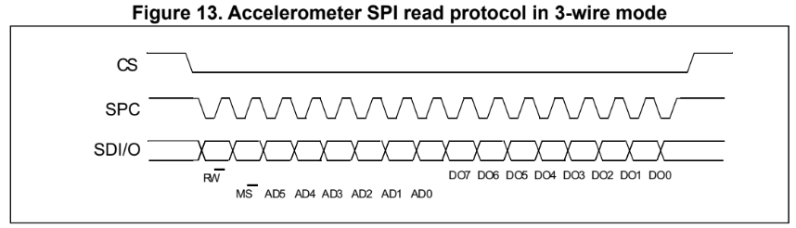
SPI Read Transaction
Chip select goes low to select the device
First byte is the register address and read/write selection
Next bytes are the data to write
SDO
SDI

Slide 59
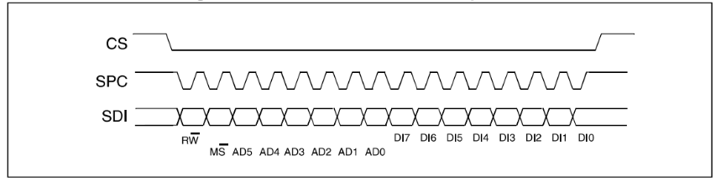
SPI Write Transaction
Chip select goes low to select the device
First byte is the register address and read/write selection
Next bytes are the data to write
SDO

Slide 60
nRF SPI Implementation
nrfx_spim driver: nRF SPI Master (Controller)
Expects data in “XFER” (transfer) operations
Can either be read, write, or read AND write (both simultaneously)
Flags control whether CS pin goes high afterwards or if it stays low
Or you could just manually control the CS pin

Slide 61
Outline
SPI
I2C
Using SPI and I2C

