Slide 1
Lecture 16 Wrapup + Microprocessors
CE346 – Microcontroller System Design
Branden Ghena – Fall 2024
Some slides borrowed from: Josiah Hester (Northwestern), Prabal Dutta (UC Berkeley)

Slide 2
Administrivia
Bonus office hours on Friday
Friday 1-5 pm in the lab room
PMs will be there as well to support
Tuesday and Thursday after Thanksgiving will be office hours too
In this classroom
Come ask project questions or just work on things
Tuesday plan: talk about embedded research
Happy to tailor that as anyone wants
Talk about research and PhD generally, talk about specific projects, etc.

Slide 3
Today’s Goals
Discuss remaining parts of the Microbit and nRF52833
Realize that we’ve covered almost everything on the system!!
Compare and contrast other microcontrollers

Slide 4
Outline
What haven’t we talked about?
Microbit
nRF52833
Other hardware systems
Other microcontrollers
Microprocessors
FPGAs

Slide 5
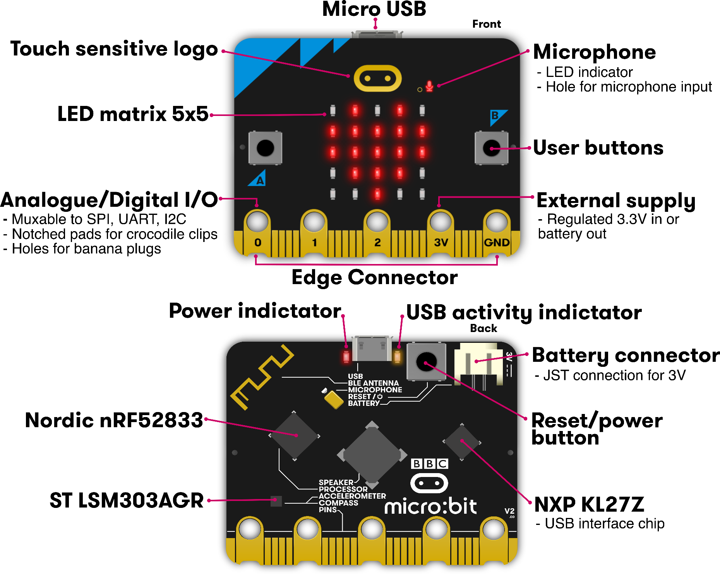
Microbit
Used almost all of this!
Remaining:
Batteries
Wireless
KL27Z I2C

Slide 6
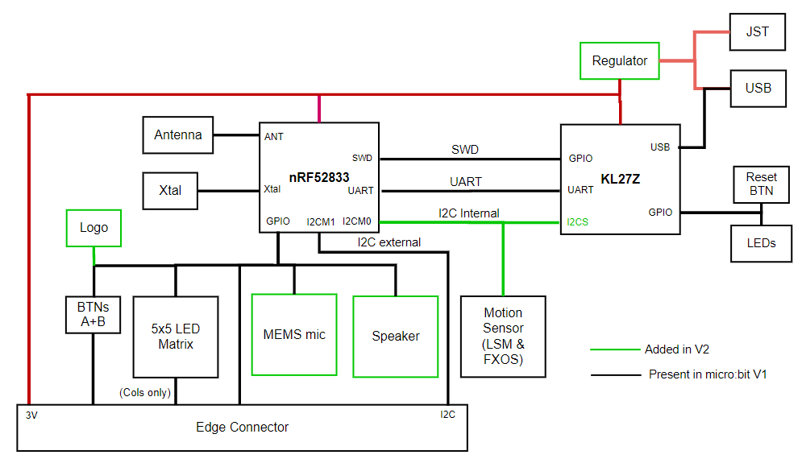
Internal Microbit connections

Slide 7
KL27 I2C Interface
Device information
Version of board and JTAG firmware
Power state of board
USB, Battery, both
Voltage values for battery and VIN
USB connection state
Disable the power LED!!
Flash Storage
128 kB of the KL27’s Flash is readable/writable over I2C
https://github.com/microbit-foundation/spec-i2c-protocol/blob/main/spec/index.md

Slide 8
Outline
What haven’t we talked about?
Microbit
nRF52833
Other hardware systems
Other microcontrollers
Microprocessors
FPGAs

Slide 9
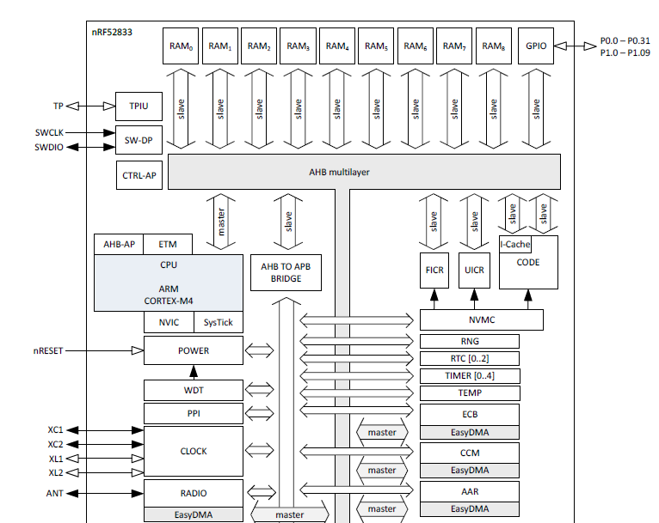
nRF52833 Peripherals
Tour of the nRF52833 peripherals
With some details on the ones we haven’t talked about
Wireless
Crypto
Audio

Slide 10
nRF52833 Peripherals
Cortex-M4F processor
32-bit ARM core
Floating point
Includes Interrupt control and SysTick (an extra timer)

Slide 11
nRF52833 Peripherals
Memory buses

Slide 12
nRF52833 Peripherals
JTAG and Debugging
Allows code updates
Allows GDB to step through code

Slide 13
nRF52833 Peripherals
Volatile memory
SRAM, 128 kB

Slide 14
nRF52833 Peripherals
Nonvolatile memory
Flash, 512 kB
Non-Volatile Memory Controller

Slide 15
nRF52833 Peripherals
Power and Clock management

Slide 16
nRF52833 Peripherals
GPIO pins

Slide 17
nRF52833 Peripherals
Various timers
Watchdog Timer
Real-Time Counter
Timer peripheral

Slide 18
nRF52833 Peripherals
Programmable Peripheral Interconnect
Random Number Generator
Temperature sensor

Slide 19
nRF52833 Peripherals
Wireless radio
Bluetooth Low Energy
802.15.4 (Zigbee or Thread)
Cryptography
ECB (AES mode)
CCM (AES mode)
AAR (Accelerated Address Resolver)
For BLE random addresses

Slide 20
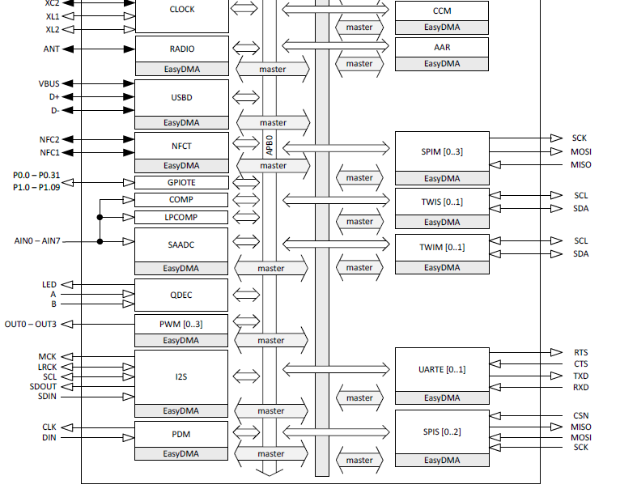
nRF52833 Peripherals
Wired communication protocols
USB Device
SPI
Controller/Peripheral
TWI (I2C)
Controller/Peripheral
UART

Slide 21
nRF52833 Peripherals
Inter-IC Sound (I2S)
Wired communication bus explicitly for audio data
Unrelated to I2C
Like a synchronous UART
Clock, data in, data out
Additional signals
MCK – synchronization
LRCK – left/right channel select

Slide 22
nRF52833 Peripherals
NFC
Near-Field Communication
Close-range wireless communication protocol
“Tap-to-pay” systems

Slide 23
nRF52833 Peripherals
GPIOTE
GPIO interrupts

Slide 24
nRF52833 Peripherals
Analog inputs
Comparator
Low-Power Comparator
Successive Approximation Analog-to-Digital Converter

Slide 25
nRF52833 Peripherals
Quadrature Decoder peripheral
Detects rotation speeds and direction
Usually for motors

Slide 26
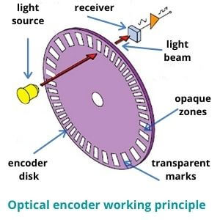
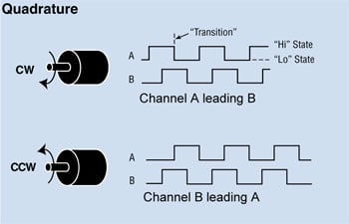
Quadrature Encoding
Usually two receivers and disks: A & B That gets you direction and speed

Slide 27
nRF52833 Peripherals
Pulse Width Modulation
Pulse Density Modulation
Similar idea to PWM
Input-only peripheral
Targets microphones

Slide 28
nRF52833 is complete
That’s just about everything!
First 550 out of 600 pages of nRF52833 datasheet
Remaining 50 are hardware details
Pinout for different packages
Recommended circuit layout
Soldering details

Slide 29
Break + Open Question
What doesn’t the nRF52833 have a peripheral for? (i.e., what could you imagine a peripheral for that it doesn’t have)

Slide 30
Outline
What haven’t we talked about?
Microbit
nRF52833
Other hardware systems
Other microcontrollers
Microprocessors
FPGAs

Slide 31
Microcontroller knowledge is transferrable
Your knowledge of microcontrollers applies to almost all of them
They have similar peripherals that work in similar ways
The exact names and configurations will definitely be different
But the fundamentals stay the same
Let’s prove this with a quick view of two microcontrollers
Atmel SAM4L
Texas Instruments MSP430

Slide 32
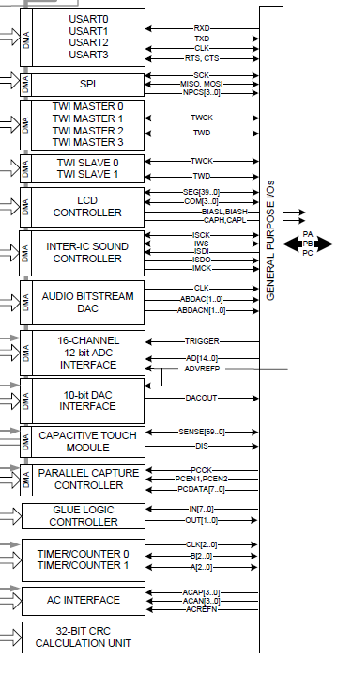
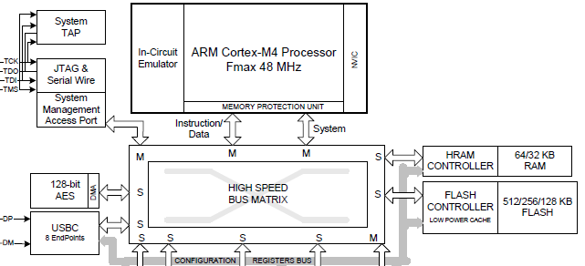
Atmel SAM4L Microcontroller
ARM Cortex M4F (same processor!)
Lots of very configurable peripherals
USART, SPI, TWI, I2S, DAC, ADC, Timer, …
Kind of a “do-everything” microcontroller

Slide 33
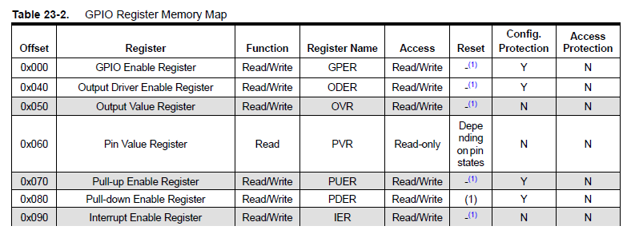
SAM4L GPIO
GPIO register map (heavily abbreviated)

Slide 34
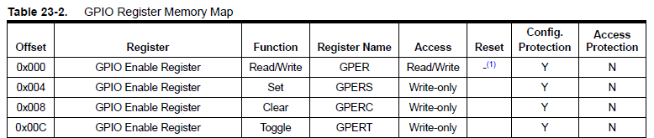
Setting or clearing individual bits
Actually, each register appears four times in a row
Read/write version
Set version (like nRF *SET)
Clear version (like nRF *CLR)
Toggle version

Slide 35
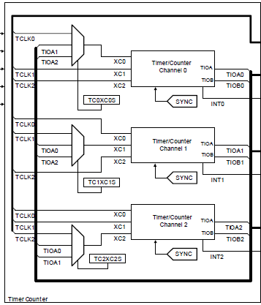

SAM4L Timers
Three 16-bit timers
Each of which can have multiple inputs clock signals with prescaler values
Timers can be chained together to make up to a 48-bit timer
One register for reading counter
Three registers for “compare interrupts”

Slide 36
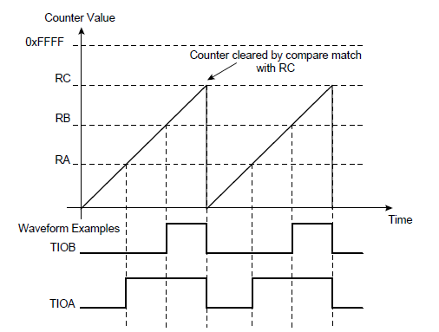
SAM4L PWM
PWM peripheral is essentially built into Timer peripheral
Timer peripheral also supports a “Waveform” mode where it generates an output GPIO signal, i.e. PWM
One comparison point is low-to-high transition, another is high-to-low transition

Slide 37
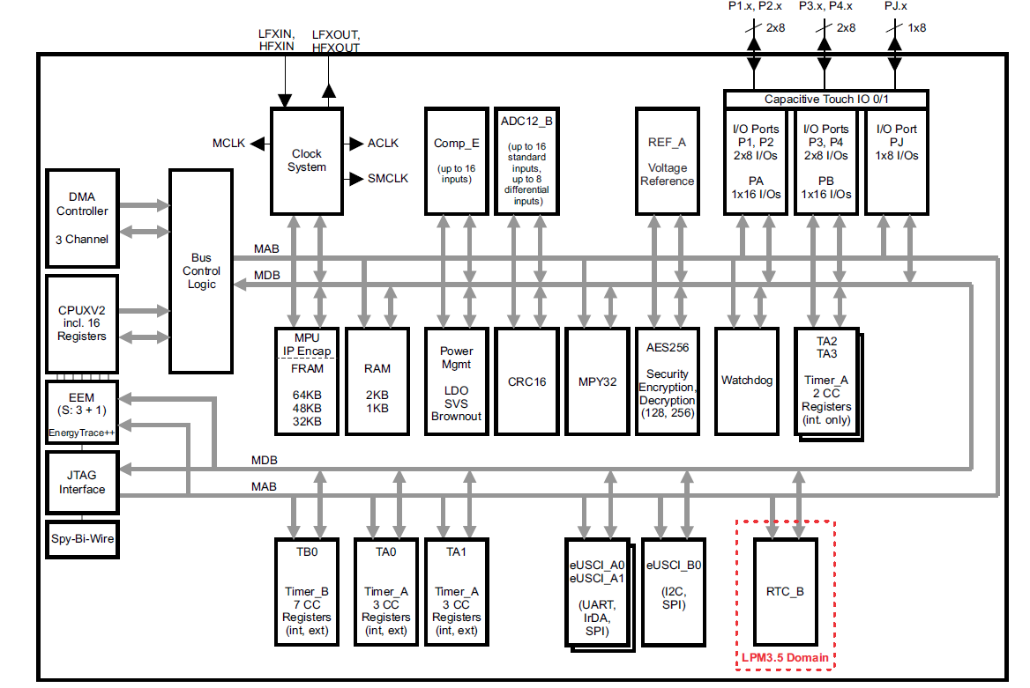
Texas Instruments MSP430 (MSP430FR59xx)
Example of a very different microcontroller
16-bit custom architecture processor
2 kB RAM
64 kB FRAM

Slide 38
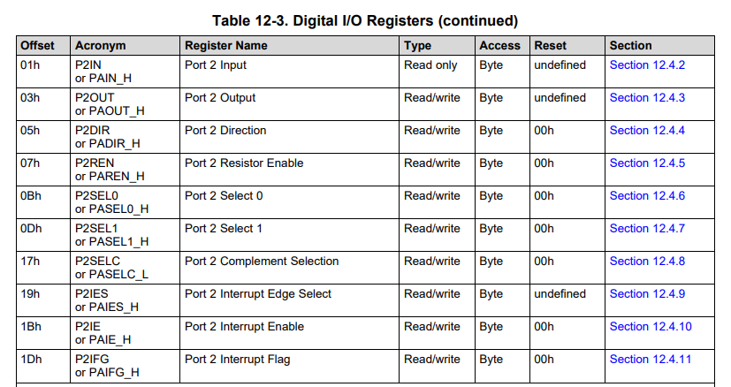
MSP430 GPIO register map
Registers are a single byte in size
Oddly, some have an “undefined” reset state

Slide 39
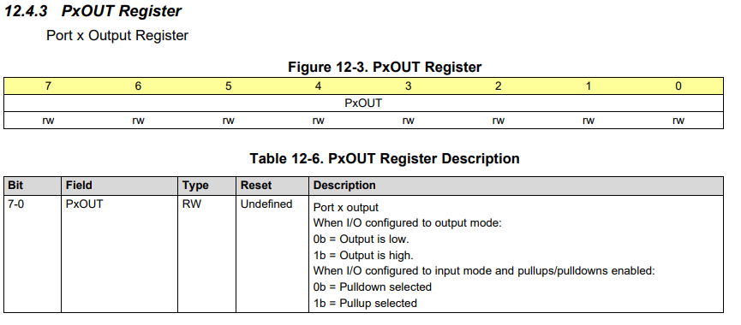
Example MSP430 GPIO register: OUT
Example 8-bit register. Controls 8 pins in a GPIO “port”

Slide 40
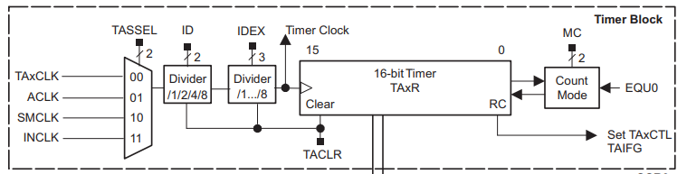
MSP430 Timer peripheral
A choice of input clocks goes through dividers to run a 16-bit timer
Five total timers available on the system
Some can trigger external output pins, some are only internal

Slide 41
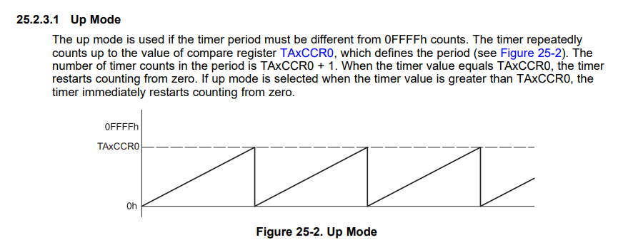
MSP430 PWM
The MSP430 Timer peripheral handles PWM as well!

Slide 42
Outline
What haven’t we talked about?
Microbit
nRF52833
Other hardware systems
Other microcontrollers
Microprocessors
FPGAs

Slide 43
Microprocessor system design
What about modern microprocessors? (really SoC’s)
Similar idea, but a LOT more stuff
Various peripherals, which might not be focused on sensor I/O
Less ADCs and I2C more Ethernet and Graphics
External memory busses
Microprocessors expect external memory to exist on the system
Which means that they need pins for an external memory bus

Slide 44
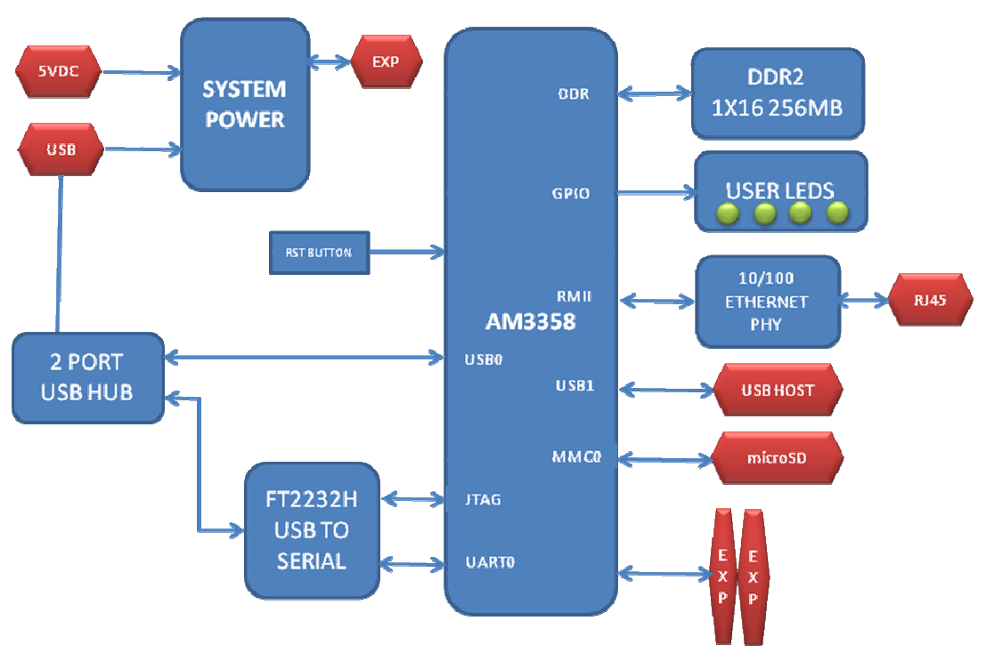
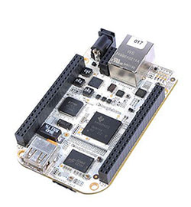
Beaglebone
Gross diagram that’s actually in their datasheet
Cheap, single board computer
Like Raspberry Pi

Slide 45
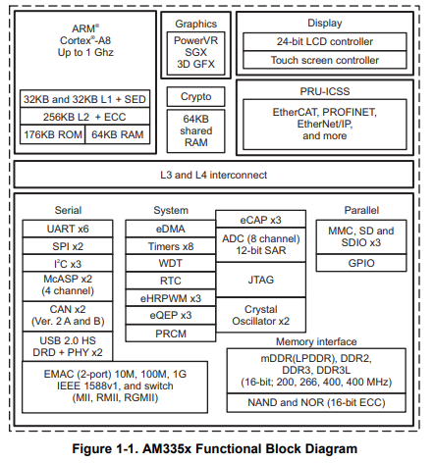
AM3358 processor
ARM Cortex A8
32-bit processor
1 GHz clock
300 pins!!
Internal memory
176 kB ROM
64 kB RAM
External memory
DDR2/3, 400 MHz RAM
NAND or NOR Flash

Slide 46
AM3358 peripherals
Advanced peripherals
Graphics
Ethernet
USB, CAN
Regular peripherals
GPIO, Timers
ADC
UART, SPI, I2C

Slide 47
How much bigger is a microprocessor?
nRF52833 datasheet:
600 pages total
AM3358 datasheet:
250 pages of electrical information
5000 pages of peripheral information
And it’s not that the basic peripherals are much larger
UART: 60 pages
I2C: 20 pages
Four different timers at ~30 pages each

Slide 48
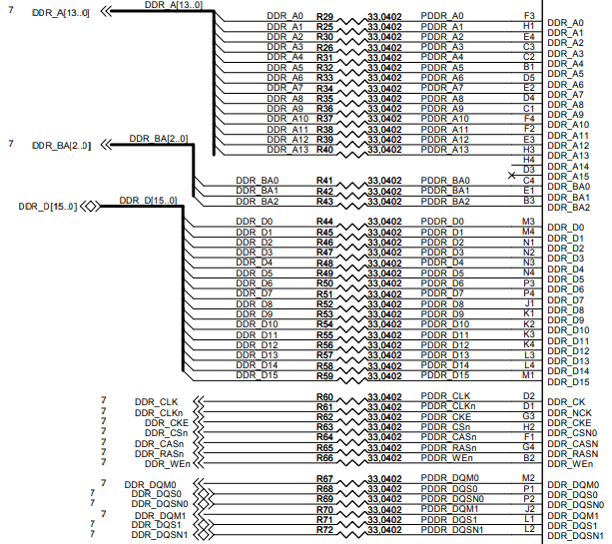
Memory interface - DDR
Pinout on the Beaglebone
Double Data Rate (DDR)
Address bits
17 pins (3 bank, 14 address)
Bank + Address selects a 2 kB chunk out of 2 GB
Data bits
16 pins
Clocks, Chip select
Various sequencing signals

Slide 49
Break + Question
Wires (traces) for high-speed busses like memory must be match, to ensure that all are exactly the same length. Why?

Slide 50
Break + Question
Wires (traces) for high-speed busses like memory must be match, to ensure that all are exactly the same length. Why?
Speed of electricity in the wires matters
If one wire is a foot longer than the others, its signal arrives 1 ns late
Even fractions of nanoseconds could matter for high-speed communication

Slide 51
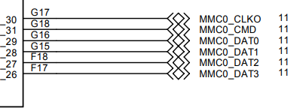
Flash interface - MMC
Multi-media Card interface
Used to communicate with SD Cards
Also for eMMC Flash chips (which act like SD Cards, but soldered in place)
For SD cards SPI can usually be used
For eMMC 4-bit version of interface
Clock
Command
Data 0, 1, 2, 3
Pinout on the Beaglebone

Slide 52
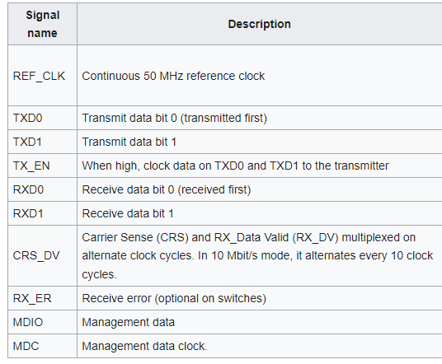
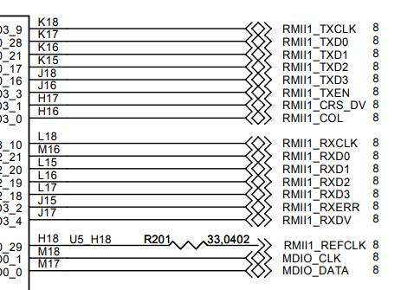
Ethernet interface - RMII
Reduced Media-Independent Interface (RMII)
Pinout on the Beaglebone

Slide 53
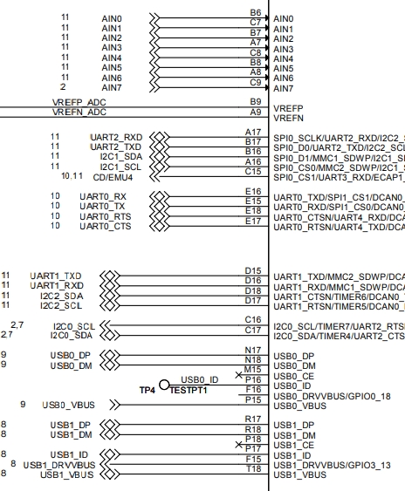
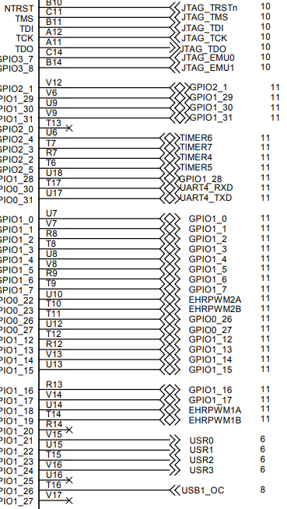
Other processor pinouts on the Beaglebone
Lots of acronyms that we recognize!
Analog inputs
UARTs
I2C
GPIOs
Timers

Slide 54
Resources on the Beaglebone and its microprocessor
https://beagleboard.org/bone-original
https://beagleboard.org/static/beaglebone/BEAGLEBONE_SCHEM_A3.pdf
https://transistor-man.com/files/emu/beaglebone_hardware/BONE_SRM.pdf
https://www.ti.com/product/AM3358

Slide 55
Outline
What haven’t we talked about?
Microbit
nRF52833
Other hardware systems
Other microcontrollers
Microprocessors
FPGAs

Slide 56
FPGA systems
When else might you run into large busses like memory?
On an FPGA!
Field-Programmable Gate Array (FPGA)
Configurable hardware
Engineers write a description of the hardware (Verilog or VHDL)
FPGA implements that hardware
Much faster than software, but still slower than a custom chip

Slide 57
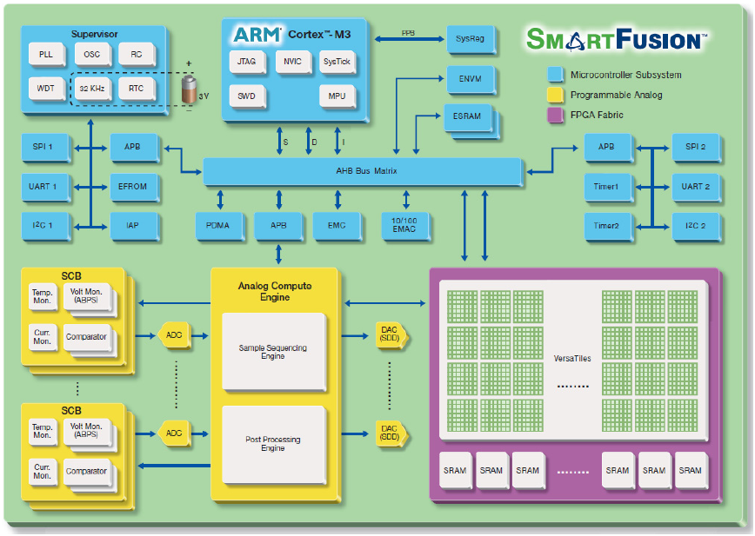
Combined FPGA + Microcontroller

Slide 58
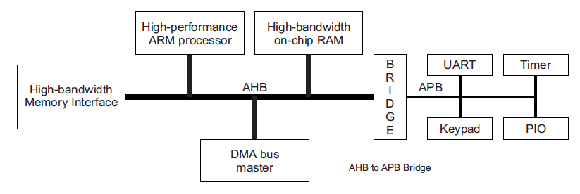
Busses: AHB vs APB
Advanced Peripheral Bus (APB)
Simpler interface
Lower power
Used for most peripheral communication
Advanced High-performance Bus (AHB)
Multiple bus controllers
Pipelined operation
Burst transfers of data
Used for high-speed memory operations

Slide 59
APB usage
Bus has three states
IDLE
Nothing is happening
Default
SETUP
A transfer of data is about to happen
Address and configuration signals are set
ACCESS
Data is actually transferred over the bus

Slide 60
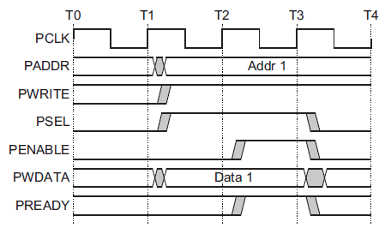
Example APB write operation
Setup phase begins
with this rising edge
Setup
Phase
Access
Phase

Slide 61
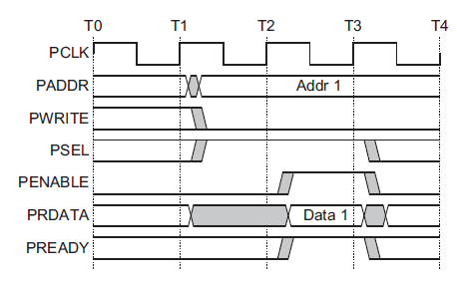
Example APB read operation
Setup phase begins
with this rising edge
Setup
Phase
Access
Phase

Slide 62
With an FPGA you can create your own peripherals
Busses can be exposed to the FPGA for it to use
Example use case
Custom camera with selectable pixel lines and an ADC
Don’t want to manually control it with software (too slow)
Create a hardware peripheral on the FPGA that takes software commands like “grab a frame” and implements them

Slide 63
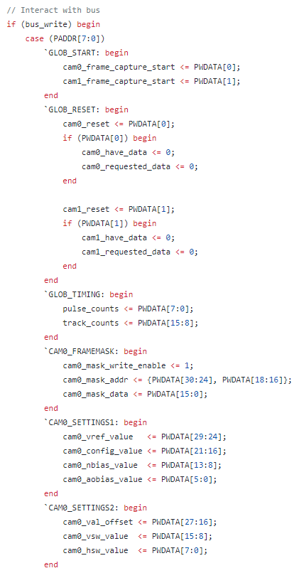
Example register map
Verilog HDL that describes a register map
Reads in the address from the bus to determine which register is written to
Modifies internal registers based on the bits of the data

Slide 64
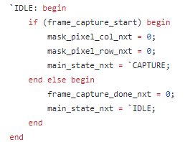
Performing peripheral operations
On every clock edge, check status registers
If they are active, iterate through a state machine
Possibly many states to make the actual operation occur

Slide 65
Outline
What haven’t we talked about?
Microbit
nRF52833
Other hardware systems
Other microcontrollers
Microprocessors
FPGAs

