Slide 1
Lecture 02 Embedded Software
CE346 – Microcontroller System Design
Branden Ghena – Spring 2025
Some slides borrowed from: Josiah Hester (Northwestern), Prabal Dutta (UC Berkeley)

Slide 2
Administrivia
Make sure you have your personal lab setup working
Ask in office hours or on Piazza if you run into issues
Labs will start this Friday!!!
You MUST come to your scheduled lab session
If there’s some known obligation and you give me a heads up, I can let you move to the other section
If you want to permanently change lab sessions (to the later lab at 3pm) let me know
I’ll hand out Microbits as part of lab

Slide 3
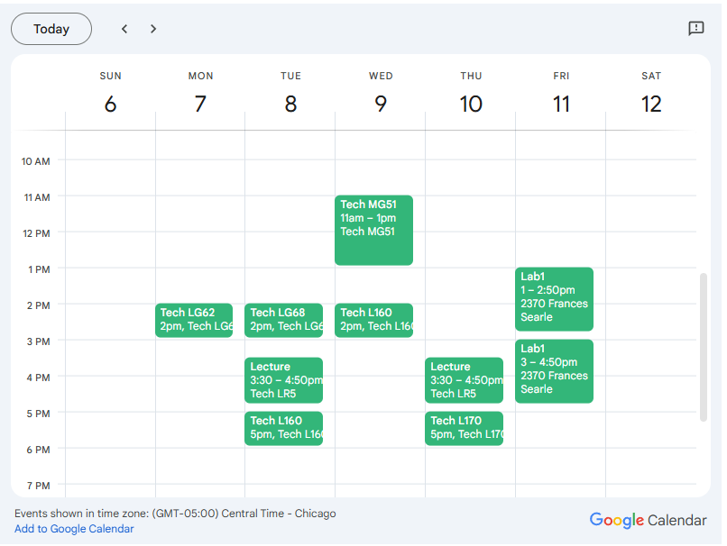
Weekly Schedule
Office Hours
Monday 2-3
Tuesday 2-3, 5-6 (joint)
Wednesday 11-1, 2-3
Thursday 5-6
Checkoffs and debugging
But also ANY class question
These are for you to use

Slide 4
Today’s Goals
Discuss challenges of embedded software
Describe compilation and linking of embedded code
(Actually applies to all code, but you probably never learned much about linking before)
Introduce Memory-Mapped I/O as a mechanism for communicating with peripherals
Explore the microcontroller boot process

Slide 5
Outline
Embedded Software Overview
Embedded Toolchain
Lab Software Environment
Memory-Mapped I/O
Boot Process

Slide 6
Review: C memory layout
Address 0xFFFFFFFFFFFFFFFF
Stack Section
Local variables
Function arguments
Heap Section
Memory granted through malloc()
Static Section (a.k.a. Data Section)
Global variables
Static function variables
Text Section (a.k.a Code Section)
Program code
Stack
Heap
Static
Text
Address 0x0000000000000000

Slide 7
Assumptions of embedded programs
Expect limitations
Very little memory
Very little computational power
Very little energy
Don’t expect a lot of support
Likely no operating system
Might not even have error reporting capabilities
Your code runs the entire system
Single application on the system that runs forever
Moral: think differently about your programs

Slide 8
Ramifications of limited memory
Stack and Data sections are limited
Be careful about too much recursion
Be careful about large local variables
Large data structures defined globally are preferred
In embedded, we often encourage global variables for large things
Fail at compile time rather than run-time
Heap section might exist but should only be used cautiously
What do you do if the heap runs out?

Slide 9
Avoiding dynamic memory
Malloc is scary in an embedded context
What if there’s no more memory available?
Traditional computer
Swap memory to disk
Worst case: wait for a process to end (or kill one)
Embedded computer
There’s likely only a single application
And it’s the one asking for more memory
So it’s not giving anything back anytime soon
This is unlikely to happen at boot
Instead it’ll happen hours or days into running as memory is slowly exhausted…

Slide 10
Limitations on processing power
Typically not all that important
Code still runs pretty fast
10 MHz -> 100 ns per cycle (i.e. ~100 ns per instruction)
~10 million instructions per second
Controlling hardware usually doesn’t have a lot of code complexity
Quickly gets to the “waiting on hardware” part (apps are I/O bound)
Problems
Machine learning
Learning on the device is a big challenge
Memory limitations make it hard to fit weights anyways
Cryptography
Public key encryption takes seconds to minutes

Slide 11
Common programming languages for embedded
C
For all the reasons that you assume
Easy to map variables to memory usage and code to instructions
Assembly
Not entirely uncommon, but rarer than you might guess
C code optimized by a modern compiler is likely faster
Notable uses:
Cryptography to create deterministic algorithms
Operating Systems to handle process swaps
C++
Similar to C but with better library support
Libraries can take up a lot of code space though ~100 KB
Some specialized versions of libraries take up less space

Slide 12
Rarer programming languages for embedded
Rust
Modern language with safety and reliability guarantees
Increasingly relevant in the embedded space
But with a high learning curve
Python, Javascript, Scratch, etc.
Mostly toy languages
Fine for simple things but incapable of complex operations
Especially low-level things like managing memory
Microbit supports all of these, play around with them sometime:
https://makecode.microbit.org/
https://python.microbit.org/v/3
https://scratch.mit.edu/microbit

Slide 13
What’s missing from programming languages?
The embedded domain has several requirements that other domains do not
What is missing from programming languages that it wants?
Sense of time
Sense of energy

Slide 14
Programming languages have no sense of time
Imagine a system that needs to send messages to a motor every 10 milliseconds
Write a function that definitely completes within 10 milliseconds
Accounting for timing when programming is very challenging
We can profile code and determine timing at runtime
If we know many details of hardware, instructions can give timing
Unless the code interacts with external devices

Slide 15
Determining energy use is rather complicated
Software might
Start executing a loop
Turn on/off an LED
Send messages over a wired bus to another device
Determining energy these operations take is really difficult
Even with many details of the hardware
Different choices of processor clocks can have a large impact
Often profiled at runtime after writing the code
Iterative write-test-modify cycle

Slide 16
Break + Question
Which program takes longer to run?
Program 1:
volatile float value = 1337.3235;
volatile float result = sqrt(value);
Program 2:
printf(“Hello world!\n”);

Slide 17
Break + Question
Which program takes longer to run?
Program 1:
volatile float value = 1337.3235;
volatile float result = sqrt(value);
33 microseconds
~2112 instructions
Program 2:
printf(“Hello world!\n”);
3392 microseconds
~217088 instructions
Majority of the time isn’t spent in instructions though
Printf takes about 100x longer!!

Slide 18
Outline
Embedded Software Overview
Embedded Toolchain
Lab Software Environment
Memory-Mapped I/O
Boot Process

Slide 19
Embedded compilation steps
Same first steps as any system
Compiler
Turn C code into assembly
Optimize code (often for code size instead of speed)

Slide 20
Cross compilers compile for different architectures
The compiler we’ll be using is a cross compiler
Run on one architecture but compile code for another
Example: runs on x86-64 but compiles armv7e-m
GCC naming scheme: ARCH-VENDOR-(OS-)-ABI-gcc
arm-none-eabi-gcc
ARM architecture
No vendor
No OS
Embedded Application Binary Interface
Others: arm-none-linux-gnueabi-gcc, i686-pc-windows-msvc-gcc

Slide 21
Embedded compilation steps
Same first steps as any system
Compiler
Turn C code into assembly
Optimize code (often for size instead of speed)
Linker
Combine multiple C files together
Resolve dependencies
Point function calls at correct place
Connect creation and uses of global variables

Slide 22
Informing linker of system memory
Linker actually places code and variables in memory
It needs to know where to place things
How do x86-64 compilers know which addresses to use?

Slide 23
Informing linker of system memory
Linker actually places code and variables in memory
It needs to know where to place things
How do x86-64 compilers know which addresses to use?
Standard layout for all processes
Virtual memory allows all applications to use the same memory addresses
Embedded solution
Only run a single application
Provide our own standard layout: an LD file
Specifies memory layout for a certain system
Places sections of code in different places in memory

Slide 24
Anatomy of an LD file
nRF52833: 512 KB Flash, 128 KB SRAM
First, LD file defines memory regions
MEMORY {
FLASH (rx) : ORIGIN = 0x00000000, LENGTH = 0x80000
RAM (rwx) : ORIGIN = 0x20000000, LENGTH = 0x20000
}
A neat thing about microcontrollers: pointers have meaning
Just printing the value of a pointer can tell you if it’s in Flash or RAM

Slide 25
Anatomy of an LD file
It then places sections of code into those memory regions
.text : {
KEEP(*(.Vectors))
*(.text*)
*(.rodata*)
. = ALIGN(4);
} > FLASH __etext = .;
.data : AT (__etext) {
__data_start__ = .;
*(.data*)
__data_end__ = .;
} > RAM
.bss : {
. = ALIGN(4);
__bss_start__ = .;
*(.bss*)
. = ALIGN(4);
__bss_end__ = .;
} > RAM

Slide 26
Sections of code
Where do these sections come from?
Most are generated by the compiler
.text, .rodata, .data, .bss
You need to be deep in the docs to figure out how the esoteric ones work
Some are generated by the programmer
Allows you to place certain data items in a specific way
__attribute__((section(".foo")))
int test[10] = {0,0,0,0,0,0,0,0,0,0};

Slide 27
Embedded compilation steps
Same first steps as any system
Compiler
Turn C code into assembly
Optimize code (often for size instead of speed)
Linker
Combine multiple C files together
Resolve dependencies
Point function calls at correct place
Connect creation and uses of global variables
Output: a binary (or hex) file

Slide 28
Loading the hex file onto a board
This is a use case for JTAG
You provide it a hex file which specifies addresses and values
It writes those into Flash on the microcontroller
The LD file already specified addresses
So passing around hex files is enough to load an application
But a hex file for one microcontroller won’t work on another with a different memory layout

Slide 29
Example
Demonstrated in the blink application in lab repo
https://github.com/nu-ce346/nu-microbit-base/tree/main/software/apps/blink

Slide 30
Outline
Embedded Software Overview
Embedded Toolchain
Lab Software Environment
Memory-Mapped I/O
Boot Process

Slide 31
Embedded environments
There are a multitude of embedded software systems
Every microcontroller vendor has their own
Popular platforms like Arduino
We’re using the Nordic software development libraries plus some extensions made by my research group
It’ll be a week until that matters for the most part
We’ll start off by writing low-level drivers ourselves without libraries

Slide 32
Software Development Kit (SDK)
Libraries provided by Nordic for using their microcontrollers
Actually incredibly well documented! (relatively)
Various peripherals and library tools
SDK documentation
https://docs.nordicsemi.com/bundle/sdk_nrf5_v16.0.0/page/index.html
Warning: search doesn’t really work
Possibly more useful: the list of data structures
Search that page for whatever “thing” you’re working with
https://docs.nordicsemi.com/bundle/sdk_nrf5_v16.0.0/page/annotated.html

Slide 33

nRF52x-base
Wrapper built around the SDK by Lab11
Branden Ghena, Brad Campbell (UVA), Neal Jackson, a few others
Allows everything to be used with Makefiles and command line
https://github.com/lab11/nrf52x-base
We include it as a submodule
It has a copy of the SDK code and softdevice binaries
It has a whole Makefile system to include to proper C and H files
We include a Board file that specifies our specific board’s needs and capabilities
Go to repo to explain

Slide 34
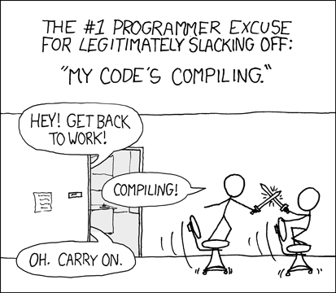
Break + xkcd
https://xkcd.com/303/

Slide 35
Outline
Embedded Software Overview
Embedded Toolchain
Lab Software Environment
Memory-Mapped I/O
Boot Process

Slide 36
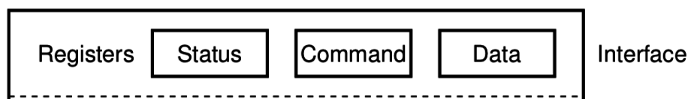
How does a computer talk with peripherals?
A peripheral is a hardware unit within a microcontroller
Sort of a “computer-within-the-computer”
Performs some kind of action given input, generates output
We interact with a peripheral’s interface
Called registers (actually are from EE perspective, but you can’t use them)
Read/Write like they’re data
How do we read/write them?
Options:
Special assembly instructions
Treat like normal memory

Slide 37

Memory-mapped I/O (MMIO): treat devices like normal memory
Certain physical addresses do not actually go to memory
Instead they correspond to peripherals
And any instruction that accesses memory can access them too!
Every microcontroller I’ve ever seen uses MMIO
Address
0xFFFFFFFF
0xFFFF0000
control reg.
data reg.
0x00000000

Slide 38
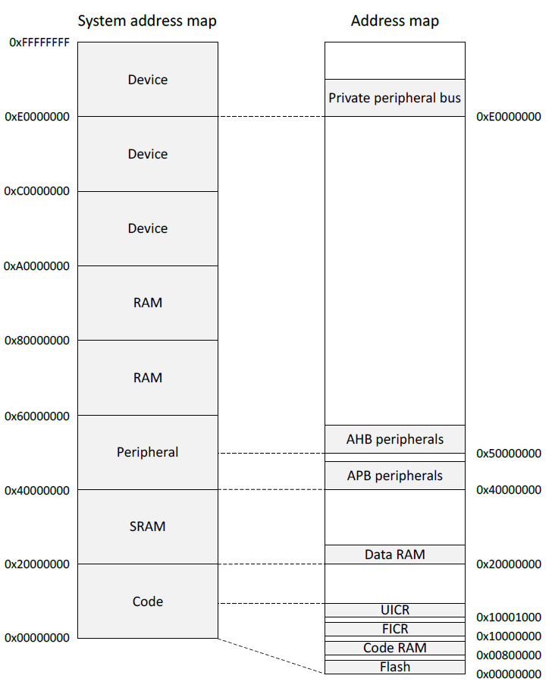
Memory map on nRF52833
Flash 0x00000000
SRAM 0x20000000
APB peripherals 0x40000000
Everything but GPIO
AHB peripherals 0x50000000
Just GPIO
UICR – User Information Config
FICR – Factory Information Config

Slide 39
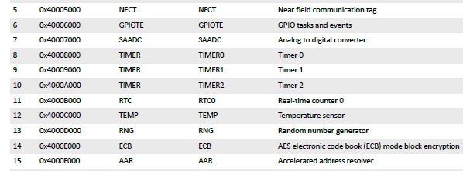
Example nRF52 peripheral placement
0x1000 is plenty of space for each peripheral
1024 registers, each 32 bits
No reason to pack them tighter than that

Slide 40
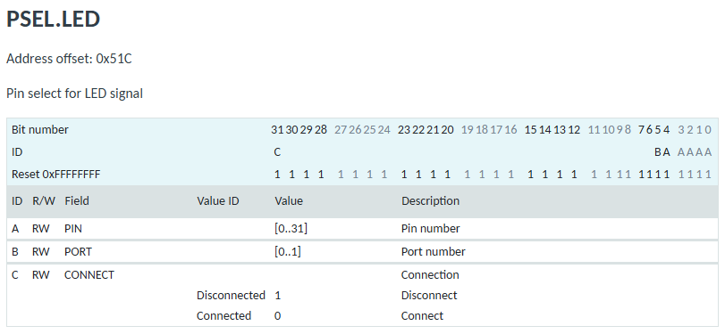
Example register layout
32-bit value
Bits 0-4 are field A
Bit 5 is field B
Bit 31 is field C
Others are unused
Each field has value ranges and descriptions of what it means

Slide 41
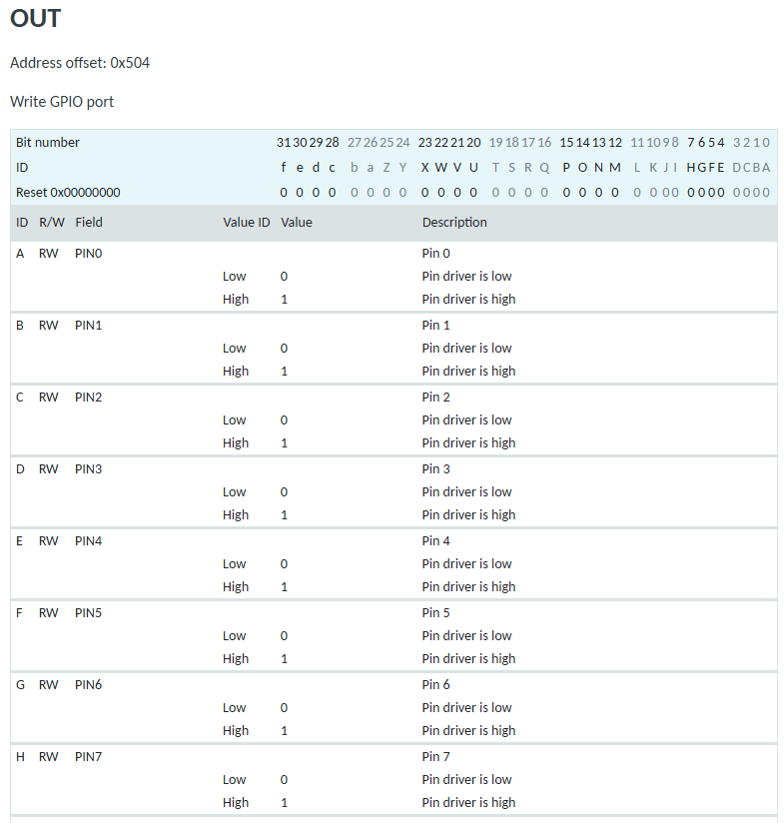
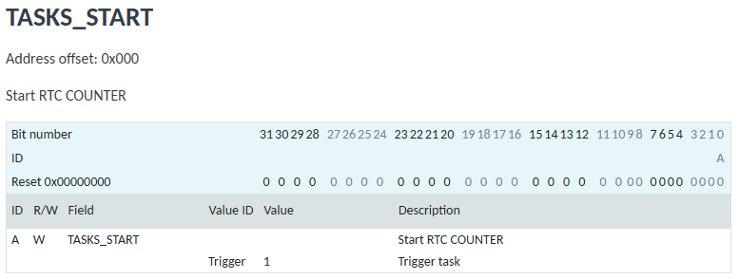
Registers can vary wildly in complexity

Slide 42
Bit Masking
How do you manipulate certain bits within a number?
Use bit manipulation operations
~, &, |, <<, >>
Steps
Create a “bit mask” which is a pattern to choose certain bits
Use & or | to combine it with your number
Optional: Use >> to move the bits to the least significant position

Slide 43
Bit mask values
Selecting bits, use the AND operation
1 means to select that bit
0 means to not select that bit
Writing bits
Writing a one, use the OR operation
1 means to write a one to that position
0 is unchanged
Writing a zero, use the AND operation
0 means to write a zero to that position
1 is unchanged
Select bottom four bits:
num & 0x0F
Set 6th bit to one:
num | (1 << 6)
num | (0b01000000)
Clear 6th bit to zero: num & (~(1 << 6))
num & (~(0b01000000))
num & (0b10111111)

Slide 44
Example: selecting bits
0b01100100
Input: 0b01100100
Select bits 2 and 3 from a number
Mask: 0b00001100
0b01100100
& 0b00001100
0b00000100
In C: result = (input & 0x0C) >> 2;
Finally, shift right by two to get the values in the least significant position:
0b00000001

Slide 45
Manipulating a register value
Check Port value
value = (REG >> 5) & 1 or (REG & (1 << 5)) >> 5
Write port value
REG |= (1 << 5) // set port to 0
REG &= ~(1 << 5); // set port to 1

Slide 46
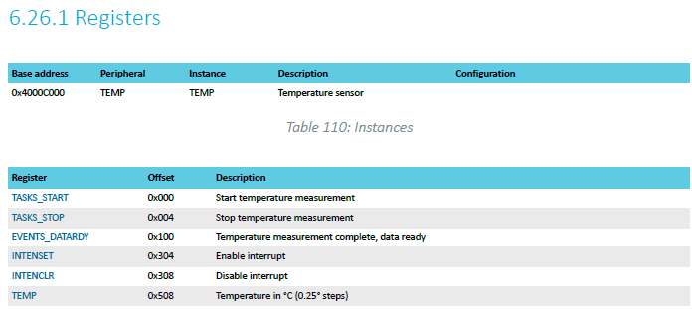
TEMP on nRF52833 example
Internal temperature sensor
0.25° C resolution
Range equivalent to microcontroller IC (-40° to 105° C)
Various configurations for the temperature conversion (ignoring)
https://docs.nordicsemi.com/bundle/ps_nrf52833/page/temp.html

Slide 47
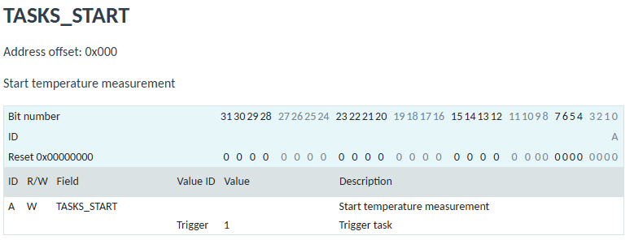
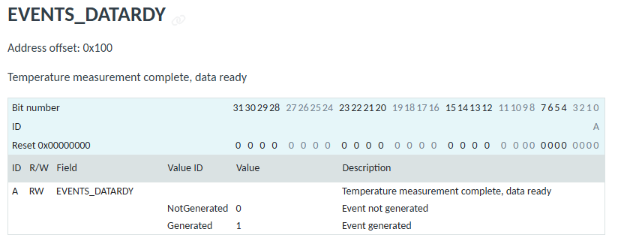
Interacting with the temperature peripheral

Slide 48
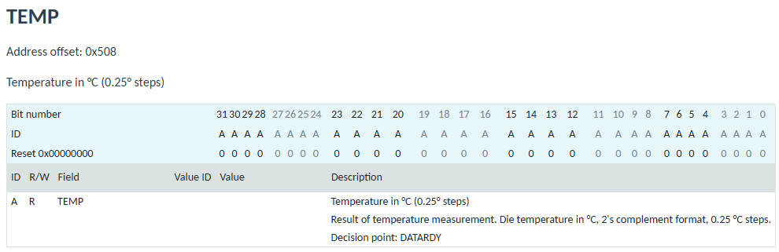
Reading a temperature value
32-bit value
2’s complement (i.e., signed)
0.25 ℃ steps (so 0 = 0℃, 4 = 1℃, etc.)

Slide 49
MMIO addresses for TEMP
What addresses do we need? (ignore interrupts for now)
0x4000C000 – TASKS_START
0x4000C100 – EVENTS_DATARDY
0x4000C508 - TEMP

Slide 50
Accessing addresses in C
What does this C code do?
*(uint32_t*)(0x4000C000) = 1;

Slide 51
Accessing addresses in C
What does this C code do?
*(uint32_t*)(0x4000C000) = 1;
0x4000C000 is cast to a uint32_t*
Then dereferenced
And we write 1 to it
“There are 32-bits of memory at 0x4000C000. Write a 1 there.”

Slide 52
Example code
To the terminal!
Let’s write it from scratch

Slide 53
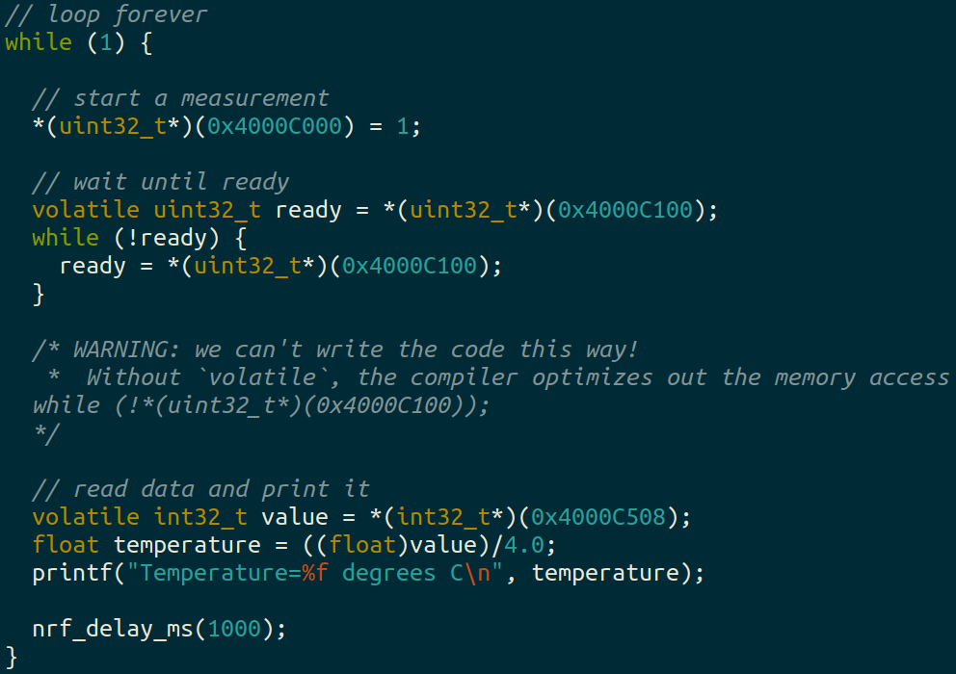
Example code (temp_mmio app)

Slide 54
Using structs to manage MMIO access
Writing simple C code and access peripherals is great!
Problems:
Need to remember all these long addresses
Need to make sure compiler doesn’t stop us!
Solution:
Wrap entire access in a struct!
Compilers turn it into the same thing in the end anyways

Slide 55
C structs
Collection of variables placed together in memory
typedef struct {
uint32_t variable_one;
uint32_t variable_two;
uint32_t array[2];
} example_struct_t;
Placement rules - Variables are placed adjacent to each other in memory except:
Fields are always aligned to a multiple of their size
Padding added to the end to make the total size a multiple of the biggest member
Microcontrollers can usually ignore these: all registers are the same size!

Slide 56
Temperature peripheral MMIO struct
typedef struct {
uint32_t TASKS_START;
uint32_t TASKS_STOP;
uint32_t _unused_A[62];
uint32_t EVENTS_DATARDY;
uint32_t _unused_B[0x204/4 - 1];
uint32_t INTENSET;
uint32_t INTENCLR;
uint32_t _unused_C[(0x508 – 0x308)/4 – 1];
uint32_t TEMP;
} temp_regs_t;
volatile temp_regs_t* TEMP_REGS = (temp_regs_t*)(0x4000C000);
With increasingly verbose ways to write the size of the “unused” space (any of these will do, but don’t forget the -1)

Slide 57
Temperature peripheral MMIO struct
typedef struct {
uint32_t TASKS_START;
uint32_t TASKS_STOP;
uint32_t _unused_A[62];
uint32_t EVENTS_DATARDY;
uint32_t _unused_B[0x204/4 - 1];
uint32_t INTENSET;
uint32_t INTENCLR;
uint32_t _unused_C[(0x508 – 0x308)/4 – 1];
uint32_t TEMP;
} temp_regs_t;
volatile temp_regs_t* TEMP_REGS = (temp_regs_t*)(0x4000C000);
// code to access
TEMP_REGS->TASKS_START = 1;
while (TEMP_REGS->EVENTS_DATARDY == 0);
float temperature = ((float)TEMP_REGS->TEMP)/4.0;

Slide 58
Using MMIO structs
Note: structs still don’t get you individual bits, they only get you the 32-bit registers themselves
You’ll need to do bit manipulations to get the read/write fields you want
Bit fields are an option in C that can allow access to individual bits, but are generally not used
Implementation-specific details for how they actually work
What if you need to change multiple fields simultaneously?

Slide 59
Break + Question
Are compiled binaries portable to other types of microcontrollers?

Slide 60
Break + Question
Are compiled binaries portable to other types of microcontrollers?
Definitely not
1) Each microcontroller has its own layout of Flash and RAM, so we might need to put our code in different locations
2) Each microcontroller has its own MMIO addresses and devices And every device works at least slightly differently
Can sometimes get away with it for microcontrollers in the same family
I.e., class code might work on an nRF52840 instead of our nRF52833

Slide 61
Outline
Embedded Software Overview
Embedded Toolchain
Lab Software Environment
Memory-Mapped I/O
Boot Process

Slide 62
How does a microcontroller start running code?
Power comes on
Microcontroller needs to start executing assembly code
You expect your main() function to run
But a few things need to happen first

Slide 63
Step 0: set a stack pointer
Assembly code might need to write data to the stack
Might call functions that need to stack registers
ARM: Valid address for the stack pointer is at first address in Flash
Needs to point to somewhere in RAM
Hardware loads it into the Stack Pointer when it powers on

Slide 64
Step 1: set the program counter (PC)
a.k.a. the Instruction Pointer (IP) in x86 land
32-bit ARM: valid instruction pointer is at address 4 in Flash
Could point to RAM, usually to Flash though
In interrupt terms: this is the “Reset Handler”!
Automatically loaded into the PC after the SP is loaded
Again, hardware does this

Slide 65
Step 2: “reset handler” prepares memory
Code that handles system resets
Either reset button or power-on reset
Address was loaded into PC in Step 1
Reset handler code:
Loads initial values of .data section from Flash into RAM
Loads zeros as values of .bss section in RAM
Calls SystemInit
Starts correct clocks for the system
Handles various hardware configurations/errata
Calls _start
nu-microbit-base/software/nrf52x-base/sdk/nrf5_sdk_16.0.0/modules/nrfx/mdk/gcc_startup_nrf52833.S nu-microbit-base/software/nrf52x-base/sdk/nrf5_sdk_16.0.0/modules/nrfx/mdk/system_nrf52.c

Slide 66
Step 3: set up C runtime
_start is provided by newlib
An implementation of libc – the C standard library
Startup is a file usually named crt0
Does more setup, almost none of which is relevant for our system
Probably is this code that actually zeros out .bss
Sets argc and argv to 0
Calls main() !!!
https://sourceware.org/git/gitweb.cgi?p=newlib-cygwin.git;a=blob_plain;f=libgloss/arm/crt0.S;hb=HEAD

Slide 67
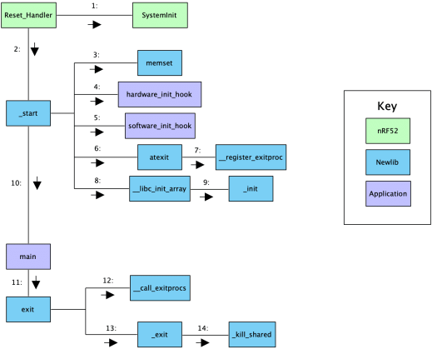
Online writeup with way more details and a diagram
Relevant guide!!
https://embeddedartistry.com/blog/2019/04/17/exploring-startup-implementations-newlib-arm/
Covers the nRF52!

Slide 68
Outline
Embedded Software Overview
Embedded Toolchain
Lab Software Environment
Memory-Mapped I/O
Boot Process

