Slide 1
Lecture 06 Driver Design
CE346 – Microcontroller System Design
Branden Ghena – Spring 2025
Some slides borrowed from: Josiah Hester (Northwestern), Prabal Dutta (UC Berkeley)

Slide 2
Administriva
Project Proposals due later this week
Feel free to chat with me if you’ve got any questions about ideas
Emailed project groups already
If you’re still looking for a group, or another group member, let me know
Tuesday later office hours (with me) moved
Now in Tech L251
From 5:00-6:30 pm
(Bigger room with more time)

Slide 3
Today’s Goals
Deep-dive into driver design options
Explore another aspect of device driver design
Non-blocking vs Blocking interfaces
Discuss how interrupts interact with these
Event-loop as a partial alternative
Introduce State Machines for coordinating logic
Consider how an LED matrix driver could be constructed

Slide 4
Outline
Driver Interfaces (Blocking and Non-Blocking)
Event-driven Model
State Machines
Continuous Operation

Slide 5
How should we write driver software?
There are various knobs available to us from hardware
Polling, Interrupts, DMA
There are also various software interface design
Synchronous
Asynchronous
Callback
Event-driven model

Slide 6
Synchronous device drivers
Synchronous functions
Function call issues a command
Does not return until action is complete and result is ready
Example: most functions we’re used to
sqrt() for example
printf() also mostly works this way (with some exceptions)
Arduino interfaces are usually like this!
Easy to get started with and understand

Slide 7
Downside of synchronous code: the waiting
How long will it take until the function returns?
Immediately, seconds, minutes?
What if there’s an error and the device never responds?
More advanced interface could include a timeout option
Synchronous designs require other synchronous designs
We can build synchronous interfaces from asynchronous ones
But we can’t go the other way

Slide 8
Asynchronous drivers
Goal: let the hardware run on its own and have the code get back to it later
Challenge: programmers don’t think that way
Other challenge: how do we “get back to it later”?
Callbacks
Event-driven model

Slide 9
Callbacks
Callbacks reuse a similar idea to interrupts
When the event occurs, call this function
General pattern
Call driver function with one argument being a function pointer
Driver sets up interaction and returns immediately
Later the event happens and the driver calls the function pointer

Slide 10
Function pointers in C
Harder than in Javascript or C++. Can’t define anonymous function inline
Instead create a pointer to an existing function in your code
void myfun(int a) {
// do something here
}
void main() {
void (*fun_ptr)(int) = &myfun;
fun_ptr(10); // dereference happens automatically
}
& is actually unnecessary. With or without are identical.

Slide 11
Callback functions
uint32_t timer_start( uint32_t microseconds, void (*callback_fn)(void*), void* context );
timer_start(duration, my_timer_handler, context);
“Context” is often provided as well (void*)
Ability for caller to pass an argument for the callback function
Often a pointer to a position in a structure or a shared variable to modify

Slide 12
Callbacks usually run in an interrupt mode
If the interrupt handler calls the callback, the callback will be within that same interrupt mode
Be careful which variables you modify!!
Could lead to concurrency issues if you modify a public structure
Starts to get pretty annoying
Embedded systems have to deal with concurrency issues just like OSes

Slide 13
Building synchronous code out of callbacks
Callback handlers can be used to build synchronous code
void myfun(void* context) {
*(boolean*)context = true; // context is the flag pointer
}
void timer_start_blocking(duration) {
volatile boolean flag = false;
timer_start(duration, &myfun, &flag);
while (!flag) { // spin-loop }
}

Slide 14
Live Coding: Temp driver example
nu-microbit-base/software/apps/temp_driver/
Some necessary functions
NVIC_EnableIRQ(irq); // TEMP_IRQn is for the Temperature Sensor
NVIC_SetPriority(irq, priority)

Slide 15
Outline
Driver Interfaces (Blocking and Non-Blocking)
Event-driven Model
State Machines
Continuous Operation

Slide 16
Interrupts are frustrating
We do not always want to block on every call
We also do not want to deal with concurrency issues
An alternative: one main event loop
Polls necessary sensors
Iterates through state machine and determine actions
Runs at a certain frequency

Slide 17
Event loop
Rather than polling a single driver, poll all of them
Each time through the loop check all relevant inputs
Respond to events that are necessary
Sleep until ready to start again
while (1) {
time start = get_time();
boolean result = check_timer();
if (result) { check_gps(); }
adjust_throttle();
delay_ms(1000 – (get_time() – start));
}

Slide 18
Downsides of event loop design
Timeliness can be a problem
How long between the timer being ready and the GPS being checked in this example?
Maximum of 1 second plus the time spent checking other stuff
while (1) {
time start = get_time();
boolean result = check_timer();
if (result) { check_gps(); }
adjust_throttle();
delay_ms(1000 – (get_time() – start));
}

Slide 19
Top-half / Bottom-half handler design
Top half
Interrupt handler
Immediately continues next transaction
Or signals for top half to continue (often with shared variable)
Bottom half
Performs logic to actually process and respond to the event
Run in a non-interrupt context when the scheduler is ready for it
Usually safe to run it even while interrupts could be occurring

Slide 20
Live Coding: Temperature event-loop example
nu-microbit-base/software/apps/temp_event_loop/
Some necessary functions
NVIC_EnableIRQ(irq); // TEMP_IRQn is for the Temperature Sensor
NVIC_SetPriority(irq, priority)

Slide 21
Driver design is about the public interfaces
Internally, an “event-loop” driver likely uses interrupts and callbacks
Externally, it presents non-blocking interfaces that also don’t require callbacks
Hides the complexity within itself
In C, we choose the public interfaces by putting them in the header file (.h file)
Internal stuff goes in the C file and gets marked as static

Slide 22
Outline
Driver Interfaces (Blocking and Non-Blocking)
Event-driven Model
State Machines
Continuous Operation

Slide 23
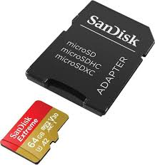
Complex devices often have multiple states of operation
Temperature peripheral
Start a temperature measurement
Wait for temperature to be ready
SD Card
Can accept data very quickly, but then takes a while to process the data
Write configuration for which block you’re accessing
Wait as it reconfigures itself
Write data to the SD Card
Wait as the SD Card records the data
Repeat

Slide 24
Finite State Machine (FSM)
Model of computation
Often used in code and hardware design to bring structure to complexity
FSM components
A set of states for some system
Inputs to the system
Transitions between states based on inputs
Not necessarily all states can connect to all other states
FSMs can generate output
Moore machine: output depends on the current state
Mealy machine: output depends on the current state plus the current inputs

Slide 25

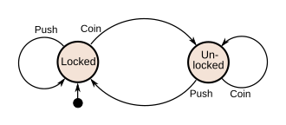
State machine for a turnstyle
Starts in the “Locked” state
Inputs are “Coin” or “Push”
Transitions are shown with arrows
Output: status of the user (stuck still or moving through)

Slide 26
State machines can help structure actions in code
if (state == A){ // do A actions here state = B;
} else if (state == B) { // do B actions here if (input == VALUE) { state = C; } else { state = A; }
A
B
} else if (state == C) { // do C actions here state = A; }
C

Slide 27
Enums in C
Enum (short for enumeration) allows you to make a new type with limited possibilities
Great for tracking your possible states
typedef enum { IDLE, INITIALIZING, READING,
OFF, } state_t;
state_t curr_state = IDLE;
if (curr_state == READING) { ...

Slide 28
Temperature Sensor State Machine Example
Possible Temperature states
Uninitialized
Idle
Waiting
Simple enough that we don’t need to bother with the states
Although we could track states for error checking
Uninitialized
Idle
Waiting

Slide 29
Truncated example of SD Card driver state machine
On error
On error
Idle
InitReset
StartReadBlocks
InitCheckVersion
WaitReadBlocks
InitRepeatHCSInit
InitAppSpecificInit
ReadBlockComplete
InitCheckCapacity
…
InitComplete
https://github.com/tock/tock/blob/master/capsules/extra/src/sdcard.rs#L482

Slide 30
Calling into the state machine
Might be executed each time through the loop
Just call “advance_state_machine()” each time through the main loop
Game logic might do this, for example
Could advance through interrupts or timers
On hardware event, run the state machine and determine what to do now
Often some state transitions are manual and some are automatic
Idle -> Running on function call to start some action
Running -> Idle after an interrupt occurs

Slide 31
Outline
Driver Interfaces (Blocking and Non-Blocking)
Event-driven Model
State Machines
Continuous Operation

Slide 32
Continuous operation
For some sensors/actuators they might be continuously updating in the background
For those, we only need one init_and_start() function and a read or write function
Continuous sensors are always ready with the most recent sample
Continuous actuators will always update to the new command as soon as possible
They might skip a command if you give it multiple very quickly

Slide 33
Continuously updating temperature
Temperature driver design
In the interrupt handler, copy over the value
Start the next event, which will automatically re-trigger the interrupt
No more is_ready() function, data is always ready with the most up-to-date value
Might be a little behind real-time, but only by one sample
For temperature specifically, this would result in a TON of interrupts
Probably want to combine with a timer to run it more slowly

Slide 34
LED Matrix design
This is a good example of a continuous operation actuator
General driver design
Split operation between a Model and a View (Model-View-Controller design)
Model contains what you want the state of the LEDs to be
Only updates when the user calls a function
Updates immediately (non-blocking)
View contains the code to take the model and display it on the LEDs
Continuously updates the LED states with a timer

Slide 35
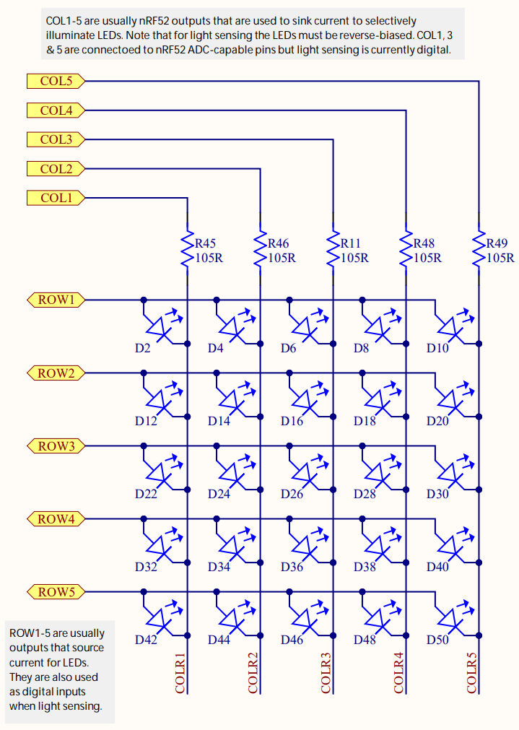
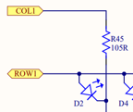
LEDs on the Microbit
Use two GPIO pins to control each LED
Row high as VDD
Column low as Ground
Remember, connections only exist where there are dots

Slide 36
Controlling the LED matrix
LOW
We can light up all the LEDs at once:
Set all rows to High
Clear all columns to Low
LOW
LOW
LOW
LOW
HIGH
HIGH
HIGH
HIGH
HIGH

Slide 37
Controlling the LED matrix
LOW
But now how do we turn off the right middle LED?
LOW
LOW
LOW
LOW
HIGH
HIGH
HIGH
HIGH
HIGH

Slide 38
Can we control by row?
LOW
But now how do we turn off the right middle LED?
What if we clear the row to Low?
Messes up the entire row
LOW
LOW
LOW
LOW
HIGH
HIGH
LOW
HIGH
HIGH

Slide 39
Can we control by column?
HIGH
But now how do we turn off the right middle LED?
What if we set the column to High?
Messes up the entire column
We don’t actually have arbitrary control over the whole thing at once
LOW
LOW
LOW
LOW
HIGH
HIGH
HIGH
HIGH
HIGH

Slide 40
Persistence of vision
The solution here is to abuse how human eyes work
Eyes can’t detect changes in light that are going faster than a certain speed
Or if they do at all, it’s interpreted as slightly dimmer light
Any given LED should be above ~100 Hz to keep humans from noticing the flicker

Slide 41
Persistance of vision on an LED matrix

Slide 42
One column at a time
HIGH
What if we instead control a single column at a time?
First column, all LEDs on
HIGH
HIGH
HIGH
LOW
HIGH
HIGH
HIGH
HIGH
HIGH

Slide 43
One column at a time
HIGH
What if we instead control a single column at a time?
Same for second column through fourth column
HIGH
HIGH
LOW
HIGH
HIGH
HIGH
HIGH
HIGH
HIGH

Slide 44
One column at a time
HIGH
What if we instead control a single column at a time?
Same for second column through fourth column
HIGH
LOW
HIGH
HIGH
HIGH
HIGH
HIGH
HIGH
HIGH

Slide 45
One column at a time
HIGH
What if we instead control a single column at a time?
Same for second column through fourth column
LOW
HIGH
HIGH
HIGH
HIGH
HIGH
HIGH
HIGH
HIGH

Slide 46
One column at a time
LOW
What if we instead control a single column at a time?
Last column we only turn on some of the LEDs
As long as we keep cycling through columns fast enough, the whole thing becomes a display
HIGH
HIGH
HIGH
HIGH
HIGH
HIGH
LOW
HIGH
HIGH

Slide 47
LED matrix full design
Requires GPIO pins and a Timer
When the Timer fires
Change which column you are displaying
Update the row pins based on this new column
Read row data from a 5x5 array that models what the screen should show
When the user wants to change the display
Update that 5x5 array in memory
It’ll start getting drawn on the screen the next time the Timer fires

Slide 48
Outline
Driver Interfaces (Blocking and Non-Blocking)
Event-driven Model
State Machines
Continuous Operation

