Slide 1
Lecture 10 Wired Communication: UART
CE346 – Microcontroller System Design
Alexis Maya-Isabelle Shuping – Spring 2025
Some slides borrowed from: Josiah Hester (Northwestern), Prabal Dutta (UC Berkeley), Alanson Sample (Michigan)

Slide 2
Today’s Goals
Explore tradeoffs in wired communication
Signals, Speed, Timing, Topology
Describe a wired serial communication protocol: UART
Discuss nRF52 implementation of UART

Slide 3
Outline
Wired Communication
UART
nRF52 UARTE

Slide 4
Purpose of communication
Goal: convey digital information between two devices
Simple solution
Digital I/O pin – 1-bit of information
Complex solution
Send multiple bits (arbitrarily many)
While also minimizing
Time, Energy, Pins, Errors, etc.

Slide 5
Wired versus wireless communication
Wired
Send digital signals across one or more wires
Advantages: Reliable, Low energy, Often simpler topology
Disadvantages: Physically limiting
Wireless
Send digital signals across another medium (usually RF)
Advantages: Physically flexible,
Disadvantages: Unreliable, High energy, Usually broadcast

Slide 6
Wired versus wireless communication
Wired
Send digital signals across one or more wires
Advantages: Reliable, Low energy, Often simpler topology
Disadvantages: Physically limiting
Today + next two lectures: UART, I2C, SPI, USB
Wireless
Send digital signals across another medium (usually RF)
Advantages: Physically flexible,
Disadvantages: Unreliable, High energy, Usually broadcast
After that: Wireless Communication

Slide 7
Tradeoffs in Wired Communication
What We Control:
Number of Signals
Controlling Timing
Network topology
What It Affects:
Communication Speed
System Cost

Slide 8
Effect: Communication Speed
Round-trip-time inherently limited by the speed of light
Speed of electricity 50-99% of that
29 cm (11.4 in) = 1 nanosecond
Totally relevant for Gbps speeds within computers
Also limited by interference
Faster signals are harder to distinguish
More susceptible to interference (matters less for wired comms)
Limited by whether the other device can keep up
Might need some flow-control signaling to slow down when not ready

Slide 9
Example communication speed
Note: Speeds are always measured in bits per second
Internal, low-energy communication
UART, 1-1000 kbps
I2C, 100-400 kbps
SPI, 1-100 Mbps
External (mostly serial) communication
USB, 1-10000 Mbps
Ethernet, 1-1000 Mbps
HDMI, 4-48 Gbps
Internal parallel communication
PCI, 8-32 Gbps
RAM, 12-25 Gbps

Slide 10
Effect: Implementation Cost
Difficult to speak in specific terms, as every project and implementation is unique
However, certain methodologies are more expensive than others
General rule: simpler architectures are cheaper!
As we scale up, even small changes in per-unit cost can become very significant

Slide 11
Other Effects
We’ll mostly look at protocols in terms of cost and speed in this lecture
However, there are many other tradeoffs to consider, as well!
Power usage
Very important for battery-powered devices
Reliability
Critical for medical, aerospace, and other life-sustaining applications
Longevity
And many others!

Slide 12




Tradeoffs in Wired Communication
What We Control:
Number of Signals
Controlling Timing
Network topology
What It Affects:
Communication Speed
System Cost

Slide 13

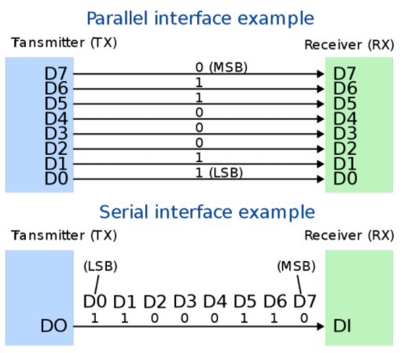

Tradeoff: number of signals
Serial interface
Single wire
Transmit data as a “series” of bits separated by time
Parallel interface
Multiple wires
How many depends on the system
Transmit data across multiple “parallel” wires simultaneously
Still separate by time for more data than wires
Transmitter
Transmitter

Slide 14
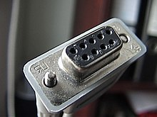
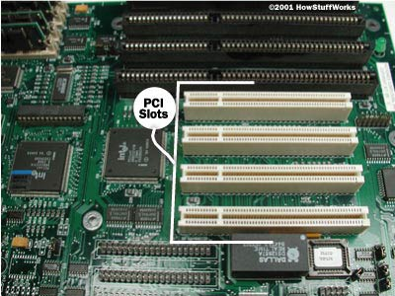
Serial versus parallel
Serial
Cheaper to use less wires
Slower to transmit data
Examples
RS-232, UART, I2C, USB (2.0)
Parallel
More expensive for more pins and wires
Faster to transmit data
Examples
Internal buses, PCI, USB (3.0)

Slide 15
Tradeoffs in Wired Communication
What We Control:
Number of Signals
Serial Parallel
Controlling Timing
Network topology
What It Affects:
Communication Speed
System Cost

Slide 16


Tradeoff: controlling timing
Synchronous systems can be Serial (top) or Parallel (bottom)
Synchronous communication
Clock signal sent along with data
Data is captured at edge of clock signal (rising or falling)
Advantage: send signals very fast
Disadvantage: extra pin and wire
Asynchronous communication
Agree upon timing in advance and read data at that rate
Advantage: no need for clock signal
Disadvantage: clock synchronization
Transmitter
Receiver
b0
b1
b2
b3
b4
b5
b6
b7
DATA
CLK
Transmitter
Receiver
b0
b0
b0
b0
b0
b0
D0
b1
D1
b2
D2
b3
D3
b4
D4
b5
D5
b6
D6
b7
D7
CLK

Slide 17
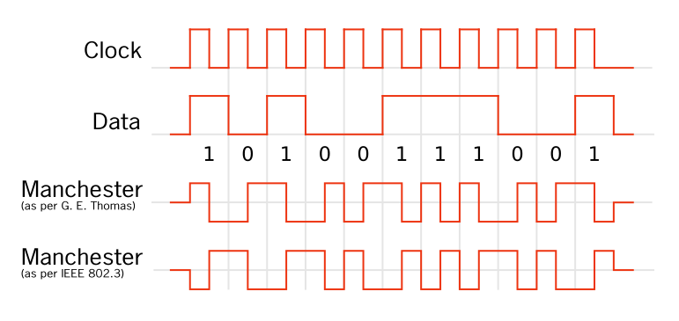
Compromise: combining signals and clocks
There is a method of recovering the clock from the signal
Either the clock is directly encoded in the signal
Or the signal will have mandatory high/low changes to synchronize
https://en.wikipedia.org/wiki/Clock_recovery
https://en.wikipedia.org/wiki/Self-clocking_signal

Slide 18
Tradeoffs in Wired Communication
What We Control:
Number of Signals
Serial Parallel
Controlling Timing
Sync Async
Network topology
What It Affects:
Communication Speed
System Cost

Slide 19


How to connect: point-to-point networks
How do we connect computers in a network?
This is a question of “network topology”
Simple option: just connect them directly
Problem: what if I find a third computer?

Slide 20

How to connect: bus networks
Connect everything to one wire in parallel
Actually a “multidrop bus”
Scales pretty well to many computers
Problem: which computer gets to transmit when?
Simultaneous transmissions conflict
Need a scheme for “arbitration”, deciding who transmits when

Slide 21

How to connect: ring networks
Connect everything with point-to-point connections
Connect the last computer back to the first computer
Also known as Daisy-Chain (without the last connection back to the start)
Problem: what if a computer stops sending?

Slide 22


How to connect: star networks
Connect to a hub with point-to-point connections
Hub connects all computers
Hub is a simple computer with one job: transfer communications between computers
Hopefully more reliable than any of the computers

Slide 23
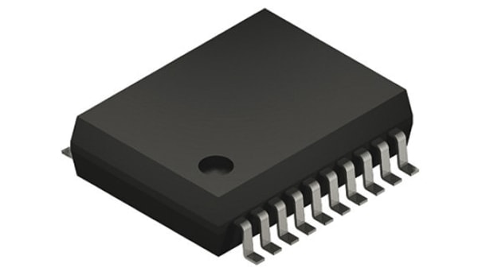
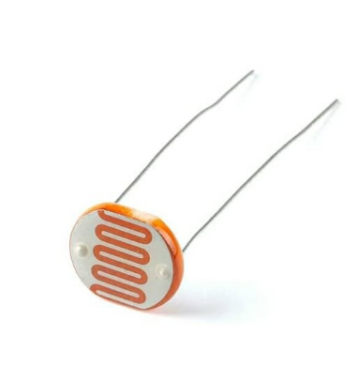
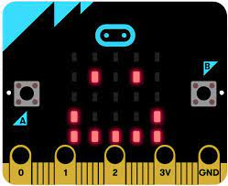
Microcontrollers are often hubs of star networks
Connect to multiple different sensors
Sometimes a few sensors are connected on a bus

Slide 24
Tradeoffs in Wired Communication
What We Control:
Number of Signals
Serial Parallel
Controlling Timing
Sync Async
Network topology
Point Bus Ring Star
What It Affects:
Communication Speed
System Cost

Slide 25
Break + Open Question
What network topology is WiFi?
Point-to-Point
Shared Bus
Ring
Star

Slide 26
Break + Open Question
What network topology is WiFi?
Point-to-Point
Shared Bus
Ring
Star
Any wireless device can hear any other wireless device (in range)
BUT, it tries to emulate a Star topology, where each device only talks to the router

Slide 27
Outline
Wired Communication
UART
nRF52 UARTE

Slide 28
UART Overview
Serial Async Point
Universal Asynchronous Receiver Transmitter
Serial communication between two devices
Two wires: transmit and receive
Simple to implement and very common on microcontrollers
Tradeoff choices: Serial, Asynchronous, Point-to-Point
Most frequently used to send text data between devices
Microcontroller printf() output
GPS to microcontroller
Radio AT commands to/from microcontroller

Slide 29
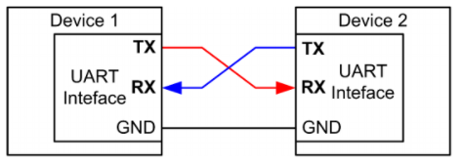
UART: chip-to-chip communication
Serial Async Point
Usually implemented as a two-wire interface
TXD: Transmits data
RXD: Receives data
Optionally two additional pins for flow control
No clock signal! Asynchronous
Note: TX connects to RX (you’ll always get this wrong on the first try)

Slide 30
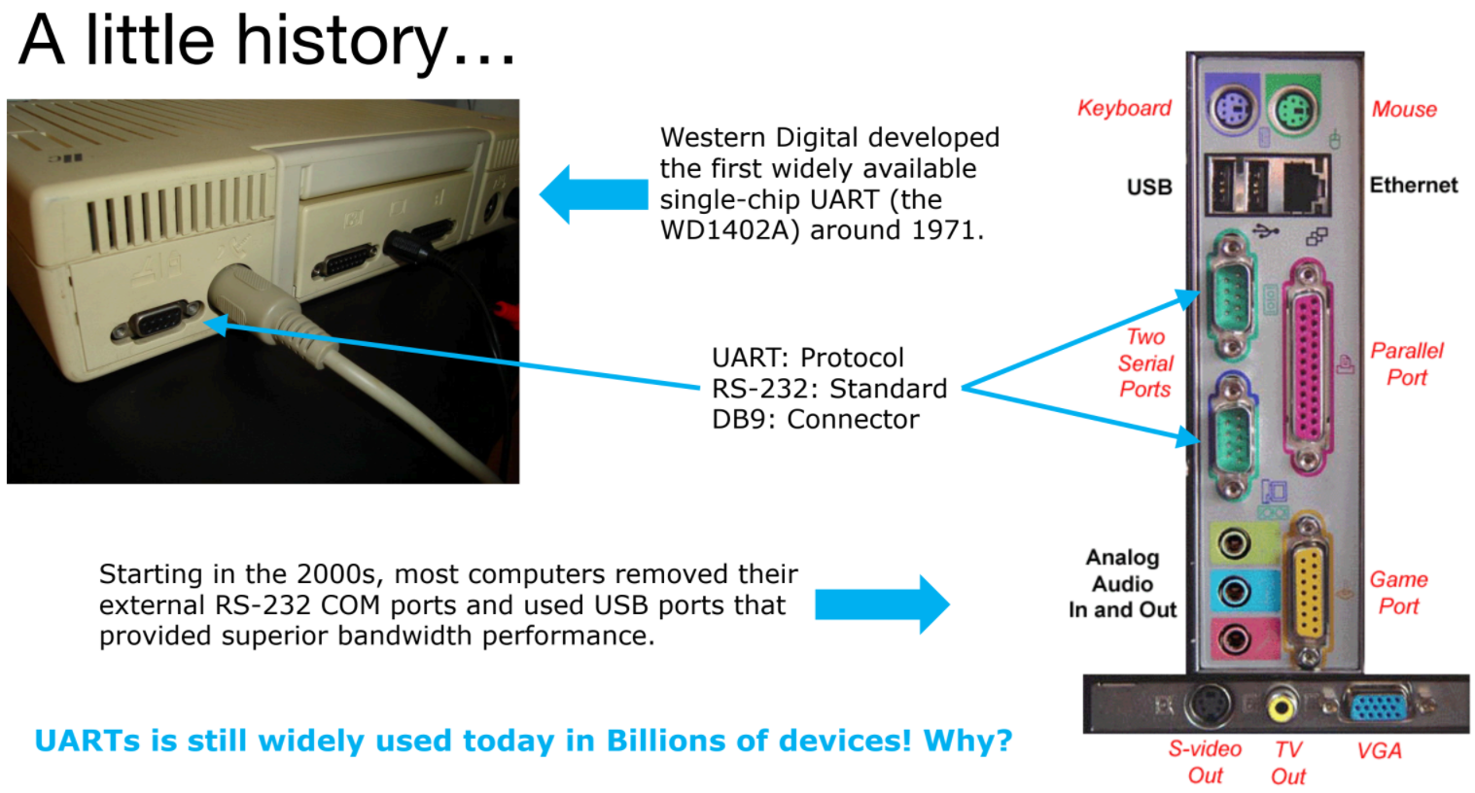

Slide 31
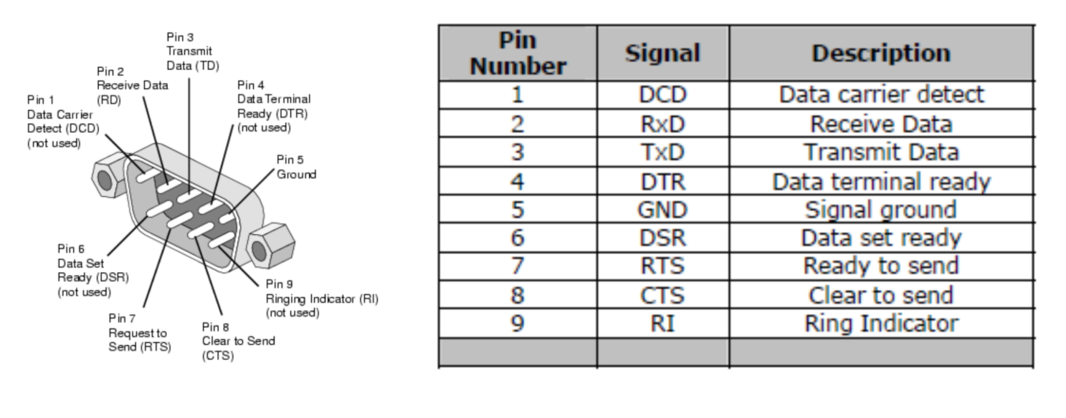
Serial communication - DB9 connector
Common pattern in cables
Ground (must be common), often VCC, Tx, RX
Plus extra wires for signaling metadata
Signal voltage not compatible with modern microcontrollers!
Up to +/- 15 volts

Slide 32
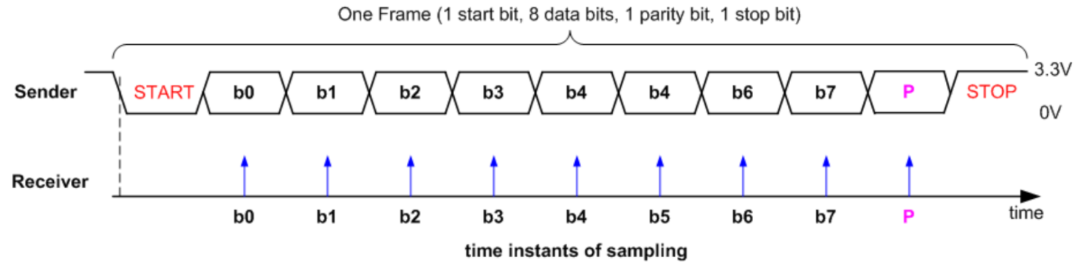
UART data frame
Signal is high by default
Goes low to trigger Start
Send each data bit (high=1, low=0), plus optionally parity bit
Goes high to trigger Stop

Slide 33
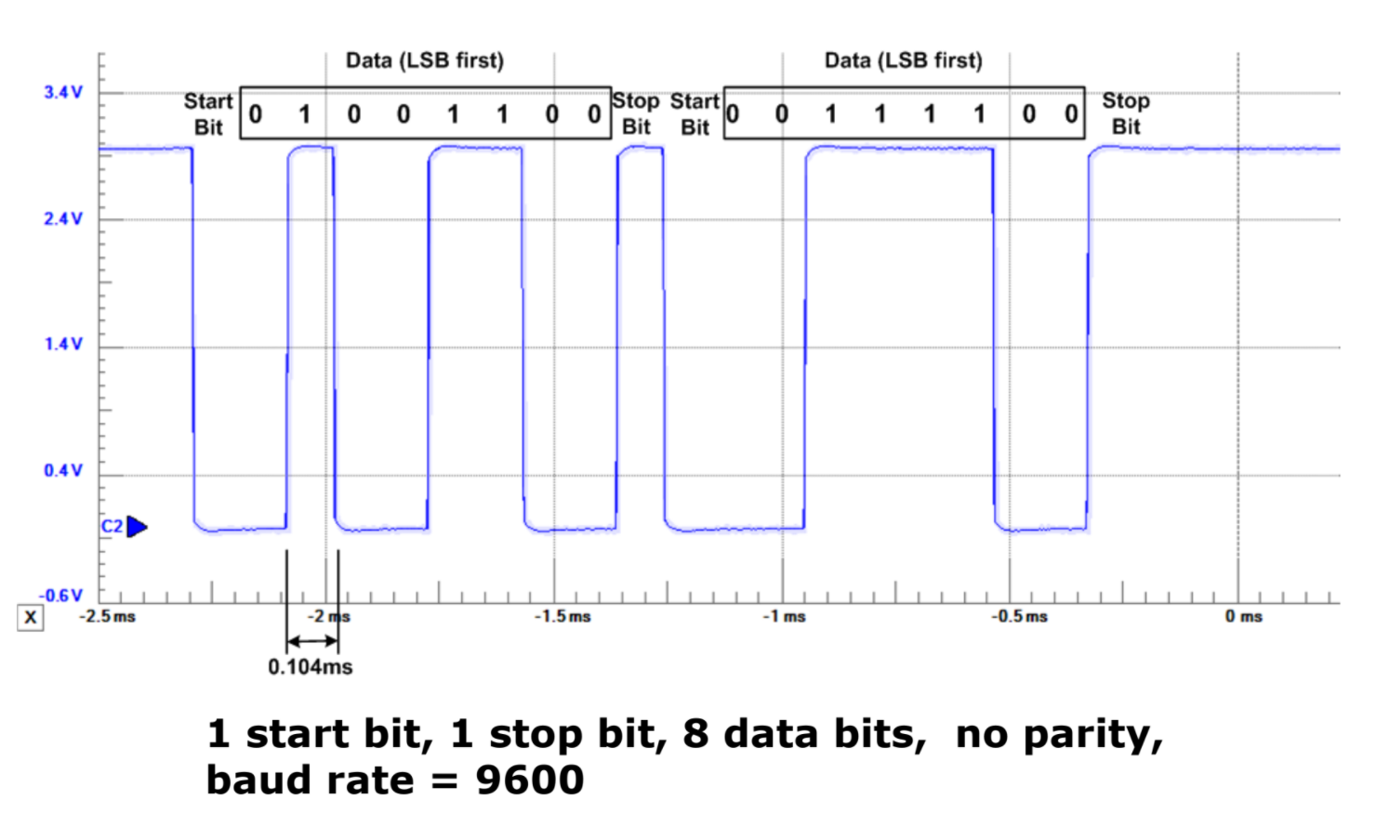
UART example, transmitting 0x32 and 0x3C

Slide 34
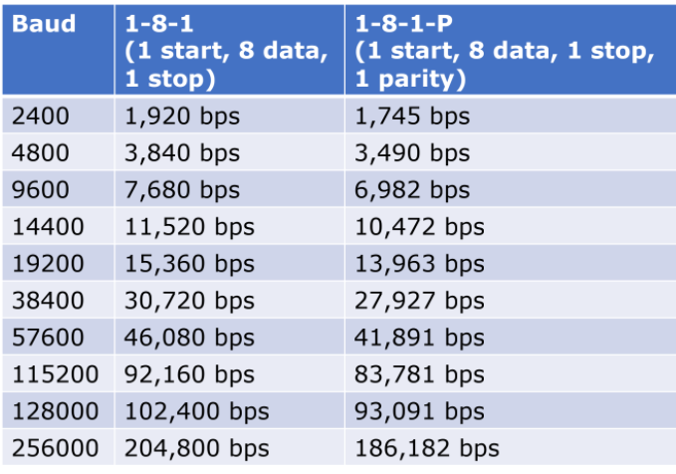
UART baud rates
Baud rate is a measure of “symbols per second”
Typically 1 bit per symbol, but not always
UART is 1 bit per symbol, but 8 data bits per 10/11 symbols
Any baud rate is possible
But there are a handful of normal configurations
115200 and 9600 are most common
We use 38400 for labs!

Slide 35
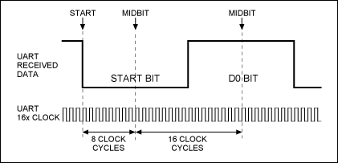
UART sampling rate
How do we make asynchronous communication work?
Both sides must agree on the baud rate
Listen for start bit
Conceptually:
Only need to sample 9-10 more times at baud rate spacing
Short enough that clocks should not diverge too much
Realistically:
Sample 8 or 16 times per bit
Determine boundaries between bits
Select most common value between boundaries

Slide 36
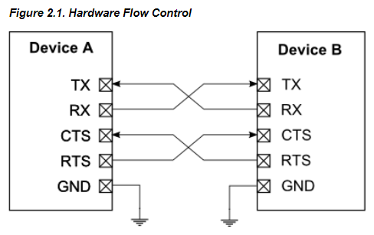
UART flow control
How do we ensure that the other device is ready for the message?
Add two pins for “hardware flow control”
Ready To Send (RTS) output, signals that you want to send data
Clear to Send (CTS) input, signals that other device is ready to receive
Software flow control is possible too
Send special byte that means pause or resume transmissions
Only works with ASCII though (otherwise, byte might be valid data)

Slide 37
UART error conditions
Parity failure
Bit error when receiving data
Overrun
New data arrived and overwrote buffer in peripheral before it was read
Framing
Did not see Stop Bit when expected (should be guaranteed “1”)
Break condition
Signal is low for entire message (Zero data plus Framing Error)
Often used as a signal between devices

Slide 38
Detecting errors with parity
If enabled, choose one configuration for all UART messages
Even parity: total number of “1” bits in data is even
Odd parity: total number of “1” bits in data is odd
Parity bit: set to 1 or 0 based on configuration and message data
If message doesn’t match parity configuration at receiver, there was a bit error (single error detecting)
Example: Data = 10101011 (five “1” bits)
Odd parity: set parity bit to zero
Even parity: set parity bit to one

Slide 39
UART Pros and Cons
Pros
Only uses two wires
No clock signal is necessary
Can do error detection with parity bit
Cons
Data frame is limited to 8 bits out of 10 bits (20% signaling overhead)
Doesn’t support multiple device interactions (point-to-point only)
Relatively slow to ensure proper reception

Slide 40
Longer Decoding Example
How many bytes are transmitted here?
Notes:
REMINDER: animation messed up here

Slide 41
Longer Decoding Example
START
STOP
START
START
STOP
STOP
How many bytes are transmitted here? 3 bytes

Slide 42
Break + Longer Decoding Example
START
STOP
START
START
STOP
STOP
How many bytes are transmitted here? 3 bytes
What is the data for the first byte?
Remember: least significant bit is first
What message is sent here?

Slide 43
Break + Longer Decoding Example
 |  |  | 0 | 0 | 0 | 1 | 0 | 0 | 1 | 0
START
STOP
START
START
STOP
STOP
How many bytes are transmitted here? 3 bytes
What is the data for the first byte? 0b01001000 -> 0x48
Remember: least significant bit is first
What message is sent here?

Slide 44
Break + Longer Decoding Example
 |  |  | 0 | 0 | 0 | 1 | 0 | 0 | 1 | 0 |  |  | 1 | 0 | 0 | 1 | 0 | 0 | 1 | 0 |  |  | 1 | 0 | 0 | 0 | 0 | 1 | 0 | 0
START
STOP
START
START
STOP
STOP
How many bytes are transmitted here? 3 bytes
What is the data for the first byte? 0b01001000 -> 0x48
Remember: least significant bit is first
What message is sent here? 0x48, 0x49, 0x21
In ASCII: HI!

Slide 45
Real-world signals don’t have the guide
Assume the smallest step you ever see is the bit length
Check that the start/stop bits are where you expect
Calculate the values
Or use a logic analyzer that can decode it for you

Slide 46
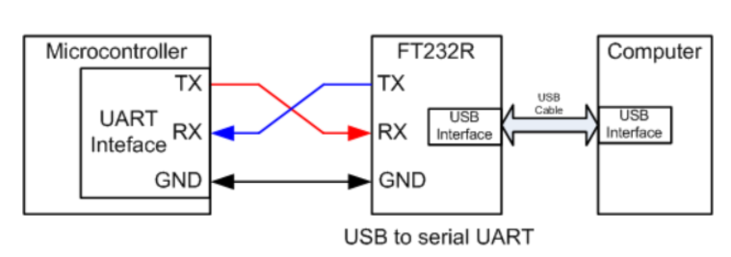
UART to USB bridge
FTDI makes the most common chip to do this (FT232)
Microbit uses a microcontroller to do this!
Secondary microcontroller connects to USB
Also connects to nRF52833 via UART and JTAG
ttyACM0 is a “virtual serial device” on top of USB, miniterm is a serial console

Slide 47
Outline
Wired Communication
UART
nRF52 UARTE

Slide 48
Which UART peripheral?
Two peripherals in the nRF52 documentation
UART peripheral
Standard UART without DMA
Deprecated (as in, they strongly suggest not using it)
UARTE peripheral
Standard UART with DMA
Their registers overlap
They are two different ways of using the same hardware
Only one at a time can be “active”

Slide 49
UARTE Peripheral
Configurations
Pins: TXD, RXD, and optionally RTS, CTS
Baudrate, Parity, Flow control
Actions
Transmit via DMA
Provide a pointer to RAM (not Flash) and a length
Receive via DMA
Provider a pointer to RAM and a length

Slide 50
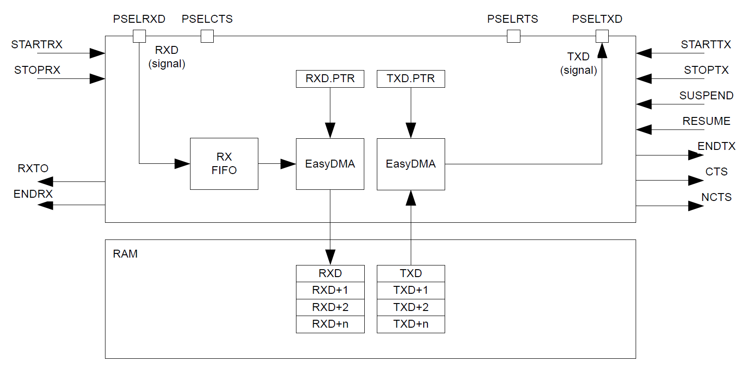
UARTE peripheral

Slide 51
UARTE peripheral
Pins: RX, TX, (optional) CTS and RTS

Slide 52
UARTE peripheral
Receive connects directly to buffer in RAM

Slide 53
UARTE peripheral
Transmit connects directly from buffer in RAM (not flash!)

Slide 54
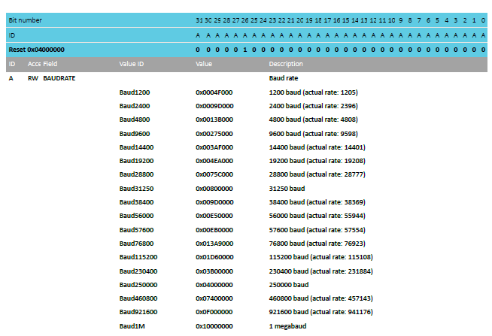
UARTE baudrates
Choose from standard, preconfigured baudrates
That values are 32-bit numbers implies other baudrates are possible…

Slide 55
Typical UART configurations
Baud rate 115200
No parity
No flow control
Probably covers ~70% of UART communication
Baud rate 9600, No parity, No flow control covers another 15%
We are the rare case of an unusual baudrate 38400
It was as fast as the Microbit could keep up with

Slide 56
UARTE driver code
Pretty straightforward to implement driver for this
Definitely could have been a lab
DMA is exactly what you want
Pointer to buffer of data (in RAM)
Length
Go!
More interesting: how does printf() use the UART?

Slide 57
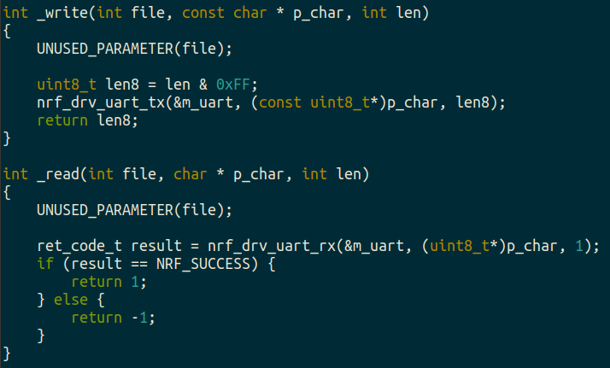
boards/microbit_v2/microbit_retarget.c
printf() eventually calls _write()with formatted data
Converts stdio calls into UART TX and RX
Library just sets DMA and starts Tx

Slide 58
Outline
Wired Communication
UART
nRF52 UARTE

