Slide 1
Lecture 11 Wired Communication: SPI and I2C
CE346 – Microprocessor System Design
Branden Ghena – Spring 2025
Slides adapted from: Branden Ghena (Northwestern), Josiah Hester (Georgia Tech), Prabal Dutta (UC Berkeley), Sparkfun

Slide 2
Project Hardware
I have a bunch of stuff to hand to groups today!
If you haven’t placed your first set of parts orders yet, do so ASAP
Due by end-of-day Saturday
I will place next round of orders on Sunday
Warnings about receiving hardware
Check what you received, and ask questions!
I might have substituted something
I may have a different number of items
I may have forgotten some adapter you need

Slide 3
Today’s Goals
Discuss additional wired communication protocols: SPI and I2C
Understand tradeoffs in design
UART, SPI, and I2C are each useful for different scenarios
Explore real-world usage of SPI and I2C

Slide 4
Outline
Review
SPI
I2C
Using SPI and I2C

Slide 5




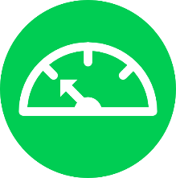
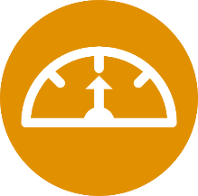
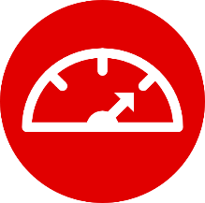




Tradeoffs in Wired Communication
Number of Signals
Serial Parallel
Communication Speed
kbps Mbps Gbps
Controlling Timing
Sync Async
Network topology
Point Bus Ring Star

Slide 6
UART
Serial kbps Async Point
Number of Signals: Two (plus optional flow control)
Communication Speed: Usually 1 to 100 kbps
Controlling Timing: Asynchronous
Network Topology: Point-to-Point

Slide 7
UART Pros and Cons
Pros
Only uses two wires
No clock signal is necessary
Can do error detection with parity bit
Cons
Data frame is limited to 8 bits (20% signaling overhead)
Doesn’t support multiple device interactions (point-to-point only)
Relatively slow to ensure proper reception
Let’s get rid of all the cons (by sacrificing on all the pros)

Slide 8
Outline
Review
SPI
I2C
Using SPI and I2C

Slide 9


Let’s start with timing control
How do we move from asynchronous to synchronous communication?

Slide 10
Let’s start with timing control
How do we move from asynchronous to synchronous communication?
Just add a clock signal!

Slide 11
Synchronous UART
USART
Synchronous/Asynchronous
Just add a clock line
Common peripheral in many microcontrollers to allow adaptable communication
Could build various protocols (like SPI or UART) on top of it
Still point-to-point limited in this form
Serial Mbps Sync Point
Transmitter
Receiver
b0
b1
b2
b3
b4
b5
b6
b7
DATA
CLK

Slide 12

Now, let’s change the network topology
How do we allow communication with more than one device?
Start by choosing a network topology.

Slide 13

Now, let’s change the network topology
How do we allow communication with more than one device?
Start by choosing a network topology.
Bus = (relatively) simple to implement

Slide 14
Synchronous serial communication with a single device
Device 1
Microcontroller
Device 2
Data Out Clock
Data In Clock
Device 3

Slide 15
Want bi-directional communication, so three wires
Device 1
Microcontroller
Device 2
Data Out Data In Clock
Data In Data Out Clock
Device 3

Slide 16
Wire signals to all devices to form a bus
Device 1
Data In Data Out Clock
Microcontroller
Device 2
Data Out Data In Clock
Data In Data Out Clock
Device 3
Data In Data Out Clock

Slide 17
Communicating on a bus
How do you distinguish which device you are talking to?

Slide 18
Communicating on a bus
How do you distinguish which device you are talking to?
Address for each device
Devices must always listen and then discard messages that aren’t for them
Need to define packet format so it’s clear where the address is
Need a method for addressing devices
GPIO pin for each device
Signal which device is being communicated with
Only activates communication on transition of “select” line
Needs a separate pin for each device

Slide 19
Separate chip select line for each device
Device 1
Data In Data Out Clock
Chip Select
Microcontroller
Device 2
Data Out Data In Clock
Chip Select (2) Chip Select (1) Chip Select (3)
Data In Data Out Clock
Chip Select
Device 3
Data In Data Out Clock
Chip Select

Slide 20




Serial Peripheral Interface (SPI)
Serial, synchronous, bus communication protocol
Single controller with multiple peripherals
Within a circuit board
High-speed communication
Multiple Mbps
Serial Mbps Sync Bus
Device 1
Serial Data In Serial Data Out Serial Clock
$$\overline{\text{Chip} \text{Select} }$$
Microcontroller
Device 2
Serial Data Out Serial Data In Serial Clock
$$\overline{\text{Chip} \text{Select} }$$
$$\overline{\text{Chip} \text{Select} }$$
$$\overline{\text{Chip} \text{Select} }$$
Serial Data In Serial Data Out Serial Clock
$$\overline{\text{Chip} \text{Select} }$$
Device 3
Serial Data In Serial Data Out Serial Clock
$$\overline{\text{Chip} \text{Select} }$$

Slide 21
A note on outdated notation
Master/Slave paradigm
Master is the “Computer” and is in charge of interaction
Slave is the “Device” and has little control over interaction parameters
Really common notation in EE side of the world.
Not intended to be harmful, but also literally inconsiderate.
Field is changing for the better. It’s going to take some time.
Controller/Peripheral
Central/Peripheral
Device/Peripheral
Master/Minion
Primary/Secondary

Slide 22
SPI naming schemes
Historical SPI Naming
MISO – Master In Slave Out
MOSI – Master Out Slave In
SS – Slave Select
Revised SPI Naming
SDI – Serial Data In -> also known as CIPO (Controller In, Peripheral Out)
SDO – Serial Data Out -> also known as COPI (Controller Out, Peripheral In)
CS – Chip Select
https://www.oshwa.org/a-resolution-to-redefine-spi-signal-names
https://www.sparkfun.com/spi_signal_names

Slide 23

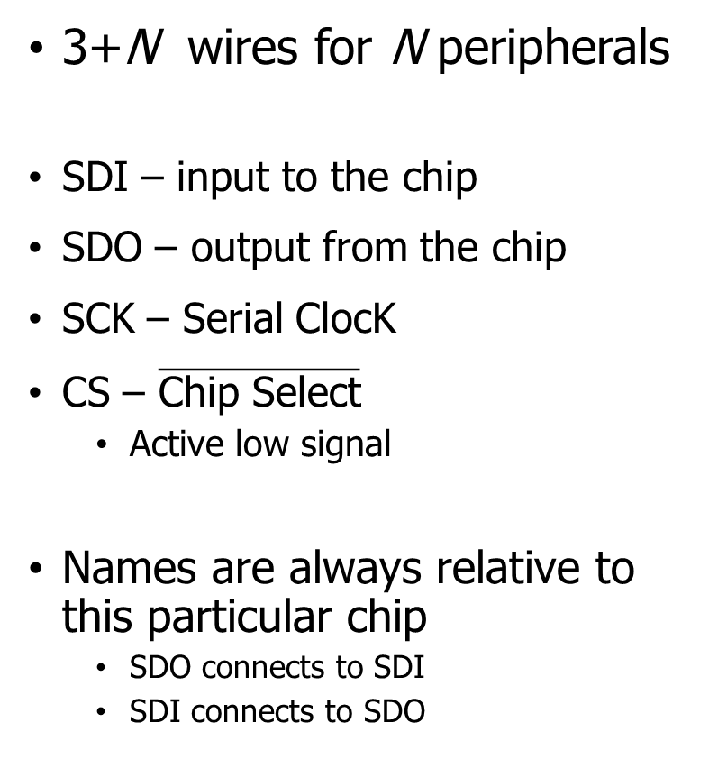



SPI wiring
3+N wires for N peripherals
SDI – input to the chip
SDO – output from the chip
SCK – Serial ClocK
CS – $\overline{\text{Chip} \text{Select}}$
Active low signal
Names are always relative to this particular chip
SDO connects to SDI
SDI connects to SDO
Device 1
SDI SDO SCK
$$\overline{\text{CS}}$$
Microcontroller
Device 2
SDO SDI SCK
$$\overline{\text{CS}}$$
$$\overline{\text{CS}}$$
$$\overline{\text{CS}}$$
SDI SDO SCK
$$\overline{\text{CS}}$$
Device 3
SDI SDO SCK
$$\overline{\text{CS}}$$

Slide 24
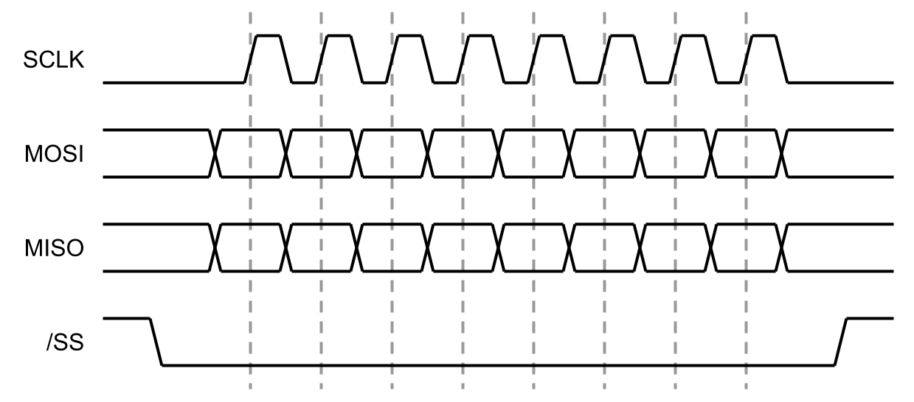
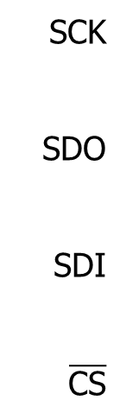
SPI timing diagram
CS goes low to start transaction and high to end
Data is sent synchronously with clock signals
Capable of full-duplex transfers
Both directions at the same time
SCK
SDO
SDI
$$\overline{\text{CS}}$$

Slide 25
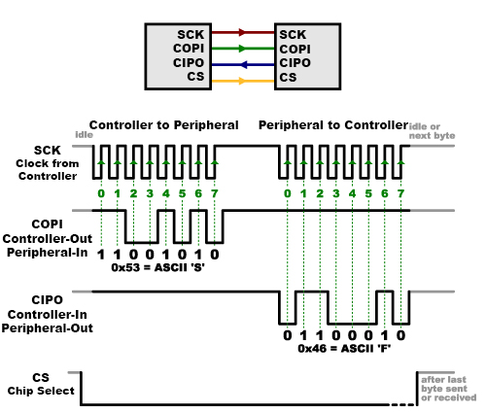
SPI communication
Transactions usually in multiples of bytes (as many as needed)
Either bit endianness is possible
nRF can do LSb first OR MSb first
No need for framing bits (start/stop)
CS handles that

Slide 26
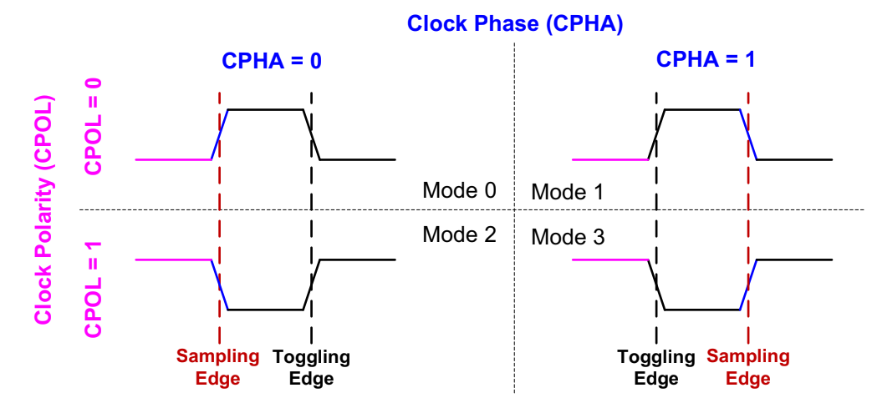
SPI configurations
CPOL – is the clock default low or default high
CPHA – is data read on first edge or second edge
Peripherals tell you what their configuration is (usually 0 and 0)

Slide 27
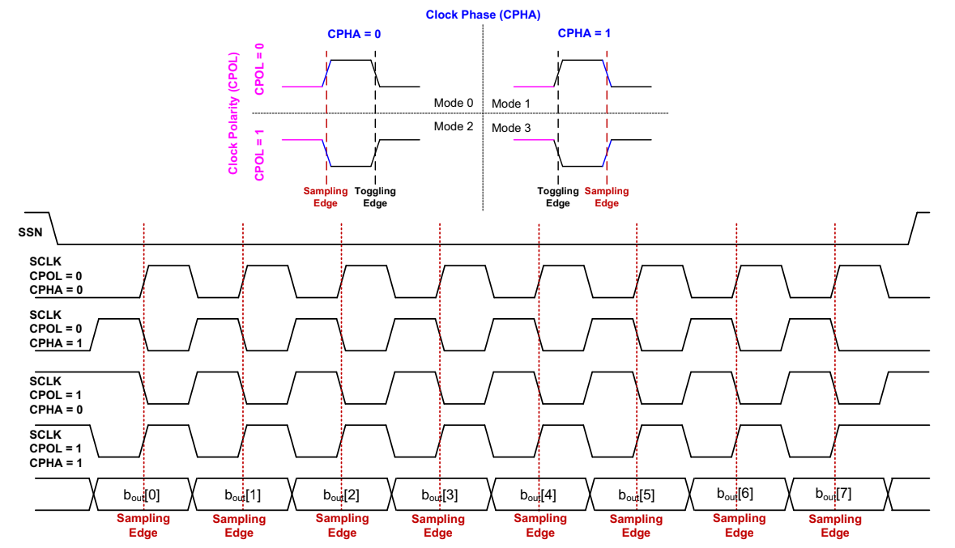

Slide 28
SPI data rate
No particular requirements
Speed can go as fast as your clock and line capacitance can handle
Datasheet for devices will specify their speeds
Sort-of standard rates (less so than UART, for example)
700 kbps
3.4 Mbps
10 Mbps

Slide 29
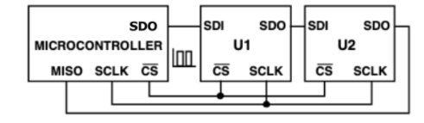
Daisy-chaining SPI
SPI can also be formed into a ring bus
Doesn’t save on pins, but does reduce wires…
At the cost of reliability and speed
Fairly rare in practice

Slide 30
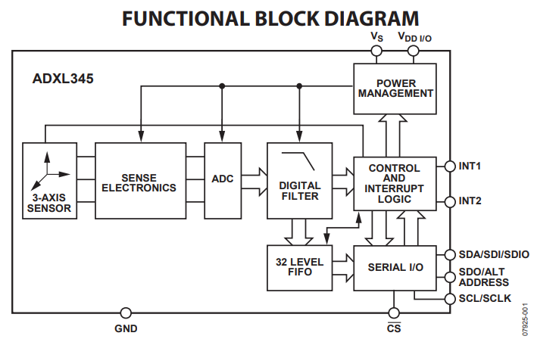
How do we determine when peripheral has information?
Controller starts/stops SPI transfers
Could ask peripheral periodically
Peripherals often add interrupt outputs to signal controller that an event has occurred
More pins, yay!

Slide 31
Use Cases
High-speed peripherals
Microphone, External ADC, Displays!
External memory
Memory chips
SD cards
All SD cards support a SPI communication mode
QSPI – Quad SPI (four SDO lines for more throughput)
Often used for communication with external memory

Slide 32
SPI Pros and Cons
Pros
Faster throughput (and no overhead)
No restrictions on data frame
No addressing requirements or word size assumptions
Full duplex transfers
Cons
Many pins: 3+N (for N peripherals)
CS line scales linearly (other signals are a bus)
Controller must initiate all transfers
Not designed for multi-controller scenarios

Slide 33
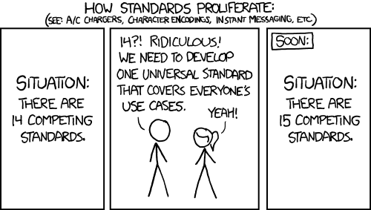
Relevant xkcd
https://xkcd.com/927/

Slide 34
Outline
Review
SPI
I2C
Using SPI and I2C

Slide 35
Choosing different tradeoffs from other wired communication
Things we like from SPI
Communication over a bus
Synchronous communication
Things we want from new protocol
Fewer I/O pins
Use a single data line for bi-directional communication
Needs addressing and more specified data frame
Multiple controllers sharing the bus
Needs a bus contention solution

Slide 36
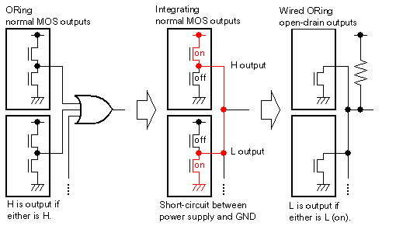
Bus contention could short a shared bus
Want to enable multiple controllers
Problem
What if they each try to transmit different data?
At some point, there will be a short-circuit

Slide 37
Disconnected I/O pins enable shared communication
ANDing
I/O pins often have three states
High
Low
Disconnected (also known as High-Impedance/High-Z)
We can use this third state to enable communication over a shared line
Low or Disconnected
Wired-AND
1 if they are all disconnected
0 if any are low

Slide 38
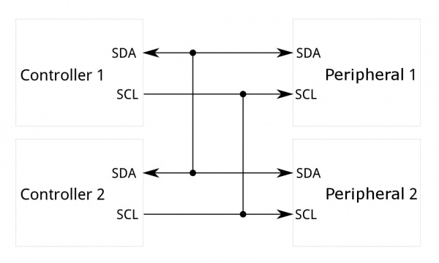
Inter-Integrated Circuit (I²C)
Two-wire, synchronous, bus communication
Ubiquitous in the embedded world
De-facto standard for sensors
Invented and patented by Phillips (now NXP)
Patent expired in 2004
Also known as Two-Wire Interface (TWI)
Occasionally as System Management Bus (SMBus or SMB) but that’s actually a related but separate thing
Serial kbps Sync Bus

Slide 39
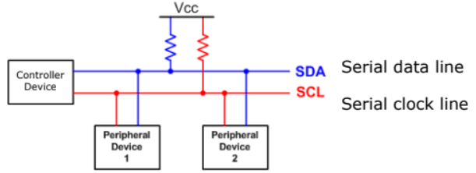
I2C overview
SDA – Serial Data
SCL – Serial Clock
Usually 100 kHz or 400 kHz
Communication is a shared bus between all controller(s) and peripheral(s)
Pull-up resistors for open-drain communication

Slide 40
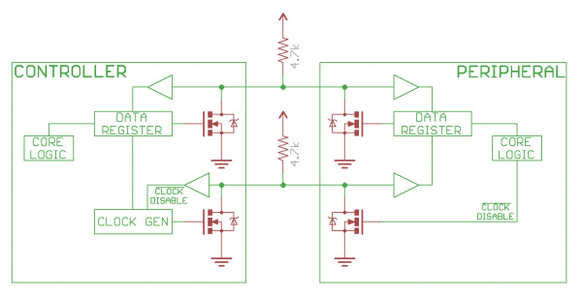
Open drain bus communication
SDA and SCL are open-drain
1 – high-impedance, let line float high
0 – active drive, pull line low
Pull-up resistor to provide high signal
Low enough resistance that current can flow in a reasonable amount of time
Common value: 4.7 kΩ

Slide 41
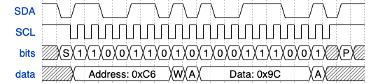
I2C transaction walkthrough
XXX: FORGOT TO EDIT THE SDA signal to match the bits Also swap SDA and SCL order while you’re at it
0
0
Address: 0x66
Data: 0x9C
Here’s a one-byte I2C write to a device
Let’s walk through all the parts of how this works

Slide 42
I2C transaction walkthrough
0
0
Address: 0x66
Data: 0x9C
Default state for SDA and SCL is high
A transaction starts when data goes low while clock is still high
Usually, data changes when clock is low
Known as a “Start Condition”

Slide 43
I2C transaction walkthrough
0
0
Address: 0x66
Data: 0x9C
First byte sent has two parts
7-bit chip address
1-bit read/write indication (1 for read, 0 for write)
Values are read MSb first (reverse of other protocols 😱)

Slide 44
I2C transaction walkthrough
0
0
Address: 0x66
Data: 0x9C
Acknowledgement is sent by the other device
Sender briefly changes to an input (high-z)
1 is the default state of the bus, which means no device responded
0 means some device responded, which is an ack

Slide 45
I2C transaction walkthrough
0
0
Address: 0x66
Data: 0x9C
Data byte(s) are sent after the address
For a write, bytes are sent by the controller
For a read, bytes are sent by the peripheral
Other device acknowledges each byte along the way

Slide 46
I2C transaction walkthrough
0
0
Address: 0x66
Data: 0x9C
Stop condition
Let data go high while clock is still high
Returns bus to default state

Slide 47
Bus arbitration
Arbitration decides which controller gets to proceed if multiple try to communicate simultaneously
What happens in I2C if one controller wants a low bit and the other wants a high bit?

Slide 48
Bus arbitration
Arbitration decides which controller gets to proceed if multiple try to communicate simultaneously
What happens in I2C if one controller wants a low bit and the other wants a high bit?
Low bit wins! (so smaller address or data)
Each controller constantly checks whether SDA matches the voltage level it expects
Stops attempting to transmit if it ever does not
(Only actually needs to check high signals)

Slide 49
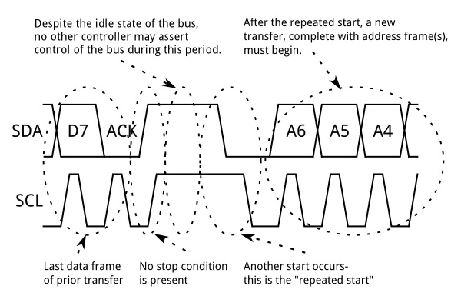
Repeated start conditions
Repeated start conditions allow the bus to be used again while arbitration was won
Trigger another Start condition without triggering Stop condition
Send address again
Frequently used for write then read pattern
Write which value you want
Then repeated start and read

Slide 50
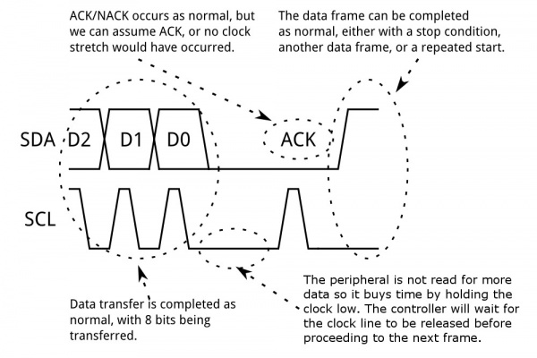
Clock stretching
Clock is an open-drain line too
Either device could keep it low
Transaction can be briefly paused by holding SCL low
ready

Slide 51
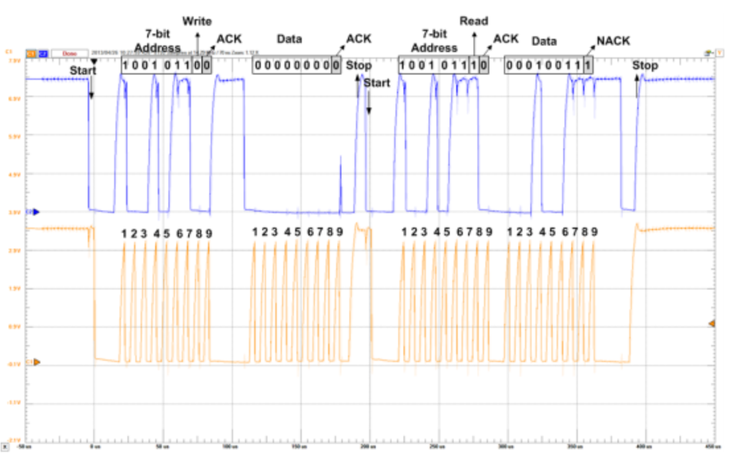
Real-world I2C transactions

Slide 52
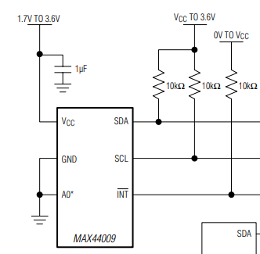
Each I2C device on a bus must have a different address
Shared addresses would cause both to respond
ICs often have one or more address pin(s) used to select bit(s) of address
0 pins: only one may be on bus
1 pin: two may be on bus
2 pins: four may be on bus
If no address pins (or not enough), need an I2C address translator chip
Translates addresses for one or more peripheral chips
A0 is low: address 1001010x
A0 is high: address 1001011x

Slide 53
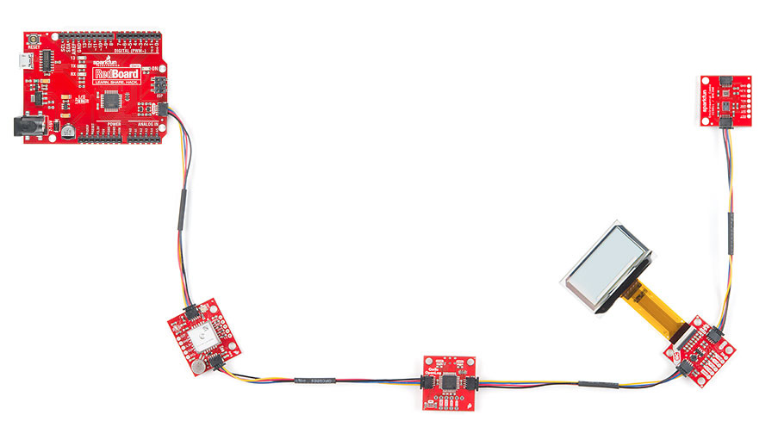
Sparkfun Qwiic connect system
System for wiring multiple prototyping boards together
Four-pin connector
VCC (3.3 volts)
Ground
SDA
SCL
Daisy-chains through boards
Actually connects to chips in parallel as a bus
https://www.sparkfun.com/qwiic

Slide 54
System Management Bus (SMBus)
Related communication specification
A little more strict in places, but generally interoperable
Adds ability to broadcast or unicast messages
Generic addresses for Controller and various peripherals (Battery)
Adds an open-drain shared interrupt signal
High-impedance or pull low, just like SDA and SCL
Allows any device to alert a controller
Controller has to probe bus to determine which device wants attention

Slide 55
I2C use cases
Various sensors
Usually low to medium speed
Even relatively high speed stuff often has I2C for convenience
Accelerometers and microphones
Often with intelligent filtering built in
Communication between microcontrollers
Either can act as the Controller when necessary
Commonly exists internally within smartphones and laptops too
Light sensors, Temperature sensors, etc.

Slide 56
I2C Pros and Cons
Pros
Wiring is simple
Only uses two pins
Very widely supported
Cons
Relatively slow communication rate
Speed versus power use tradeoff (due to pull-down resistor)
Open collector makes debugging difficult

Slide 57
Open Question
Why are SPI and I2C common internally in embedded systems, but not common externally? (like USB, Ethernet, HDMI, etc.)

Slide 58
Open Question
Why are SPI and I2C common internally in embedded systems, but not common externally? (like USB, Ethernet, HDMI, etc.)
Too slow:
Especially I2C (100 Kbps compared to 12 Mbps for slowest USB)
Not robust:
No effort put into the electrical encoding of data or error checking
Long external cables lead to additional errors
Overall: they’re too simple

Slide 59
Outline
Review
SPI
I2C
Using SPI and I2C

Slide 60
Common sensor interaction pattern
First write one byte to the device
This selects what data you want to interact with, called a “register address”
Second read/write one (or more) bytes
This is the actual data
SPI and I2C devices both work this way
Datasheet will have a list of registers you can read/write
Each register will have some address: that’s the first byte you write

Slide 61
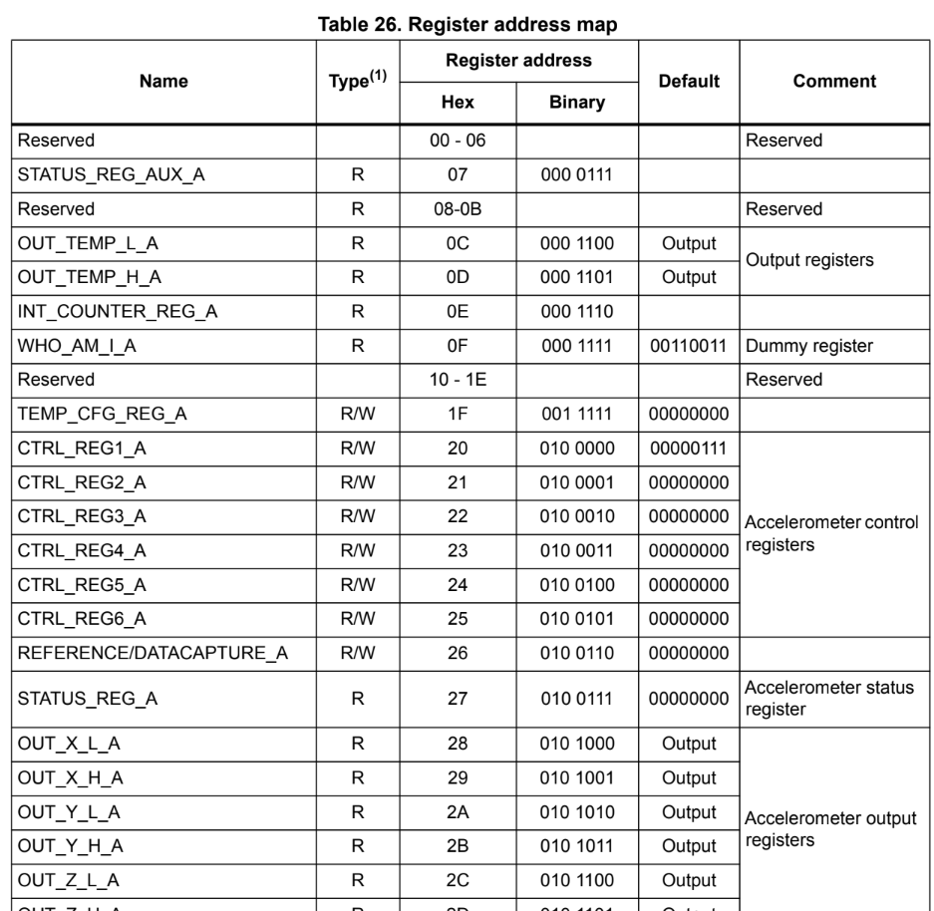
Example: Microbit accelerometer
Details of each register on later pages show you the structure of the data read or written

Slide 62
Register/data pattern in I2C
I2C is the more difficult of these
Need some way to tell the device “this transaction is still going”, but switch from writing to reading
This is the use of the “repeated start” option
Continues the “transaction”

Slide 63
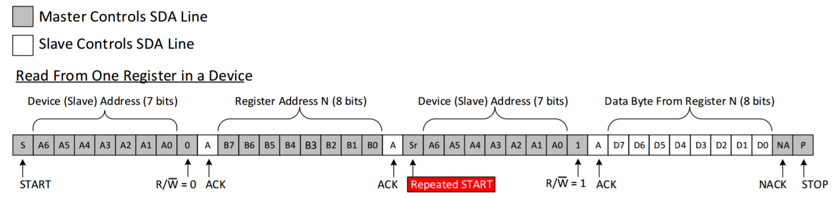
I2C Read Transaction
Controller Controls SDA Line
Peripheral Controls SDA Line
First, write the address of the register you want
Then, repeated start
Finally, read the data from the device

Slide 64
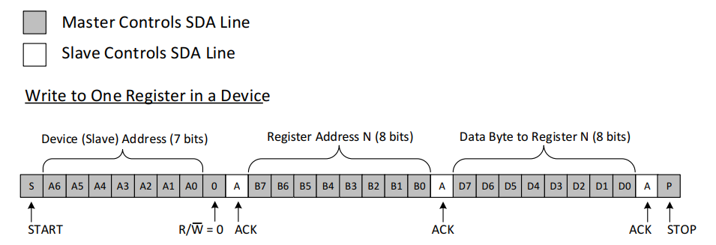
I2C Write Transaction
Controller Controls SDA Line
Peripheral Controls SDA Line
Just write the data. No need to change modes in the middle
Some devices also allow “repeated start” in the middle of write transactions
But it’s not necessary

Slide 65
nRF I2C Implementation
nrf_twi_mngr driver: I2C (Two-Wire Interface) manager
Expects transactions to occur and is set up to run those
Takes in an array of “transfer” operations as an argument
Each operation is either a read or a write
Includes a device address, includes a pointer to data and length
Includes flags like NRF_TWI_MNGR_NO_STOP which does not execute a stop bit after one operation
Your job is to set up the array of transfer operations
Then the driver will make it happen

Slide 66
Register/data pattern in SPI
SPI is easier to implement transactions for
No indication of reading/writing by default
You can just hold Chip Select low and stop clocking if you want to pause
Need some way to indicate to the peripheral whether you’re reading or writing though
Possibly different register addresses for read versus write
Possibly 7-bit addresses, with a bit leftover for read/write specification
Some devices just work uni-directionally
Can’t read from a screen

Slide 67
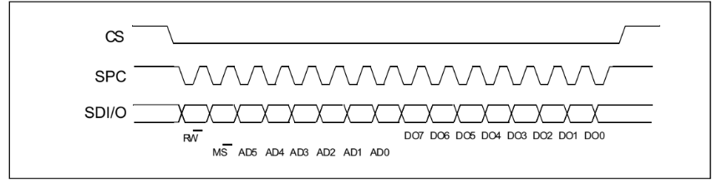

SPI Read Transaction
Chip select goes low to select the device
First byte is the register address and read selection
Next bytes are from the peripheral (read data)
SDO
SDI

Slide 68
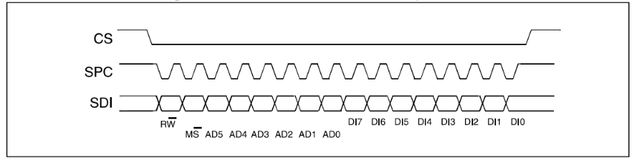
SPI Write Transaction
Chip select goes low to select the device
First byte is the register address and write selection
Next bytes are the data to write
SDO

Slide 69
nRF SPI Implementation
nrfx_spim driver: nRF SPI Master (Controller)
Expects data in “XFER” (transfer) operations
Can either be read, write, or read AND write (both simultaneously)
Flags control whether CS pin goes high afterwards or if it stays low
Or you could just manually control the CS pin with GPIO which is usually easier…

Slide 70
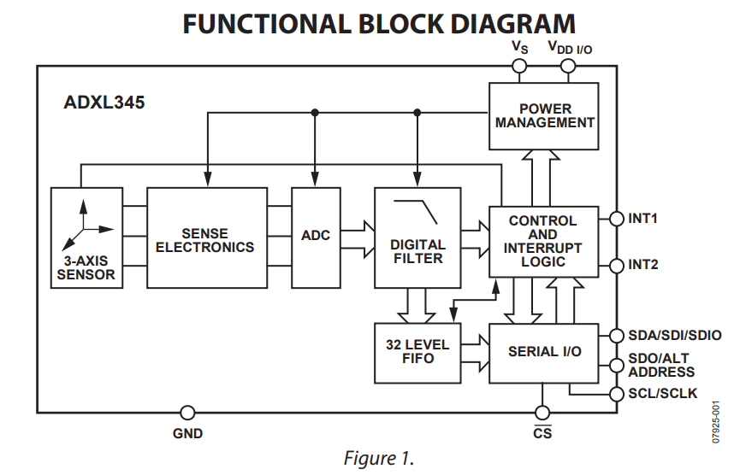
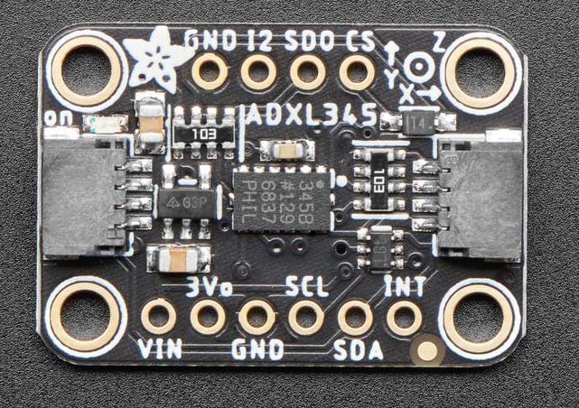
Example: ADXL345 accelerometer
3-axis accelerometer
Pretty high accuracy: 13-bit resolution, +/- 16 g
Can use either SPI or I2C
https://www.analog.com/media/en/technical-documentation/data-sheets/adxl345.pdf

Slide 71
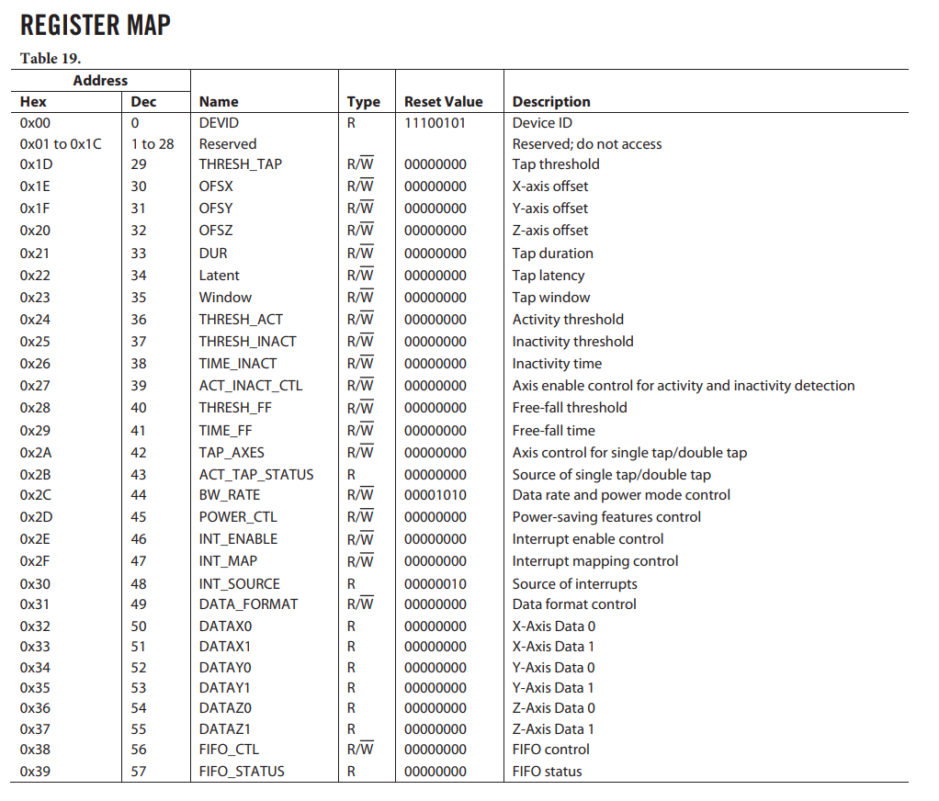
What fields can we access?
Same “registers” for SPI and I2C
Transactions:
Register address sent first
Register value sent second
Some are read/write while others are read-only

Slide 72
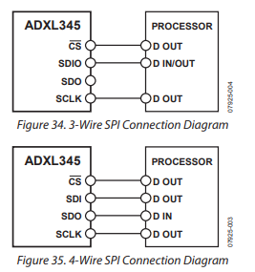
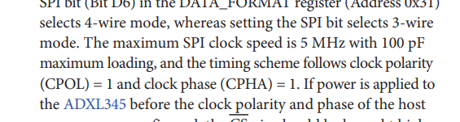
ADXL345 SPI configuration
Normally uses 4-wire SPI
Can also use a 3-wire SPI version
One wire for in and out
SPI Config
5 MHz (or slower)
CPOL=1 CPHA=1 (ugh, not the default)

Slide 73
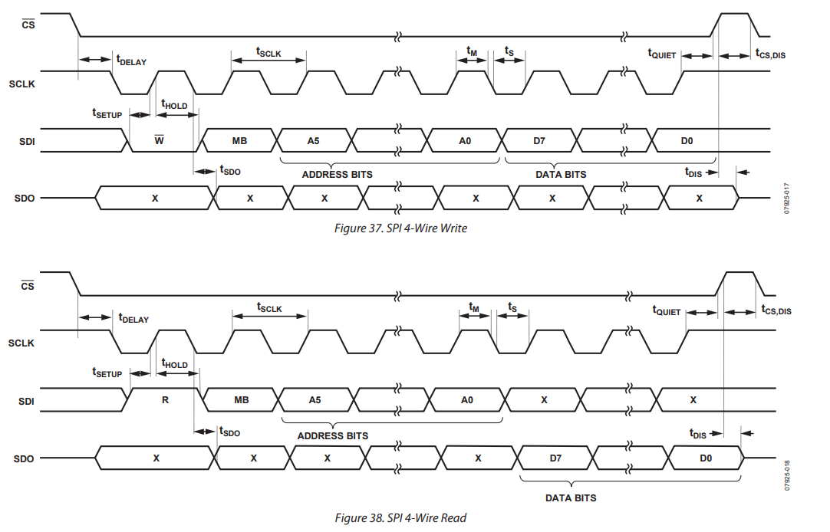
ADXL345 SPI transactions

Slide 74
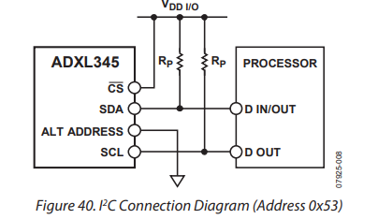
ADXL345 I2C configuration
Connection of CS pin determines mode
Connecting to power puts it in I2C mode
Supports 100 kHz or 400 kHz mode
Address: selectable with pin
Pin low: 0b1010011 (0x53)
Pin high: 0b0011101 (0x1D)

Slide 75
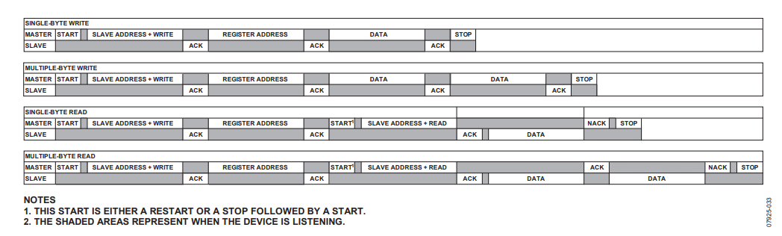
ADXL345 I2C transactions

Slide 76
Outline
Review
SPI
I2C
Using SPI and I2C

