Slide 1
Lecture 12 Other Protocols
CE346 – Microcontroller System Design
Branden Ghena – Spring 2025
Some slides borrowed from: Josiah Hester (Northwestern), Prabal Dutta (UC Berkeley)

Slide 2
Final Project Details
A bunch of little posts on Piazza with details
Some might apply to your project
Details on grading that you might be interested in
Link so you can make a private repo for your code
Two big notes
You MUST cite work you use
Don’t use Lab1 (MMIO GPIO) or Lab2 (Virtual Timers) in your final project

Slide 3
Other final project stuff
I’ll do one more round of ordering later this week
After that the purchases will slow down
Lab this Friday will be office hours instead!
You are not required to attend
But I’ll be there to answer project questions if you have any
You’re welcome to just come and work too
Next week Friday will be project check-ins
More details to come

Slide 4
Administrivia
Lecture schedule for the rest of the quarter
Thursday (05/22) – Wireless Communication
Tuesday (05/27) – Nonvolatile Memory & Energy Management
Also the final quiz
Thursday (05/29) – Microprocessors + Wrapup
Tuesday (06/03) & Thursday (06/05) – Project Office Hours

Slide 5
Today’s Goals
Discuss more advanced wired communication protocols
With a little less detail
Just give a taste of what they are like
Think about higher-layer concerns like data routing, interpretation, and reliability

Slide 6
Outline
USB
CAN
Bit-banging
1-wire
Neopixel LED strips
Video Protocols
VGA
HDMI

Slide 7
USB references
USB in a NutShell
https://www.beyondlogic.org/usbnutshell
Other stuff I found useful
https://www.usbmadesimple.co.uk/
http://kofa.mmto.arizona.edu/stm32all/blue_pill/usb/an57294.pdf
https://en.wikipedia.org/wiki/USB

Slide 8
Universal Serial Bus (USB)
Pervasive wired communication protocol
Universal accurately applies!
Targets predominantly external devices over a plug/cable
Good combination of simple and capable
Base version for simple devices does not require too much in terms of pins or resources
More complex versions can transfer a significant amount of data
These grew organically over time though
Great support for interoperability
Generic device profiles that allowed for plug-and-play
Supported by OS initiatives to include driver software

Slide 9
USB is a layered protocol
USB protocol describes how to:
Electrically send bits
Send frames of multiple bytes
Communicate data between two devices
Communicate specific application data (through device classes)
Much more complicated, compared to others
SPI: only how to electrically send bits
UART and I2C: how to send frames of bytes

Slide 10
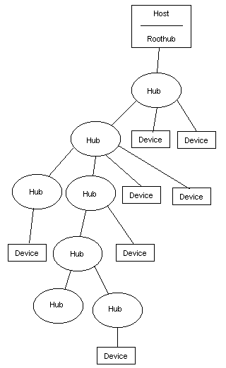
Roles and topology
Hosts and Devices
USB On-The-Go allows host negotiation
Added later. Supports devices like smartphones
Host is in charge of communication (“Upstream”)
Devices provide various capabilities Host can interact with (“Downstream”)
Tiered star topology
Host connects to hubs, which connect to devices
Up to 127 devices per hub. Up to 5 layers of hubs

Slide 11
USB Outline
Low-layer details
How are bits sent
How are packets (collections of bits) sent
Higher-layer details
How do we interact with devices
How do we determine what devices are and how they work

Slide 12
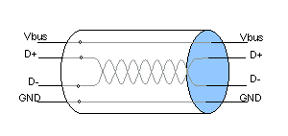
USB signals
Four signals
Vbus (5 volts, can power devices)
D+
D-
Ground
D+/D- are a differential pair
Signals are inverses of each other
Usually, occasionally act separately to signal special conditions
Increases voltage difference between states (5 - -5 = 10 volts)
Wires are twisted to avoid interference

Slide 13
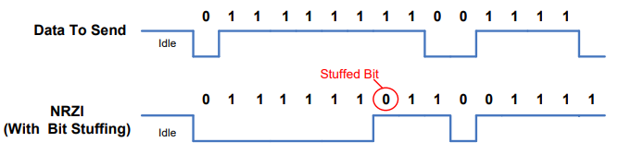
Synchronizing data
No clock signal!! How is USB so fast?
Partially EE magics: better receivers, matched wire impedance
Partially easier to distinguish signal states
Also guaranteed transitions, which allow resynchronization
Transitions are used to denote data (non-return-to-zero inverted)
With guaranteed transition in within every 8 bits (bit stuffing)
Allows clocks on the two devices to synchronize

Slide 14
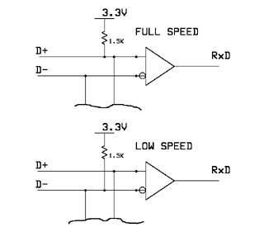
USB speeds
USB 1.0
Low Speed: 1.5 Mbps
Not clear if this is used anymore
Full Speed: 12 Mbps
Microcontrollers tend to support Full Speed
We’re focusing on details from it
USB 2.0
High Speed: 480 Mbps
USB 3.0+
Super Speed: 5-20 Gbps
Adds multiple parallel data connections
Pull-up resistors allow for detection of a plugged device
Also identify speed

Slide 15
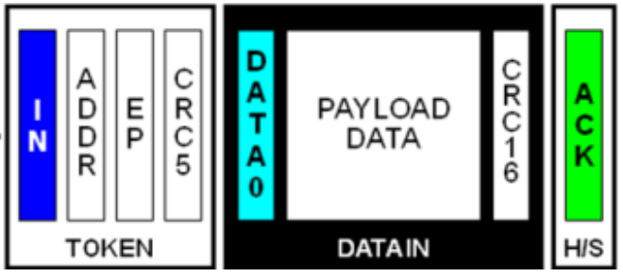
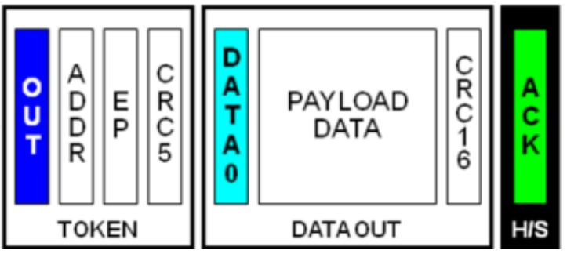
USB interactions
Reading data from Device
General transaction format
Host sends a Token packet: identifies transfer direction and device
Host or Device send data depending on direction
Other side acknowledges receipt of data
Like a maxed-out version of the I2C transaction pattern
Host always initiates communication
Writing data to Device

Slide 16
USB token packets
Packet fields
Sync field, allows transmitter and receiver clocks to synchronize
Packet ID, determines what type of packet is being sent
Token type: Setup device, Read from device, or Write to device
Address+Endpoint to identify Device
CRC, (Cyclical Redundancy Check) to detect bit errors
5-bit CRC

Slide 17
USB data packets
Packet fields
Sync field, allows transmitter and receiver clocks to synchronize
Packet ID, determines what type of packet is being sent
Data: application data
Data, up to 1023 bytes (full speed, often capped at 64 for microcontrollers, probably bigger for modern USB versions)
CRC, (Cyclical Redundancy Check) to detect bit errors
16-bit CRC

Slide 18
Cyclic Redundancy Check (CRC)
Determines if the data received matches the data sent
CRC value is calculated on original data and appended to message
CRC value is recalculated on the received data
Value appended to message and value recalculated MUST match
Essentially some kind of hash operation
Turns many bits into some smaller number of bits that are unique-ish
CRC algorithms are:
Particularly good at single bit errors AND contiguous bit errors
Relatively simple to calculate
Very widely used in communication

Slide 19
Break + Question
Reading data from Device
Why have two CRC values?
Writing data to Device

Slide 20
Break + Question
Reading data from Device
Why have two CRC values?
Devices that aren’t addressed want to be able to determine that right away without reading all of the data
For reading, data is sent by two different devices, so it needs two CRCs
Keep writes the same for symmetry
Writing data to Device

Slide 21
USB Outline
Low-layer details
How are bits sent
How are packets (collections of bits) sent
Higher-layer details
How do we interact with devices
How do we determine what devices are and how they work

Slide 22
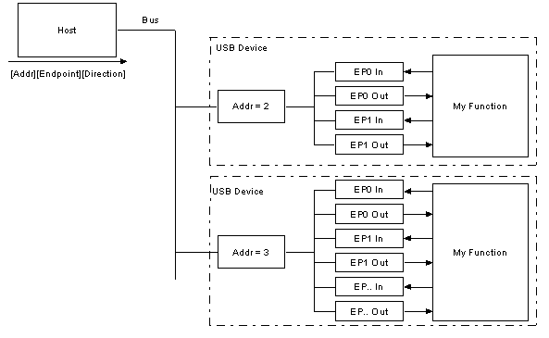
Interacting with USB devices
Each Device is given a separate address on the bus
Each Device also has a number of Endpoints
Logical communication channels
Direct data and guide communication patterns

Slide 23
USB endpoint types
Interrupt transfers
Guaranteed latency, small amounts of data
Important sensor data (mice and keyboards)
Polled frequently by Host
Bulk transfers
Sporadic large transfers, reliable communication
General reading/writing of data (flash drives and USB serial)
Polled by Host whenever there is available bandwidth
Isochronous transfers
Guaranteed data rate, unreliable communication
Continuous data streaming (audio and webcams)
Polled frequently by host

Slide 24
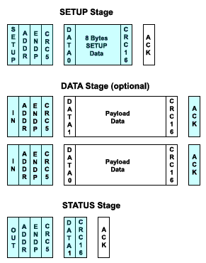
USB control endpoint
Every USB Device has a special Control endpoint as well
Used for setting up the USB Device driver on the Host
Initializing a Device
Host sends SETUP transaction requesting device descriptor
Host performs IN transaction to read device descriptor
Host performs OUT transaction to write device status

Slide 25
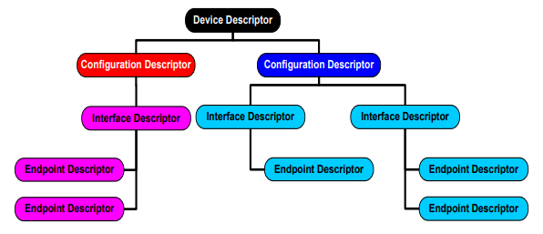
USB device descriptors
Tree structure describing the device
Interfaces it provides
Endpoints associated with each interface
Transmitted as an array of bytes

Slide 26
Example Microbit
Interface: Communications, Abstract (modem), CDC
Endpoint: 3, IN, Interrupt
Interface: CDC Data, CDC DATA interface
Endpoint: 1, IN, Bulk
Endpoint: 2, OUT, Bulk
Interface: Vendor Specific Class, Subclass, Protocol
Endpoint: 5, IN, Bulk
Endpoint: 4, OUT, Bulk
Interface: Mass Storage, SCSI, MSD interface
Endpoint: 7, IN, Bulk
Endpoint: 6, OUT, Bulk
Virtual serial device
SEGGER JTAG interface
USB external filesystem

Slide 27
lsusb output
lsusb
List USB devices
Combine with –s flag to select a single device
Combine with -v flag for verbose mode with more information

Slide 28
Minimal virtual serial USB Device
Virtual Serial Device
Endpoint 0: Control, IN/OUT
Respond to IN requests by setting up OUT with a buffer of descriptor data of the correct size
Endpoint 1: Interrupt, IN
Needed for serial modem controls, just ignore it
Endpoint 2: Bulk, OUT
Connect to buffer from _write() (just takes raw characters)
Endpoint 3: Bulk, IN
Connect buffer to _read() (just provides raw characters)

Slide 29

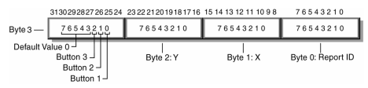
HID USB Device (Human Interface Device)
Used for human interaction devices, like keyboard/mouse
“Report” structure is provided over Interrupt IN endpoint
Or on demand via Control IN endpoint
Example mouse with x,y and three buttons

Slide 30
USB summary
Specification for fast data communication
Specification for interacting with abstract device types
Connects correct driver to interpret and send data
Pros
Very fast
Very interoperable
Cons
Hardware and software are way more complex than simple protocols like UART, SPI, and I2C
Not very energy efficient

Slide 31
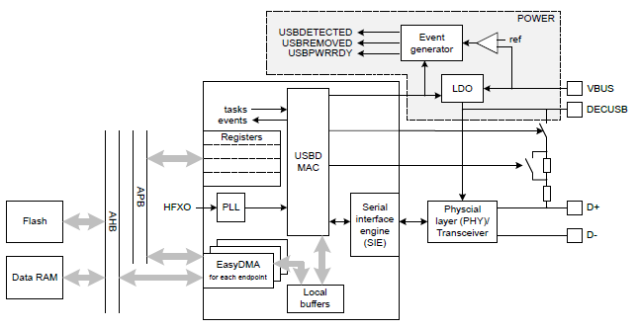
nRF52 USBD
Implements USB Device (not Host)
Control endpoint
14 bulk/interrupt (7 IN, 7 OUT)
64-byte transfers
2 isochronous (1 IN, 1 OUT)
1023-byte transfers
Full-speed USB
With 5 volt signals

Slide 32
Break + Question
What are the ramifications of many USB devices sharing a bus?
Consider: throughput and latency
What if I really had 127 USB mice on a single USB hub?
What if it was microphones instead?

Slide 33
Break + Question
What are the ramifications of many USB devices sharing a bus?
Consider: throughput and latency
Devices need to share bandwidth
Also devices are “polled” one-at-a-time
What if I really had 127 USB mice on a single USB hub?
What if it was microphones instead?
Certainly latency would be really bad
You might saturate the data throughput capabilities!

Slide 34
Outline
USB
CAN
Bit-banging
1-wire
Neopixel LED strips
Video Protocols
VGA
HDMI

Slide 35
Controller Area Network (CAN bus)
Designed for highly reliable interactions within a vehicle
Multi-master with arbitration
Similar to I2C
Mechanism for sending messages with “identifiers”
Identifies the data in the message, not the device its for
Lower value identifiers have high priority
All messages are received by all CAN nodes
Which can decide at higher levels which identifiers they care about

Slide 36
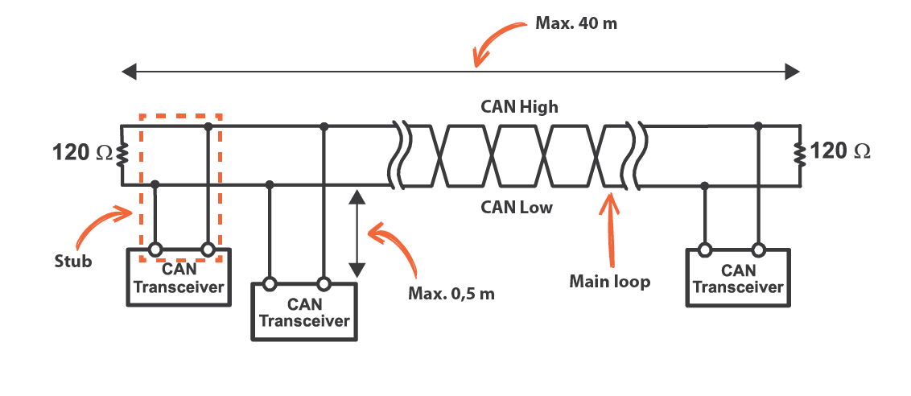
CAN physical connections
Two differential, wired-AND signal lines
Transitions are used to transmit bits (non-return-to-zero) with bit-stuffing
Combines aspects of USB and I2C
125 kHz – 5 Mbps speeds

Slide 37

CAN packet format
11-bit identifier
Check bits as they are sent to see if you win arbitration
Up to 8 bytes (64 bits) of data
Very small messages!
CRC for bit error detection
Acknowledgement
Like I2C, let the line float and see if another device responds
If not, explicitly retransmit!

Slide 38
CAN message types
Data frame
Transmission of data for a certain identifier
Remote frame
Requests data transmission of a certain identifier
Error frame
Transmitted when an error is detected with the previous message
Overload frame
Transmitted by a node that is too busy to respond right now

Slide 39
CAN reliability design – detecting errors
Check for errors everywhere and appropriately handle
Bit error
If the value found on the bus differs from the one sent
Stuff error
If 6 consecutive bits of the same type are found
CRC error
If CRC does not match
Form error
Format field has unexpected values
Acknowledgement error
No ACK received
Devices detecting an error broadcast a message signifying it!
Multiple devices sending the same message works without arbitration loss
Previous message is then retransmitted

Slide 40
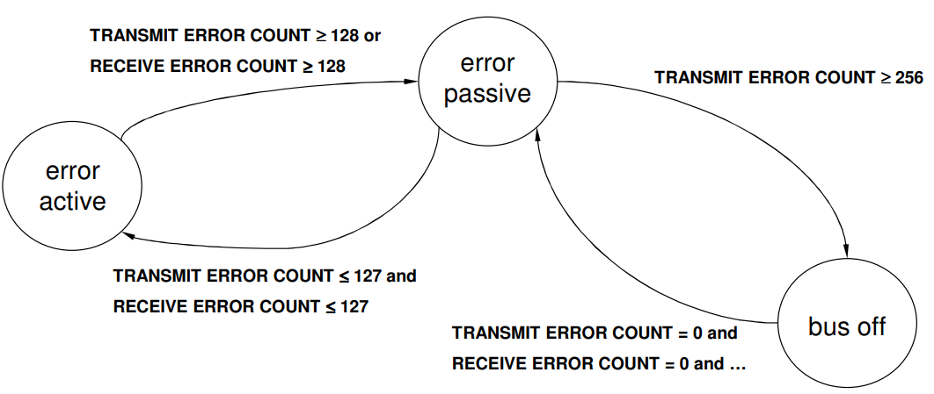
CAN reliability design – handling errors
Each node accepts the possibility that maybe it is the faulty one
Track errors and successes and change device state
Passive: limited error signaling and transmissions
Bus off: does not transmit in any way
Idea is that the CAN controller hardware can be faulty but still detect it in some cases

Slide 41
CAN summary
Designed for reliable vehicular communication
Multi-master bus with serial communication
Pros
Highly reliable
Extensible to many devices
Cons
Special-purpose design. Whole system has to agree on identifiers
Relatively slower throughput

Slide 42
Break + Open Question
Why is CAN a good choice for vehicles (historically)?
What problems is CAN facing today?

Slide 43
Break + Open Question
Why is CAN a good choice for vehicles (historically)?
High reliability
A few low-data-rate sensors scattered throughout the car
What problems is CAN facing today?
Camera data doesn’t fit in 8-byte packets…

Slide 44
Outline
USB
CAN
Bit-banging
1-wire
Neopixel LED strips
Video Protocols
VGA
HDMI

Slide 45
Controlling a protocol without a peripheral
If your microcontroller doesn’t have a hardware peripheral to control a certain protocol, you could still emulate it
Known as bit-banging
Example: use GPIO to create a UART
Set high/low values with certain timings to make start, data, and stop bits
Probably based on an interrupt if microcontroller is fast enough
Or maybe is hard-coded with delays
For reading the UART, instead read bits from the bus at a given rate
Expect start/stop bits, but ignore them

Slide 46
Two bit-banging examples
1-Wire Protocol
Neopixel LED strip

Slide 47
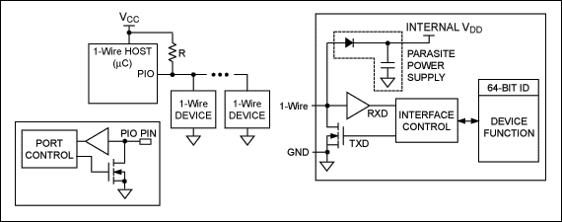
1-Wire Protocol
Similar to I2C, but without a clock line
Devices can optionally power themselves off the data line

Slide 48
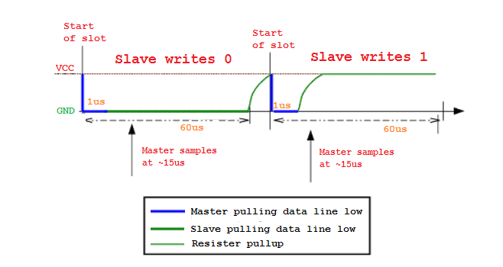
1-wire read operations
Controller drives line low then releases, and samples 15 μs later
Falling edge wakes up peripheral devices
Peripheral device either drives low for a 0 or also releases for a 1
Peripheral writes 0
Peripheral writes 1
Controller samples at ~15 μs
Controller samples at ~15 μs
Controller pulling data line low
Peripheral pulling data line low
Resistor pullup

Slide 49
Controlling 1-wire with a UART
1-wire is not supported by most microcontrollers
Instead, it must be emulated either with GPIO or with another protocol
Example: UART plus an external transistor can emulate 1-wire
Run UART way faster than 1-wire: each UART byte is one 1-wire bit
Connect TX to a transistor which can connect to Ground or disconnect
Connect RX to the data line
To read, write data 0xFF
Start bit pulls line low to trigger peripheral device
8 data bits do not affect data line (disconnected)
RX line will match 0xFF for reading a 1, or will be anything else for a 0

Slide 50
Two bit-banging examples
1-Wire Protocol
Neopixel LED strip

Slide 51
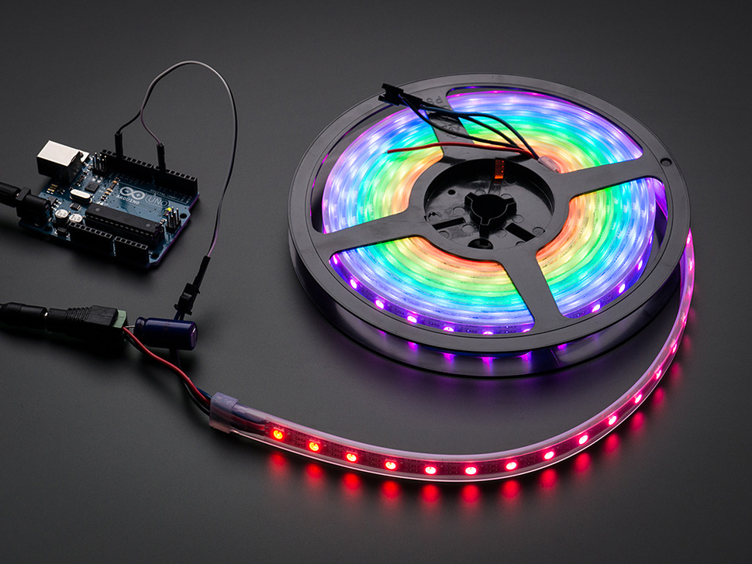
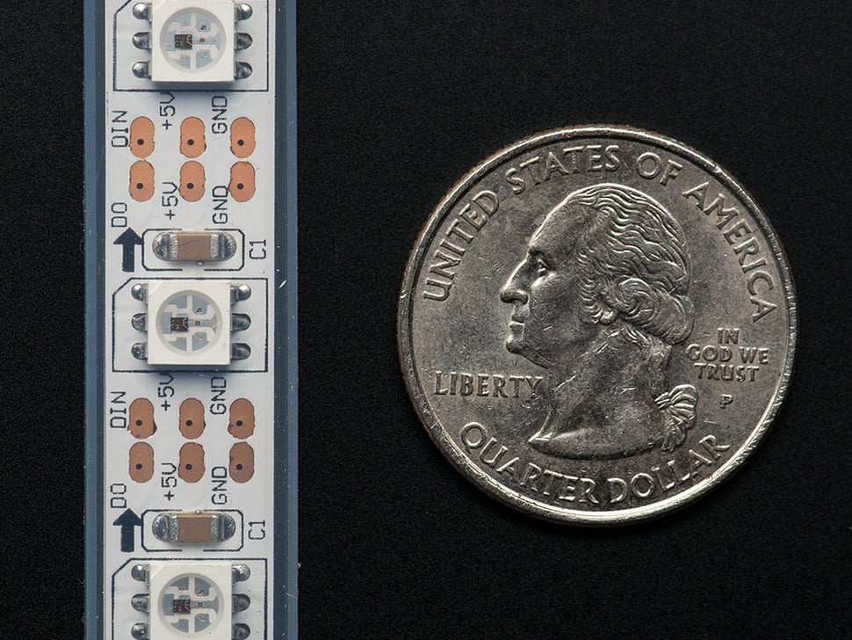
Neopixel LED strips
LEDs on a long strip connected in series
Often capable of RGB control
Custom protocol for driving them

Slide 52
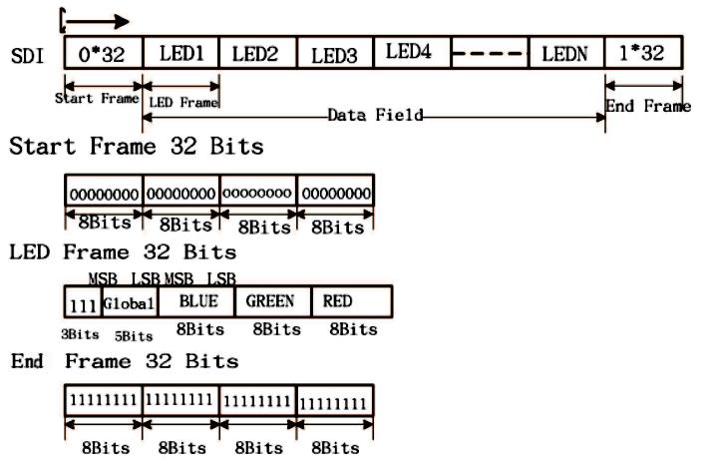
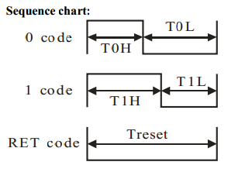
Neopixel protocol
32 bits for each LED
After the first LED gets its data, all the next bits are forwarded down the chain
Each bit is represented by an amount of time high and low

Slide 53
Emulating Neopixel protocol with SPI
Idea: configure SPI speed so N bits line up with the period of the bit
For example, 8 bits per period
To send a 0 bit: 0xE0 (0b11100000)
To send a 1 bit: 0xF8 (0b11111000)
From the Neopixel perspective, that data is just the square wave it wanted
Warning: I don’t promise the actual numbers here are correct. Just the overall idea. Recalculate the numbers yourself based on timing requirements

Slide 54
Emulating Neopixel protocol with PWM
Idea: these are just differing duty-cycle square waves i.e., PWM
Set PWM period to equal the period for sending a bit
Needs to be a left-aligned PWM signal
To send a 0 bit: 30% duty cycle
To send a 1 bit: 70% duty cycle
Driver translates colors into a byte array, then bits in the array into duty cycles, then just plays the duty cycles
Warning: I don’t promise the actual numbers here are correct. Just the overall idea. Recalculate the numbers yourself based on timing requirements

Slide 55
Details on NeoPixels
Datasheets:
https://cdn-shop.adafruit.com/product-files/2757/p2757_SK6812RGBW_REV01.pdf
https://cdn-shop.adafruit.com/datasheets/WS2812B.pdf
Good writeups on using NeoPixels:
https://github.com/japaric/ws2812b/blob/master/firmware/README.md
https://wp.josh.com/2014/05/13/ws2812-neopixels-are-not-so-finicky-once-you-get-to-know-them/

Slide 56
Outline
USB
CAN
Bit-banging
1-wire
Neopixel LED strips
Video Protocols
VGA
HDMI

Slide 57
Controlling video output
Not very common for embedded systems
Either directly connected to a screen over SPI/I2C, or not at all
Very common for traditional computing though
And while we’re talking about protocols, let’s look at them!
Reminder: memory is a huge embedded systems concern here
640 x 480 pixels @ 18-bit color = 675 kB
nRF52833 RAM: 128 kB, Flash: 512 kB

Slide 58
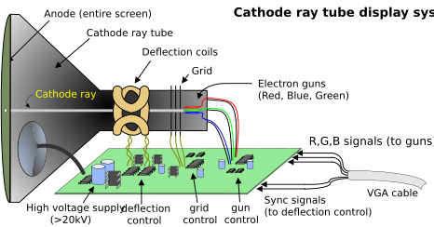
Old-school VGA display design
Screen lights up when hit with electrons
Separate Red, Green, and Blue activation areas
System directs electrons at each pixel of the screen on a loop

Slide 59
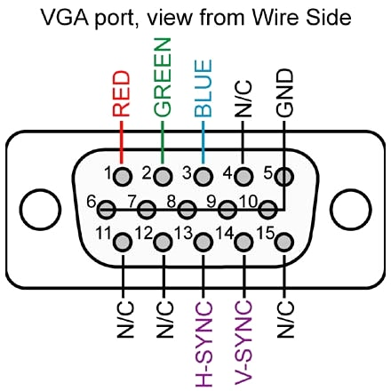
VGA connector
All data goes to the display (write-only)
Horizontal and Vertical sync lines
Timing control
Horizontal: when each row restarts
Vertical: when the entire screen restarts
Red/Green/Blue lines
Analog voltage for intensity: 0-0.7 volts
Requires a high-speed DAC (RAMDAC)
Ground pins
To connect ground between devices

Slide 60
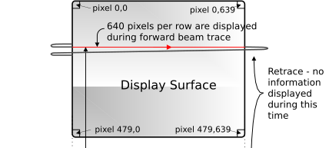
Example display: 640x480 at 60 Hz
Send each pixel in a row at 20 MHz (40 ns per pixel)
25 μs for the entire 640 pixel row
6.35 μs pause before next row
After all 480 rows, 1.43 ms pause before next frame
High resolution devices would have to go faster
Possibly MUCH faster
https://digilent.com/reference/learn/programmable-logic/tutorials/vga-display-congroller/start

Slide 61
More modern VGA devices
Protocol doesn’t really make any sense for a digital device
But it already existed and was very popular
So LCD monitors implemented it too
ADC reads in analog voltages for Red, Green, and Blue into a memory
Data from the memory is displayed on the screen
Bits -> DAC -> Wire -> ADC -> Bits
That’s a lot of unnecessary work

Slide 62
VGA Extension - Display Data Channel (DDC)
Uses extra wires in the VGA connector
Originally “4-bit monitor ID”, but rarely used in practice
Instead uses two pins as I2C data and clock lines
Monitor is always a peripheral device at address 0x50
Provides a “Extended Display Identification Data” payload
128-256 bytes of data
“Descriptor” for the display, like USB descriptors
Identifies manufacturer, resolution(s), refresh rate(s), timing requirements

Slide 63
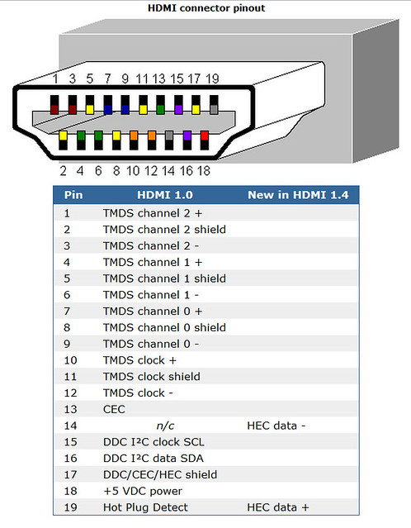
HDMI
Clock plus three data “channels”
Transition-Minimized Differential Signaling (TMDS)
Similar to USB with twisted pair wiring
Send data packets to display
I2C data and clock for Display Data Channel (DDC)
Adapted from VGA
Consumer Electronics Control (CEC) enables control of devices
Only uses 1-wire to reduce pin count

Slide 64
Outline
USB
CAN
Bit-banging
1-wire
Neopixel LED strips
Video Protocols
VGA
HDMI

