Slide 1
Lecture 13 Wireless Communication
CE346 – Microcontroller System Design
Branden Ghena – Spring 2025
Some slides borrowed from: Josiah Hester (Northwestern), Prabal Dutta (UC Berkeley)

Slide 2
Administrivia
Heads up: office hours today are going to be busy
Quite a few groups still need Lab 6 checkoffs
I’m still ordering more hardware if people need things
Next order will be today after class
How to get project help
Office hours (including Fridays)
Piazza post (I’ve added some posts on general stuff)
Find guides on the Internet

Slide 3
Today’s Goals
Explore important issues in wireless communication
Physical and Data Link layers particularly
Describe several wireless networks that are very important to modern Internet of Things devices
Bluetooth Low Energy
Thread and Zigbee (802.15.4)
WiFi (802.11)
Low-Power Wide-Area Networks
nRF52833 supports these! But our Microbit library doesn’t 😢
Except for 15.4, which IS now supported! See example apps

Slide 4
Outline
Wireless Communication Overview
Wireless Protocols
Overview
Bluetooth Low Energy
802.15.4
WiFi
Low-Power Wide-Area Networks

Slide 5
Wireless: high-level idea
Normally, we want to keep all electric signals contained in a wire
Don’t want to receive interference from other signals or cause interference
Antennas are good at the opposite:
They spill electrical signals out into the world
They receive electrical signals from the world
This means we can send information from one device to another without wires!

Slide 6
Why use wireless?
There are no wires!
No need to install and maintain wires
Reduces cost
Simplifies deployment – place devices wherever makes sense
Supports mobile users
Move around office, campus, city
Move devices around home

Slide 7
What is hard about wireless?
There are no wires!
Wired networks are constant, reliable, and physically isolated
Ethernet has the same throughput minute-to-minute
Bits sent through Ethernet or USB are (usually) received
Wireless networks are variable, error-prone, and shared
WiFi throughput changes based on location and walls
Signals from nearby devices interfere with your signals
Individual bits might flip or never be heard at all

Slide 8
Wireless is a shared medium
Wired communication has signals confined to a conductor
Copper or fiber
Guides energy to destination
Protects signal from interference
Wireless communication is inherently broadcast
Energy is distributed in space
Signals must compete with other signals in same frequency band

Slide 9
Increasing network capacity is challenging
Wired networks just add more wires
Buses are many signals in parallel to send more data
Wireless networks are harder
Adding more links just increases interference
Need to expand to different frequencies

Slide 10
Model of RF communication
Energy that radiates spherically from an antenna at a “carrier frequency”
Good enough for understanding communication
Attenuation with distance
Density of energy reduces over time, distance
Signal strength reduced, errors go up
Two key features
Range and data rate affect error rates
Spatial reuse of frequencies

Slide 11
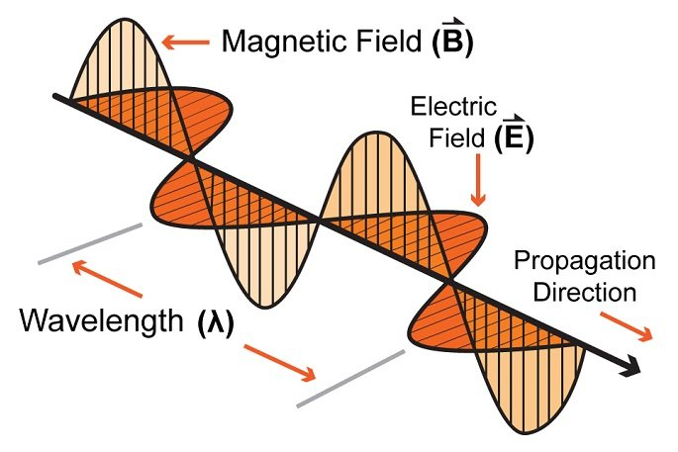
Signal qualities
Signal strength
The amount of energy transmitted/received
Signal frequency and bandwidth
Which “channel” the signal is sent on
Signal modulation
How data is encoded in the signal

Slide 12
Signal qualities
Signal strength
The amount of energy transmitted/received
Signal frequency and bandwidth
Which “channel” the signal is sent on
Signal modulation
How data is encoded in the signal

Slide 13
Wireless signals are incredibly low power
Maximum BLE transmit power for the nRF52840:
8 dBm -> 6.31 mW (10⁻³)
Minimum BLE receive power for the nRF52840:
-95 dBm -> 316.2 fW (10⁻¹⁵)
Signal strength decreases in energy spherically
Eventually the signal is too quiet to receive reliably

Slide 14

Some Intuitions for Signal Propagation, Power, Gain, etc.
Popular nRF52840 development kit:
Max BLE transmit power for nRF52840: 8 dBm (6.31 mW)
Min BLE receive sensitivity for nRF52840: -95 dBm (316.2 fW)
6.31 mW

Slide 15
Some Intuitions for Signal Propagation, Power, Gain, etc.
Popular nRF52840 development kit:
Max BLE transmit power for nRF52840: 8 dBm (6.31 mW)
Min BLE receive sensitivity for nRF52840: -95 dBm (316.2 fW)
.25 m

Slide 16
Some Intuitions for Signal Propagation, Power, Gain, etc.
Popular nRF52840 development kit:
Max BLE transmit power for nRF52840: 8 dBm (6.31 mW)
Min BLE receive sensitivity for nRF52840: -95 dBm (316.2 fW)
1 m

Slide 17
Some Intuitions for Signal Propagation, Power, Gain, etc.
Popular nRF52840 development kit:
Max BLE transmit power for nRF52840: 8 dBm (6.31 mW)
Min BLE receive sensitivity for nRF52840: -95 dBm (316.2 fW)
2 m

Slide 18
Some Intuitions for Signal Propagation, Power, Gain, etc.
Popular nRF52840 development kit:
Max BLE transmit power for nRF52840: 8 dBm (6.31 mW)
Min BLE receive sensitivity for nRF52840: -95 dBm (316.2 fW)
2 m
46 dB path loss!
0.00016 mW

Slide 19
Signal strength varies significantly across technologies
Bluetooth Low Energy (local area)
nRF52840 transmit power: 8 dBm (6.31 milliwatt)
nRF52840 receive sensitivity: -95 dBm (316.2 femtowatt)
LoRa (wide area)
SX127X LoRa transmit power: 20 dBm (100 milliwatt)
SX127X LoRa receive sensitivity: -148 dBm (1.6 attowatt)

Slide 20
Signal qualities
Signal strength
The amount of energy transmitted/received
Signal frequency and bandwidth
Which “channel” the signal is sent on
Signal modulation
How data is encoded in the signal

Slide 21
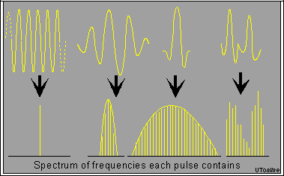
Complex waveforms have a center frequency and a width
A pure sinusoid is energy at exactly one frequency
A messy sinusoid with data layered on top of it has nearby energy
There’s a center of the signal energy
Plus some amount of width, which depends on how complicated the data layered on top is

Slide 22
How do radio stations work?
FM radio in cars is a good example of frequencies
All of FM radio has an allocation of 87.5 to 108.0 MHz
Each station takes has up to ~200 kHz of bandwidth
First station is 87.7 MHz +/- 100 kHz
Ranges from 87.6 to 87.8
Second station is 87.9 MHz +/- 100 kHz
Ranges from 87.8 to 88.0
What if they overlapped? They interfere with each other
You’d possibly hear both. Or get junk data that’s neither.

Slide 23
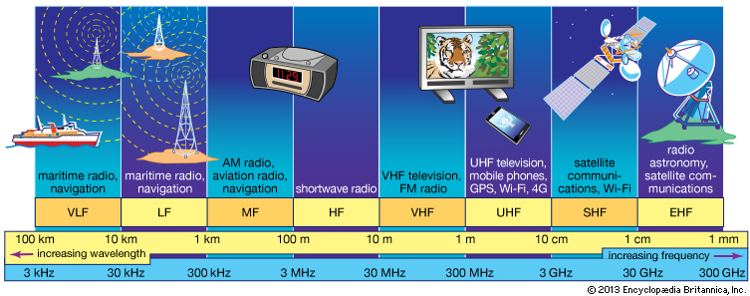
RF communication
IoT focus

Slide 24
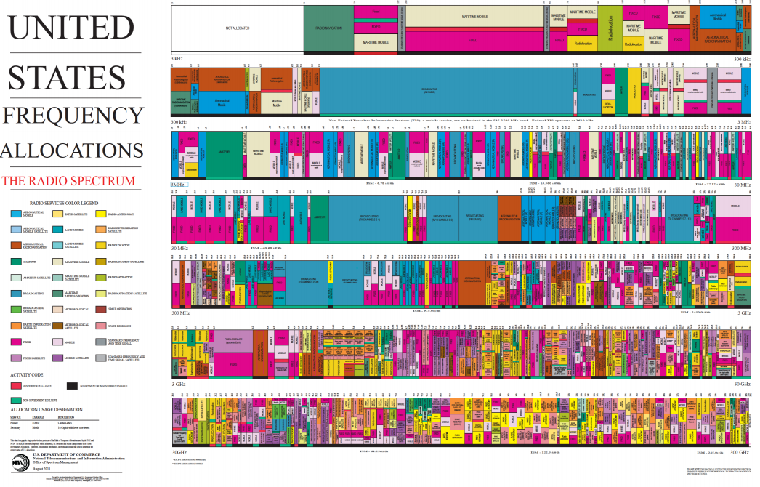
Wireless spectrum is allocated to specific uses

Slide 25
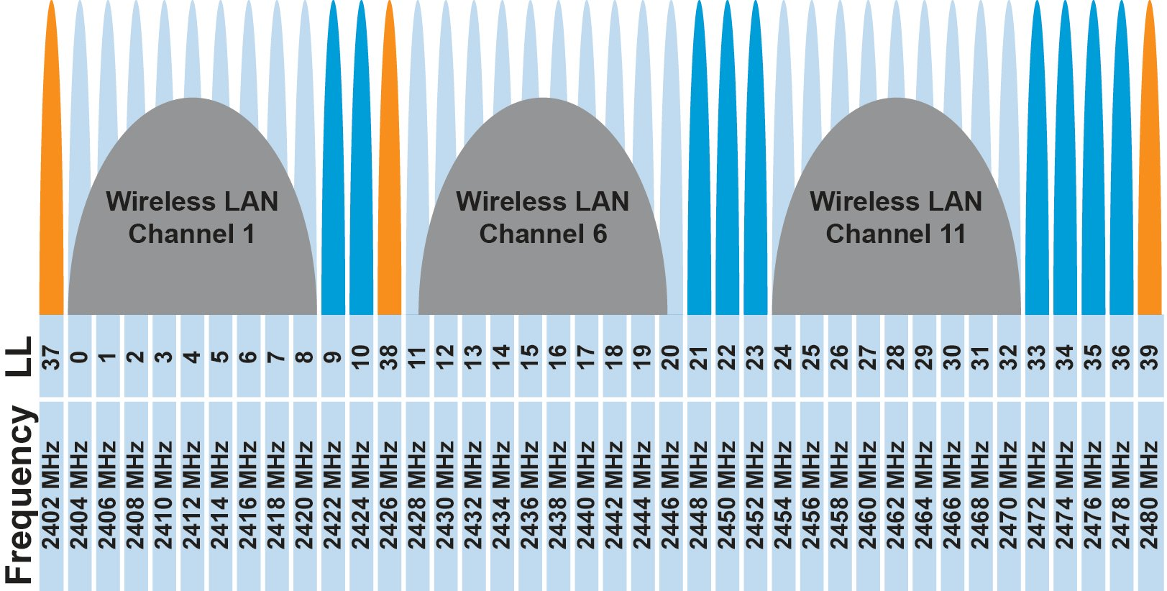
Unlicensed bands are where IoT thrives
902 MHz – 928 MHz
LPWANs
2.4 GHz to 2.5 GHz
WiFi, BLE, Thread
5 GHz
Faster WiFi
Cellular uses licensed bands at great cost
Why pay?

Slide 26
Unlicensed bands are where IoT thrives
902 MHz – 928 MHz
LPWANs
2.4 GHz to 2.5 GHz
WiFi, BLE, Thread
5 GHz
Faster WiFi
Cellular uses licensed bands at great cost
Why pay? No interference from other users

Slide 27
Signal qualities
Signal strength
The amount of energy transmitted/received
Signal frequency and bandwidth
Which “channel” the signal is sent on
Signal modulation
How data is encoded in the signal

Slide 28
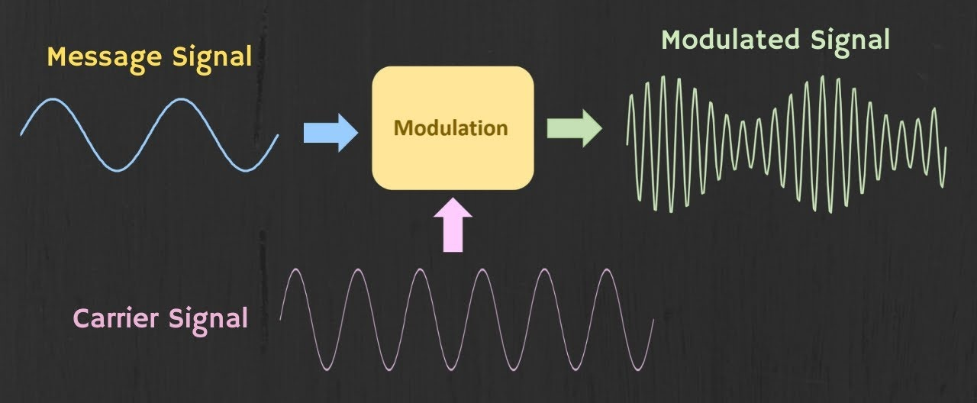
Modulation
Encoding signal data in an analog “carrier” signal
Carrier signal defines the frequency
Modulation scheme + data define bandwidth required

Slide 29
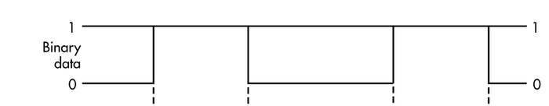
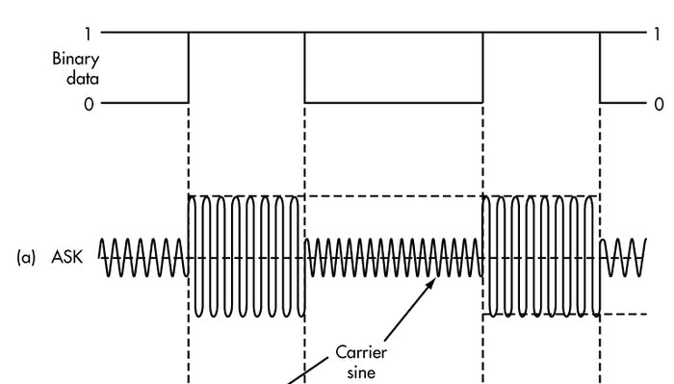
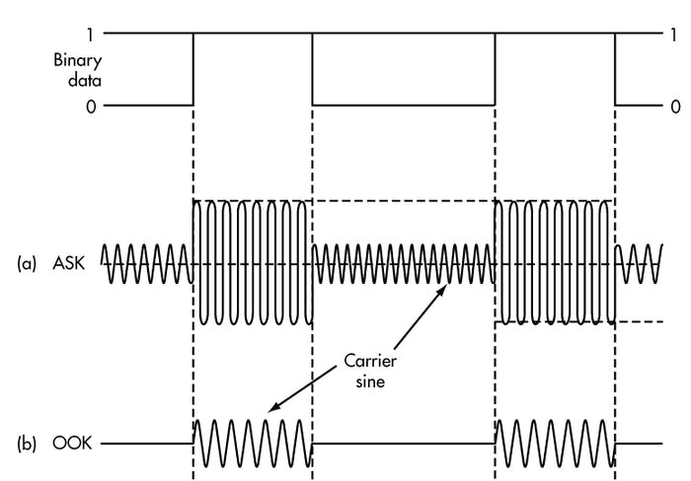
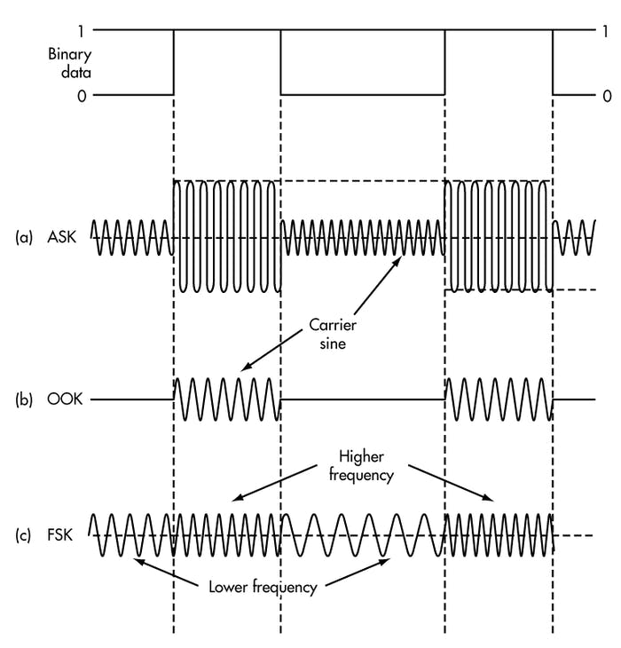
Common modulation types
Encoding binary data on a signal
Amplitude-shift Keying (ASK)
Modify amplitude of carrier signal
On-Off Keying (OOK) is an extreme example
Frequency-shift Keying (FSK)
Modify frequency of carrier signal

Slide 30
Break + Open Question
What lets some protocols travel further than others?
WiFi is about 100 meters
Cellular is more than 1000 meters

Slide 31
Break + Open Question
What lets some protocols travel further than others?
WiFi is about 100 meters
Cellular is more than 1000 meters
Multiple different parameters affect this
More transmit power
More receive sensitivity (receive at a lower power)
Modulation that makes it easier to recover bits without errors
Bandwidth can also affect error rates, which in turn affects distance
Frequency kinda-sorta, but not as much as people think

Slide 32
Outline
Wireless Communication Overview
Wireless Protocols
Overview
Bluetooth Low Energy
802.15.4
WiFi
Low-Power Wide-Area Networks

Slide 33
What is the role of a wireless protocol?
Multiple methods exist for sending bits wirelessly
Protocols make choices about how to use them
Select exact configurations for bit communication (Physical Layer)
Determine how to send packets of data (Data Link Layer)
What are the fields within a packet?
Which device sends a packet and when can it do so?
Organize communication between devices (Network Layer)
How are devices named?
How is communication directed between those devices?

Slide 34
Framing
Typical packet structure
Preamble - Existence of packet and synchronization of clocks
Header - Addresses, Type, Length
Data - Payload plus higher layer headers (e.g. IP packet)
Trailer - Padding, CRC
Wireless considerations
Control information for Physical Layer
Ensure robustness for header
Possibly different data rates for different parts of packet
Preamble | Destination Address | Source Address | Type and Length | Data | CRC

Slide 35
Medium Access Control
How does a network determine which transmitter gets to transmit?
Remember: the wireless medium is inherently broadcast
Two simultaneous transmitters may lose both packets

Slide 36
Analogy: wireless medium as acoustic
Activity: How do we determine who gets to speak?
Two simultaneous speakers also lose both “transmissions”
How many different methods can you come up with?

Slide 37
Analogy: wireless medium as acoustic
Activity: How do we determine who gets to speak?
Two simultaneous speakers also lose both “transmissions”
How many different methods can you come up with?
Eye contact (or raise hand) -> out-of-band communication
Wait until it’s quiet for some time -> carrier sense multiple access
Strict turn order -> time division multiple access
Just speak and hope it works -> ALOHA
Everybody sing at different tones -> frequency division multiple access (stretching the metaphor)
Others?

Slide 38
ALOHA
ALOHAnet (1971)
University of Hawaii – Norman Abramson
First demonstration of wireless packet network
Rules
If you have data to send, send it
Two (or more) simultaneous transmissions will collide and be lost
Wait a duration of time for an acknowledgement
If transmission was lost, try sending again “later”
Want some kind of exponential backoff scheme here

Slide 39
CSMA/CA – Carrier Sense Multiple Access with Collision Avoidance
First listen for a duration and determine if anyone is transmitting
If idle, you can transmit
If busy, wait and try again later
“listen before send”
More expensive than Aloha, but far more reliable
Higher energy and lower data rate due to time spent listening
Don’t mess up messages that have already started
Collisions can only occur if there are multiple waiting devices

Slide 40
TDMA – Time Division Multiple Access
Split transmissions in time
Devices share the same channel
Splits time into fixed-length windows
Each device is assigned one or more windows
Can build a priority system here with uneven split among devices
Requires synchronization between devices
Often devices must listen periodically to resynchronize
Less efficient use of slots reduce synchronization
Large guard windows. E.g., 1.5 second slot for a 1 second transmission

Slide 41
Break + Question
Access controls to shared busses in wired systems as well!
Which of these MAC protocols is I2C using?
Which of these MAC protocols is USB using?

Slide 42
Break + Question
Access controls to shared busses in wired systems as well!
Which of these MAC protocols is I2C using?
CSMA/CA – senses the carrier to detect collisions
Which of these MAC protocols is USB using?
TDMA – Host decides when each device can talk

Slide 43
Outline
Wireless Communication Overview
Wireless Protocols
Overview
Bluetooth Low Energy
802.15.4
WiFi
Low-Power Wide-Area Networks

Slide 44
Comparison of wireless protocols
Data
Throughput
Bluetooth
BLE
Zigbee
Range

Slide 45
Comparison of wireless protocols
WiFi
Data
Throughput
Bluetooth
BLE
Zigbee
Range

Slide 46
Comparison of wireless protocols
WiFi
Cellular
Data
Throughput
Bluetooth
Low-Power Wide-Area Networks
BLE
Zigbee
Range

Slide 47
Comparison of wireless protocols
WiFi
Cellular
Why don’t we always max out range and throughput?
Data
Throughput
Bluetooth
Low-Power Wide-Area Networks
BLE
Zigbee
Range

Slide 48
Comparison of wireless protocols
WiFi
Higher Power & Higher Cost
Cellular
Data
Throughput
Bluetooth
Low-Power Wide-Area Networks
BLE
Zigbee
Lower Power & Lower Cost
Range

Slide 49
Protocols
Bluetooth Low Energy
802.15.4 – Zigbee and Thread
WiFi
Low-Power Wide-Area Networks

Slide 50
Bluetooth Low Energy
Bluetooth Classic was good for enabling device to device communication
But not particularly fast discovery or low energy operation
Bluetooth Low Energy was developed to improve this
Focuses on low-energy interactions
Much lower throughput that Bluetooth
Supported by hardware devices already in smartphones
Humans can interact directly with nearby devices!!

Slide 51
BLE mechanisms
Advertising
Discovery
Advertisements – broadcast messages indicating device details
Ephemeral, uni-directional communication from Advertiser to Scanner(s)
ALOHA access control
Connections
Interaction
Bi-directional communication between Peripheral and Central
Maintained for some duration
TDMA access control

Slide 52
BLE network topology
Peripheral
Connection
Central & Scanner
Scanner
Connection
Peripheral
Advertisement
Advertisement
Advertisement
Advertisement
Advertiser
Advertiser
Advertiser

Slide 53
Protocols
Bluetooth Low Energy
802.15.4 – Zigbee and Thread
WiFi
Low-Power Wide-Area Networks

Slide 54
802.15.4 & Thread & Zigbee
802.15.4 is a low-energy method for transmitting bits (physical layer)
Radio chips have been widely available for 15-20 years
Significant amounts of sensor network research have focused on building layers on top of 802.15.4
Access control layers (CSMA)
Network layers
Thread is a selection of these possibilities to make a network
Uses IPv6 networking!!
Zigbee makes slightly different selections
Focuses on automatic interpretation and discovery of sensors and actuators

Slide 55
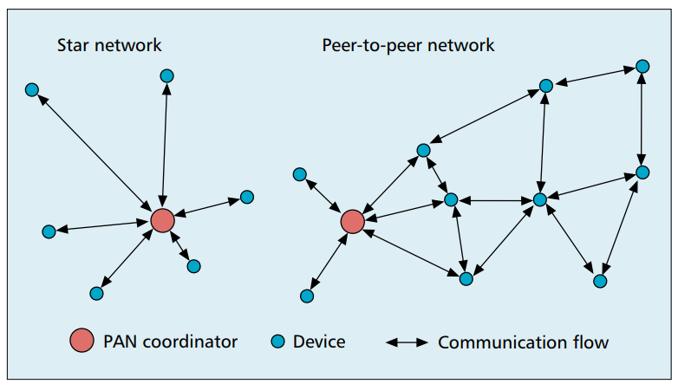
802.15.4 topology
Expects use cases as Star or Mesh networks

Slide 56

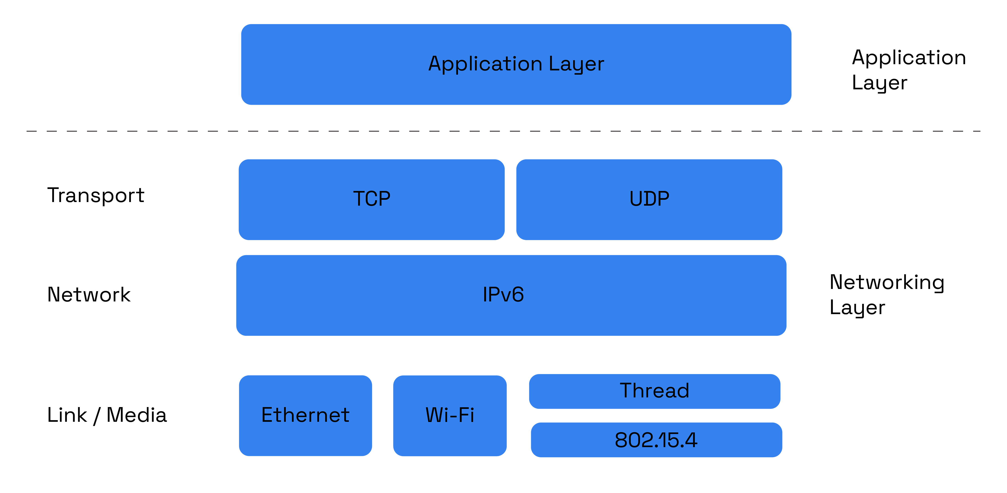
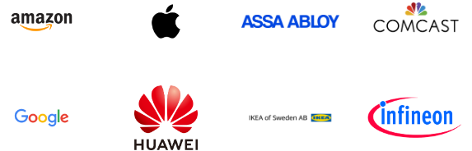
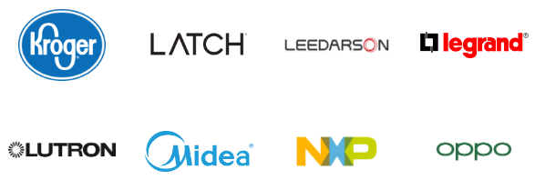
Matter standard
Lots of member companies
Standard for interoperable smart home devices (October 2022)
Uses IPv6 over 802.15.4/Thread to send packets
Uses standardized device classes with descriptors for application logic

Slide 57
Protocols
Bluetooth Low Energy
802.15.4 – Zigbee and Thread
WiFi
Low-Power Wide-Area Networks

Slide 58
WiFi (802.11)
Ubiquitous wireless communication
High energy requirements for high throughput communication
Now accessible through relatively low power radios
ESP32, Electric Imp, and company
Still significantly more effort than BLE or Thread
IoT devices can use the same WiFi that’s already available
No need for additional infrastructure!!

Slide 59
802.11 major updates
 | Protocol | Year | Frequency | PHY | Max Rate | Range
- | 802.11 | 1997 | 2.4 GHz | DSSS/FHSS | 2 Mbps | 20 m
1 | 802.11b | 1999 | 2.4 GHz | DSSS | 11 Mbps | 35 m
2 | 802.11a | 1999 | 5 GHz | OFDM | 54 Mbps | 35 m
3 | 802.11g | 2003 | 2.4 GHz | OFDM | 54 Mbps | 38 m
4 | 802.11n | 2009 | 2.4/5 GHz | OFDM + MIMO | 600 Mbps | 70 m
5 | 802.11ac | 2013 | 5 GHz | OFDM + MU-MIMO (downlink only) | 3400 Mbps | 35 m
6 | 802.11ax | 2021 | 2.4/5/[6] GHz | OFDMA + MU-MIMO | 9600 Mbps | 35 m
7 | 802.11be | 2024 | 2.4/5/6 GHz | OFDMA + MU-MIMO | 23000 Mbps | 35 m
802.11b was very popular but is now usually unsupported
802.11a never saw major deployment
WiFi Alliance rebranded 802.11ac as “WiFi 5” and backported scheme

Slide 60
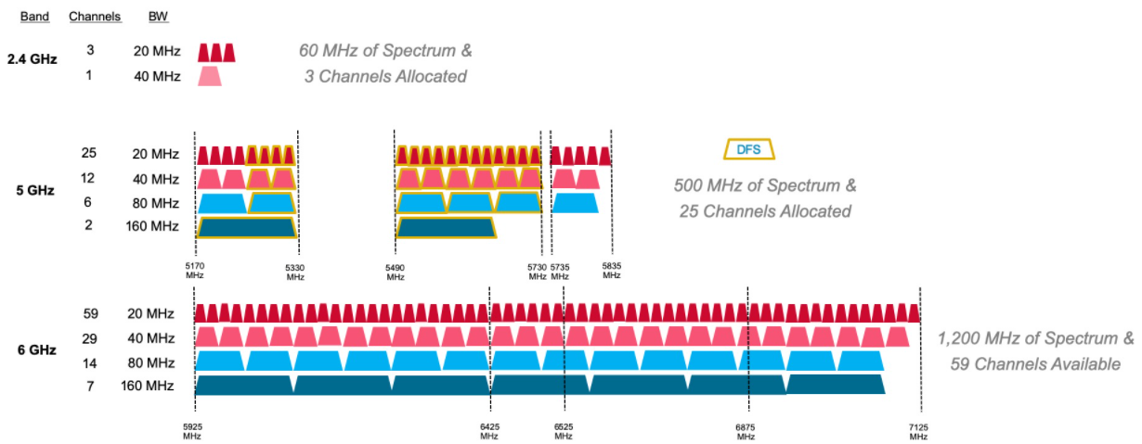
WiFi bandwidth
More bandwidth means higher data rate (with same error rate)

Slide 61
WiFi bandwidth
More bandwidth means higher data rate (with same error rate)
5 GHz band allows larger bandwidth allocations for more data rate

Slide 62
WiFi 6E: WAY more bandwidth means better data rates

Slide 63
Protocols
Bluetooth Low Energy
802.15.4 – Zigbee and Thread
WiFi
Low-Power Wide-Area Networks

Slide 64

LPWANS: How do we collect data from a sensor?
Manually collect measurements
Too much work
Connect it to WiFi (or Ethernet)
Too many separate networks
Pay for cellular access
Too expensive for many devices

Slide 65
LPWANS: How do we collect data from MANY sensors?
Manually collect measurements
Too much work
Connect it to WiFi (or Ethernet)
Too many separate networks
Pay for cellular access
Too expensive for many devices

Slide 66
We need another network option
Requirements:
Wide area of coverage
Deploy fewer gateways
Low power
So we can deploy on batteries
Doesn’t need high throughput
Sensor data is relatively small

Slide 67
LPWANs (Low-Power Wide-Area Networks)
How do we collect data from city-scale deployments?
There’s an unmet need for long-range, but low-throughput networks
Existing cellular technologies focus on human requirements
Still a brand new space (relatively)
Unlicensed-band technologies since 2015: Sigfox and LoRaWAN
Cellular technologies since 2019: LTE-M and NB-IoT
Focus on long-range, low-energy, low-throughput
One gateway can cover an entire city!!

Slide 68
LoRaWAN
Open communication standard built with proprietary LoRa PHY
Low rate (1-20 kbps) and long range (~5 km)
Shorter range than Sigfox but much higher bit rate
Most popular LPWAN protocol
Target of academic research
Industry involvement in hardware and deployments

Slide 69
LoRaWAN network details

Slide 70
If you find this interesting…
I also teach a special topics course!
CS433 Wireless Protocols for the Internet of Things
Spring quarter 2026
Lab course, similar to this one but more on-your-own
Design project instead of a final project
Spend some time learning and playing around with wireless protocols. Especially
Bluetooth Low Energy
802.15.4 (Thread and Zigbee)
WiFi (802.11)
LPWANs (LoRaWAN and others)

Slide 71
Outline
Wireless Communication Overview
Wireless Protocols
Overview
Bluetooth Low Energy
802.15.4
WiFi
Low-Power Wide-Area Networks

