Slide 1
Lecture 15 Wrapup + Microprocessors
CE346 – Microcontroller System Design
Branden Ghena – Spring 2025
Some slides borrowed from: Josiah Hester (Northwestern), Prabal Dutta (UC Berkeley)

Slide 2
Administrivia
Project check-ins on Friday
Friday 1-5 pm in the lab room
PMs will be there to chat with groups and generally provide help
Tuesday and Thursday next week will be office hours instead of lecture
Next (probably last) project orders on Sunday
Put things on list by end-of-day Saturday
After that it’ll “make the best out of what you have”

Slide 3
Today’s Goals
Discuss remaining parts of the Microbit and nRF52833
Realize that we’ve covered almost everything on the system!!
Compare and contrast other microcontrollers and other similar hardware platforms

Slide 4
Outline
What haven’t we talked about?
Microbit
nRF52833
Other hardware systems
Microcontroller history
Other microcontroller peripherals
Microprocessors
FPGAs

Slide 5
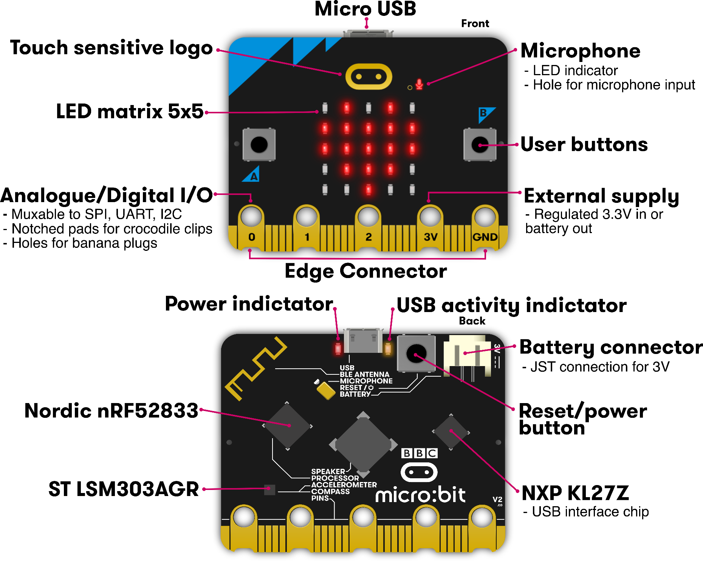
Microbit
Used almost all of this!
Remaining:
Batteries
Wireless
KL27Z I2C

Slide 6
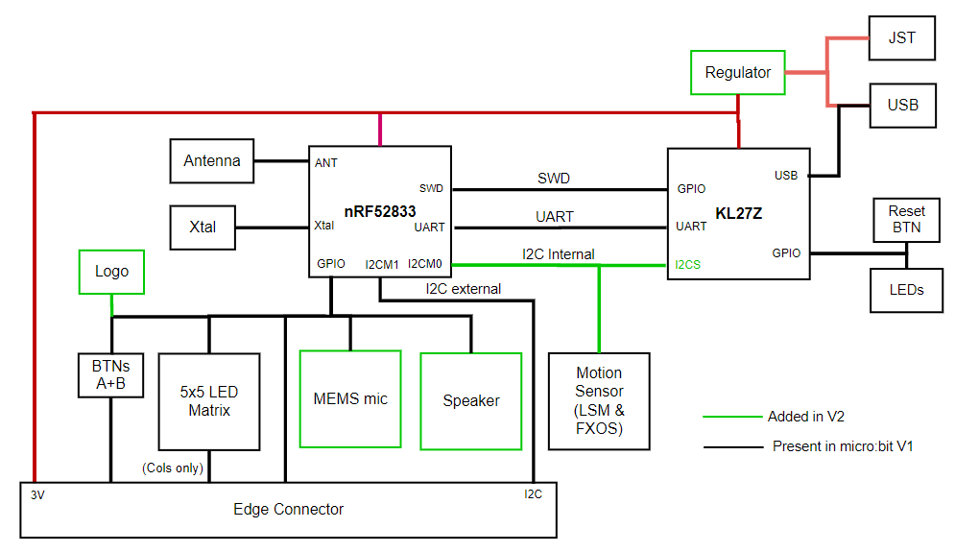
Internal Microbit connections

Slide 7
KL27 I2C Interface
Device information
Version of board and JTAG firmware
Power state of board
USB, Battery, both
Voltage values for battery and VIN
USB connection state
Disable the power LED!!
Flash Storage
128 kB of the KL27’s Flash is readable/writable over I2C
https://github.com/microbit-foundation/spec-i2c-protocol/blob/main/spec/index.md

Slide 8
Outline
What haven’t we talked about?
Microbit
nRF52833
Other hardware systems
Microcontroller history
Other microcontroller peripherals
Microprocessors
FPGAs

Slide 9
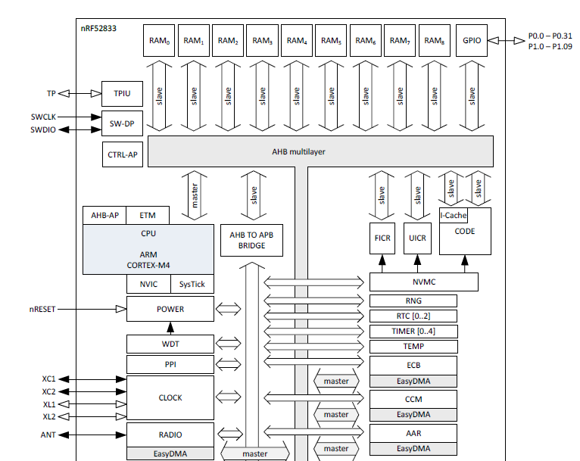
nRF52833 Peripherals
Tour of the nRF52833 peripherals
With some details on the ones we haven’t talked about
Wireless
Crypto
Audio

Slide 10
nRF52833 Peripherals
Cortex-M4F processor
32-bit ARM core
Floating point
Includes Interrupt control and SysTick (an extra timer)

Slide 11
nRF52833 Peripherals
Memory buses

Slide 12
nRF52833 Peripherals
JTAG and Debugging
Allows code updates
Allows GDB to step through code

Slide 13
nRF52833 Peripherals
Volatile memory
SRAM, 128 kB

Slide 14
nRF52833 Peripherals
Nonvolatile memory
Flash, 512 kB
Non-Volatile Memory Controller

Slide 15
nRF52833 Peripherals
Power and Clock management

Slide 16
nRF52833 Peripherals
GPIO pins

Slide 17
nRF52833 Peripherals
Various timers
Watchdog Timer
Real-Time Counter
Timer peripheral

Slide 18
nRF52833 Peripherals
Programmable Peripheral Interconnect
Event->Task chaining
Random Number Generator
Temperature sensor

Slide 19
nRF52833 Peripherals
Wireless radio
Bluetooth Low Energy
802.15.4 (Zigbee or Thread)
Cryptography
ECB (AES mode)
CCM (AES mode)
AAR (Accelerated Address Resolver)
For BLE random addresses

Slide 20
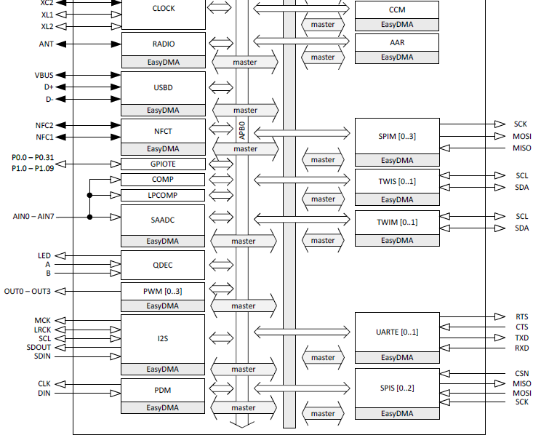
nRF52833 Peripherals
Wired communication protocols
USB Device
SPI
Controller/Peripheral
TWI (I2C)
Controller/Peripheral
UART

Slide 21
nRF52833 Peripherals
Inter-IC Sound (I2S)
Wired communication bus explicitly for audio data
Unrelated to I2C
Like a synchronous UART
Clock, data in, data out
Additional signals
MCK – synchronization
LRCK – left/right channel select

Slide 22
nRF52833 Peripherals
NFC
Near-Field Communication
Close-range wireless communication protocol
“Tap-to-pay” systems

Slide 23
nRF52833 Peripherals
GPIOTE
GPIO interrupts

Slide 24
nRF52833 Peripherals
Analog inputs
Comparator
Low-Power Comparator
Successive Approximation Analog-to-Digital Converter

Slide 25
nRF52833 Peripherals
Quadrature Decoder peripheral
Detects rotation speeds and direction
Usually for motors

Slide 26
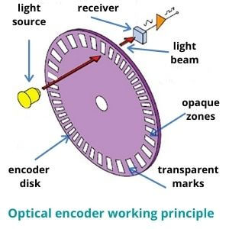
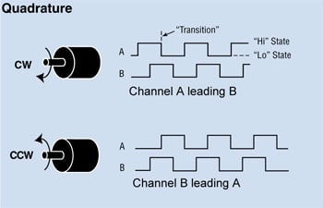
Quadrature Encoding
Usually two receivers and disks: A & B That gets you direction and speed

Slide 27
nRF52833 Peripherals
Pulse Width Modulation
Pulse Density Modulation
Similar idea to PWM
Input-only peripheral
Targets microphones

Slide 28
nRF52833 is complete
That’s just about everything!
First 550 out of 600 pages of nRF52833 datasheet
Remaining 50 are hardware details
Pinout for different packages
Recommended circuit layout
Soldering details

Slide 29
Break + Open Question
What doesn’t the nRF52833 have a peripheral for? (i.e., what could you imagine a peripheral for that it doesn’t have)

Slide 30
Outline
What haven’t we talked about?
Microbit
nRF52833
Other hardware systems
Microcontroller history
Other microcontroller peripherals
Microprocessors
FPGAs

Slide 31
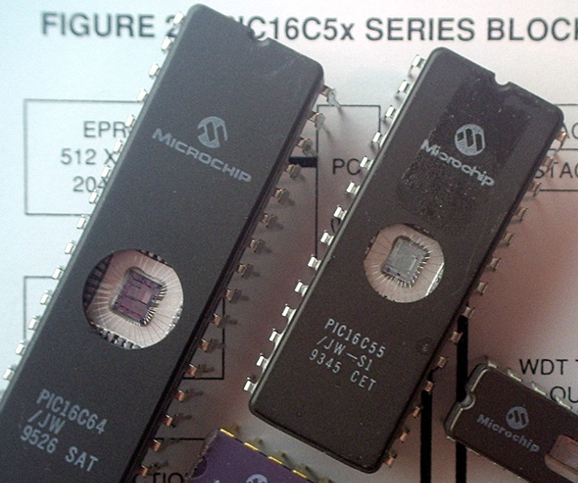
Older microcontrollers (90s-00s)
Focus: cheap, small computer systems
PIC
8, 16, and 24-bit MIPs architecture
PICAXE available with Basic interpreter
AVR
8-bit custom architecture (AVR architecture)
Used in Arduinos
AT Tiny 4: $0.30 per unit
4 I/O pins, 32 Bytes RAM, 512 Bytes ROM

Slide 32
More capable microcontrollers (00s-10s)
Focus: diversify into extreme low power and more capable systems
MSP430
16-bit custom architecture (MSP430 architecture)
Capable, but also extremely low power
<1 μA sleep current
STM32, Atmel SAM series (Cortex-M0, M3, M4, M4F)
32-bit ARM architecture (ARMv7)
Leverage success of ARM on smartphones
Every peripheral under the sun. Plus a variety of memory choices

Slide 33
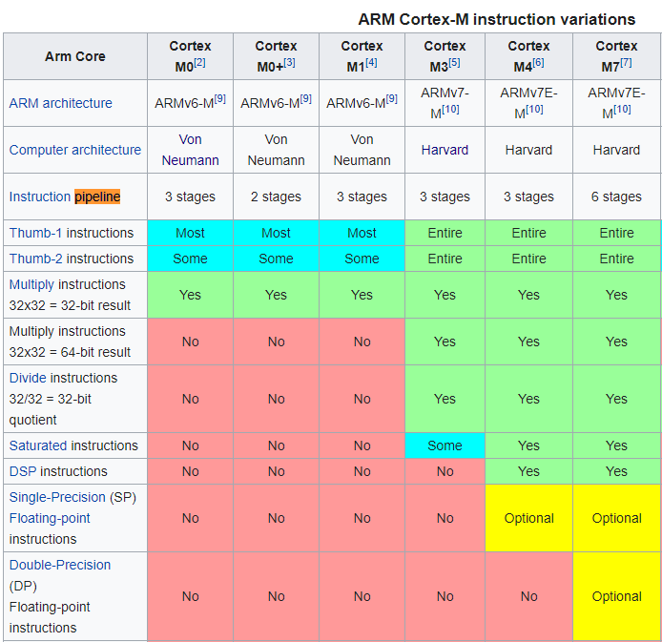
Cortex M Series
A number of options for increasing capabilities
In practice:
Cortex-M0+ for low-end systems
Cortex-M4 for high capability systems
New systems
M23, M33, M55, M85
Faster
Some have DSP instructions
https://en.wikipedia.org/wiki/ARM_Cortex-M

Slide 34
Modern system-on-chips (10s-20s?)
Focus: increase memory and capability
Include radios in the same chip
nRF51 and nRF52 series
32-bit ARM microcontrollers (Cortex M)
Include 2.4 GHz radio: Bluetooth Low Energy and 802.15.4/Thread
Others have followed this same path
TI CC26XX
Apollo3
STM32WL

Slide 35
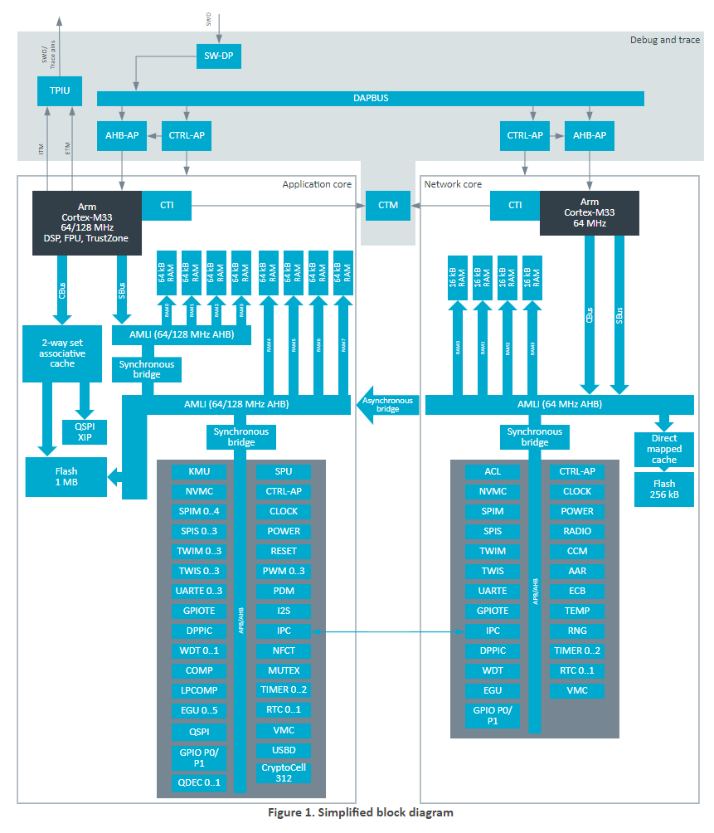
Future microcontrollers (20s and beyond)
Multi-core systems
Not for performance, but for separation of concerns
Run radio code on one core
Application code goes on the other core
Also allows BIG.little architecture
Higher performance core when interpreting data
Lower performance core for sampling sensors
nRF54 series really emphasizes this
Multiple BIG ARM processors and little RISC-V processors

Slide 36
Break + Open Question
Consider the lifecycles of computer systems
i.e., how long are people still actively using them for?
How long does a processor generation need to be supported?
Think Intel Core i7-7500U or Apple M1
How long does a microcontroller chip need to be supported?
Think nRF52833 or MSP430

Slide 37
Break + Open Question
Consider the lifecycles of computer systems
i.e., how long are people still actively using them for?
How long does a processor generation need to be supported?
Think Intel Core i7-7500U or Apple M1
After some number of years, new products no longer use it
Old products eventually wear out or are unsupported
How long does a microcontroller chip need to be supported?
Think nRF52833 or MSP430
New products might still use them years later, because redesigning embedded systems is hard and new chips aren’t that much better

Slide 38
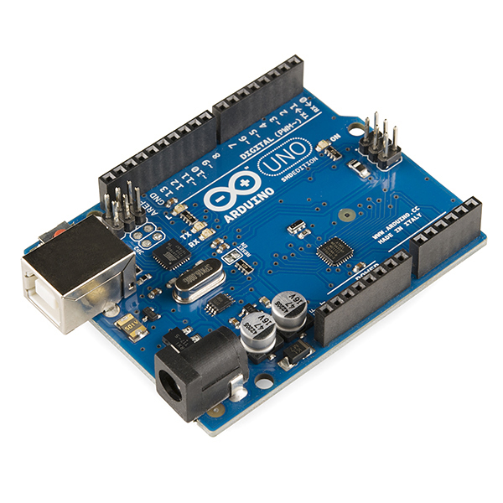
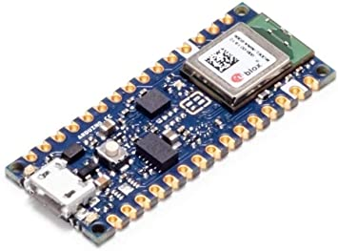
Popular components rarely die
Majority of popular older options still exist
Designers can trade off cost, capability, and efficiency alongside “modern features”
Upgrading for an existing product is unlikely
Large cost, little benefit
Example: Arduino still primarily uses AVR
Works just fine for its needs
Also releases new boards with nRF52s (Arduino Nano 33 BLE)

Slide 39
Fall 2024: cheapest microcontroller
ATTINY10-TSHR
8-bit custom architecture
32 bytes of RAM
1 kB of Flash
4 I/O pins
$0.44 per microcontroller
Still an “active” chip being manufactured

Slide 40
Outline
What haven’t we talked about?
Microbit
nRF52833
Other hardware systems
Microcontroller history
Other microcontroller peripherals
Microprocessors
FPGAs

Slide 41
Microcontroller knowledge is transferrable
Your knowledge of microcontrollers applies to almost all of them
They have similar peripherals that work in similar ways
The exact names and configurations will definitely be different
But the fundamentals stay the same
Let’s prove this with a quick view of two microcontrollers
Atmel SAM4L
Texas Instruments MSP430

Slide 42
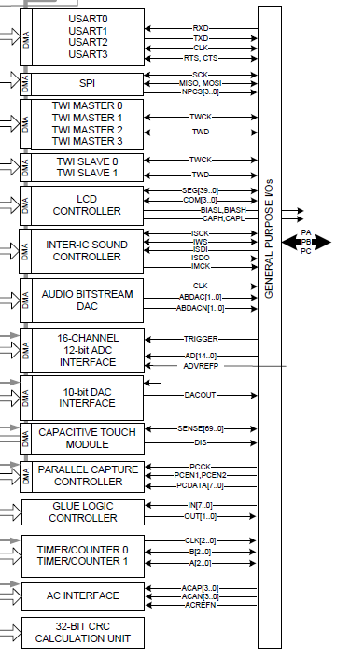
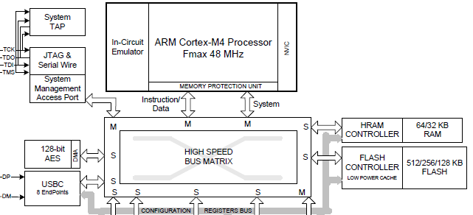
Atmel SAM4L Microcontroller
ARM Cortex M4F (same processor!)
Lots of very configurable peripherals
USART, SPI, TWI, I2S, DAC, ADC, Timer, …
Kind of a “do-everything” microcontroller

Slide 43
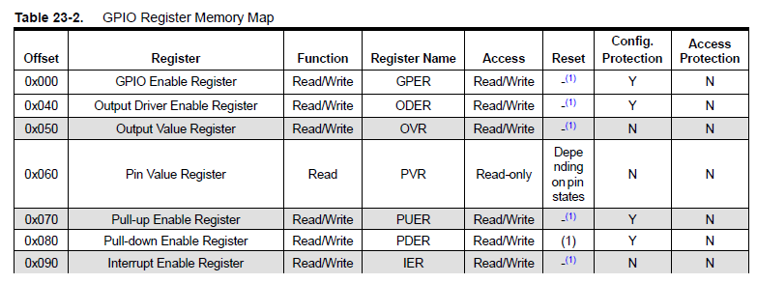
SAM4L GPIO
GPIO register map (heavily abbreviated)

Slide 44
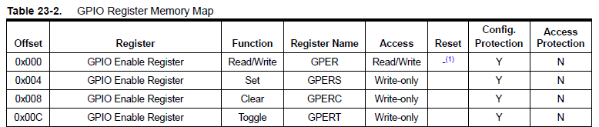
Setting or clearing individual bits
Actually, each register appears four times in a row
Read/write version
Set version (like nRF *SET)
Clear version (like nRF *CLR)
Toggle version

Slide 45
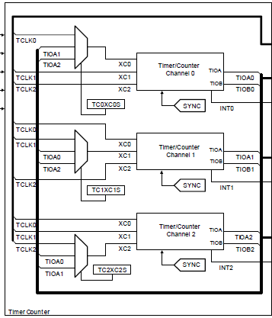

SAM4L Timers
Three 16-bit timers
Each of which can have multiple inputs clock signals with prescaler values
Timers can be chained together to make up to a 48-bit timer
One register for reading counter
Three registers for “compare interrupts”

Slide 46
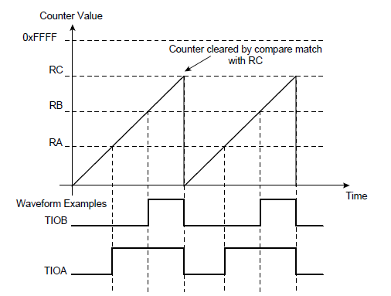
SAM4L PWM
PWM peripheral is essentially built into Timer peripheral
Timer peripheral also supports a “Waveform” mode where it generates an output GPIO signal, i.e. PWM
One comparison point is low-to-high transition, another is high-to-low transition

Slide 47
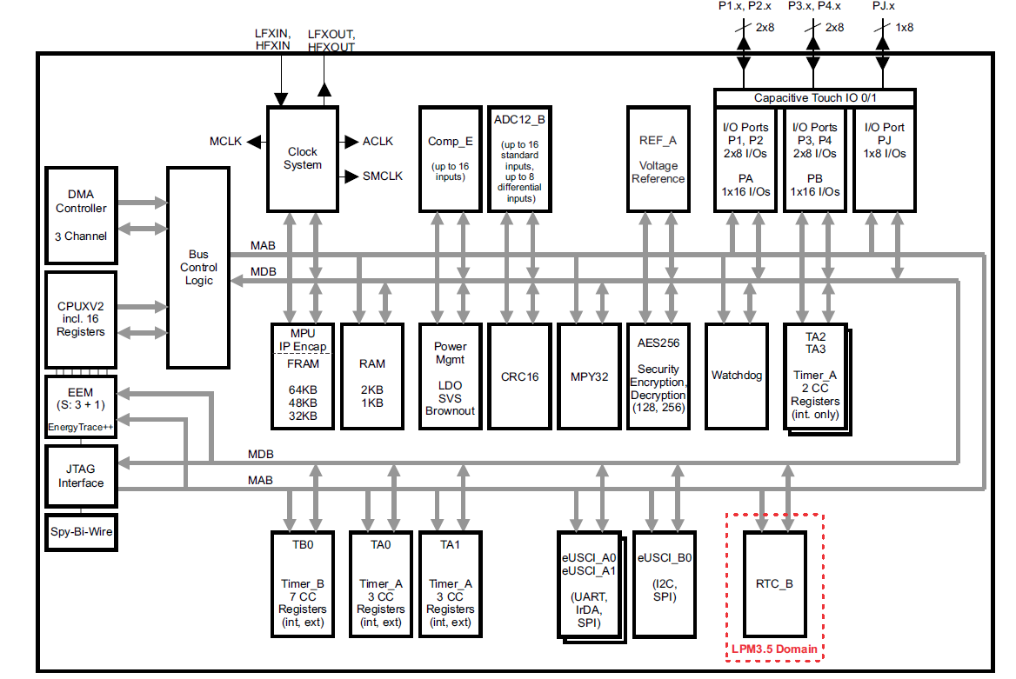
Texas Instruments MSP430 (MSP430FR59xx)
Example of a very different microcontroller
16-bit custom architecture processor
2 kB RAM
64 kB FRAM
Non-volatile, byte-writable

Slide 48
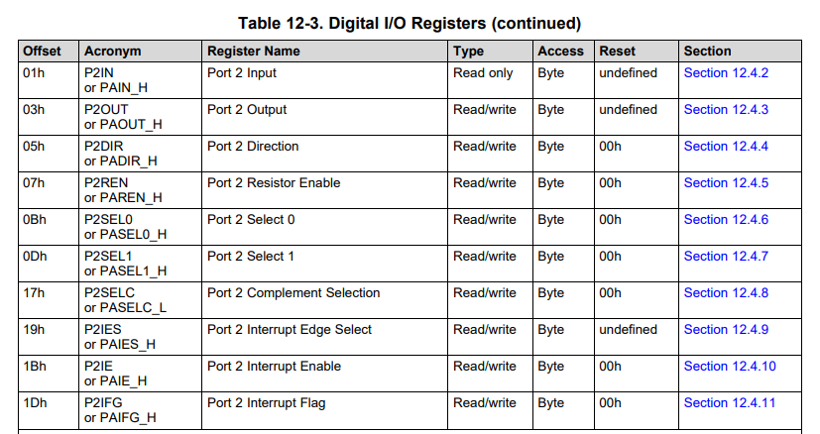
MSP430 GPIO register map
Registers are a single byte in size
Oddly, some have an “undefined” reset state 😱

Slide 49
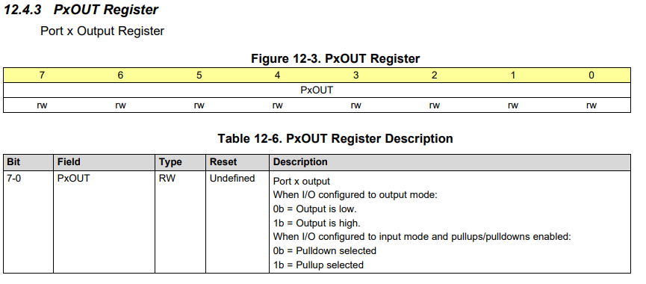
Example MSP430 GPIO register: OUT
Example 8-bit register. Controls 8 pins in a GPIO “port”

Slide 50
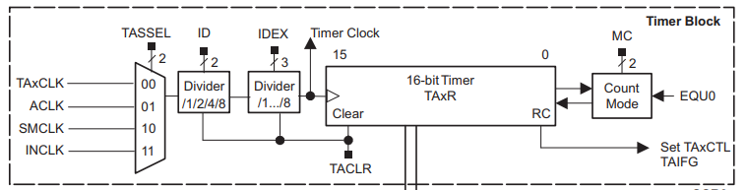
MSP430 Timer peripheral
A choice of input clocks goes through dividers to run a 16-bit timer
Five total timers available on the system
Some can trigger external output pins, some are only internal

Slide 51
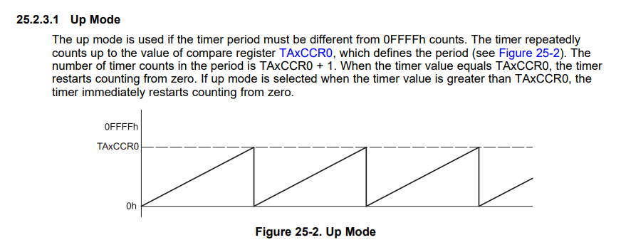
MSP430 PWM
The MSP430 Timer peripheral handles PWM as well!

Slide 52
Outline
What haven’t we talked about?
Microbit
nRF52833
Other hardware systems
Microcontroller history
Other microcontroller peripherals
Microprocessors
FPGAs

Slide 53
Microprocessor system design
What about modern microprocessors? (really SoC’s)
Similar idea, but a LOT more stuff
Various peripherals, which might not be focused on sensor I/O
Less ADCs and I2C more Ethernet and Graphics
External memory busses
Microprocessors expect external memory to exist on the system
Which means that they need pins for an external memory bus

Slide 54
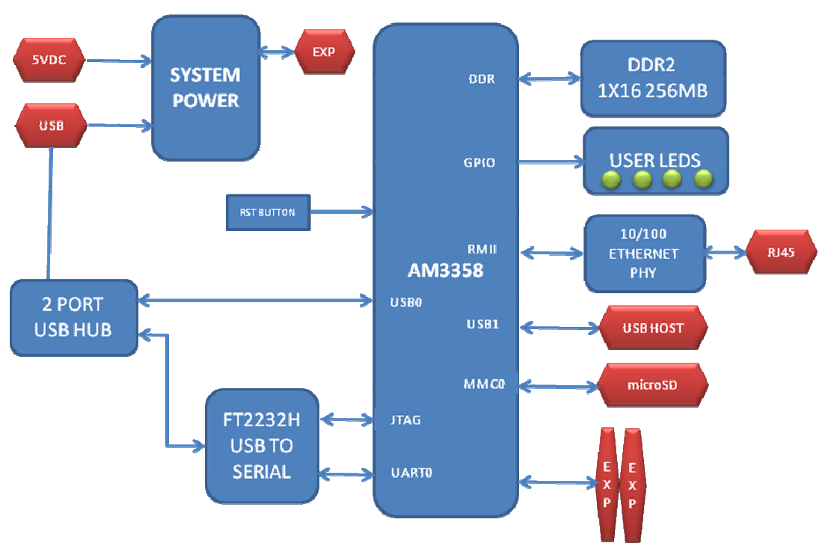
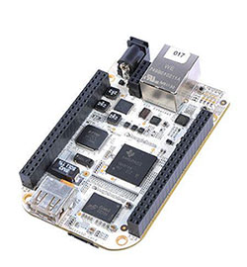
Beaglebone
Gross diagram that’s actually in their datasheet
Cheap, single board computer
Like Raspberry Pi

Slide 55
Resources on the Beaglebone and its microprocessor
https://beagleboard.org/bone-original
https://beagleboard.org/static/beaglebone/BEAGLEBONE_SCHEM_A3.pdf
https://transistor-man.com/files/emu/beaglebone_hardware/BONE_SRM.pdf
https://www.ti.com/product/AM3358

Slide 56
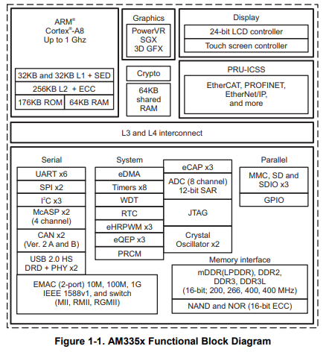
AM3358 processor
ARM Cortex A8
32-bit processor
1 GHz clock
300 pins!!
Internal memory
176 kB ROM
64 kB RAM
External memory
DDR2/3, 400 MHz RAM
NAND or NOR Flash

Slide 57
AM3358 peripherals
Advanced peripherals
Graphics
Ethernet
USB, CAN
Regular peripherals
GPIO, Timers
ADC
UART, SPI, I2C

Slide 58
How much bigger is a microprocessor?
nRF52833 datasheet:
600 pages total
AM3358 datasheet:
250 pages of electrical information
5000 pages of peripheral information
And it’s not that the basic peripherals are much larger
UART: 60 pages
I2C: 20 pages
Four different timers at ~30 pages each

Slide 59
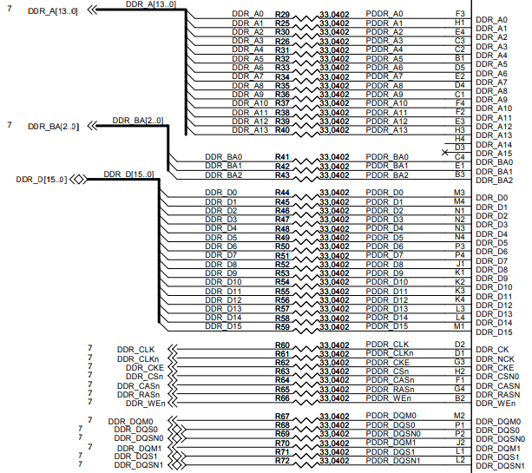
Memory interface - DDR
Pinout on the Beaglebone
Double Data Rate (DDR)
Address bits
17 pins (3 bank, 14 address)
Bank + Address selects a 2 kB chunk out of 2 GB
Data bits
16 pins
Clocks, Chip select
Various sequencing signals

Slide 60
Break + Question
Wires (traces) for high-speed busses like memory must be match, to ensure that all are exactly the same length. Why?

Slide 61
Break + Question
Wires (traces) for high-speed busses like memory must be match, to ensure that all are exactly the same length. Why?
Speed of electricity in the wires matters
If one wire is a foot longer than the others, its signal arrives 1 ns late
Even fractions of nanoseconds could matter for high-speed communication

Slide 62
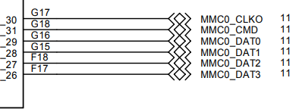
Flash interface - MMC
Multi-media Card interface
Used to communicate with SD Cards
Also for eMMC Flash chips (which act like SD Cards, but soldered in place)
For SD cards SPI can usually be used
For eMMC 4-bit version of interface
Clock
Command
Data 0, 1, 2, 3
Pinout on the Beaglebone

Slide 63
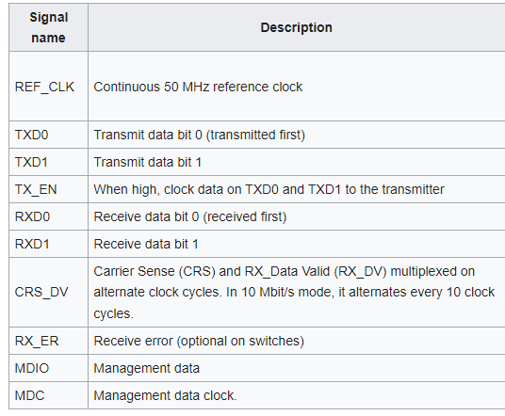
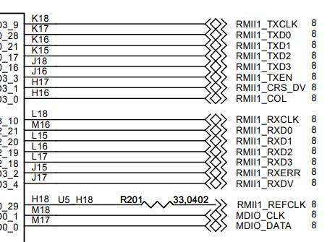
Ethernet interface - RMII
Reduced Media-Independent Interface (RMII)
Pinout on the Beaglebone

Slide 64
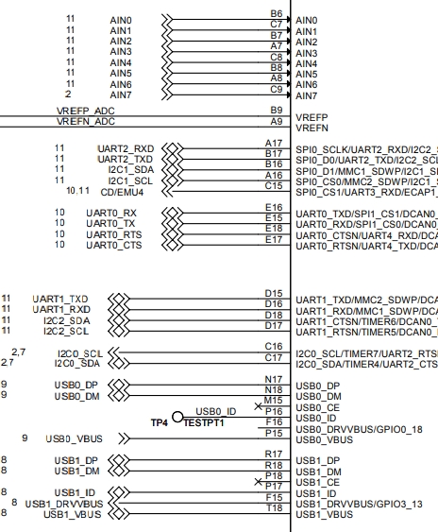
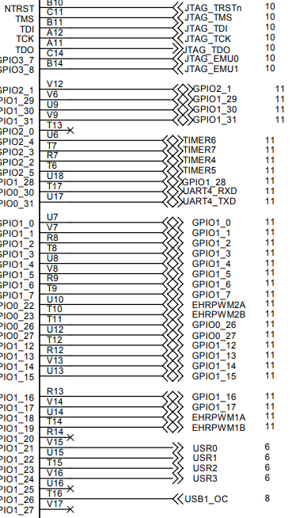
Other processor pinouts on the Beaglebone
Lots of acronyms that we recognize!
Analog inputs
UARTs
I2C
GPIOs
Timers

Slide 65
Outline
What haven’t we talked about?
Microbit
nRF52833
Other hardware systems
Microcontroller history
Other microcontroller peripherals
Microprocessors
FPGAs

Slide 66
FPGA systems
When else might you run into large busses like memory?
On an FPGA!
Field-Programmable Gate Array (FPGA)
Configurable hardware
Engineers write a description of the hardware (Verilog or VHDL)
FPGA implements that hardware
Much faster than software, but still slower than a custom chip

Slide 67
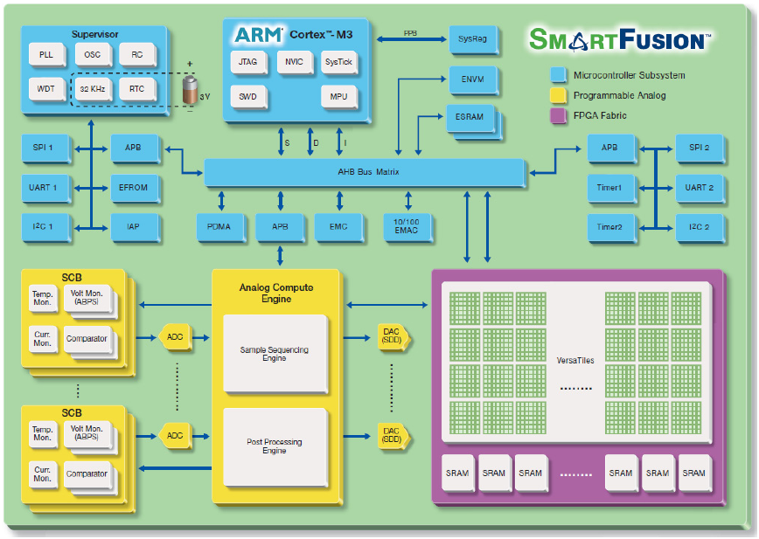
Combined FPGA + Microcontroller

Slide 68
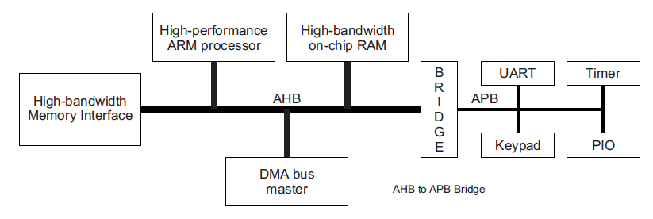
Busses: AHB vs APB
Advanced Peripheral Bus (APB)
Simpler interface
Lower power
Used for most peripheral communication
Advanced High-performance Bus (AHB)
Multiple bus controllers
Pipelined operation
Burst transfers of data
Used for high-speed memory operations

Slide 69
APB usage
Bus has three states
IDLE
Nothing is happening
Default
SETUP
A transfer of data is about to happen
Address and configuration signals are set
ACCESS
Data is actually transferred over the bus

Slide 70
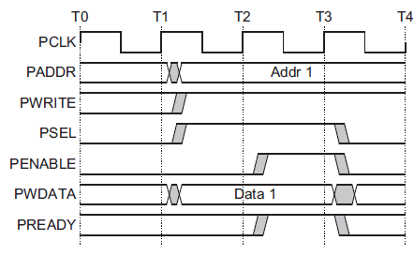
Example APB write operation
Setup phase begins
with this rising edge
Setup
Phase
Access
Phase

Slide 71
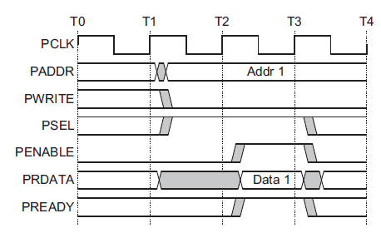
Example APB read operation
Setup phase begins
with this rising edge
Setup
Phase
Access
Phase

Slide 72
With an FPGA you can create your own peripherals
Busses can be exposed to the FPGA for it to use
Example use case
Custom camera with selectable pixel lines and an ADC
Don’t want to manually control it with software (too slow)
Create a hardware peripheral on the FPGA that takes software commands like “grab a frame” and implements them

Slide 73
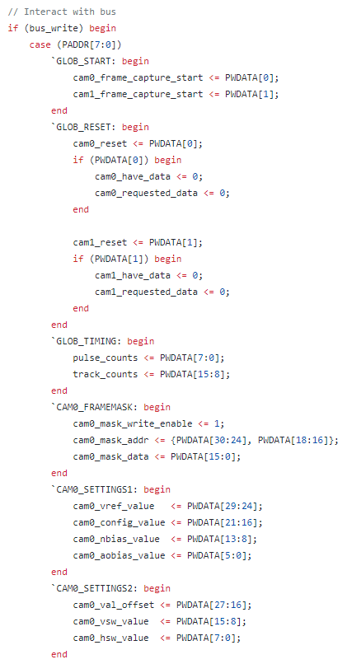
Example register map
Verilog HDL that describes a register map
Reads in the address from the bus to determine which register is written to
Modifies internal registers based on the bits of the data

Slide 74
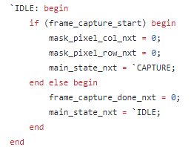
Performing peripheral operations
On every clock edge, check status registers
If they are active, iterate through a state machine
Possibly many states to make the actual operation occur

Slide 75
Outline
What haven’t we talked about?
Microbit
nRF52833
Other hardware systems
Microcontroller history
Other microcontroller peripherals
Microprocessors
FPGAs

