Slide 1
Lecture 07 Thread
CS397/497 – Wireless Protocols for IoT
Branden Ghena – Spring 2022
Materials in collaboration with Pat Pannuto (UCSD)
With some advice from Neal Jackson (UC Berkeley)

Slide 2
Administrivia
Lab 2 due today
If you’re still having problems with it, let me know
Lots of little issues that people have been having
It’s just not a very robust toolchain
Lab 3 probably out tomorrow sometime
Goal is going to be to actually write some code that sends/receives BLE advertisements
Going to be a small group assignment
I’m going to extend it to be more than a week, probably 2 weeks?
I might overlap it with the Thread lab though

Slide 3
Today’s Goals
Explore 802.15.4 packet structure
Describe goals and capabilities of Thread networks
Understand addressing in Thread networks
Describe runtime behaviors like network joining

Slide 4
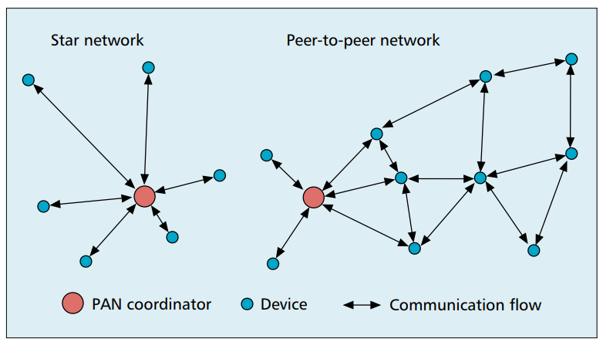
802.15.4 network topologies
Only specifies PHY and MAC, but has use cases in mind

Slide 5
Modes of operation
Beacon-enabled PAN
Slotted CSMA/CA
Structured communication patterns
Optionally with some TDMA scheduled slots
Non-beacon-enabled PAN
Unslotted CSMA/CA
No particular structure for communication
Could be defined by other specifications, like Thread or Zigbee

Slide 6
Beacon-enabled superframe structure
Beacon
Beacon
…
Contention Access Period
Inactive Period
Beacons occur periodically [15 ms – 245 seconds]
Devices must listen to each beacon
Contention Access Period
Slotted CSMA/CA synchronized by beacon start time
Inactive Period
No communication occurring. Assumes sleepy devices

Slide 7
Non-beacon-enabled PAN
…
Contention Access Period
Same idea, just no beacons
Which removes synchronization benefit (and slotted CSMA/CA)
Also removes beacon listening cost
Devices only need to check for activity before transmitting
Still need an algorithm to determine when it should receive data
All the time is a huge energy drain
Algorithms can get complicated here
Could BLE mechanism of listen-after-send apply?
Only if sending to a high-power device, not among equals

Slide 8
Outline
802.15.4 Packet Structure
Thread Overview
Thread Addressing
Runtime Behavior
Using IP

Slide 9
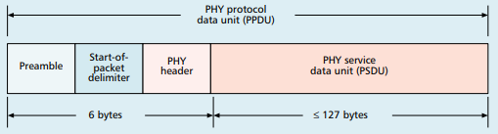
Base packet format
Synchronization
Preamble: four bytes of 0x00
Start-of-Packet: 0xA7
PHY Header
One field: length 0-127
Why still 8 bits?

Slide 10
Base packet format
Synchronization
Preamble: four bytes of 0x00
Start-of-Packet: 0xA7
PHY Header
One field: length 0-127
Why still 8 bits? Because computers depend on bytes

Slide 11
MAC frame format
Frame control
Header
Sequence number
8-bit monotonically increasing
Addressing fields
PAN and addresses
Varies based on frame type
Frame payload
Depends on frame type
Frame check sequence
16-bit CRC

Slide 12
Frame control
Frame type
Type of payload included
Security enabled
Packet is encrypted
(extra 0-14 byte header)
Frame pending
Fragmented packet
Acknowledgement required
PAN ID compression
No PAN ID if intra-network
Addressing modes
Which fields to expect
Why no length field?

Slide 13
Frame control
Frame type
Type of payload included
Security enabled
Packet is encrypted
(extra 0-14 byte header)
Frame pending
Fragmented packet
Acknowledgement required
PAN ID compression
No PAN ID if intra-network
Addressing modes
Which fields to expect
Why no length field?
Already in prior header

Slide 14
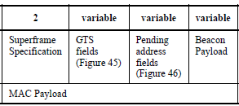
Frame types - Beacon
Beacon
Information about the communication structure of this network
Sent in response to requests from scanning devices
Sent periodically at start of Superframes (if in use)
Sent without CSMA/CA
MAC Header
Source address only, broadcast to everyone
Packet contents
Superframe details, including Guaranteed Time Slots (if any)
Pending addresses lists devices for which Coordinator has data

Slide 15
Frame types - Data
Data
Data from higher-layer protocols
MAC Header
Source and/or Destination addresses as necessary
Packet Contents
Whatever bytes are desired (122 bytes – address sizes)
May be fragmented across packets

Slide 16
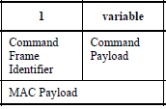
Frame types – MAC Command
MAC Command
Various commands for supporting link layer
Join/leave network
Change coordinator within network
Request data from coordinator
Request Guaranteed Time Slot
MAC Header
Source and/or Destination addresses as necessary

Slide 17
Frame types - Acknowledgement
Acknowledgement
Acknowledges a Data or MAC Command packet
Not beacons or other acknowledgements
What happens if acknowledgement isn’t received?
MAC Header
Repeats Sequence Number of acknowledged packet
No Source or Destination addresses
Sent T_{IFS} after the packet it is acknowledging (immediately)

Slide 18
Frame types - Acknowledgement
Acknowledgement
Acknowledges a Data or MAC Command packet
Not beacons or other acknowledgements
What happens if acknowledgement isn’t received?
Packet will be transmitted again
MAC Header
Repeats Sequence Number of acknowledged packet
No Source or Destination addresses
Sent T_{IFS} after the packet it is acknowledging (immediately)

Slide 19
Analysis: maximum goodput
Assume best possible case for data transmission
122 Bytes per packet
At 250 kbps -> 3.904 ms
Plus Inter-frame spacing of 40 symbols
At 62.5 kBaud -> 0.640 ms
122 Bytes / 4.544 ms -> 214 kbps
Compare to BLE advertisements: 9.92 kbps
Compare to BLE connections: 520 kbps

Slide 20
Break + Open Question
What is 802.15.4 good for?

Slide 21
Outline
802.15.4 Packet Structure
Thread Overview
Thread Addressing
Runtime Behavior
Using IP

Slide 22
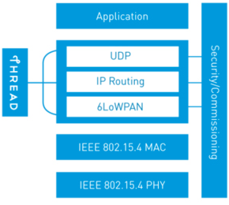
Thread overview
Build a networking layer on top of 15.4
Reuses most of PHY and MAC
Adds IP communication
Handles addressing and mesh maintenance
Goals
Simplicity – easy to install and operate
Efficiency – years of operation on batteries
Scalability – hundreds of devices in a network
Security – authenticated and encrypted communication
Reliability – mesh networking without single point of failure
Industry-focused, but based in academic research

Slide 23
References on Thread
Request for specification: https://www.threadgroup.org/ThreadSpec
Frustratingly locked down 😡
Overview on capabilities: https://openthread.io/guides/thread-primer
Excellent overview
Lifting heavily for these slides

Slide 24
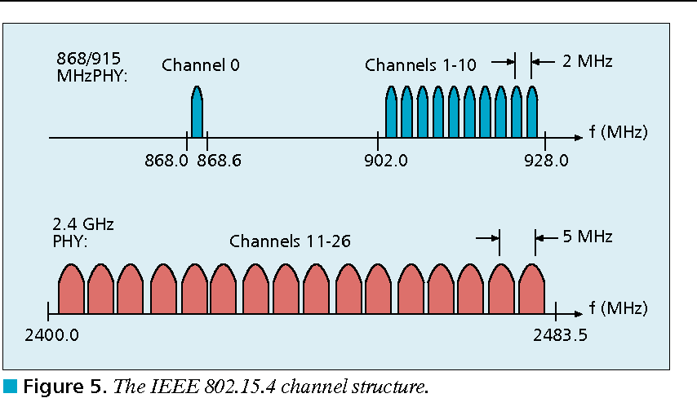
Changes to Physical Layer
Remove all non-2.4 GHz PHY options
Otherwise the same
OQPSK
16 channels, 5 MHz spacing
Typical TX power 0 dBm
Typical RX sensitivity -100 dBm

Slide 25
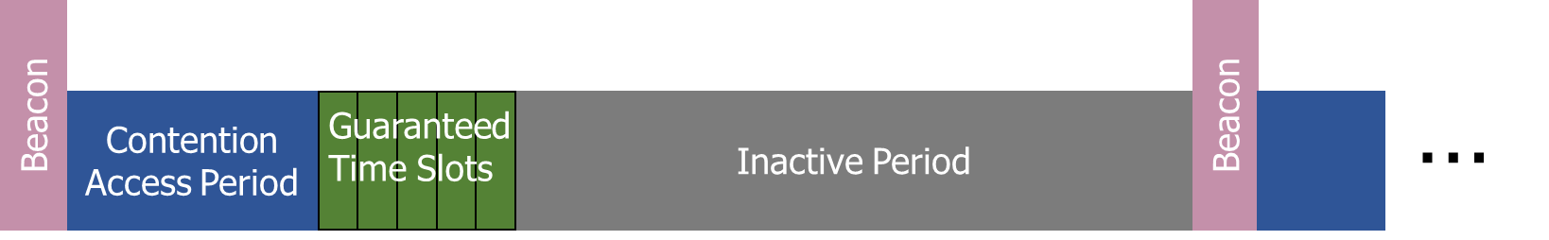
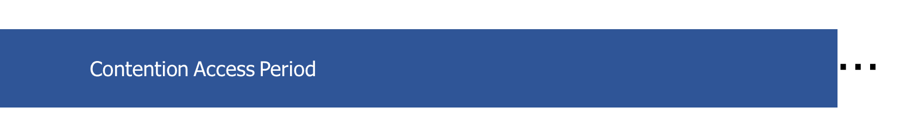
Changes to Link Layer and MAC
Non-beacon-enabled PAN only
No superframe structure
No periodic beacons
No Guaranteed Time Slots
Throw out most existing MAC Commands
Remove network joining/leaving
Remove changing coordinators
Remove Guaranteed Time Slot request
Network joining will be handled at a higher layer

Slide 26
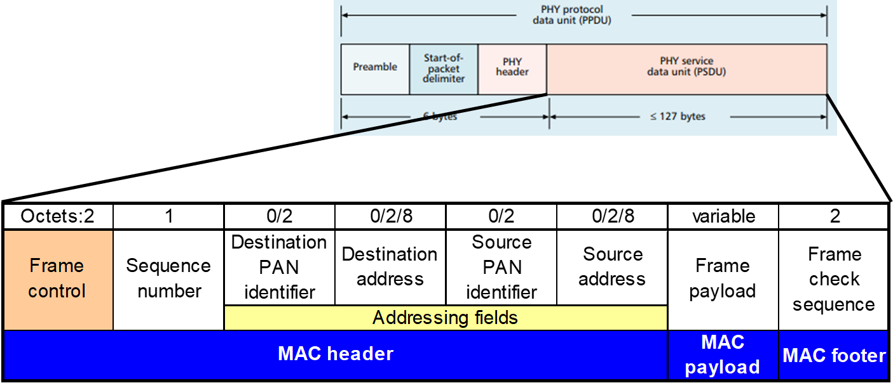
Changes to Link Layer and MAC
Keep unslotted CSMA/CA algorithm
Keep packet structure
Keep Frame Types
Beacon
MAC Command
Beacon Request
Data Request
Data
Acknowledgement

Slide 27
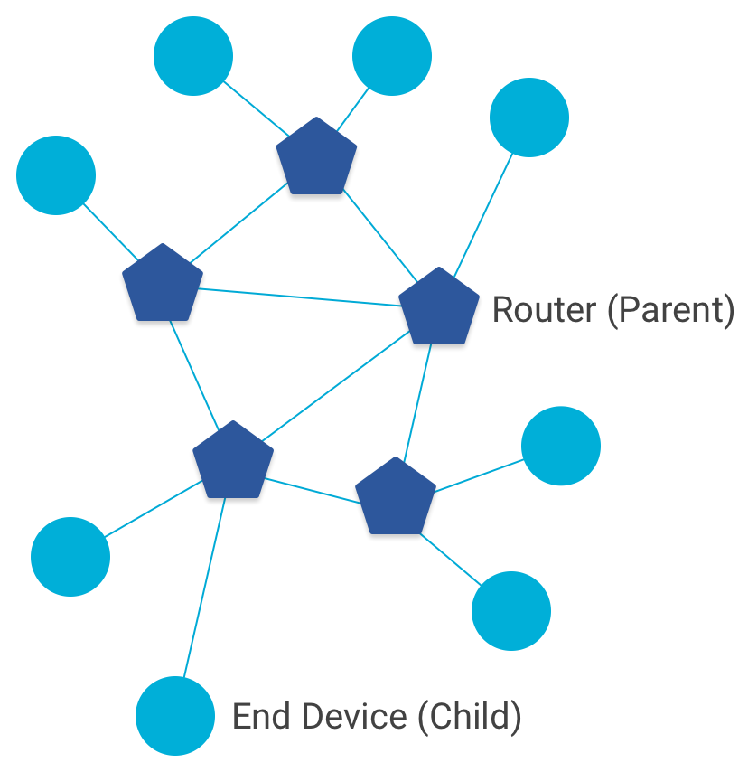
Combination of star and mesh topology
Routers (parent)
Mesh communication with other routers
Radio always on
Forwards packets for network devices
Enables other devices to join network
32 routers per network
End devices (child)
Communicates with one parent (router)
Does not forward packets
Can disable transceiver to save power
Send packets periodically to avoid timeout
511 end devices per router

Slide 28
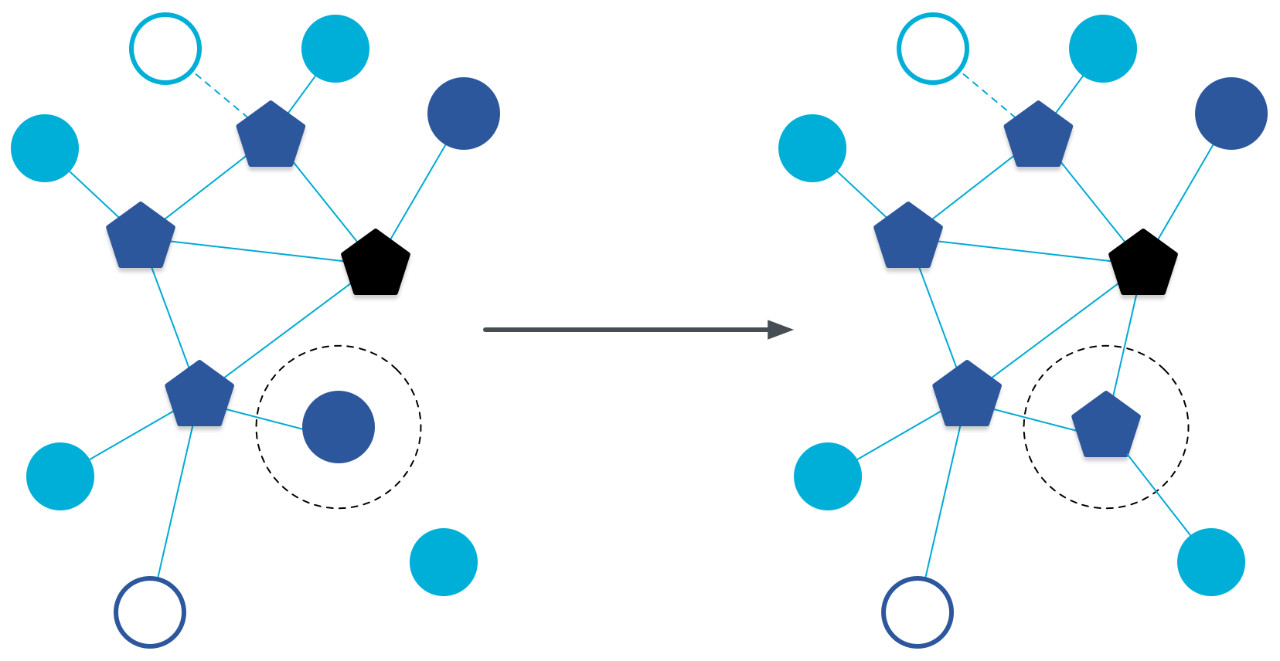
Router promotion
“Router Eligible End Device”
A router without any children
Can operate as an end device with one connection (lower power)
Promotes to a router when a joining end device relies on it
If there is room for an additional router (max 32, typical 16-23)

Slide 29
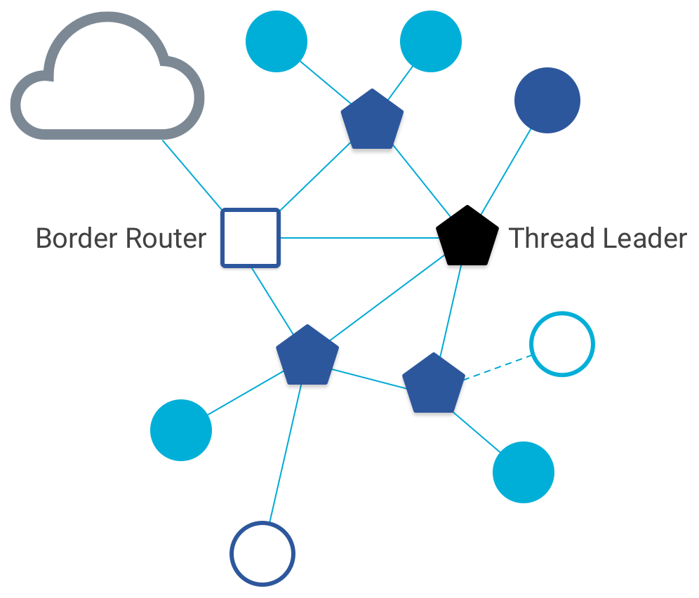
Other special roles
Thread leader
Device in charge of making decisions
Addresses, Joining details
Automatically selected from routers
One leader at any given time
Additional leader is selected if the network partitions
Border router
Router that also has connectivity to another network
Commonly WiFi or Ethernet
Provides external connectivity
Multiple border routers may exist at once

Slide 30
Outline
802.15.4 Packet Structure
Thread Overview
Thread Addressing
Runtime Behavior
Using IP

Slide 31
Thread uses IPv6 for communication
Why IP?
If Wireless Sensor Networks represent a future of billions of connected devices distributed throughout the physical world
Why shouldn’t they run standard protocols wherever possible?
Why IPv6?
Generalized, Flexible, Capable
Benefits
Interoperability with normal computers and networks
Reuse state of the art developed standards instead of remaking them
Security, Naming, Discovery, Services
Costs
Packet overhead can be high (will fix)
Complexity for supporting protocols
Hui and Culler, “IP is Dead, Long Live IP for Wireless Sensor Networks”. 2008

Slide 32
Background: IPv6
Replacement to Internet Protocol v4
(Something unrelated used version number 5)
Extended addressing for devices
32-bits for IPv4 addresses -> 128-bits for IPv6 addresses
Example: a39b:239e:ffff:29a2:0021:20f1:aaa2:2112
Supports multiple transmit models
Broadcast: one-to-all
Multicast: one-to-many
Unicast: one-to-one
Various other improvements

Slide 33
Background: IPv6 address notation rules
Groups of zeros can be replaced with “::”
Can only use “::” in one place in the address
Leading zeros in a 16-bit group can be omitted
0000:0000:0000:0000:0000:0000:0000:0001 → ::1
2345:1001:0023:1003:0000:0000:0000:0000 → 2345:1001:23:1003::
aecb:0222:0000:0000:0000:0000:0000:0010 → aecb:222::10
Special addresses
Localhost - ::1 (IPv4 version is 127.0.0.1)
Link-Local Network - fe80:: (bottom 64-bits are ~device MAC address)
Local Network – fc00:: and fd00::
Global Addresses – 2000:: (various methods for allocating bottom bits)

Slide 34
Background: IPv6 datagram format
Priority: like “type of service” in IPv4.
Flow label: ambiguous
Next header: TCP, UDP
Hop limit = TTL
version
priority
flow label
payload length
next header
hop limit
source address
(128 bits)
destination address
(128 bits)
data
(variable length, typically a TCP or UDP segment)
how much overhead?
40 bytes of IPv6
20 more than IPv4
32 bits

Slide 35
6LoWPAN
Method for running IPv6 over 802.15.4 links
IPv6 over Low-Power Wireless Personal Area Networks
IETF Standard (RFC4944 + updates in RFC6282)
Directly out of the research world (Jonathan Hui + David Culler)
Research Paper: IP is Dead, Long Live IP for Wireless Sensor Networks
Thesis of work: sensor networks can and should use IPv6
Important goals
Compress IPv6 headers
Handle fragmentation of packets
Enable sending packets through mesh

Slide 36
6LoWPAN header compression
40 bytes of IPv6 header are a lot for a 127-byte payload
Most important goals
Communication with devices in the 15.4 network should be low-overhead
Communication outside of the 15.4 network should still minimize overhead where possible
Assume a bunch of common parameters to save space
A bunch of options are set to default values
Payload length can be re-determined from packet length
Source/Destination addresses can often be reassembled from link layer data
Plus information about network address assignment known by routers
Border router “inflates” the packet before sending externally

Slide 37
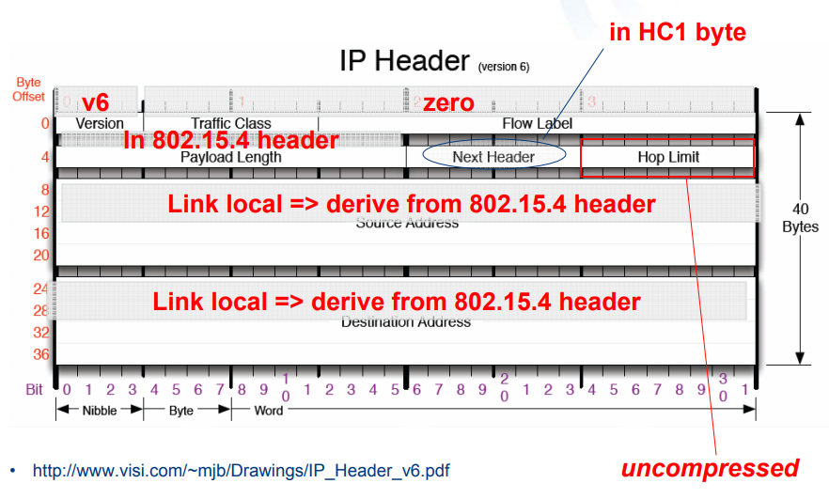
Example of compression
Note: Thread actually uses IPHC (not HC1) from rfc6282

Slide 38
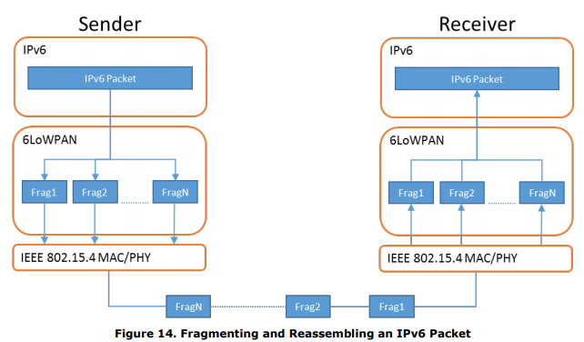
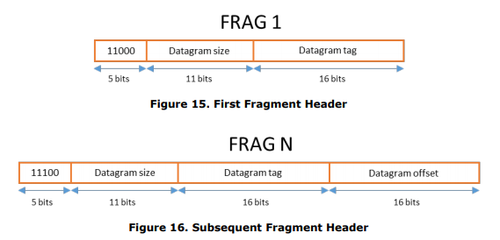
6LoWPAN fragmentation
Only the first packet of the fragments will hold the IPv6 header
Tag, offset, and size are used to reconstruct

Slide 39

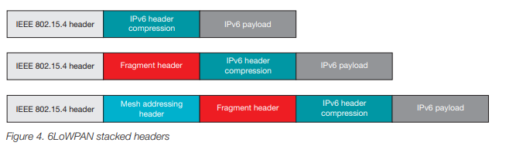
6LoWPAN mesh forwarding
Additional header with originator and final addresses
Which of these headers are used depends on the packet

Slide 40
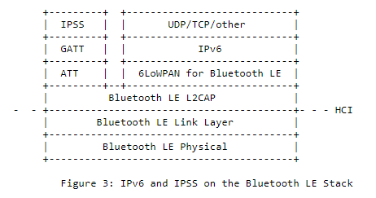
Sidebar: IPv6 over BLE
RFC7668 defines 6LoWPAN techniques for BLE connections

Slide 41
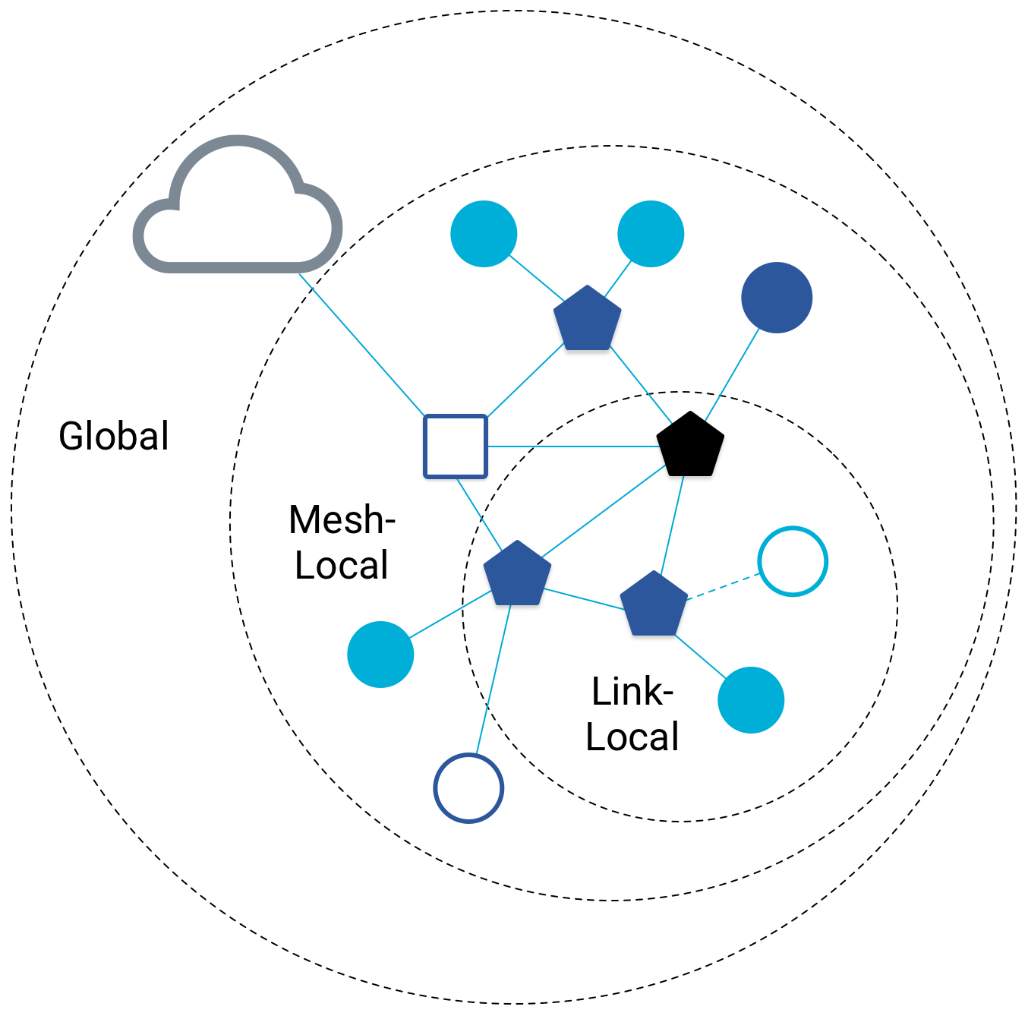
Benefit to IPv6: multiple address spaces per Thread device
Each device gets an IPv6 address for each way to contact it
Global IP address
Mesh-local IP address
Link-local IP address
Topology-based IP address
Role-based IP address(es)

Slide 42
Traditional addresses in Thread
Link-Local Addresses
FE80::/16
Bottommost 64-bits are EUI-64 (MAC address with 0xFFFE in the middle)
Permanent for a given device (no matter the network)
Used for low-layer interactions with neighbors (discovery, routing info)
Mesh-Local Addresses
FD00::/8 (FD00:: and FC00:: are for local networks)
Remaining bits are randomly chosen as part of joining the network
Permanent while connection is maintained to a network
Used for application-layer interactions
Global Addresses
2000::/3
Public address for communicating with broader internet through Border Router
Various methods for allocation (SLAAC, DHCP, Manual)

Slide 43
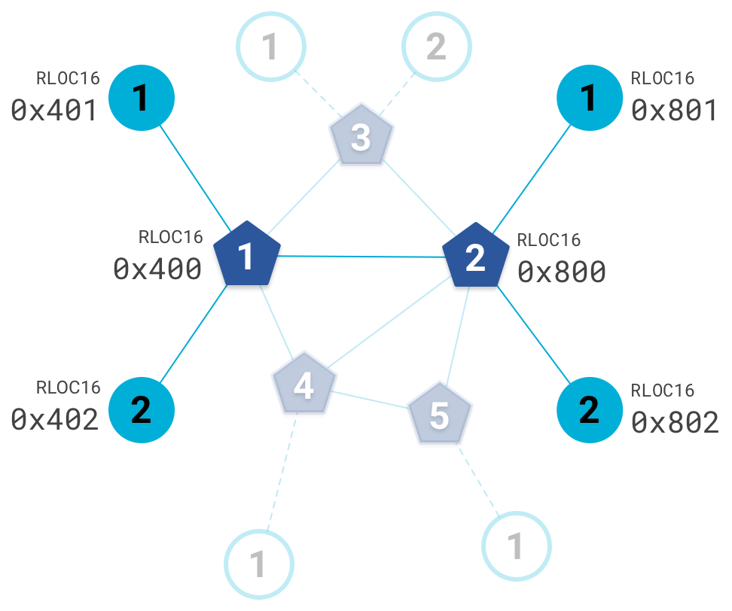
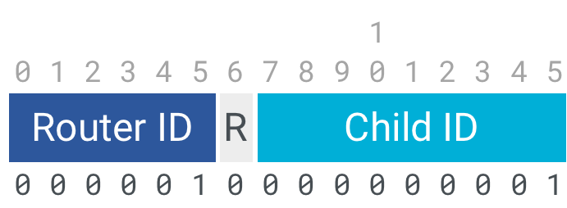
Topology-based addresses in Thread
FD00::00ff:fe00:RLOC16
Same top bits as mesh-local
Routing Locator (RLOC)
Router ID plus Child ID
Changes with network topology
Used for routing packets

Slide 44
Role-based addresses in Thread
Multicast
FF02::1 – link-local, all listening devices
FF02::2 – link-local, all routers/router-eligible
FF03::1 – mesh-local, all listening devices
FF03::2 – mesh-local, all routers/router-eligible
Anycast
FD00::00FF:FE00:FCxx
00 – Thread Leader
01-0F – DHCPv6 Agent
30-37 – Commissioner
etc.

Slide 45
Break + Open Question
Why use Thread instead of basic 802.15.4?

Slide 46
Break + Open Question
Why use Thread instead of basic 802.15.4?
Full specification of upper layers
Clarifies how data is transmitted between devices on a network
Cleans up a lot of things otherwise left implementation-dependent
Interaction with the world outside of the sensor network!
Gateway can be a dumb forwarder of packets
Devices can directly talk to NTP servers or POST data to a website!

Slide 47
Outline
802.15.4 Packet Structure
Thread Overview
Thread Addressing
Runtime Behavior
Using IP

Slide 48
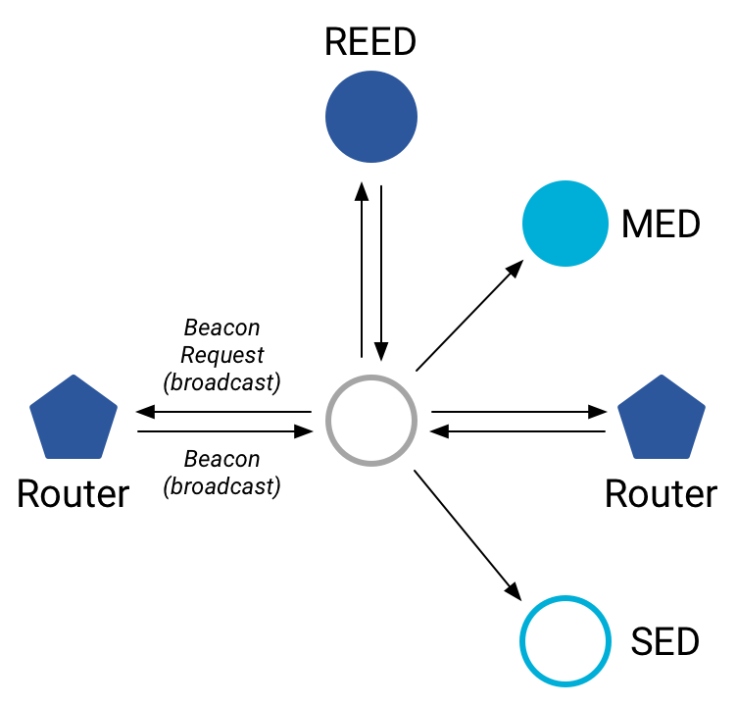
Discovering Thread networks
Beacon request MAC command
Routers/Router-eligible devices respond
Payload contains information about network
Thread network specification
PAN ID – 16-bit ID
XPAN ID – extended 64-bit ID
Network Name – human-readable
Active scanning across channels can quickly find all existing nearby networks

Slide 49
Creating a new network
Select a channel (possibly by scanning for availability)
Become a router
Elect yourself as Thread Leader
Respond to Beacon Requests from other devices
Further organization occurs through Mesh-Level Establishment protocol

Slide 50
Mesh-Level Establishment
Creating and configuring mesh links
Payloads placed in UDP packets within IPv6 payloads
Commands for mesh
Establish link
Advertise link quality
Connect to parent
TLVs (Type-Length-Value)
Various data types that may be helpful within those packets
Addresses, Link Quality, Routing Data, Timestamps
0 | Command Type | TLV | … | TLV
OR (secure version)
255 | Aux Header | Command Type | TLV | … | TLV | MIC

Slide 51
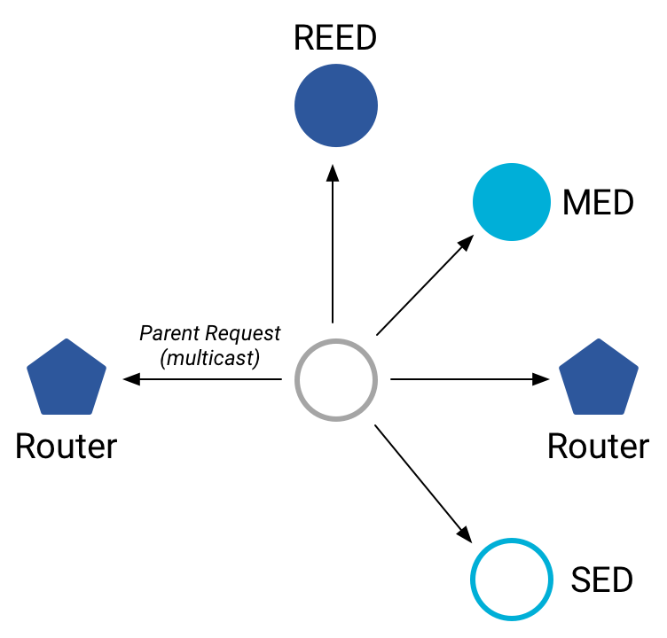
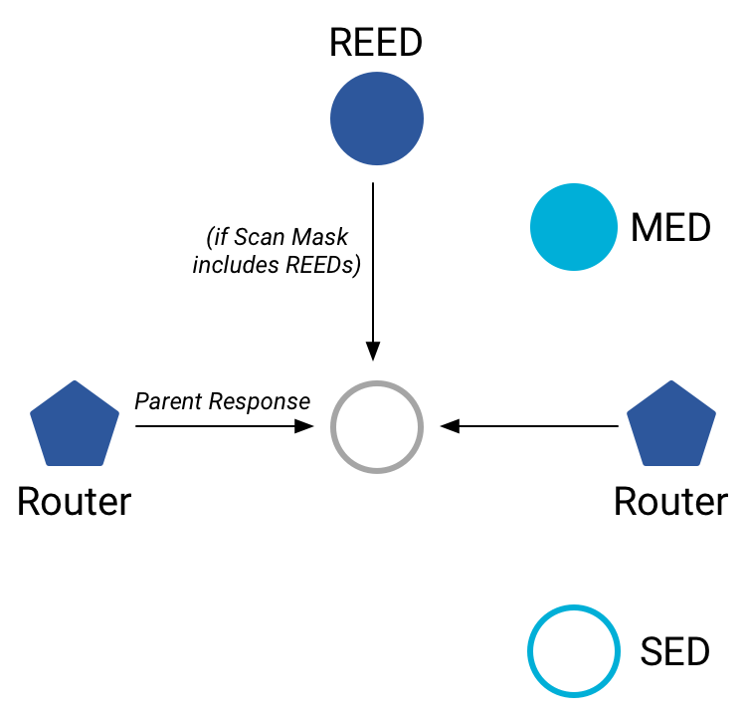
Joining an existing network
All devices join as a child of some existing router
Send a Parent Request (to all routers/router-eligible)
Using the multicast, link-local address
Receive a Parent Response (from all routers/router-eligible separately)
Contains information on link quality
Send a Child ID Request (to router with best link)
Contains parameters about the new child device
Receive a Child ID Response (from that router)
Contains address configurations

Slide 52
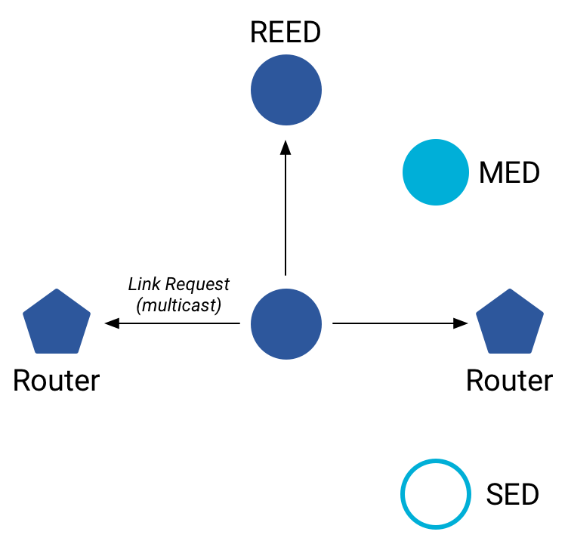
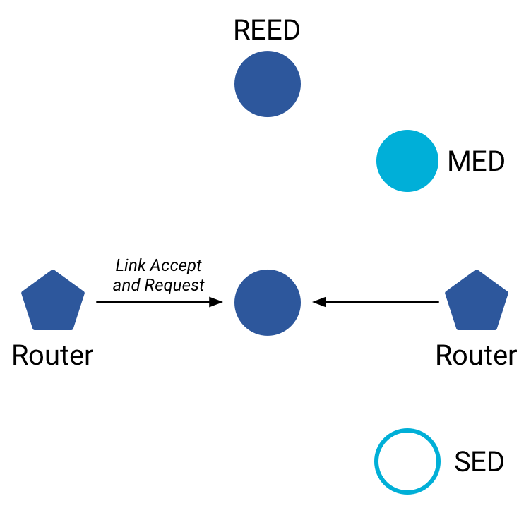
Becoming a router
Thread tries to maintain 16-23 routers (max 32)
Goals: path diversity, extend connectivity
Send a Link Request (to all routers/router-eligible)
Using the multicast, link-local address
Receive Link Accept and Request (from each router separately)
Forms bi-directional link
Send a Link Accept (to each router individually)

Slide 53
Outline
802.15.4 Packet Structure
Thread Overview
Thread Addressing
Runtime Behavior
Using IP

Slide 54
Communicating with IP
Any communication that layers on top of IP is now possible
If there is a library to support it
Common choices
UDP
DNS – translate hostnames into IP addresses
SNTP – get real-world time, accuracy better than 1 second
CoAP – send and receive data

Slide 55
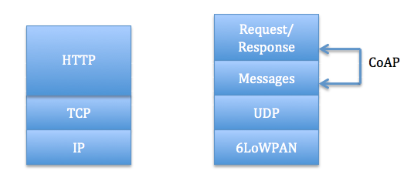
Constrained Application Protocol - CoAP
HTTP, but over UDP targeting less-capable devices
Same REST architecture
Adds capability for automatic retransmissions
CoAP Requests
Have a type: GET, POST, PUT, DELETE
Have a URL: /file/etc
Have data up to 65 KB

Slide 56
Sensor networks don’t use TCP (yet?)
Uncommon choice: TCP
Concerns: Too large, too slow, poorly suited to lossy networks
Also concerning: We’re just replicating TCP poorly
Work in progress:
Sam Kumar, Michael Anderson, Hyung-Sin Kim, David Culler. “Performant TCP for Low-Power Wireless Networks”. 2020.
The debate is still very much open

Slide 57
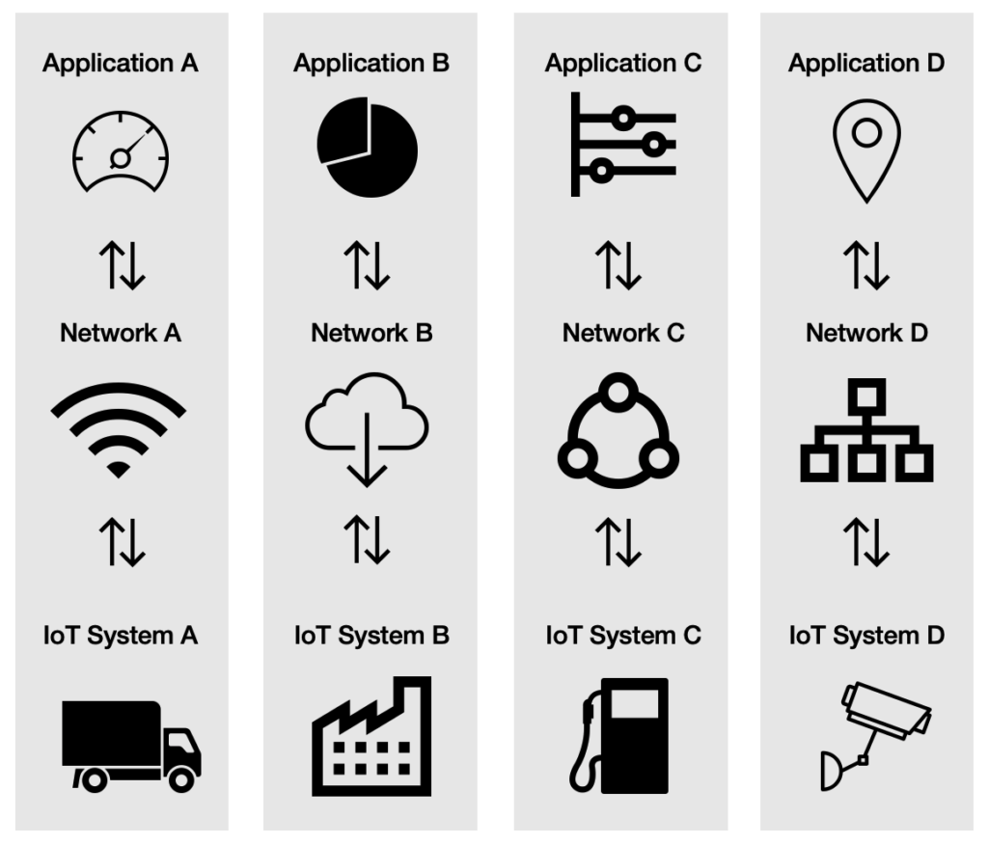
A problem: the siloed internet of things
Problem: companies are more interested in selling you the whole stack
Which then makes it harder for devices to be interoperable
This is not Thread or IP-specific, but a problem all IoT devices are facing
Branden’s concern:
What IP address do you send data to?
Manufacturer’s server is an obvious choice

Slide 58
Outline
802.15.4 Packet Structure
Thread Overview
Thread Addressing
Runtime Behavior
Using IP

