Slide 1
Lecture 02 Network Fundamentals
CS397/497 – Wireless Protocols for IoT
Branden Ghena – Spring 2024
Materials in collaboration with Pat Pannuto (UCSD) and Brad Campbell (UVA)
Some slides borrowed from: Peter Steenkiste (CMU), Christian Poellabauer (Notre Dame)

Slide 2
Administrivia
Let me know if you don’t have access to something
Wireless lab comes out either late tonight or early tomorrow
Individual: using wireshark and sniffing packets
Group survey is out (posted on Piazza)
Everyone will be working in groups of three
If you’re missing a group member, I can pair you
If you have a full group, still fill it out so I know

Slide 3
Forgotten last lecture: late policy and slip days
Late policy
You can submit assignments late
20% reduction in maximum points per day late
Slip days
Automatically extend deadlines without penalty (automatic, don’t ask)
Three total to use throughout the quarter
Example
Submit an assignment three days late with no penalty
Submit an assignment four days late with a one-day penalty
Submit three assignments each one day late with no penalty
Warning: all group members are charged a slip day
So it’s possible one person gets a penalty when the others don’t

Slide 4
Today’s Goals
Introduce OSI layer model of communication
Provide background on Internet layering
Overview of concerns for the Physical layer
Speak the “lingo” of wireless communication
Present technology aspects that we will return to in specific protocols

Slide 5
Outline
OSI Layers
Internet Architecture (Upper Layers)
Physical Layer
Overview
Signal Strength
Signal Frequency and Bandwidth
Signal Modulation

Slide 6
Communication layers
Application
Presentation
Session
Transport
Network
Data Link
Physical
What goes on at each of these?

Slide 7
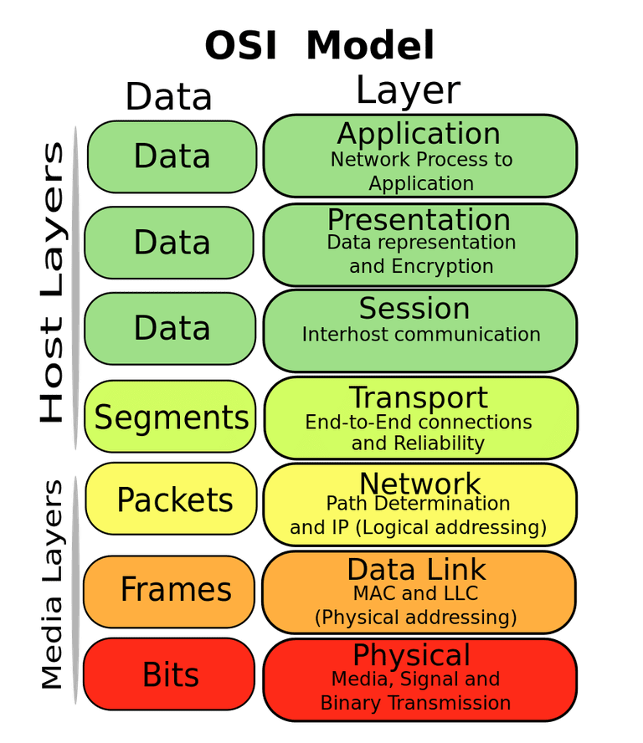
OSI model of communication layers
Open Systems Interconnection (OSI)
Transport
Sending data between applications
TCP and UDP
Network
Sending data between networked computers
IP
Data Link
Sending collections of bits
Ethernet, WiFi
Physical
Sending individual bits
Ethernet, WiFi

Slide 8
Where does this class focus?
Transport
Sending data between applications
TCP and UDP
Network
Sending data between networked computers
IP
Data Link
Sending collections of bits
Ethernet, WiFi
Physical
Sending individual bits
Ethernet, WiFi
CS domain
CS340, CS440
This course!
EE domain EE307, EE378, EE380

Slide 9
Protocols are “layered”
Headers for each layer of communication wrap data
Data is wrapped with header for the network to make a packet
i.e., bytes are added to the start/end of it
Packet is wrapped with header for the link to make a frame
Internet Packet
Data
Packet Header
Frame Header
Ethernet Frame

Slide 10


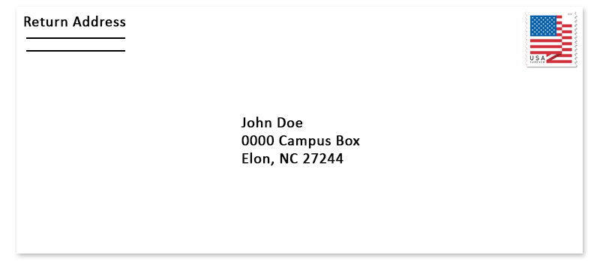

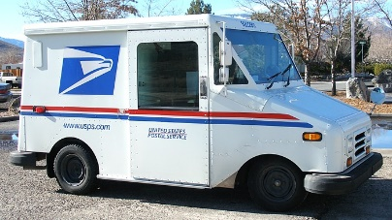


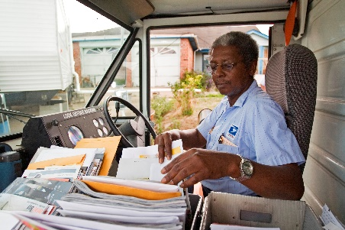
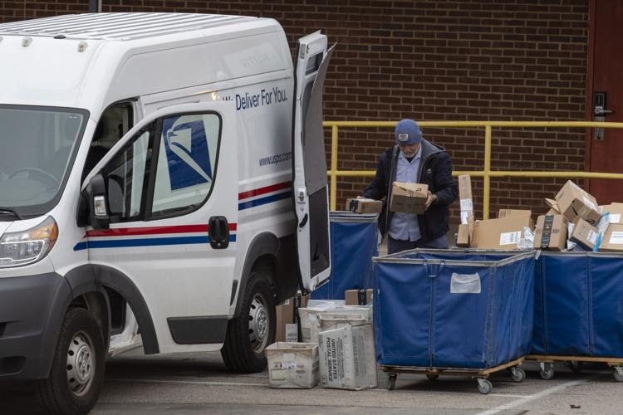
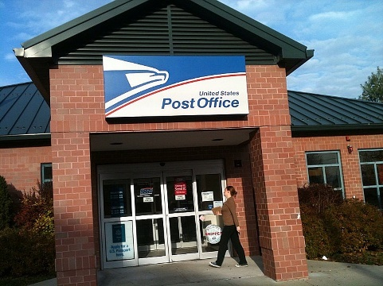
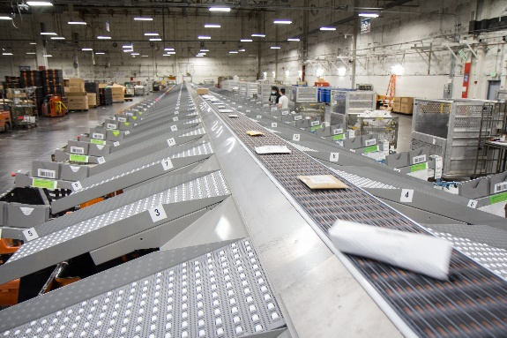
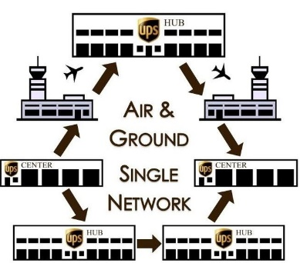
Analogy: Sending a letter
Application: Purpose/type of letter
Transport: Carrier service
Network: Street Address
Link: Transfer to post office
Physical: Moving tangible object
Courier
Named recipient
Mailing/shipping infrastructure

Slide 11
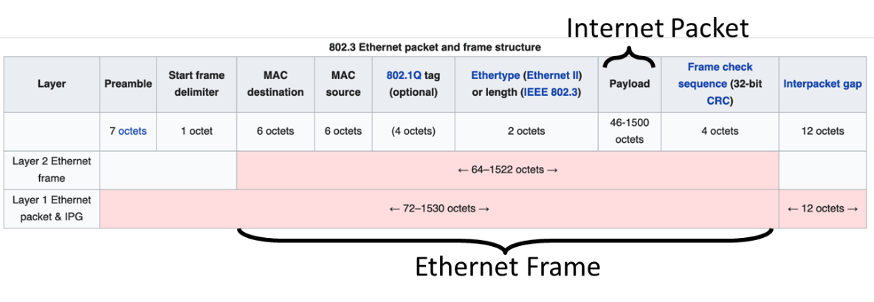
Example of layering for Ethernet and IP
Headers for each layer of communication wrap data
Data is wrapped with header for network to make a packet
Packet is wrapped with a header for the link to make a frame

Slide 12
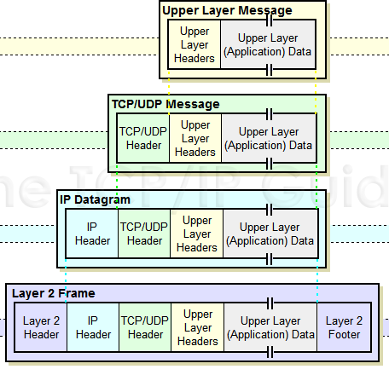
Packet encapsulation
Upper-layer packet is the payload for the lower-layer packet

Slide 13
Transmitting data between networks
LAN1
Host A
Host B
LAN2
client
server
(1)
data
(8)
data
protocol
software
protocol
software
internet packet
(2)
data
PH
(7)
data
PH
LAN1
adapter
LAN2
adapter
LAN1 frame
Router
(3)
data
PH
FH1
(6)
data
PH
FH2
LAN1
adapter
LAN2
adapter
LAN2 frame
(4)
data
PH
FH1
data
PH
FH2
(5)
PH: Internet packet header
FH: LAN frame header
protocol
software

Slide 14
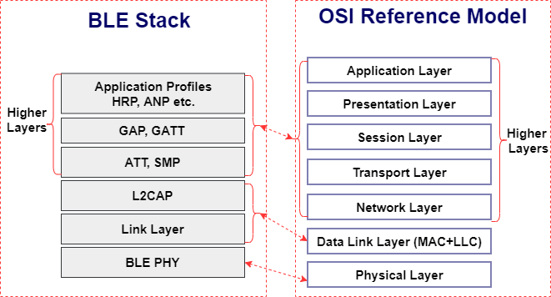
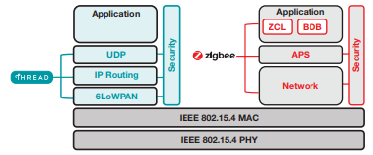
Model does not equal reality
Wireless protocols don’t always split between layers cleanly
Usually explain parts of physical, data link, and possibly upper layers
Model still helps conceptualize stack-up though
Layering of some type still occurs

Slide 15
Layering for IoT (joke) (kind of)
MQTT
MQTT is a publish/subscribe message broker

Slide 16
Outline
OSI Layers
Internet Architecture (Upper Layers)
Physical Layer
Overview
Signal Strength
Signal Frequency and Bandwidth
Signal Modulation

Slide 17
The global Internet
Most famous example of an internet (uppercase to distinguish)
Based on the TCP/IP protocol family
IP (Internet Protocol)
Provides a naming scheme and unreliable delivery of packets from host-to-host
UDP (Unreliable Datagram Protocol)
Uses IP to provide unreliable data delivery from process-to-process
TCP (Transmission Control Protocol)
Uses IP to provide reliable data delivery from process-to-process
Accessed via a mix of Unix file I/O and the sockets interface

Slide 18
Hardware and software organization of an Internet application
Internet client host
Internet server host
Client
User code
Server
Sockets interface
(system calls)
TCP/IP
Kernel code
TCP/IP
Hardware interface
(interrupts)
Network
adapter
Hardware
and firmware
Network
adapter
Global IP Internet

Slide 19
A programmer’s view of the internet
1. Hosts are mapped to a set of 32-bit IP addresses
129.105.7.30
2. The set of IP addresses is mapped to a set of identifiers called Internet domain names
129.105.7.30 is mapped to moore.wot.eecs.northwestern.edu
3. A process on one Internet host can communicate with a process on another Internet host over a connection

Slide 20
1. IP addresses
32-bit IP addresses are stored in an IP address struct
IP addresses are always stored in memory in network byte order (big-endian)
Remember: most computers use little-endian😭
True in general for any integer transferred in a packet header from one machine to another
E.g., the port number used to identify an Internet connection
By convention, each byte in a 32-bit IP address is represented by its decimal value and separated by a period
IP address: 0x8169071E = 129.105.7.30
/* Internet address structure */
struct in_addr {
uint32_t s_addr; /* network byte order (big-endian) */
};

Slide 21
2. Internet domain names
unnamed root
.net
.edu
.gov
.com
Top-level domain names
mit
northwestern
berkeley
amazon
Second-level domain names
eecs
mccormick
www
54.230.48.28
Third-level domain names
and onwards…
wot
www
129.105.1.129
Note: Northwestern owns 129.105.x.x
moore
129.105.7.30
hanlon
129.105.7.27

Slide 22
Domain Naming System (DNS)
The Internet maintains a mapping between IP addresses and domain names in a huge worldwide distributed database called DNS
Conceptually, programmers can view the DNS database as a collection of millions of host entries
Each host entry defines the mapping between a set of domain names and IP addresses
A special name: localhost
Refers back to the computer being used (IP address 127.0.0.1)

Slide 23
3. Internet connections
A socket is an endpoint of a connection
Socket address is an IPaddress:port pair
IP address identifies the computer
Port identifies the process on the computer
Clients and servers communicate by sending streams of bytes over connections. Most connections are:
Point-to-point: connects a pair of processes.
Full-duplex: data can flow in both directions at the same time,
[TCP adds] Reliable: stream of bytes sent by the source is eventually received by the destination in the same order it was sent.

Slide 24
Ports are used to identify services to the kernel
Server host 128.2.194.242
Client host
Service request for
128.2.194.242:80
(i.e., the Web server)
Web server
(port 80)
Client
Kernel
Echo server
(port 7)
Service request for
128.2.194.242:7
(i.e., the echo server)
Web server
(port 80)
Client
Kernel
Echo server
(port 7)

Slide 25
How does the Internet handle routing packets?
IP layer
Describes application connection
Packets from my computer <---> Google
Link layer (Ethernet)
Describes individual links
Packets from my computer <---> my router
Routing
Using link-layer building blocks to get packets from one IP to another

Slide 26
Addressing
How to solve the routing problem?
I need to know how to get data from me to you
How does the post office work?
I know where you live (your address)
Zip Code
City
Street
House Number
Name

Slide 27
A problem with addressing
Your computer moves all the time
Home, school, Starbucks...

Slide 28
Assigning and finding IP address ranges
In general, network operators don’t change that often
Solution:
Tie IP addresses to network operators
Assign computers IPs as they join networks
Key Point:
Networks ”own” a block of IP address space
”The Internet” is a network of networks

Slide 29

Routing
2.0.0.0/8
1.0.0.0/8
10.0.0.0/8
5.0.0.0/8
4.0.0.0/8

Slide 30
Routing
2.0.0.0/8
→10.0.0.0/8
1.0.0.0/8
→2.0.0.0/8
→10.0.0.0/8
→4.0.0.0/8
→5.0.0.0/8
→10.0.0.0/8
10.0.0.0/8
5.0.0.0/8
→10.0.0.0/8
4.0.0.0/8
→5.0.0.0/8
→10.0.0.0/8

Slide 31
Routing Adaptation
2.0.0.0/8
→10.0.0.0/8
1.0.0.0/8
→2.0.0.0/8
→10.0.0.0/8
→4.0.0.0/8
→5.0.0.0/8
→10.0.0.0/8
10.0.0.0/8
5.0.0.0/8
→10.0.0.0/8
4.0.0.0/8
→5.0.0.0/8
→10.0.0.0/8

Slide 32
Identifying your computer?
Every network card has its own MAC address
IPs are (somewhat) dynamic, ”owned” by local networks
MACs are hardware and static, ”owned” by specific computers
Manufacturers own blocks of MACs, ”spend” them each time they make a device
”Connecting” to a network
Your computer leases an IP from the local network
Only the local router knows your MAC, everyone else sees your IP
Note: this overview ignores NATs, which are commonplace today

Slide 33
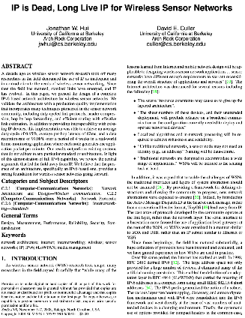
So how does the Internet of Things fit into the Internet?
“IP is the Narrow Waist of the Internet”
IP is Dead, Long Live IP for Wireless Sensor Networks
A recurring theme in this class:
How does this actually attach to the Internet
Physically, direct IP connection [hello Hue Hub, Wyze Hub, August Hub, …]
Logically, through another device [are BLE devices really part of the IoT?]

Slide 34
Break + Thinking
What are the steps for viewing a website?

Slide 35
Break + Thinking
What are the steps for viewing a website?
You enter a domain name for the website
Computer looks up domain name to get IP Address
Computer sends request to IP_address:80
Computer gets back data, which it renders into a website

Slide 36
ALL the layers
A ‘famous’ interview question
“What happens when you type google.com into your browser’s address bar and press enter?”
https://github.com/alex/what-happens-when (11 pages!)
Keyboard events
Parsing URL
DNS lookup
Opening socket
HTTP protocol
HTML parsing
GPU rendering

Slide 37
Outline
OSI Layers
Internet Architecture (Upper Layers)
Physical Layer
Overview
Signal Strength
Signal Frequency and Bandwidth
Signal Modulation

Slide 38
Physical Layer
How bits are transmitted
Wireless makes this entirely different from wired cases
Important considerations
Signal strength
Modulation
Frequency

Slide 39
Why use wireless?
There are no wires!
No need to install and maintain wires
Reduces cost
Simplifies deployment – place devices wherever makes sense
Supports mobile users
Move around office, campus, city
Move devices around home

Slide 40
What is hard about wireless?
There are no wires!
Wired networks are constant, reliable, and physically isolated
Ethernet has the same throughput minute-to-minute
Bits sent through Ethernet or USB are (usually) received
Wireless networks are variable, error-prone, and shared
WiFi throughput changes based on location and walls
Signals from nearby devices interfere with your signals
Individual bits might flip or never be heard at all

Slide 41
Wireless is a shared medium
Wired communication has signals confined to a conductor
Copper or fiber
Guides energy to destination
Protects signal from interference
Wireless communication is inherently broadcast
Energy is distributed in space
Signals must compete with other signals in same frequency band

Slide 42
Increasing network capacity is challenging
Wired networks just add more wires
Buses are many signals in parallel to send more data
Wireless networks are harder
Adding more links just increases interference
Need to expand to different frequencies

Slide 43
Model of RF communication
Energy that radiates spherically from an antenna
Attenuation with distance
Density of energy reduces over time, distance
Signal strength is reduced, errors go up
Two key features
Error rates depend on distance
Spatial reuse of frequencies

Slide 44
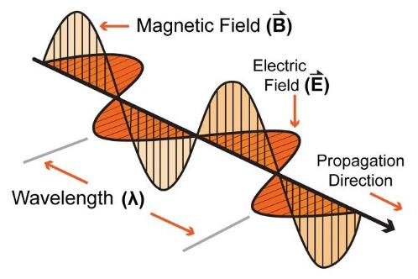
Signal qualities
Signal strength
The amount of energy transmitted/received
Signal frequency and bandwidth
Which “channel” the signal is sent on
Signal modulation
How data is encoded in the signal

Slide 45
Outline
OSI Layers
Internet Architecture (Upper Layers)
Physical Layer
Overview
Signal Strength
Signal Frequency and Bandwidth
Signal Modulation

Slide 46
Signal qualities
Signal strength
The amount of energy transmitted/received
Signal frequency and bandwidth
Which “channel” the signal is sent on
Signal modulation
How data is encoded in the signal

Slide 47
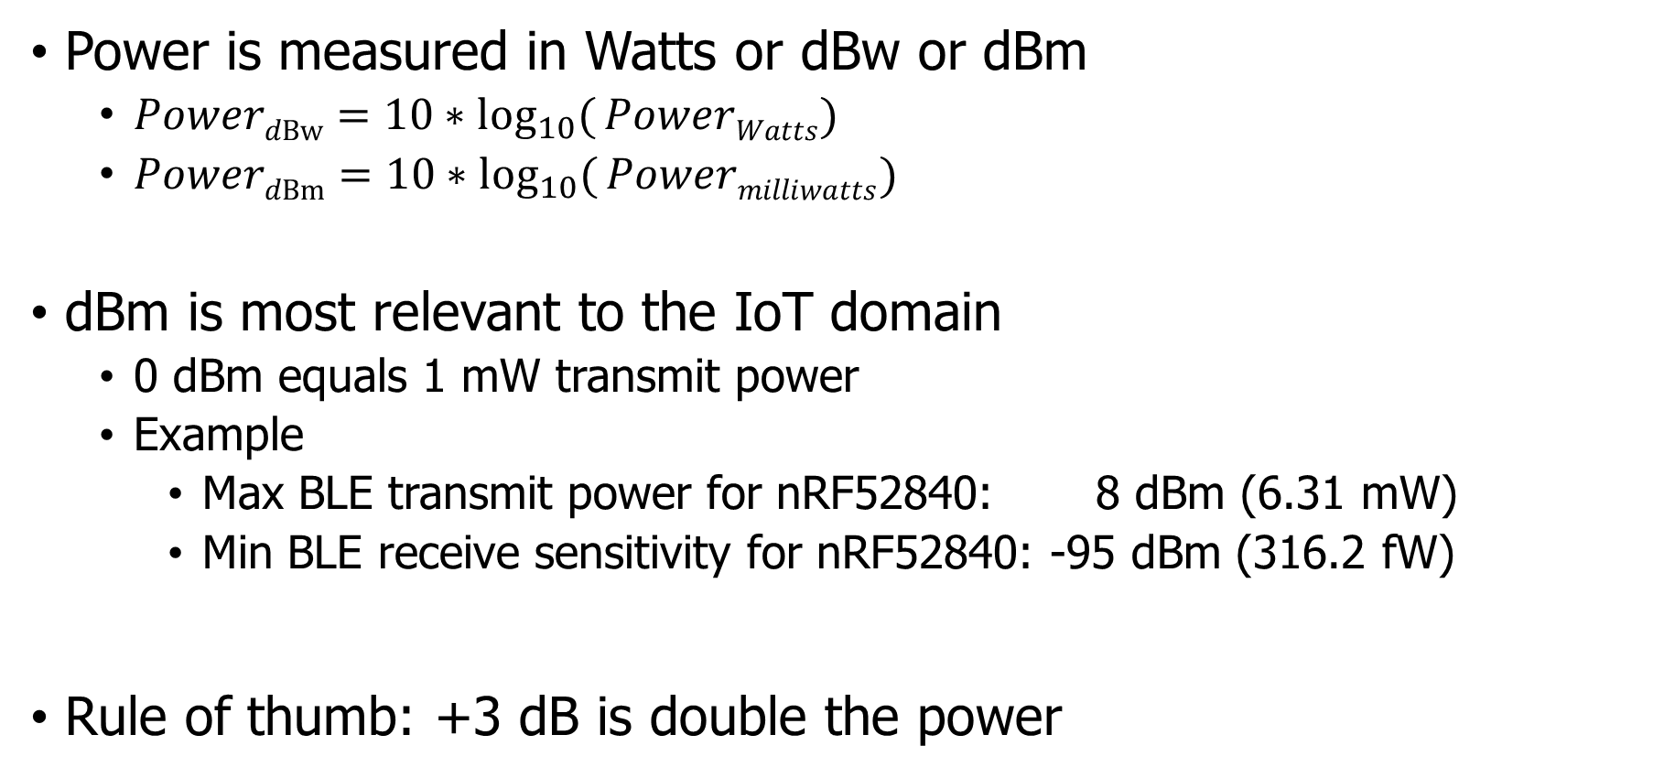
Signal strength is measured in decibels
Power is measured in Watts or dBw or dBm
${PowerdBw=10∗log}_{10}({PowerWatts})$
${PowerdBm=10∗log}_{10}({Powermilliwatts})$
dBm is most relevant to the IoT domain
0 dBm equals 1 mW transmit power
Example
Max BLE transmit power for nRF52840: 8 dBm (6.31 mW)
Min BLE receive sensitivity for nRF52840: -95 dBm (316.2 fW)
Rule of thumb: +3 dB is double the power

Slide 48
Signal strength varies significantly across technologies
Bluetooth Low Energy (local area)
nRF52840 transmit power: 8 dBm (6.31 mW)
nRF52840 receive sensitivity: -95 dBm (316.2 fW)
LoRa (wide area)
SX127X LoRa transmit power: 20 dBm (100 mW)
SX127X LoRa receive sensitivity: -148 dBm (1.6 attoWatt)

Slide 49
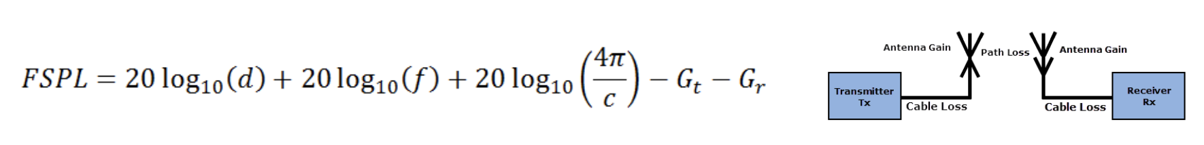
Propagation degrades RF signals
Attenuation in free space
Signals get weaker as they travel over long distances
Signal spreads out → Free Space Path Loss (FSPL)

Slide 50

Some intuitions for signal propagation, power, gain, etc
We will use the nrf52840 in lab:
Max BLE transmit power for nRF52840: 8 dBm (6.31 mW)
Min BLE receive sensitivity for nRF52840: -95 dBm (316.2 fW)
6.31 mW

Slide 51
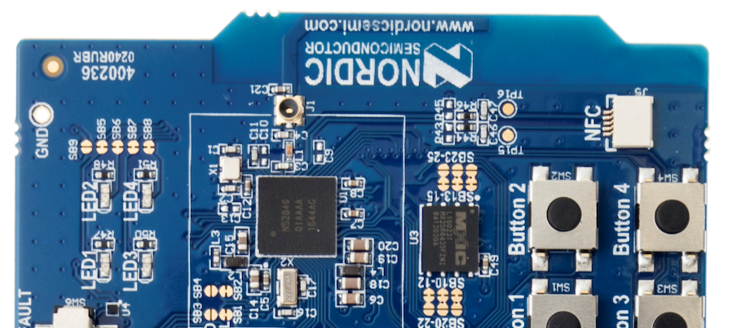
Wait, is not an antenna
Indeed, this little strip of metal is the actual antenna
Receiver only recovers the part of the signal that hits its antenna (“aperture”)

Slide 52
Some Intuitions for Signal Propagation, Power, Gain, etc.
We will use the nrf52840 in lab:
Max BLE transmit power for nRF52840: 8 dBm (6.31 mW)
Min BLE receive sensitivity for nRF52840: -95 dBm (316.2 fW)
6.31 mW

Slide 53
Some Intuitions for Signal Propagation, Power, Gain, etc.
We will use the nrf52840 in lab:
Max BLE transmit power for nRF52840: 8 dBm (6.31 mW)
Min BLE receive sensitivity for nRF52840: -95 dBm (316.2 fW)
.25 m

Slide 54
Some Intuitions for Signal Propagation, Power, Gain, etc.
We will use the nrf52840 in lab:
Max BLE transmit power for nRF52840: 8 dBm (6.31 mW)
Min BLE receive sensitivity for nRF52840: -95 dBm (316.2 fW)
1 m

Slide 55
Some Intuitions for Signal Propagation, Power, Gain, etc.
We will use the nrf52840 in lab:
Max BLE transmit power for nRF52840: 8 dBm (6.31 mW)
Min BLE receive sensitivity for nRF52840: -95 dBm (316.2 fW)
2 m

Slide 56
Some Intuitions for Signal Propagation, Power, Gain, etc.
We will use the nrf52840 in lab:
Max BLE transmit power for nRF52840: 8 dBm (6.31 mW)
Min BLE receive sensitivity for nRF52840: -95 dBm (316.2 fW)
2 m
46 dB path loss!
0.00016 mW

Slide 57
Okay.. So what’s the limit?
We will use the nrf52840 in lab:
Max BLE transmit power for nRF52840: 8 dBm (6.31 mW)
Min BLE receive sensitivity for nRF52840: -95 dBm (316.2 fW)
8 dBm – -95 dBm = 103 dB link margin
For FSPL alone for a 2.4 GHz signal, 103 dB is 1,400 m!
Bluetooth does not go 1.4 km…

Slide 58
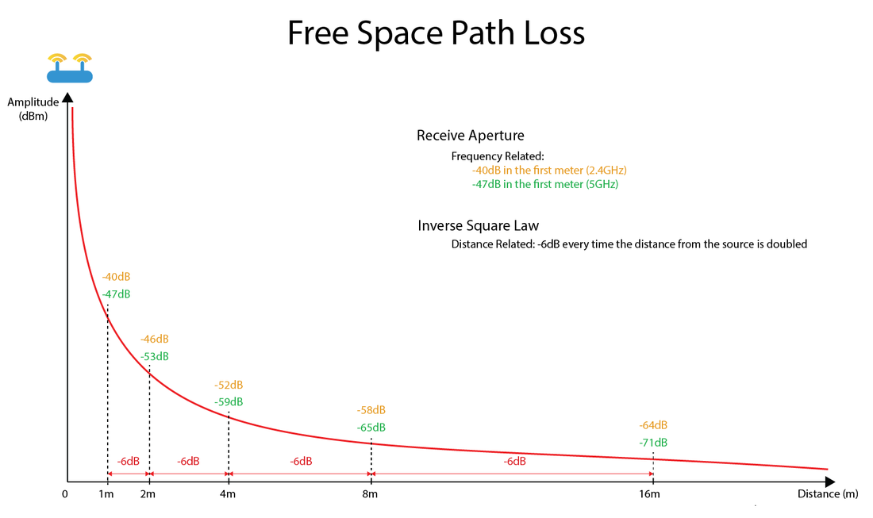
Free-Space Path Loss Model
https://semfionetworks.com/blog/free-space-path-loss-diagrams/

Slide 59
Propagation is one thing that degrades RF signals
Attenuation in free space
Signals get weaker as they travel over long distances
Signal spreads out -> free space path loss
Important: distance is NOT the only signal strength loss
Free space path loss calculation will not give you accurate range for a signal
Obstacles can weaken signal through absorption or reflection
Precise quantitative details are in the EE domain
We’ll use examples to develop qualitative instincts in this class

Slide 60
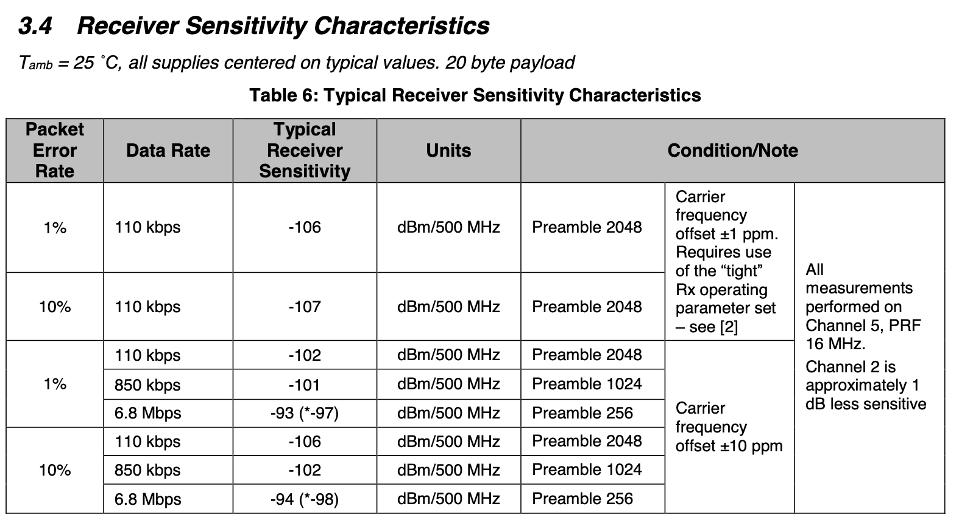
Many factors affect the ability to actually receive data
Here’s some examples, from DW1000 [ultra wideband transceiver]

Slide 61
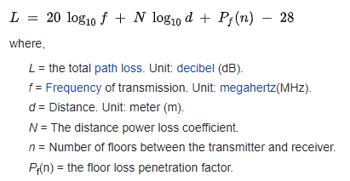
ITU model for Indoor Attenuation
Models like this are more trustworthy less bad than Free-Space Path Loss
https://en.wikipedia.org/wiki/ITU_model_for_indoor_attenuation

Slide 62
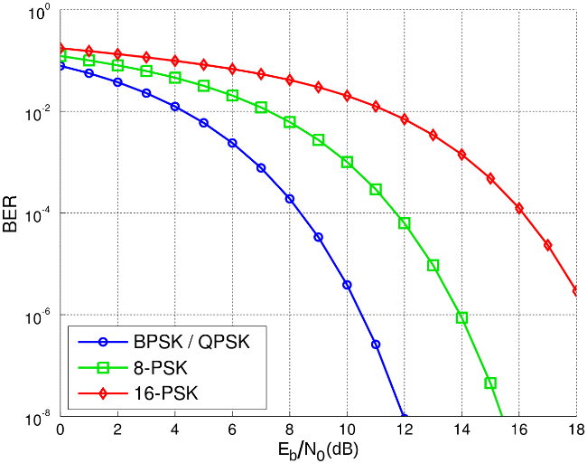
Lower received energy increases error rates
BER: Bit Error Rate
Odds that a transmitted bit will be received incorrectly
More Errors
Less Errors
Less Energy Received
More Energy Received

Slide 63
Big Idea: many RF factors are interconnected
Energy, Distance, Throughput, and Reliability are all interconnected in communication
Protocols make choices of some and get the results on the others
To get more distance, choose one or more:
Increase energy
Communicate slower
Accept a higher error rate

Slide 64
Break + Say hi to your neighbors
Things to share
Name
Major
One of the following
Favorite Candy
Favorite Pokemon
Favorite Emoji

Slide 65
Break + Say hi to your neighbors
Things to share
Name -Branden
Major -EE, CE, and CS
One of the following
Favorite Candy - Twix
Favorite Pokemon - Eevee
Favorite Emoji - 🍢

Slide 66
Outline
OSI Layers
Internet Architecture (Upper Layers)
Physical Layer
Overview
Signal Strength
Signal Frequency and Bandwidth
Signal Modulation

Slide 67
Signal qualities
Signal strength
The amount of energy transmitted/received
Signal frequency and bandwidth
Which “channel” the signal is sent on
Signal modulation
How data is encoded in the signal

Slide 68
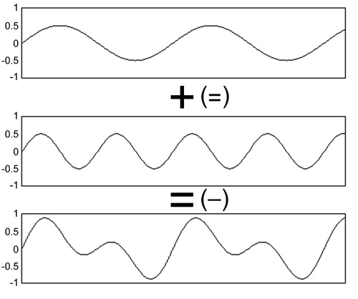
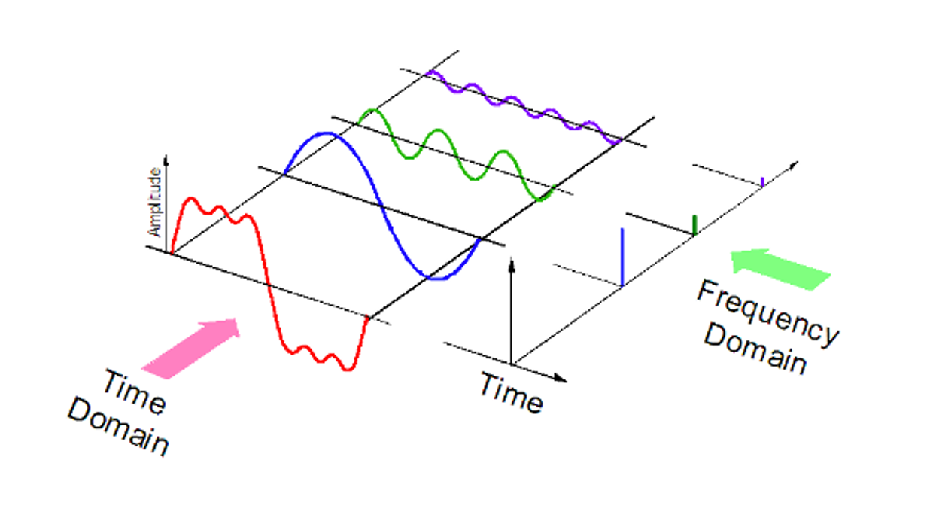
Sum of sinusoids can be reversed
RF signals are fundamentally sinusoids of electromagnetic energy
Sinusoids at different frequencies can be combined and pulled apart again later
Particularly, it’s relatively easy for hardware to determine if there’s energy present on a given frequency
Although very close frequencies might be difficult to disentangle

Slide 69
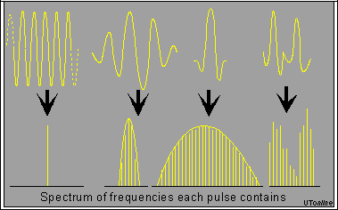
Complex waveforms have a center frequency and a width
A pure sinusoid is energy at exactly one frequency
A messy sinusoid with data layered on top of it has nearby energy
There’s a center of the signal energy
Plus some amount of width, which depends on how complicated the data layered on top is

Slide 70
How do radio stations work?
FM radio in cars is a good example of frequencies
All of FM radio has an allocation of 87.5 to 108.0 MHz
Each station takes has up to ~200 kHz of bandwidth
First station is 87.7 MHz +/- 100 kHz
Ranges from 87.6 to 87.8
Second station is 87.9 MHz +/- 100 kHz
Ranges from 87.8 to 88.0
What if they overlapped? They interfere with each other
You’d possibly hear both. Or get junk data that’s neither.

Slide 71
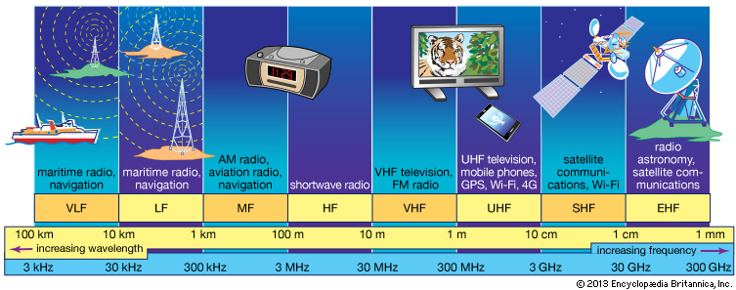
RF communication frequencies
IoT focus

Slide 72
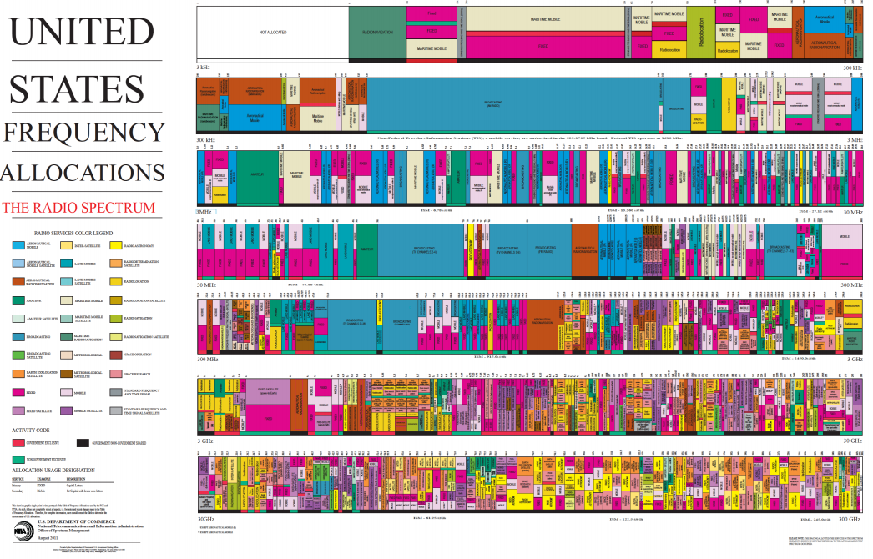
Wireless spectrum is allocated to specific uses

Slide 73
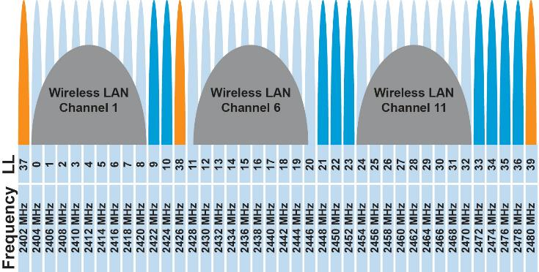
Unlicensed bands are where IoT thrives
902 MHz – 928 MHz
LPWANs
2.4 GHz to 2.5 GHz
WiFi, BLE, Thread
5 GHz
Faster WiFi

Slide 74
Unlicensed bands are where IoT thrives
902 MHz – 928 MHz
LPWANs
2.4 GHz to 2.5 GHz
WiFi, BLE, Thread
5 GHz
Faster WiFi
Cellular uses licensed bands at great cost
Why?

Slide 75
Unlicensed bands are where IoT thrives
902 MHz – 928 MHz
LPWANs
2.4 GHz to 2.5 GHz
WiFi, BLE, Thread
5 GHz
Faster WiFi
Cellular uses licensed bands at great cost
Why? No interference from other users

Slide 76

Different technologies use spectrum in different ways
How spectrum is used affects: cost ($), robustness, throughput…
We will talk about how each technology uses spectrum, and implications
This graphic shows how BLE and WiFi interoperate; more on this next week

Slide 77
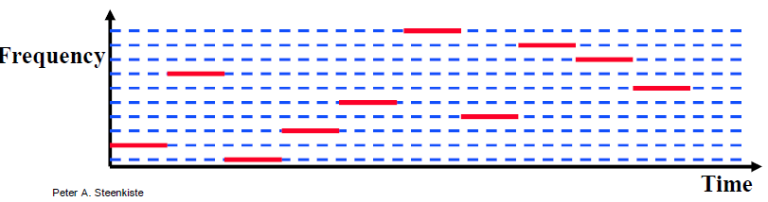
Frequency Hopping Spread Spectrum
Transmitter hops through a sequence of transmit channels
Spend some “dwell time” on each channel before hopping again
Receiver must know the hopping pattern
Avoid causing or receiving prolonged interference

Slide 78
Sidebar: inventor of FHSS – Hedy Lamarr
Actress, inventor, and all-around badass
Designed FHSS with George Antheil during WWII based on music ideas
Idea: torpedo control can’t be easily jammed if it jumps around
https://en.wikipedia.org/wiki/Hedy_Lamarr#Inventing_career

Slide 79
Outline
OSI Layers
Internet Architecture (Upper Layers)
Physical Layer
Overview
Signal Strength
Signal Frequency and Bandwidth
Signal Modulation

Slide 80
Signal qualities
Signal strength
The amount of energy transmitted/received
Signal frequency and bandwidth
Which “channel” the signal is sent on
Signal modulation
How data is encoded in the signal

Slide 81
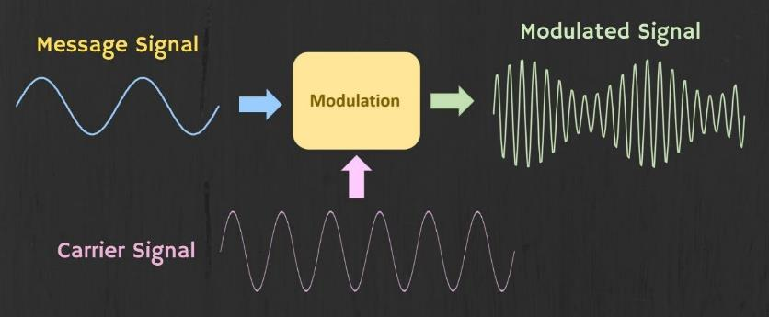
Modulation
Encoding signal data in an analog “carrier” signal
Carrier signal defines the frequency
Modulation scheme + data define bandwidth required

Slide 82
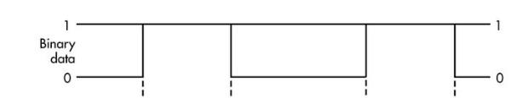
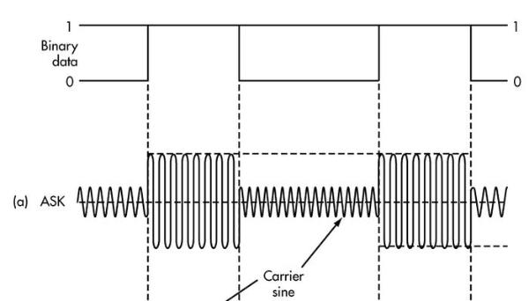
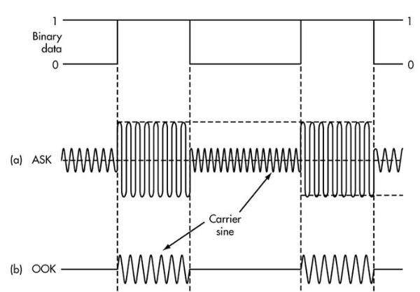
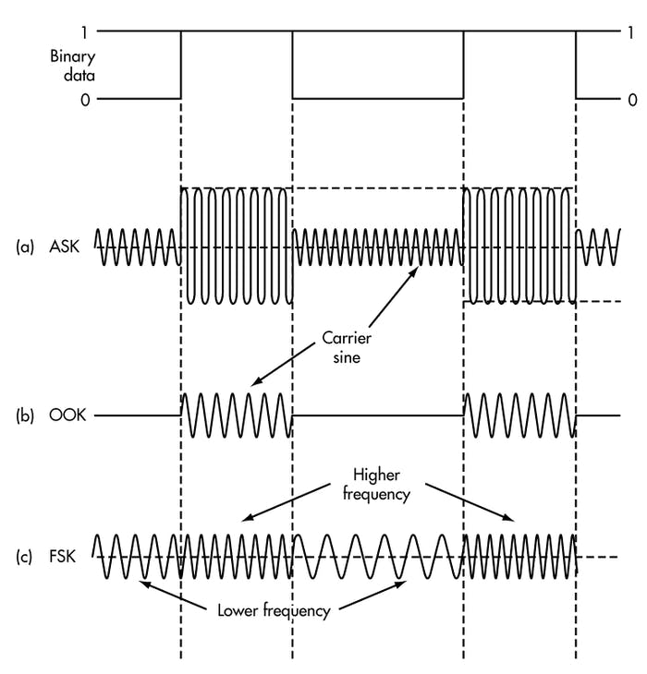
Modulation types
Encoding binary data on a signal
Amplitude-shift Keying (ASK)
Modify amplitude of carrier signal
On-Off Keying (OOK) is an extreme example
Frequency-shift Keying (FSK)
Modify frequency of carrier signal

Slide 83
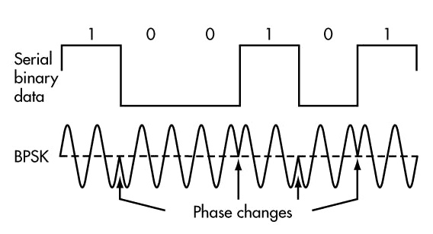
Modulation types
Phase-shift keying (PSK)
Modify phase of carrier signal
Usually differential: the change signifies data
More complicated possibilities exist
QAM (Quadrature Amplitude Modulation) combines amplitude and phase shift keying
Allows for more than one bit per “symbol”

Slide 84
Modulation tradeoffs
Various tradeoffs between different modulation schemes
Bandwidth requirements, transceiver hardware, immunity to noise, etc.
ASK (amplitude) is simple but susceptible to noise
Noise exists in the real world
FSK (frequency) is relatively simple and robust to noise, but uses more bandwidth
Bandwidth is limited, but still commonly used
PSK (phase) energy efficient and robust, but more complex hardware
More expensive hardware, but very commonly used

Slide 85
Outline
OSI Layers
Internet Architecture (Upper Layers)
Physical Layer
Overview
Signal Strength
Signal Frequency and Bandwidth
Signal Modulation

