Slide 1
Lecture 09 IoT Network Routing
CS397/497 – Wireless Protocols for IoT
Branden Ghena – Spring 2024
With slides from Federico Ferrari (ETH Zurich) and assistance from Andreas Biri (ETH Zurich)
Materials in collaboration with Pat Pannuto (UCSD) and Brad Campbell (UVA)

Slide 2
Today’s Goals
Overview of routing for mesh networks
Walkthrough of one protocol (AODV: what ZigBee uses)
Describe research in improving data dissemination

Slide 3
Outline
Simple Routing
Mesh Routing
Better Flooding
Low-power Access Control

Slide 4
Routing goals
Have a packet, have a destination, how do we connect them?
We’ll think about a couple of approaches here
Simple techniques
Broadcast, tree structures
Mesh techniques
Understand the available routes and select a “good” one

Slide 5
Simple routing solutions
Broadcast
The link-layer solution for everything
Star topology
Only one location to send to: parent
Single parent needs to store information about all children
Addresses, schedules, etc.
Tree topology
“Star of stars”
Two choices: send to descendent or send to parent
Each parent needs to store information about all children beneath it
Original ZigBee approach (knowledge built into addressing scheme)

Slide 6
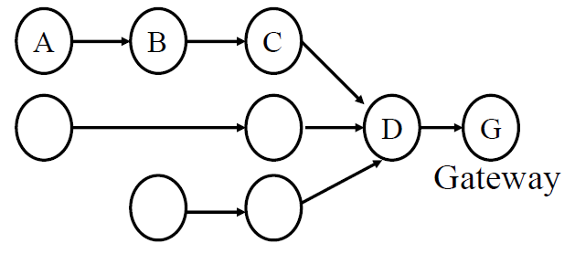
Many-to-one routing (Collection Tree Protocol, CTP)
Tree optimization for sensor networks
Keep all devices except the “gateway” as simple as possible
Each device only needs to remember hop to gateway
If gateway wants to send message back, it must include a full hop path

Slide 7
Outline
Simple Routing
Mesh Routing
Better Flooding
Low-power Access Control

Slide 8
Mesh Routing
Mesh topology makes routing question more complicated
Multiple hops in a route
Multiple routes between source and destination
Becomes a graph theory question based on cost metric
B
C
A
D
F
E

Slide 9
Flooding
Mesh equivalent of broadcast
Each node sends to each other node
Eventually packets will reach the desired destination
Not really routing at all…
Question: how do we make it stop?

Slide 10
Flooding
Mesh equivalent of broadcast
Each node sends to each other node
Eventually packets will reach the desired destination
Not really routing at all…
Question: how do we make it stop?
Maximum retransmissions counter on each packet
Decrement at each hop. Drop packet when it hits zero
Need some guess for how many hops to destination
Or keep some history of recently flooded packets
Don’t retransmit a recently sent packet

Slide 11
Reactive routing
Build up a map of the routes through a network
Hopefully the “optimal” routes
Map routes in reaction to a packet arrival
Sensor devices are slow and limited
Most likely to resend to same prior address
Discover a route when it is needed, then cache for next time

Slide 12
Ad-hoc On-demand Distance Vector Routing (AODV)
On-demand: Construct routes only when needed
Modern ZigBee routing approach (for Mesh topology)
Routing table
Destination node -> Next hop (for all cached destinations)
Store only next hop instead of full route
All routers along the path must also have Destination->Next mappings
Also keep hops-to-destination and last-seen-destination-sequence-number
Route discovery
Upon demand: check table
If not cached send Route Request (RREQ) via Flooding
Route is unknown, so flooding is needed
AODV documentation: https://www.ietf.org/rfc/rfc3561.txt

Slide 13
AODV Route Requests (RREQs)
Request ID | Source Address | Destination Address | Source SeqNo | Destination SeqNo | Hop Count
Request ID identifies this RREQ
Used to discard duplicates during flooding
Unless less hops and equally recent, OR more recent
Sequence Numbers are per-device, monotonically increasing
Used as a notion of “how recently” device has been seen
Source SeqNo is the source’s most recent sequence number
Destination SeqNo is the most recently seen from the destination by the source. (Defaults to zero)
Hop Count is the number of hops this request has taken
Starts at 1 and incremented by each transmitter along the path

Slide 14
Example AODV RREQ (A to F)
Request ID | Source Address | Destination Address | Source SeqNo | Destination SeqNo | Hop Count
A wants to find a route to F, so it sends out an RREQ
B
C
A
D
F
E

Slide 15
Example AODV RREQ (A to F)
Request ID | Source Address | Destination Address | Source SeqNo | Destination SeqNo | Hop Count
1 | A | F | 1 | 0 | 1
B and D also opportunistically add a routing table entry for A
B
C
A
D
F
E

Slide 16
Example AODV RREQ (A to F)
Request ID | Source Address | Destination Address | Source SeqNo | Destination SeqNo | Hop Count
1 | A | F | 1 | 0 | 2
B goes first via some access control protocol (D also in contention)
A and D ignore duplicate Request ID C opportunistically adds a routing table entry to A
B
C
A
D
F
E

Slide 17
Example AODV RREQ (A to F)
Request ID | Source Address | Destination Address | Source SeqNo | Destination SeqNo | Hop Count
1 | A | F | 1 | 0 | 2
D goes next by some access control protocol (C also in contention)
A, B, and C ignore duplicate Request ID E and F opportunistically add routing table entries to A
B
C
A
D
F
E

Slide 18
Example AODV RREQ (A to F)
Request ID | Source Address | Destination Address | Source SeqNo | Destination SeqNo | Hop Count
1 | A | F | 1 | 0 | 3
C and E repeat this process with Hop Count 3 (but everyone ignores them)
They go one-at-a-time, but I’m getting tired of drawing these
Actually, they’re in contention with the response from F
B
C
A
D
F
E

Slide 19
AODV Route Response (RREP)
Source Address | Destination Address | Destination SeqNo | Hop Count
Reply is sent unicast back to the source via newly constructed route
Each node along the way already knows the route back
Includes most recent own sequence number as a sense of recency
“Destination” from the perspective of the original RREQ
No need for source sequence number anymore

Slide 20
Example AODV RREP (F to A)
Source Address | Destination Address | Destination SeqNo | Hop Count
F | A | 7 | 2
F sends response back to A via D
D opportunistically adds a routing table entry for F
B
C
A
D
F
E

Slide 21
Break + Practice
C wants to send a packet to E
What RREQ(s) are sent and what RREP(s) are sent?
B
C
A
D
F
E

Slide 22
Break + Practice
C wants to send a packet to E
What RREQ(s) are sent and what RREP(s) are sent?
RREQs:
C -> (B,D,F)
(B or D) -> A
(D or F) -> E
RREPs:
E -> (D or F) -> C
Network could have multiple configurations
B
C
A
D
F
E

Slide 23
RREP optimization
An intermediate node responds with RREP if it already has a path to destination with a more recent Destination sequence number
Source may get multiple RREP responses with different recency and hop counts
So, some intermediate node could respond “here’s the route I knew of when sequence number was 5”
Then, destination node could respond “here’s the route right now, I’m actually on sequence number 12”
Likely want the most recent
If equally recent, use the least hops

Slide 24
When to update your route
Routing table entries are updated on RREP if:
Sequence number in routing table is marked as invalid
Destination sequence number in the RREP is greater the listed one
Sequence numbers are the same, but the route was marked as inactive
Sequence numbers are the same, but the hop count is smaller

Slide 25
Route maintenance in AODV
If a link in the routing table breaks, all active neighbors are informed with Route Error (RERR) messages
After some number of retransmissions and timeouts
RERR contains destination address that broke
Nodes receiving RERR can start RERQ for destination address
Which lets them find a new path through the network
And updates everyone’s cached next-hops

Slide 26
Similar alternative: Dynamic Source Routing (DSR)
Another reactive routing technique
Similar design as AODV
In DSR, routing tables have full route to destination
Each packet transmission includes a list of hops to destination
So the route to an important destination only has to be stored on the source device that cares about it
Intermediate nodes do not need any route storage for that destination
Cost is extra bytes used in each packet for route
During discovery, all paths are returned by destination
So source gets a full list of possible route choices

Slide 27
Tradeoffs for reactive routing
Upside: no transmissions unless there is demand
Routes might appear, disappear, reappear, but no need to update if no one actually wants to transmit anything
Downside: large, variable delay when actually sending a packet
Full RREQ/RREP protocol before data can actually be sent
Route might have broken at some point
So data will be sent based on cached information
RERR will occur
RREQ/RREP will occur
Then data will be sent again

Slide 28
Proactive routing
Alternative to reactive is to know the routes ahead of time
Periodically query for the possible routes in the network
Save all routes that are important (maybe just all routes?)
Also redetermine routes whenever topology changes (nodes join/leave)
Upside: when a packet arrives, route to destination is already known
Downside: requires more memory and effort on part of routers
Wastes some network bandwidth on checking for route changes

Slide 29
Distance-Vector
Keep routes as “next hops” rather than full routes
AODV uses this method (DV for Distance Vector)
Can be combined with proactive techniques too
Each router periodically informs neighbors of its shortest paths to each destination (in terms of hop count)
Essentially just broadcast your routing table
Routers choose the best route available
Either old next-hop it was already aware of
Or new next-hop through neighbor (with cost of their hops + 1)
Need to be careful to avoid loops!

Slide 30
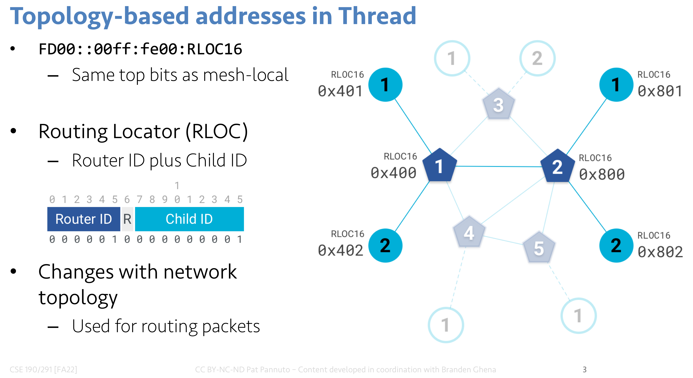
Thread routing
Uses a proactive, distance-vector protocol for unicast routing
If node is a child, send packet to parent router
If node is a router,
Consult table for address within mesh
(RLOC helps here!)
Send to border router for address outside of mesh
Multicast uses a data dissemination protocol (Trickle)
Or falls back to flooding

Slide 31
Break + Discussion
Hop count is one possible metric for determining routes
What else might be considered?

Slide 32
Reliability as a cost metric
Link quality can very from node to node
Fewest hops might not be the “fastest” or “most reliable” path
ETX: minimize “expected transmissions”
Measure link quality over time to determine each link’s reliability
B
C
A
D
F
E

Slide 33
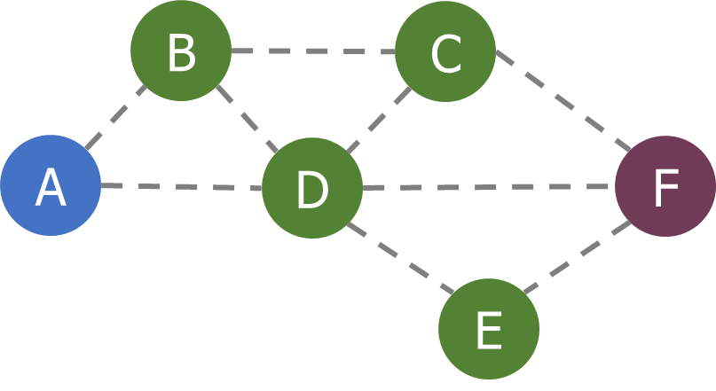
Alternative cost metrics
Spatial reuse
Prefer transmission on links that do not interfere with each other
Improves ability to pipeline data through network
Example: A<->B and E<->F
Energy availability
Prefer routing through nodes with more remaining available energy
Prefer wall-powered nodes over battery-powered
Arbitrarily complex combinations possible

Slide 34
Outline
Simple Routing
Mesh Routing
Better Flooding
Low-power Access Control

Slide 35
Flooding is a recreation of broadcasts
Goal: get information to all nodes
This is the problem of “data dissemination”
Problem: difficult in Mesh topologies
Packet loss, retransmission delays
Really, the desire for data dissemination is just to broadcast to all nodes
But broadcast transmissions don’t reach far enough to cover entire mesh

Slide 36
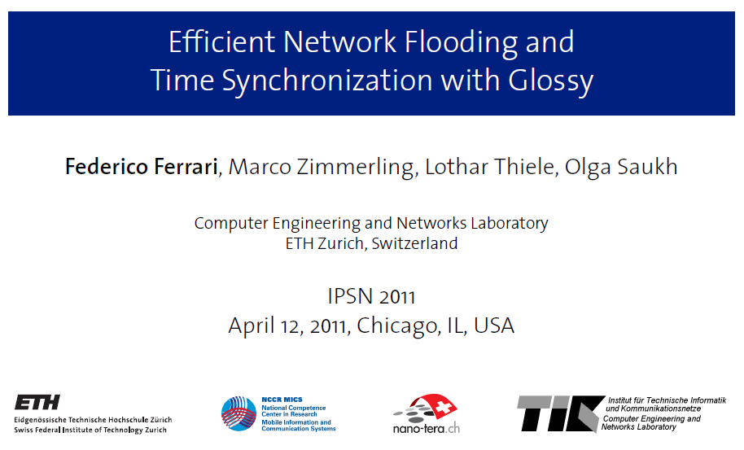
Glossy: what if we expand broadcast range by having multiple nodes participate?

Slide 37
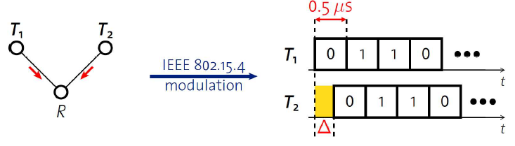
Synchronous transmissions
Multiple nodes transmit same packet at same time
R can receive packet with high probability if Δ is small
May even improve probability of reception (more energy at receiver)
500 ns is 1/32 of a symbol for 802.15.4 (chip duration)

Slide 38
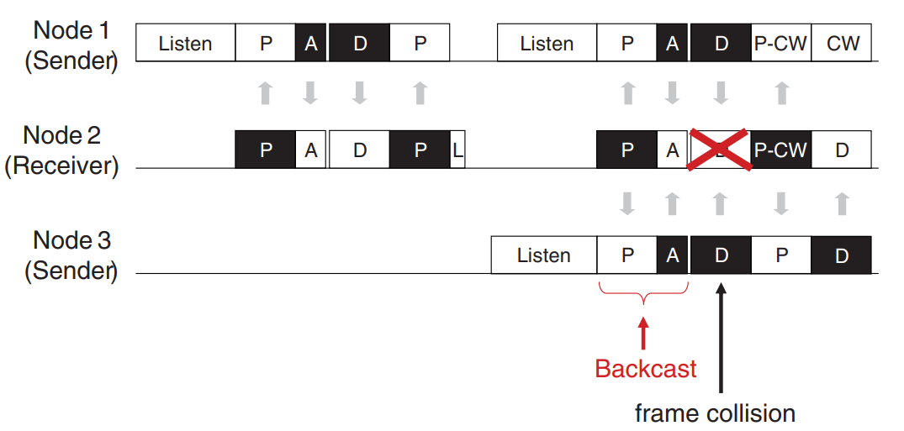
Sidebar: broadcast transmission acknowledgements
P = Probe (data request) A = Acknowledgement
D = Data transmission L = Listening period
P-CW = Probe with Contention Window for response
A-MAC: https://web.eecs.umich.edu/~prabal/pubs/papers/dutta12amac.pdf

Slide 39
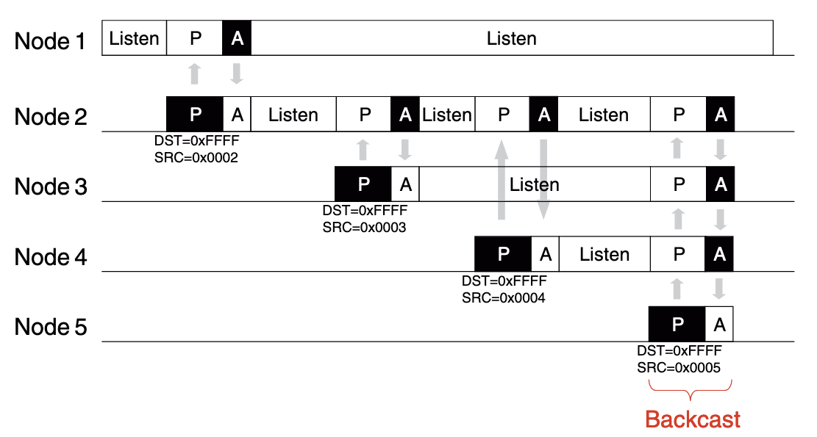
How do we avoid interference?
Fundamental insight:
“say exactly the same thing at exactly (enough) the same time” leads to coherence instead of interference
In 802.15.4, an ACK is sent exactly 192 µs after receiving
The ACK packet contains only the sequence number being ACK’d
Does not contain source address of the ACK-er
Which is why this works:

Slide 40
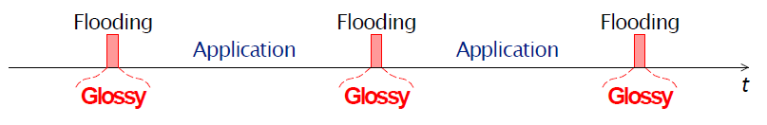
Glossy key techniques
Temporally decouple network flooding from application tasks
Exploit synchronous transmissions for fast network flooding

Slide 41
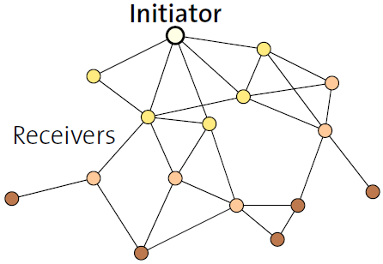
Fast packet propagation in Glossy

Slide 42
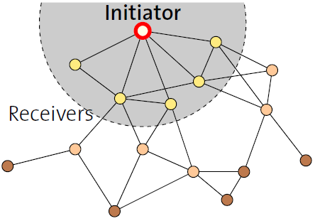
Fast packet propagation in Glossy

Slide 43
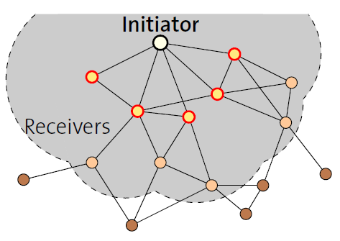
Fast packet propagation in Glossy

Slide 44
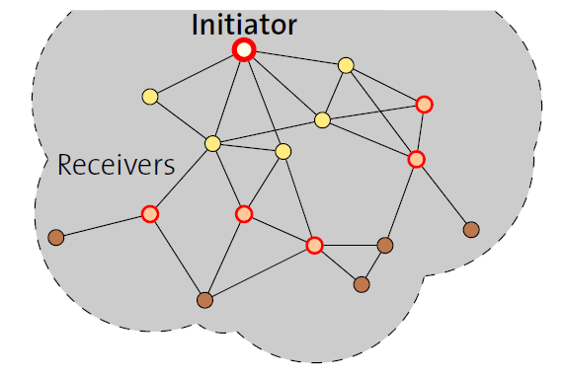
Fast packet propagation in Glossy

Slide 45
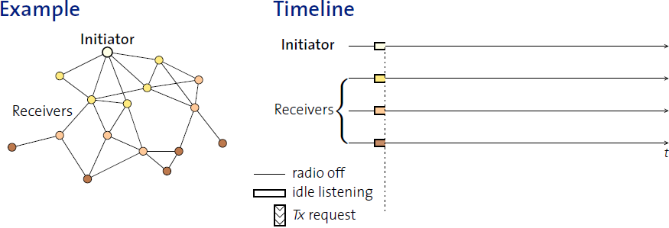
Glossy details
When Glossy starts
All nodes turn on radios to receive

Slide 46
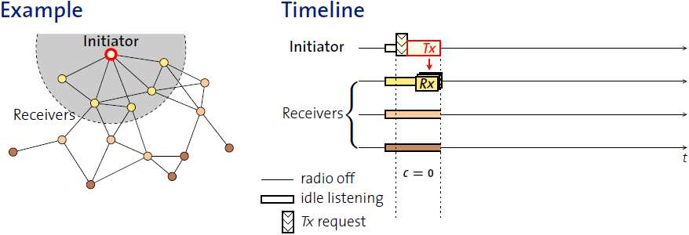
Glossy details
Initiator
Set relay counter in packet, C = 0
Broadcast packet

Slide 47
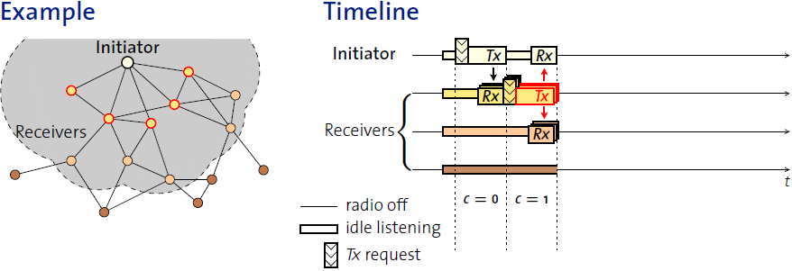
Glossy details
At packet reception:
Increment relay counter C
Transmit synchronously (at a fixed period after the reception)

Slide 48
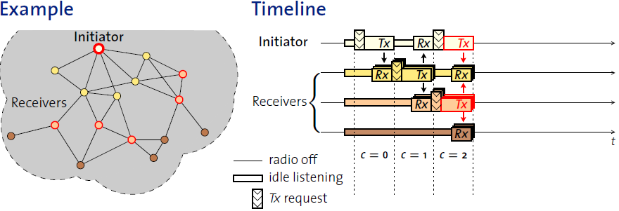
Glossy details
At packet reception:
Increment relay counter C
Transmit synchronously (at a fixed period after the reception)

Slide 49
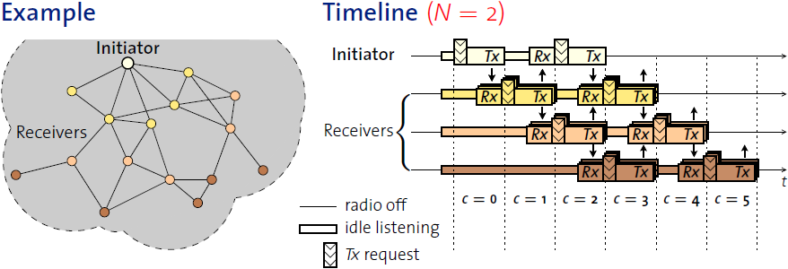
Glossy details
Stop rebroadcasting and turn off radio when
Already transmitted N times
Networks pick N for reliability/energy tradeoff

Slide 50
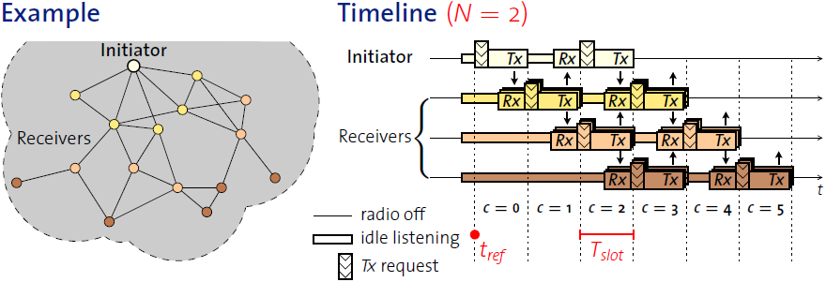
Glossy details
T_{slot} is constant by design
Needs to be short to make constructive interference work
Beginning of slot (t_{ref}) provides synchronization point
As a bonus, all nodes are synchronized after flooding event

Slide 51
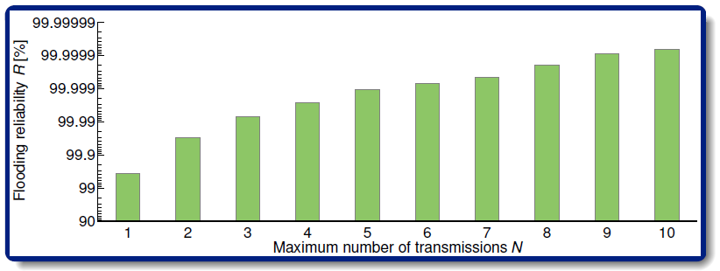
Glossy implementation
Device must be able to have tight time bounds on rx/tx
500 ns wiggle room maximum
Includes receive, processing, transmission
Implies a maximum physical distance for a network
Need to pick an N for reliability

Slide 52
Application of Glossy: avoid routing altogether
Low-Power Wireless Bus (LWB)
Federico Ferrari, Zimmerling, Mottola, Thiele. SenSys’12
Use Glossy for all device communication
Make one broadcast domain (a bus) where all nodes communicate
Avoids all issues of routing, everything is a broadcast
Works for unicast, multicast, anycast, and broadcast transmissions
General idea: TDMA Glossy floods
Synchronization is already given to nodes by Glossy
One coordinator makes the TDMA schedule

Slide 53
Outline
Simple Routing
Mesh Routing
Better Flooding
Low-power Access Control

Slide 54
Always-on Radios Simplify Protocols
Many protocols assume a more-powerful device with lots of energy
BLE: Central
Thread: Router/Leader
Zigbee: Router/Coordinator
WiFi: Router
LoRa: Gateway
This assumption simplifies the “when to listen” problem
Powerful device: always listen
Low-power device: listen-after-talk or synchronized schedule

Slide 55


Slide 56

Early 2000s

Slide 57
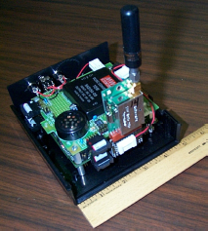

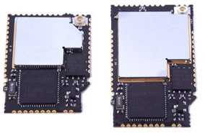
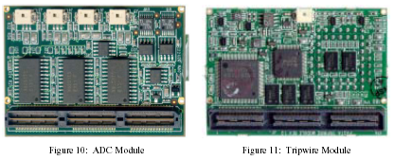
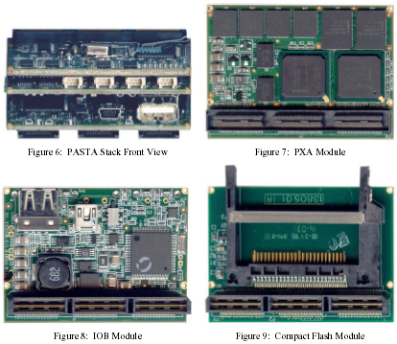
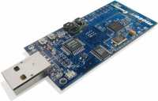
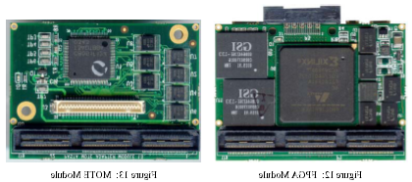
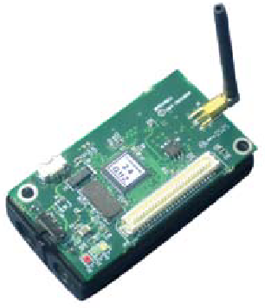
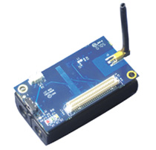
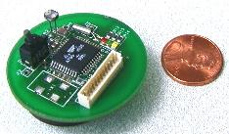
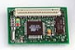
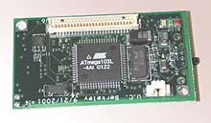
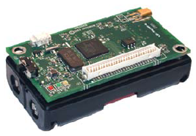
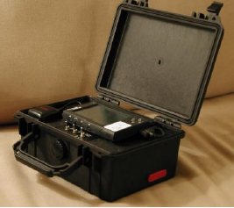
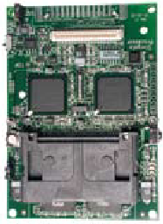
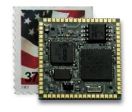
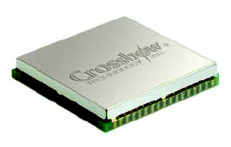
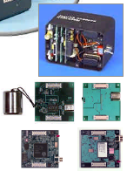

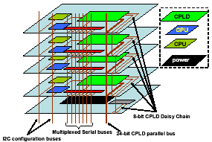
Early days of low power sensor nodes
Tmote Mini
[Sentilla07]
Telos/Tmote
[Polastre05]
PC/104 [Cerpa01]
PASTA [Bajura05]
Mica [Hill01]
Mica2 [Xbow03]
MicaZ [Xbow05]
Iris [Xbow07]
WeC [Hill98]
Rene [Hill99]
MicaZ Stamp
[Xbow06]
Iris OEM
[Xbow07]
WINSng [Pottie00]
Stargate [Intel]
WINS [Rockwell]
mPlatform[Lymberopoulos07]

Slide 58
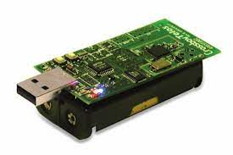
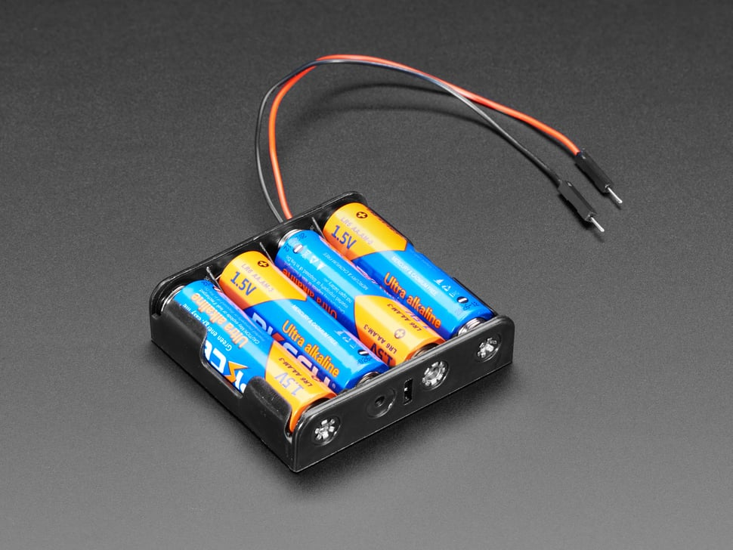
Low power goal: multi-year operation using batteries
Power_{node} = P_{CPU} + P_{TX} + P_{RX} + P_{SLEEP}
Energy_{BATT} = P_{node} * lifetime
For Lifetime to increase, P_{node} must decrease
P_{CPU} ≫ P_{SLEEP}
P_{TX} ≫ P_{SLEEP}
P_{RX} ≫ P_{SLEEP}
Solution: Minimize Compute, TX, and RX
Maximize Sleep

Slide 59
Low power MAC principles
Communication is possible if one device is receiving while other is transmitting
Devices can only coordinate using the data communication channel (i.e. no out-of-band communication)
No global synchronization mechanism
Goal: scheme to schedule TX and RX to permit communication while minimizing energy
Energy is paramount, but additional metrics:
Latency
Throughput
Reliability
Network scale
A
B
Both devices want to minimize the time they are receiving or transmitting (i.e. their radio is on) to reduce power draw

Slide 60
Low Power Listening (LPL) - B-MAC (2004)
CCA
CCA
CCA
RX
TX ACK
CCA
Sleep
Sleep
Sleep
Sleep
Sleep
Receiver
Preamble
TX
RX ACK
Sleep
Sleep
Transmitter
Method:
Receiver periodically samples the channel
Transmitter sends a preamble long enough to ensure receiver will detect it
Upon detection, receiver stays awake to receive transmitted packet
Receiver ACKs if packet received correctly
Versatile Low Power Media Access for Wireless Sensor Networks. Joseph Polastre, Jason Hill and David Culler. SenSys 2004

Slide 61
LPL performance
Sensor sample period controls the packet rate
CCA check interval
Too small: energy wasted on idle listening
Too large: energy wasted on transmissions (long preambles)
In general, it’s better to have larger preambles than to check more often!
Time between listening
(checking if the channel is idle)
Versatile Low Power Media Access for Wireless Sensor Networks. Joseph Polastre, Jason Hill and David Culler. SenSys 2004

Slide 62
LPL Drawback
A
CCA
CCA
CCA
RX
TX ACK
CCA
Sleep
Sleep
Sleep
Sleep
Sleep
Receiver
B
Preamble
TX
RX ACK
Sleep
Sleep
Transmitter
C
CCA
CCA
CCA
RX
DROP
CCA
Sleep
Sleep
Sleep
Sleep
Sleep
Receiver
Spend time listening to packets for someone else!
A
C
B
Versatile Low Power Media Access for Wireless Sensor Networks. Joseph Polastre, Jason Hill and David Culler. SenSys 2004

Slide 63
X-MAC: Shorter preambles and destination information
A
RX
RX
TX ACK
RX
TX ACK
RX
Sleep
Sleep
Sleep
Sleep
Receiver
B
TX (DST ID)
TX (DST ID)
TX (DST ID)
RX ACK
TX
RX ACK
Sleep
Sleep
Transmitter
Method
Transmitter sends a short “I have a packet for this address” packet
Nodes periodically listen, and ACK if the packet is for them
Upon receiving the ACK, the transmitter sends full packet
Receiver successfully receives the full packet.
X-MAC: A Short Preamble MAC Protocol for Duty-Cycled Wireless Sensor Networks. Michael Buettner, Gary V. Yee, Eric Anderson, Richard Han. SenSys 2006.

Slide 64
X-MAC: Overhearing node drops out early
A
RX
RX
TX ACK
RX
TX ACK
RX
Sleep
Sleep
Sleep
Sleep
Receiver
B
TX (DST ID)
TX (DST ID)
TX (DST ID)
RX ACK
TX
RX ACK
Sleep
Sleep
Transmitter
C
RX
RX
Sleep
Sleep
Sleep
Overhearer
X-MAC: A Short Preamble MAC Protocol for Duty-Cycled Wireless Sensor Networks. Michael Buettner, Gary V. Yee, Eric Anderson, Richard Han. SenSys 2006.

Slide 65
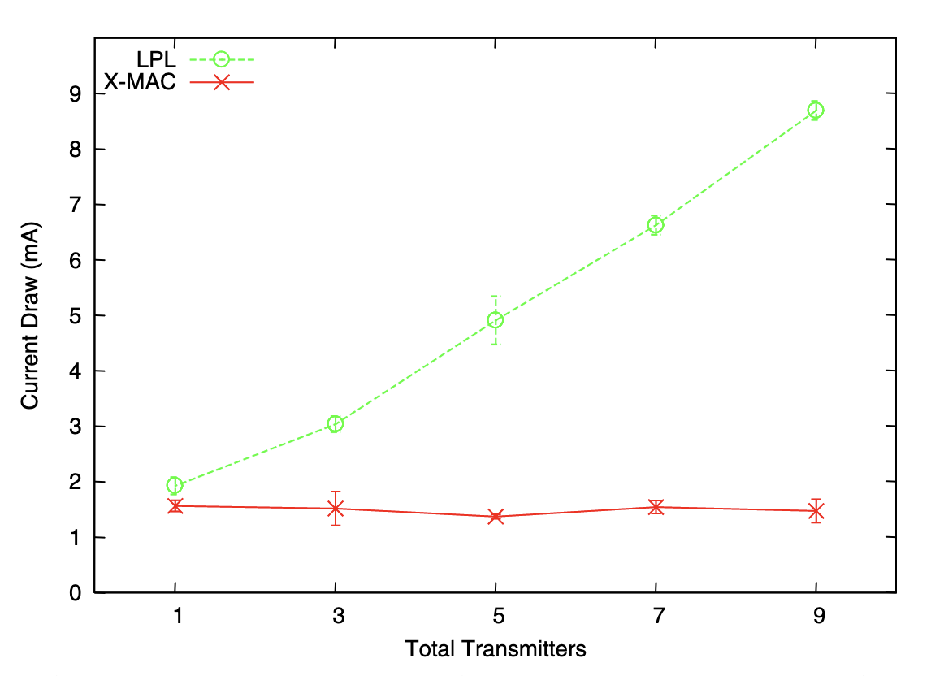
X-MAC: lower power draw than LPL with multiple nearby transmitters
X-MAC: A Short Preamble MAC Protocol for Duty-Cycled Wireless Sensor Networks. Michael Buettner, Gary V. Yee, Eric Anderson, Richard Han. SenSys 2006.

Slide 66
LPL (B-MAC) and X-MAC are transmitter-initiated MAC protocols
Receiving nodes continuously periodically sample the wireless channel
When they detect a transmission they listen to receive packets
Transmitting nodes are only active when they want to transmit
Receiving nodes prone to unnecessary wakeups
Have to receive all nearby transmissions to see if the packet happens to be for them
Unnecessary wakeups lead to increasing receive energy → shorter lifetime
In general, difficult for receiver to know if it should stay awake or go back to sleep

Slide 67
Low Power Probing (LPP) is receiver initiated
A
TX Probe
RX
TX Probe
RX
TX ACK
TX Probe
RX
Sleep
Sleep
Sleep
Sleep
Receiver
B
RX
TX
RX ACK
Sleep
Sleep
Transmitter
Method
Receiver periodically transmits a probe, listens afterward
Transmitter listens for probe packet from intended recipient
Transmitter sends packet after receiving the correct probe packet
Works a lot like BLE advertisements!!
RI-MAC: A Receiver-Initiated Asynchronous Duty Cycle MAC Protocol for Dynamic Traffic Loads in Wireless Sensor Networks. Yanjun Sun, Omer Gurewitz, David B. Johnson. SenSys 2008.
Koala: Ultra-Low Power Data Retrieval in Wireless Sensor Networks. Razvan Musaloiu-E., Chieh-Jan Mike Liang, Andreas Terzis. IPSN 2008.

Slide 68
LPP introduces a new challenge for multiple nodes. What happens with multiple transmitters?
RX
TX
Sleep
Sleep
Transmitter
TX Probe
TX Probe
RX
TX Probe
Collision!!
Sleep
Sleep
Sleep
Sleep
Receiver
RX
TX
Sleep
Sleep
Transmitter
If multiple transmitters receive a probe, they both transmit, leading to a collision and a lost packet
Receiver is unsure if there even was a packet at all, or just noise/interference on the channel
RI-MAC: A Receiver-Initiated Asynchronous Duty Cycle MAC Protocol for Dynamic Traffic Loads in Wireless Sensor Networks. Yanjun Sun, Omer Gurewitz, David B. Johnson. SenSys 2008.
Koala: Ultra-Low Power Data Retrieval in Wireless Sensor Networks. Razvan Musaloiu-E., Chieh-Jan Mike Liang, Andreas Terzis. IPSN 2008.

Slide 69
A-MAC resolves this with backcast constructive interference
RX
TX ACK
TX
RX
CCA
CCA
TX
RX ACK
Sleep
Sleep
Sleep
Transmitter
TX Probe
TX Probe
RX ACK
RX
TX Probe
Listen
RX
TX ACK
Listen
RX
TX ACK
Listen
Collision!!
Sleep
Sleep
Sleep
Receiver
RX
TX ACK
TX
RX
CCA
TX
RX ACK
Sleep
Sleep
Transmitter
Method
Transmitters send an ACK in response to a probe packet
With multiple transmitters, the ACKs collide, but interfere non-destructively, so the receiver still receives an ACK
The receiver stays awake to receive a packet, but the packet collides
The receiver sends a new probe, informing transmitters there was a collision
Transmitters use CSMA/CA to send packets
Design and Evaluation of a Versatile and Efficient Receiver-Initiated Link Layer for Low-Power Wireless. Prabal Dutta, Stephen Dawson-Haggerty, Yin Chen, Chieh-Jan Mike Liang, and Andreas Terzis. SenSys 2010.

Slide 70
Summary: asynchronous low power MAC protocols
Transmitter initiated protocols
Receivers periodically sample the channel
Transmitters transmit sufficiently to ensure recipients heard
Examples: LPL, X-MAC
Pros:
Simple, intuitive
Can balance TX and RX energy with sample interval
Cons:
Receivers prone to false wake-ups
High idle listening energy costs
Receiver initiated protocols
Receivers periodically transmit probes
Transmitters listen for a probe before sending a packet
Examples: RI-MAC, Koala, A-MAC
Pros:
Fixed, small listening energy cost for receivers
Cons:
Multiple transmitters leads to collisions

Slide 71
Outline
Simple Routing
Mesh Routing
Better Flooding
Low-power Access Control

