Slide 1
Lecture 02 Physical and Link Layers
CS397/497 – Wireless Protocols for IoT
Branden Ghena – Winter 2021
Some slides borrowed from: Peter Steenkiste (CMU), Christian Poellabauer (Notre Dame)

Slide 2
Today’s Goals
Introduce OSI layer model of communication
Overview of concerns for the Physical and Data link layers
Speak the “lingo” of wireless communication
Present technology aspects that we will return to in specific protocols
Describe Medium Access Control mechanisms

Slide 3
Outline
OSI Layers
Physical Layer
Data Link Layer

Slide 4
Communication layers
Application
Presentation
Session
Transport
Network
Data Link
Physical
What goes on at each of these?

Slide 5
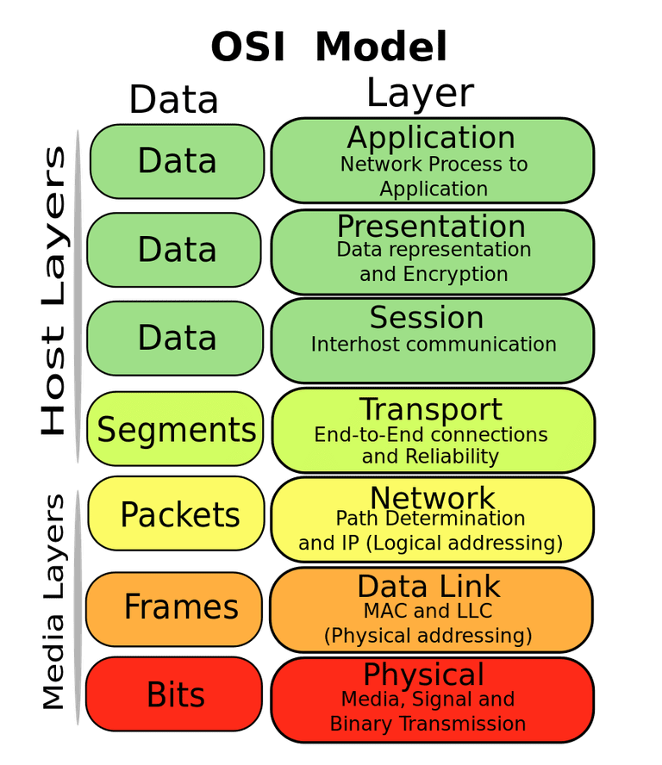
OSI model of communication layers
Transport
How to form connections between computers
TCP and UDP
Network
How to send packets between networks
IP
CS domain: CS340
Data Link
How to send frames of data
Ethernet, WiFi
Our focus
Physical
How to send individual bits
Ethernet, WiFi
EE domain: EE307, EE380, EE395

Slide 6
Protocols are “layered”
Headers for each layer of communication wrap data
Data is wrapped with header for the network to make a packet
Packet is wrapped with header for the link to make a frame
Internet Packet
Data
Packet Header
Frame Header
Ethernet Frame

Slide 7
Transmitting data between networks
LAN1
Host A
Host B
LAN2
client
server
(1)
data
(8)
data
protocol
software
protocol
software
internet packet
(2)
data
PH
(7)
data
PH
LAN1
adapter
LAN2
adapter
LAN1 frame
Router
(3)
data
PH
FH1
(6)
data
PH
FH2
LAN1
adapter
LAN2
adapter
LAN2 frame
(4)
data
PH
FH1
data
PH
FH2
(5)
PH: Internet packet header
FH: LAN frame header
protocol
software

Slide 8
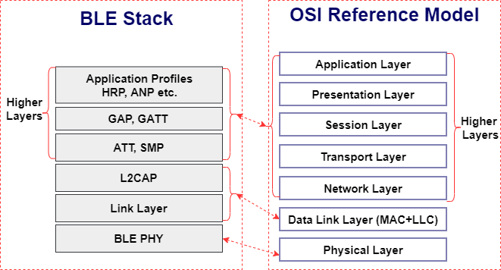
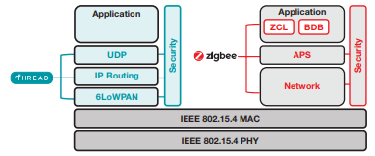
Model != reality
Wireless protocols don’t always split between layers cleanly
Usually explain parts of physical, data link, and possibly upper layers
Model still helps conceptualize stack-up though
Layering of some type still occurs

Slide 9
Layering for IoT (joke) (kind of)
MQTT
MQTT is a publish/subscribe message broker

Slide 10
Outline
OSI Layers
Physical Layer
Data Link Layer

Slide 11
Physical Layer
How bits are transmitted
Wireless makes this entirely different from wired cases
Important considerations
Signal strength
Modulation
Frequency

Slide 12
Why use wireless?
There are no wires!
No need to install and maintain wires
Reduces cost
Simplifies deployment – place devices wherever makes sense
Supports mobile users
Move around office, campus, city
Move devices around home

Slide 13
What is hard about wireless?
There are no wires!
Wired networks are constant, reliable, and physically isolated
Ethernet has the same throughput minute-to-minute
Bits sent through Ethernet or USB are (usually) received
Wireless networks are variable, error-prone, and shared
WiFi throughput changes based on location and walls
Signals from nearby devices interfere with your signals
Individual bits might flip or never be heard at all

Slide 14
Wireless is a shared medium
Wired communication has signals confined to a conductor
Copper or fiber
Guides energy to destination
Protects signal from interference
Wireless communication is inherently broadcast
Energy is distributed in space
Signals must compete with other signals in same frequency band

Slide 15
Increasing network capacity is challenging
Wired networks just add more wires
Buses are many signals in parallel to send more data
Wireless networks are harder
Adding more links just increases interference
Need to expand to different frequencies

Slide 16
Model of RF communication
Energy that radiates spherically from an antenna
Attenuation with distance
Density of energy reduces over time, distance
Signal strength is reduced, errors go up
Two key features
Error rates depend on distance
Spatial reuse of frequencies

Slide 17
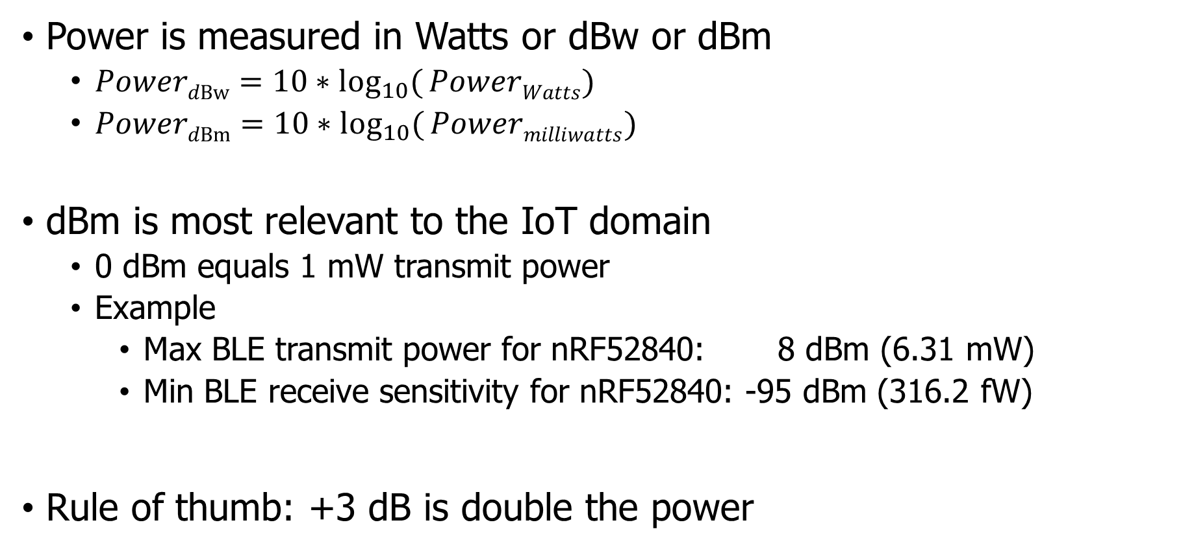
Signal strength is measured in decibels
Power is measured in Watts or dBw or dBm
${PowerdBw=10∗log}_{10}({PowerWatts})$
${PowerdBm=10∗log}_{10}({Powermilliwatts})$
dBm is most relevant to the IoT domain
0 dBm equals 1 mW transmit power
Example
Max BLE transmit power for nRF52840: 8 dBm (6.31 mW)
Min BLE receive sensitivity for nRF52840: -95 dBm (316.2 fW)
Rule of thumb: +3 dB is double the power

Slide 18
Propagation degrades RF signals
Attenuation in free space
Signals get weaker as they travel over long distances
Signal spreads out -> free space path loss
Obstacles can weaken signal through absorption or reflection
Important: distance is NOT the only signal strength loss
Free space path loss calculation will not give you accurate range for a signal

Slide 19
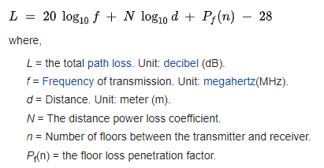
ITU model for Indoor Attenuation
Models like this are more trustworthy than FSPL
https://en.wikipedia.org/wiki/ITU_model_for_indoor_attenuation

Slide 20
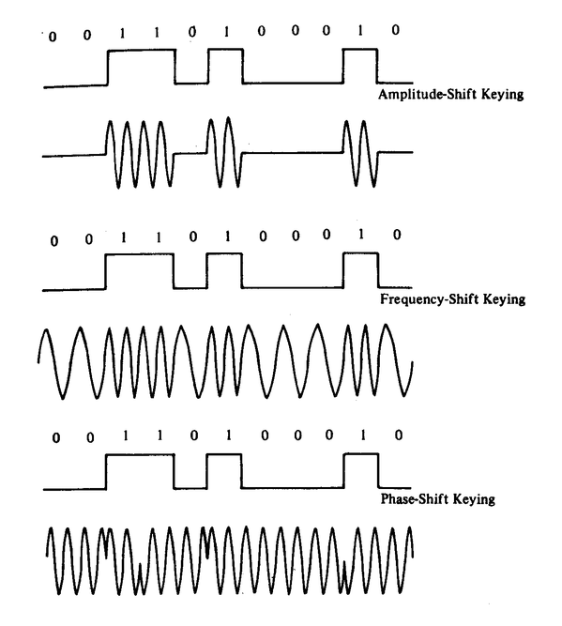
Modulation
Encoding digital data in an analog “carrier” signal
Basic forms:
Amplitude-shift Keying (ASK)
Modify amplitude of carrier signal
Frequency-shift Keying (FSK)
Modify frequency of carrier signal
Phase-shift Keying (PSK)
Modify phase of carrier signal

Slide 21
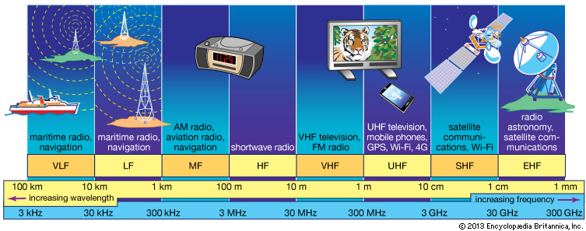
RF communication frequencies
IoT focus

Slide 22
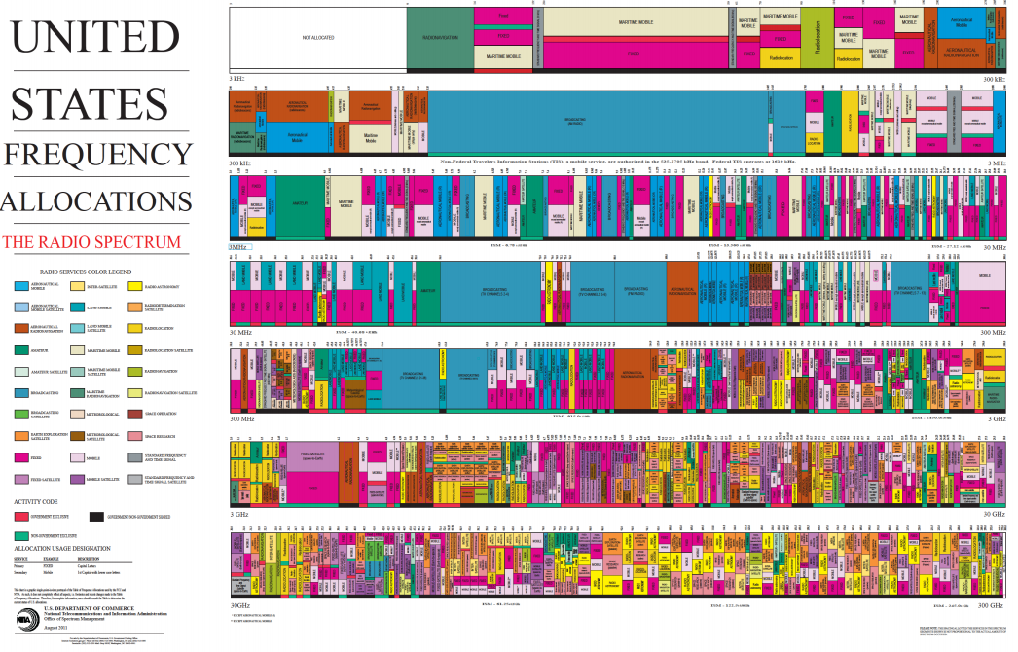
Wireless spectrum is allocated to specific uses

Slide 23
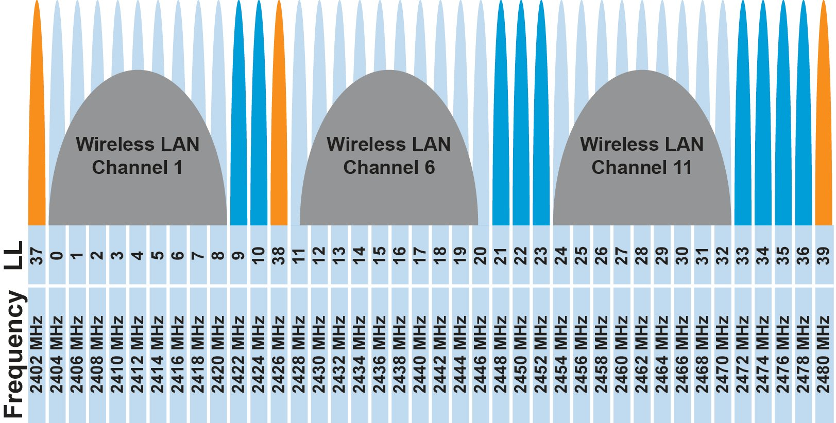
Unlicensed bands are where IoT thrives
902 MHz – 928 MHz
LPWANs
2.4 GHz to 2.5 GHz
WiFi, BLE, Thread
5 GHz
Faster WiFi
Cellular uses licensed bands at great cost
Why?

Slide 24
Unlicensed bands are where IoT thrives
902 MHz – 928 MHz
LPWANs
2.4 GHz to 2.5 GHz
WiFi, BLE, Thread
5 GHz
Faster WiFi
Cellular uses licensed bands at great cost
Why? No interference from other users

Slide 25
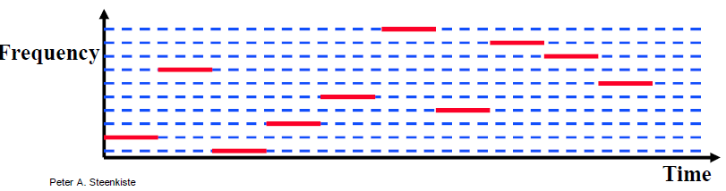
Frequency Hopping Spread Spectrum
Transmitter hops through a sequence of transmit channels
Spend some “dwell time” on each channel before hopping again
Receiver must know the hopping pattern
Avoid causing or receiving prolonged interference

Slide 26
Sidebar: inventor of FHSS – Hedy Lamarr
Actress and Inventor
Designed FHSS with George Antheil during WWII
Idea: torpedo control can’t be easily jammed if it jumps around
https://en.wikipedia.org/wiki/Hedy_Lamarr#Inventor

Slide 27
Outline
OSI Layers
Physical Layer
Data Link Layer

Slide 28
Data Link Layer
Framing
Combine arbitrary bits into a “packet” of data
Logical link control
Manage transfer between transmitter and receiver
Error detection and correction
Media access
Controlling which device gets to transmit next
Inherently coupled to PHY and its decisions

Slide 29
Framing
Typical packet structure
Preamble - Existence of packet and synchronization of clocks
Header - Addresses, Type, Length
Data - Payload plus higher layer headers (e.g. IP packet)
Trailer - Padding, CRC
Wireless considerations
Control information for Physical Layer
Ensure robustness for header
Explicit multi-hop routing
Possibly different data rates for different parts of packet
Preamble | Destination Address | Source Address | Type and Length | Data | CRC

Slide 30
Error control: detection and recovery
Detection: only detect errors
Make sure corrupted packets get discarded
Cyclical Redundancy Checks
Detect single bit errors
Detect “burst” errors of several contiguous bits
Recovery: also try to recover from small bit errors
Forward error correction
Retransmissions
Far more important for wireless because the cost of transmission is higher

Slide 31
Medium Access Control
How does a network determine which transmitter gets to transmit?
Remember: the wireless medium is inherently broadcast
Two simultaneous transmitters may lose both packets

Slide 32
Analogy: wireless medium as acoustic
How do we determine who gets to speak?
Two simultaneous speakers also lose both “transmissions”

Slide 33
Analogy: wireless medium as acoustic
How do we determine who gets to speak?
Two simultaneous speakers also lose both “transmissions”
Eye contact (or raise hand) -> out-of-band communication
Wait until it’s quiet for some time -> carrier sense multiple access
Strict turn order -> time division multiple access
Just speak and hope it works -> ALOHA
Everybody sing at different tones -> frequency division multiple access (stretching the metaphor)
Others?

Slide 34
MAC protocol categorization
Medium Access Control Protocols
Contention-Based Protocols
Contention-Free Protocols
ALOHA
CSMA
FDMA
TDMA
Also, CDMA

Slide 35
ALOHA
ALOHAnet (1971)
University of Hawaii – Norman Abramson
First demonstration of wireless packet network
Rules
If you have data to send, send it
Two (or more) simultaneous transmissions will collide and be lost
Wait a duration of time for an acknowledgement
If transmission was lost, try sending again “later”
Want some kind of exponential backoff scheme here

Slide 36
Packet collisions
Each packet transmission has a window of vulnerability
Twice the on-air duration of a packet
Transmissions during the packet are bad
Transmissions before packet can also be bad

Slide 37
Slotted ALOHA
Split time into synchronized “slots”
Any device can transmit whenever it has data
But it must transmit at the start of a slot
And its transmission cannot be longer than a slot
Removes half of the possibilities for collisions!
At the cost of some synchronization method
time

Slide 38
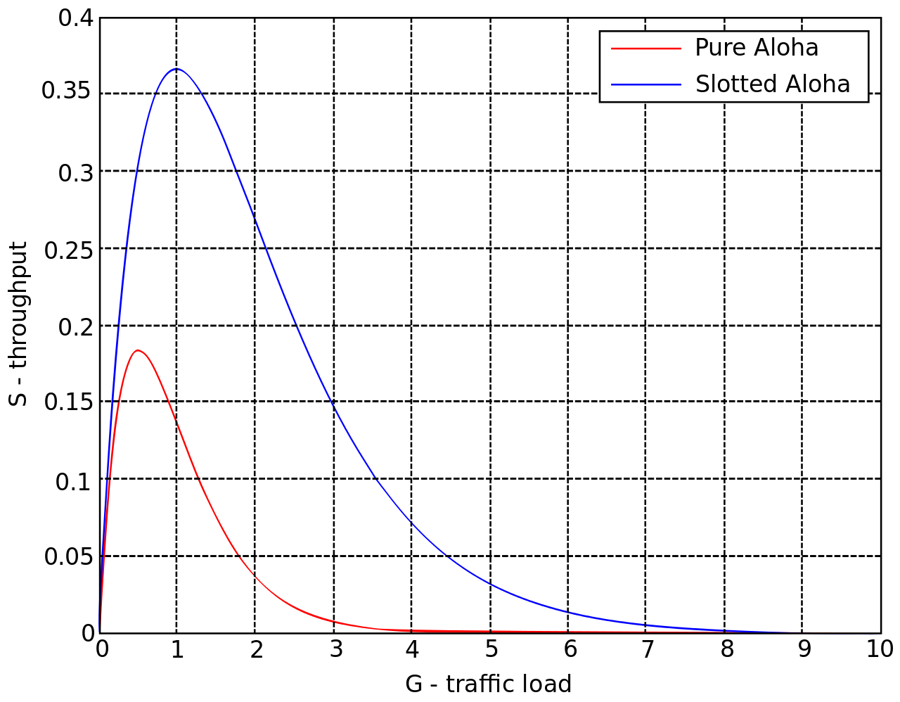
ALOHA throughput
It can be shown that traffic maxes out at
ALOHA: 18.4%
Slotted ALOHA: 36.8%
Assuming Poisson distribution of transmission attempts
Slotted throughput is double because the “before” collisions can no longer occur

Slide 39
Capture effect
Actually, two packets at once isn’t always a total loss
The louder packet can still sometimes be heard if loud enough
How much louder?
Ballpark 12-14 dB
When does this work?
Depends on the radio hardware
Louder packet first almost always works
Louder packet second sometimes works

Slide 40
CSMA/CA – Carrier Sense Multiple Access with Collision Avoidance
First listen for a duration and determine if anyone is transmitting
If idle, you can transmit
If busy, wait and try again later
“listen before send”
Can be combined with notion of slotting
If current slot is idle, transmit in next slot
If current slot is busy, follow some algorithm to try again later

Slide 41
CSMA/CD – CSMA with Collision Detection
Detect collisions during your own transmission
Works great on wired mediums (Ethernet, I2C)
Somewhere between challenging and impossible for wireless
Transmit and receive are usually the same antenna
Receiving while transmitting would be drowned out by transmission
Remember: TX at 8 dBm and RX at -95 dBm

Slide 42
Hidden terminal problem
Device C
Device A
Device B

Slide 43
CSMA with RTS/CTS
Hidden terminal problem means that two transmitters might never be able to detect each other’s transmissions
A partial solution
When channel is idle, transmitter sends a short Request To Send (RTS)
Receiver will send a Clear To Send (CTS) to only one node at a time
RTS collisions are faster and less wasteful than hidden terminal collisions
Downside: overhead is high for waiting for CTS when contention is low

Slide 44
Contention-free access control protocols
Goal: split up communication such that devices will not conflict
Can be predetermined or reservation-based
Devices might request to join the schedule and be given a slot
Devices lose their slot if it goes unused for some amount of time
Reservations often occur during a dedicated CSMA contention slot
Assignment of schedules can be complicated
Really efficient at creating a high-throughput network
Assuming they are all following the same protocol
Otherwise, interference can be very problematic

Slide 45
FDMA – Frequency Division Multiple Access
Split transmissions in frequency
Different carrier frequencies are independent
Fundamentally how RF spectrum is split
Technically, each device uses a separate, fixed frequency
Walkie-talkies
Conceptually, how RF channels work
WiFi networks pick different bands
802.15.4 picks a channel to communicate on

Slide 46
TDMA – Time Division Multiple Access
Split transmissions in time
Devices share the same channel
Splits time into fixed-length windows
Each device is assigned one or more windows
Can build a priority system here with uneven split among devices
Requires synchronization between devices
Often devices must listen periodically to resynchronize
Less efficient use of slots reduce synchronization
Large guard windows. E.g. 1.5 second slot for a 1 second transmission

Slide 47
Real-world protocol access control
ALOHA
BLE advertisements
Unlicensed LPWANs: Sigfox, LoRaWAN
CSMA
WiFi (slotted, CSMA/CA)
TDMA
BLE connections
Cellular LPWANs: LTE-M and NB-IoT

Slide 48
Outline
OSI Layers
Physical Layer
Data Link Layer

