Slide 1
Lecture 04 BLE Advertisement Deep Dive
CS397/497 – Wireless Protocols for IoT
Branden Ghena – Winter 2021

Slide 2
Announcements
I updated the Project Proposal link on canvas with additional information about your proposal
https://canvas.northwestern.edu/courses/133790/assignments/841765
Reminder: due end-of-day on the 1st
Come talk to me in office hours about your project before then if you’ve got questions or concerns
Also feel free to post project ideas on campuswire

Slide 3
Today’s Goals
Describe BLE scanning role
Deep dive into advertisements. Questions we might ask as researchers.
How much energy do advertisements take?
What is the probability of receiving a packet?
What is the probability of receiving data?
What are the real-world use cases of advertisements?

Slide 4
Outline
BLE roles
Advertising
Scanning
Energy Use
Packet Collisions
Advertisement Use Cases

Slide 5
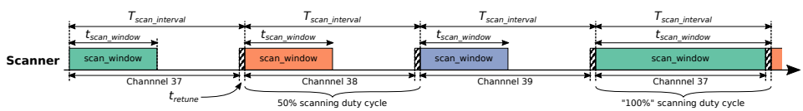
Scanning Pattern
Iterate through channels, listening for advertisements
T_{scan_interval} controls rate at which channels are changes
T_{scan_window} controls duty cycle of listening
Why listen at a low duty cycle?

Slide 6
Scanning Pattern
Iterate through channels, listening for advertisements
T_{scan_interval} controls rate at which channels are changes
T_{scan_window} controls duty cycle of listening
Why listen at a low duty cycle? Save energy

Slide 7
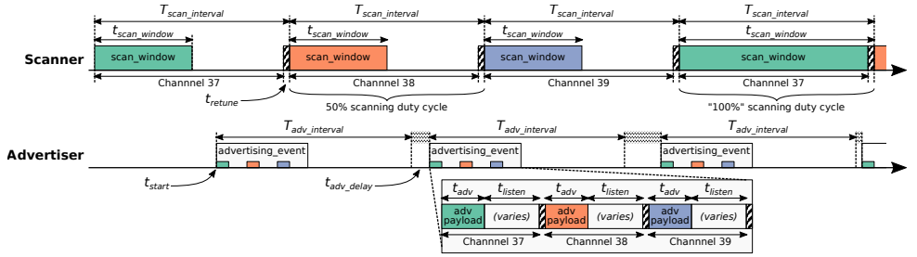
Putting it all together
Advertisements are received when the channel of the scan window and the channel of the advertisement overlap in time (and space)

Slide 8
A warning about scanning expectations
Scanners will NOT receive 100% of packets sent
Even ignoring range issues
Packets are lost due to (in roughly descending order):
Duty cycle
Sharing 2.4 GHz antenna with WiFi
Retune period after each scanning interval
Dropped packets in the receive software
Packet collisions

Slide 9
Outline
BLE roles
Advertising
Scanning
Energy Use
Packet Collisions
Advertisement Use Cases

Slide 10
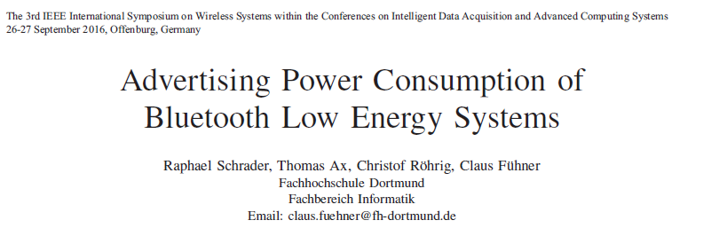
Paper: power measurements of BLE advertisements
Schrader, Raphael, et al. "Advertising power consumption of bluetooth low energy systems." 2016 3rd International Symposium on Wireless Systems within the Conferences on Intelligent Data Acquisition and Advanced Computing Systems (IDAACS-SWS). IEEE, 2016.

Slide 11
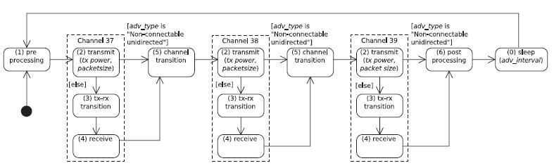
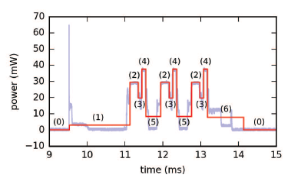
Energy model for BLE advertisements
Is this valuable?
Is this surprising?
Does this seem accurate?
When does it apply?

Slide 12
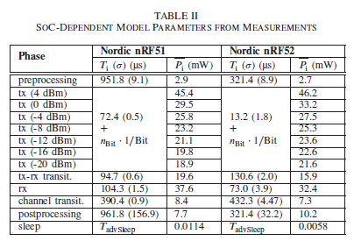
Measurements of Power Use
Power use and duration (energy)
nRF51 (nRF51822)
nRF52 (nRF52832)
Does this seem accurate?
What conditions are the tests performed under?

Slide 13
Overall thoughts on the paper?
Any additional thoughts?
Grad students: is this a good paper?
And how are you defining good?

Slide 14
Overall thoughts on the paper?
Any additional thoughts?
Grad students: is this a good paper?
And how are you defining good?
Note: I think this would make an excellent class project.
~70-80% of this would be sufficient for a good grade.

Slide 15
How much energy does it cost to send data over advertisements?
Configuration
nRF51822 microcontroller
Maximum payload size
+4 dBm transmit power
Connectable advertisement
Sleep power 11 µW
One packet per second example:
110 µW average
~270 days on a CR2032
One packet per minute example:
13 µW average
~2250 days on a CR2032

Slide 16
Outline
BLE roles
Advertising
Scanning
Energy Use
Packet Collisions
Advertisement Use Cases

Slide 17
Questions about network capability
What are the odds that a transmitted advertisement will be received?
Packet reception rate
If M redundant advertisements are sent instead, what are the odds that at least one are received?
Data reception rate
How do these odds vary with number of devices, advertising interval, and packet size?

Slide 18
BLE advertisements are periodic, broadcast transmissions.
Advertisement events occur periodically (T_{adv_interval}: 20 ms–10 s).
Random delay appended before each transmission (t_{adv_delay}: 0–10 ms).
Data payload of up to 31 bytes.
advertisement event
advertisement event
time
T_{adv_interval}
+ t_{adv_delay}
Bluetooth SIG. Bluetooth Core Specification 4.2. (2014).
Notes:
How does communication work with BLE advertisements?
Each advertisement has a payload, which we can place sensor data in.
If data naturally has a periodic update rate, we can match the advertisement interval to that, so each advertisement has new sensor data.

Slide 19
What causes transmissions not to be received?
Not within range of the gateway.
Or various other losses within the gateway itself
Two devices try to send at the same time (packet collision).
X
X
broadcast domain

Slide 20
What is the probability of a packet collision?
time
t_{adv_0}
Packet 0
Jeon, Wha Sook, et al. "Performance analysis of neighbor discovery process in bluetooth low-energy networks." (IEEE Transactions on Vehicular Technology, 2016). Perez-Diaz de Cerio, David, et al. "Analytical and experimental performance evaluation of BLE neighbor discovery process including non-idealities of real chipsets." (Sensors, 2017).

Slide 21
What is the probability of a packet collision?
time
t_{adv_1}
t_{adv_0}
Packet 0
Packet 1
Packet 1
Packet 1
Packet 1
Packet 1
Jeon, Wha Sook, et al. "Performance analysis of neighbor discovery process in bluetooth low-energy networks." (IEEE Transactions on Vehicular Technology, 2016). Perez-Diaz de Cerio, David, et al. "Analytical and experimental performance evaluation of BLE neighbor discovery process including non-idealities of real chipsets." (Sensors, 2017).
Notes:
Collisions occur if any part of the two packets overlap
Particularly true for BLE that only has an 8-bit preamble

Slide 22
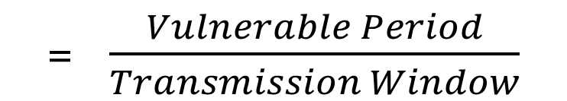
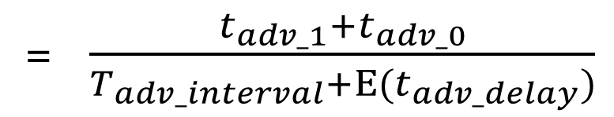
What is the probability of a packet collision?
time
t_{adv_1}
t_{adv_0}
Packet 0
Packet 1
Probability of Collision
= $\frac{Vulnerable Period}{Transmission Window}$
= $\frac{t_{adv_1}+t_{adv_0}}{T_{adv_interval}+Ε(t_{adv_delay})}$
Jeon, Wha Sook, et al. "Performance analysis of neighbor discovery process in bluetooth low-energy networks." (IEEE Transactions on Vehicular Technology, 2016). Perez-Diaz de Cerio, David, et al. "Analytical and experimental performance evaluation of BLE neighbor discovery process including non-idealities of real chipsets." (Sensors, 2017).
Notes:
The vulnerable period is the sum of the two advertisement durations
While the transmission window is the advertisement interval plus the expected value of the random delay

Slide 23
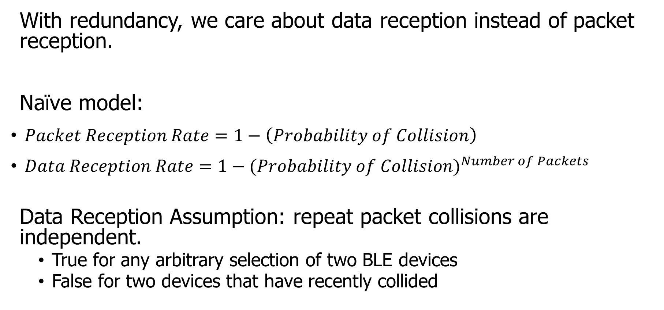
How do we determine reception rate?
With redundancy, we care about data reception instead of packet reception.
Naïve model:
$Packet Reception Rate=1−\left(Probability of Collision\right)$
$Data Reception Rate=1−{(Probability of Collision)}^{Number of Packets}$
Data Reception Assumption: repeat packet collisions are independent.
True for any arbitrary selection of two BLE devices
False for two devices that have recently collided
Notes:
Earlier we demonstrated the probability of collision, which can be used to determine packet reception rates.
Now with redundancy, we don’t care about the reception of any one packet, but the reception rate of the data that is being sent over them.
Naively, we can take the probability of collision and repeat it for any number of redundant packets.
There is an assumption in that model that repeat collisions are independent, which I’ll show you is false.

Slide 24
When are transmissions from two devices independent?
Assumption is true for any BLE device that has been advertising for some time
Sum of random delays grows the uncertainty of transmission.
Applied to periodic transmissions, any point in interval becomes equally likely.
Range of 1x delay, 2x delay, 3x delay, until it wraps
time
T_{adv_interval}
delay
T_{adv_interval}
delay
T_{adv_interval}
delay

Slide 25
When are transmissions from two devices NOT independent?
Independence assumption is false for two BLE devices that have recently collided.
If T_{adv_interval} is identical, next transmissions with be close in time.
Collision is determined by difference of random delays.
Further repeat collisions have the same probability of occurrence.
New time period collisions could occur within
time
T_{adv_interval}
delay
Notes:
If two devices have collided before, and have the same interval, at the next period they will certainly collide again.
BLE has a random delay appended to reduce this possibility.
But we’ve now greatly reduced the transmission window that the a collision could occur in. We can calculate this to determine a distinct probability of repeat collision.
Note that further repeat collisions are bounded by the same difference of random delays, and therefore have the probability of a second repeat collision is the same as the probability of a first repeat collision.

Slide 26





Calculating probability of a repeat collision
Difference of two uniform random delays forms a triangular distribution
probability
t_{adv_1}
t_{adv_0}
Probability of Repeat Collision
difference in transmission time
$$−t_{adv_delay}$$
$$−t_{adv_1}$$
$$0$$
$$t_{adv_0}$$
$$t_{adv_delay}$$

Slide 27
Important lesson: spend time on things that are important
How important was accounting for repeat collisions?
Maximum error is about a 1% change in Data Reception Rate.
This is due to size of delay 10 ms compared to size of transmission ~300 µs.
200 ms interval advertisements

Slide 28
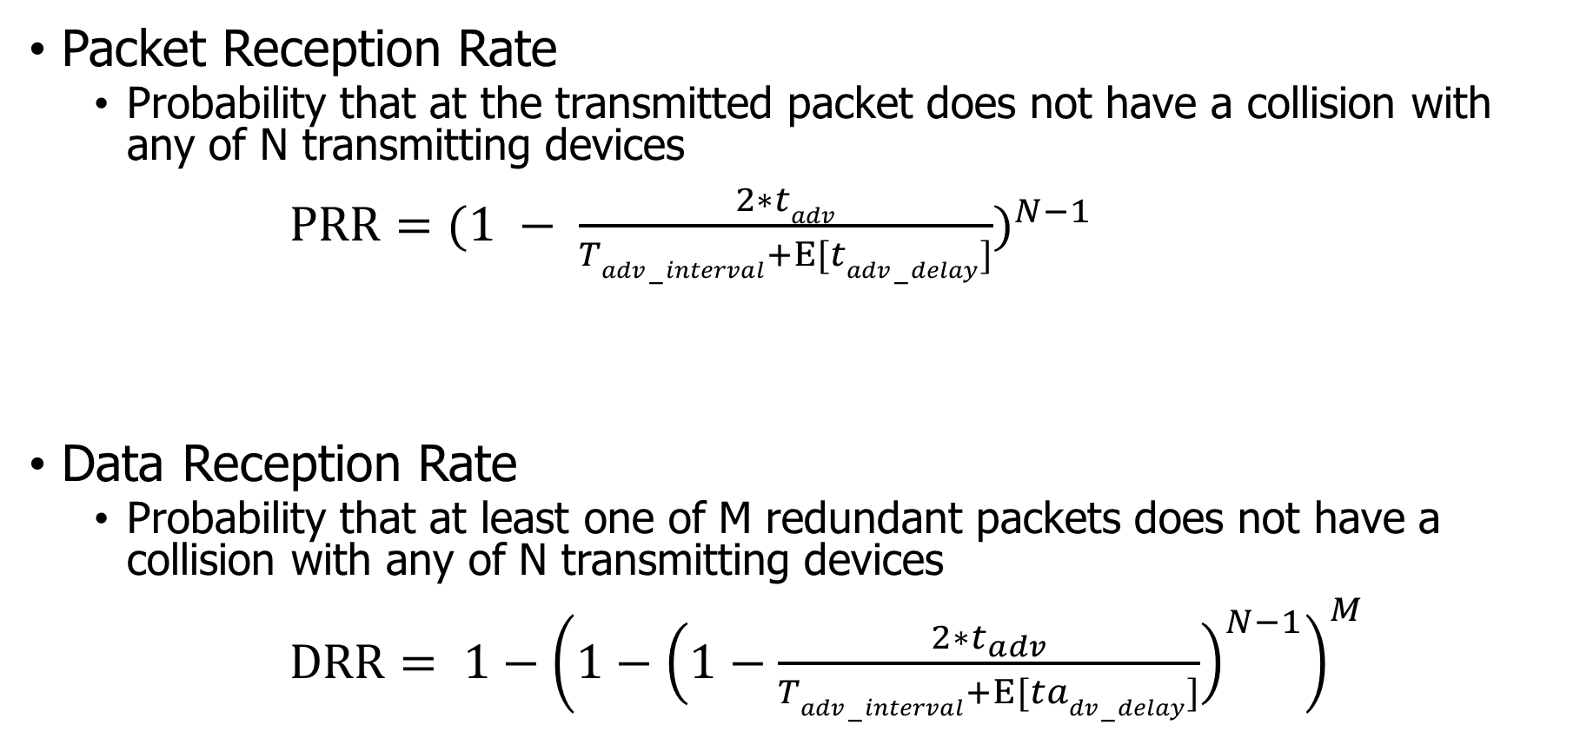
Equations for modeling data transmissions
Packet Reception Rate
Probability that at the transmitted packet does not have a collision with any of N transmitting devices
$PRR={(1 − \frac{2∗tadv}{Tadv−interval+Ε[tadv−delay]})}^{N−1}$
Data Reception Rate
Probability that at least one of M redundant packets does not have a collision with any of N transmitting devices
$DRR= {1−\left(1−{\left(1−\frac{2∗t_{adv}}{Tadv−interval+Ε[tadv−delay]}\right)}^{N−1}\right)}^{M}$

Slide 29
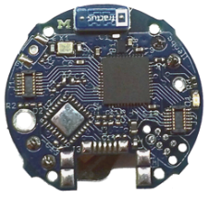
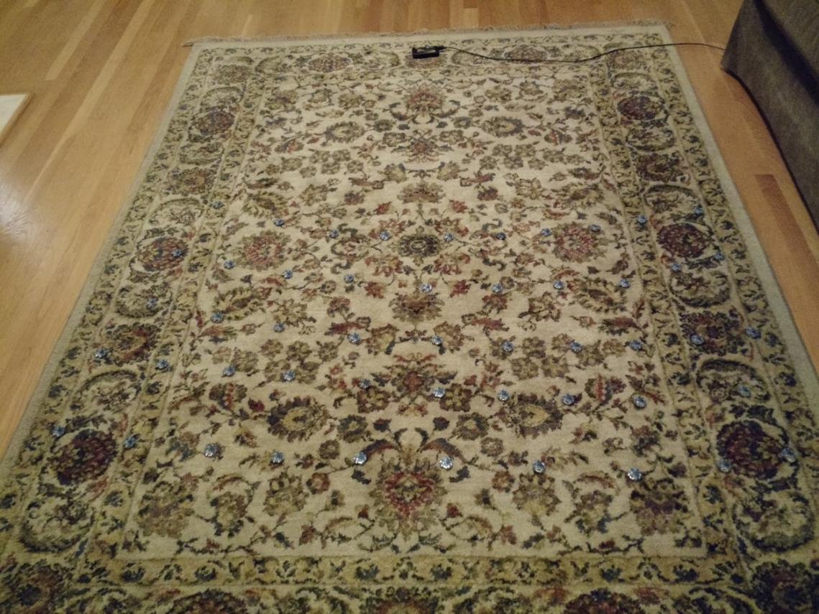
Is the model valid?
Empirical testing setup:
50 devices
1 meter from scanner
5-10 cm apart
Transmit monotonically increasing sequence numbers.
Sweep number of devices and advertising intervals.

Slide 30
The model is accurate across advertisement rates and deployment sizes.
Accuracy is fairly consistent across intervals.
The model consistently overestimates the measured PRR values.
The effect could be due to RF interference.

Slide 31
The model accurately accounts for redundancy as well.
The same dataset can be used to measure the effect of redundancy by grouping sets of sequence numbers.
The model again slightly overestimates, but error reduces quickly as DRR approaches 100%.

Slide 32
What questions can we answer with a collision model?
Original questions
What are the odds that a transmitted advertisement will be received?
If M redundant advertisements are sent instead, what are the odds that at least one are received?
How do these odds vary with number of devices, advertising interval, and packet size?
Additional questions
Can redundancy make advertisements reliable?
Is it better to transmit often for high redundancy or rarely for less congestion?

Slide 33
Redundancy results in high DRR even with many devices.
In this example, a sensor has new data once per second and sends it in 1-3 packets.
Even without redundancy, data reception rates never fall below 87% even with 200 devices in a deployment, assuming no interference.

Slide 34
Redundancy is (normally) better than less congestion.
Design question:
Send more packets to gain from redundancy? OR
Send less packets to reduce congestion?
The answer changes, but only with many devices.
Notes:
This plot changes with advertisement rate, and can get as low as 100 devices

Slide 35
Outline
BLE roles
Advertising
Scanning
Energy Use
Packet Collisions
Advertisement Use Cases

Slide 36
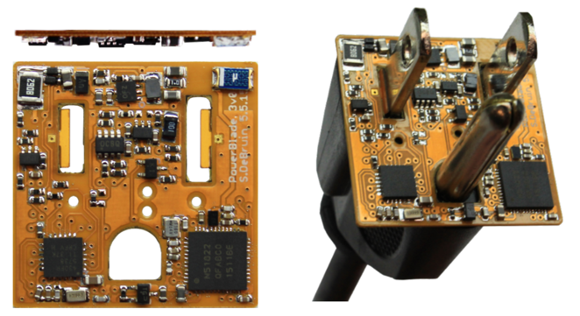
Advertisements are already being used for communication.
BLE advertisements are uncoordinated, broadcast messages designed for discovery.
Devices are being deployed using advertisements.
Beacons – iBeacon
Tracking – Tile
Local communication – Apple Continuity
Sensor deployments – PowerBlade
Notes:
PowerBlade is a great example of this.
It’s a plug-load power meter
Initially configured to use advertisements as a simple method for reading measurements with a smartphone
We are interested in household deployments where dozens of PowerBlades will be deployed to measure all the loads in a home
Can we still use BLE advertisements for data transfer in the presence of many other devices?

Slide 37
Beacons
Advertising with advertisements!
Web of Things
Real-world tags that broadcast virtual-world identifiers
iBeacon and Eddystone
Formats for sending URLs and device identifiers
Use existing BLE fields (Service Data and Manufacturer-Specific Data)

Slide 38
Tracking
Find devices nearby
Get a sense of distance to the device
Find my X
Tile: find my keys
Apple: find my device
Uses TX power level field
Lists the transmitted power of the device
Pathloss = TX power – RSSI (all in dBm)

Slide 39
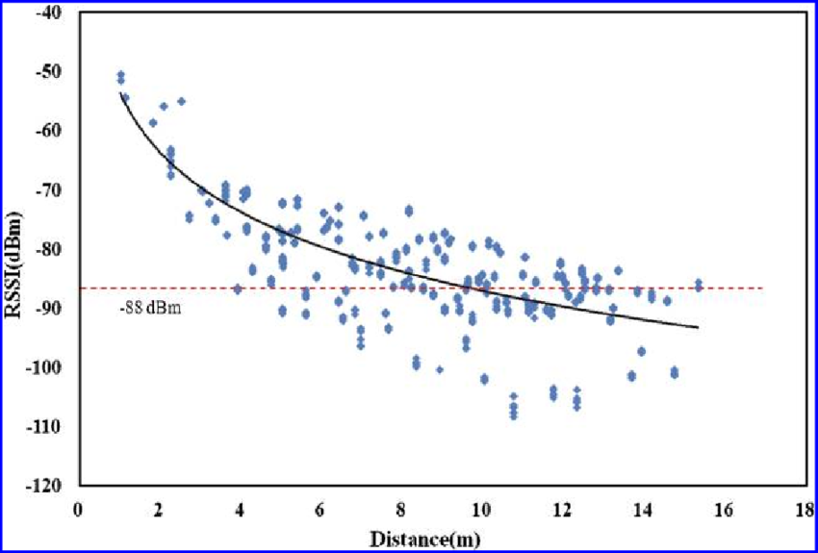
Problem with RSSI-based distance – not accurate
Pathloss is NOT only due to distance
RSSI is way worse at this than you hope it would be
Citation: literally everyone has made this figure at some point

Slide 40
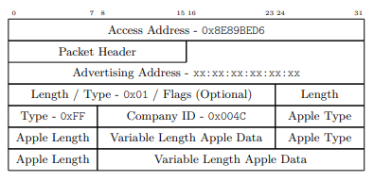
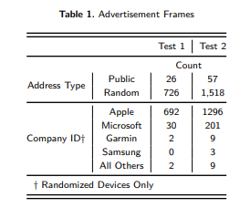
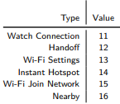
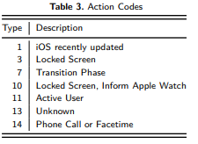
Local communication
Communication with only nearby devices
Apple Continuity
Martin, Jeremy, et al. "Handoff all your privacy–a review of apple’s bluetooth low energy continuity protocol." Proceedings on Privacy Enhancing Technologies 2019.4 (2019): 34-53.

Slide 41
Sensor deployments
Report data so gateways and users can retrieve it simultaneously
Easy introspection during a deployment
Satisfy users’ curiosity
Ignore difficult questions about networking
Just broadcast the data!
DeBruin, Samuel, et al. "Powerblade: A low-profile, true-power, plug-through energy meter." Proceedings of the 13th ACM Conference on Embedded Networked Sensor Systems. 2015.

Slide 42
Outline
BLE roles
Advertising
Scanning
Energy Use
Packet Collisions
Advertisement Use Cases
Bonus: Scan Responses

Slide 43
Scan requests/responses seem intriguing
Why not send most data in scan responses instead of advertisements?
Theoretically could reduce energy costs
Scan we use scan requests as a form of acknowledgement?
Could relieve need for redundant transmissions
Problem: scan requests/responses don’t work all that well

Slide 44
Scan Requests and Responses are broken
Goal: provide a little extra advertisement data on demand
Problem: exponential backoff for lost messages
If there is a request without a response, scanners assume collision with another scanner and exponentially back off from requesting
But collisions are far more likely between a device and a scanner, which should not have back off
Result is that scan requests will occur far less frequently than expected
Instead, just send additional advertisements with different data
Kravets, Robin, Albert F. Harris III, and Roy Want. "Beacon trains: blazing a trail through dense BLE environments." Proceedings of the Eleventh ACM Workshop on Challenged Networks. 2016.

Slide 45
Outline
BLE roles
Advertising
Scanning
Energy Use
Packet Collisions
Advertisement Use Cases
Bonus: Scan Responses

