Slide 1
Lecture 08 Bonus Thread
CS397/497 – Wireless Protocols for IoT
Branden Ghena – Winter 2021
With some advice from Neal Jackson (UC Berkeley)

Slide 2
Today’s Goals
Wallow in disappointment that the lab isn’t working
Understand addressing in Thread networks
Describe runtime behaviors like network joining
Discuss uses of IP in sensor networks

Slide 3
Outline
Thread Addressing
Runtime Behavior
Using IP

Slide 4
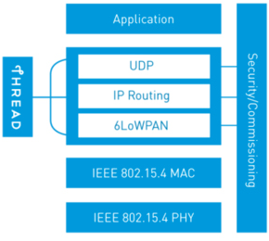
Thread overview
Build a networking layer on top of 15.4
Reuses most of PHY and MAC
Adds IP communication
Handles addressing and mesh maintenance
Goals
Simplicity – easy to install and operate
Efficiency – years of operation on batteries
Scalability – hundreds of devices in a network
Security – authenticated and encrypted communication
Reliability – mesh networking without single point of failure
Industry-focused, but based in academic research

Slide 5
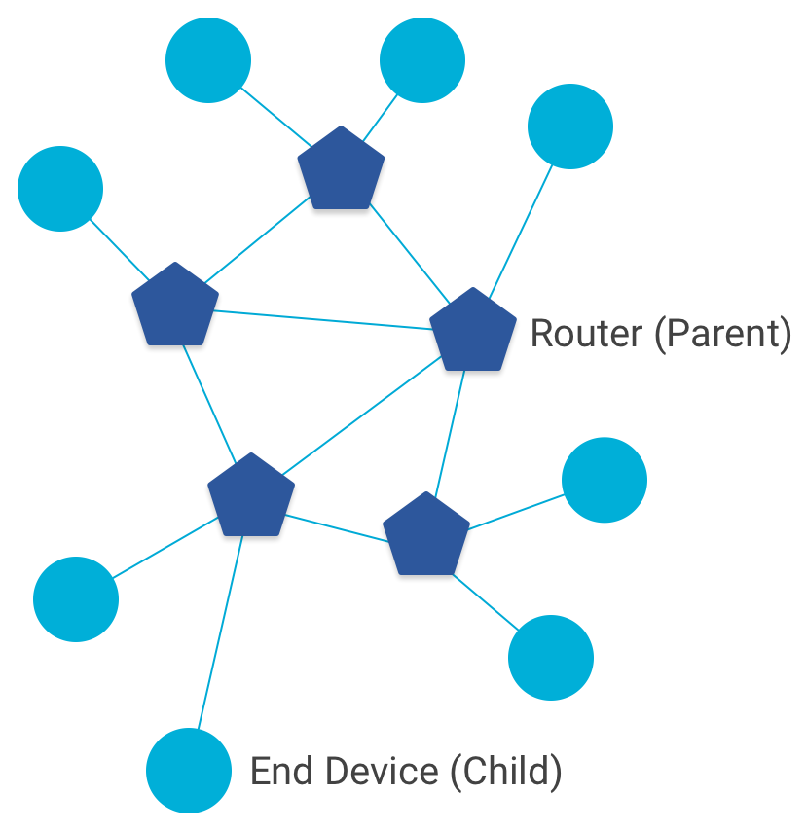
Combination of star and mesh topology
Routers (parent)
Mesh communication with other routers
Radio always on
Forwards packets for network devices
Enables other devices to join network
32 routers per network
End devices (child)
Communicates with one parent (router)
Does not forward packets
Can disable transceiver to save power
Send packets periodically to avoid timeout
511 end devices per router

Slide 6
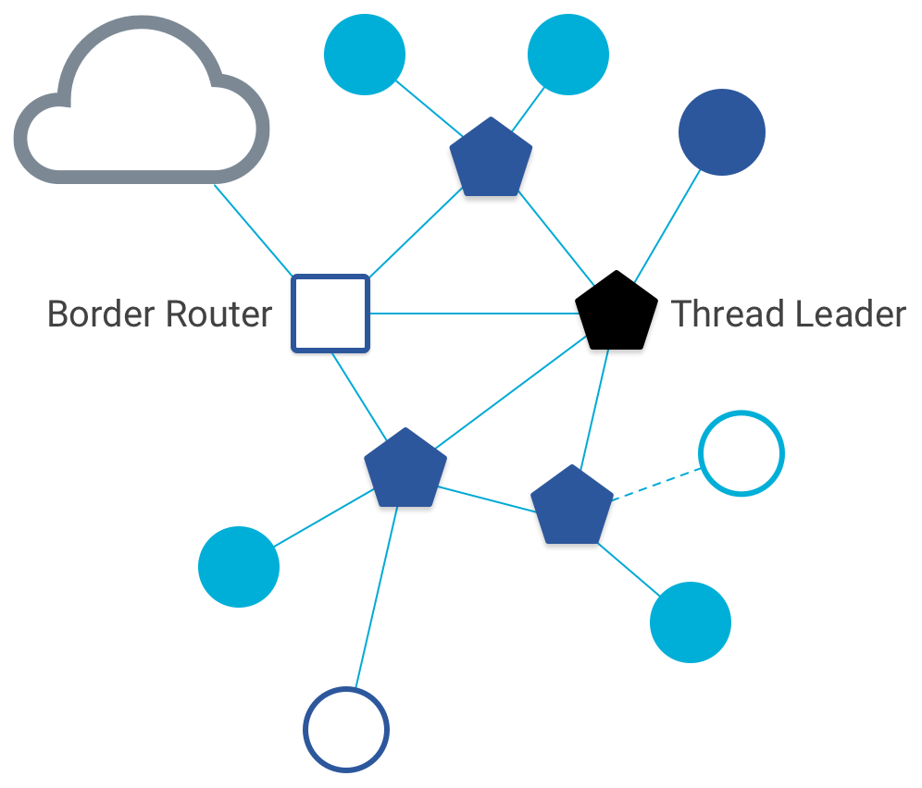
Other special roles
Thread leader
Device in charge of making decisions
Addresses, Joining details
Automatically selected from routers
One leader at any given time
Additional leader is selected if the network partitions
Border router
Router that also has connectivity to another network
Commonly WiFi or Ethernet
Provides external connectivity
Multiple border routers may exist at once

Slide 7
Background: IPv6 address notation rules
Groups of zeros can be replaced with “::”
Can only use “::” in one place in the address
Leading zeros in a 16-bit group can be omitted
0000:0000:0000:0000:0000:0000:0000:0001 → ::1
2345:1001:0023:1003:0000:0000:0000:0000 → 2345:1001:23:1003::
aecb:0222:0000:0000:0000:0000:0000:0010 → aecb:222::10
Special addresses
Localhost - ::1 (IPv4 version is 127.0.0.1)
Link-Local Network - fe80:: (bottom 64-bits are ~device MAC address)
Local Network – fc00:: and fd00::
Global Addresses – 2000:: (various methods for allocating bottom bits)

Slide 8
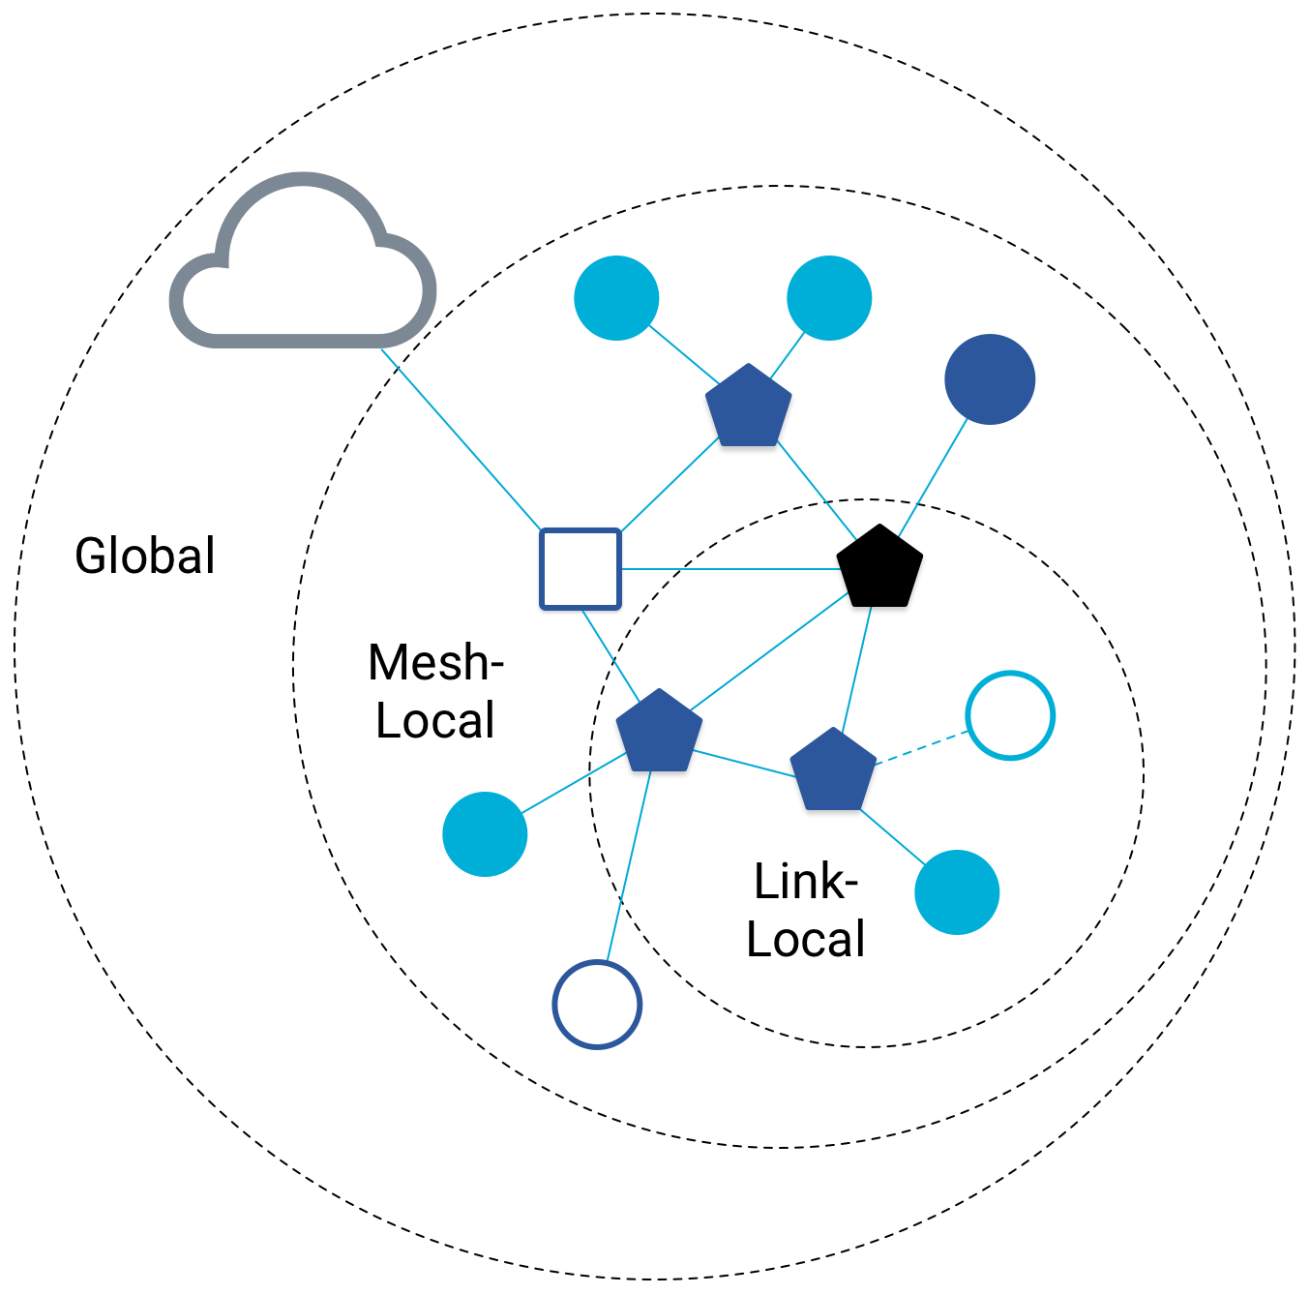
Benefit to IPv6: multiple address spaces per Thread device
Each device gets an IPv6 address for each way to contact it
Global IP address
Mesh-local IP address
Link-local IP address
Topology-based IP address
Role-based IP address(es)

Slide 9
Traditional addresses in Thread
Link-Local Addresses
FE80::/16
Bottommost 64-bits are EUI-64 (MAC address with 0xFFFE in the middle)
Permanent for a given device (no matter the network)
Used for low-layer interactions with neighbors (discovery, routing info)
Mesh-Local Addresses
FD00::/8 (FD00:: and FC00:: are for local networks)
Remaining bits are randomly chosen as part of joining the network
Permanent while connection is maintained to a network
Used for application-layer interactions
Global Addresses
2000::/3
Public address for communicating with broader internet through Border Router
Various methods for allocation (SLAAC, DHCP, Manual)

Slide 10
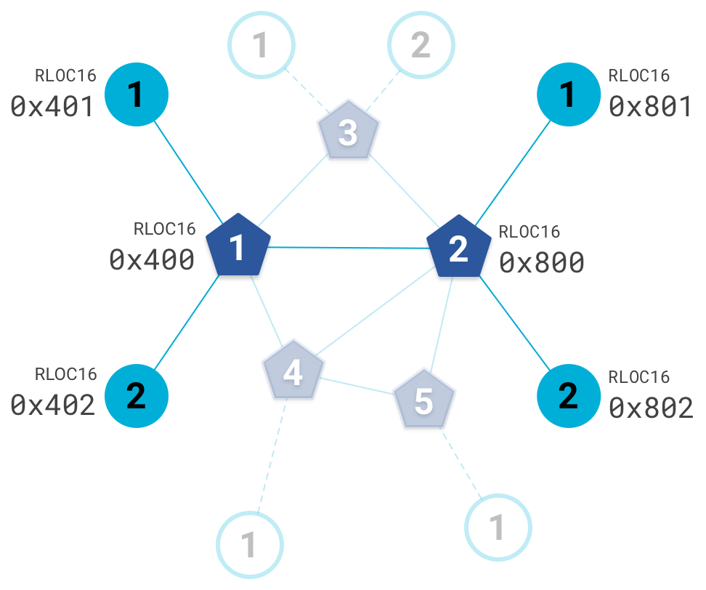
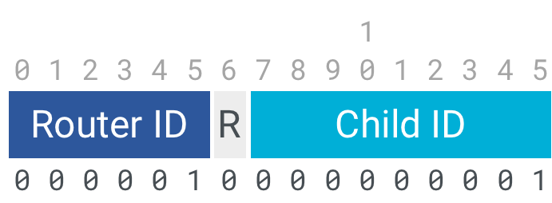
Topology-based addresses in Thread
FD00::00ff:fe00:RLOC16
Same top bits as mesh-local
Routing Locator (RLOC)
Router ID plus Child ID
Changes with network topology
Used for routing packets

Slide 11
Role-based addresses in Thread
Multicast
FF02::1 – link-local, all listening devices
FF02::2 – link-local, all routers/router-eligible
FF03::1 – mesh-local, all listening devices
FF03::2 – mesh-local, all routers/router-eligible
Anycast
FD00::00FF:FE00:FCxx
00 – Thread Leader
01-0F – DHCPv6 Agent
30-37 – Commissioner
etc.

Slide 12
Outline
Thread Addressing
Runtime Behavior
Using IP

Slide 13
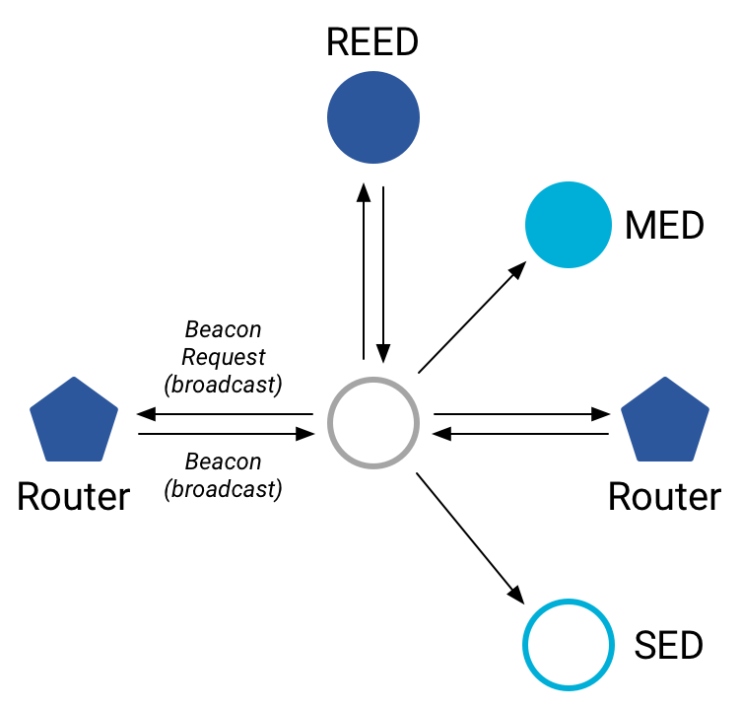
Discovering Thread networks
Beacon request MAC command
Routers/Router-eligible devices respond
Payload contains information about network
Thread network specification
PAN ID – 16-bit ID
XPAN ID – extended 64-bit ID
Network Name – human-readable
Active scanning across channels can quickly find all existing nearby networks

Slide 14
Creating a new network
Select a channel (possibly by scanning for availability)
Become a router
Elect yourself as Thread Leader
Respond to Beacon Requests from other devices
Further organization occurs through Mesh-Level Establishment protocol

Slide 15
Mesh-Level Establishment
Creating and configuring mesh links
Payloads placed in UDP packets within IPv6 payloads
Commands for mesh
Establish link
Advertise link quality
Connect to parent
TLVs (Type-Length-Value)
Various data types that may be helpful within those packets
Addresses, Link Quality, Routing Data, Timestamps
0 | Command Type | TLV | … | TLV
OR (secure version)
255 | Aux Header | Command Type | TLV | … | TLV | MIC

Slide 16
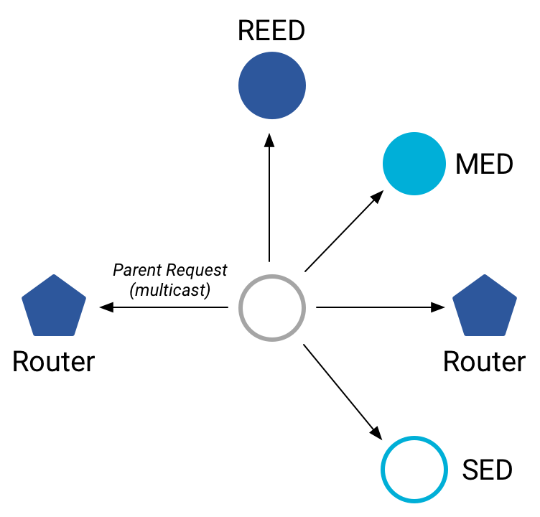
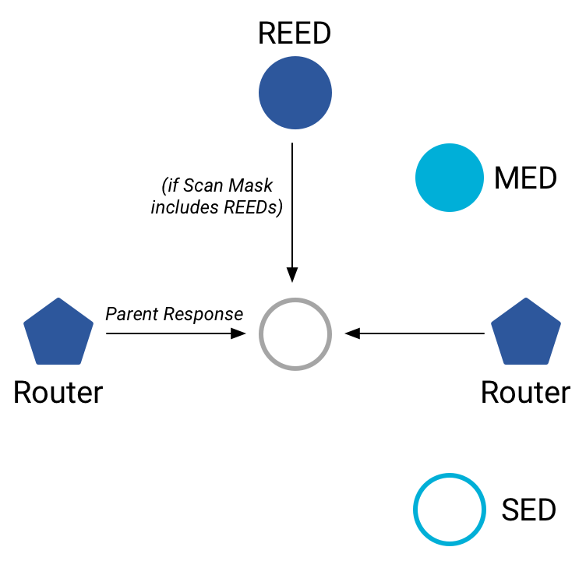
Joining an existing network
All devices join as a child of some existing router
Send a Parent Request (to all routers/router-eligible)
Using the multicast, link-local address
Receive a Parent Response (from all routers/router-eligible separately)
Contains information on link quality
Send a Child ID Request (to router with best link)
Contains parameters about the new child device
Receive a Child ID Response (from that router)
Contains address configurations

Slide 17
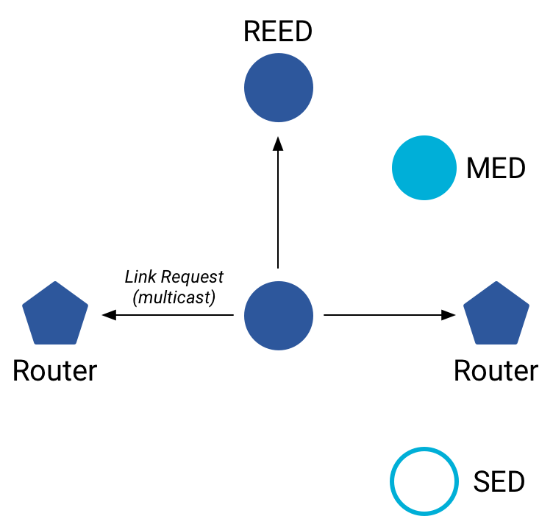
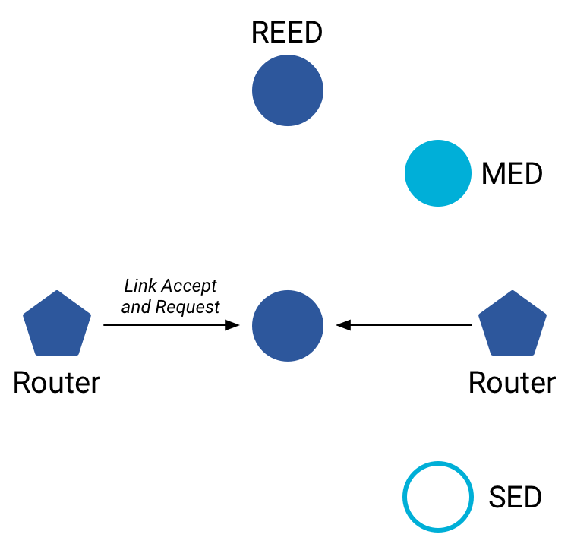
Becoming a router
Thread tries to maintain 16-23 routers (max 32)
Goals: path diversity, extend connectivity
Send a Link Request (to all routers/router-eligible)
Using the multicast, link-local address
Receive Link Accept and Request (from each router separately)
Forms bi-directional link
Send a Link Accept (to each router individually)

Slide 18
Outline
Thread Addressing
Runtime Behavior
Using IP

Slide 19
Communicating with IP
Any communication that layers on top of IP is now possible
If there is a library to support it
Common choices
UDP
DNS – translate hostnames into IP addresses
SNTP – get real-world time, accuracy better than 1 second
CoAP – send and receive data

Slide 20
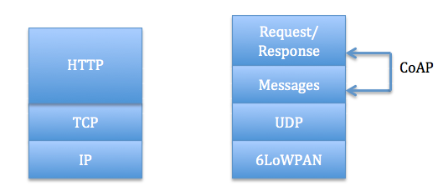
Constrained Application Protocol - CoAP
HTTP, but over UDP targeting less-capable devices
Same REST architecture
Adds capability for automatic retransmissions
CoAP Requests
Have a type: GET, POST, PUT, DELETE
Have a URL: /file/etc
Have data up to 65 KB

Slide 21
Sensor networks don’t use TCP (yet?)
Uncommon choice: TCP
Concerns: Too large, too slow, poorly suited to lossy networks
Also concerning: We’re just replicating TCP poorly
Work in progress:
Sam Kumar, Michael Anderson, Hyung-Sin Kim, David Culler. “Performant TCP for Low-Power Wireless Networks”. 2020.
The debate is still very much open

Slide 22
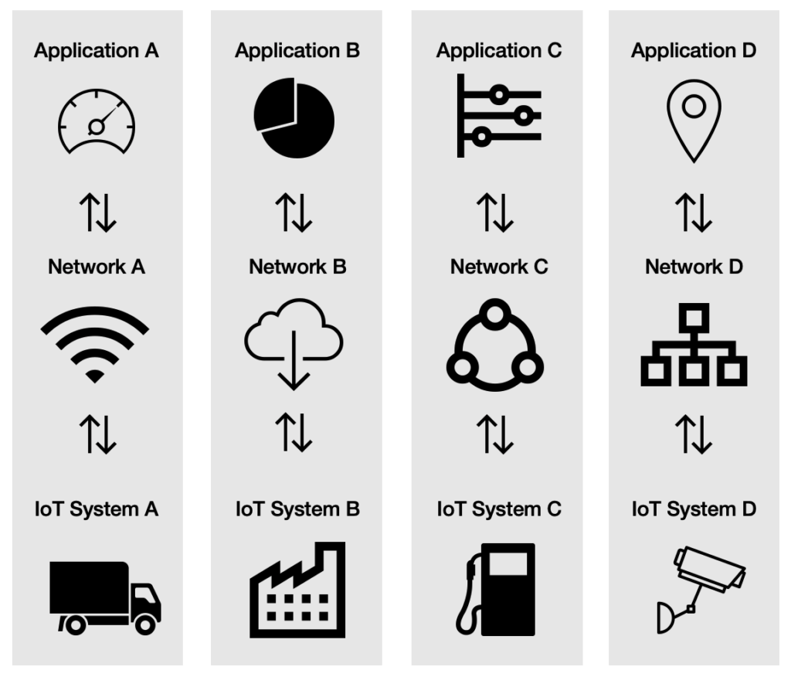
A problem: the siloed internet of things
Problem: companies are more interested in selling you the whole stack
Which then makes it harder for devices to be interoperable
This is not Thread or IP-specific, but a problem all IoT devices are facing
IP question:
What IP address do you send data to?
Manufacturer’s server is an obvious choice

Slide 23
Outline
Thread Addressing
Runtime Behavior
Using IP

