Slide 1
Lecture 14 Deep-Dive into LPWANs
CS397/497 – Wireless Protocols for IoT
Branden Ghena – Winter 2021

Slide 2
Today’s Goals
Overview of other unlicensed LPWAN approaches
Sigfox
802.11ah
TV Whitespaces
Discuss Cellular IoT protocols
Deep-dive into challenges LPWANs face

Slide 3
Outline
Unlicensed LPWANs
Sigfox
802.11ah
TV Whitespaces
Cellular IoT
LPWAN Challenges

Slide 4

Sigfox
Very low-rate (600 bps), very long-range (10+ km) communication
Star-topology networks, with always-listening gateways
Any number of low-power end devices
Uplink-focused communication
Applications: very low-rate metering

Slide 5
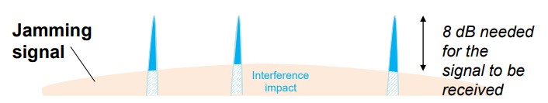
Sigfox PHY
Unlicensed-band communication
Europe 868 MHz. US 902-928 MHz (915 MHz band)
Ultra-narrowband 600 Hz (100 Hz Europe) channel bandwidth
Detection only needs to occur at very specific frequency
Helps improve signal-to-noise ratio

Slide 6
Sigfox unbalanced uplink and downlink
Uplink
600 Hz bandwidth, 600 bps, DBPSK
Downlink
1.5 kHz bandwidth, 600 bps, GFSK
Particularly optimized for Europe
Uplink on 1% duty cycle channel, up to 14 dBm
Downlink on 10% duty cycle channel, up to 27 dBm
Works fine in US too
Gets more power (24 dBm up is typical, up to 32 dBm down) and more range

Slide 7
Sigfox link budget
Why transmit at 100-600 bps?
For greatly increased link budget
Link budget: 150-160 dBm
Assuming Tx at ~20 dBm
Means Rx Sensitivity of -130 dBm (10 dBm better than LoRaWAN)
Resulting range: 10-15 km in urban environments
Except that buildings lead to dead spots in range

Slide 8
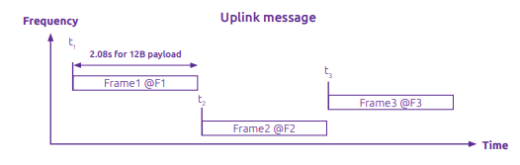
Sigfox MAC
Aloha-style access control (send whenever)
No acknowledgements!
Send message three times for increased reliability
Then listen for downlink at a set period later on a known frequency

Slide 9

Sigfox uplink packet
Up to 29 bytes total per packet
Payload: up to 12 bytes 😱
Other fields
Preamble + Frame Sync are really a 6 byte field for radio sync
Authentication: 2-5 bytes
Frame Check Sequence: 16-bit CRC

Slide 10
Aside: why faster bitrate in the US?
Packet size up to 29 bytes (232 bits)
At 100 bps: 2.32 seconds on air
At 600 bps: 0.387 seconds on air
Maximum dwell time for 915 MHz band: 400 ms

Slide 11

Sigfox downlink packet
Similar structure, 28 bytes total
Payload: up to 8 bytes
Larger preamble + frame sync of 13 bytes
Error Correcting Code for increased reliability

Slide 12
Sigfox deployments
Proprietary network with managed deployment
Like cellular networks
Sigfox deploys networks and transports data
140 uplink messages plus 4 downlink message per day
Connectionless communication
Devices are registered with the networks
Keys are provided in the software image
Any deployed Sigfox gateway can collect transmitted data
Enables mobile applications

Slide 13
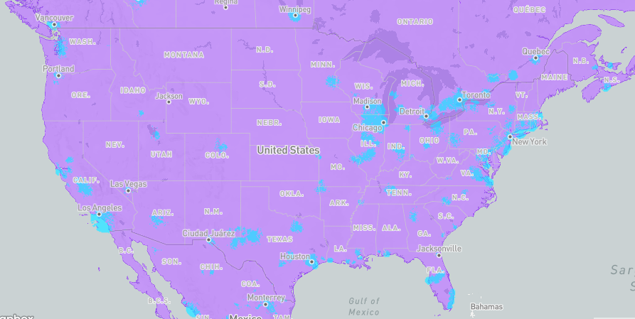
Sigfox coverage (Winter 2021)

Slide 14
Outline
Unlicensed LPWANs
Sigfox
802.11ah
TV Whitespaces
Cellular IoT
LPWAN Challenges

Slide 15
IEEE standard for LPWANs
802.11ah (HaLow) standard in 2016
First real hardware in 2020
Still not in real-world use yet
Focus on the indoor-to-outdoor scenario
Medium range (maximum 1 km)
915 MHz communication
NOT interoperable with other 802.11 access points and devices
Theoretically up to 356 Mbps
Practically, most devices are expected to implement 150 kbps to 8 Mbps

Slide 16
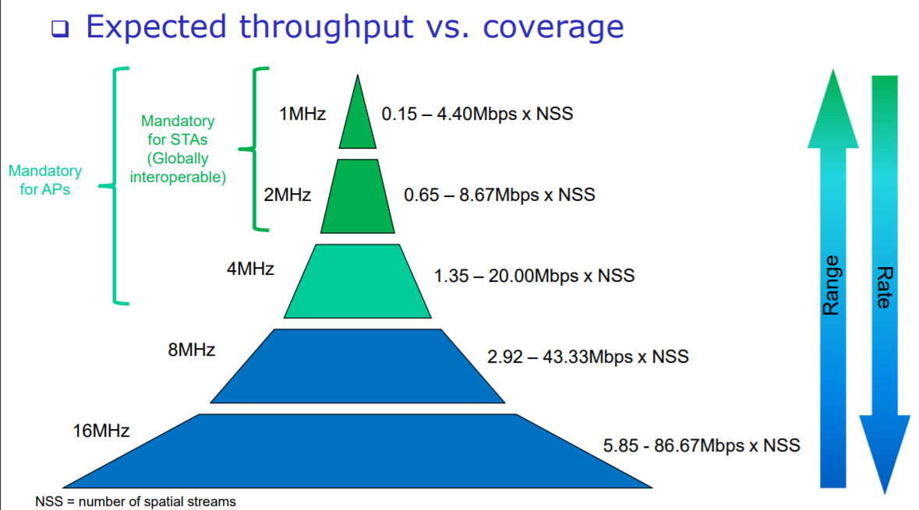
802.11ah allows multiple bandwidth allocations

Slide 17
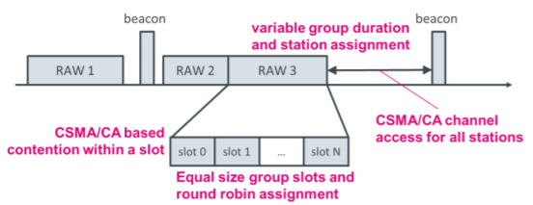
802.11ah architecture
Star topology
Up to 8191 devices per access point
Devices are assigned to a group
Groups are scheduled slots with TDMA
Within a slot CSMA/CA is used for contention among devices
Devices not in the group can sleep until their slot
Traditional IP communication on top of that
And traditional 802.11 security mechanisms (WPA2/TLS)

Slide 18
Outline
Unlicensed LPWANs
Sigfox
802.11ah
TV Whitespaces
Cellular IoT
LPWAN Challenges

Slide 19
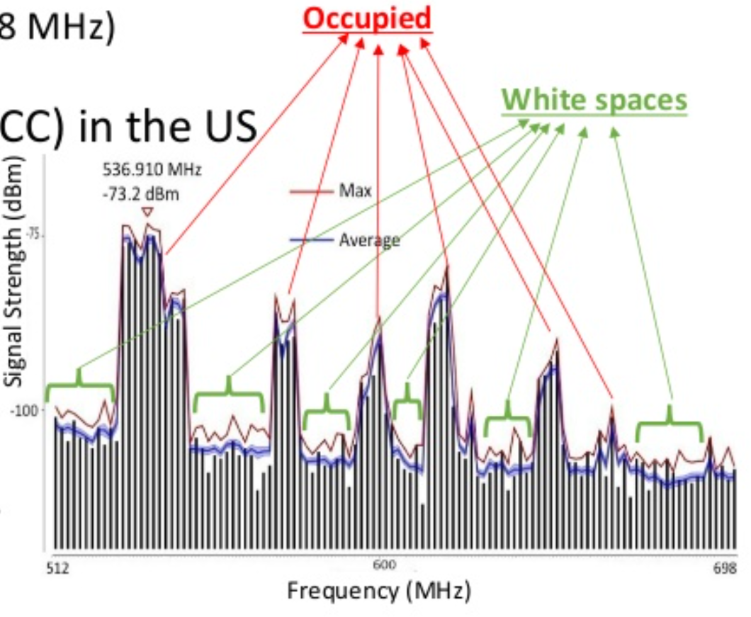
TV whitespaces
Unused TV channels between 54 MHz and 698 MHz
VHF (54-216 MHz)
UHF (470-698 MHz)
6 MHz channel width
Allocated but unused
FCC allows unlicensed use
IF you do not interfere with primary users

Slide 20
Sensing channel use
Variation in use
Spatial: Cannot assume same channel will be free everywhere
Temporal: Cannot assume channel will be free at all times
Cognitive radio approach
Dynamically identify unused portions of spectrum
Database approach
Let someone else do the scanning. Consult database based on location and time

Slide 21
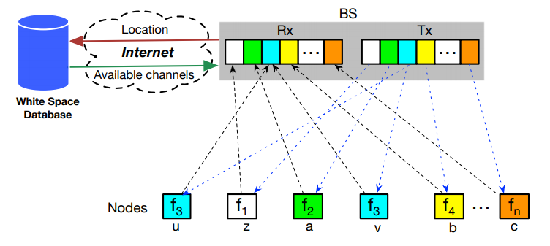
Sensor Networks Over tv Whitespaces (SNOW)
A design for sensor networks over whitespaces
Base Station manages channel for deployment
Frequency division for devices. Each uplinks on separate subcarrier
Downlink is one OFDM transmission. Each device hears its frequency

Slide 22
Outline
Unlicensed LPWANs
Sigfox
802.11ah
TV Whitespaces
Cellular IoT
LPWAN Challenges

Slide 23
3GPP
3rd Generation Partnership Project (3GPP)
Developed 3G, 4G, 5G
Industry alliance for development of telecoms standards
Established around 1998
Makes “Releases” which are roughly analogous to IEEE standards/versions
Release 8 (2008) LTE ~4G
Release 15 (2018) NR (New Radio) ~5G
Focused on the practical
Different group actually defined 4G (ITU). 3GPP made LTE

Slide 24
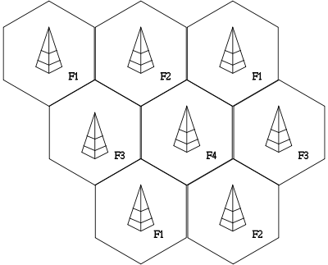
Cells in a cellular network
Split a physical area into a number of non-overlapping cells
Each cell gets a cell tower and a frequency band assigned to it
Apply frequency bands so nearby cells use different frequencies

Slide 25
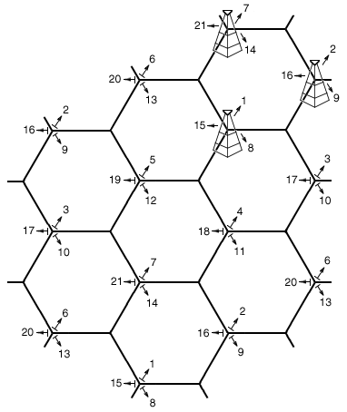
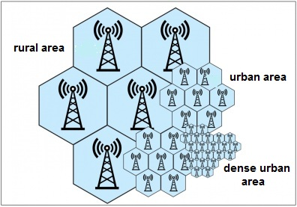
More complicated real-world cells
Place towers at corners of cells
Directional antennas send three different frequency bands, one per cell
Each cell gets three tower and three bands
Density of cells varies based on expected number of users
Change cell size using Power Control

Slide 26
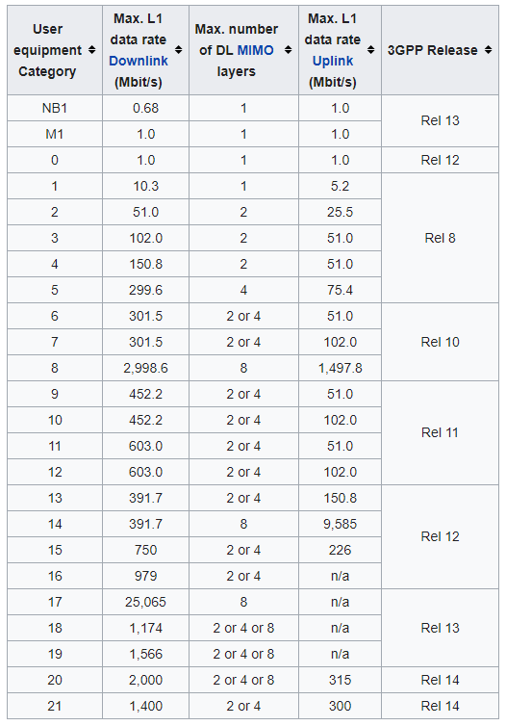
LTE Categories
Different equipment supports different “categories” of LTE
Maximum MCS index supported
Examples
iPhone 6 (2015): Cat 4
Pixel 3 (2018): Cat 16

Slide 27
Additional low-end categories for IoT
LTE Cat 0
Traditional LTE, but focused on the really low end
LTE-M (LTE Cat M1)
375 kbps uplink, 300 kbps downlink (for the actually implemented mode)
Reduced power and maximum bandwidth
Increased range
NB-IoT (LTE Cat NB1)
65 kbps uplink, 26 kbps downlink
Reduced power and greatly reduced bandwidth
Greatly increased range

Slide 28
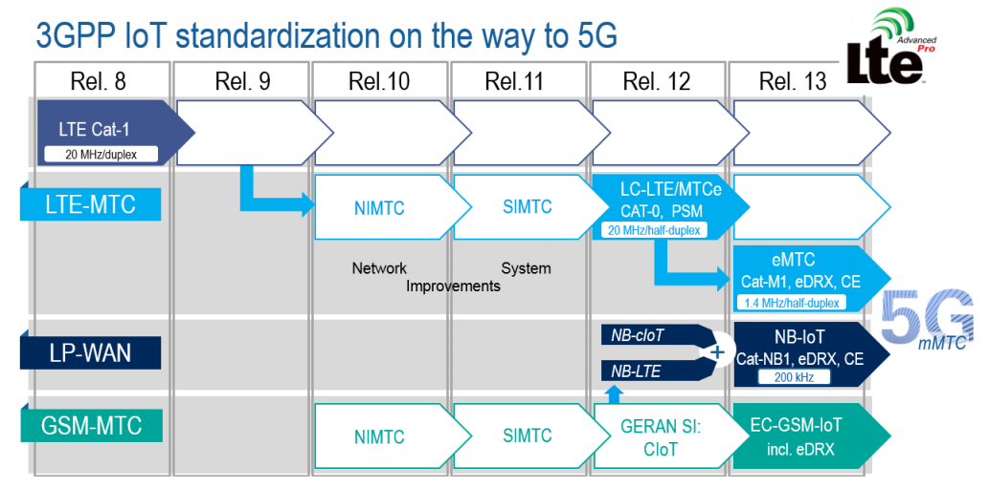
LTE-M and NB-IoT were developed in parallel

Slide 29
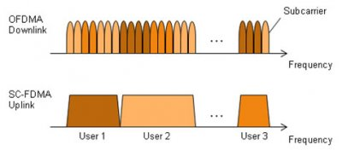
LTE-M and NB-IoT downlink and uplink
OFDMA downlink
Put the more complicated hardware in the cell tower
SC-FDMA (single carrier FDMA) uplink
Blocks of subchannels combined into one signal
Similar concept, but simpler for end devices to implement

Slide 30
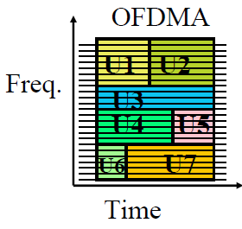
LTE resource allocation
Cellular uses OFDMA to schedule
Time + Frequency -> “2D Scheduling”
Cellular uses single channels up to 20 MHz
Further divides these into 100 Resource Blocks
Resource Block
12 subcarriers for OFDM in frequency (15 kHz each)
7 symbols in time (0.5 ms)
Remember, better modulation can pack many bits into a symbol
Devices are allocated frequency and time based on what they are sending
Allocated in units of Resource Blocks

Slide 31
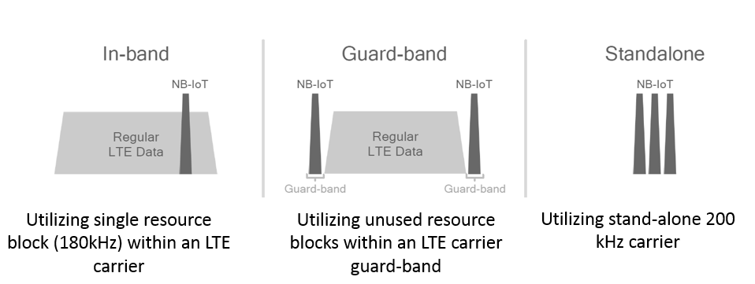
Resources used by LTE-M and NB-IoT
LTE-M uses up to 6 resource blocks
1.4 MHz of bandwidth (1.080 MHz)
Can co-exist with other normal LTE traffic, scheduled by cell tower
Limited to only some capability of LTE
NB-IoT uses up to 1 resource block
200 kHz of bandwidth (180 kHz)
Multiple deployment options
Guard-band in practice

Slide 32
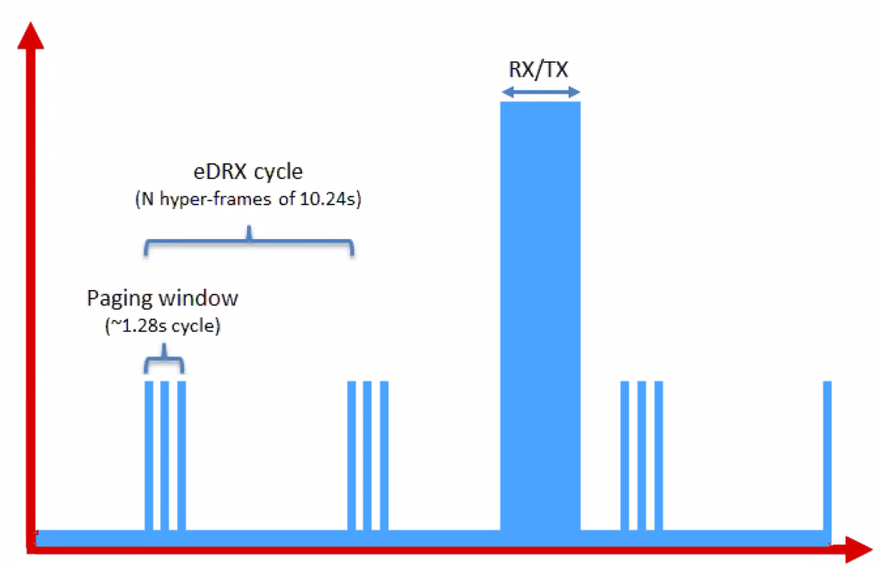
Reducing power for IoT devices
Reduce maximum Tx power to 20 dBm
Increased receive sensitivity will cover it
Extended Discontinuous Reception
Allow devices to reduce paging period and still stay on network
Cell tower will hold messages

Slide 33
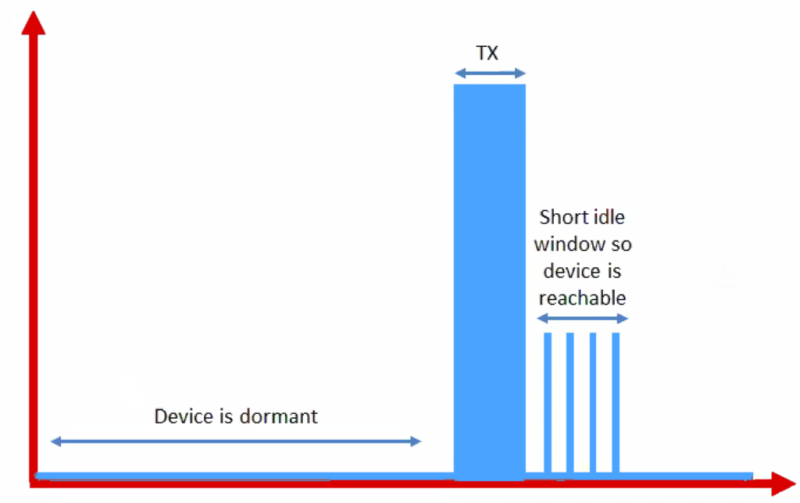
Further power reduction for simple devices
Power Saving Mode
For very simple, uplink-focused devices allow them to turn off entirely but stay connected
Minutes to days in duration
Notify tower before sleeping, listen for packets after each transmission

Slide 34
Improved range for LTE-M and NB-IoT
LTE defines a Maximum Coupling Loss (MCL) a.k.a Link Budget
Traditional cellular: 144 dB (~2.5 km)
LTE-M: 160 dB (~5 km)
NB-IoT: 164 dB (~10 km)
Sigfox: ~155 dB
LoRaWAN: ~143 dB
Note that cellular networks are on higher frequencies
Example: 1900 GHz

Slide 35
Cellular deployments
Originally unclear which would be dominant
Verizon and AT&T focused on LTE-M
T-Mobile focused on NB-IoT
All rolled out services nationwide in the 2018-2019 timeframe
Networks are expanding to provide both capabilities
LTE-M: AT&T, T-Mobile, US Cellular, Verizon
NB-IoT: AT&T, T-Mobile
Pricing models still very uncertain
NB-IoT example: $5 per device per year up to 12 MB, 10 packets per hour
Future adoption will greatly depend on these

Slide 36
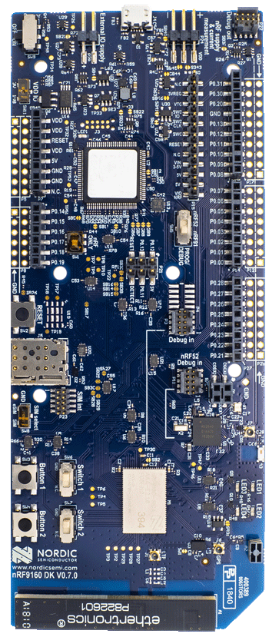
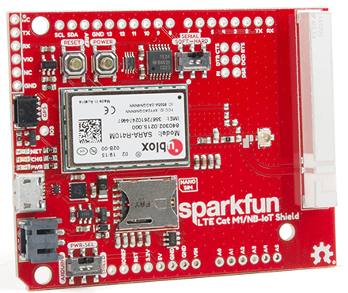
Microcontroller support
Devices need to be certified
Hardware and software
Tend to be modules or dual-core systems
Add a SIM card to connect to network

Slide 37
Outline
Unlicensed LPWANs
Sigfox
802.11ah
TV Whitespaces
Cellular IoT
LPWAN Challenges

Slide 38
Do novel networks meet application needs?
How do we compare varied requirements and capabilities?
Networks have throughput per gateway and range of gateway.
Applications have throughput per device and deployment area.
Each gateway must support throughput for all devices in its coverage area.
Deployment areas are often wider than a single gateway’s range.
Solution: compare the density of communication.
Data communication rate per unit area.

Slide 39
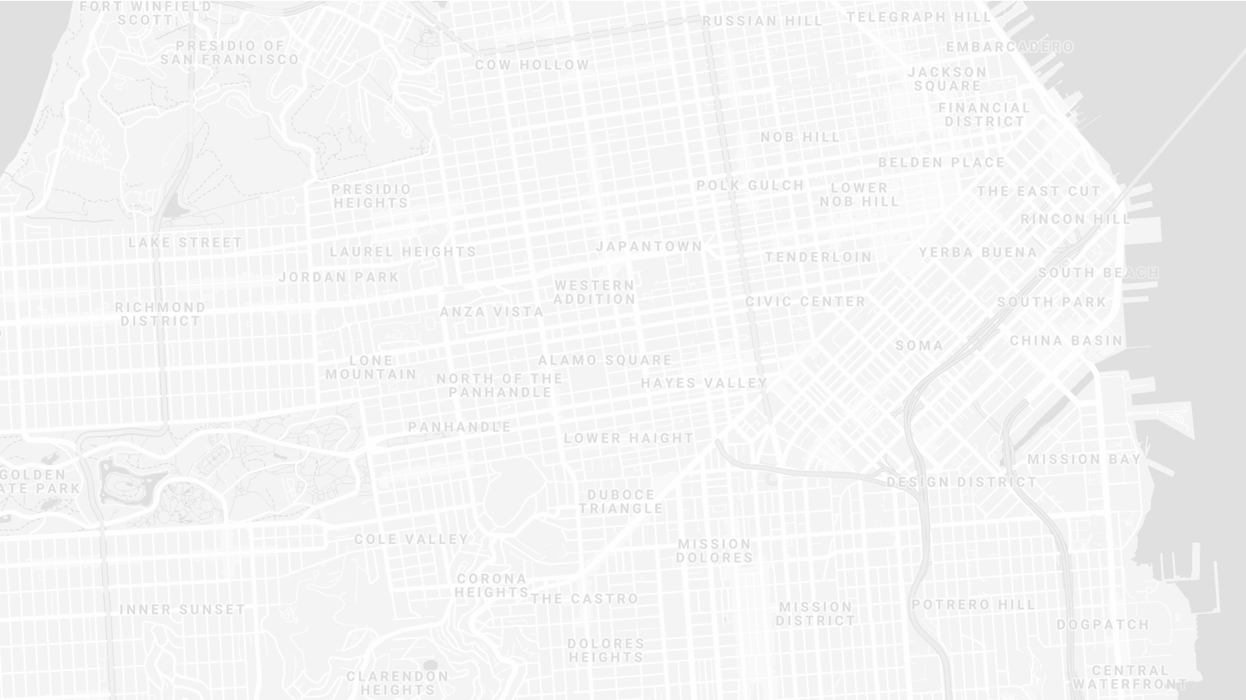
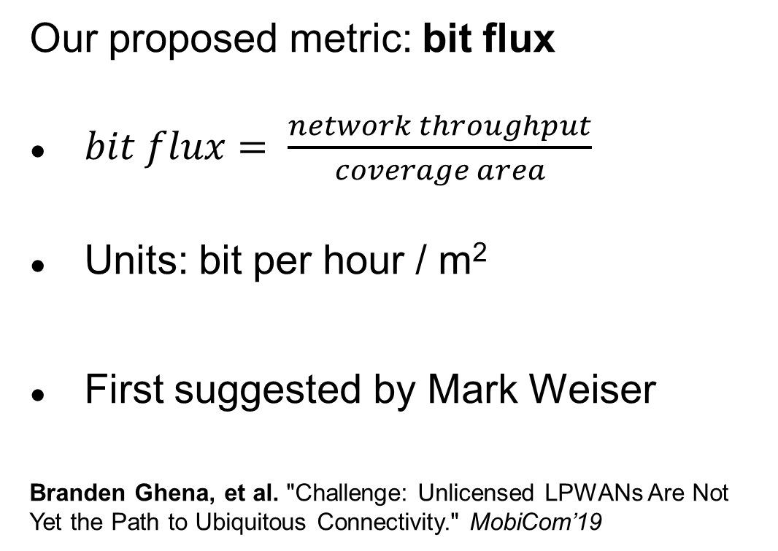
New metric for wide-area communication.
Our proposed metric: bit flux
$bit flux= \frac{network throughput}{coverage area}$
Units: bit per hour / m²
First suggested by Mark Weiser
Branden Ghena, et al. "Challenge: Unlicensed LPWANs Are Not Yet the Path to Ubiquitous Connectivity." MobiCom’19
Notes:
bit flux is our metric for data density
throughput divided by coverage area
As with many ideas, this was first suggested by Mark Weiser

Slide 40
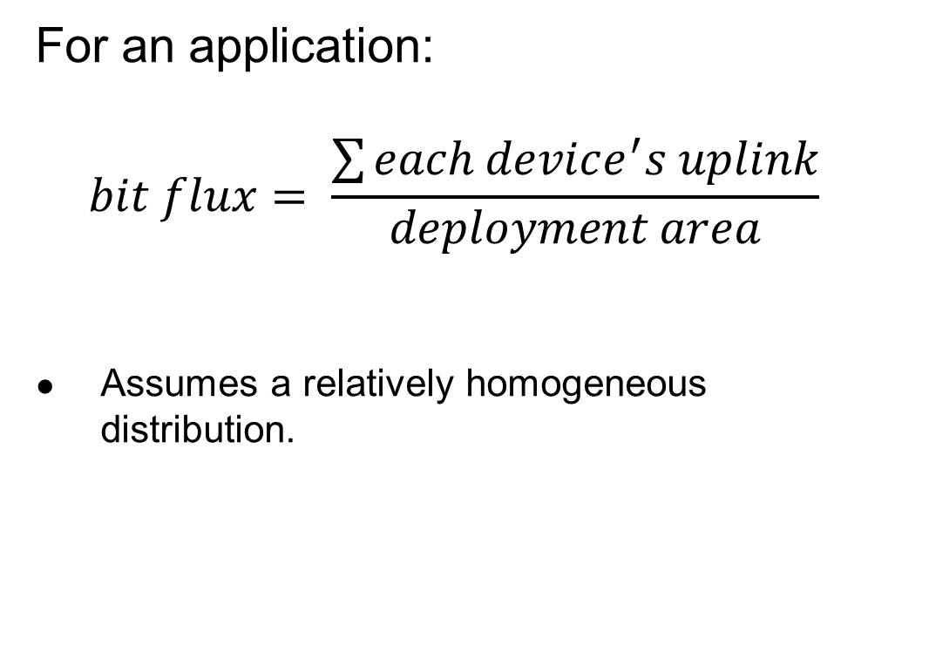
Bit flux can measure application needs.
For an application:
$$bit flux= \frac{\sum{each device^{′}s uplink}}{deployment area}$$
Assumes a relatively homogeneous distribution.
Notes:
For applications, bit flux sums the data needs for each device in the deployment
And divides by the total deployment area
To determine the application uplink density

Slide 41
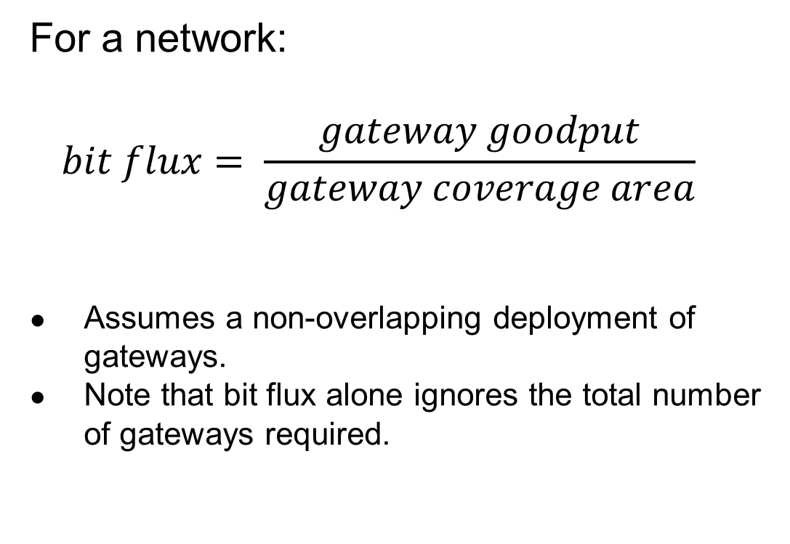
Bit flux can measure network capabilities.
For a network:
$$bit flux= \frac{gateway goodput}{gateway coverage area}$$
Assumes a non-overlapping deployment of gateways.
Note that bit flux alone ignores the total number of gateways required.
Notes:
For networks, we divide the goodput of a network
By the coverage area of a single gateway
This gives us a number that represents the data density that a network can support, at any width of deployment

Slide 42

Bit flux accounts for spatial reuse.
Reducing coverage area and deploying additional gateways improves capacity.
$bit flux↑ = \frac{gateway goodput}{coverage area↓}$
Notes:
Bit flux also accounts for spatial reuse in networks
Reducing range (and deploying more gateways), reduces the coverage area for each gateway, increasing the network bit flux

Slide 43
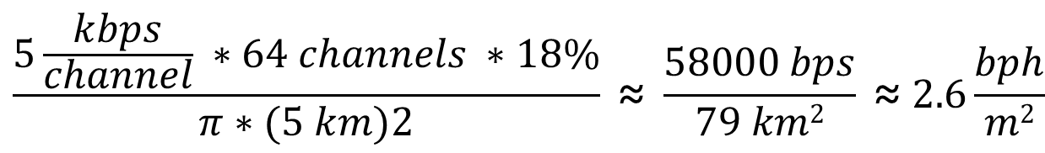
Bit flux measurement for LoRaWAN.
ALOHA access control
$$\frac{5\frac{kbps}{channel} ∗64 channels ∗18\%}{π∗(5 km)2} \text{≈} \frac{58000 bps}{79 km2} \text{≈} 2.6\frac{bph}{m2}$$
Hata model
Notes:
Here is the bit flux measurement for a LoRaWAN network
In the US, LoRaWAN has 64 channels for uplink
But it relies on an ALOHA access control mechanism, so packet collisions reduce throughput significantly

Slide 44
Networks differ in capability by orders of magnitude.
Notes:
We can calculate bit flux for each of the networks we’re interested in
We note that there are several orders of magnitude difference in the throughput capability of each network
Particularly between cellular communication and unlicensed LPWANs

Slide 45
Range reduction results in a bit flux curve for each network.
Notes:
These points are at the maximum range for each network, but they have the ability to perform power control and reduce range
This creates a curve for each network, where we can reduce range (and install more gateways) in order to increase network capability

Slide 46
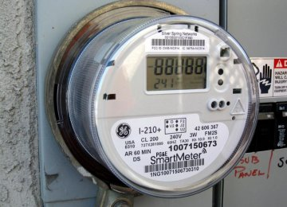
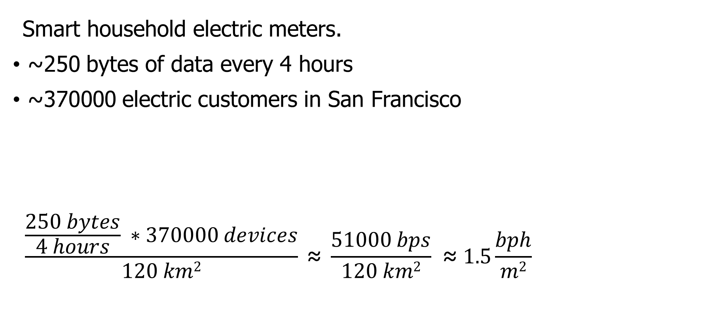
Let’s compare network capabilities to a real-world application.
Smart household electric meters.
~250 bytes of data every 4 hours
~370000 electric customers in San Francisco
$$\frac{\frac{250 bytes}{4 hours} ∗370000 devices}{120 km2} \text{≈} \frac{51000 bps}{120 km2} \text{≈} 1.5\frac{bph}{m2}$$
Notes:
Now that we can measure the capability of each network, lets compare that to the needs of an application
The example I’ll be talking through is Electricity Metering, there are about a dozen others in the paper
PG&E smart meters send about 250 bytes every 4 hours
This isn’t a lot of data, but smart meters are densely deployed, with three hundred thousand across San Francisco

Slide 47
All networks are capable of meeting the data needs of electricity metering.
Electricity Metering Application
Notes:
We can plot the need of the Electricity Metering application as a line on our bit flux figure
Any network above this line is capable of serving the application’s needs
Sigfox needs range reduction, but all networks are capable of serving this application’s needs
So, great! Networks can serve ubiquitous applications. Problem solved, right?

Slide 48
Unlicensed LPWANs lag behind Cellular IoT in ability to support applications.
2G < 0.03% utilized
Notes:
Let’s visualize this instead as the number of gateways deployed and the proportion of network utilized.
Again, because of power control, there is a tradeoff here. We could deploy a single gateway for everything, or many gateways with reduced range to increase capacity.
Cellular networks have no problem with this application
With a single gateway, LTE-M could spend 1% of its capacity to service this app.
Unlicensed LPWANs, however, have choices to make on how many gateways they deploy and how much capacity they are willing to spend on this one application

Slide 49
Sigfox requires range reduction to meet application needs.
Capacity Problem
Throughput capability of Sigfox is insufficient to support application needs
It can only support the application with reduced range and additional gateways
Notes:
There are two particular problems we can see with the unlicensed LPWANs
The first is a capacity issue:
Sigfox can’t satisfy the application at all without power control.
Range is sufficient for a single gateway to cover the city, but it wouldn’t be able to keep up with the data.

Slide 50
Capacity solutions are relatively straightforward.
Better access control mechanisms.
Recover simultaneous transmissions (Choir and Charm).
Increase bandwidth (TV white spaces).
All likely come at the cost of increased energy usage…
Results in a protocol that looks pretty similar to cellular…
Adwait Dongare, et al. "Charm: exploiting geographical diversity through coherent combining in low-power wide-area networks.“ IPSN’18
Rashad Eletreby, et al. "Empowering low-power wide area networks in urban settings." SIGCOMM’17
Abusayeed Saifullah, et al. "SNOW: Sensor network over white spaces." SenSys’16
Notes:
Solving these capacity problems is relatively straightforward
And a lot of research from our community has begun that path
One solution would be better access control mechanisms than the ALOHA
We could also significantly increase the available bandwidth through the use of TV white spaces

Slide 51
LoRaWAN devotes most of its network capacity to a single application.
Coexistence Problem
LoRaWAN can meet application needs
But only by using 50% of the 915 MHz unlicensed-band spectrum
Notes:
But there is a second problem, that of coexistence
LoRaWAN could handle the application with only 2 or 3 gateways
Remember, that we are calculating bit flux for LoRaWAN using all available channels
As long as you are willing to commit 50% of the 915 MHz spectrum to electricity metering

Slide 52
Coexistence is inevitable in urban areas.
Urban environments and long range lead to many overlapping deployed networks.
Capacity problems worsen coexistence by devoting more bandwidth to one application.
It’s not just electricity metering…
Notes:
You might try to say it’s fine to dedicate so much of a network to a single application. I dedicate 50% of my home WiFi to Netflix all the time…
But coexistence cannot be ignored in urban areas
There won’t just be one network, but two, or three, or more
And they all have to share the same bandwidth for all deployed applications

Slide 53
Coexistence in unlicensed bands is a more difficult problem.
No methods for inter-network negotiation so far.
Without buy-in from most deployments, all access control becomes uncoordinated.
Cellular IoT does not have this problem
Notes:
Solving these coexistence problems are more difficult
We need methods for coordination and negotiation between deployed networks
And without buy-in from all networks, collisions are inevitable
It doesn’t matter that you are using a wonderful scheduling TDMA algorithm to send data without collisions if your neighbor is transmitting whenever they want
And a really important point is that cellular IoT doesn’t face this problem

Slide 54
Cellular may dominate future deployments.
LTE-M and NB-IoT are now deployed in the US (and worldwide).
Licensed bandwidth avoids the coexistence problem.
Cellular may solve many applications but is not a perfect solution.
Still has higher energy and monetary costs for use.
Also limited to where service is already available.
Notes:
Occupying licensed bands means LTE-M and NB-IoT don’t have multiple overlapping networks to coordinate with
So coexistence isn’t a concern
And they already have more capacity than the unlicensed protocols
Without solutions for unlicensed LPWANs, deployments will move to cellular networks
And when the applications leave, research will leave as well
Without real solutions to the problems they face, we’re in danger of losing an exciting research domain
We pose this as a challenge to the community to develop coexistence and capacity solutions for unlicensed LPWANs

Slide 55
Unlicensed LPWANs are still useful for some scenarios.
Controlled or unoccupied regions have reduced coexistence concerns.
Industrial factories, farms, parks and forests.
Unlicensed networks are very exciting for research.
Anyone can deploy a network wherever they want.
Much easier to explore protocol modifications and new technologies.
Research suffers without real-world applications.
Problem areas are strong recommendations for new research.
New research is only useful if they will have real-world impacts.

Slide 56
Implications – Low-Power Wide-Area Networks.
Existing unlicensed LPWANs face significant challenges in supporting urban applications.
Best suited for industrial or agricultural uses in controlled environments.
Research directions for unlicensed LPWANs:
improve network capacity,
and enable coexistence.
Cellular IoT networks (LTE-M and NB-IoT) are positioned to solve the needs of city-scale sensing.
If the money and energy costs are there.

Slide 57
Outline
Unlicensed LPWANs
Sigfox
802.11ah
TV Whitespaces
Cellular IoT
LPWAN Challenges

