Slide 1
Lecture 04 BLE Advertisement Deep Dive
CS397/497 – Wireless Protocols for IoT
Branden Ghena – Winter 2023
Materials in collaboration with Pat Pannuto (UCSD)

Slide 2
Announcements
Hardware for labs
I have some! I’ll pass out more after class today
Everyone needs their own board and USB cable
I’ll record which board is going to which student
You’ll have to return them before the end of the quarter or else
Each group will end up with three among them

Slide 3
Announcements
Hw: Background
About 50% of you have submitted so far
Due today by 11:59 pm
Lab1: Wireshark
About 30% of you have submitted so far
Due Friday by 11:59 pm
Late policy:
20% reduction per day late
3 slip days to use throughout the quarter

Slide 4
Today’s Goals
Describe BLE advertising and scanning roles
Deep dive into advertisements. Questions we might ask as researchers.
What are the real-world use cases of advertisements?
How much energy do advertisements take?
What is the probability of receiving a packet?
What is the probability of receiving data?

Slide 5
Outline
BLE roles
Advertising
Scanning
Communicating with advertisements
Advertisement Use Cases
Energy Use
Packet Collisions

Slide 6
BLE network topology
Peripheral
Connection
Central & Scanner
Scanner
Connection
Peripheral
Advertisement
Advertisement
Advertisement
Advertisement
Advertiser
Advertiser
Advertiser

Slide 7
Advertising
BLE discovery mechanism
Make nearby devices aware of advertiser’s existence
Communicate some information from or about advertiser
Traditional purpose is to enable connections, but this is also useful for general communication
Advertisements
Periodic broadcast messages with data
Scan Requests/Responses
Scanner sends responses after getting a request
Only occurs when scanner is listening
Almost literally “bonus advertisement data”

Slide 8
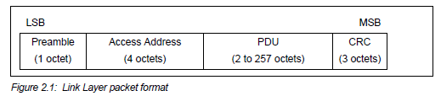
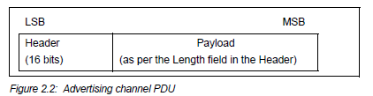
Advertising packet layering

Slide 9
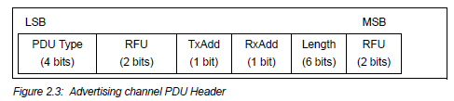
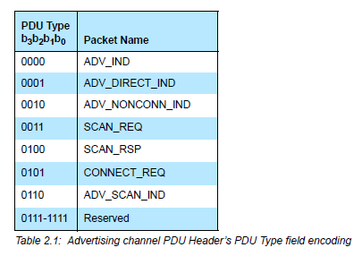
BLE advertising header
ADV_IND
Advertisement
Allows connections and scan requests
ADV_NONCONN_IND
Advertisement
No connections or scan requests
ADV_SCAN_IND
Advertisement
No connections but allows scan requests
SCAN_REQ
Scan request
SCAN_RSP
Scan response

Slide 10

Advertisement payloads
AdvA – address of the advertiser
TxAdd bit from header specifies if this is a “public” or “random” address
Remaining up to 31 bytes are available for use
Putting it all together, up to 47 bytes total:
BLE Packet
Advertising PDU
Preamble 1 Byte | Access Address 4 Bytes | Header 2 Bytes | Advertiser Address 6 Bytes | Advertiser Data (Payload) 0-31 Bytes | CRC 3 Bytes

Slide 11
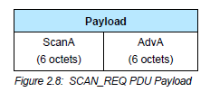
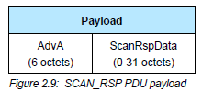
Scan Requests and Responses
Scan request
Just the two addresses: the scanner’s and the advertiser’s
Scan response
Identical to an advertisement
But only occurs after a request

Slide 12
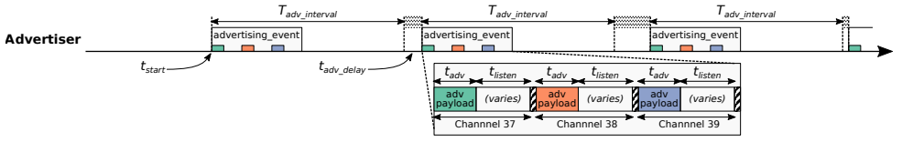
Advertising timing
Advertising Events occur periodically [20ms – 10.24 s] (or longer)
Plus a random delay after each instance [0-10ms]
Why?
User picks the rate as a tradeoff of energy and discovery latency

Slide 13
Advertising timing
Advertising Events occur periodically [20ms – 10.24 s] (or longer)
Plus a random delay after each instance [0-10ms]
Why? Avoid repeat collisions
User picks the rate as a tradeoff of energy and discovery latency

Slide 14
Advertising event
Three transmissions, one on each advertising channel
Always in the same order
Transmission, followed by listening window on that same channel
Requests will be sent >=150 us (Inter-Frame Spacing, IFS) after Tx
Followed by a retune to the next channel frequency
This short listen window is the magic “low energy” part

Slide 15
Preserving energy in communication
Most energy is spent listening
This is due primarily to how long listening durations are compared to transmissions
Example: maximum-sized BLE transmission:
8 bits/byte * 47 bytes = 376 bits at 1 Mbps = 0.376 ms transmitting
So listening for an entire second is >2500 times longer
But listening for only 0.376 ms requires sub-ms synchronization, which itself costs energy to manage…
Instead, when advertising, nRF radios listen for ~0.200 ms, only after a transmission

Slide 16
Payload of an advertisement
What do you stick in the BLE payload anyways?
Theoretically whatever you want, but that isn’t very compatible
Point is to specify capabilities of the advertiser
Desire: specify payloads in such a way that all scanners can interpret what they mean about the device
This is different from traditional internet packets
Broadcasts are for _anyone_ to hear, not a specific server/application
Which fields are or aren’t present is device-specific
A lot more possible fields than will really be used on any device

Slide 17
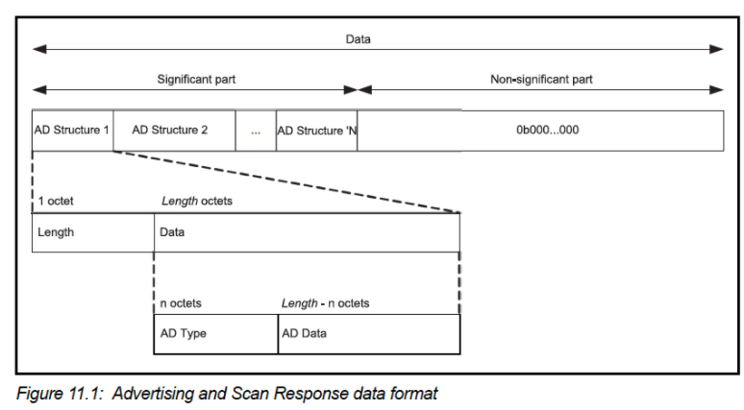
TLV Format
Type – Length – Value (Wikipedia)
Actually, BLE does the length part first
Scanner can hop through length/type pairs to find what interests it

Slide 18
Payload types
Listed in the Core Specification Supplement [Supplement v9]
Each might have their own considerations about AD Data format
Flags (supported modes: BLE and Bluetooth) required by Apple?
Name
Service UUID
TX Power Level
Manufacturer-specific data
And about twenty others

Slide 19
Outline
BLE roles
Advertising
Scanning
Communicating with advertisements
Advertisement Use Cases
Energy Use
Packet Collisions

Slide 20
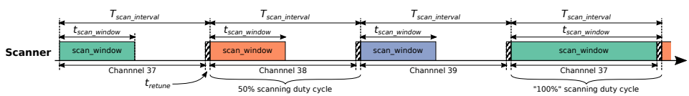
Scanning Pattern
Iterate through channels, listening for advertisements
T_{scan_interval} controls rate at which channels are changes
T_{scan_window} controls duty cycle of listening
Why listen at a low duty cycle?

Slide 21
Scanning Pattern
Iterate through channels, listening for advertisements
T_{scan_interval} controls rate at which channels are changes
T_{scan_window} controls duty cycle of listening
Why listen at a low duty cycle? Save energy

Slide 22
A warning about scanning expectations
Scanners will NOT receive 100% of packets sent
Even ignoring range issues
Packets are lost due to (in roughly descending order):
Duty cycle
Sharing 2.4 GHz antenna with WiFi
Retune period after each scanning interval
Dropped packets in the receive software
Packet collisions

Slide 23
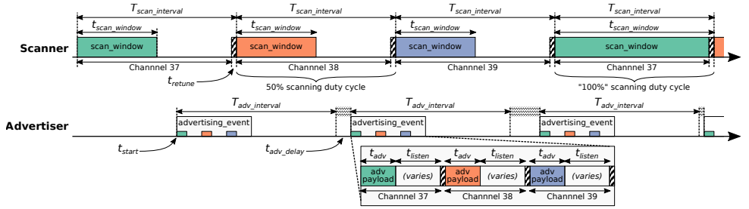
Break + Putting it all together
Advertisements are received when the channel of the scan window and the channel of the advertisement overlap in time (and space)

Slide 24
Outline
BLE roles
Advertising
Scanning
Communicating with advertisements
Advertisement Use Cases
Energy Use
Packet Collisions

Slide 25
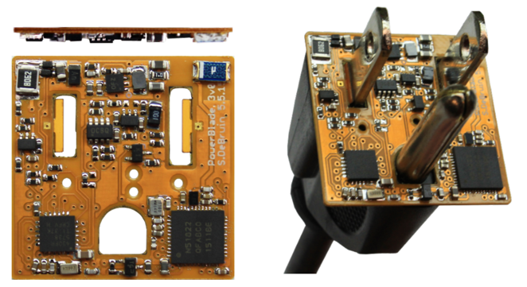
Advertisements are already being used for communication.
BLE advertisements are uncoordinated, broadcast messages designed for discovery.
Devices are being deployed using advertisements.
Beacons – iBeacon
Tracking – Tile
Local communication – Apple Continuity
Sensor deployments – PowerBlade
Notes:
PowerBlade is a great example of this.
It’s a plug-load power meter
Initially configured to use advertisements as a simple method for reading measurements with a smartphone
We are interested in household deployments where dozens of PowerBlades will be deployed to measure all the loads in a home
Can we still use BLE advertisements for data transfer in the presence of many other devices?

Slide 26
Beacons
Advertising with advertisements!
Web of Things
Real-world tags that broadcast virtual-world identifiers
iBeacon and Eddystone
Formats for sending URLs and device identifiers
Use existing BLE fields (Service Data and Manufacturer-Specific Data)

Slide 27
Tracking
Find devices nearby
Get a sense of distance to the device
Find my X
Tile: find my keys
Apple: find my device (before UWB radios)
Uses TX power level field
Lists the transmitted power of the device
Pathloss = TX power – RSSI (all in dBm)

Slide 28
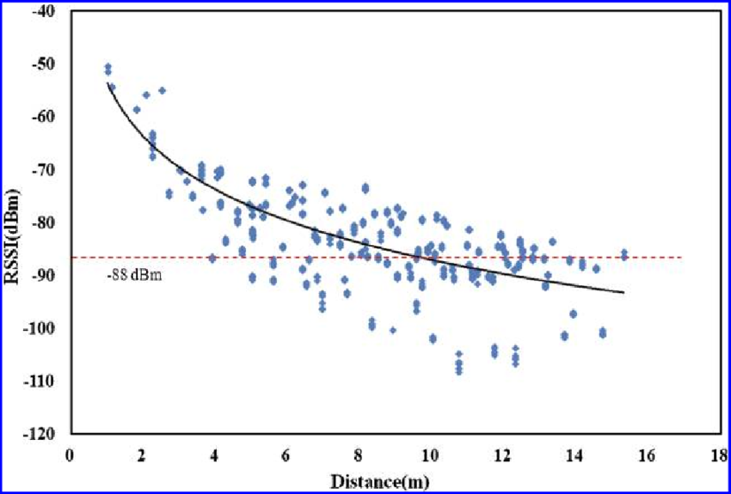
Problem with RSSI-based distance – not accurate
Pathloss is NOT only due to distance
RSSI is way worse at this than you hope it would be
Citation: literally everyone has made this figure at some point

Slide 29
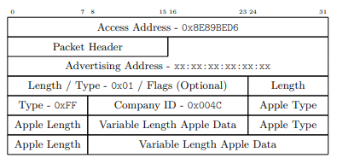
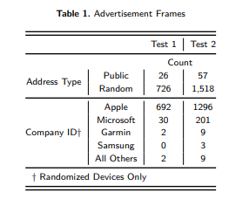
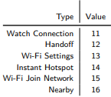
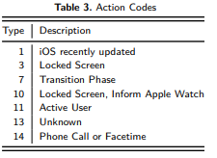
Local communication: Apple Continuity
Communication with only nearby devices
Apple Continuity
Martin, Jeremy, et al. "Handoff all your privacy–a review of apple’s bluetooth low energy continuity protocol." Proceedings on Privacy Enhancing Technologies 2019.4 (2019): 34-53.

Slide 30
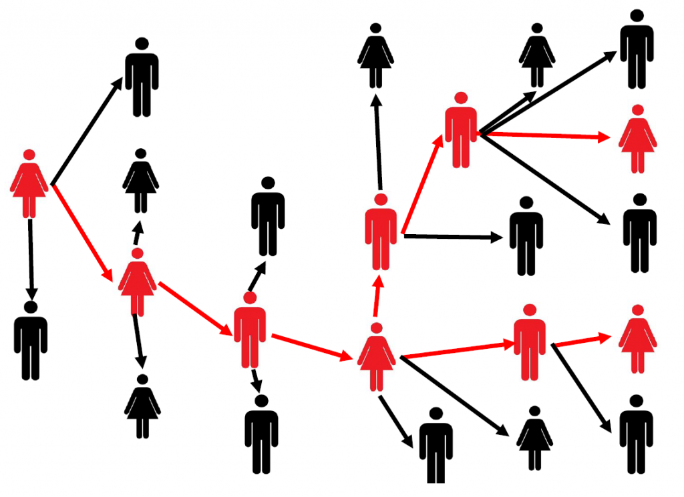
Local Communication: Exposure Notifications
Apple and Google collaboration to use phones for contact tracing
Smartphone constantly broadcasts identifier.
Periodically, each smartphone listens for broadcasts around it.
Check list of identifiers to see if you’ve been around someone who is sick.
Requires government/healthcare system interactions to determine when an identifier should be flagged as sick
24 states (not Illinois) adopted this
Implemented at OS level in background

Slide 31
Sensor deployments
Report data so gateways and users can retrieve it simultaneously
Easy introspection during a deployment
Satisfy users’ curiosity
Ignore difficult questions about networking
Just broadcast the data!
DeBruin, Samuel, et al. "Powerblade: A low-profile, true-power, plug-through energy meter." Proceedings of the 13th ACM Conference on Embedded Networked Sensor Systems. 2015.

Slide 32
Outline
BLE roles
Advertising
Scanning
Communicating with advertisements
Advertisement Use Cases
Energy Use
Packet Collisions

Slide 33
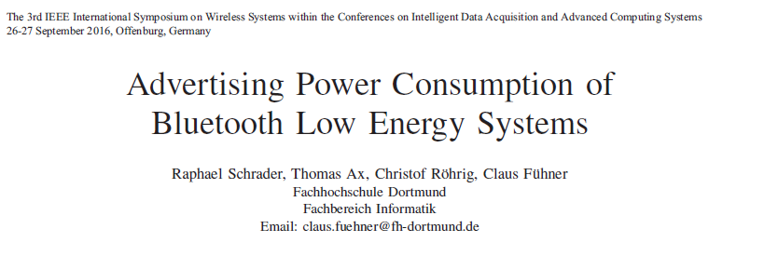
Paper: power measurements of BLE advertisements
Schrader, Raphael, et al. "Advertising power consumption of bluetooth low energy systems." 2016 3rd International Symposium on Wireless Systems within the Conferences on Intelligent Data Acquisition and Advanced Computing Systems (IDAACS-SWS). IEEE, 2016.

Slide 34
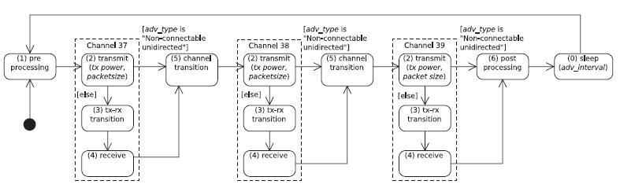
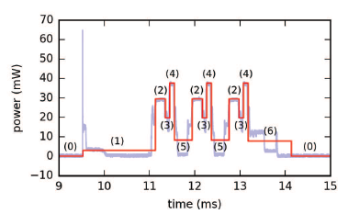
Energy model for BLE advertisements
Creates a set of states and metrics for how much power each uses and for what duration
power * duration = energy

Slide 35
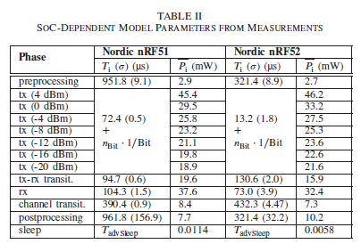
Measurements of Power Use
Power use and duration (energy)
nRF51 (nRF51822)
nRF52 (nRF52832)

Slide 36
How much energy does it cost to send data over advertisements?
Configuration
nRF51822 microcontroller
Maximum payload size
+4 dBm transmit power
Connectable advertisement
Sleep power 11 µW
One packet per second example:
110 µW average
~270 days on a CR2032
One packet per minute example:
13 µW average
~2250 days on a CR2032

Slide 37
Outline
BLE roles
Advertising
Scanning
Communicating with advertisements
Advertisement Use Cases
Energy Use
Packet Collisions

Slide 38
Questions about network capability
What are the odds that a transmitted advertisement will be received?
Packet reception rate
If M redundant advertisements are sent instead, what are the odds that at least one are received?
Data reception rate
How do these odds vary with number of devices, advertising interval, and packet size?

Slide 39
BLE advertisements are periodic, broadcast transmissions.
Advertisement events occur periodically (T_{adv_interval}: 20 ms–10 s).
Random delay appended before each transmission (t_{adv_delay}: 0–10 ms).
Data payload of up to 31 bytes.
advertisement event
advertisement event
time
T_{adv_interval}
+ t_{adv_delay}
Bluetooth SIG. Bluetooth Core Specification 4.2. (2014).
Notes:
How does communication work with BLE advertisements?
Each advertisement has a payload, which we can place sensor data in.
If data naturally has a periodic update rate, we can match the advertisement interval to that, so each advertisement has new sensor data.

Slide 40
What causes transmissions not to be received?
Not within range of the gateway.
Or various other losses within the gateway itself
Two devices try to send at the same time (packet collision).
X
X
broadcast domain

Slide 41
What is the probability of a packet collision?
time
t_{adv_0}
Packet 0
Jeon, Wha Sook, et al. "Performance analysis of neighbor discovery process in bluetooth low-energy networks." (IEEE Transactions on Vehicular Technology, 2016). Perez-Diaz de Cerio, David, et al. "Analytical and experimental performance evaluation of BLE neighbor discovery process including non-idealities of real chipsets." (Sensors, 2017).

Slide 42
What is the probability of a packet collision?
time
t_{adv_1}
t_{adv_0}
Packet 0
Packet 1
Packet 1
Packet 1
Packet 1
Packet 1
Jeon, Wha Sook, et al. "Performance analysis of neighbor discovery process in bluetooth low-energy networks." (IEEE Transactions on Vehicular Technology, 2016). Perez-Diaz de Cerio, David, et al. "Analytical and experimental performance evaluation of BLE neighbor discovery process including non-idealities of real chipsets." (Sensors, 2017).
Notes:
Collisions occur if any part of the two packets overlap
Particularly true for BLE that only has an 8-bit preamble

Slide 43
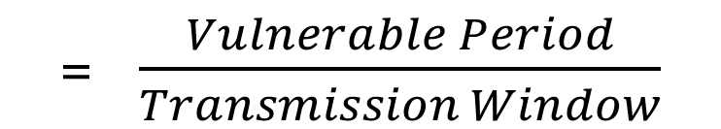
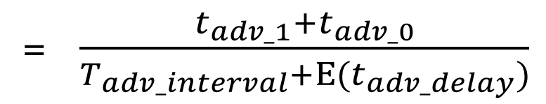
What is the probability of a packet collision?
time
t_{adv_1}
t_{adv_0}
Packet 0
Packet 1
Probability of Collision
= $\frac{Vulnerable Period}{Transmission Window}$
= $\frac{t_{adv_1}+t_{adv_0}}{T_{adv_interval}+Ε(t_{adv_delay})}$
Jeon, Wha Sook, et al. "Performance analysis of neighbor discovery process in bluetooth low-energy networks." (IEEE Transactions on Vehicular Technology, 2016). Perez-Diaz de Cerio, David, et al. "Analytical and experimental performance evaluation of BLE neighbor discovery process including non-idealities of real chipsets." (Sensors, 2017).
Notes:
The vulnerable period is the sum of the two advertisement durations
While the transmission window is the advertisement interval plus the expected value of the random delay

Slide 44
Break + Determine Probability of Multiple Failures
Given:
Probability of Collision
Determine:
Probability of Reception for data sent redundantly across M packets

Slide 45
Break + Determine Probability of Multiple Failures
Given:
Probability of Collision
Determine:
Probability of Reception for data sent redundantly across M packets
i.e., what are the odds that at least one of the packets doesn’t collide
1 – (Probability of Collision^{M})
(P_{c})^{M} = Probability that all of them collide
1-that = Probability that NOT all of them collide

Slide 46
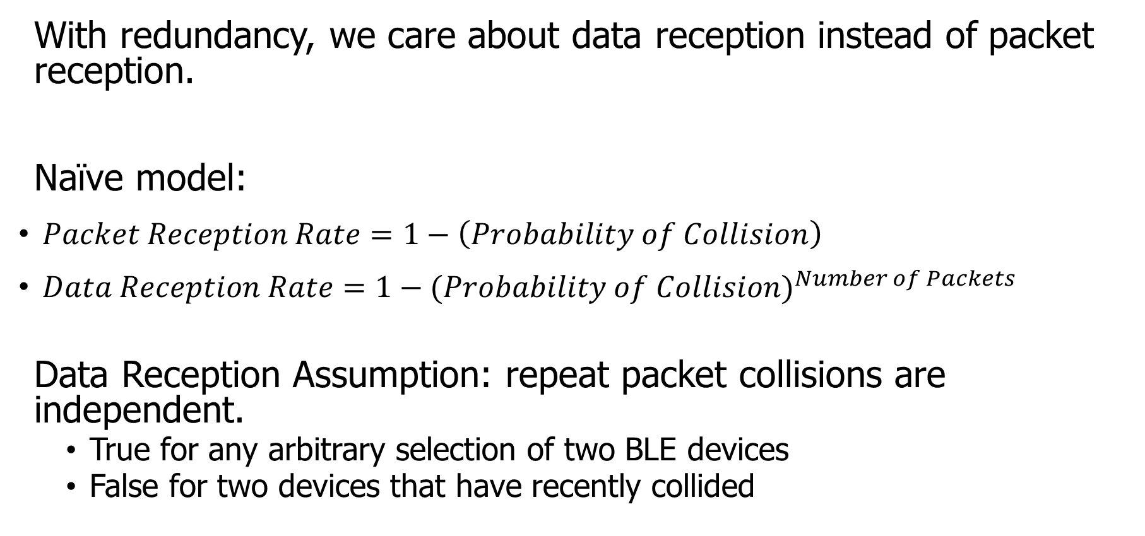
How do we determine reception rate?
With redundancy, we care about data reception instead of packet reception.
Naïve model:
$Packet Reception Rate=1−\left(Probability of Collision\right)$
$Data Reception Rate=1−{(Probability of Collision)}^{Number of Packets}$
Data Reception Assumption: repeat packet collisions are independent.
True for any arbitrary selection of two BLE devices
False for two devices that have recently collided
Notes:
Earlier we demonstrated the probability of collision, which can be used to determine packet reception rates.
Now with redundancy, we don’t care about the reception of any one packet, but the reception rate of the data that is being sent over them.
Naively, we can take the probability of collision and repeat it for any number of redundant packets.
There is an assumption in that model that repeat collisions are independent, which I’ll show you is false.

Slide 47
When are transmissions from two devices independent?
Assumption is true for any BLE device that has been advertising for some time
Sum of random delays grows the uncertainty of transmission.
Applied to periodic transmissions, any point in interval becomes equally likely.
Range of 1x delay, 2x delay, 3x delay, until it wraps
time
T_{adv_interval}
delay
T_{adv_interval}
delay
T_{adv_interval}
delay

Slide 48
When are transmissions from two devices NOT independent?
Independence assumption is false for two BLE devices that have recently collided.
If T_{adv_interval} is identical, next transmissions with be close in time.
Collision is determined by difference of random delays.
Further repeat collisions have the same probability of occurrence.
New time period collisions could occur within
time
T_{adv_interval}
delay
Notes:
If two devices have collided before, and have the same interval, at the next period they will certainly collide again.
BLE has a random delay appended to reduce this possibility.
But we’ve now greatly reduced the transmission window that the a collision could occur in. We can calculate this to determine a distinct probability of repeat collision.
Note that further repeat collisions are bounded by the same difference of random delays, and therefore have the probability of a second repeat collision is the same as the probability of a first repeat collision.

Slide 49





Calculating probability of a repeat collision
Difference of two uniform random delays forms a triangular distribution
probability
t_{adv_1}
t_{adv_0}
Probability of Repeat Collision
difference in transmission time
$$−t_{adv_delay}$$
$$−t_{adv_1}$$
$$0$$
$$t_{adv_0}$$
$$t_{adv_delay}$$

Slide 50
Important lesson: spend time on things that are important
How important was accounting for repeat collisions?
Maximum error is about a 1% change in Data Reception Rate.
This is due to size of delay 10 ms compared to size of transmission ~300 µs.
200 ms interval advertisements

Slide 51
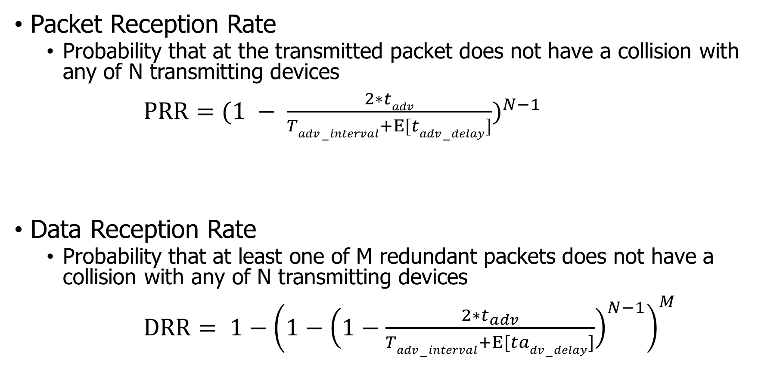
Equations for modeling data transmissions
Packet Reception Rate
Probability that at the transmitted packet does not have a collision with any of N transmitting devices
$PRR={(1 − \frac{2∗tadv}{Tadv−interval+Ε[tadv−delay]})}^{N−1}$
Data Reception Rate
Probability that at least one of M redundant packets does not have a collision with any of N transmitting devices
$DRR= {1−\left(1−{\left(1−\frac{2∗t_{adv}}{Tadv−interval+Ε[tadv−delay]}\right)}^{N−1}\right)}^{M}$

Slide 52
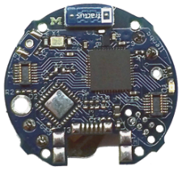
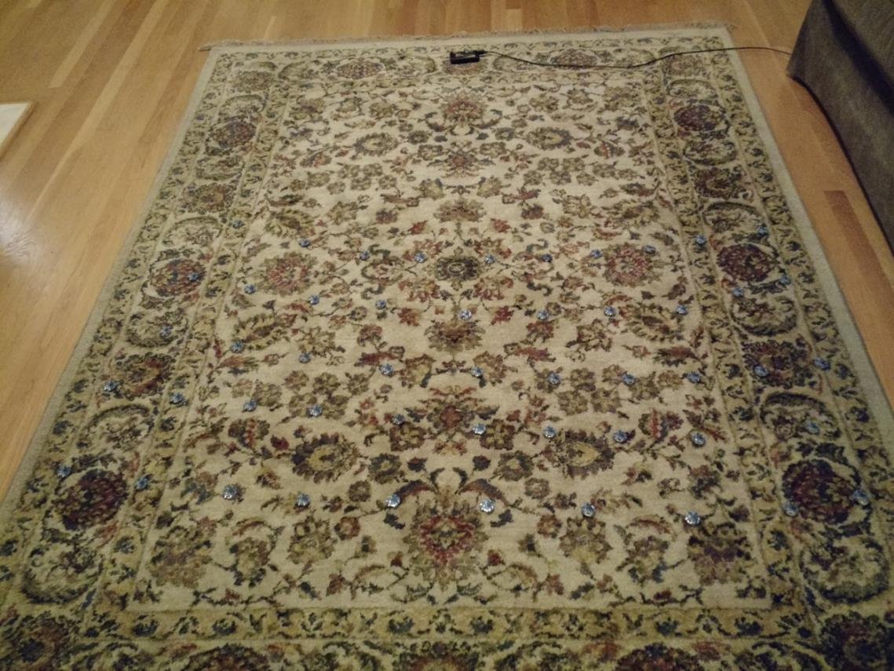
Is the model valid?
Empirical testing setup:
50 devices
1 meter from scanner
5-10 cm apart
Transmit monotonically increasing sequence numbers.
Sweep number of devices and advertising intervals.

Slide 53
The model is accurate across advertisement rates and deployment sizes.
Accuracy is fairly consistent across intervals.
The model consistently overestimates the measured PRR values.
The effect could be due to RF interference.

Slide 54
The model accurately accounts for redundancy as well.
The same dataset can be used to measure the effect of redundancy by grouping sets of sequence numbers.
The model again slightly overestimates, but error reduces quickly as DRR approaches 100%.

Slide 55
What questions can we answer with a collision model?
Original questions
What are the odds that a transmitted advertisement will be received?
If M redundant advertisements are sent instead, what are the odds that at least one are received?
How do these odds vary with number of devices, advertising interval, and packet size?
Additional questions
Can redundancy make advertisements reliable?
Is it better to transmit often for high redundancy or rarely for less congestion?

Slide 56
Redundancy results in high DRR even with many devices.
In this example, a sensor has new data once per second and sends it in 1-3 packets.
Even without redundancy, data reception rates never fall below 87% even with 200 devices in a deployment, assuming no interference.

Slide 57
Redundancy is (normally) better than less congestion.
Design question:
Send more packets to gain from redundancy? OR
Send less packets to reduce congestion?
The answer changes, but only with many devices.
Notes:
This plot changes with advertisement rate, and can get as low as 100 devices

Slide 58
Outline
BLE roles
Advertising
Scanning
Communicating with advertisements
Advertisement Use Cases
Energy Use
Packet Collisions
Bonus: Scan Responses

Slide 59
Scan requests/responses seem intriguing
Why not send most data in scan responses instead of advertisements?
Theoretically could reduce energy costs
Scan we use scan requests as a form of acknowledgement?
Could relieve need for redundant transmissions
Problem: scan requests/responses don’t work all that well

Slide 60
Scan Requests and Responses are broken
Goal: provide a little extra advertisement data on demand
Problem: exponential backoff for lost messages
If there is a request without a response, scanners assume collision with another scanner and exponentially back off from requesting
But collisions are far more likely between a device and a scanner, which should not have back off
Result is that scan requests will occur far less frequently than expected
Instead, just send additional advertisements with different data
Kravets, Robin, Albert F. Harris III, and Roy Want. "Beacon trains: blazing a trail through dense BLE environments." Proceedings of the Eleventh ACM Workshop on Challenged Networks. 2016.

Slide 61
Outline
BLE roles
Advertising
Scanning
Communicating with advertisements
Advertisement Use Cases
Energy Use
Packet Collisions
Bonus: Scan Responses

