Slide 1
Lecture 05 BLE Connections
CS397/497 – Wireless Protocols for IoT
Branden Ghena – Winter 2023
Materials in collaboration with Pat Pannuto (UCSD)

Slide 2
Administrivia
Lab: BLE
Available now!
Two parts: Wireshark & Programming your Dev Kits
Not everyone has to have everything working
Just one submission per group
Homework: BLE Packets
Should be out later tonight
Goal: not busy work, but actually get you interpreting payload data

Slide 3
Today’s Goals
Explore how connections work
What does the link layer look like?
How do higher layers interact to share data?
Investigate network questions about connections
Overview of additions in BLE 5.0

Slide 4
Useful documentation
[5.2 specification] [4.2 specification] (link to PDF download)
https://www.novelbits.io/deep-dive-ble-packets-events/
Thinking about BLE connection data transfer rates
https://punchthrough.com/maximizing-ble-throughput-on-ios-and-android/
https://punchthrough.com/maximizing-ble-throughput-part-2-use-larger-att-mtu-2/
https://punchthrough.com/maximizing-ble-throughput-part-3-data-length-extension-dle-2/

Slide 5
Outline
Connection PHY and Link Layer
Connection Investigations
GATT
BLE 5

Slide 6
Overview of connections
Connections are for bi-directional communication with higher throughput than advertisements
Simple view
A peripheral is either advertising or in a connection
A central is scanning and in one or more connections
(Remember: actually false, devices can have many roles simultaneously)
While in a connection both devices act like servers
Either device can read/write fields available on the other device

Slide 7
Once a connection is established, BLE has more PHY options
LE 1M (default)
1 Msym/s (BLE encodes 1 bit / symbol, so this is also 1 Mbit/s)
LE 2M
2 Msym/s
LE Coded
1 Msym/s + FEC
S = 2, ~2x range, ½ effective data rate – 500 Kbit/s goodput
S = 8, ~4x range, 125 Kbits/s goodput

Slide 8
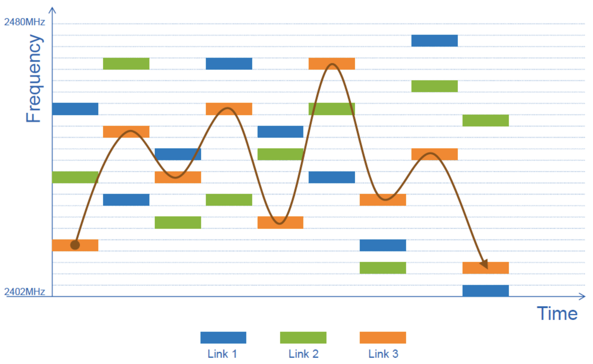
Frequency Hopping Spread Spectrum (FHSS)
Recall: Each BLE channel is 2 MHz wide, 40 channels,
3 are used for advertising, remaining 37 are for connections
Frequency hopping: f_{n+1} = (f_{n} + hop) mod 37
Which exact channels are used and in what order might vary
“Adaptive Frequency Hopping” avoids bad channels

Slide 9
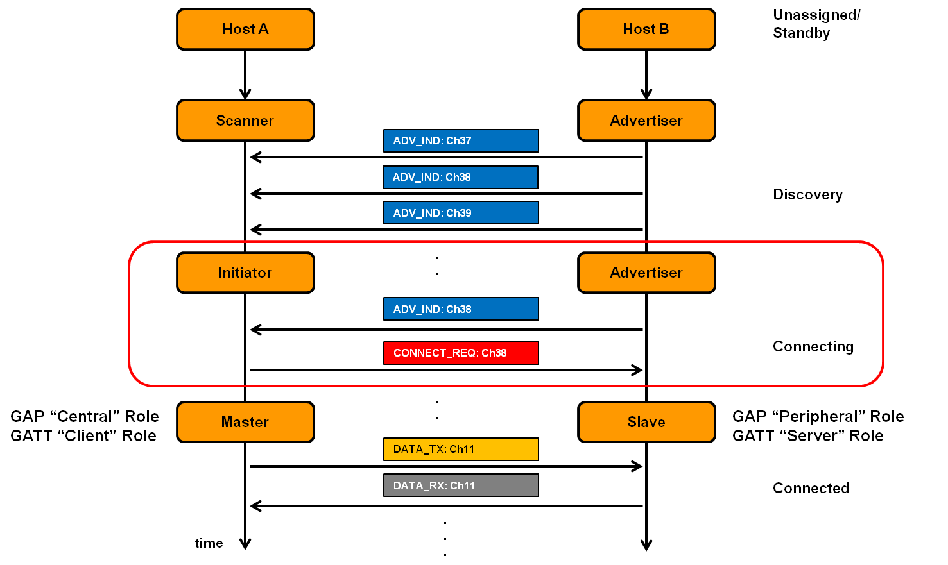
Connection timeline (in picture form)
Central
Peripheral

Slide 10
Connection timeline
Initiating a connection
Peripheral is sending broadcast advertisements
Central is scanning and receives an advertisement
Central sends connection request
During a connection
Central sends a packet each “connection interval”
Peripheral immediately responds with a packet
Multiple packets may be exchanged this way until done
Repeat at next connection interval
Ending a connection
Either device sends termination packet
Timeout occurs on either device

Slide 11
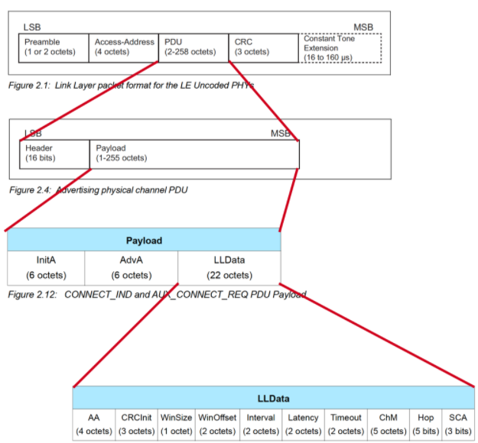
Connection request packet
Scanner waits until it sees an advertisement from a device it wants to connect to
Requesting a connection (in higher layers) just starts this search process
Sends connection request payload in response to advertisement

Slide 12

Request parameters
Specifies parameters of the connection
Peripheral must either agree or totally reject the connection
Peripheral can later propose a change to the connection parameters
Interval is how frequently connection events occur (7.5ms – 4s)
Timeout is how long since hearing from a device before the connection breaks
Channel Map and Hop have to do with FHSS pattern

Slide 13
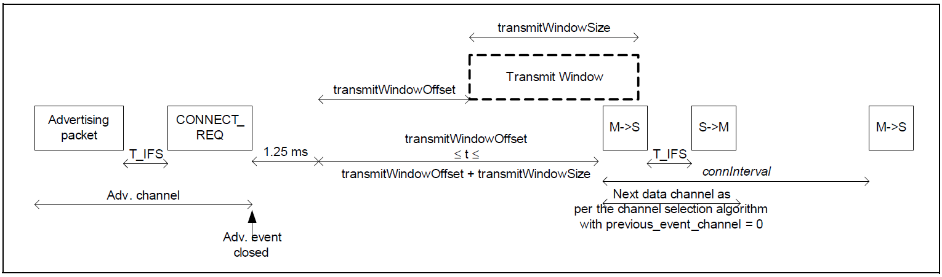
The Central schedules the first connection event
WinSize and WinOffset specify start of the first connection event
Places an “anchor” point that defines the TDMA schedule for this device
Interval specifies duration between connection events starting at “anchor”
Allows Central to place this connection, avoiding others it has
Before first response from peripheral, timeouts are faster
Central to Peripheral
Peripheral to Central
Central to Peripheral

Slide 14
Steady-state connection timing
Connection Interval
Central to Peripheral
Peripheral to Central
Central to Peripheral
Peripheral to Central
Central to Peripheral
Peripheral to Central
Central to Peripheral
Peripheral to Central
Central to Peripheral
Peripheral to Central
Hop to next data channel
Hop to next data channel
Optional packets
Some data can be exchanged at each interval
Might just be acknowledgements
Additional packets can be sent if there is a lot to transmit
Each interval is on the next channel in the hopping sequence
Peripheral can skip a number of intervals to save energy
Defined by the Latency connection request parameter

Slide 15
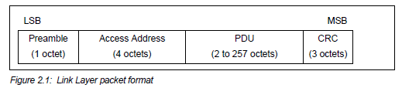
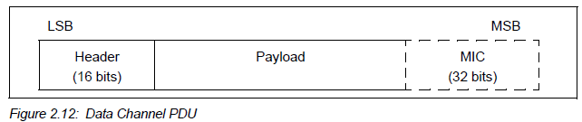
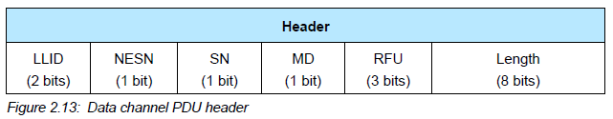
Connection packet layering
LLID – link layer ID
Empty data / Fragment
Data
Control
MD – more data (continues connection event)
Optional authentication
[Next Expected] Sequence Number – acknowledgements

Slide 16
Link Layer header length
Question: What is the maximum possible payload size?
Notes:
Expectation: They look at “length” and say 2^8 = 255 (or maybe 256; why is that wrong?)

Slide 17
Link Layer header length
Question: What is the maximum possible payload size?
251 Bytes
= 257 - header - MIC
Notes:
Expectation: They look at “length” and say 2^8 = 255 (or maybe 256; why is that wrong?)

Slide 18
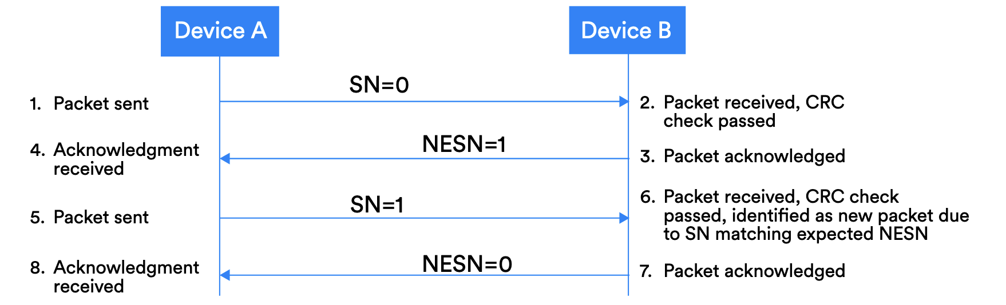
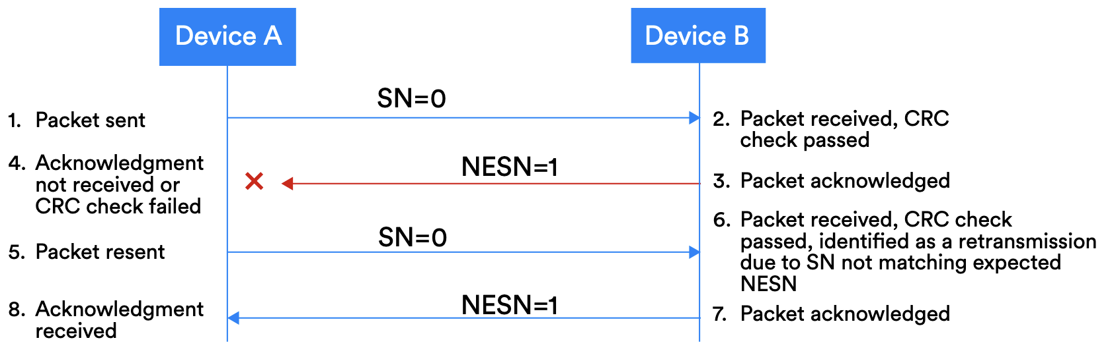
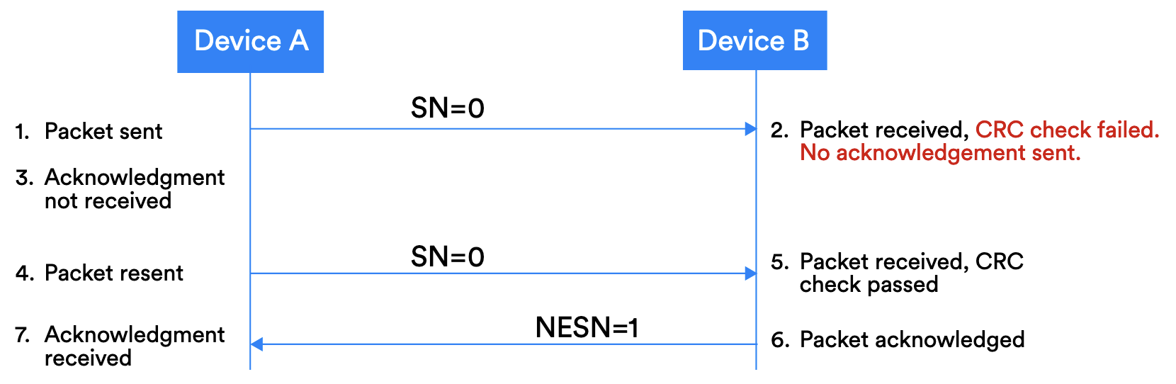
Acknowledgement protocol
See §4.2.3 of Reliability Doc for more

Slide 19
“Control” and “Data” separation: very common networking theme
LLID – link layer ID
Empty data / Fragment
Data
Control

Slide 20
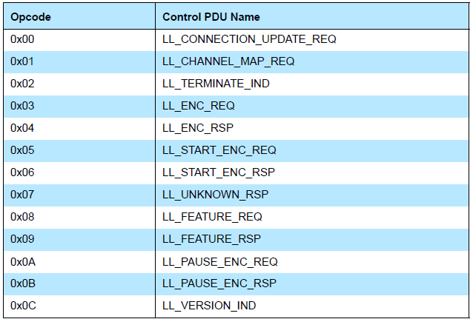
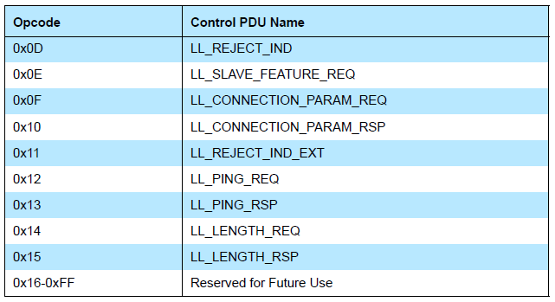
Control payloads
Examples:
Request update to connection parameters like interval (by peripheral)
Begin encrypting communication
Terminate a connection
Note: Control payloads can all be handled by the link layer – not passed up!

Slide 21
Data payloads
SDU – Service Data Unit
Logical packet that may be split into several physical packets
Channel ID
Destination for data
ATTributes or Security
Can also make custom endpoints
Length (16 bits) | Channel ID (16 bits) | L2CAP SDU Length* (16 bits) | Information Payload (0 to 249 octets)

Slide 22
Summarizing what’s sent in a BLE connection
Control packets
Version
Bluetooth version, Company ID of Software Stack
Features
Various connection features supported by the device
Encryption, Ping, Channel selection algorithms, Various 5.0 features
Etc.
Extended packet length, Various 5.0 features (change PHY)
Various “procedures” for setting up changes in the connection
Data packets
Attribute discovery
Attribute reading

Slide 23
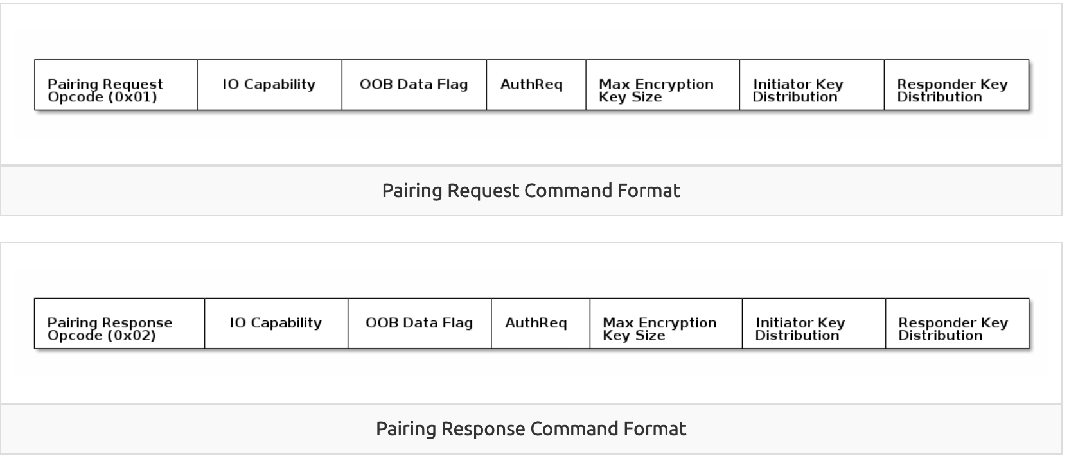
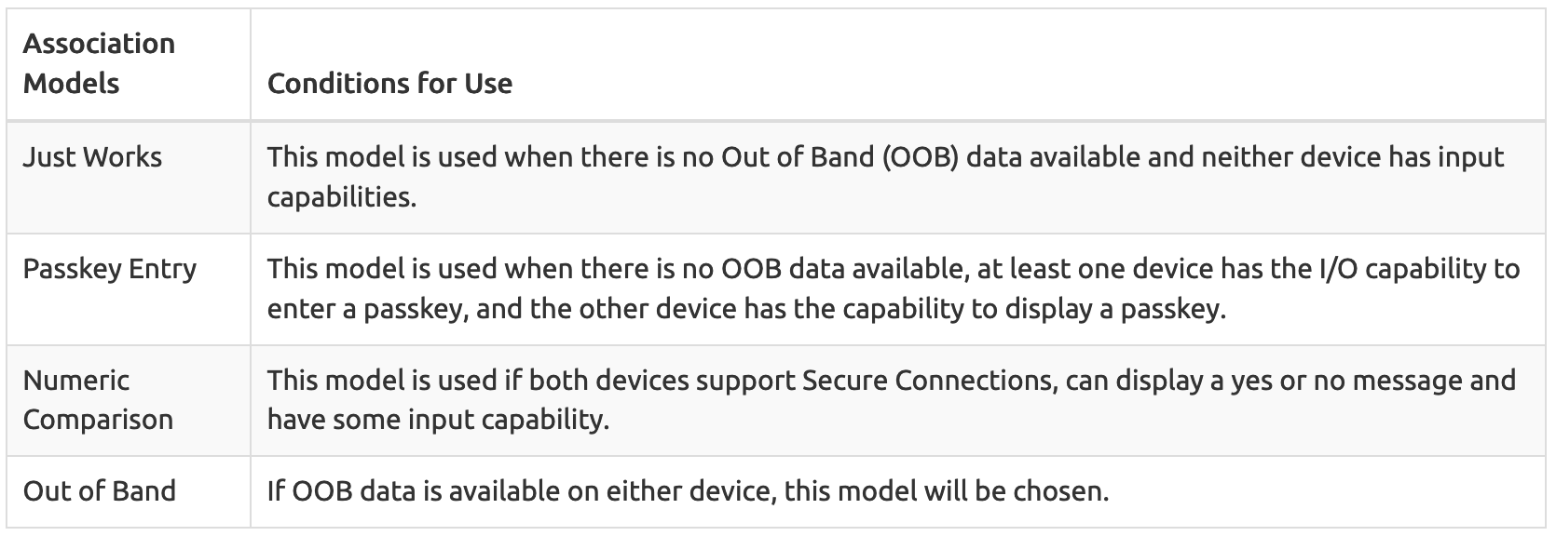
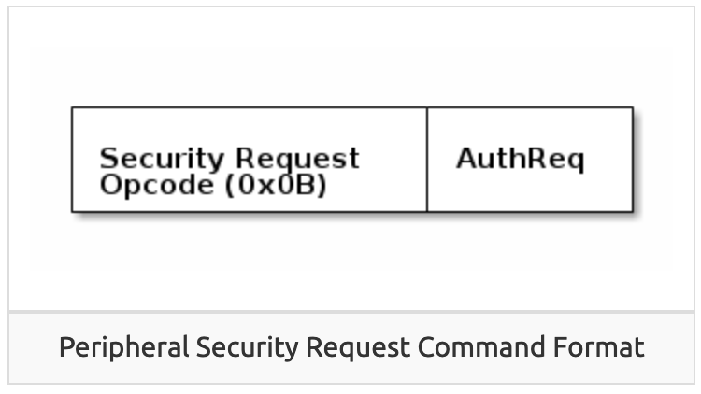
Very briefly: security in connections
Either side can request secure connection [central -> Pairing; peripheral -> Security Req]
“Bonding” saves pairing info between connections
Excellent TI resource here for more details: https://dev.ti.com/tirex/explore/node?node=AOPOY.GDApakIOYjiwoY6A__pTTHBmu__LATEST

Slide 24
Very briefly: security in addresses
All devices have a unique, hardware “Identity Address”, but may not share it
Public Address - Use the Identity Address. (The BDA never changes.)
Random Static Address - Generate a random address per power cycle. The address cannot be regenerated at any other time. Can be used as an Identity Address.
Resolvable Private Address (RPA) - Generate a random address with a given time interval. Generated using Identity Resolving Key (IRK) which can also be used by trusted peers (bonded devices) to resolve the Random Address to the Identity Address.
Non-resolvable Private Address - Generate a random address with a given time interval. Generated randomly. Cannot be resolved to an Identity Address.

Slide 25
Ending connections
Termination control packet
Timeout parameter from connection parameters
Human-based devices may just wander away from each other
Or be shut off, or reprogrammed, etc.

Slide 26
Break + Check your understanding
What makes connections more reliable than advertisements?
How does a Peripheral send data to a Central in a connection?
Why is a “termination” control packet useful?

Slide 27
Break + Check your understanding
What makes connections more reliable than advertisements?
Each packet sent is acknowledged or resent
TDMA schedule and FHSS means less likely to collide
How does a Peripheral send data to a Central in a connection?
Wait until next connection interval
Respond to packet from Central with a data payload
Why is a “termination” control packet useful?
Timeout could delay for a while
Enables re-connection if desired

Slide 28
Outline
Connection PHY and Link Layer
Connection Investigations
GATT
BLE 5

Slide 29
Questions about how a connection “network” works
How does TDMA MAC for connections work?
Implies a schedule
Implies synchronization
How many devices can be in a network?
How much throughput can a device have?

Slide 30
Questions about how a connection “network” works
How does TDMA MAC for connections work?
Implies a schedule
Implies synchronization
How many devices can be in a network?
How much throughput can a device have?

Slide 31
How is the TDMA schedule created/managed?
Only the central needs to know the schedule
It controls interactions with the peripheral(s) it is connected to
Anchor point and connection interval determines the schedule for a specific device
Central to Peripheral
Peripheral to Central
Central to Peripheral

Slide 32
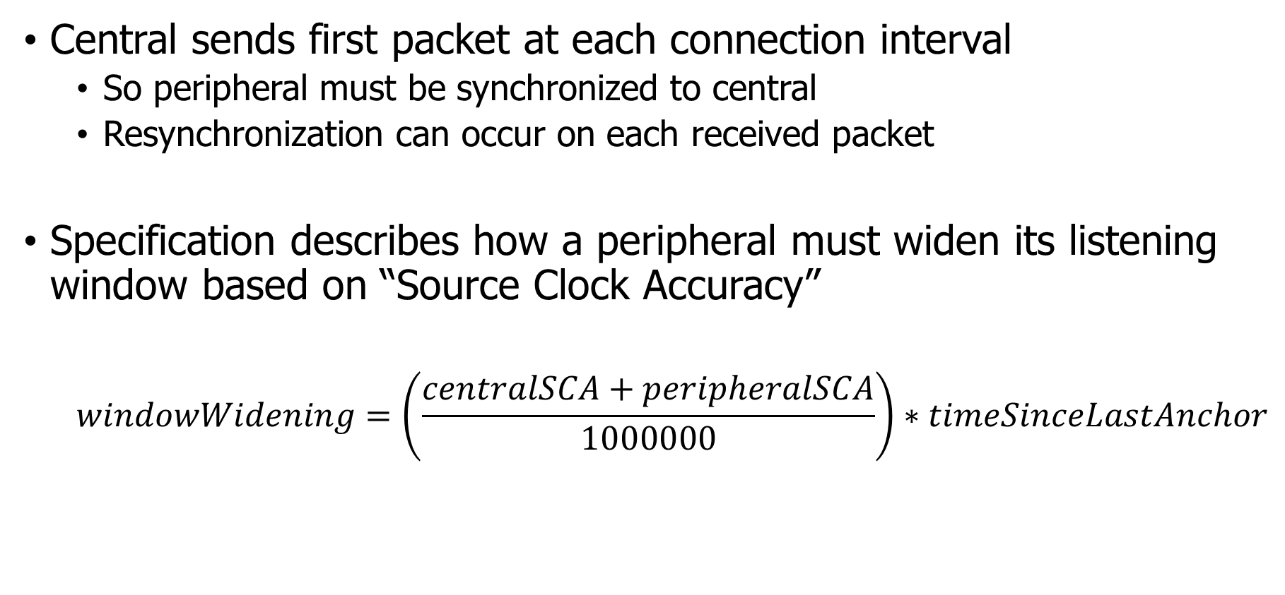
How is synchronization managed?
Central sends first packet at each connection interval
So peripheral must be synchronized to central
Resynchronization can occur on each received packet
Specification describes how a peripheral must widen its listening window based on “Source Clock Accuracy”
$$windowWidening=\left(\frac{centralSCA+peripheralSCA}{1000000}\right)∗timeSinceLastAnchor$$

Slide 33
Clock drift is an energy burden due to large guard bands and energy cost of precise timekeeping
CC2520 Radio + AM18xx RTC:
300s * 2ppm * 2 = 1.2 ms guard
1.2 ms * 60 mW = 36 μJ (RF loss)
300s * 150nW = 45 μJ (RTC loss)
≈ 100 μJ loss / packet @ 300 s
1200 μs
@ 2ppm
Guard
Device time
(CC2520 is a 15.4 radio, but same idea applies) Max connection interval in BLE is 4 seconds
Static Power:
100 nW+
300 s
Wall time

Slide 34
Questions about how a connection “network” works
How does TDMA MAC for connections work?
Implies a schedule
Implies synchronization
How many devices can be in a network?
How much throughput can a device have?

Slide 35
How many devices can be connected?
We can schedule with granularity of at least 1.25 ms (offset steps)
That’s at least 800 devices per second
Intervals go up to 4 seconds, so multiply by four
That’s 3200 devices per max interval
Plus central can skip intervals on occasion without dropping the connection
And really the offset defines a window. More granularity is available
Answer: thousands of devices
Although each is sending minimum-sized packets each interval

Slide 36
How many devices can be connected in the real world?
The limit is much much lower on real devices
Example: Android sets a limit at around 4-15
nRF52 s140 softdevice allows up to 20
Connection management is often done in firmware
Softdevice for nRF, firmware on the radio chip in smartphones
Limited by memory and complexity

Slide 37
Questions about how a connection “network” works
How does TDMA MAC for connections work?
Implies a schedule
Implies synchronization
How many devices can be in a network?
How much throughput can a device have?

Slide 38
How much throughput can a device have?
1 Mbps? That’s the PHY data rate

Slide 39
How much throughput can a device have?
1 Mbps? That’s the PHY data rate
Not even close. Packet overhead plus timing delays
Step 1: decrease connection interval as much as possible
More connection events per second mean more data
Range: 7.5 ms to 4.0 s
Somewhat device-specific configuration
Android allows 7.5 ms
iOS allows 15 ms

Slide 40
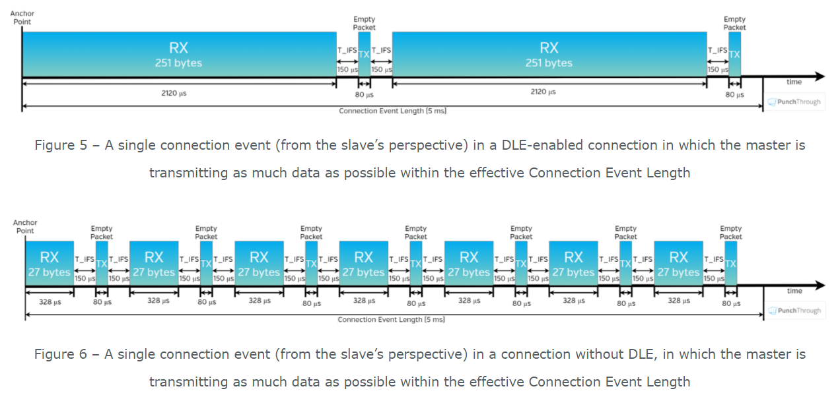
How much throughput can a device have?
Step 2, increase packet size

Slide 41
How much throughput can a device have?
488 bytes per connection event
Maximum sized packets, discounting headers and timing delays
Connection event every 7.5 ms
Result: 520 kbps (65 kB per second)
iOS result 260 kbps
Original BLE 4.1 result on Android: 128 kbps
Lower in practice due to lost packets

Slide 42
Outline
Connection PHY and Link Layer
Connection Investigations
GATT
BLE 5

Slide 43
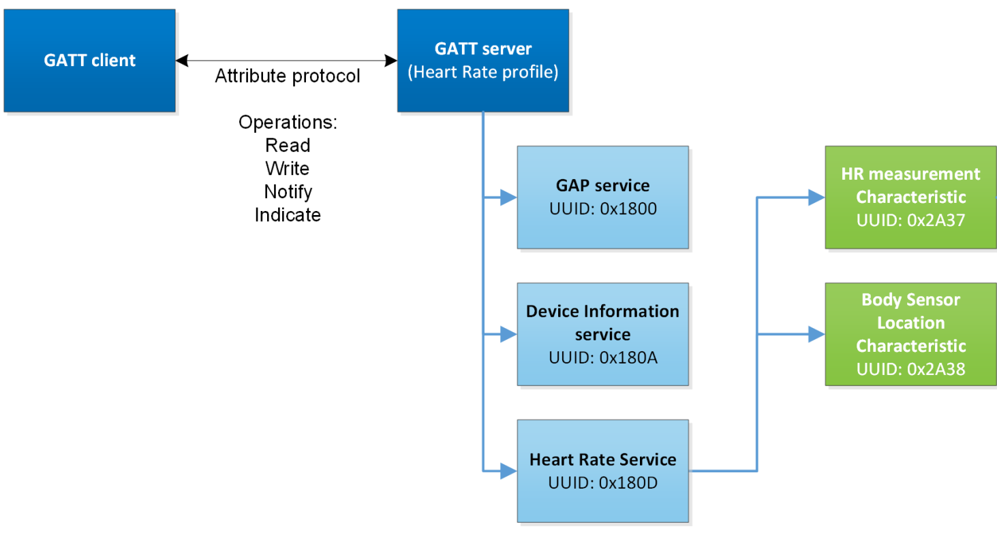
Overview of Generic Attribute Profile (GATT)

Slide 44
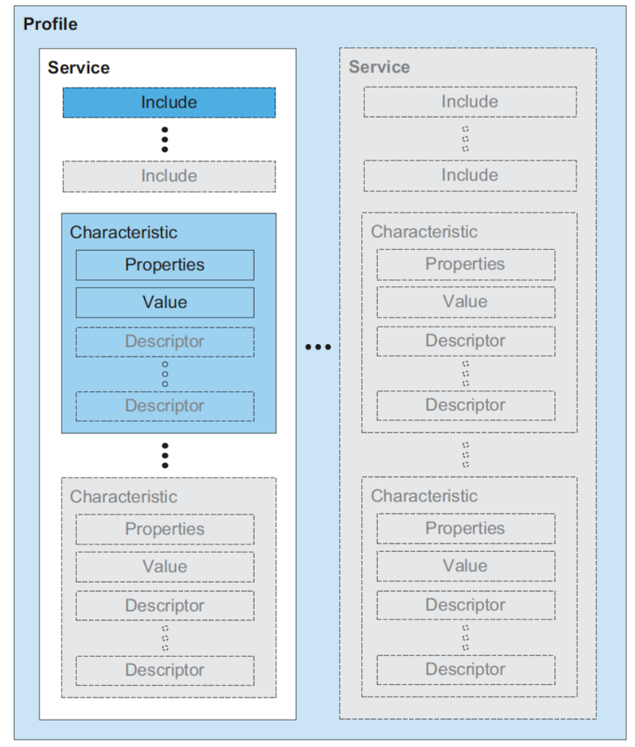
Attribute server keywords
Characteristic
A field with properties and a value
Descriptor: metadata about the characteristic
Service
Collection of characteristics
Profile
Collection of services

Slide 45
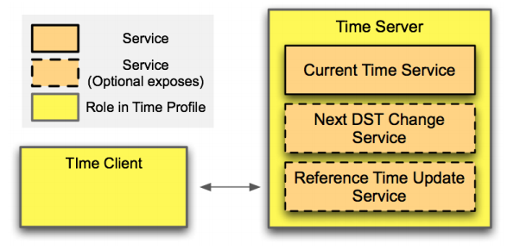
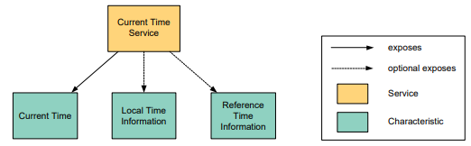
Example: Time Profile

Slide 46
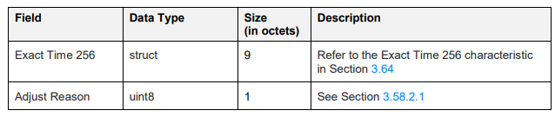
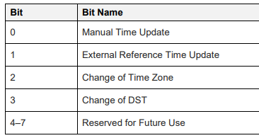
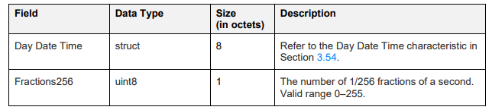
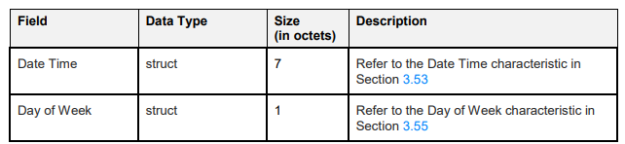
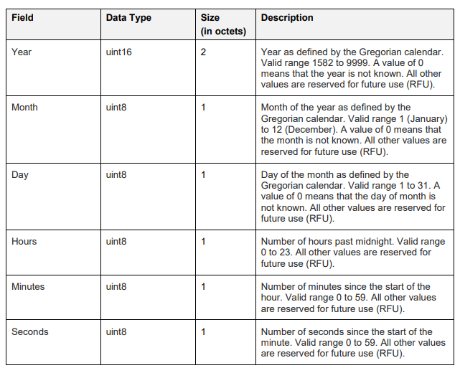
Current time characteristic
The Bluetooth SIG are pedantic people

Slide 47
Documentation of GATT standards
https://www.bluetooth.com/specifications/gatt/
Various profiles and services that have been standardized
GATT Specification Supplement
Various characteristic definitions that have been standardized
Both incredibly specific and woefully inexhaustive

Slide 48
UUIDs and handles
Universally Unique Identifiers
128-bit, mostly random with a few bits for versioning
Example: 00000000-0000-1000-8000-00805F9B34FB
This is the default BLE UUID for known services
You can generate your own UUID for custom services
Handles
Too long to pass around all the time, so pick 16 bits that mean that UUID
Must be unique among services/characteristics on that device
Taken from UUID: 0000xxxx-0000-1000-8000-00805F9B34FB
Handle often sequentially incremented for each new characteristic within a service
Resource: Useful post on identifying handles in the wild

Slide 49
Discovery
When a connection first occurs, each device can query the other for a list of services
And can further query for a list of characteristics in that service
Gets a list of handles/UUIDs
Standardized UUIDs can be interpreted immediately
Custom services/characteristics need documentation from the manufacturer

Slide 50
Interacting with characteristics
Depends on their permissions
Readable, Writable, Notify-able, etc.
Notify
Automatically get a message sent whenever the characteristic value updates
Note: have to enable this on both sides, it’s not the default behavior
Long characteristics are automatically fragmented across multiple packets and/or connection events
L2CAP is in charge of this

Slide 51
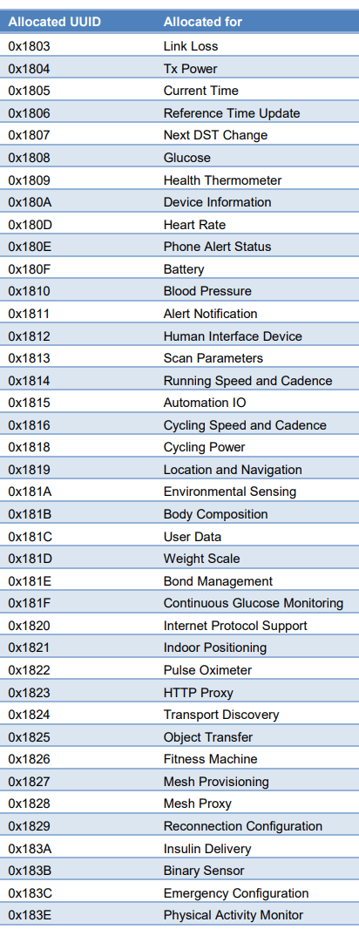
Break + Example Services
https://btprodspecificationrefs.blob.core.windows.net/assigned-values/16-bit%20UUID%20Numbers%20Document.pdf

Slide 52
Outline
Connection PHY and Link Layer
Connection Investigations
GATT
BLE 5

Slide 53
Changes in BLE 5
Major changes
Multiple physical layers (optional implementation 😡)
Advertising extensions
Localization extensions (will discuss later with localization)
Minor changes
Various quality of life improvements
Examples:
Advertise on channels in any order
Better data channel hopping algorithm

Slide 54
Revised physical layers
2 Mbps PHY
Transmit data faster
Transmit more data in the same time
Coded PHY
Forward Error Correction in the data stream
1 bit -> 2 symbols or 8 symbols
Makes bits more reliable -> longer distance
500 kbps and 125 kbps modes
Connections can switch to these PHYs after creation
Advertisements can use these with extensions only

Slide 55
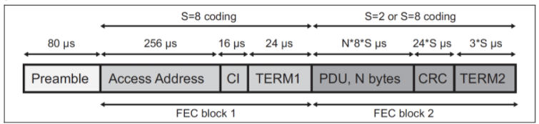
Coded PHY mixes physical and link layers
Different PHY settings at different times
Make beginning headers extra-reliable
Data might be slightly less reliable as a trade for faster speed
Packet sent with coded PHY

Slide 56
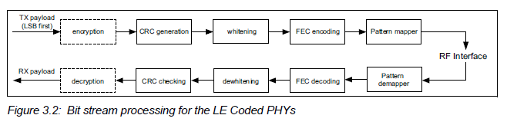
Revised processing path

Slide 57
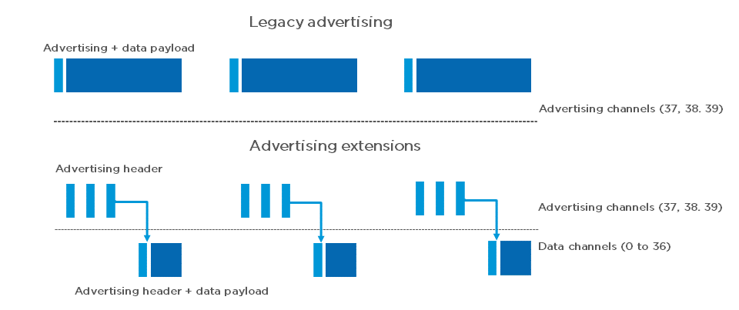
Extended advertising
Allow bigger payloads and/or different PHYs
Uses Data Channels to do so. Why?
Regular advertisements point to extended advertisements

Slide 58
Extended advertising
Allow bigger payloads and/or different PHYs
Uses Data Channels to do so. Why? Packet collisions!
Regular advertisements point to extended advertisements

Slide 59
Procedure for scanning extended advertisements
Scan on 3 primary channels for advertising packets.
If ADV_EXT_IND is scanned, record the secondary channel information (which channel and when etc.)
Scan the specific secondary channel at the given time.

Slide 60
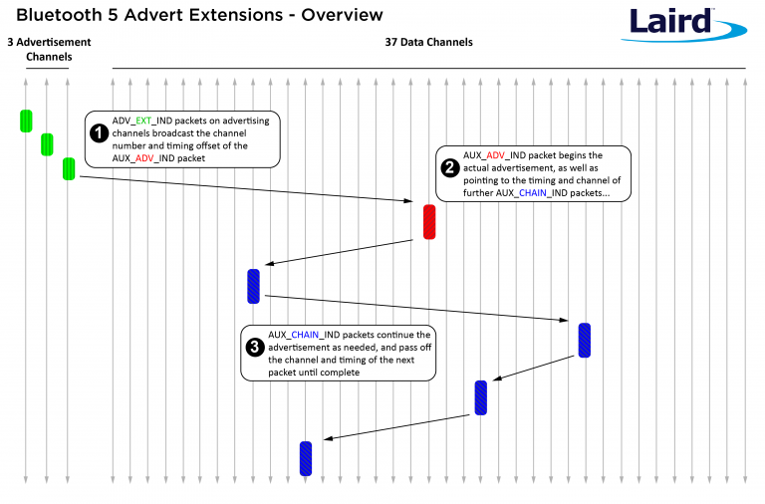
Extended advertisement train on data channels
Use case: long advertisements that need to be fragmented

Slide 61
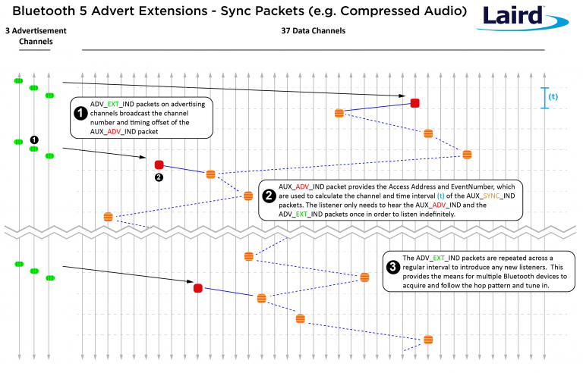
Periodic advertising on data channels
Use case: publicly-available localized audio sources
TV in a bar
Commentary in a museum
Broadcast analogy of a connection
Downside:
how many of these can a gateway follow at a time?

Slide 62
Outline
Connection PHY and Link Layer
Connection Investigations
GATT
BLE 5

