Slide 1
Lecture 07 Thread
CS397/497 – Wireless Protocols for IoT
Branden Ghena – Winter 2023
Materials in collaboration with Pat Pannuto (UCSD)
With some advice from Neal Jackson (UC Berkeley)

Slide 2
Administrivia
Hw: BLE Packets due today (19/33)
Do it. It’s good for you. Much like eating spinach.
Lab: BLE due on Monday (6/33)
If you haven’t started, do so ASAP
Some people had various hardware/software issues getting started
Once you’ve gotten to “blink an LED”, everything should be good from there
Lab: Thread (-1/33)
Should be out Friday or Saturday
Will require multiple of you to be together in one space to work on it

Slide 3
Today’s Goals
Explore 802.15.4 packet structure
Describe goals and capabilities of Thread networks
Understand addressing in Thread networks
Describe runtime behaviors like network joining

Slide 4
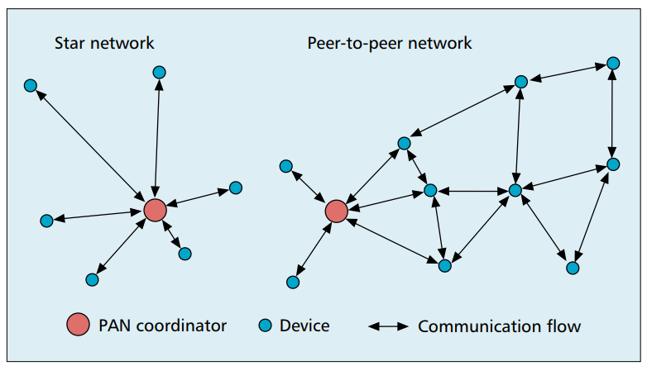
802.15.4 network topologies
Only specifies PHY and MAC, but has use cases in mind

Slide 5
Modes of operation
Beacon-enabled PAN
Slotted CSMA/CA
Structured communication patterns
Optionally with some TDMA scheduled slots
Non-beacon-enabled PAN
Unslotted CSMA/CA
No particular structure for communication
Could be defined by other specifications, like Thread or Zigbee

Slide 6
Beacon-enabled superframe structure
Beacon
Beacon
…
Contention Access Period
Inactive Period
Beacons occur periodically [15 ms – 245 seconds]
Devices must listen to each beacon
Contention Access Period
Slotted CSMA/CA synchronized by beacon start time
Inactive Period
No communication occurring. Assumes sleepy devices

Slide 7
Non-beacon-enabled PAN
…
Contention Access Period
Same idea, just no beacons
Which removes synchronization benefit (and slotted CSMA/CA)
Also removes beacon listening cost
Devices only need to check for activity before transmitting
Still need an algorithm to determine when it should receive data
All the time is a huge energy drain
Algorithms can get complicated here
Could BLE mechanism of listen-after-send apply?
Only if sending to a high-power device, not among equals

Slide 8
802.15.4 specification versions
2011
Four PHY options (UWB)
MAC capability to support ranging (distance measurements)
2015
Six PHY options (RFID, Smart Utility, TV White Space)
Time Slotted Channel Hopping (TSCH) access control (TDMA+FDMA)
2020
Several new PHY options (China medical band, alternate modulations)

Slide 9
Major 802.15.4 uses
Zigbee & Thread
Both build upon the 15.4 PHY and Link primitives
Using most but discarding some
Both consider higher-level application considerations
Building a network
Communicating between devices
Application logic

Slide 10
Outline
Thread Overview
Thread Addressing
Runtime Behavior
Using IP

Slide 11
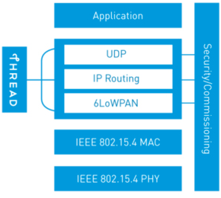
Thread overview
Build a networking layer on top of 15.4
Reuses most of PHY and MAC
Adds IP communication
Handles addressing and mesh maintenance
Goals
Simplicity – easy to install and operate
Efficiency – years of operation on batteries
Scalability – hundreds of devices in a network
Security – authenticated and encrypted communication
Reliability – mesh networking without single point of failure
Industry-focused, but based in academic research

Slide 12
References on Thread
Request for specification: https://www.threadgroup.org/ThreadSpec
Frustratingly locked down 😡
Overview on capabilities: https://openthread.io/guides/thread-primer
Excellent overview
Lifting heavily for these slides

Slide 13
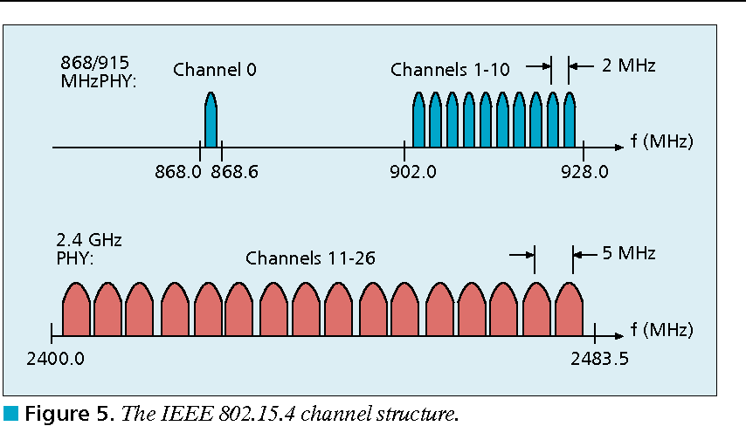
Changes to Physical Layer
Remove all non-2.4 GHz PHY options
Otherwise the same
O-QPSK
16 channels, 5 MHz spacing
Typical TX power 0 dBm
Typical RX sensitivity -100 dBm

Slide 14
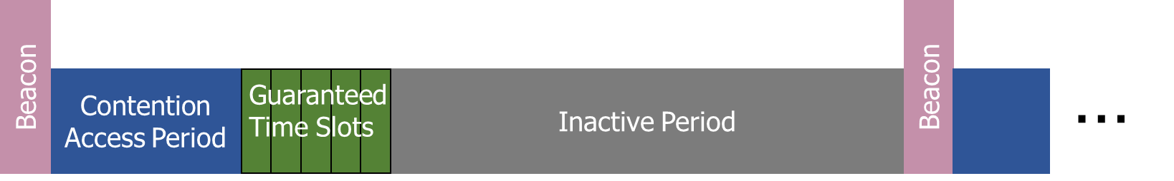
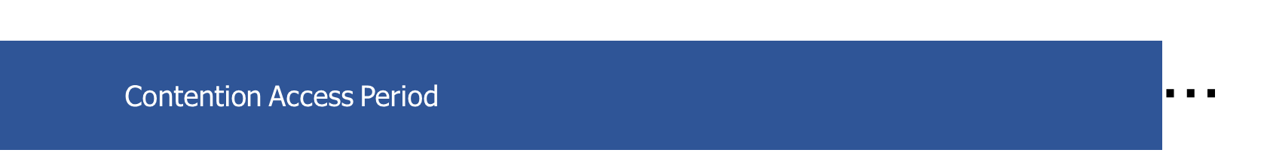
Changes to Link Layer and MAC
Non-beacon-enabled PAN only
No superframe structure
No periodic beacons
No Guaranteed Time Slots
Throw out most existing MAC Commands
Remove network joining/leaving
Remove changing coordinators
Remove Guaranteed Time Slot request
Network joining will be handled at a higher layer

Slide 15
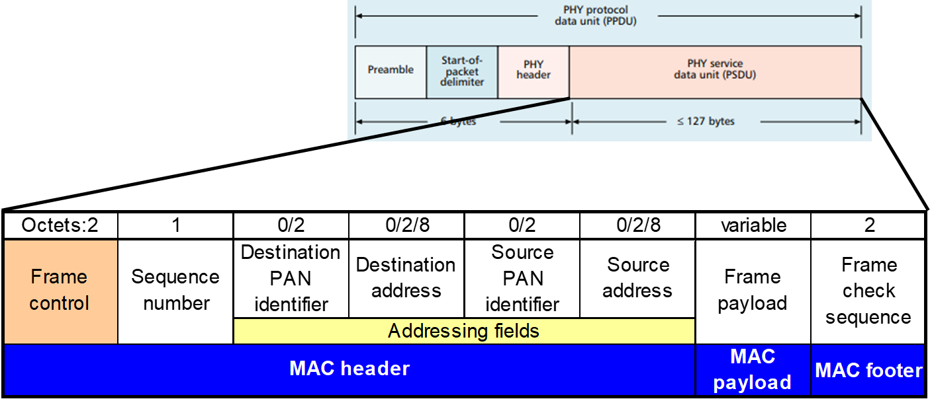
Changes to Link Layer and MAC
Keep unslotted CSMA/CA algorithm
Keep packet structure
Keep Frame Types
Beacon
MAC Command
Beacon Request
Data Request
Data
Acknowledgement

Slide 16
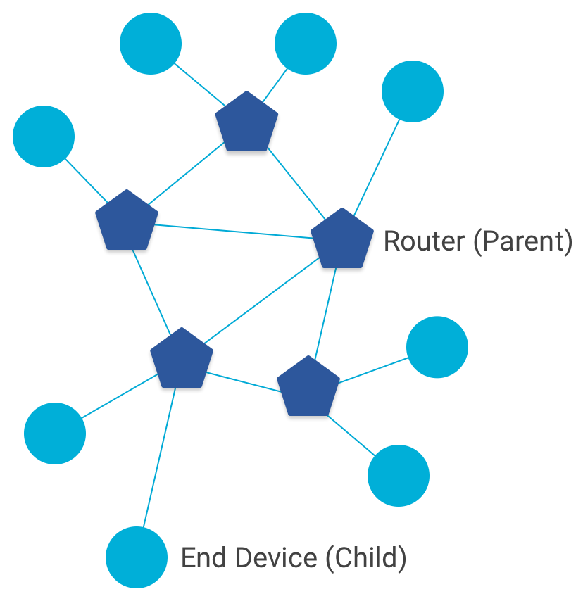
Combination of star and mesh topology
Routers (parent)
Mesh communication with other routers
Radio always on
Forwards packets for network devices
Enables other devices to join network
32 routers per network
End devices (child)
Communicates with one parent (router)
Does not forward packets
Can disable transceiver to save power
Send packets periodically to avoid timeout
511 end devices per router

Slide 17
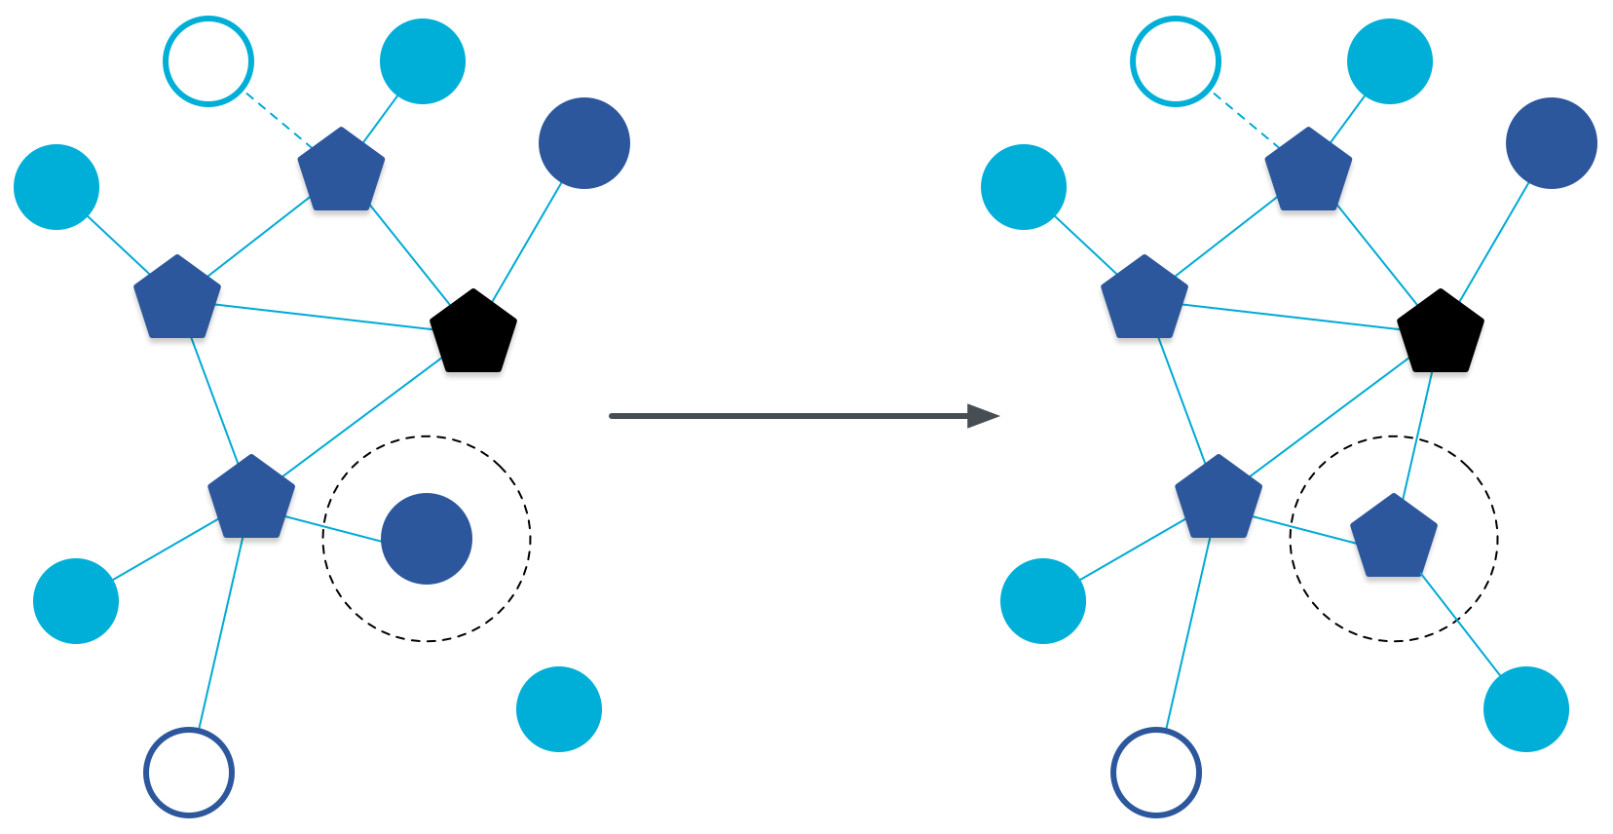
Router promotion
“Router Eligible End Device”
A router without any children
Can operate as an end device with one connection (lower power)
Promotes to a router when a joining end device relies on it
If there is room for an additional router (max 32, typical 16-23)

Slide 18
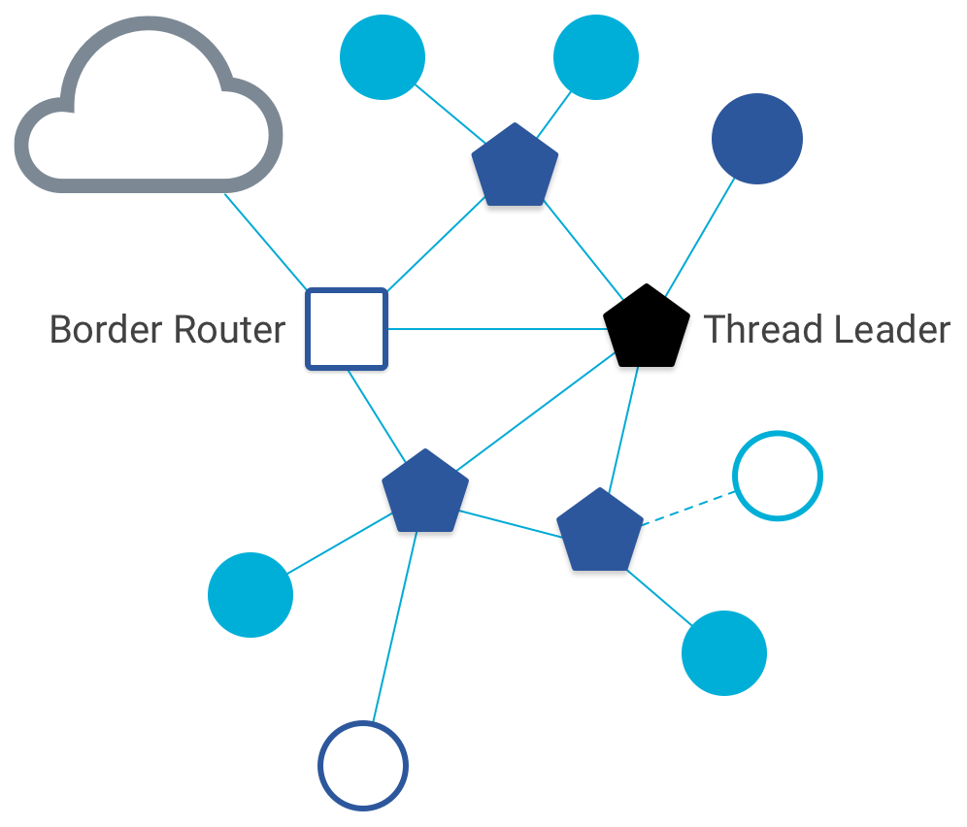
Other special roles
Thread leader
Device in charge of making decisions
Addresses, Joining details
Automatically selected from routers
One leader at any given time
Additional leader is selected if the network partitions
Border router
Router that also has connectivity to another network
Commonly WiFi or Ethernet
Provides external connectivity
Multiple border routers may exist at once

Slide 19
Why use Thread instead of basic 802.15.4?
Full specification of upper layers
Clarifies how data is transmitted between devices on a network
Cleans up a lot of things otherwise left implementation-dependent
Interaction with the world outside of the sensor network!
Gateway can be a dumb forwarder of packets
Devices can directly talk to NTP servers or POST data to a website!

Slide 20
Outline
Thread Overview
Thread Addressing
Runtime Behavior
Using IP

Slide 21
Thread uses IPv6 for communication
Why IP?
If Wireless Sensor Networks represent a future of billions of connected devices distributed throughout the physical world
Why shouldn’t they run standard protocols wherever possible?
Why IPv6?
Generalized, Flexible, Capable
Benefits
Interoperability with normal computers and networks
Reuse state of the art developed standards instead of remaking them
Security, Naming, Discovery, Services
Costs
Packet overhead can be high (will fix)
Complexity for supporting protocols
Hui and Culler, “IP is Dead, Long Live IP for Wireless Sensor Networks”. 2008

Slide 22
Background: IPv6
Replacement to Internet Protocol v4
(Something unrelated used version number 5)
Extended addressing for devices
32-bits for IPv4 addresses -> 128-bits for IPv6 addresses
Example: a39b:239e:ffff:29a2:0021:20f1:aaa2:2112
Supports multiple transmit models
Broadcast: one-to-all
Multicast: one-to-many
Unicast: one-to-one
Various other improvements

Slide 23
Background: IPv6 address notation rules
Groups of zeros can be replaced with “::”
Can only use “::” in one place in the address
Leading zeros in a 16-bit group can be omitted
0000:0000:0000:0000:0000:0000:0000:0001 → ::1
2345:1001:0023:1003:0000:0000:0000:0000 → 2345:1001:23:1003::
aecb:0222:0000:0000:0000:0000:0000:0010 → aecb:222::10
Special addresses
Localhost - ::1 (IPv4 version is 127.0.0.1)
Link-Local Network - fe80:: (bottom 64-bits are ~device MAC address)
Local Network – fc00:: and fd00::
Global Addresses – 2000:: (various methods for allocating bottom bits)

Slide 24
Background: IPv6 datagram format
Priority: like “type of service” in IPv4.
Flow label: ambiguous
Next header: TCP, UDP
Hop limit = TTL
version
priority
flow label
payload length
next header
hop limit
source address
(128 bits)
destination address
(128 bits)
data
(variable length, typically a TCP or UDP segment)
how much overhead?
40 bytes of IPv6
20 more than IPv4
32 bits

Slide 25
6LoWPAN
Method for running IPv6 over 802.15.4 links
IPv6 over Low-Power Wireless Personal Area Networks
IETF Standard (RFC4944 + updates in RFC6282)
Directly out of the research world (Jonathan Hui + David Culler)
Research Paper: IP is Dead, Long Live IP for Wireless Sensor Networks
Thesis of work: sensor networks can and should use IPv6
Important goals
Compress IPv6 headers
Handle fragmentation of packets
Enable sending packets through mesh

Slide 26
6LoWPAN header compression
40 bytes of IPv6 header are a lot for a 127-byte payload
Most important goals
Communication with devices in the 15.4 network should be low-overhead
Communication outside of the 15.4 network should still minimize overhead where possible
Assume a bunch of common parameters to save space
A bunch of options are set to default values
Payload length can be re-determined from packet length
Source/Destination addresses can often be reassembled from link layer data
Plus information about network address assignment known by routers
Border router “inflates” the packet before sending externally

Slide 27
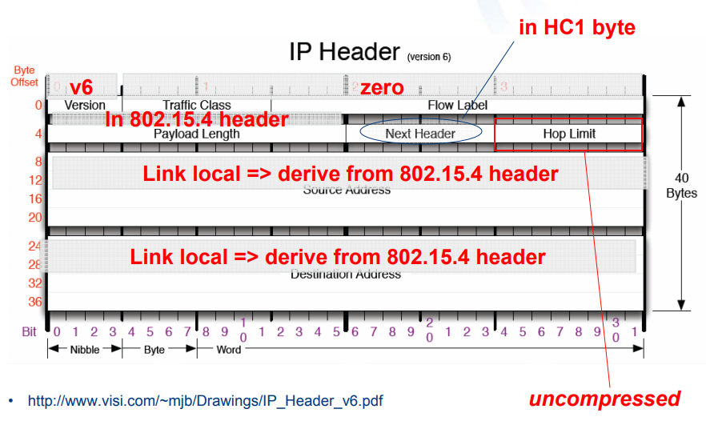
Example of compression
Example of HC1 header compression
Note: Thread actually uses IPHC from rfc6282 (not HC1), but similar idea

Slide 28
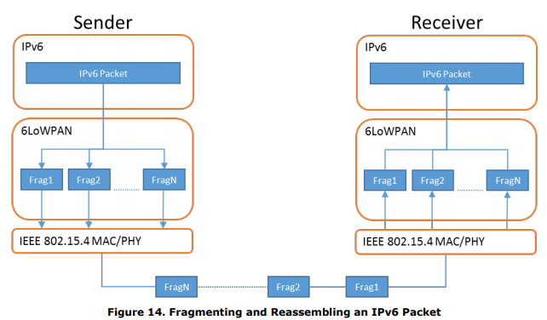
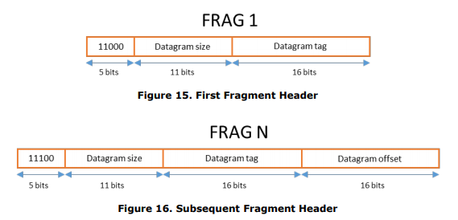
6LoWPAN fragmentation
Only the first packet of the fragments will hold the IPv6 header
Tag, offset, and size are used to reconstruct

Slide 29

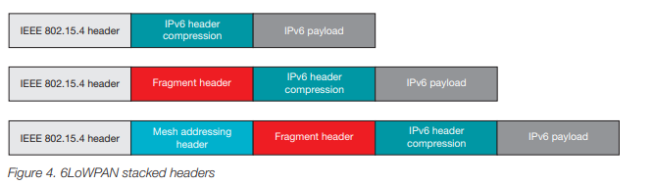
6LoWPAN mesh forwarding
Additional header with originator and final addresses
Which of these headers are used depends on the packet

Slide 30
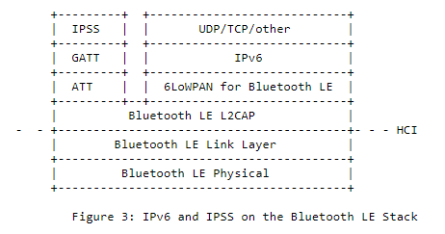
Sidebar: IPv6 over BLE
RFC7668 defines 6LoWPAN techniques for BLE connections

Slide 31
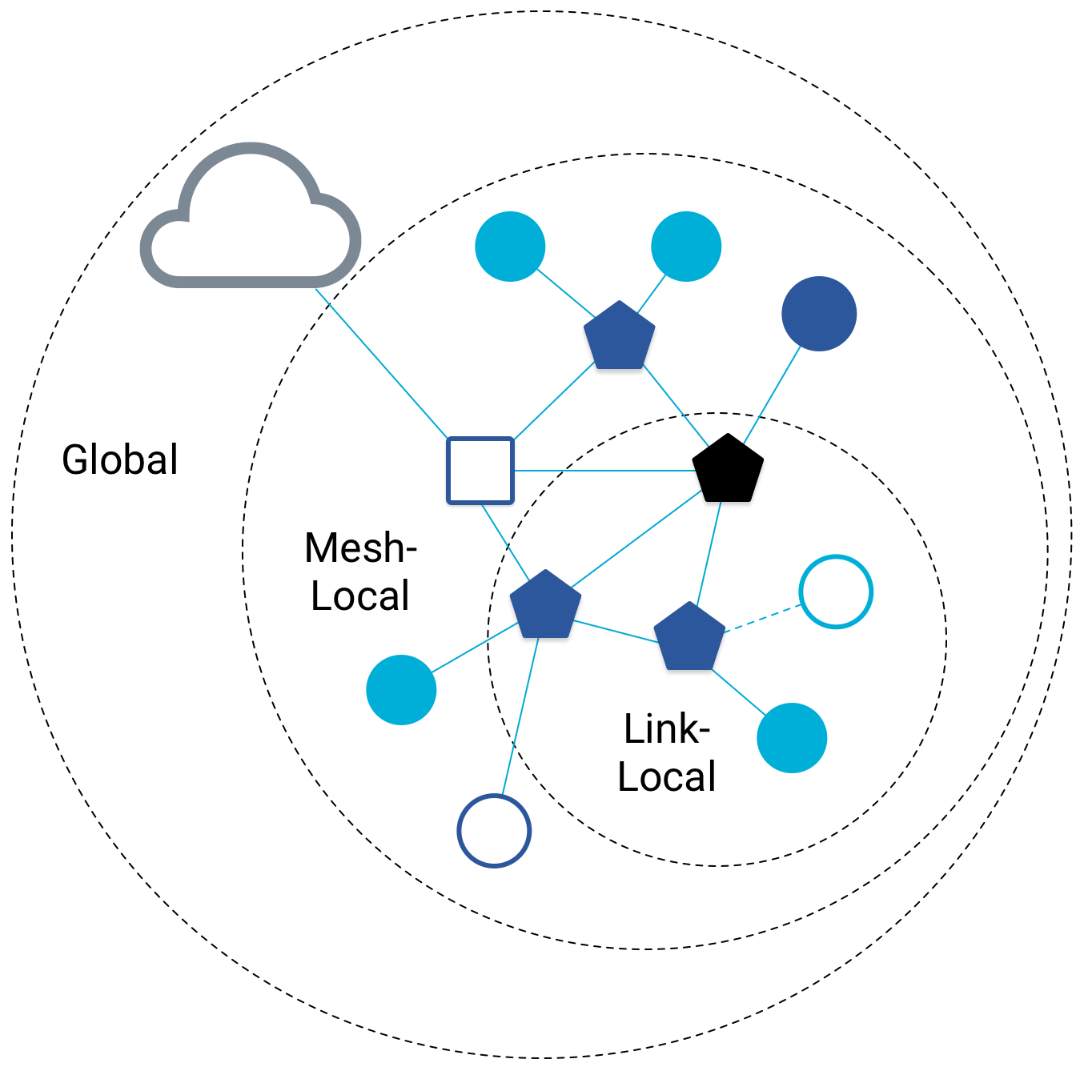
Benefit to IPv6: multiple address spaces per Thread device
Each device gets an IPv6 address for each way to contact it
Global IP address
Mesh-local IP address
Link-local IP address
Topology-based IP address
Send to parent
Send to child
Role-based IP address(es)
Send to all Routers
Send to Border Router

Slide 32
Traditional addresses in Thread
Link-Local Addresses
FE80::/16
Bottommost 64-bits are EUI-64 (MAC address with 0xFFFE in the middle)
Permanent for a given device (no matter the network)
Used for low-layer interactions with neighbors (discovery, routing info)
Mesh-Local Addresses
FD00::/8 (FD00:: and FC00:: are for local networks in IPv6)
Remaining bits are randomly chosen as part of joining the network
Permanent while connection is maintained to a network
Used for application-layer interactions
Global Addresses
2000::/3 (2000:: are for global, unicast IP addresses in IPv6)
Public address for communicating with broader internet through Border Router
Various methods for allocation (SLAAC, DHCP, Manual)

Slide 33
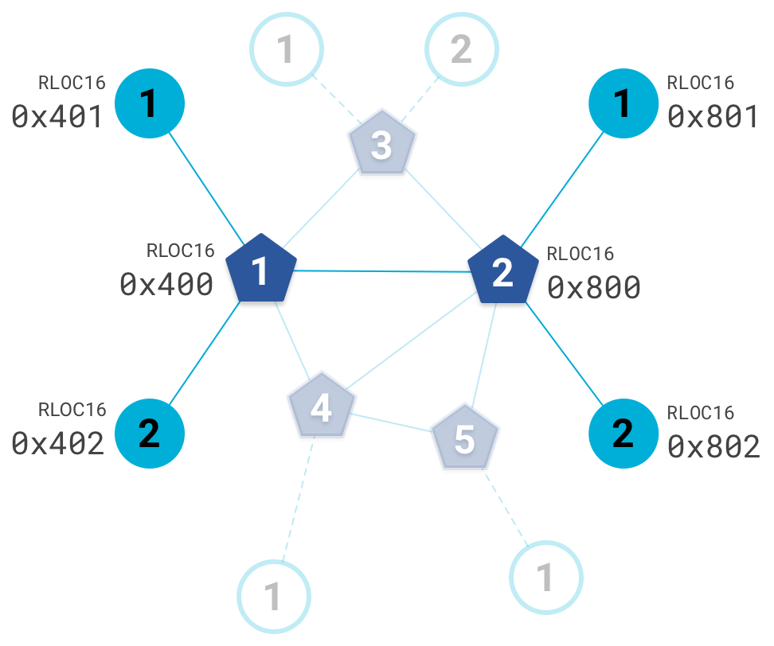
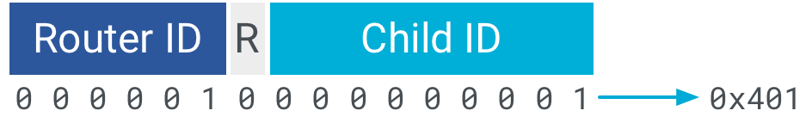
Topology-based addresses in Thread
FD00::00FF:FE00:RLOC16
Same top bits as mesh-local
Routing Locator (RLOC)
Router ID concatenated with Child ID
Changes with network topology
Used for routing packets

Slide 34
Role-based addresses in Thread
Multicast
FF02::1 – link-local, all listening devices
FF02::2 – link-local, all routers/router-eligible
FF03::1 – mesh-local, all listening devices
FF03::2 – mesh-local, all routers/router-eligible
Anycast
FD00::00FF:FE00:FCxx
00 – Thread Leader
01-0F – DHCPv6 Agent
30-37 – Commissioner
etc.

Slide 35
Break + Question
Which type of address to use for communication
Global
Mesh-local
Link-local
Topology
Role-based
Communicate with each circled target
4
3
Your Node
1
2

Slide 36
Break + Question
Options
Global
Mesh-local
Link-local
Topology
Role-based
Green node
Mesh-local
Topology (parent)
Link-local
Brown node
Mesh-local
Topology (other child of parent)
Maybe link-local
Pink node
Mesh-local
Role-based
Purple “cloud”
Global
4
3
Your Node
1
2

Slide 37
Outline
Thread Overview
Thread Addressing
Runtime Behavior
Using IP

Slide 38
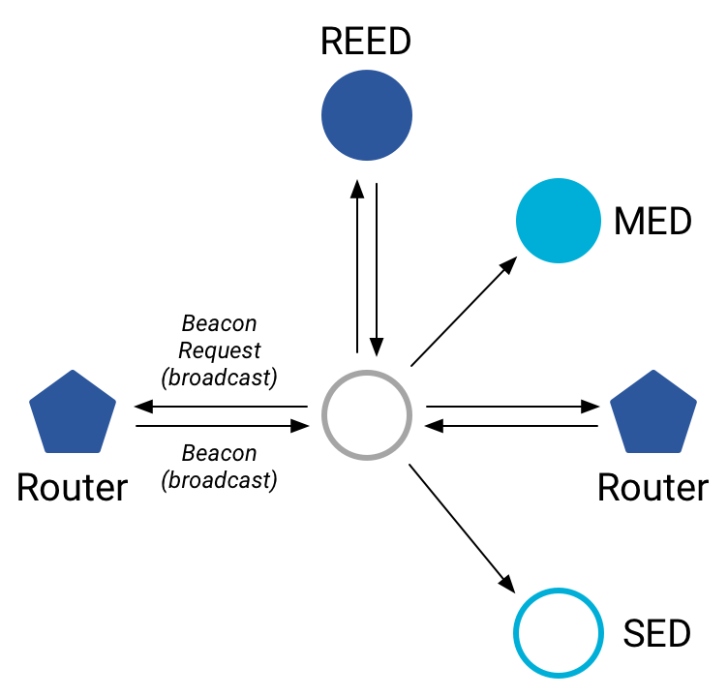
Discovering Thread networks
“Beacon Request” MAC command
Routers/Router-eligible devices respond
Payload contains information about network
Thread network specification
PAN ID – 16-bit ID
XPAN ID – extended 64-bit ID
Network Name – human-readable
Active scanning across channels can quickly find all existing nearby networks

Slide 39
Creating a new network
Select a channel (possibly by scanning for availability)
Become a router
Elect yourself as Thread Leader
Respond to Beacon Requests from other devices
Further organization occurs through Mesh-Level Establishment protocol

Slide 40
Mesh-Level Establishment
Creating and configuring mesh links
Payloads placed in UDP packets within IPv6 payloads
Commands for mesh
Establish link
Advertise link quality
Connect to parent
TLVs (Type-Length-Value)
Various data types that may be helpful within those packets
Addresses, Link Quality, Routing Data, Timestamps
0 | Command Type | TLV | … | TLV
OR (secure version)
255 | Aux Header | Command Type | TLV | … | TLV | MIC

Slide 41
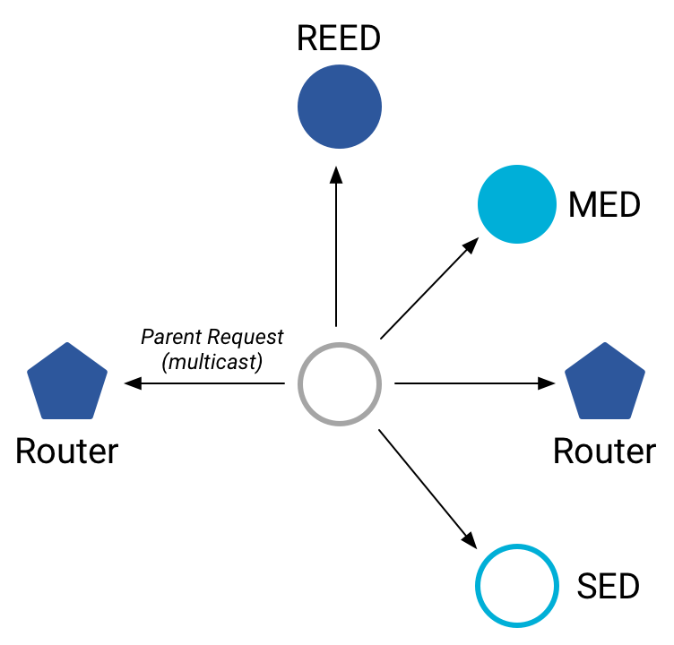
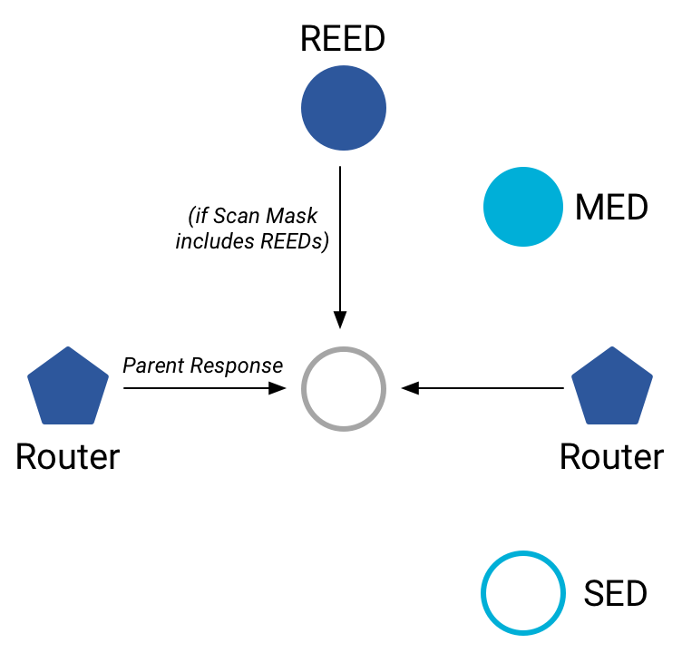
Joining an existing network
All devices join as a child of some existing router
Send a Parent Request (to all routers/router-eligible)
Using the multicast, link-local address
Receive a Parent Response (from all routers/router-eligible separately)
Contains information on link quality
Send a Child ID Request (to router with best link)
Contains parameters about the new child device
Receive a Child ID Response (from that router)
Contains address configurations

Slide 42
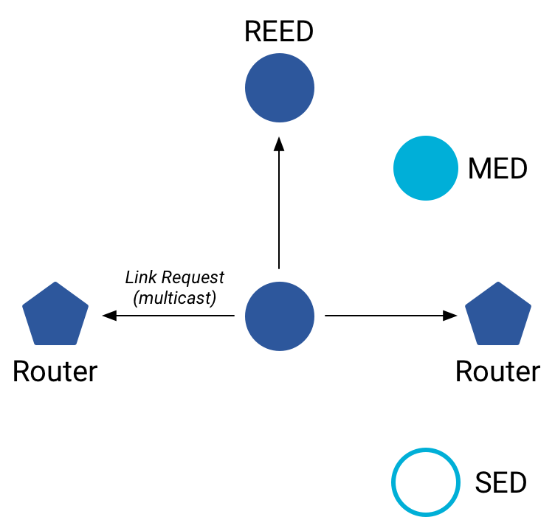
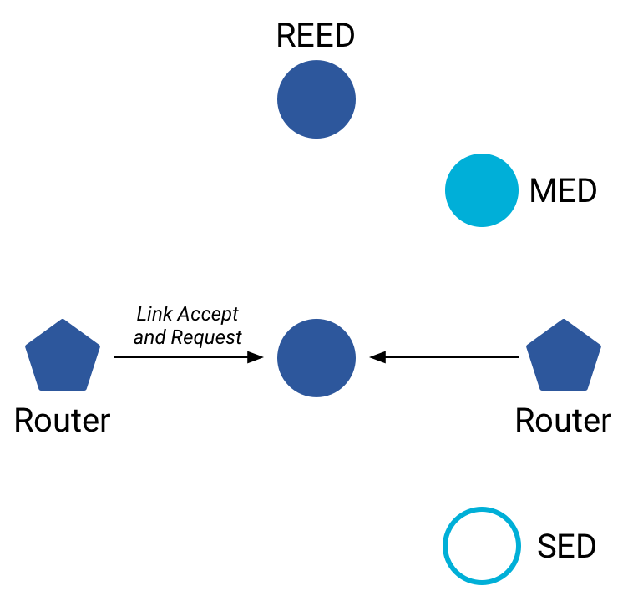
Becoming a router
Thread tries to maintain 16-23 routers (max 32)
Goals: path diversity, extend connectivity
Send a Link Request (to all routers/router-eligible)
Using the multicast, link-local address
Receive Link Accept and Request (from each router separately)
Forms bi-directional link
Send a Link Accept (to each router individually)

Slide 43
Outline
Thread Overview
Thread Addressing
Runtime Behavior
Using IP

Slide 44
Communicating with IP
Any communication that layers on top of IP is now possible
If there is a library to support it
Common choices
UDP
DNS – translate hostnames into IP addresses
SNTP – get real-world time, accuracy better than 1 second
CoAP – send and receive data

Slide 45
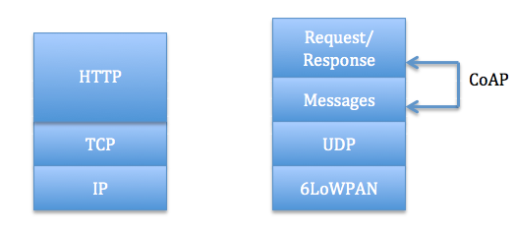
Constrained Application Protocol - CoAP
HTTP, but over UDP targeting less-capable devices
Same REST architecture
Adds capability for automatic retransmissions
CoAP Requests
Have a type: GET, POST, PUT, DELETE
Have a URL: /file/etc
Have data up to 65 KB

Slide 46
Sensor networks don’t use TCP (yet?)
Uncommon choice: TCP
Concerns: Too large, too slow, poorly suited to lossy networks
Also concerning: We’re just replicating TCP poorly
Work in progress:
Sam Kumar, Michael Anderson, Hyung-Sin Kim, David Culler. “Performant TCP for Low-Power Wireless Networks”. 2020.
The debate is still very much open

Slide 47
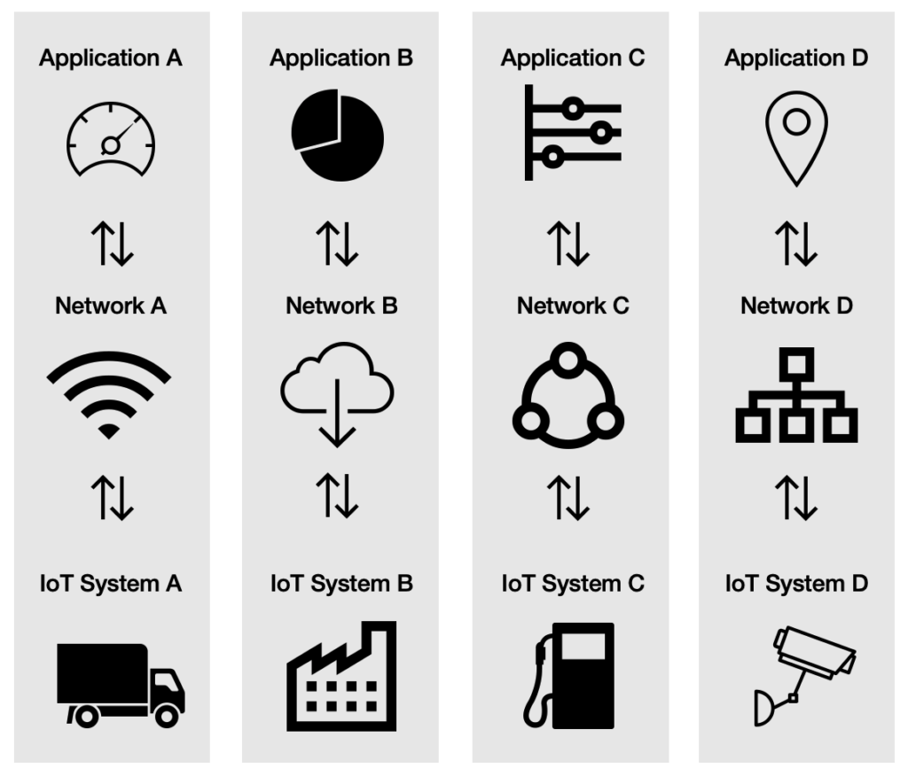
A problem: the siloed internet of things
Problem: companies are more interested in selling you the whole stack
Which then makes it harder for devices to be interoperable
This is not Thread or IP-specific, but a problem all IoT devices are facing
Branden’s concern:
What IP address do you send data to?
Manufacturer’s server is an obvious choice

Slide 48
Outline
Thread Overview
Thread Addressing
Runtime Behavior
Using IP

