Slide 1
Lecture 01 Introduction
CS433 – Wireless Protocols for IoT
Branden Ghena – Spring 2026
Materials in collaboration with Pat Pannuto (UCSD) and Brad Campbell (UVA)

Slide 2
Welcome to CS433!
Goal: get a feel for wireless communication and protocols
How are they used?
Why are they different and in what ways?
Which applications are they most useful for?
30 students (22 undergrad, 8 grad)
Lots of different backgrounds and interests (CS, CE, EE, ME, Data Science, IT)
This course is based on discussion and questions
Expect to attend classes, ask questions, and interact with others
You’re hopefully here because you want to be and want to learn

Slide 3
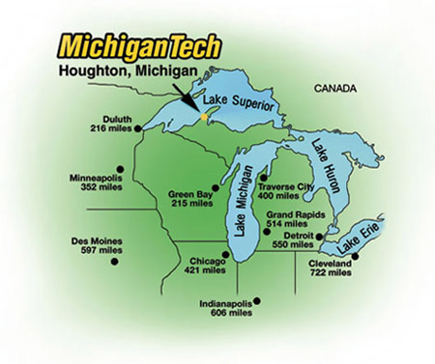
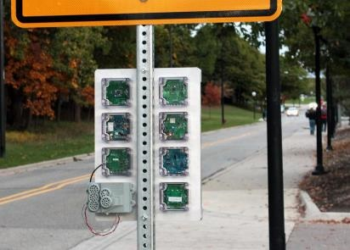
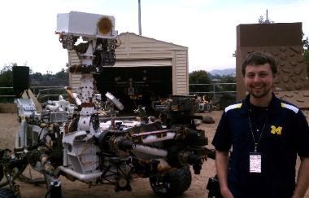
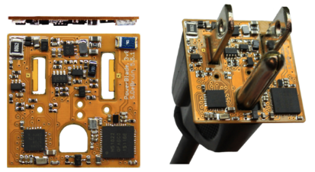







Branden Ghena (he/him)
Assistant Faculty of Instruction
Education
Undergrad: Michigan Tech
Master’s: University of Michigan
PhD: University of California, Berkeley
Research
Resource-constrained sensing systems
Low-energy wireless networks
Embedded operating systems: Tock
Teaching
Computer Systems
CS213: Intro to Computer Systems
CS343: Operating Systems
CE346: Microprocessor System Design
CS433: Wireless Protocols for the IoT
Things I love

Slide 4
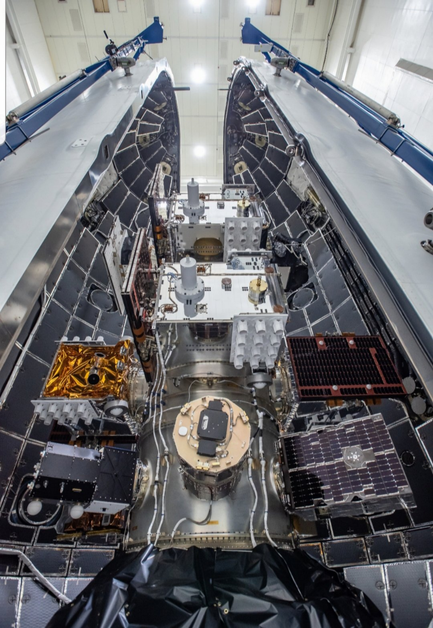
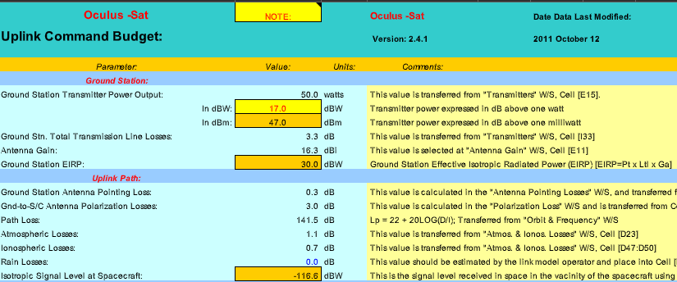
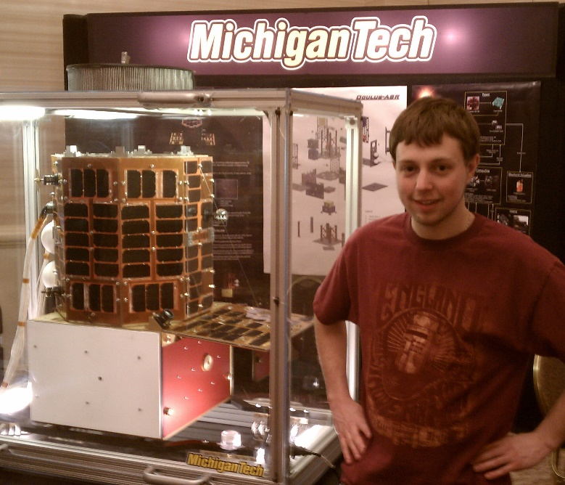
Undergraduate: satellite radios and computers
How the heck are you supposed to learn this stuff?

Slide 5

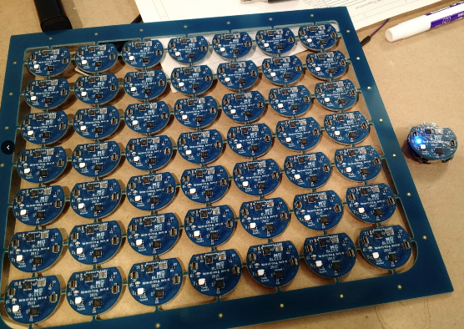
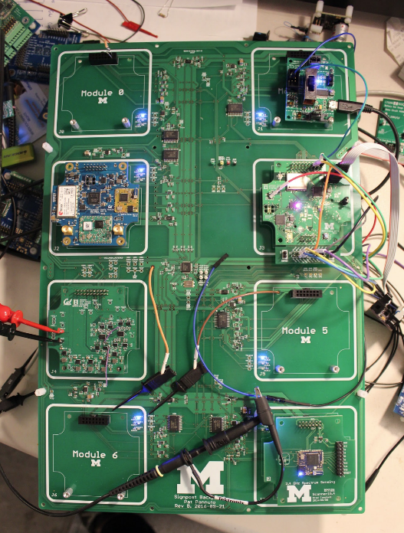
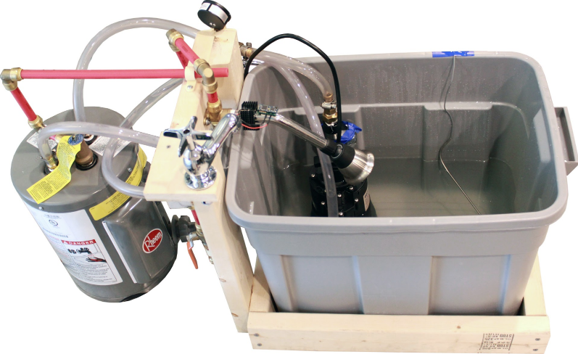
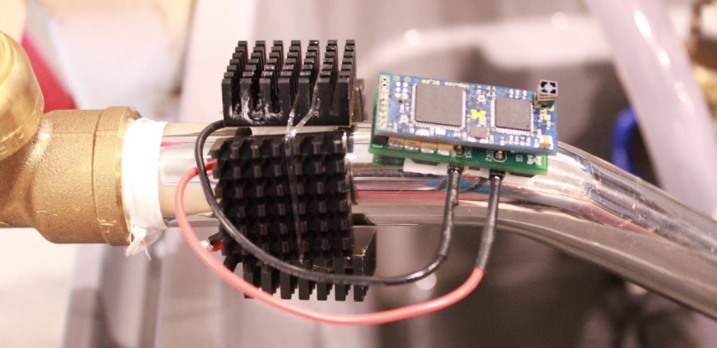
Grad school: resource-constrained embedded systems
Most interesting to me: the interfaces
Hardware and software
Applications and OS
Communication
Again: learn by doing
With significant assistance from my peers

Slide 6
Faculty: now I can choose what to teach!
Goal: provide classes that teach more advanced embedded systems topics
Overlaps strongly with CS and ECE, but hopefully useful to other engineering and sciences domains too
Result: this course!
Course goals: make students familiar with a number of different wireless protocols and their tradeoffs
Practical hands-on experience with as many networks as possible
Open-ended design for final, chance to delve deeply into materials
Updated to a real course number last year: CS433
Let me know if you still see CS397 references around anywhere

Slide 7
Today’s Goals
Introduction to the Internet of Things and Embedded Systems
Overview of the course
Introduction to wireless communication

Slide 8
Outline
Who and Why
Internet of Things
Embedded Systems
Course Overview
Overview of wireless networks

Slide 9

Perspective of this course
This class is about wireless protocols
For a specific domain: the Internet of Things
So we’ll spend some amount of time discussing the Internet of Things and embedded systems

Slide 10
Group Discussion: what is the Internet of Things?
Name a few Internet of Things devices
What are the qualities that designate those devices at “IoT”?

Slide 11
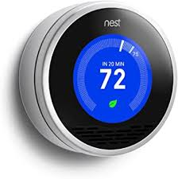
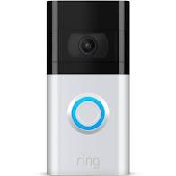



Group Discussion: what is the Internet of Things?
Name a few Internet of Things devices
What are the qualities that designate those devices at “IoT”?

Slide 12
Group Discussion: what is the Internet of Things?
Name a few Internet of Things devices
What are the qualities that designate those devices at “IoT”?

Slide 13
Thought experiment: headphones
What about battery powered wireless headphones?
Would that still count as IoT?

Slide 14
Thought experiment: headphones
What about battery powered wireless headphones?
Would that still count as IoT?
Feels to me like a personal device rather than infrastructure
Something important about having many users

Slide 15
Thought experiment: desktop IoT
What if the Nest thermostat was powered by an entire desktop?
8-core x86-64 processor, 32 GB RAM, 1 TB SSD
Would that still count as IoT?
Why don’t we see that in practice?

Slide 16
Thought experiment: desktop IoT
What if the Nest thermostat was powered by an entire desktop?
8-core x86-64 processor, 32 GB RAM, 1 TB SSD
Would that still count as IoT?
Why don’t we see that in practice?
Cost

Slide 17
Focus on energy needs
The origins of IoT are battery-powered sensing systems
And energy-harvesting devices
Why do we put so much focus on systems with batteries?
Why do they need batteries?

Slide 18
Focus on energy needs
The origins of IoT are battery-powered sensing systems
And energy-harvesting devices
Why do we put so much focus on systems with batteries?
Why do they need batteries?
Deployability

Slide 19
Largest IoT challenges: power and communication
This class is about wireless technologies
For resource-constrained systems, such as the IoT
We will focus on the tradeoffs between technologies
How they balance differing constraints
Power, spectrum, complexity, etc.
And the technical foundations of these designs and differences

Slide 20
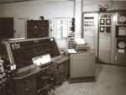
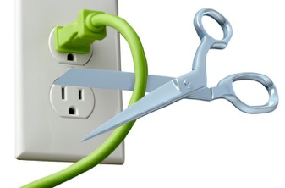
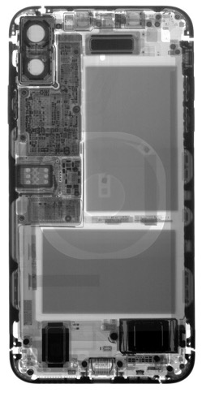
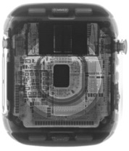
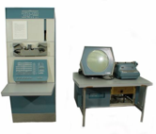


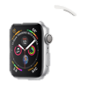

Energy is the defining constraint of emerging technologies
Mainframe
Computer
Workstation
By volume, the emerging computing classes are mostly energy storage
Volume is shrinking cubically
Laptop
Mini Computer
Battery
IoT/Wearable
Personal Computer
Smartphone
Notes:
Defining feature of modern computing classes is the amount of energy storage required to allow their operation
Clip art: http://www.ctecsolar.com/cut-cord-electric-company/
X-rays: iFixit teardowns

Slide 21
Branden’s take on the Internet of Things
Key features
Computation
Local to the device
With some capability for arbitrary compute and storage
Connectivity
Almost certainly wireless
Likely Internet, possibly local
Interaction
Sensing or Actuation
Secondary features
Low energy
(Relatively) Low cost

Slide 22
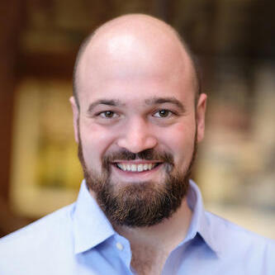
Pat Pannuto’s take on the Internet of Things
His early grad school essays described the “last inch” problem
Now he often says “expanding the reach of digital world”
For him, it is about ‘networked’ ‘things’
Which implicitly adds some computational capacity
Assistant Professor, UC San Diego
https://patpannuto.com/
He teaches a version of this course there, and we share materials back-and-forth!

Slide 23
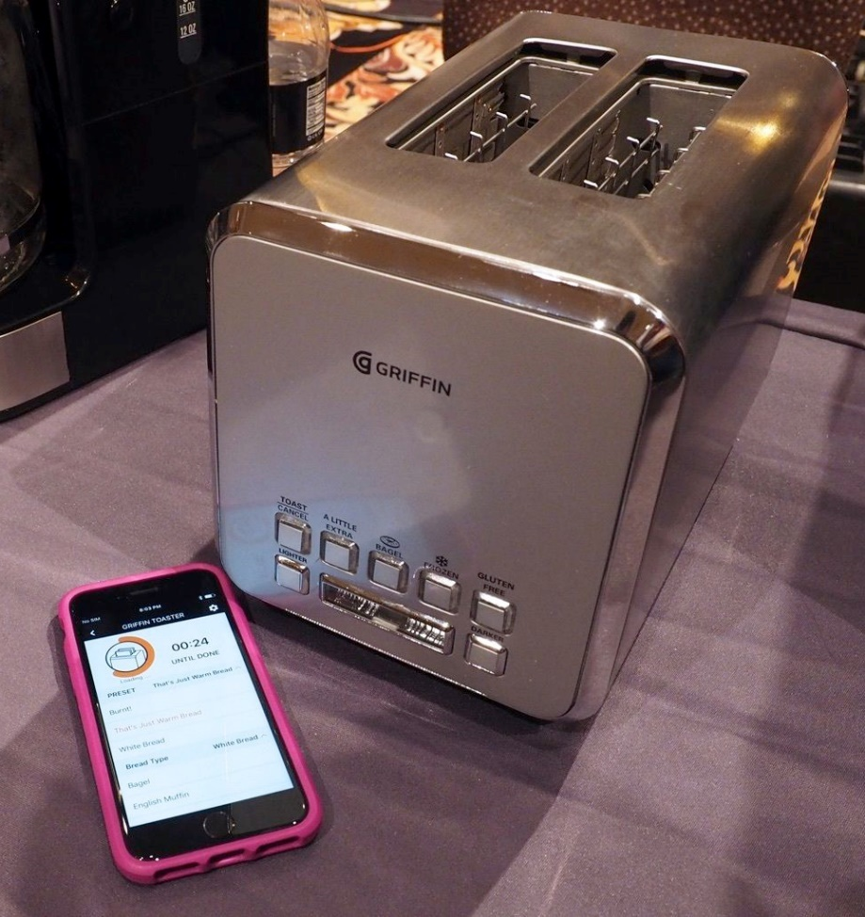
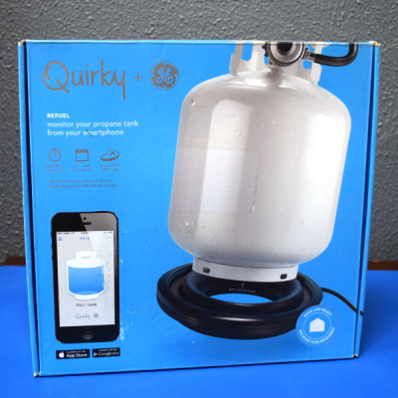
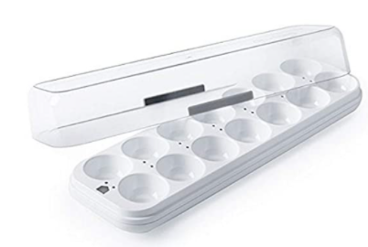
Warning: Internet of Crap

Slide 24
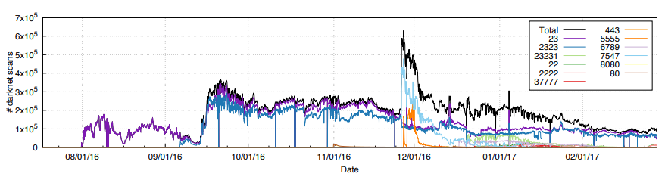
Internet of Insecure Crap
Mirai botnet (2016)
Takes control of up to 600,000 insecure connected devices
IP-attached cameras, DVRs, routers, printers
Used to DoS websites

Slide 25
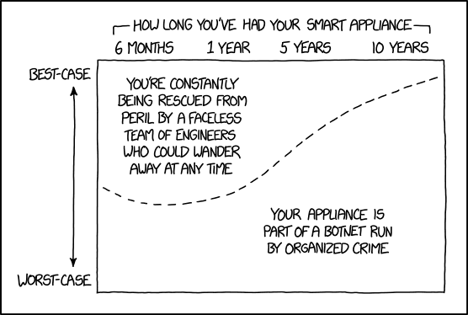
Break + xkcd
https://xkcd.com/1966/

Slide 26
Outline
Who and Why
Internet of Things
Embedded Systems
Course Overview
Overview of wireless networks

Slide 27
What are embedded systems
Embedded systems are devices containing computers that are used as a device rather than as a computer
Computers are embedded into the device
Internet of Things devices are embedded devices
But there are embedded systems that are not IoT
Smart vehicles and Robotics
Personal devices
Security or management chips inside other devices (like laptops/smartphones)
Example: USB-C power brick has more compute than Apollo 11 did
https://forrestheller.com/Apollo-11-Computer-vs-USB-C-chargers.html https://www.popularmechanics.com/technology/a30916315/usb-c-charger-apollo-11-computer/

Slide 28
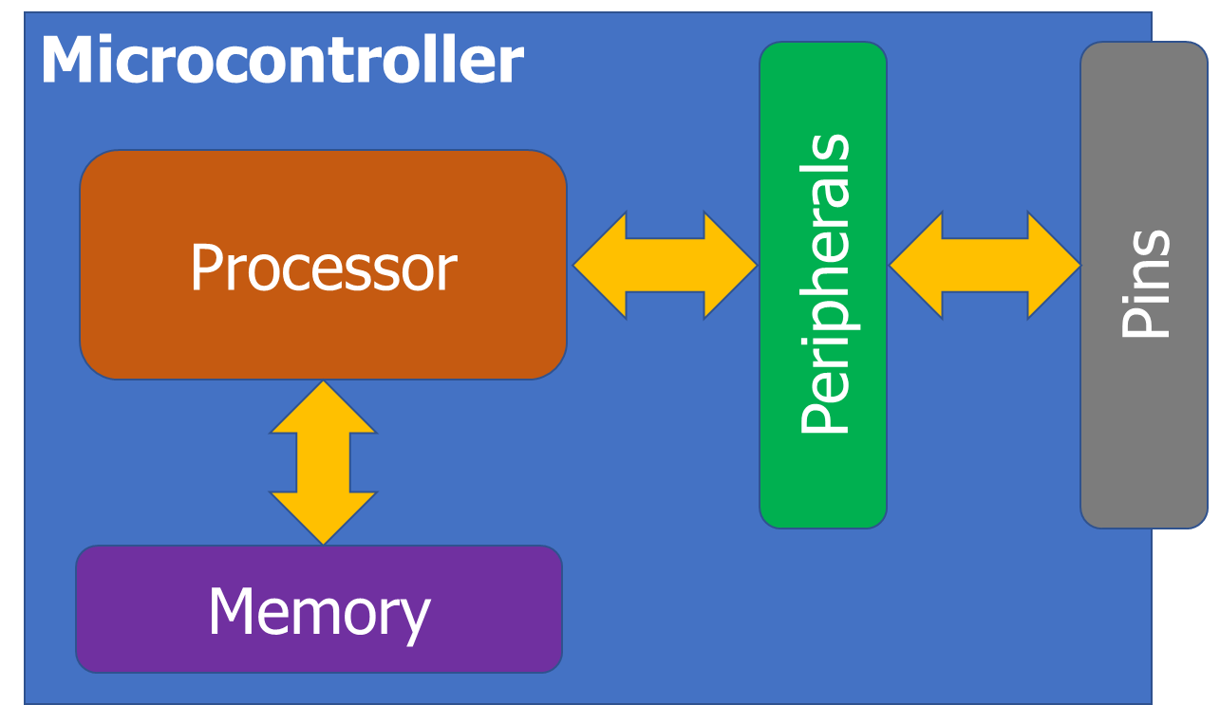
Microcontrollers drive most embedded systems
Microcontroller: entire computer in a single chip
Processor
Working memory: SRAM (type of RAM)
Nonvolatile memory: Flash (like SSD)
Peripherals
I/O pins
Analog Inputs and Outputs
Timers
Wireless radios
Cryptography accelerators
Buses
UART
I2C
SPI
USB

Slide 29
How is a microcontroller different?
A very constrained computer
Simple processor
16 or 32 bits (usually 32-bit these days)
Processor speed in MHz
Single core, pipelined processor
No cache, or maybe a very small instruction cache
Memory measured in kB
Code executes right from read-only Flash (which is part of the address space)
Sometimes no OS support at all
“bare-metal” programming

Slide 30
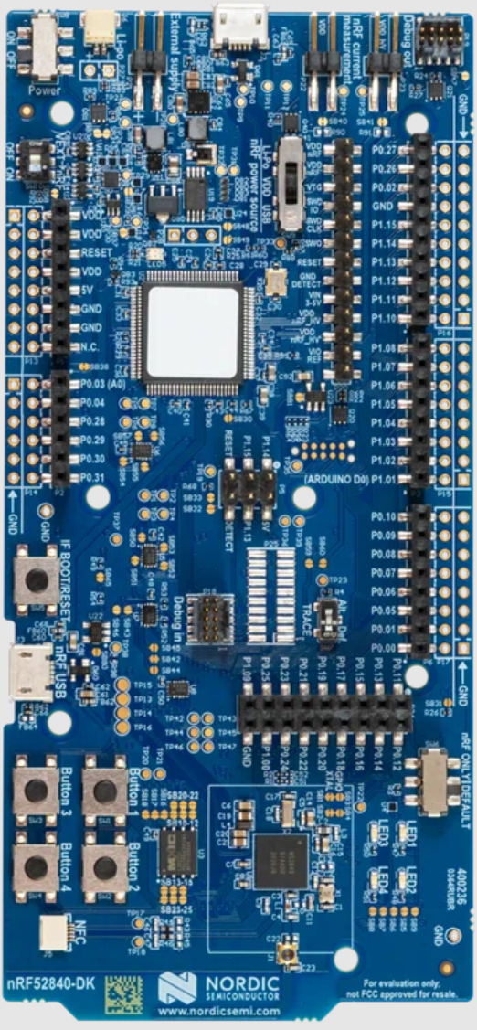
Nordic nRF52840DK - BLE & Thread
nRF52840 microcontroller dev kit
Microcontroller is the bottom chip
Everything else is just to program it, measure power, and connect to external things
nRF52840
64 MHz, 32-bit ARM Cortex-M4F
1 MB Flash, 256 KB RAM
A bunch of peripherals
Bluetooth Low Energy and 802.15.4 communication

Slide 31
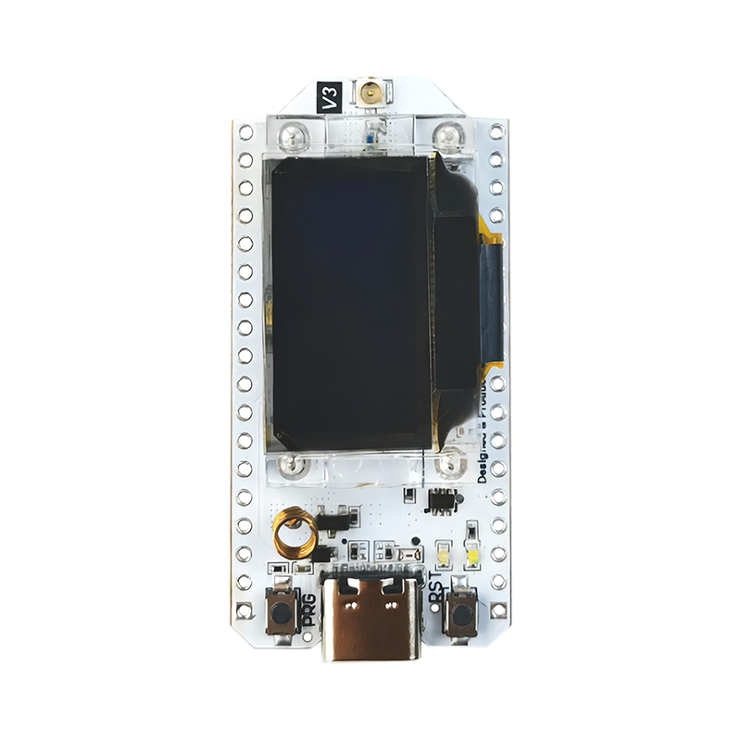
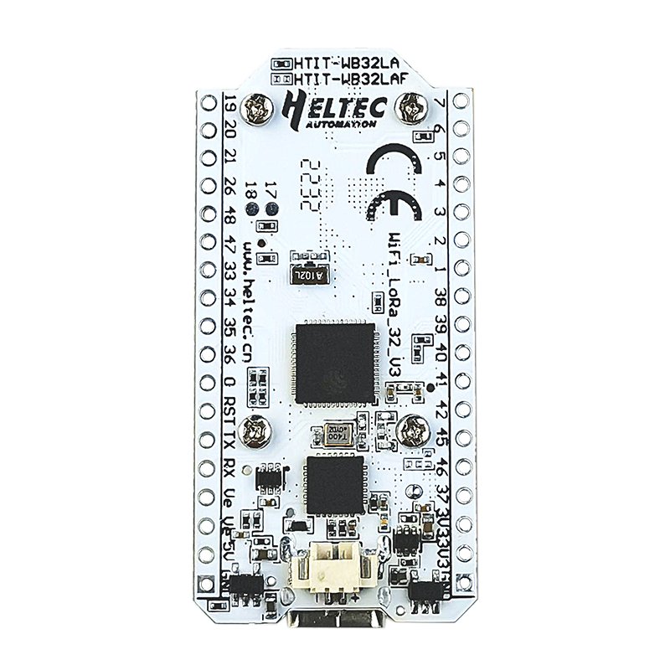
Heltec WiFi LoRa 32 v3 - WiFi & LoRa
ESP32 microcontroller
240 MHz, 32-bit custom architecture
384 kB Flash, 512 kB RAM
A bunch of peripherals
WiFi and Bluetooth Low Energy communication
SX1262
LoRa transceiver (connected over SPI)
OLED display

Slide 32
Embedded systems are programmed in C
C++ also used
Occasionally other things (Rust, Lua, Python) or even assembly
But even the few things C gives you aren’t necessarily available
Heap space possibly nonexistent
You have to choose some space in RAM to save as a heap
And then include the algorithm for allocating that memory
Printf could be nonexistent too!!
There’s no STDIN/STDOUT/STDERR because there is no shell
Might be able to do serial output though – our boards can

Slide 33
Embedded software
There are a multitude of embedded software systems
Every microcontroller vendor has their own
Popular platforms like Arduino
Embedded OSes
Contiki, Riot, Zephyr, Mynewt, FreeRTOS, Tock
nRF52840DK has support across all of these
WiFi LoRa 32 v3 should work with some
Best support likely in Arduino

Slide 34
Break + Question
What’s the advantage of a microcontroller? Why not use a traditional computer processor instead?

Slide 35
Break + Question
What’s the advantage of a microcontroller? Why not use a traditional computer processor instead?
Simplicity
Processor, memory, and peripherals are all in one chip
Makes the circuit board easier to design too
Cheaper in practice
They don’t sell as many low-end processors anymore
They still sell many low-end microcontrollers
(this is somewhat of a circular chain though)

Slide 36
Outline
Who and Why
Internet of Things
Embedded Systems
Course Overview
Overview of wireless networks

Slide 37
Course Staff
Instructor: Me!
PMs: Evan Bertis-Sample + Arthur Mendes Pereira
Lots of prior experience in this area
We’ll have weekly office hours to support you all
Schedule posted probably next week

Slide 38
Asking questions
Class and office hours are always an option!
Ed Discussion:
Post questions
Answer each other’s questions
Find lab partners
Information from the course staff
Post private info just to course staff
Please do not email me! Post to Ed instead!
Let me know if you don’t have access

Slide 39
Lectures
Tuesdays and Thursdays, in this room at this time
No particular textbook makes sense for this class
Very few schools teach this area of communication/networks
Automatically recorded (best-effort)
Panopto tab in Canvas
Slides posted to Canvas homepage right before lecture

Slide 40
Grading
45% Lab projects - hands-on semi-guided activities
Small groups of three students (except for the first one)
5 of these in total
22.5% Homeworks - pencil-on-paper practice
4 of these, with the last worth 1.5x
Individual work
15% Quizzes - 15-minute, on-paper
3 of these
Tuesdays during the last part of class, dates on Canvas
17.5% Final design project - paper writeup
One of these due during exam week
Individual work

Slide 41
Labs
Practice interacting with and considering networks
Group work (teams of three) except the first one
1-2 weeks to complete them
Should all include real hardware and real wireless communication
Wireshark (worth a little less, individual starter lab)
Bluetooth
Thread
WiFi
LoRaWAN
Graded primarily on “checkoffs”

Slide 42
Friday lab sessions
Reserved time on Fridays to start labs
Time when you whole group is available to work together
I’ll be there to help answer questions and get you started
You are expected to attend these when we’re starting a new lab
Let me know in advance if you’re sick and can’t make it
Attendance is part of your grade for these
Some Fridays are “Lab Office Hours”, so I’ll be there but you aren’t required to be. Good time to work and get checkoffs though

Slide 43
Homeworks
Analysis, designing, calculating
Background
BLE packets
Matter
Cellular (worth double)
Usually take the form of some details on paper and you looking stuff up on your own
Looking through wireless specifications and searching on the internet
Individual work

Slide 44
Late Policy
You can submit homeworks and labs late
20% penalty to maximum grade per day late
Example: two days late means maximum grade is 60%
There are exceptions to this:
We will be flexible with deadlines for problems outside of your control
Sick, family emergency, broken computer
Contact me (via Ed Discussion) as soon as possible

Slide 45
Slip Days
Slip days let you turn in a homework late and receive no penalty
Each student gets 3 slip days
Apply to homeworks and labs (not final project or quizzes)
You don’t need to tell us you’re using them, we’ll just automatically apply them at the end of the year as best helps your grade
Be sure to coordinate about them on partner assignments
Examples:
Turn in a homework three days late
Turn in a homework two days late and a lab one day late
Turn in a homework four days late with only a one-day penalty

Slide 46
Quizzes
In-class, on-paper, closed notes individual quizzes
Usually about 15 minutes and held at the end of lecture
Cover the last three weeks worth of material
So make sure you’re up-to-date on what we’re talking about
First quiz is Tuesday, April 21st (fourth week of classes)

Slide 47
Final design project
Design a communication plan for an application of your choice
Explain application and determine what its constraints are
Cost, power, scale, data, reliability
Actually think through how it will work, citing real-world capabilities
Research and cite data you find
Explain and consider tradeoffs
This is the “final project” for the course
Design rather than real hardware

Slide 48
On upper-level courses
The point is to be here because you’re actually interested in the material
Come to lecture and discuss ideas with us
Focus on actually understanding stuff
You can help guide the course
It’s okay to derail lecture (sometimes) with interesting tangents
I’m happy to add material on other topics if you ask for it

Slide 49
What to expect
Very curated and structured
(e.g. CS111)
Real world project at a job
Computing course structure and guidance
autograder
online documentation
detailed programming assignments
defining requirements and milestones
course-specific libraries
multiple solutions
full provided documentation
real-world software stacks
Figure stuff out on your own! (or with a group)
Goal is to help prepare you to engineer projects in the real world

Slide 50
Architecture of a lecture
Full
Administrivia
+ stretch break
Open Question
Summary
+ Bonus
Attention
0
20
25
50
53
78
80
Time (minutes)

Slide 51
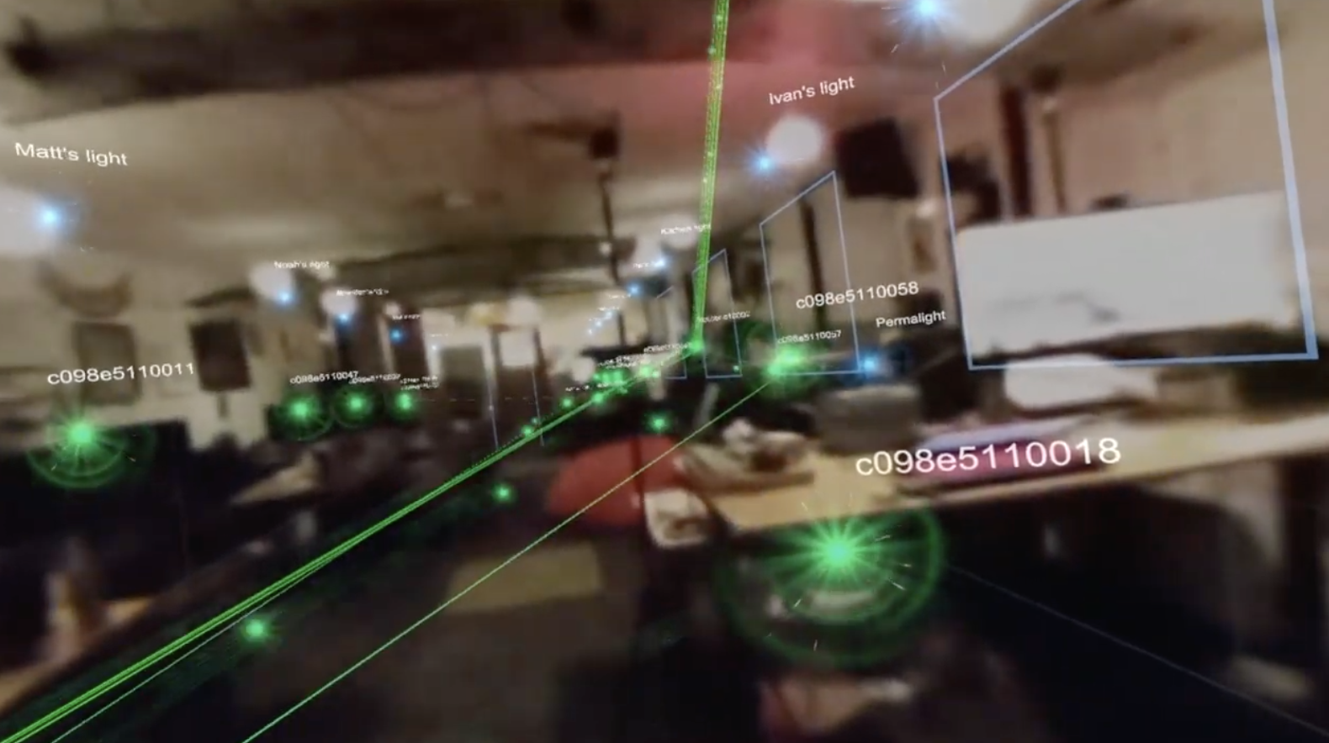
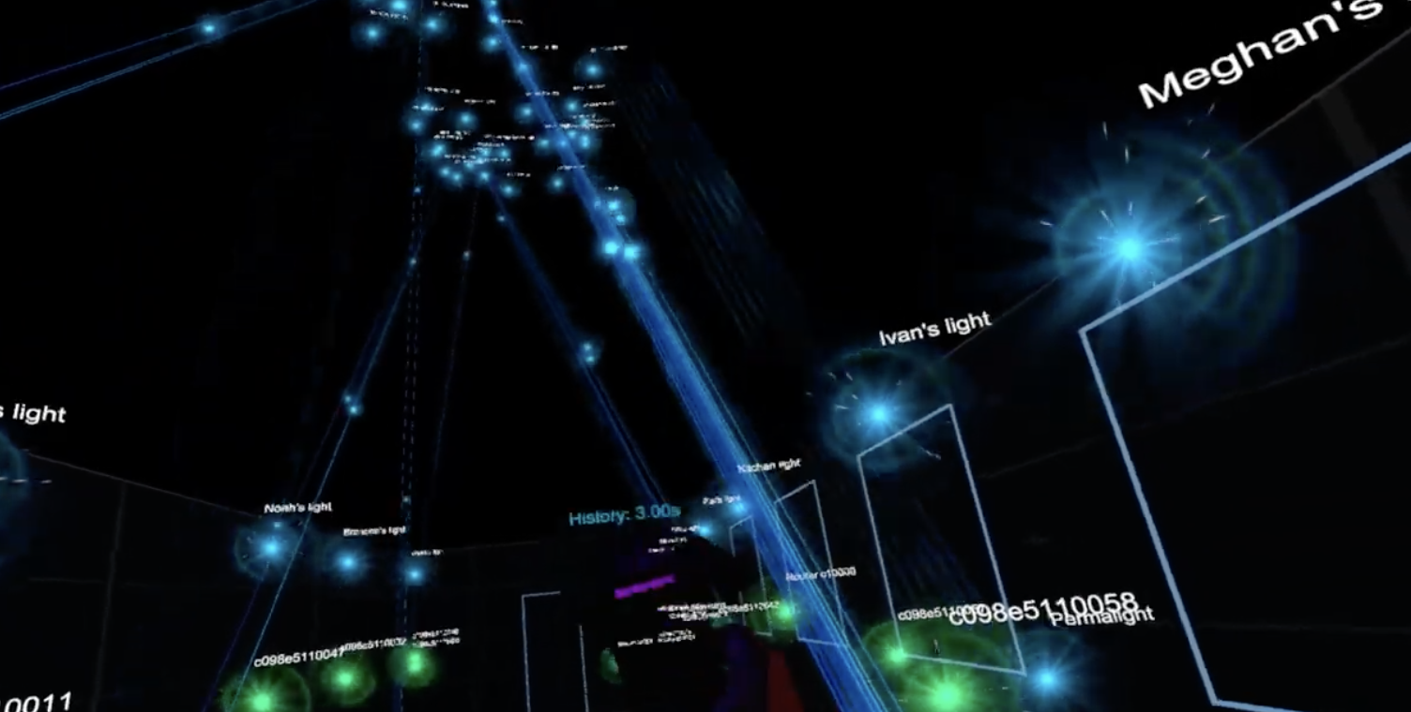
Break+Video
Wireless Network Visualization Dr. Meghan Clark – UC Berkeley -> Resideo https://www.youtube.com/watch?v=KLOdp54_qJ4

Slide 52
Outline
Who and Why
Internet of Things
Embedded Systems
Course Overview
Overview of wireless networks

Slide 53
Bluetooth Low Energy (BLE)
Bluetooth Classic was good for enabling device to device communication
But not particularly low energy
And very bad at short-term, one-time connections
Bluetooth Low Energy was developed to improve this
Focuses on low-energy interactions
Much lower throughput that Bluetooth
Supported by hardware devices already in smartphones
Humans can interact directly with nearby devices!!

Slide 54
802.15.4 & Thread
802.15.4 is a low-energy physical layer
Radio chips have been widely available for 15-20 years
Significant amounts of sensor network research have focused on building layers on top of 802.15.4
Access control layers
Network layers
Thread is a selection of these possibilities to make a network
Uses IPv6 networking!!
Basis for modern smart-home standards: Matter

Slide 55
WiFi (802.11)
Ubiquitous wireless communication
High energy requirements for high throughput communication
Now accessible through relatively low power radios
ESP32 is dominant here
Still significantly more effort than BLE or Thread
IoT devices can use the same WiFi that’s already available
No need for additional infrastructure!!

Slide 56
LPWANs (Low-Power Wide-Area Networks)
How do we collect data from city-scale deployments?
There’s an unmet need for long-range, but low-throughput networks
Existing cellular technologies focus on human requirements
Still a brand new space (relatively)
Unlicensed-band technologies in last 10 years: Sigfox and LoRaWAN
Cellular technologies in last 4 years: LTE-M and NB-IoT
Focus on long-range, low-energy, low-throughput
One gateway can cover an entire city!!

Slide 57
Extra topics
Backscatter
Insanely low-energy communication
Enables energy-harvesting indoor devices
Localization
How do we find all this stuff?
And how do devices determine where they are relative to each other?
Satellite Communication
Satellite-to-ground communication (some satellite-to-cellular)
Other topics are possible if desired! (seriously!)
Reach out and tell me what you want to learn about (that’s clearly a class topic)

Slide 58
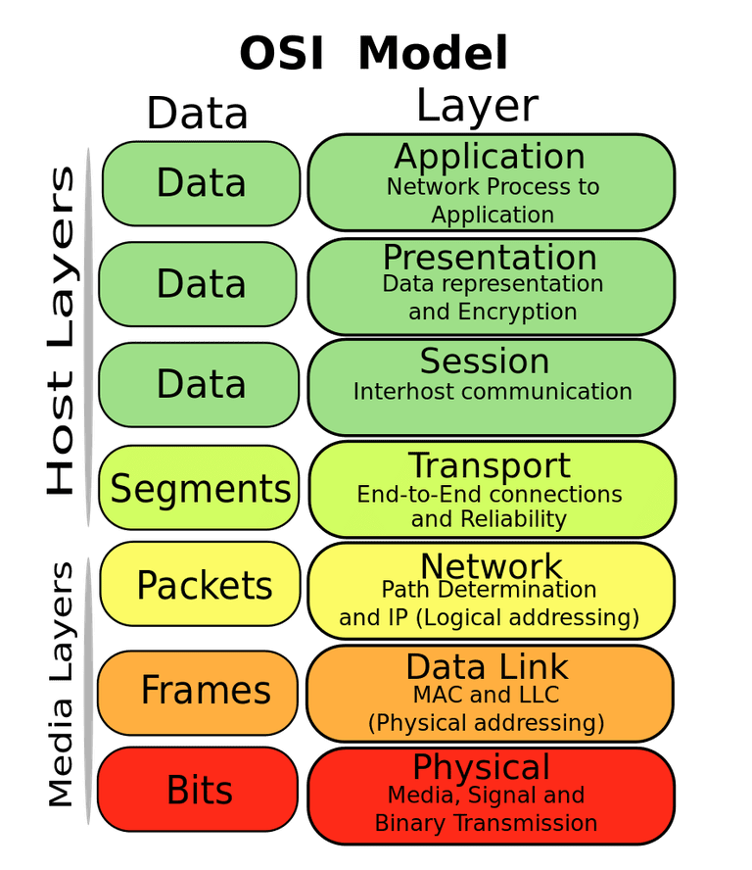
OSI model of communication layers
Transport
Sending data between applications
TCP and UDP
Network
Sending data between networked computers
IP
Data Link
Sending collections of bits
Ethernet, WiFi
Physical
Sending individual bits
Ethernet, WiFi

Slide 59
Where does this class focus?
Transport
Sending data between applications
TCP and UDP
Network
Sending data between networked computers
IP
Data Link
Sending collections of bits
Ethernet, WiFi
Physical
Sending individual bits
Ethernet, WiFi
CS domain
CS340, CS440
This course!
EE domain EE307, EE378, EE380

Slide 60
Outline
Who and Why
Internet of Things
Embedded Systems
Course Overview
Overview of wireless networks

