Slide 1
Lecture 04 BLE Advertisements
CS433 – Wireless Protocols for IoT
Branden Ghena – Spring 2026
Materials in collaboration with Pat Pannuto (UCSD) and Brad Campbell (UVA)

Slide 2
Announcements
BLE packets homework is posted now
Lab: BLE this Friday (with hardware!)
Need to make groups of three students
Fill out partnership survey on Ed Discussion ASAP

Slide 3
Today’s Goals
Quick overview of Physical and Link layers for BLE
Describe BLE advertising and scanning roles
Deep dive into advertisements. Questions we might ask as researchers.
What are the real-world use cases of advertisements?
How much energy do advertisements take?
What is the probability of receiving a packet?
What is the probability of receiving data?

Slide 4
Basics of Bluetooth Low Energy (BLE)
Direct device-to-device communication
Usually: Computer to Thing
Smartphone to device, Laptop to device, etc.
Focus on making the “Thing” really low energy
Push energy-intensive requirements onto “Computer”
Devices (Computer or Thing) are servers with accessible fields
Not the traditional send-explicit-packets interface you might be expecting
Lower layers are still exchanging packets to make it work

Slide 5
Bluetooth Classic and BLE co-exist & have different use cases
Bluetooth Classic (around since 1999)
Continuous data communication
Can afford higher battery power requirements
Bluetooth Low Energy (introduced in 2010)
Small amounts of data transfer
Low power requirements
“months or years” on small batteries
Ideal for IoT devices
Headphones
Mobile Photo
Printers
Fitness Trackers
Tracking Devices (eg: Apple AirTag)
Switches
and Sensors
Car BT Audio
Notes:
As mentioned before, devices needing continuous, short-range data and audio streaming use Bluetooth Classic. This version of Bluetooth is standard in wireless printers, keyboards, speakers, and in-car entertainment systems.
Similarly, Bluetooth Low Energy (LE) powers a range of computer peripherals and audio devices. But due to low power usage, it’s ideal for IoT devices like fitness monitors, smart watches, and the like.
smart home, health, sport, and fitness sectors.
Bluetooth latest core specification: v5.3

Slide 6
BLE mechanisms
Advertising
Discovery
Advertisements – broadcast messages indicating device details
Ephemeral, uni-directional communication from Advertiser to Scanner(s)
ALOHA access control
Connections
Interaction
Bi-directional communication between Peripheral and Central
Maintained for some duration
TDMA access control

Slide 7
BLE network topology
Peripheral
Connection
Central & Scanner
Scanner
Connection
Peripheral
Advertisement
Advertisement
Advertisement
Advertisement
Advertiser
Advertiser
Advertiser

Slide 8
Multiple roles at the same time
Topology picture is a simplification of roles
A single device can have multiple roles simultaneously
Scanning and Advertising simultaneously
Peripheral and Scanner and Advertiser simultaneously
Peripheral and Scanner and Central and Advertiser simultaneously
Getting a bit out of hand though
One Peripheral can even be connected to multiple Centrals
Not in the original design though: you’ll find old docs saying you can’t
And it’s not a normal use-case for BLE

Slide 9
Break + Check your understanding
Which roles is each device likely to have?
Keyboard
Laptop
Smartphone

Slide 10
Break + Check your understanding
Which roles is each device likely to have?
Keyboard
Advertiser and Peripheral
Laptop
Scanner and Central
Smartphone
Advertiser, Peripheral, Scanner, and Central

Slide 11
Outline
BLE Layers
Physical Layer
Link Layer
BLE roles
Advertising
Scanning
Scan Responses
Communicating with advertisements
Advertisement Use Cases
Energy Use
Packet Collisions

Slide 12
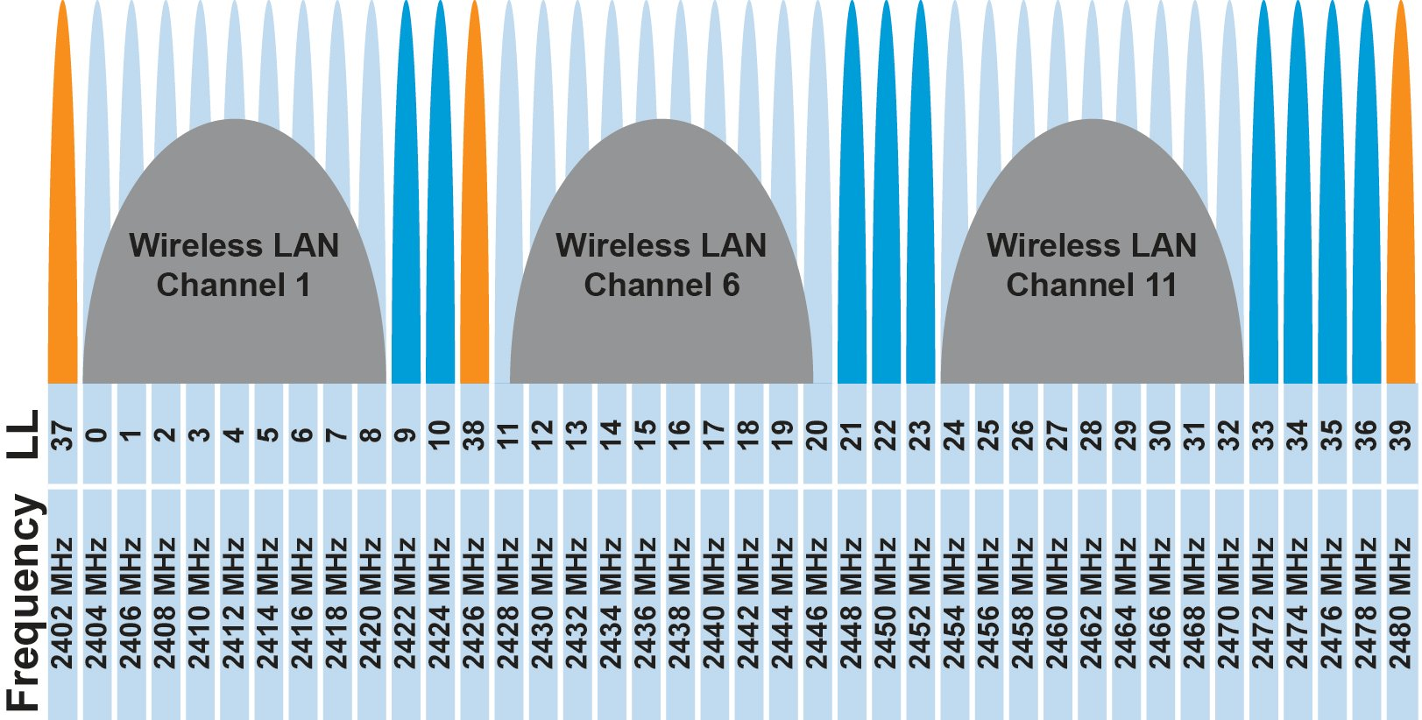
BLE frequency
2.4 GHz carrier, Forty 2-MHz channels, 1 Mbps data rate
37, 38, 39 for advertising
0-36 for connection (FHSS)
Why doesn’t BLE avoid WiFi altogether?

Slide 13
BLE frequency
2.4 GHz carrier, Forty 2-MHz channels, 1 Mbps data rate
37, 38, 39 for advertising
0-36 for connection (FHSS)
Why doesn’t BLE avoid WiFi altogether?
Can’t on 2.4 GHz
Wants 2.4 GHz for technology improvements

Slide 14
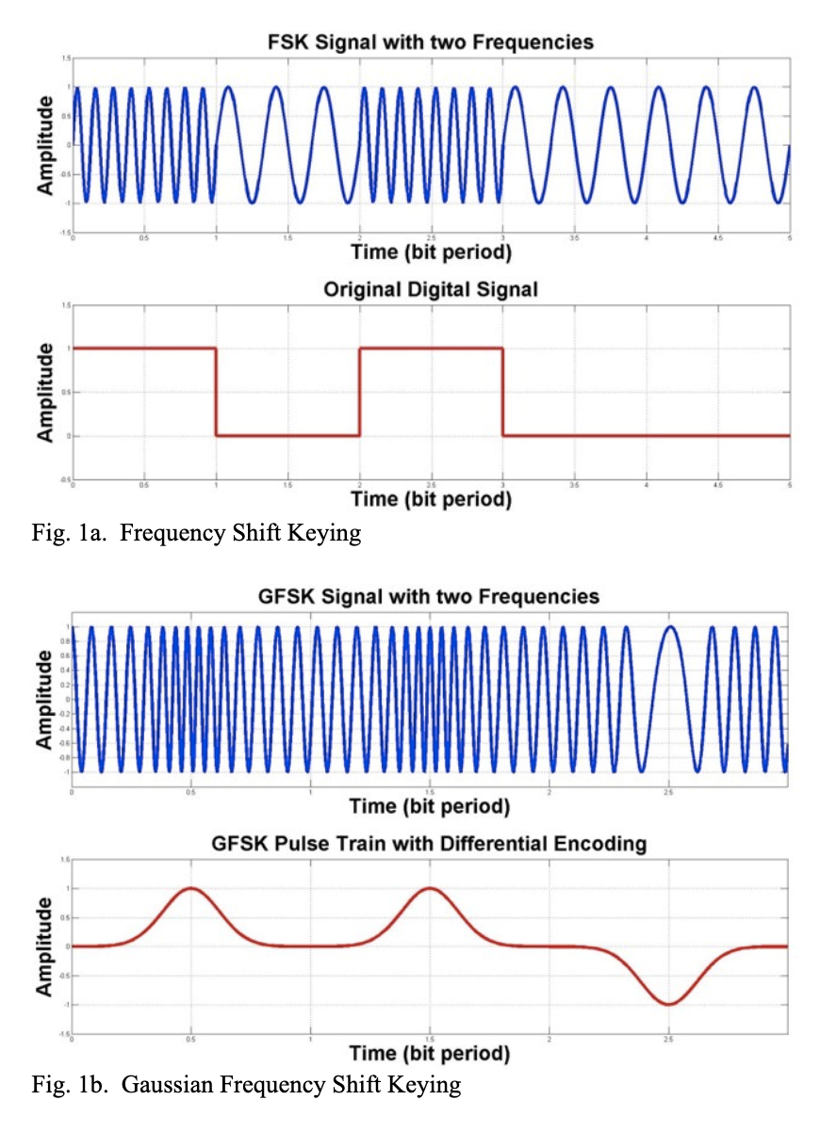
BLE modulation
Gaussian Frequency-Shift Keying (GFSK)
Improvement on base Frequency-shift Keying
Smoother transitions between bits -> reduces nearby interference

Slide 15
Why use GFSK?
Gaussian FSK lessens spectral leakage at the expense of some loss in intersymbol discriminability
Translation: GFSK reduces bandwidth at the cost of bit errors
Notes:
Images from http://j3.rf-explorer.com/40-rfe/article/53-tutorial-how-to-use-rf-explorer-to-monitor-a-rfbee?start=4

Slide 16
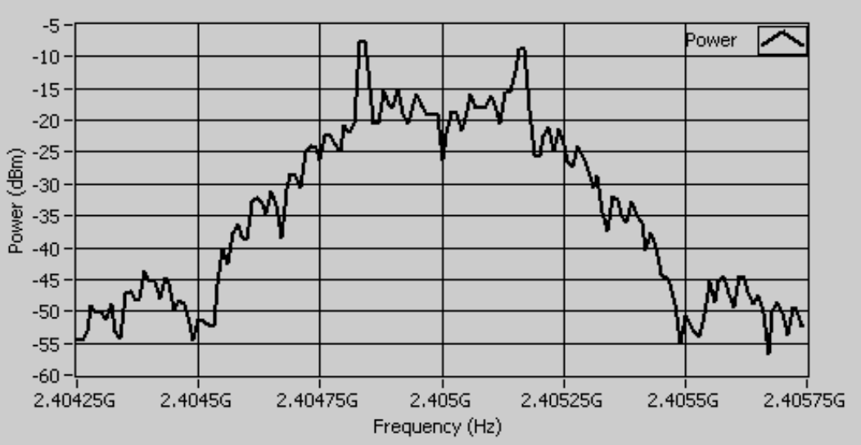
An example from `good case` BLE hardware
2 MHz BLE channels (+/- 0.001 GHz)
Energy focused on +/- 0.55 MHz
With some much smaller energy near the edges of the channel
Notes:
Fig 8 in https://download.ni.com/evaluation/rf/intro_to_bluetooth_test.pdf

Slide 17
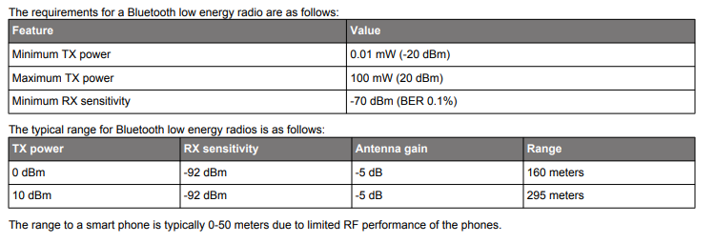
BLE signal strength
Remember nRF52840 capabilities
Transmit: up to 8 dBm
Receive sensitivity: -95 dBm

Slide 18
Outline
BLE Layers
Physical Layer
Link Layer
BLE roles
Advertising
Scanning
Scan Responses
Communicating with advertisements
Advertisement Use Cases
Energy Use
Packet Collisions

Slide 19
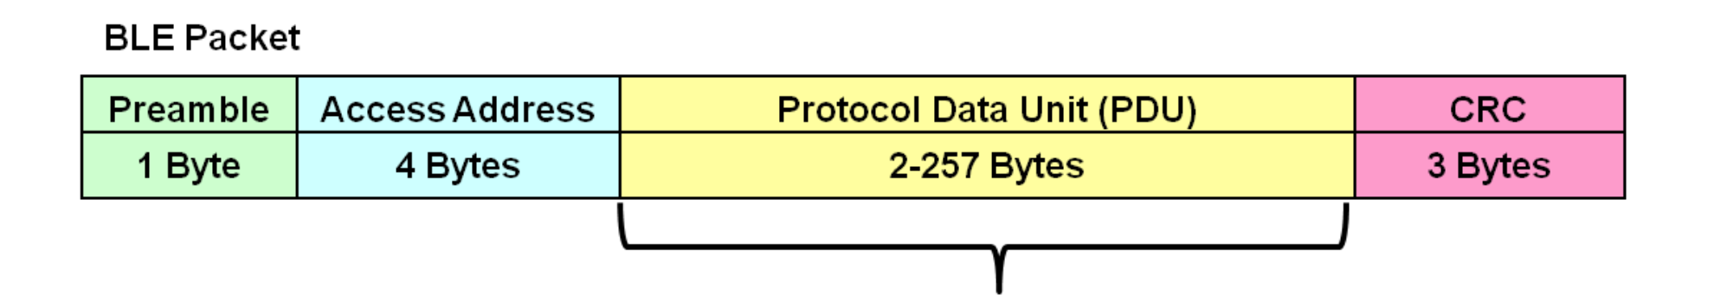
Packet structure
Same packet structure for both advertisements and connections
Fields are filled in little endian (the opposite of network byte order 😡)
Access address unique for each connection
Somewhat randomly chosen (spec has rules)
In Advertising always set to 0x8E89BED6
Data

Slide 20
Device addresses
Public and private address forms
Public
48 bits: 24-bits of company ID, 24-bits of company assigned number
Literally the same MAC address scheme as Ethernet and WiFi
Private
Top two MSbs specify type. Options:
46 bits of random
46 bits of hash of an identity key
Why have the two types?

Slide 21
Device addresses
Public and private address forms
Public
48 bits: 24-bits of company ID, 24-bits of company assigned number
Literally the same MAC address scheme as Ethernet and WiFi
Private
Top two MSbs specify type. Options:
46 bits of random
46 bits of hash of an identity key
Why have the two types? Privacy

Slide 22
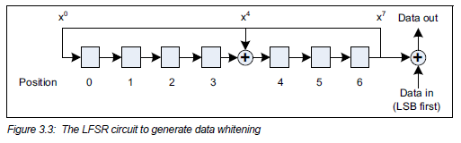
Data whitening
Avoid long series of repetitive bits (all zeros or all ones)
Would cause RF noise to be more focused in one direction
Radio hardware desires output to have zero DC-bias (or close to that)
Great example of the PHY and MAC being interwoven in wireless
I always forget this exists, since hardware usually handles it automatically

Slide 23
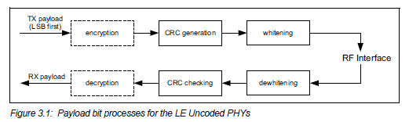
Bit processing pipeline

Slide 24
Break + Question
With enough scanners, could you track BLE devices as they move?

Slide 25
Break + Question
With enough scanners, could you track BLE devices as they move?
Link Layer
Depends on how long they use a device address for
You can do a scan of BLE transmissions to find device addresses
Scans at multiple locations can detect when a device moves throughout an area
But if the device re-randomizes between two scanners, you can’t follow it anymore
Re-randomizing at a scanner could be detectable…
Or if the user has more than one device with unsynchronized rotation schedules

Slide 26
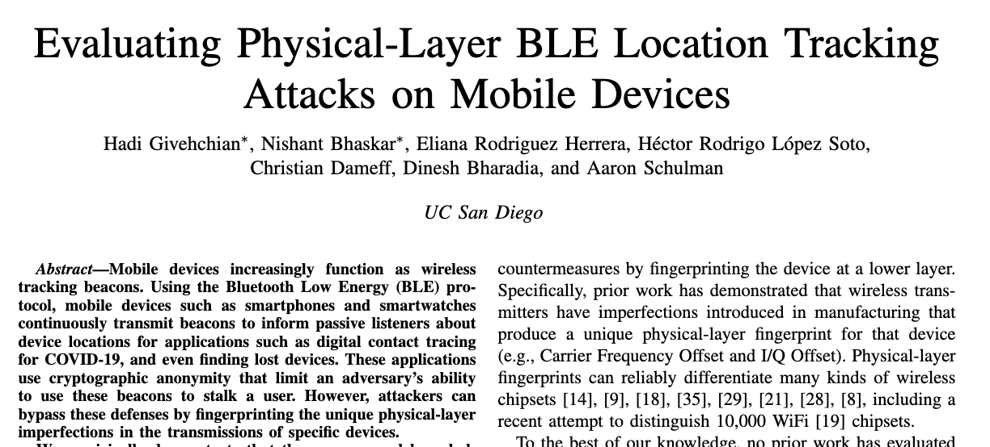
Break + Question
With enough scanners, could you track BLE devices as they move?
Physical Layer
Fingerprint unique physical-layer imperfections in signals
Looking at things like amplitude and timing
2022 paper out of UCSD explores this

Slide 27
Outline
BLE Layers
Physical Layer
Link Layer
BLE roles
Advertising
Scanning
Scan Responses
Communicating with advertisements
Advertisement Use Cases
Energy Use
Packet Collisions

Slide 28
BLE network topology
Peripheral
Connection
Central & Scanner
Scanner
Connection
Peripheral
Advertisement
Advertisement
Advertisement
Advertisement
Advertiser
Advertiser
Advertiser

Slide 29
Advertising
BLE discovery mechanism
Make nearby devices aware of advertiser’s existence
Communicate some information from or about advertiser
Traditional purpose is to enable connections, but this is also useful for general communication
Advertisements
Periodic broadcast messages with data
Scan Requests/Responses
Scanner sends responses after getting a request
Only occurs when scanner is listening
Almost literally “bonus advertisement data”

Slide 30
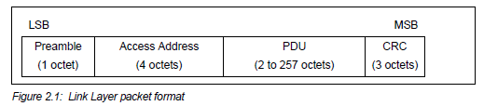
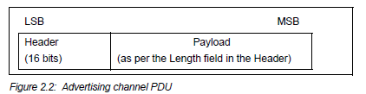
Advertising packet layering

Slide 31
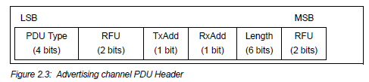
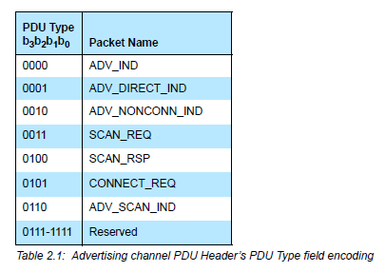
BLE advertising header
ADV_IND
Advertisement
Allows connections and scan requests
ADV_NONCONN_IND
Advertisement
No connections or scan requests
ADV_SCAN_IND
Advertisement
No connections but allows scan requests
SCAN_REQ
Scan request
SCAN_RSP
Scan response
RFU: Reserved
for Future Use

Slide 32

Advertisement payloads
AdvA – address of the advertiser
TxAdd bit from header specifies if this is a “public” or “random” address
Remaining up to 31 bytes are available for use
Putting it all together, up to 47 bytes total:
BLE Packet
Advertising PDU
Preamble 1 Byte | Access Address 4 Bytes | Header 2 Bytes | Advertiser Address 6 Bytes | Advertiser Data (Payload) 0-31 Bytes | CRC 3 Bytes

Slide 33
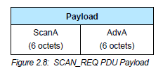
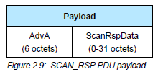
Scan Requests and Responses
Scan request
Request for additional information
Just the two addresses: the scanner’s and the advertiser’s
Scan response
Identical to an advertisement in structure but only occurs after a request
Usually has additional data not in the advertisement

Slide 34
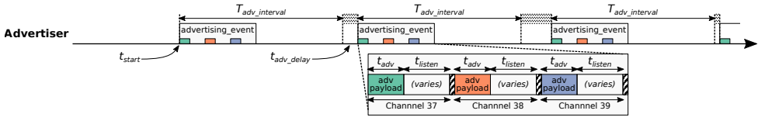
Advertising timing
Advertising Events occur periodically [20ms – 10.24 s] (or longer)
Plus a random delay after each instance [0-10ms]
Why?
User picks the rate as a tradeoff of energy and discovery latency

Slide 35
Advertising timing
Advertising Events occur periodically [20ms – 10.24 s] (or longer)
Plus a random delay after each instance [0-10ms]
Why? Avoid repeat collisions
User picks the rate as a tradeoff of energy and discovery latency

Slide 36
Advertising event
Three transmissions, one on each advertising channel
Usually in the same order
Transmission, followed by listening window on that same channel
Requests will be sent >=150 us (Inter-Frame Spacing, IFS) after Tx
Followed by a retune to the next channel frequency
This short listen window is the magic “low energy” part

Slide 37
Preserving energy in communication
Most energy is spent listening
This is due primarily to how long listening durations are compared to transmissions
Example: maximum-sized BLE transmission:
8 bits/byte * 47 bytes = 376 bits at 1 Mbps = 0.376 ms transmitting
So listening for an entire second is >2500 times longer

Slide 38
Payload of an advertisement
What do you stick in the BLE payload anyways?
Theoretically whatever you want, but that isn’t very compatible
Point is to specify capabilities of the advertiser
Desire: specify payloads in such a way that all scanners can interpret what they mean about the device
This is different from traditional internet packets
Broadcasts are for _anyone_ to hear, not a specific server/application
Which fields are or aren’t present is device-specific
A lot more possible fields than will be used on any one device

Slide 39
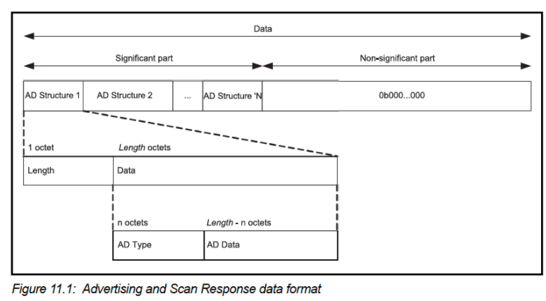
TLV Format
Type – Length – Value (Wikipedia)
Actually, BLE does the length part first
Scanner can hop through length/type pairs to find what interests it

Slide 40
Payload types
Listed in the Core Specification Supplement [Supplement v9]
Each might have their own considerations about AD Data format
Flags (supported modes: BLE and Bluetooth) required by Apple?
Name
Service UUID
TX Power Level
Manufacturer-specific data
And about twenty others

Slide 41
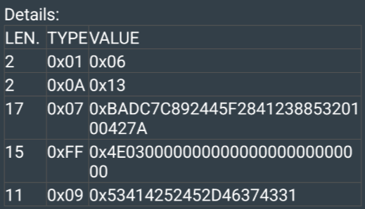
Example: BLE advertisement payload
This particular payload (52 bytes) is a combination of advertisement data and scan response data
Example payload:
02 01 06 02 0A 13 11 07 BA DC 7C 89 24 45 F2 84 12 38 85 32 01 00 42 7A 0F FF 4E 03 00 00 00 00 00 00 00 00 00 00 00 00 0B 09 53 41 42 52 45 2D 46 37 43 31
Break + Question:
What is the Local Name of this device? Type 0x09
Bytes in the Local Name type are ASCII values
Bonus: what is this device?

Slide 42
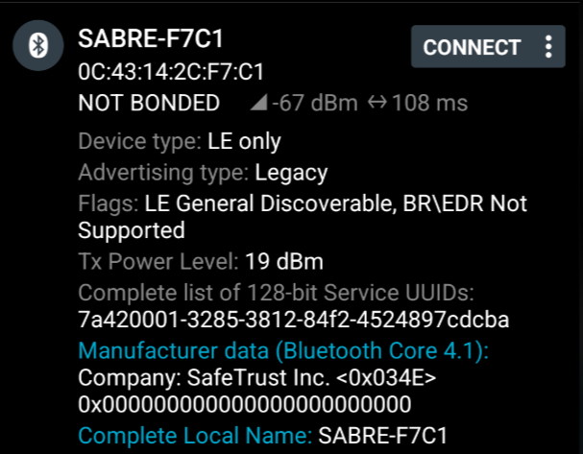
Example: BLE advertisement payload
This particular payload (52 bytes) is a combination of advertisement data and scan response data
Example payload:
02 01 06 02 0A 13 11 07 BA DC 7C 89 24 45 F2 84 12 38 85 32 01 00 42 7A 0F FF 4E 03 00 00 00 00 00 00 00 00 00 00 00 00 0B 09 53 41 42 52 45 2D 46 37 43 31

Slide 43
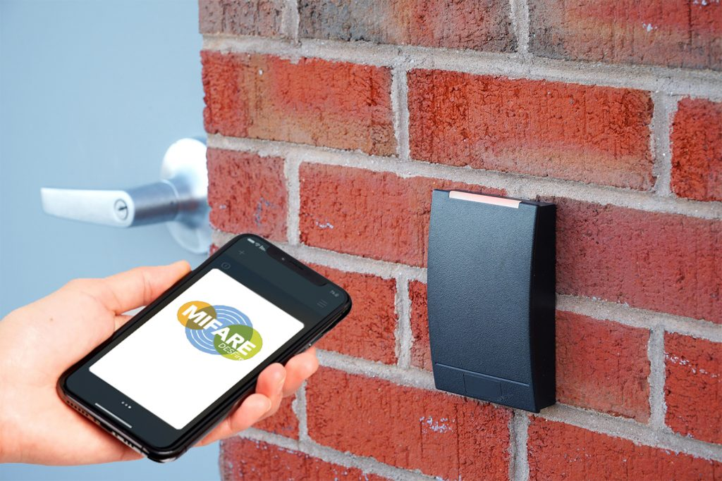
What is this device?
Bluetooth module for door ID scanner

Slide 44
Outline
BLE Layers
Physical Layer
Link Layer
BLE roles
Advertising
Scanning
Scan Responses
Communicating with advertisements
Advertisement Use Cases
Energy Use
Packet Collisions

Slide 45
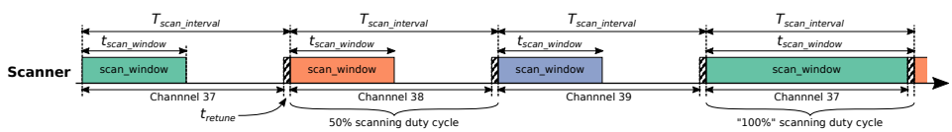
Scanning Pattern
Iterate through channels, listening for advertisements
T_{scan_interval} controls rate at which channels are changes
T_{scan_window} controls duty cycle of listening
Why listen at a low duty cycle?

Slide 46
Scanning Pattern
Iterate through channels, listening for advertisements
T_{scan_interval} controls rate at which channels are changes
T_{scan_window} controls duty cycle of listening
Why listen at a low duty cycle? Save energy

Slide 47
A warning about scanning expectations
Scanners will NOT receive 100% of packets sent
Even ignoring range issues
Packets are lost due to (in roughly descending order):
Duty cycle
Sharing 2.4 GHz antenna with WiFi
Packet collisions
Retune period after each scanning interval
Dropped packets in the receive software

Slide 48
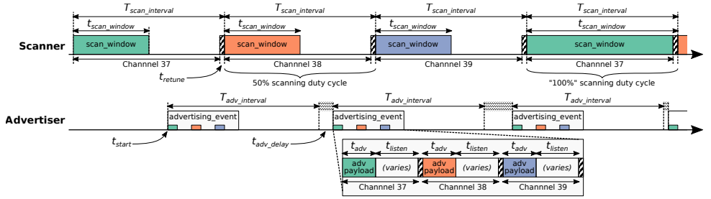
Putting it all together
Advertisements are received when the channel of the scan window and the channel of the advertisement overlap in time (and space)

Slide 49
Outline
BLE Layers
Physical Layer
Link Layer
BLE roles
Advertising
Scanning
Scan Responses
Communicating with advertisements
Advertisement Use Cases
Energy Use
Packet Collisions

Slide 50
Scan requests/responses seem intriguing
Why not send most data in scan responses instead of advertisements?
Theoretically could reduce energy costs
Scan we use scan requests as a form of acknowledgement?
Could relieve need for redundant transmissions
Problem: scan requests/responses don’t work all that well

Slide 51
Scan Requests and Responses are broken
Goal: provide a little extra advertisement data on demand
Problem: exponential backoff for lost messages
Scanners backoff if there is a request without a response
Assumption: collision with another scanner
But collisions also occur with other devices advertising
Which shouldn’t require backoff
Result: scan requests occur less frequently than expected/desired
Instead, just send additional data in additional advertisements
Kravets, Robin, Albert F. Harris III, and Roy Want. "Beacon trains: blazing a trail through dense BLE environments." Proceedings of the Eleventh ACM Workshop on Challenged Networks. 2016.

Slide 52
Outline
BLE Layers
Physical Layer
Link Layer
BLE roles
Advertising
Scanning
Scan Responses
Communicating with advertisements
Advertisement Use Cases
Energy Use
Packet Collisions

Slide 53
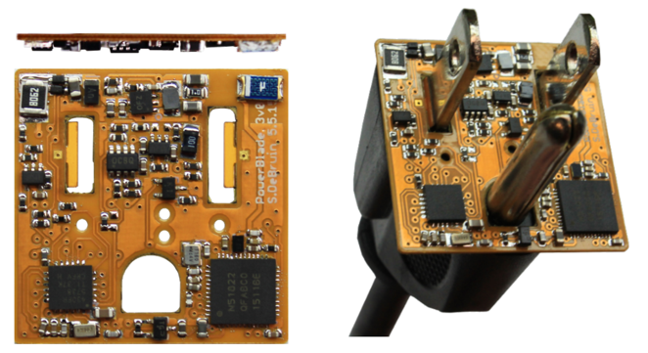
Advertisements are sufficient for some applications
BLE advertisements are uncoordinated, broadcast messages designed for discovery.
Devices are being deployed using advertisements.
Beacons – iBeacon
Tracking – Tile
Local communication – Apple Continuity
Sensor deployments – PowerBlade
Notes:
PowerBlade is a great example of this.
It’s a plug-load power meter
Initially configured to use advertisements as a simple method for reading measurements with a smartphone
We are interested in household deployments where dozens of PowerBlades will be deployed to measure all the loads in a home
Can we still use BLE advertisements for data transfer in the presence of many other devices?

Slide 54
Beacons
Advertising with advertisements!
Web of Things
Real-world tags that broadcast virtual-world identifiers
iBeacon and Eddystone
Formats for sending URLs and device identifiers
Use existing BLE fields (Service Data and Manufacturer-Specific Data)
Faded in popularity significantly

Slide 55
Tracking
Find devices nearby
Get a sense of distance to the device
Find my X
Tile: find my keys
Apple: find my device (before UWB radios)
Uses TX power level field
Lists the transmitted power of the device
Pathloss = TX power – RSSI (all in dBm)

Slide 56
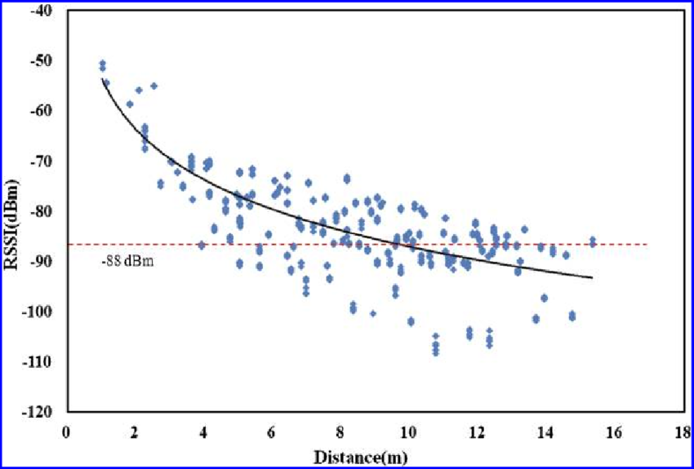
Problem with RSSI-based distance – not accurate
Pathloss is NOT only due to distance
RSSI is way worse at this than you hope it would be
Citation: literally everyone has made this figure at some point

Slide 57
Local communication: Apple “Continuity”
Key part of Apple’s “ecosystem”, including:
Handoff
Start tasks on one device and continue on another device
Universal Clipboard,
Copying of data from one Apple device and pasting on another
iPhone Cellular Calls
Make calls using iPhone’s cellular connection on Mac or iPad

Slide 58
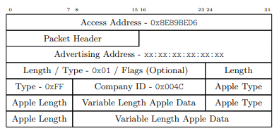
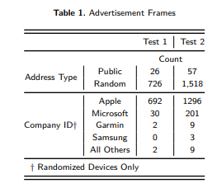
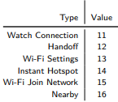
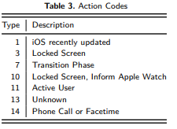
Communication with only nearby devices
Uses BLE “Manufacturer Specific Data” to communicate
Martin, Jeremy, et al. "Handoff all your privacy–a review of apple’s bluetooth low energy continuity protocol." Proceedings on Privacy Enhancing Technologies 2019.4 (2019): 34-53.

Slide 59
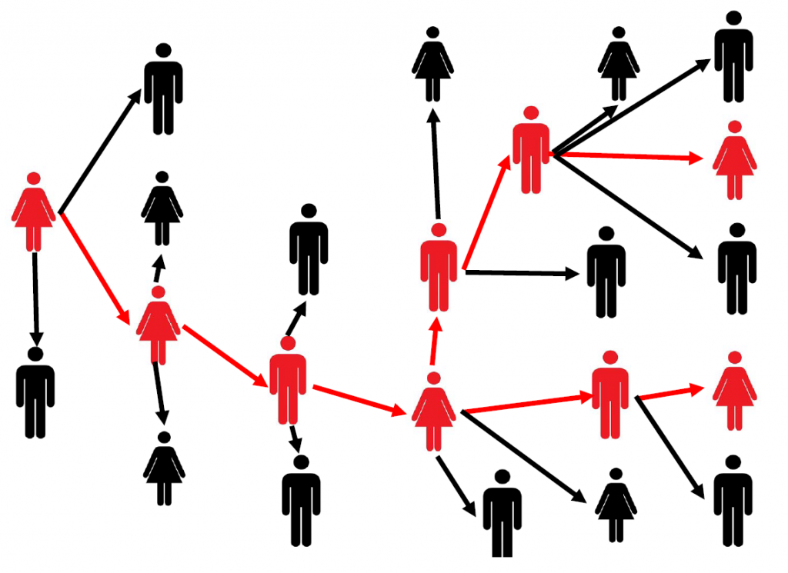
Local Communication: Exposure Notifications
Apple and Google collaboration to use phones for contact tracing
Smartphone constantly broadcasts identifier.
Periodically, each smartphone listens for broadcasts around it.
Check list of identifiers to see if you’ve been around someone who is sick.
Requires government/healthcare system interactions to determine when an identifier should be flagged as sick
24 states (not Illinois) adopted this
Implemented at OS level in background

Slide 60
Sensor deployments
Report data so gateways and users can retrieve it simultaneously
Easy introspection during a deployment
Satisfy users’ curiosity
Ignore difficult questions about networking
Just broadcast the data!
DeBruin, Samuel, et al. "Powerblade: A low-profile, true-power, plug-through energy meter." Proceedings of the 13th ACM Conference on Embedded Networked Sensor Systems. 2015.

Slide 61
Outline
BLE Layers
Physical Layer
Link Layer
BLE roles
Advertising
Scanning
Scan Responses
Communicating with advertisements
Advertisement Use Cases
Energy Use
Packet Collisions

Slide 62
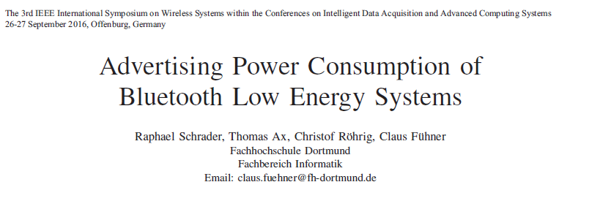
Paper: power measurements of BLE advertisements
Schrader, Raphael, et al. "Advertising power consumption of bluetooth low energy systems." 2016 3rd International Symposium on Wireless Systems within the Conferences on Intelligent Data Acquisition and Advanced Computing Systems (IDAACS-SWS). IEEE, 2016.

Slide 63
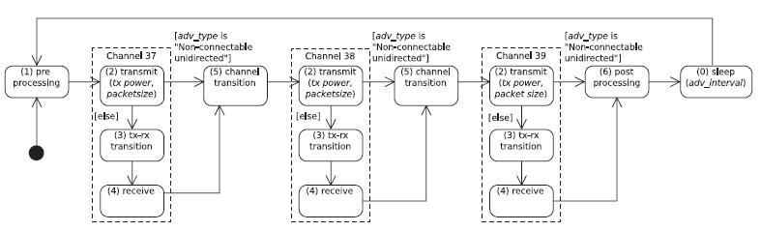
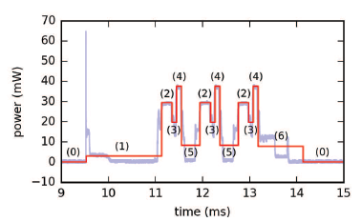
Energy model for BLE advertisements
Creates a set of states and metrics for how much power each uses and for what duration
power * duration = energy

Slide 64
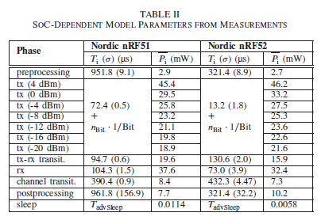
Measurements of Power Use
Power use and duration (energy)
nRF51 (nRF51822)
nRF52 (nRF52832)

Slide 65
How much energy does it cost to send data over advertisements?
Configuration
nRF51822 microcontroller
Maximum payload size
+4 dBm transmit power
Connectable advertisement
Sleep power 11 µW
One packet per second example:
110 µW average
~270 days on a CR2032
One packet per minute example:
13 µW average
~2250 days on a CR2032

Slide 66
Break + Open Question
How long does the lifetime of a BLE advertiser need to be?

Slide 67
Outline
BLE Layers
Physical Layer
Link Layer
BLE roles
Advertising
Scanning
Scan Responses
Communicating with advertisements
Advertisement Use Cases
Energy Use
Packet Collisions

Slide 68
Questions about network capability
What are the odds that a transmitted advertisement will be received?
Packet reception rate
If M redundant advertisements are sent instead, what are the odds that at least one are received?
Data reception rate
How do these odds vary with number of devices, advertising interval, and packet size?

Slide 69
What causes transmissions not to be received?
Not within range of the gateway.
Or various other losses within the gateway itself
Two devices try to send at the same time (packet collision).
X
X
broadcast domain

Slide 70
What is the probability of a packet collision?
time
t_{adv_0}
Packet 0
Jeon, Wha Sook, et al. "Performance analysis of neighbor discovery process in bluetooth low-energy networks." (IEEE Transactions on Vehicular Technology, 2016). Perez-Diaz de Cerio, David, et al. "Analytical and experimental performance evaluation of BLE neighbor discovery process including non-idealities of real chipsets." (Sensors, 2017).

Slide 71
What is the probability of a packet collision?
time
t_{adv_1}
t_{adv_0}
Packet 0
Packet 1
Packet 1
Packet 1
Packet 1
Packet 1
Jeon, Wha Sook, et al. "Performance analysis of neighbor discovery process in bluetooth low-energy networks." (IEEE Transactions on Vehicular Technology, 2016). Perez-Diaz de Cerio, David, et al. "Analytical and experimental performance evaluation of BLE neighbor discovery process including non-idealities of real chipsets." (Sensors, 2017).
Notes:
Collisions occur if any part of the two packets overlap
Particularly true for BLE that only has an 8-bit preamble

Slide 72
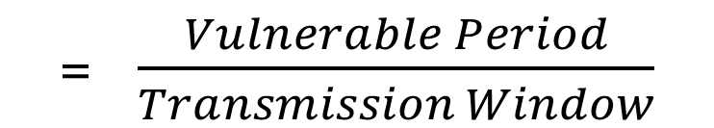
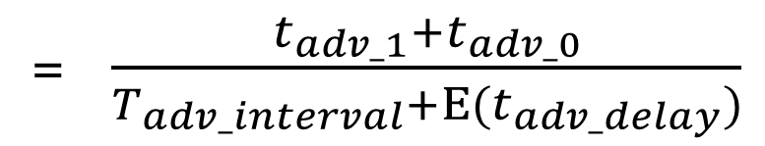
What is the probability of a packet collision?
time
t_{adv_1}
t_{adv_0}
Packet 0
Packet 1
Probability of Collision
= $\frac{Vulnerable Period}{Transmission Window}$
= $\frac{t_{adv_1}+t_{adv_0}}{T_{adv_interval}+Ε(t_{adv_delay})}$
Jeon, Wha Sook, et al. "Performance analysis of neighbor discovery process in bluetooth low-energy networks." (IEEE Transactions on Vehicular Technology, 2016). Perez-Diaz de Cerio, David, et al. "Analytical and experimental performance evaluation of BLE neighbor discovery process including non-idealities of real chipsets." (Sensors, 2017).
Notes:
The vulnerable period is the sum of the two advertisement durations
While the transmission window is the advertisement interval plus the expected value of the random delay

Slide 73
Determine Probability of Multiple Failures
Given:
Probability of Collision
Determine:
Probability of Reception for data sent redundantly across M packets
i.e., what are the odds that at least one of the packets doesn’t collide
1 – (Probability of Collision^{M})
(P_{c})^{M} = Probability that all of them collide
1-that = Probability that NOT all of them collide

Slide 74
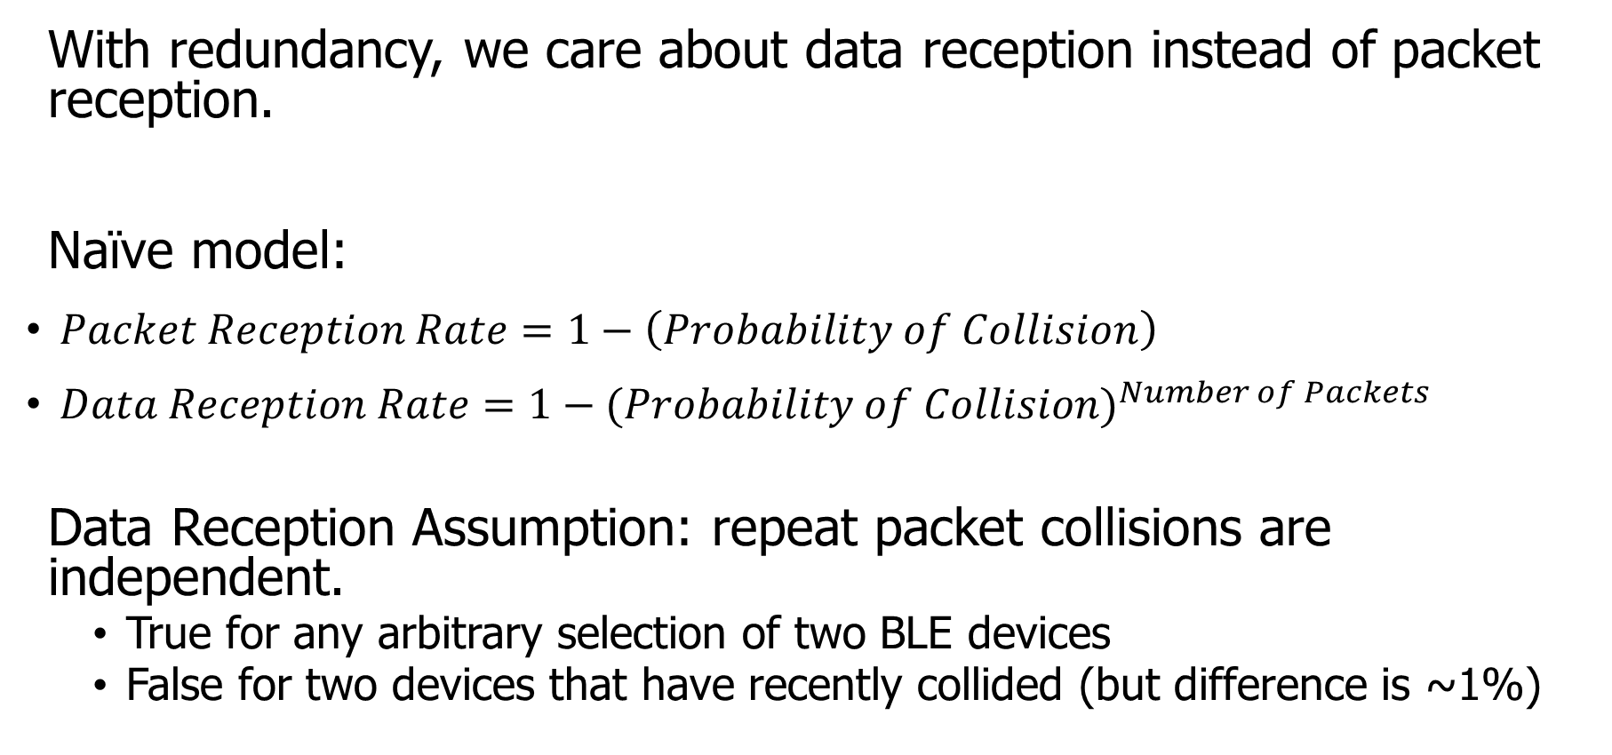
How do we determine reception rate?
With redundancy, we care about data reception instead of packet reception.
Naïve model:
$Packet Reception Rate=1−\left(Probability of Collision\right)$
$Data Reception Rate=1−{(Probability of Collision)}^{Number of Packets}$
Data Reception Assumption: repeat packet collisions are independent.
True for any arbitrary selection of two BLE devices
False for two devices that have recently collided (but difference is ~1%)
Notes:
Earlier we demonstrated the probability of collision, which can be used to determine packet reception rates.
Now with redundancy, we don’t care about the reception of any one packet, but the reception rate of the data that is being sent over them.
Naively, we can take the probability of collision and repeat it for any number of redundant packets.
There is an assumption in that model that repeat collisions are independent, which I’ll show you is false.

Slide 75
When are transmissions from two devices independent?
Assumption is true for any BLE device that has been advertising for some time
Sum of random delays grows the uncertainty of transmission.
Applied to periodic transmissions, any point in interval becomes equally likely.
Range of 1x delay, 2x delay, 3x delay, until it wraps
time
T_{adv_interval}
delay
T_{adv_interval}
delay
T_{adv_interval}
delay

Slide 76
When are transmissions from two devices NOT independent?
Independence assumption is false for two BLE devices that have recently collided.
If T_{adv_interval} is identical, next transmissions with be close in time.
Collision is determined by difference of random delays.
Further repeat collisions have the same probability of occurrence.
New time period collisions could occur within
time
T_{adv_interval}
delay
Notes:
If two devices have collided before, and have the same interval, at the next period they will certainly collide again.
BLE has a random delay appended to reduce this possibility.
But we’ve now greatly reduced the transmission window that the a collision could occur in. We can calculate this to determine a distinct probability of repeat collision.
Note that further repeat collisions are bounded by the same difference of random delays, and therefore have the probability of a second repeat collision is the same as the probability of a first repeat collision.

Slide 77





Calculating probability of a repeat collision
Difference of two uniform random delays forms a triangular distribution
probability
t_{adv_1}
t_{adv_0}
Probability of Repeat Collision
difference in transmission time
$$−t_{adv_delay}$$
$$−t_{adv_1}$$
$$0$$
$$t_{adv_0}$$
$$t_{adv_delay}$$

Slide 78
Important lesson: spend time on things that are important
How important was accounting for repeat collisions?
Maximum error is about a 1% change in Data Reception Rate.
This is due to size of delay 10 ms compared to size of transmission ~300 µs.
200 ms interval advertisements

Slide 79
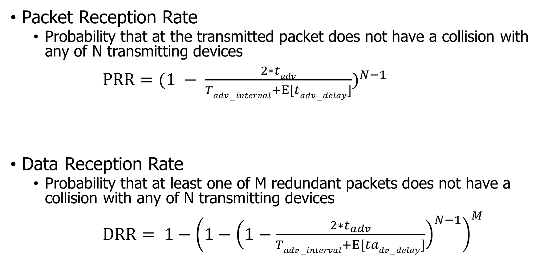
Equations for modeling data transmissions
Packet Reception Rate
Probability that at the transmitted packet does not have a collision with any of N transmitting devices
$PRR={(1 − \frac{2∗tadv}{Tadv−interval+Ε[tadv−delay]})}^{N−1}$
Data Reception Rate
Probability that at least one of M redundant packets does not have a collision with any of N transmitting devices
$DRR= {1−\left(1−{\left(1−\frac{2∗t_{adv}}{Tadv−interval+Ε[tadv−delay]}\right)}^{N−1}\right)}^{M}$

Slide 80
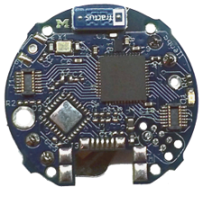
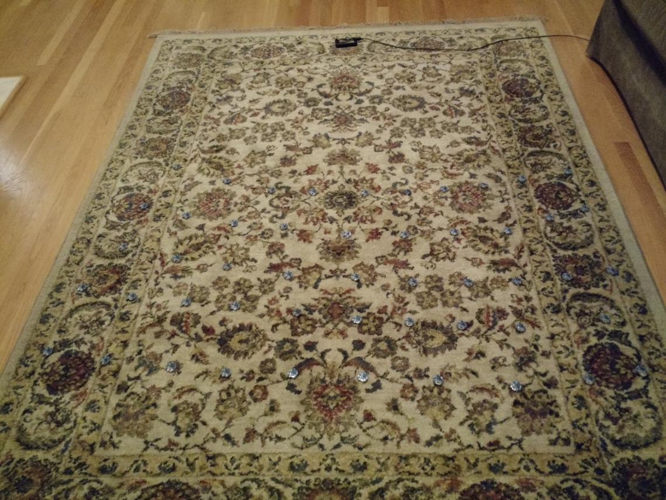
Is the model valid?
Empirical testing setup:
50 devices
1 meter from scanner
5-10 cm apart
Transmit monotonically increasing sequence numbers.
Sweep number of devices and advertising intervals.

Slide 81
Redundancy results in high DRR even with many devices.
In this example, a sensor has new data once per second and sends it in 1-3 packets.
Even without redundancy, data reception rates never fall below 87% even with 200 devices in a deployment, assuming no interference.

Slide 82
Redundancy is (normally) better than less congestion.
Design question:
Send more packets to gain from redundancy? OR
Send less packets to reduce congestion?
The answer changes, but only with many devices.
Notes:
This plot changes with advertisement rate, and can get as low as 100 devices

Slide 83
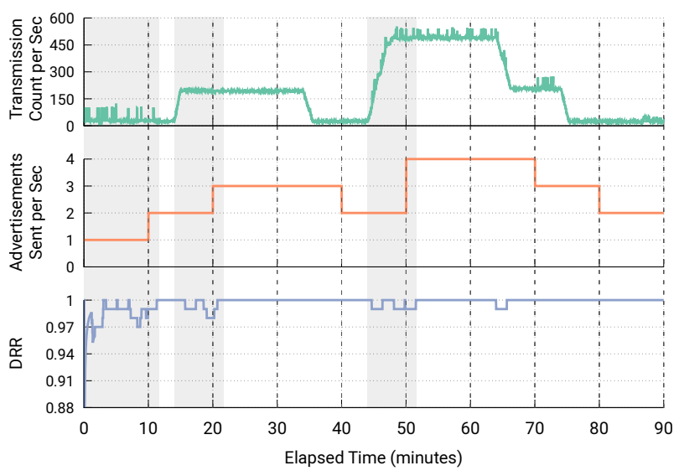
Automatic adaptation to advertising environment
Devices could automatically adjust to the environment for best transmission rate
Scan and count how many unique devices are seen
Estimate DRR based on that traffic environment for redundancy from 1-10 packets per second
Choose the optimal result

Slide 84
Outline
BLE Layers
Physical Layer
Link Layer
BLE roles
Advertising
Scanning
Scan Responses
Communicating with advertisements
Advertisement Use Cases
Energy Use
Packet Collisions

