Slide 1
Lecture 08 ZigBee & Interoperability
CS433 – Wireless Protocols for IoT
Branden Ghena – Spring 2026
Materials in collaboration with Pat Pannuto (UCSD) and Brad Campbell (UVA)

Slide 2
Updates
Lab: BLE
Due Thursday
Last part “LED Control Application” is more work than many of the prior parts
Hw: Matter
Will post this today or tomorrow

Slide 3
Today’s Goals
Introduce ZigBee as another 802.15.4 implementation
Explore ZigBee application layer
Discuss interoperability designs and the Matter standard

Slide 4
Outline
ZigBee overview
ZigBee PHY and MAC
ZigBee application layer
Interoperability

Slide 5
ZigBee goals
Enable automatic communication between devices
Low complexity
Low power
Focus on home automation and industrial control/monitoring
From our perspective
802.15.4 PHY and MAC
Plus well-defined Server/Client interactions
Similar to BLE (actually, BLE is similar to ZigBee)
Designed for higher-power devices than Thread or BLE
Although still relatively low power

Slide 6
ZigBee history
Intertwined with the creation of 802.15.4
Both are founded around the same time
ZigBee Alliance involved in the original 802.15.4 specification
Recently renamed: Connectivity Standards Alliance (CSA)
Original plan: 802.11/WiFi <-> 802.15.4/ZigBee
Original specification 2004 (following 802.15.4 in 2003)
Updated 2006, 2007, 2015, (2017?)
2015 version is also known as ZigBee Pro
We’ll focus on 2015, but look at previous stuff too
Application layer stuff hasn’t changed considerably

Slide 7
ZigBee resources
ZigBee Specification (2015)
ZigBee Cluster Library Specification (2016)
Useful resources
ZigBee overview: https://www.cse.wustl.edu/~jain/cse574-14/ftp/j_13zgb.pdf
NXP library guides (include overview on ZigBee)
ZigBee Protocol: https://www.nxp.com/docs/en/user-guide/JN-UG-3113.pdf
ZigBee Cluster Library: https://www.nxp.com/docs/en/user-guide/JN-UG-3115.pdf
ZigBee Home Automation: https://www.nxp.com/docs/en/user-guide/JN-UG-3076.pdf

Slide 8
Outline
ZigBee overview
ZigBee PHY and MAC
ZigBee application layer
Interoperability

Slide 9
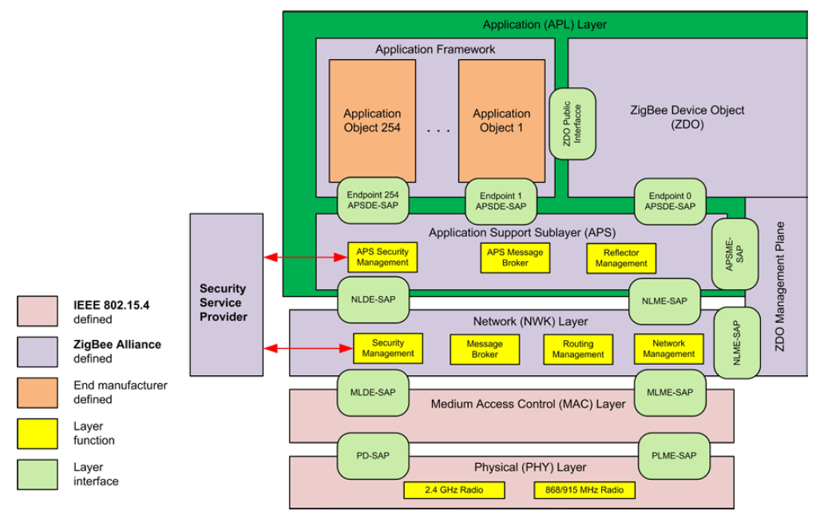
ZigBee stack

Slide 10
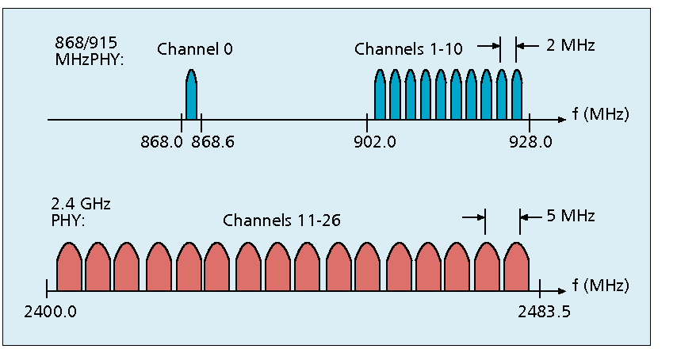
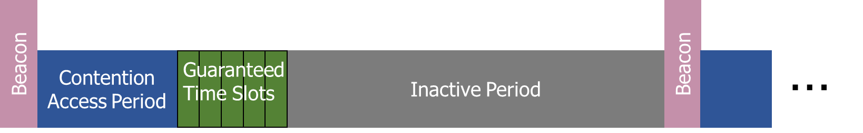

Use of 802.15.4
Basic answer: everything
Reuse all of PHY (including non-2.4 GHz channels)
Reuse all of MAC (including beacon-enabled network and GTS)
Same CSMA/CA mechanism

Slide 11
ZigBee devices (same roles as 802.15.4 defines)
ZigBee Coordinator (ZC)
Starts the network and decides on key parameters
Is also a Router
ZigBee Router (ZR)
Higher-power, more-capable devices
Radios always on (except during inactive superframe)
Connect to one or more children
Connect to one or more routers
ZigBee End Device (ZED)
Lower-power, less-capable devices
Always a child of one router

Slide 12
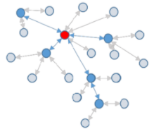
Older ZigBee - tree networks
Original preferred topology
Uses beacon-enabled network
Synchronization via beacon superframes
Can reduce power requirements for routers
Some things get simpler
Address assignment is simple
If you restrict network size
Routing is straightforward
But likely more hops for router-to-router communication

Slide 13
ZigBee tree network complications
Distributed routing scheme limits topologies
There is a limit on number of routers
Each router has a maximum number of children
There is a maximum limit for router depth
Note: many protocols have limits. Thread has device count limits too!
Needs a beacon scheduling mechanism
Each parent must both participate in a superframe
And also send their own superframe beacons
Need to keep inactive period large if there is significant router depth
Each beacon includes a TX offset field specifying parent beacon time
Helps prevent hidden terminal problem

Slide 14
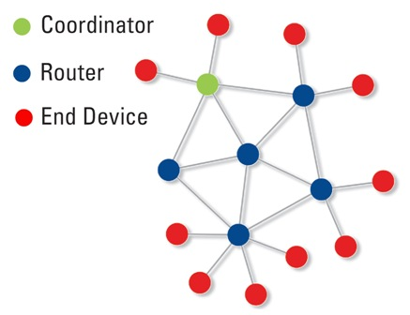
Modern ZigBee – mesh networks
Presently preferred topology
Uses non-beacon-enabled network
All routers are always-on devices
Allows arbitrary communication between routers
Some tradeoffs
Higher power routers
Routing more complicated (potentially better algorithms though)
Addressing more complicated
Assign random addresses to each node
Include a method for address conflict resolution

Slide 15
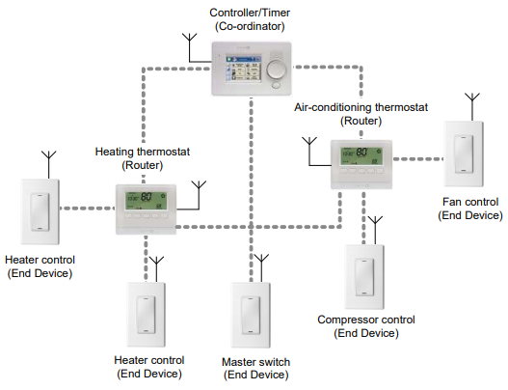
Example ZigBee network

Slide 16
Break + Design Question
How frequently should End Devices communicate?
Constantly or periodically, and at what period?
Each group:
Pick an Industrial or Commercial smart device (not a home bulb/switch)
Consider its energy, latency, and reliability requirements
Determine communication pattern
We’ll share around the room

Slide 17
ZigBee End Device polling
Packets are held in ZigBee Routers for up to 7.68 seconds
Compare to undefined duration for Thread (at least minutes)
Reduction in “low energy” capability for end devices
Limiting timeouts makes Router design simpler
ZigBee codifies polling behavior for End Devices
Long Polling - steady state polling period, example: 7.5 seconds
Short Polling – polling period while waiting on data, example: 1 second

Slide 18
Outline
ZigBee overview
ZigBee PHY and MAC
ZigBee application layer
Interoperability

Slide 19
Analogies between BLE and ZigBee
BLE Profile
BLE Service
BLE Characteristic
ZigBee Profile + Device Type
ZigBee Cluster
ZigBee Attribute
Also ~ZigBee Commands

Slide 20
ZigBee application-layer terms
Devices act as servers and clients
Profiles – detail application-level features
Includes network configurations
For example: security or reliability
Includes definitions of various Device Types
Specify a collection mandatory and optional Clusters
Clusters – collection of Attributes and Commands
Attributes – information, readable and/or writable
Commands – control, writable, may elicit a response

Slide 21
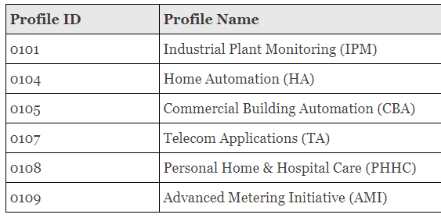
ZigBee profiles
Broad classes of device purposes
Contains multiple Device Type definitions
Define more features of device than the profiles from BLE
Pick various optional network/MAC features, like security or commissioning

Slide 22
Example ZigBee profile: Home Automation Device Types
Generic Devices
On/Off Switch
On/Off Output
Remote Control
Door Lock
Door Lock Controller
Simple Sensor
Smart Plug
Intruder Alarm System Devices
IAS Control and Indicating
IAS Ancillary Control
IAS Zone
IAS Warning Device
Lighting
On/Off Light
Dimmable Light
Colour Dimmable Light
On/Off Light Switch
Dimmer Switch
Colour Dimmer Switch
Light Sensor
Occupancy Sensor
HVAC Devices
Thermostat
Each bullet point is a Device Type
Which is a list of mandatory and optional Clusters

Slide 23
ZigBee Device Types
A collection of Clusters
Some mandatory and some optional
Lists Clusters as Server side or Client Side
Server side Cluster is an input
Client side Cluster is an output
Example: light bulbs implement server, switches implement client

Slide 24
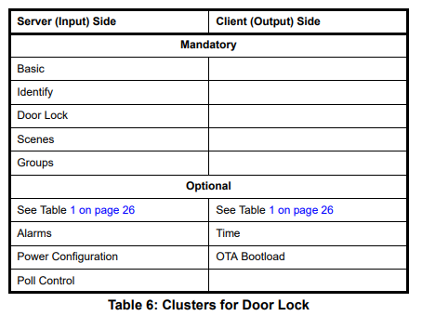
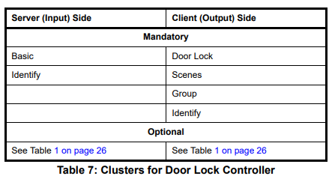
Example Device Types: door lock and door lock controller

Slide 25
ZigBee Clusters
A collection of Attributes and Commands
Analogous to BLE Services
Can be optional or mandatory
ZigBee Cluster Library defines standard Clusters
Lists Attributes and Commands for each
Attributes
Type – uint8, enum, bitmap, string, etc.
Permissions - Read/Write/Report (receive automatic updates)
How to interpret meaning of value
Commands
Field(s), Type of each, Interpretation of each

Slide 26
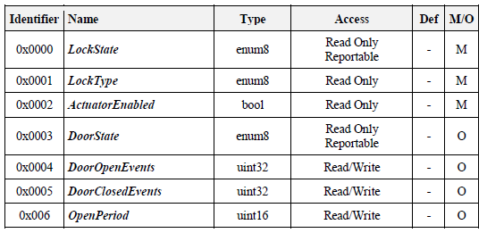
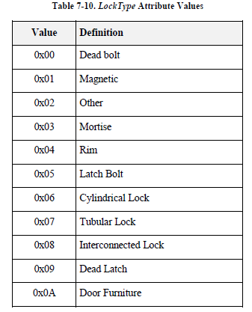
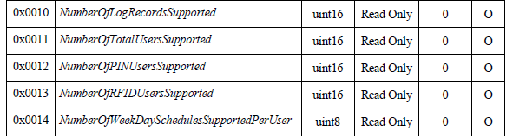
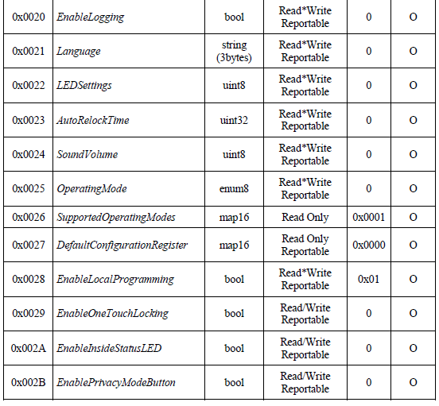
Example Cluster: door lock attributes

Slide 27
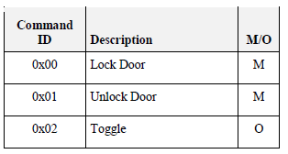
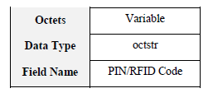
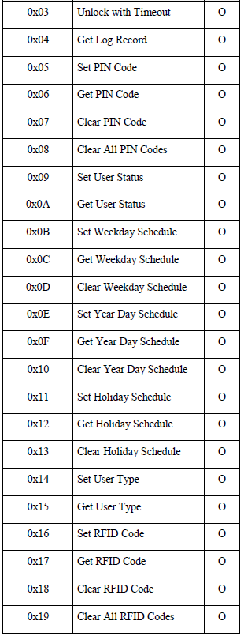
Example Cluster: door lock commands (client side)
Server-side
Performs actions when it receives these commands
Client-side
Capable of sending these commands

Slide 28
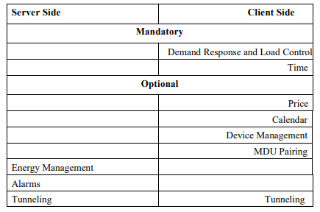
Example ZigBee profile: Smart Energy
Interactions with energy providers for efficiency and cost savings
Devices
Energy service interface
Metering device
Load control device
Clusters
Demand response
Metering
Price
Key establishment (e.g. security)

Slide 29
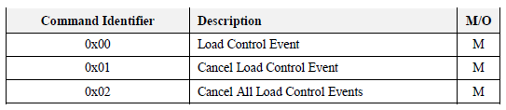
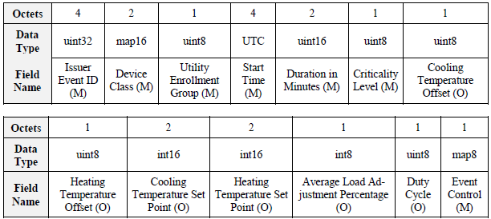
Example: demand response cluster
No attributes, only commands
Load Control Command Payload

Slide 30
Endpoints
Each ZigBee device has a number of Endpoints (up to 240)
Number by which remote applications can contact it
Analogous to a Port in TCP/UDP
Each Endpoint has one Device Type attached to it
Communication refers to the Endpoint number,
Then the Cluster ID within it,
Then the Attribute/Command ID within that
Endpoints can be queried to determine what they provide
Special case: Endpoint 0 – ZigBee Device Object
All devices must implement the ZigBee Device Object
Attributes and Commands for controlling a network device
Network parameters are configured just like a light or door lock

Slide 31
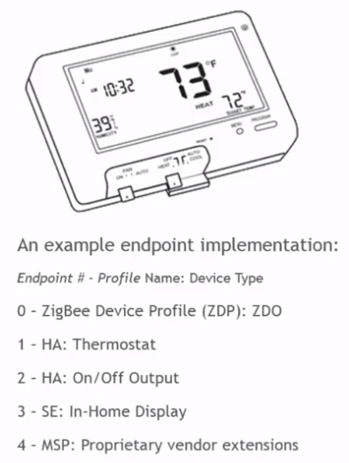
Example Endpoints for a device
Even simple devices hopefully have three endpoints:
ZigBee Device Object
<Their functionality>
Over The Air Bootloader (code updates)

Slide 32
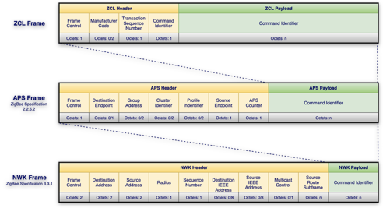
ZigBee application layer packets

Slide 33
Security is still a concern: Phillips Hue Bridge Vulnerability
ZCL data needs to be handled properly
Phillips Hue Bridge had a buffer overflow when handling long string names
Allowed attackers to break in through Zigbee to attack the IP network
Steps
Figure out Zigbee network encryption keys with power analysis
Upload hacked software via OTA update mechanism to a device
Buffer overflow bridge with large ZCL payload with attack instructions
Further gives access to internal IP network to attack other devices
https://nvd.nist.gov/vuln/detail/CVE-2020-6007
https://www.trendmicro.com/vinfo/us/security/news/cybercrime-and-digital-threats/researchers-use-smart-light-bulbs-to-infiltrate-networks

Slide 34
Break + Comparison
ZigBee
Standardized services
Low-power end devices
Higher power routers
Mesh for extended range and connectivity
No interface on most consumer hardware
BLE
Standardized services
Low-power end devices
Higher power scanner/centrals
Star topology for simplicity and focus on single “Central” device
Compatible with smartphones

Slide 35
Outline
ZigBee overview
ZigBee PHY and MAC
ZigBee application layer
Interoperability

Slide 36
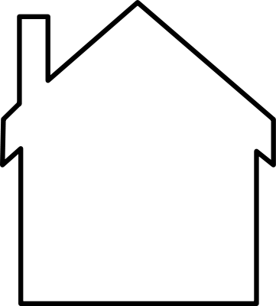
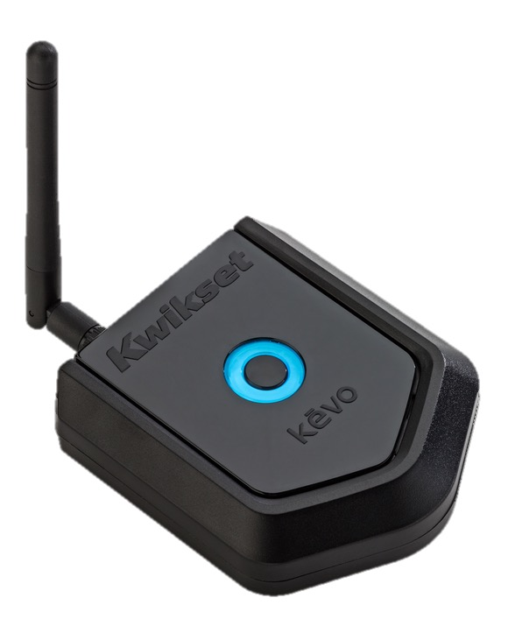
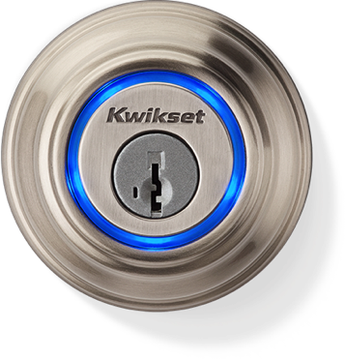
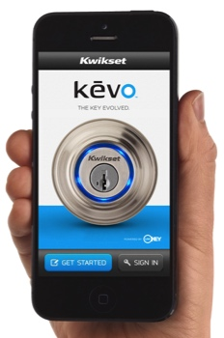
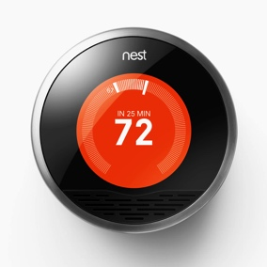
“When I leave, turn down the AC”
Kevo
Nest
Clumsy, and two companies now know that I locked my door.
Slide courtesy of Prabal Dutta
Notes:
Sometimes this makes sense—ASR, for example (Alexa Skills)

Slide 37
“When I leave, turn down the AC”
Kevo
IFTTT
Nest
Clumsy, and two three companies now know that I locked my door.
Slide courtesy of Prabal Dutta
Notes:
Sometimes this makes sense—ASR, for example (Alexa Skills)

Slide 38
“When I leave, turn down the AC”
Oops, Kevo went out of business
Kevo
IFTTT
Nest
Slide courtesy of Prabal Dutta
Notes:
Sometimes this makes sense—ASR, for example (Alexa Skills)

Slide 39









What does it look like without three different clouds?
”Standardization” is the answer? Custom adaptations?
Notes:
MTConnect is read only
OPC UA is so complex that you have to hire consultants to implement it anyway

Slide 40
Reusing ZCL across other networks
Can we use ZigBee Cluster Library to enable device interoperability
Even if we don’t want to use the ZigBee protocol?
dotdot was an effort to spread ZigBee Clusters more widely
Runs same application-layer on top of various lower layers
ZigBee, BLE, Thread, WiFi, Ethernet

Slide 41
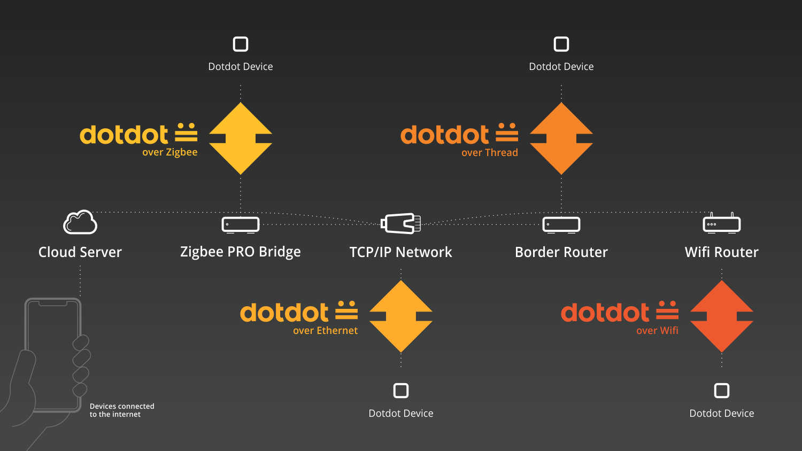
dotdot provides ZigBee-style control over various networks

Slide 42
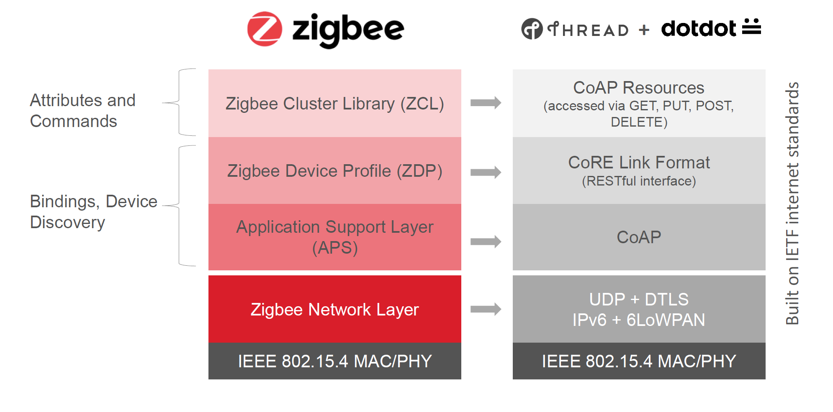
Example dotdot over Thread

Slide 43
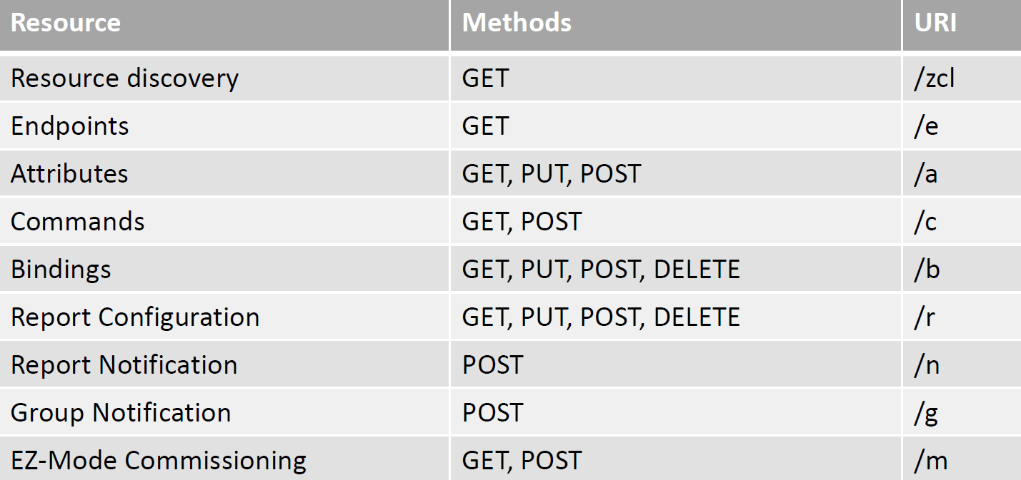
ZCL to CoAP mappings

Slide 44
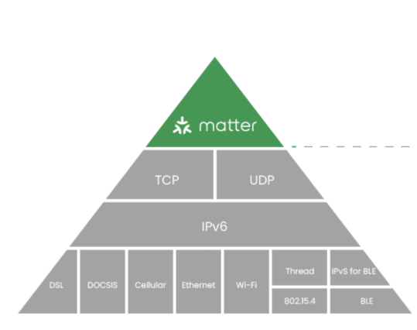
Zigbee Connectivity Standards Alliance today
2021 rebrand
Zigbee fading in relevance, utility
Zigbee group created/creating new standard: Matter
Announced Dec 2019; first products shipped Fall 2022
Setting up as a cross-platform solution focused on nailing Smart Home
Commissioning devices
Security
Device interactions

Slide 45
Matter documentation
Specification
Version 1.5 (November 2025): https://csa-iot.org/wp-content/uploads/2025/11/23-27349-009_Matter-1.5-Core-Specification.pdf
Nordic has a decent Matter overview with actual technical details: https://developer.nordicsemi.com/nRF_Connect_SDK/doc/latest/nrf/ug_matter_intro_overview.html
Documentation from “Project Chip”: https://project-chip.github.io/connectedhomeip-doc/index.html
Documentation on Matter’s website: https://handbook.buildwithmatter.com/

Slide 46
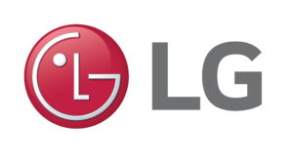















Matter Members

Slide 47
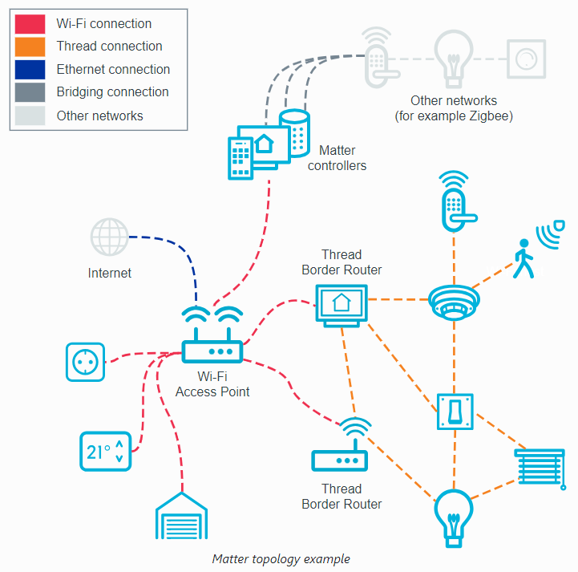
Matter Overview
Assumes networks already exist
How do we communicate with devices over those networks in a way that’s network-agnostic and vendor-agnostic?
Two big parts:
Devices joining the network
Communicating information between devices

Slide 48
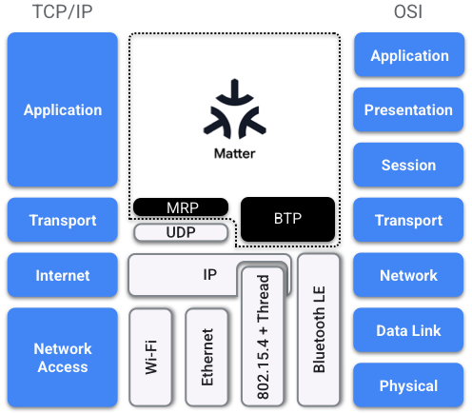
Matter communication architecture
Multiple Phy/Link layers: Ethernet, WiFi, or Thread
IPv6 networking
Multiple transport layers
TCP, UDP, custom BLE layer for device setup only

Slide 49
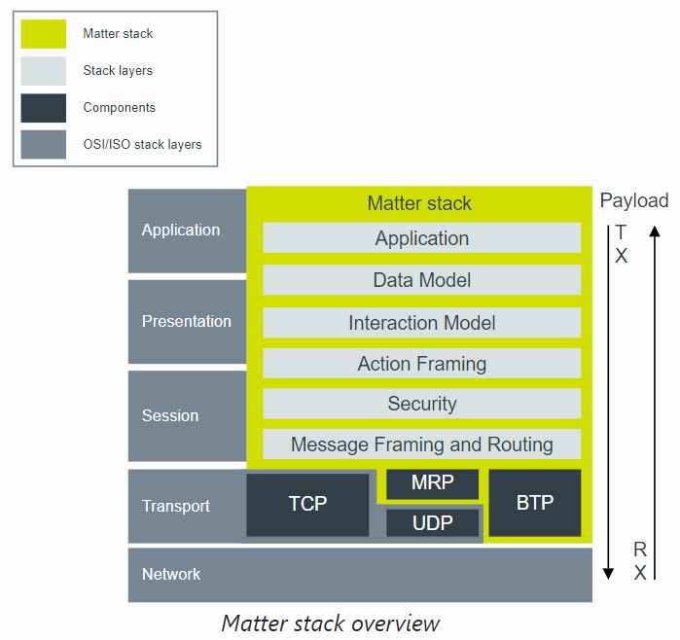
What does matter add?
Application-layer protocol for how to interact with devices and understand data
Includes security model for encrypting and authenticating messages
MRP – Message Reliability Protocol
UDP + Retransmissions
BTP – Bluetooth Transport Protocol
For device setup

Slide 50
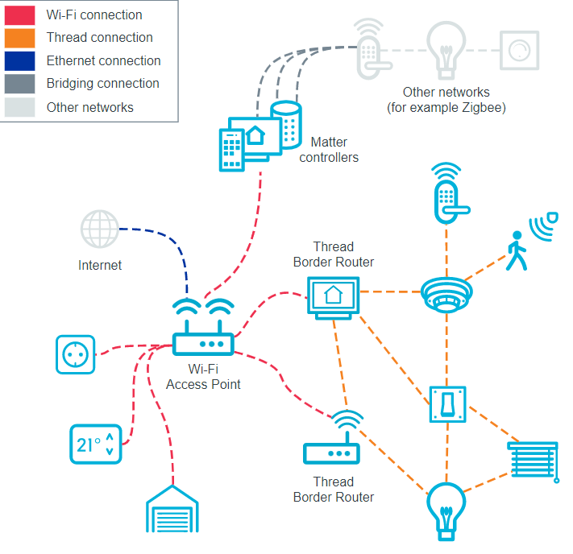
Connecting many devices
Ambitious goals of interoperability
“Fabric”: logical set of devices that share a security domain and can communicate
Devices in Matter can support “multi-fabric”
This would enable connecting device ecosystems together
Google Home AND Apple Home simultaneously
Does have to be implemented though…

Slide 51
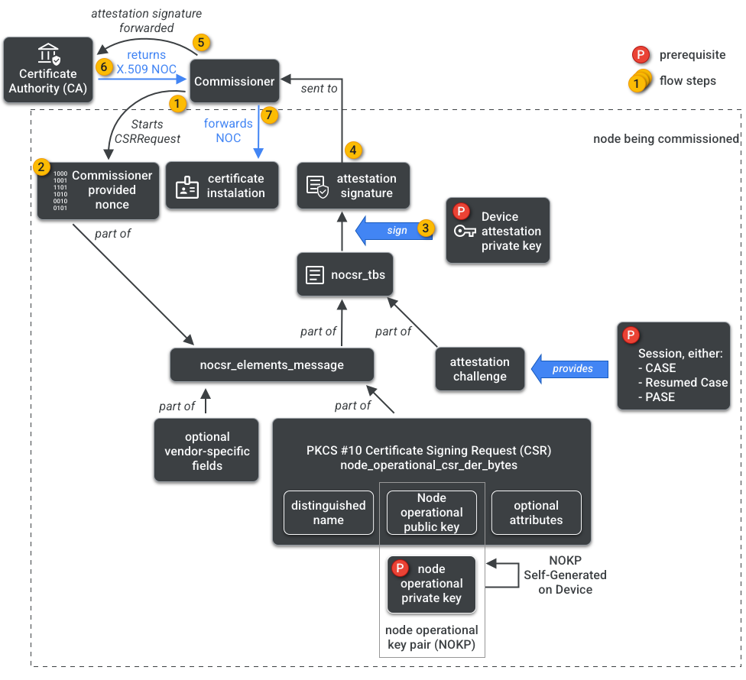
Challenge: credentials for devices joining the fabric
“simple” Matter joining process
Turns into a complicated process
Should this device be allowed to join?
How do we provide credentials for the device for encrypted, authenticated communication within the network?

Slide 52
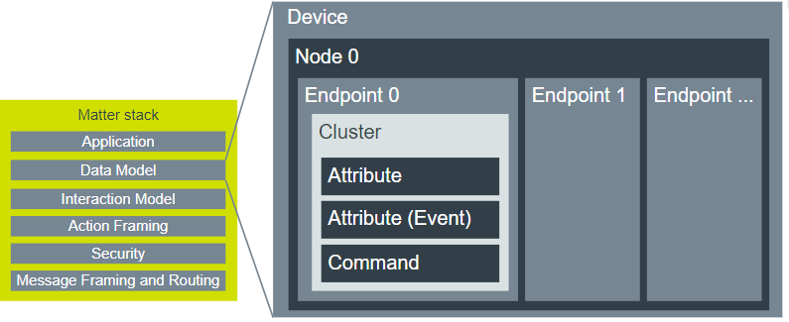
Matter uses ZigBee Cluster Library idea for interactions
“Action Framing” layer converts from raw packet data into device interactions
https://developer.nordicsemi.com/nRF_Connect_SDK/doc/latest/nrf/ug_matter_overview_architecture.html

Slide 53
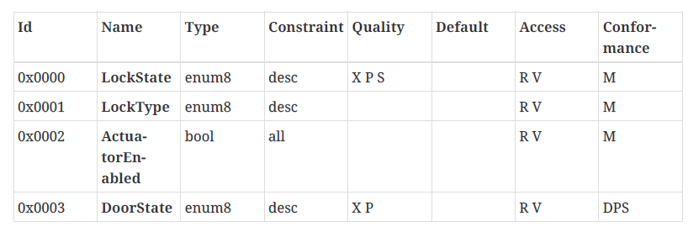
Matter reuses ZCL device attributes
Matter
ZigBee

Slide 54
Supported device types
General devices
Lighting
Smart Plugs/Outlets
Closures (door/window/shades)
Switches and Controls
Appliances
Refrigerators, Dishwashers, Microwaves, Ovens, Laundry, Dryers
HVAC, Fans, Portable Air Conditioners, Air Purifiers
Heat pumps, Solar Panels, Home batteries
Robotics vacuum cleaners
Sensors
Contact, Light, Occupancy, Temperature, Pressure, etc.
Smoke and Carbon Monoxide Alarms, Air Quality Sensors
Leak sensors, Rain sensors
Cameras

Slide 55
Currently supported Matter device types
Matter 1.0 (October 2022)
Lighting
Smart Plugs/Outlets
Switches and Controls
Sensors (contact, light, occupancy, temperature, pressure, etc.)
Closures (door/window/shades)
HVAC
Matter 1.2 (October 2023)
Refrigerators, Dishwashers, Laundry
Smoke and Carbon Monoxide Alarms, Air Quality Sensors
Fans, Portable Air Conditioners, Air Purifiers
Robotics vacuum cleaners

Slide 56
More recent Matter device additions
Matter 1.3 (May 2024)
Kitchen appliances: microwaves, ovens, cooktops,
Dryers
Electric vehicle chargers
Leak sensors, water valves, rain sensors
Matter 1.4 (November 2024)
Heat pumps, Solar panels
Also improvements to commissioning/joining steps
Matter 1.5 (November 2025)
Cameras
Also TCP transport layer (mostly for image data)

Slide 57
Recent updates to Matter
Matter 1.4 (November 2024)
Device types: Solar panels, Home batteries, Heat pumps
Improvements to commissioning/joining steps
Matter 1.5 (November 2025)
Device types: Cameras
Adds TCP transport support (mostly for camera image data)

Slide 58
What supports matter?
https://matterdevices.io/
Still an evolving system
Support is increasingly added to new devices
Needs a Matter Controller and (for thread) Thread border router
Goal: get those integrated into home WiFi routers
Version 1.4 added some specification on how this works
Current controllers: Apple Homepod, Apple TV, Google TV, Google Nest WiFi, Samsung SmartThings Hub, and others…
Only controllers support thread (all of the above do)

Slide 59
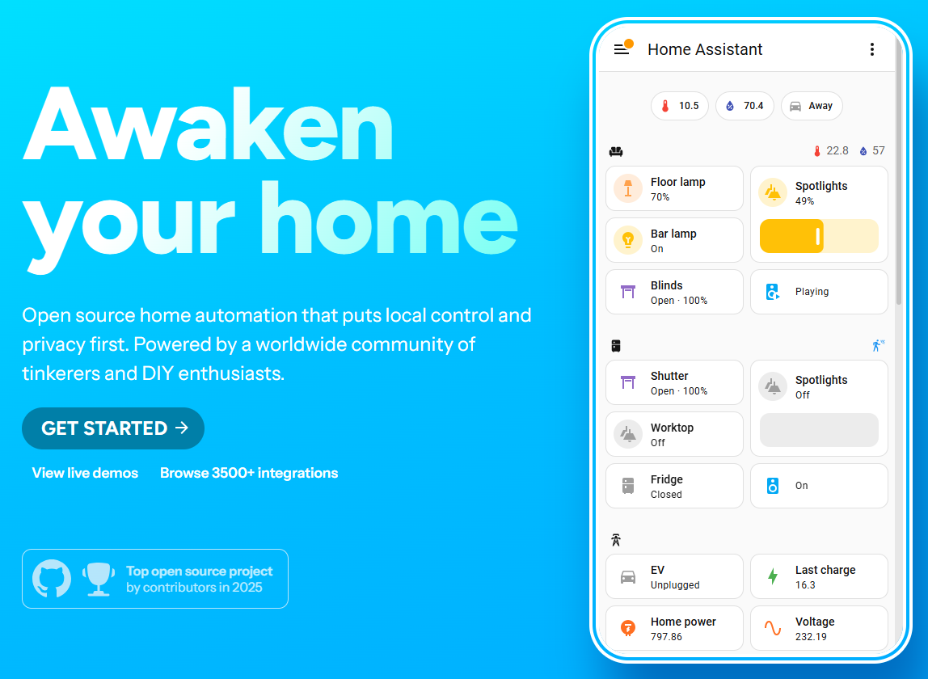
How do you actually use matter?
Mostly smartphone apps
Google Home
Apple Home
Home Assistant
The goal is that any matter-capable device can “just work” with these apps

Slide 60
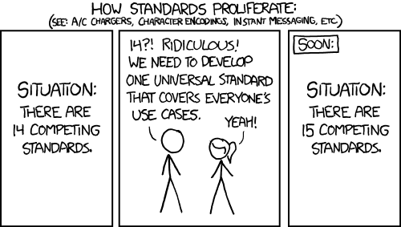
Is ZCL the right standard for device interactions?
Seems better than making something new from scratch
https://xkcd.com/927/

Slide 61
Outline
ZigBee overview
ZigBee PHY and MAC
ZigBee application layer
Interoperability

