Slide 1
Lecture 10 WiFi PHY
CS433 – Wireless Protocols for IoT
Branden Ghena – Spring 2026
Materials in collaboration with Pat Pannuto (UCSD) and Brad Campbell (UVA)

Slide 2
Administrivia
Hw: Matter
Due Thursday
Lab: Thread
Due next week Thursday
Lab: WiFi
Overlaps with Lab: Thread unfortunately
Moving on to WiFi lab this Friday

Slide 3
Today’s Goals
Discuss WiFi physical layers
Get a feel for what choices are leading to more throughput
Think a little about what the costs of that are
Explore how WiFi has continuously improved over 30 years

Slide 4
Outline
WiFi Overview
WiFi PHY
802.11/802.11b
802.11a/802.11g
802.11n/802.11ac
802.11ax
802.11be and Beyond
Real-World WiFi

Slide 5
What is WiFi?
Most successful wireless protocol (family)
Small Area (~35m), high performance (up to 9,600 Mbit/s)
~30 years young
We’ll do some history
Note the parallels in technology development
First: Maximize the performance of a single channel
Now: Improve performance through parallelism (more channels working together)

Slide 6


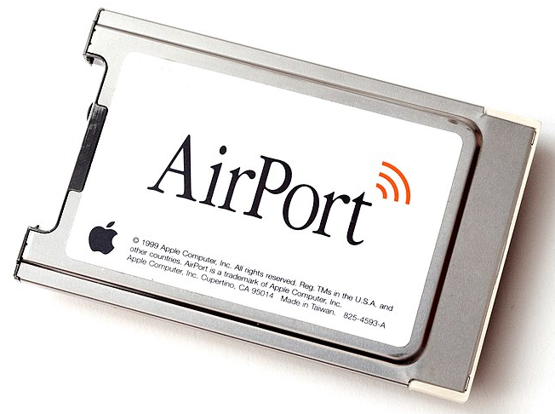
802.11 timeline
1985 – US FCC rules ISM band for unlicensed use
1990s – WaveLAN (NCR Corporation, Netherlands)
Wireless ethernet for cashier systems
1997 – 802.11 specification
1999 – 802.11b and 802.11a amendments
1999 – WiFi Alliance formed for certification of devices
1999 – Apple iBook is the first consumer WiFi product

Slide 7
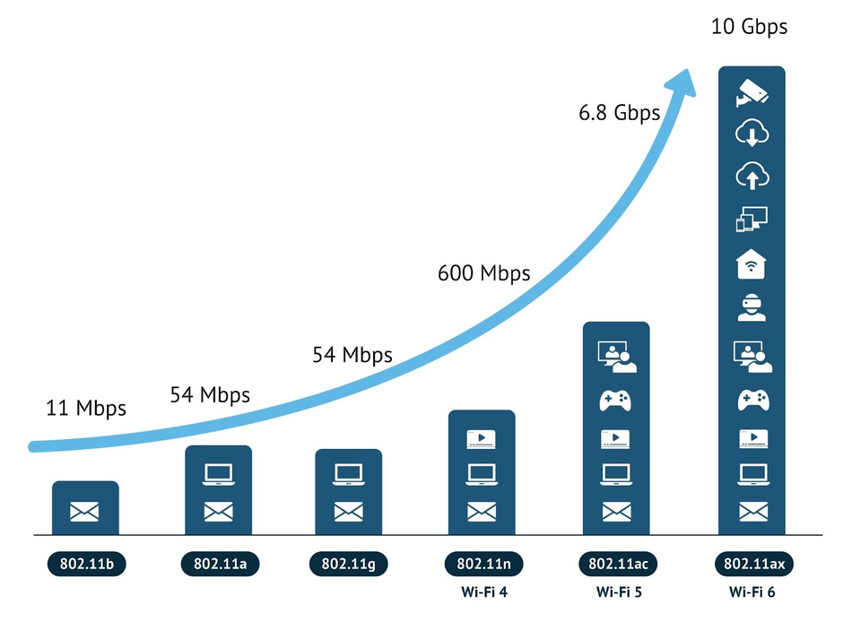
Many different “versions” of WiFi

Slide 8
802.11 major amendments
 | Protocol | Year | Frequency | PHY | Max Rate | Range
- | 802.11 | 1997 | 2.4 GHz | DSSS/FHSS | 2 Mbps | 20 m
1 | 802.11b | 1999 | 2.4 GHz | DSSS | 11 Mbps | 35 m
2 | 802.11a | 1999 | 5 GHz | OFDM | 54 Mbps | 35 m
3 | 802.11g | 2003 | 2.4 GHz | OFDM | 54 Mbps | 38 m
4 | 802.11n | 2009 | 2.4/5 GHz | OFDM + MIMO (single user) | 600 Mbps | 70 m
5 | 802.11ac | 2013 | 5 GHz | OFDM + MU-MIMO (downlink only) | 3400 Mbps | 35 m
6 | 802.11ax | 2021 | 2.4/5/[6] GHz | OFDMA + MU-MIMO (up and down) | 9600 Mbps | 35 m
7 | 802.11be | 2024 | 2.4/5/6 GHz | OFDMA + MU-MIMO (up and down) | 23000 Mbps | 35 m
802.11b was very popular but is now usually unsupported
802.11a never saw major deployment
WiFi Alliance rebranded 802.11ac as “WiFi 5” and backported scheme

Slide 9
Resources
Peter Steenkiste – Carnegie Mellon University
https://www.cs.cmu.edu/~prs/wirelessS18/handouts/L11-AdHoc.pdf
https://www.cs.cmu.edu/~prs/wirelessS18/handouts/L12-LAN.pdf
Raj Jain – Washington University in Saint Louis
https://www.cse.wustl.edu/~jain/cse574-14/ftp/j_05lan.pdf
https://www.cse.wustl.edu/~jain/cse574-14/ftp/j_06lan.pdf
Honestly
https://en.wikipedia.org/wiki/IEEE_802.11

Slide 10
Outline
WiFi Overview
WiFi PHY
802.11/802.11b
802.11a/802.11g
802.11n/802.11ac
802.11ax
802.11be and Beyond
Real-World WiFi

Slide 11
WiFi Physical Layer
Details start to get pretty messy here for multiple reasons:
Different countries/regions have different standards
Channels look a little different in different areas
WiFi has evolved over the last 30 years
Different features are designed for different amendments
WiFi is focused on improving throughput
Solutions that were initially “too complicated” no longer are

Slide 12
Goal: improve throughput
In twenty years, WiFi has gone from 2 Mbps to 9.6 Gbps
How does a network PHY improve its throughput?

Slide 13
Goal: improve throughput
In twenty years, WiFi has gone from 2 Mbps to 9.6 Gbps
How does a network PHY improve its throughput?
More capable modulation and/or bit transmission
Techniques like OFDM and MIMO
More bandwidth
Increased channel with at 2.4 Ghz and bigger 5 GHz channels
Better spatial use
MIMO + beam steering

Slide 14
Walking through PHY changes by amendment
 | Protocol | Year | Frequency | PHY | Max Rate | Range
- | 802.11 | 1997 | 2.4 GHz | DSSS/FHSS | 2 Mbps | 20 m
1 | 802.11b | 1999 | 2.4 GHz | DSSS | 11 Mbps | 35 m
2 | 802.11a | 1999 | 5 GHz | OFDM | 54 Mbps | 35 m
3 | 802.11g | 2003 | 2.4 GHz | OFDM | 54 Mbps | 38 m
4 | 802.11n | 2009 | 2.4/5 GHz | OFDM + MIMO | 600 Mbps | 70 m
5 | 802.11ac | 2013 | 5 GHz | OFDM + MU-MIMO | 3400 Mbps | 35 m
6 | 802.11ax | 2021 | 2.4/5/[6] GHz | OFDMA + MU-MIMO | 9600 Mbps | 35 m
7 | 802.11be | 2024 | 2.4/5/6 GHz | OFDMA + MU-MIMO | 23000 Mbps | 35 m

Slide 15
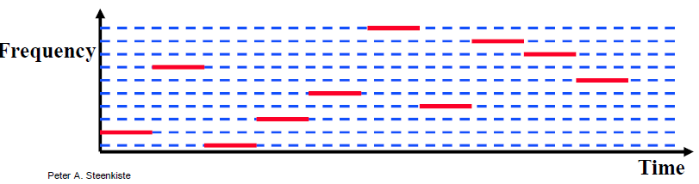
Original WiFi specification (1997)
Legacy WiFi
Frequency Hopping Spread Spectrum (FHSS)
GFSK (Gaussian Frequency-Shift Keying)
Relatively simple radio design
Frequency hopping over 80 channels (1 MHz each)
Actually supports an Infrared PHY as well!!

Slide 16
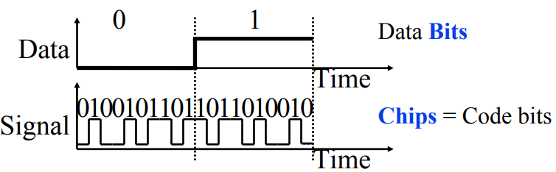
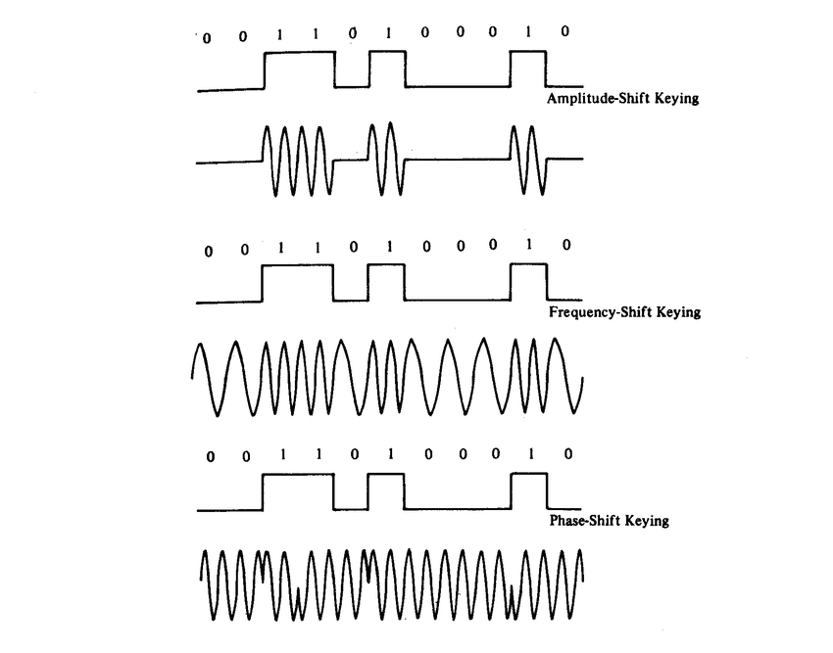
802.11b (1999)
802.11b
Direct Sequence Spread Spectrum (DSSS)
DBPSK and DQPSK (Differential Binary/Quadrature Phase-Shift Keying)
Translate data into “codes”
Each data bit corresponds to several code bits (Chips)
Chips are what is actually modulated over the air
Data can be recovered by knowing the code patterns
Modulation
Phase-shift Keying (of the Chips)

Slide 17
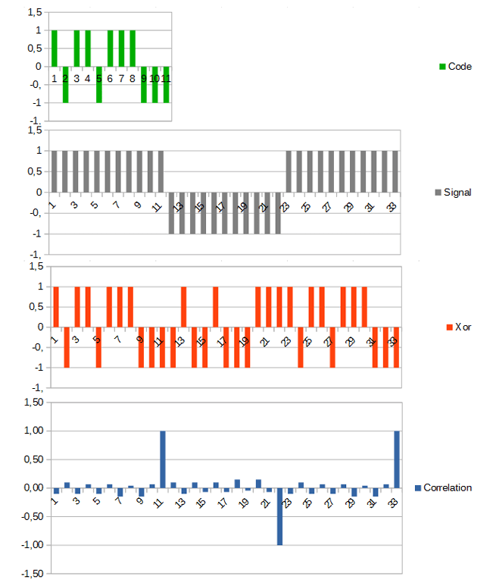
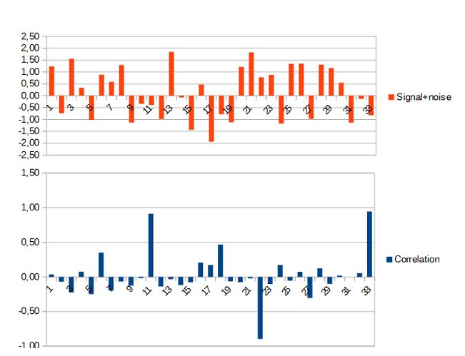
DSSS example from 802.15.4
Data sent is 101
Code is longer than data, so we replicate bits
Data is recoverable, even with noise
https://circuitcellar.com/research-design-hub/dsss-in-a-nutshell/

Slide 18
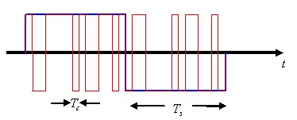
DSSS goals
DSSS increases bandwidth of a signal
Beyond what is needed for the data
Energy is smeared across the frequencies
More robust against interference
Narrowband signals knock out only part of the signal
Data can be recovered from partial code
Cost: using a lot of bandwidth for only a little data

Slide 19
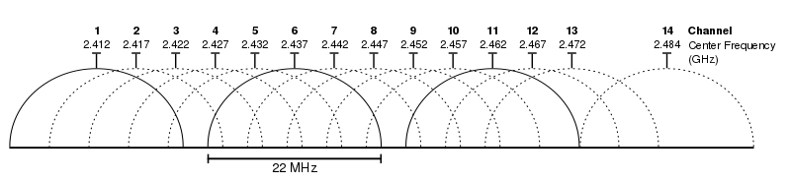
802.11b channels
14 channels total
1-11 for US
1-13 for most of the rest of the world
1-14 for Japan (but 14 only for 802.11b)
22 MHz channels
5 MHz spacing -> significant channel overlap
Channels 1, 6, and 11 can be used without overlap

Slide 20
Break + Question
If the majority of channels overlap, why even have them?

Slide 21
Break + Question
If the majority of channels overlap, why even have them?
Different options for different regions
Inside US use three channels: 1, 6, 11
Outside of North America can use four channels: 1, 5, 9, 13
Historical: avoid other 2.4 GHz users
If they’re at the low end of the band, you could switch to channel 2 or 3

Slide 22
Walking through PHY changes by amendment
 | Protocol | Year | Frequency | PHY | Max Rate | Range
- | 802.11 | 1997 | 2.4 GHz | DSSS/FHSS | 2 Mbps | 20 m
1 | 802.11b | 1999 | 2.4 GHz | DSSS | 11 Mbps | 35 m
2 | 802.11a | 1999 | 5 GHz | OFDM | 54 Mbps | 35 m
3 | 802.11g | 2003 | 2.4 GHz | OFDM | 54 Mbps | 38 m
4 | 802.11n | 2009 | 2.4/5 GHz | OFDM + MIMO | 600 Mbps | 70 m
5 | 802.11ac | 2013 | 5 GHz | OFDM + MU-MIMO | 3400 Mbps | 35 m
6 | 802.11ax | 2021 | 2.4/5/[6] GHz | OFDMA + MU-MIMO | 9600 Mbps | 35 m
7 | 802.11be | 2024 | 2.4/5/6 GHz | OFDMA + MU-MIMO | 23000 Mbps | 35 m

Slide 23
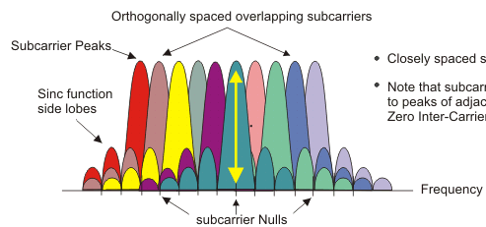
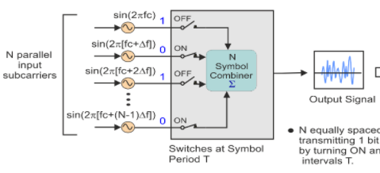
OFDM enables higher throughput
Replace DSSS with Orthogonal Frequency Division Multiplexing
OFDM idea
Split band into a number of narrow subcarriers
Subcarriers are spaced so that they don’t interfere
Transmit on multiple subcarriers at once to increase throughput
Recall DSSS

Slide 24
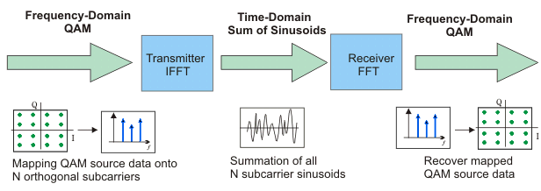
OFDM enables higher throughput at complexity cost
Receivers collect signal from entire channel
And then can split it apart to gain the data on each subcarrier
Tradeoffs
Benefits: more throughput, still robust against narrowband interference
Costs: more complicated and sensitive radio design

Slide 25
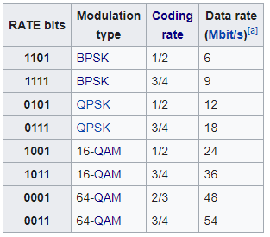
802.11a (1999)
Applied OFDM techniques on the 5 GHz band
Enabled more data throughput 54 Mbps (compare to 11 Mbps for 802.11b)
Multiple rates available
BPSK/QPSK/QAM over OFDM
Quadrature Amplitude Modulation (QAM)
2, 4, 16, 64 bits per symbol
Coding rate
Forward error correction on top of data
3/4 -> 3 data bits + 1 redundancy bit
Data rate * Coding rate is more realistic data rate
Goodput would also discount headers and control
Never reached widespread adoption
Regulatory hurdles in some regions
More complicated hardware delayed it

Slide 26
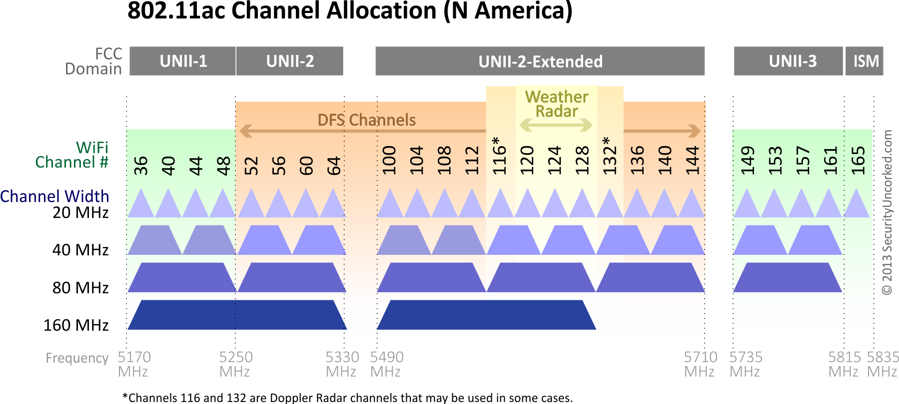
802.11a channels
802.11a did promote the use of 5 GHz band
Several 20 MHz channels with no overlap
Big increase from “three” channels of 2.4 GHz
Typically only the 9 green channels below can be used
But rules vary with regions

Slide 27
5 Ghz channel limitations
Various regional rules on a number of different channels
DFS Channels
Dynamically shared with radar systems
WiFi systems can use them only if they can detect radar and immediately stop using them if a conflict occurs
Examples
US: any orange or yellow if following the DFS rules
Canada: only orange if following the DFS rules, never yellow

Slide 28
Walking through PHY changes by amendment
 | Protocol | Year | Frequency | PHY | Max Rate | Range
- | 802.11 | 1997 | 2.4 GHz | DSSS/FHSS | 2 Mbps | 20 m
1 | 802.11b | 1999 | 2.4 GHz | DSSS | 11 Mbps | 35 m
2 | 802.11a | 1999 | 5 GHz | OFDM | 54 Mbps | 35 m
3 | 802.11g | 2003 | 2.4 GHz | OFDM | 54 Mbps | 38 m
4 | 802.11n | 2009 | 2.4/5 GHz | OFDM + MIMO | 600 Mbps | 70 m
5 | 802.11ac | 2013 | 5 GHz | OFDM + MU-MIMO | 3400 Mbps | 35 m
6 | 802.11ax | 2021 | 2.4/5/[6] GHz | OFDMA + MU-MIMO | 9600 Mbps | 35 m
7 | 802.11be | 2024 | 2.4/5/6 GHz | OFDMA + MU-MIMO | 23000 Mbps | 35 m

Slide 29
802.11g (2003)
Applies OFDM to 2.4 GHz band
Increases throughput from 11 Mbps to 54 Mbps
Repeats rate choices of 802.11a but on more support 2.4 GHz band
Same 2.4 GHz channels as 802.11b, but 20 MHz bandwidth
Still 1, 6, 11 in US
1, 5, 9, 13 in other regions
Backwards compatible with 802.11b
Capable of DSSS communication when required

Slide 30

Cost of supporting 802.11b
802.11g uses a completely different PHY layer than 802.11b
DSSS -> OFDM
Unintelligible to old receivers creating an interoperability problem
Interoperability mode: send part of message in old format
DSSS header with OFDM payload
Adds overhead and slows down the entire network
Starting with 802.11n, routers don’t support 802.11b by default

Slide 31
Truth or Fiction: “An 802.11b device slows your whole network to b speed”
Aka, should you have followed all the blogs telling you to do this?:
A: ”Sort of”, and “no”
When active, b devices slow networks simply because they occupy the channel
Cutting off your b devices doesn’t cut off your neighbor’s
Contention [without coordination] is the bigger problem
On own network, routers are “b-aware”, and can schedule around efficiently
At cost of “talking b” to everyone a little

Slide 32
Improved WiFi hardware is in high demand
Typically, standards lead hardware by several years
BLE 5.2 was out while BLE 5.0 was just being adopted in phones
Development of 802.11g hardware started before finalization of standard
Demand for increased performance was already high in 2003
Phenomena continues in modern WiFi and Cellular protocols
Hardware supports some features as soon as it’s clear they’ll exist

Slide 33
Walking through PHY changes by amendment
 | Protocol | Year | Frequency | PHY | Max Rate | Range
- | 802.11 | 1997 | 2.4 GHz | DSSS/FHSS | 2 Mbps | 20 m
1 | 802.11b | 1999 | 2.4 GHz | DSSS | 11 Mbps | 35 m
2 | 802.11a | 1999 | 5 GHz | OFDM | 54 Mbps | 35 m
3 | 802.11g | 2003 | 2.4 GHz | OFDM | 54 Mbps | 38 m
4 | 802.11n | 2009 | 2.4/5 GHz | OFDM + MIMO | 600 Mbps | 70 m
5 | 802.11ac | 2013 | 5 GHz | OFDM + MU-MIMO | 3400 Mbps | 35 m
6 | 802.11ax | 2021 | 2.4/5/[6] GHz | OFDMA + MU-MIMO | 9600 Mbps | 35 m
7 | 802.11be | 2024 | 2.4/5/6 GHz | OFDMA + MU-MIMO | 23000 Mbps | 35 m

Slide 34
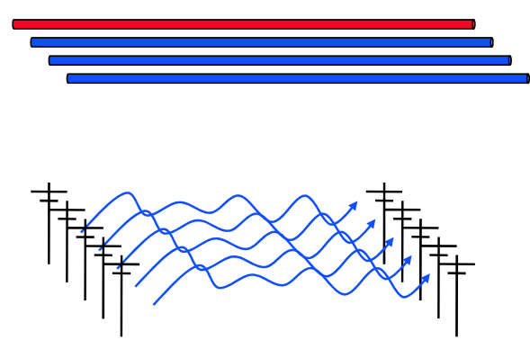
How do we increase throughput?
Wired world
Add more wires in parallel
Wireless world
Add more antennas?

Slide 35
How do we increase throughput?
Water world
Fatter pipes
Wireless world
Fatter channels (with more bandwidth)
802.11.n — Y NOT BOTH?

Slide 36
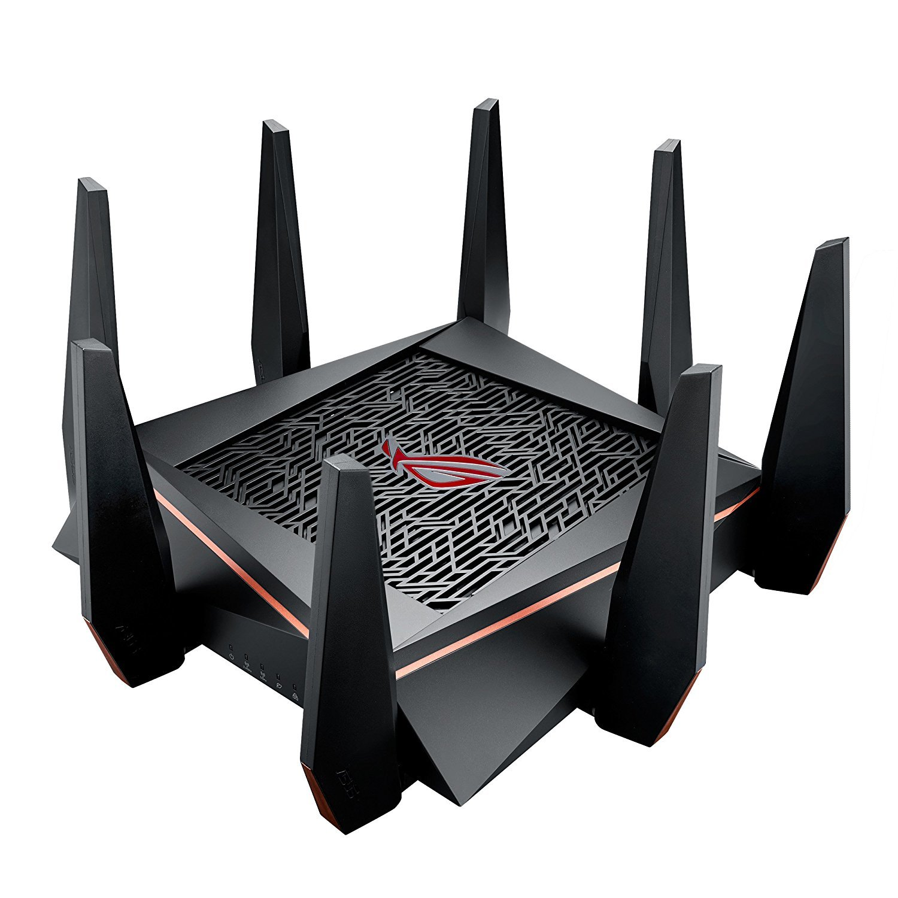
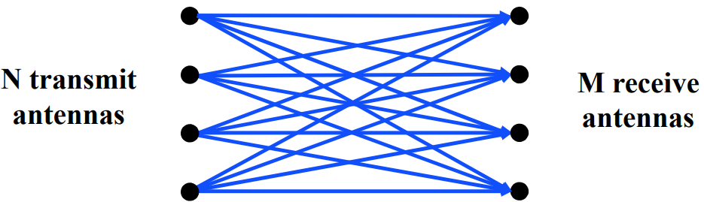
MIMO – Multiple In Multiple Out
N x M subchannels can be used to send data simultaneously
Huge boost in data throughput
Antenna diversity adds to reliability as well
The signals may interfere with each other
But receiving all of them allows the data to be recovered
Matrix of transmitted signals × receiver antennas
Beamforming
Use interactions between array of antennas to focus energy on the receiver
Way outside of the scope of this class

Slide 37
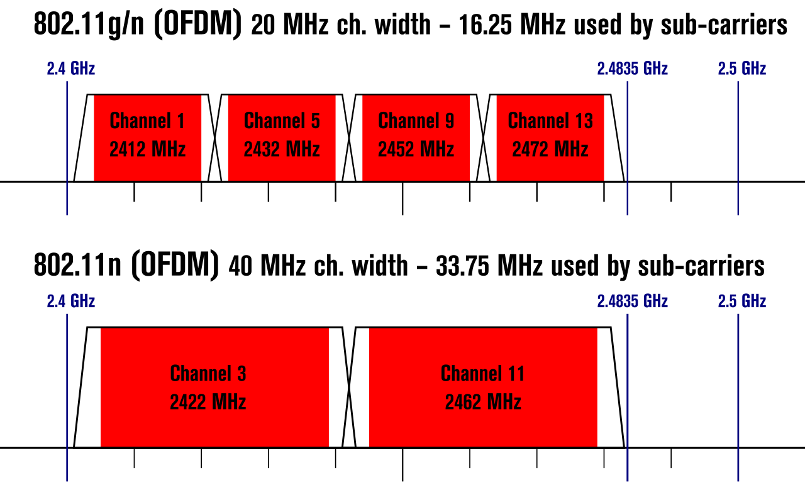
Expandable bandwidth
OFDM allows many subcarriers within a channel to be used at once
Throughput scales with the amount of bandwidth available
Allow larger 40 MHz channels to be used

Slide 38
802.11n (2009)
Supports OFDM and MIMO on 2.4 GHz and 5 GHz
Supports 20 MHz and 40 MHz channels
Easier to create large channels in 5 GHz band
Backwards compatible with 802.11g (tries not to be with 802.11b)
Wildly successful
Still the 2.4 GHz band protocol (802.11ac is 5 GHz only)
A little less than half of the networks visible to me are still 802.11n
My apartment “building WiFi” was still 802.11g…

Slide 39
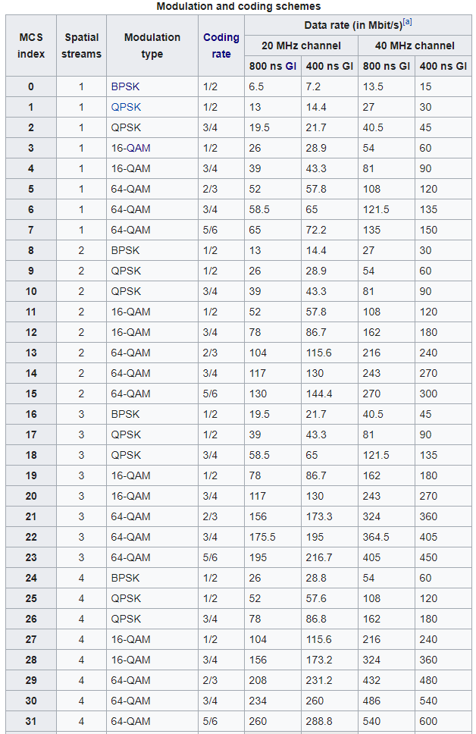
802.11n modulation and coding schemes
MCS – Modulation and Coding Scheme
GI – Guard Interval: delay between transmitted symbols

Slide 40
Break + Open Question
How much bandwidth is acceptable to use?
Is it okay for a WiFi network to use the entire 2.4 GHz spectrum?

Slide 41
Break + Open Question
How much bandwidth is acceptable to use?
Is it okay for a WiFi network to use the entire 2.4 GHz spectrum?
Maybe. At least the range is pretty short!
Only next-door neighbor’s network interfere with your network
Someone further away isn’t affected at all
Need to share with neighbors nearby though
Theoretically better to have separate allocations than to overlap and deal with the collisions

Slide 42
Walking through PHY changes by amendment
 | Protocol | Year | Frequency | PHY | Max Rate | Range
- | 802.11 | 1997 | 2.4 GHz | DSSS/FHSS | 2 Mbps | 20 m
1 | 802.11b | 1999 | 2.4 GHz | DSSS | 11 Mbps | 35 m
2 | 802.11a | 1999 | 5 GHz | OFDM | 54 Mbps | 35 m
3 | 802.11g | 2003 | 2.4 GHz | OFDM | 54 Mbps | 38 m
4 | 802.11n | 2009 | 2.4/5 GHz | OFDM + MIMO | 600 Mbps | 70 m
5 | 802.11ac | 2013 | 5 GHz | OFDM + MU-MIMO | 3400 Mbps | 35 m
6 | 802.11ax | 2021 | 2.4/5/[6] GHz | OFDMA + MU-MIMO | 9600 Mbps | 35 m
7 | 802.11be | 2024 | 2.4/5/6 GHz | OFDMA + MU-MIMO | 23000 Mbps | 35 m

Slide 43
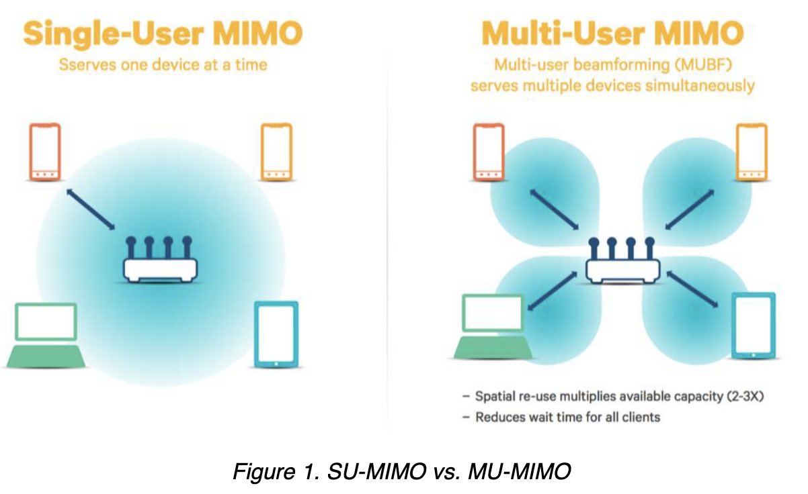
”The MIMO Gap”
Access points have 3-4 [or more now] antennas
Client devices have 1-2 [or more now] antennas
While absolute numbers keep going up, trend holds
Asymmetric design pattern again: More complexity in the AP than clients
Original MIMO was one device at a time
Now expand to be multiple devices simultaneously

Slide 44
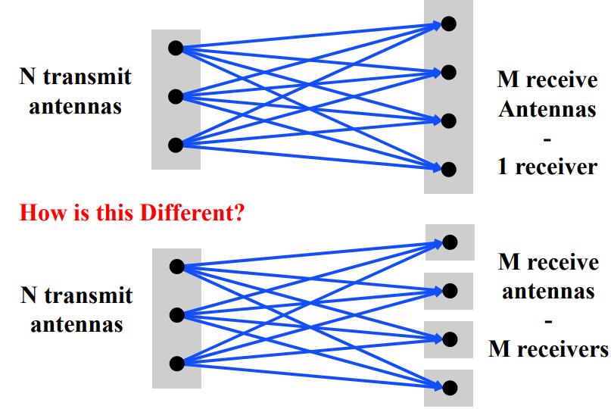
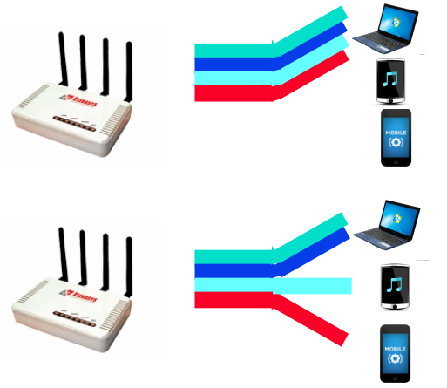
Multi-user Multiple In Multiple Out (MU-MIMO)
Multi-user MIMO uses the same techniques to send in parallel to multiple devices
Devices cannot cancel out interference anymore
Send slower, more reliable data streams to overcome this

Slide 45
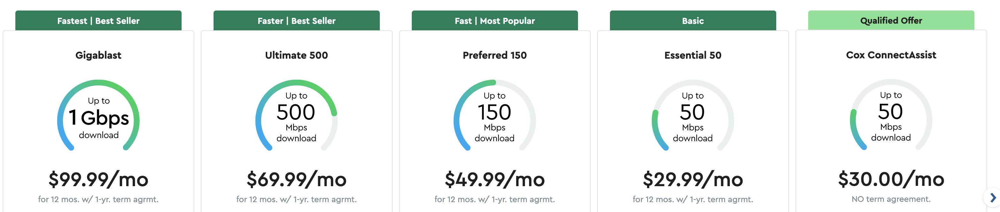
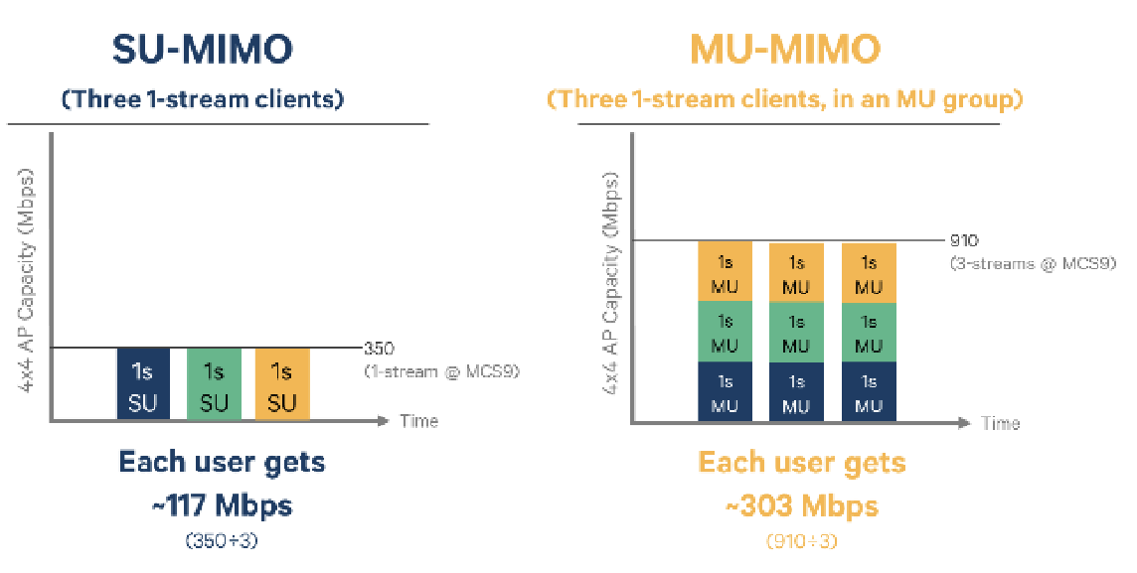
How much data can a single device use?

Slide 46
802.11ac (2013)
Update for 5 GHz band only
Supports Downlink MU-MIMO (from AP to device)
Supports channels widths up to 160 MHz
Engineering updates: up to 256-QAM
Routers apply 802.11ac to 5 GHz and 802.11n to 2.4 GHz
Still in wide use (as of 2026)
Northwestern WiFi networks are mostly 802.11ac (Eduroam, Device, Guest)
But also support 802.11ax (WiFi 6) on 6 GHz channels! (new as of 2026)

Slide 47
802.11ac channels

Slide 48
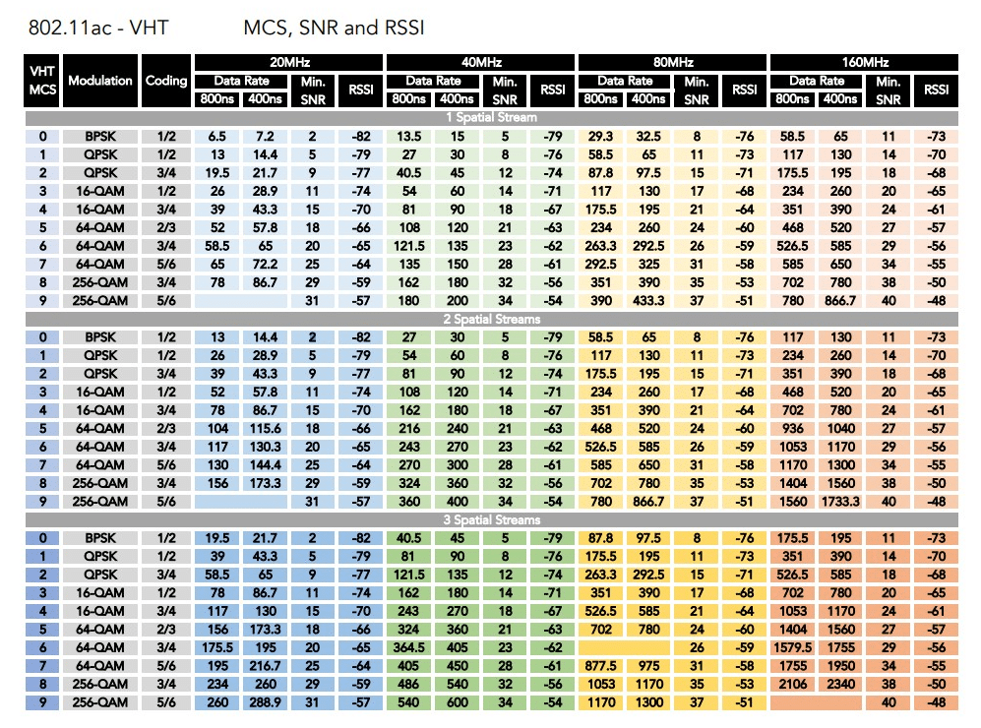
802.11ac modulation and coding schemes
4 spatial streams is also allowed, getting up to 3466 Mbps

Slide 49
Walking through PHY changes by amendment
 | Protocol | Year | Frequency | PHY | Max Rate | Range
- | 802.11 | 1997 | 2.4 GHz | DSSS/FHSS | 2 Mbps | 20 m
1 | 802.11b | 1999 | 2.4 GHz | DSSS | 11 Mbps | 35 m
2 | 802.11a | 1999 | 5 GHz | OFDM | 54 Mbps | 35 m
3 | 802.11g | 2003 | 2.4 GHz | OFDM | 54 Mbps | 38 m
4 | 802.11n | 2009 | 2.4/5 GHz | OFDM + MIMO | 600 Mbps | 70 m
5 | 802.11ac | 2013 | 5 GHz | OFDM + MU-MIMO | 3400 Mbps | 35 m
6 | 802.11ax | 2021 | 2.4/5/[6] GHz | OFDMA + MU-MIMO | 9600 Mbps | 35 m
7 | 802.11be | 2024 | 2.4/5/6 GHz | OFDMA + MU-MIMO | 23000 Mbps | 35 m

Slide 50
New directions in WiFi focus: Aggregate throughput across all devices
For point-to-point, WiFi is “(more than) fast enough”
Now the problem is the quantity of devices in a single space
Desktop, laptop, tablet, smartphone, smartwatch, IoT devices, etc.
Insight: Bring established cellular techniques to WiFi

Slide 51
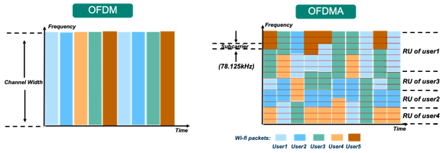
Orthogonal Frequency Division Multiple Access
OFDM: split channel into subcarriers and transmit on those
OFDMA: allocate subcarriers to a device for an amount of time
Turns OFDM into an access control mechanism (frequency + time)
Complicated question: which device gets which subcarriers at which time?

Slide 52
OFDM vs OFDMA Orthogonal Frequency Division Multiplexing vs. Orthogonal Frequency Division Multiple Access
Net spectrum usage ~the same
In same time slot, assign sub-carriers to different users
Effect: Lower bandwidth per user, but more simultaneous users
This is the same strategy cellular “resource blocks” use
Called “Resource Units” in WiFi

Slide 53
802.11ax (2021)
Standard approved in February 2021
First devices started supporting it in 2019 (WiFi 6)
6 GHz band (WiFi 6E)
1.2 GHz of bandwidth (5.925-7.125 GHz)
2020: US FCC made band available for unlicensed use!!!
EU followed by June 2021
OFDMA
MAC scheduling variant of OFDM
AP schedules devices based on time and subcarrier allocations

Slide 54
Other 802.11ax improvements
Uplink MU-MIMO
Multiple devices can transmit to the Access Point simultaneously as long as they use separate frequencies
Enabled by OFDMA resource unit scheduling
Target Wake Time
Support for low-power devices (taken from 802.11ah HaLow)
Station (IoT device) informs Access Point that it will sleep for some duration before checking in
Access Point saves packets until Station wakes and can even schedule wake times to avoid overlap with other devices (TDMA)

Slide 55
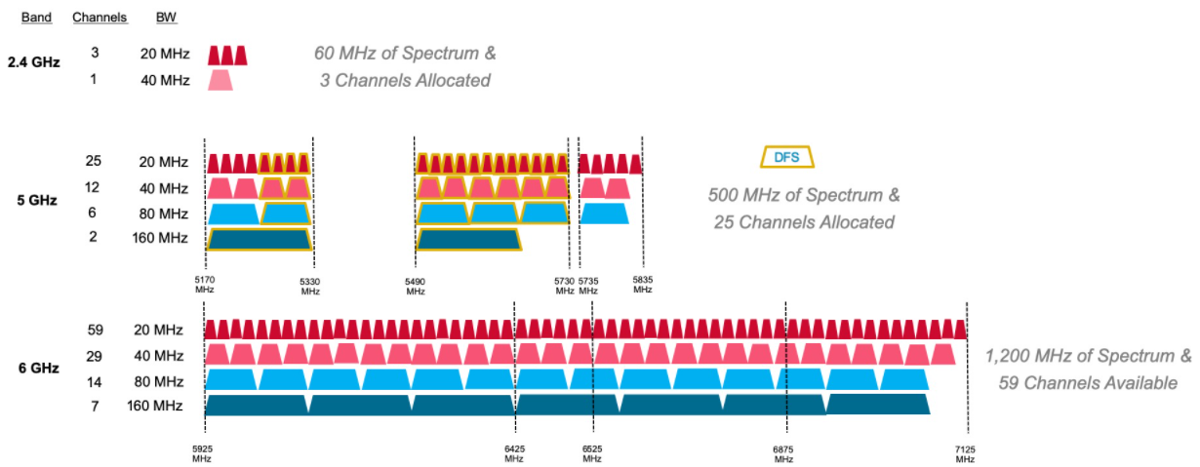
6 GHz band is an enormous amount of bandwidth

Slide 56
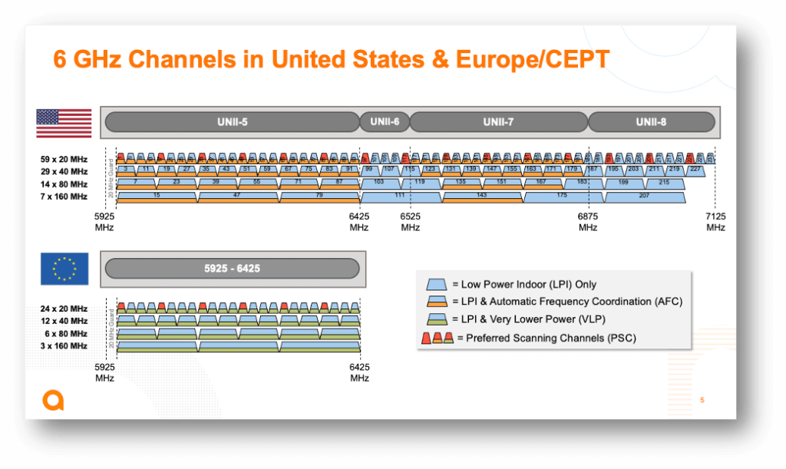
Less bandwidth in the 6 GHz band in Europe (still a lot)

Slide 57
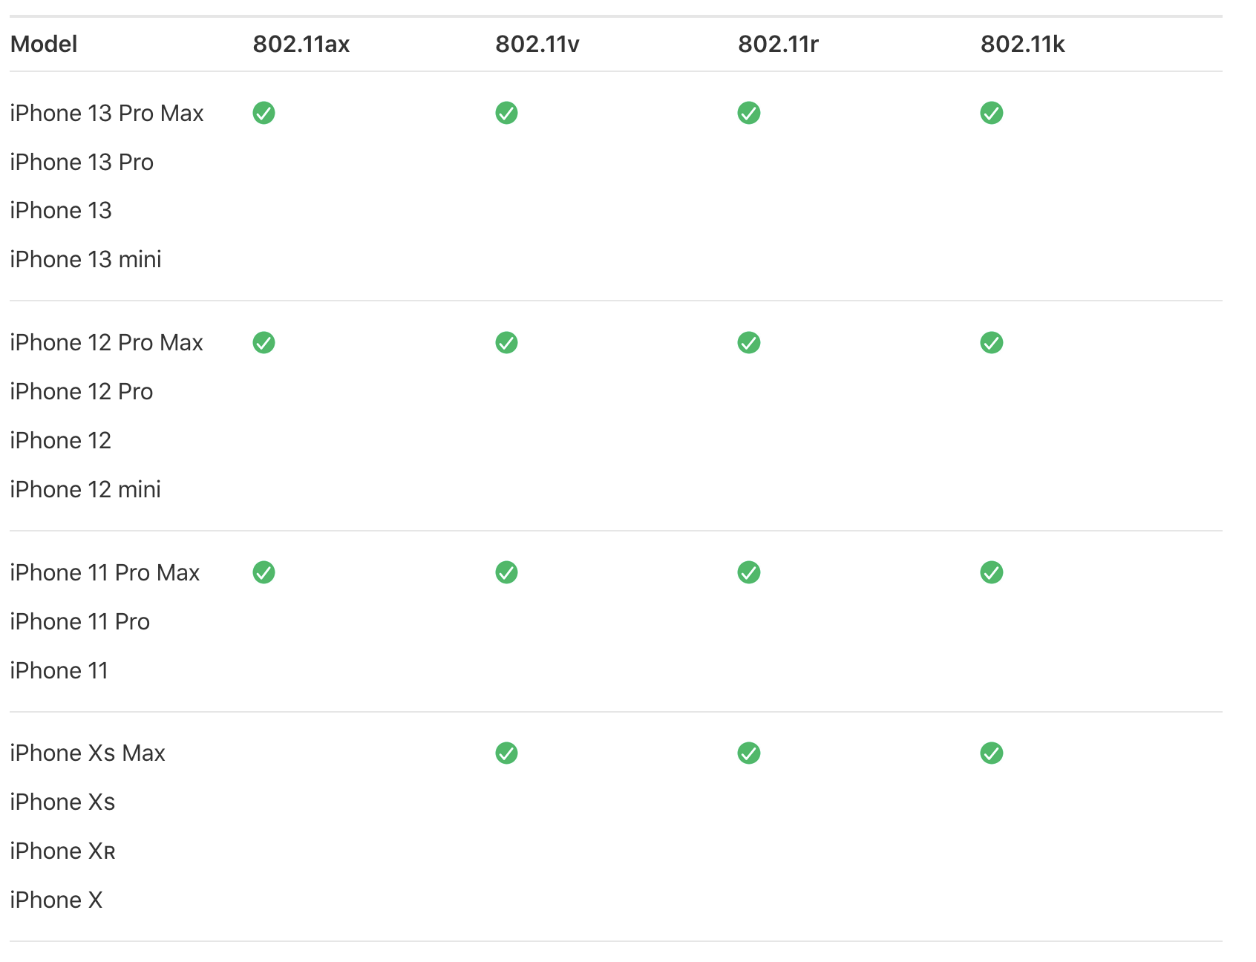
Reminder: WiFi technology (and to some extent cellular) a unicorn – HW support rolls out before specification
Standard Finalized: Sep 2020
Standard Ratified: Feb 2021
Release: Sep 2019 →

Slide 58
WiFi 6 Hardware
Two varieties:
WiFi 6
Most of the features, but NOT the new frequencies
WiFi 6E
Includes the extra 6 GHz channels
Basically entirely unused as of 2023
WiFi 6E is the stuff you want for future proofing
Devices capable of 6E started rolling out in 2022-2023
iPhone 15 (2023), Macbooks 2023 and newer
Google Pixel 6 (2022) and newer

Slide 59
Walking through PHY changes by amendment
 | Protocol | Year | Frequency | PHY | Max Rate | Range
- | 802.11 | 1997 | 2.4 GHz | DSSS/FHSS | 2 Mbps | 20 m
1 | 802.11b | 1999 | 2.4 GHz | DSSS | 11 Mbps | 35 m
2 | 802.11a | 1999 | 5 GHz | OFDM | 54 Mbps | 35 m
3 | 802.11g | 2003 | 2.4 GHz | OFDM | 54 Mbps | 38 m
4 | 802.11n | 2009 | 2.4/5 GHz | OFDM + MIMO | 600 Mbps | 70 m
5 | 802.11ac | 2013 | 5 GHz | OFDM + MU-MIMO | 3400 Mbps | 35 m
6 | 802.11ax | 2021 | 2.4/5/[6] GHz | OFDMA + MU-MIMO | 9600 Mbps | 35 m
7 | 802.11be | 2024 | 2.4/5/6 GHz | OFDMA + MU-MIMO | 23000 Mbps | 35 m

Slide 60
802.11be (2024)
“WiFi 7”
Ratified in September 2024
Essentially: more of everything
More channel bonding / wider bandwidth: up to 320 MHz
Including non-contiguous blocks now that we have OFDMA
Up to 4096-QAM
Up to 16-stream MIMO
New features
AP coordination for non-enterprise networks
Lots of fancy timing estimation stuff (802.1Q)
Primary focus seems to be AV-streaming Quality-of-Service (QoS)

Slide 61
802.11bn what (might be) coming next?
Target release: 2028
But lots of pressure from the billion-dollar WiFi industry means that some hardware “support” will certainly arrive early
Focus on reliability, not throughput increases
Planned to be the exact same throughput as WiFi 7
Goals:
Increase throughput in noisy environments
Reduce latency for all devices
More authoritative details:
Future Directions for Wi-Fi 8 and Beyond https://ieeexplore.ieee.org/document/9864321
https://en.wikipedia.org/wiki/IEEE_802.11bn
Notes:
It’s really 57–71 GHz, and in total is ~10x the bandwidth of all prior bands combined

Slide 62
Outline
WiFi Overview
WiFi PHY
802.11/802.11b
802.11a/802.11g
802.11n/802.11ac
802.11ax
802.11be and Beyond
Real-World WiFi

Slide 63
Goal: improve throughput
In twenty years, WiFi has gone from 2 Mbps to 9.6 Gbps
How does a network PHY improve its throughput?
More capable modulation and/or bit transmission
Techniques like OFDM and MIMO
Original 2 Mbps -> 54 Mbps with OFDM -> 346 Mbps with MIMO (100x)
Engineering improvements are baked into these steps too
More bandwidth
Increased channel with at 2.4 Ghz and bigger 5 GHz channels
346 Mbps with 20 MHz -> 3466 Mbps with 160 MHz (10x)

Slide 64
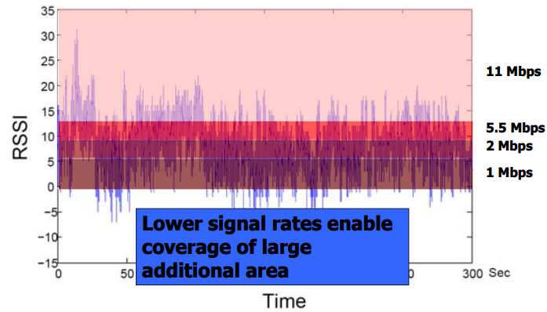
Bit rate adaptation
All modern WiFi standards support multiple bit rates (MCS)
Many factors can influence the choice of bit rate
Capability of device: not all devices support all bit rates
Range and packet reliability (interference)

Slide 65
Bit rate adaptation
Selecting the right rate at the right time is a complex problem
And needs to be decided per-device
Trial and Error
Failures -> reduce rate
Successes -> increase rate
Signal strength
Use channel state information to decide
Context sensitive
Mobile devices can use lower rates for higher reliability

Slide 66
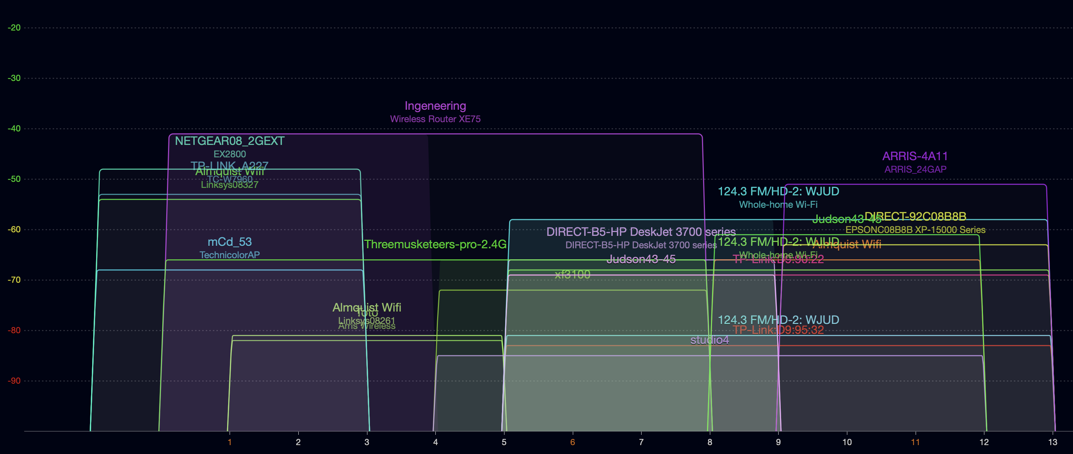
Real-world 802.11 channel use – 2.4 Ghz
Collected from Branden’s prior apartment building in Evanston
Tool: WiFi Explorer (MacOS only, paid)
On Android try “WiFiAnalyzer”
Lots of congestion
Some devices only use 20 MHz bandwidth (mostly on channel 1 or 11 here)
Some devices use 40 MHz bandwidth (<1 through 8, or 5-13)

Slide 67
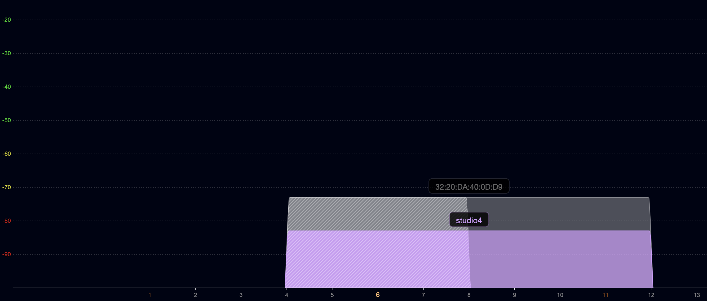
Some real-world devices are weird
Why make a 40 MHz allocation centered on channel 6??
Similarly, some 20 MHz networks use channels 2, 9, or 10

Slide 68
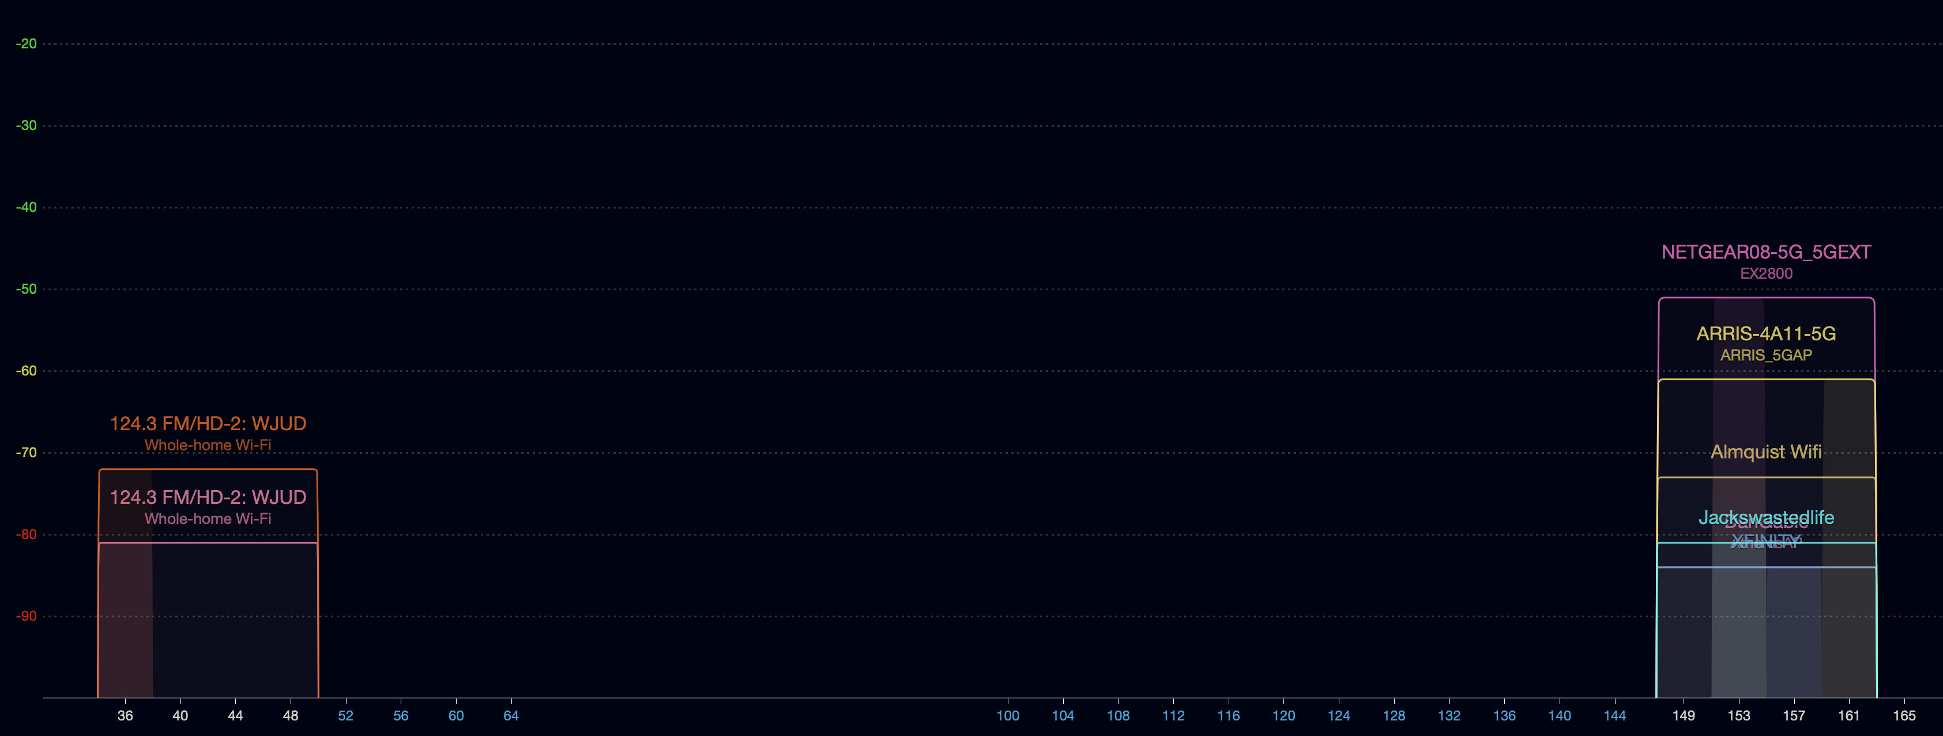
Real-world 802.11 channel use – 5 Ghz
Much less choice
80 MHz bandwidth on lower channels or upper channels
Why no use of channel 165?

Slide 69
Real-world 802.11 channel use – 5 Ghz
Much less choice
80 MHz bandwidth on lower channels or upper channels
Why no use of channel 165? Only 20 MHz, can’t be 100 MHz in size

Slide 70
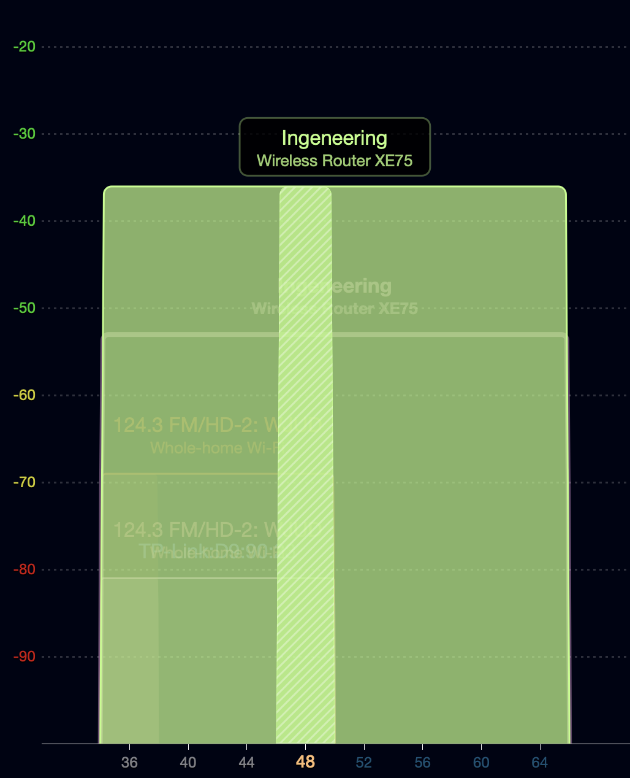
What does a new, (moderately) expensive router get you?
TP-Link Deco XE75
WiFi 6E with Mesh
https://www.tp-link.com/us/deco-mesh-wifi/product-family/deco-xe75/
160 MHz bandwidth channel 💪
Uses channels 52-64 which have special rules
Must detect radar use and leave channel if it occurs (DFS)
Must control transmission power between devices (TPC)
Also has a 160 MHz bandwidth allocation on channels 33-61 of the 6 GHz space
My scans showed no other network in the 6 GHz bands

Slide 71
Outline
WiFi Overview
WiFi PHY
802.11/802.11b
802.11a/802.11g
802.11n/802.11ac
802.11ax
802.11be and Beyond
Real-World WiFi

