Slide 1
Lecture 12 Evolution of Cellular
CS433 – Wireless Protocols for IoT
Branden Ghena – Spring 2026
Materials in collaboration with Pat Pannuto (UCSD) and Brad Campbell (UVA)

Slide 2
Administrivia
Lab: Thread due Thursday
Lab: WiFi due next week Thursday
Lab office hours on Friday
Come finish WiFi lab and be free next week
Quiz today at 1:30
Tell your friends

Slide 3
Today’s Goals
Introduction to the Wide-area communication space
Understand fundamentals of cellular technology
Learn how “older” cellular technology works
And why it is relevant to the IoT today
Good video overview of cellular: https://www.youtube.com/watch?v=0faCad2kKeg
(we watched a few minutes of this on modulation earlier in class)

Slide 4
Outline
Wide-Area Network Background
Cellular Network Technologies
1G
2G
3G/4G and beyond

Slide 5
Wide area networks
Communication at the region/city scale rather than the building/residence scale
Throughout cities
Agricultural deployments
Industrial facilities
City-scale sensing is one very popular domain
What might we want to sense throughout a city?

Slide 6
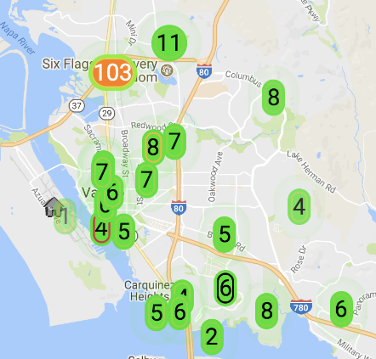
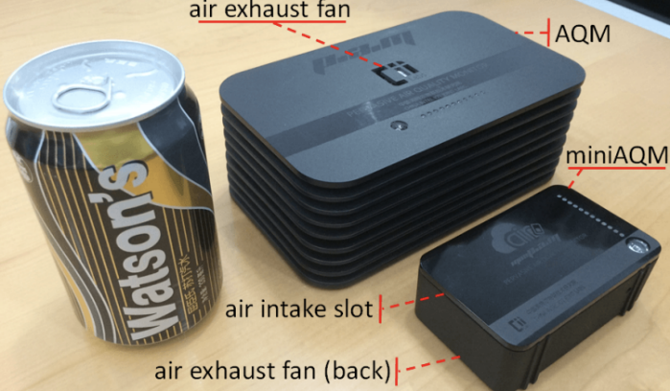
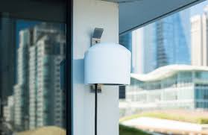
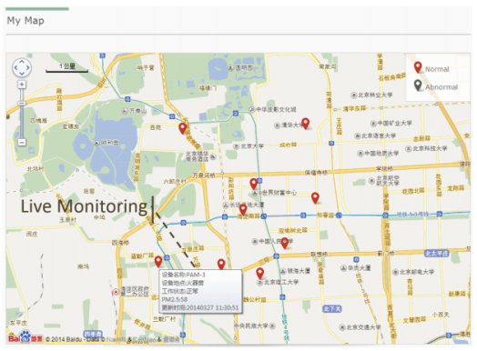
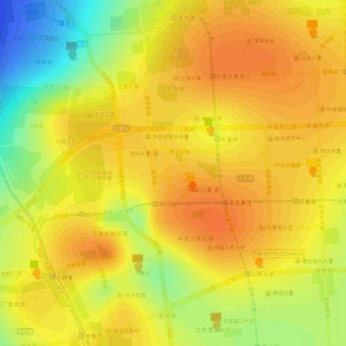
Air quality monitoring
[2]
[2]
[1]
[1]
[1] Cheng et al. AirCloud: a cloud-based air-quality monitoring system for everyone. 2014. [2] Purple Air. 2018.

Slide 7
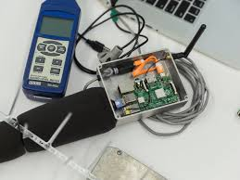
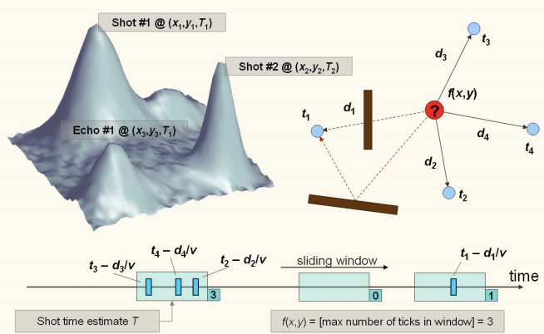
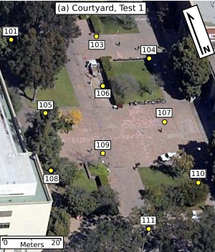
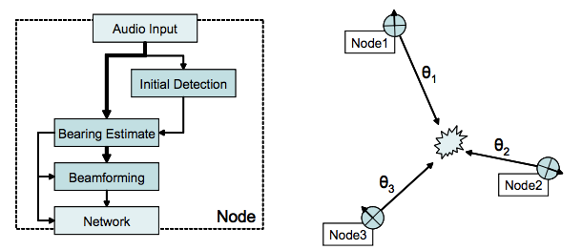
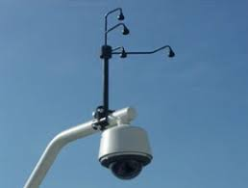
Audio detection, classification, and localization
[3]
[2]
[1]
[1]
[1] Girod et al. The Design and Implementation of a Self-Calibrating Distributed Acoustic Sensing Platform. 2006. [2] Lédeczi et al. Multiple Simultaneous Acoustic Source Localization in Urban Terrain. 2005. [3] Sounds of New York City. 2016.

Slide 8
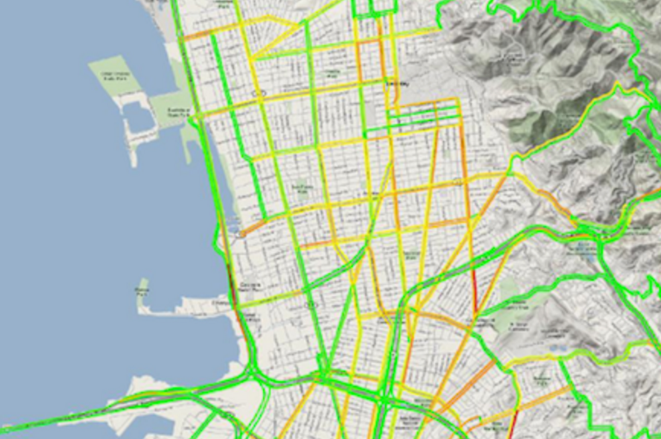
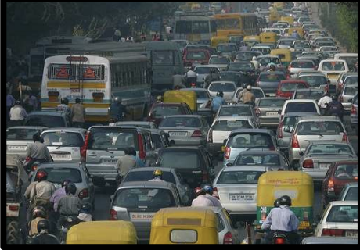
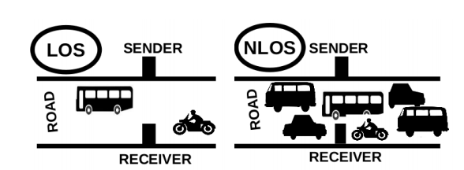
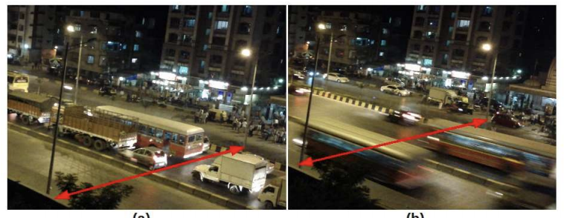
Traffic queue sensing and congestion control
[1]
[1]
[1]
[1] Sen et al. Kyun Queue: A Sensor Network System To Monitor Road Traffic Queues, 2012

Slide 9
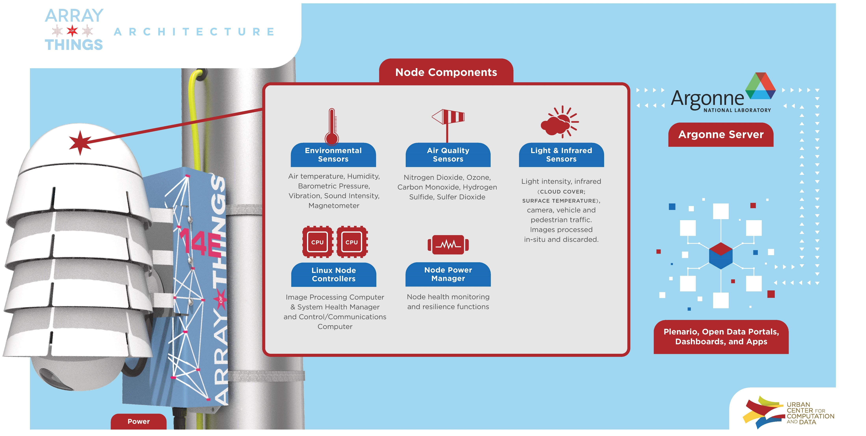
Array of Things project - Chicago

Slide 10
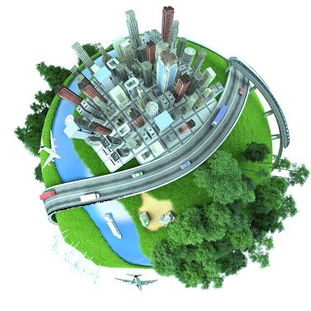








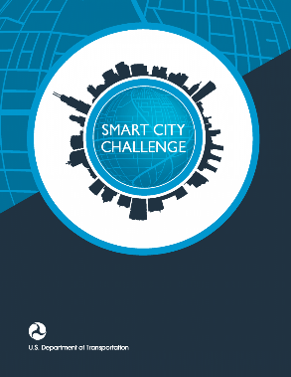



Slide 11
Considering wide-area networks
WiFi
Data
Throughput
Range

Slide 12
Considering wide-area networks
WiFi
Data
Throughput
Bluetooth
BLE
Zigbee
Range

Slide 13
Considering wide-area networks
WiFi
Higher Power & Higher Cost
Data
Throughput
Bluetooth
BLE
Zigbee
Lower Power & Lower Cost
Range

Slide 14
Considering wide-area networks
WiFi
4G
Higher Power & Higher Cost
3G
Data
Throughput
Bluetooth
2G
BLE
Zigbee
Lower Power & Lower Cost
Range

Slide 15
Takeaway: Cellular provides the IoT the only reliable global coverage available today
If the goal is deploy-today + work-anywhere, cell is the only option
(Or increasingly satellite, we’ll cover that later in class)
That’s not to say cell actually works everywhere!
Just the best-available

Slide 16
Outline
Wide-Area Network Background
Cellular Network Technologies
1G
2G
3G/4G and beyond

Slide 17
Poll: What decade was the first commercial mobile phone?
1910-1920
1920-1930
1930-1940
1940-1950
1950-1960
1960-1970
1970-1980
1980-1990
1990-2000
2000-2010

Slide 18
The first commercial mobile phone was in 1946!
By 1948, 5000 users placing around 30,000 calls weekly
“The equipment, of course employing vacuum tubes, weighed eighty pounds, filled much of a vehicle’s trunk and drew so much power that it would cause the headlights to dim. Service cost $15 per month, plus thirty to forty cents per local call, equivalent to $175 2012 dollars, plus $3.50 to $4.65 per call. “
https://ethw.org/The_Foundations_of_Mobile_and_Cellular_Telephony
https://www.smithsonianmag.com/innovation/first-mobile-phone-call-was-made-75-years-ago-180978003/

Slide 19
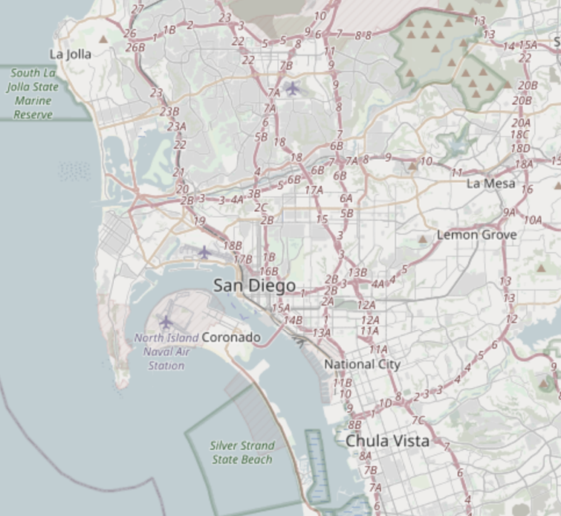
The first `mobile` network architecture
Single transmitter tower, multiple receiver towers
Why?
Notes:
A single transmitter on a central tower provided a handful of channels for an entire metropolitan area. Between one and eight receiver towers handled the call return signals. At most, three subscribers could make calls at one time in any city using the single transmitter and the tiny amount of spectrum allocated by the Federal Communications Commission to this service. It was in effect a massive party line, where a tightly controlled number of subscribers had to listen first for someone else on the line, and, if finding the line free, signal an operator, who would place the call. During the call, the user depressed a button on the handset to talk and released it to listen.

Slide 20
The first `mobile` network architecture
Single transmitter tower, multiple receiver towers
Why? Transmission energy of phone!
Medium Access Control?
Push-to-talk [half-duplex]
City-wide “party line”
Maximum of three concurrent callers
Notes:
A single transmitter on a central tower provided a handful of channels for an entire metropolitan area. Between one and eight receiver towers handled the call return signals. At most, three subscribers could make calls at one time in any city using the single transmitter and the tiny amount of spectrum allocated by the Federal Communications Commission to this service. It was in effect a massive party line, where a tightly controlled number of subscribers had to listen first for someone else on the line, and, if finding the line free, signal an operator, who would place the call. During the call, the user depressed a button on the handset to talk and released it to listen.

Slide 21
1965: The Improved Mobile Telephone Service
“More spectrum”
Bell: VHF Low (35-44 MHz, 9 channels), VHF High (152-158 MHz, 11 channels), UHF (454-460 MHz, 12 channels)
7 channels at VHF, and 12 channels at UHF for "RCCs" (Radio Common Carriers)
These will end up becoming pagers, mostly
“Full Duplex”
Implemented as channel pairs (two half-duplex)
Increased spectrum is still not enough
Limited to 40,000 total subscribers
E.g. NYC had 2,000 people on 12 channels with a typical wait of 30 minutes to place a call
Phones fit in a briefcase now
Notes:
Also now full duplex, and no more operators

Slide 22
Quick review: How can we share spectrum?
Frequency division
Already doing that
Time division
Already doing that
Code division
Won’t come to mobile networks until the 80’s
Spatial division!!

Slide 23
What’s wrong inefficient with this picture?
Early mobile networks handled the mobility challenge with wide-area coverage
The active user could be anywhere in the 40~60 mile range of the transmit tower
So they had exclusive access to that whole area!
12 frequency channels → 12 users

Slide 24
The “cell” in cellular networks
Cells use spatial division
Reduce transmit power, smaller area
Now…
12 / 3 = 4 channels per cell
* 6 cells in area
= 24 users of same spectrum!
And we can choose the cell size based on our expected needs

Slide 25
Spatial division tradeoffs
?
Need more infrastructure (more towers)
Need logic to support handoff
Cellular concept in Bell labs at 1947 [one year after first mobile], but no handoff solution yet

Slide 26
How often does handoff need to happen anyway?
Really a question of “how big are cells”
A back-of-envelope answer for “Handoffs per 3-minute call”:
 | Speed (mph) | Speed (kph) | Cell Radius (km) | Handoffs
Freeway, rural | 65 | 104 | 16 | 0.33
Freeway, urban | 65 | 104 | 1.6 | 3.25
Surface streets, urban | 30 | 48 | 1 | 2.4
Pedestrian, urban | 1.5 | 2.4 | 1 | 0.12
Pedestrian, microcell | 1.5 | 2.4 | 0.1 | 1.2
Table data from Arthur H. M. Ross, PhD: http://www.cdg.org/technology/cdma_technology/a_ross/handoff.asp

Slide 27
Sidebar: bullet trains and airplanes
Commercially operating high-speed rail (~200-400 km/h)
Fastest: 431 km/h (268 mph) – Shanghai Maglev
Commercial airlines (~800-1200 km/h)
Standard: 988 km/h (614 mph) – Boeing 747
Fastest: 2180 km/h (1354 mph) – Concorde (no longer operational)
5G specs seem to support up to 500 km/h
Per prior chart: ~1.5 handoffs per 3 minute call
Less impactful for non-real-time internet browsing

Slide 28
Introducing 1G! (First Generation)
AMPS — Advanced Mobile Phone Service (circa 1983)
Other 1G’s:
Nordic Mobile Telephone (NMT) — Nordics, Eastern Europe, Russia
Total Access Communications System (TACS) — UK, West Germany, Portugal South Africa
Radiocom 2000 — France
1G is defined by:
Analog voice channels
Established by digital control channel ← handoffs

Slide 29
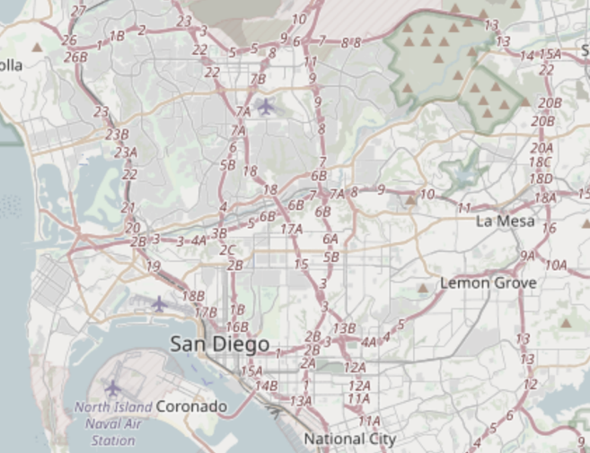
Break + Discussion: How to implement handoff?
<brainstorm>

Slide 30
How does AMPS implement handoff?
Base station detects weak signal
Base station tells mobile about new, better tower
Base station sends cutover trigger
Lots bad about this:
No `make before break` — many drops!
Mobile has better estimates than base station

Slide 31
Spatial division in practice
Directional antennas at tessellation corners provide redundant coverage [robustness!]

Slide 32
Spatial division in practice
Directional isolation is imperfect, requires many bands in practice
~5-7 cells are within conflict range, so we need to divide channels by ~7

Slide 33
Over time, AMPS did also get more frequencies
AMPS in the US:
850 MHz band
Divided into “A” block and “B” block
Granted to local phone company and “wireless company” respectively
Each block had 21 control, 395 voice channels
Divide by 7 to get voice channels per cell: ~56
So ~56 users per cell, rather than 12 for the entire city
Several expansions of this frequency block
Most interesting: in 1989 UHF TV channels 70-83 added 666 more channels

Slide 34
The first “sunset”
Single-user analog channels is not very efficient
Wireless carriers want to replace 1G
Key Takeaway: Spectrum allocation is the most scarce resource, therefore want to maximize efficiency of its use [efficiency: number of paying customers / spectrum?]
But many things in the built environment rely on AMPS
Because when they were built, AMPS was the most reliable
OnStar
ADT home alarms [got sued!]
Some systems made adapters, others just stopped working
FCC required network support until early 2008 (dropped soon after)
Notes:
Options: SOL mostly. People sold adapter kits to replace transmit modules where possible [see 2G OnStar example for this happening now later in slides]. ADT got sued class-action for selling products that were ‘destined to fail’ (suit failed).

Slide 35
Aside: Super cool hackaday projects
Building your own 1G network!
https://hackaday.com/tag/amps/
https://github.com/unsynchronized/gr-amps
⚠ ⚠ ⚠ This uses spectrum you do not own ⚠ ⚠ ⚠
“The FCC can levy fines of up to $11,000, per transmitter, per day, with up to six months in federal prison, for violations of the Code of Federal Regulations.”
Could deploy with wired connections though…

Slide 36
Outline
Wide-Area Network Background
Cellular Network Technologies
1G
2G
3G/4G and beyond

Slide 37
IS-54 aka 2G aka TDMA aka D-AMPS (Digital AMPS)
Deployed ~1993
Used TDMA to share AMPS channels
Each AMPS analog channel-pair was 30 kHz
Digital compression allowed for 3 time slots per channel — tripled capacity!
Later iterations would compress further, 6 time slots per channel
Without additional bandwidth: 6*56 = 336 simultaneous devices per cell
Beat out competing FDMA analog solution from Motorola
Narrowband AMPS, “N-AMPS”, compressed calls to fit in 10 kHz channels
Also encrypted [poorly: CMEA broken publicly in 1997]

Slide 38
GSM aka 2G
Wait, didn’t the last slide say 2G was something else?
What is “2G” then?
Exactly.
“2G” isn’t one technology, it’s a collection of “second generation” protocols
This is true for later generations too
And if you think this is confusing, it only gets worse
Anecdote: Pat as a Qualcomm intern in 2010 asked everyone I met there “what actually is 4G,” and every engineer just laughed at me

Slide 39
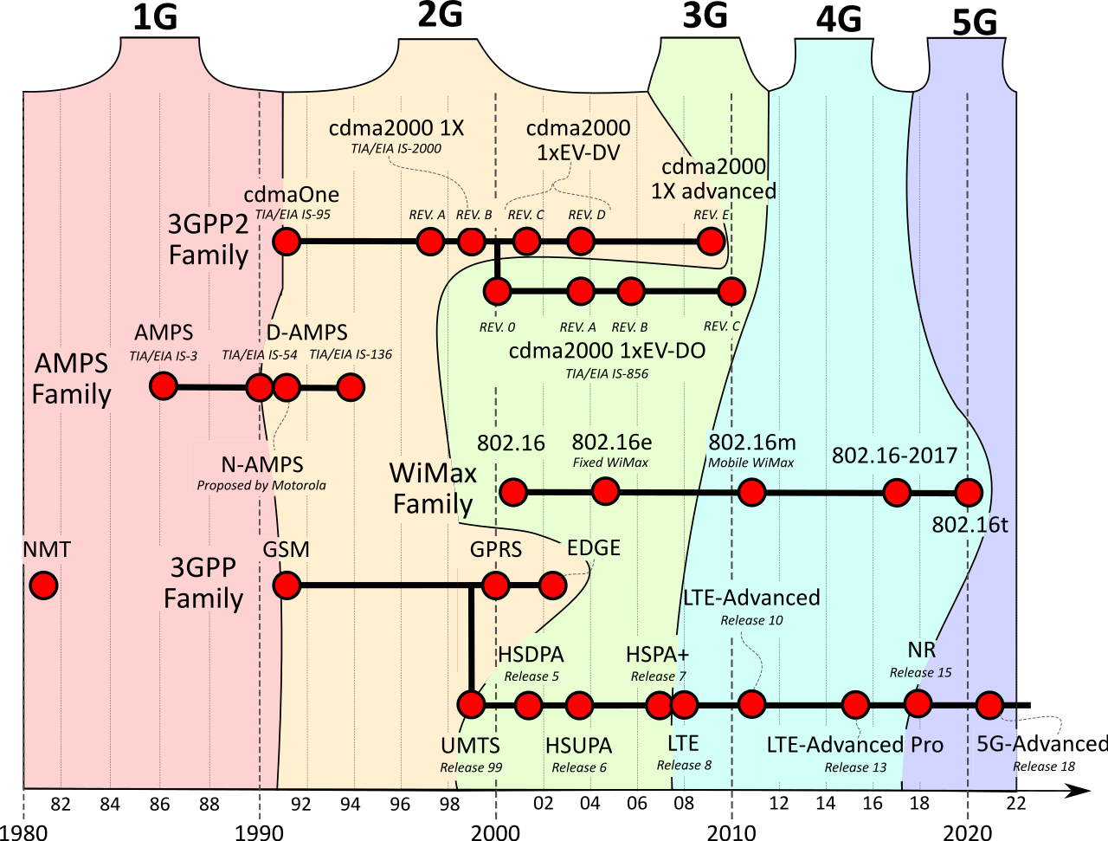
Cellular generations
Multiple competing technologies
Edges of these get quite a bit “fuzzy”

Slide 40
CDMA in 2G
One family of 2G protocols used CDMA access control
Deployed mostly in North America, Japan, and South Korea
Eventually lost out to GSM family, which evolved into today’s LTE and 5G systems

Slide 41
CDMA Principle
High level concept
Expand binary data into larger bit patterns, like DSSS does
Each phone gets a unique bit pattern
Use those bit patterns to distinguish data
Which works even when packets collide
Hard parts
Bit patterns must be “orthogonal” and unique to each phone sharing a cell
Orthogonal: dot product is zero. Means they don’t affect each other
Packets must either be sent synchronously (downlink from station)
Or asynchronously (uplink to station) but with a probability of loss

Slide 42
CDMA math example for two transmitters
Transmitting: data bit 1: +code, data bit 0: -code
Receiving: dot product of signal and code: >0 = 1, <0 = 0
Device A: Code (1, -1)
Data bits: {1, 0} -> {+code, -code} -> {(1, -1), (-1, 1)}
Device B: Code (1, 1),
Data bits: {0, 0} -> {(-1, -1), (-1, -1)}
Signal: {(1, -1), (-1, 1)} + {(-1, -1), (-1, -1)} = {(0, -2), (-2, 0)}
Decoding
Data for Device A: (1, -1) ⋅ {(0, -2), (-2, 0)} = {2, -2} -> {1, 0}
Data for Device B: (1, 1) ⋅ {(0, -2), (-2, 0)} = {-2, -2} -> {0, 0}

Slide 43
GSM
D-AMPS was sunset when AMPS was sunset in 2008
So “modern” 2G is entirely built upon GSM
“Global System for Mobile Communications”
It is a standard [the dominant 2G]
GSM meant “phone” for a while in parts of Europe
(and apparently still in Belgium?)
GSMA is the GSM Association; which a lot of people just call GSM
Because GSM made [a] 3G and LTE [which is a 4g?] and 5g [ish! more next time]
Yay.

Slide 44
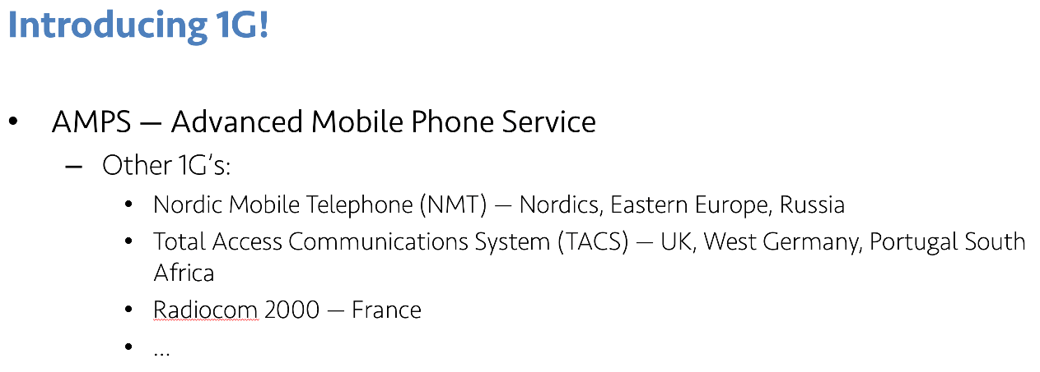
Origins of GSM
An incredible sweet spot of timing, technology need, and politics?
1987: 13 European countries sign accord to use one wireless standard
10 months later: GSM standard ratified
Insight: Not a ton new in GSM by ‘87, just a lot of arbitrary design decisions
Combined with broad agreement
Not a very `mobile` mobile network…
Notes:
Lot of patting-on-back for co-operation history, but it seems somewhat genuine; plus 4 dudes who just plowed through their standard
— Insight: GSM

Slide 45
The real innovation of GSM was the indirection and interoperability it enabled
Europe hit this problem before the US because the US is large
(and US telecoms owned/operated subsidiaries in Canada)
Coincided with major growth in global mobility
Mobile devices needed to be able to use other carriers infrastructure
Early GSM isn’t anything fancy in modulation, data, etc
It’s all about the control channels

Slide 46
GSM evolved over time to add data
GSM was voice-only at first
Then overlaid data on the voice channel
Circuit Switched Data (CSD)
9.6 — 14.4 kb/s
Previous hacks were literally cell phone calling a modem (~3.5 kb/s); same concept
Then added actual packetized data [“2.5G”]
General Packet Radio Service (GPRS)
Throughput 9.2 – 21.55 kbit/s/timeslot [goodput 8-20 kbit/s/timeslot]
Enhanced Data Rates for GSM Evolution (EDGE)

Slide 47
https://en.wikipedia.org/wiki/File:Gsm_structures.svg

Slide 48
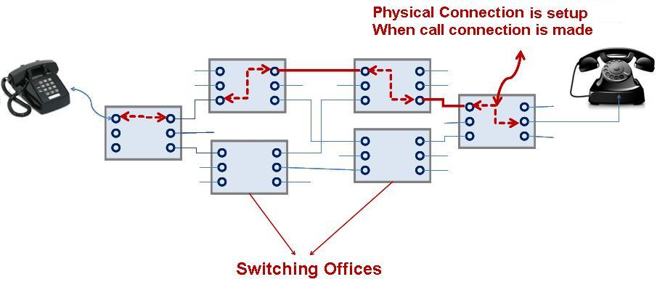
Circuit switching

Slide 49
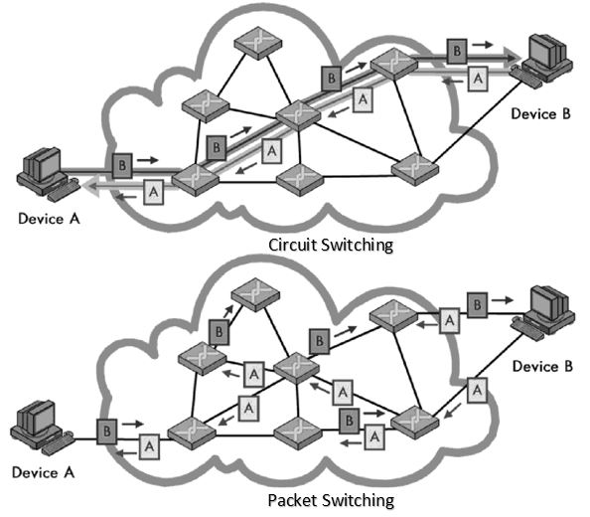
Comparing circuits vs packets
Circuit switching
Virtual electrical connections between two devices
Full capacity is dedicated to only those two devices
Packet switching
Chunks of data get routed between devices
Overhead to figure out where they go

Slide 50
So why does the IoT care about 2G?
It’s easy to implement
2G == GMSK
3G = QPSK [requires better hardware]
4G and up is more complex
It’s cheap
Relative to other cellular plans, anyways. This may be changing finally
It’s low power*
*For select IoT workloads
Energy-per-bit of continuous stream improves each generation
Energy-per-event of infrequent event is more tricky though

Slide 51
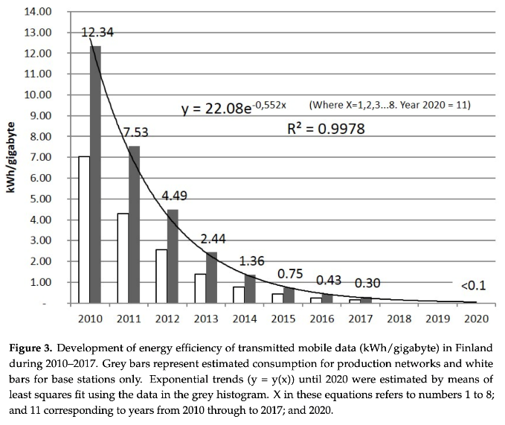
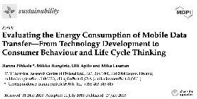
Corollary to improved throughput is improved energy performance
Same philosophy as high-performance architecture, etc
There is always baseline load, which going faster amortizes
Notes:
Pic as citation pretty lazy Pat… :D

Slide 52
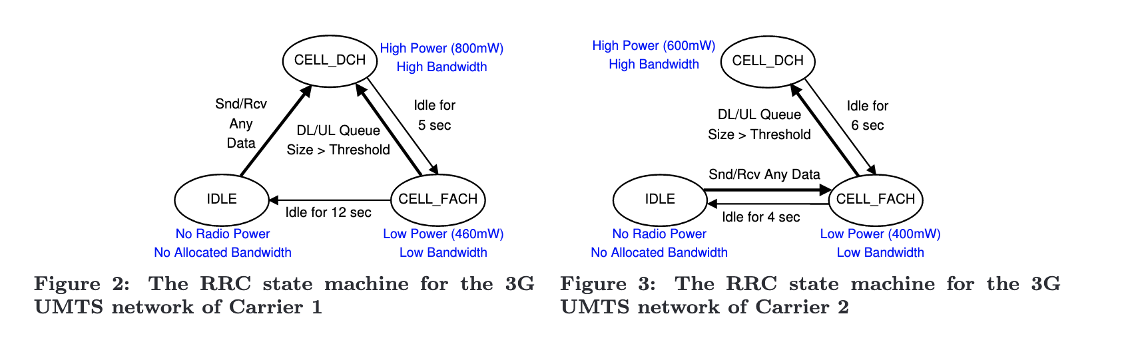
But energy per transaction is complex
Radios, cellular protocols, and cellular providers have state machines
Hard to predict a priori and globally ☹
Characterizing radio resource allocation for 3G networks; Feng Qian, Zhaoguang Wang, Alexandre Gerber, Zhuoqing Morley Mao, Subhabrata Sen, Oliver Spatscheck; SIGCOMM’10

Slide 53
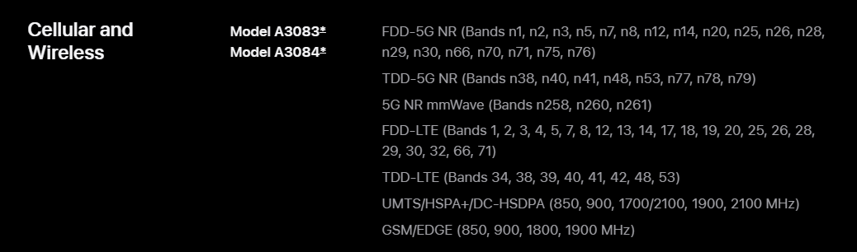
Why might 2G continue to survive [globally]?
More coverage for lower costs
2G has longer range than 3G
It fills the legacy niche
High performance HW includes fallbacks
2G/3G radios, then 2G/3G/4G radios, now 2G/3G/4G/5G radios
Consider the iPhone 16 Pro (2024):
Brick phones still popular!

Slide 54
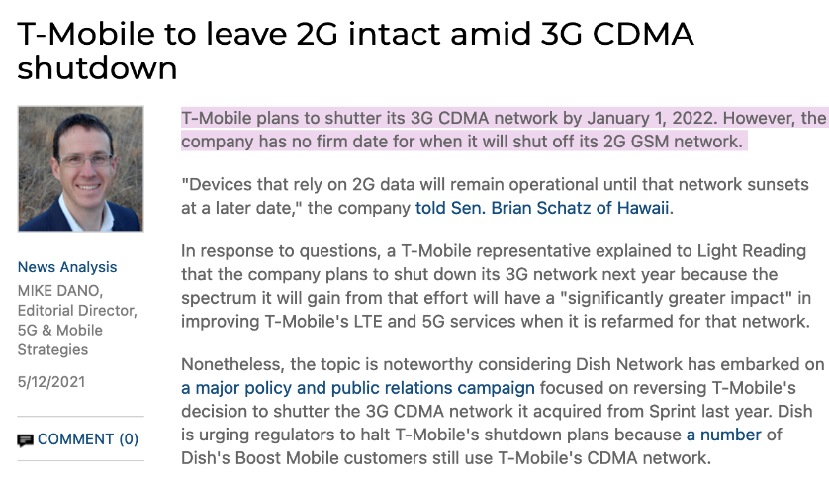
2G in the US… [Plans]
AT&T stopped servicing 2G networks in 2016
Verizon Wireless also phased out its 2G CDMA network at the end of 2020
Sprint had plans to shut down 2G in April 2022
Purchased by T-Mobile anyways
T-Mobile plans on
2023 April 2024 February 2025 Still running…
2026: they’ve apparently been slowly phasing out regions

Slide 55
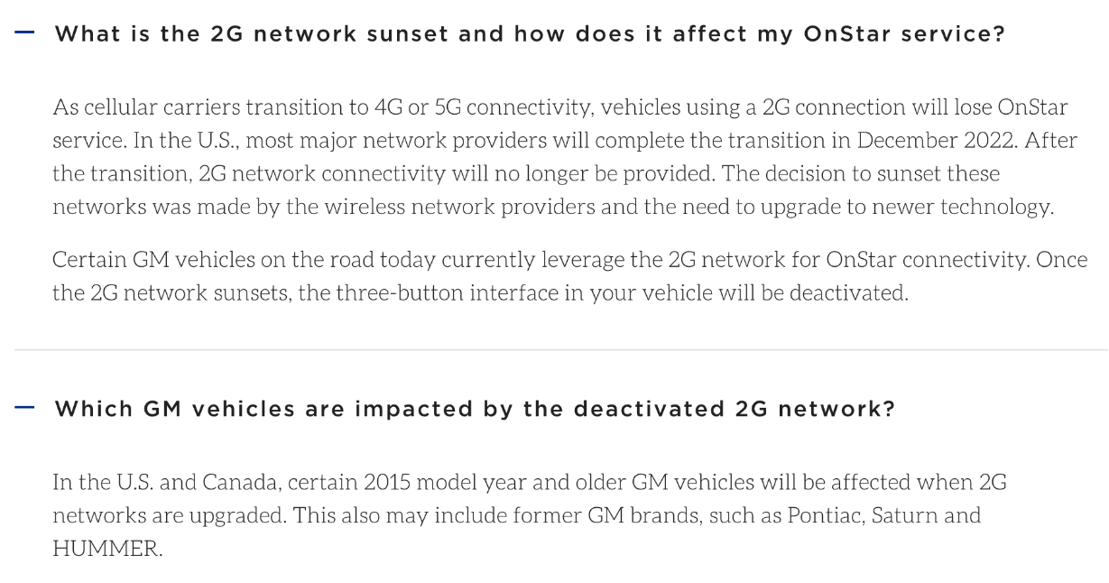
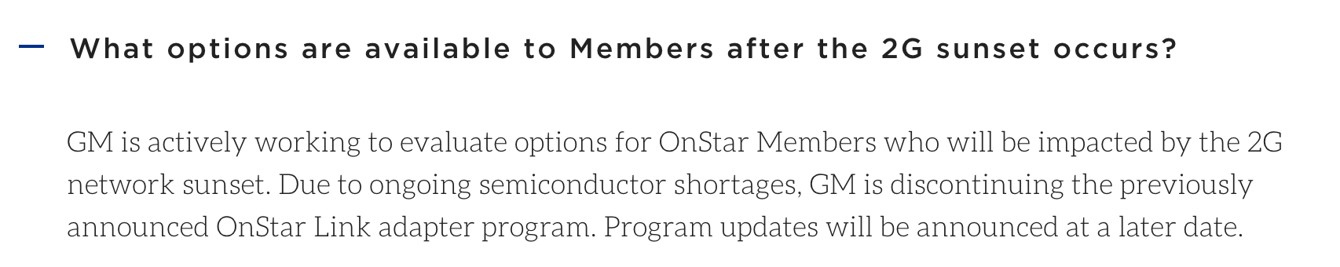
Does GM ever learn? [Could they have?]
What would you put in cars if you were the PM of OnStar today?
Moved to 4G…

Slide 56
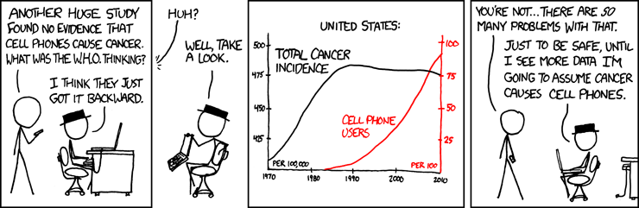
Break + xkcd
https://xkcd.com/925/

Slide 57
Outline
Wide-Area Network Background
Cellular Network Technologies
1G
2G
3G/4G and beyond

Slide 58
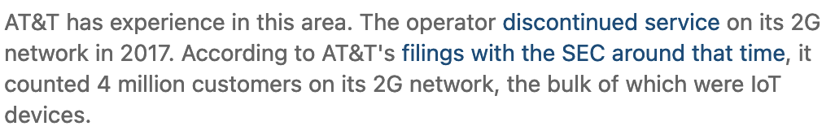
Starting with the end: the 3G sunset
Announced retirements:
Verizon: Dec 2022
AT&T: Feb 2022
T-Mobile: Finally got there in July 2022 (after months of delays)
2G reminder
Verizon and AT&T actually did sunset 2G
T-Mobile plans on ???
AT&T: 2.7% of customers will be affected by 3G shutdown

Slide 59
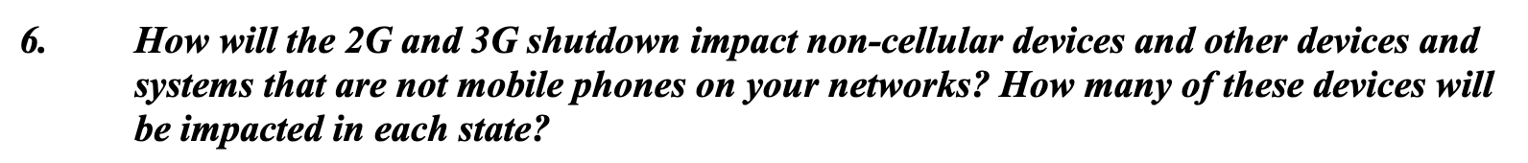
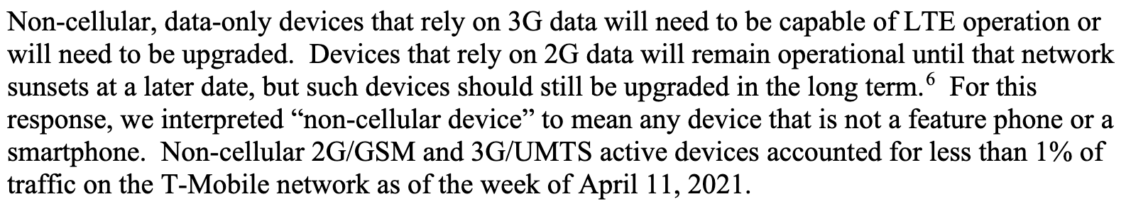
Why does 2G have staying power that 3G doesn’t?
T-Mobile’s letter to Congress on 2g/3g sunset
n.b. Senator Schatz seems to get this stuff
Notes:
Pat’s personal guess: There are critical infrastructure bits that are/will-be effectively 2G only that will take a long time to replace. One band of 2G will live on for years. These are less frequent M2M, so one band is plenty and hit the pragmatic long-tail of legacy devices; also fixes 3g sunset. Reading between the lines, T-Mobile [which is really Deutsche-Telekom, which is really a global conglomerate, which can’t sunset 2g globally for a long time and so will have internal infra anyway] will provide 2g services for everything left; can do MVNO-like takeover of devices that need to run on sunset networks [assuming they can roam to the one band that’s left]

Slide 60
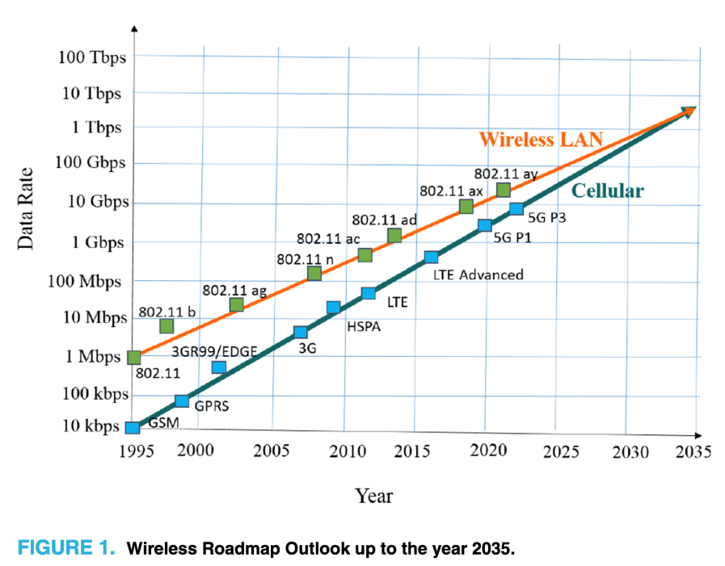
So what did [*]G provide over 2G anyway?
Biggest thing is throughput
Not really relevant for IoT stuff
And a spectrum land-grab
Wireless providers advocated for global availability of channels
With some success
Terahertz Band: The Last Piece of RF Spectrum Puzzle for Communication Systems (preprint; Elayan et al.)

Slide 61
Aside: Eventually, the naming thing got annoying, so an international standards body fixed* it *Yeah, you know how this story will end
The International Telecommunications Union (ITU) is a UN branch
ITU-R set standards for what can be considered “a 4G technology”
”Generations” are now defined by speed
E.g. to qualify as “a 4G technology”: 100 Mb/s+ (mobile), 1 Gb/s+ (stationary)
Fun game: How fast is LTE?
LTE spec maxes out at 300 MB/s down and 75 MB/s up
It seems LTE has been retroactively classified as 3.95G
[By everyone except the wireless carriers?]

Slide 62
Outline
Wide-Area Network Background
Cellular Network Technologies
1G
2G
3G/4G and beyond

Slide 63
Outline
Wide-Area Network Background
Cellular Network Technologies
1G
2G
3G/4G and beyond
Bonus: IoT on Global Cellular
Story by Pat Pannuto & nLine

Slide 64
Sizing networks is hard
Sometimes you just lose performance…

Slide 65
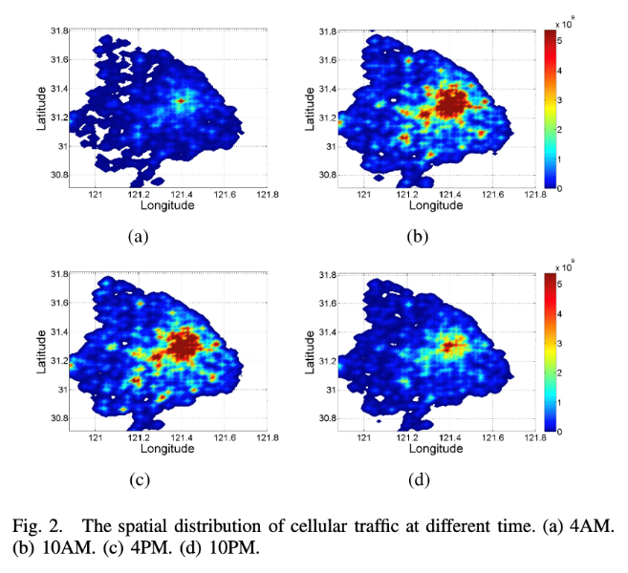
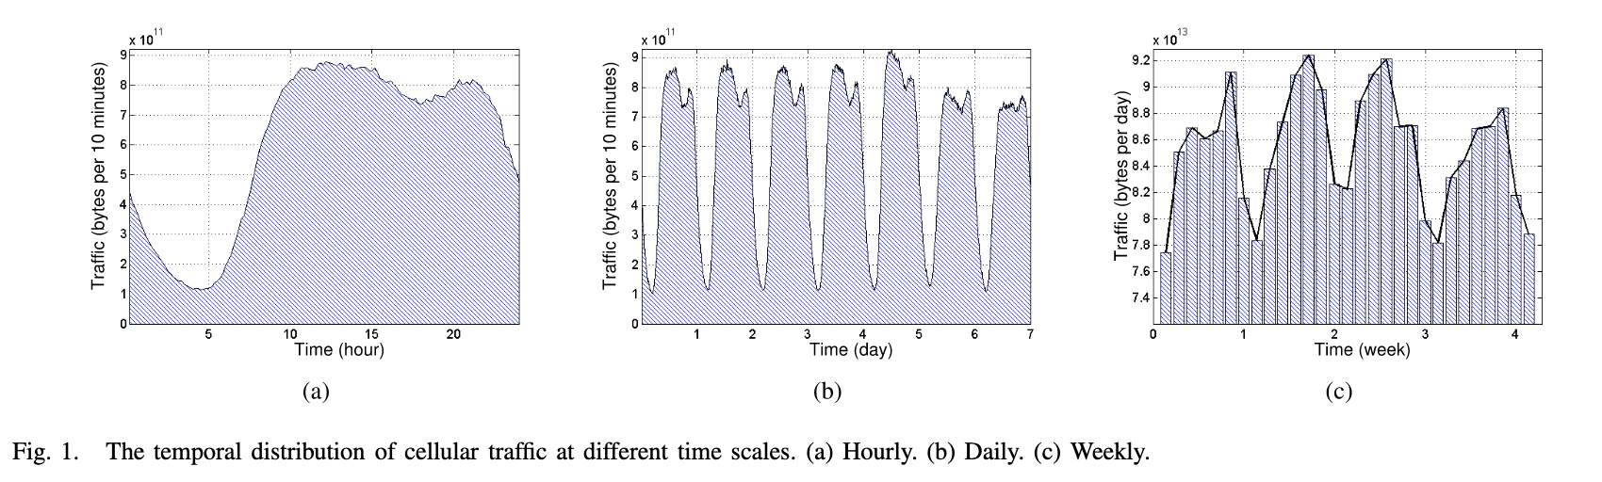
Traffic fluctuates in all networks, for cellular it becomes a function of both when and where you are
Understanding Mobile Traffic Patterns of Large Scale Cellular Towers in Urban Environment; Xu, Li, Wang, Zhang, Jin; IEEE ToN

Slide 66
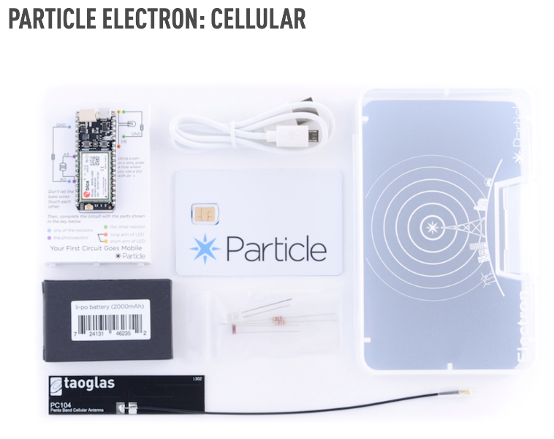
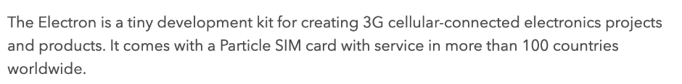
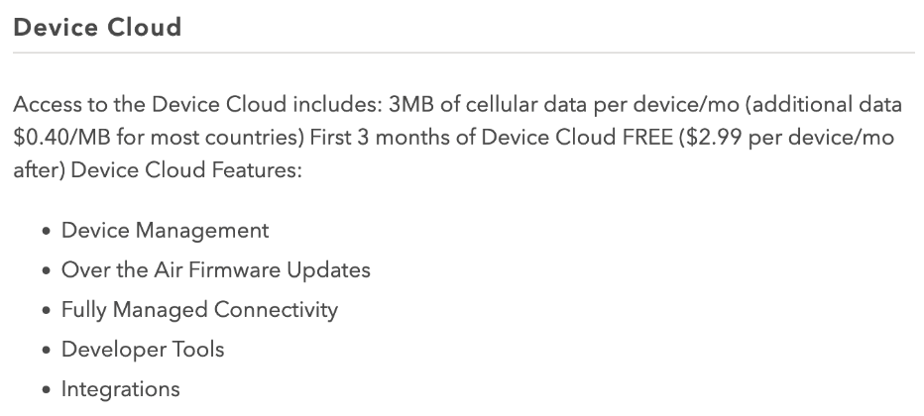
Why does this matter for IoT Deployments?
Say you’re building a power grid sensor you want to deploy globally…

Slide 67
What is a MVNO “Mobile Virtual Network Operator”
Decoupling the builders of infrastructure from the sellers
Not a new concept, but seeing aggressive growth
MetroPCS; Cricket; Boost Mobile; etc
GoogleFi; Xfinity Cellular

Slide 68
So how does Particle, a small IoT platform startup, provide global cellular coverage?
We deployed some Electrons in Accra, Ghana sending a message once per minute 24/7 for a few weeks
PRR [POST Reception Rate] changes over time
Almost zero PRR from ~7-9am and ~4-7pm daily
Introducing traffic priority
Call Particle: “What gives?”
Particle buys from T-Mobile
T-Mobile buys from Deutsche-Telekom [didn’t own them yet]
DT buys from Vodafone
Vodafone buys from MTN
MTN has 5 tiers of traffic priority on their network [guess which tier we were in?]

Slide 69
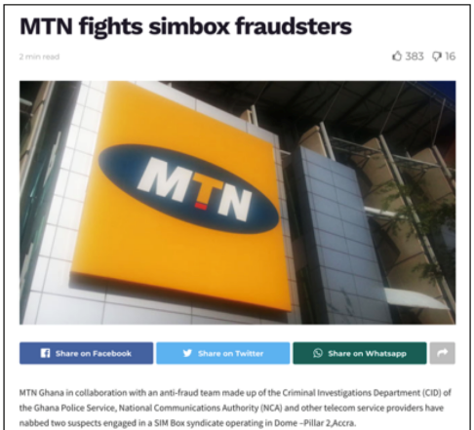
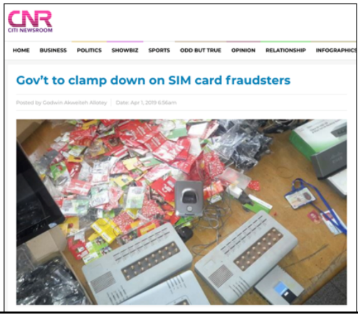
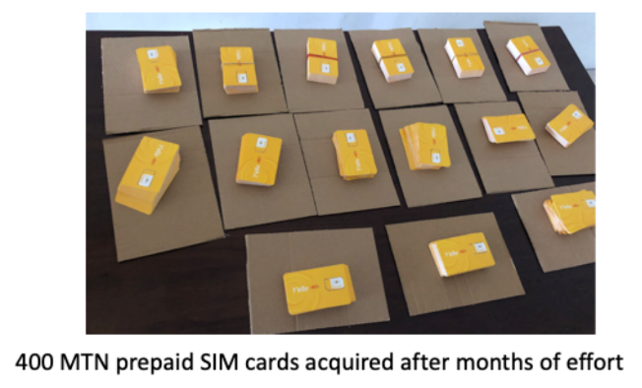
So how do you get higher on the priority list?
You buy from MTN
… also not easy
Limit of 3 SIMs / person due to fraud
Particularly important due to prevalence of SIM-based mobile money

Slide 70
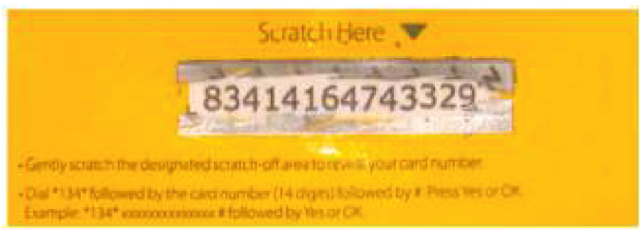
So how do you deploy in Tanzania?
Not limited in SIMs, but limited in payment plans
Post-paid plans not an option
Need to purchase ‘airtime recharges’
Which you use by texting from that phone to an SMS shortcode
So now you must have in-country staff!

Slide 71
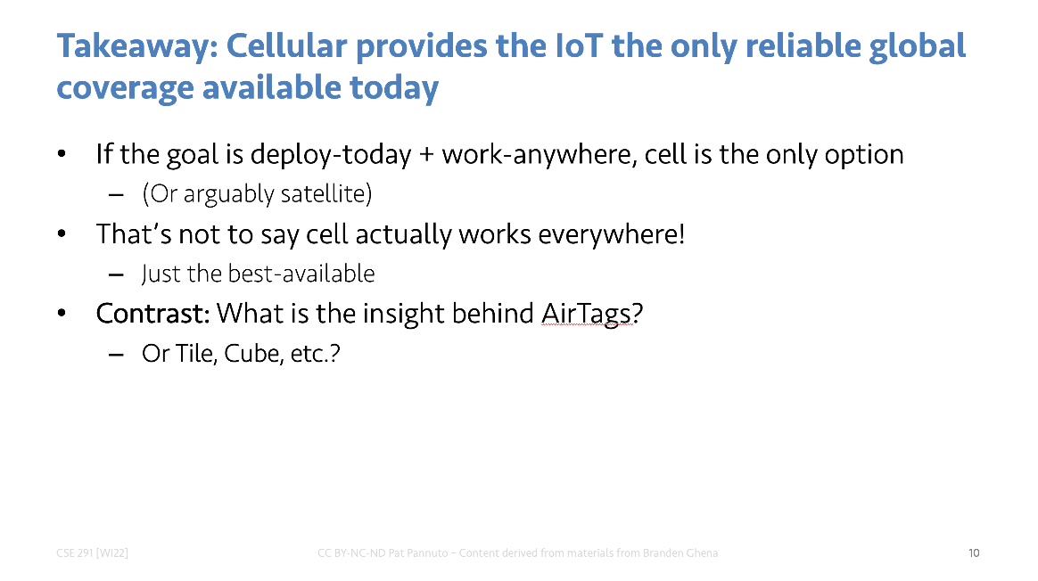
So how do you actually realize this claim?
Good. Question.

