Slide 1
Lecture 13 Cellular IoT & LPWAN Design
CS433 – Wireless Protocols for IoT
Branden Ghena – Spring 2026
Materials in collaboration with Pat Pannuto (UCSD) and Brad Campbell (UVA)

Slide 2
Administrivia
Hw: Cellular
Posted now: investigate costs of a cellular IoT deployment in two countries
Claim your countries ASAP, only two students per country
Lab: Thread
Due today. Office hours 6:30-8:00 pm
Friday: Lab Office Hours
Attendance isn’t required, but I’ll be there to help

Slide 3
Today’s Goals
Understand how modern “Cellular for IoT” fit into the existing cellular infrastructure, and what they do at a technical level to suit IoT needs
Discuss real-world concerns with cellular device deployments
Apply knowledge from the course to understand LPWAN design

Slide 4
Outline
Cellular IoT
IoT on Global Cellular
LPWAN Design

Slide 5
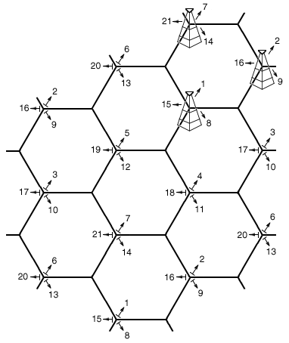
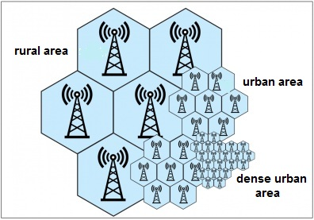
Reminder: the cell in cellular technologies
Place towers at corners of cells
Directional antennas send three different frequency bands, one per cell
Each cell gets three tower and three bands
Density of cells varies based on expected number of users
Change cell size using Power Control

Slide 6
3GPP
3rd Generation Partnership Project (3GPP)
Industry alliance for development of telecoms standards
Established around 1998
Makes “Releases” which are roughly analogous to IEEE standards/versions
Release 8 (2008) LTE ~4G
Release 15 (2018) NR (New Radio) ~5G
Focused on the practical
ITU post-hoc defined “4G”, 3GPP defined LTE

Slide 7
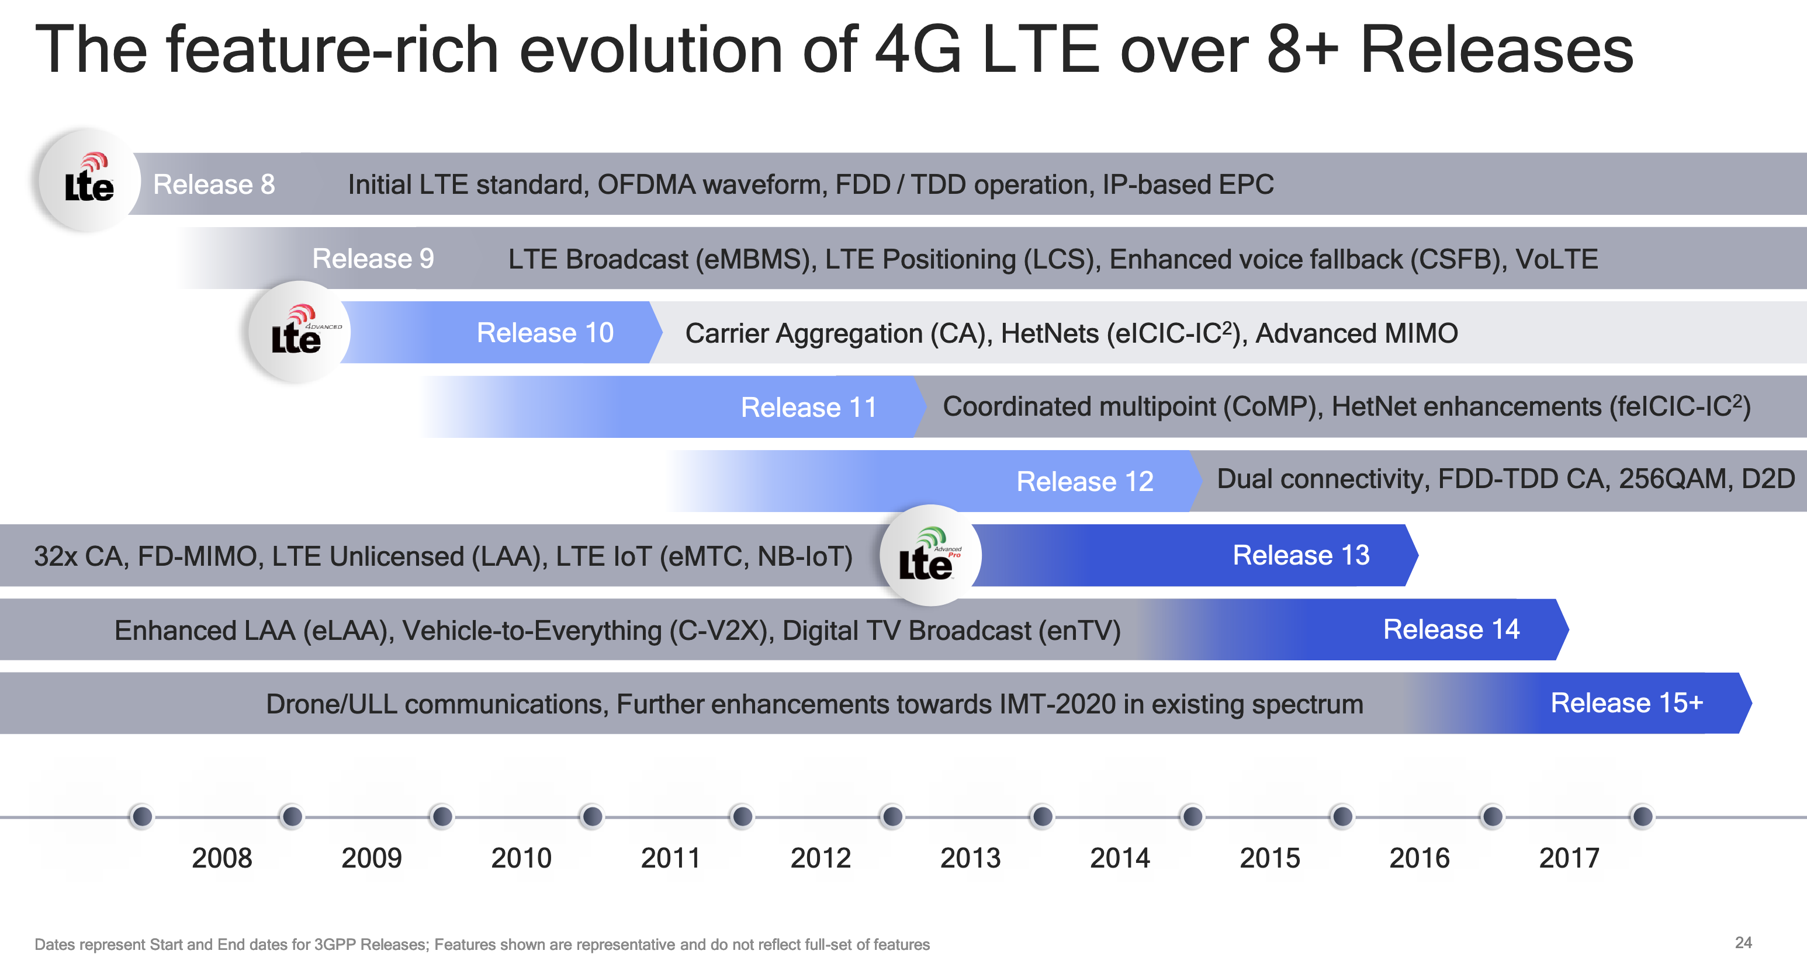
Mapping ”4G”, “LTE”, “LTE Advanced”, etc onto actual technologies
This Qualcomm presentation is great: https://www.qualcomm.com/media/documents/files/demystifying-3gpp-and-the-essential-role-of-qualcomm-in-leading-the-expansion-of-the-mobile-ecosystem.pdf

Slide 8
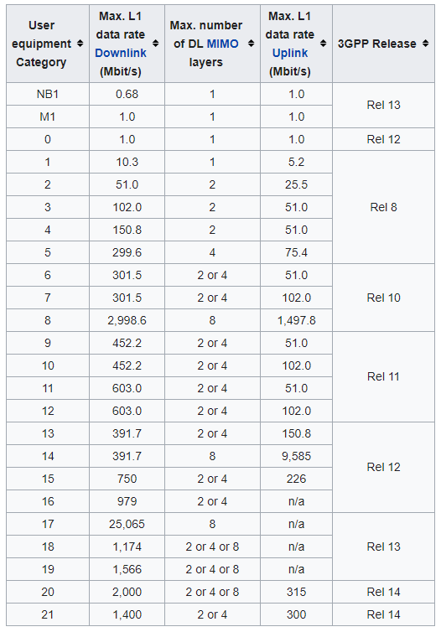
LTE Categories
Different equipment supports different “categories” of LTE
Maximum MCS index supported
Examples
iPhone 6 (2015): Cat 4
Pixel 3 (2018): Cat 16
Notes:
MCS = Modulation Coding Scheme
https://mcsindex.com/ looks like all the tables for WiFi; not clear whether this is the same for cell

Slide 9
Additional low-end categories for IoT
LTE Cat 0
Traditional LTE, but focused on the really low end
1 Mbps for uplink and downlink
LTE-M (LTE Cat M1)
375 kbps uplink, 300 kbps downlink (for the commonly implemented mode)
Reduced power and maximum bandwidth
Increased range
NB-IoT (LTE Cat NB1)
65 kbps uplink, 26 kbps downlink
Reduced power and greatly reduced bandwidth
Greatly increased range

Slide 10
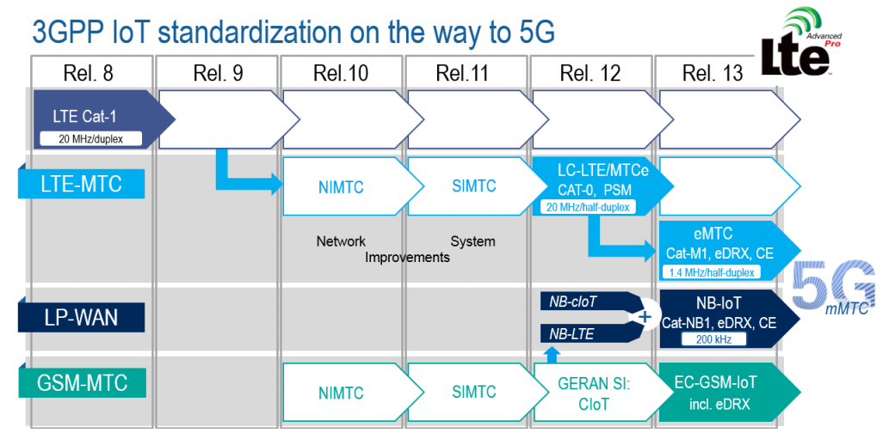
LTE-M and NB-IoT were developed in parallel

Slide 11
Why do we need “special categories” for IoT on cell?
We can treat IoT devices differently than human-centric devices
Pragmatic for the end device
Lower power
Allow for long-off periods
Pragmatic for network operators
Allows for scale– network no longer needs to assume that devices could always be on in each cell or that they all possibly need a lot of throughput

Slide 12
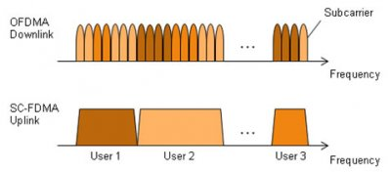
LTE-M and NB-IoT downlink and uplink
OFDMA downlink
Put the more complicated hardware in the cell tower [simple FFT demodulator]
SC-FDMA (single carrier FDMA) uplink
Blocks of subchannels combined into one signal
Essentially just send a single signal, with increased bandwidth.
Simpler for end devices to implement

Slide 13
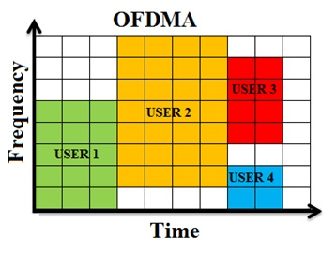
LTE resource allocation
Cellular uses OFDMA to schedule
Time + Frequency -> “2D Scheduling”
Cellular uses single channels up to 20 MHz
Further divides these into 100 Resource Blocks
Resource Block
12 subcarriers for OFDM in frequency (15 kHz each)
7 symbols in time (0.5 ms)
Devices are allocated frequency and time based on what they are sending
Allocated in units of Resource Blocks
One “Resource Block”

Slide 14
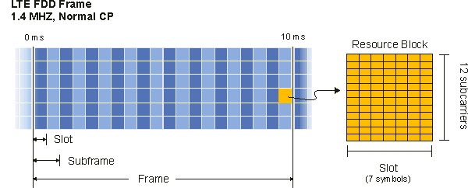
Resources used by LTE-M and NB-IoT
LTE-M uses up to 6 resource blocks
1.4 MHz of bandwidth (1.080 MHz)
Can co-exist with other normal LTE traffic, scheduled by cell tower
Limited to only some capability of LTE (much less throughput)

Slide 15
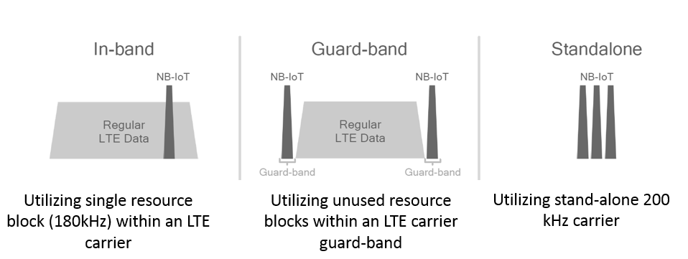
Resources used by LTE-M and NB-IoT
NB-IoT uses up to 1 resource block
200 kHz of bandwidth (180 kHz)
Multiple deployment options
Guard-band very common in practice

Slide 16
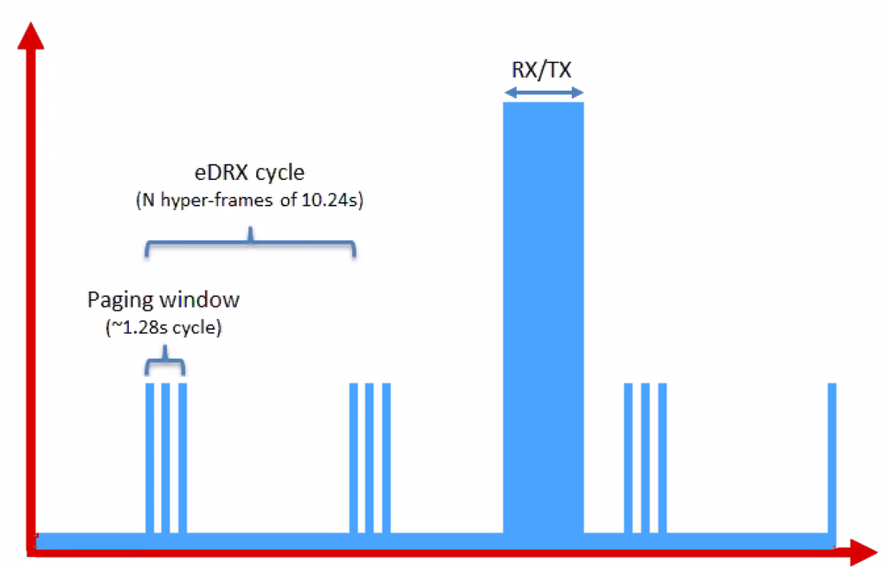
Reducing energy use for IoT devices
Reduce max Tx power to 20 dBm
Increased receive sensitivity at tower will cover it
Extended Discontinuous Reception (eDRX)
Allow devices to reduce paging period and still stay on network
Cell tower will hold messages
What does this get to?
“For a LTE-M1 device that transmits data once per day, and wakes up every 60 hyper frames to check for commands (this would be about every 10 minutes), a life of 4.7 years is achievable on 2 AA batteries.”
Graphics, quote from https://www.link-labs.com/blog/lte-e-drx-psm-explained-for-lte-m1

Slide 17
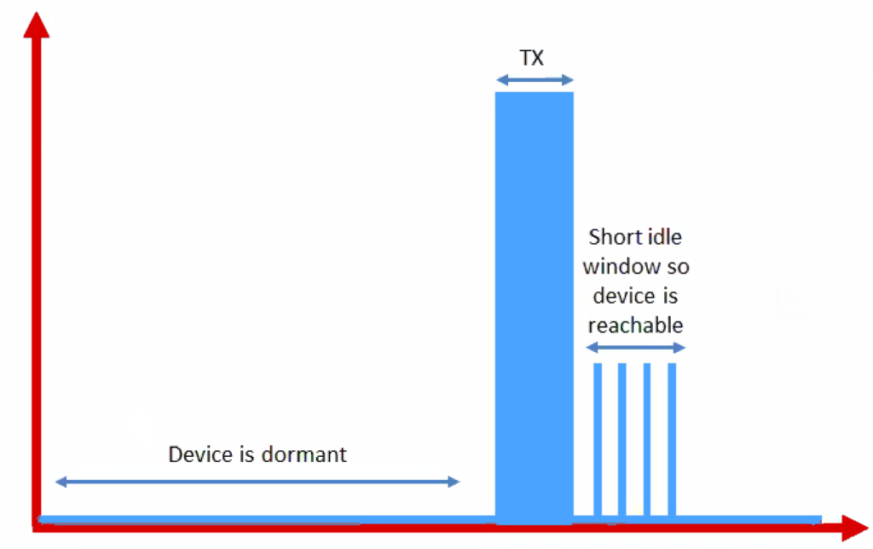
Further power reduction for simple devices
Power Saving Mode (PSM)
For very simple, uplink-focused devices, allow them to turn off entirely but stay connected
Minutes to days in duration
Notify tower before sleeping, listen for packets after each transmission
Graphics from https://www.link-labs.com/blog/lte-e-drx-psm-explained-for-lte-m1

Slide 18
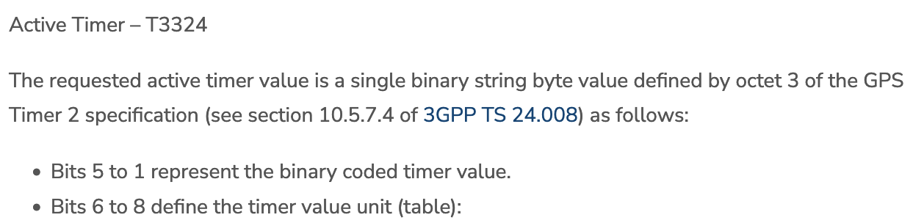
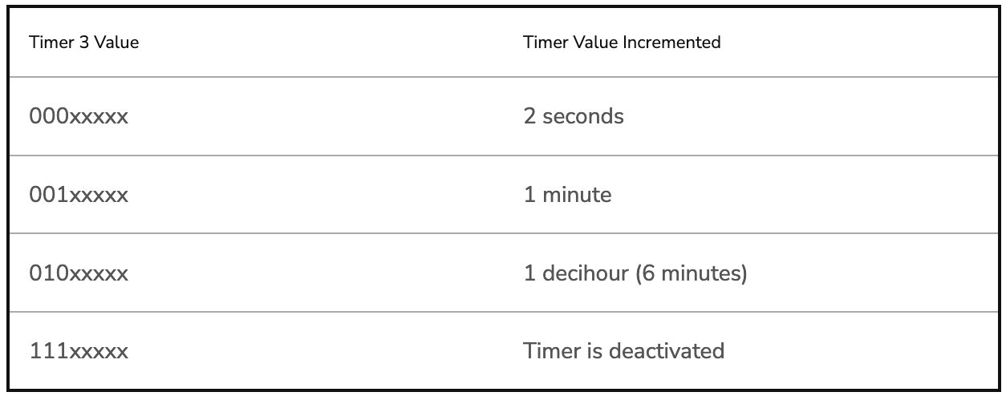
Some numbers from an actual telecom: Aeris [n.b. Aeris has been a leader in cellular M2M since the 90’s]
PSM has two timers, devices request values, tower chooses actual:
Extended Timer (“sleep” timer)
3GPP max is 35,712,00s [413.33 days]
Aeris timer range: Min 240m [4h]; Max 413 days
“Aeris Fusion” timer range: Max: 12.9 days
Active Timer (how long will the device stay in idle after communication?)
Seconds or minutes
Numbers from https://aeriscom.zendesk.com/hc/en-us/articles/360049848254-Understanding-LTE-M-Power-Management-Modes
Notes:
Really hard to tell difference between Aeris and Aeris Fusion. I think Aeris Fusion is a new product that allows devices (same SIM?) to dynamically switch between an IoT profile and a full-fledge voice / high-bw data profile. My guess then is that Aeris network is all their own owned infra, and Fusion is them acting as an MVNO [thus limited to others for wakeup range]

Slide 19
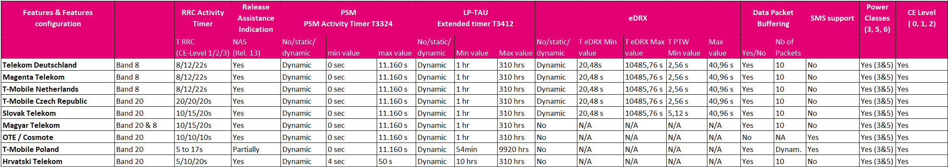
Variety of features supported in real-world
Almost certainly out-of-date details for NB-IoT networks
PSM 0 seconds – 3 hours (or 4-50 seconds?)
eDRX 20 seconds – 3 hours (or not supported at all?)
Packet buffering none to 10 packets (or dynamic???)
https://docs.iotcreators.com/docs/nb-iot-network-information

Slide 20
Improved range for LTE-M and NB-IoT
LTE defines a Maximum Coupling Loss (MCL) a.k.a Link Budget
Traditional cellular: 144 dB (~2.5 km)
LTE-M: 160 dB (~5 km)
NB-IoT: 164 dB (~10 km)
Sigfox: ~155 dB
LoRaWAN: ~143 dB
Note that many cellular bands are often on higher frequencies
Example: 1900 MHz
Coarsely, lower frequency is longer range, but it’s complicated

Slide 21
Cellular deployments
Originally unclear which would be dominant
Verizon and AT&T focused on LTE-M
T-Mobile focused on NB-IoT
All rolled out services nationwide in the 2018-2019 timeframe
Networks expanded provide both capabilities
LTE-M: AT&T, T-Mobile, Verizon
NB-IoT: AT&T, T-Mobile, Verizon
Pricing models still very uncertain
NB-IoT example: $5 per device per year up to 12 MB, 10 packets per hour
Future adoption will greatly depend on these

Slide 22
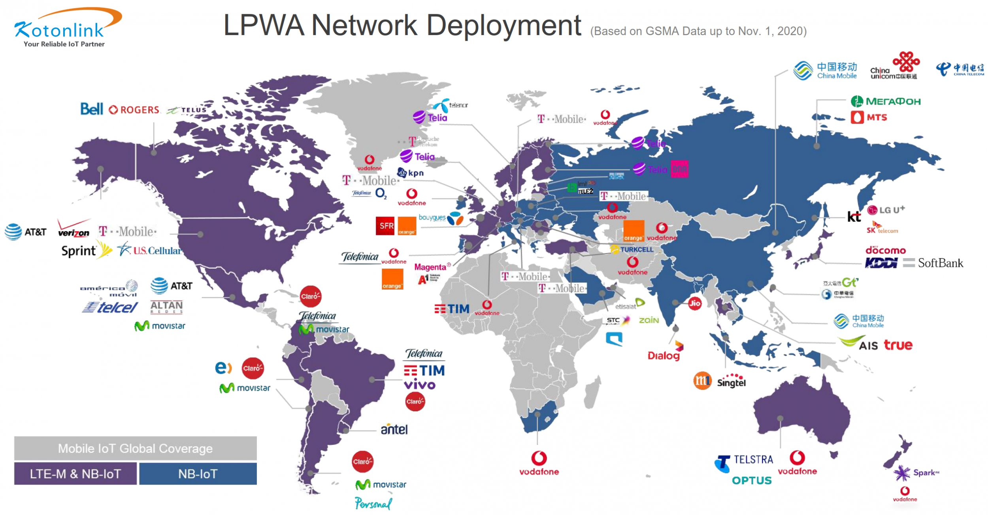

Slide 23
Break + Open Question
Cellular hardware almost always requires certified radio modules where you can’t change the code at all. Why?

Slide 24
Break + Open Question
Cellular hardware almost always requires certified radio modules where you can’t change the code at all. Why?
Otherwise you could cheat at the protocols!!
Or just generally not follow them fairly.
Avoids “tragedy of the commons” by allowing specific trusted devices only

Slide 25
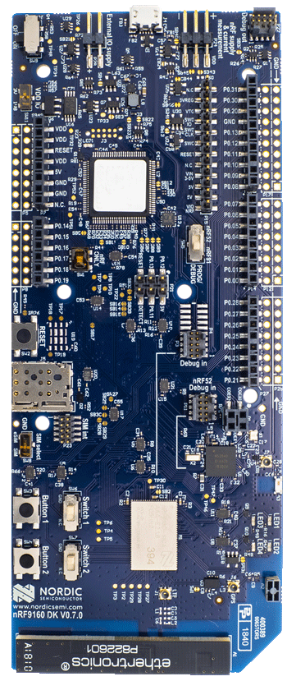
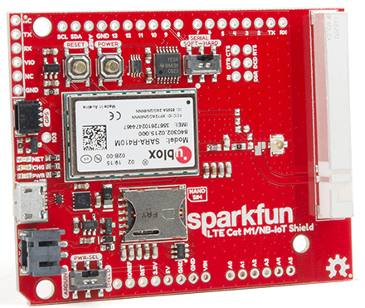
Microcontroller support
Devices need to be certified
Hardware and software
Tend to be modules or dual-core systems
Add a SIM card to connect to network

Slide 26

What about 5G?
NB-IoT and LTE-M are the low-power, wide-area 5G solutions
Intent is to coexist with 5G solutions for human-centric devices
Even if 4G sunset occurs, LTE-M and NB-IoT will still be around
https://www.ericsson.com/en/reports-and-papers/nb-iot-and-lte-m-in-the-context-of-5g-industry-white-paper

Slide 27
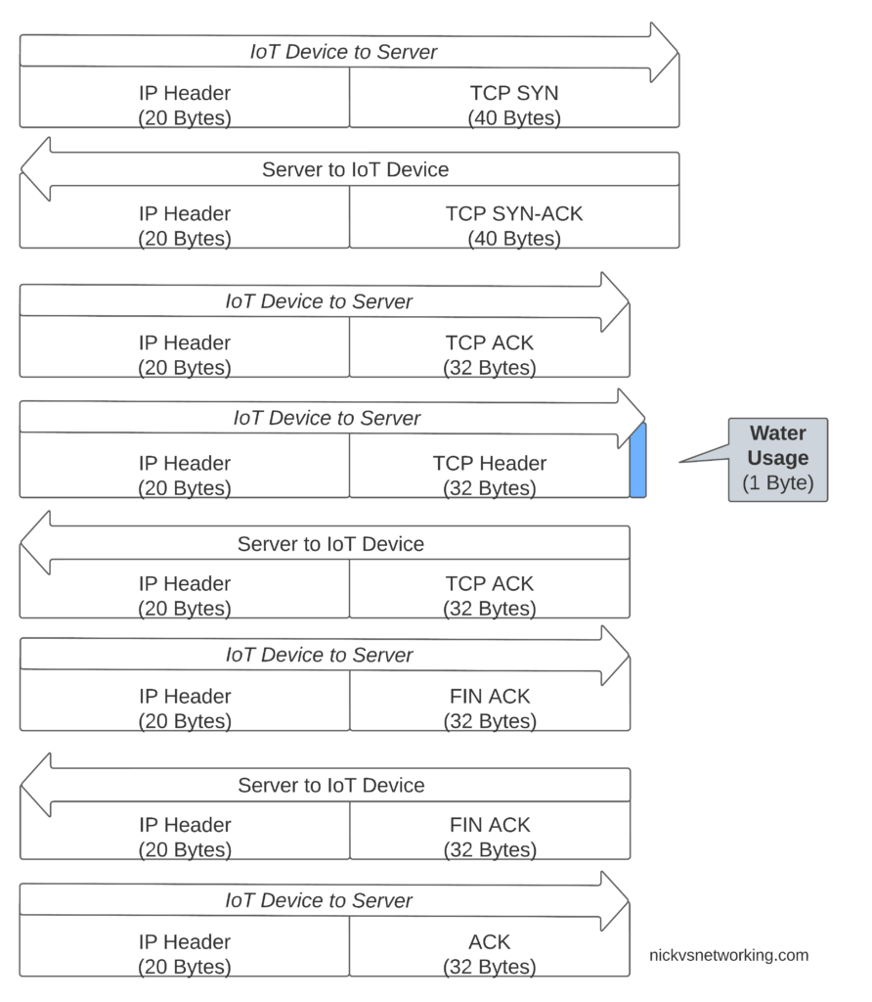
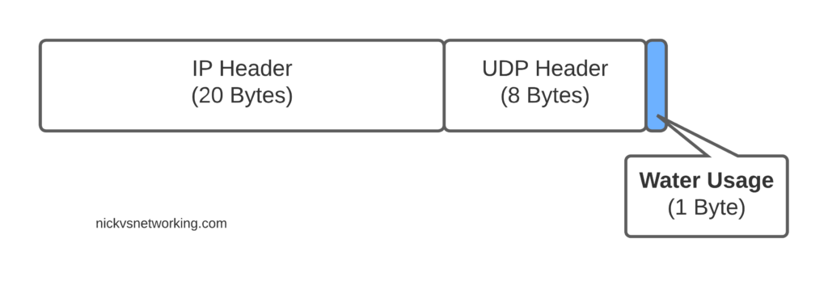
Support for IoT - Non-IP Data Delivery (NIDD)
Reduce the amount of data necessary to transmit
Registers device with a single “destination IP”
Device just transmits data payload, network handles sending it to server
TCP Data Transmission
UDP Data Transmission
NIDD Data Transmission
https://nickvsnetworking.com/nb-iot-nidd-basics/

Slide 28
Outline
Cellular IoT
IoT on Global Cellular
Story by Pat Pannuto & nLine
LPWAN Design

Slide 29
Sizing networks is hard
Sometimes you just lose performance…

Slide 30
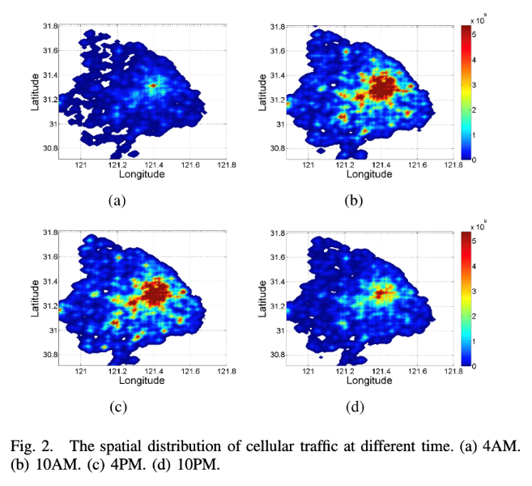
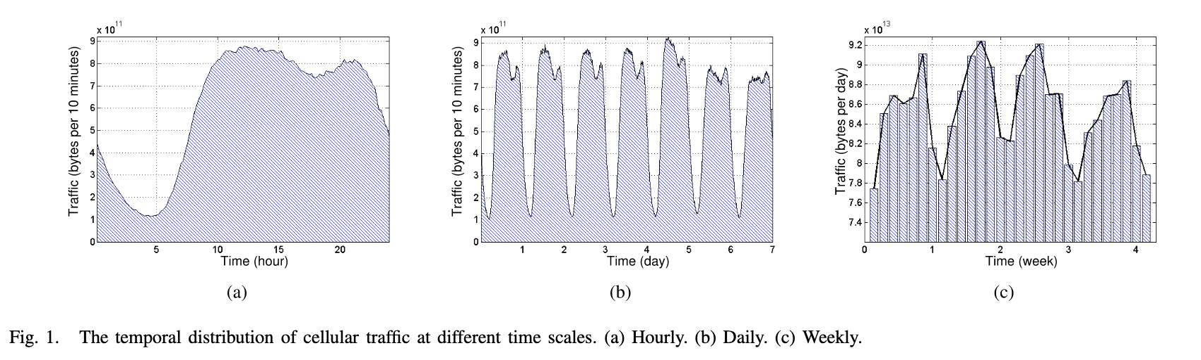
Traffic fluctuates in all networks, for cellular it becomes a function of both when and where you are
Understanding Mobile Traffic Patterns of Large Scale Cellular Towers in Urban Environment; Xu, Li, Wang, Zhang, Jin; IEEE ToN

Slide 31
What is an MVNO? “Mobile Virtual Network Operator”
Decoupling the builders of infrastructure from the sellers
Allows carriers to sell off additional unused network capacity
Not a new concept, but seeing aggressive growth
MetroPCS, Cricket, Boost Mobile, Mint Mobile, Google Fi, etc.

Slide 32
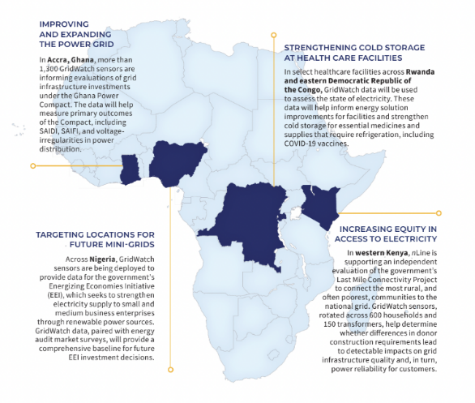
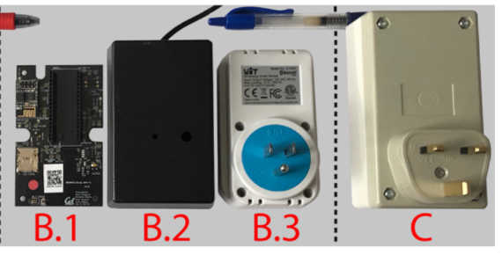
Why do cellular details matter to IoT?
PlugWatch (Klugman, Adkins, et al.)
Design:
Wall-powered sensor with battery-backup to detect outages and report over cellular
Infrastructure to collect measurements and cross-correlate
Deployments throughout Africa
https://lab11.eecs.berkeley.edu/content/pubs/klugman19scale.pdf

Slide 33
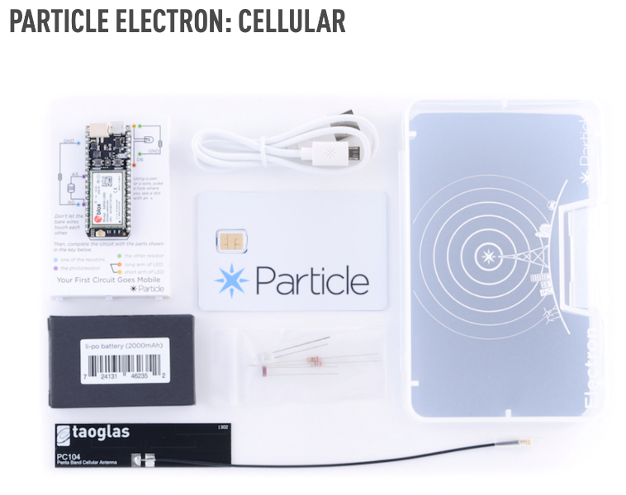
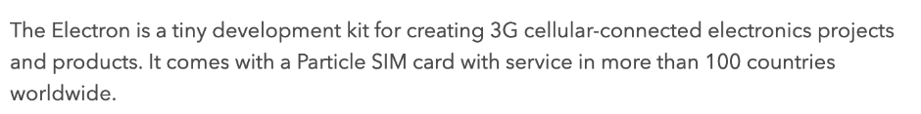
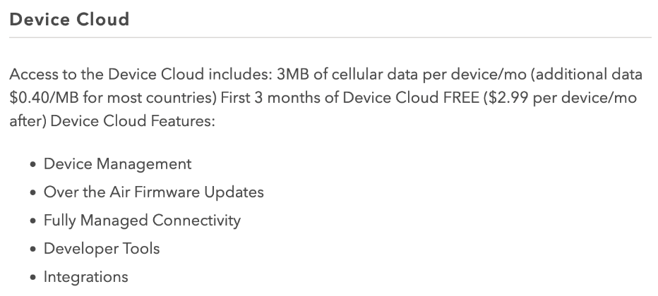
How does PlugWatch work internationally?
Particle dev kit: microcontroller + cellular radi
Also sells a plan with 3G connectivity worldwide

Slide 34
So how does Particle, a small IoT platform startup, provide global cellular coverage?
We deployed some Electrons in Accra, Ghana sending a message once per minute 24/7 for a few weeks
Packet Reception Rate (PRR) changes over time
Almost zero PRR from ~7-9am and ~4-7pm daily
Introducing traffic priority
Call Particle: “What gives?”
Particle buys from T-Mobile
T-Mobile buys from Deutsche-Telekom [didn’t own them yet]
DT buys from Vodafone
Vodafone buys from MTN
MTN has 5 tiers of traffic priority on their network
Guess which tier PlugWatch devices are in?

Slide 35
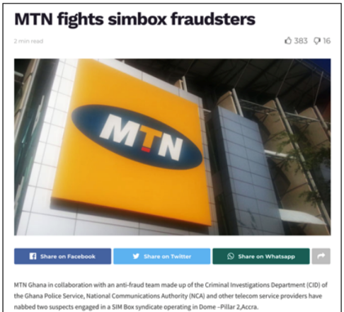
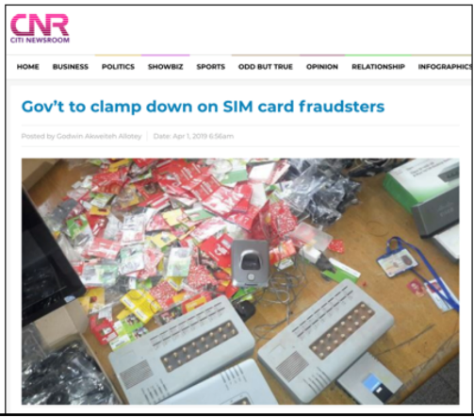
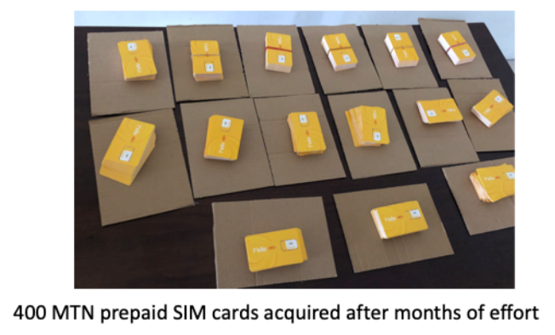
So how do you get higher on the priority list?
You buy from MTN
… also not easy
Limit of 3 SIMs / person due to fraud
Particularly important due to prevalence of SIM-based mobile money

Slide 36
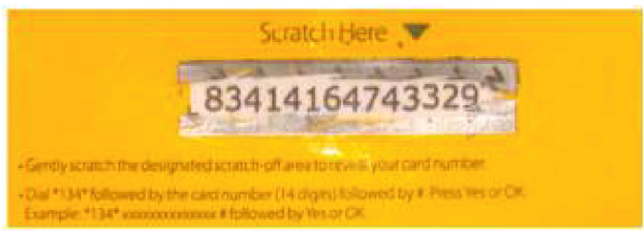
So how do you deploy in Tanzania?
Not limited in SIMs, but limited in payment plans
Post-paid plans not an option
Need to purchase ‘airtime recharges’
Which you use by texting from that phone to an SMS shortcode
So now you must have in-country staff!

Slide 37
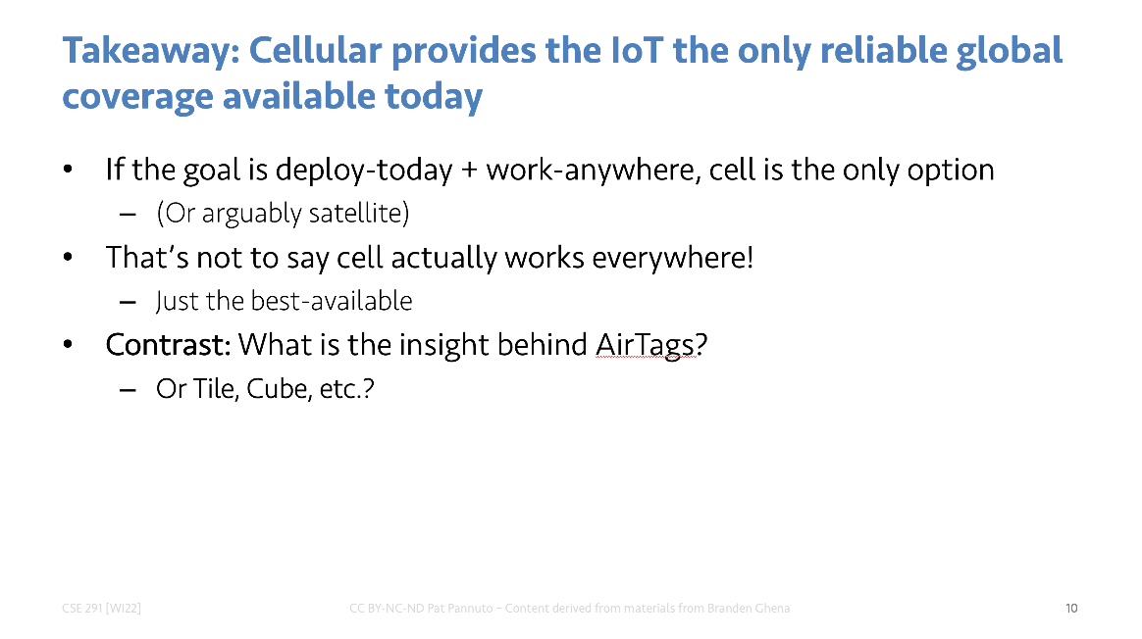
So how do you actually realize this claim?
Good. Question.

Slide 38
Outline
Cellular IoT
IoT on Global Cellular
LPWAN Design

Slide 39
LTE-M and NB-IoT design constrained by fitting within existing cellular ecosystem
What might a fresh design look like?
Caveat: In ISM bands!
So it’s an unlicensed, shared communication band

Slide 40
Design a wide-area network (ignore low-power for now)
What PHY choices would you make?

Slide 41
Design a wide-area network (ignore low-power for now)
What PHY choices would you make?
Modulation
Tx Power
Carrier Frequency Band
Data Throughput
Channel Bandwidth

Slide 42
Design a wide-area network (ignore low-power for now)
What PHY choices would you make?
Modulation
Unclear. Can’t be too crazy for cheap devices but there’s a bit of leeway there.
Tx Power
High (much higher than 0 dBm)
Carrier Frequency Band
Low (something lower than 2.4 GHz, 915 MHz or lower?)
Data Throughput
Low (much lower than 1 Mbps. Reduce )
Channel Bandwidth
Unclear. Likely less bandwidth available on lower frequency carrier.
Higher bandwidth gives longer range (by increasing reliability)
Lower bandwidth gives more simultaneous devices (for a fixed allocation)

Slide 43
Design a low-power wide-area network
Any particular MAC choices for lower power?
Device Roles
When do devices listen?
Access Control Mechanism

Slide 44
Design a low-power wide-area network
Any particular MAC choices for lower power?
Device Roles
Diversity of devices in network
High power gateway, low power devices in star topology
When do devices listen?
Devices should be off whenever possible
Listen-after-send for downlink
Access Control Mechanism
CSMA is problematic due to hidden terminal problem (see next slide)
No TDMA access control if it can be avoided
Removes requirement for synchronization which costs energy
What’s left: Aloha, FDMA, CDMA, ???

Slide 45
Long-range CSMA is problematic
Long-range makes everything more challenging
Kilometers of range mean kilometers between devices
Detection of channel use is less reliable
Active research in clear channel assessment for LPWANs
Hidden terminal problem has a wider range
Distance between two sensors >1x range <2x range
For WiFi, this is ~100 m. For LPWANs this could be ~1 km
Might make RTS/CTS more important
Result: CSMA doesn’t dominate LPWANs like it does WLANs

Slide 46
LPWANs overview (common qualities)
Unlicensed 915 MHz band (902-928 MHz)
Higher power transmissions: ~20 dBm (100 mW)
Low data rate 100 kbps or less
Range on the order of multiple kilometers
Simple Aloha access control

Slide 47
Outline
Cellular IoT
IoT on Global Cellular
LPWAN Design

