Slide 1
Lecture 14 Unlicensed LPWANs
CS433 – Wireless Protocols for IoT
Branden Ghena – Spring 2026
Materials in collaboration with Pat Pannuto (UCSD) and Brad Campbell (UVA)

Slide 2
Administrivia
WiFi Lab due Thursday
Cellular Homework due next week Thursday
Last homework
Counts as 1.5x points
About half of you have made a reservation already
No duplicates, No MVNOs

Slide 3
Final Design Project
Writeup, typically 6-15 pages
Due early exam week (Tuesday, June 09th)
Section A
Explain some application
Consider the constraints on the application
Choose wireless technologies that seem to best work for it
Section B
Model and compare energy/battery life
Section C
Compare other aspects of performance
Choose a best option for your system

Slide 4
Today’s Goals
Overview of unlicensed-band LPWAN approaches
LoRaWAN
Sigfox
802.11ah
TV Whitespaces
Understand what needs these networks are trying to satisfy, and differences in how they attempt to achieve that

Slide 5
Resources
LoRaWAN
LoRaWAN Specification version 1.1
LoRaWAN Regional Parameters version 1.0.2
Sigfox
Sigfox Technical Overview
IETF Descriptions
https://www.ietf.org/proceedings/97/slides/slides-97-lpwan-25-sigfox-system-description-00.pdf
https://tools.ietf.org/html/draft-zuniga-lpwan-sigfox-system-description-04

Slide 6
Outline
Wide-Area Network Background
Unlicensed LPWANs
LoRaWAN
Sigfox
802.11ah
TV Whitespaces

Slide 7
Wide area networks
Communication at the region/city scale rather than the building/residence scale
Throughout cities
Agricultural deployments
Industrial facilities
City-scale sensing is one very popular domain
What might we want to sense throughout a city?

Slide 8
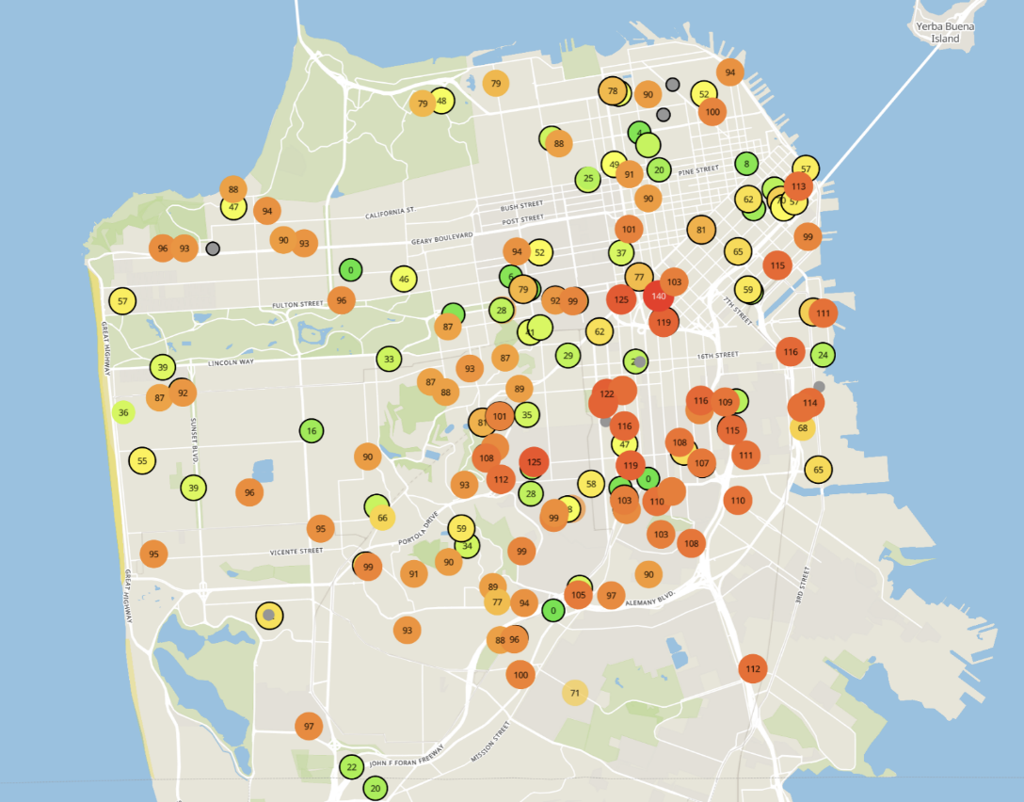
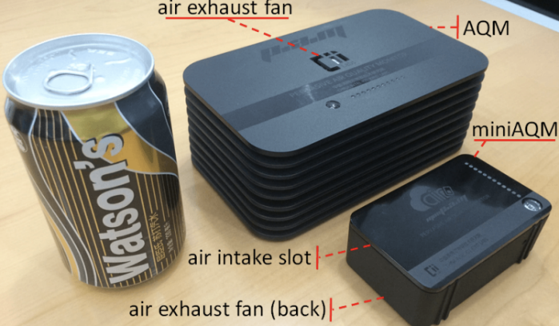
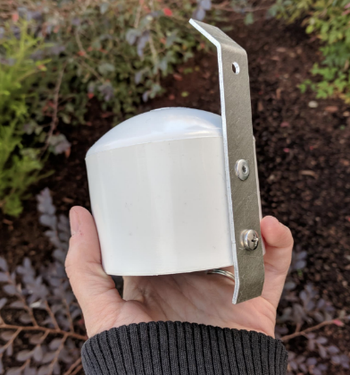
Example application: air quality monitoring
[1]
[2]
[2]
[1] Cheng et al. AirCloud: a cloud-based air-quality monitoring system for everyone. 2014. [2] Purple Air. 2019.

Slide 9

How do we collect data from a sensor?
Manually collect measurements
Too much work
Connect it to WiFi (or Ethernet)
Too many separate networks
Pay for cellular access
Too expensive for many devices

Slide 10
How do we collect data from MANY sensors?
Manually collect measurements
Too much work
Connect it to WiFi (or Ethernet)
Too many separate networks
Pay for cellular access
Too expensive for many devices

Slide 11
We need another network option
Requirements:
Wide area of coverage
Deploy fewer gateways
Low power
So we can deploy on batteries
Doesn’t need high throughput
Sensor data is relatively small

Slide 12
Long-range, low-data needs haven’t historically been met
WiFi
Data
Throughput
Range

Slide 13
Long-range, low-data needs haven’t historically been met
WiFi
Data
Throughput
Bluetooth
BLE
Zigbee
Range

Slide 14
Long-range, low-data needs haven’t historically been met
WiFi
Higher Power & Higher Cost
Data
Throughput
Bluetooth
BLE
Zigbee
Lower Power & Lower Cost
Range

Slide 15
Long-range, low-data needs haven’t historically been met
WiFi
4G
Higher Power & Higher Cost
3G
3G
Data
Throughput
2G
Bluetooth
2G
BLE
Zigbee
Lower Power & Lower Cost
Range

Slide 16
Long-range, low-data needs haven’t historically been met
WiFi
4G
Higher Power & Higher Cost
3G
Data
Throughput
Bluetooth
2G
Low-Power Wide-Area Networks
BLE
Zigbee
Lower Power & Lower Cost
Range

Slide 17
LPWANs overview (common qualities)
Unlicensed 915 MHz band (902-928 MHz in North America)
EU: 863-870 MHz (notably less bandwidth)
China: 779-787 MHz
Higher power transmissions: ~20 dBm (100 mW)
Low data rate 100 kbps or less
Range on the order of multiple kilometers
Simple Aloha access control

Slide 18
Long-range CSMA is problematic
Long-range makes everything more challenging
Kilometers of range mean kilometers between devices
Detection of channel use is less reliable
Active research in clear channel assessment for LPWANs
Hidden terminal problem has a wider range
Distance between two sensors >1x range <2x range
For WiFi, this is ~100 m. For LPWANs this could be ~1 km
Might make RTS/CTS more important
Result: CSMA doesn’t dominate LPWANs like it does WLANs

Slide 19
Outline
Wide-Area Network Background
Unlicensed LPWANs
LoRaWAN
Sigfox
802.11ah
TV Whitespaces

Slide 20
LoRaWAN
Open communication standard built with proprietary LoRa PHY
Low rate (1-20 kbps) and long range (~5 km)
Shorter range than Sigfox but much higher bit rate
Most popular LPWAN protocol
Target of academic research
Industry involvement in hardware and deployments

Slide 21
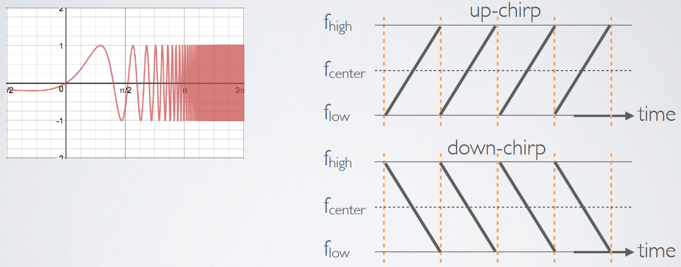
LoRa PHY uses a different modulation
Chirp Spread Spectrum (CSS)
Modulation technique where frequency is varied linearly from lowest to highest within a channel

Slide 22
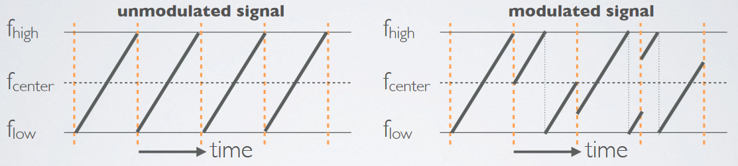
Chirp Spread Spectrum
Data is modulated in the starting and ending points of chirp
Frequency increases linearly, modulo bounds of the channel

Slide 23
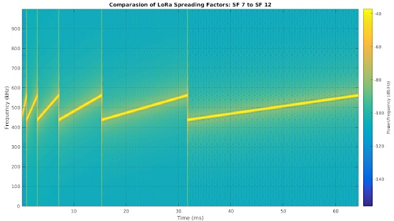
CSS has a Spreading Factor which determines bit rate
Spreading Factor is essentially the rate-of-change of frequency
Slope of the line
Lower values of spreading factor (steeper slope) are faster data rate
Important: different spreading factors are (mostly) orthogonal!
Two can overlap in time, space, and channel without a collision

Slide 24
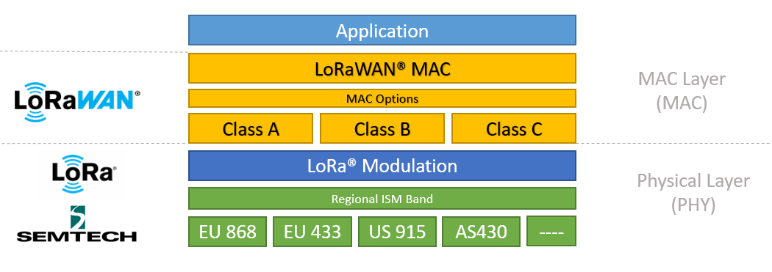
LoRa vs. LoRaWAN
LoRa: physical layer protocol
LoRaWAN: MAC and network layer
(In practice we often conflate LoRa and LoRaWAN.)
https://lora-developers.semtech.com/documentation/tech-papers-and-guides/lora-and-lorawan/

Slide 25
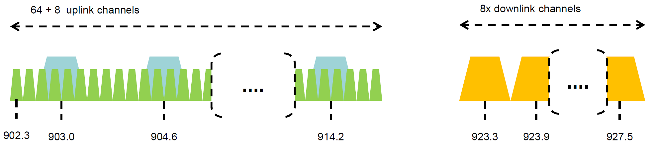
LoRaWAN channels (in the US)
Sixty-four, 125 kHz uplink channels
Frequency Hopping over the 64 uplink channels
Plus eight, 500 kHz overlapping uplink channels (not very used in practice)
Eight, 500 kHz downlink channels

Slide 26
LoRaWAN data rates
Data Rate Index | Spreading Factor | Bit Rate
125 kHz Uplink Rates
0 | SF10, 125 kHz | 980 bps
1 | SF9, 125 kHz | 1760 bps
2 | SF8, 125 kHz | 3125 bps
3 | SF7, 125 kHz | 5470 bps
500 kHz Uplink Rates
4 | SF8, 500 kHz | 12500 bps
500 kHz Downlink Rates
8 | SF12, 500 kHz | 980 bps
9 | SF11, 500 kHz | 1760 bps
10 | SF10, 500 kHz | 3900 bps
11 | SF9, 500 kHz | 7000 bps
12 | SF8, 500 kHz | 12500 bps
13 | SF7, 500 kHz | 21900 bps
Data rate options depend on channel in use
Unbalanced uplink and downlink
64-channel uplink
1-5 kbps data rate
Allowable rates based on US dwell time restriction (400 ms)
Different in different regions

Slide 27
LoRaWAN link budget
Typical TX power 20 dBm
Up to 30 dBm for 64-channel hopping
Up to 26 dBm for 8-channel hopping
Receive sensitivity -119 dBm
Compare to -100 dBm for 802.15.4 and -95 dBm for BLE
Resulting range is about a kilometer in urban environments

Slide 28
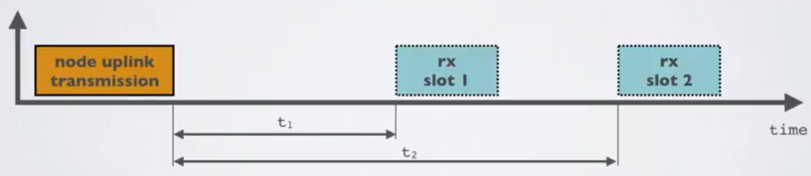
LoRaWAN MAC
Uplink: Aloha - transmit whenever
Randomly split across 64 uplink channels (reduced odds of collision)
Devices at different spreading factors also do not collide
Packets are very long though: up to 400 ms in duration
Downlink: listen-after-send (class A device)
Two windows for RX on different channels

Slide 29
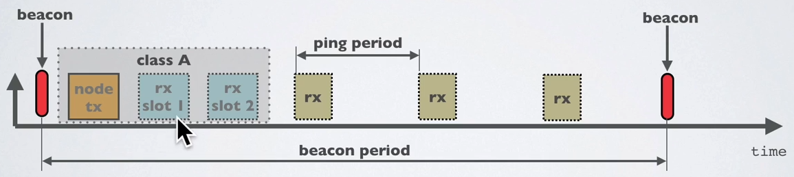
Optional downlink mechanisms
Periodic listening (class B device)
Synchronized with periodic beacons
TX still unsynchronized Aloha
Not commonly used
Continuous listening (class C device)
Always-on receivers

Slide 30
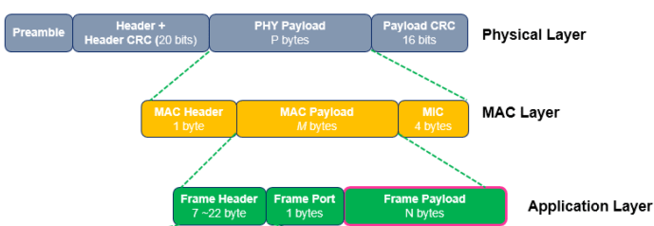
LoRaWAN packet format
Frame header includes device address
MAC Payload maximum size depends on data rate
Again based on dwell time in the US
Data Rate Index | MAC Payload Size
0 | 19 bytes
1 | 61 bytes
2 | 133 bytes
3 | 250 bytes
4 | 250 bytes

Slide 31
LoRaWAN gateways
No synchronization with end devices
Instead listen to entire bandwidth simultaneously
Only 12 MHz total
Recognize preambles and allocate hardware to decode packet
Number of simultaneously decoded packets depends on decoders
Cheap gateways: 8 decoders
Good gateways: 64 decoders

Slide 32
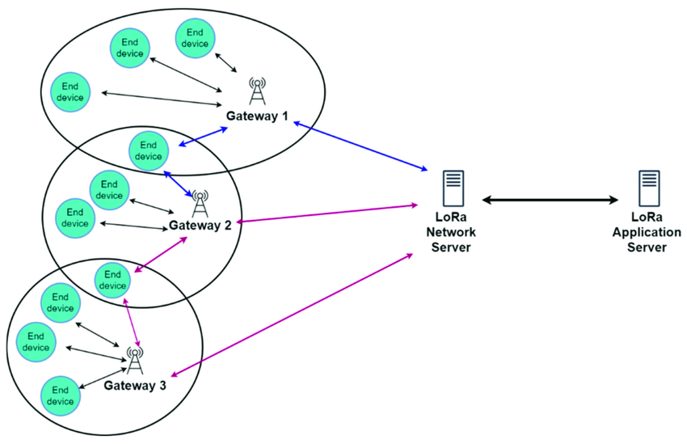
LoRaWAN star-of-stars topology
Each gateway is a star network
Many gateways connect to a LoRaWAN backend
https://www.researchgate.net/publication/360965985_LoRaWAN_Communication_Protocols_A_Comprehensive_Survey_under_an_Energy_Efficiency_Perspective

Slide 33
LoRaWAN network details
Each gateway is a star network
Many gateways connect to a LoRaWAN backend

Slide 34
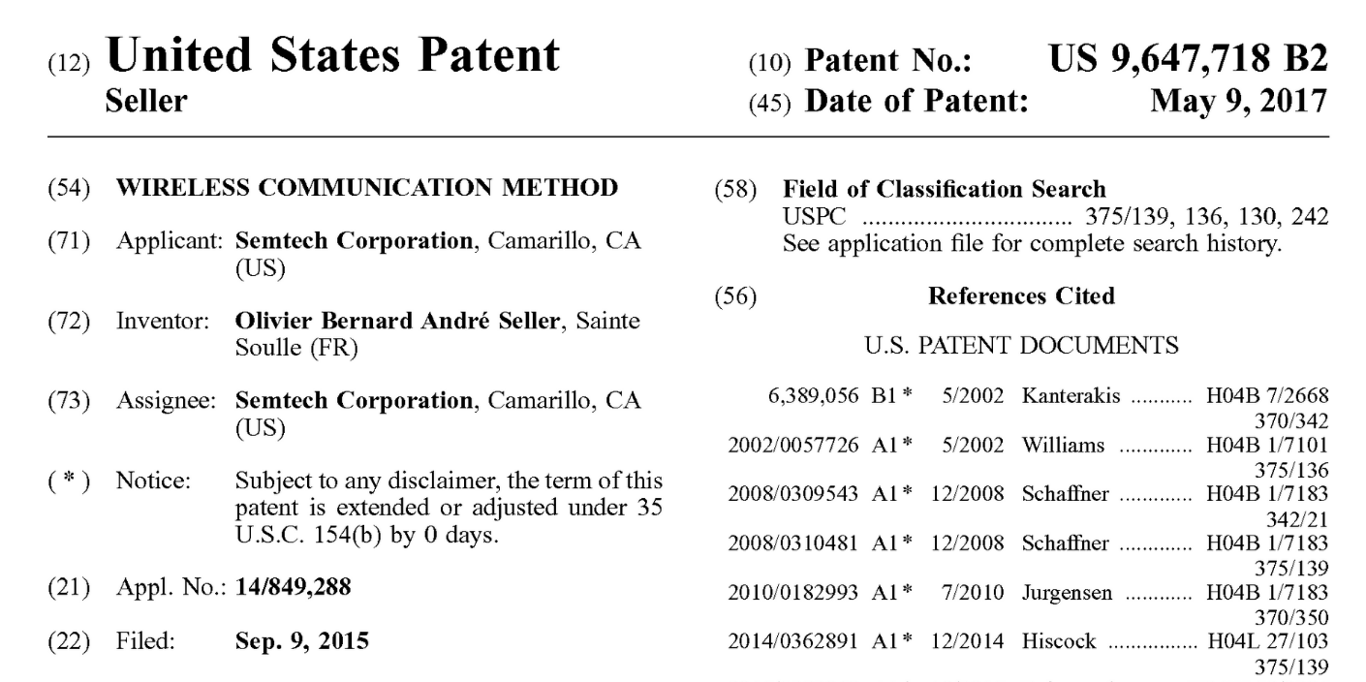
Note about LoRa hardware
LoRa PHY is patented
Hardware controlled by Semtech
Good for interoperability
Openness? Innovation?
Less good

Slide 35
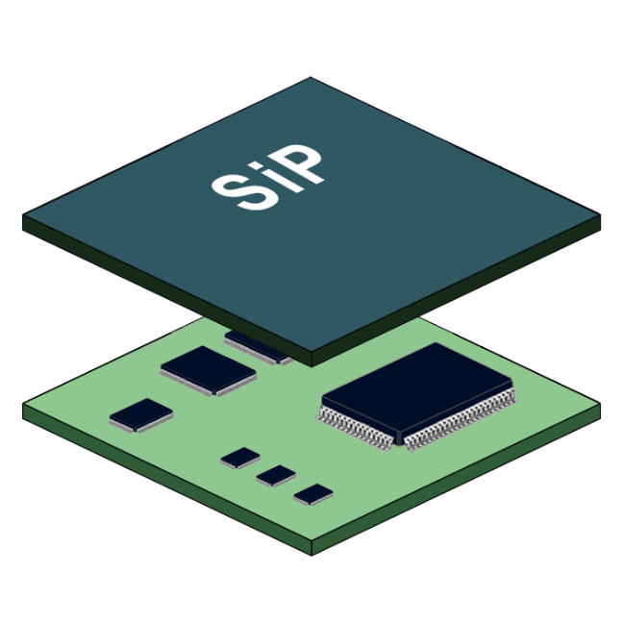
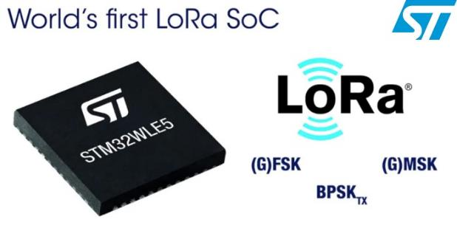
LoRaWAN hardware
Numerous hardware modules and development kits
Almost all use Semtech radio chips (Semtech owns LoRa PHY)
Some microcontrollers now support LoRa
STM32WL and SAMR34 (System in Package)
Both include a Semtech radio internally, connected over a SPI bus

Slide 36
Joining a LoRaWAN Network
Two modes:
OTAA (Over the air activation): Dynamic join procedure that sets up security keys
ABP (Activation By Personalization): Legacy approach with pre-shared security keys
OTAA Joining: two packets
Join-request: from end device to the Network Server
Join-accept: from Network Server to the end device

Slide 37
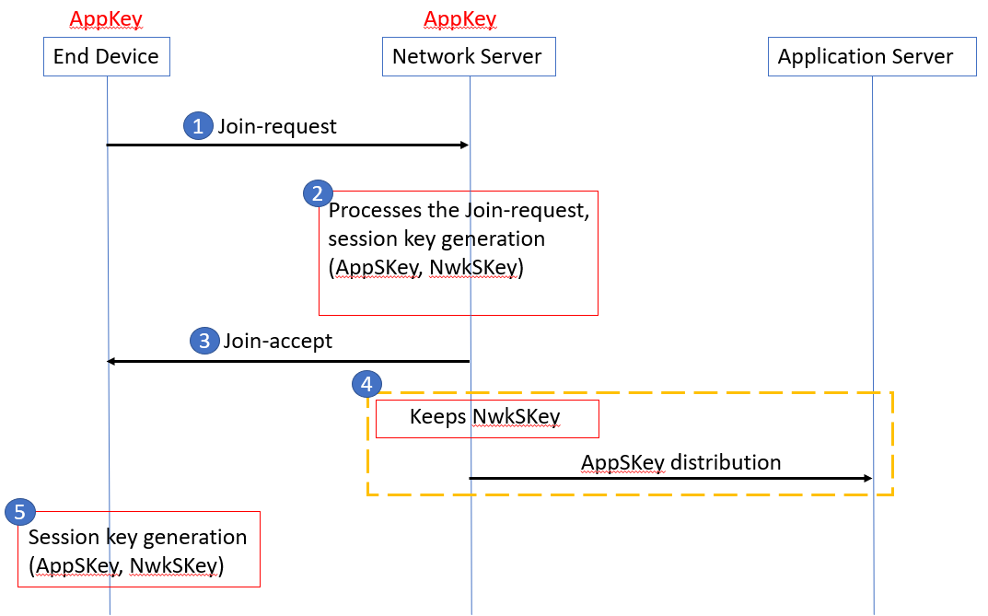
OTAA Join Procedure
Device knows three things:
AppEUI: Identifier for the application the device uses on the application server
DevEUI: Device ID
AppKey: AES-128 bit secret registered with the network server
Join Request
Device sends (AppEUI, DevEUI, Nonce) and MIC using AppKey
Join Accept
Network server responds with AppNonce encrypted with AppKey
Device and network server compute the same AppSKey to encrypt all future payloads

Slide 38
LoRaWAN network providers
You can always manage your own network
Buy a gateway and run whatever backend software you want
Somewhat-managed network providers
The Things Network (predominantly in Europe)
But available in the US too!
Helium
Anyone can buy and install their own gateway, which serves everyone
Microtransactions to pay for communication

Slide 39
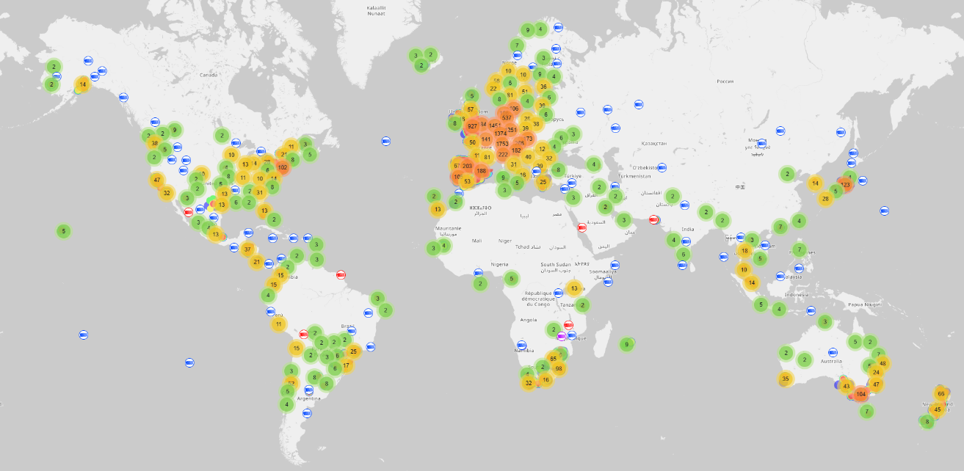
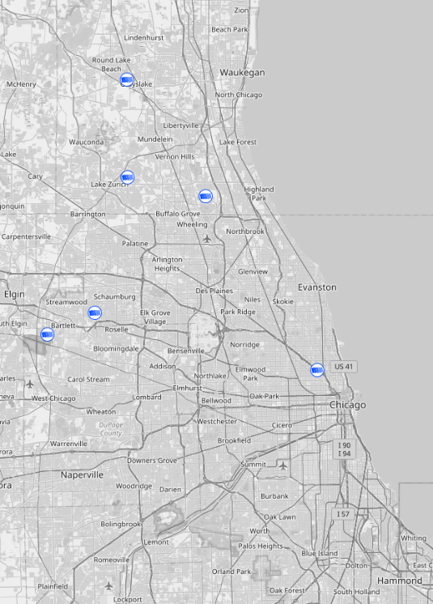
The Things Network gateways (Spring 2026)
21000 gateways active in last two weeks (May 2026)
Closest to Evanston is in Logan Square ~15 miles away

Slide 40
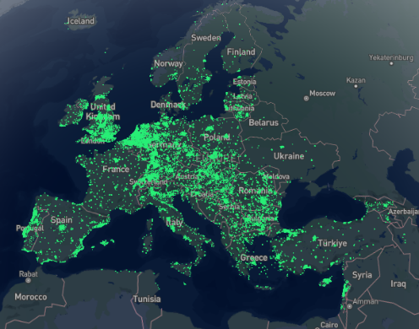
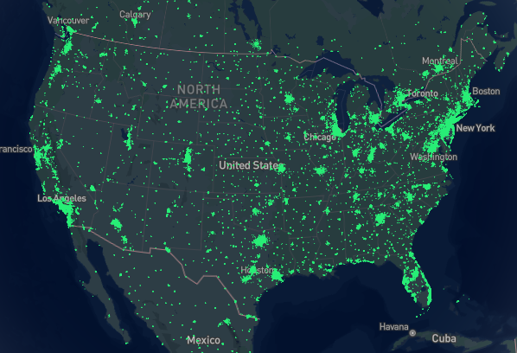
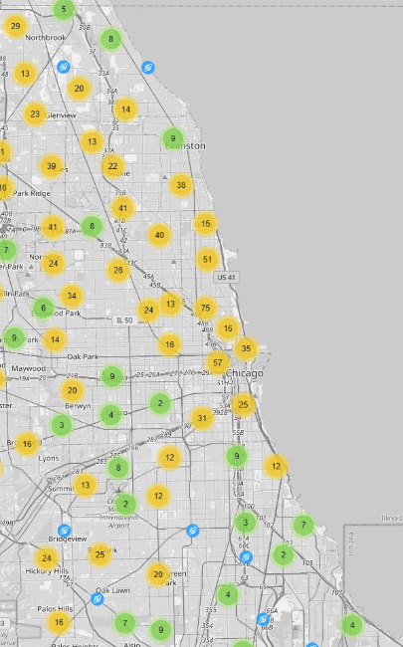
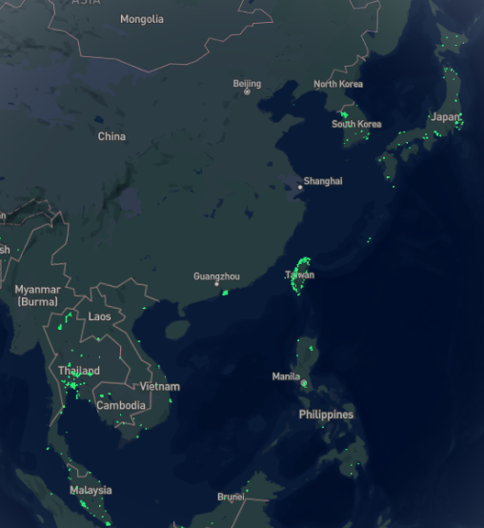
Helium gateways (Spring 2025)
May 2022: 800,000 hotspots, with +80K in last 30 days
Feb 2023: 980,000 hotspots, with +3K in last 30 days
May 2025: 285,000 hotspots… I think they pruned dead gateways
May 2026: 197,000 hotspots
Several gateways in Evanston, including one on far south side of campus

Slide 41
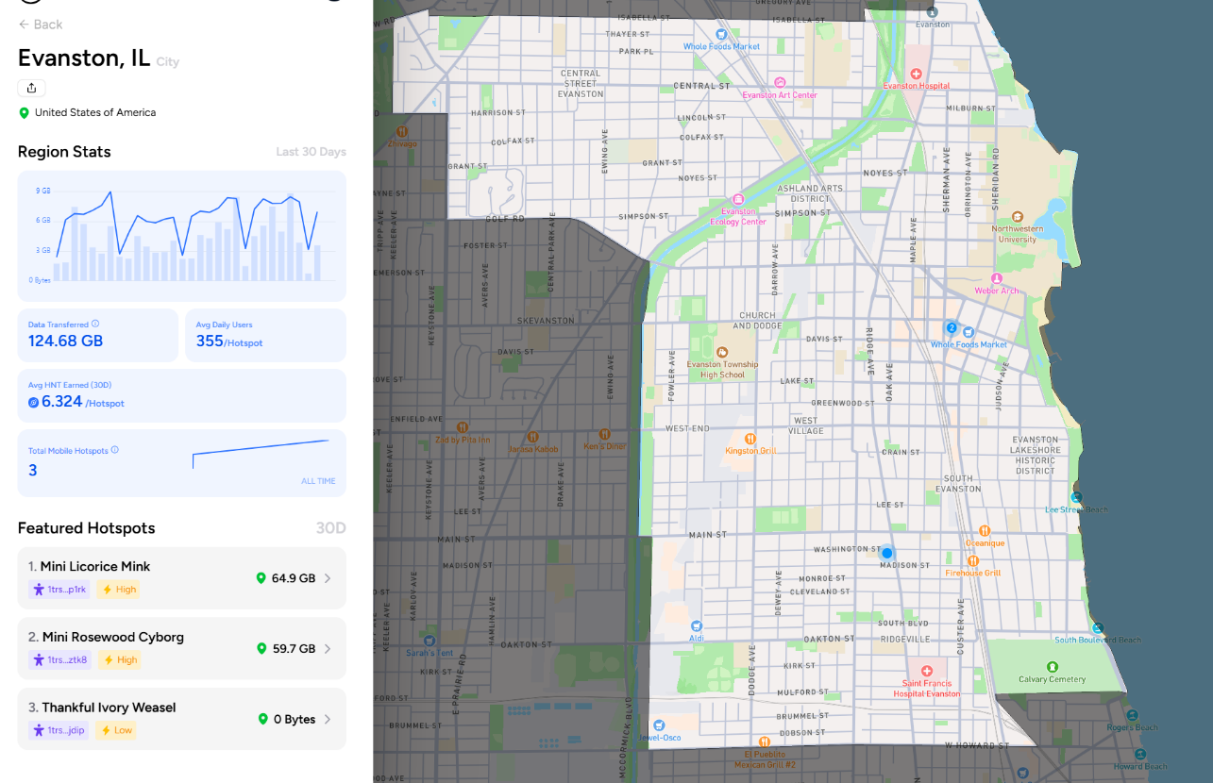
Evanston Helium Network
Three gateways, two downtown
Best gateway earns about $8 a month (Spring 2026)
Costs $499
https://world.helium.com/en/network/mobile/region/22399

Slide 42
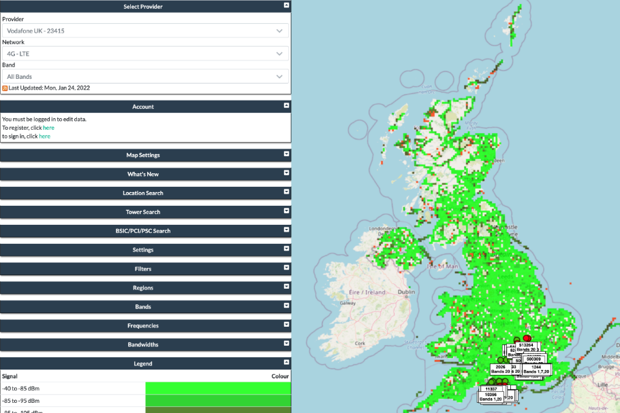
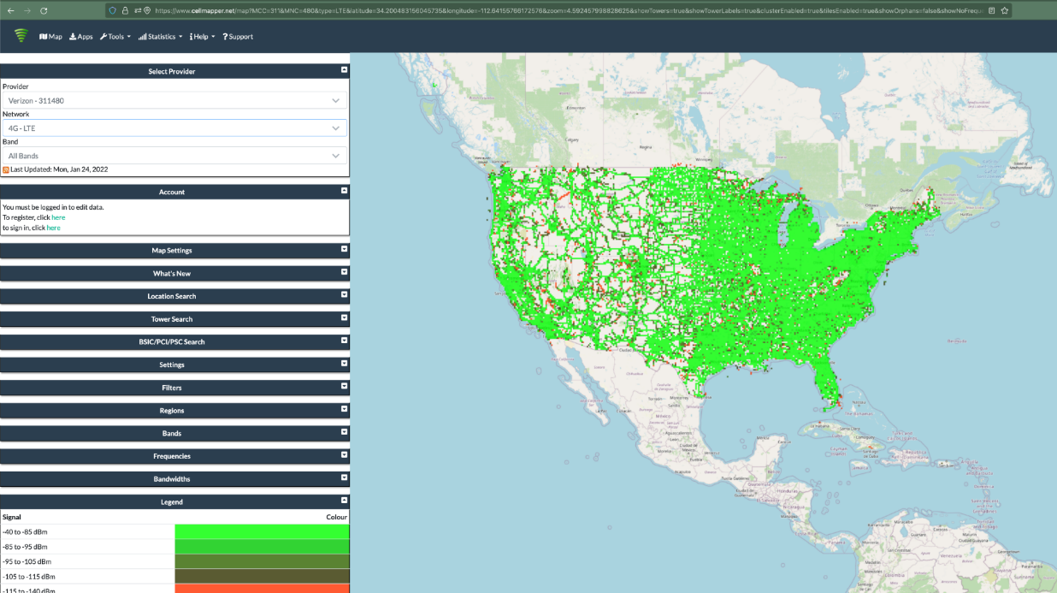
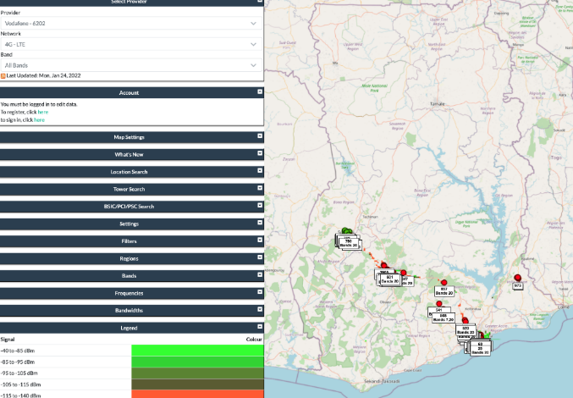
Quick reality check: Cellular?
~350,000 sites across ~150,000 towers
In the just US

Slide 43
Break + Open Question
What kinds of use cases exist for LoRaWAN?
What can you do with 1-5 kbps uplink, 1-22 kbps downlink?
Multiplied by 64 channels uplink, 8 channels downlink

Slide 44
Break + Open Question
What kinds of use cases exist for LoRaWAN?
What can you do with 1-5 kbps uplink, 1-22 kbps downlink?
Multiplied by 64 channels uplink, 8 channels downlink
Outdoor small-sized sensing seems possibly achievable!
With a low enough rate, it could support many devices
Code updates on devices could be tough

Slide 45
Outline
Wide-Area Network Background
Unlicensed LPWANs
LoRaWAN
Sigfox
802.11ah
TV Whitespaces

Slide 46

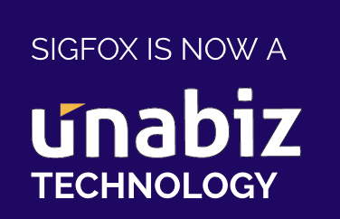
Sigfox
Very low-rate (600 bps), very long-range (10+ km) communication
Star-topology networks, with always-listening gateways
Any number of low-power end devices
Uplink-focused communication
Applications: very low-rate metering

Slide 47
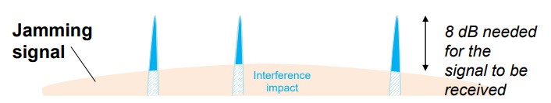
Sigfox PHY
Unlicensed-band communication
Europe 868 MHz. US 902-928 MHz (915 MHz band)
Ultra-narrowband 600 Hz (100 Hz Europe) channel bandwidth
Detection only needs to occur at very specific frequency
Helps improve signal-to-noise ratio

Slide 48
Sigfox unbalanced uplink and downlink
Uplink
600 Hz bandwidth, 600 bps, DBPSK
Downlink
1.5 kHz bandwidth, 600 bps, GFSK
Particularly designed for Europe
Uplink on 1% duty cycle channel, up to 14 dBm
Downlink on 10% duty cycle channel, up to 27 dBm
Works fine in US too
Gets more power (24 dBm up is typical, up to 32 dBm down) and more range

Slide 49
Sigfox link budget
Why transmit at 100-600 bps?
For greatly increased link budget
Link budget: 150-160 dBm
Assuming Tx at ~20 dBm
Means Rx Sensitivity of -130 dBm (10 dBm better than LoRaWAN)
Resulting range: 10-15 km in urban environments
Except that buildings lead to dead spots in range

Slide 50
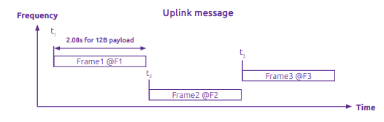
Sigfox MAC
Aloha-style access control (send whenever)
No acknowledgements!
Send message three times for increased reliability
Then listen for downlink at a set period later on a known frequency

Slide 51

Sigfox uplink packet
Up to 29 bytes total per packet
Payload: up to 12 bytes 😱
Other fields
Preamble + Frame Sync are really a 6 byte field for radio sync
Authentication: 2-5 bytes
Frame Check Sequence: 16-bit CRC

Slide 52
Aside: why faster bitrate in the US?
Packet size up to 29 bytes (232 bits)
At 100 bps: 2.32 seconds on air
At 600 bps: 0.387 seconds on air
Maximum dwell time for 915 MHz band: 400 ms

Slide 53

Sigfox downlink packet
Similar structure, 28 bytes total
Payload: up to 8 bytes
Larger preamble + frame sync of 13 bytes
Error Correcting Code for increased reliability

Slide 54
Sigfox deployments
Proprietary network with managed deployment
Like cellular networks
Sigfox deploys networks and transports data
140 uplink messages plus 4 downlink message per day
Connectionless communication
Devices are registered with the networks
Keys are provided in the software image
Any deployed Sigfox gateway can collect transmitted data
Enables mobile applications

Slide 55
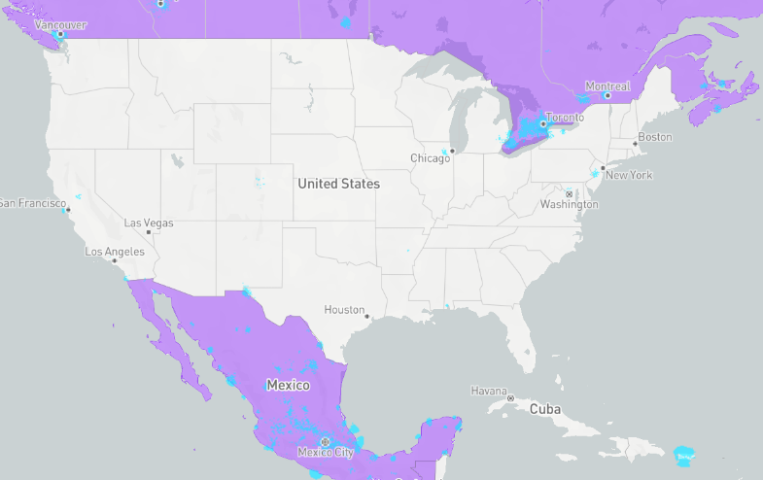
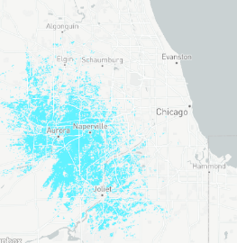
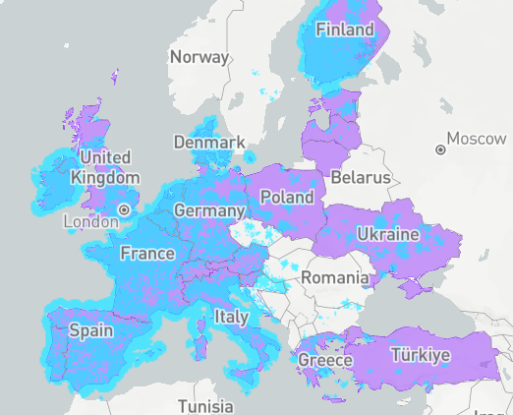
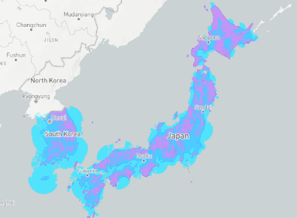
Sigfox coverage (Spring 2026)
Not focused on US coverage right now (coverage is blue)
Much higher availability in Europe
No longer planned rollout in US (purple)
January 2022
Sigfox filed for bankruptcy
April 2022
Sigfox purchased by UnaBiz
Renamed: Sigfox “0G” Technology
December 2024
Reports 14 million connected devices worldwide

Slide 56
Break + Open Question
What kinds of use cases exist for Sigfox?
What can you do with 600 bps uplink, 600 bps downlink?
Multiplied by ?hundreds? of channels (~400 in Europe)

Slide 57
Break + Open Question
What kinds of use cases exist for Sigfox?
What can you do with 600 bps uplink, 600 bps downlink?
Multiplied by ?hundreds? of channels (~400 in Europe)
Many devices that aren’t doing very much
Simple status monitoring (water, electric, etc.)
Not metering necessarily, but activity detection
Did a breaker trip?, is water flowing?, etc.
Definitely no code updates

Slide 58
Insights from large IoT Network Provider
Really neat Reddit post from CEO of 0G IoT Solutions in Mexico
500,000 connected devices (mostly electric meters)
8 million daily messages
Key points
Ultra-low power is very important: 5+ year life on AA batteries
12 bytes is definitely sufficient for some applications
Multi-technology is the future
They provide: Sigfox + LoRaWAN + NB-IoT/LTE-M
Hidden costs dominate
Hardware + connectivity: 15% of total cost
Cloud, maintenance, management: 85% of total cost
https://www.reddit.com/r/IOT/comments/1sf1rh2/we_operate_500000_iot_devices_on_a_sigfox_0g/

Slide 59
Outline
Wide-Area Network Background
Unlicensed LPWANs
LoRaWAN
Sigfox
802.11ah
TV Whitespaces

Slide 60
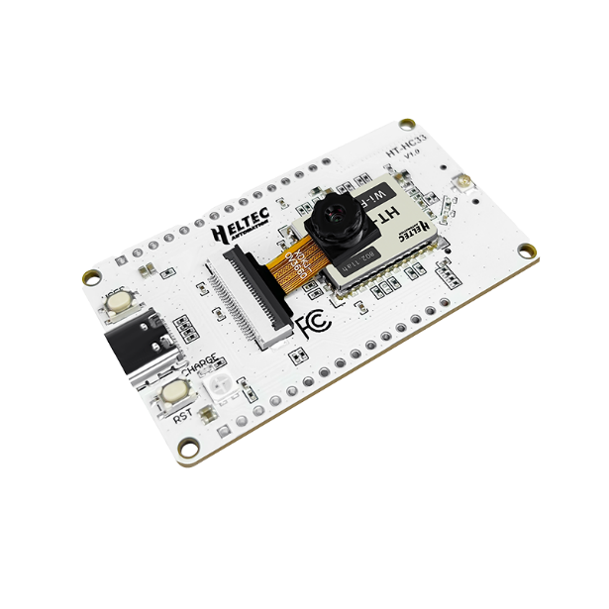
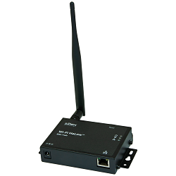
IEEE standard for LPWANs
802.11ah (HaLow) standard in 2016
First real hardware in 2020
Hardware and dev kits available (Heltec makes one)
Unclear if there are real-world deployments, but things are moving
Focus on the indoor-to-outdoor scenario
Medium range (maximum 1 km, so expect 100s of meters)
915 MHz communication
NOT interoperable with other 802.11 access points and devices
Theoretically up to 356 Mbps
Practically, most devices are expected to implement 150 kbps to 8 Mbps

Slide 61
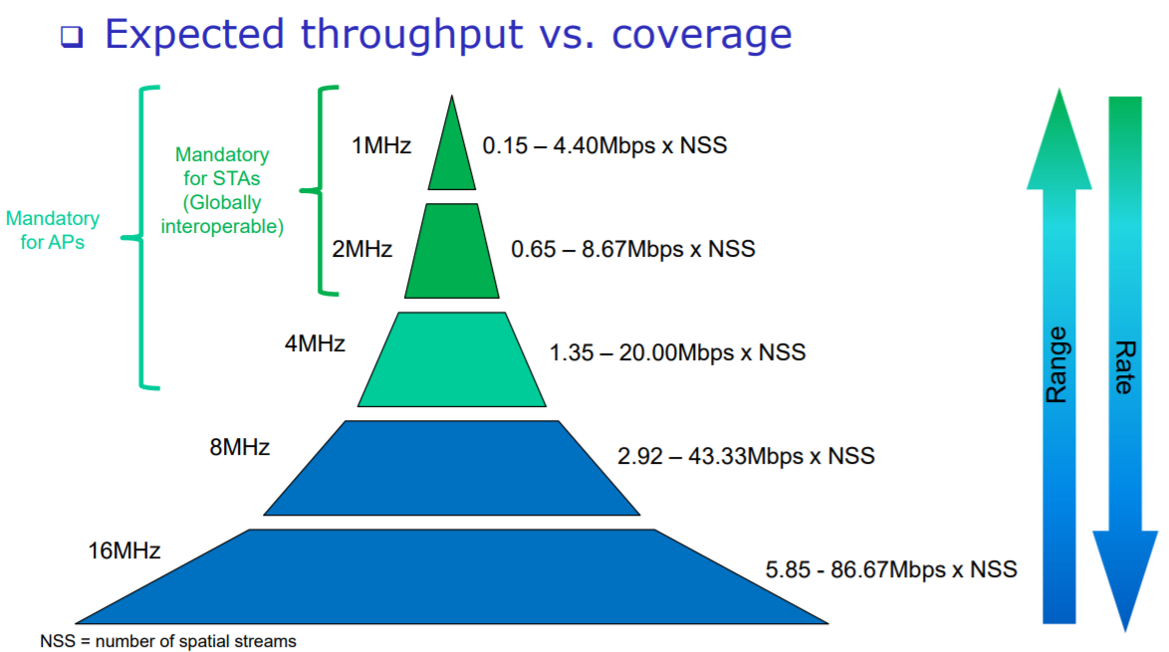
802.11ah allows multiple bandwidth allocations
Physical layer: like a more limited WiFi
OFDM
Various MCS levels
BPSK up to 256-QAM
MIMO support up to 4 antennas

Slide 62
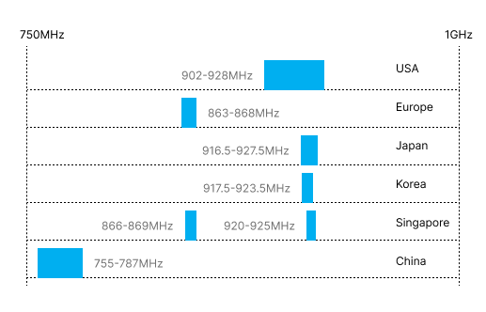
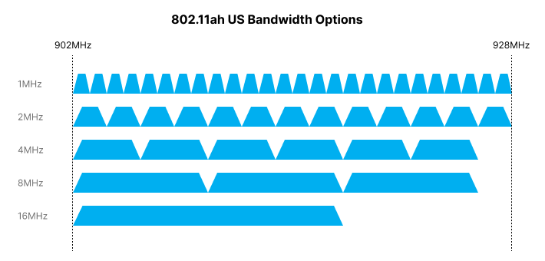
802.11ah frequency bands
Frequency and available bandwidth vary by region
16 MHz allocation possible in US/China
4 MHz max in Europe
Given range, probably want more smaller allocations to avoid contention
Twenty-six 1 MHz bands up to 4 Mbps

Slide 63
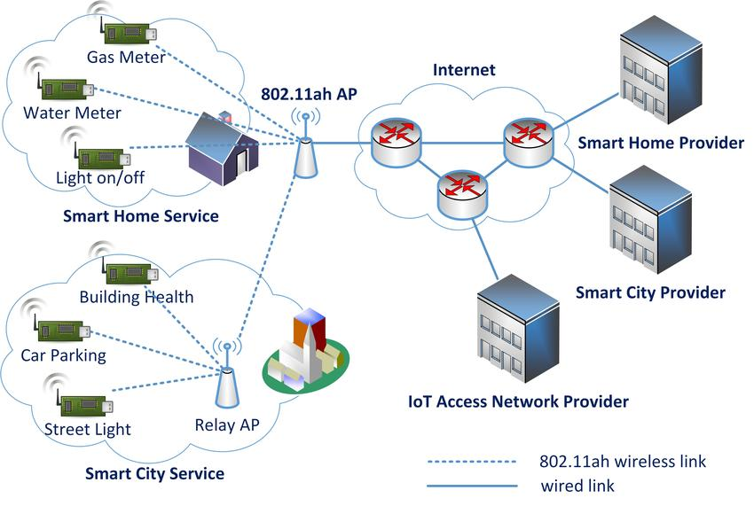
HaLow Network Model

Slide 64
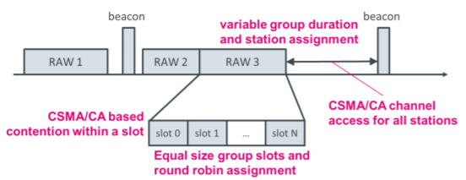
802.11ah architecture
Star topology
Up to 8191 devices per access point
Devices are assigned to a group
Groups are scheduled slots with TDMA
Within a slot CSMA/CA is used for contention among devices
Devices not in the group can sleep until their slot
Groups can be assigned by location to avoid hidden-terminal problem
Traditional IP communication on top of that
And traditional 802.11 security mechanisms (WPA2/TLS)

Slide 65
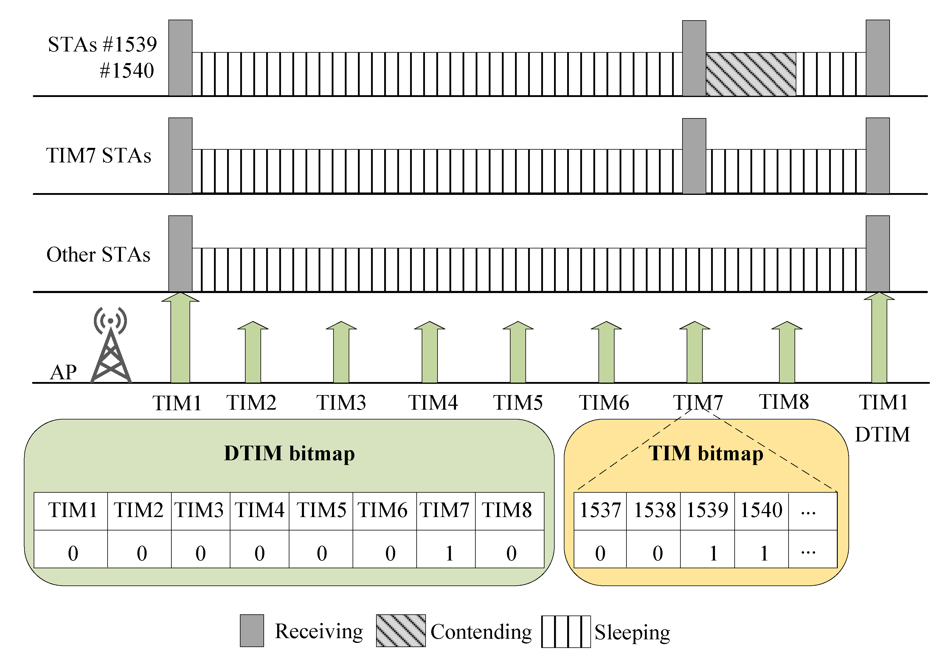
Example group scheduling
For low-power communication, reduce the amount of time devices might need to listen
Hierarchical
Entire groups are indicated if any traffic exists for any of them
Then additional indication of which device when that group starts

Slide 66
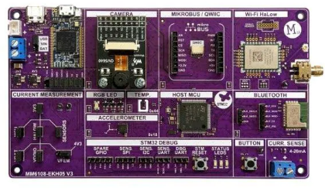
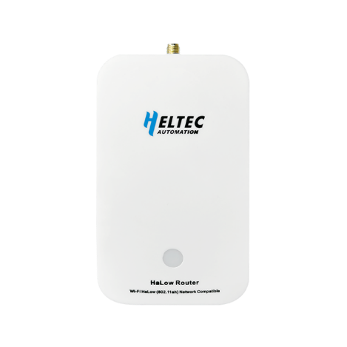
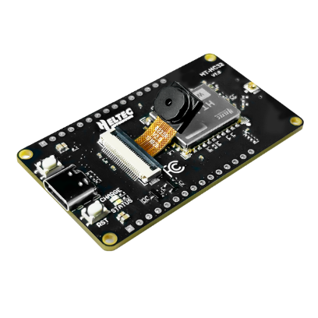
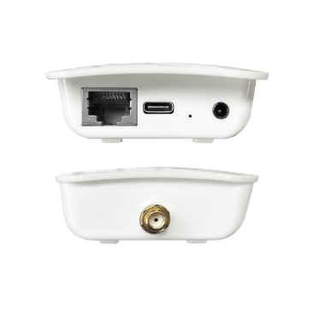
802.11ah hardware
Limited, but improving!
Morse Micro developer of HaLow radio chip
$30 for the MM6108 soc
Morse Micro dev board - $150
Heltec sells hardware
802.11ah access point - $80
Dev board with ESP32 + HaLow radio - $45
Radio module - $13
Built around MM6108
(not sure how it’s so much cheaper…)

Slide 67
Outline
Wide-Area Network Background
Unlicensed LPWANs
LoRaWAN
Sigfox
802.11ah
TV Whitespaces

Slide 68
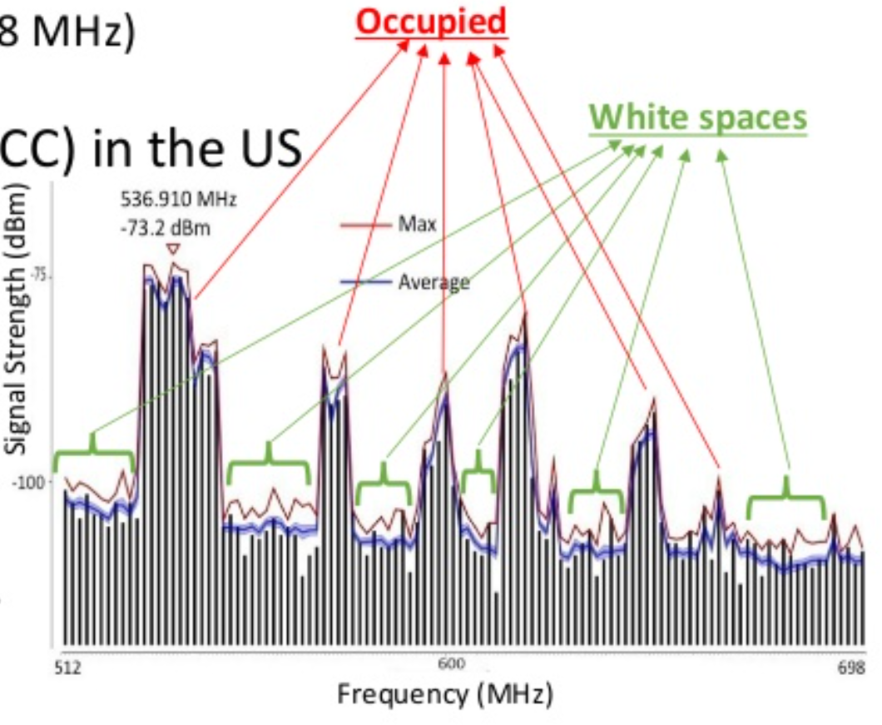
TV whitespaces
Unused TV channels between 54 MHz and 698 MHz
VHF (54-216 MHz)
UHF (470-698 MHz)
6 MHz channel width
Allocated but unused
FCC allows unlicensed use
IF you do not interfere with primary users

Slide 69
Sensing channel use
Variation in use
Spatial: Cannot assume same channel will be free everywhere
Temporal: Cannot assume channel will be free at all times
Cognitive radio approach
Dynamically identify unused portions of spectrum
Database approach
Let someone else do the scanning. Consult database based on location and time

Slide 70
802.11af
IEEE standard for whitespaces circa 2014
Not much (any?) use to date
US/Canada-specific
Limits general-purpose product appeal
Requires infrastructure about whitespace availability
People are figuring this out, but not really available yet
[n.b. very active area of research]

Slide 71
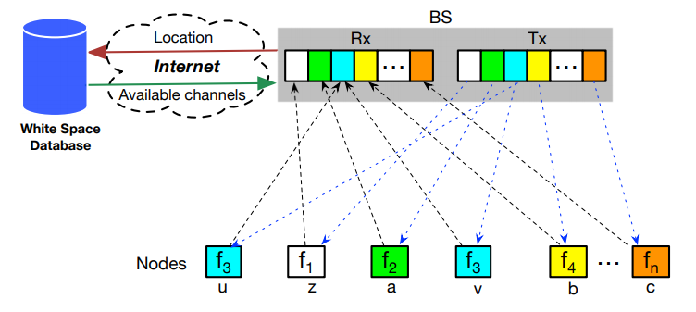
Sensor Networks Over tv Whitespaces (SNOW)
A design for sensor networks over whitespaces
Base Station manages channel for deployment
Frequency division for devices. Each uplinks on separate subcarrier
Downlink is one OFDM transmission. Each device hears its frequency

Slide 72
Outline
Bonus: crowd lighting systems

Slide 73
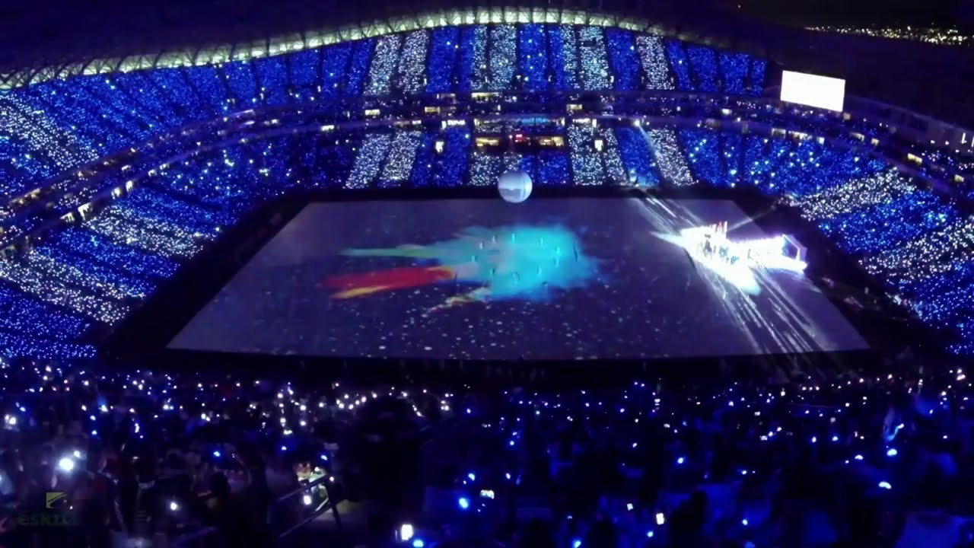
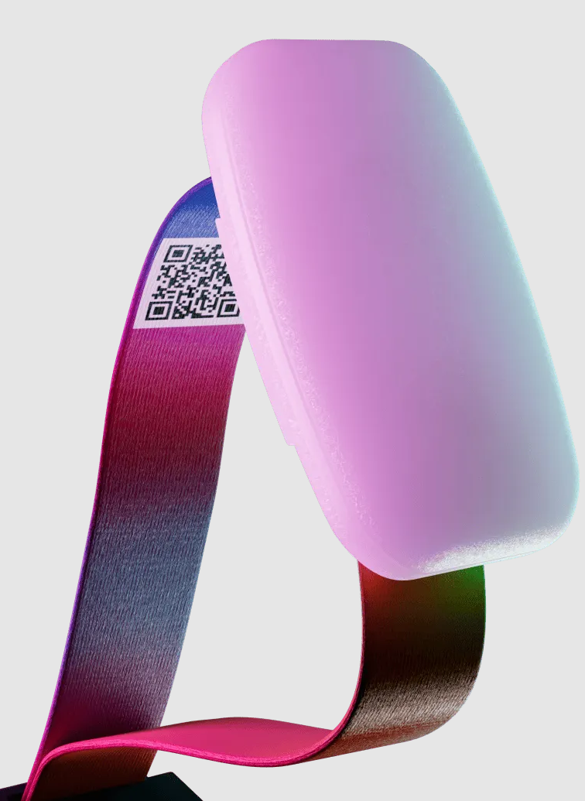
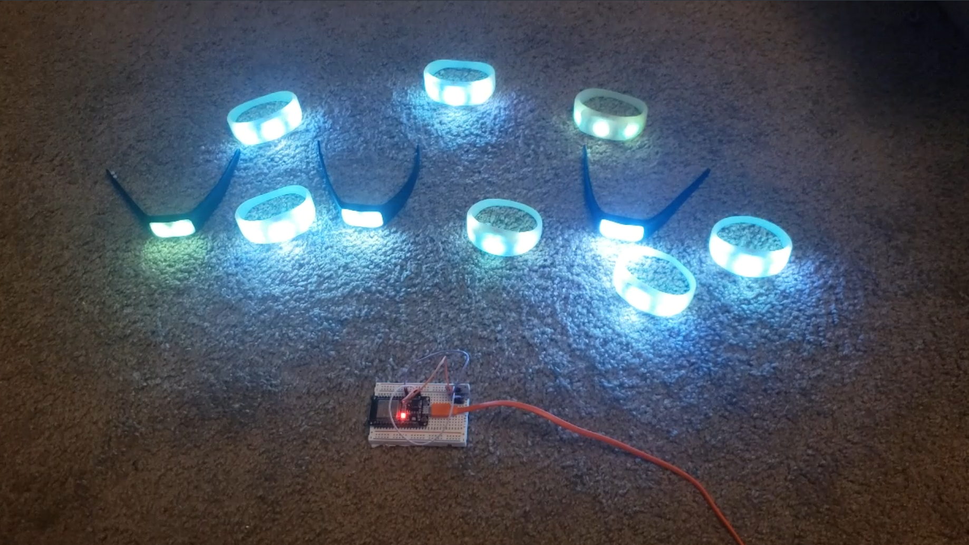
Synchronized crowd lighting
Seen at large concerts and games
Wrist bracelet (or hat) handed out to audience members

Slide 74
How would you make these work?
Various implementations are possible
Do NOT need to use complicated protocols like we covered today as these are downlink-only systems with very short lifetimes

Slide 75


How do the PixMob versions work?
RGB LEDs + Microcontroller + IR receiver
Moving IR transmitter targets areas of the audience with signals over IR
Like a TV remote control
Schedules colors and timings
Reverse engineered
https://github.com/danielweidman/pixmob-ir-reverse-engineering
https://github.com/jamesw343/PixMob_IR

Slide 76
Outline
Wide-Area Network Background
Unlicensed LPWANs
LoRaWAN
Sigfox
802.11ah
TV Whitespaces

