Slide 1
Lecture 15 LPWANs Challenges
CS433 – Wireless Protocols for IoT
Branden Ghena – Spring 2026
With images from Swarun Kumar (CMU) and Dinesh Bharadia (UCSD)
Materials in collaboration with Pat Pannuto (UCSD) and Brad Campbell (UVA)

Slide 2
Administrivia
Lab: WiFi
Due tonight (can use slip days if necessary)
For throughput optimization two requirements
Do at least something at the PHY layer (there are multiple low-hanging fruit here)
Do something for packet size (definitely consider what the packet size ought to be)
You should be able to beat 100 kbps without much effort
And much faster is possible
Lab: LoRa
Tomorrow! See you all in lab

Slide 3
Today’s Goals
Deep-dive into challenges LPWANs face
Explore academic research improving LoRaWAN capabilities and exploring LoRaWAN deployments

Slide 4
Outline
LPWAN Challenges
Improving LoRaWAN
Wide-area Network Analyses

Slide 5
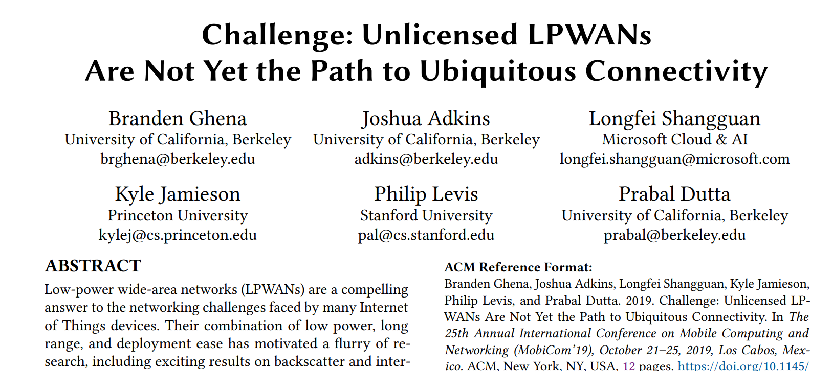
Challenge for Unlicensed LPWANs Paper
MobiCom 2019

Slide 6
Two major categories of low-power, wide-area network protocols
Unlicensed LPWANs
Sigfox, LoRaWAN, etc.
Unlicensed band, 915 MHz (US)
Managed or user deployable
Cellular IoT
LTE-M and NB-IoT
Licensed cellular bands
Managed networks
Rolled out US-wide
Notes:
Cellular IoT includes the new machine-to-machine focused cellular protocols, LTE-M and NarrowBand-IoT
These operate in the standard licensed cellular bands in managed networks
On the right you can see
Each of these networks have range on the order of kilometers
Throughput focuses on uplink, with rates of ten to several thousand kbps
We also have 2G plotted as an example of the kinds of networks we’re evolving from
LPWANs have lower throughput, but increased range over the 2G protocol

Slide 7
Do novel networks meet application needs?
How do we compare varied requirements and capabilities?
Networks have throughput per gateway and range of gateway.
Applications have throughput per device and deployment area.
Each gateway must support throughput for all devices in its coverage area.
Deployment areas are often wider than a single gateway’s range.
Solution: compare the density of communication.
Data communication rate per unit area.

Slide 8
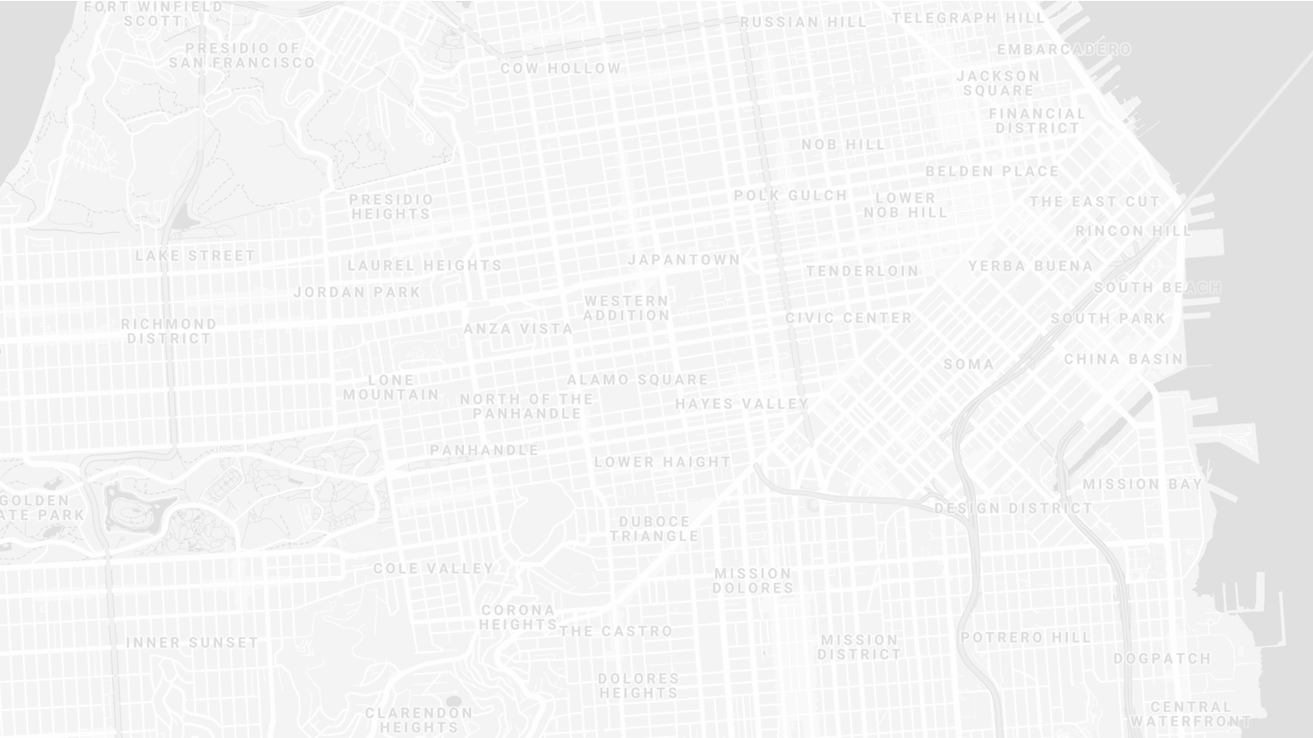
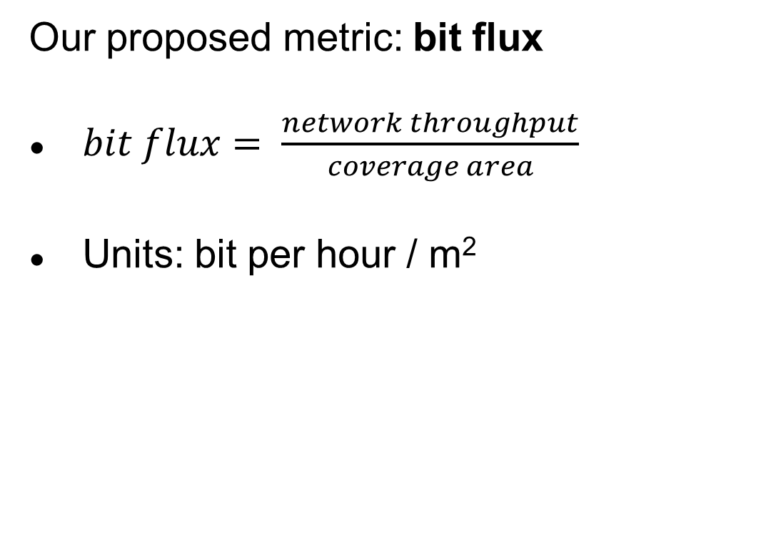
New metric for wide-area communication.
Our proposed metric: bit flux
$bit flux= \frac{network throughput}{coverage area}$
Units: bit per hour / m²
Notes:
bit flux is our metric for data density
throughput divided by coverage area
As with many ideas, this was first suggested by Mark Weiser

Slide 9
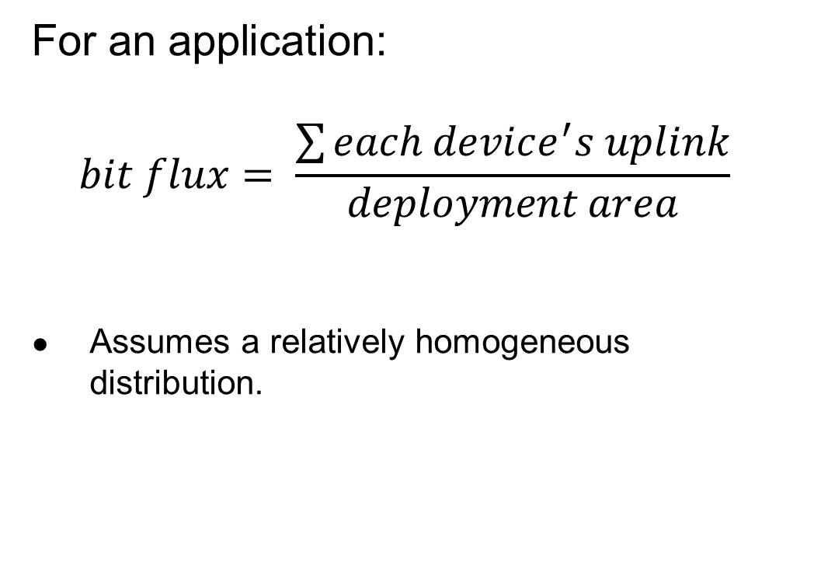
Bit flux can measure application needs.
For an application:
$$bit flux= \frac{\sum{each device^{′}s uplink}}{deployment area}$$
Assumes a relatively homogeneous distribution.
Notes:
For applications, bit flux sums the data needs for each device in the deployment
And divides by the total deployment area
To determine the application uplink density

Slide 10
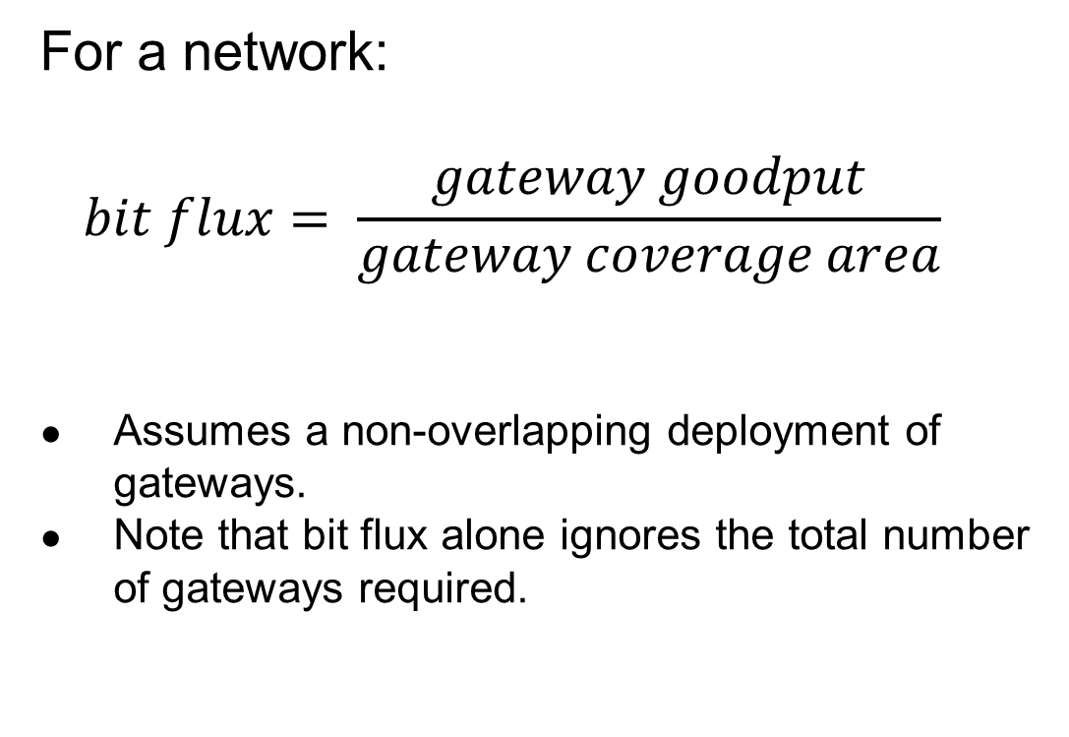
Bit flux can measure network capabilities.
For a network:
$$bit flux= \frac{gateway goodput}{gateway coverage area}$$
Assumes a non-overlapping deployment of gateways.
Note that bit flux alone ignores the total number of gateways required.
Notes:
For networks, we divide the goodput of a network
By the coverage area of a single gateway
This gives us a number that represents the data density that a network can support, at any width of deployment

Slide 11

Bit flux accounts for spatial reuse.
Reducing coverage area and deploying additional gateways improves capacity.
$bit flux↑ = \frac{gateway goodput}{coverage area↓}$
Notes:
Bit flux also accounts for spatial reuse in networks
Reducing range (and deploying more gateways), reduces the coverage area for each gateway, increasing the network bit flux

Slide 12
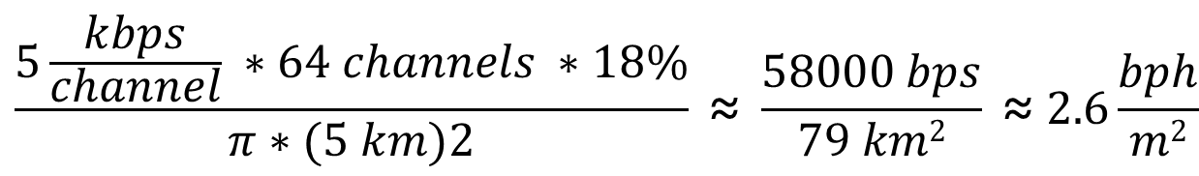
Bit flux measurement for LoRaWAN.
ALOHA access control
$$\frac{5\frac{kbps}{channel} ∗64 channels ∗18\%}{π∗(5 km)2} \text{≈} \frac{58000 bps}{79 km2} \text{≈} 2.6\frac{bph}{m2}$$
Hata model
Notes:
Here is the bit flux measurement for a LoRaWAN network
In the US, LoRaWAN has 64 channels for uplink
But it relies on an ALOHA access control mechanism, so packet collisions reduce throughput significantly

Slide 13
Networks differ in capability by orders of magnitude.
Notes:
We can calculate bit flux for each of the networks we’re interested in
We note that there are several orders of magnitude difference in the throughput capability of each network
Particularly between cellular communication and unlicensed LPWANs

Slide 14
Range reduction results in a bit flux curve for each network.
Notes:
These points are at the maximum range for each network, but they have the ability to perform power control and reduce range
This creates a curve for each network, where we can reduce range (and install more gateways) in order to increase network capability

Slide 15
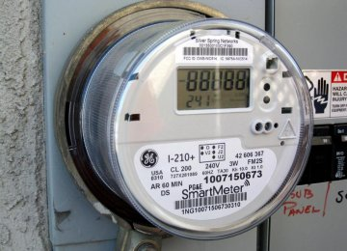
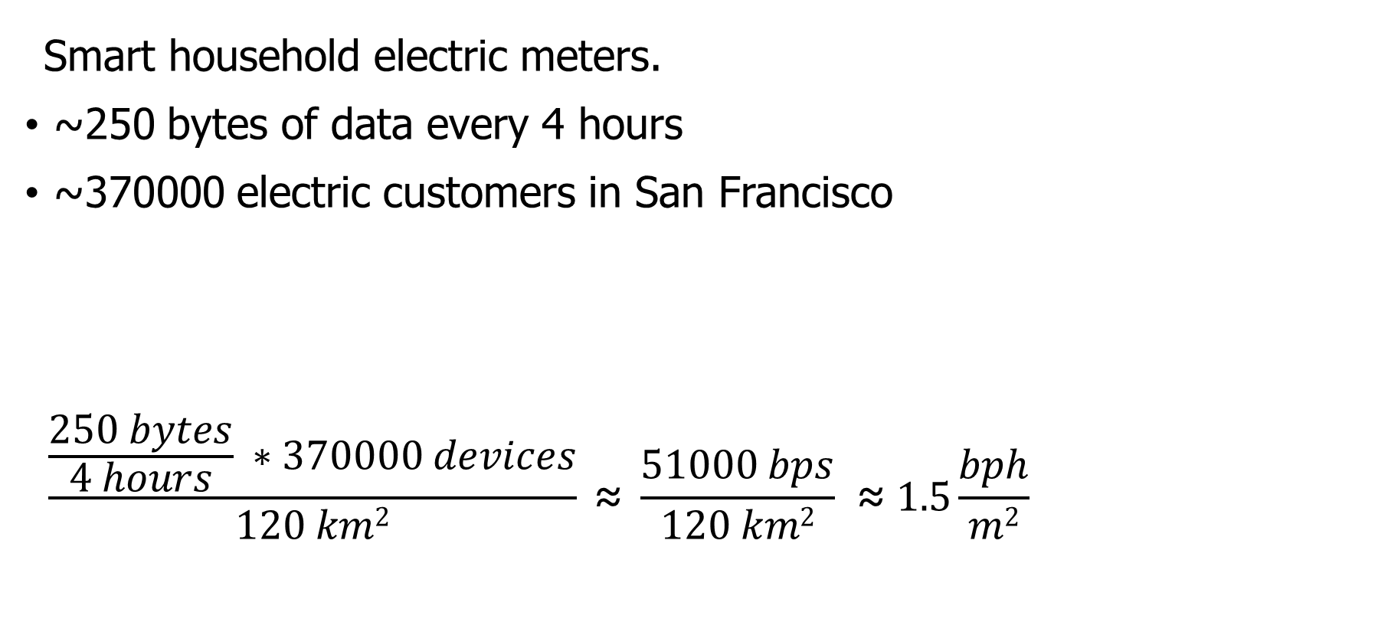
Let’s compare network capabilities to a real-world application.
Smart household electric meters.
~250 bytes of data every 4 hours
~370000 electric customers in San Francisco
$$\frac{\frac{250 bytes}{4 hours} ∗370000 devices}{120 km2} \text{≈} \frac{51000 bps}{120 km2} \text{≈} 1.5\frac{bph}{m2}$$
Notes:
Now that we can measure the capability of each network, lets compare that to the needs of an application
The example I’ll be talking through is Electricity Metering, there are about a dozen others in the paper
PG&E smart meters send about 250 bytes every 4 hours
This isn’t a lot of data, but smart meters are densely deployed, with three hundred thousand across San Francisco

Slide 16
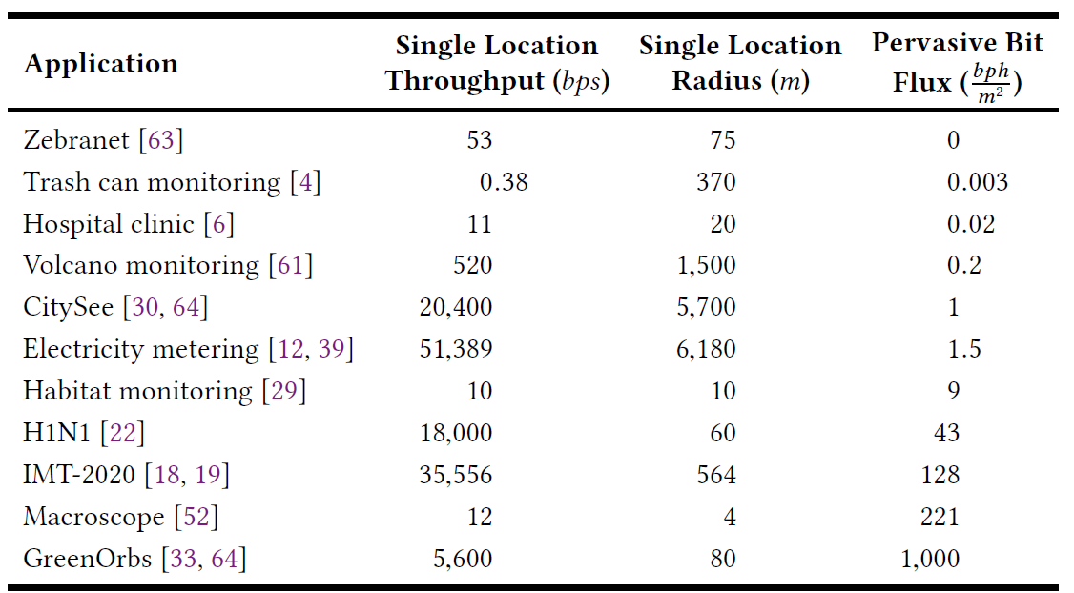
Bitflux for various applications
See paper for full details on each application
Creates a comparison point between applications and networks!
https://brandenghena.com/projects/lpwan/ghena19lpwans.pdf

Slide 17
All networks are capable of meeting the data needs of electricity metering.
Electricity Metering Application
Notes:
We can plot the need of the Electricity Metering application as a line on our bit flux figure
Any network above this line is capable of serving the application’s needs
Sigfox needs range reduction, but all networks are capable of serving this application’s needs
So, great! Networks can serve ubiquitous applications. Problem solved, right?

Slide 18
Unlicensed LPWANs lag behind Cellular IoT in ability to support applications.
2G < 0.03% utilized
Notes:
Let’s visualize this instead as the number of gateways deployed and the proportion of network utilized.
Again, because of power control, there is a tradeoff here. We could deploy a single gateway for everything, or many gateways with reduced range to increase capacity.
Cellular networks have no problem with this application
With a single gateway, LTE-M could spend 1% of its capacity to service this app.
Unlicensed LPWANs, however, have choices to make on how many gateways they deploy and how much capacity they are willing to spend on this one application

Slide 19
Sigfox requires range reduction to meet application needs.
Capacity Problem
Throughput capability of Sigfox is insufficient to support application needs
It can only support the application with reduced range and additional gateways
Notes:
There are two particular problems we can see with the unlicensed LPWANs
The first is a capacity issue:
Sigfox can’t satisfy the application at all without power control.
Range is sufficient for a single gateway to cover the city, but it wouldn’t be able to keep up with the data.

Slide 20
Capacity solutions are relatively straightforward.
Better access control mechanisms. Explore CSMA?
Recover simultaneous transmissions (Choir and Charm).
Increase bandwidth (TV white spaces).
All likely come at the cost of increased energy usage…
Results in a protocol that looks pretty similar to cellular…
Adwait Dongare, et al. "Charm: exploiting geographical diversity through coherent combining in low-power wide-area networks.“ IPSN’18
Rashad Eletreby, et al. "Empowering low-power wide area networks in urban settings." SIGCOMM’17
Abusayeed Saifullah, et al. "SNOW: Sensor network over white spaces." SenSys’16
Notes:
Solving these capacity problems is relatively straightforward
And a lot of research from our community has begun that path
One solution would be better access control mechanisms than the ALOHA
We could also significantly increase the available bandwidth through the use of TV white spaces

Slide 21
LoRaWAN devotes most of its network capacity to a single application.
Coexistence Problem
LoRaWAN can meet application needs
But only by using 50% of the 915 MHz unlicensed-band spectrum
Notes:
But there is a second problem, that of coexistence
LoRaWAN could handle the application with only 2 or 3 gateways
Remember, that we are calculating bit flux for LoRaWAN using all available channels
As long as you are willing to commit 50% of the 915 MHz spectrum to electricity metering

Slide 22
Coexistence is inevitable in urban areas.
Urban environments and long range lead to many overlapping deployed networks.
Capacity problems worsen coexistence by devoting more bandwidth to one application.
It’s not just electricity metering…
Notes:
You might try to say it’s fine to dedicate so much of a network to a single application. I dedicate 50% of my home WiFi to Netflix all the time…
But coexistence cannot be ignored in urban areas
There won’t just be one network, but two, or three, or more
And they all have to share the same bandwidth for all deployed applications

Slide 23
Coexistence in unlicensed bands is a more difficult problem.
No methods for inter-network negotiation so far.
Without buy-in from most deployments, all access control becomes uncoordinated.
Cellular IoT does not have this problem
Notes:
Solving these coexistence problems are more difficult
We need methods for coordination and negotiation between deployed networks
And without buy-in from all networks, collisions are inevitable
It doesn’t matter that you are using a wonderful scheduling TDMA algorithm to send data without collisions if your neighbor is transmitting whenever they want
And a really important point is that cellular IoT doesn’t face this problem

Slide 24
Cellular may dominate future deployments.
LTE-M and NB-IoT are now deployed in the US (and worldwide).
Licensed bandwidth avoids the coexistence problem.
Cellular may solve many applications but is not a perfect solution.
Still has higher energy and monetary costs for use.
Also limited to where service is already available.
Notes:
Occupying licensed bands means LTE-M and NB-IoT don’t have multiple overlapping networks to coordinate with
So coexistence isn’t a concern
And they already have more capacity than the unlicensed protocols
Without solutions for unlicensed LPWANs, deployments will move to cellular networks
And when the applications leave, research will leave as well
Without real solutions to the problems they face, we’re in danger of losing an exciting research domain
We pose this as a challenge to the community to develop coexistence and capacity solutions for unlicensed LPWANs

Slide 25
Unlicensed LPWANs are still useful for some scenarios.
Controlled or unoccupied regions have reduced coexistence concerns.
Industrial factories, farms, parks and forests.
Unlicensed networks are very exciting for research.
Anyone can deploy a network wherever they want.
Much easier to explore protocol modifications and new technologies.
Research suffers without real-world applications.
Problem areas are strong recommendations for new research.
New research is only useful if they will have real-world impacts.

Slide 26
Implications – Low-Power Wide-Area Networks.
Existing unlicensed LPWANs face significant challenges in supporting urban applications.
Best suited for industrial or agricultural uses in controlled environments.
Research directions for unlicensed LPWANs:
improve network capacity,
and enable coexistence.
Cellular IoT networks (LTE-M and NB-IoT) are positioned to solve the needs of city-scale sensing.
If the money and energy costs are there.

Slide 27
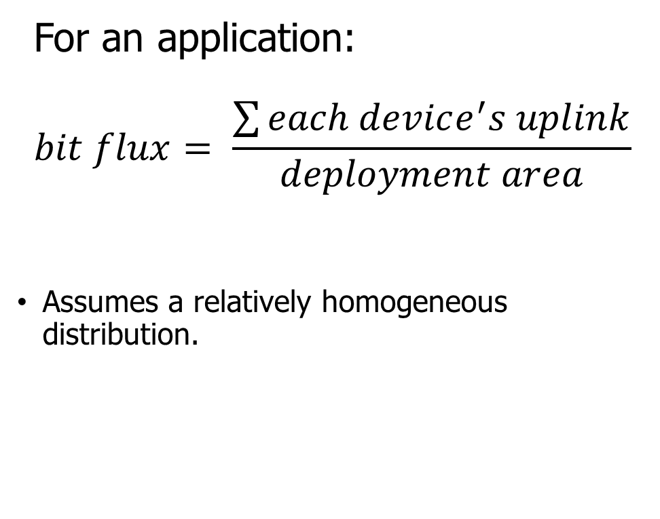
Break + Question
How important is a homogenous distribution?
Can you come up with a scenario where this breaks?
For an application:
$$bit flux= \frac{\sum{each device^{′}s uplink}}{deployment area}$$
Assumes a relatively homogeneous distribution.

Slide 28
Break + Question
How important is a homogenous distribution?
Can you come up with a scenario where this breaks?
Consider densely populated pockets of transmission over wide areas
Deployment area needs to correspond to pockets, not to entire range
For an application:
$$bit flux= \frac{\sum{each device^{′}s uplink}}{deployment area}$$
Assumes a relatively homogeneous distribution.

Slide 29
Outline
LPWAN Challenges
Improving LoRaWAN
Wide-area Network Analyses

Slide 30
Unlicensed LPWANs are a very active research area
Active work on:
Better access control mechanisms
Increasing bandwidth by utilizing other spectrums like TV white spaces
Recover simultaneous transmissions
Goal: reduce re-transmissions, increase end-device sleep and battery life
Let’s look at some research improvements that have been made to LoRa

Slide 31
Resources
Swarun Kumar (CMU) - https://swarunkumar.com/lpwan.html
Choir
https://swarunkumar.com/papers/choir-sigcomm2017.pdf
https://swarunkumar.com/slides/choir-sigcomm2017.pdf
Charm
https://swarunkumar.com/papers/charm-ipsn2018.pdf
Opportunistic Packet Recovery
https://swarunkumar.com/papers/opr-mobisys2020.pdf
BSMA
https://github.com/ucsdwcsng/bsma_lora/blob/09b998355498d6268ab0c1e940b395ec62a026a0/docs/full_paper_3495243.3560544.pdf

Slide 32
Can we distinguish data LoRa chirps that have collided?

Slide 33
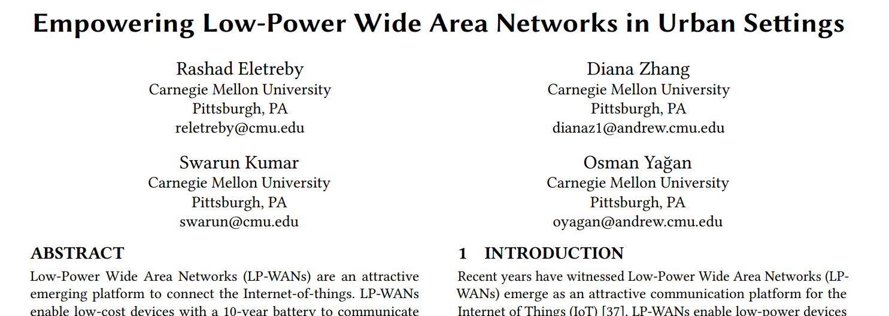
Choir Paper
SIGCOMM 2017

Slide 34
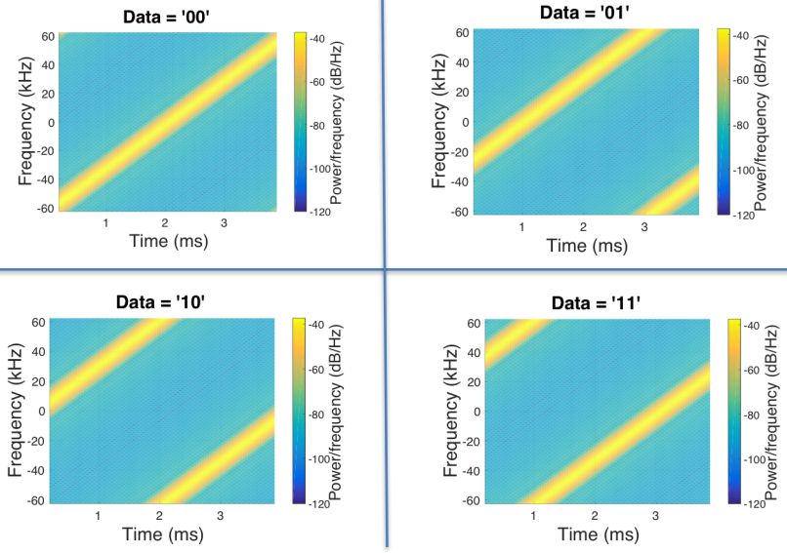
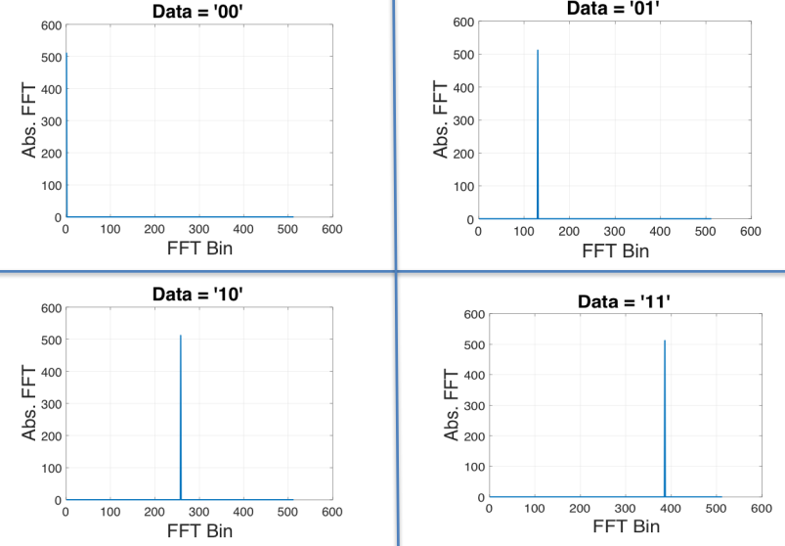
Choir concept
Can we distinguish data from LoRa chirps that have collided?
Yes! By applying signal processing to the problem
Data in time domain
Data in frequency domain

Slide 35
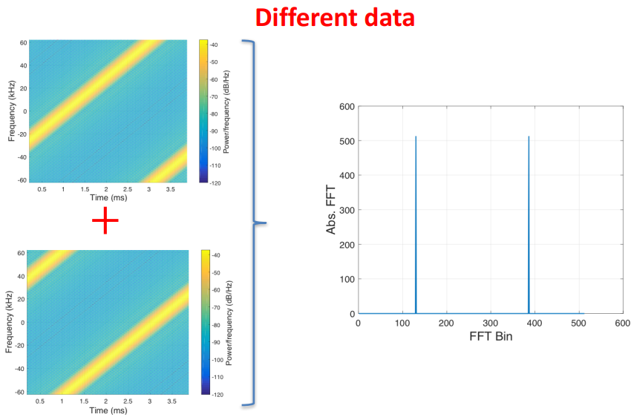
What happens when LoRa chirps collide?

Slide 36
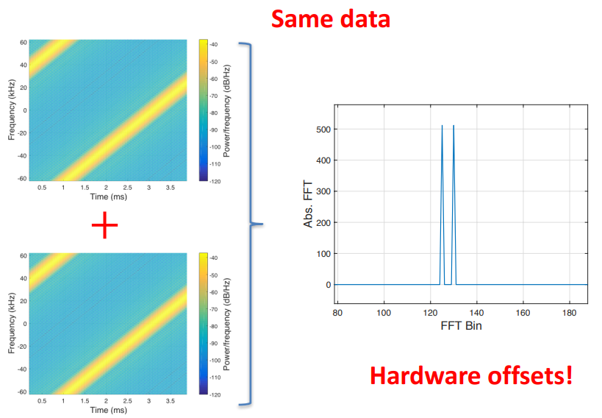
What happens when LoRa chirps collide?

Slide 37
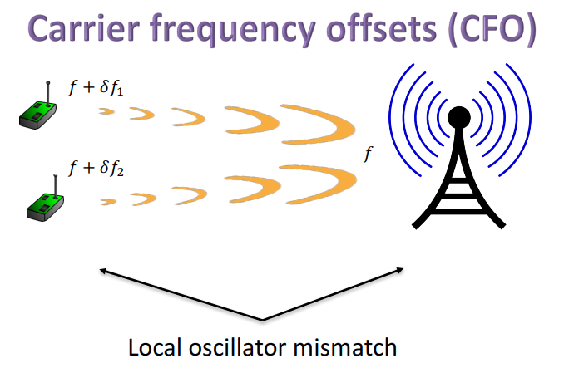
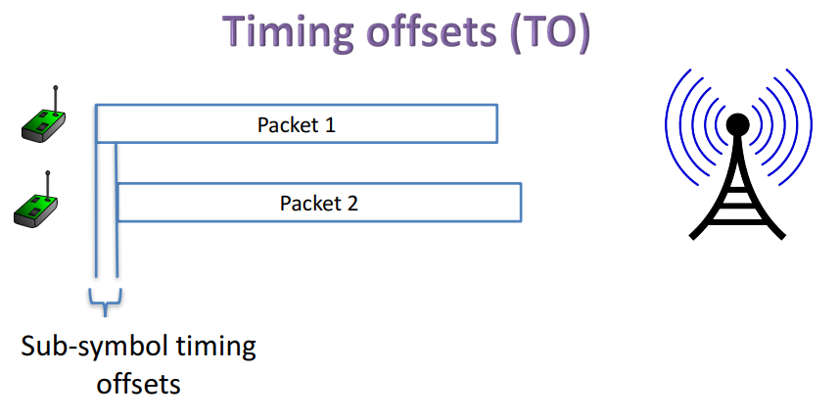
Imperfections in hardware create offsets

Slide 38
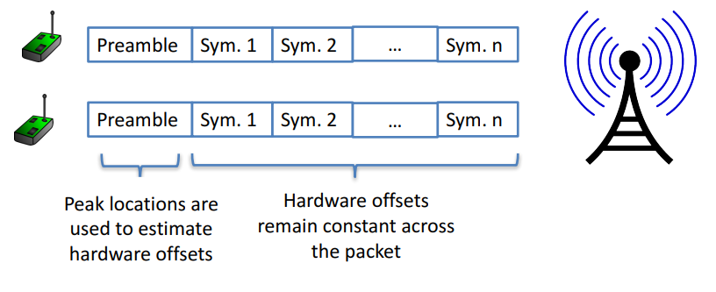
Decoding colliding packets

Slide 39
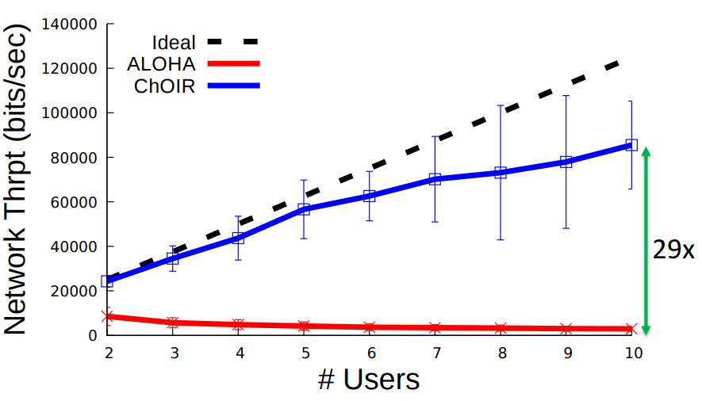
Choir results
Recovering collided packets resolves losses due to Aloha transmission!
Increases maximum throughput on the network considerably!
Downsides:
Requires hardware modifications on gateways
Computationally expensive

Slide 40
Can we recover weak LoRaWAN signals?

Slide 41
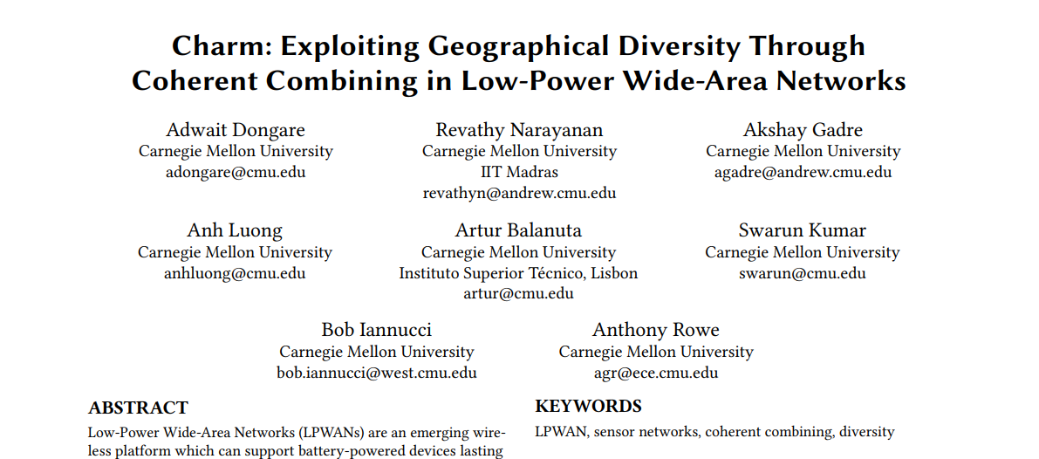
Charm Paper
IPSN 2018

Slide 42
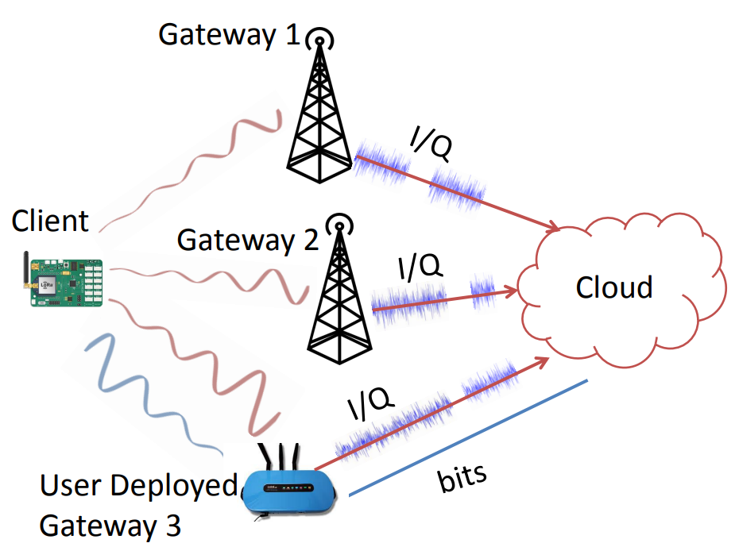
Charm
Take advantage of multiple gateways in range of a device
Combine signals received at each gateway to recover packets that weren’t received cleanly
Particularly useful at decoding weak signals

Slide 43
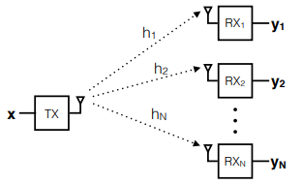
Coherent combining
Signal received at each receiver is a combination of
Signal
Wireless channel
Random noise
Signal and wireless channel are similar at all receivers
Noise is different though! Possibly independent?
When combined, signals are coherent (build in strength) whereas noise is incoherent (spreads out)

Slide 44
Charm uses coherent combining across gateways
Gateways send signal data to the cloud
The cloud can perform combining on the data and recover signals
Challenges
Only send the data when it’s needed
Tight time synchronization on the data
Gateway hardware changes

Slide 45
Can we recover packets that have bad CRCs?

Slide 46
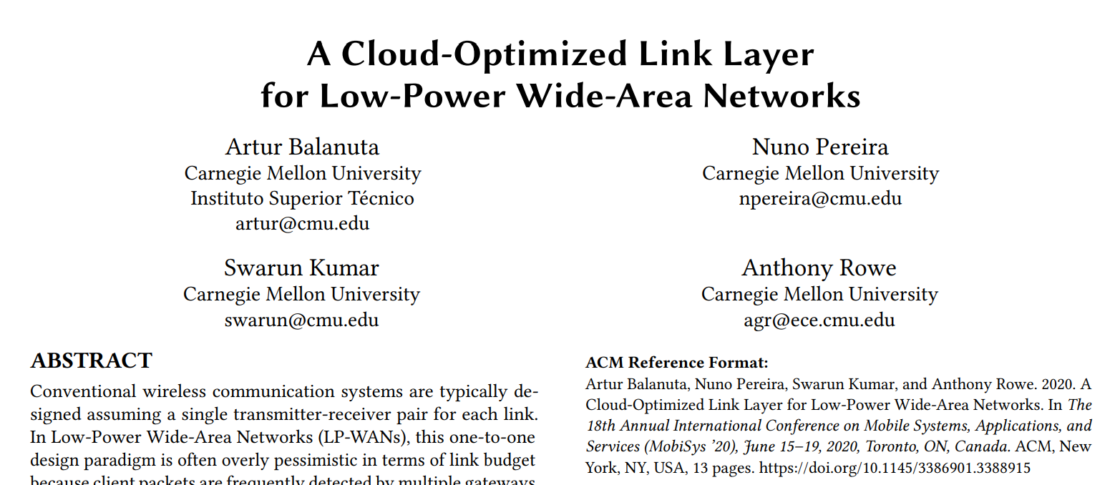
Opportunistic Packet Recovery Paper
MobiSys 2020

Slide 47
Opportunistic Packet Recovery (OPR)
Can we recover packets that have bad CRCs?
What if we have some information about where the interference might have occurred during the signal transmission?
OPR demonstrates that we can recover packets!
Process
Receive bits even for bad packets
Measure RSSI for each bit along the way
Look for changes in RSSI that signals interference
Try different values for the effected bits until the CRC succeeds!

Slide 48
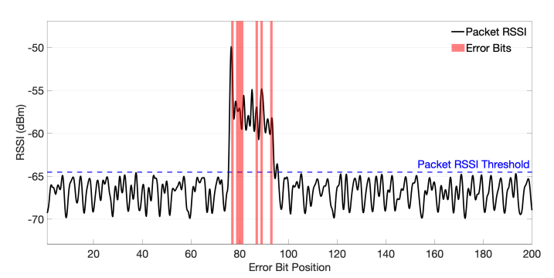
Detecting error bits in transmitted packets
Correctly identifies 83% of the corrupted bits with 17% false positives

Slide 49
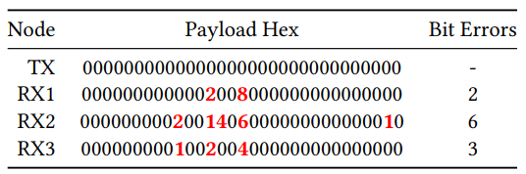
Multiple gateways do even better
If multiple gateways receive the packet, they can compare their received data
Common bits are likely correct, while differences are likely interference

Slide 50
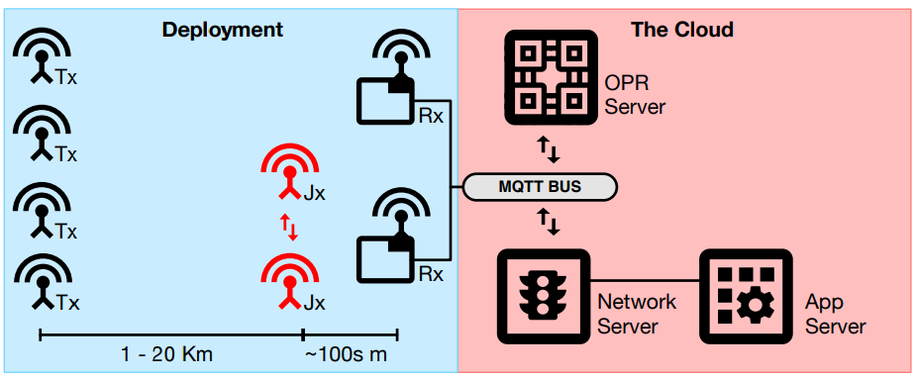
OPR total design
Bad packets are sent to the OPR Server for handling along with RSSI data
OPR server attempts to reconstruct the packet
In practice, system can correct up to 72% of CRC errors!
Also completes correction in time for the ACK response (within 1 second)
Downsides: not really much, this should really be used in practice

Slide 51
Can LoRa use a CSMA approach?

Slide 52
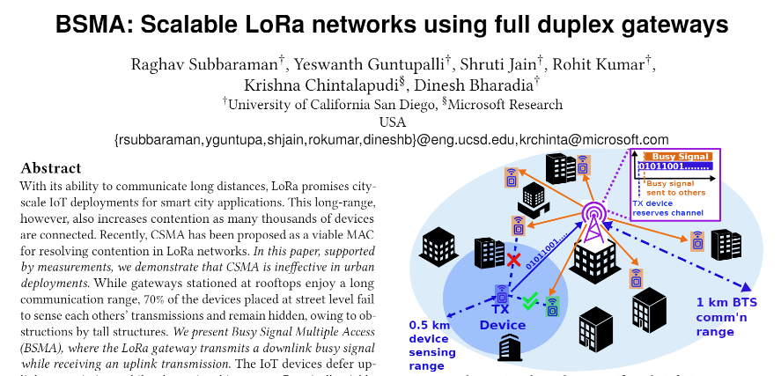
Busy-Signal Multiple Access (BSMA) Paper
MobiCom 2022

Slide 53
CSMA provides better throughput than Aloha
Current LoRaWAN uses Aloha for uplink communication
So there’s nothing stopping devices from colliding
Switching to CSMA could provide significantly more throughput
Reduces time and energy wasted on packet collisions
Concern: does CSMA for LoRa actually work in the real world?

Slide 54
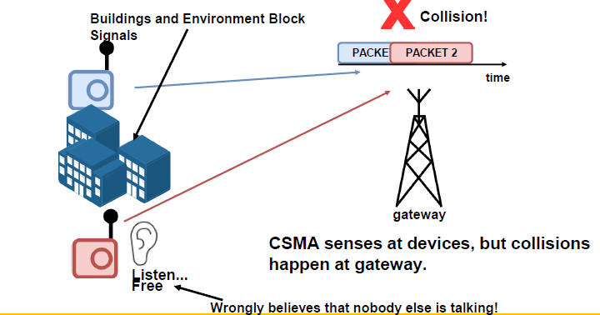
Obstructions cause hidden terminal problem
Hidden terminal problem is a concern here
Devices may not be able to hear each other
Measured reality: devices fail to detect simultaneous transmissions 70% of the time!!

Slide 55
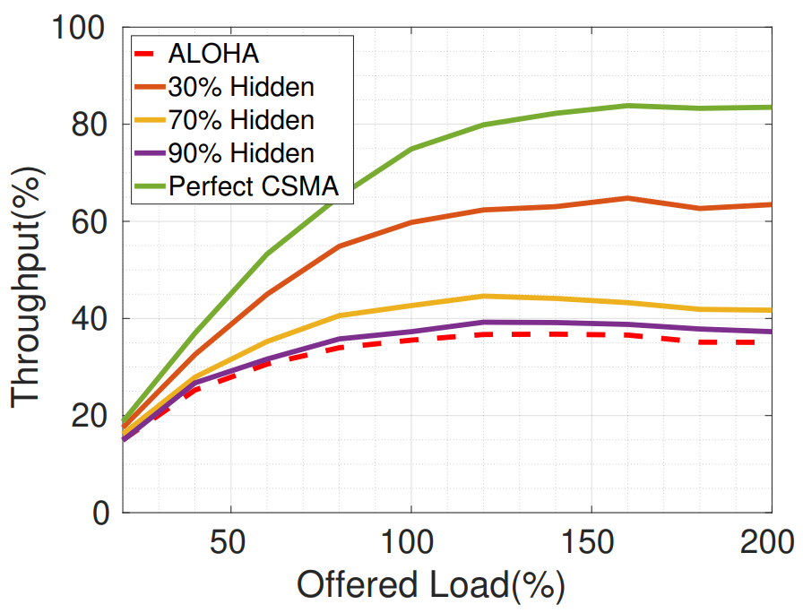
Hidden terminals greatly reduce CSMA throughput
Perfect CSMA could provide twice the throughput of Aloha
But, at 70% failure for CSMA, it’s not really an improvement over Aloha

Slide 56
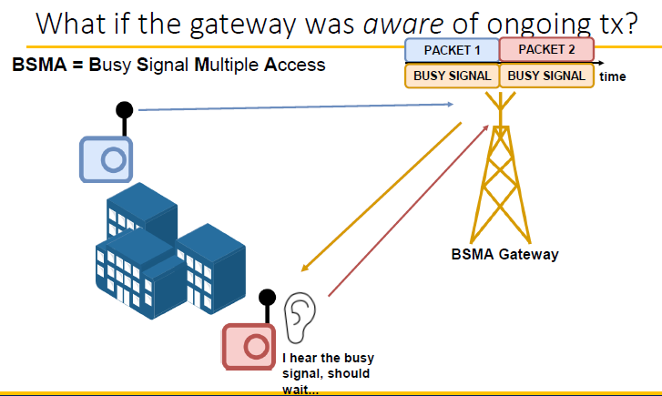
Busy-signal can alleviate this problem!
Idea: have the Gateway transmit a “busy signal” on one of the downlink channels while an uplink is in progress
Other devices can hear the gateway, even if they can’t hear each other

Slide 57
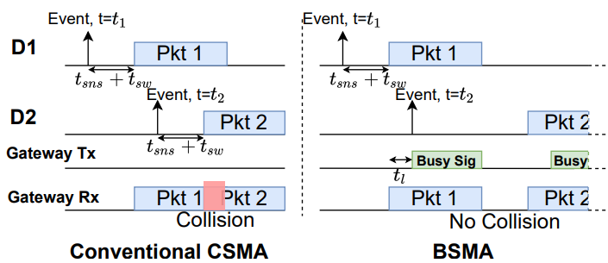
BSMA design
End devices do not attempt to transmit while a busy signal is present
Instead, they defer transmission for a random duration, and go back to sleep
When waking up, they sense for a busy signal again before transmitting

Slide 58
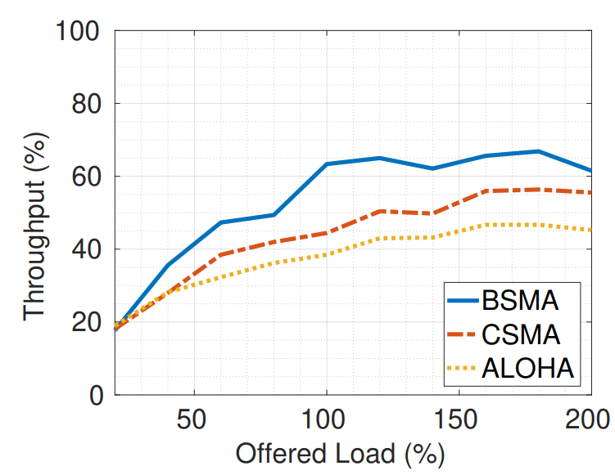
Real-world improvements from BSMA application
50% improvement over Aloha when network is under load
Still some packets are lost due to collisions
Could be combined with other approaches to still recover collided data
Maybe even intentionally send busy signal based on number of acceptable collisions
Greatly reduced energy per packet as well
Since they’re more likely to be received, and sensing doesn’t cost too much
Downside:
Must allocate channels for busy signal(s)

Slide 59
Break + Open Question
What are the challenges in translating all of this research into real-world use?

Slide 60
Break + Open Question
What are the challenges in translating all of this research into real-world use?
Improve gateway hardware: how do people buy/make it?
Needs a manufacturer to be interested
Multiple gateways are necessary
Not applicable to very small deployments
Network operators (TTN or Helium) would be good targets
They also have backend stuff running anyways, so adding OPR should be possible!

Slide 61
Outline
LPWAN Challenges
Improving LoRaWAN
Wide-area Network Analyses

Slide 62
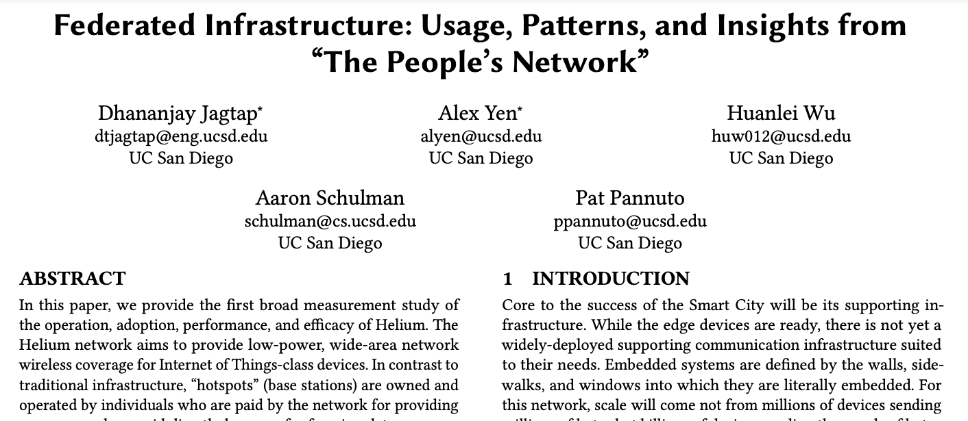
“The Helium Paper”
IMC 2021

Slide 63
Cell providers put spectacular effort ($$) into rolling out new wireless technologies
T-Mobile 4G 2014
T-Mobile 4G 2017
Notes:
Look at what T-Mobile’s 3G network in 2010
And how much work they had to do over three years to get to this coverage map in 2013
Now look at their 4G map in 2014
And what they had to do in the next 3 years to get to this map in 2017

Slide 64
What if we could just get people to put mini towers up on their own?
These are Internet-connected hotspots deployed as part of a crowd-sourced wireless infrastructure called Helium
Notes:
[need to say people are using their home internet for backhaul for Helium]
People are building this on top of wireline and cellular network

Slide 65
People will do a lot if you pay them (Especially if you pay them in cryptocurrency)
People are paying real USD to buy Helium access points (~$400/ea)
They put in their time and energy to install and maintain them
…all so that they can earn Helium Tokens (HNT) on the Helium Blockchain
The Helium blockchain pays users HNT for coverage and ferrying data
Fall 2021 Numbers:
250,000 Hotspots deployed
Adding 2,000 new hotspots / day
(Helium’s blockchain came online on July 29, 2019)

Slide 66
The study: What does it look like when a network goes from 0 to 250,000 in two years?
Because of the blockchain, we can can see how it happened
We can observe historical growth and current utilization
Because it’s a peer-to-peer network, we can observe active infrastructure
We can learn about the ISPs people are relying on for backhaul
Because of the open nature, we can easily do field measurements
We can analyze performance, robustness, and coverage of Helium
Notes:
This network was built in only two years, and to our knowledge because it grew so fast no one had a chance to study it yet — because of the blockchain, we can do history and current

Slide 67
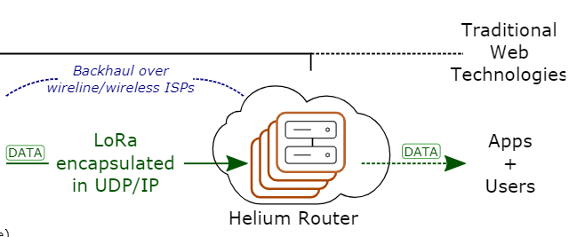

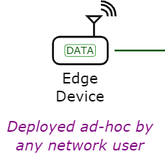
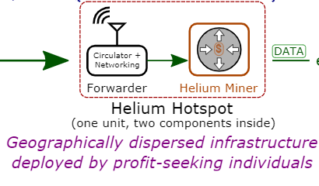

The Helium Architecture

Slide 68
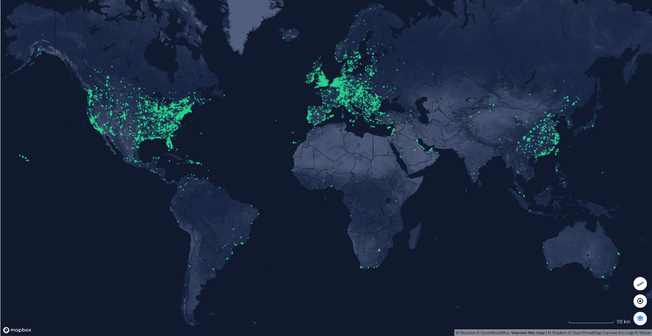
This study mostly thinks in terms of hotspots
Notes:
Hotspots are the hard physical infrastructure. These are the things that people have to put all over the world to provide coverage for end devices; these are also the physical devices that have to keep working (and keep working well) to provide continuous and reliable coverage.

Slide 69
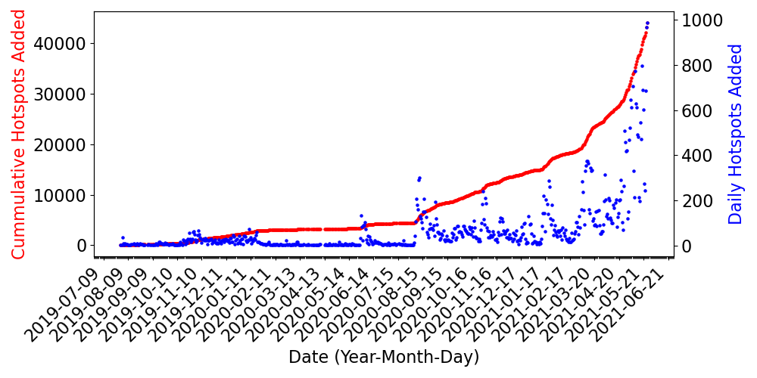
Cumulative and Daily Growth of Helium
Notes:
“one concern is that easy-to-deploy hotspot hardware is easy-to-move hardware, so we follow up with this analysis and look at the hotspot location changes”

Slide 70
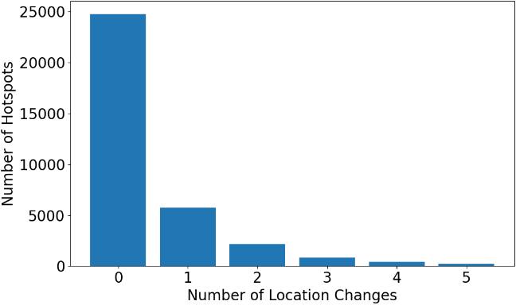
Once-deployed, most hotspots don’t move
94.8%
71.9%
<1%
Notes:
go through percentages of number of hotspots that change locations n times

Slide 71
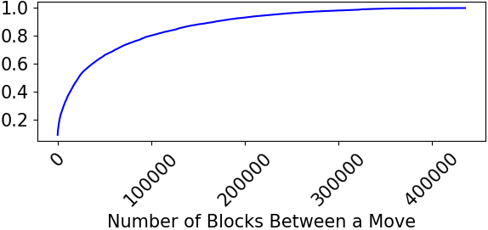
And if a hotspot is going to move, it moves early on Takeaway: Coverage is reasonably stable
63.2%
35.8%
1 month
17.9%
1 week
1 day
Notes:
go over CDF of number of blocks between a move

Slide 72
ISPs Become a Chokepoint
 | ISP | Number of Hotspots
1 | Spectrum | 2497
2 | Comcast | 1922
3 | Verizon | 1590
4 | Cablevision | 450
5 | AT&T | 338
1,588 cities rely on only 1 ASN (~an ISP)
414 of these cities have at least 2 hotspots
(Palma, Spain has 76 hotspots)
2020 Spectrum outage in LA could have taken down 291 out of 333 hotspots (87%)
Notes:
Explain that Helium is a decentralized network with centralized infrastructure and that we want to examine potential choke points within the network
“in the following table, we list the top
(the backbone of Helium still relies on the Internet, in which ISPs are centralized)
2020 Spectrum outage could have lead to 87% of hotspots being taken down in LA

Slide 73
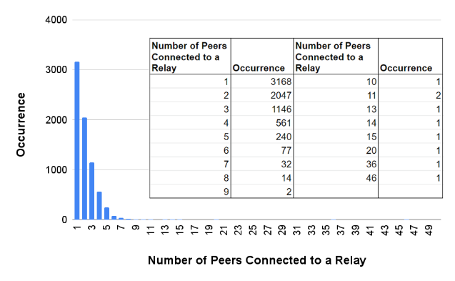
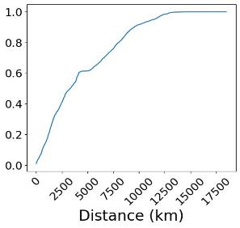
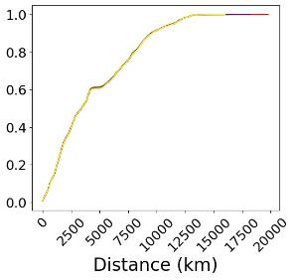
Majority of hotspots are locked behind NATs Takeaway: Network likely deployed in residential settings by amateur operators
55.48% of hotspots (with non-empty listening addresses) are relayed
Harms performance (two geo-unaware hops to a hotspot) and reliability
(Actual)
(Random)
Notes:
“we then look at another centralized point of failure which involves hotspot relays”
hotspots also pose as relays if they can only forward outbound data
relays pose as a potential risk for unexpected centralization and unexpected performance losses
in the first figure, we see that the majority of relays usually only have 1-3 peers
however, looked for extreme cases
“then hypothesized whether these centralized super peers are formed based on geographical location”

Slide 74
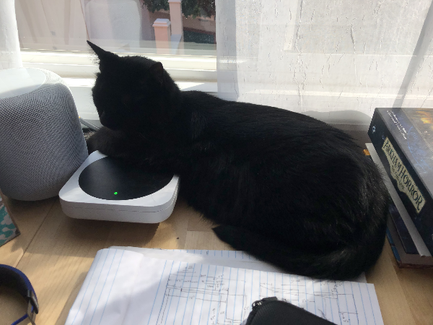
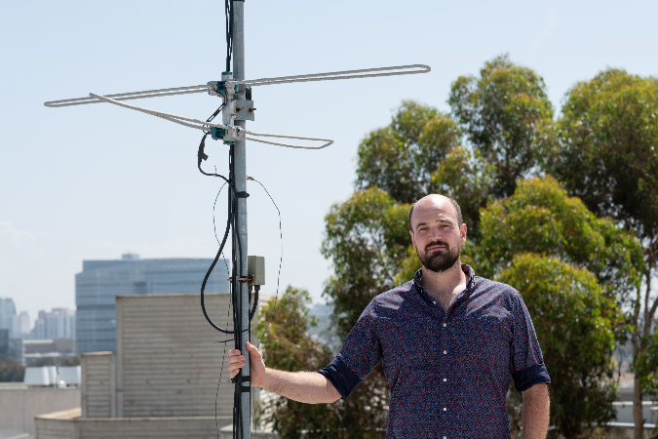
What this study doesn’t measure (well): The end-user performance of the network
Notes:
first show left example and then show right example (lol)
(most people will not have antennae on right, but this example is exemplifying the issue of unpredictable coverage)
analyze because there are many factors that contribute towards coverage

Slide 75
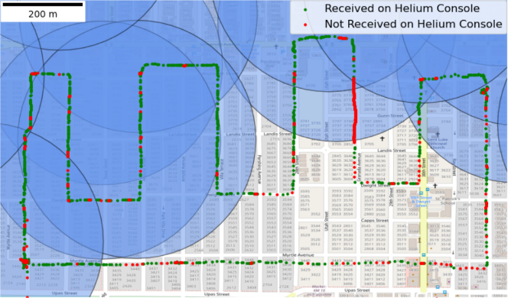
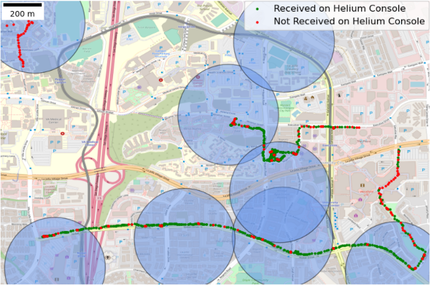
Simplistic coverage models to do not map to real-world performance
(Urban)
(Suburban)
Notes:
real-world coverage experiment
attempted to send packets to hotspots while walking around outside
Helium implements ACK and NACK protocol; ACK (green) → packet confirmed to be received on console, NACK (red) → packet not confirmed to be received on the console
blue circle represents a 300m coverage radius (HIP 17?), but as per the previous slide, the range of cover depends on various factors, such as the antenna
tried to show that coverage is good in circle and less good outside of circle
Helium firmware update could have caused the red line of NACKs directly within the coverage areas

Slide 76
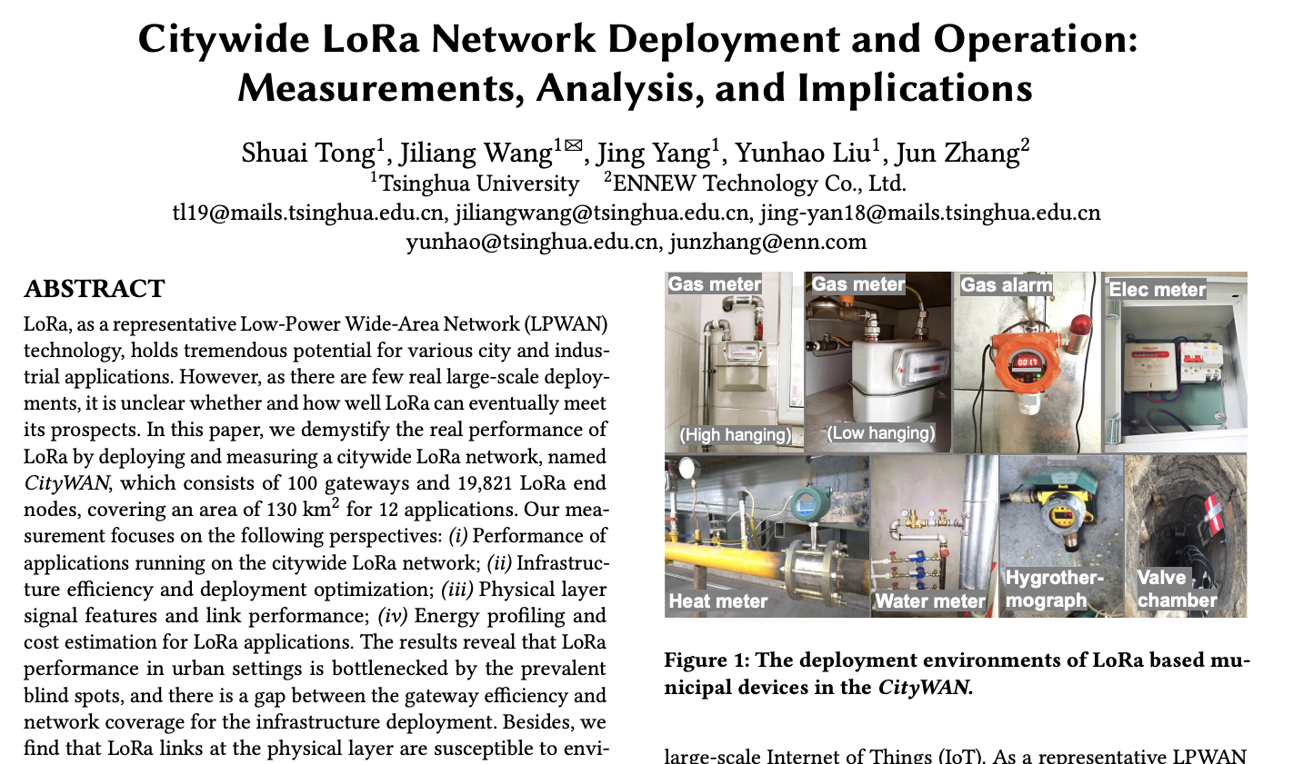
“The CityWAN Paper”
SenSys 2023

Slide 77
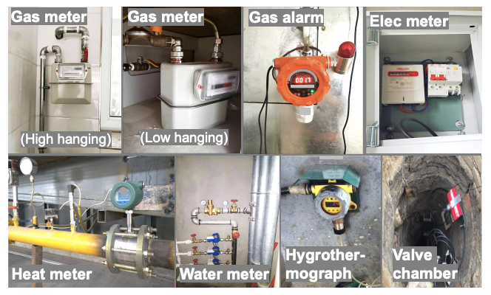

What happens if we “really deploy” LoRa at-scale in a real city?
Looks at realistic use cases, mostly utility metering

Slide 78

Location of physical infrastructure (in, deeply in, outside a building) makes a significant difference

Slide 79

Coverage becomes less “simple sphere” the further you get from the gateway
Also sometimes referred to as “urban canyon” effect

Slide 80

Emerging, non-traditional demodulators from research do help in real-world settings

Slide 81

There is significant variance over time in the quality of individual links

Slide 82

Link failures tend to be coordinated in time

Slide 83

Competing users for ISM band demonstrate regular interference
In deployment city, Digital Terrestrial Multimedia Broadcast (DTMB, a digital TV standard) partially overlaps with LoRa
Runs from the hours of 6:00-24:00
5 SNR loss to LoRa transmissions while running

Slide 84

Some channels are worse than others
Though this varies with time…
Left: Over a 24h window
Right: Over a month-long view (of same link)

Slide 85

Being high up helps you see more gateways, and seeing more than “a few” gateways makes packet loss rare

Slide 86


Reliability doesn’t come for free… long SFs take meaningfully longer to send (and thus consume much more energy/packet)

Slide 87


…but there is more to a deployment than just battery life for real world networks
This is an excellent example of the type of technology comparison we expect for the final design report…
(though you have to also include the text that explains how you get your numbers!)

Slide 88
In sum: Does LoRa live up to its promises for Smart Cities?
It depends and work is ongoing.

Slide 89
Outline
LPWAN Challenges
Improving LoRaWAN
Wide-area Network Analyses

