Slide 1
Lecture 16 Localization
CS433 – Wireless Protocols for IoT
Branden Ghena – Spring 2026
Materials in collaboration with Pat Pannuto (UCSD) and Brad Campbell (UVA)

Slide 2
Administrivia
Last assignments
Hw: Cellular – due Thursday (05/28)
Lab: LoRa – due next week Thursday (06/04)
Final Design Project – due exam week Tuesday (06/09)
Last quiz next week Tuesday
Topics: Cellular, LPWANs, Localization, Satellite Communications

Slide 3
Today’s Goals
Discuss ideas in localization
Uses wireless signals for the process
Important for the Internet of Things
Describe background on GPS
Overview of indoor localization techniques
Fingerprinting, Ultra-wideband, etc.

Slide 4
Why care about localization?
My opinion: location information is critical to the IoT
Interpreting sensed data relies on real-world location
Indoor: where is the motion sensed or temperature measured
City-scale: how do measurements change over geographical space
IoT applications use location context
“When I get home do X”
“Turn on all the lights in room X”

Slide 5
Outline
Localization Background
GPS
Indoor Localization
Overview
Fingerprinting
Ultra-wideband
Other techniques

Slide 6
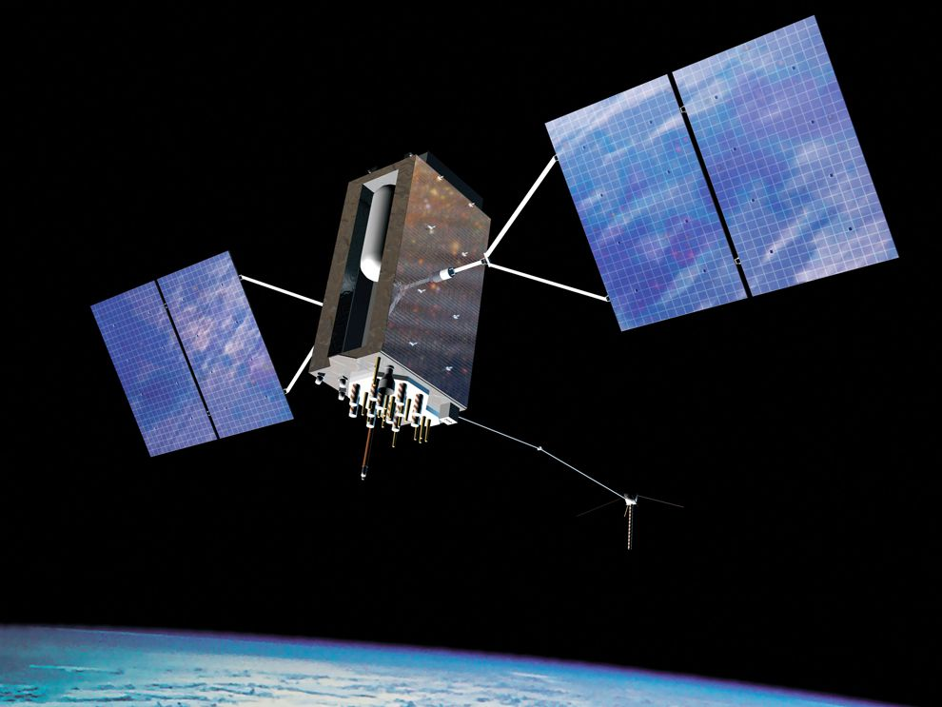
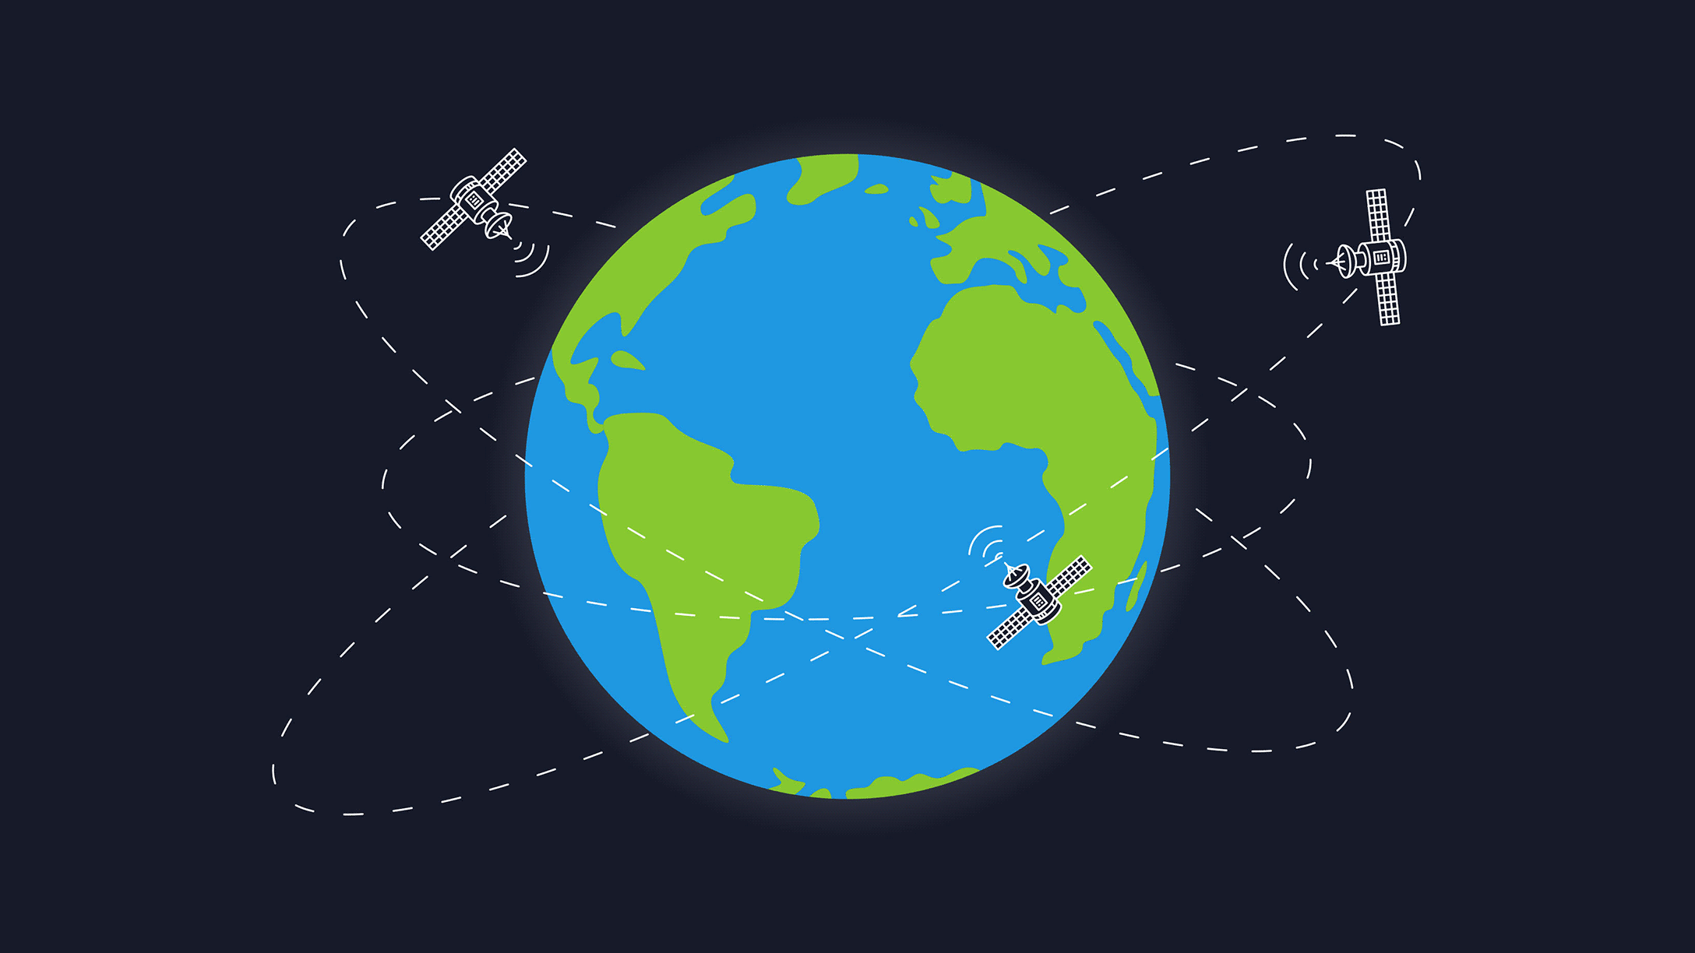
Background knowledge?
How does GPS work anyways?

Slide 7
Background knowledge?
How does GPS work anyways?
Know the position of all satellites
Receive signals from multiple satellites
Determine distance from each satellite
Trilateration

Slide 8
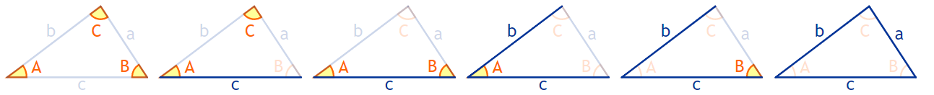
Background: trigonometry
A triangle can be solved by knowing 3 features
Three sides
Two sides and any angle
Two angles and any side
Three angles gets the type of the triangle, but not the size
Need at least one side to determine size

Slide 9
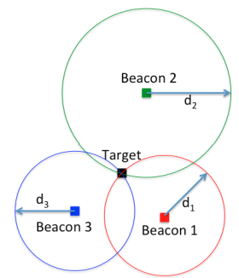
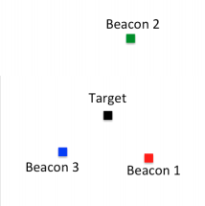
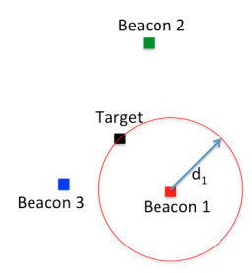
Trilateration
Determine distance from each beacon, then find position
Apply trigonometry to solve triangle with beacons. Requires:
3 lengths (or some angles and lengths…)
Solve two triangles and get 3D position
Most common and accurate localization approach

Slide 10
Determining distance
Making trilateration work requires distance measurements
Techniques
RSSI
Time of Flight
Time Difference of Arrival

Slide 11
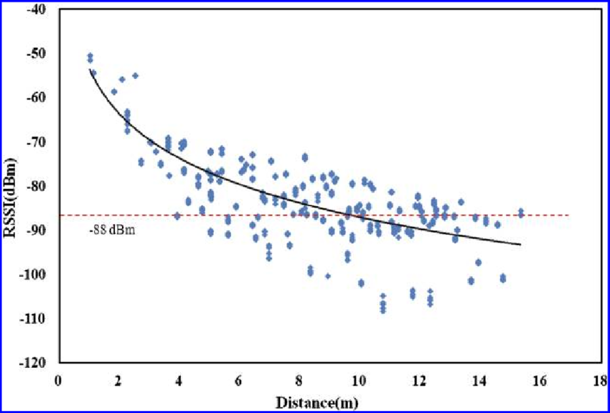
Reminder: problem with RSSI-based distance – not accurate
Pathloss is NOT only due to distance
RSSI is way worse at this than you hope it would be
Citation: literally everyone has made this figure at some point

Slide 12
Time of flight (also known as time of arrival, ToA)
Determine distance by knowing:
Exact position of infrastructure
Transmit time
Receive time
Signal velocity (i.e. speed of light)
One side transmits and the other listens
Device to tower, for instance
Requires time synchronization between infrastructure and device
Synchronization must be very good: 1 μs = 300 meters, 1 ns = 0.3 meters

Slide 13
Time difference of arrival (TDoA)
Device transmits and infrastructure receives transmission
Multiple infrastructure nodes receive at different times based on distance
Can go other direction too with some complications
Determine distance by knowing
Exact position of infrastructure
Time of arrival at two different locations
Signal velocity (i.e. speed of light)
Doesn’t require synchronization with infrastructure!
Still requires synchronization between infrastructure nodes (maybe easier?)
Requires the device to transmit loud enough for infrastructure to hear it

Slide 14
How many anchors are needed?
3 anchors gets a 2D location
Two possible 3D locations are valid
4 anchors gets a 3D location
Shortcut: if the alignment is right, 3 anchors can guess 3D
3 anchors result in two possible points that satisfy equations
One will be on the ground, the other somewhere mid-air or underground

Slide 15
Real-world complication: accuracy
No distance measurement will be perfect
Which means trilateration will not be perfect either
Need to solve equations in a fuzzy manner looking for least error

Slide 16
Outline
Localization Background
GPS
Indoor Localization
Overview
Fingerprinting
Ultra-wideband
Other techniques

Slide 17
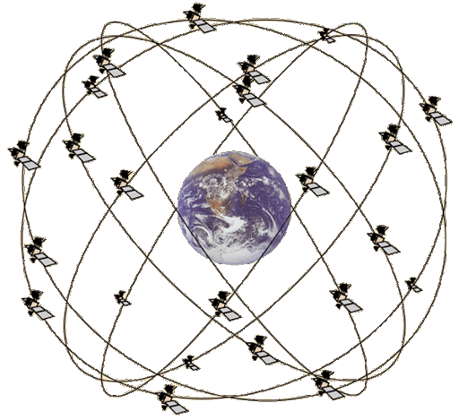
GPS overview
Trilateration using Time of Flight from at least 4 satellites
Satellites in well-known orbits with VERY stable clocks
Satellites placed in Medium Earth Orbit (20,000 KM)
Orbit earth twice per day
Placed such that 4 are in view everywhere, always
31 operational satellites as of April 2026
Most recent launch April 2026
Comparisons
LEO 200-2000 km, ISS at 340 km
GEO 35,000 km

Slide 18
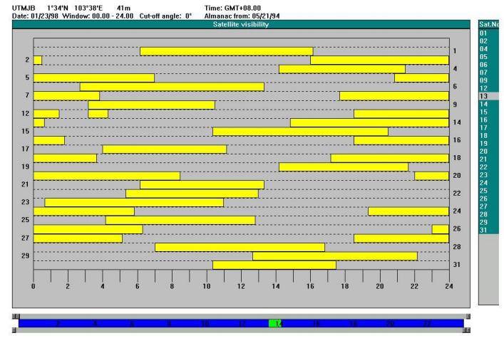
Satellite visibility overhead

Slide 19
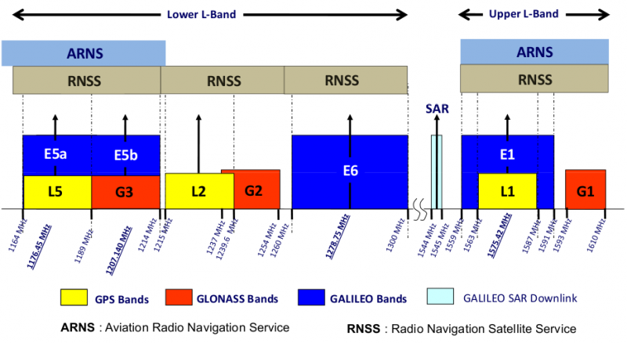
GPS PHY
GPS frequency
1.2 GHz and 1.5 GHz
10-15 MHz bandwidth
BPSK modulation
Signal has to travel 20,000 km, but most of that is through space
Tx power 25 Watts (44 dBm)
Rx sensitivity -140 dBm to -160 dBm (50 bps data rate)
~200 dBm total link budget

Slide 20
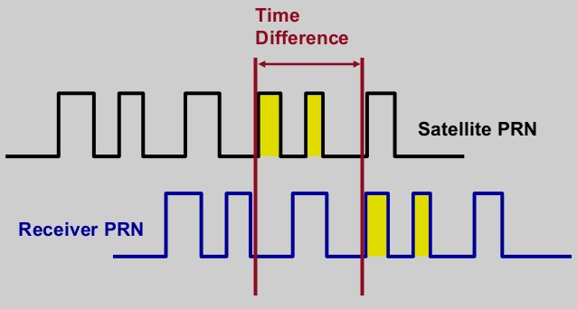
GPS transmissions
Each satellite sends a unique pseudo-random number sequence
Sequence repeats in time (over minutes) and is well-known
Position in signal is used to calculate time of flight (if you know precise time)
Different and manually selected for each satellite
Why pseudo-random?
Spreads tiny data over a wide bandwidth for reliability (same DSSS technique at 802.15.4 and 802.11b)

Slide 21
GPS requires signals from multiple satellites
4 satellites are needed to determine location and time
3 for 2D location (assume on ground) and 1 for time offset
Solve for both as a single equation
Steps to finding location
Initialize time to whatever you heard from a satellite (~100 ms sync)
Get time of arrival from four satellites
Four variables
x, y, z, and time offset

Slide 22
Additional GPS data
Receiver needs to know additional information
Current time
Position of each satellite
GPS transmission has this data layered on top (at 50 bps)
Listening for (up to) 30 seconds gets time and this one satellite’s position
Known as ephemeris
Valid for up to 4 hours
Listening for 12.5 minutes gets all satellites’ positions
Known as almanac
Valid for up to two weeks
Cold-start for an embedded device takes significant time

Slide 23
Break + Question
How would you make a system connect to GPS faster?
Cell phones don’t take 12.5 minutes to get a fix after booting

Slide 24
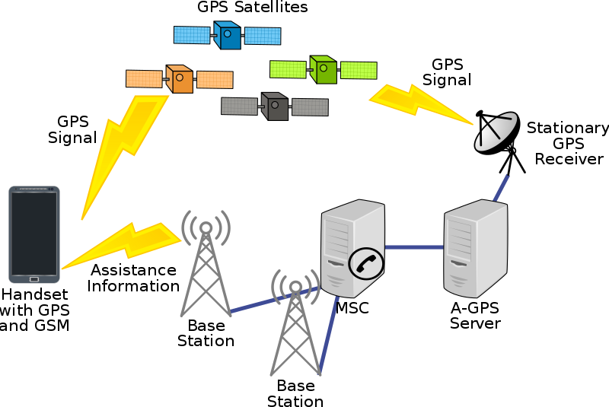
Assisted GPS
How is cell phone GPS so quick?
Download almanac from the internet (only 1.8 kB)
Bootstrap location information
Cell towers can give coarse position
Enables device to know which satellites are overhead

Slide 25
Using GPS in the real-world
Usually connected over a serial connection and send “human-readable” NMEA messages
$GPGGA,210230,3855.4487,N,09446.0071,W,1,07,1.1, 370.5,M,-29.5,M,,*7A

Slide 26
GPS sentence type
Usually connected over a serial connection and send “human-readable” NMEA messages
$GPGGA,210230,3855.4487,N,09446.0071,W,1,07,1.1, 370.5,M,-29.5,M,,*7A
Format of data
GGA = “Global Positioning System Fix Data”
Specifies what the other comma-separated fields will be

Slide 27
Time in a GPS sentence
Usually connected over a serial connection and send “human-readable” NMEA messages
$GPGGA,210230,3855.4487,N,09446.0071,W,1,07,1.1, 370.5,M,-29.5,M,,*7A
Current time in UTC
HHMMSS format

Slide 28
Lat/Lon in a GPS sentence
Usually connected over a serial connection and send “human-readable” NMEA messages
$GPGGA,210230,3855.4487,N,09446.0071,W,1,07,1.1, 370.5,M,-29.5,M,,*7A
Latitude (blue) and Longitude (red)
DDMM.MMMM format (degrees and minutes [60th of a degree])
Warning: normal GPS coordinates are in DDD.DDDDDD format
Need to translate by dividing minutes by 60

Slide 29
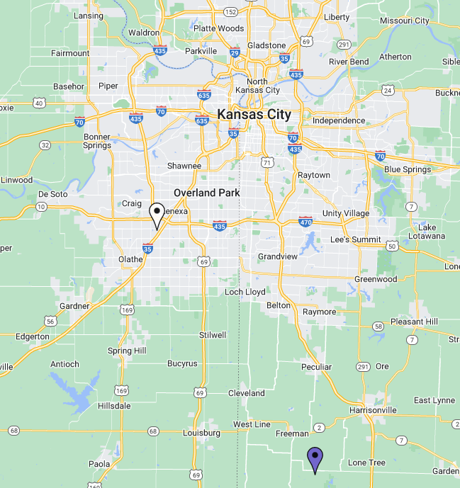
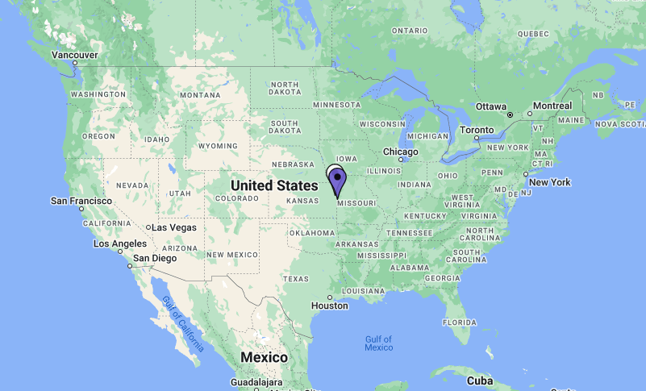
Make sure you use the correct GPS coordinates
38 degrees, 55.4487 minutes N -> 38.924145 degrees
94 degrees, 46.0071 minutes W -> -94.766785 degrees
About 49 km apart

Slide 30
Other GPS “sentence” parameters
Usually connected over a serial connection and send “human-readable” NMEA messages
$GPGGA,210230,3855.4487,N,09446.0071,W,1,07,1.1, 370.5,M,-29.5,M,,*7A
Number of Satellites seen (red)
Altitude in meters (blue)
More satellites can give you true 3D positioning

Slide 31
Original GPS had a built-in accuracy limitation
Selective Availability
Pseudorandom adjustment to the signals to reduce accuracy
Could be recovered if you know the specific pseudorandom key
Public use (no key)
50 m accuracy horizontally
100 m accuracy vertically
Original GPS was intended for military only
With limited GPS for everyone else (i.e., other nations)
In 2000, was removed from GPS, leading to about 5 m accuracy

Slide 32
Other positioning system implementations
Global Navigation Satellite System (GNSS)
Formal name for a global localization system
US: GPS
Russia: GLONASS
China: BeiDou
EU: Galileo
India and Japan have regional systems
Lunar system in design!
Modern GNSS hardware can use multiple at once for better accuracy
Some systems have additional features
Search and rescue support
Messaging
Anti-spoofing technology

Slide 33
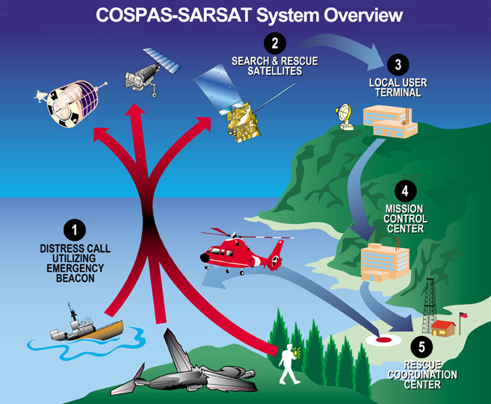
Search and Rescue Functionality
406 MHz band reserved for rescue beacons
100 kHz bandwidth
Galileo, GLONASS, GPS, and BeiDou support
Plus some other satellites
Galileo can also send custom respond messages
“Return Link Service”

Slide 34
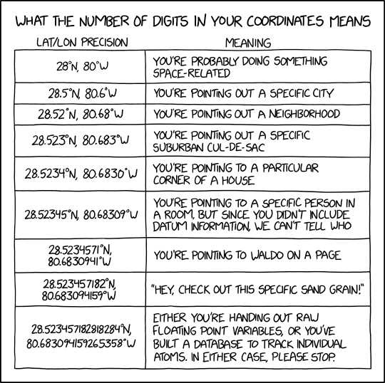
Break + xkcd
https://xkcd.com/2170/

Slide 35
Outline
Localization Background
GPS
Indoor Localization
Overview
Fingerprinting
Ultra-wideband
Other techniques

Slide 36
Clearing something up
The goal is NOT directing people through a building
Just because that’s what GPS is used for outdoors doesn’t mean we need that application indoors

Slide 37
Goal of indoor localization
The goal is positioning things within a building
Where can I find object X?
X: where am I located?
X and Y: are we near each other?
Robotic navigation is also important
Although there are many approaches here

Slide 38
Localization classes
Absolute location
X, Y, Z position based on already known infrastructure locations
Like GPS does
Installed localization hardware known as anchors
Relative location
Position relative to some other device
Technically absolute location is a version of this
Might only need a few devices
How far is the smartphone from the computer?

Slide 39
Localization knowledge
What kind of a result is actually useful?
You are at {15, 27.5, 1}
You are in Room 224
Depends on the application
Additional systems on top of the localization method can translate between location representations

Slide 40
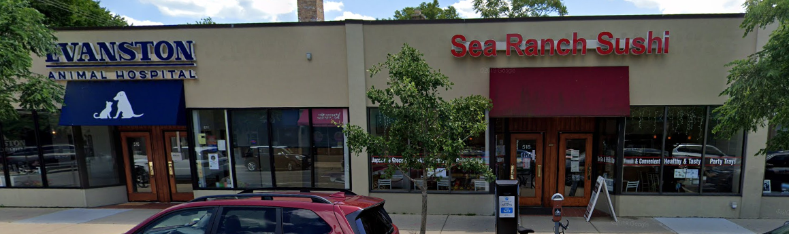
Barrier problem
“I’m here to pick up fish”
Walls are very contextually important, but difficult for many localization systems to detect

Slide 41
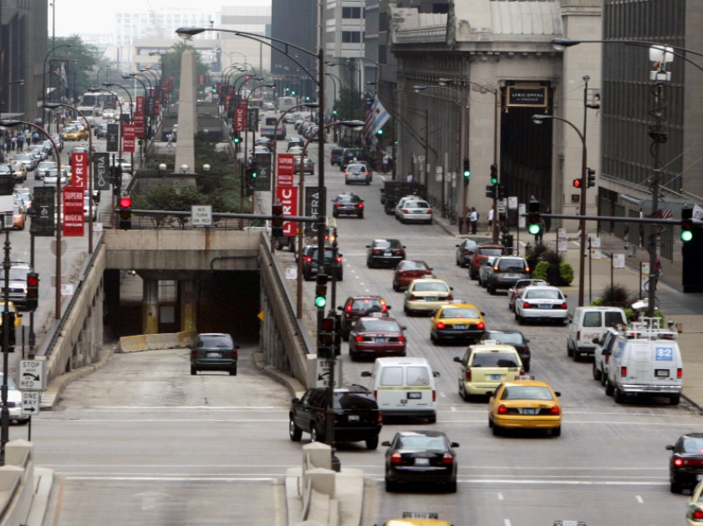
GPS version of barrier problem: overlapping roads
GPS can’t always tell which road you’re on if multiple overlap
And you might not get GPS at all in a tunnel
Chicago example: Wacker Drive
Upper for local traffic
Lower for express route

Slide 42
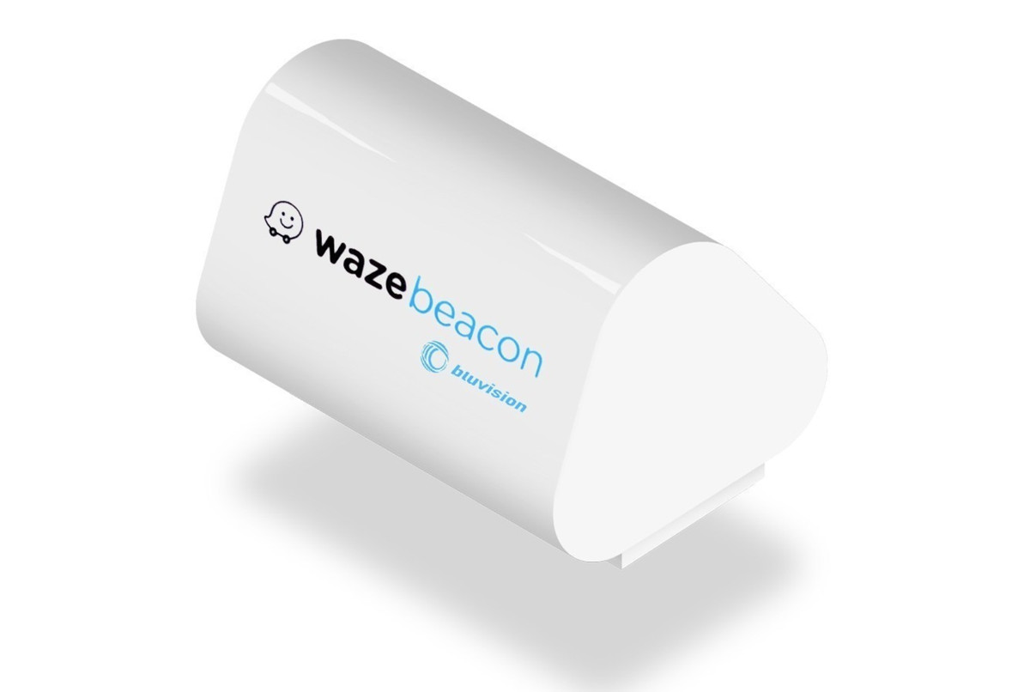
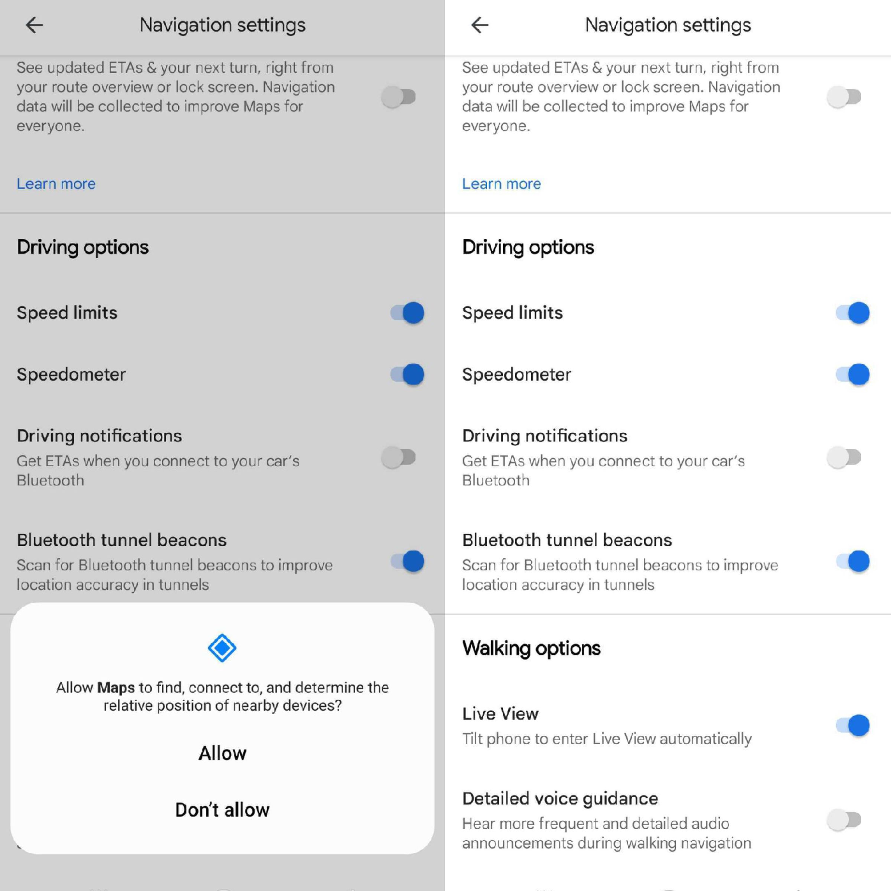
GPS barrier solution
Add BLE beacons
Short range such that they can only be detected if you’re actually on the road near them
Navigation apps can use BLE beacons to determine your real location
Google Maps added the feature in early 2024
It was off on my phone, go into Settings and then “Navigation Settings” to enable it.
Was deployed in Chicago
Seems that the batteries have died…
https://chicago.curbed.com/2018/9/7/17786634/waze-beacons-wacker-drive-chicago-signal
https://www.theverge.com/2024/1/16/24039896/google-maps-android-tunnels-bluetooth-beacons

Slide 43
Accuracy notation
“40 cm median accuracy”
Majority of measurements are within 40 cm of reality!
What about the other half?
90th percentile error is often more important for real-world use
My least favorite aspect of localization
Be wise to these tricks

Slide 44
Outline
Localization Background
GPS
Indoor Localization
Overview
Fingerprinting
Ultra-wideband
Other techniques

Slide 45
Mapping existing infrastructure
Can we repurpose existing infrastructure for localization?
For example: WiFi access points
Benefit: localization works with unmodified hardware
Mapping instead of trilateration
Make a map of infrastructure and use that to locate device
Coarse example: existence of WiFi network SSIDs
Fine-grained example: signal strength to each Access Point
Known as fingerprinting

Slide 46
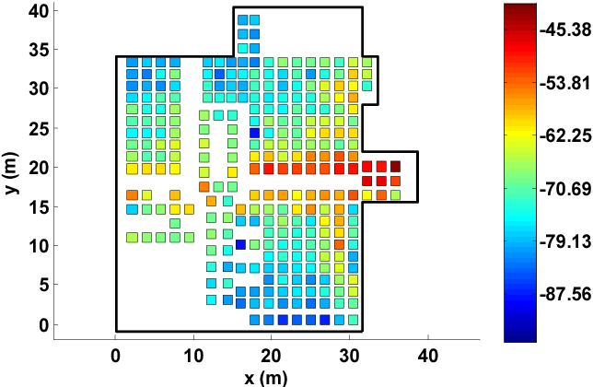
Fingerprinting overview
At setup time, for many locations throughout building
Measure signal strength to Access Point
Record measurement in a database with location
At run time, for the device that wants a location
Measure signal strength to Access Point
Look up measurement in database to get location

Slide 47
Fingerprinting improvements
Measurements can use several Access Points simultaneously
Improves accuracy quite a bit
Doesn’t have to be WiFi based at all
Cellular networks can do fingerprinting
Deploy your own BLE beacons throughout environment
Apply techniques for minimizing error in signal strength
Measurement won’t match record exactly
But minimizing error should approach the same location

Slide 48
Fingerprinting challenges
Effort to create database in the first place
Manually take measurements at every location
Environment is not stable
Signal strength changes as chairs, doors, and people move
Need ability to periodically re-measure
Update database with most recent recording while in use
Measurements vary between devices
Differ based on antennas, cases, how you hold it, etc.

Slide 49
Fingerprinting accuracy
State-of-the-art: median accuracy of 0.5-1.5 meters
Not bad depending on the application!
Likely places you in the right room, or at least nearby
Long tail can be large, but more access points helps this
Barrier problem capability depends on walls
Some materials attenuate signal strength more than others

Slide 50
Break + Open Question
WiFi is only one example of a signal you could fingerprint. What else could you use?

Slide 51
Outline
Localization Background
GPS
Indoor Localization
Overview
Fingerprinting
Ultra-wideband
Other techniques

Slide 52
Improving accuracy
To get really good accuracy, let’s return to trilateration
Plan: Send an RF signal from one device and time how long it takes to reach another
Brief transmissions rather than continuous like GPS
Problem: When does this signal arrive?
Need to pick somewhere in rise as the “arrival time”

Slide 53
Multipath problem
Real-world signals bounce off of things in the environment
Multiple, time-delayed versions of signal arrive at antenna
Result smears out the arrival of energy in time
More reflections mean more peak energy, but longer rise time
This isn’t predictable. Depends on the exact environment configuration

Slide 54
Why does ultra-wideband yield better localization performance?
Wider bandwidth makes the RF pulse narrower in time
Make it narrow enough, and multipath becomes entirely separate

Slide 55
Ultra-wideband localization system
Narrow ultra-wideband pulses makes arrival timing work
The rest is a copy of well-known techniques
Deploy anchors in the environment with known positions
Measure distance between anchors and device
Time of Flight (if anchors transmit)
Time Difference of Arrival (if devices transmit)
Trilateration to find position

Slide 56
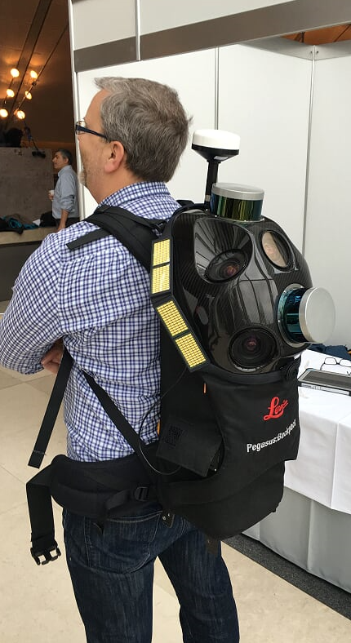
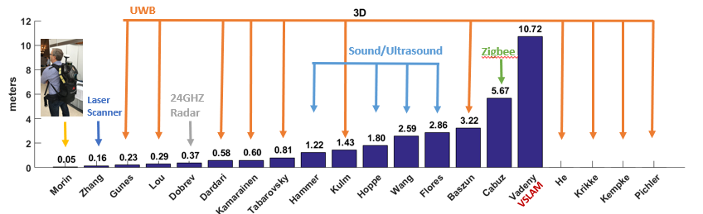
Localization state-of-the art
Microsoft indoor localization competition, 2016
Teams are given a day to measure and deploy their systems in a space
Provide {x, y, z} coordinates using up to 5 anchors in large open room

Slide 57
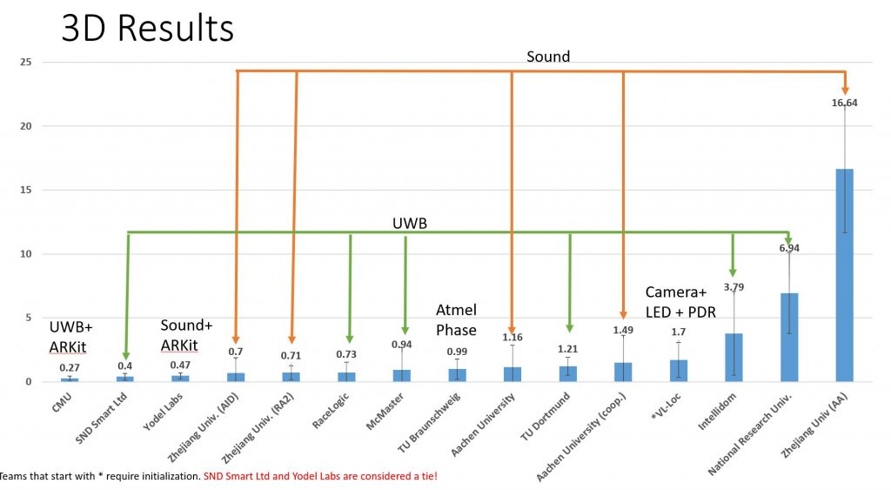
2019 results (Microsoft indoor localization competition)

Slide 58
Improvements to ultra-wideband
Improve results with multiple, diverse measurements
Sources of diversity
Send on multiple channels
Send with multiple antennas
Receive with multiple antennas
Measure each combination of these and average to get better results
Combine with backscatter approaches
Result is very slow (minutes to locate device) but very low power (<1μW)
Most inventory doesn’t move!

Slide 59
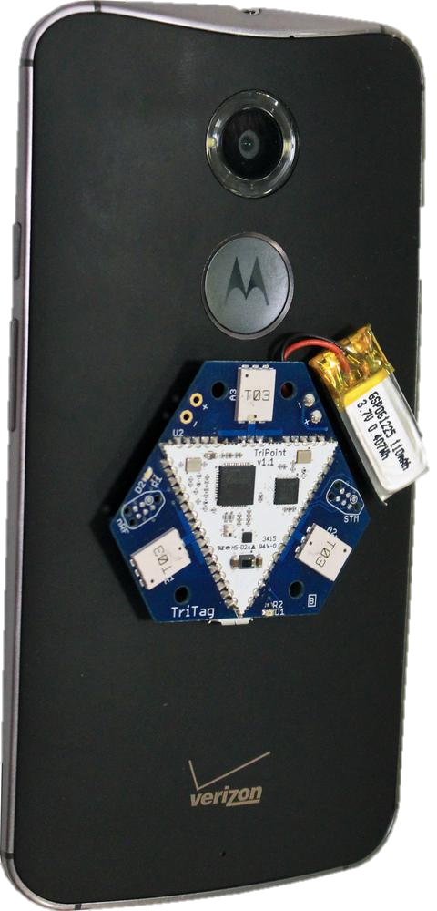
Bringing UWB to the real world
Ultra-wideband radios were previously specialized
Needed to build special hardware to use them
Modern smartphones are now including UWB radios!!!
Apple, Google, Samsung, and others
Opens a big area of development
Ranging capabilities and possibly communication

Slide 60
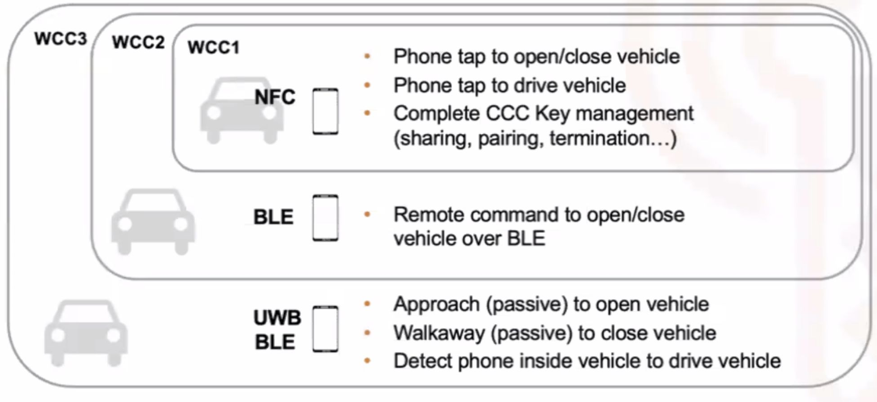
UWB applications
Asset tracking
“Find My” and new smart tags
Digital car key
Apps already exist for this on Android and iOS
Typically communication over BLE plus ranging over UWB
Similarly home IoT locks and hotel keycards
https://www.theverge.com/23970875/digital-car-key-iphone-unlock-start-ccc-standard

Slide 61
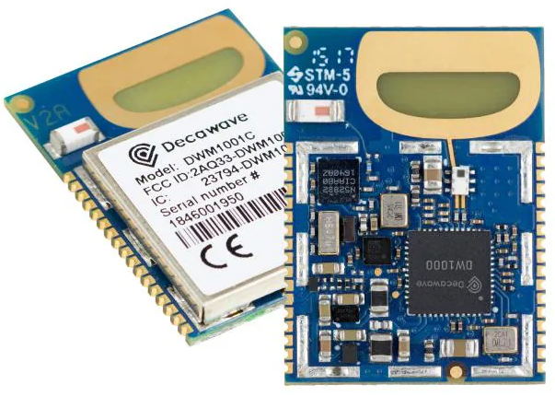
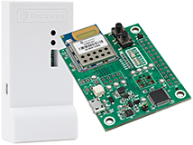
UWB IoT capabilities
Decawave was a company that made UWB radios
Decawave bought by Qorvo
Develops UWB radio chips and modules
UWB module: $45 (at quantity one)

Slide 62
Outline
Localization Background
GPS
Indoor Localization
Overview
Fingerprinting
Ultra-wideband
Other techniques

Slide 63
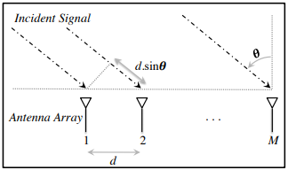
Angle of arrival (AoA)
Trilateration doesn’t only require distances, angles work
Although you still need at least one distance to form triangle
Antenna arrays can be used to determine the angle of an incoming signal
Allows the use of normal RF communication (WiFi or BLE)
BLE 5.1 includes AoA localization

Slide 64
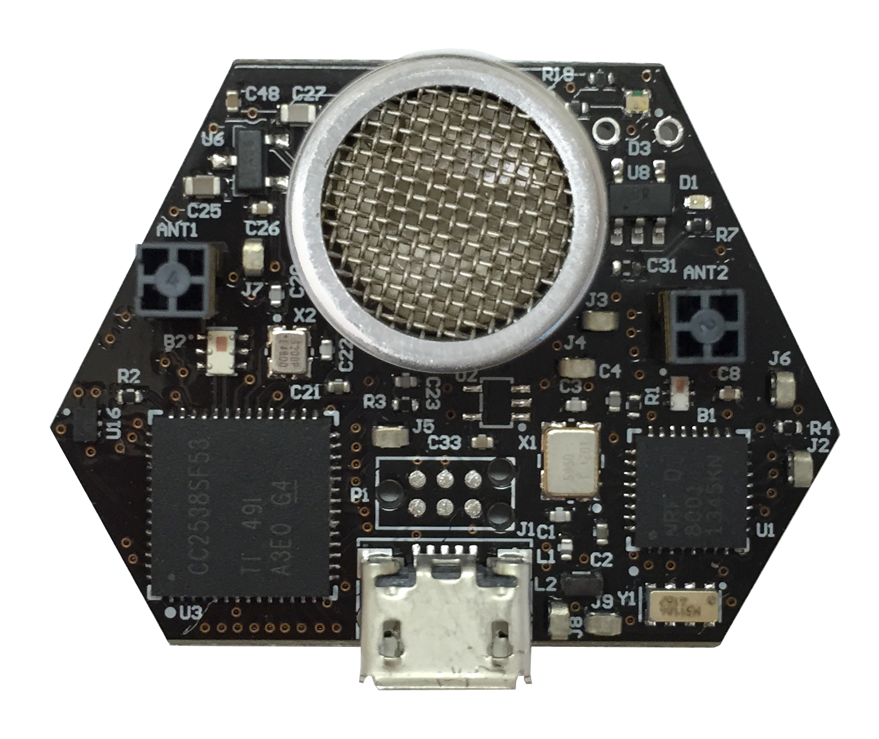
Ultrasound
Advantages
Solves the barrier problem
Human spaces already designed to contain sound
Easier to get high-accuracy results
Sound is ~1,000,000x slower than light
Less synchronization is needed to get same accuracy
Disadvantages
More energy to transmit
Slower update rate (still sub-second)
Limited range
Pets can hear it…

Slide 65
Inertial navigation
If you know acceleration, you can get position, just integrate!
With quite a bit of error
Accurate over short distances with filtering approaches
Can be used to augment other systems
Get a fix every few seconds from localization system
Use inertial navigation to interpolate between measurements
IMUs (Inertial Measurement Units) available in all smartphones
Accelerometer, Gyroscope, Magnetometer

Slide 66
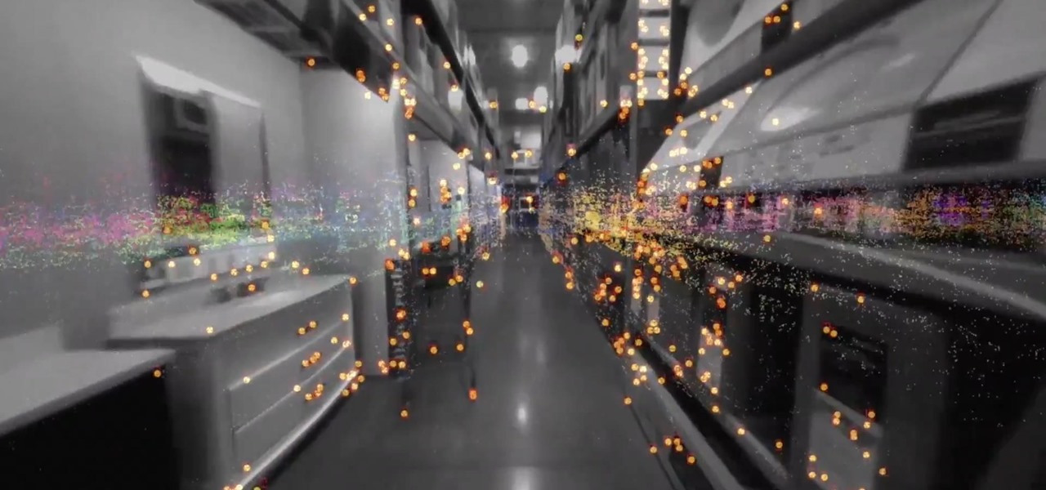
ARKit (and other AR techniques)
Leverage smartphone cameras for positioning
Pictures of a user’s surroundings can be compared to floorplan
Related to SLAM techniques (Simultaneous Localization And Mapping)
Can build an incredibly accurate system
With a bit of bootstrapping
Probably applies most to robotics use cases

Slide 67
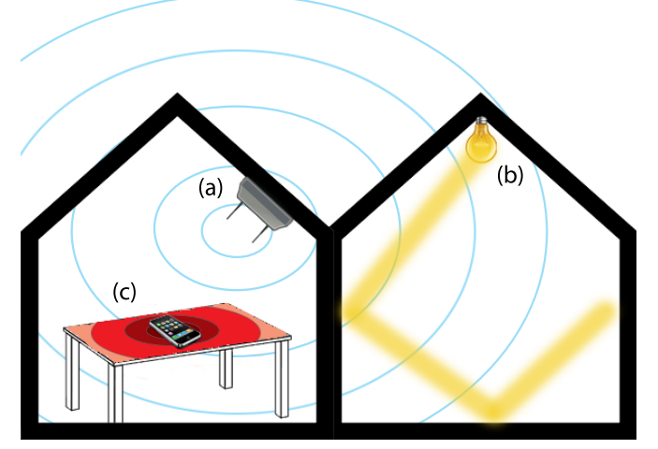
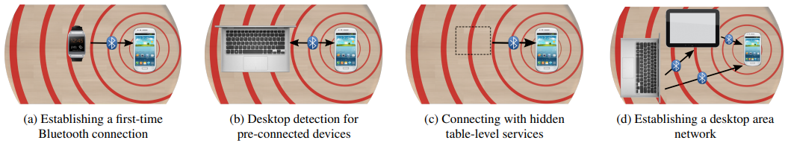
Vibrations
Determine shared context of a table
Vibratory motors and IMUs are common
Signaling demonstrates nearby devices

Slide 68
Outline
Localization Background
GPS
Indoor Localization
Overview
Fingerprinting
Ultra-wideband
Other techniques

