Slide 1
Lecture 17 Satellite Communication
CS433 – Wireless Protocols for IoT
Branden Ghena – Spring 2026
Materials in collaboration with Pat Pannuto (UCSD) and Brad Campbell (UVA)

Slide 2
Administrivia
Hw: Cellular
Due tonight (can use slip days if necessary)
Need to fill out Spreadsheet AND submit on Gradescope
Return hardware
When you’re done with the lab, I need your hardware back
Options:
Give it to me before or after lecture
Leave it with me or the PMs at office hours
Return it to my office (Tech L368)

Slide 3
Today’s Goals
Understand the capabilities and restrictions of satellite communication
Explore real-world satellite communication
Discuss directions for cellular-to-satellite communication

Slide 4
Outline
Overview
Satellite Communication
Voyager
Satellite Communications Providers
Cellular-to-Satellite Communication

Slide 5
Why use satellite communication?
True global connectivity
Cellular is dependent on someone actually building a cell tower near the area you want to communicate in
Remote areas are out-of-luck (mountain, forest, ocean)
Satellites act as moving cell towers
With enough of them, you could cover the globe

Slide 6
Satellite communication challenges
Distances involved
Path loss
Latency
Large deployment areas
Shared bandwidth
Handoffs
Deployment considerations
Cost
Coordination
Ignoring the difficulty of making the satellite itself

Slide 7
Satellite communication challenges
Distances involved
Path loss
Latency
Large deployment areas
Shared bandwidth
Handoffs
Deployment considerations
Cost
Coordination
Ignoring the difficulty of making the satellite itself

Slide 8
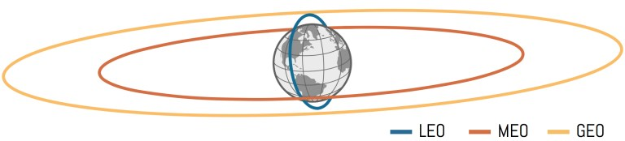
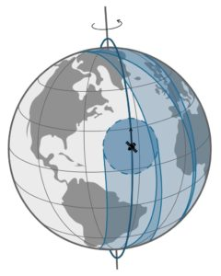
Satellite orbits - LEO
Low Earth Orbit (LEO)
160-2000 km
Includes most current human spaceflight (ISS at 400 km)
Roughly 90 minutes per complete orbit of Earth
Polar orbit will eventually cover all of Earth
Group of satellites (constellation) can cover all of earth simultaneously if using enough satellites
https://aerospace.csis.org/aerospace101/earth-orbit-101/

Slide 9
Satellite orbits
Geostationary Orbit (GEO) (a.k.a. geosynchronous orbit)
35768 km
Exactly 24 hours per complete orbit
Result: fixed location in the sky over a position on Earth
All of Earth can be covered with only a few satellites
Or an operator can choose to only service a specific region
https://aerospace.csis.org/aerospace101/earth-orbit-101/

Slide 10
Satellite orbits
Medium-Earth Orbit (MEO)
Between LEO and GEO
Roughly 12 hours per complete orbit
GNSS satellites (GPS, Galileo, etc.) are here
Smaller constellation and longer lifetime than LEO orbit
Radiation belts make this area more difficult to use
https://aerospace.csis.org/aerospace101/earth-orbit-101/

Slide 11
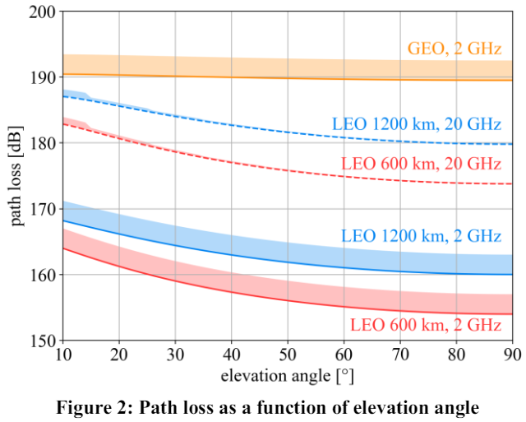
Path loss to orbit
Distance contributes significantly to signal strength loss. Frequency can hurt too
Increased frequency leads to smaller antenna leads to less energy collected leads to weaker signal (somewhat)
Being at an angle on the horizon increases the total distance and the path loss
https://arxiv.org/pdf/2103.09156

Slide 12
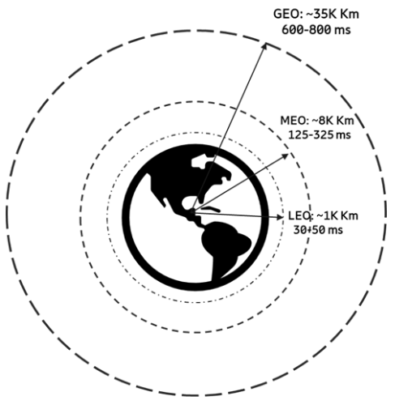
Latency to orbit
Even at speed of light, orbit distances contribute to communication delay
3GPP figures shown here include round-trip-time AND real-world delays through network
https://www.5gamericas.org/wp-content/uploads/2022/01/5G-Non-Terrestrial-Networks-2022-WP-Id.pdf

Slide 13
Satellite communication challenges
Distances involved
Path loss
Latency
Large deployment areas
Shared bandwidth
Handoffs
Deployment considerations
Cost
Coordination
Ignoring the difficulty of making the satellite itself

Slide 14
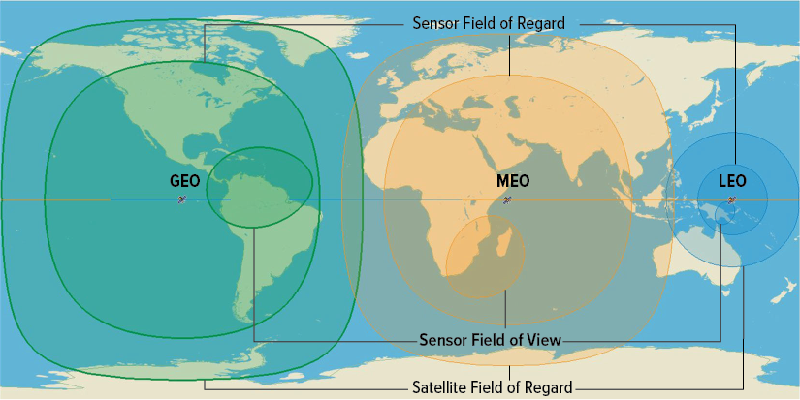
A single satellite provides considerable deployment area
Coverage areas can get VERY wide here
Biggest: all possible line-of-sight to satellite
Middle: limited to ≥20º above horizon
Smallest: example image sensing region

Slide 15
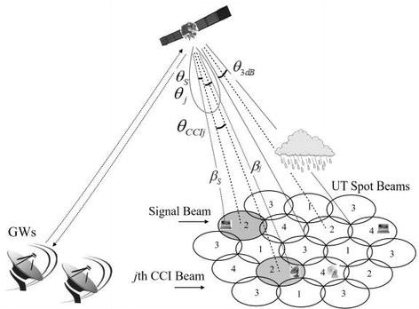
Huge coverage areas share bandwidth among many users
Same problem as LPWANs: data throughput is shared across entire coverage area
Cellular solution can apply here
Reduce coverage area and provide overlapping cells of coverage
One satellite could support many cells
Limitations:
Needs many channels to support cells
Backhaul to downstation needs enough throughput for sum of all cells

Slide 16
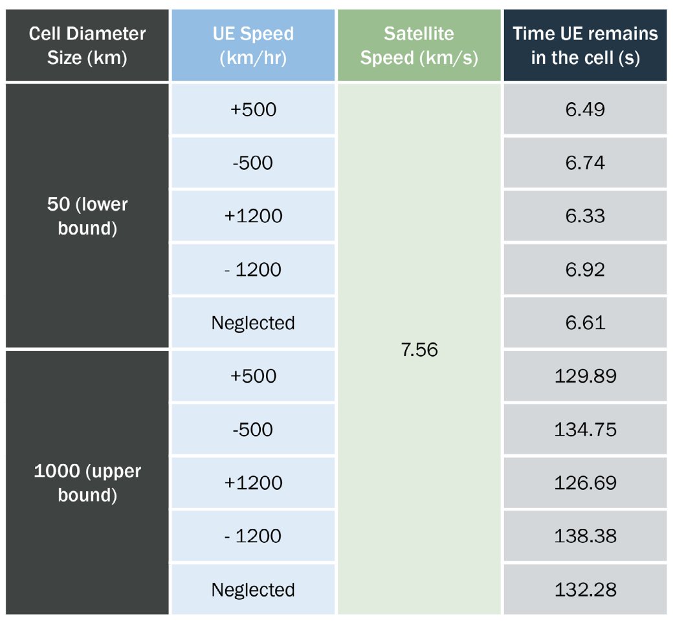
Moving satellites lead to many handoffs
In LEO, satellites are moving around 7 km/s (25,000 km/h)
Comparatively, mobility of the user equipment is irrelevant
Depending on cell size, the device might leave the cell within seconds
Smaller cells exacerbate this problem

Slide 17
Satellite communication challenges
Distances involved
Path loss
Latency
Large deployment areas
Shared bandwidth
Handoffs
Deployment considerations
Cost
Coordination
Ignoring the difficulty of making the satellite itself

Slide 18
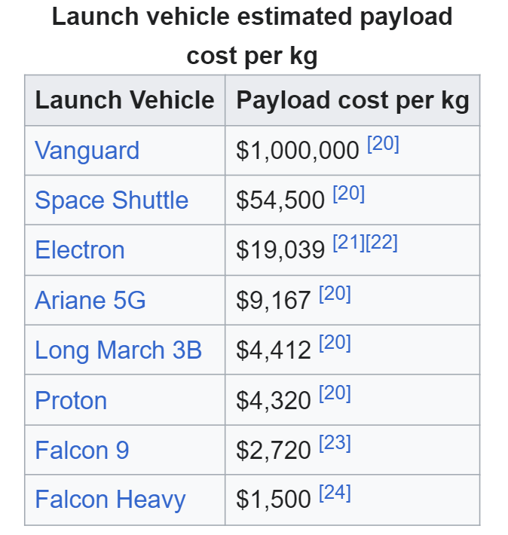
Getting hardware in orbit isn’t cheap
Costs have dropped significantly in recent years, but are still $1000 per kg
Satellite total mass for reference:
Starlink v1.0: 260 kg
Starlink v2.0: 1250 kg
GPS: 1000-2000 kg

Slide 19
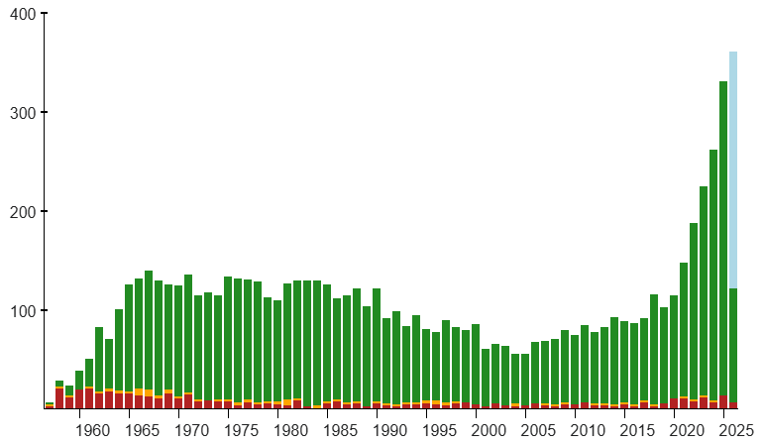
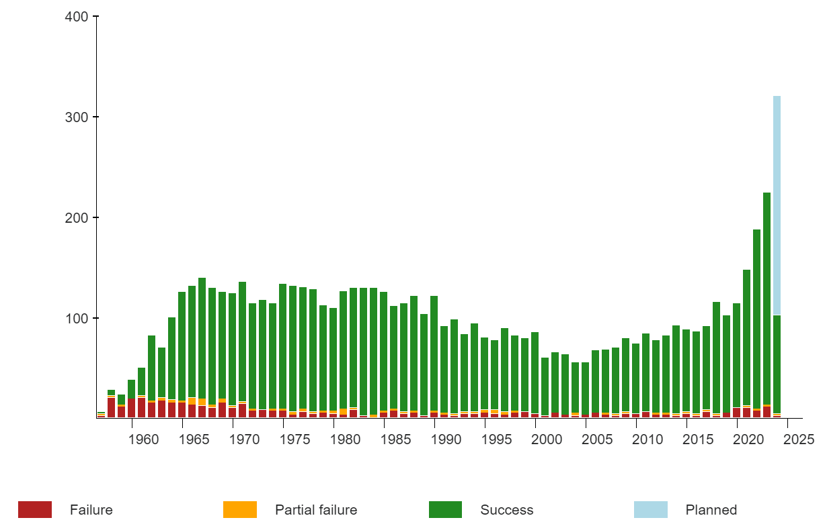
Actually finding a rocket to launch with has become easier
SpaceX (and other commercial rockets) have led a recent renaissance in number of rocket launches per year
SpaceX alone responsible for 87% of all mass sent to space in 2023
2019: 104 launches
2025: 330 launches
2026: 350+ planned
This availability is generating new interest in satellite communications
https://en.wikipedia.org/wiki/Timeline_of_spaceflight#Orbital_launches_by_year

Slide 20

Frequency allocations often must be world-wide
GEO satellites can focus on a region and provide a channel for that region
LEO constellations aiming for world-wide coverage must have a world-wide frequency allocation
International Telecommunication Union (ITU) helps coordinate frequency allocations
UN agency

Slide 21
Break + Question
What do you do if a country doesn’t agree to let your satellite transmit on a certain frequency?

Slide 22
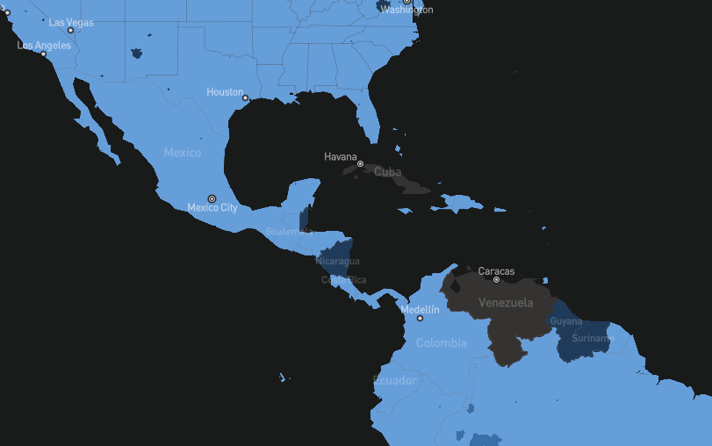
Break + Question
What do you do if a country doesn’t agree to let your satellite transmit on a certain frequency?
Blackout over specific regions
Satellites must already know their own locations to high accuracy, so this is possible

Slide 23
Outline
Overview
Satellite Communication
Voyager
Satellite Communications Providers
Cellular-to-Satellite Communication

Slide 24
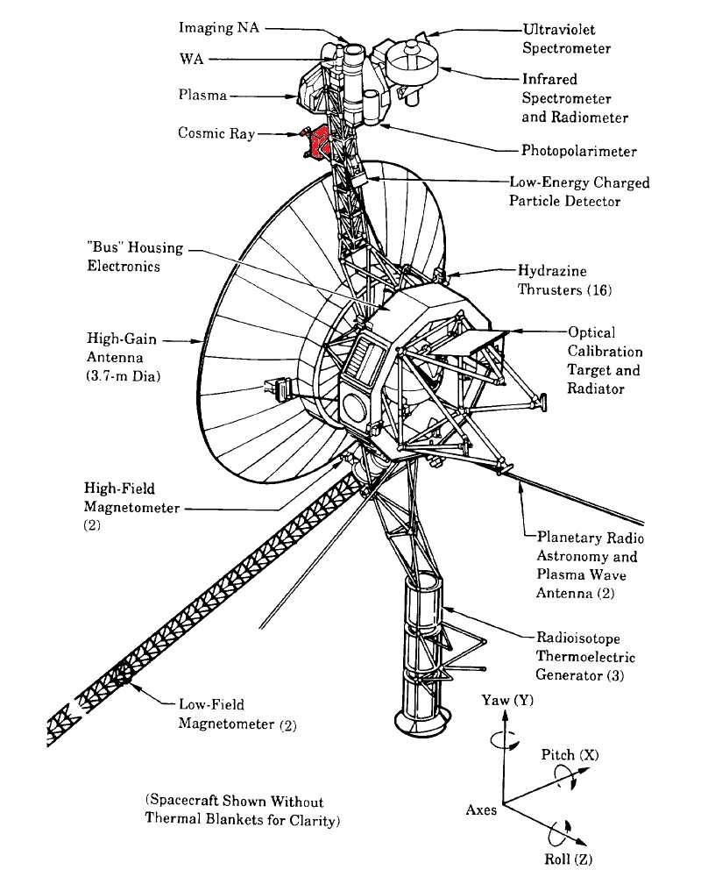
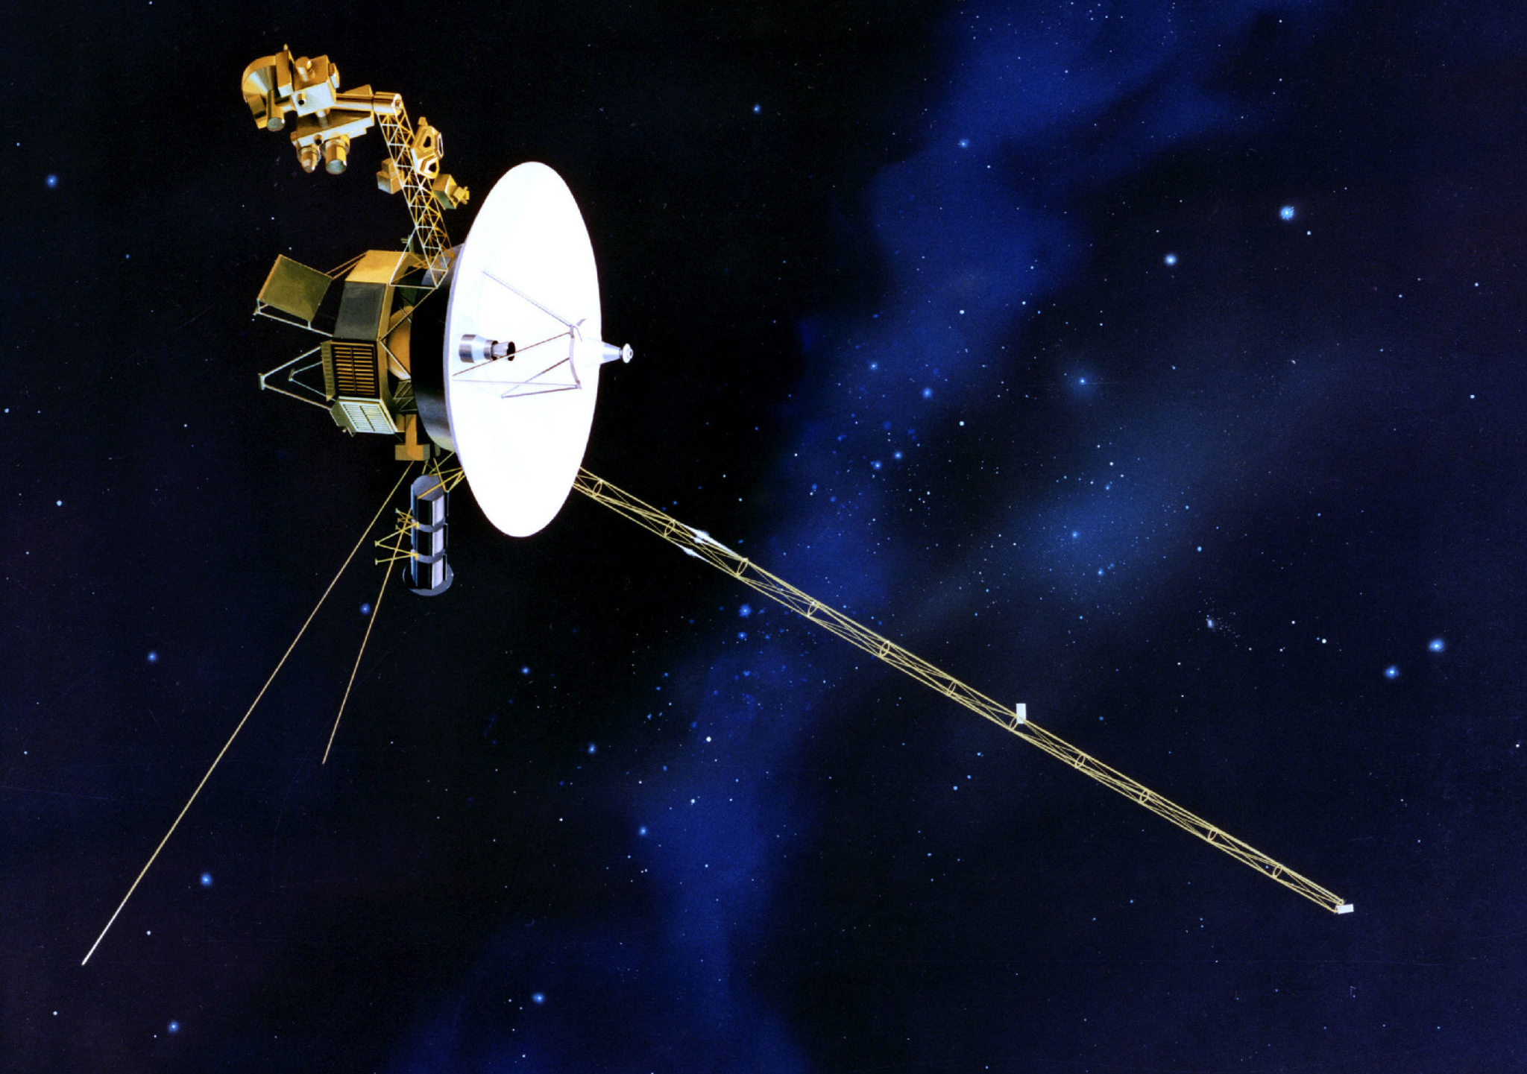
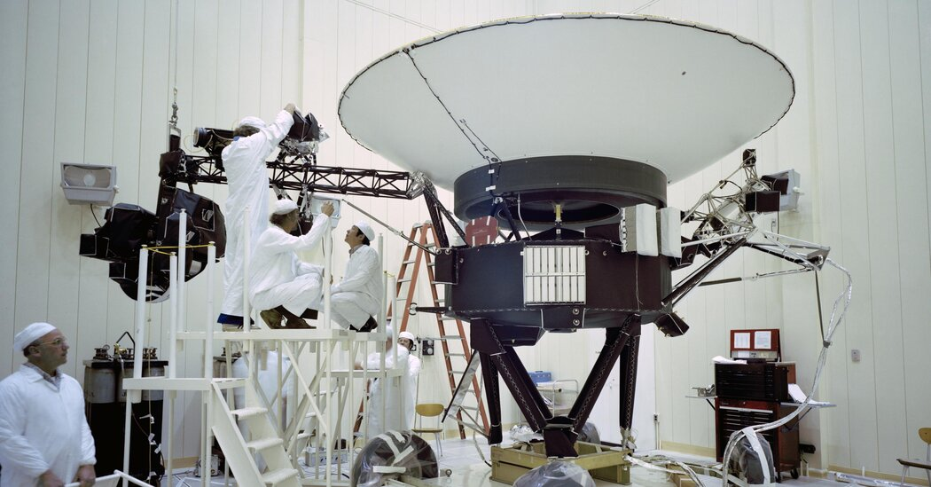
Voyager 1 and 2 (1977)
Boom arm is 43 feet

Slide 25
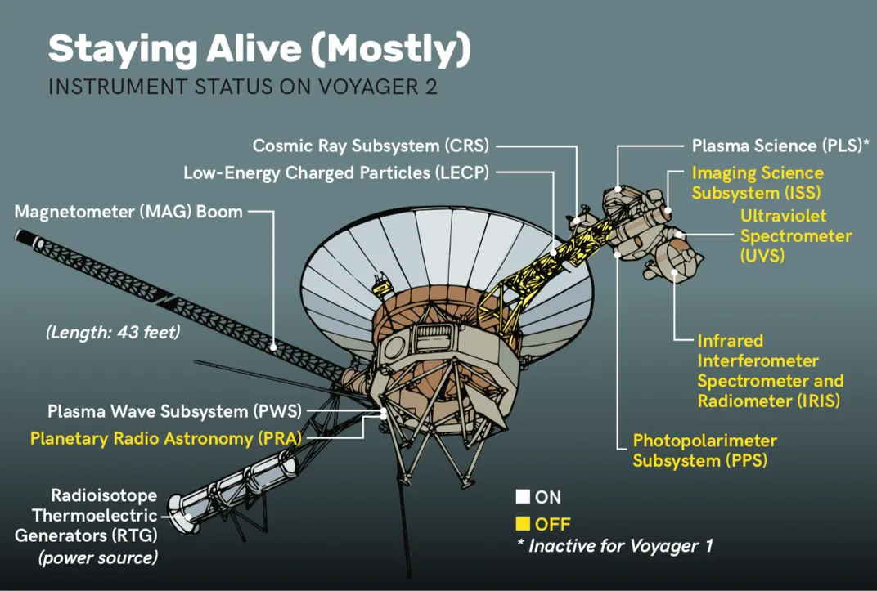
Voyager still functional
Voyager 2
Jupiter: 1979
Saturn: 1981
Uranus: 1985
Neptune: 1989
Edge of solar system: 2018
Still sending data!
So is Voyager 1

Slide 26
Voyager still (mostly) functional
Voyager 2
Jupiter: 1979
Saturn: 1981
Uranus: 1985
Neptune: 1989
Edge of solar system: 2018
Still sending data!
So is Voyager 1
CRS: Planned decommission in 2026

Slide 27
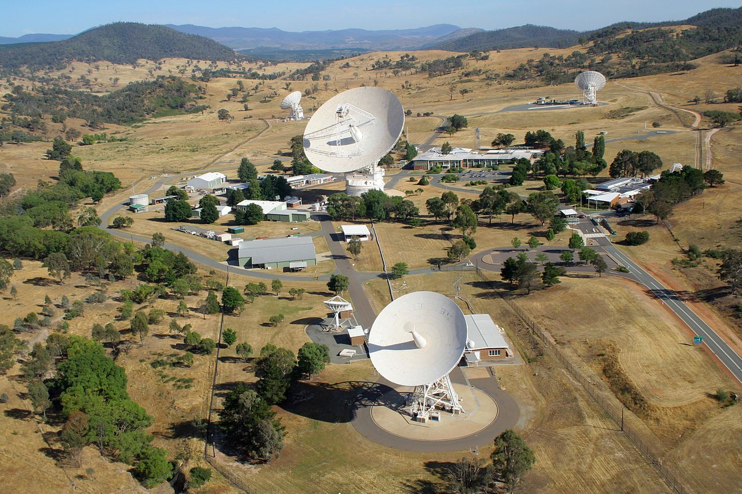
How do we communicate with satellites so far away?
Deep Space Network Canberra complex
Three of these: Goldstone, CA, USA
Madrid, Spain
Canberra, Australia

Slide 28
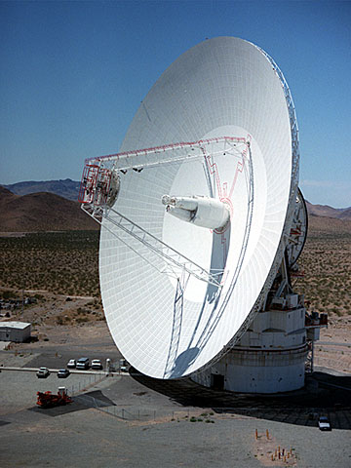
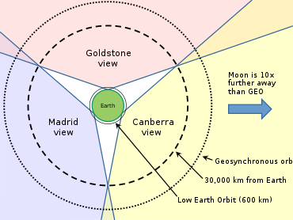
Deep Space Network
Receives data from NASA deep space missions
70-meter antenna (~70 dB gain)
Array of four 34-meter antennas

Slide 29
Voyager 2 path loss calculation
Frequency: 8.415 GHz communication (100 kHz bandwidth)
Distance: 21,300,000,000 km (May 2026)
Free Space Path Loss: 317.5 dB Voyager 1 is further out: 319 dB of Path Loss
In 2002, FSPL was 308 dB (see source below)
So ~10 dB loss per 25 years
https://descanso.jpl.nasa.gov/DPSummary/Descanso4--Voyager_ed.pdf

Slide 30
Other factors
Voyager 2 Transmit:
Transmission power: 41 dBm (12 Watts)
Antenna gain: 48 dB
DSN Receiver:
Antenna gain: 74 dB
Other factors:
Pointing error: -0.3 dB
Atmospheric loss: -0.04 dB
Polarization loss: -0.08 dB
https://descanso.jpl.nasa.gov/DPSummary/Descanso4--Voyager_ed.pdf

Slide 31
Total received power from Voyager
Received power: 41 + 48 + 74 - ~1 -317.5 = -155.5 dBm
Compare to minimum receive sensitivity for IoT protocols:
-95 dBm for BLE
-119 dBm for LoRa
-141 dBm for NB-IoT
Voyager transmits at 160 bps
https://descanso.jpl.nasa.gov/DPSummary/Descanso4--Voyager_ed.pdf

Slide 32
Voyager uplink math
Biggest difference: transmission power 72.55 dBm (18 kW)
Antennas and frequency are slightly different too
DSN 62 dB gain, Voyager 34.6 dB gain
FSPL (at 2.113 GHz): 305.5 dB
Received power: 72.55 + 62 + 34.6 - ~1 -305.5 = -137.5 dBm
Almost 20 dB better than downlink
https://descanso.jpl.nasa.gov/DPSummary/Descanso4--Voyager_ed.pdf

Slide 33
Outline
Overview
Satellite Communication
Voyager
Satellite Communications Providers
Cellular-to-Satellite Communication

Slide 34
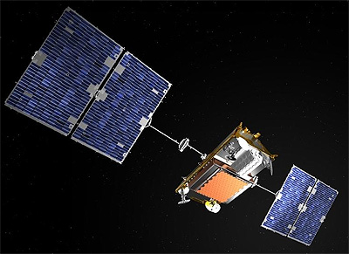
Iridium Constellation
Active since 1997
82 active satellites in LEO for global coverage
Each green dot is a satellite
Yellow is coverage
Red is overlapping coverage

Slide 35
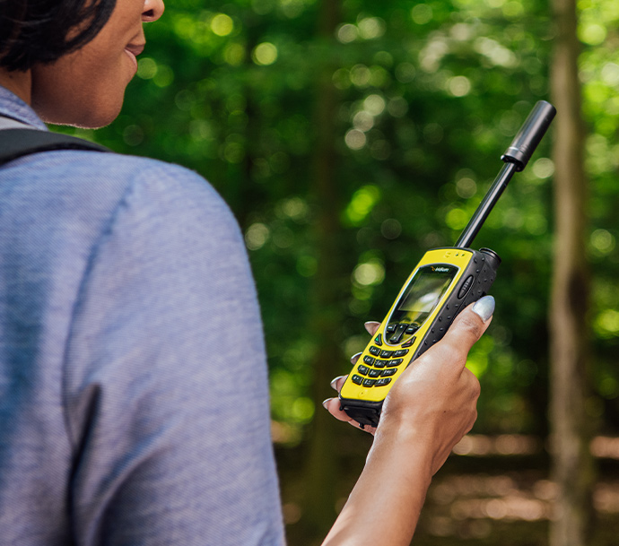
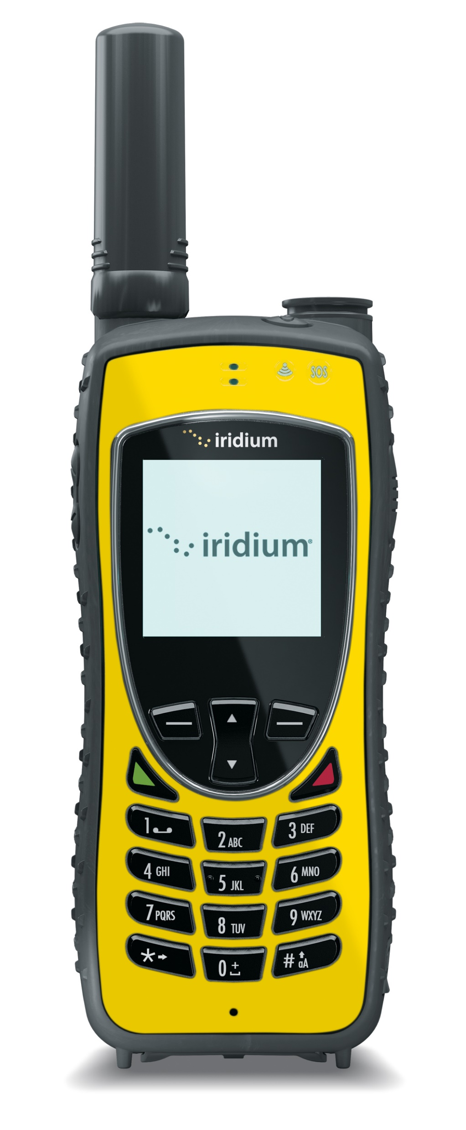
Iridium satellite phones
Initially marketed as general consumer phones
Total failure leading to bankruptcy
Modern focus: highly reliable global niche
Journalists, explorers, military
SMS and Voice service
Up to 4 hours of talk time
Costs
$1800 for phone
Roughly $1 per minute for global voice coverage
$400 gets you 3000 text messages

Slide 36
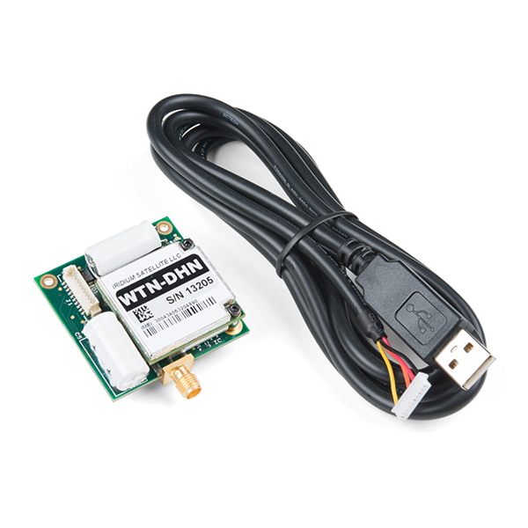
Using Iridium from a device
RockBLOCK radio module
$300
5V at 500 mA (max)
Comparable to cellular modems
Communication
340 byte uplink packets
270 byte downlink packets
$15 per month active plus ~$0.003 per byte
https://www.sparkfun.com/products/14498

Slide 37

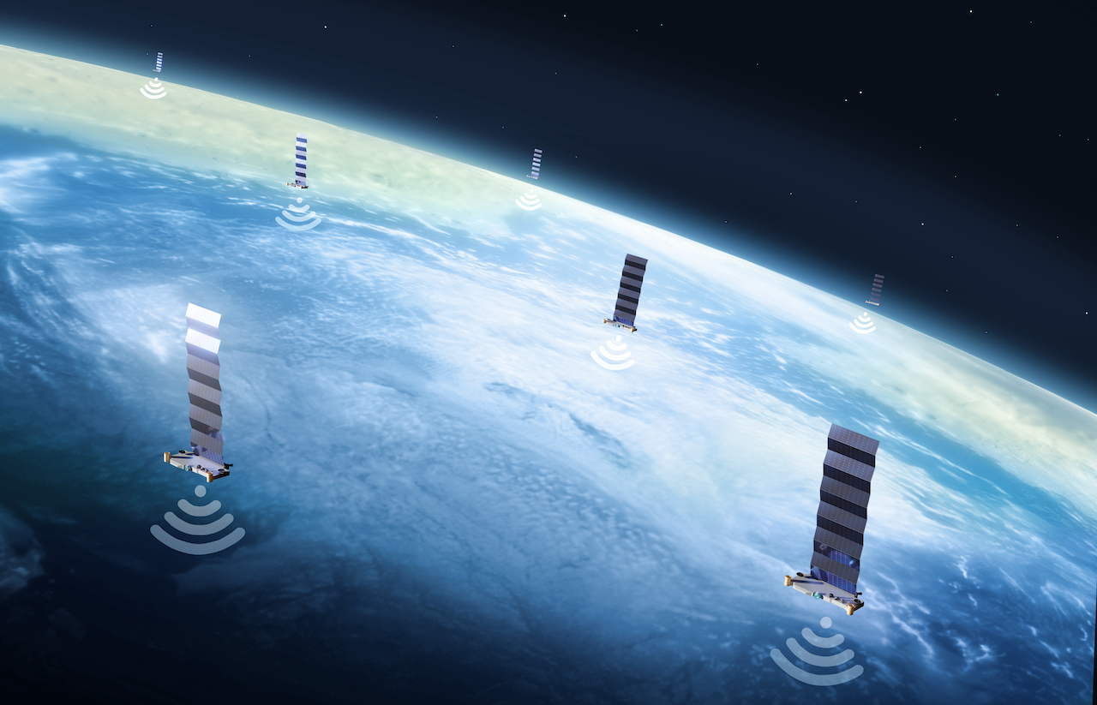
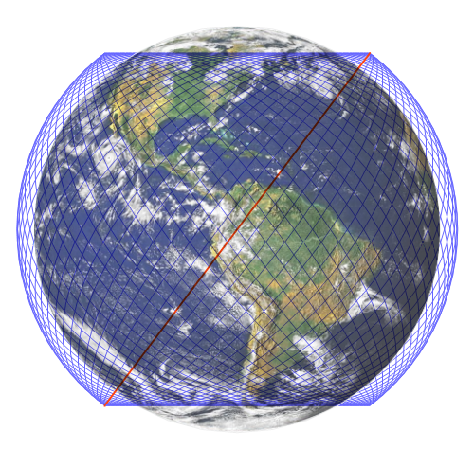
Starlink constellation
Over 10,000 satellites (as of March 2026)
12000-34000 planned
Service began in 2021

Slide 38
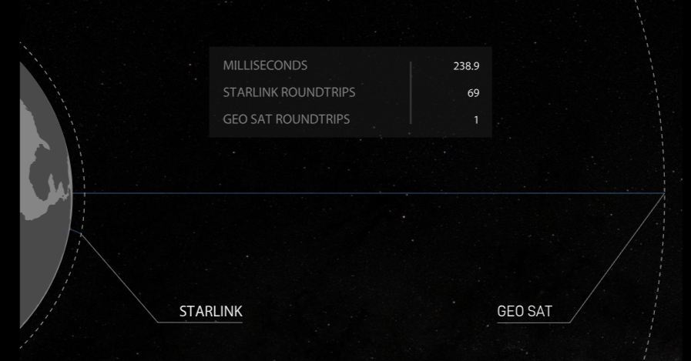
Starlink is deployed in LEO
LEO orbit allows much lower latency for communication than GEO
~60-70x faster
Which enables voice/video operation
Downside is more frequent replacement of satellites
Which is necessary for technology improvements anyways

Slide 39
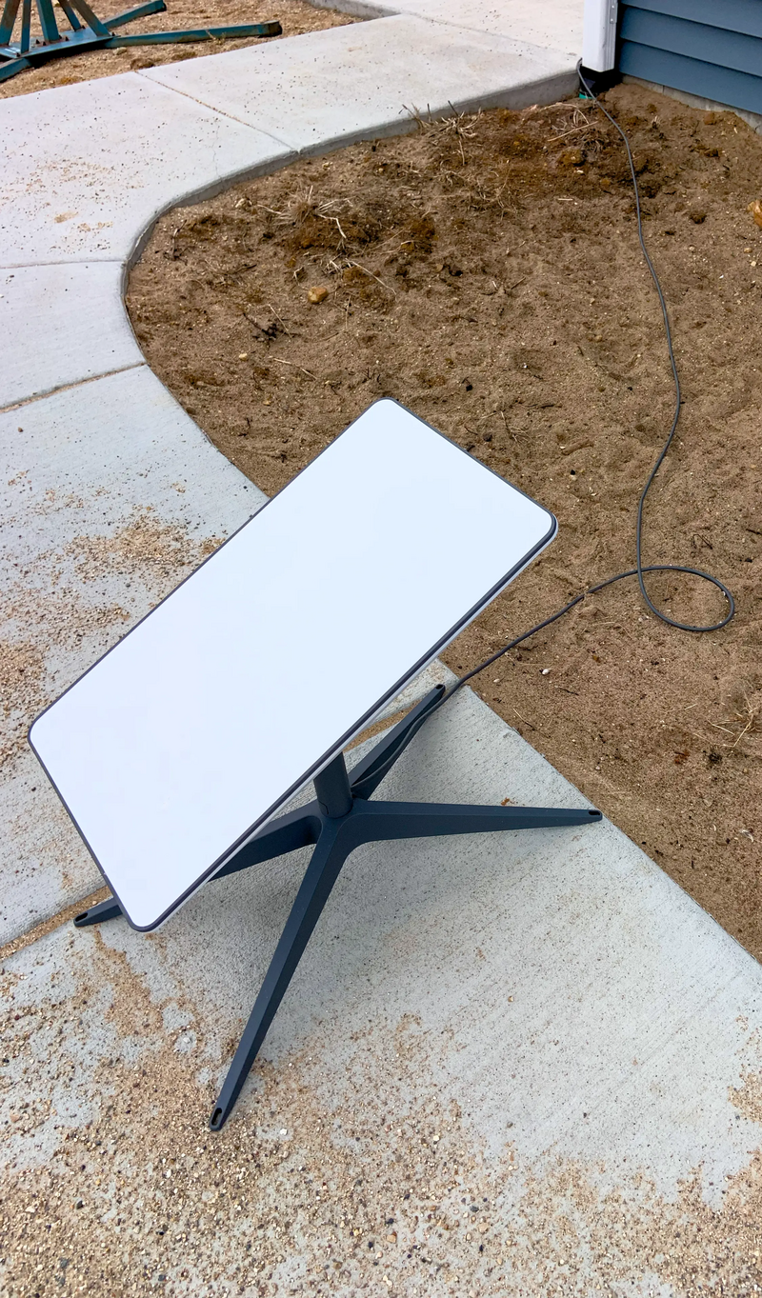
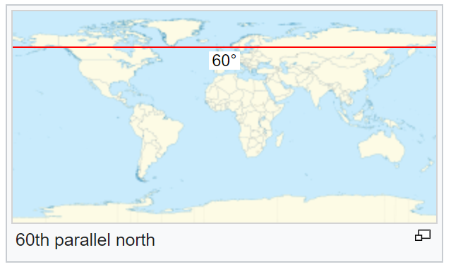
Starlink targets consumer connectivity
Broadband via satellite
45-280 Mbps down, 10-30 Mbps up
25-60 ms latency
Anywhere on Earth below 60° latitude
But communications must be approved by individual countries (160+ per SpaceX)
Costs
$350 for a hardware kit
$55/month for continuous service

Slide 40
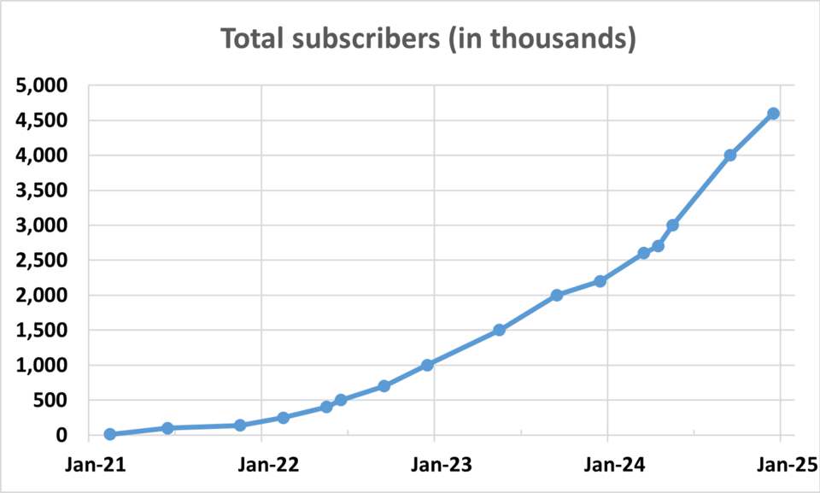
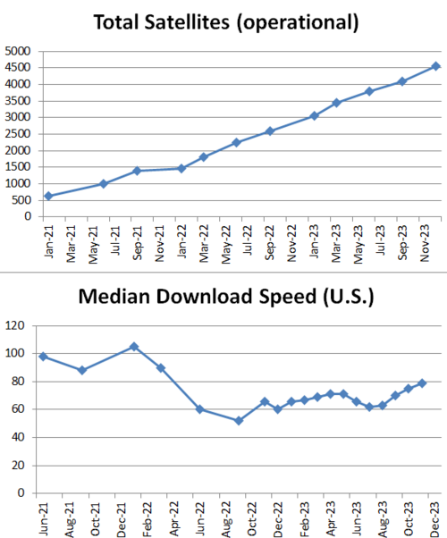
Starlink growth over two-year period
Growth in subscribers has been sustained by growth in satellite deployments
Roughly 1 satellite per 1000 users (May 2026)
10,000 satellites and 10 million users
At $55 per month and five years life: $3.3 million revenue per satellite (<$2 million for cost + launch)
Note: download speed chart cuts off in 2023
https://en.wikipedia.org/wiki/Starlink

Slide 41
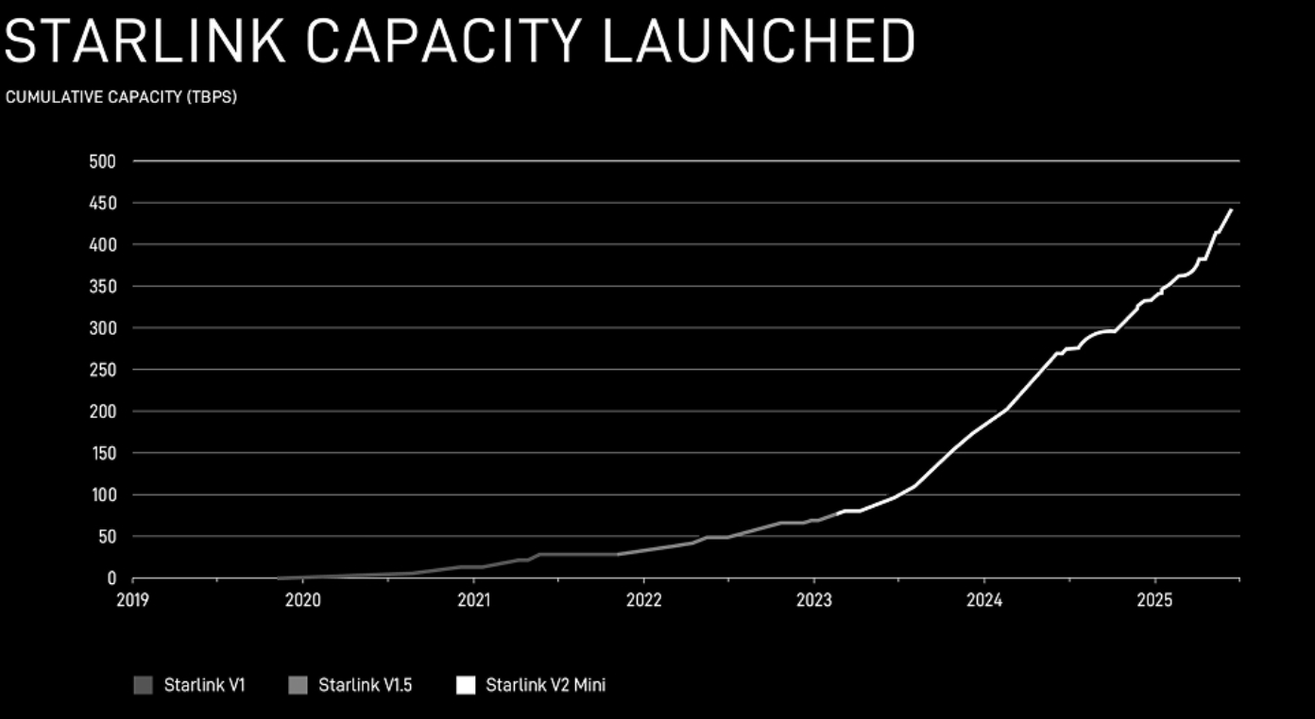
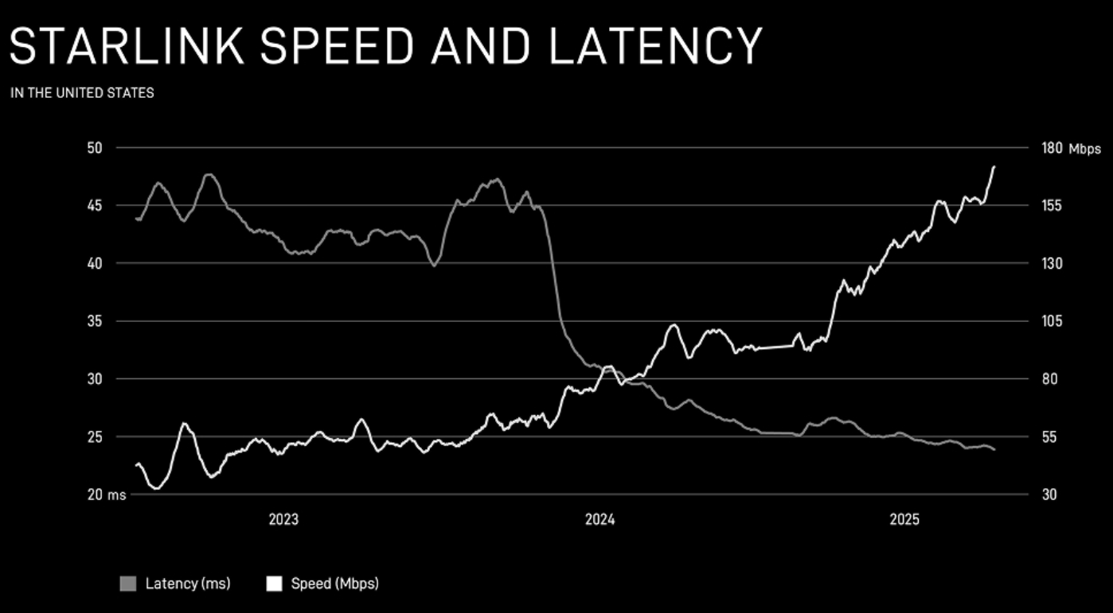
Data from Starlink

Slide 42
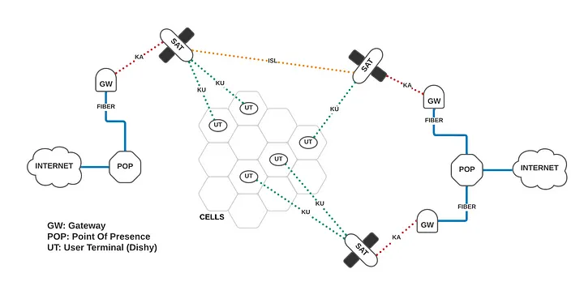
Starlink operation model
https://mikepuchol.com/modeling-starlink-capacity-843b2387f501

Slide 43
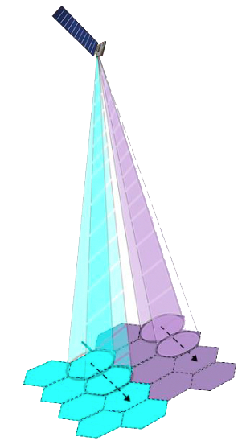
Starlink user communication
Starlink cells are 15 miles in diameter
Each satellite can communicate with 16 cells simultaneously (16 beams)
Cells can be directed at any location in view of the satellite
Can redirect cell locations quickly to time divide one beam into many cells per second
http://www.satmagazine.com/story.php?number=1026762698

Slide 44
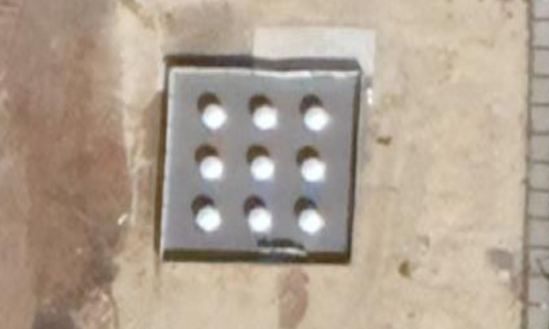
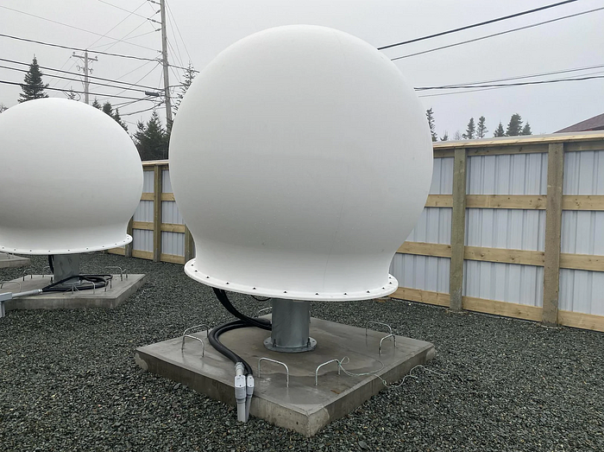
Starlink ground stations
Ground stations deployed worldwide
Not entirely clear how many? 150+
20 Gbps throughput from satellite to ground station (shared among all its cells)
Some regions (including eastern US) have a limitation on the band Starlink is using for downlink
Starlink only gets to use 50% of it
https://www.pcmag.com/news/what-is-a-starlink-pop-how-ground-stations-improve-latency-capacity
https://starlinkinstallationpros.com/starlink-ground-station-backbone-of-satellite-internet/

Slide 45
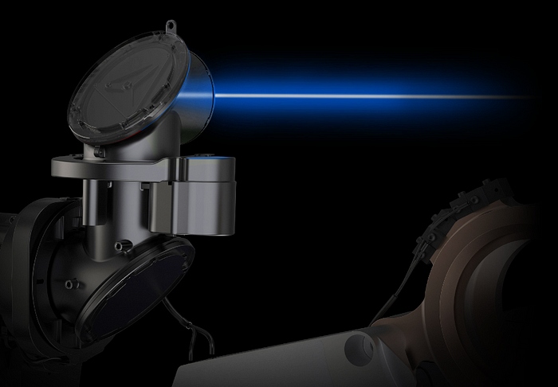
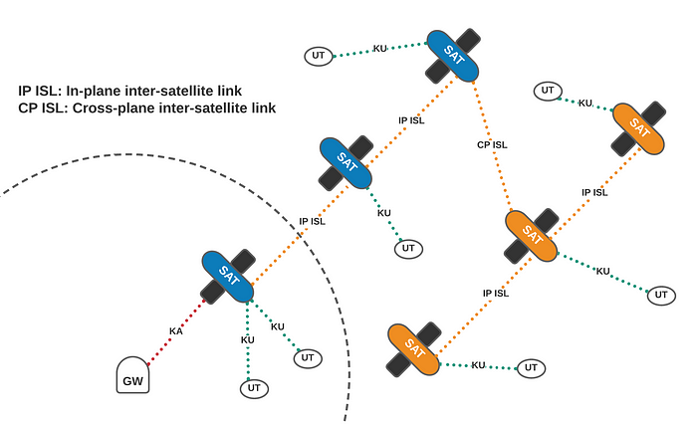
Starlink inter-satellite links
What if a ground station isn’t in view?
Use mesh networks!!
Uses lasers to communicate with nearby satellites
Position of each satellite is well-known

Slide 46
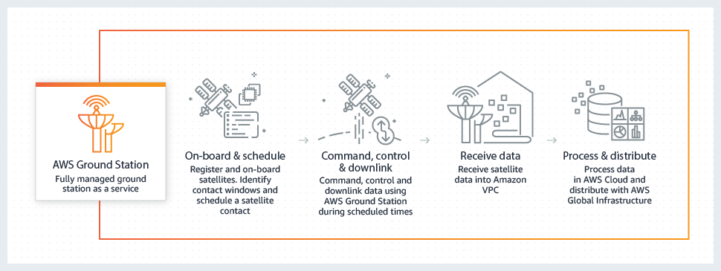
Amazon’s response: “Amazon Leo”
First prototype satellites in 2023
Service sometime in 2025? 2026?
300+ satellites in orbit (May 2026)
One advantage: AWS “ground station as a service” already exists

Slide 47
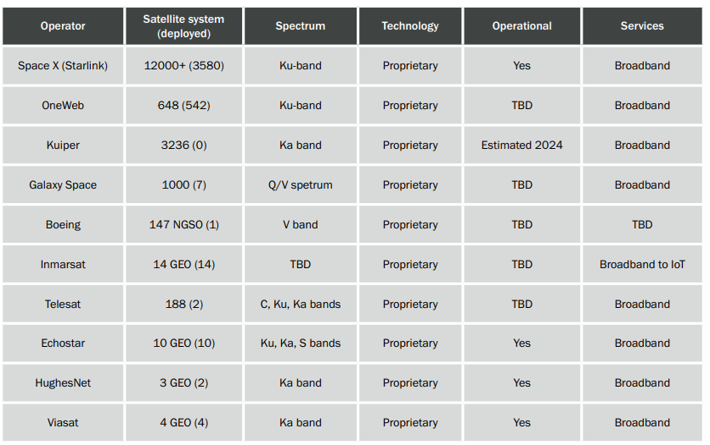
Satellite broadband providers (2023)
https://www.5gamericas.org/wp-content/uploads/2023/07/Update-on-5G-Non-terrestrial-Networks-Id.pdf

Slide 48
Break + Question
Is there a limit to how much stuff we can have in orbit? What about old, defunct satellites?

Slide 49
Break + Question
Is there a limit to how much stuff we can have in orbit? What about old, defunct satellites?
Space Junk!! Major concern
2022: FCC requires all satellites launched after 2024 to deorbit within five years of ending their mission
For GEO, graveyard orbit: location to move your satellite to that no one wants to use anyways
Need to move there before you run out of propellant

Slide 50
Outline
Overview
Satellite Communication
Voyager
Satellite Communications Providers
Cellular-to-Satellite Communication

Slide 51
Goals of “Non-Terrestrial Networks”
Support connectivity in “remote, unserved, and underserved areas”
Target is remote regions: cities already have good cell coverage
Supplemental Coverage from Space (SCS)
Not intended to replace primary coverage
In the US:
57 million people live in “rural” areas
4 million km² results in ~10000 15-mile-diameter (24 km) cells
https://docs.fcc.gov/public/attachments/DOC-391794A1.pdf
http://www.satmagazine.com/story.php?number=1026762698

Slide 52
Apple Emergency SOS (2022)
Allows for calling emergency services over satellite communication
Messages emergency contacts with your location as well
Possibly additional functionality: call AAA for roadside assistance
Globalstar constellation
24-satellite deployment in LEO (~1400 km)
Frequencies: 1.6 GHz uplink, 2.4 GHz downlink (doesn’t overlap with WiFi)
Apple is guaranteed up to 85% of Globalstar bandwidth
April 2026: Amazon acquiring Globalstar
Free for first few years (until Nov 2025? Nov 2026?)
No sense of how they’ll charge for it after that

Slide 53
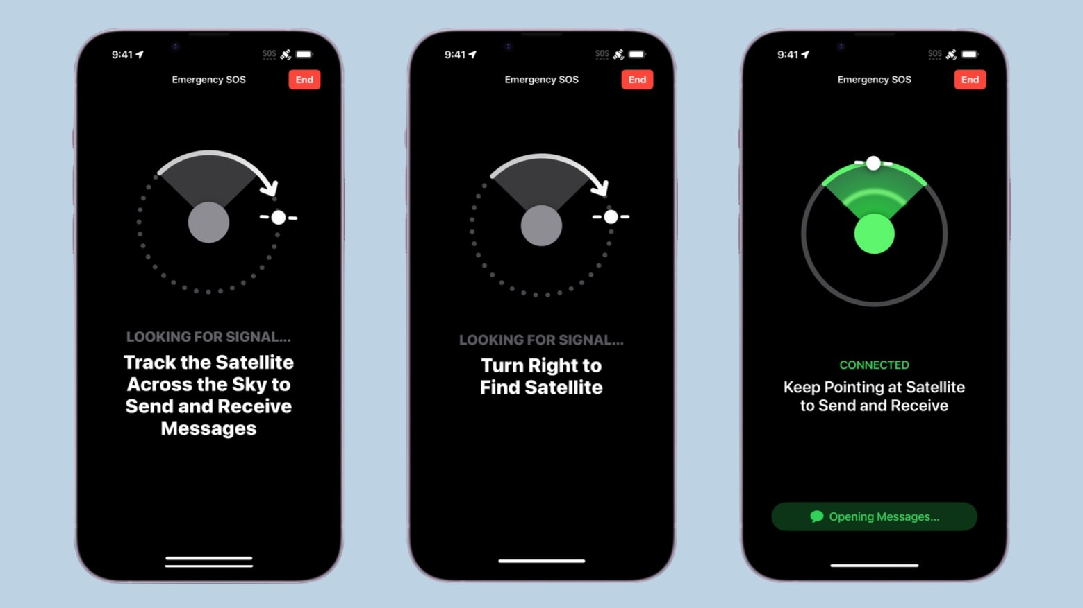
Emergency SOS pointing requirement
How do we handle distance?
Have users accurately point directional antenna at satellite
Combine with very slow data rates for better connectivity
Pointing requirements are going away as technology in phones improves

Slide 54
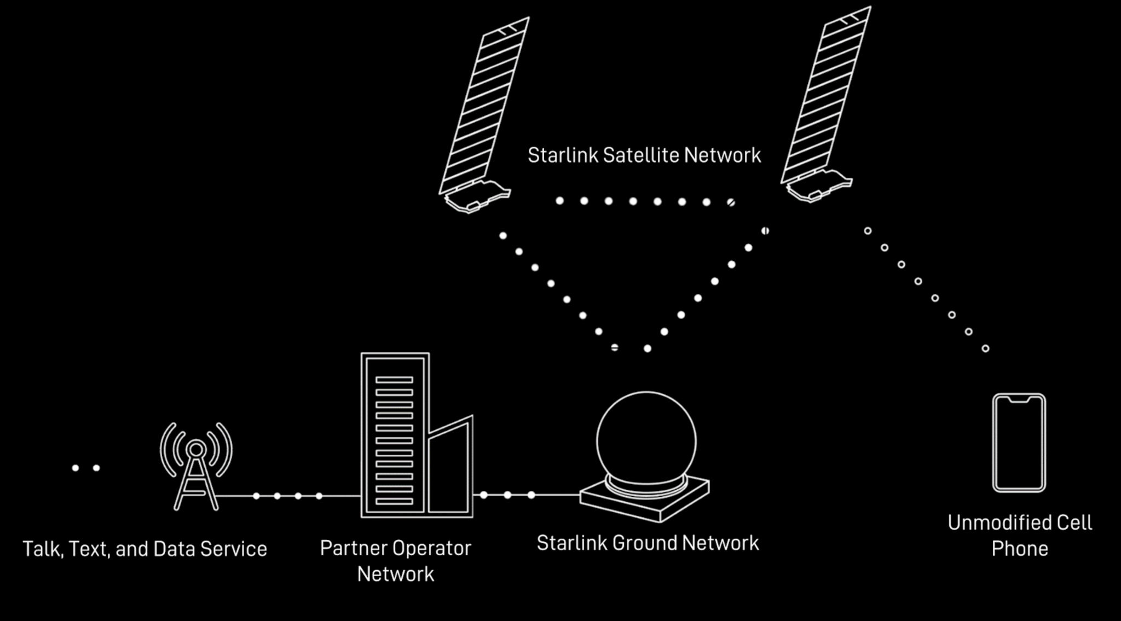
Satellite to cellular suddenly seems viable
T-Mobile and SpaceX: T-Satellite
Announced in 2022
Available now!
Apple, Samsung, and Google support
Qualcomm and Iridium partnership
2023: Announced in January, ended in November
Qualcomm: going to focus on standards-based approaches
2025: Qualcomm radio chips for Iridium communications
AST SpaceMobile partners with AT&T and Verizon (2024)
“77 publicly announced partnerships over 43 countries” (March 2024)
May 2026: AT&T, T-Mobile, and Verizon joint venture on satellite technologies to address coverage gaps
https://insidetowers.com/partnerships-show-potential-of-satellite-to-cell-phone-market/

Slide 55

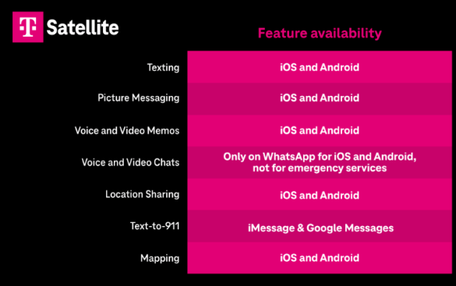
T-Mobile + SpaceX collaboration
T-Mobile and SpaceX: T-Satellite
Announced in 2022
Available starting July 2025
Included in some existing T-Mobile plans
$10 per month for first standalone plans
Text and Data
Data is limited: select apps only
No voice calling yet
Limited locations initially
US, Canada, New Zealand, Japan
IoT support planned

Slide 56
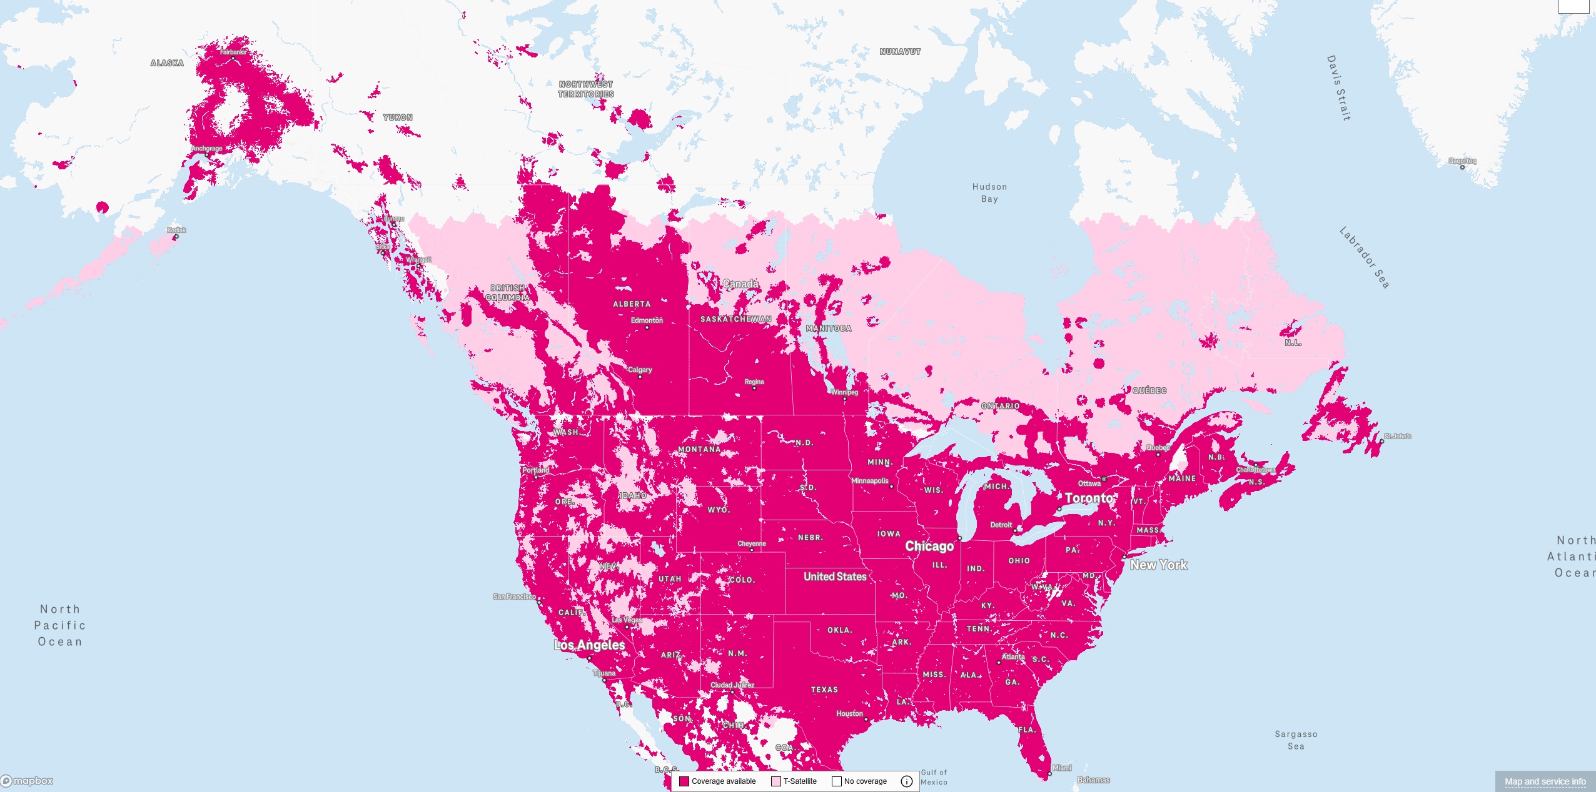
T-Mobile “new” coverage map
Light-pink is satellite communication
Cutting off at ~60 degrees north in latitude

Slide 57
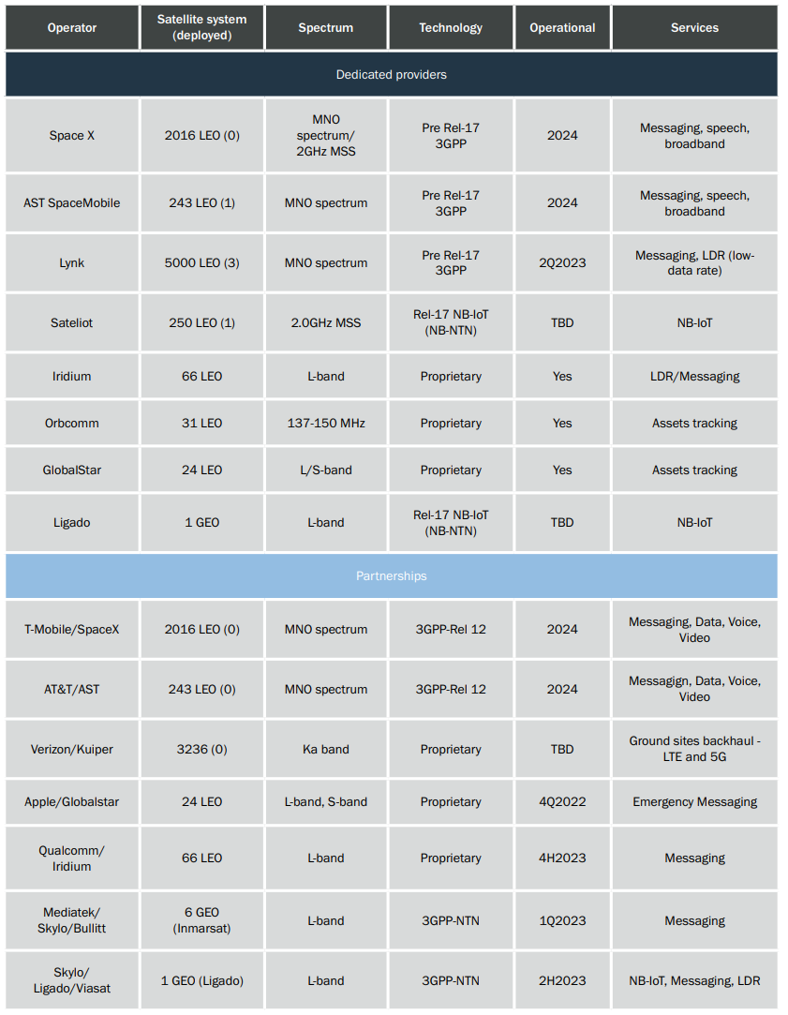
Planned and existing cellular/satellite partnerships (2023)
https://www.5gamericas.org/wp-content/uploads/2023/07/Update-on-5G-Non-terrestrial-Networks-Id.pdf

Slide 58
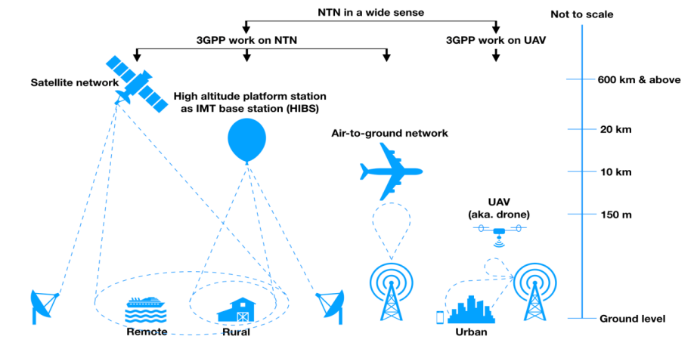
3GPP non-terrestrial networks
Satellites part of a broader Non-Terrestrial Networks (NTN) domain

Slide 59
3GPP 5G satellite requirements
Release 17 (2022) included requirements for NTN. Shall support:
Service continuity between terrestrial and satellite networks
Mobility across various access network types
Low power IoT type of communication
LTE-M and NB-IoT are rolled into general LTE support
Additional IoT focus
Network can broadcast satellite parameters so devices understand coverage and timing for communication
Assumes GNSS capability in IoT devices for timing and location
https://www.3gpp.org/technologies/ntn-overview
https://www.5gamericas.org/wp-content/uploads/2022/01/5G-Non-Terrestrial-Networks-2022-WP-Id.pdf

Slide 60
FCC gets involved (2023-2024)
Approves regulatory framework for “Supplemental Coverage from Space” (March 2024)
FCC attempting to fast-track new deployments
But also restricting them from interfering with existing stuff
Allocates some frequencies for SCS use, new ideas on a case-by-case basis
Communication classes
Primary: existing “Mobile Satellite Services” like Globalstar and Iridium
Secondary: new SCS services
Must not disrupt existing MSS communications
https://docs.fcc.gov/public/attachments/FCC-23-22A1_Rcd.pdf
https://docs.fcc.gov/public/attachments/FCC-24-28A1.pdf
https://spacenews.com/taking-the-next-steps-for-satellite-to-smartphone-services/

Slide 61
Reality of satellite cellular coverage
Low throughput communication per device
Needs to share bandwidth over a wide area
Path loss involved means reducing bitrate to keep acceptable error rate
Targets rural areas without existing coverage
Somewhat mitigates need to share bandwidth
Some connectivity is better than none, right?
User-focused applications: text, low-rate data, maybe voice
Specialized rather than general-purpose networking
Initial focus on emergency services makes sense

Slide 62
IoT and space coverage could be mutually beneficial
Resulting non-terrestrial networks:
Global coverage (including remote regions)
Throughput too limited for primary human use
But is going to exist for backup use
Which means it might often go unused
Pretty great scenario for IoT communication
Secondary quality-of-service (below emergency communications)
Infrequent data uplink of relatively small packets
Secondary monetary stream for service providers

Slide 63
Outline
Overview
Satellite Communication
Voyager
Satellite Communications Providers
Cellular-to-Satellite Communication

Slide 64
Outline
Bonus: Oculus-ASR

Slide 65
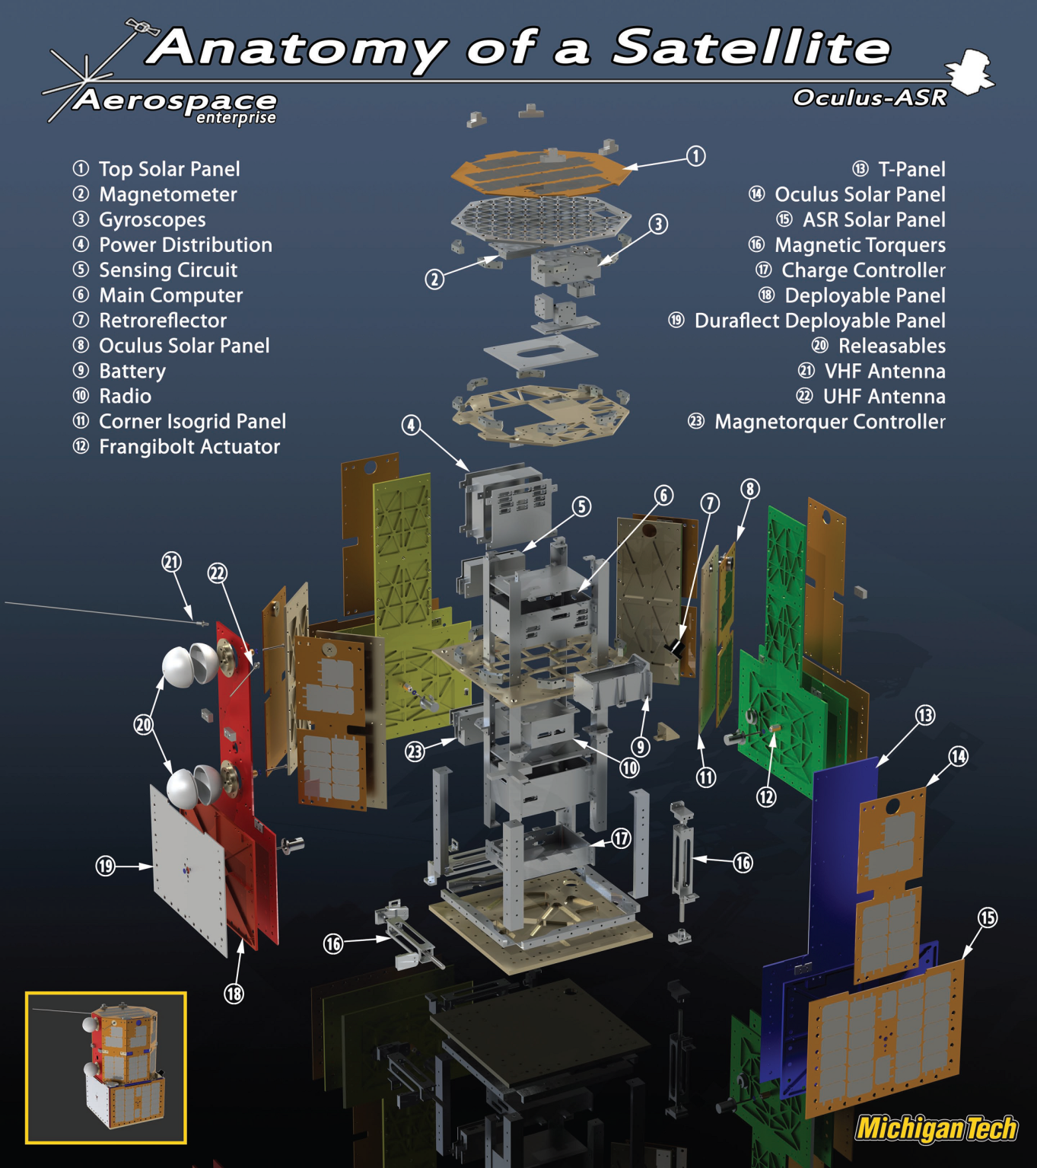
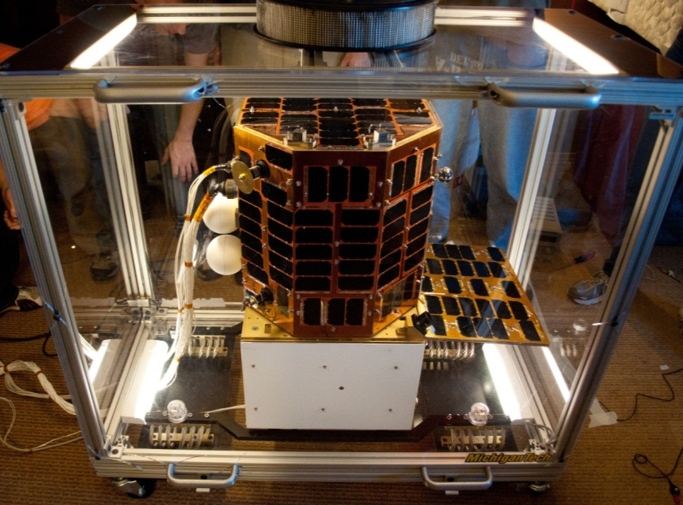

Oculus-ASR
Satellite I worked on from 2009-2013

Slide 66
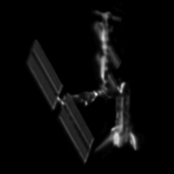
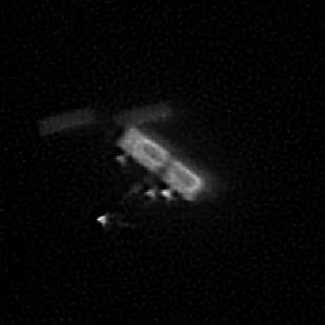
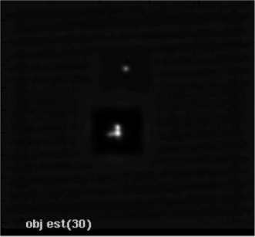

Oculus-ASR mission
Can we determine a satellite’s attitude and detect shape changes from the ground using only information gained from unresolved optical images?
Goal: Space Situational Awareness calibration
In coordination with Air Force Research Lab (AFRL) and Air Force Maui Optical and Supercomputing Observatory (AMOS)

Slide 67

Winner of Nanosat-6: 2011
Winner gets funding to complete satellite plus a launch to space!

Slide 68


Launched in 2019
STP-2 mission
Second Falcon Heavy launch

Slide 69


Oculus communication design
440 MHz downlink and 145 MHz uplink
Amateur bands, coordinated with IARU and AMSAT
9600 bps GMSK modulation (type of FSK)
Beacons data every 30 seconds

Slide 70
Oculus link budget
Transmit power: 34 dBm (3 W)
Path loss: 151 dB (at ~600 km)
Receiver antenna gain: 14 dB
Received power: -103 dB

Slide 71


Oculus packet data
108 byte beacon packets
Source: Command document I wrote as a junior undergraduate

