Slide 1
Lecture 01 Introduction
CS213 – Intro to Computer Systems
Branden Ghena – Winter 2025
Slides adapted from: St-Amour, Hardavellas, Bustamente (Northwestern), Bryant, O’Hallaron (CMU), Garcia, Weaver (UC Berkeley)

Slide 2
Welcome to CS213!
In brief: how does a computer work anyway?
We will explore that question across four major sections:
Representations of information on a computer
How the machine executes software
How memory is organized
How the operating system manages this all for efficiency and security

Slide 3
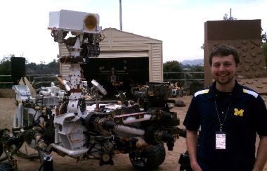
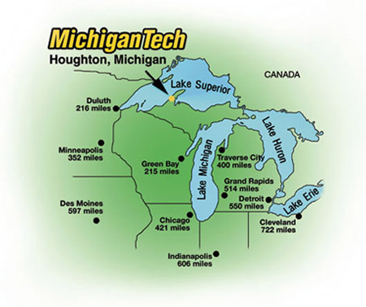
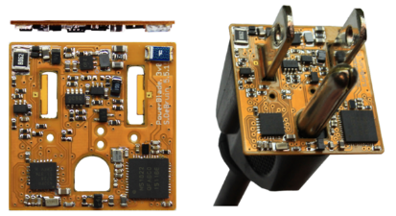

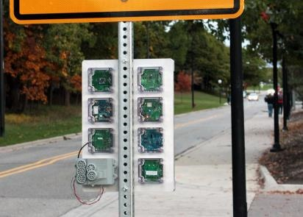




Branden Ghena (he/him)
Assistant Faculty of Instruction
Education
Undergrad: Michigan Tech
Master’s: University of Michigan
PhD: University of California, Berkeley
Research
Resource-constrained sensing systems
Low-energy wireless networks
Embedded operating systems
Teaching
Computer Systems
CS213: Intro to Computer Systems
CS343: Operating Systems
CS/CE346: Microcontroller System Design
CS433: Wireless Protocols for the IoT
Things I love

Slide 4
Asking questions, four ways
You can always ask questions during lecture!
I’ll let you know if I need to move on for now and answer you after class
We’ll take breaks during lecture
I’ll pause after each break to see if any questions came up
I will hang out after class for questions
Plenty of time to answer everyone
You can always ask questions on Piazza too
The class message board app

Slide 5
Today’s Goals
Introduce the theme and goals of the course
Describe how this class is going to function
Discuss how a computer system works at a high level
Begin exploring how computers represent information with bits and bytes

Slide 6
Outline
Course Themes
Logistics
Running a program
Representing numbers with binary

Slide 7
Convenient computing
Computers operate on integers, reals, structs, arrays, etc.
Computers operate on variables and functions
Computers execute conditionals, loops, etc.
Memory is an infinite bag of objects my program can allocate
Memory doesn’t have to be shared with any other program
Memory is always equivalently fast to access
Etc.
Notes:
Conveniences which you’re familiar with from 111, and to some extent also 211

Slide 8
Convenient illusions in computing
Computers operate on integers, reals, structs, arrays, etc.
Computers operate on variables and functions
Computers execute conditionals, loops, etc.
Memory is an infinite bag of objects my program can allocate
Memory doesn’t have to be shared with any other program
Memory is always equivalently fast to access
Etc.
None of these are actually true!
But we usually program as if they were, and we get away with it!
What’s going on?
Notes:
Conveniences which you’re familiar with from 111, and to some extent also 211

Slide 9
The power of abstraction
These illusions are called abstractions
They approximate reality, but leave out details
Instead, they provide an interface that we can work and think with
We can forget about those details, and be more productive
Abstractions we love
Abstract data types
Asymptotic analysis
High-level programming languages
Operating systems
Etc.

Slide 10
The Limits of Abstraction
Sometimes, abstractions break down
Their implementation is buggy
Mismatch between expected interface and implementation
Their performance is inadequate
We need control over the details they hide
Security concerns make these details important
At that point, details come rushing back
Can’t pretend they don’t exist anymore
We must know how to deal with them
This class prepares you to be ready when that happens

Slide 11
When do abstractions break?
Let’s talk about some real-world examples of “broken” software
That broke because of how the underlying system actually works
Dates and Times
Network Security
Ordering of Loop Iteration

Slide 12
Complicated designs fail in unexpected ways
Some software engineers at Microsoft came up with a cute way of storing dates
Two-digit year, month, date, hour, minute concatenated into a 10-digit number
Example: 2005230710 -> May 23, 2020 at 7:10 AM
Stored as a 32-bit signed number (int)
Convenient, because these are easy to use in C/C++
Maximum value for an int: 2147483647
Result: Starting January 1st, 2022, Microsoft Exchange email servers could no longer send email
2201010001 is greater than the largest 32-bit number
Microsoft had to issue an emergency patch

Slide 13
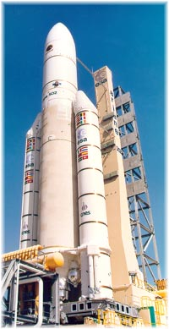
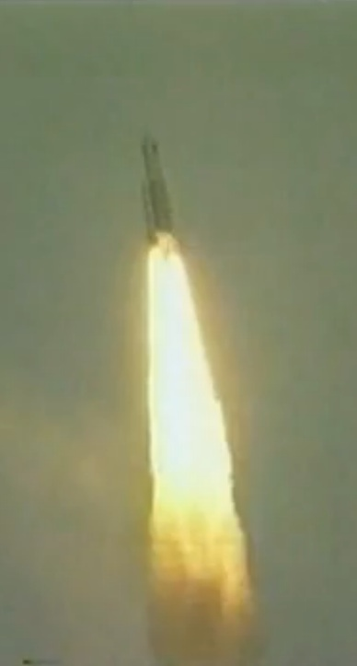
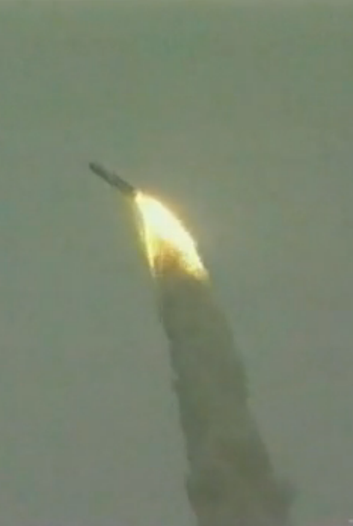
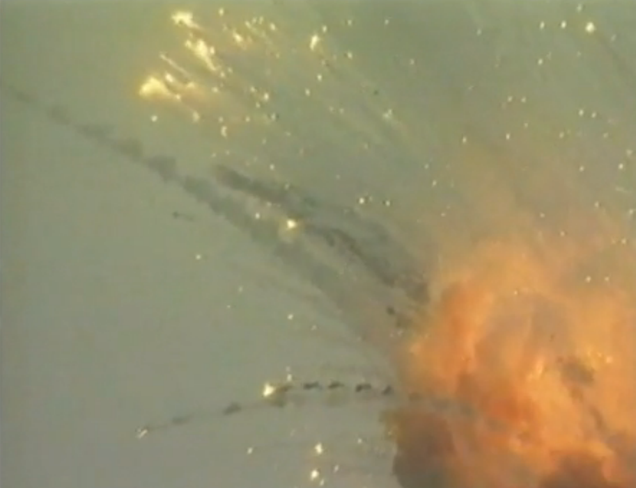
Expectation mismatches lead to real-world problems
Ariane 5 explosion (1996)
Inertial reference system converted a 64-bit float to a 16-bit integer
Expectation: converting from decimal to whole numbers is safe
Had worked in the past in Ariane 4, but Ariane 5 was faster
Speed too large to fit in a 16-bit integer -> software fault
Reality: rocket explodes
double
short

Slide 14
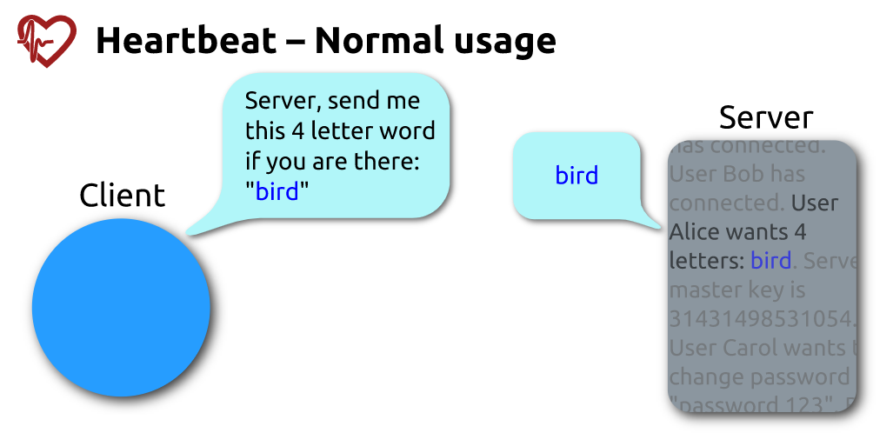
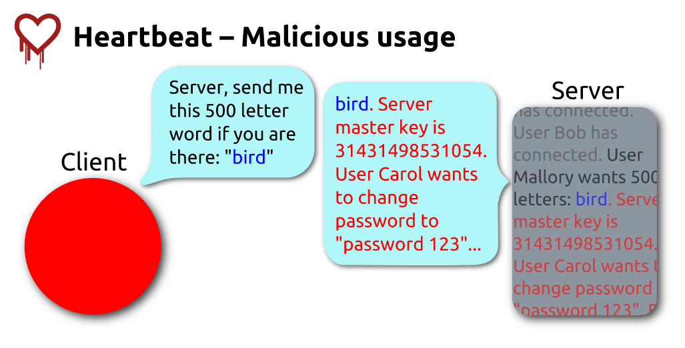
Simple bugs can result in massive vulnerabilities
Heartbleed: 2014 vulnerability in OpenSSL found by Google security
Normally, clients can check if a server is active by sending a message and listening for echoed response
C library forgot to check bounds of array and could be abused to return important memory
17% of servers on the Internet were vulnerable (500,000)
“…worst vulnerability found (at least in terms of its potential impact) since commercial traffic began to flow on the Internet.” – Forbes, Joseph Steinberg

Slide 15
Hardware realities impact software performance
Abstracted lower-level details can affect performance a lot!
Question: does the order of iterating through an array matter?
Each column in a row OR each row in a column?
Answer: right code is 10-32 times slower on Intel systems
Due to cache design and performance
void copyij(int src[4096][4096],
int dst[4096][4096])
{
for (int i=0; i<4096; i++){
for (int j=0; j<4096; j++){
dst[i][j] = src[i][j];
}
}
}
void copyji(int src[4096][4096],
int dst[4096][4096])
{
for (int j=0; j<4096; j++){
for (int i=0; i<4096; i++){
dst[i][j] = src[i][j];
}
}
}

Slide 16
CS213 goals
Break through abstractions to understand how computer processors and memories affect software design and performance
Introduce concepts of “computer systems” areas:
Architecture, Compilers, Security, Networks, Operating Systems, etc.

Slide 17
Course design goal
Most systems courses are builder-centric
Computer Architecture: design a pipelined processor in Verilog
Operating Systems: implement portions of an operating system
Compilers: write a compiler for a simple language
Networking: implement and simulate network protocols
Fun, for sure
But ultimately, many more of you will build on systems
Rather than build systems directly
This course is programmer-centric
Purpose is to show that by knowing more about the underlying system, one can be more effective as a programmer
Not just a course for dedicated hackers
We want to bring out the hacker in everyone!

Slide 18
Outline
Course Themes
Logistics
Running a program
Representing numbers with binary

Slide 19


Course Staff
TA (2)
Connor Selna
PhD student in parallel architecture
Jess Jeng
PhD student in quantum computing
PMs (14):
Christian Lee Daniel Lee
Ethan Foong Ethan Hamilton
Haresh Wedanayake Jay Park
Jerry Han Leo Zhang
Max Smith Milind Maiti
Natalie Hill Nathan Wang
Ryan Wong Sean Rhee
Their role: support student questions via office hours and piazza

Slide 20
Course details - how to learn stuff
Lectures: here in class, Tuesdays and Thursdays
Please attend and ask questions!
Panopto tab on Canvas should have best-effort recordings (a few hours later) and I also post the slides to the Canvas homepage right before class
Textbook:
Computer Systems: A Programmer’s Perspective 3rd Edition
A very useful reference (definitely aligns with class materials)
Office hours: (starting next week)
Likely a mix of mostly in-person and some online
More info will be posted to Piazza when schedule is ready
Can reach out on Piazza to schedule a meeting too

Slide 21
Asking questions
Class and office hours are always an option!
We can do extra questions right after class too
Piazza: (similar to Campuswire)
Post questions
Answer each other’s questions
Find lab partners
Find posts from the course staff
Post private info just to course staff
Please do not email me! Post to Piazza instead!
I’ll be updating roster again a few times

Slide 22
Grades
Grade breakdown
48% Programming Labs (4 labs at 12% each)
12% Homeworks (4 homeworks at 3% each)
20% Midterm Exam 1
20% Midterm Exam 2
Exact number to letter mapping is a little flexible
But this course is NOT curved

Slide 23
Programming Labs
Four labs
Pack Lab – manipulate bits and bytes of a file
Bomb Lab – deconstruct software to understand it
Attack Lab – exploit security vulnerabilities in software
SETI Lab – make software faster with concurrency
Work on these preferably as a group of two
Work together and don’t split up assignments (otherwise you won’t learn)
Individual is acceptable but less good
We’ll do a pairing survey if you don’t already have a partner in mind
Very different from CS211 style projects
Emphasis on the thinking rather than the programming

Slide 24
Lab difficult ranking (ranked by past PMs)
Lab | Difficulty (out of 10) | What is challenging about it?
1. Pack Lab | 6 | C programming
2. Bomb Lab | 9 | Interpreting assembly code
3. Attack Lab | 5 | Debugging what’s going wrong
4. SETI Lab | 8 | C programming AND big codebase
Be warned: Bomb Lab and SETI Lab are during the busiest parts of the quarter
Midterm exam season and last week of quarter, respectively

Slide 25
Homeworks
Worksheet-style practice problems to help you actually understand what’s going on and practice for exams
This class can feel a little like a math class sometimes
(But not all the time! I promise)
Four homeworks that cover class topics
The first releases on Thursday!
Important practice, but not meant to be too difficult
Last quarter 85% of the class had an A- or better on these

Slide 26
Midterm Exams
First midterm exam will be during class time
Second midterm exam will be during exam week
Important: Thursday of exam week is our scheduled slot
Not cumulative, second midterm is second half of class
But material in this class builds on itself…
Exams are serious in CS213. They’re how we judge your individual understanding

Slide 27
Three special policies in CS213
Minimum midterm average rule
Late policy
Slip days

Slide 28
Weighing midterm exams
A concern in CS213: we allow lots of group work
But we need to individually assess you as well
Especially to make sure that you’re ready for future systems courses
Normal way to do this is make the exams a huge portion of your grade
We really don’t want to do that in CS213
Not fun to have your letter grade decided by a single test
Compromise: require a minimum average exam grade to pass
But still keep exam weights low so most of your grade is the projects

Slide 29
Minimum Midterm Average Rule
To pass, you need at least a 60% average across the two exams
Overall exam averages are usually in the high 70%s
Examples: 55% and 65% or 80% and 40% or 60% and 60%
BUT, we do want to reward improvement
The average rule waived if your second midterm is 85% or higher
29% and 85% (would be 57% average) has no penalty
Bottom line: either do well or show significant improvement
By the numbers:
In Winter 2024, it affected 14 students out of 191 (7% of the class)
However: ~15 more dropped after first midterm

Slide 30
Late Policy
You can submit homeworks and labs late
20% penalty to maximum grade per day late
Example: two days late means maximum grade is 60%
There are exceptions to this:
We will be flexible with deadlines for problems outside of your control
Sick, family emergency, broken computer
Contact me (via Piazza) as soon as possible

Slide 31
Slip Days
Slip days let you turn in a homework late and receive no penalty
Each student gets 3 slip days
Apply to homeworks and labs
You don’t need to tell us you’re using them, we’ll just automatically apply them at the end of the year as best helps your grade
Be sure to coordinate about them on partner assignments
Examples:
Turn in homework 1 three days late
Turn in homework 4 two days late and SETI lab one day late
Turn in homework 2 four days late with only a one-day penalty

Slide 32
Academic Integrity
This is something I take very seriously
Collaboration good; plagiarism bad
You should know where that line is, and be nowhere near it
When in doubt, ask the instructor before you do something you’re not sure about
At no point should you see someone else’s solutions
Not your colleagues’, not your friends’, not your cousin’s, not something you found online, not ChatGPT’s answer either
I report everything suspicious to the dean

Slide 33
Break + Architecture of a lecture
Full
Administrivia
+ stretch break
Open Question
Summary
+ Bonus
Attention
0
20
25
50
53
78
80
Time (minutes)

Slide 34
Expectations
This class is hard
And it’s hard in a different way. Lots of new material that builds on itself
You have an opportunity to learn a lot from it
I’m confident that you can all succeed
Labs, Homeworks, Lecture, Office Hours are all designed to support you
You’ll gain a much deeper understanding of how computers operate
Maybe it’s not for you, maybe you’ll love it

Slide 35
How to succeed in this class
Come to lecture
Ask questions
Consult the textbook for clarity and practice
Start assignments early
Stay on top of the material

Slide 36
Outline
Course Themes
Logistics
Running a program
Representing numbers with binary

Slide 37
Hello World
What happens when you run “hello” on your system?
And why does it happen?
Goal: introduce key concepts, terminology, and components
/*
* hello world
*/
#include <stdio.h>
int main()
{
printf(“hello, world\n”);
}
Notes:
If you think of the classical “Hello world!” program, the course helps you understand what happens and why when you run hello

Slide 38
Compiling hello
Compiling hello
GCC is our compiler
It takes our source code (hello.c)
A text file containing characters
Text file = readable by humans
And translates (compiles) it into assembly code
A text representation of x86 instructions our processor can run
Here, not explicitly stored in a file
We’ll be working with assembly a lot this quarter
Then translates (assembles) that into an executable (hello)
A binary file containing x86 machine code that our processor understands
Binary file = not meant to be read by humans (in rare cases we might have to)
unix> gcc –o hello hello.c
Notes:
Shell – a command line interpreter that follows that basic loop; if what you entered is not a built-in command, it assumes it is an executable that it should load and run … to understand what happen next we need to understand the HW arch a bit

Slide 39
Running hello
Running hello
What does the shell do?
Prints a prompt
Waits for you to type a command
Interpret the command
Then loads and runs the hello program
What happens at the hardware level?
unix> ./hello
hello, world
unix>
Notes:
Shell – a command line interpreter that follows that basic loop; if what you entered is not a built-in command, it assumes it is an executable that it should load and run … to understand what happen next we need to understand the HW arch a bit

Slide 40
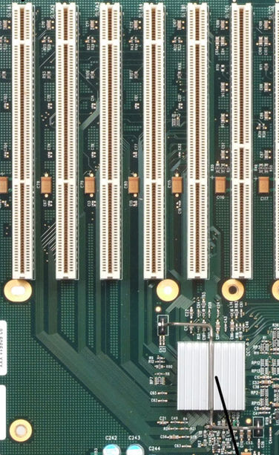
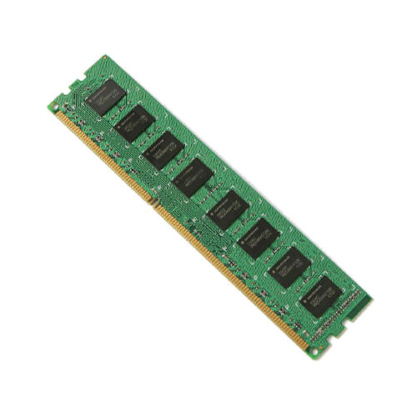
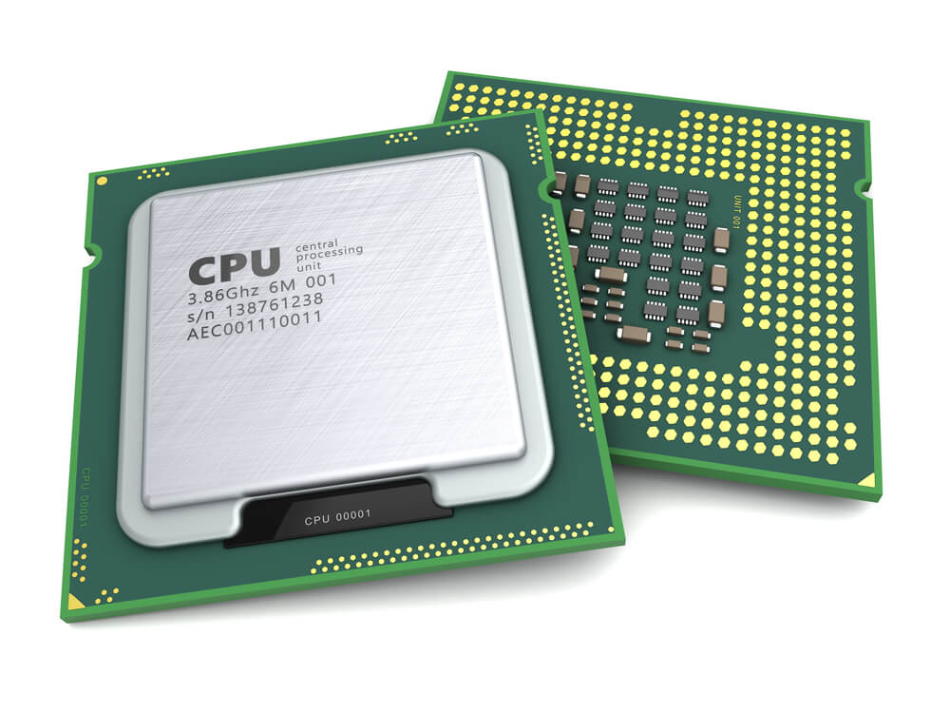
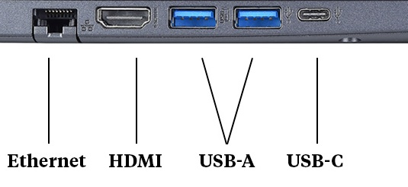
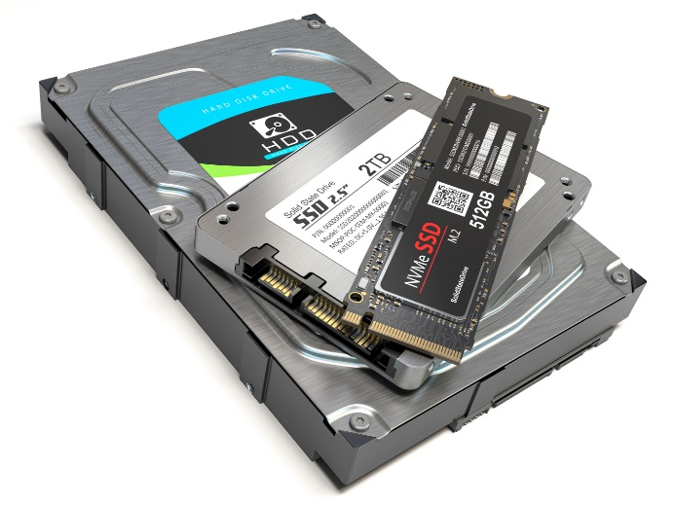
Hardware organization
Processor: Executes instructions stored in main memory
Main mem.: Temporary storage device. Holds both a program and the data it manipulates.
Buses: wires that transfer data
System bus
Memory bus
Processor
Main
memory
I/O
bridge
I/O bus
Expansion slots for
other devices such
as network adapters
USB
controller
Graphics
adapter
Disk
controller
Mouse
Keyboard
Display
hello executable
stored on disk
Disk
Input/Output (I/O) Devices:
System connections to outside world.
Disk: Persistent storage device

Slide 41
Running hello
Reading the ./hello command from the keyboard
System bus
Memory bus
Processor
Main
memory
./hello
I/O
bridge
I/O bus
Expansion slots for
other devices such
as network adapters
USB
controller
Graphics
adapter
Disk
controller
Mouse
Keyboard
Display
hello executable
stored on disk
Disk
User types ./hello

Slide 42
Running hello
Shell program loads the hello
executable into main memory
System bus
Memory bus
Processor
Main
memory
./hello
I/O
bridge
hello code
I/O bus
Expansion slots for
other devices such
as network adapters
USB
controller
Graphics
adapter
Disk
controller
Mouse
Keyboard
Display
hello executable
stored on disk
Disk

Slide 43
Running hello
The processor reads the hello code,
executes instructions, and displays “hello…”
System bus
Memory bus
Processor
Main
memory
./hello
I/O
bridge
hello code
I/O bus
Expansion slots for
other devices such
as network adapters
USB
controller
Graphics
adapter
Disk
controller
Mouse
Keyboard
Display
hello executable
stored on disk
Disk
"hello,world\n"

Slide 44
The Operating System (OS)
Neither hello nor our shell interfaced with the hardware directly
All interactions were mediated by the operating system
Operating system: a layer of software interposed between the application program and the hardware
Primary goals
Protect resources from misuse by applications
Provide simple and uniform mechanisms for manipulating hardware devices
Manage sharing of resources between applications
Application programs
Software
Operating system
Processor
Main memory
I/O devices
Hardware

Slide 45
Key idea: a computer system is more than just hardware
A collection of intertwined hardware and software that must cooperate to achieve the end goal – running applications
Hardware: expensive, fast, immutable
Software: cheap (comparatively), slow, flexible
Different tradeoffs
So we’ll use them for different roles!
The rest of the course will expand on this

Slide 46
Open Question + Break
What part of the hello example takes the longest to run on a computer?

Slide 47
Open Question + Break
What part of the hello example takes the longest to run on a computer?
The user typing (seconds)
Maybe that’s cheating and we should start after they hit enter

Slide 48
Open Question + Break
What part of the hello example takes the longest to run on a computer?
The user typing (seconds)
Maybe that’s cheating and we should start after they hit enter
Almost certainly loading the program from disk (milliseconds)
Possibly sending text to graphics (microseconds – milliseconds)
Definitely not executing the code (nanoseconds – microseconds)

Slide 49
Outline
Course Themes
Logistics
Running a program
Representing numbers with binary

Slide 50
Learning binary
To understand how a computer really works we need to understand that data it operates on
Computers hold data in memory as individual ones and zeros
These ones and zeros make up binary values
So, we’re going to need to understand binary
Binary will definitely come up again in this and other classes

Slide 51
Positional Numbering Systems
The position of a numeral (e.g., digit) determines its contribution to the overall number
Makes arithmetic simpler (compared to, say, roman numerals)
Any number has one canonical representation
Example: base 10
10456₁₀ = 1*10⁴ + 0*10³ + 4*10² + 5*10¹ + 6*10⁰
Usually, we leave out the zeros:
1*10⁴ + 4*10² + 5*10¹ + 6*10⁰

Slide 52
Other bases are also possible
Base 60, used by the Babylonians
The source of 60 seconds in a minute, 60 minutes in an hour
And 360 degrees in a circle
Base 20, used by the Maya and Gauls
Parts of this remain in French today
Base 2, used by computers
Example: 10010010₂
Same idea as before: 1*2⁷ + 1*2⁴ + 1*2¹ = 128₁₀ + 16₁₀ + 2₁₀ = 146₁₀

Slide 53
Base 2 Example
Computer Scientists use base 2 a LOT (especially in computer systems)
Let’s convert 138₁₀ to base 2
We need to decompose 138₁₀ into a sum of powers of 2
Start with the largest power of 2 that is smaller or equal to 138₁₀
Subtract it, then repeat the process
138₁₀ – 128₁₀ = 10₁₀
10₁₀ – 8₁₀ = 2₁₀
2₁₀ – 2₁₀ = 0₁₀
138₁₀ = 1×128 + 0×64 + 0×32 + 0×16 + 1×8 + 0×4 + 1×2 + 0×1
138₁₀ = 1×2⁷ + 0×2⁶ + 0×2⁵ + 0×2⁴ + 1×2³ + 0×2² + 1×2¹ + 0×2⁰
138₁₀ = 10001010₂

Slide 54
Binary practice
Convert 101₂ to decimal
= 1×2² + 0×2¹ + 1×2⁰
= 4 + 0 + 1
= 5₁₀
Convert 4₁₀ to binary: 100₂ (one less than 5)

Slide 55
Why computers use Base 2
Simple electronic implementation
Easy to store with electronics that can have two states (bistable)
Reliably transmitted on noisy and inaccurate wires
Straightforward implementation of arithmetic functions
(Pretty much) all computers use base 2
Although some communication methods use more states per transmitted “
0
1
0
3.3V
2.8V
Voltage
0.5V
0.0V
Time

Slide 56
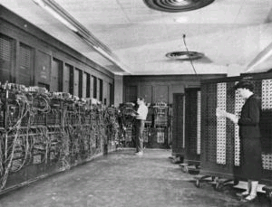
Why don’t computers use Base 10?
Because implementing it electronically is a pain
Hard to store
ENIAC (first general-purpose electronic computer) used 10 vacuum tubes / digit
Hard to transmit
Need high precision to encode 10 signal levels on single wire
Messy to implement digital logic functions
Addition, multiplication, etc.
(See CE203 for details)

Slide 57
Base 16: Hexadecimal
Hex | Decimal | Binary
0 | 0 | 0000
1 | 1 | 0001
2 | 2 | 0010
3 | 3 | 0011
4 | 4 | 0100
5 | 5 | 0101
6 | 6 | 0110
7 | 7 | 0111
8 | 8 | 1000
9 | 9 | 1001
A | 10 | 1010
B | 11 | 1011
C | 12 | 1100
D | 13 | 1101
E | 14 | 1110
F | 15 | 1111
Writing long sequences of 0s and 1s is tedious and error-prone
And takes up a lot of space on a page!
So we’ll often use base 16 (also called hexadecimal)
Base 2 = 2 symbols (0, 1) Base 10 = 10 symbols (0-9) Base 16, need 16 symbols
Use letters A-F once we run out of decimal digits

Slide 58
Base 16: Hexadecimal
Hex | Decimal | Binary
0 | 0 | 0000
1 | 1 | 0001
2 | 2 | 0010
3 | 3 | 0011
4 | 4 | 0100
5 | 5 | 0101
6 | 6 | 0110
7 | 7 | 0111
8 | 8 | 1000
9 | 9 | 1001
A | 10 | 1010
B | 11 | 1011
C | 12 | 1100
D | 13 | 1101
E | 14 | 1110
F | 15 | 1111
16 = 2⁴, so every group of 4 bits becomes a hexadecimal digit (or hexit)
If we have a number of bits not divisible by 4, add 0s on the left (always ok, just like base 10)
1 0 1 0 0 1 0 1 1 1 1 0 1 1
0 0
0x297B
“0x” prefix = it’s in hex

Slide 59
Bytes
A single bit doesn’t hold much information
Only two possible values: 0 and 1
So we’ll typically work with larger groups of bits
For convenience, we’ll refer to groups of 8 bits as bytes
And usually work with multiples of 8 bits at a time
Conveniently, 8 bits = 2 hexits
Some examples
1 byte: 0b01100111 = 0x67
2 bytes: 11000100 00101111₂ = 0xC42F
“0b” prefix = it’s in binary

Slide 60
Practice problem
Hex | Decimal | Binary
0 | 0 | 0000
1 | 1 | 0001
2 | 2 | 0010
3 | 3 | 0011
4 | 4 | 0100
5 | 5 | 0101
6 | 6 | 0110
7 | 7 | 0111
8 | 8 | 1000
9 | 9 | 1001
A | 10 | 1010
B | 11 | 1011
C | 12 | 1100
D | 13 | 1101
E | 14 | 1110
F | 15 | 1111
Convert 0x42 to decimal
Steps
Convert 0x42 to binary:
Convert binary to decimal:

Slide 61
Practice problem
Hex | Decimal | Binary
0 | 0 | 0000
1 | 1 | 0001
2 | 2 | 0010
3 | 3 | 0011
4 | 4 | 0100
5 | 5 | 0101
6 | 6 | 0110
7 | 7 | 0111
8 | 8 | 1000
9 | 9 | 1001
A | 10 | 1010
B | 11 | 1011
C | 12 | 1100
D | 13 | 1101
E | 14 | 1110
F | 15 | 1111
Convert 0x42 to decimal
Steps
Convert 0x42 to binary:
0x4 -> 0b0100 0x2 -> 0b0010
0x42 -> 0b 0100 0010
Convert binary to decimal:

Slide 62
Practice problem
Hex | Decimal | Binary
0 | 0 | 0000
1 | 1 | 0001
2 | 2 | 0010
3 | 3 | 0011
4 | 4 | 0100
5 | 5 | 0101
6 | 6 | 0110
7 | 7 | 0111
8 | 8 | 1000
9 | 9 | 1001
A | 10 | 1010
B | 11 | 1011
C | 12 | 1100
D | 13 | 1101
E | 14 | 1110
F | 15 | 1111
Convert 0x42 to decimal
Steps
Convert 0x42 to binary:
0x4 -> 0b0100 0x2 -> 0b0010
0x42 -> 0b 0100 0010
Convert binary to decimal:
1*2⁶ + 1*2¹ = 64 + 2 = 66

Slide 63
Practice problem
Convert 0x42 to decimal
Alternate method:
0x42
= 4×16¹ + 2×16⁰
= 64 + 2
= 66
But you’re honestly better off converting hex to binary first
It’s good practice!

Slide 64
Practice problem
Convert 0x42 to decimal
Critical thinking:
What are the maximum and minimum values?
Minimum 0 (0x00)
Maximum 255 (0xFF)
How big is 0x42 out of 0xFF?
~25% (0x40, 0x80, 0xC0, 0x100)
So 255/4 ≈ 256/4 ≈ 64

Slide 65
Big idea: bits can be used to represent anything
Depending on the context, the bits 11000011 could mean
The number 195
The number -61
The number -1.1875
The value True
The character ‘├’
The ret x86 instruction
You have to know the context to make sense of any bits you have!
People and software they write determine what the bits actually mean

Slide 66
Outline
Course Themes
Logistics
Running a program
Representing numbers with binary

