Slide 1
Lecture 03 Data Operations
CS213 – Intro to Computer Systems
Branden Ghena – Winter 2025
Slides adapted from: St-Amour, Hardavellas, Bustamente (Northwestern), Bryant, O’Hallaron (CMU), Garcia, Weaver (UC Berkeley)

Slide 2
Administrivia
You should all have access to Piazza and Gradescope
Contact me via email immediately if you don’t!!
Office hours are now running
See Canvas homepage for office hours times
Mostly in-person with a few online hours
Online uses gather.town (Room B)
Office hours queue on the Canvas homepage when things get busy
Note: no office hours next Monday for MLK Day

Slide 3
Administrivia
Homework 1 due this week Thursday
Submit on Gradescope
Pack Lab should be out later today!
Sometime this evening
Pack Lab partnership survey on Piazza
If you want a partner but don’t know who you want to work with
I’ll pair people from the list right after I post the lab
You’ll do Pack Lab on one of the EECS servers
Usually we use Moore, but any EECS server should be fine for this lab
SSH + Command Line interface
See Piazza post with some details on accessing the servers

Slide 4
Today’s Goals
Finish encodings thoughts from last time
Explore operations we can perform on integers and more generally on binary numbers
Understand the edge cases of those operations

Slide 5
Outline
Binary and Hex
Memory
Encoding
Integer Encodings
Signed Integers
Converting Sign
Converting Length
Other encodings

Slide 6
Big Idea: What do bits and bytes mean in a system?
The answer is: it depends!
Depending on the context, the bits 11000011 could mean
The number 195
The number -61
The number -19/16
The character ‘├’
The ret x86 instruction
You have to know the context to make sense of any bits you have!
Looking at the same bits in different contexts can lead to interesting results
Information = bits + context!
An encoding is a set of rules that gives meaning to bits

Slide 7
Encoding strings (The C way)
Represented by array of characters
Each character encoded in ASCII format
NULL character (code 0) to mark the end
Compatibility
Byte ordering not an issue (data all single-byte!)
ASCII text files generally platform independent
Except for different conventions of line termination character(s)!
char S[6] = "18243";
Big-Endian
Little-Endian
0x31
0x38
0x32
0x34
0x33
0x00
0x31
0x38
0x32
0x34
0x33
0x00

Slide 8
Encoding color
RGB colors
3-byte values
First byte is Red, then Green, then Blue
Usually specified in hexadecimal
#FF0000 -> maximum red, zero green or blue
#4E2A84 -> 1/4 red, 1/8 blue, 1/2 green (Northwestern Purple)
2²⁴ possible colors = 16777216 colors

Slide 9
Interpreting file contents
Collections of data
Usually in permanent storage on your computer
Regular files
Arbitrary data
Think of as a big array of bytes
Non-regular files would be directories, symbolic links, or other less used things

Slide 10
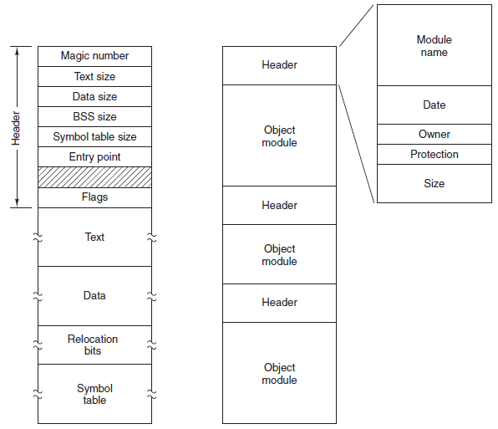
What about different types of regular files?
Text files versus Executables versus Tar files
All just differing patterns of bytes!
It really is just all data. The meaning is in how you interpret it.
Executable File
Archive (tar)

Slide 11
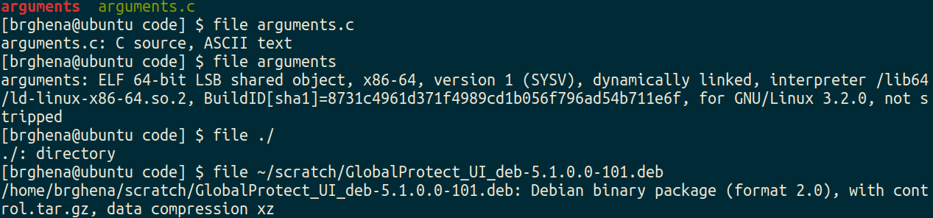
Identifying regular files
file in Linux command line can help determine the type of a file
https://github.com/file/file

Slide 12
Encoding time
Unix time:
32-bit signed integer counting seconds elapsed since initial time
Initial time was January 1st at midnight UTC, 1970
Current Unix time (as of last editing this slide): 1736874154
Negative numbers would mean times before 1970
Problem: when does Unix time hit the maximum value?
2147483647 seconds from January 1st 1970
Result: January 19th, 2038
This is the “Year 2038 Problem”

Slide 13
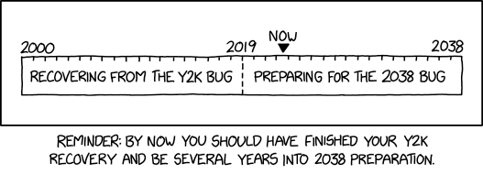
Bonus xkcd comic
https://xkcd.com/2697/

Slide 14
Outline
Integer Operations
Addition
Negation and Subtraction
Multiplication and Division
Binary Operations
Boolean Algebra
Shifting
Bit Masks

Slide 15
C versus the hardware
Operations you can perform on binary numbers have edge conditions
Usually going above or below the bit width
If we say what happens in that scenario, it’ll be what “the hardware” (i.e., a computer) does
In today’s examples, pretty much every computer does the same thing
That is not the same as what C does
Unclear choices are left as: UNDEFINED BEHAVIOR 😱
Which is to say, the compiler can make any choice it wants

Slide 16
Unsigned Addition
Like grade-school addition, but in base 2, and ignores final carry
If you want, can do addition in base 10 and convert to base 2. Same result! But here we’re going to understand what the hardware is doing.
Example: Adding two 4-bit numbers
5₁₀ + 3₁₀ = 8₁₀ ✔
1
1
1
0101
+ 0011
1
0
0
0
Notes:
If u + v < 2^w, the leading bit in the w+1-bit representation of the sum will be 0 so discarding it doesn’t change anything
If u + v > 2^w, the leading bit will equal 1 and discarding it will be the same as subtracting 2^w

Slide 17
Unsigned Addition and Overflow
What happens if the numbers get too big?
Example: Adding two 4-bit numbers
13₁₀ + 3₁₀ = 16₁₀
Too large for 4 bits! Overflow
Result is the 4 least significant bits (all we can fit): so 0₁₀
Truncate most-significant bits that do not fit
Gives us modular (= modulo) behavior: 16 modulo 2⁴ = 0
1
1
1
1
1101
+ 0011
1
0
0
0
0
Notes:
If u + v < 2^w, the leading bit in the w+1-bit representation of the sum will be 0 so discarding it doesn’t change anything
If u + v > 2^w, the leading bit will equal 1 and discarding it will be the same as subtracting 2^w

Slide 18
Modulo behavior in binary numbers
10000
0000
1111
0001
1110
0010
1101
0011
-1
1100
0100
+1
1011
0101
1010
0110
1001
0111
1000

Slide 19
Unsigned addition is modular
Implements modular arithmetic
UAdd_{w}(u , v) = (u + v) mod 2^{w}
Need to drop carry bit, otherwise results will keep getting bigger
Example in base 10: 80₁₀ + 40₁₀ = 120₁₀ (2-digit inputs become a 3-digit output!)
Warning: C does not tell you that the result had an overflow!
Unsigned addition in C silently truncates most-significant bits beyond the limit
Operands: w bits
u
• • •
+
v
• • •
True Sum: w+1 bits
u + v
• • •
UAdd Result: w bits
UAdd_{w}(u , v)
• • •
Notes:
If u + v < 2^w, the leading bit in the w+1-bit representation of the sum will be 0 so discarding it doesn’t change anything
If u + v > 2^w, the leading bit will equal 1 and discarding it will be the same as subtracting 2^w

Slide 20
Signed (2’s Complement) Addition
Works exactly the same as unsigned addition!
Just add the numbers in binary, and the result will work out
Signed and unsigned sum have the exact same bit-level representation
Computers use the same machine instruction and the same hardware!
That’s a big reason 2’s complement is so nice! Shares operations with unsigned
Notes:
The w-bit two’s complement sum of two numbers has the exact same bit-level representation as the unsigned sum; most computers use the same machine instruction

Slide 21
Signed addition example
Same addition method as unsigned
Example: Adding two 4-bit signed numbers
-5₁₀ + 3₁₀ = -2₁₀ ✔
1
1
1011 (-8 + 3 = -5)
+ 0011 ( +3)
1 (-8 + 6 = -2)
1
1
0
Notes:
If u + v < 2^w, the leading bit in the w+1-bit representation of the sum will be 0 so discarding it doesn’t change anything
If u + v > 2^w, the leading bit will equal 1 and discarding it will be the same as subtracting 2^w

Slide 22
Combining negative and positive numbers
Overflow sometimes makes signed addition work!
Example: Adding two 4-bit signed numbers
-3₁₀ + 3₁₀ = 0₁₀
Too large for 4 bits! Drop the carry bit
Result is what we expect as long as we truncate
1
1
1
1
1101 (-8 + 5 = -3)
+ 0011 ( +3)
1
0
0
0
0
Notes:
If u + v < 2^w, the leading bit in the w+1-bit representation of the sum will be 0 so discarding it doesn’t change anything
If u + v > 2^w, the leading bit will equal 1 and discarding it will be the same as subtracting 2^w

Slide 23
Signed addition and overflow
Overflow can still happen in signed addition though
Example: Adding two 4-bit signed numbers
5₁₀ + 3₁₀ = -8₁₀ (+8 is too big to fit)
Remember, this was also unsigned 5₁₀ + 3₁₀ = 8₁₀
1
1
1
0101
+ 0011
1
0
0
0
Notes:
If u + v < 2^w, the leading bit in the w+1-bit representation of the sum will be 0 so discarding it doesn’t change anything
If u + v > 2^w, the leading bit will equal 1 and discarding it will be the same as subtracting 2^w

Slide 24
Signed addition and negative overflow
Overflow also happens in the negative direction
Example: Adding two 4-bit signed numbers
-5₁₀ + -5₁₀ = +6₁₀ (-10 was too small to fit)
1
1
1
1011
+ 1011
10
1
1
0
Notes:
If u + v < 2^w, the leading bit in the w+1-bit representation of the sum will be 0 so discarding it doesn’t change anything
If u + v > 2^w, the leading bit will equal 1 and discarding it will be the same as subtracting 2^w

Slide 25
Overflow: hardware vs C standard
Hardware implementations for unsigned and signed addition are the same
Both implement truncation of overflowing bits, leads to modular arithmetic
Unsigned overflow in C is defined as modular arithmetic
Signed overflow in C is UNDEFINED BEHAVIOR
Compiler probably does modular result
But there are no promises about this and it can make assumptions
So don’t rely on it
Generally: overflow is bad and is to be avoided!

Slide 26
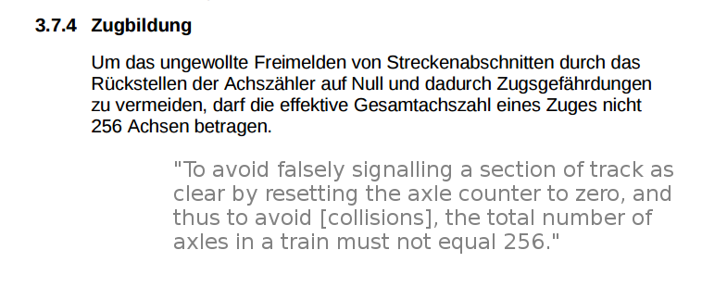
Overflow in the real world
In Switzerland, there’s a rule that trains are not allowed to have exactly 256 axles

Slide 27
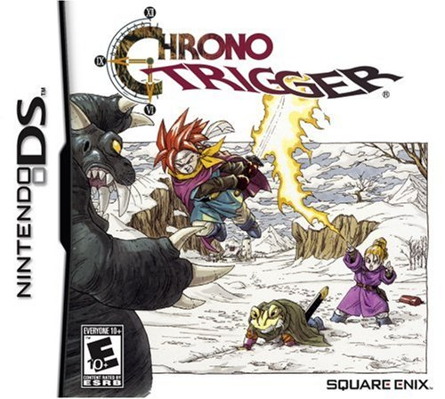

Video games bugs can be exploited
Dream Devourer
Special boss in the Nintendo DS edition
Wanted to make it even more challenging
~32000 hit points
Takes forever to defeat
Hit points stored as a 16-bit signed integer
Range: -32768 to +32767
How do speedrunners defeat the boss?

Slide 28
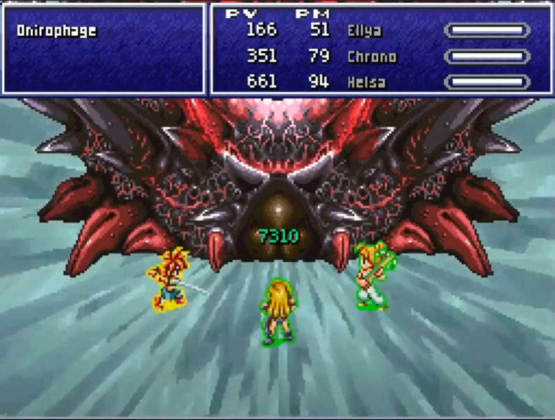
Chrono Trigger signed overflow bug
Solution: heal it
Hit points go negative and it dies

Slide 29
Outline
Integer Operations
Addition
Negation and Subtraction
Multiplication and Division
Binary Operations
Boolean Algebra
Shifting
Bit Masks

Slide 30
Negating a number
In C:
x = -y;
Operation
Determine the negative, signed version of the number (two’s complement)
Hardware method: flip bits and add one
Complement operator (~)
Flips all bits: zeros become a one and ones become a zero
~0b1011 -> 0b0100

Slide 31
Negating via Complement & Increment
Claim: The following is true for 2’s complement
~x + 1 == -x
Complement
Observation: ~x + x == 1111…11₂ == -1
Increment
~x + 1 == ~x + x - x + 1 == -1 - x + 1 == -x
Example, 4 bits: 6₁₀ = 0110₂
Complement: 1001₂ → Increment = 1010₂ = -8 + 2 = -6₁₀
x
1
0
0
1
1
1
0
1
+
~x
0
1
1
0
0
0
1
0
-1
1
1
1
1
1
1
1
1

Slide 32
Subtraction in two’s complement
Subtraction becomes addition of the negative number
5 – 3 = 5 + -3 = 2
Both unsigned and signed subtraction
Convert subtractor to its two’s complement negative form
i.e., negate it
Then do addition
Treat result as an unsigned number
1
1
1
0101 (+5)
+ 1101 ( -3)
10
0
1
0

Slide 33
C rules vs hardware rules
Exact same overflow rules apply
Unsigned subtraction overflow can wrap below zero to make a large number
Modular arithmetic
Signed subtraction overflow is UNDEFINED BEHAVIOR
And therefore should not be trusted

Slide 34
Break + practice
Adding two 8-bit binary numbers:
Also determine the decimal version of the result
00010101
+ 10110001

Slide 35
Break + practice
Adding two 8-bit binary numbers:
Also determine the decimal version of the result
Unsigned encoding
Signed encoding
1
1
1
00010101
+ 10110001
16+4+1 = 21
16+4+1 = 21
128+32+16+1 = 177
OR
-128+32+16+1 = -79
1
1
0
0
0
1
1
0
128+64+4+2 = 198
-128+64+4+2 = -58

Slide 36
Break + practice
Adding two 8-bit binary numbers:
Also determine the decimal version of the result
Unsigned encoding
Signed encoding
1
1
1
00010101
+ 10110001
16+4+1 = 21
16+4+1 = 21
128+32+16+1 = 177
OR
-128+32+16+1 = -79
1
1
0
0
0
1
1
0
128+64+4+2 = 198
-128+64+4+2 = -58
What about unsigned subtraction 21-79?
That would treat the result as unsigned, with the value 198
Modular arithmetic in action

Slide 37
Outline
Integer Operations
Addition
Negation and Subtraction
Multiplication and Division
Binary Operations
Boolean Algebra
Shifting
Bit Masks

Slide 38
Multiplication
Goal: Compute the Product of two w-bit numbers x, y
Either signed or unsigned
But, exact results can be bigger than w bits
Double the size (2w), in fact!
Example in base 10: 50₁₀ * 20₁₀ = 1000₁₀
(2-digit inputs become a 4-digit output!)
As with addition, result is truncated to fit in w bits
Because computers are finite, results can’t grow indefinitely

Slide 39
Unsigned Multiplication
u
Operands: w bits
• • •
*
v
• • •
True Product: 2*w bits
u · v
• • •
• • •
UMult_{w}(u , v)
Discard w bits: w bits
• • •
Standard Multiplication Function
Equivalent to grade-school multiplication
But ignores most significant w bits of the result
As a person, we can do base 10 multiplication, convert to base 2, then truncate
Implements modular arithmetic like addition does
UMult_{w}(u , v) = (u · v) mod 2^{w}

Slide 40
Unsigned multiplication
Example: Multiplying two 4-bit numbers
2₁₀ * 5₁₀ = 10₁₀ ✔
0010
x 0101
0010
0
0000
0010
00
+ 0000
000
0001010
Notes:
If u + v < 2^w, the leading bit in the w+1-bit representation of the sum will be 0 so discarding it doesn’t change anything
If u + v > 2^w, the leading bit will equal 1 and discarding it will be the same as subtracting 2^w

Slide 41
Signed (2’s Complement) Multiplication
u
Operands: w bits
• • •
*
v
• • •
True Product: 2*w bits
u · v
• • •
• • •
TMult_{w}(u , v)
Discard w bits: w bits
• • •
Standard Multiplication Function
Ignores most significant w bits
Lower bits still give the correct result
So we can use same machine instruction for both!
Again, that’s one reason why 2’s complement is so nice
In C, signed overflow is undefined
...but probably you’ll see the two’s complement behavior

Slide 42
Signed multiplication
Example: Multiplying two’s complement 5-bit numbers
11110
x 00011
-2
What are these two 5-bit numbers?
3
11110
What is the result of this addition?
+ 11110
0
1011010
1
0
1
1
0
1
0
-2₁₀ * 3₁₀ = -6₁₀ ✔
Notes:
If u + v < 2^w, the leading bit in the w+1-bit representation of the sum will be 0 so discarding it doesn’t change anything
If u + v > 2^w, the leading bit will equal 1 and discarding it will be the same as subtracting 2^w

Slide 43
What about divide?
Annoying operation, not going to discuss in this class
Similar to long division process
Tedious and complicated to get right
I’ve worked on computers that don’t have hardware support for division at all!!
Important thing to remember is that integers don’t have fractional parts
In C: 1/2 == 0
We’ll need a different encoding for fractional numbers: floating point

Slide 44
Outline
Integer Operations
Addition
Negation and Subtraction
Multiplication and Division
Binary Operations
Boolean Algebra
Shifting
Bit Masks

Slide 45
Boolean algebra
You’ve programmed with and and or in earlier classes
Written && and || in C and C++
Boolean algebra is a generalization of that
A mathematical system to represent logic (propositional logic)
2 truth values: true = 1, false = 0
Operations: and &, or |, not (or complement) ~

Slide 46
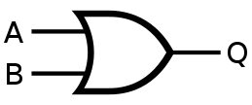


Performing Boolean algebra
Follow the rules for each operation to compute results
Rules are like those you know from programming
OR: | AND: & NOT: ~ 1: True 0: False
(1 | 0) & 0
1 & 0
0
(1 & 1) & ~(0 | 0)
1 & ~(0)
1 & 1
1

Slide 47
Truth tables for Boolean algebra
For each possible value of each input, what is the output
Column for each input
Column for the output operation
~A
A | ~A
0 | 1
1 | 0
A | B
A | B | A | B
0 | 0 | 0
0 | 1 | 1
1 | 0 | 1
1 | 1 | 1
A & B
A | B | A & B
0 | 0 | 0
0 | 1 | 0
1 | 0 | 0
1 | 1 | 1

Slide 48

Exclusive Or (xor)
A ^ B
A | B | A ^ B
0 | 0 | 0
0 | 1 | 1
1 | 0 | 1
1 | 1 | 0
An operation you likely haven’t used before:
Xor - either A or B, but not both
^ symbol in C
We can build Xor out of &, |, and ~
A^B = (~A & B) | (A & ~B)
(exactly one of A and B is true)
A^B = (A | B) & ~(A & B)
(either is true but not both are true)
The two definitions are equivalent
Produce the same Truth Table

Slide 49
Practice problem
(A & B) | B
A | B | (A&B)|B
0 | 0
0 | 1
1 | 0
1 | 1

Slide 50
Practice problem
(A & B) | B
A | B | (A&B)|B
0 | 0
0 | 1
1 | 0
1 | 1
0
1
0
1

Slide 51
Practice problem
(A & B) | B
A | B | (A&B)|B
0 | 0 | 0
0 | 1 | 1
1 | 0 | 0
1 | 1 | 1
This is equivalent to B (A has no influence on the solution)

Slide 52
De Morgan’s Law
We can express Boolean operators in terms of the others
De Morgan’s laws: allow swapping & with |
A & B = ~(~A | ~B) → ~(A & B) = ~A | ~B
(neither A nor B is false)
A | B = ~(~A & ~B) → ~(A | B) = ~A & ~B
(A and B are not both false)
Useful for simplifying logical statements

Slide 53
Generalized Boolean algebra
Boolean operations can be extended to work on collections of bits (i.e., bytes)
Operations are applied one bit at a time: bitwise
All of the properties of Boolean algebra still apply
Relationships between operations, etc.
Bitwise operations are usable in C: &, |, ~, ^
Can operate on any integer type (long, int, short, char, signed or unsigned)
01101001
& 01010101
01000001
01101001
| 01010101
01111101
01101001
^ 01010101
00111100
~ 01010101
10101010
01000001
01111101
00111100
10101010

Slide 54
Warning: bitwise operations are NOT logical operations
Logical operations in C: ||, &&, ! (logical Or, And, and Not)
Only operate on a single bit
View 0 as “False”
View anything nonzero as “True”
Always return 0 or 1
Short-circuit evaluation: only checks the first operand if that is sufficient
Examples
!0x41 -> 0x00 !0x00 -> 0x01 !!0x41 -> 0x01
0x59 && 0x35 -> 0x01
(p != NULL) && *p (short circuit evaluation avoids null pointer access)
Don’t confuse the two!! It’s a common C mistake

Slide 55
Break + Practice
Hex | Decimal | Binary
0 | 0 | 0000
1 | 1 | 0001
2 | 2 | 0010
3 | 3 | 0011
4 | 4 | 0100
5 | 5 | 0101
6 | 6 | 0110
7 | 7 | 0111
8 | 8 | 1000
9 | 9 | 1001
A | 10 | 1010
B | 11 | 1011
C | 12 | 1100
D | 13 | 1101
E | 14 | 1110
F | 15 | 1111
0x37 | 0xAA
0x06 ^ 0xFF
A | B
A | B | A | B
0 | 0 | 0
0 | 1 | 1
1 | 0 | 1
1 | 1 | 1
A ^ B
A | B | A & B
0 | 0 | 0
0 | 1 | 1
1 | 0 | 1
1 | 1 | 0

Slide 56
Break + Practice
Hex | Decimal | Binary
0 | 0 | 0000
1 | 1 | 0001
2 | 2 | 0010
3 | 3 | 0011
4 | 4 | 0100
5 | 5 | 0101
6 | 6 | 0110
7 | 7 | 0111
8 | 8 | 1000
9 | 9 | 1001
A | 10 | 1010
B | 11 | 1011
C | 12 | 1100
D | 13 | 1101
E | 14 | 1110
F | 15 | 1111
0x37 | 0xAA
0x06 ^ 0xFF
00110111
| 10101010
00000110
^ 11111111
10111111
11111001
A | B
A | B | A | B
0 | 0 | 0
0 | 1 | 1
1 | 0 | 1
1 | 1 | 1
A ^ B
A | B | A & B
0 | 0 | 0
0 | 1 | 1
1 | 0 | 1
1 | 1 | 0

Slide 57
Break + Practice: C example of bitwise operators
unsigned char x = 13;
unsigned char y = 11;
unsigned char z = x & y;
What decimal value is in z now?
Remember: unsigned char is an 8-bit value

Slide 58
Break + Practice: C example of bitwise operators
unsigned char x = 13;
unsigned char y = 11;
unsigned char z = x & y;
What decimal value is in z now?
Remember: unsigned char is an 8-bit value
x: 0b00001101
y: 0b00001011
z: 0b00001001
-> 9

Slide 59
Outline
Integer Operations
Addition
Negation and Subtraction
Multiplication and Division
Binary Operations
Boolean Algebra
Shifting
Bit Masks

Slide 60
Left Shift: x << y
Argument x
00000010
Shift bit-vector x left by y positions
Throw away extra bits on left
Fill empty bits with 0
Same behavior for signed or unsigned
Equivalent to multiplying by 2^{y}
And then taking modulo (i.e. truncating overflow bits)
Undefined behavior in C when:
y < 0, or y ≥ bit_width(x)
Also when some non-0 bits get shifted off (probably they get truncated)
<< 3
00000010000
00000010000
00010000
Argument x
10100010
<< 3
10100010000
10100010000
00010000
Notes:
For x << k, what is the effect of the shift if k >= w, the number of bits of x data type?
e.g.
x << 32
x >> 36
x >> 40
For C, nothing standard but most commonly use lower log_2 w bits of the shift; for Java that’s a rule; effectively that’s k mod w, so for a 32b data type
x << 32 same as x << 0
x >> 36 same as x >> 4
x >> 40 same as x >> 8

Slide 61
Right Shift: x >> y
Argument x
01100010
Shift bit-vector x right y positions
Throw away extra bits on right
But how to fill the new bits that open up?
Will depend on signed vs unsigned
Unsigned: Logical shift
Always fill with 0’s on left
Signed: Arithmetic shift
Replicate most significant bit on left
Necessary for two’s complement integer representation (sign extension!)
Undefined behavior in C when:
y < 0, or y ≥ bit_width(x)
Logi. >> 2
00011000
00011000
00011000
Arith. >> 2
00011000
00011000
00011000
Argument x
10100010
Logi. >> 2
00101000
00101000
00101000
Arith. >> 2
11101000
11101000
11101000
Notes:
For x << k, what is the effect of the shift if k >= w, the number of bits of x data type?
e.g.
x << 32
x >> 36
x >> 40
For C, nothing standard but most commonly use lower log_2 w bits of the shift; for Java that’s a rule; effectively that’s k mod w, so for a 32b data type
x << 32 same as x << 0
x >> 36 same as x >> 4
x >> 40 same as x >> 8

Slide 62
Practice shifting in C
unsigned char x = 0b10100010;
x << 3 = ?
0b00010000
Steps:
0b10100010000
0b10100010000
unsigned char x = 0b10100010;
x >> 2 = ?
0b00101000
Steps:
0b0010100010
0b0010100010
signed char x = 0b10100010;
x >> 2 = ?
0b11101000
Steps:
0b1110100010
0b1110100010
Note:
GCC supports the prefix 0b for binary literals (like 0x… for hex) directly in C.
This is not part of the C standard! It may not work on other compilers.

Slide 63
Concept: Not all operations are equally expensive!
Some operations are pretty simple to perform in hardware
E.g., addition, shifting, bitwise operations
Also true of doing the same by hand on paper
Others are much more involved
E.g., multiplication, or even more so division
Consider long multiplication / long division; quite tedious!
Hardware is not doing the exact same thing, but similar principle
For best performance: swap expensive operations with simple ones!
Doesn’t work in all cases, but often does when mult/div by constants

Slide 64
Shift to divide
Division by powers of two could be shifts
unsigned int x = y / 2; unsigned int x = y >> 1;
Even more important because division is a complicated operation
Multiply is implemented in (relatively) simple hardware on most systems
Compiler might actually translate your divide-by-powers-of-two operations into shift operations though!
Warning: rounding needs to be handled correctly for signed numbers and division
See bonus slides

Slide 65
Compilers automatically chose the best operations
Should you use shifts instead of multiply/divide in your C code?
NO
Just write out the math
Math is more readable if that’s what you meant
Compiler automatically converts code to get best performance
These two mean the same thing, but one is way more understandable
int x = y * 32;
int x = (y << 5);

Slide 66
Outline
Integer Operations
Addition
Negation and Subtraction
Multiplication and Division
Binary Operations
Boolean Algebra
Shifting
Bit Masks

Slide 67
Bit Masking
How do you manipulate certain bits within a number?
Combines some of the ideas we’ve already learned
~, &, |, <<, >>
Steps
Create a “bit mask” which is a pattern to choose certain bits
Use & or | to combine it with your number
Optional: Use >> to move the bits to the least significant position

Slide 68
How to operate on bits
Selecting bits, use the AND operation
1 means to select that bit
0 means to not select that bit
Writing bits
Writing a one, use the OR operation
1 means to write a one to that position
0 is unchanged
Writing a zero, use the AND operation
0 means to write a zero to that position
1 is unchanged
Select bottom four bits:
num & 0x0F
Set 6th bit to one:
num | (1 << 6)
num | (0b01000000)
Clear 6th bit to zero: num & (~(1 << 6))
num & (~(0b01000000))
num & (0b10111111)

Slide 69
Example: swap nibbles in byte
Nibble - 4 bits (one hexit)
Input: 0x4F -> Output 0xF4
Method:
1. Shift and select upper four bits
2. Shift and select lower four bits
3. Combine the two nibbles
uint8_t lower = input >> 4;
uint8_t upper = input << 4;
uint8_t output = upper | lower; // combines two halves
What are the values of the new upper bits?
Unsigned -> Will be zero
Shifting implicitly zero’d out irrelevant bits. Otherwise we would have needed an & operation too.

Slide 70
Example: selecting bits
0b01100100
Input: 0b01100100
Select bits 2 and 3 from a number
Mask: 0b00001100
0b01100100
& 0b00001100
0b00000100
In C: result = (input & 0x0C) >> 2;
Finally, shift right by two to get the values in the least significant position:
0b00000001

Slide 71
Outline
Integer Operations
Addition
Negation and Subtraction
Multiplication and Division
Binary Operations
Boolean Algebra
Shifting
Bit Masks

Slide 72
Outline
Dividing with bit shift
Bonus material isn’t required and won’t be on an exam
Unless it becomes main lecture material in a different lecture
Usually the material is just for students who want more depth
As is the case here

Slide 73
Unsigned Power-of-2 Divide with Right Shift
⎣ x ⎦ : round x down
⎡ x ⎤ : round x up
Quotient of unsigned by power of 2
u >> k gives ⎣ u / 2^{k} ⎦
Uses logical shift
Pink part would be remainder / fractional part (right of the point)
Shift just drops it: equivalent to rounding down
k
u
•••
•••
Operands:
Binary Point
/
2^{k}
0
•••
0
1
0
•••
0
0
Division:
u / 2^{k}
.
0
0
•••
0
0
•••
•••
Result:
⎣ u / 2^{k} ⎦
0
0
•••
0
0
•••

Slide 74
Signed Power-of-2 Divide with Shift (Almost)
Quotient of signed by power of 2
x >> k gives ⎣ x / 2^{k} ⎦
Uses arithmetic shift
Also rounds down, again by dropping bits
But signed division should round towards 0! (that’s its math definition)
That means rounding up for negative numbers!
Example, 4 bits: -6 / 4 = -1.5 (should round towards 0, to -1)
1010₂ >> 2 = 1110₂ = -2₁₀
Rounds the wrong way!
k
x
•••
•••
Operands:
Binary Point
/
2^{k}
0
•••
0
1
0
•••
0
0
Division:
x / 2^{k}
.
0
•••
•••
•••
Result:
RoundDown(x / 2^{k})
0
•••
•••

Slide 75
Correct Signed Power-of-2 Divide
Want ⎡ x / 2^{k} ⎤ (round towards 0)
Math identity: ⎡x / y⎤ = ⎣ (x + y - 1) / y ⎦
Compute negative case as ⎣(x+2^{k}-1)/ 2^{k} ⎦ → gets us correct rounding!
Computing both cases in C: (x<0 ? (x + (1<<k)-1) : x) >> k
Biases dividend toward 0
Case 1: No rounding
Example, 4 bits: -8 / 2² = -2 bias = (1<<2)-1 = 3
(1000 + 0011) >> 2 = 1011 >> 2 = 1110 = -2₁₀ (correct, no rounding)
all bits at positions 0...(k-1) are 0
k
Dividend:
x
1
•••
0
•••
0
0
+2^{k} –1
0
•••
0
0
1
•••
1
1
Binary Point
1
•••
1
•••
1
1
Divisor:
/
2^{k}
0
•••
0
1
0
•••
0
0
⎡ x / 2^{k} ⎤
.
0
1
•••
1
1
1
•••
1
•••
1
1
Biasing has no effect; all affected bits are dropped
Notes:
Ceiling (x / y) = floor (x + y - 1) / y)

Slide 76
Correct Signed Power-of-2 Divide (Cont.)
Case 2: Rounding
some bits at positions 0...(k-1) are 1
k
Dividend:
x
1
•••
•••
+2^{k} –1
0
•••
0
0
1
•••
1
1
1
•••
•••
Incremented by 1
Binary Point
Divisor:
/
2^{k}
0
•••
0
1
0
•••
0
0
⎡ x / 2^{k} ⎤
.
0
1
•••
1
1
1
•••
•••
Incremented by 1
Biasing adds 1 to final result; just what we wanted
Example, 4 bits: -6 / 2² = -1 bias = (1<<2)-1 = 3
(1010 + 0011) >> 2 = 1101 >> 2 = 1111 = -1₁₀ (correct, rounds towards 0)
Compiler does that for you (but you need to be able to read it!)

