Slide 1
Lecture 04 Floating Point
CS213 – Intro to Computer Systems
Branden Ghena – Winter 2025
Slides adapted from: St-Amour, Hardavellas, Bustamente (Northwestern), Bryant, O’Hallaron (CMU), Garcia, Weaver (UC Berkeley)

Slide 2
Administrivia
Homework 1 due today! (11:59 pm Central)
Submit on Gradescope
About 55% of the class has submitted so far 🧡
Pack Lab is out
Get started on this ASAP
If you still need a partner, I’ll take last-chance requests today
No Office Hours on Monday (01/20) for MLK Day holiday
Normal office hours on Friday and Tuesday though

Slide 3
Today’s Goals
Explore representing real (decimal) numbers with binary
Understand IEEE754 encoding
Discuss encoding impacts on floating-point arithmetic

Slide 4
What is hard about floating point?
LOTS OF RULES
No, more than that
Homework 2 will give you a chance to practice
Plus on exams you’ll have a notes sheet to write down rules on

Slide 5
Outline
Fractional Binary Numbers
Representing Floating Point
Smaller Floating Point
Floating Point Arithmetic

Slide 6
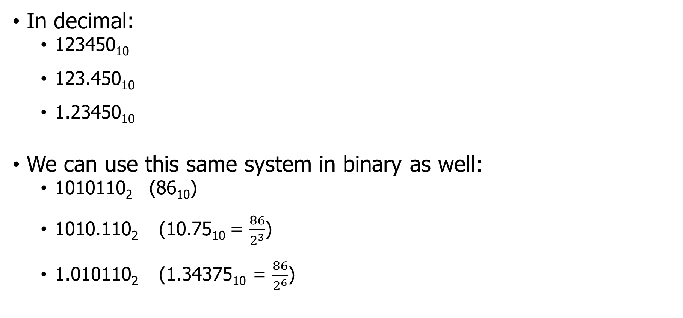
Floating point numbers
In decimal:
123450₁₀
123.450₁₀
1.23450₁₀
We can use this same system in binary as well:
1010110₂ (86₁₀)
1010.110₂ (10.75₁₀ = $\frac{86}{2^{3}}$)
1.010110₂ (1.34375₁₀ = $\frac{86}{2^{6}}$)

Slide 7
Fractional Binary Numbers
Representation
Bits to right of “binary point” represent fractional powers of 2
Represents rational number:
2^{i}
2^{i–1}
2² = 4
• • •
2¹ = 2
2⁰ = 1
b_{i}
b_{i–1}
• • •
b₂
b₁
b₀
.
b_{–1}
b_{–2}
b_{–3}
• • •
b_{–j}
1/2 = 2⁻¹
1/4 = 2⁻²
• • •
1/8 = 2⁻³
2^{–j}
Notes:
First step is to understand how fractional numbers are represented in binary
As with decimal representation, the weighting of the digits is defined relative to the decimal point symbol;
For binary, the weighting of the binary digit is defined relative to the binary point symbol

Slide 8
Example binary conversion
1010.110
Before the binary point:
1*2³ + 0*2² + 1*2¹ +0*2⁰
= 1*2³ + 1*2¹ = 8+2 = 10
After the binary point:
1*2⁻¹ + 1*2⁻² + 0*2⁻³
= 1*2⁻¹ + 1*2⁻² = ½ + ¼ = ¾ = 0.75

Slide 9
Fractional Binary Number Examples
101.
Note:
This the number 3!
This is the number 7!
This is the number 63!
11
5+3/4 = 0b
2+7/8 = 0b
63/64 = 0b
10.111
0.111111
Notes:
Shifting the binary point right, multiplies by 2, shifting left divides by 2

Slide 10
Scientific Notation Binary
Scientific notation works in binary just like in decimal
Decimal: 134 = 1.34 * 10²
Binary: 101 = 1.01 * 2²
Positive and negative exponents change the direction the point moves
Positive powers get bigger: 1.00101 * 2⁴ -> 10010.1
Negative powers get smaller: 1.00101 * 2⁻³ -> 0.00100101

Slide 11
Binary point is part of the solution, but not an entire encoding
Some problems remain:
Computers are finite, but real numbers are not
Need to choose how many bits to use
Many decimal numbers would take infinite binary bits to represent perfectly
3.14₁₀ = 11.0010001111010111₂ (we could keep going)
We also need to represent where the “binary point” is located
We’ll use scientific notation and some of our bits to do so
Should do signed numbers while we’re at it

Slide 12
Outline
Fractional Binary Numbers
Representing Floating Point
Smaller Floating Point
Floating Point Arithmetic

Slide 13
Floating Point Standard – IEEE754
Floating point representations
Encodes rational numbers of the form V = m × 2e
Base 2 scientific notation!
IEEE Standard 754 (IEEE floating point)
Established in 1985 as uniform standard for floating point arithmetic
Before that, many idiosyncratic formats
Headed by William Kahan, CS prof. at UC Berkeley (later won Turing Award for it)
Supported by all major CPUs
Driven by numerical concerns and numerical analysts
Nice standards for rounding, overflow, underflow
Had to be implementable in fast hardware as well and support many languages

Slide 14
Flow for floating point translations
Translating between decimal and IEEE754 floating point has a clear set of steps that you always take
Steps from Decimal to IEEE754:
Decimal
Floating point binary
Scientific notation binary
IEEE754 encoding
Steps for IEEE754 to Decimal:
IEEE754 encoding
Scientific notation binary
Floating point binary
Decimal

Slide 15
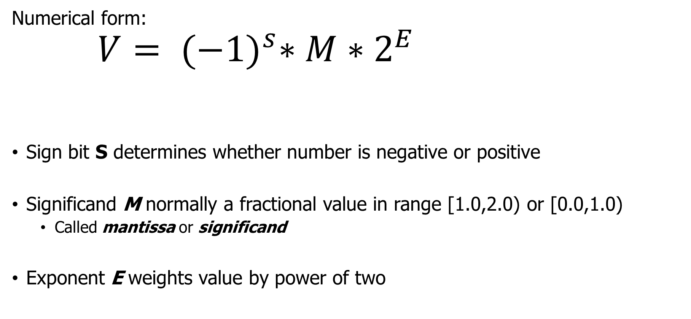
Floating Point Representation
Exponent
Numerical form:
$$V= {(−1)}^{s}∗M∗2^{E}$$
Sign bit S determines whether number is negative or positive
Significand M normally a fractional value in range [1.0,2.0) or [0.0,1.0)
Called mantissa or significand
Exponent E weights value by power of two
Sign bit
Significand (Mantissa)
Notes:
Instead, we would like to represent numbers like x * 2^y by using x and y

Slide 16
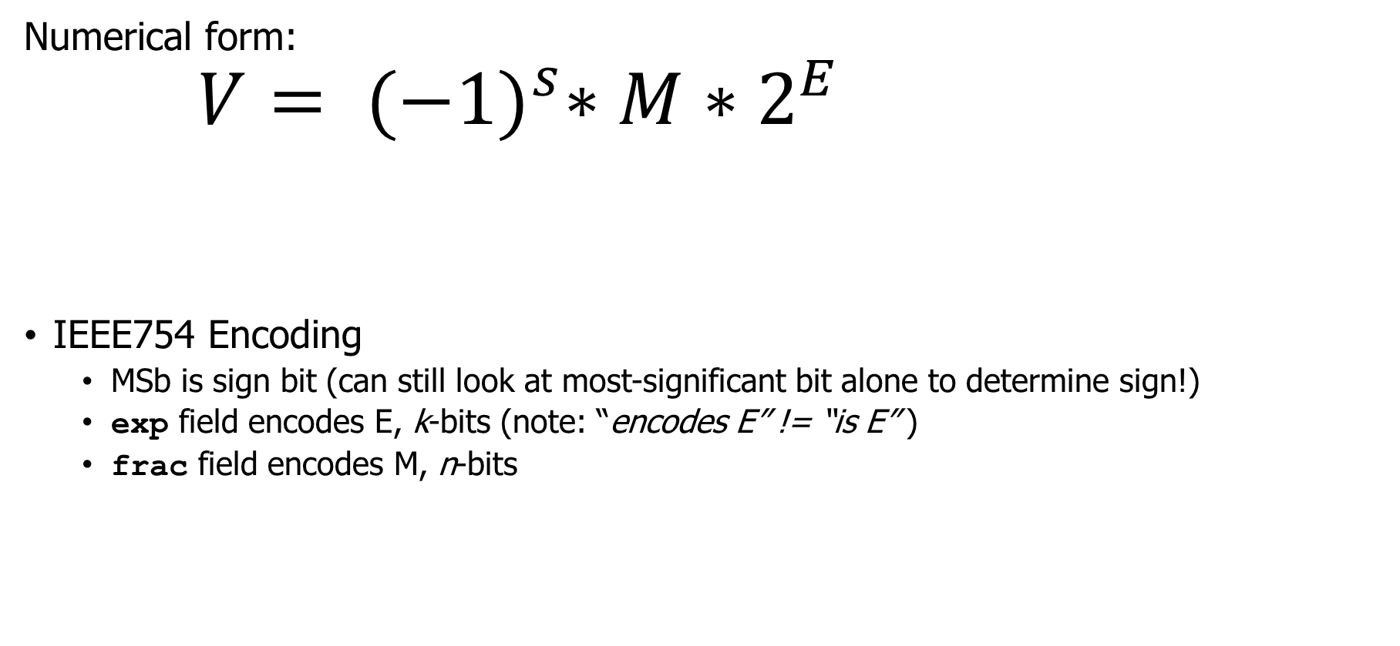
IEE754 Floating Point Encoding
Exponent
Numerical form:
$$V= {(−1)}^{s}∗M∗2^{E}$$
IEEE754 Encoding
MSb is sign bit (can still look at most-significant bit alone to determine sign!)
exp field encodes E, k-bits (note: “encodes E” != “is E” )
frac field encodes M, n-bits
Sign bit
Significand (Mantissa)
s
exp
frac
Notes:
Instead, we would like to represent numbers like x * 2^y by using x and y

Slide 17
IEEE754 Floating Point Precision
Sizes
Single precision: k = 8 exp bits, n= 23 frac bits (32b total). float in C
Double precision: k = 11 exp bits, n = 52 frac bits (64b total). double in C
31
30
23
22
0
s
exp
frac
63
62
52
51
32
s
exp
frac
31
0
frac
Notes:
Extended precision, btw is what the Intel processors will use when operating on numbers loaded on the floating point registers (and converted back and forth as you move in and out of memory)
The 1 wasted bit is there for backwards compatibility to 8087/80287 which were generating “unnormal” FP numbers and explicitly encoded the integer part for faster computation.

Slide 18
Categories for IEEE754 Encoded Values
Value encoded – three cases, depending on value of exp
Normalized, the most common
Denormalized (very small values)
Special values – infinity and NaN
s
≠ 0 && not all 1s
frac
s
00000000
frac
Infinity
s
11111111
00000000000000000000000
NaN
s
11111111
≠0
Notes:
Neither all zeroes nor all ones -> normalized, the most common case
All zero for denormalized, to represent zero and very small numbers close to it;
# So what’s the representation of 0 in FP? How many zeros are there?

Slide 19
Categories for IEE754 Encoded Values
Value encoded – three cases, depending on value of exp
Normalized, the most common
Denormalized (very small values)
Special values – infinity and NaN
s
≠ 0 && not all 1s
frac
s
00000000
frac
Infinity
s
11111111
00000000000000000000000
NaN
s
11111111
≠0
Notes:
Neither all zeroes nor all ones -> normalized, the most common case
All zero for denormalized, to represent zero and very small numbers close to it;
# So what’s the representation of 0 in FP? How many zeros are there?

Slide 20

Normalized, Signifcand
$$V= {(−1)}^{s}∗M∗2^{E}$$
Condition: not a special exponent (all zeros or ones)
Significand is encoded with implied leading 1
M = 1.xxx…x₂ (1+f where f = 0.xxx₂)
xxx…x: bits of frac used directly
Idea: every normalized number is 1.xxxx
So we’re not going to include the leading 1 in the frac
We’ll just know it’s there when we convert to decimal
Saves one extra bit in the encoding!
s
exp
frac
Notes:
Exponent field is represented as a signed integer in biased form – E = Exp – bias
The bias for 32b single precision yields exponents ranging from -126 to +127
The implied leading 1 is just a trick to get an additional bit of pecision

Slide 21
Normalized, Exponent
$$V= {(−1)}^{s}∗M∗2^{E}$$
Condition: not a special exponent (all zeros or ones)
Exponent coded as a biased value
E = Exp – Bias
Exp : unsigned value denoted by exp
Bias : Bias value = 2^{k-1} - 1, k is number of exponent bits
Single precision (8-bit exp): 127 (Exp: 1…254, E: -126…127)
Double precision (11-bit exp): 1023 (Exp: 1…2046, E: -1022…1023)
Exponent really just pushes the binary point around
1.11 * 2^2 = 11.1 * 2^1 = 111.0 * 2^0 = 111
111 * 2^-2 = 11.1 * 2^-1 = 1.11 * 2^0 = 1.11
s
exp
frac
Notes:
Exponent field is represented as a signed integer in biased form – E = Exp – bias
The bias for 32b single precision yields exponents ranging from -126 to +127
The implied leading 1 is just a trick to get an additional bit of pecision

Slide 22

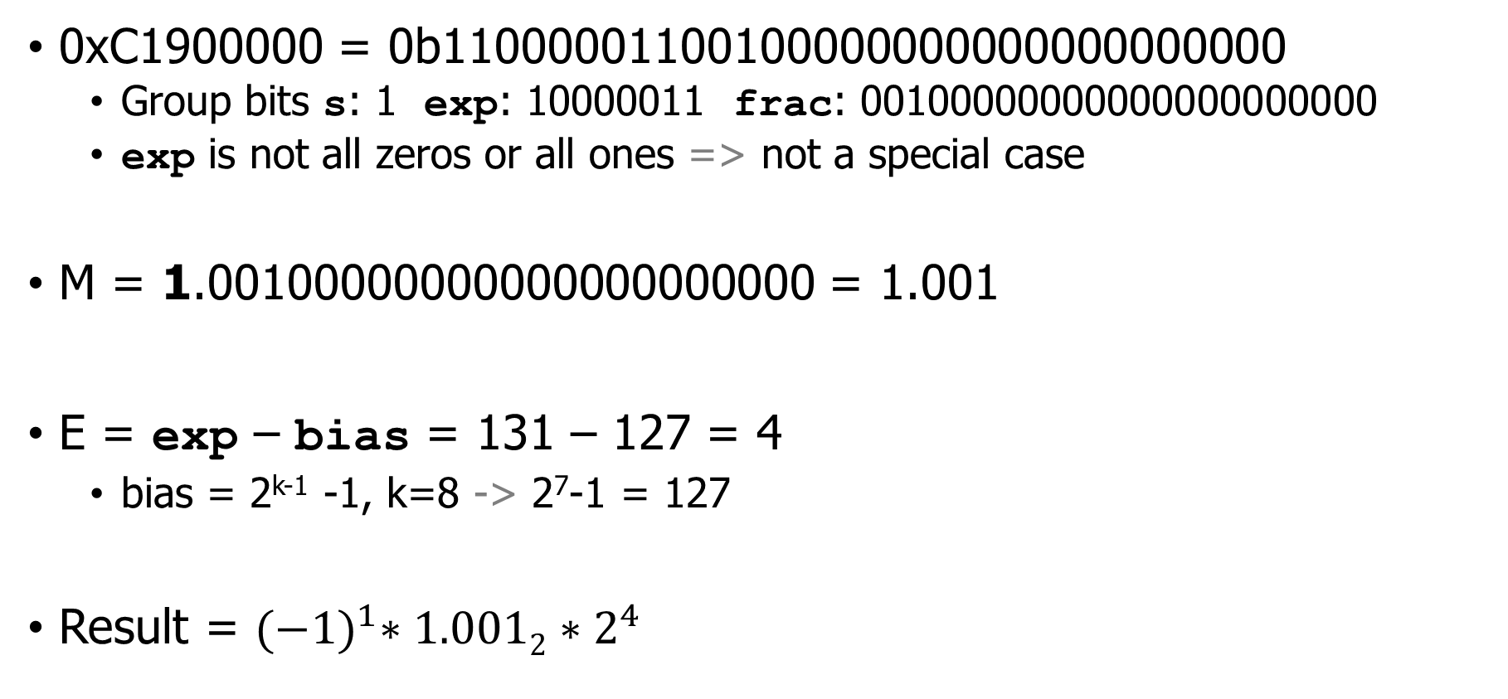
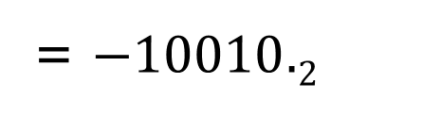
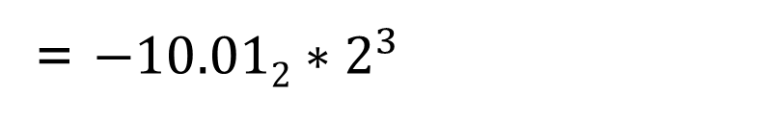
Decoding example for normalized floating point (32-bit)
0xC1900000 = 0b11000001100100000000000000000000
Group bits s: 1 exp: 10000011 frac: 00100000000000000000000
exp is not all zeros or all ones => not a special case
M = 1.00100000000000000000000 = 1.001
E = exp – bias = 131 – 127 = 4
bias = 2^{k-1} -1, k=8 -> 2⁷-1 = 127
Result = ${(−1)}^{1}∗1.0012∗2^{4}$
= $−10.012∗2^{3}$
= $−10010.2$
= -18
$$V= {(−1)}^{s}∗M∗2^{E}$$
s
exp
frac

Slide 23
Normalized Encoding Example
Value
float F = 15213.0; // single precision: 8 exp bits, 23 frac bits
15213₁₀ = 11101101101101₂ = 1.1101101101101₂ × 2¹³
Significand
M = 1.1101101101101₂
frac = 11011011011010000000000 pad with 0s on the right. (example: 1.5 = 1.500)
Exponent
E = 13
Bias = 127
exp = E + Bias = 140 =10001100₂
More examples and practice in the
bonus slides after the end
Floating Point Representation:
Hex: 4 6 6 D B 4 0 0 Binary: 0100 0110 0110 1101 1011 0100 0000 0000
exp: 100 0110 0
frac: 110 1101 1011 0100 0000 0000

Slide 24
Normalized Numbers: Why These Choices?
Significand coded with implied leading 1
Any non-zero integer will start with a 1 bit somewhere
Leading 1 carries no information, so don’t need to store it!
Can express mantissas between:
1.0 when frac is all 0s
2.0 (nearly) when frac is all 1s
Want smaller? Use a smaller exponent!
Exponent coded as biased value
E = Exp – Bias
Alternative to using two’s complement to represent signed integers
Reasons are a bit tricky
Floating point binary values increase in the same order as unsigned, which means they can be compared just like integer encodings
Bias also provides a more useful range (when considering denormalized)

Slide 25
Question + Break
0x3F800000 = 0b00111111100000000000000000000000
Group bits s: 0 exp: 01111111 frac: 00000000000000000000000
exp is not 0…0 or 1…1 => not a special case
M =
E = exp – bias =
bias = 2^{k-1} -1, k=8 -> 2⁷-1 = 127
$$V= {(−1)}^{s}∗M∗2^{E}$$
s
exp
frac

Slide 26
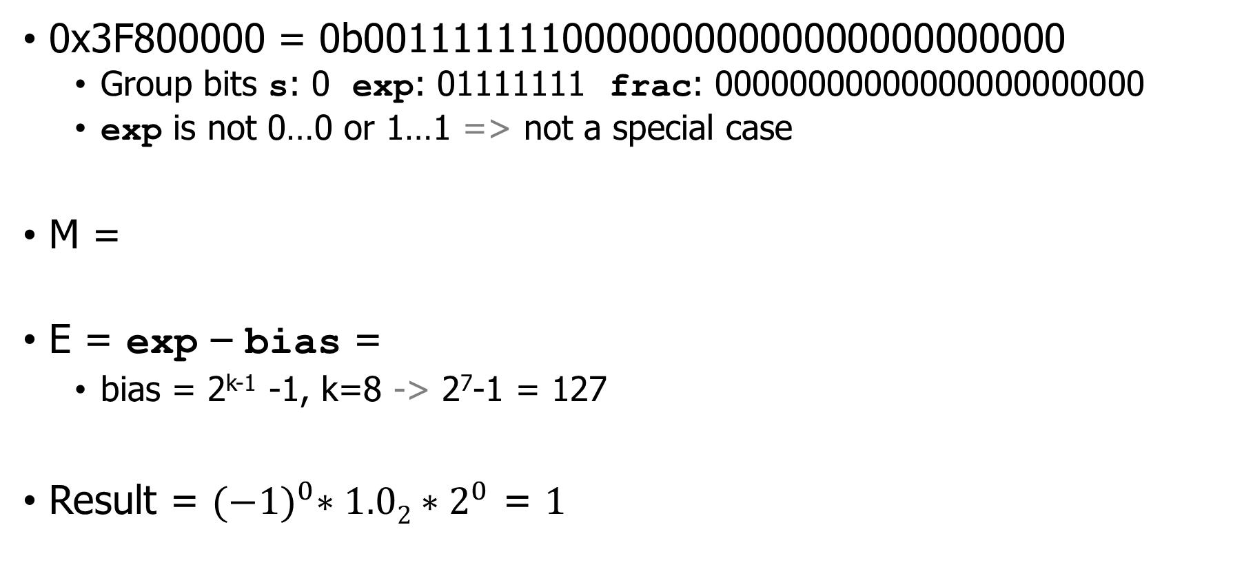
Question + Break
0x3F800000 = 0b00111111100000000000000000000000
Group bits s: 0 exp: 01111111 frac: 00000000000000000000000
exp is not 0…0 or 1…1 => not a special case
M =
E = exp – bias =
bias = 2^{k-1} -1, k=8 -> 2⁷-1 = 127
Result = ${(−1)}^{0}∗1.02∗2^{0}$ = $1$
1.00000000000000000000000 = 1.0
127 – 127 = 0
$$V= {(−1)}^{s}∗M∗2^{E}$$
s
exp
frac

Slide 27
Live Practice – pick a hex number
0xXXXX0000 =
$$V= {(−1)}^{s}∗M∗2^{E}$$
31
30
23
22
0
s
exp
frac

Slide 28
Categories for IEE754 Encoded Values
Value encoded – three cases, depending on value of exp
Normalized, the most common
Denormalized (very small values)
Special values – infinity and NaN
s
≠ 0 && not all 1s
frac
s
00000000
frac
Infinity
s
11111111
00000000000000000000000
NaN
s
11111111
≠0
Notes:
Neither all zeroes nor all ones -> normalized, the most common case
All zero for denormalized, to represent zero and very small numbers close to it;
# So what’s the representation of 0 in FP? How many zeros are there?

Slide 29
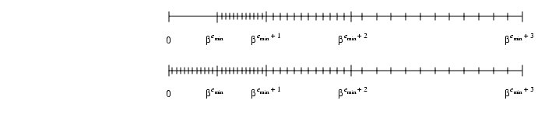
Normalized floating point leaves a gap around zero
Gap is the size of 1.0000 * 2^{Min Exponent} (due to leading 1 bit)
And how do we encode “zero” anyways?
Problem: if we just kept doing what we’re doing we never get to 0
We keep getting half-way there
0
Spacing:
2⁻¹²⁴
2⁻¹²⁵
2⁻¹²⁶
0
Spacing:
2⁻¹²⁴
2⁻¹²⁵
2⁻¹²⁶
2⁻¹²⁶

Slide 30
Solution is to do something different for the smallest numbers
Gap is the size of 1.0000 * 2^{Min Exponent} (due to leading 1 bit)
And how do we encode “zero” anyways?
Solution: fill in numbers between 0 and 1 * 2^{Min Exponent}
Using same spacing as the previous range, in the form 0.XXXXX
0
Spacing:
2⁻¹²⁴
2⁻¹²⁵
2⁻¹²⁶
0
Spacing:
2⁻¹²⁴
2⁻¹²⁵
2⁻¹²⁶
2⁻¹²⁶

Slide 31


Denormalized Values
$$V= {(−1)}^{s}∗M∗2^{E}$$
Purpose: gracefully represent numbers approaching ±0
Condition: exp = 000…0₂
Value
Exponent value E = 1 - Bias
Note: not simply E = 0 - Bias as it would be if we followed the previous rules
This means we’re re-using the spacing from smallest normalized numbers
Significand value M = 0.xxx…x₂ (0.frac)
xxx…x: bits of frac. Leading 0 instead of leading 1
Cases
exp = 000…0, frac = 000…0 => Represents value 0
Note that we have distinct values +0 and –0
exp = 000…0, frac ≠ 000…0 => Numbers very close to 0.0

Slide 32
Categories for IEE754 Encoded Values
Value encoded – three cases, depending on value of exp
Normalized, the most common
Denormalized (very small values)
Special values – infinity and NaN
s
≠ 0 && not all 1s
frac
s
00000000
frac
Infinity
s
11111111
00000000000000000000000
NaN
s
11111111
≠0
Notes:
Neither all zeroes nor all ones -> normalized, the most common case
All zero for denormalized, to represent zero and very small numbers close to it;
# So what’s the representation of 0 in FP? How many zeros are there?

Slide 33
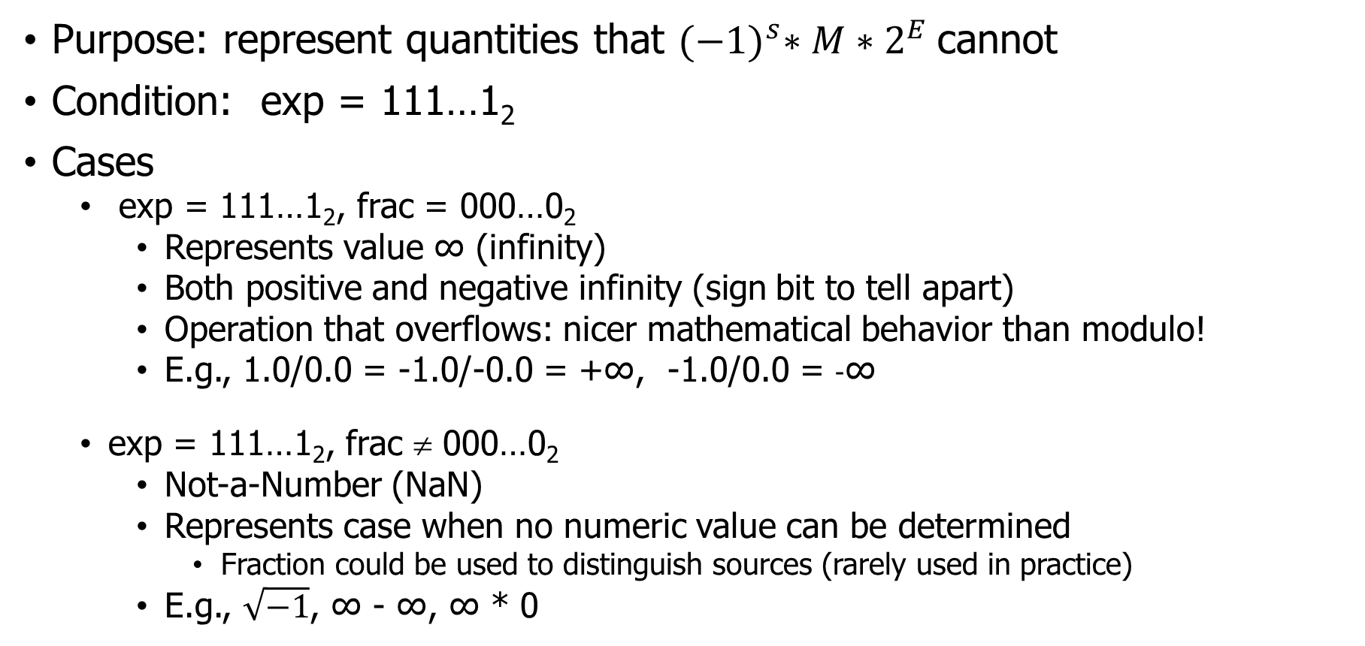
Special Values
Purpose: represent quantities that ${(−1)}^{s}∗M∗2^{E}$cannot
Condition: exp = 111…1₂
Cases
exp = 111…1₂, frac = 000…0₂
Represents value ∞ (infinity)
Both positive and negative infinity (sign bit to tell apart)
Operation that overflows: nicer mathematical behavior than modulo!
E.g., 1.0/0.0 = -1.0/-0.0 = +∞, -1.0/0.0 = -∞
exp = 111…1₂, frac ≠ 000…0₂
Not-a-Number (NaN)
Represents case when no numeric value can be determined
Fraction could be used to distinguish sources (rarely used in practice)
E.g., $\sqrt{−1}$, ∞ - ∞, ∞ * 0

Slide 34
Floating Point in C
C guarantees two levels
float single precision
double double precision
Conversions
int → float
maybe rounded
less bits for actual value (32 → 23)
int or float → double
exact value preserved
double has greater range and higher precision (52 bits for frac)
double → float
may overflow, underflow (too small to represent), or be rounded (IEEE 754)
C99 standard says undefined if value out of range
double or float → int
rounded toward zero (-1.999 → -1)
C99 standard says undefined if value out of range
Notes:
“inexact” exception may also be raised for significant loss of precision, but that appears to be implementation-dependent

Slide 35

Break + Summary of FP Real Number Encodings
-∞
+∞
NaN
-Normalized
-Denorm
+Denorm
+Normalized
NaN
−0
+0
$$V= {(−1)}^{s}∗M∗2^{E}$$
 | Normalized | Denormalized
s | 0/1 means +/- | 0/1 means +/-
exp | exp ≠ 000…0₂ and exp ≠ 111…1₂ | exp = 000…0₂
frac | x₁x₂x₃…x_{j} | x₁x₂x₃…x_{j}
Bias= | 2^{(k-1)} – 1, for k exponent bits | 2^{(k-1)} – 1, for k exponent bits
E= | exp – Bias | 1 – Bias
M= | 1. x₁x₂x₃…x_{j} a.k.a. 1.frac | 0. x₁x₂x₃…x_{j} a.k.a. 0.frac
V= | (–1)^{s} × (1.frac) × 2^{(exp – Bias)} | (–1)^{s} × (0.frac) × 2^{(1 – Bias)}
Notes:
The set of values that can be represented
- The two infinites are at the extremes
- the denormalized numbers are clustered around zero
- the representable numbers are not uniformly distributed (denser nearer the origin)

Slide 36
Outline
Fractional Binary Numbers
Representing Floating Point
Smaller Floating Point
Floating Point Arithmetic

Slide 37
Floating point examples
We’ll often do floating point in custom bit widths
Rather than 32-bit (float) or 64-bit (double)
Reasons
64 is just too many bits to write out and think about
Make sure you understand the concepts of floating point
Smaller versions still demonstrate concepts! (e.g., 8-bit)

Slide 38
Example: Tiny Floating Point
8-bit Floating Point Representation
Sign bit is in the most significant bit.
Next four (k) bits are exp, with a bias of 7 (2^{k-1}-1)
Last three (n) bits are frac
Same general form as IEEE 754 format
normalized, denormalized numbers
representation of 0, NaN, infinity
Sidebar: increasingly useful for Machine Learning use!
Models often don’t need 32-bits of precision
7
6
3
2
0
s
exp
frac
Notes:
Consider a simple 8b FP representation (so that we can enumerate the space)

Slide 39
Denormalized encoding example
0
7
6
3
2
s
exp
frac
Convert 5/512 to 8-bit tiny float
5/512 = 0b101 * 2⁻⁹ = 10.1 * 2⁻⁸ = 1.01 * 2⁻⁷
E = exp - bias -> -7 = exp – (2⁽⁴⁻¹⁾-1) -> -7 = exp – 7
exp = 0 ???
But exp can’t be less than 1 (or we’re denormalized)
So, the answer must be a denormalized number. Reset the problem!

Slide 40
Denormalized encoding example
0
7
6
3
2
s
exp
frac
Convert 5/512 to 8-bit tiny float
5/512 = 0b101 * 2⁻⁹ = 10.1 * 2⁻⁸ = 1.01 * 2⁻⁷
E = 1 – bias = 1 – 7 = -6
0.xxx * 2⁻⁶ -> 1.01 * 2⁻⁷ = 0.101 * 2⁻⁶
S: 0 (positive) exp: 0000(denorm) frac: 101
0b0 0000 101 -> 0x05

Slide 41
Exponents for 8-bit tiny floats
Bias = 2⁴⁻¹ - 1 = 7 (4-bit exp)
Denormalized E = 1 - Bias
exp exp E 2E
0 0000 -6 1/64 (denorms)
1 0001 -6 1/64
2 0010 -5 1/32
3 0011 -4 1/16
4 0100 -3 1/8
5 0101 -2 1/4
6 0110 -1 1/2
7 0111 0 1
8 1000 +1 2
9 1001 +2 4
10 1010 +3 8
11 1011 +4 16
12 1100 +5 32
13 1101 +6 64
14 1110 +7 128
15 1111 n/a (inf, NaN)
Normalized E = exp – Bias
Special

Slide 42
Dynamic Range of 8-bit tiny float
s exp frac E Value
s exp frac E Value
0 0000 000 -6 0
0 0000 001 -6 1/8*1/64(2⁻⁶)= 1/512
0 0000 010 -6 2/8*1/64 = 2/512
...
0 0000 110 -6 6/8*1/64 = 6/512
0 0001 001 -6 9/8*1/64 = 9/512
...
0 0110 110 -1 14/8*1/2 = 14/16
0 0110 111 -1 15/8*1/2 = 15/16
0 0111 000 0 8/8*1 = 1
0 0111 001 0 9/8*1 = 9/8
0 0111 010 0 10/8*1 = 10/8
...
0 1110 110 7 14/8*128 = 224
0 1110 111 7 15/8*128 = 240
0 1111 000 n/a inf
0 1111 001 n/a NaN
...
0 1111 111 n/a NaN
0 0000
111
-6
7/8*1/64 = 7/512
0 0001
000
-6
8/8*1/64 = 8/512
Notes:
One interesting property of this representation – if you look at the numbers as unsigned integers, they occur in ascending order as do the values they represent in floating point -> no accident, this mean you can sort them using an integer sort routine. Minor issue is with negative numbers since they have a leading one and occur in descending order – but you can handle that (check if both are zero, then check the sign bits and compare the numbers as unsigned).

Slide 43
Dynamic Range of 8-bit tiny float
s exp frac E Value
s exp frac E Value
0 0000 000 -6 0
0 0000 001 -6 1/8*1/64(2⁻⁶)= 1/512
0 0000 010 -6 2/8*1/64 = 2/512
...
0 0000 110 -6 6/8*1/64 = 6/512
0 0001 001 -6 9/8*1/64 = 9/512
...
0 0110 110 -1 14/8*1/2 = 14/16
0 0110 111 -1 15/8*1/2 = 15/16
0 0111 000 0 8/8*1 = 1
0 0111 001 0 9/8*1 = 9/8
0 0111 010 0 10/8*1 = 10/8
...
0 1110 110 7 14/8*128 = 224
0 1110 111 7 15/8*128 = 240
0 1111 000 n/a inf
0 1111 001 n/a NaN
...
0 1111 111 n/a NaN
0 0000
111
-6
7/8*1/64 = 7/512
0 0001
000
-6
8/8*1/64 = 8/512
Notes:
One interesting property of this representation – if you look at the numbers as unsigned integers, they occur in ascending order as do the values they represent in floating point -> no accident, this mean you can sort them using an integer sort routine. Minor issue is with negative numbers since they have a leading one and occur in descending order – but you can handle that (check if both are zero, then check the sign bits and compare the numbers as unsigned).

Slide 44
Dynamic Range of 8-bit tiny float
Bias = 7
V= (–1)^{s} × (0.frac) × 2^{(1 – Bias)}
Denormalized numbers
s exp frac E Value
s exp frac E Value
0 0000 000 -6 0
0 0000 001 -6 1/8*1/64(2⁻⁶)= 1/512
0 0000 010 -6 2/8*1/64 = 2/512
...
0 0000 110 -6 6/8*1/64 = 6/512
0 0001 001 -6 9/8*1/64 = 9/512
...
0 0110 110 -1 14/8*1/2 = 14/16
0 0110 111 -1 15/8*1/2 = 15/16
0 0111 000 0 8/8*1 = 1
0 0111 001 0 9/8*1 = 9/8
0 0111 010 0 10/8*1 = 10/8
...
0 1110 110 7 14/8*128 = 224
0 1110 111 7 15/8*128 = 240
0 1111 000 n/a inf
0 1111 001 n/a NaN
...
0 1111 111 n/a NaN
0 0000
111
-6
7/8*1/64 = 7/512
0 0001
000
-6
8/8*1/64 = 8/512
Normalized numbers
V= (–1)^{s} × (1.frac) × 2^{(exp – Bias)}
Special values
Notes:
One interesting property of this representation – if you look at the numbers as unsigned integers, they occur in ascending order as do the values they represent in floating point -> no accident, this mean you can sort them using an integer sort routine. Minor issue is with negative numbers since they have a leading one and occur in descending order – but you can handle that (check if both are zero, then check the sign bits and compare the numbers as unsigned).

Slide 45
Dynamic Range of 8-bit tiny float
Bias = 7
V= (–1)^{s} × (0.frac) × 2^{(1 – Bias)}
Denormalized numbers
s exp frac E Value
s exp frac E Value
0 0000 000 -6 0
0 0000 001 -6 1/8*1/64(2⁻⁶)= 1/512
0 0000 010 -6 2/8*1/64 = 2/512
...
0 0000 110 -6 6/8*1/64 = 6/512
0 0001 001 -6 9/8*1/64 = 9/512
...
0 0110 110 -1 14/8*1/2 = 14/16
0 0110 111 -1 15/8*1/2 = 15/16
0 0111 000 0 8/8*1 = 1
0 0111 001 0 9/8*1 = 9/8
0 0111 010 0 10/8*1 = 10/8
...
0 1110 110 7 14/8*128 = 224
0 1110 111 7 15/8*128 = 240
0 1111 000 n/a inf
0 1111 001 n/a NaN
...
0 1111 111 n/a NaN
0 0000
111
-6
7/8*1/64 = 7/512
0 0001
000
-6
8/8*1/64 = 8/512
Normalized numbers
V= (–1)^{s} × (1.frac) × 2^{(exp – Bias)}
Special values
Notes:
One interesting property of this representation – if you look at the numbers as unsigned integers, they occur in ascending order as do the values they represent in floating point -> no accident, this mean you can sort them using an integer sort routine. Minor issue is with negative numbers since they have a leading one and occur in descending order – but you can handle that (check if both are zero, then check the sign bits and compare the numbers as unsigned).

Slide 46
Dynamic Range of 8-bit tiny float
Bias = 7
V= (–1)^{s} × (0.frac) × 2^{(1 – Bias)}
Denormalized numbers
s exp frac E Value
s exp frac E Value Notes of Interest
0 0000 000 -6 0
0 0000 001 -6 1/8*1/64(2⁻⁶)= 1/512
0 0000 010 -6 2/8*1/64 = 2/512
...
0 0000 110 -6 6/8*1/64 = 6/512
0 0001 001 -6 9/8*1/64 = 9/512
...
0 0110 110 -1 14/8*1/2 = 14/16
0 0110 111 -1 15/8*1/2 = 15/16
0 0111 000 0 8/8*1 = 1
0 0111 001 0 9/8*1 = 9/8
0 0111 010 0 10/8*1 = 10/8
...
0 1110 110 7 14/8*128 = 224
0 1110 111 7 15/8*128 = 240
0 1111 000 n/a inf
0 1111 001 n/a NaN
...
0 1111 111 n/a NaN
closest to zero
0 0000
111
-6
7/8*1/64 = 7/512
largest denorm
0 0001
000
-6
8/8*1/64 = 8/512
smallest norm > 0
Normalized numbers
V= (–1)^{s} × (1.frac) × 2^{(exp – Bias)}
closest to 1 below
closest to 1 above
largest norm
Special values
Notes:
One interesting property of this representation – if you look at the numbers as unsigned integers, they occur in ascending order as do the values they represent in floating point -> no accident, this mean you can sort them using an integer sort routine. Minor issue is with negative numbers since they have a leading one and occur in descending order – but you can handle that (check if both are zero, then check the sign bits and compare the numbers as unsigned).

Slide 47
Distribution of Values
6-bit IEEE-like format
exp = 3 exponent bits
frac = 2 fraction bits
Bias is 3 (2³⁻¹-1)
Notice how the distribution gets denser toward zero.
-∞
+∞
Notes:
All representable numbers; two infinites at the end

Slide 48
Distribution of Values (Close-up View)
6-bit IEEE-like format
exp = 3 exponent bits
frac = 2 fraction bits
Bias is 3 (2³⁻¹-1)
Smooth transition between normalized and de-normalized numbers due to definition E = 1 - Bias for denormalized values
Zeros are denormalized numbers too! (+0 and -0)
5
4
2
1
0
s
exp
frac

Slide 49
Outline
Fractional Binary Numbers
Representing Floating Point
Smaller Floating Point
Floating Point Arithmetic

Slide 50
Floating Point Operations
Conceptual view
x +_{float} y = Fit(x +_{math} y)
x *_{float} y = Fit(x *_{math} y)
First compute exact, mathematical result
As a human: convert to decimal first, do math in decimal
Then make it fit into desired precision
Step 1: Determine frac, exp
Frac must be of the form 1.xxxx (0.xxx if denormalized)
Change exp if needed to get frac to that form (e.g., if result is 101.xxx)
Step 2: Possibly overflow if exponent too is large
Unlike integer overflow, result is mathematically reasonable: infinity
Step 3: Possibly round to fit into frac if we have too many mantissa bits

Slide 51
Rounding
Default rounding mode for IEEE floating point is Round-to-even
Other methods are statistically biased (round up, round down, round-to-zero)
Sum of set of positive numbers will consistently be over- or under- estimated
Round to nearest number
If exactly in between, round to nearest even number
Round-to-even example
Illustrated with rounding of money
$1.40 $1.60
Rounded $1 $2
Notes:
Rounds nearest even is not arbitrary, it looks to avoid biases on results by rounding up ~50% of the time and down the rest

Slide 52
Rounding
Default rounding mode for IEEE floating point is Round-to-even
Other methods are statistically biased (round up, round down, round-to-zero)
Sum of set of positive numbers will consistently be over- or under- estimated
Round to nearest number
If exactly in between, round to nearest even number
Round-to-even example
Illustrated with rounding of money
$1.40 $1.60 $1.50 $2.50 –$1.50
Rounded $1 $2
Notes:
Rounds nearest even is not arbitrary, it looks to avoid biases on results by rounding up ~50% of the time and down the rest

Slide 53
Rounding
Default rounding mode for IEEE floating point is Round-to-even
Other methods are statistically biased (round up, round down, round-to-zero)
Sum of set of positive numbers will consistently be over- or under- estimated
Round to nearest number
If exactly in between, round to nearest even number
Round-to-even example
Illustrated with rounding of money
$1.40 $1.60 $1.50 $2.50 –$1.50
Rounded $1 $2 $2 $2 –$2
Notes:
Rounds nearest even is not arbitrary, it looks to avoid biases on results by rounding up ~50% of the time and down the rest

Slide 54
Closer Look at Round-to-even
Rounding to other decimal places than the decimal point
When exactly halfway between two possible values
Round so that least significant digit is even
E.g., round to nearest hundredth (i.e., 2 decimal digits in fractional part)
1.2349999 => 1.23 (Less than half way)
1.2350001 => 1.24 (Greater than half way)
1.2350000 => 1.24 (Half way—round to even)
1.2450000 => 1.24 (Half way—round to even)

Slide 55
Rules for IEEE754 rounding
Always truncate the bits that don’t fit
If bits were truncated, round. Two options for rounding:
Add 0 to least-significant remaining bit (round down)
Add 1 to least-significant remaining bit (round up)
To decide which, look at the bits that are being truncated:
If they are less than 100…, round down (add 0)
If they are more than 100…, round up (add 1)
If they exactly equal 100…,
Either add 0 or 1, whichever makes the least-significant remaining bit 0
0 is even

Slide 56
Rounding Binary Numbers
Rules reminder:
If they are less than 100…, round down (add 0)
If they are more than 100…, round up (add 1)
If they exactly equal 100…,
Either add 0 or 1, whichever makes the least-significant remaining bit 0
Examples
Round to nearest 1/4 (keep 2 bits right of binary point)
Value Binary Rounded Action Rounded Value
2+3/32 10.00011₂ 10.00₂ (<1/2—down) 2
2+3/16 10.00110₂ 10.01₂ (>1/2—up) 2+1/4
2+3/8 10.01100₂ 10.10₂ (1/2—up to even) 2+1/2
2+5/8 10.10100₂ 10.10₂ (1/2—down to even) 2+1/2
2+7/8 10.11100₂ 11.00₂ (1/2—up to even) 3
Notes:
Note the first two are not half way (not of the format XX..X.YY..Y100)
Note the last two are and the resulting rounded number has the least significant bit = 0

Slide 57
Important: remember how rounding works
Only two options when rounding
Leave the number alone
Or add one to the number
1010.000010010000
Part to remove is 10…0, so we need to round
Options are:
1010.0000100 (leave it alone)
1010.0000101 (add one)
Pick the one that ends in zero: 1010.0000100

Slide 58
Mathematical Properties of FP Arithmetic
Mathematical properties of FP Addition
Addition is Associative? NO
(x + y) + z = x + (y + z)
Possibility of overflow and inexactness of rounding
(3.14 + 1e10) - 1e10 = 0 (rounding)
3.14 + (1e10 - 1e10) = 3.14
Mathematical properties of FP Multiplication
Multiplication is Associative? NO
(x × y) × z = x × (y × z)
Possibility of overflow, inexactness of rounding
Multiplication distributes over addition? NO
x × (y + z) = (x × y) + (x × z)
Possibility of overflow, inexactness of rounding
More in bonus slides

Slide 59
Floating Point Summary
IEEE Floating point (IEEE 754) has clear mathematical properties
But not always the ones you may expect!
Represents numbers of form (-1)^{S} × M × 2E
One can reason about operations independent of implementation
As if computed with perfect precision and then rounded
Not quite the same as arithmetic on real numbers
Violates associativity/distributivity
Makes life difficult for compilers & serious numerical applications programmers

Slide 60
Flow for floating point
Translating between decimal and IEEE754 floating point has a clear set of steps that you always take
Steps from Decimal to IEEE754:
Decimal
Floating point binary
Scientific notation binary
IEEE754 encoding
Steps for IEEE754 to Decimal:
IEEE754 encoding
Scientific notation binary
Floating point binary
Decimal

Slide 61
Outline
Fractional Binary Numbers
Representing Floating Point
Smaller Floating Point
Floating Point Arithmetic

Slide 62
Outline
Bonus slides
Use these for additional practice
And if you’re interested in additional topics

Slide 63
Interesting Numbers for float/double
Description exp frac Numeric Value^{{single prec., double prec.}}
Zero 00…00 00…00 0.0
Smallest Pos. Denorm. 00…00 00…01 2^{– {23,52}} X 2^{– {126,1022}}
Single ~ 1.4 X 10^{–45}
Double ~ 4.9 X 10^{–324}
Largest Denormalized 00…00 11…11 (1.0 – ε) X 2^{– {126,1022}}
Single ~ 1.18 X 10^{–38}
Double ~ 2.2 X 10^{–308}
Smallest Pos. Normalized 00…01 00…00 1.0 X 2^{– {126,1022}}
Just slightly larger than largest denormalized
One 01…11 00…00 1.0
Largest Normalized 11…10 11…11 (2.0 – ε) X 2 ^{{127,1023}}
Single ~ 3.4 X 10³⁸
Double ~ 1.8 X 10³⁰⁸
Notes:
Smallest denormalized – 1 bit in the least significant position

Slide 64
Normalized Encoding Example
Value
float F = 12345.0; // single precision: k=8, n=23
12345₁₀ = 11000000111001₂ = 1.1000000111001₂ X 2¹³
Significand
M = 1.1000000111001₂
frac = 10000001110010000000000 (drop leading 1, add 10 zeros)
Exponent
E = 13
Bias = 127
E = exp – Bias → exp = E + Bias = 140 =10001100₂
Floating Point Representation:
Hex: 4 6 4 0 E 4 0 0 Binary: 0100 0110 0100 0000 1110 0100 0000 0000
Notes:
The blue box shows the common part between the bit-level representation of the 12345 integer and the floating point (all the same but for the leading 1 dropped)

Slide 65
Creating a Floating Point Number
Carnegie Mellon
s | exp | frac
1 | 4-bits | 3-bits
Steps
Is the number within the range (-2^{1-Bias}, +2^{1-Bias})?
If yes, “denormalize” to have a leading 0
otherwise, normalize to have leading 1
Round to fit within fraction
Postnormalize to deal with effects of rounding
QUIZ in next three slides
Convert 8-bit unsigned numbers to tiny floating point format

Slide 66
Step 1: Normalize
Carnegie Mellon
s | exp | frac
1 | 4-bits | 3-bits
Requirement
Set binary point so that numbers of form 1.xxxxx
Adjust all to have leading one
Decrement exponent as shift left
Value Binary Fraction Exponent
128
13
17
19
138
63
10000000
00001101
00010001
00010011
10001010
00111111
1.0000000
1.1010000
1.0001000
1.0011000
1.0001010
1.1111100
7
3
4
4
7
5

Slide 67
Step 2: Rounding
1.BBGRXXX
Guard bit: LSB of result
Sticky bit: OR of remaining bits
Round bit: 1st bit removed
Round up conditions
round up if <Guard, Round, Sticky> = <x11> because >0.5
round up if <Guard, Round, Sticky> = <110> as per round to even rules
Value Fraction GRS Incr? Rounded
128
13
17
19
138
63
1.0000000
1.1010000
1.0001000
1.0011000
1.0001010
1.1111100
000
100
010
110
011
111
N
N
N
Y
Y
Y
1.000
1.101
1.000
1.010
1.001
10.000

Slide 68
Step 3: Postnormalize
Carnegie Mellon
Issue
Rounding may have caused overflow
Handle by shifting right once & incrementing exponent
Value Rounded Exp Adjusted Result
128 1.000 7 128
13 1.101 3 13
17 1.000 4 16
19 1.010 4 20
138 1.001 7 144
63 10.000 5
M=1.000 exp=6 64

Slide 69
Floating Point Puzzles
For each of the following C expressions, either:
Argue that it is true for all argument values
Explain why not true
x == (int)(double) x
x == (int)(float) x
d == (double)(float) d
f == (float)(double) f
f == -(-f);
1.0/2 == 1/2.0
d*d >= 0.0
(f+d)-f == d
int x = …;
float f = …;
double d = …;
Assume neither
d nor f is NaN
Notes:
Tmax = 01111..111 (32 bits) → 1.1111..1 (31 bits) * 2^30 → 1.11..1 (23 bits) * 2^30 = Tmax - 256

Slide 70
Floating Point Puzzles
For each of the following C expressions, either:
Argue that it is true for all argument values
Explain why not true
x == (int)(double) x
x == (int)(float) x
d == (double)(float) d
f == (float)(double) f
f == -(-f);
1.0/2 == 1/2.0
d*d >= 0.0
(f+d)-f == d
Yes
No (x = TMax)
No (d = 1e40)
Yes
Yes
Yes
Yes
No (f = 1.0e20, d = 1.0; f+d rounded to 1.0e20
int x = …;
float f = …;
double d = …;
Assume neither
d nor f is NaN
Notes:
Tmax = 01111..111 (32 bits) → 1.1111..1 (31 bits) * 2^30 → 1.11..1 (23 bits) * 2^30 = Tmax - 256

Slide 71
Floating-Point Multiplication, Directly
For cases where you can’t work with exact results
E.g., when doing it in hardware
Operands
(–1)^{s1} M1 2^{E1} * (–1)^{s2} M2 2^{E2}
Exact result
(–1)^{s} M 2E
Sign s: s1 ^ s2
Significand M: M1 * M2
Exponent E: E1 + E2
Fixing
If M ≥ 2, shift M right, increment E
If E out of range, overflow
Round M to fit frac precision
Implementation
Biggest chore is multiplying significands
E1=3 M1=1.11010010
E2=5 M2=1.11001110
--------------------------------------------
E=8 M=11.01001000111111
E=8+1 M=1.101001000111111
E=9 M=1.1010010010

Slide 72
Floating-Point Addition, Directly
E1 – E2
Operands
(–1)^{s1} M1 2^{E1}
(–1)^{s2} M2 2^{E2}
Assume E¹ > E²
Exact Result
(–1)^{s} M 2E
Sign s, significand M: Result of signed align & add
Exponent E: E¹
Fixing
If M ≥ 2, shift M right, increment E
if M < 1, shift M left k places, decrement E by k
Overflow if E out of range
Round M to fit frac precision
(–1)^{s1} M1
+
(–1)^{s2} M2
(–1)^{s} M
E1=5 M1=1.11010010
E2=2 M2=1.11001110
E2=2 M2=0001.11001110
-----------------------------------
E1=5 M1=1.11010010
E2=5 M2=0.00111001110
------------------------------------
E =5 M =10.00001011110
E =6 M =1.000001011110

Slide 73
Mathematical Properties of FP Add
Compare to those of Abelian Group
Closed under addition? YES
But may generate infinity or NaN
Commutative? YES
Associative? NO
Overflow and inexactness of rounding
(3.14+1e10)-1e10=0 (rounding)
3.14+(1e10-1e10)=3.14
0 is additive identity? YES
Every element has additive inverse? ALMOST
Except for infinities & NaNs
Monotonicity
a ≥ b ⇒ a+c ≥ b+c? ALMOST
Except for NaNs
Notes:
For the mathematically inclined; skip

Slide 74
Mathematical Properties of FP Multiplication
Compare to commutative ring
Closed under multiplication? YES
But may generate infinity or NaN
Multiplication Commutative? YES
Multiplication is Associative? NO
Possibility of overflow, inexactness of rounding
1 is multiplicative identity? YES
Multiplication distributes over addition? NO
Possibility of overflow, inexactness of rounding
Monotonicity
a ≥ b & c ≥ 0 ⇒ a *c ≥ b *c? ALMOST
Except for NaNs
Notes:
For the mathematically inclined; skip

