Slide 1
Lecture 05 Intro to x86-64 Assembly
CS213 – Intro to Computer Systems
Branden Ghena – Winter 2025
Slides adapted from: St-Amour, Hardavellas, Bustamente (Northwestern), Bryant, O’Hallaron (CMU), Garcia, Weaver (UC Berkeley)

Slide 2
Administrivia
Pack Lab
Due in one week from today (Tuesday, January 28)
If you haven’t yet, get started right away!
Lots of conceptually difficult parts to understand
Lots of C code to write, which you may have forgotten
Especially, make sure you don’t have issues logging into Moore
Takes ~24 hours to fix and we won’t be giving extensions for it
This assignment is 12% of your overall course grade, and takes at least that much effort
Not an “easier first assignment”

Slide 3
Today’s Goals
Introduce assembly and the x86-64 Instruction Set Architecture
Discuss background of the factors that affected its evolution
Understand registers: the analogy to variables in assembly
Explore our first assembly instruction: mov

Slide 4
Outline
Assembly Languages
Registers
x86-64 Assembly
Introduction
Move Instruction
Memory Addressing Modes

Slide 5
Assembly (Also known as: Assembly Language, ASM)
Purpose of a CPU: execute instructions
High-level programs (like in C) are split into many small instructions
Assembly is a low-level programming language where the program instructions match a particular architecture’s operations
Assembly is a human-readable text representation of machine code
Each assembly instruction is one machine instruction (usually)

Slide 6
Programs can be written in assembly or machine instructions
C Program (source code)
a = (b+c)–(d+e);
Assembly Program
addq %rdi, %rsi
addq %rdx, %rcx
subq %rcx, %rsi
movq %rsi, %rax
Machine Instructions
0x4889D3
0x488903
0x53 0x5B

Slide 7
There are many assembly languages
Instruction Set Architecture: All programmer-visible components of a processor needed to write software for it
Operations the processor can execute
The system’s state (registers, memory, program counter)
The effect operations have on system state
Each assembly language has instructions that match a particular processor’s Instruction Set Architecture (ISA)
Assembly is not portable to other architectures (like C is)

Slide 8
Which instructions should an assembly include?
Each assembly language has its own operations
There are some obviously useful instructions:
Add, subtract, and bit shift
Read and write memory
But what about:
Only run the next instruction if these two values are equal
Perform four pairwise multiplications simultaneously
Add two ascii numbers together (‘2’ + ‘3’ = 5)
Notes:
Add two ascii numbers is a real x86 instruction. No joke

Slide 9

Instruction Set Philosophies
Early trend: add more instructions to do elaborate operations Complex Instruction Set Computing (CISC)
Handle many different types of operations
More options for the compiler
Complicated hardware runs more slowly
Opposite philosophy later began to dominate: Reduced Instruction Set Computing (RISC)
Simpler (and smaller) instruction set makes it easier to build fast hardware
Let software do the complicated operations by composing simpler ones
Modern reality is somewhere between these two

Slide 10



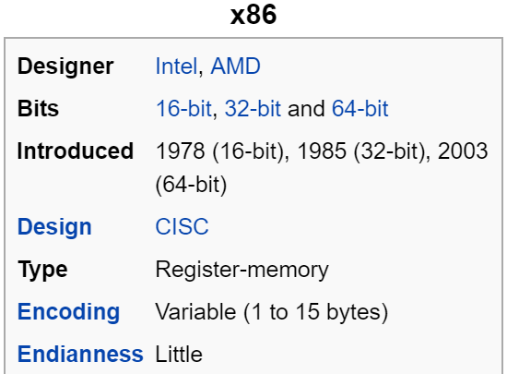
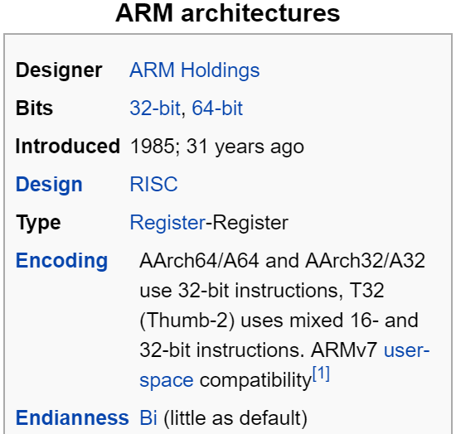
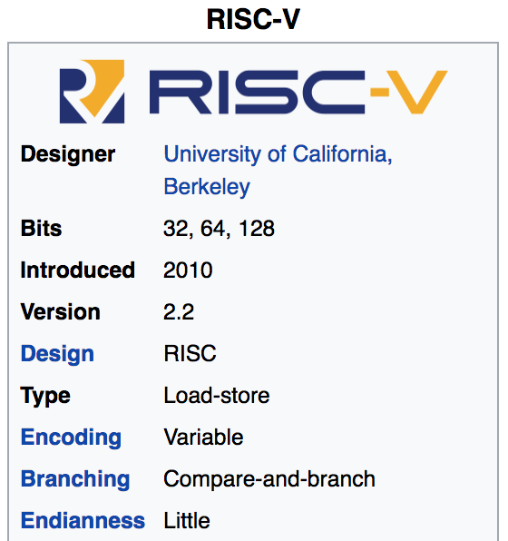
Mainstream Instruction Set Architectures
PCs & Servers
(Core i3, i5, i7, M)
x86 Instruction Set
Smartphones (iPhone, Android), Apple Hardware, Raspberry Pi, Embedded systems
ARM Instruction Set
Open-source
Relatively new, designed for cloud computing, embedded systems, academic use RISCV Instruction Set

Slide 11
Instruction Set Architecture sits at software/hardware interface
Source code
Compiler
Architecture
Hardware
Different applications
or algorithms
Perform optimizations,
generate instructions
Instruction set
Different implementations
Intel Pentium 4
C Language
x86-64
Program A
Intel Core i7
GCC
AMD Ryzen
Program B
Clang
ARMv8 (AArch64/A64)
ARM Cortex-A53
Apple M1

Slide 12
Intel x86 Processors
Dominate desktop and server market, and Windows laptops
No longer completely dominant in laptops though (MacOS moved to ARM)
Complex instruction set computer (CISC)
Many different instructions with many different formats
But, only small subset encountered by normal programs
Design evolved over time
Backwards compatible up until 8086, introduced in 1978
Added more features as time goes on
Historical legacy has large impact on architecture

Slide 13
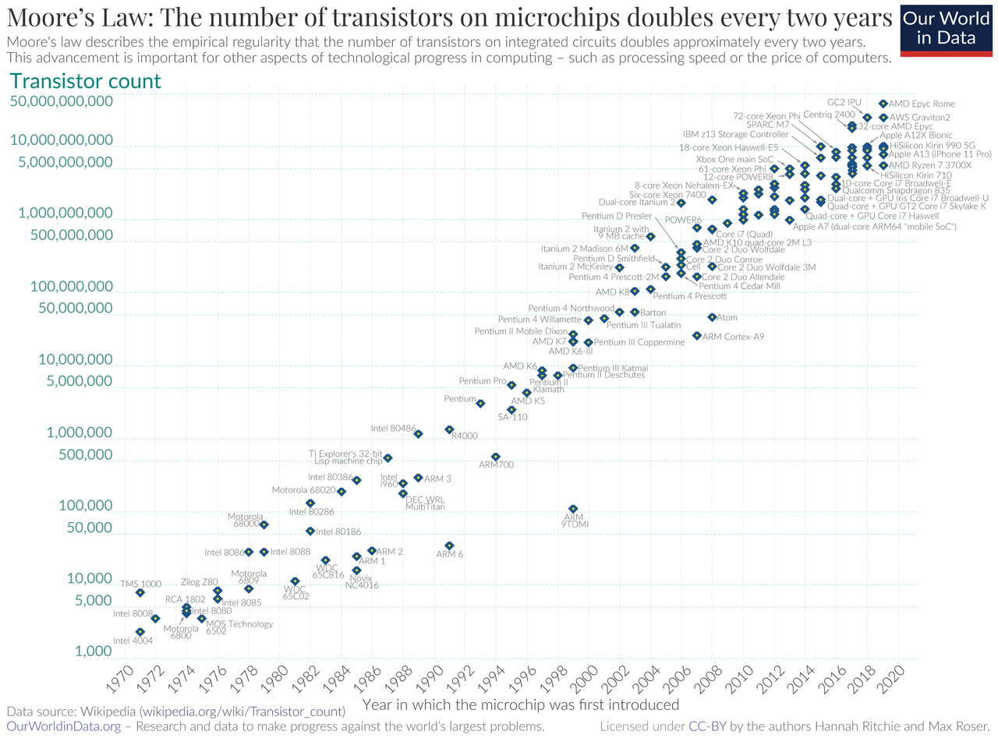
Moore’s Law – CPU transistors counts
“Number of transistors in a chip doubles every 18 months”
Transistors are getting exponentially smaller!
How small? Today: 3nm!
< ½ the size of most viruses!
Notes:
Gordon Moore – first version of the law – ’65: double every year; restated in ‘75: double every two years
Was simplified to “every 18 months”

Slide 14
Evolution of x86 ISA
Name | Date | Transistors | Comments
8086 | 1978 | 29k | 16b processor, basis for IBM PC & DOS; 1MB address space
80286 | 1982 | 134K | Elaborate (!useful) addressing; basis for IBM PC and Windows
386 | 1985 | 275K | Extended to 32b, added “flat addressing” that Linux/gcc uses
486 | 1989 | 1.9M | Improved performance; integrated FP unit into chip
Pentium | 1993 | 3.1M | Improved performance
PentiumPro | 1995 | 6.5M | Conditional move instructions; big change in microarch. (P6)
Pentium II | 1997 | 7M | Merged Pentium/MMZ + PentiumPro, MMX instructions within P6
Pentium III | 1999 | 8.2M | Integer and floating point vector instructions (SSE); Level2 cache
Pentium 4 | 2001 | 42M | 8B ints and floating point formats to vector instructions
Pentium 4E | 2004 | 125M | Hyperthreading (able to run 2 programs simultaneously), 64b
Core 2 | 2006 | 291M | P6-like, multicore, no hyperthreading
Core i7 (Nehalem) | 2008 | 781M | Hyperthreading + multicore, TurboBoost (run fewer cores faster)
Core i3 (Nehalem) | 2010 | 383M+177M | GPU on second silicon die within package (at 2010 version)
Core i3, i5, i7 (Sandy Bridge) | 2011 | 997M (i7 – 4 cores) | Cores and GPU within the same processor die
Core i3, i5, i7 (Ivy Bridge) | 2012 | 1400M (i7 – 4 cores) | Tri-gate transistors, much lower power consumption
Xeon E7 8800 V4 (Broadwell-EX) | 2016 | >5690M (22 cores) | 14nm technology
Notes:
The x86 processor line has a long evolutionary development; started with a 16b microprocessor …
This is a list of some notable models, dates and a few key features
386 – first 32b, added flat addressing for Linux
Pentium 4E – hyperthreading and 64b
Core 2 – first multicore from Intel
Each successive processor has been designed to be backward compatible – able to run code from previous version; many strange artifacts result from this

Slide 15
Backwards Compatibility The cause of, and solution to, all of life’s problems.
Programs that worked on one x86 processor should keep working on the next one
Old programs work on new processors, which makes upgrading possible
Even today’s x86-64 processors boot thinking they are 8086s!
Adding powerful new features while keeping backwards compatibility is a careful balancing act
Backwards compatibility introduces a lot of constraints
May rule out “cleaner” designs that would break existing programs
The cause of some “surprising” aspects of the design of x86-64
“The x86 really isn't all that complex—it just doesn't make a lot of sense.” — Mike Johnson (AMD's x86 architect), 1994
Not just a hardware thing!

Slide 16
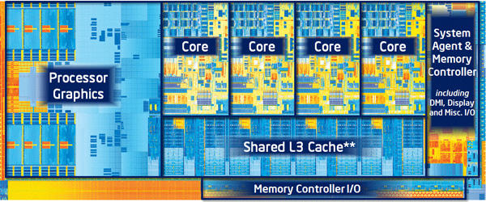
In this class
x86-64/EMT64: the current standard
Some asides on IA32: The traditional x86
Presentation
Book covers x86-64; web aside on IA32
Labs will be based on x86-64

Slide 17
Outline
Assembly Languages
Registers
x86-64 Assembly
Introduction
Move Instruction
Memory Addressing Modes

Slide 18
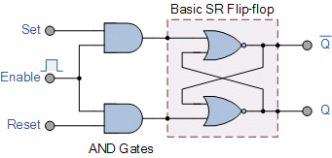
Hardware uses registers for variables
Unlike C, assembly doesn’t have variables as you know them
Instead, assembly uses registers to store values
Registers are:
Small memory chunks of a fixed size
Can be read or written
Limited in number
Very fast and low power to access
Registers are different from variables or RAM:
They don’t have an address
We can only access them in assembly
They don’t have types (just bits)
The operation performed determines how contents are treated

Slide 19
How many registers?
Tradeoff between speed and availability
More registers can hold more variables
Simultaneously; all registers are slower
Also registers take physical space within the chip
x86-64 has 16 registers (for integer operations)
Historically only 8 registers 😱
Added 8 more with 64-bit extensions

Slide 20
How big should each register be?
Registers are usually the size of a word
The natural unit of data for a processor
Width of the data type that a CPU can process in one instruction
Likely the size of its registers
Imprecise term that will inevitably slip into explanations
x86 processors started with 16-bit words
IA32 upgraded to 32-bit “double word” registers
x86-64 upgraded again 64-bit “quad word” registers

Slide 21
Why did we change the register size??
Registers need to be able to hold memory addresses
So, the size of a register limits the total size of memory!!
Each address is a single byte of memory
Memory limitations based on register size
16-bit registers: 2¹⁶ addresses = 2¹⁶ bytes = 64 KB of RAM
32-bit registers: 2³² addresses = 2³² bytes = 4 GB of RAM
64-bit registers: 2⁶⁴ addresses = 2⁶⁴ bytes = 16 EB of RAM
Kilobyte, Megabyte, Gigabyte, Terabyte, Petabyte, Exabyte
We moved to 32-bit in the early 90s and 64-bit in the late-00s
No computer has 128-bit words, although many have special-purpose registers that big

Slide 22
x86-64 64-bit Integer Registers
%rax
%r8
%rbx
%r9
%rcx
%r10
%rdx
%r11
%rsi
%r12
%rdi
%r13
%rsp
%r14
%rbp
%r15
original x86 registers
additional x86-64 registers

Slide 23
Historical Register Purposes
Name Origin (mostly obsolete)
%rax
Accumulate
Base
Counter
Data
Source Index
Destination Index
Stack Pointer (still important)
Base Pointer
%rbx
%rcx
%rdx
%rsi
%rdi
%rsp
%rbp

Slide 24
x86-64 Integer Registers
64-bit names
%rax
%r8
%eax
%r8d
%rbx
%r9
%ebx
%r9d
%rcx
%r10
%ecx
%r10d
%rdx
%r11
%edx
%r11d
%rsi
%r12
%esi
%r12d
%rdi
%r13
%edi
%r13d
%rsp
%r14
%esp
%r14d
%rbp
%r15
%ebp
%r15d
32-bit names

Slide 25
Historical Register Purposes
Name Origin (mostly obsolete)
%rax
%eax
Accumulate
Base
Counter
Data
Source Index
Destination Index
Stack Pointer (still important)
Base Pointer
%rbx
%ebx
%rcx
%ecx
%rdx
%edx
%rsi
%esi
%rdi
%edi
%rsp
%esp
%rbp
%ebp

Slide 26
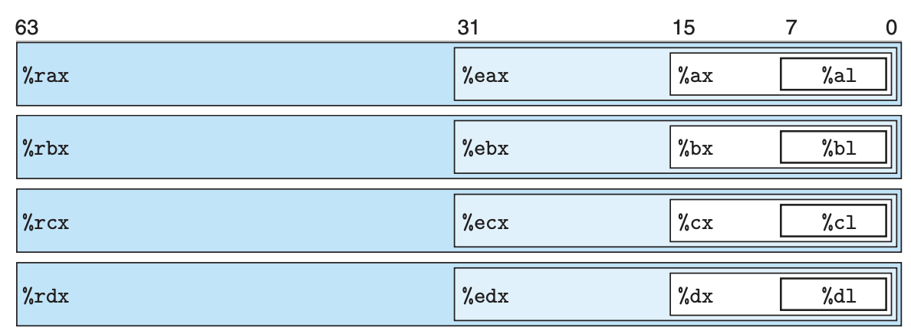
x86-64 Register Access Options
Registers can be accessed by any of these names to work with 8-byte, 4-byte, 2-byte, or 1-byte data

Slide 27
x86-64 Register Access Options
The same data can be accessed under different names and widths
Example: store 64-bit value 0x0000000000010A0B in %rax
%rax: 0x0000000000010A0B (64-bit)
%eax: 0x00010A0B (32-bit)
%ax: 0x0A0B (16-bit)
%al: 0x0B (8-bit)

Slide 28
x86-64 full register naming
16-bit registers
8-bit
8-bit
%rax
%eax
%ax
%ah
%al
%rbx
%ebx
%bx
%bh
%bl
%rcx
%ecx
%cx
%ch
%cl
%rdx
%edx
%dx
%dh
%dl
%rsi
%esi
%si
%sil
%rdi
%edi
%di
%dil
%rbp
%ebp
%bp
%bpl
%rsp
%esp
%sp
%spl
%r8
%r8d
%r8w
%r8b
…
…
…
%r15b
%r15
%r15d
%r15w
32-bit registers
64-bit registers

Slide 29
Registers versus Memory
What if there are more variables than registers?
Keep most frequently used in registers and move the rest to memory (called spilling to memory)
Why not put all variables in memory?
Smaller is faster: registers 100-500 times faster
Memory Hierarchy
Registers: 16 registers * 64 bits = 128 Bytes
RAM: 4-32 GB
SSD: 100-1000 GB

Slide 30
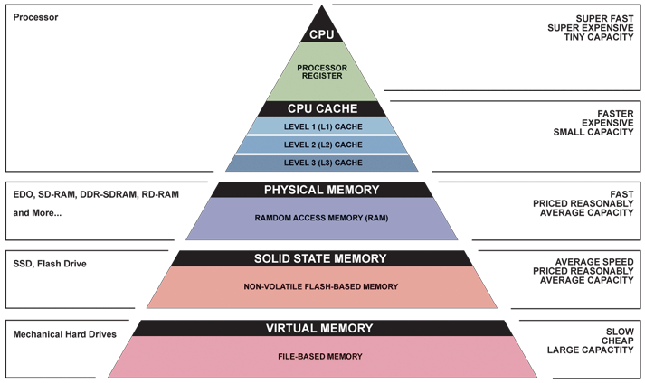
Memory Hierarchy
Registers
Memory

Slide 31
Special-purpose register: Instruction Pointer
Instruction Pointer: %rip (not listed in prior tables)
Contains the address of the currently executing instruction
Actually special-purpose, only used for this one thing
Processor hardware uses %rip when loading instructions
Load instruction from memory pointed to by %rip
Advance %rip to the next instruction
Repeat
Note: hardware does this automatically, you don’t (usually) interact with this at all

Slide 32
Assembly Programmer’s View of System State
CPU
Memory
Registers
Addresses
PC
Code
Data
Stack
Data
Condition
Codes
Instructions
Programmer-visible state
Named registers
Together in “register file”
Heavily used program data
The Instruction Pointer (%rip in x86-64)
Address of next instruction
Condition codes
Store status information about most recent arithmetic operation
Used for conditional branching
Memory
Byte-addressable array
Code and user data
Includes the Stack (for supporting procedures and variables)
Notes:
Preview for the coming lectures

Slide 33
Break + Question
Which of these is FALSE?
[A] Registers are faster to access than memory
[B] Registers do not have a type
[C] Registers can have special purposes
[D] Registers are dynamically created as needed

Slide 34
Break + Question
Which of these is FALSE?
[A] Registers are faster to access than memory
[B] Registers do not have a type
[C] Registers can have special purposes
[D] Registers are dynamically created as needed
There are a fixed number of registers for a given architecture

Slide 35
Outline
Assembly Languages
Registers
x86-64 Assembly
Introduction
Move Instruction
Memory Addressing Modes

Slide 36
Writing Assembly Code? In 2025???
Chances are, you’ll never write a program in assembly, but understanding assembly is the key to the machine-level execution model:
Behavior of programs in the presence of bugs
When high-level language model breaks down
Tuning program performance
Understanding compiler optimizations and sources of program inefficiency
Implementing systems software
What are the “states” of processes that the OS must manage
Using special units (timers, I/O co-processors, etc.) inside processor!
Fighting malicious software
Distributed software is in binary form
Notes:
Compilers are much better and more patient than you are
I hope that you are never writing a program in assembly
Not even to eke the very last bit of performance out
Because compilers are much better at it
Understanding assembly will help you
Like how C will help you better appreciate the magic that Java does for you
Similarly, understanding assembly will help you understand what the machine is doing for you
Sometimes you actually do have to poke around with GDB in the assembly (this is what gets shipped to you!)

Slide 37
Example x86-64 Assembly
.text
.globl multstore
.type multstore, @function
# multiply and store to memory
multstore:
pushq %rbx # save to stack
movq %rdx, %rbx
call mult2
movq %rax, (%rbx)
popq # restore from stack
ret

Slide 38
Example x86-64 Assembly
.text
.globl multstore
.type multstore, @function
# multiply and store to memory
multstore:
pushq %rbx # save to stack
movq %rdx, %rbx
call mult2
movq %rax, (%rbx)
popq # restore from stack
ret
Various assembly instructions

Slide 39
Example x86-64 Assembly
.text
.globl multstore
.type multstore, @function
# multiply and store to memory
multstore:
pushq %rbx # save to stack
movq %rdx, %rbx
call mult2
movq %rax, (%rbx)
popq # restore from stack
ret
Comments use the # symbol

Slide 40
Example x86-64 Assembly
.text
.globl multstore
.type multstore, @function
# multiply and store to memory
multstore:
pushq %rbx # save to stack
movq %rdx, %rbx
call mult2
movq %rax, (%rbx)
popq # restore from stack
ret
Labels are arbitrary names that mark a section of code
We’ll get back to these later

Slide 41
Example x86-64 Assembly
.text
.globl multstore
.type multstore, @function
# multiply and store to memory
multstore:
pushq %rbx # save to stack
movq %rdx, %rbx
call mult2
movq %rax, (%rbx)
popq # restore from stack
ret
Assembler directives
(mostly ignore these)
Can be used to specify data versus code regions, make functions linkable with other code, and many other tasks.

Slide 42
x86-64 Instructions
General Instruction Syntax:
op src, dst
1 operator, 2 operands
op = operation name (“operator”)
src1 = source location (“source”)
dst = destination location (“destination”)
Keep hardware simple via regularity

Slide 43
Careful! Two Syntaxes for Assembly
Intel/Microsoft Format
ATT Format
lea eax,[ecx+ecx*2]
sub esp,8
cmp dword ptr [ebp-8],0
mov eax,dword ptr [eax*4+100h]
leal (%ecx,%ecx,2),%eax
subl $8,%esp
cmpl $0,-8(%ebp)
movl $0x100(,%eax,4),%eax
Intel/Microsoft mnemonics vs. ATT
Operands listed in opposite order: mov Dest, Src vs. movl Src, Dest
Constants not preceded by ‘$’, Denote hex with ‘h’ at end: 100h vs. $0x100
Operand size indicated by operands rather than operator suffix: sub vs. subq
Addressing format shows effective address computation: [eax*4+100h] vs. $0x100(,%rax,4)
gcc (gas), gdb, objdump work on the ATT format
We will always use the ATT format as well
Notes:
ATT named after AT&T who used to operate Bell Labs many years ago; ATT is what gcc, objdump, etc consider

Slide 44
Short Break + Example x86-64 Assembly
.text
.globl multstore
.type multstore, @function
# multiply and store to memory
multstore:
pushq %rbx # save to stack
movq %rdx, %rbx
call mult2
movq %rax, (%rbx)
popq # restore from stack
ret
What might this instruction do?
(op src, dst)

Slide 45
Outline
Assembly Languages
Registers
x86-64 Assembly
Introduction
Move Instruction
Memory Addressing Modes

Slide 46
Three Basic Kinds of Instructions
Transfer data between memory and register
Load data from memory into register
%reg = Mem[address]
Store register data into memory
Mem[address] = %reg
Perform arithmetic operation on register or memory data
c = a + b; z = x << y; i = h & g;
Control flow: what instruction to execute next
Unconditional jumps to/from procedures
Conditional branches
Remember: Memory is indexed just like an array of bytes!

Slide 47
Moving Data
General form: mov_ source, destination
Missing letter _ specifies size of operands
Reminder: backwards compatibility means “word” = 16 bits
Lots of these in typical code
movb src, dst
Move 1-byte “byte”
movw src, dst
Move 2-byte “word”
movl src, dst
Move 4-byte “long word”
movq src, dst
Move 8-byte “quad word”
Native size for x86-64
Note: Instructions must be used with properly-sized register names And they’re also a helpful hint about the sizes being used

Slide 48
Operand Types (src and dst)
%rax
%rcx
Immediate: Constant integer data
Examples: $0x400, $-533
Like C literal, but prefixed with ‘$’
Encoded with 1, 2, 4, or 8 bytes depending on the instruction
Register: 1 of 16 integer registers
Examples: %rax, %r13
But %rsp reserved for special use
Others have special uses for particular instructions
Memory: Consecutive bytes of memory at a computed address
Simplest example: (%rax) treats value of %rax as an address → access memory
Various other “address modes” we’ll talk about later
%rdx
%rbx
%rsi
%rdi
%rsp
%rbp
%rN (r8-r15)

Slide 49
MOV Operand Combinations
 | Source | Dest | Src, Dest | C Analog
movq | Imm | Reg | movq $0x4, %rax
 |  | Mem | movq $-147, (%rax)
 | Reg | Reg | movq %rax, %rdx
 |  | Mem | movq %rax, (%rdx)
 | Mem | Reg | movq (%rax), %rdx
var_a = 0x4;
*p_a = -147;
var_d = var_a;
*p_d = var_a;
var_d = *p_a;
Cannot do memory-memory transfer with a single instruction
How would you do it?
Notes:
Mem -> Reg
Reg -> Mem
movq (%rax), %rdx
movq %rdx, (%rbx)

Slide 50
MOV Operand Combinations
 | Source | Dest | Src, Dest | C Analog
movq | Imm | Reg | movq $0x4, %rax
 |  | Mem | movq $-147, (%rax)
 | Reg | Reg | movq %rax, %rdx
 |  | Mem | movq %rax, (%rdx)
 | Mem | Reg | movq (%rax), %rdx
var_a = 0x4;
*p_a = -147;
var_d = var_a;
*p_d = var_a;
var_d = *p_a;
Cannot do memory-memory transfer with a single instruction
How would you do it? 1) Mem->Reg, 2) Reg->Mem
Notes:
Mem -> Reg
Reg -> Mem
movq (%rax), %rdx
movq %rdx, (%rbx)

Slide 51
Example of Move Instructions: swap()
void swap(long* xp, long* yp)
{
long t0 = *xp;
long t1 = *yp;
*xp = t1;
*yp = t0;
}
Register Variable
%rdi ⇔ xp
%rsi ⇔ yp
%rax ⇔ t0
%rdx ⇔ t1
swap:
movq (%rdi), %rax
movq (%rsi), %rdx
movq %rdx, (%rdi)
movq %rax, (%rsi)
ret
Initial state:
Registers
Memory
%rdi
%rsi
%rax
%rdx

Slide 52
Example of Move Instructions: swap()
Registers
Memory
Word
Address
%rdi
0x120
123
123
0x120
%rsi
0x100
0x118
0x110
%rax
0x108
%rdx
456
0x100
swap:
movq (%rdi), %rax # t0 = *xp
movq (%rsi), %rdx # t1 = *yp
movq %rdx, (%rdi) # *xp = t1
movq %rax, (%rsi) # *yp = t0
ret
Notes:
But actually, pointers are just addresses!
Showing here 8-byte words of memory, addresses jump by 8

Slide 53
Example of Move Instructions: swap()
Registers
Memory
Word
Address
%rdi
0x120
123
123
0x120
%rsi
0x100
0x118
0x110
%rax
123
0x108
%rdx
456
0x100
swap:
movq (%rdi), %rax # t0 = *xp
movq (%rsi), %rdx # t1 = *yp
movq %rdx, (%rdi) # *xp = t1
movq %rax, (%rsi) # *yp = t0
ret

Slide 54
Example of Move Instructions: swap()
Registers
Memory
Word
Address
%rdi
0x120
123
123
0x120
%rsi
0x100
0x118
0x110
%rax
123
0x108
%rdx
456
456
0x100
swap:
movq (%rdi), %rax # t0 = *xp
movq (%rsi), %rdx # t1 = *yp
movq %rdx, (%rdi) # *xp = t1
movq %rax, (%rsi) # *yp = t0
ret

Slide 55
Example of Move Instructions: swap()
Registers
Memory
Word
Address
%rdi
0x120
456
123
0x120
%rsi
0x100
0x118
0x110
%rax
123
0x108
%rdx
456
456
0x100
swap:
movq (%rdi), %rax # t0 = *xp
movq (%rsi), %rdx # t1 = *yp
movq %rdx, (%rdi) # *xp = t1
movq %rax, (%rsi) # *yp = t0
ret

Slide 56
Example of Move Instructions: swap()
Registers
Memory
Word
Address
Note: these did not change
%rdi
0x120
456
123
0x120
%rsi
0x100
0x118
0x110
%rax
123
0x108
%rdx
456
123
0x100
swap:
movq (%rdi), %rax # t0 = *xp
movq (%rsi), %rdx # t1 = *yp
movq %rdx, (%rdi) # *xp = t1
movq %rax, (%rsi) # *yp = t0
ret

Slide 57
Break + Open Question
How does the number of available registers affect a system?
What if x86-64 only had two registers?
What if x86-64 instead had 512 registers?

Slide 58
Break + Open Question
How does the number of available registers affect a system?
What if x86-64 only had two registers?
“Register Pressure” becomes a problem
Accessing 3+ things at once requires memory
Way more memory reads/writes
What if x86-64 instead had 512 registers?
Most of the registers would never be used
For any realistic program
Could have spent that silicon on something more important

Slide 59
Outline
Assembly Languages
Registers
x86-64 Assembly
Introduction
Move Instruction
Memory Addressing Modes

Slide 60
Memory Addressing Modes: Basic
Common need: interact with memory
Exact address might be made of multiple parts
Indirect: (R) Mem[Reg[R]]
Data in register R specifies the memory address
Like pointer dereference in C
Example: movq (%rcx), %rax
Displacement: D(R) Mem[Reg[R]+D]
Data in register R specifies the start of some memory region
Constant displacement D specifies the offset from that address
Example: movq 8(%rbp), %rdx

Slide 61
Complete Memory Addressing Modes
General:
D(Rb,Ri,S) Mem[Reg[Rb]+Reg[Ri]*S+D]
Rb: Base register (any register)
Ri: Index register (any register except %rsp)
S: Scale factor (1, 2, 4, 8) – why these numbers?
D: Constant displacement value (a.k.a. immediate)
Special cases (see textbook Figure 3.3 or next slide)
D(Rb,Ri) Mem[Reg[Rb]+Reg[Ri]+D] (S=1)
(Rb,Ri,S) Mem[Reg[Rb]+Reg[Ri]*S] (D=0)
(Rb,Ri) Mem[Reg[Rb]+Reg[Ri]] (S=1,D=0)
(,Ri,S) Mem[Reg[Ri]*S] (Rb=0,D=0)
Sizes of common C types!
Notes:
Syntax for memory operands can be more complex
Designed to do things that are common with pointers
D: displacement, add a constant
Rb: base pointer
Ri: index into array
S: scale the index (pointer arithmetic needs to scale by the size of the pointer target)
compiler keeps track of what the pointer points to and scales accordingly
int x[] x[i]
ith element of an array of ints: Ri=i, S=4 (bytes)
See figure 3.3 in 3e textbook

Slide 62
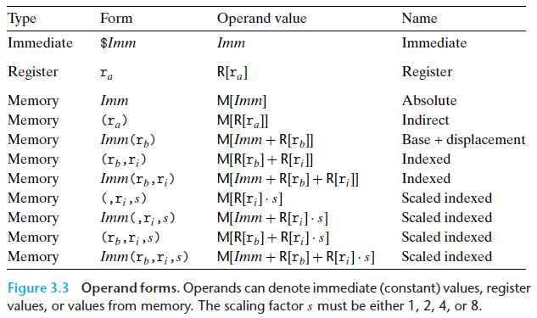
Full list of addressing mode forms

Slide 63
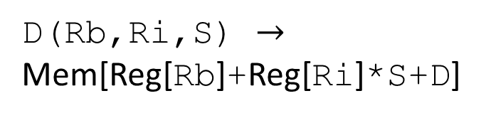
Address Computation Examples
%rdx
0xf000
D(Rb,Ri,S) $→$
Mem[Reg[Rb]+Reg[Ri]*S+D]
%rcx
0x0100
Expression | Address Computation | Address
0x8(%rdx)
(%rdx,%rcx)
(%rdx,%rcx,4)
0x80(,%rdx,2)

Slide 64
Address Computation Examples
%rdx
0xf000
D(Rb,Ri,S) $→$
Mem[Reg[Rb]+Reg[Ri]*S+D]
%rcx
0x0100
Expression | Address Computation | Address
0x8(%rdx) | %rdx + 0x8 | 0xf008
(%rdx,%rcx)
(%rdx,%rcx,4)
0x80(,%rdx,2)

Slide 65
Address Computation Examples
%rdx
0xf000
D(Rb,Ri,S) $→$
Mem[Reg[Rb]+Reg[Ri]*S+D]
%rcx
0x0100
Expression | Address Computation | Address
0x8(%rdx) | %rdx + 0x8 | 0xf008
(%rdx,%rcx) | %rdx + %rcx*1 | 0xf100
(%rdx,%rcx,4)
0x80(,%rdx,2)

Slide 66
Address Computation Examples
%rdx
0xf000
D(Rb,Ri,S) $→$
Mem[Reg[Rb]+Reg[Ri]*S+D]
%rcx
0x0100
Expression | Address Computation | Address
0x8(%rdx) | %rdx + 0x8 | 0xf008
(%rdx,%rcx) | %rdx + %rcx*1 | 0xf100
(%rdx,%rcx,4) | %rdx + %rcx*4 | 0xf400
0x80(,%rdx,2)

Slide 67
Address Computation Examples
%rdx
0xf000
D(Rb,Ri,S) $→$
Mem[Reg[Rb]+Reg[Ri]*S+D]
%rcx
0x0100
Expression | Address Computation | Address
0x8(%rdx) | %rdx + 0x8 | 0xf008
(%rdx,%rcx) | %rdx + %rcx*1 | 0xf100
(%rdx,%rcx,4) | %rdx + %rcx*4 | 0xf400
0x80(,%rdx,2) | %rdx*2 + 0x80 | 0x1e080

Slide 68
Outline
Assembly Languages
Registers
x86-64 Assembly
Introduction
Move Instruction
Memory Addressing Modes

