Slide 1
Lecture 10 Buffer Overflows
CS213 – Intro to Computer Systems
Branden Ghena – Winter 2025
Slides adapted from: St-Amour, Hardavellas, Bustamente (Northwestern), Bryant, O’Hallaron (CMU), Garcia, Weaver (UC Berkeley)

Slide 2
Administrivia
Continue work on Bomb Lab
Due this Thursday, February 13th
Attack Lab will go out sometime tonight or tomorrow
Due on Tuesday, February 25th
Drop deadline this week
If I’m worried about you, I sent you an email yesterday
If you’re worried, I’m happy to chat about it

Slide 3
Today’s Goals
Introduce the domain of Computer Security
Understand buffer overflows and return-oriented programming
What enables them
How they are used
How to protect against them

Slide 4


Why is computer security so important?
Most public security happens at least in some portion on the honor system
Pretty easy to break a window
Keyed locks are easy to pick
Master keys can be determined and manufactured (Matt Blaze attack)
Laws apply after you’ve done it

Slide 5
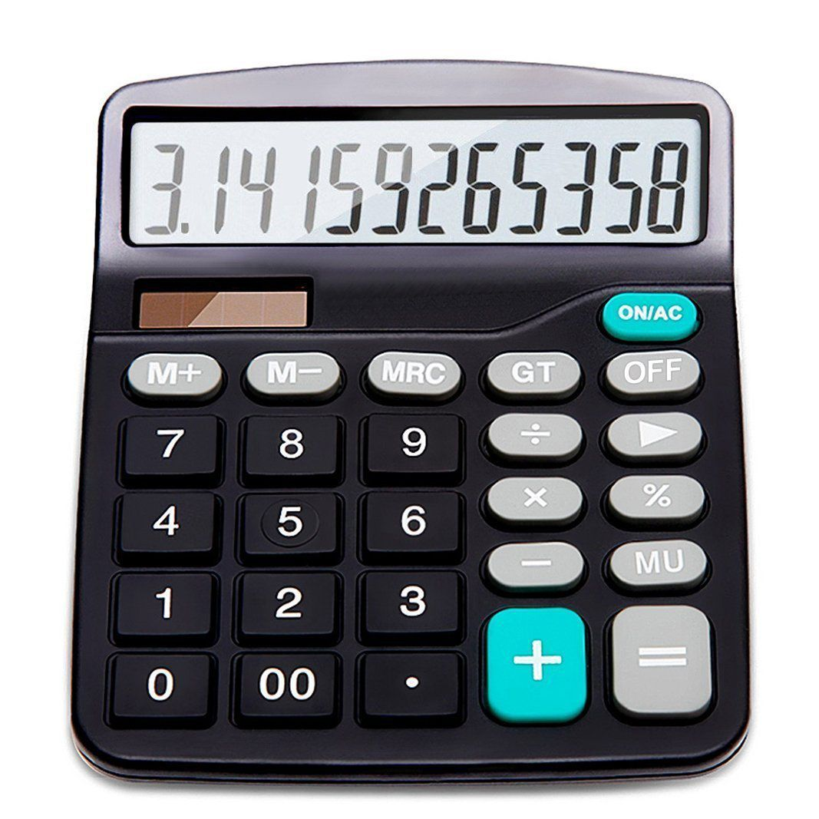
Early computers didn’t have any security either
Simple machines for doing computation do not have private files or contention
Sometimes there were multiple users, but all were employees of the same company
Permissions needed to be as secure as a file in a locked drawer on a desk
“The act of breaking into a computer system has to have the same social stigma as breaking into a neighbor's house. It should not matter that the neighbor's door is unlocked.” - Ken Thompson, Turing Award Lecture, 1984

Slide 6
Connectivity of computers makes security a top concern
Security of physical items is dependent on the fact that only one person can possess a thing at a time
And it’s usually obvious when theft occurs
Not the case for private information on a computer!
The internet makes security incredibly important
Usually not people breaking into computers manually, one at a time
Instead, it is computers breaking into computers by means of scripting
And you can access a computer from anywhere on Earth
Breaking into or controlling one car is a crime
Controlling 100,000 cars remotely is a problem for the manufacturer

Slide 7
Outline
Buffer Overflows
Protecting Against Buffer Overflows
Return-Oriented Programming
Protecting Against Return-Oriented Programming

Slide 8
Memory Referencing Bug Example
typedef struct {
int a[2];
double d;
} struct_t;
double fun(int i) {
volatile struct_t s; // volatile ≈ don’t optimize this away
s.d = 3.14;
s.a[i] = 1073741824; // Possibly out of bounds
return s.d;
}
fun(0) ➙ 3.14
fun(1) ➙ 3.14
fun(2) ➙ 3.1399998664856
fun(3) ➙ 2.00000061035156
fun(4) ➙ 3.14
fun(5) ➙ 3.14
fun(6) ➙ Segmentation fault (core dumped)
Abuses undefined behavior
Result is system specific

Slide 9
Memory Referencing Bug Example
typedef struct {
int a[2];
double d;
} struct_t;
fun(0) ➙ 3.14
fun(1) ➙ 3.14
fun(2) ➙ 3.1399998664856
fun(3) ➙ 2.00000061035156
fun(4) ➙ 3.14
fun(5) ➙ 3.14
fun(6) ➙ Segmentation fault
Explanation:
Return Addr | 6
? | 5
? | 4
d4 ... d7 | 3
d0 ... d3 | 2
a[1] | 1
a[0] | 0
Location accessed by fun(i)
struct_t

Slide 10
Such problems are a BIG deal
Generally called a “buffer overflow”
Going past end of memory allocated for an array (AKA buffer)
Why is it a big deal?
#1 technical cause of security vulnerabilities
(#1 overall cause is social engineering)
Most common form:
Unchecked lengths on string inputs
Particularly with character arrays on the stack
Sometimes referred to as “stack smashing”

Slide 11
String library code
Implementation of Unix function gets
No way to specify limit on number of characters to read
Similar problems with other Unix functions
strcpy, strcat: Copies string of arbitrary length
scanf, fscanf, sscanf, when given %s specifier
/* Get string from stdin */
char *gets(char *dest) { int c = getchar();
char *p = dest;
while (c != EOF && c != '\n') {
*p++ = c;
c = getchar();
}
*p = '\0';
return dest;
}
No bounds checking!

Slide 12
Vulnerable buffer code
int main(){ printf("Type a string:"); call_echo(); return 0; }
unix>./bufdemo-nsp
Type a string:012
012
unix>./bufdemo-nsp
Type a string: 00001111222233334444555
00001111222233334444555
void call_echo() {
echo();
}
Much more than 4 characters!
/* Prints whatever is read */ void echo(){ char buf[4]; /* Way too small! */ gets(buf); puts(buf); }
unix>./bufdemo-nsp
Type a string: 0000111122223333444455556
Segmentation Fault

Slide 13
Buffer Overflow Disassembly
echo:
00000000004006cf <echo>:
4006cf: 48 83 ec 18 sub $24,%rsp
4006d3: 48 89 e7 mov %rsp,%rdi
4006d6: e8 a5 ff ff ff callq 400680 <gets>
4006db: 48 89 e7 mov %rsp,%rdi
4006de: e8 3d fe ff ff callq 400520 <puts@plt>
4006e3: 48 83 c4 18 add $24,%rsp
4006e7: c3 retq
Sidebar: the compiler is optimizing here to use 8-byte alignment instead of 16-byte. It knows no function this calls needs 16-byte alignment.
call_echo:
00000000004006e8 <call_echo>:
4006e8: 48 83 ec 08 sub $8,%rsp
4006ec: b8 00 00 00 00 mov $0,%eax
4006f1: e8 d9 ff ff ff callq 4006cf <echo>
4006f6: 48 83 c4 08 add $8,%rsp
4006fa: c3 retq

Slide 14
Buffer Overflow Stack
After call to gets
Offsets from %rsp in hex
void echo() { char buf[4];
gets(buf); . . . }
echo:
subq $24, %rsp
movq %rsp, %rdi
call gets
. . .
 | 0 | 1 | 2 | 3 | 4 | 5 | 6 | 7
… | Stack frame for call_echo
28
20
18 | Return Address (8 bytes)
10 | 20 bytes unused
08
00 | ?? | ?? | ?? | ??
return address
call_echo:
. . .
4006f1: callq 4006cf <echo>
4006f6: add $8,%rsp
. . .
Stack grows down
%rsp
buf[0]
buf[1]
buf[3]

Slide 15
Buffer Overflow Stack Example
After call to gets
Offsets from %rsp in hex
void echo() { char buf[4];
gets(buf); . . . }
echo:
subq $24, %rsp
movq %rsp, %rdi
call gets
. . .
 | 0 | 1 | 2 | 3 | 4 | 5 | 6 | 7
… | Stack frame for call_echo
28
20
18 | F6 | 06 | 40 | 00 | 00 | 00 | 00 | 00
10 | 20 bytes unused
08
00 | ?? | ?? | ?? | ??
return address
call_echo:
. . .
4006f1: callq 4006cf <echo>
4006f6: add $8,%rsp
. . .
Stack grows down
%rsp
buf[0]
buf[1]
buf[3]

Slide 16
Buffer Overflow Stack Example #1
After call to gets
Offsets from %rsp in hex
void echo() { char buf[4];
gets(buf); . . . }
echo:
subq $24, %rsp
movq %rsp, %rdi
call gets
. . .
 | 0 | 1 | 2 | 3 | 4 | 5 | 6 | 7
… | Stack frame for call_echo
28
20
18 | F6 | 06 | 40 | 00 | 00 | 00 | 00 | 00
10 | 34 | 34 | 34 | 34 | 35 | 35 | 35 | 00
08 | 32 | 32 | 32 | 32 | 33 | 33 | 33 | 33
00 | 30 | 30 | 30 | 30 | 31 | 31 | 31 | 31
return address
call_echo:
. . .
4006f1: callq 4006cf <echo>
4006f6: add $8,%rsp
. . .
Stack grows down
%rsp
buf[0]
buf[1]
buf[3]
buf[7]
unix>./bufdemo-nsp
Type a string: 00001111222233334444555
00001111222233334444555
Overflowed buffer, but did not corrupt state

Slide 17
Buffer Overflow Stack Example #2
After call to gets
Offsets from %rsp in hex
void echo() { char buf[4];
gets(buf); . . . }
echo:
subq $24, %rsp
movq %rsp, %rdi
call gets
. . .
 | 0 | 1 | 2 | 3 | 4 | 5 | 6 | 7
… | Stack frame for call_echo
28
20
18 | 36 | 00 | 40 | 00 | 00 | 00 | 00 | 00
10 | 34 | 34 | 34 | 34 | 35 | 35 | 35 | 35
08 | 32 | 32 | 32 | 32 | 33 | 33 | 33 | 33
00 | 30 | 30 | 30 | 30 | 31 | 31 | 31 | 31
return address
call_echo:
. . .
4006f1: callq 4006cf <echo>
4006f6: add $8,%rsp
. . .
Stack grows down
%rsp
buf[0]
buf[1]
buf[3]
buf[7]
Is it a string?
Is it an address?
Depends on context!
unix>./bufdemo-nsp
Type a string: 0000111122223333444455556
Segmentation Fault
Overflowed buffer and corrupted return address. Could point to unmapped memory, etc.

Slide 18
Buffer Overflow Stack Example #3
After call to gets
Offsets from %rsp in hex
void echo() { char buf[4];
gets(buf); . . . }
echo:
subq $24, %rsp
movq %rsp, %rdi
call gets
. . .
 | 0 | 1 | 2 | 3 | 4 | 5 | 6 | 7
… | Stack frame for call_echo
28
20
18 | 00 | 06 | 40 | 00 | 00 | 00 | 00 | 00
10 | 34 | 34 | 34 | 34 | 35 | 35 | 35 | 35
08 | 32 | 32 | 32 | 32 | 33 | 33 | 33 | 33
00 | 30 | 30 | 30 | 30 | 31 | 31 | 31 | 31
return address
call_echo:
. . .
4006f1: callq 4006cf <echo>
4006f6: add $8,%rsp
. . .
Stack grows down
%rsp
buf[0]
buf[1]
buf[3]
buf[7]
unix>./bufdemo-nsp
Type a string: 000011112222333344445555
000011112222333344445555
Overflowed buffer, corrupted return address, but program seems to work! Latent bug!

Slide 19
Buffer Overflow Stack Example #3 Explained
After call to gets
Offsets from %rsp in hex
register_tm_clones:
. . .
400600: mov %rsp,%rbp
400603: mov %rax,%rdx
400606: shr $0x3f,%rdx
40060a: add %rdx,%rax
40060d: sar %rax
400610: jne 400614
400612: pop %rbp
400613: retq
 | 0 | 1 | 2 | 3 | 4 | 5 | 6 | 7
… | Stack frame for call_echo
28
20
18 | 00 | 06 | 40 | 00 | 00 | 00 | 00 | 00
10 | 34 | 34 | 34 | 34 | 35 | 35 | 35 | 35
08 | 32 | 32 | 32 | 32 | 33 | 33 | 33 | 33
00 | 30 | 30 | 30 | 30 | 31 | 31 | 31 | 31
return address
Stack grows down
%rsp
buf[0]
buf[1]
buf[3]
buf[7]
“Returns” to unrelated code
Lots of things happen, without modifying critical state
Eventually executes retq back to main as if nothing happened...

Slide 20
Break + Question
After call to gets
Offsets from %rsp in hex
 | 0 | 1 | 2 | 3 | 4 | 5 | 6 | 7
… | Stack frame for call_echo
28
20
18 | Return Address (8 bytes)
10 | 20 bytes unused
08
00 | ?? | ?? | ?? | ??
Generally: How many bytes must be written to corrupt the return address? (assume char buf[4];)
Is the answer the same for all programs?
Is it the same each time the code runs?
return address
Stack grows down
%rsp
buf[0]
buf[1]
buf[3]

Slide 21
Break + Question
After call to gets
Offsets from %rsp in hex
 | 0 | 1 | 2 | 3 | 4 | 5 | 6 | 7
… | Stack frame for call_echo
28
20
18 | Return Address (8 bytes)
10 | 20 bytes unused
08
00 | ?? | ?? | ?? | ??
Generally: How many bytes must be written to corrupt the return address? (assume char buf[4];) -> 25 bytes
Is the answer the same for all programs?
No! Depends how much stack space the function uses
Is it the same each time the code runs?
Almost certainly yes. Functions usually use the same amount of stack space each time
return address
Stack grows down
%rsp
buf[0]
buf[1]
buf[3]

Slide 22
Malicious use of buffer overflow
Max Memory Address
…
void foo(){
bar();
...
}
void bar() {
char buf[64];
gets(buf);
...
}
return
address
A
foo stack frame
A
B
08048444 <malicious_code>:
8048444: 55 push %ebp
8048445: 89 e5 mov %esp,%ebp
8048447: 53 push %ebx
8048448: 83 ec 24 sub $0x24,%esp
804844b: 8d 5d f4 lea -0xc(%ebp),%ebx
804844e: 89 1c 24 mov %ebx,(%esp)
8048451: e8 fa fe ff ff call 8048350
8048456: 89 1c 24 mov %ebx,(%esp)
data
written
by
gets()
pad
bar stack frame
exploit
code
buf
Address B
…
Input string contains binary representation of executable code
Overwrite return address with address of buffer
When bar() returns, where do we go?
Into the beginning of malicious_code on the stack! 😱
Memory Address 0

Slide 23
Injecting assembly instructions: figure out what to inject
Injected assembly instructions
BEFORE call to gets
inject:
mov $1,%rax
retq
Offsets from %rsp in hex
 | 0 | 1 | 2 | 3 | 4 | 5 | 6 | 7
… | Stack frame for call_echo
28
20
18 | F6 | 06 | 40 | 00 | 00 | 00 | 00 | 00
10 | 20 bytes unused
08
00 | ?? | ?? | ?? | ??
Injected machine code
return address
inject:
b8 01 00 00 00
c3
Stack grows down
%rsp
buf[0]
buf[1]
buf[3]
We’ve got the payload we want to inject
We know there is an array that we can overflow to inject the code and change a return address

Slide 24
Injecting assembly instructions: figure out where buffer is
Injected assembly instructions
BEFORE call to gets
inject:
mov $1,%rax
retq
Offsets from %rsp in hex
 | 0 | 1 | 2 | 3 | 4 | 5 | 6 | 7
… | Stack frame for call_echo
28
20
18 | F6 | 06 | 40 | 00 | 00 | 00 | 00 | 00
10 | 20 bytes unused
08
00 | ?? | ?? | ?? | ??
Injected machine code
return address
inject:
b8 01 00 00 00
c3
Stack grows down
%rsp
buf[0]
buf[1]
buf[3]
We need to figure out the address of buf which is equal to the value in %rsp
Use GDB for this! It will be the same each time we run. Assume we find it’s: 0x7FFFFFFF00002000

Slide 25
Injecting assembly instructions: inject payload
Injected assembly instructions
AFTER call to gets
inject:
mov $1,%rax
retq
Offsets from %rsp in hex
 | 0 | 1 | 2 | 3 | 4 | 5 | 6 | 7
… | Stack frame for call_echo
28
20
18 | F6 | 06 | 40 | 00 | 00 | 00 | 00 | 00
10
08
00 | b8 | 01 | 00 | 00 | 00 | c3
Injected machine code
return address
inject:
b8 01 00 00 00
c3
Stack grows down
%rsp
buf[0]
buf[1]
buf[3]
buf[7]
Inject machine code for the instructions we want (machine code is a byte stream, so endianness doesn’t apply here)

Slide 26
Injecting assembly instructions: inject payload
Injected assembly instructions
AFTER call to gets
inject:
mov $1,%rax
retq
Offsets from %rsp in hex
 | 0 | 1 | 2 | 3 | 4 | 5 | 6 | 7
… | Stack frame for call_echo
28
20
18 | F6 | 06 | 40 | 00 | 00 | 00 | 00 | 00
10 | 00 | 00 | 00 | 00 | 00 | 00 | 00 | 00
08 | 00 | 00 | 00 | 00 | 00 | 00 | 00 | 00
00 | b8 | 01 | 00 | 00 | 00 | c3 | 00 | 00
Injected machine code
return address
inject:
b8 01 00 00 00
c3
Stack grows down
%rsp
buf[0]
buf[1]
buf[3]
buf[7]
Inject machine code for the instructions we want (machine code is a byte stream, so endianness doesn’t apply here)
Pad with a bunch of zeros afterwards

Slide 27
Injecting assembly instructions: inject payload
Injected assembly instructions
AFTER call to gets
inject:
mov $1,%rax
retq
Offsets from %rsp in hex
 | 0 | 1 | 2 | 3 | 4 | 5 | 6 | 7
… | Stack frame for call_echo
28
20
18 | 00 | 20 | 00 | 00 | FF | FF | FF | 7F
10 | 00 | 00 | 00 | 00 | 00 | 00 | 00 | 00
08 | 00 | 00 | 00 | 00 | 00 | 00 | 00 | 00
00 | b8 | 01 | 00 | 00 | 00 | c3 | 00 | 00
Injected machine code
return address
inject:
b8 01 00 00 00
c3
Stack grows down
%rsp
buf[0]
buf[1]
buf[3]
buf[7]
Inject machine code for the instructions we want (machine code is a byte stream, so endianness doesn’t apply here)
Pad with a bunch of zeros afterwards Overwrite return address with address of %rsp (0x7FFFFFFF00002000, also little-endian)

Slide 28
Injecting assembly instructions: inject payload
Injected assembly instructions
AFTER call to gets
inject:
mov $1,%rax
retq
Offsets from %rsp in hex
 | 0 | 1 | 2 | 3 | 4 | 5 | 6 | 7
… | Stack frame for call_echo
28
20 | F6 | 06 | 40 | 00 | 00 | 00 | 00 | 00
18 | 00 | 20 | 00 | 00 | FF | FF | FF | 7F
10 | 00 | 00 | 00 | 00 | 00 | 00 | 00 | 00
08 | 00 | 00 | 00 | 00 | 00 | 00 | 00 | 00
00 | b8 | 01 | 00 | 00 | 00 | c3 | 00 | 00
Injected machine code
return address
inject:
b8 01 00 00 00
c3
Stack grows down
%rsp
buf[0]
buf[1]
buf[3]
buf[7]
Inject machine code for the instructions we want (machine code is a byte stream, so endianness doesn’t apply here)
Pad with a bunch of zeros afterwards Overwrite return address with address of %rsp (0x7FFFFFFF00002000, also little-endian)
After that write the original return address value (0x00000000004006F6)

Slide 29
What code runs after the injection
echo:
00000000004006cf <echo>:
4006cf: 48 83 ec 18 sub $24,%rsp
4006d3: 48 89 e7 mov %rsp,%rdi
4006d6: e8 a5 ff ff ff callq 400680 <gets>
4006db: 48 89 e7 mov %rsp,%rdi
4006de: e8 3d fe ff ff callq 400520 <puts@plt>
4006e3: 48 83 c4 18 add $24,%rsp
4006e7: c3 retq
Injection occurs here
Returning goes to our injected code on the stack
Injected assembly instructions:
inject:
mov $1,%rax
retq
Returning here goes to the original location in call_echo
The stack frame is a bit screwed up, but maybe we’ll get away with that??
We’re back to the original code, but the return value is now set to 1

Slide 30
Scenario for malicious behavior
What if the echo function was instead supposed to read in a user’s password and check it
Returns 1 if the password was correct
Now with our injected payload, we forced a 1 value to be returned
By manually setting %rax to 1
And then still returning to the call_echo function which hopefully runs as normal
So we can make the program believe that we entered the correct password!!!

Slide 31
Exploits based on buffer overflows
Buffer overflow bugs can allow remote machines to execute arbitrary code on victim machines
Distressingly common in real programs
Programmers keep making the same mistakes 😭
Recent measures make these attacks much more difficult
Examples across the decades
Original “Internet worm” (1988)
Attacked fingerd server, replicated itself across the internet
Stuxnet (2010)
Attack on Iran nuclear program, malicious code destroyed centrifuges
… and many, many more
You will learn some of these tricks with the attack lab
Hopefully convincing you to never leave such holes in your programs!

Slide 32
Example: The original Internet worm (1988)
Internet worm
Early versions of the finger server (fingerd) used gets() to read the argument sent by the client:
finger branden@northwestern.edu
Worm attacked fingerd server by sending phony argument:
finger “exploit-code padding new-return-address”
Exploit code: execute a root shell on the victim machine with a direct TCP connection to the attacker
Once on a machine, scanned for other machines to attack
Invaded ~6000 computers in hours (10% of the Internet ☺ )
See June 1989 article in Communications of the ACM
The young author of the worm was prosecuted…

Slide 33
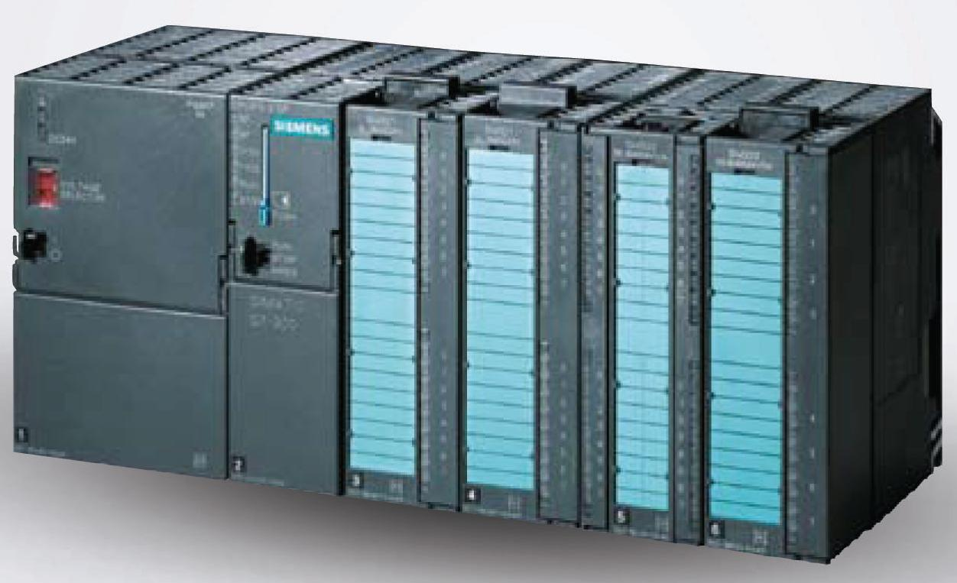
Example: Attack on Nuclear Plants (2010)
Stuxnet
Spread through buffer overflow
Disrupted Iran’s nuclear program
Damage uranium enrichment plants
Malicious code destroys centrifuges
At the time, likely the most sophisticated malware ever
Targets only specific Siemens SCADA systems, plants with Natanz-like centrifuge cascade setups
Centrifuge rotor frequency: 1064 Hz
Stuxnet speeds rotors up to 1410 Hz
Spinning so fast destroys the rotors
Was somewhat effective: may have destroyed 1,000 centrifuges, reduced output, sowed chaos

Slide 34
Outline
Buffer Overflows
Protecting Against Buffer Overflows
Return-Oriented Programming
Protecting Against Return-Oriented Programming

Slide 35
1. Avoiding Buffer Overflow Vulnerability
/* Echo Line */ void echo() { char buf[4]; /* Way too small! */ fgets(buf, 4, stdin); /* length limit! */ puts(buf); }
Use safe library routines that limit string lengths
fgets instead of gets
strncpy instead of strcpy
Don’t use scanf with %s conversion specification
Use fgets to read the string
Or use format specifier %ns where n is a suitable integer
Also: don’t write your programs in C, when possible
Fundamental design of C is to be fast, not to be secure

Slide 36
2. System-Level Protection: Randomized Stack
Stack base
Buffer overflow attack requires knowing the absolute address of the buffer
To overwrite return address to that
At start of program, allocate a random amount of space on stack
Different every time the program runs
Shifts stack addresses for entire program
Program still runs fine
Legitimate accesses to the stack are relative to %rsp
But absolute addresses get randomly shifted
Don’t know what return address should be!
Still not impossible to overcome (NOP sled)
Random
allocation
main
Application
Code
B?
pad
exploit
code
B?

Slide 37
3. System-Level Protection: Explicit Execute Page Permissions
Non-executable stack
On x86-64, can mark a region of memory as “non-executable”
Trying to execute something in that region → crash
More about page permissions in the virtual memory lecture (later in class)
OpenBSD goes further: W^X
A region of memory can be writeable or executable, but not both (xor!)
Causes trouble for JITs
Stack after call to gets()
P stack frame
B
pad
data written
by gets()
exploit
code
Q stack frame
B
Any attempt to execute this code will fail

Slide 38
Break + Open Question
Why is a buffer overflow in a web browser so bad?

Slide 39
Break + Open Question
Why is a buffer overflow in a web browser so bad?
The buffer overflow will exist in at least all instances of the same version of the web browser installed on the same OS and architecture
Possibly many other versions too
If it can be triggered from a website, then you could run malicious code on computers without any manual effort
Any website could be suspect
Scale is enormous: Chrome has roughly 3 billion users

Slide 40
Outline
Buffer Overflows
Protecting Against Buffer Overflows
Return-Oriented Programming
Protecting Against Return-Oriented Programming

Slide 41
How else are buffer overflows dangerous?
Without the ability to write malicious code, our computers are safe, right??
Some computers won’t fix it: legacy hardware, forgot, etc.
Buffer overflows are definitely still happening
Can we take advantage of that in some way?

Slide 42
Finding a new way to abuse a vulnerability
Buffer overflows can still write values to the stack
Even if they can’t place malicious code directly on the stack, they can always modify return addresses
We can use that idea to build an attack from pieces of already existing program code that we reuse for malicious purposes
This is one of those ideas that sounds impossible to pull off in the real world
But actually, it totally works AND we’ll have you do it in Attack Lab!

Slide 43
Return-Oriented Programming (ROP)
Challenge (for would-be hackers)
Stack randomization → predicting buffer location is hard
So it’s hard to know where to jump and start executing
Making stack non-executable → injecting code doesn’t work
We can inject anything we want, but we can’t run it
Alternative strategy: Don’t inject your own code!
Use code that’s already in the program!
It’s in a predictable location!
Otherwise, don’t know where to call/jump
It’s executable
Otherwise, the program wouldn’t run at all…

Slide 44
Return-Oriented Programming (ROP)
But wait, the code I want to run isn’t in the program!
Unlikely that, e.g., a mail client includes code to, e.g., launch missiles
Key idea: construct the code you want to run from pieces that you find in the program!
We’ll call these pieces gadgets
Strategy: find machine code fragments that do one small step of the malicious program you want to run, then return
Then we’ll put these small steps together to get the whole program
These return instructions will be the glue that tie them together
“The program” includes the standard library!
Things like printf, scanf, etc.
That’s a lot of code! So, lots of gadgets to choose from

Slide 45
Gadget Examples
Use the end of existing functions
Repurpose parts of instructions
long ab_plus_c
(long a, long b, long c){ return a*b + c;
}
00000000004004d0 <ab_plus_c>:
4004d0: 48 0f af fe imul %rsi,%rdi
4004d4: 48 8d 04 17 lea (%rdi,%rdx,1),%rax
4004d8: c3 ret
Gadget: rax ← rdi + rdx
Address: 0x4004d4
void setval (unsigned *p) { *p = 3347663060u;
}
00000000004004d9 <setval>:
4004d9: c7 07 d4 48 89 c7 movl $0xc78948d4,(%rdi)
4004df: c3 ret
Encodes: movq %rax, %rdi
Gadget: rdi ← rax
Address: 0x4004dc

Slide 46
Combining Gadgets
Let’s say our malicious program is this: %rax = (%rbx * %rcx) + %rdi
And let’s say we found the following gadgets in the standard library
Combine gadgets by adding pointers to them to the stack
Arrange on the stack by overflowing a buffer, like before
0000000000400474 <g1>:
400474: 48 0f af cb imul %rbx,%rcx
400478: c3 retq
Given a large enough standard library, can find gadgets that do pretty much anything we want! Plenty of code to pick from.
000000000040056d <g3>:
40056d: 48 89 f8 mov %rdi,%rax
400570: c3 retq
0000000000400739 <g2>:
400739: 48 01 cf add %rcx,%rdi
40073c: c3 retq
40056d
400739
400474
%rsp
…
…
buf

Slide 47
Gadget Execution
Step 1: we overflowed the buffer, like before
We set up the stack with the gadget addresses, as on last slide
Now we’re about to return from the vulnerable function (echo)
00000000004006cf <echo>:
...
4006d6: e8 a5 ff ff ff callq 400680 <gets>
...
4006e7: c3 retq
0000000000400474 <g1>:
400474: 48 0f af cb imul %rbx,%rcx
400478: c3 retq
%rip = 4006e7
…
000000000040056d <g3>:
40056d: 48 89 f8 mov %rdi,%rax
400570: c3 retq
40056d
400739
400474
%rsp
0000000000400739 <g2>:
400739: 48 01 cf add %rcx,%rdi
40073c: c3 retq
…
…
buf

Slide 48
Gadget Execution
Step 2: return from echo
Get the return address from %rsp
Oh, that’s the address of the first gadget!
00000000004006cf <echo>:
...
4006d6: e8 a5 ff ff ff callq 400680 <gets>
...
4006e7: c3 retq
0000000000400474 <g1>:
400474: 48 0f af cb imul %rbx,%rcx
400478: c3 retq
%rip = 400474
…
000000000040056d <g3>:
40056d: 48 89 f8 mov %rdi,%rax
400570: c3 retq
40056d
400739
400474
%rsp
0000000000400739 <g2>:
400739: 48 01 cf add %rcx,%rdi
40073c: c3 retq

Slide 49
Gadget Execution
Step 3: run the first gadget
%rcx = %rbx × %rcx
00000000004006cf <echo>:
...
4006d6: e8 a5 ff ff ff callq 400680 <gets>
...
4006e7: c3 retq
0000000000400474 <g1>:
400474: 48 0f af cb imul %rbx,%rcx
400478: c3 retq
%rip = 400474
…
000000000040056d <g3>:
40056d: 48 89 f8 mov %rdi,%rax
400570: c3 retq
40056d
400739
%rsp
0000000000400739 <g2>:
400739: 48 01 cf add %rcx,%rdi
40073c: c3 retq

Slide 50
Gadget Execution
Step 4: return from the first gadget
Get the return address from %rsp
QUIZ: where do we go next?
400739, that’s gadget 2!
00000000004006cf <echo>:
...
4006d6: e8 a5 ff ff ff callq 400680 <gets>
...
4006e7: c3 retq
0000000000400474 <g1>:
400474: 48 0f af cb imul %rbx,%rcx
400478: c3 retq
%rip = 400478
…
000000000040056d <g3>:
40056d: 48 89 f8 mov %rdi,%rax
400570: c3 retq
40056d
400739
%rsp
0000000000400739 <g2>:
400739: 48 01 cf add %rcx,%rdi
40073c: c3 retq

Slide 51
Gadget Execution
Step 5: run the second gadget
%rdi = (%rbx × %rcx) + %rdi
00000000004006cf <echo>:
...
4006d6: e8 a5 ff ff ff callq 400680 <gets>
...
4006e7: c3 retq
0000000000400474 <g1>:
400474: 48 0f af cb imul %rbx,%rcx
400478: c3 retq
%rip = 400739
…
000000000040056d <g3>:
40056d: 48 89 f8 mov %rdi,%rax
400570: c3 retq
40056d
%rsp
0000000000400739 <g2>:
400739: 48 01 cf add %rcx,%rdi
40073c: c3 retq

Slide 52
Gadget Execution
Step 6: return from the second gadget
Get the return address from %rsp
Oh, that’s the address of the third gadget!
00000000004006cf <echo>:
...
4006d6: e8 a5 ff ff ff callq 400680 <gets>
...
4006e7: c3 retq
0000000000400474 <g1>:
400474: 48 0f af cb imul %rbx,%rcx
400478: c3 retq
%rip = 40056d
…
000000000040056d <g3>:
40056d: 48 89 f8 mov %rdi,%rax
400570: c3 retq
40056d
%rsp
0000000000400739 <g2>:
400739: 48 01 cf add %rcx,%rdi
40073c: c3 retq

Slide 53
Gadget Execution
Step 7: run the third gadget
%rax = (%rbx × %rcx) + %rdi
We’ve run the program we wanted to run. Our job is done.
00000000004006cf <echo>:
...
4006d6: e8 a5 ff ff ff callq 400680 <gets>
...
4006e7: c3 retq
0000000000400474 <g1>:
400474: 48 0f af cb imul %rbx,%rcx
400478: c3 retq
%rip = 40056d
…
%rsp
000000000040056d <g3>:
40056d: 48 89 f8 mov %rdi,%rax
400570: c3 retq
0000000000400739 <g2>:
400739: 48 01 cf add %rcx,%rdi
40073c: c3 retq

Slide 54
Gadget Execution
Step 8: Return from the third gadget
At this point, return to whatever address we find on the stack.
That’s past the data we put there ourselves, so it’s whatever was there before. Maybe not meant to be an address! Could be anything!
But we don’t care about what the program does anymore!
We’ve run the code we wanted to run, nothing else matters!
(Maybe we stole from bank accounts, launched missiles, etc.)
0000000000400474 <g1>:
400474: 48 0f af cb imul %rbx,%rcx
400478: c3 retq
%rip = ???
…
%rsp
000000000040056d <g3>:
40056d: 48 89 f8 mov %rdi,%rax
400570: c3 retq
0000000000400739 <g2>:
400739: 48 01 cf add %rcx,%rdi
40073c: c3 retq

Slide 55
Return-Oriented Programming Execution
Trigger with ret instruction in the current function
“Returns” to gadget 1, instead of to its caller
Gadget 1 does its thing, then returns to gadget 2, etc.
Repeat as necessary
Complete! You’ve “run” the “function” you wanted to run!
Gadget n code
c3
...
...
...
Gadget 2 code
c3
Gadget 1 code
c3
%rsp

Slide 56
Outline
Buffer Overflows
Protecting Against Buffer Overflows
Return-Oriented Programming
Protecting Against Return-Oriented Programming

Slide 57
1. Avoiding buffer overflow vulnerabilities
Write better code please
Return-oriented programming starts with a buffer overflow
To set up gadget addresses on the stack
No buffer overflow, no return-oriented programming!

Slide 58
2. Stack Canaries
Idea
Place special value (“canary”) on stack just beyond buffer
Check for corruption before exiting function
So we can detect buffer overflows before we run malicious code
Then just crash the program instead of doing bad things
Analogy: canary in a coal mine
GCC Implementation
-fstack-protector
Now the default for potentially vulnerable functions
(disabled in attack lab to show the vulnerability)
unix>./bufdemo-sp
Type a string:0123456
0123456
unix>./bufdemo-sp
Type a string:01234567
*** stack smashing detected ***

Slide 59
2. Stack Canaries - Disassembly
echo:
40072f: sub $0x18,%rsp
400733: mov %fs:0x28,%rax
40073c: mov %rax,0x8(%rsp)
400741: xor %eax,%eax
400743: mov %rsp,%rdi
400746: callq 4006e0 <gets>
40074b: mov %rsp,%rdi
40074e: callq 400570 <puts@plt>
400753: mov 0x8(%rsp),%rax
400758: xor %fs:0x28,%rax
400761: je 400768 <echo+0x39>
400763: callq 400580 <__stack_chk_fail@plt>
400768: add $0x18,%rsp
40076c: retq
Read value from a special, read-only segment in memory
Store it on the stack at offset 8 from %rsp
Check the canary is fine using xor (0 if the two values are identical)
Notes:
“canary” from the history use of these birds to detect the presence of dangerous gases in mines
%gs:20 is segmented addressing, from the 80286, store as read-only.

Slide 60
2. Stack Canaries - Setting up canary
After call to gets
/* Echo Line */ void echo() { char buf[4]; /* Way too small! */ gets(buf); puts(buf); }
Offsets from %rsp in hex
 | 0 | 1 | 2 | 3 | 4 | 5 | 6 | 7
… | Stack frame for call_echo
28
20
18 | Return Address (8 bytes)
10 | Canary (8 bytes)
08 | 12 bytes unused
00 | ?? | ?? | ?? | ??
return address
Stack grows down
echo:
. . .
movq %fs:40, %rax # Get canary
movq %rax, 8(%rsp) # Place on stack
xorl %eax, %eax # Erase canary
. . .
%rsp
buf[0]
buf[1]
buf[3]

Slide 61
2. Stack Canaries - Setting up canary
After call to gets
/* Echo Line */ void echo() { char buf[4]; /* Way too small! */ gets(buf); puts(buf); }
Offsets from %rsp in hex
 | 0 | 1 | 2 | 3 | 4 | 5 | 6 | 7
… | Stack frame for call_echo
28
20
18 | Return Address (8 bytes)
10 | 00 | Canary (overwritten)
08 | 32 | 32 | 32 | 32 | 33 | 33 | 33 | 33
00 | 30 | 30 | 30 | 30 | 31 | 31 | 31 | 31
return address
echo:
. . .
movq 8(%rsp), %rax # Retrieve from stack
xorq %fs:40, %rax # Compare to canary
je .L6 # If same, OK
call __stack_chk_fail # FAIL
.L6: . . .
Stack grows down
%rsp
buf[0]
buf[1]
buf[3]
Input: 000111122223333
Code crashes due to canary mismatch

Slide 62
3. Address space layout randomization (ASLR)
Like stack randomization, generalized to all of memory
Especially: executable code
Code, stack, heap all start in random locations
Determined when program starts up
You know the gadget you want is at the end of ab_plus_c
But if you don’t know where ab_plus_c is, that’s no use!
Can be circumvented by clever side-channel attacks
But really hard! Much harder than ROP
code
heap
heap
stack
code
stack
???? <ab_plus_c>:
????: 48 0f af fe
????: 48 8d 04 17
????: c3

Slide 63
Security is an arms race
There is no single fix for system security
New attacks are constantly being discovered
New solutions are constantly being applied
Find a vulnerability and how it can be exploited
Fix vulnerability
Go back to 1
A good goal is to at least avoid all the simple known attacks
Designing with security in mind can make vulnerabilities harder to find in the first place

Slide 64
Outline
Buffer Overflows
Protecting Against Buffer Overflows
Return-Oriented Programming
Protecting Against Return-Oriented Programming

