Slide 1
Lecture 07 Standard I/O and Dynamic Arrays
CS211 – Fundamentals of Computer Programming II
Branden Ghena – Fall 2021
Slides adapted from: Jesse Tov

Slide 2
Administrivia
Homeworks are getting harder! Remember to start early
Homework 4 builds on top of Homework 3
Remember that there will be a break after homework 4
Homework 4 due October 21
Nothing due October 28
Homework 5 due November 4

Slide 3
Today’s Goals
Explore input and output to files
What C library functions allow interacting with files?
How do stdin, stdout, and stderr work?
Practice dynamic memory allocation with arrays
How do we make a dynamically-sized array?
Introduce linked lists as another approach for dynamic data storage

Slide 4
Getting the code for today
cd ~/cs211/lec/ (or wherever you put stuff)
tar -xkvf ~cs211/lec/07_stdio_arrays.tgz
cd 07_stdio_arrays/

Slide 5
Outline
File Input and Output in C
Standard Input and Output
Dynamic Arrays
Linked Lists

Slide 6
Files
Collections of data
Usually in permanent storage on your computer
Types of files
Regular files
Arbitrary data
Think of as a big array of bytes (just like memory)
Directories
Collections of regular files
Special files
Links, pipes, devices (see CS343)

Slide 7
How do we interact with files?
Analogy: think of a file as a book
Big array of characters (bytes)
Open the book, starting at the first page
Read from the book
Write to the book
Change pages (without reading everything in between)
Close the book when finished

Slide 8
System calls for interacting with files
Open the book, starting at the first page
fopen()
Read from the book
fread()
Write to the book
fwrite()
Change pages (without reading everything in between)
fseek()
Close the book when finished
fclose()

Slide 9
Opening files
FILE* fopen(const char* filename, const char* mode);
filename is the string path for the file
“/home/brghena/class/cs211/f21/hw/hw01/src/circle.c”
“./arguments.c”
“arguments.c”
mode specifies what you intend to do with the file
“r” - read only (must exist)
“w” - write (overwrites if exists)
“a” - append (starts writing at end of file if exists)

Slide 10
Open returns a FILE object
FILE* fopen(const char* filename, const char* mode);
Pointer type for an object used to interact with the file
A “handle” to the file
Other file interaction functions will take in a FILE* as an argument
Don’t need to remember the file path and look it up every time
NULL instead specifies an error attempting to open the file

Slide 11
Reading files
size_t fread(void* ptr, size_t size, size_t count, FILE* stream);
ptr is a pointer to an array to read into
At least size * count bytes in length
size is the number of bytes for each element in the array
count is the number of elements to read
stream is the file pointer returned from a previous call to fopen()
Note: nowhere do we specify where to start reading
Library keeps track of a file offset with the file
Updated on each read
First read of 100 bytes starts at zero, next starts 100 bytes in

Slide 12
How do we know when we finished the file?
size_t fread(void* ptr, size_t size, size_t count, FILE* stream);
Return from read is the count of elements actually read
Less than count means there was either an error or end-of-file was reached
feof() lets you check if end-of-file was reached
ferror() lets you check for particular errors

Slide 13
Writing files looks a lot like reading
size_t fwrite(const void* ptr, size_t size, size_t count, FILE* stream);
Array to write from, size of elements in the array, number of elements to write, and a file pointer
Returns number of elements actually written
Write occurs at the current file offset

Slide 14
Moving the file offset
int fseek(FILE* stream, long int offset, int origin);
Moves to offset for this file descriptor based on origin:
SEEK_SET – set to offset (essentially start of file plus offset)
SEEK_CUR – current location plus the offset
SEEK_END – end of file plus the offset (which can be negative)
Returns zero if successful
Anything else means an error occurred
ftell() gets the current location in a file
So you can seek back there later

Slide 15
Closing a file
int fclose(FILE* stream);
Closes the file
Returns zero on success
It is an error to keep using the file descriptor after it is closed
Just like with dynamic memory management

Slide 16
References
https://www.cplusplus.com/reference/cstdio/
Explanation of and links for everything in <stdio.h>

Slide 17
Buffered I/O
C standard library buffers your interactions to make them more efficient
One big write to a file is MUCH faster than many small writes
Sometimes you want to write to output right now
fflush() guarantees that the buffer is written now
Otherwise no write is guaranteed until fclose() is called
Example: printf() buffers until a newline is reached
So a print right before a fault might not appear unless it includes a ‘\n’

Slide 18
Example: kitten tool
Command line tool: cat – prints out the contents of files
Does so very efficiently
Our program: kitten – prints out the contents of one file
No efficiency promises
Writing kitten only requires file I/O mechanisms we’ve discussed!

Slide 19
Live coding: implement kitten
kitten.c
Requirements
Parse argv[] to find file to open
Open the file
Read in lines from the file repeatedly
If end-of-file is reached, break
Print contents of file
Handle errors

Slide 20
Outline
File Input and Output in C
Standard Input and Output
Dynamic Arrays
Linked Lists

Slide 21
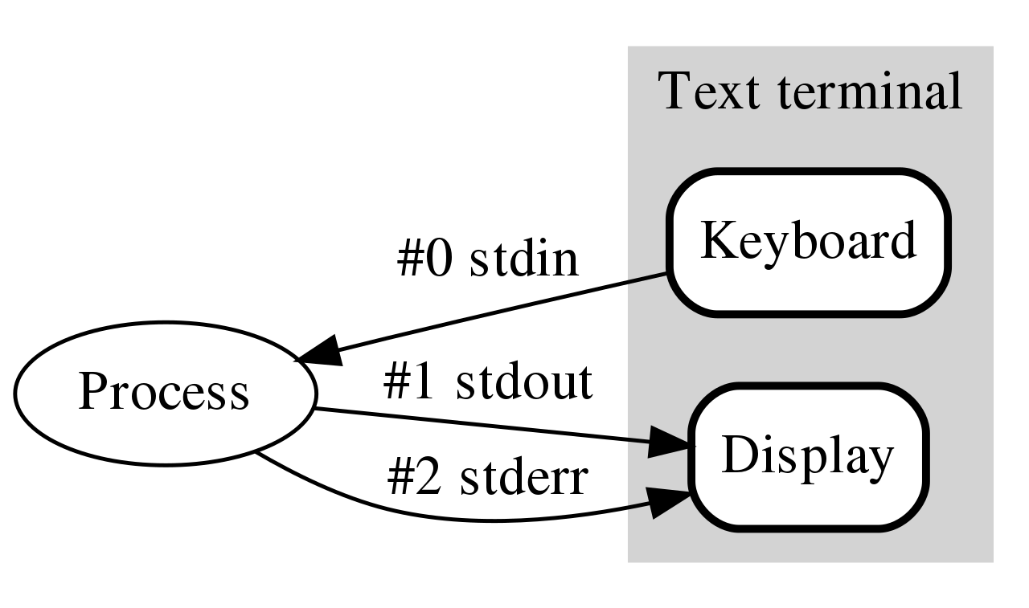
How do programs talk to users?
We glossed over this before
printf()
scanf()
Work through the same file mechanism
Three special files created for each program
stdin – standard input
stdout – standard output
stderr – standard error
printf() -> fprintf(stdout) -> handle arguments & fwrite(stdout)

Slide 22
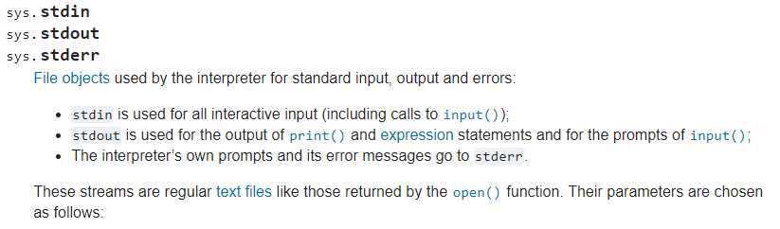
Standard I/O is a process thing, not a C thing
You can access them in Python, for instance
https://docs.python.org/3/library/sys.html#sys.stdin

Slide 23
Standard I/O is configured by the shell
When you run a program in command line, the shell attaches a standard input, standard output, and standard error to it
Defaults
stdin - read from terminal
stdout - write to terminal
stderr - write to terminal

Slide 24
Live coding: kitten upgrades
kitten.c
Errors should be written to stderr
Output can be written to stdout directly using fwrite()
Instead of using printf() in a loop to do it for us

Slide 25
Redirecting standard I/O
Shells by default setup standard I/O to connect to the keyboard and the screen
But any file will also work
Shell I/O redirection commands
COMMAND < filename
Connect standard input to filename
COMMAND > filename
Connect standard output to filename (overwrite)
COMMAND >> filename
Connect standard output to filename (append)

Slide 26
Piping commands
A command shell desire is to run multiple commands where the output of the first feeds into the second
COMMAND1 | COMMAND2
Connects stdout of COMMAND1 to stdin of COMMAND2
Example: print out files and sort by size
ls –lah | sort –h

Slide 27
Sidebar: super useful command for testing
tee [OPTION]... [FILE]...
Reads from stdin and write to both stdout and file
Example: prints out a list of files and saves results
ls –lah | tee results.txt
I run this with various programs I’m testing, so I can record the results, but also seem them in real-time.

Slide 28
Example: redirection with kitten
Standard I/O redirection is handled when the process is created
So it does not need to be aware of it at all
Our kitten tool works with redirection automatically!
./kitten arguments.c > OUTPUT_FILE

Slide 29
Break + Thinking Excercise
Take a look at the cat command to see the other commands
How hard would they be to implement in kitten?

Slide 30
Outline
File Input and Output in C
Standard Input and Output
Dynamic Arrays
Linked Lists

Slide 31
Dealing with dynamic input
What if you want to read in data, but you don’t know how much data there might be?
Arrays in C are a fixed size
But you can malloc() as many times as needed
Request some memory
Use until you run out
Request more memory and copy existing values over
realloc() makes this simple

Slide 32
Example of dynamic memory: read_line()
char* read_line(void)
Reads an entire line at a time from stdin
Can’t know in advance how many bytes there will be to read
Keeps reading in bytes until ‘\n’ character or end-of-file
Needs to request more memory until it holds the entire line
Note: part of the 211 library, not standard C

Slide 33
Live coding: implement read_line()
readline.c
char* read_line(void)
Requirements
Read from stdin until ‘\n’ or end-of-file (EOF)
Allocate an array to hold the read characters
Make sure to end it with a ‘\0’
Returns
NULL pointer if EOF was reached immediately
Pointer to string otherwise (not including the newline character)

Slide 34
Realloc versus malloc
We could just malloc() and copy ourselves, what does realloc() add?
realloc() can be far more efficient
Doesn’t have to copy data at all if there is room in the heap to expand
Also simpler for programmers
Can’t forget to free the old memory if realloc() does it for you

Slide 35
Default string size will change efficiency
Memory efficiency
Pointer returned could have way more memory than characters
User might hold on to memory for a while before freeing
The less wasted memory, the less memory the program needs
Runtime speed
malloc() and realloc() are slow
The fewer times we call them, the faster the program will run
Need to pick a sweet spot to balance the two of these
Real program: starts at 80 characters, doubles size when reallocating

Slide 36
Does efficiency really matter though?
If you’re writing a CS211 homework: no
If you’re writing a Javascript interpreter for Firefox,
Which has millions of users
times hundreds of websites per day for each user
times hundreds of lines of code per website
and each line of code is read with read_line()
YES

Slide 37

Break + relevant xkcd
https://xkcd.com/2347/

Slide 38
Outline
File Input and Output in C
Standard Input and Output
Dynamic Arrays
Linked Lists

Slide 39
The problem with arrays
They make a lot of sense when you have fixed data
But they’re not very flexible for dynamic data
Not smooth or simple to grow/shrink arrays
Lots of thought for how to dynamically change memory

Slide 40
An alternative: linked allocations
array_pointer:
 | 3 | 4 | 2 | 3
linked_list_pointer:
 | 3 |  |  | 4 |  |  | 2 |  |  | 3 | NULL

Slide 41
C code for a linked list structure
Array version:
int myarray[];
Linked List version:
struct node {
int value;
struct node* next;
};
typedef struct node node_t;
node_t head;

Slide 42
Rules for linked lists
The variable holding the “list” is actually a pointer to the first node of the list
Just like an array is a pointer to the first element in the array
Each node must have a pointer to the next node in the list
The last node in the list has a NULL pointer

Slide 43
Live coding example
linked_list.c
Working with a linked list
Determine length
Print values
Add elements to the list

Slide 44
Outline
File Input and Output in C
Standard Input and Output
Dynamic Arrays
Linked Lists

