Slide 1
Lecture 13 Access Control
CS211 – Fundamentals of Computer Programming II
Branden Ghena – Fall 2021
Slides adapted from: Jesse Tov (Northwestern), Hal Perkins (University of Washington)

Slide 2
Administrivia
Homework 5 is underway
Remember this is a SOLO ASSIGNMENT
Hardest part: getting used to C++ syntax
Example: calling a function on an object
Documentation: Posn<int>::right_by(…)
Means: Posn<int> has a member function called right_by()
To call it: pos.right_by(…)

Slide 3
Warning: CLion isn’t always trustworthy
CLion tries too hard to be useful
And can end up changing files you didn’t mean to
When it pops up and asks if you want to do something, usually the answer is “No!”
Example: static functions
This can end up changing code in files you didn’t mean to touch
Easiest fix is often to check out the project again and move your files over

Slide 4
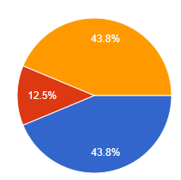
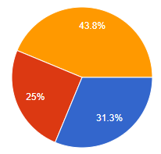
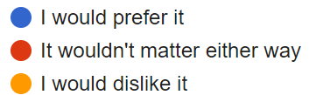
Survey results
Question: Should we change some office hours to in-person?
Mixed responses
Going to stay as-is for this quarter
Keeping a homework FAQ post on Campuswire
Wednesday
Thursday

Slide 5
Today’s Goals
Continue practice on constructors and objects
Discuss using exceptions to signal errors
Introduce concept of encapsulation and access control
How technically it’s done in C++
Why we care about it

Slide 6
Getting the code for today
Download code in a zip file from here: https://nu-cs211.github.io/cs211-files/lec/13_access.zip
Extract code wherever
Open with CLion
Make sure you open the folder with the CMakeLists.txt

Slide 7
Outline
More Constructors
Exceptions
Access Control
Encapsulation Policy

Slide 8
Today’s working example
String_Holder
Manages strings using a constant-length array to hold characters
Members:
int length
char characters[80]
Rules (invariants)
0 <= length <= 80
length matches the number of valid characters in characters

Slide 9
Live Coding: constructors for String_Holder
src/string_holder-implemented.cxx
src/string_holder.hxx
String_Holder::String_Holder()
Initialize empty
String_Holder::String_Holder(const char* str)
Construct from null-terminated string
String_Holder::String_Holder(const char* str, int len)
Construct from a length of characters
String_Holder::String_Holder(const String_Holder& other)
Copy constructor (from another String_Holder)

Slide 10
Delegating constructors
One constructor can call another to handle initialization
Delegates construction to that other constructor
// defined somewhere else
String_Holder::String_Holder(const char* str, int len);
// delegates to other constructor
String_Holder::String_Holder(const String_Holder& other)
: String_Holder(other.characters, other.length)
{}

Slide 11
Explicit constructors
The explicit keyword before a constructor means that the constructor must be manually called by the developer
Rather than automatically called by the compiler
Reason to have compiler automagic:
String_Holder str = “Test”;
Automatically calls String_Holder::String_Holder(“Test”);
Kind of nice that it just works…

Slide 12
Explicit constructors
The explicit keyword before a constructor means that the constructor must be manually called by the developer
Rather than automatically called by the compiler
Reason to use explicit:
void do_complicated_string_stuff(String_Holder str);
do_complicated_string_stuff(“Test”);
Also automatically calls the constructor
But maybe the user just passed in the wrong argument and a compile error would have been better…

Slide 13
Enforcing invariants with constructors
What if a user violates the rules?
0 <= length <= 80
length matches the number of valid characters in characters
Possibilities
Probably length should be an unsigned int to start with
Truncate length to 80
Only copy over as many characters as will fit
But what if there’s no obvious choice for what to do?
Constructor cannot return a value to say it failed

Slide 14
Outline
More Constructors
Exceptions
Access Control
Encapsulation Policy

Slide 15
Exceptions conceptually
Stop running this code and return a special error to the caller
Things went wrong, so we can’t just keep executing code like normal
If the caller doesn’t expect the error and can’t handle it, repeat the process
Again stop running the code and return the special error

Slide 16
Exceptions are “thrown” by the function
throw keyword performs the special “error return”
Takes an argument of the error to return
Example: throw std::invalid_argument(“String is too long”);
Actually, you can throw anything (for historical reasons)
throw 6;
You should almost certainly throw a class based on std::exception
https://en.cppreference.com/w/cpp/error/exception

Slide 17
Properly handling exceptions
If no caller in the “call stack” handles the exception, the program will exit
Handle exceptions with a try-catch block
try {
// code that could throw an exception goes here
} catch (const std::invalid_argument& ex) {
// code to handle the exception goes here
}
This example only catches std::invalid_argument exceptions

Slide 18
General try-catch form
try {
// code that could throw exceptions
} catch ( some specific exception ) {
// handler code
} catch ( another specific exception ) { // handler code
} catch (...) {
// general case matches all exceptions
// actually includes the ... in the C++ code }

Slide 19
Live coding: exceptions
src/string_holder-exception.cxx
Functions to add to:
String_Holder::String_Holder(const char*, int)
Ensure that int values are:
>= 0
< MAX_STRING_LENGTH
String_Holder::char_at(int)
Ensure that int values are:
>= 0
< length

Slide 20
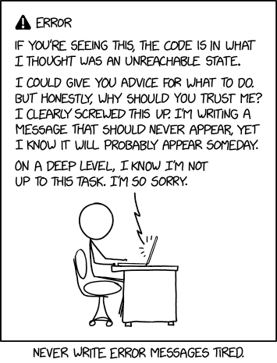
Break + Relevant XKCD
https://xkcd.com/2200/

Slide 21
Outline
More Constructors
Exceptions
Access Control
Encapsulation Policy

Slide 22
The problem of public access
Constructors (and other member functions) that enforce rules are insufficient
Anyone could access the data member directly
String_Holder str(“Test String”);
str->length = 5000;
std::cout << str; // oops, UNDEFINED BEHAVIOR

Slide 23
Access modifiers
By default, all data and functions are “public”
struct My_struct {
// accessible to all parts of the program
}

Slide 24
Access modifiers
Can choose to make data/functions “private”
struct My_struct {
private:
// accessible only to member functions
}

Slide 25
Access modifiers
Can choose exactly which data / functions are publicly accessibly versus privately accessible!
struct My_struct {
public:
// accessible to all parts of the program
private:
// accessible only to member functions
}

Slide 26
Access modifiers
Can choose exactly which data / functions are publicly accessibly versus privately accessible!
struct My_struct {
public:
// accessible to all parts of the program
private:
// accessible only to member functions
public:
// accessible to all parts of the program
}

Slide 27
Structs versus Classes
Struct and Class are interchangeable
The difference is the default behavior
Both can use private: and public: access modifiers
struct Test {
// accessible to all parts of the program
}
class Test {
// accessible only to member functions
}

Slide 28
Style convention
Use classes for abstractions (smart data)
Example: String_Holder, Ball
Use structs for “plain old data”
Example: Position, Dimension
We intentionally violated this in homework 5 to keep things simple
And to make transition from C simpler: “structs with functions”

Slide 29
Additional specifier: protected
Like private, but accessible to classes that inherit from this one
i.e., other classes that are based on this one
Will talk about more next week
If you see it around before then, consider it the same as private

Slide 30
Outline
More Constructors
Exceptions
Access Control
Encapsulation Policy

Slide 31
Encapsulation
Goal: protect the rules of your data so it remains consistent
Method:
Make the data private
Add public member functions to let clients do useful things
Don’t add public member functions that let clients do bad things (like break the rules of the data)

Slide 32
Step back: why do we care about consistency?
Helps us avoid UNDEFINED BEHAVIOR
Keep track of sizes of arrays, for instance
Avoids errors
Maybe you expect your data to always be sorted
Improves efficiency
Make assumptions about the data that you know MUST be true

Slide 33
Live coding: update String_Holder access control
Data members should be private
Convention: private members end with “_”
Functions should be public
And functions should never allow the rules to be broken

Slide 34
Encapsulation cuts off direct access to data members
Problem: functions outside of the class can never access data members, even to just read from them
Options:
Include as a member function
Add “getters” for data variables String_Holder::size()
Declare function as a friend

Slide 35
Allowing specific things access to private members
friend keyword declares another thing that can access private members from this class
Example overloaded operator! operator<<()
Needs to access the private members of String_Holder
Inside the String_Holder class definition, add:
friend std::ostream& operator<<(std::ostream&, const String_Holder&);

Slide 36
Welcome to Encapsulation
Software engineering principle:
Bundle your data and operations together
Don’t let non-bundled operations mess with your bundled data
Benefits
Correctness
Data will never become inconsistent
Flexibility
Implementation details can change without modifying the API

Slide 37
Outline
More Constructors
Exceptions
Access Control
Encapsulation Policy

