Slide 1
Lecture 02 Introducing C
CS211 – Fundamentals of Computer Programming II
Branden Ghena – Winter 2022
Slides adapted from: Jesse Tov

Slide 2
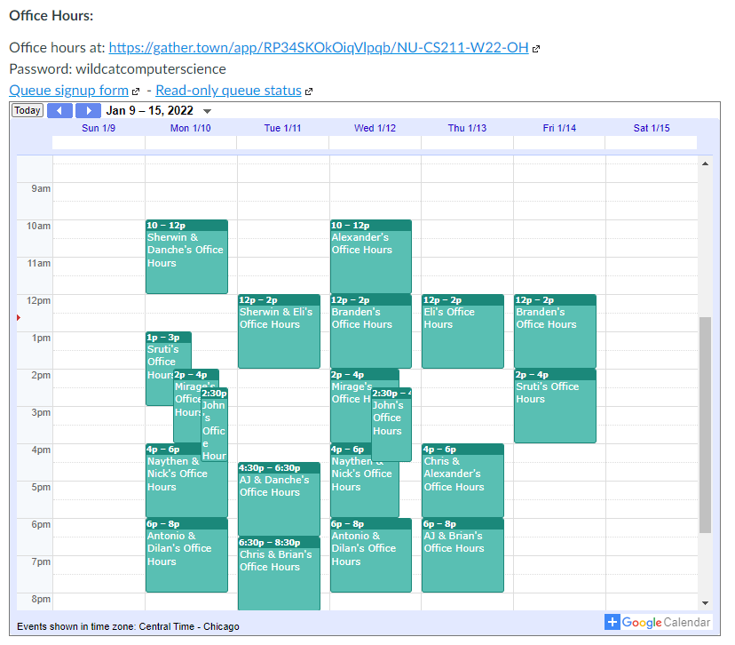
Administrivia
Office hours have started!
Check Canvas homepage for calendar
Everyone should have Campuswire access
Email me ASAP if you don’t

Slide 3
Administrivia
Lab01 is due on Friday
More than half of you have finished it already 🧡
Please reach out if you have problems!
Lab02 is released today
Practice C programming
Due on Monday
Hw01 will be released tonight
Due next week Thursday

Slide 4
Today’s Goals
Introduce the basics of C programming
Compilation
Variables
Conditionals (if)
Iteration (while and for)
Input and Output (printf and scanf)
Continue practicing use of the shell

Slide 5
Getting the examples from lecture
First, make your own cs211 directory to store class stuff in
cd ~/
mkdir cs211
The files for this class are in a zipped tarball (just like a zip file)
We can extract them right into your cs211/ directory
cd ~/cs211/
tar -xvkf ~cs211/lec/02_intro_c.tgz
cd 02_intro_c
What does that command do?: https://explainshell.com/explain?cmd=tar+-xvkf+%7Ecs211%2Flec%2F02_intro_c.tgz

Slide 6
Outline
Quick Shell Note
Hello World in C
Compilation
Computing Fibonacci Numbers
Variables
Iteration
Other C Syntax
Input and Output

Slide 7
Reminder: Helpful guides to shell commands
Great lecture notes on using the shell
https://swcarpentry.github.io/shell-novice/
Tool to explain various shell command syntax
https://explainshell.com/
Tool to explain how to use various shell commands
Just type the command into the box at the top
https://tldr.ostera.io/

Slide 8
Shell command: sudo
Superuser do
Executes a command with special administrator privilege (superuser)
Necessary for installing new programs and modifying the OS
Run it before a command to execute that command as a superuser
Example: sudo rm –rf / (don’t run this!)
You can only use sudo on computers where you are an admin
Only use with caution and care. It can destroy your computer
You’ll never need it for class stuff
You are NOT an admin on the class servers! (neither am I)

Slide 9
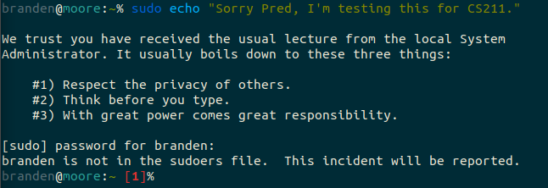
sudo example

Slide 10
sudo example

Slide 11
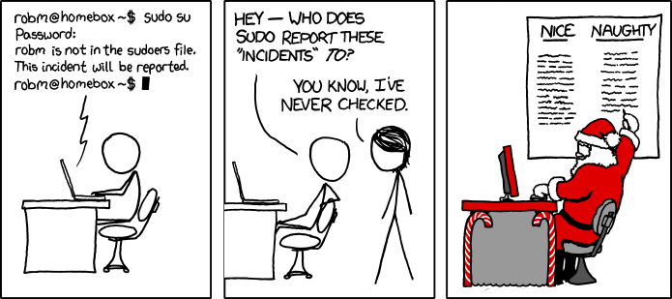
relevant xkcd (but no break, go read this later)
https://xkcd.com/838/

Slide 12
Outline
Quick Shell Note
Hello World in C
Compilation
Computing Fibonacci Numbers
Variables
Iteration
Other C Syntax
Input and Output

Slide 13
Hello world C program
hello.c
#include <stdio.h>
int main(void) {
printf("Hello, CS 211!\n");
return 0;
}

Slide 14
Hello world C program
hello.c
#include <stdio.h>
int main(void) {
printf("Hello, CS 211!\n");
return 0;
}
This is the code file where you can find this code!
See slide near beginning on how to get code from today’s lecture.

Slide 15
Hello world C program
hello.c
#include <stdio.h>
int main(void) {
printf("Hello, CS 211!\n");
return 0;
}
A function named main()

Slide 16
Hello world C program
hello.c
#include <stdio.h>
int main(void) {
printf("Hello, CS 211!\n");
return 0;
}
A function named main()
No Arguments (void)
Returns an integer

Slide 17
Hello world C program
hello.c
#include <stdio.h>
int main(void) {
printf("Hello, CS 211!\n");
return 0;
}
Call to the printf() function
One argument to the function, the string “Hello, CS211\n”

Slide 18
Hello world C program
hello.c
The printf() function is a part of the standard input/output library, included here
#include <stdio.h>
int main(void) {
printf("Hello, CS 211!\n");
return 0;
}
Call to the printf() function
One argument to the function, the string “Hello, CS211\n”

Slide 19
Hello world C program
hello.c
#include <stdio.h>
int main(void) {
printf("Hello, CS 211!\n");
return 0;
}
Returns a value, 0 (which is of type int)

Slide 20
Hello world C program
hello.c
Two special things going on here:
main() is a special function name that is called when the program runs
#include <stdio.h>
int main(void) {
printf("Hello, CS 211!\n");
return 0;
}

Slide 21
Hello world C program
hello.c
Two special things going on here:
main() is a special function name that is called when the program runs
main() returns a number that specifies whether the program succeeded or failed and how
0 means success
non-zero means failure
specific numbers mean different things to different programs
#include <stdio.h>
int main(void) {
printf("Hello, CS 211!\n");
return 0;
}

Slide 22
Outline
Quick Shell Note
Hello World in C
Compilation
Computing Fibonacci Numbers
Variables
Iteration
Other C Syntax
Input and Output

Slide 23
How do you “run” C code?
First, the C code needs to be translated
From human-readable source code
To machine code capable of being executed on a particular machine (definitely not human readable)
This translation process is called “compiling”
The tool that does it is a “compiler”
Source Code
compilation
Machine Code

Slide 24
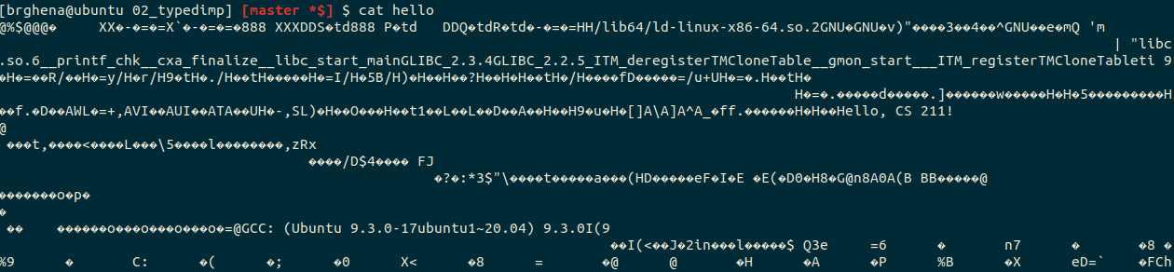
What does machine code look like?
Just a bunch of numbers
Your text editor would interpret those numbers as random characters
The computer processor reads the numbers to figure out which instruction to run
This is a version of assembly code
See CS213 for way more details

Slide 25
Compiling a C program
The compiler we’ll use is referred to as cc
Short for C Compiler
It takes in C source code and outputs executable machine code
cc hello.c
ls a.out hello.c
./a.out Hello, CS 211!
Let’s go to the shell and try it out!

Slide 26
Compiling a C program
a.out is the default name, but we probably want to use something more memorable
The -o flag specifies the output filename for the compiler
cc -o hello hello.c
ls hello hello.c
./hello Hello, CS 211!

Slide 27
Remember to compile!
You need to re-compile code every time the source code changes
You WILL forget to do this at some point
And you’ll run the program but it’ll do the old behavior rather than the new things you’ve written
Compile often!
Keep multiple windows open to make this easier
I write a handful of lines of C code, then compile again
Way easier to find one or two mistakes now than deal with MANY later

Slide 28
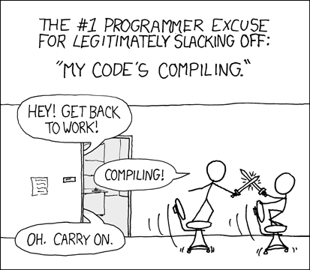
Break + relevant xkcd
https://xkcd.com/303/

Slide 29
Outline
Quick Shell Note
Hello World in C
Compilation
Computing Fibonacci Numbers
Variables
Iteration
Other C Syntax
Input and Output

Slide 30

Definition of Fibonacci Function
$fib\left(n\right)= \left\{\begin{aligned}n, if n<2; \\ fib\left(n−2\right)+fib\left(n−1\right), otherwise\end{aligned}\right.$
n | fib(n)
0 | 0
1 | 1
2 | 1
3 | 2
4 | 3
5 | 5
6 | 8
7 | 13
8 | 21

Slide 31
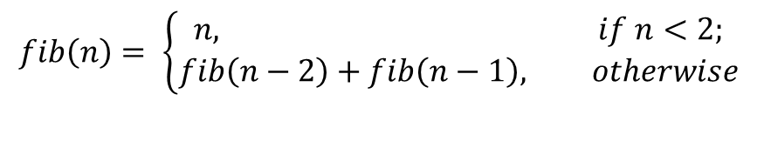
Implementing Fibonacci in C
fib.c
long fib(int n){
if (n < 2) {
return n;
} else {
return fib(n ‑ 2) + fib(n ‑ 1);
}
}
$$fib\left(n\right)= \left\{\begin{aligned}n, if n<2; \\ fib\left(n−2\right)+fib\left(n−1\right), otherwise\end{aligned}\right.$$
Recursion works in C!

Slide 32
Implementing Fibonacci in C
fib.c
long fib(int n){
if (n < 2) {
return n;
} else {
return fib(n ‑ 2) + fib(n ‑ 1);
}
}
$$fib\left(n\right)= \left\{\begin{aligned}n, if n<2; \\ fib\left(n−2\right)+fib\left(n−1\right), otherwise\end{aligned}\right.$$
if (⟨test-expr⟩) { // evaluate ⟨test-expr⟩; then… ⟨then-stms⟩ // do these if ⟨test-expr⟩ was true
} else {
⟨else-stms⟩ // do these if ⟨test-expr⟩ was false
}

Slide 33
Statements can be nested in C
if (⟨first-test-expr⟩) {
if (⟨second-test-expr⟩) {
⟨A-stms⟩
} else {
⟨B-stms⟩
}
} else {
if (⟨third-test-expr⟩) {
⟨C-stms⟩
} else {
⟨D-stms⟩
}
}

Slide 34
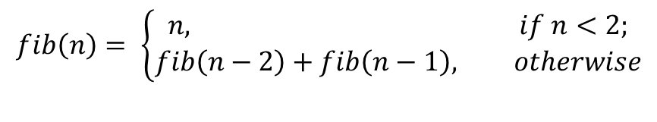
C ignores most whitespace
$$fib\left(n\right)= \left\{\begin{aligned}n, if n<2; \\ fib\left(n−2\right)+fib\left(n−1\right), otherwise\end{aligned}\right.$$
long fib(int n){
if (n < 2) {
return n;
} else {
return fib(n ‑ 2) + fib(n ‑ 1);
}
}

Slide 35
C ignores most whitespace
$$fib\left(n\right)= \left\{\begin{aligned}n, if n<2; \\ fib\left(n−2\right)+fib\left(n−1\right), otherwise\end{aligned}\right.$$
long fib(int n){
if (n < 2) {
return n;
} else {
return fib(n ‑ 2) +
fib(n ‑ 1);
}
}
C doesn’t care about whitespace

Slide 36
C ignores most whitespace
$$fib\left(n\right)= \left\{\begin{aligned}n, if n<2; \\ fib\left(n−2\right)+fib\left(n−1\right), otherwise\end{aligned}\right.$$
long fib(int n){if(n<2){return n;}else{return fib(n‑2)+fib(n‑1);}}
C really doesn’t care about whitespace

Slide 37
C ignores most whitespace
$$fib\left(n\right)= \left\{\begin{aligned}n, if n<2; \\ fib\left(n−2\right)+fib\left(n−1\right), otherwise\end{aligned}\right.$$
long fib(int n){if(n<2){return n;}else{return fib(n‑2)+fib(n‑1);}}
C really doesn’t care about whitespace
But humans do! So don’t write your code this way!!!!!!!!!!

Slide 38
A note on style
A lot of things are possible in C, but bad ideas
They can make things hard to read
They can be a source of bugs in code
We try to provide you with what we think of as “good” C code
We have a guide to how you should write your C code
This is a (small) portion of your grade on each assignment!
https://nu-cs211.github.io/cs211-files/cstyle.html

Slide 39
Outline
Quick Shell Note
Hello World in C
Compilation
Computing Fibonacci Numbers
Variables
Iteration
Other C Syntax
Input and Output

Slide 40
Values, objects, and variables
Values are the actual information we want to work with
Numbers, Strings, Images, etc.
Example: 3 is an int value while ‘a’ is a char value
An object is a chunk of memory that can hold a value of a particular type.
Example: function f has a parameter int x
Each time f is called, a “fresh” object that can hold an int is “created”
A variable is the name of an object
Assigning to a variable changes the value stored in the object named by the variable

Slide 41
Example of definition and assignment
int z = 5;
z = 7;
z = z + 4;
What happens?

Slide 42
Example of definition and assignment
int z = 5;
z = 7;
z = z + 4;
What happens?
The first statement is a definition. It creates an int object, names it z, and initializes it to the value 5
z: | 5

Slide 43
Example of definition and assignment
int z = 5;
z = 7;
z = z + 4;
What happens?
The second statement is an assignment. It replaces the value 5 stored in the object named by z with the value 7.
z: | 7

Slide 44
Example of definition and assignment
int z = 5;
z = 7;
z = z + 4;
What happens?
The third statement is also an assignment. It retrieves the current value of z (which is 7), then adds 4 to it, and then stores the result back in the object named by z.
z: | 11

Slide 45
C: Typed imperative programming
Imperative programming
Each line is a statement that changes the program’s state
Usually, the values within a variable
Type System
Variables have a type associated with them
The type determines qualities of the object
Example: how much memory it takes up
The type specifies what kind of value the variable holds
Example: integers, decimal numbers, strings, etc.

Slide 46
Types in C
Hold an integer number (like 5 or 0 or -3)
char, short, int, long, size_t, int8_t, int16_t, int32_t, etc.
These can also specify signedness
unsigned: only 0 and greater
signed: negative, 0, or positive
Hold a decimal number (like 6.238 or 0.00001 or -32566.5)
float, double
These are always negative, 0, or positive
Difference between types: how big of a value they can hold
short: 0 to 65536 OR signed short: -32768 to 32767
int: 0 to 4294967296 OR signed int: -2147483648 to 2147483647
We’ll have a whole future lecture on why the types are like this

Slide 47
Signed vs unsigned variables
All “integer” types in C can be signed or unsigned
char, short, int, long, etc.
Unsigned: only zero or positive
Signed: negative, zero, or positive
Signed is the default! If it doesn’t say, it’s usually signed
An exception is size_t which is unsigned
Comparing signed and unsigned numbers generates a warning
Should make sure they’re the same before comparing

Slide 48
Temporarily changing types while comparing
You can cast a variable to another type during an expression
To cast, put a type in parentheses before the variable name
Example
int i = 0; //int is signed by default
size_t length = 5; //size_t is unsigned
if (i > length) { // warning here!
printf(“Too big!\n”);
}

Slide 49
Temporarily changing types while comparing
You can cast a variable to another type during an expression
To cast, put a type in parentheses before the variable name
Example
int i = 0; //int is signed by default
size_t length = 5; //size_t is unsigned
if (i > (int)length) { // no warning anymore!
printf(“Too big!\n”);
}

Slide 50
typedef can be used to make new C type names
Typedef creates a new type name that is a copy of an existing type
Typedef keyword is followed by two types
First type: the original type name
Second type: the new type name
Example:
typedef int x_coordinate_t;
x_coordinate_t my_variable = 5;

Slide 51
More complicated example
int prev;
int curr = 5;
int next = 8;
prev = curr;
curr = next;
next = prev + curr;
prev = curr;
curr = next;
next = prev + curr;
prev = curr;
curr = next;
next = prev + curr;

Slide 52
More complicated example
prev: | 🐝
int prev;
int curr = 5;
int next = 8;
prev = curr;
curr = next;
next = prev + curr;
prev = curr;
curr = next;
next = prev + curr;
prev = curr;
curr = next;
next = prev + curr;

Slide 53
More complicated example
prev: | 🐝
curr: | 5
int prev;
int curr = 5;
int next = 8;
prev = curr;
curr = next;
next = prev + curr;
prev = curr;
curr = next;
next = prev + curr;
prev = curr;
curr = next;
next = prev + curr;

Slide 54
More complicated example
prev: | 🐝
curr: | 5
next: | 8
int prev;
int curr = 5;
int next = 8;
prev = curr;
curr = next;
next = prev + curr;
prev = curr;
curr = next;
next = prev + curr;
prev = curr;
curr = next;
next = prev + curr;

Slide 55
More complicated example
prev: | 5
curr: | 5
next: | 8
int prev;
int curr = 5;
int next = 8;
prev = curr;
curr = next;
next = prev + curr;
prev = curr;
curr = next;
next = prev + curr;
prev = curr;
curr = next;
next = prev + curr;

Slide 56
More complicated example
prev: | 5
curr: | 8
next: | 8
int prev;
int curr = 5;
int next = 8;
prev = curr;
curr = next;
next = prev + curr;
prev = curr;
curr = next;
next = prev + curr;
prev = curr;
curr = next;
next = prev + curr;

Slide 57
More complicated example
prev: | 5
curr: | 8
next: | 13
int prev;
int curr = 5;
int next = 8;
prev = curr;
curr = next;
next = prev + curr;
prev = curr;
curr = next;
next = prev + curr;
prev = curr;
curr = next;
next = prev + curr;

Slide 58
More complicated example
prev: | 8
curr: | 8
next: | 13
int prev;
int curr = 5;
int next = 8;
prev = curr;
curr = next;
next = prev + curr;
prev = curr;
curr = next;
next = prev + curr;
prev = curr;
curr = next;
next = prev + curr;

Slide 59
More complicated example
prev: | 8
curr: | 13
next: | 13
int prev;
int curr = 5;
int next = 8;
prev = curr;
curr = next;
next = prev + curr;
prev = curr;
curr = next;
next = prev + curr;
prev = curr;
curr = next;
next = prev + curr;

Slide 60
More complicated example
prev: | 8
curr: | 13
next: | 21
int prev;
int curr = 5;
int next = 8;
prev = curr;
curr = next;
next = prev + curr;
prev = curr;
curr = next;
next = prev + curr;
prev = curr;
curr = next;
next = prev + curr;

Slide 61
More complicated example
prev: | 13
curr: | 13
next: | 21
int prev;
int curr = 5;
int next = 8;
prev = curr;
curr = next;
next = prev + curr;
prev = curr;
curr = next;
next = prev + curr;
prev = curr;
curr = next;
next = prev + curr;

Slide 62
More complicated example
prev: | 13
curr: | 21
next: | 21
int prev;
int curr = 5;
int next = 8;
prev = curr;
curr = next;
next = prev + curr;
prev = curr;
curr = next;
next = prev + curr;
prev = curr;
curr = next;
next = prev + curr;

Slide 63
More complicated example
prev: | 13
curr: | 21
next: | 34
int prev;
int curr = 5;
int next = 8;
prev = curr;
curr = next;
next = prev + curr;
prev = curr;
curr = next;
next = prev + curr;
prev = curr;
curr = next;
next = prev + curr;

Slide 64
Outline
Quick Shell Note
Hello World in C
Compilation
Computing Fibonacci Numbers
Variables
Iteration
Other C Syntax
Input and Output

Slide 65
Statements and Conditions aren’t enough
Those lines of code were actually implementing Fibonacci!
And they were doing it without requiring any recursion
Problem: it’s really repetitive to have to write out the same lines of code again and again
Solution: Iteration

Slide 66
Iteration with the While Statement
Syntax
while (⟨test-expression⟩) {
⟨body-statements⟩
}
Semantics
Evaluate ⟨test-expression⟩ to a bool
If the bool is false then skip to the statement after the while loop
Execute ⟨body-statements⟩ (if the bool was true)
Go back to step 1

Slide 67
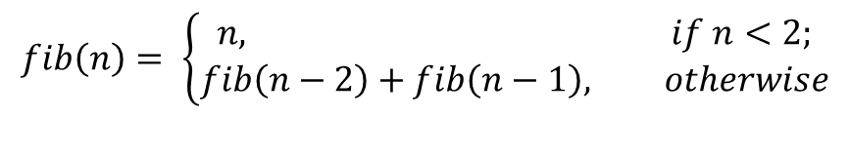
Implementing Fibonacci in C
fib.c
long fib_iterative(int n){
long curr = 0;
long next = 1;
while (n > 0) {
long prev = curr;
curr = next;
next = prev + curr;
n = n ‑ 1;
}
return curr;
}
$$fib\left(n\right)= \left\{\begin{aligned}n, if n<2; \\ fib\left(n−2\right)+fib\left(n−1\right), otherwise\end{aligned}\right.$$

Slide 68
For loops
For loops allow you to combine iteration and incrementing
When you write a for statement like this:
for (⟨start-decl⟩; ⟨test-expr⟩; ⟨step-expr⟩) {
⟨body-stms⟩
}
It’s as if you’d written this while statement:
{
⟨start-decl⟩;
while (⟨test-expr⟩) {
⟨body-stms⟩
⟨step-expr⟩;
}
}

Slide 69
Implementing Fibonacci in C
fib.c
long fib_iterative(int n){
long curr = 0;
long next = 1;
while (n > 0) {
long prev = curr;
curr = next;
next = prev + curr;
n = n ‑ 1;
}
return curr;
}
$$fib\left(n\right)= \left\{\begin{aligned}n, if n<2; \\ fib\left(n−2\right)+fib\left(n−1\right), otherwise\end{aligned}\right.$$

Slide 70
Implementing Fibonacci in C
fib.c
long fib_iterative(int n){
long curr = 0;
long next = 1;
int i = 0;
while (i < n) {
long prev = curr;
curr = next;
next = prev + curr;
i = i + 1;
}
return curr;
}
$$fib\left(n\right)= \left\{\begin{aligned}n, if n<2; \\ fib\left(n−2\right)+fib\left(n−1\right), otherwise\end{aligned}\right.$$

Slide 71
Implementing Fibonacci in C
fib.c
long fib_iterative(int n){
long curr = 0;
long next = 1;
int i = 0;
for ( ; i < n; ) {
long prev = curr;
curr = next;
next = prev + curr;
i = i + 1;
}
return curr;
}
$$fib\left(n\right)= \left\{\begin{aligned}n, if n<2; \\ fib\left(n−2\right)+fib\left(n−1\right), otherwise\end{aligned}\right.$$

Slide 72
Implementing Fibonacci in C
fib.c
long fib_iterative(int n){
long curr = 0;
long next = 1;
// int i = 0;
for (int i = 0; i < n; ) {
long prev = curr;
curr = next;
next = prev + curr;
i = i + 1;
}
return curr;
}
$$fib\left(n\right)= \left\{\begin{aligned}n, if n<2; \\ fib\left(n−2\right)+fib\left(n−1\right), otherwise\end{aligned}\right.$$

Slide 73
Implementing Fibonacci in C
fib.c
long fib_iterative(int n){
long curr = 0;
long next = 1;
for (int i = 0; i < n; i = i + 1) {
long prev = curr;
curr = next;
next = prev + curr; //i = i + 1;
}
return curr;
}
$$fib\left(n\right)= \left\{\begin{aligned}n, if n<2; \\ fib\left(n−2\right)+fib\left(n−1\right), otherwise\end{aligned}\right.$$

Slide 74
Implementing Fibonacci in C
fib.c
long fib_iterative(int n){
long curr = 0;
long next = 1;
for (int i = 0; i < n; i = i + 1) {
long prev = curr;
curr = next;
next = prev + curr; }
return curr;
}
$$fib\left(n\right)= \left\{\begin{aligned}n, if n<2; \\ fib\left(n−2\right)+fib\left(n−1\right), otherwise\end{aligned}\right.$$

Slide 75
Break + Question
What value will this code return when called as:
loop_function(6)
loop_function(5)
loop_function(3)
int loop_function(int test) {
int retval = 0;
while (test < 5) {
retval = retval + 1;
test = test + 1;
}
return retval;
}

Slide 76
Break + Question
What value will this code return when called as:
loop_function(6) returns 0
loop_function(5)
loop_function(3)
int loop_function(int test) {
int retval = 0;
while (test < 5) {
retval = retval + 1;
test = test + 1;
}
return retval;
}

Slide 77
Break + Question
What value will this code return when called as:
loop_function(6) returns 0
loop_function(5) returns 0
loop_function(3)
int loop_function(int test) {
int retval = 0;
while (test < 5) {
retval = retval + 1;
test = test + 1;
}
return retval;
}

Slide 78
Break + Question
What value will this code return when called as:
loop_function(6) returns 0
loop_function(5) returns 0
loop_function(3) returns 2
int loop_function(int test) {
int retval = 0;
while (test < 5) {
retval = retval + 1;
test = test + 1;
}
return retval;
}

Slide 79
Outline
Quick Shell Note
Hello World in C
Compilation
Computing Fibonacci Numbers
Variables
Iteration
Other C Syntax
Input and Output

Slide 80
C comments
// means a single-line comment
/* starts a multiline comment, which continues until */
How to use comments effectively
Comment “blocks” of code with their purpose
Every line is too much
Often helpful to write the comments before the code as planning
Comment tricky bits of code so you know what it means
You + several weeks = “what does that code mean?!”

Slide 81
Logical operators
|| &&
Logical OR, and Logical AND
a < 5 && b > 12
!
Logical NOT
!(a < 5) equivalent to (a >= 5)
==
Equality test
5 == 5 -> TRUE
16 == -3 -> FALSE
Don’t mix it up with assignment (single equals sign)
Really common new C programmer mistake

Slide 82
Other operators you’ll see around
+= *= -= /=
Perform the action of VAR = VAR operator ARG
a += 5 -> a = a + 5
a *= b -> a = a * b
%
Modulus operator
Returns the remainder of division
12 % 10 -> 2
~ | & ^
Bitwise NOT, OR, AND, and XOR (you’ll learn these in CS213)
Importantly, ^ is not exponentiation!!!

Slide 83
Adding and Subtracting one
++ --
Shorthand for plus 1 or minus 1
++a -> a += 1 -> a = a + 1
The auto-increment/decrement operators can go before or after the variable
(--x) subtracts one and returns the new value of x from the expression
(x--) subtracts one but returns the old value of x from the expression
Usually, this doesn’t matter, unless you write complicated statements that combine assignment and conditions
if (--x > 0) … (please just never do this)

Slide 84
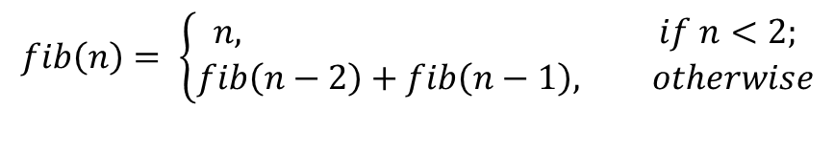
Implementing Fibonacci in C
fib.c
long fib_iterative(int n){
long curr = 0;
long next = 1;
for (int i = 0; i < n; ++i) { // i++ also works
long prev = curr;
curr = next;
next = prev + curr; }
return curr;
}
$$fib\left(n\right)= \left\{\begin{aligned}n, if n<2; \\ fib\left(n−2\right)+fib\left(n−1\right), otherwise\end{aligned}\right.$$

Slide 85
Ternary Operator
? :
Shorthand version of an if statement, determining result of expression
Example:
return (a < 5) ? a : b;
equivalent to
if (a < 5) { return a; } else { return b; }
You won’t need to use this. Usually, it just makes code harder to read.

Slide 86
Outline
Quick Shell Note
Hello World in C
Compilation
Computing Fibonacci Numbers
Variables
Iteration
Other C Syntax
Input and Output

Slide 87
printf() function
The usual way to print in C is the printf() function
Takes a format string followed by arguments to interpolate in place of the string’s format specifiers
printf("(%d, %d)\n", x, y);
%d format specifier means the argument is an int
Prints “(“ + the value of x + “, “ + the value of y + “)\n”
printf() is in the stdio.h library, which needs to be #include-ed

Slide 88
Example: formatted output
output.c
#include <stdio.h>
int main(void){
int x = 5;
double f = 5.1;
printf("sizeof x: %zu bytes\n", sizeof(x));
printf("sizeof f: %zu bytes\n", sizeof(f));
printf("x: %d\nf: %.60e\n", x, f);
}
A format specifier gives the argument’s type and maybe some options
%zu type: size_t (the return result of sizeof)
%d type: int
%.60e type: double, include 60 digits of precision

Slide 89
How do you learn format specifiers?
You look them up in a guide!
Even I don’t have them memorized…
man 3 printf
Runs in the terminal
Shows details about printf
google “printf format specifiers” (this is what I do)
cplusplus.com is a good resource
https://www.cplusplus.com/reference/cstdio/printf/

Slide 90
Reading user input
To input numbers in C, use the scanf() function
scanf reads keyboard input, converts it to the require type, and stores it in an existing variable:
int x = 0;
scanf("%d", &x);
Like printf(), scanf() uses a format string to determine what type to convert the input into
&x means to pass x’s location, not its value (more on this next week)
Careful: scanf() directives aren’t exactly the same as printf()

Slide 91
Example: reading input
input.c
#include <stdio.h>
double sqr_dbl(double n){
return n * n;
}
int main(void){
double d = 0.0;
scanf("%lf", &d);
printf("%lf squared is %lf\n", d, sqr_dbl(d));
}

Slide 92
Example: reading multiple items
multi_input.c
#include <stdio.h>
int main(void){
int x;
int y;
printf("Enter two integers: ");
scanf("%d%d", &x, &y);
printf("%d * %d = %d\n", x, y, x * y);
}

Slide 93
What if scanf() has an error?
check_input.c
scanf() returns the number of successful conversions
#include <stdio.h>
int main(void){
int x int y;
printf("Enter two integers: ");
if (scanf("%d%d", &x, &y) != 2) {
printf("Input error\n");
return 1;
}
printf("%d * %d == %d\n", x, y, x * y);
}

Slide 94
You now know the basics of C programming!
We’re missing a few simple things
You’ll practice those in Lab02 and Hw01
Structs!
We’re missing some advanced features
We’ll cover those next week

Slide 95
Outline
Quick Shell Note
Hello World in C
Compilation
Computing Fibonacci Numbers
Variables
Iteration
Other C Syntax
Input and Output

