Slide 1
Lecture 07 Standard I/O
CS211 – Fundamentals of Computer Programming II
Branden Ghena – Winter 2022
Slides adapted from: Jesse Tov

Slide 2
Administrivia
Quiz today!
Message your friends who didn’t show up to class
It’ll be 15 minutes long
I’ll stop lecture around 3:00 and hand out quizzes
Somebody let me know if I forget

Slide 3

Administrivia
Some office hours are now in-person
All are held in Tech EG20 (Wing E, Ground floor, Room 20)

Slide 4
Administrivia
Homeworks are getting harder! Remember to start early
Homework 4 (next week) will on top of Homework 3 (this week)
Remember that there will be a break after homework 4
Homework 4 due February 03
Nothing due February 10
Homework 5 due February 17
There is a break in sight!

Slide 5
Today’s Goals
Explore input and output to files
What C library functions allow interacting with files?
How do stdin, stdout, and stderr work?
If we have time:
Practice dynamic memory allocation with arrays
How do we make a dynamically-sized array?

Slide 6
Getting the code for today
cd ~/cs211/lec/ (or wherever you put stuff)
tar -xkvf ~cs211/lec/07_stdio.tgz
cd 07_stdio/

Slide 7
Outline
File Input and Output in C
Standard Input and Output
Dynamic Arrays

Slide 8
Files
Collections of data
Usually in permanent storage on your computer
Types of files
Regular files
Arbitrary data
Think of as a big array of bytes (just like memory)
Directories
Collections of regular files
Special files
Links, pipes, devices (see CS343)

Slide 9
How do we interact with files?
Analogy: think of a file as a book
Big array of characters (bytes)
Open the book, starting at the first page
Read from the book
Write to the book
Change pages (without reading everything in between)
Close the book when finished

Slide 10
System calls for interacting with files
Open the book, starting at the first page
fopen()
Read from the book
fread()
Write to the book
fwrite()
Change pages (without reading everything in between)
fseek()
Close the book when finished
fclose()

Slide 11
Opening files
FILE* fopen(const char* filename, const char* mode);
filename is the string path for the file
“/home/brghena/class/cs211/w22/hw/hw01/src/circle.c”
“./arguments.c”
“arguments.c”
mode specifies what you intend to do with the file
“r” - read only (must exist)
“w” - write (overwrites if exists)
“a” - append (starts writing at end of file if exists)

Slide 12
Open returns a FILE object
FILE* fopen(const char* filename, const char* mode);
Pointer type for an object used to interact with the file
A “handle” to the file
Other file interaction functions will take in a FILE* as an argument
Don’t need to remember the file path and look it up every time
NULL instead specifies an error attempting to open the file

Slide 13
Reading files
size_t fread(void* ptr, size_t size, size_t count, FILE* stream);
ptr is a pointer to an array to read into
At least size * count bytes in length
size is the number of bytes for each element in the array
count is the number of elements to read
stream is the file pointer returned from a previous call to fopen()
Note: nowhere do we specify where to start reading
Library keeps track of a file offset with the file
Updated on each read
First read of 100 bytes starts at zero, next starts 100 bytes in

Slide 14
How do we know when we finished the file?
size_t fread(void* ptr, size_t size, size_t count, FILE* stream);
Return from read is the count of elements actually read
Less than count means there was either an error or end-of-file was reached
feof() lets you check if end-of-file was reached
ferror() lets you check for particular errors

Slide 15
Writing files looks a lot like reading
size_t fwrite(const void* ptr, size_t size, size_t count, FILE* stream);
Array to write from, size of elements in the array, number of elements to write, and a file pointer
Returns number of elements actually written
Write occurs at the current file offset

Slide 16
Moving the file offset
int fseek(FILE* stream, long int offset, int origin);
Moves to offset for this file descriptor based on origin:
SEEK_SET – set to offset (essentially start of file plus offset)
SEEK_CUR – current location plus the offset
SEEK_END – end of file plus the offset (which can be negative)
Returns zero if successful
Anything else means an error occurred
ftell() gets the current location in a file
So you can seek back there later

Slide 17
Closing a file
int fclose(FILE* stream);
Closes the file
Returns zero on success
It is an error to keep using the file descriptor after it is closed
Just like with dynamic memory management

Slide 18
References
https://www.cplusplus.com/reference/cstdio/
Explanation of and links for everything in <stdio.h>

Slide 19
Buffered I/O
C standard library buffers your interactions to make them more efficient
One big write to a file is MUCH faster than many small writes
Sometimes you want to write to output right now
fflush() guarantees that the buffer is written now
Otherwise no write is guaranteed until fclose() is called
Example: printf() buffers until a newline is reached
So a print right before a fault might not appear unless it includes a ‘\n’ 😱

Slide 20
Example: kitten tool
Command line tool: cat – prints out the contents of files
Does so very efficiently
Our program: kitten – prints out the contents of one file
No efficiency promises
Writing kitten only requires file I/O mechanisms we’ve discussed!

Slide 21
Live coding: implement kitten
kitten.c
Requirements
Parse argv[] to find file to open
Open the file
Read in lines from the file repeatedly
If end-of-file is reached, break (feof())
Print contents of file
Handle errors

Slide 22
Outline
File Input and Output in C
Standard Input and Output
Dynamic Arrays

Slide 23
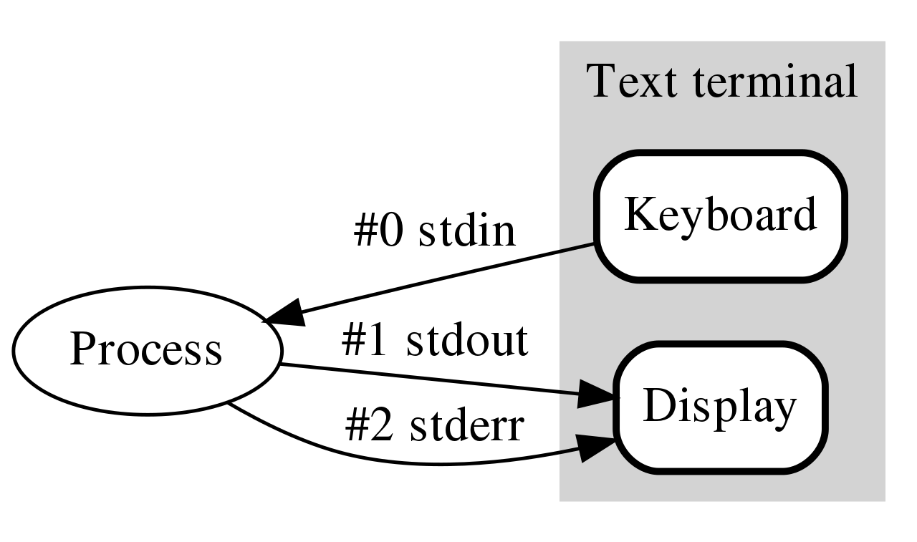
How do programs talk to users?
We glossed over this before
printf()
scanf()
Work through the same file mechanism
Three special files created for each program
stdin – standard input
stdout – standard output
stderr – standard error
printf() -> fprintf(stdout) -> handle arguments & fwrite(stdout)

Slide 24
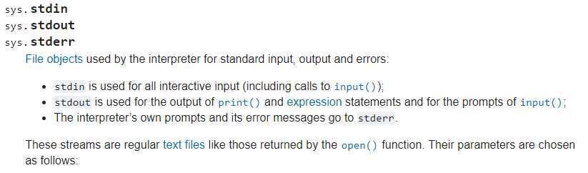
Standard I/O is a process thing, not a C thing
You can access them in Python, for instance
https://docs.python.org/3/library/sys.html#sys.stdin

Slide 25
Standard I/O is configured by the shell
When you run a program in command line, the shell attaches a standard input, standard output, and standard error to it
Defaults
stdin - read from terminal
stdout - write to terminal
stderr - write to terminal

Slide 26
Live coding: kitten upgrades
kitten.c
Errors should be written to stderr
Output can be written to stdout directly using fwrite()
Instead of using printf() in a loop to do it for us

Slide 27
Redirecting standard I/O
Shells by default setup standard I/O to connect to the keyboard and the screen
But any file will also work
Shell I/O redirection commands
COMMAND < filename
Connect standard input to filename
COMMAND > filename
Connect standard output to filename (overwrite)
COMMAND >> filename
Connect standard output to filename (append)

Slide 28
Piping commands
A command shell desire is to run multiple commands where the output of the first feeds into the second
COMMAND1 | COMMAND2
Connects stdout of COMMAND1 to stdin of COMMAND2
Example: print out files and sort by size
ls –lah | sort –h

Slide 29
Sidebar: super useful command for testing
tee [OPTION]... [FILE]...
Reads from stdin and write to both stdout and file
Example: prints out a list of files and saves results
ls –lah | tee results.txt
I run this with various programs I’m testing, so I can record the results, but also seem them in real-time.

Slide 30
Example: redirection with kitten
Standard I/O redirection is handled when the process is created
So it does not need to be aware of it at all
Our kitten tool works with redirection automatically!
./kitten arguments.c > OUTPUT_FILE

Slide 31
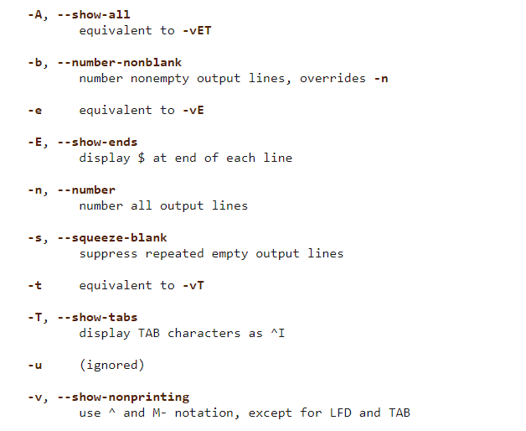
Break + Thinking Excercise
Take a look at the cat command to see the other flags it supports
How hard would these be to implement in kitten?

Slide 32
Outline
File Input and Output in C
Standard Input and Output
Dynamic Arrays

Slide 33
Dealing with dynamic input
What if you want to read in data, but you don’t know how much data there might be?
Arrays in C are a fixed size
But you can malloc() as many times as needed
Request some memory
Use until you run out
Request more memory and copy existing values over
realloc() makes this simple

Slide 34
Example of dynamic memory: read_line()
char* read_line(void)
Reads an entire line at a time from stdin
Can’t know in advance how many bytes there will be to read
Keeps reading in bytes until ‘\n’ character or end-of-file
Needs to request more memory until it holds the entire line
Note: part of the 211 library, not standard C

Slide 35
Live coding: implement read_line()
readline.c
char* read_line(void)
Requirements
Read from stdin until ‘\n’ or end-of-file (EOF)
Could fread() or just use getchar()
Allocate an array to hold the read characters
Make sure to end it with a ‘\0’
Returns
NULL pointer if EOF was reached immediately
Pointer to string otherwise (not including the newline character)

Slide 36
Realloc versus malloc
We could just malloc() and copy ourselves, what does realloc() add?
realloc() can be far more efficient
Doesn’t have to copy data at all if there is room in the heap to expand
Also simpler for programmers
Can’t forget to free the old memory if realloc() does it for you

Slide 37
Default string size will change efficiency
Memory efficiency
Pointer returned could have way more memory than characters
User might hold on to memory for a while before freeing
The less wasted memory, the less memory the program needs
Runtime speed
malloc() and realloc() are slow
The fewer times we call them, the faster the program will run
Need to pick a sweet spot to balance the two of these
Real program: starts at 80 characters, doubles size when reallocating

Slide 38
Does efficiency really matter though?
If you’re writing a CS211 homework: no
If you’re writing a Javascript interpreter for Firefox,
Which has millions of users
times hundreds of websites per day for each user
times hundreds of lines of code per website
and each line of code is read with read_line()
YES

Slide 39
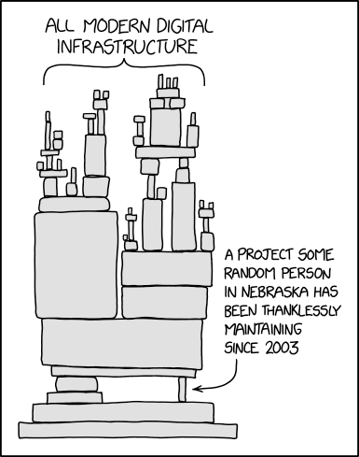
Break + relevant xkcd
https://xkcd.com/2347/

Slide 40
Outline
File Input and Output in C
Standard Input and Output
Dynamic Arrays

