Slide 1
Lecture 01 Introduction
CS211 – Fundamentals of Computer Programming II
Branden Ghena – Winter 2022
Slides adapted from: Jesse Tov

Slide 2
Welcome to CS211
Course Goal: become a better and broader programmer
First half
C programming
Unix shell
Second half
C++ programming
Introduces students to industry-standard languages and tools
Builds foundational software design skills at a medium scale

Slide 3
Online classes
We’re online for the next two weeks, but I fully expect to be back in person after that
Note: I’m not an expert in public health
For now, we’ll make the best of being online

Slide 4
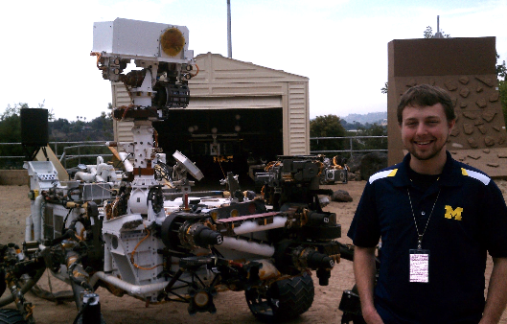
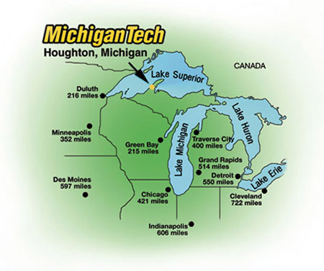
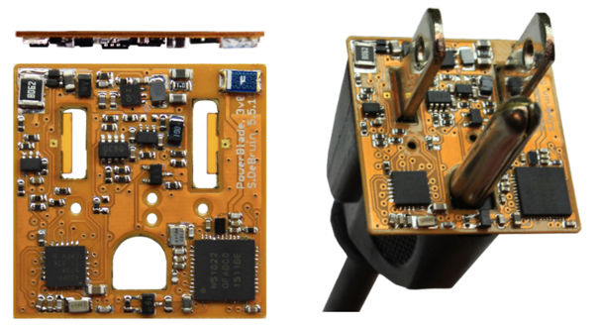
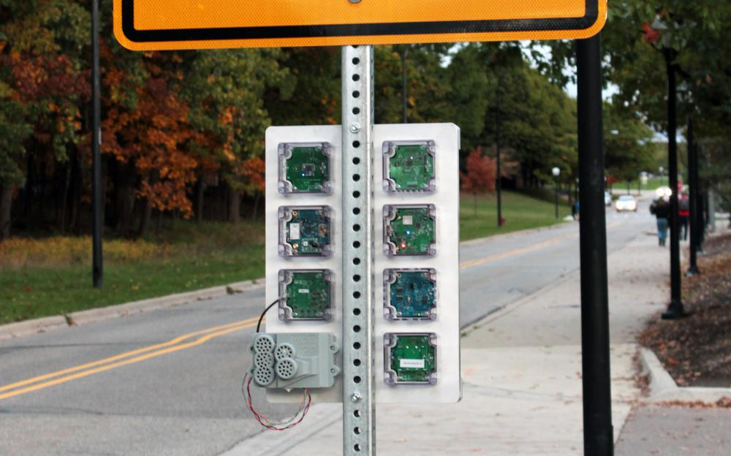



Branden Ghena (he/him)
Assistant Faculty of Instruction
Education
Undergrad: Michigan Tech
Master’s: University of Michigan
PhD: University of California, Berkeley
Research
Resource-constrained sensing systems
Low-energy wireless networks
Embedded operating systems
Teaching
Computer Systems
CS211: Fundamentals of Programming II
CS213: Intro to Computer Systems
CS343: Operating Systems
CE346: Microprocessor System Design
CS397: Wireless Protocols for the IoT
Things I love

Slide 5
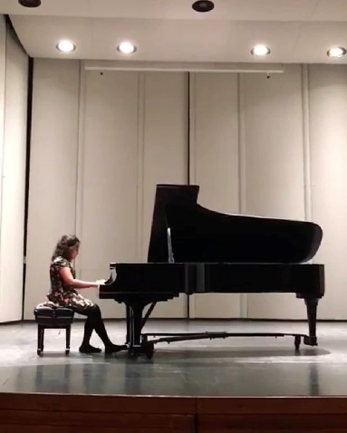
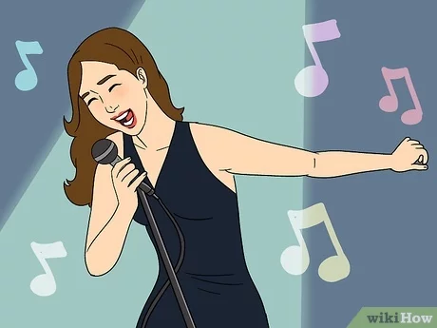



Sruti Bhagavatula (she/her)
Assistant Professor of Instruction
Education
BS: University of Illinois Chicago
MS/PhD: Carnegie Mellon University
Research
Spread of security and privacy information online
Measurement of security and privacy behavior
(Social networks, machine learning, IoT) + security/privacy
Teaching
CS 211: Fundamentals of Programming II
CS 397/497: Data Privacy
My hobbies
5

Slide 6
Questions in class
Please ask questions!!!
It’s not just you who doesn’t understand something.
You can always ask questions verbally during class
Raise hand (in-person or virtually) or just speak up
Bonus option: send messages in chat
Sruti will be watching and can answer if I don’t
We’ll have a chat system for questions when in-person too

Slide 7
Today’s Goals
Discuss why we teach (and require) this class
Describe how this class is going to function
Introduction to working in Unix shell (command line)

Slide 8
Outline
Why?
Course Overview
Unix Shell

Slide 9
What does CS211 teach?
C and C++ Programming
Unix Shell

Slide 10
C - the most important programming language
Old (1972), but nowhere near the first programming language
FORTRAN, LISP, ALGOL, COBOL, Basic, B, and many others came first
Right time, right place, right capability
Enables both low-level control and (relatively) high level thinking
Fast, efficient, and highly portable
Inspired everything that has come since
C syntax is copied partially or completely in MANY other languages
Lessons learned from using C inspired improvements to make programming easier

Slide 11
C++ - an evolutionary addition to C
Additional features on top of C
Most important: classes to support Object Oriented Programming
Also includes a significant amount of libraries that C does not
Enables more complicated software design
Manages which part of code can access which things at which times
Manages how things are named and referred to
Manages errors to help software respond to them

Slide 12
Things written in C/C++
All major modern operating systems are partially or entirely C
Windows, Linux, MacOS, Android, iOS
Scientific computing (mix of C and C++)
Mathematica, MATLAB, various scientific libraries
Video game engines (often C++)
Unreal Engine, Unity, CryEngine
Embedded control systems (usually C, occasionally C++)
Cars, Airplanes, Satellites and Rovers, Thermostats, Webcams, …

Slide 13
Upsides to C and C++
You are in charge of everything
You can do anything you want without constraints
Capable of directly interacting with hardware (“systems language”)
Grab exactly as much memory as you need and manage it yourself
Makes it incredibly fast (~100x faster than Python)
Makes it incredibly efficient (no memory is wasted)
These lead to the languages being very widely used
Top five programming languages for decades include C and C++

Slide 14
Downsides to C and C++
You are in charge of everything
And nothing is taken care of for you
Things you “can’t” do are UNDEFINED BEHAVIOR
To enable portability, the languages just straight-up don’t say what happens if you violate the rules
The computer could do anything
Backwards compatibility means features are only ever added
You’ll see this especially in C++, C just has less features total
C++ feels like a bunch of things stapled together
And there’s an amazing programming language hiding in there

Slide 15
Analogies for programming languages
Racket
Generic beginner’s car that gets you places
Python
Great car you can drive without a license
Unless you want to go really fast or on bad terrain, might be good enough
C
A racing car that goes incredibly fast but breaks down every fifty miles
C++
A souped-up version of the C racing car with dozens of extra features that only breaks down every 250 miles
But when it breaks down, nobody can figure out what went wrong
http://users.cms.caltech.edu/~mvanier/hacking/rants/cars.html

Slide 16
So why teach C and C++?
You’ll learn a lot more about programming
Syntax and ideas from C inspired a lot of other languages
Feels very different from Racket or Python
You’ll become a better programmer
You’re going to run into a lot of errors and problems in this class
Hopefully they teach you to better design and plan your code
Prepare you to dig deeper into computer systems
A “systems language” is needed to interact directly with hardware
Major options: Pascal, C, C++, Ada, Rust

Slide 17
What does CS211 teach?
C and C++ Programming
Unix Shell

Slide 18
Unix
A wildly popular operating system in the 1970s and 80s
Today refers to the family of operating systems inspired or grown from Unix
Particular design style for “everything is a file”
Various tools the OS is expected to provide
Command line interface, also known as a “shell”
Unix
Linux
Android
BSD
MacOS
iOS

Slide 19
C and Unix were born together
Operating systems used to be written in assembly
Basic instructions specific to a certain processor family (see CS213)
So supporting a new computer type meant rewriting all of your software
Unix development started in 1969 by Ken Thompson and Dennis Ritchie
Developed at Bell Labs, which was a computing research powerhouse
C language was created in 1972 by Dennis Ritchie to write Unix programs
And they quickly rewrote the whole OS in C as well
This made the OS simpler to modify and easier to port to new systems
Unix became enormously popular due in part to its portability

Slide 20
Unix shell
Text-based interface to a computer
Compare to graphical interfaces that need a mouse
Necessary for remote interactions with many computers
Cloud servers
Specialized “headless” hardware
Can be incredibly efficient and powerful
Find all JPEG files in this folder and change to be PNGs
mogrify –format png *.jpg

Slide 21

So why teach Unix shell?
Many future classes are going to require you to work on a specialized computer that is shared by the class
More resources, specific capabilities, etc.
Add another basic computing tool to your skillset
You might not use shell every day
But maybe you might
You get to feel like a “hacker”
Shell isn’t the only way to be a programmer, but is a stereotypical way

Slide 22
So, why CS211?
It’s going to make you a much better programmer
It’s going to teach you a bunch of new skills
It’s going to enable you to succeed in future classes

Slide 23
Architecture of a lecture
Full
Administrivia
+ stretch break
Open Question
Summary
+ Bonus
Attention
0
20
25
50
53
78
80
Time (minutes)

Slide 24
Outline
Why?
Course Overview
Unix Shell

Slide 25
Course Staff
TA (1)
Sherwin Shen
PhD student in Computer Science
PMs (12)
AJ Hesby Alexander Redding
Antonio Rocha Brian Gleason
Chris Song Danche Smilkova
Dilan Nair Eli Barlow
John Sanchez Mirage Modi
Naythen Farr Nick Baird
Their role: support student questions via office hours and campuswire

Slide 26
Lectures
Lectures: synchronous, recorded via Zoom (for now)
Please attend and ask questions!
Panopto tab on Canvas will have recordings (a few hours later)
This should still be true when we’re back in-person

Slide 27
Labs
Small, guided practice sessions to help you learn
Teach you a new skill/language
Two parts
Lab guide will walk you through doing some things
Lab assessment on Canvas will ask a few short questions about it
Should be easy if you did the lab
These are not formal assignments or quizzes
You may work with others on them

Slide 28
Quizzes
Multiple quizzes instead of a big exam
Should be four total
Each is roughly 15-20 minutes
Quizzes cover mainly material from the last two weeks
But build upon knowledge from the entire course
More details on these to come
We will hopefully be back in person for the first one…

Slide 29
Homeworks
Programming assignments with about a week to complete it
This is where you’ll learn the most in class
First four are C, last two are C++
Homeworks 1 and 5 are on your own
Other homeworks are with a partner of your choosing
We’ll put up a survey for those who want to be paired with a random partner
These are serious. Be careful about academic integrity on these

Slide 30
Final Project
A bigger homework, where you get to choose what you want to do
Done with a partner of your choosing
Make an “interactive program” (usually a game)
Examples: Pacman, Tetris, Two-dots, Checkers, Desert Bus
This is your chance to do something interesting and fun!
Can be a significant amount of work though

Slide 31
Grade composition
Category | Count | Total Value
Labs | 5 | 5%
Quizzes | 4 | 10%
Homework | 6 | 60%
Final project | 1 | 25%

Slide 32
Relative homework difficulties
Homework | Difficulty
Hw01 | 2
Hw02 | 5
Hw03 | 7
Hw04 | 11
Hw05 | 6
Hw06 | 9
Final Project | 10ish*
Hw04 is the last in C
Then a one week break
Hw05 is the first in C++
* But really it’s up to you

Slide 33
Late Policy
You can submit homeworks late
Quizzes and labs cannot be submitted late
10% penalty to maximum grade per day late
Example: three days late means maximum grade is 70%
Final project has a sliding scale
90% for up to 24-hours late
60% and 30% for the two days after that

Slide 34
Slip Days
Slip days let you turn in a homework late and receive no penalty
Each student gets 3 slip days
Apply to homeworks only (not final project or labs)
You don’t need to tell us you’re using them, we’ll just automatically apply them at the end of the year
Be sure to coordinate about them on partner assignments
Examples:
Turn in hw01 three days late
Turn in hw04 two days late and hw06 one day late
Turn in hw02 four days late with only a one-day penalty

Slide 35
We can support you for unexpected problems
We can be flexible with deadlines for problems outside of your control
Sick, family emergency, broken computer
Contact us (via Campuswire)

Slide 36
Collaboration in CS211, three levels:
Partner Collaboration
Your code and the other student’s code are identical because you share it and work on it together
ONLY for registered partners on specified homeworks
Close Collaboration
You communicate about code however you see fit
ONLY acceptable for labs
Arms-Length Collaboration
You discuss problems and solutions at a high level
MAY NOT read, write, look at, record, or transcribe code
MAY NOT have the code up on screen during collaboration
MUST cite your sources, both arms-length collaborators and other resources
Refer to syllabus for the official version of this policy

Slide 37
Academic Honesty
In CS211, we take cheating very seriously
Cheating is when you:
Engage in an inappropriate level of collaboration
Such as look at another student’s code
Enable another student, present or future, to cheat
Such as letting a CS211 student read your code next year
Fail to cite your sources (friend, Stack Overflow, etc.)
Such as you get a big hint and don’t acknowledge where it came from in a code comment

Slide 38
Academic Honesty
Please do not cheat in CS211
If you don’t write code, you won’t learn!
Cheating on code is super easy to catch!!
No, like really really easy
All suspected cheating is reported to the relevant dean for investigation
Last time I taught it was 8 cases
If you are unsure about a situation, ask the staff on Campuswire

Slide 39
Getting Help – Campuswire
Post questions here
Staff and I monitor and answer questions
You can also answer each other! (or note that you have the same issue)
I’ll also post useful or interesting notes here
Do NOT email me. Post to Campuswire instead
I won’t see your email until way later and then I’ll feel guilty about it

Slide 40
Getting Help – Office Hours
Office hours are mostly hosted by the PMs and TA
Sruti and I will have some too! Especially for higher-level questions
Schedule
We’re going to host a TON of office hours
Entirely remote for now (on gather.town)
Hopefully we can add some in-person hours later
Details to follow, schedule on Canvas homepage
Reminder: office hours are meant to augment the class
Attend them!

Slide 41
Getting Help – Request a Meeting
Lecture is my side gig
My main job is helping students succeed
If you are struggling, reach out and I will meet with you
Course material
Homework
Other stuff going on in your life

Slide 42
Advice
Submit assignments early and often!
If you find this course difficult, that’s because it is difficult.
However, nobody fails unless they give up.
You belong here and can succeed here.
Be kind to each other.

Slide 43
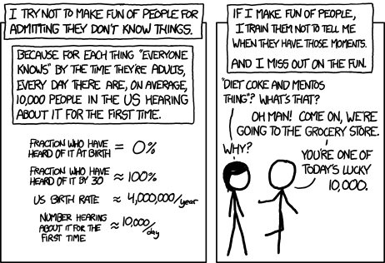
Break + relevant xkcd
https://xkcd.com/1053/

Slide 44
Outline
Why?
Course Overview
Unix Shell

Slide 45
How do you get a Unix shell?
Have a MacOS or Linux computer
Or set up Windows Subsystem for Linux (WSL) on Windows
Install Virtualbox and Linux
Installing Ubuntu is free and only takes twenty minutes
Log in to a class server remotely!
This is what we’ll do for CS211
Lab01 teaches you how to do this (posted later today)

Slide 46
Command line interfaces
Text-based commands
Positives
It’s easy to be precisely clear about what you want and how things are configured
Negatives
How do you remember everything?
Reality
There will be a few dozen commands you’ll memorize (after practice)
And you’ll learn how to look up everything else

Slide 47
Live code demo!!!

Slide 48
Commands for moving between directories
Directory structure and moving through it
ls
Lists files in the current directory
cd
Change directory
pwd
Prints the path of the current directory
Mis-typing something
“Command not found” means you tried to run something invalid
fish: somecommandyoumistyped: command not found...

Slide 49
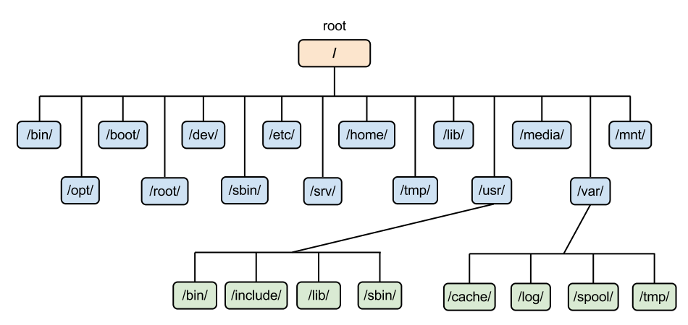
Directory structure in Linux
Example: /usr/bin/ is the path to user-installed programs

Slide 50
Special paths
. the current directory
.. the parent of the current directory
../../ the parent of the parent of the current directory
../../../ and so on…
- the previous directory you were in before the current one
~/ the home directory of the current user (your home)
~cs211 the home directory of the user cs211
(works for any user, but you’ll probably won’t interact with other users)
/ the root directory (analogous to C:\ on windows)

Slide 51
Relative vs absolute paths
Relative paths are relative to the current directory
../
src/
../../code/src/../build/
Absolute paths have the full path name to the location
/home/branden/
/home/branden/cs213/code/
/home/branden/cs213/code/src/../build/

Slide 52
Wildcard in path names
Sometimes you’re not sure exactly what the name is
Or there might be multiple files that you want to interact with simultaneously
The wildcard symbol, *, replaces any number of characters in a path name
Examples
ls /home/*/ List all files in all user’s home directories
ls ~/cs21*/ List all files in any directory starting with cs21
ls code/src/*.c List all files that end with “.c” in code/src/

Slide 53
Tab Completion
Typing takes toooooooo looooooonnnnggg
Solution, let the computer guess what you’re trying to type
Pressing tab while part-way through typing just about anything in terminal will tab-complete it for you
As long as you have typed enough characters so that only one option remains, it will complete it
If multiple options remain, it will stop trying

Slide 54
Command flags
man
Opens the manual pages for a program
Example: man ls
Flags are configurations for a command that change what it does
ls –l lists files in the current directory in a vertical list with details
ls –t sorts the ls output by most recently modified
ls –l –t does both
You can type multiple flags after a single dash
ls –lt is equivalent to ls –l –t is equivalent to ls -tl

Slide 55
Searching for things
grep –r “text” *
Explanation
Grep prints lines matching a pattern
The pattern in this case is “text”
-r means search recursively, i.e. in this directory and all subdirectories
* means to search in any file in the current directory
Summary
Search all the files here and below for the word “text”

Slide 56
Working with files
cat path
Prints out the contents of the file
mv path1 path2
Moves a file from path1 to path2
cp path1 path2
Copies a file from path1 to path2
rm path
Deletes (removes) a file

Slide 57
Editing files
There are many different terminal text editors
And there are holy wars about why one is best
There is no best. Just use whatever you like
Example editors
Vim, Emacs, Nano
In CS211, I’ll be teaching you using the Micro text editor
Occasionally I’ll open vim by accident. Someone yell at me when I do
https://micro-editor.github.io/

Slide 58
Editing with Micro
micro filename
Opens micro, editing filename
Works just like any text editor you’ve used
Mouse moves the cursor around, as do the arrow keys
Typing makes text appear
(This isn’t true in some shell editors, looking at you vim)
Ctrl-s save the file
Ctrl-o open a file
Ctrl-q quit

Slide 59
Build a C file if there’s enough time
Lab01
https://nu-cs211.github.io/cs211-files/lab/lab01.pdf

Slide 60
Don’t be overwhelmed!!!!
You have plenty of time to learn this
Lab01 guides you through the same kinds of commands I did today, step by step
Practice is the only thing that will really help
And CS211 will give you plenty of practice

Slide 61
Helpful guides
Great lecture notes on using the shell
https://swcarpentry.github.io/shell-novice/
Tool to explain various shell commands
https://explainshell.com/
Tool to explain how to use various shell commands
Just type the command into the box at the top
https://tldr.ostera.io/

Slide 62
Outline
Why?
Course Overview
Unix Shell

